Slide 1
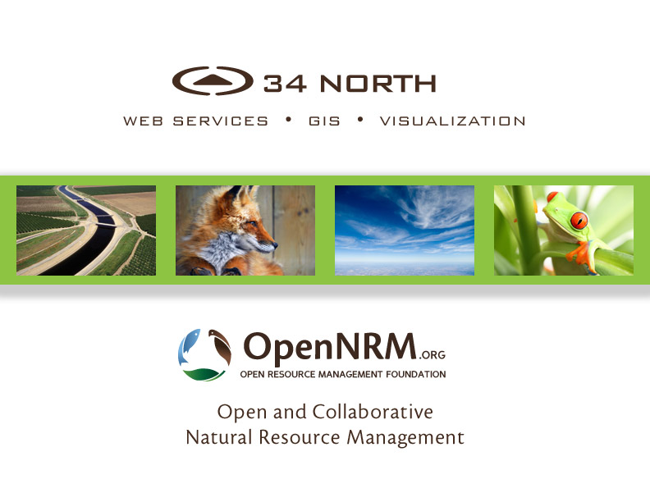

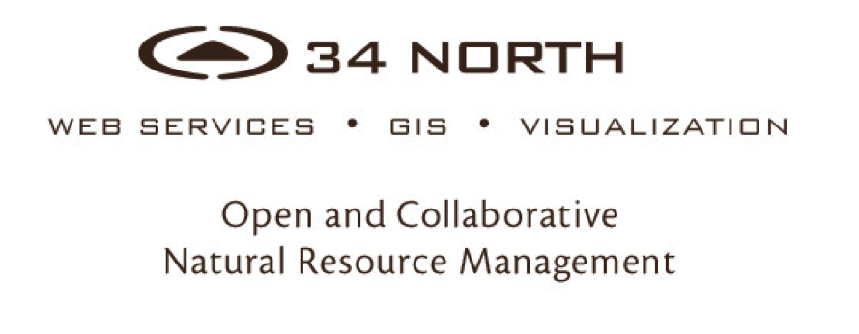

Slide 2
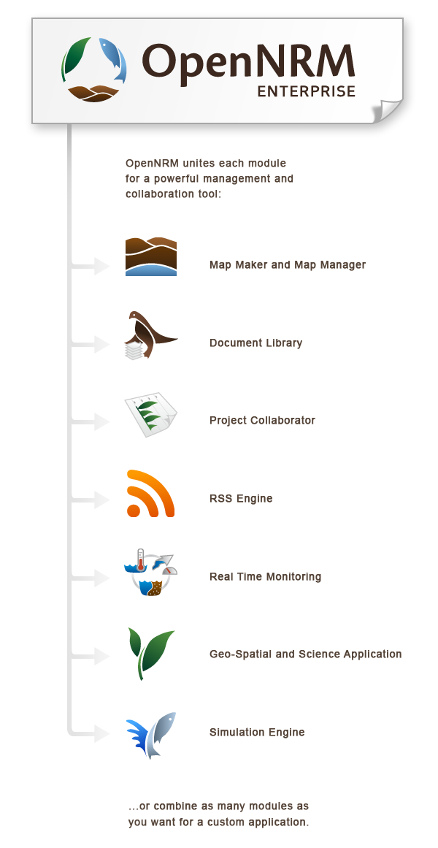
Collaborative resource management
Workspace and project management
Application for data collection, analysis, reporting and visualization
Notes:
The interchangeable modules include:
Real Time Data Management Module
Map Module
Asset Management Module
Project Management
Wiki
Data Visualization Engine
Style CMS
And Mobile component

Slide 3

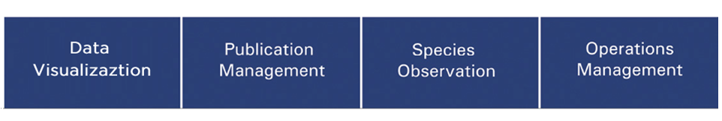
OPENNRM Workspaces are used to build data stories using Spatial Data, Observations Data, and Site Content at various scales
(Site Level, Regional Level and System Wide)
Notes:
Government Agencies, Public Utilities and NGOs
Special Interest Groups
NRM Consulting and Engineering Firms
Restoration, Conservation and Watershed Groups
Workgroups
Special Projects
34 North specifically works with:
US Bureau of Reclamation, UGSS, DWR, MWD, SFCWA, EPA, CURES, USFWS, CAFWS, SWRCB, AG Industry

Slide 4






A COLLABORATIVE EFFORT
SACRAMENTO SAN JOAQUIN BAY-DELTA
CALIFORNIA ESTUARY PORTAL
SWRCB MY WATER QUALITY PORTALS
SAN JOAQUIN RIVER REGIONAL MONITORING PROGRAM
SAN JOAQUIN REAL TIME MANAGEMENT
DWR 1641 WATER QUALITY
SACRAMENTO RIVER WATERSHED
Notes:
Multi Stakeholder Collaboration
Data Aggregation and Data Management
Data Analysis and Visualizations Mapping and GIS
Regional Document Libraries Operations Dashboards
Ecosystem Projects
Special Studies
Acoustic Telemetry Nutrients
Web Service Development
Regulatory Reporting

Slide 5
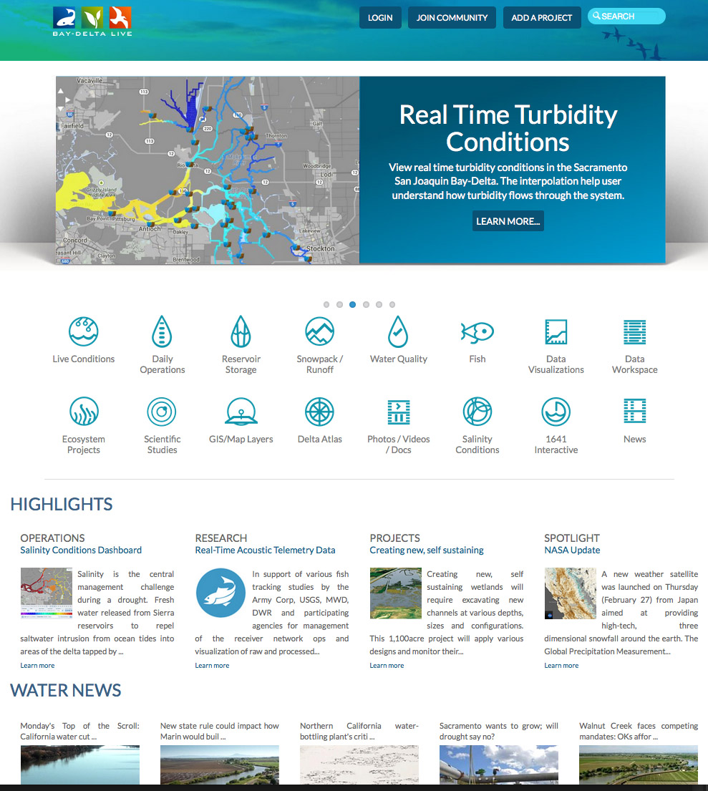
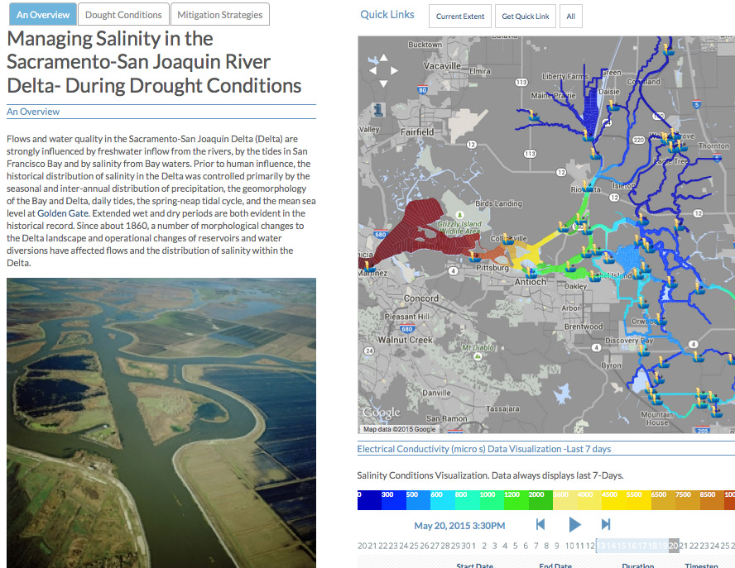
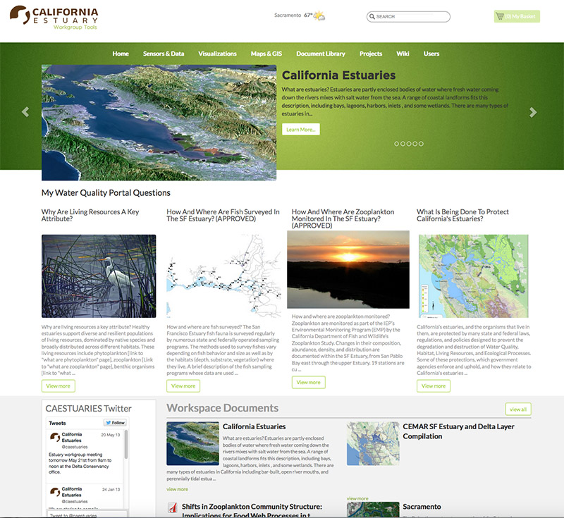
BUILDING ON EACH OTHER’S PROGRAMS
  Each region’s needs are different:
  Various Stakeholder Requirements
  Regional Data
  Region Specific Data Analysis
  Local Mapping and GIS
  Regional Document Libraries
  Stakeholder Specific Data Dashboards
  Tool for Local Ecosystem Projects
  Special Studies
  Regulatory Reporting
  Web Service Development
  …Share data and products with other portal’s for system wide view
Notes:
The SRWP is participating in a on-going regional monitoring and resource management tool development initiative: OPENNRM. SRWP is building on the current portal platform developed for managing data for Ca Estuaries, The San Joaquin Regional Monitoring Program, San Joaquin River Real Time Management Program, The Bay delta: Baydeltalive.com and DWR’s 1641 interactive reporting tools for California. New SRWP development investments are contributed back to community portals. The primary objective of the initiative is provide regional stakeholders with the tools to manage their own data. These data are then made available to the larger community for broader assessment of the California watershed.

Slide 6
BENEFITS OF A COLLABORATIVE PROGRAM
Benefit and learn from each other’s regional monitoring programs and assessment efforts
All investments are contributed back to the community: Content, GIS, data sets, mapping tools
Data is managed at the regional level and shared with all stakeholders for larger watershed assessment and analysis
Application updates
Notes:
The SRWP is participating in a on-going regional monitoring and resource management tool development initiative: OPENNRM. SRWP is building on the current portal platform developed for managing data for Ca Estuaries, The San Joaquin Regional Monitoring Program, San Joaquin River Real Time Management Program, The Bay delta: Baydeltalive.com and DWR’s 1641 interactive reporting tools for California. New SRWP development investments are contributed back to community portals. The primary objective of the initiative is provide regional stakeholders with the tools to manage their own data. These data are then made available to the larger community for broader assessment of the California watershed.

Slide 7
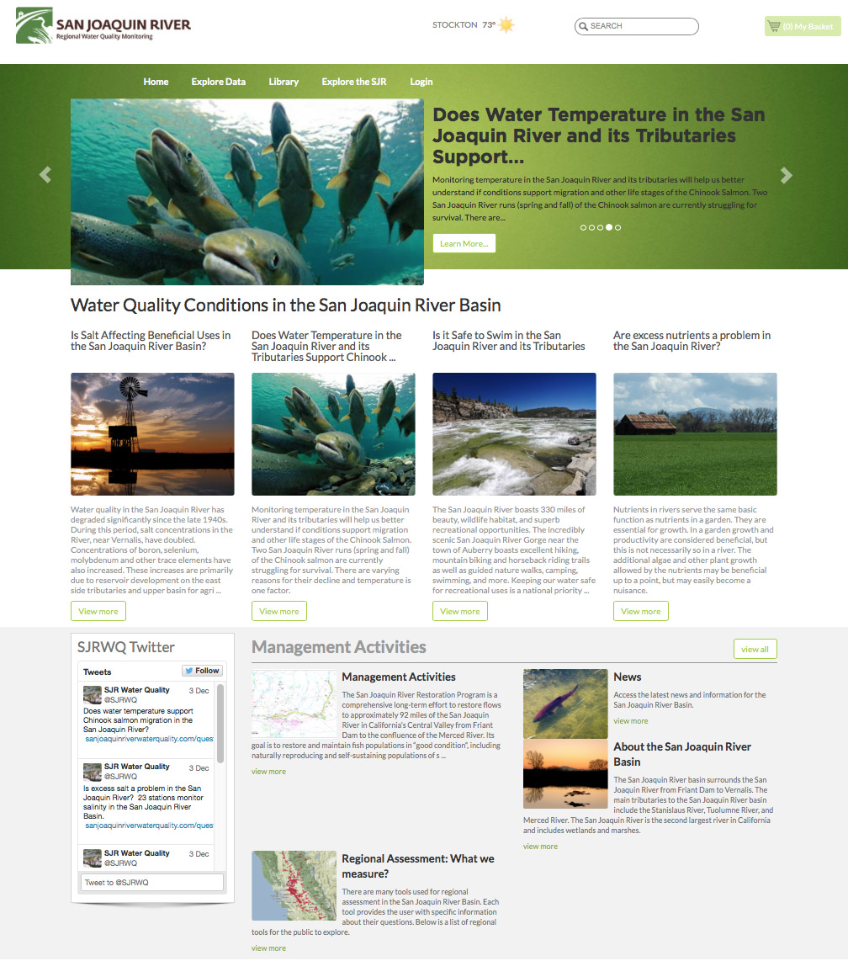
SJR REGIONAL MONITORING AND REAL TIME MANAGEMENT
50+ Datasets contributed for multi-stakeholder use and evaluation
Real Time WQ Assessments for Temperature, Salinity, Nutrients, etc. available to the public
Current phase SJR Real Time WQ Management
View model results and data dashboards
Notes:
SRWP will have access to data and GIS: Specifically NWIS and CIMIS that was contributed to the community by this project
SRWP will build on and improve upon question templates for data assessments developed by the SJRRMP. Benefit from stakeholder knowledge developed during this process.
3SRWP will benefit from and build on important data filters and analysis tools for examining WQ criteria: ex: Temperature calculations for fish migration during specific life stages, analysis of salinity discharges and the effects on water quality, data presentation methods for understanding pesticides and other contaminant data in the Sac River watershed.
This knowledge will then be contributed back to other regions for use in local initiatives.

Slide 8
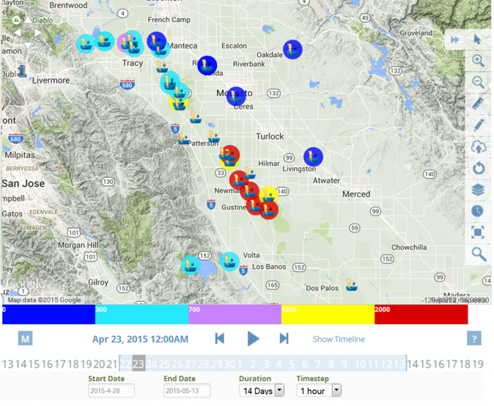
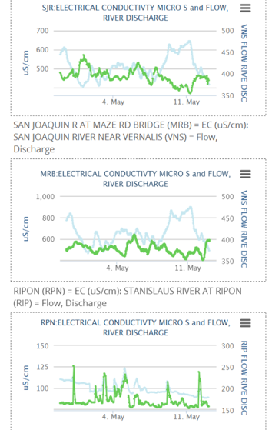
SAN JOAQUIN RMP COLLABORATORS
US Bureau of Reclamation
CURES
CV Salts
California Environmental Protection Agency
CA Department of Water Resources
State and Federal Water Contractors
CVRWQCB
AG Industry
Central Valley Irrigation Districts
_________________________________
Major Multi-Agency Effort
Regular Workgroup Meetings for Enhancements
Real Time Salinity Management
WARMF Model Online
Question Driven
Stakeholder Specific Data Dashboards
Feed Libraries

Slide 9
CA ESTUARIES PORTAL
Multi-Agency Workspace
Source project for critical estuary data: EMP, Estuary GIS, D-1641 and Trawl Data
50+ GIS files
    85+ question driven Water Quality pages on mywaterquality.ca.gov
    Assessment
    TMDL Report Cards
Notes:
The caestuaries workspace and stakeholder group is responsible for the development of:
25+ Key datasets: IEP data, trawl and salvage data, 1641 reporting project
85+ question driven WQ pages on mywaterquality.ca.gov
Important space for incubation of ideas, assessment criteria and concepts.
Key development of data visualization tools.

Slide 10
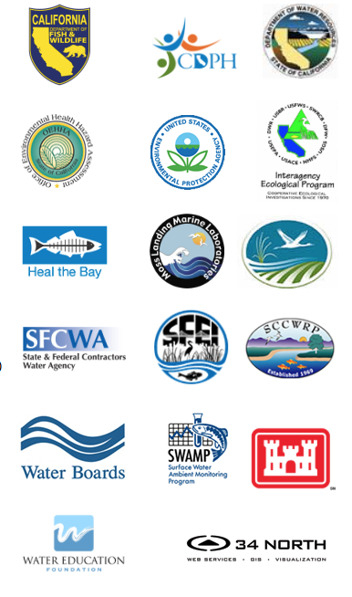
CA ESTUARIES COLLABORATORS
US Bureau of Reclamation
US Department of Fish and Wildlife
NOAA
NMFS
US Geological Survey
CA Department of Water Resources
IEP
State and Federal Contractor
Water Education Foundation
SFEI
SWRCB
AG Industry
_________________________________
Major Multi-Agency Effort
Regular Workgroup Meetings for Enhancements
150+ Registered Agency Users
1000 + Images, Documents, Research Articles
Host for 85+ State Question Pages
50+ Downloadable Datasets
1641 Interactive
Home to All California Estuaries
Feed Libraries
Home to Trawl Data 2016
Notes:
Clients include: Honeywell, USGS, DWR, MWD, History Channel,

Slide 11
BAYDELTALIVE.COM
Data central to the Delta
Extensive libraries for Delta data, photos, reports
Real time reporting dashboards: salinity, Water Quality
Weekly survey results, fish tracking
Relevant news
Collaborator workspace
Ecosystem projects
Delta Community
Post and view model results
Notes:
1. Primary project

Slide 12


BDL WORKGROUP COLLABORATORS
US Bureau of Reclamation
NOAA
NMFS
US Geological Survey
CA Department of Water Resources
Metropolitan Water District
State and Federal Contractor
US Fish and Wildlife
SWRCB
AG Industry
_________________________________
25,000 Unique Visits (Annual)
400+ Registered Users
1500 + Images, Documents, Research Articles
100+ Ecosystem Projects
250+ Downloadable Datasets
Feed Libraries
Directing development and new data investments
Notes:
Clients include: Honeywell, USGS, DWR, MWD, History Channel,

Slide 13
SRWP PORTAL
Notes:
The CA estuaries workspace and stakeholder group is responsible for the development of:
25+ Key datasets: IEP data, trawl and salvage data, 1641 reporting project
85+ question driven WQ pages on mywaterquality.ca.gov
Important space for incubation of ideas, assessment criteria and concepts.
Key development of data visualization tools.

Slide 14
SWRP MANAGEMENT ISSUES AND CHALLENGES
Drought Management
Domestic, Municipal and Industrial Water Supply
Monitoring Program Management
Sustainable Ground Water Management Act (5 high priority and 16 medium priority sub-basins)
Federal Clean Water Act/Porter-Colonge (Beneficial uses)
Regional Water Quality Control Plans
1641 Water Quality Control Plan
Nutrients
Recreation
Invasive Species Management
Fish and Wildlife
Hydropower
Fire

Slide 15

SWRP KEY FEATURES AND TOOLS
Data Catalogs
Data Management Tools
Interactive GIS
Access to 120+ GIS Layers
Document Management (400+ Records)
Projects Management
Data Dashboards
Regulatory Reporting Templates
Question Templates
Data Story Templates
Real Time Management Tools
Notes:
To address these challenges we are developing these tools

Slide 16
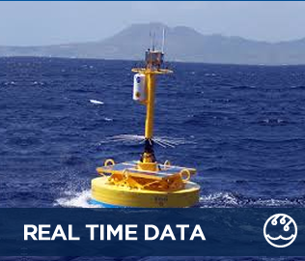
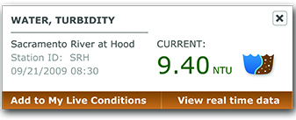
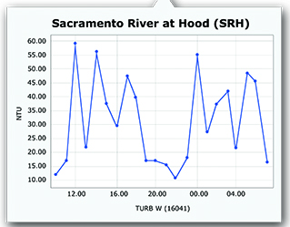
EXPLORE DATA & CATALOGS
California Data Exchange Center (CDEC)
National Water Information System (NWIS)
National Oceanic & Atmospheric Agency (NOAA)
California Irrigation Management System (CIMIS)
California Environmental Data Exchange Network (CEDEN)
SWRP Data Catalog
Water Data Library
Water Quality Exchange (WQX) and STOrage and RETrieval Data Warehouse (STORET)
…See Data Spreadsheet

Slide 17
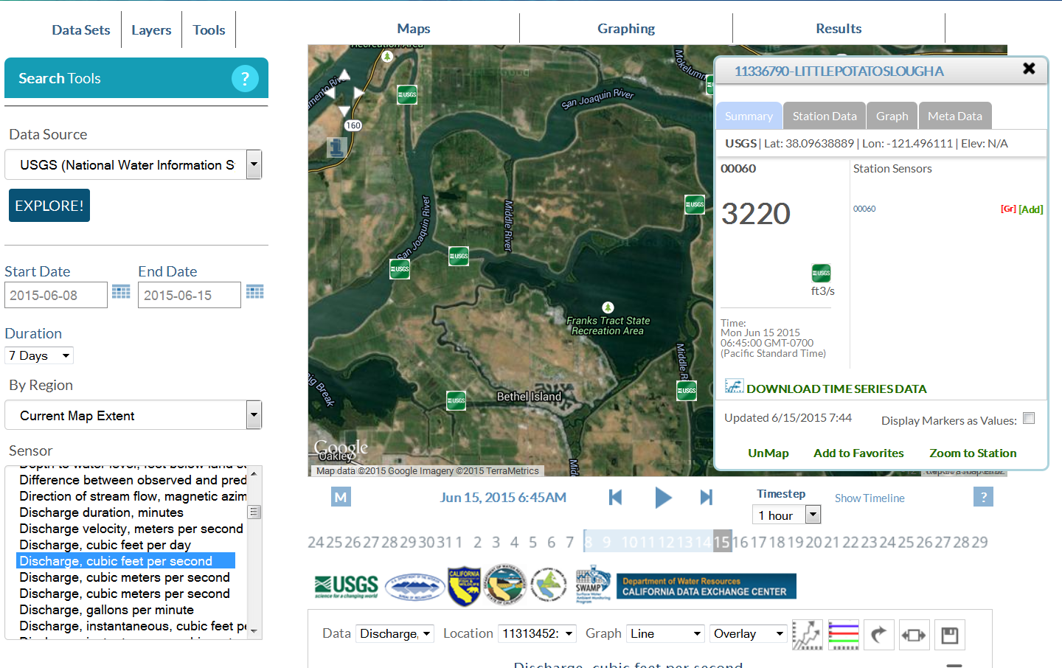
SENSOR NETWORKS
SENSOR NETWORKS

Slide 18
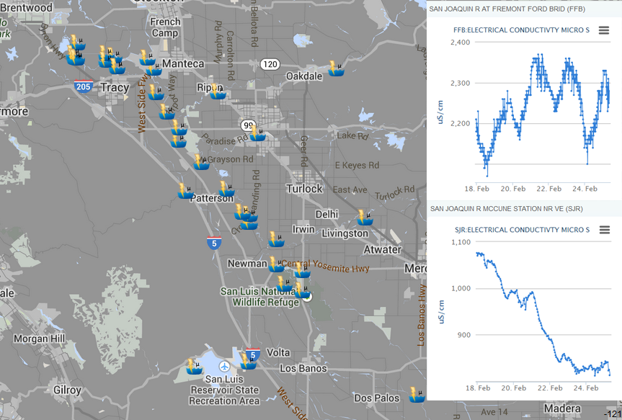
SENSOR NETWORKS
SENSOR NETWORKS
SENSOR NETWORKS

Slide 19
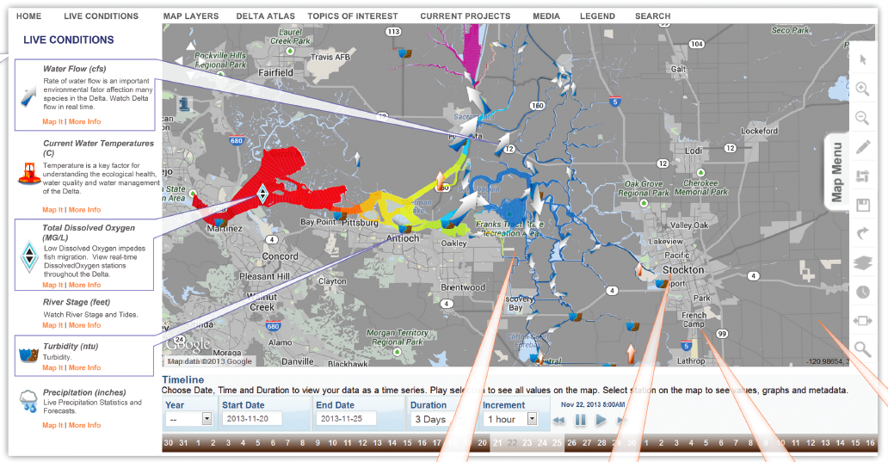
MULTI PARAMETER VISUALIZATIONS

Slide 20
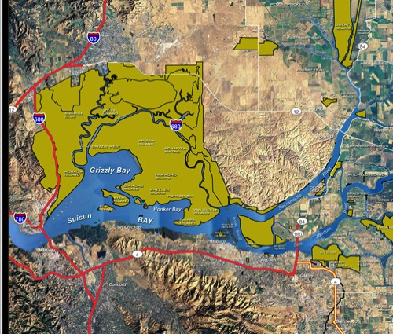
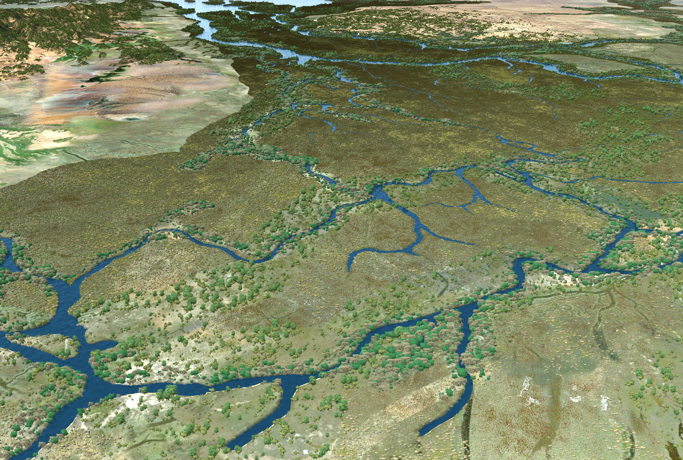
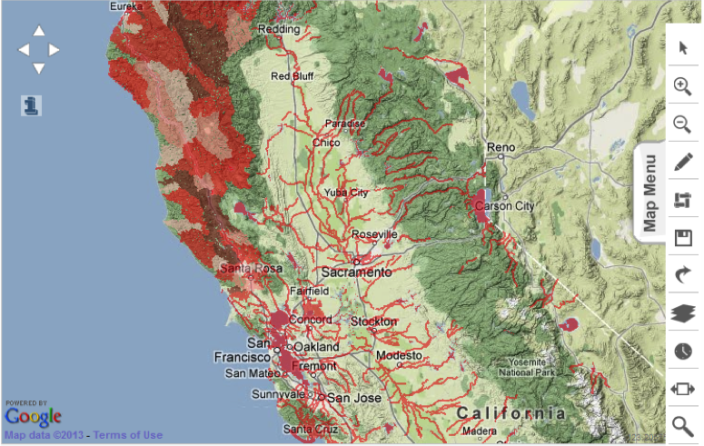
MAPPING AND GIS
Explore and analyze 120+ GIS
Species
Water Bodies
Infrastructure
Land Designation
Transporation & Infrastructure
Geopolitical
Projects
Live Conditions

Slide 21
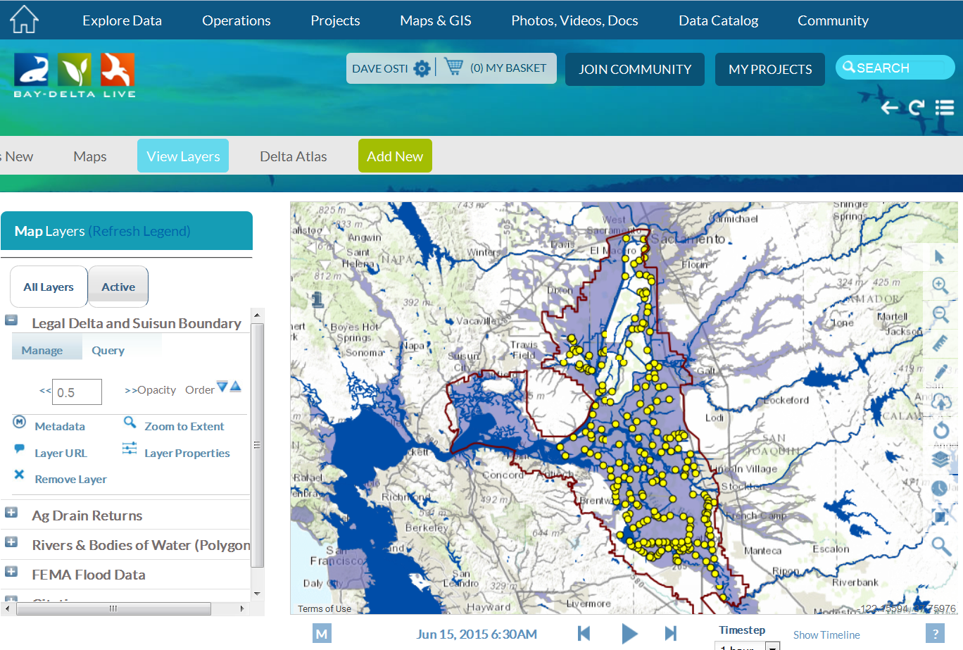
MAPS

Slide 22
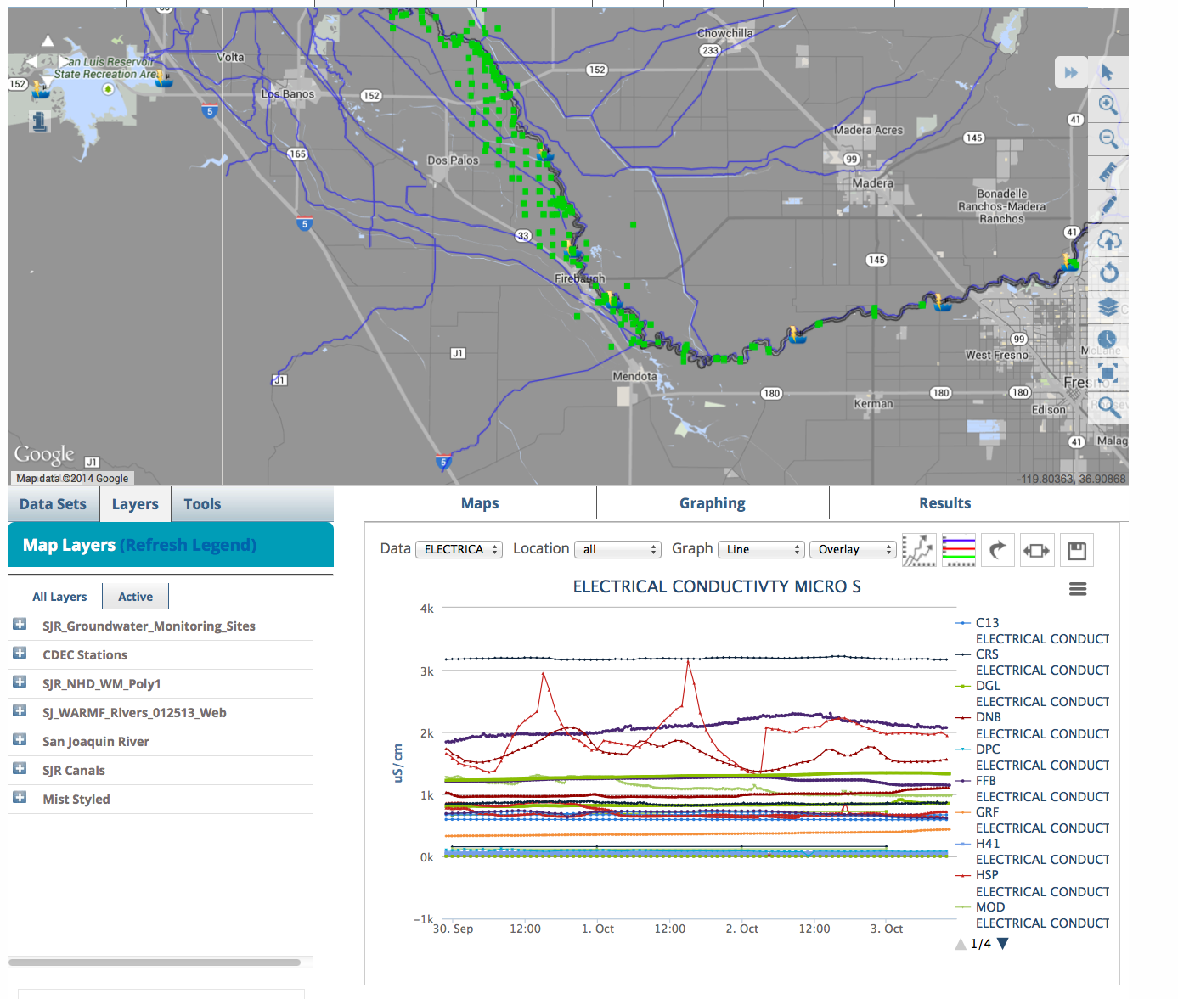
SENSOR NETWORKS

Slide 23
DOCUMENT MAMANGEMENT
Access to 394 SWIM Records
Geo-locate for Data Synthesis
Customizable Metadata
Add Images, Videos, Reports, Data
Easy portability for Use in Site
Support for Dashboards
Keep Private or Make Public
HTML Templates for Supporting Descriptions and Documentation

Slide 24
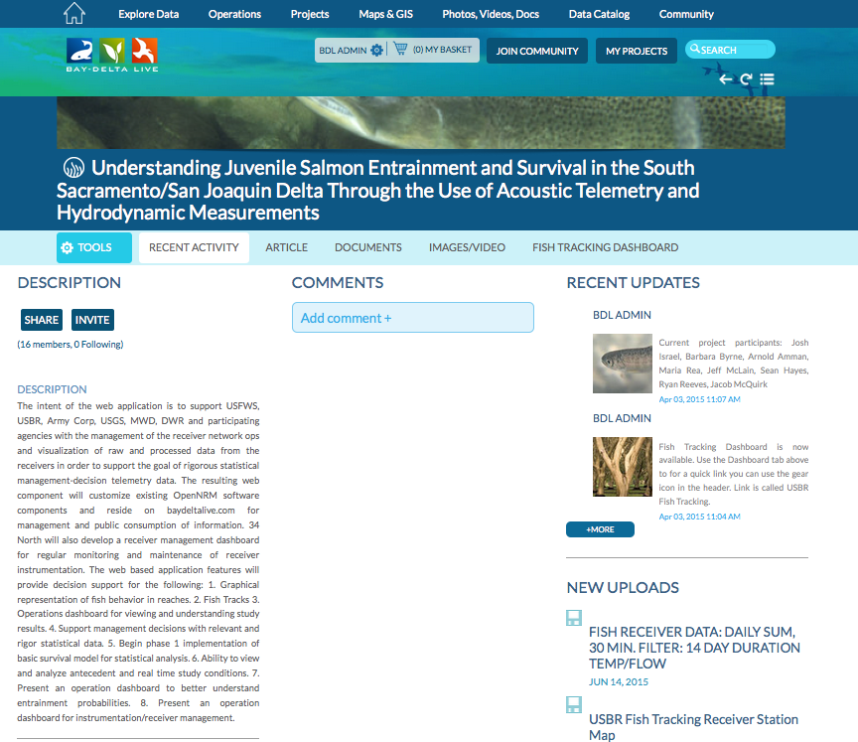

Slide 25
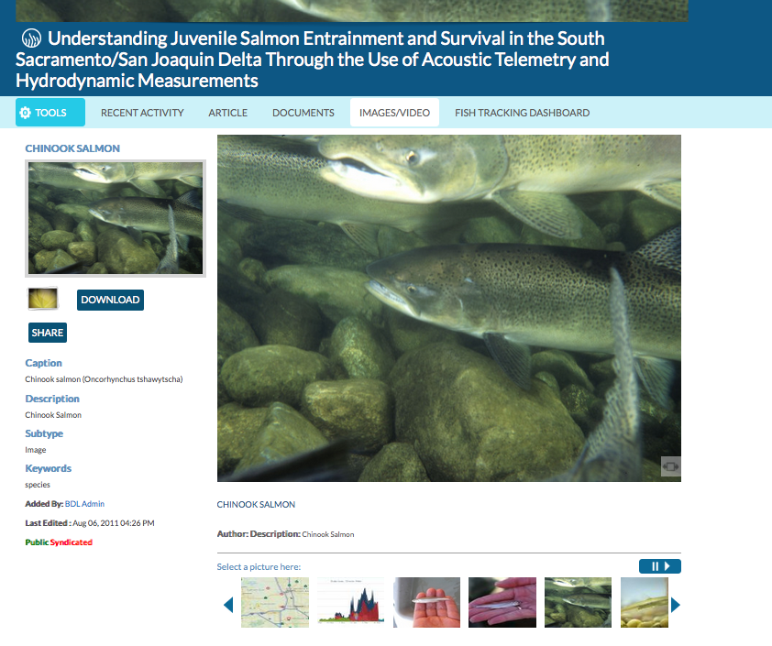

Slide 26
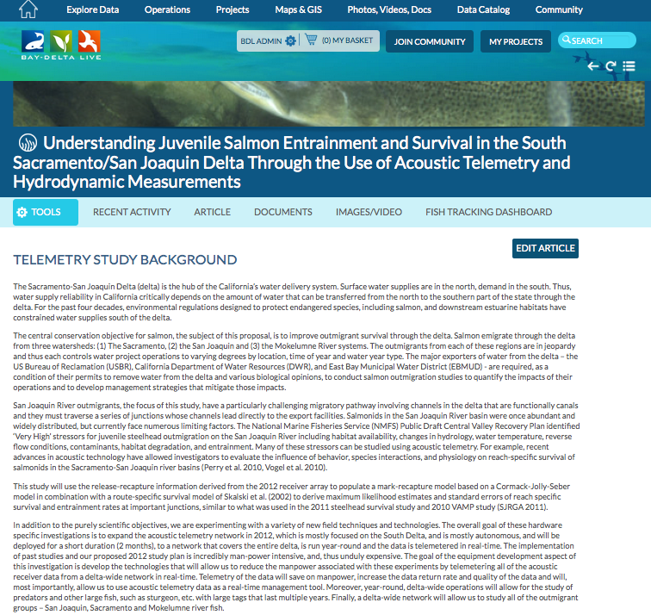

Slide 27
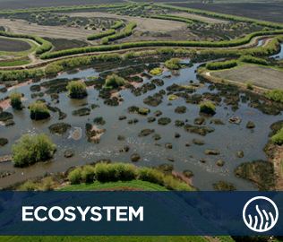
PROJECTS
Customizable Metadata
Add Images, Videos, Reports, Data, Interactive maps
Community Features: Comments, Groups, Follow
Project Data Dashboards
Invite Members
Keep private or make public
Work in the Field: Sync with Mobile App
HTML Templates for project presenation

Slide 28
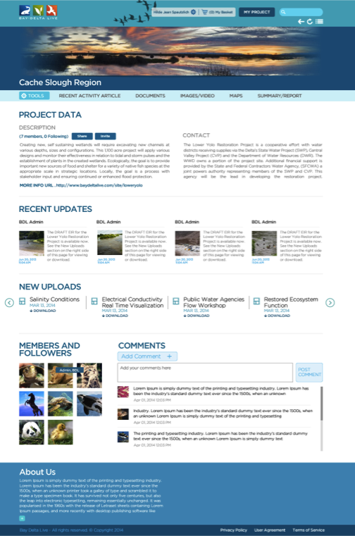
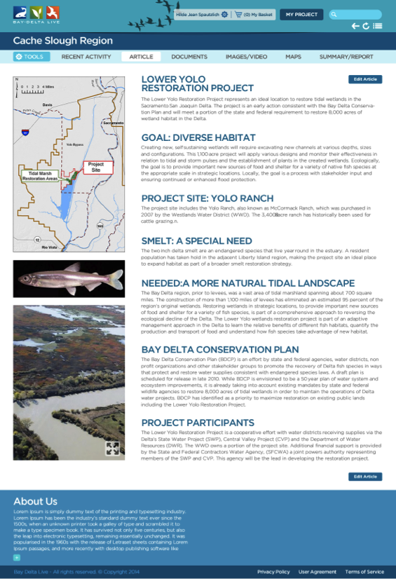
PROJECTS

Slide 29
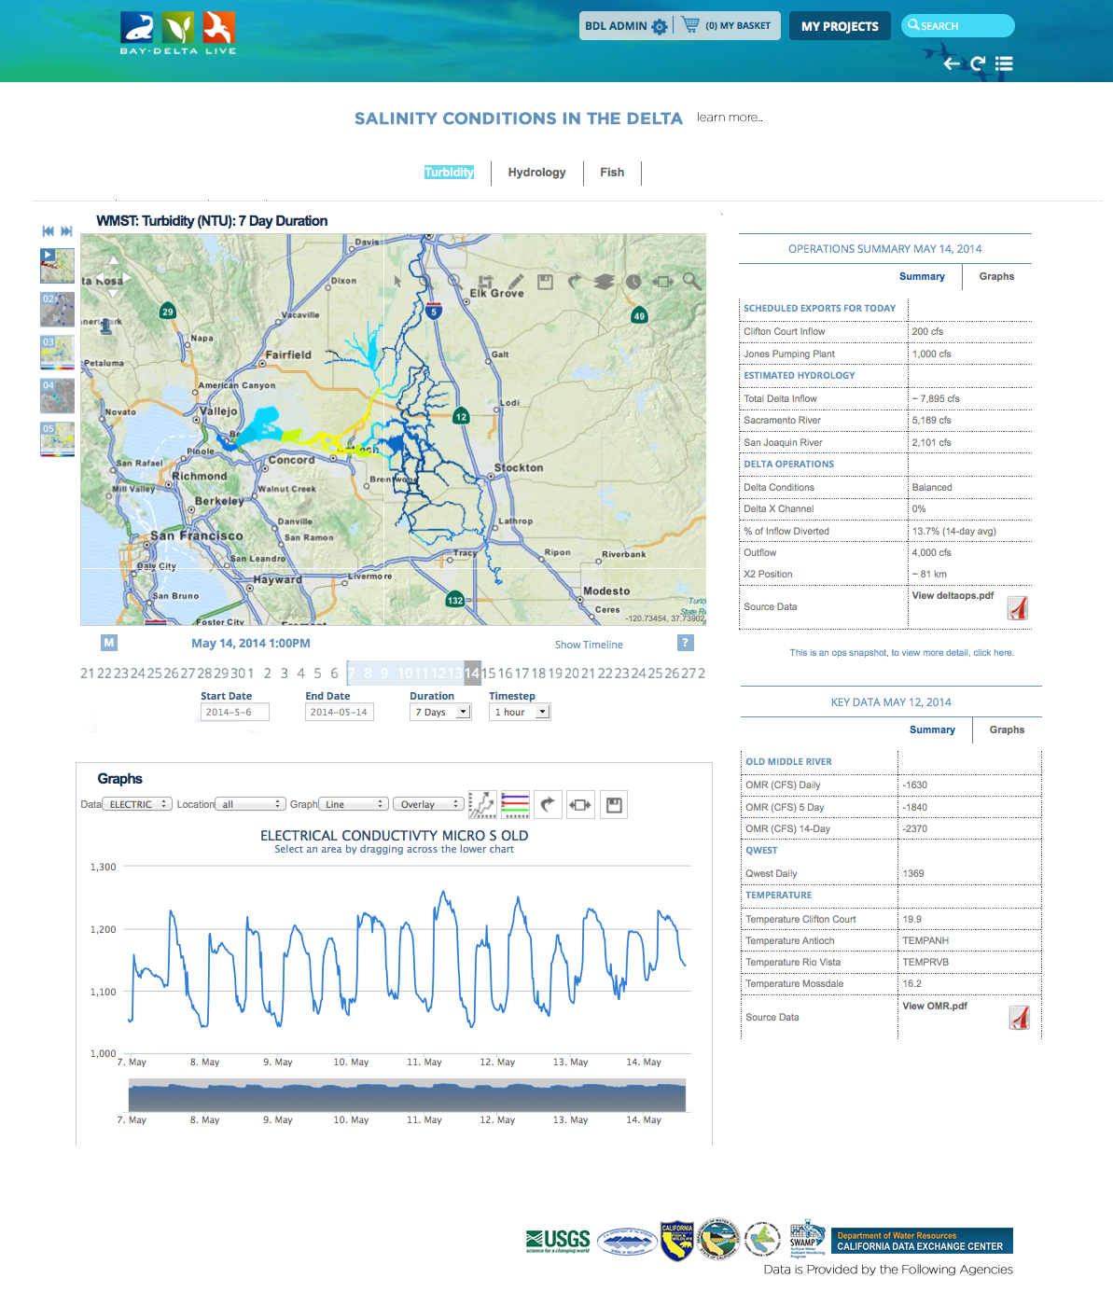
DATA DASHBOARDS
ONE VIEW DATA (Visualize, Map, Graph)
Custom view of data compilations
Project management dashboards

Slide 30
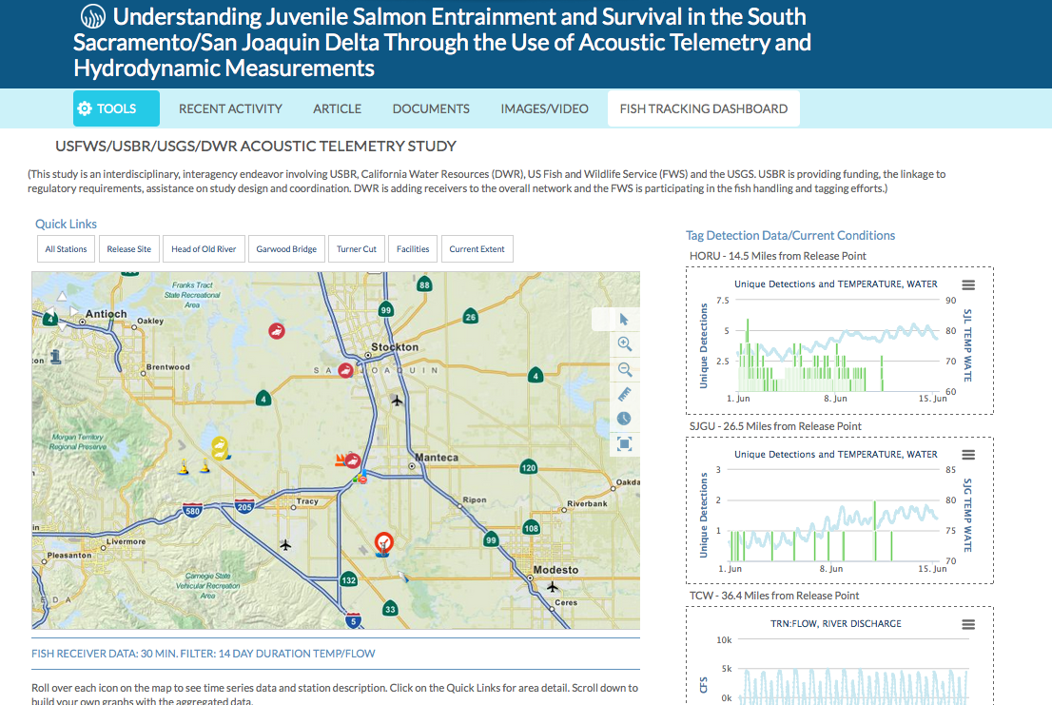
DATA DASHBOARDS: ACOUSTIC TELEMETRY STUDY

Slide 31
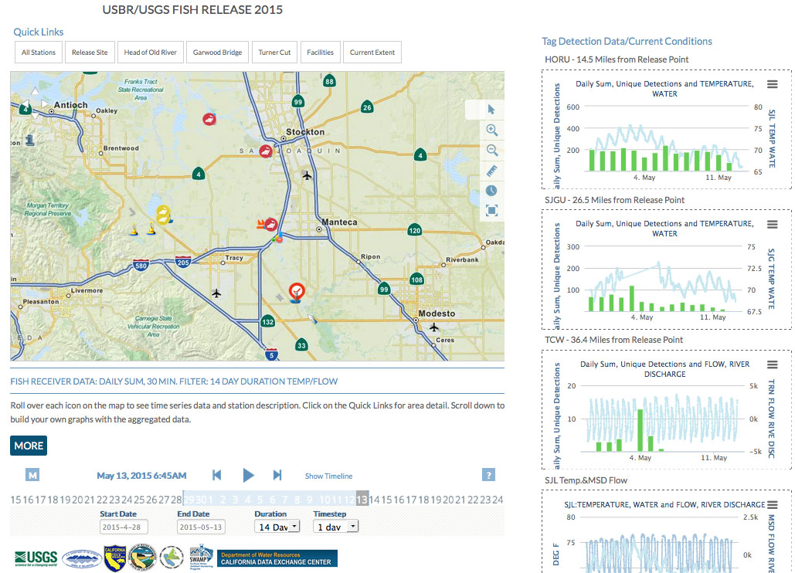
Notes:
UNIQUE DETECTIONS AND DAILY SUM (using 30 minute unique detections filter and then sums)
Data dashboard templates and filters for our use.

Slide 32
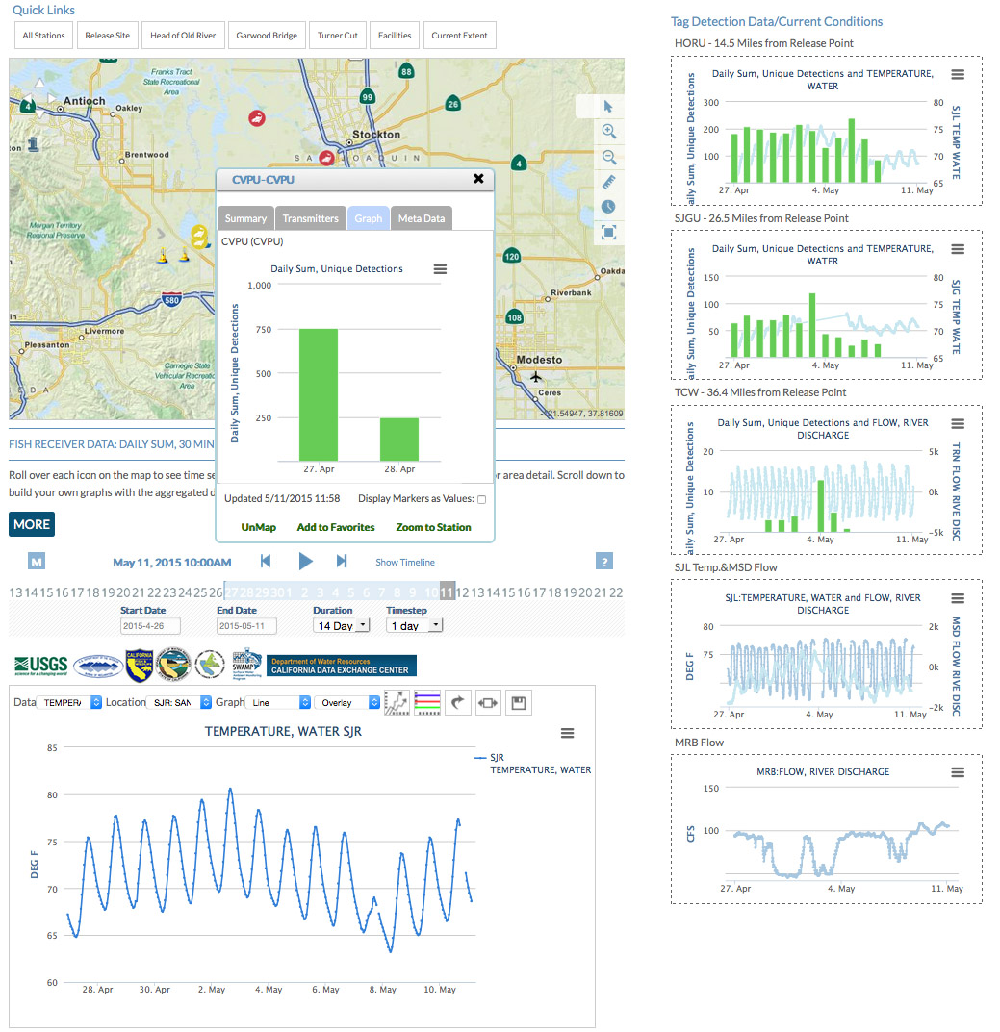

Slide 33
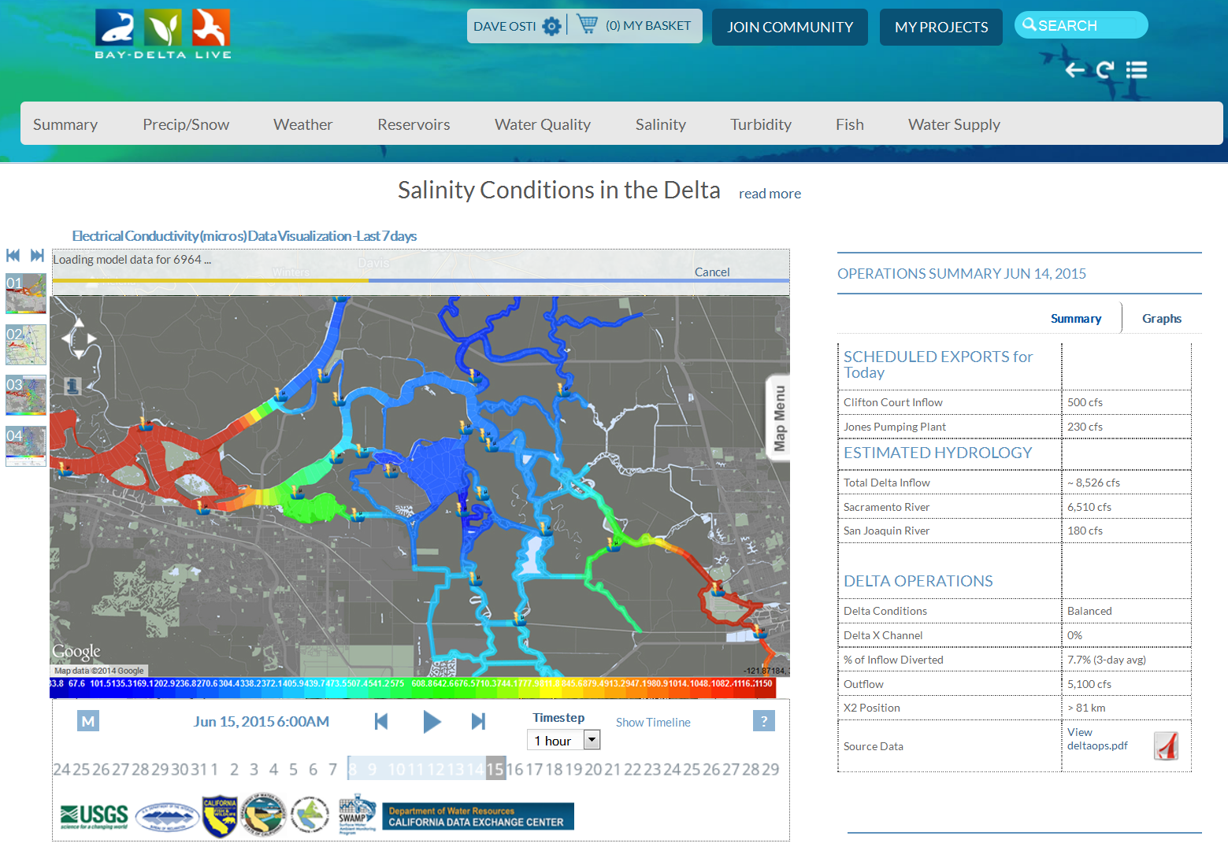

Slide 34
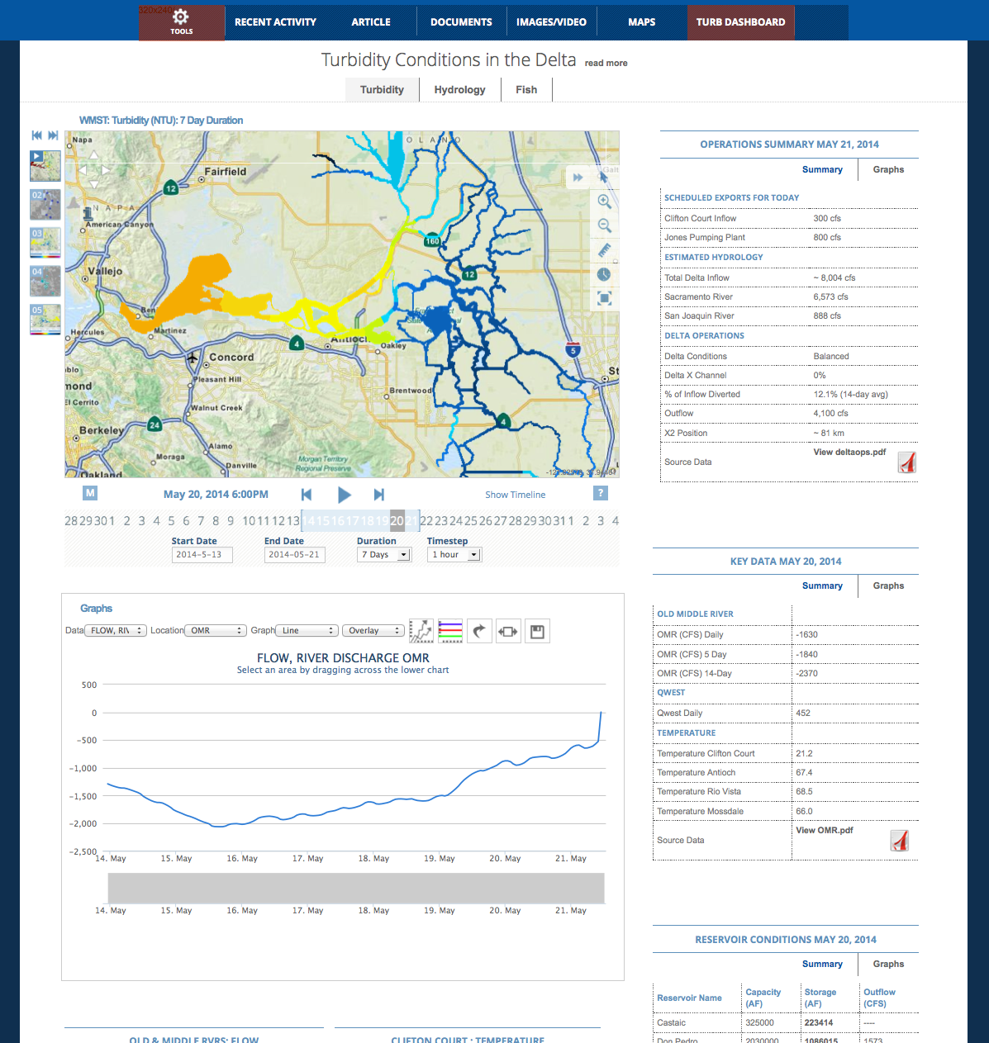
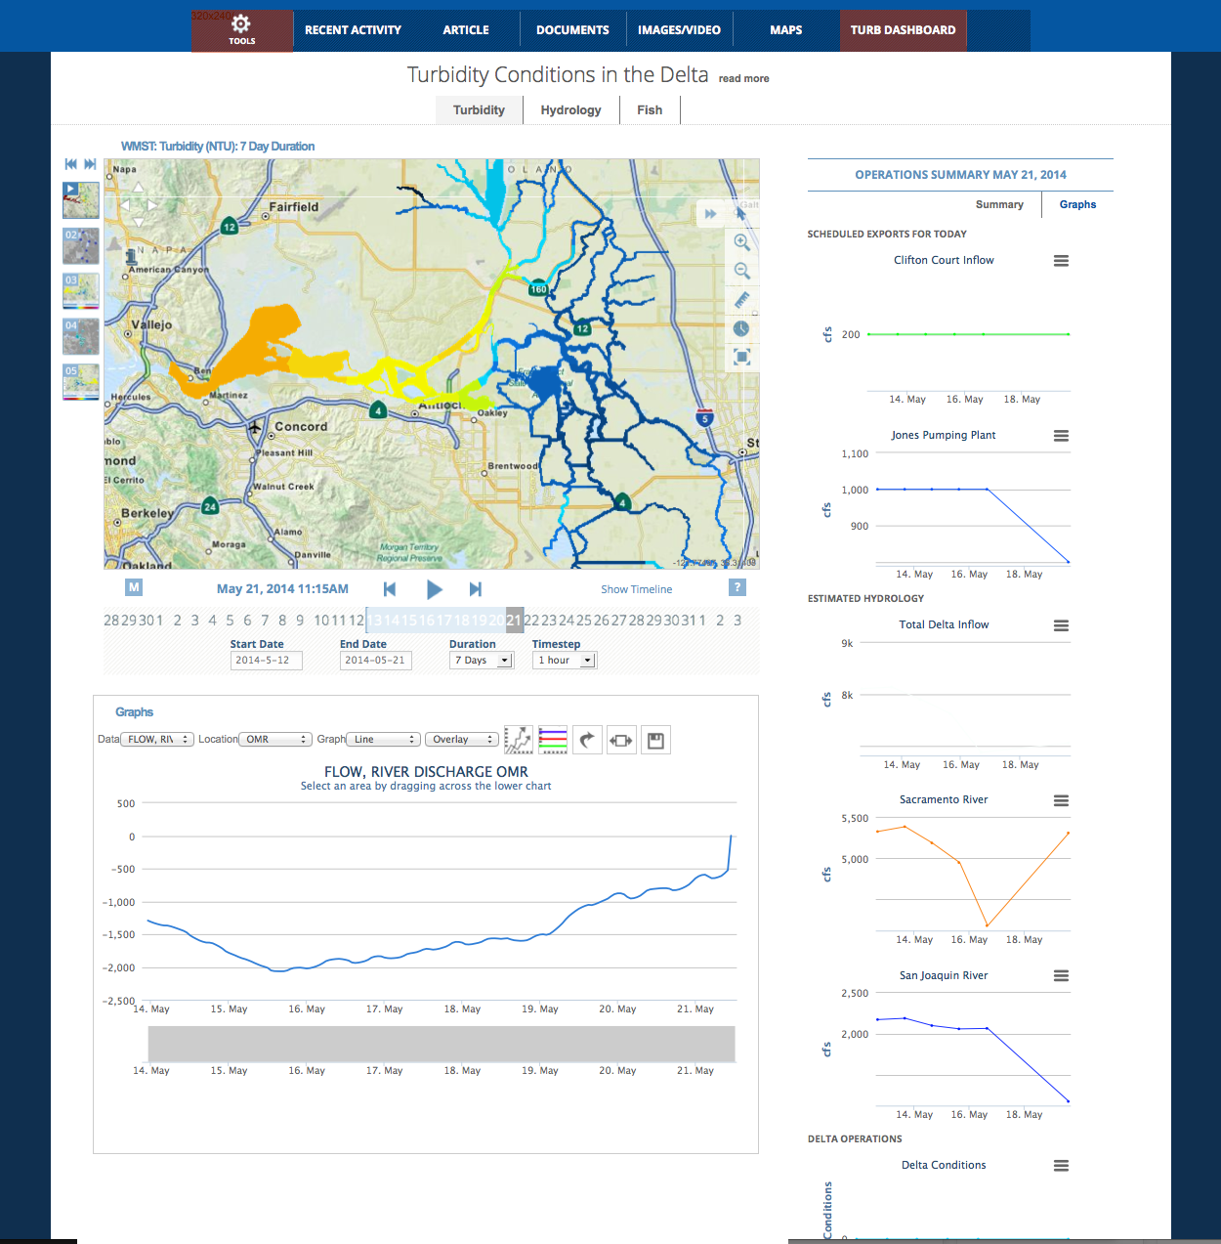
DASHBOARDS

Slide 35
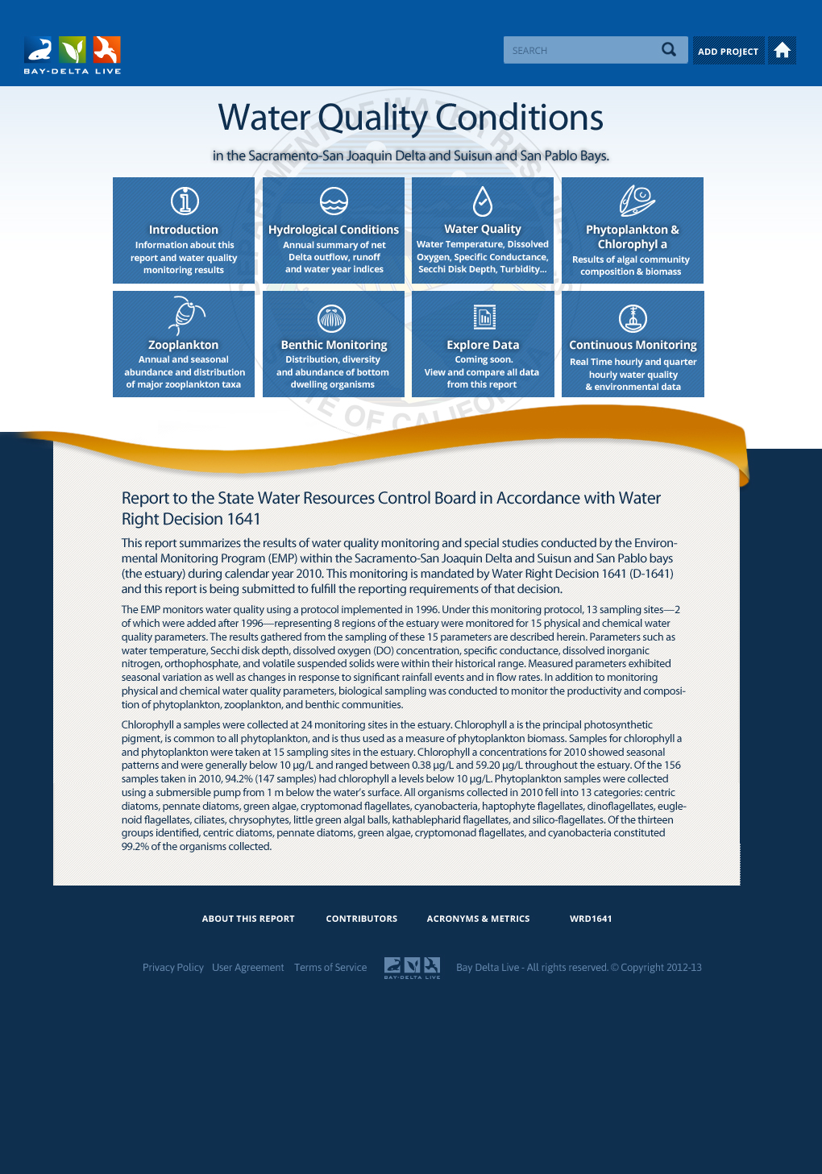

REGULATORY REPORTING
Environmental Monitoring Program (EMP) water quality monitoring and special studies for:
Hydrolologic Conditions
Water Quality
Phytoplankton and Chlorophyll a
Zooplankton
Benthic
Nutrients
Special Studies

Slide 36
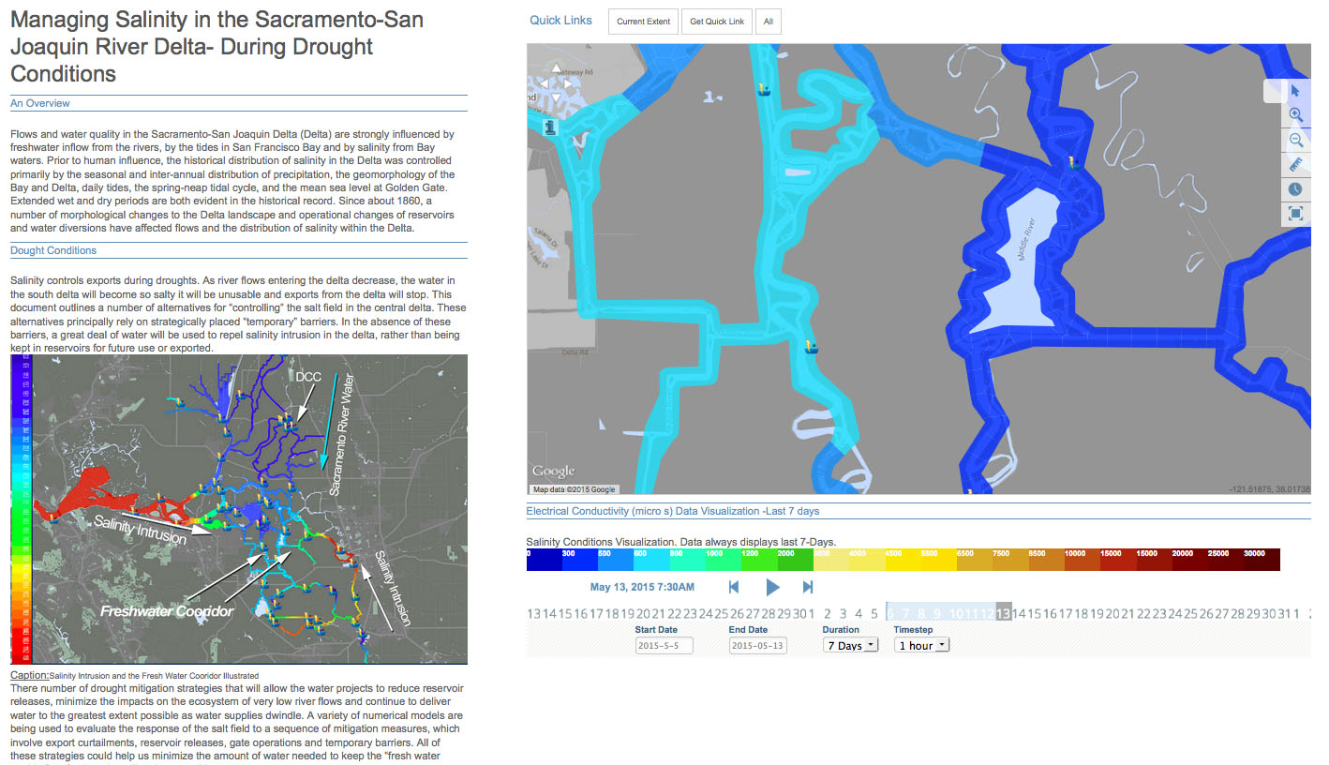
DATA STORIES
Notes:
New data story layout templates for simplifying data story for the public.

Slide 37
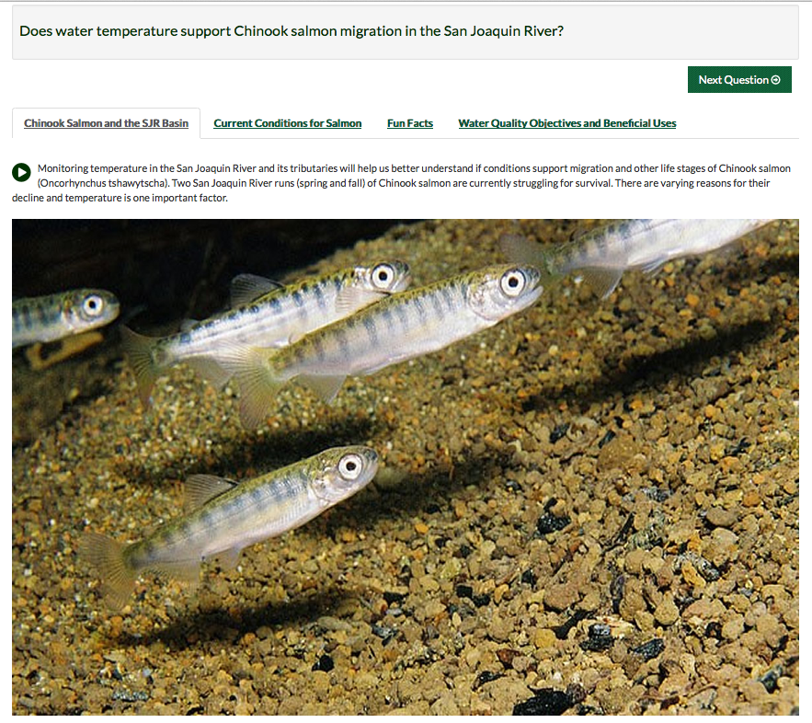
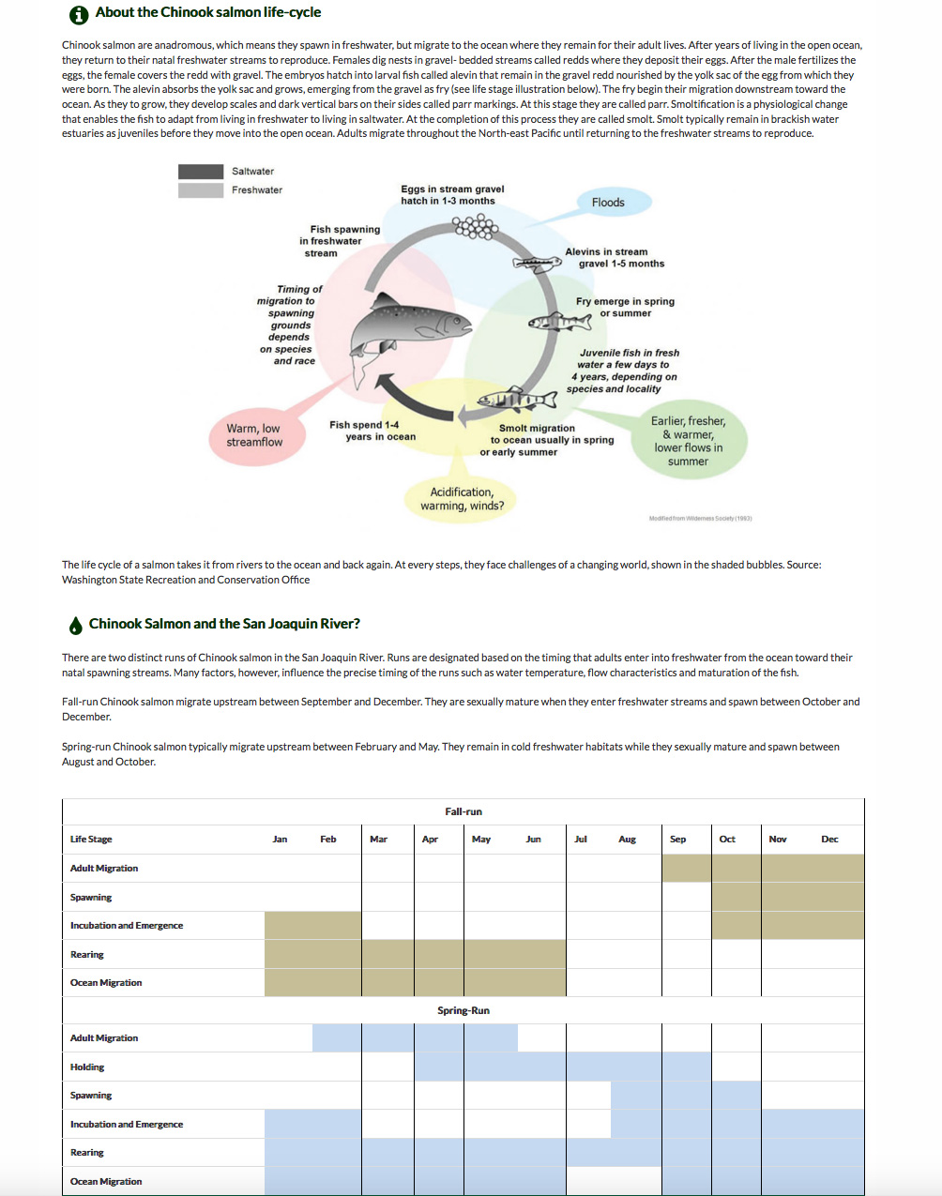
QUESTION TEMPLATES
SENSOR NETWORKS
Notes:
Sample question templates

Slide 38
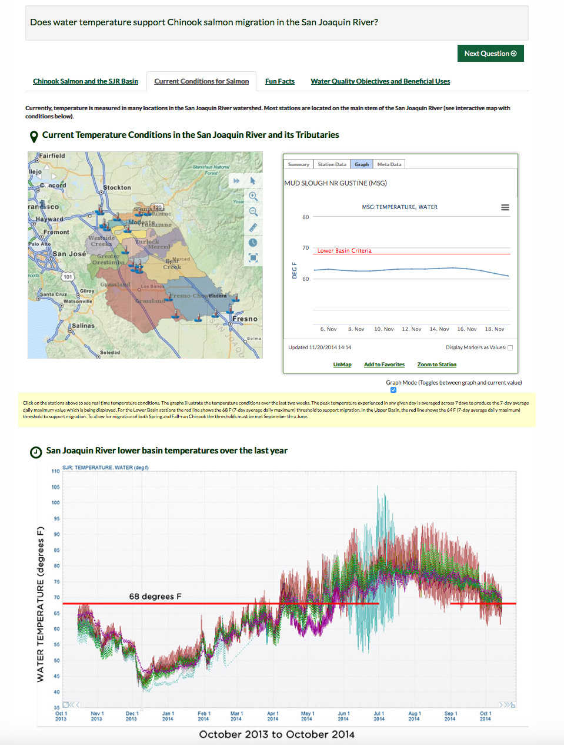
SENSOR NETWORKS

Slide 39
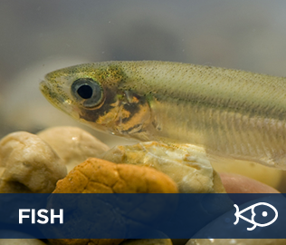
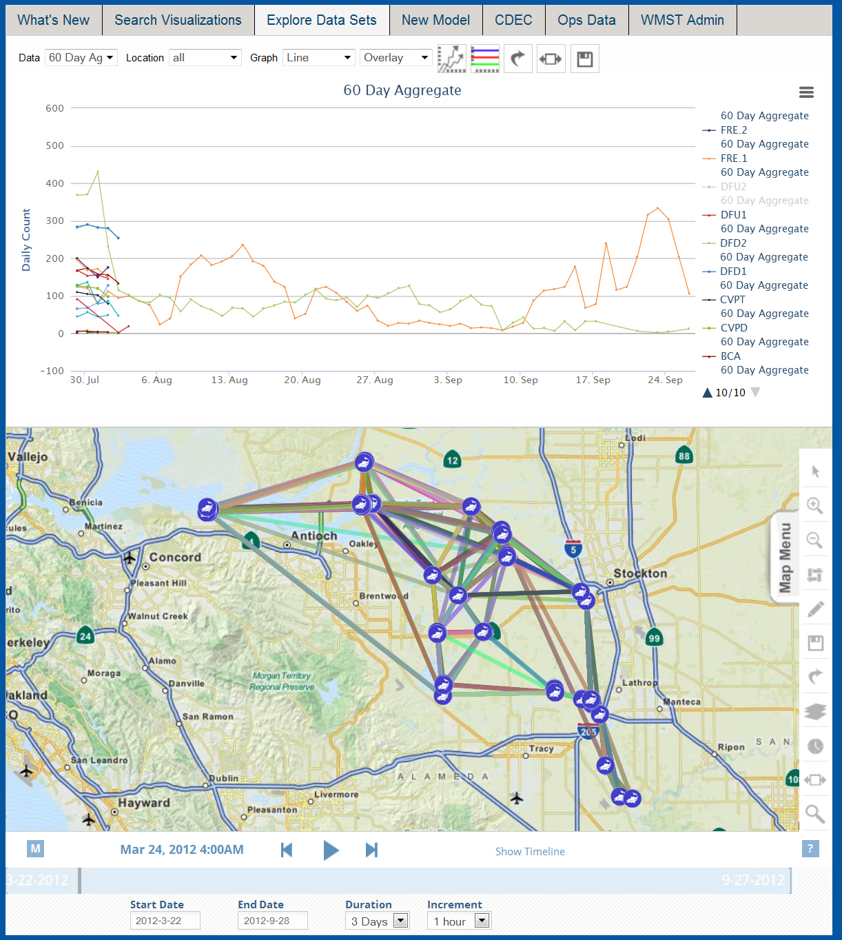

SPECIAL STUDIES
Tracking Fish
Analyze Fish Tracks
Integrate Real Time Conditions
Fish Survival Rates
Tides
Flow
X2

Slide 40
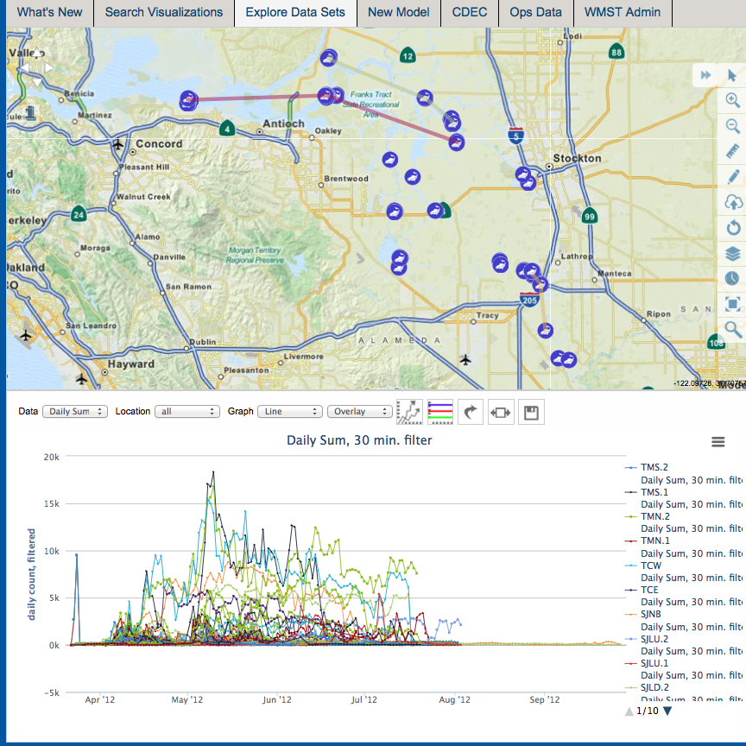
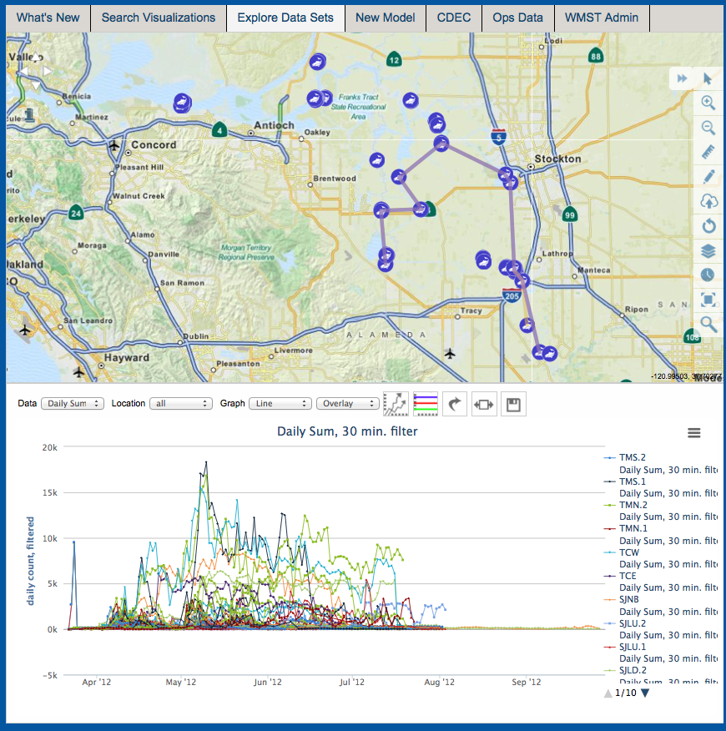
No Prior Detections
Fastest Way Out

Slide 41
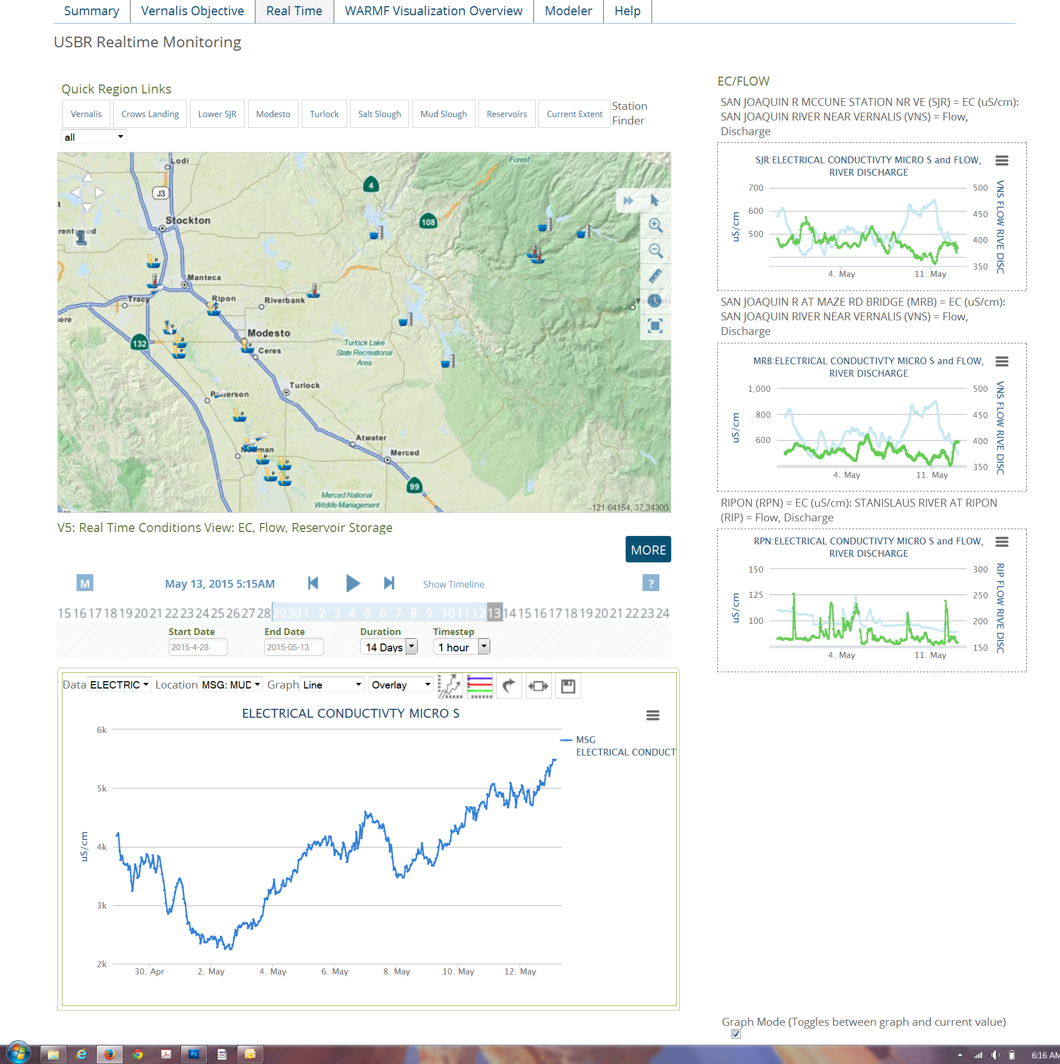
REAL TIME TMDL MANAGEMENT: SJRRTM
Notes:
Stakeholder driven real time salinity management in the SJR Basin.
More than 50 + active stakeholder involved in real time analysis and assessment of SJR salinity.
Data dashboards customized for each stakeholder’s data needs
Collaborative forum for posting operations data: Diversions and Discharges.

Slide 42
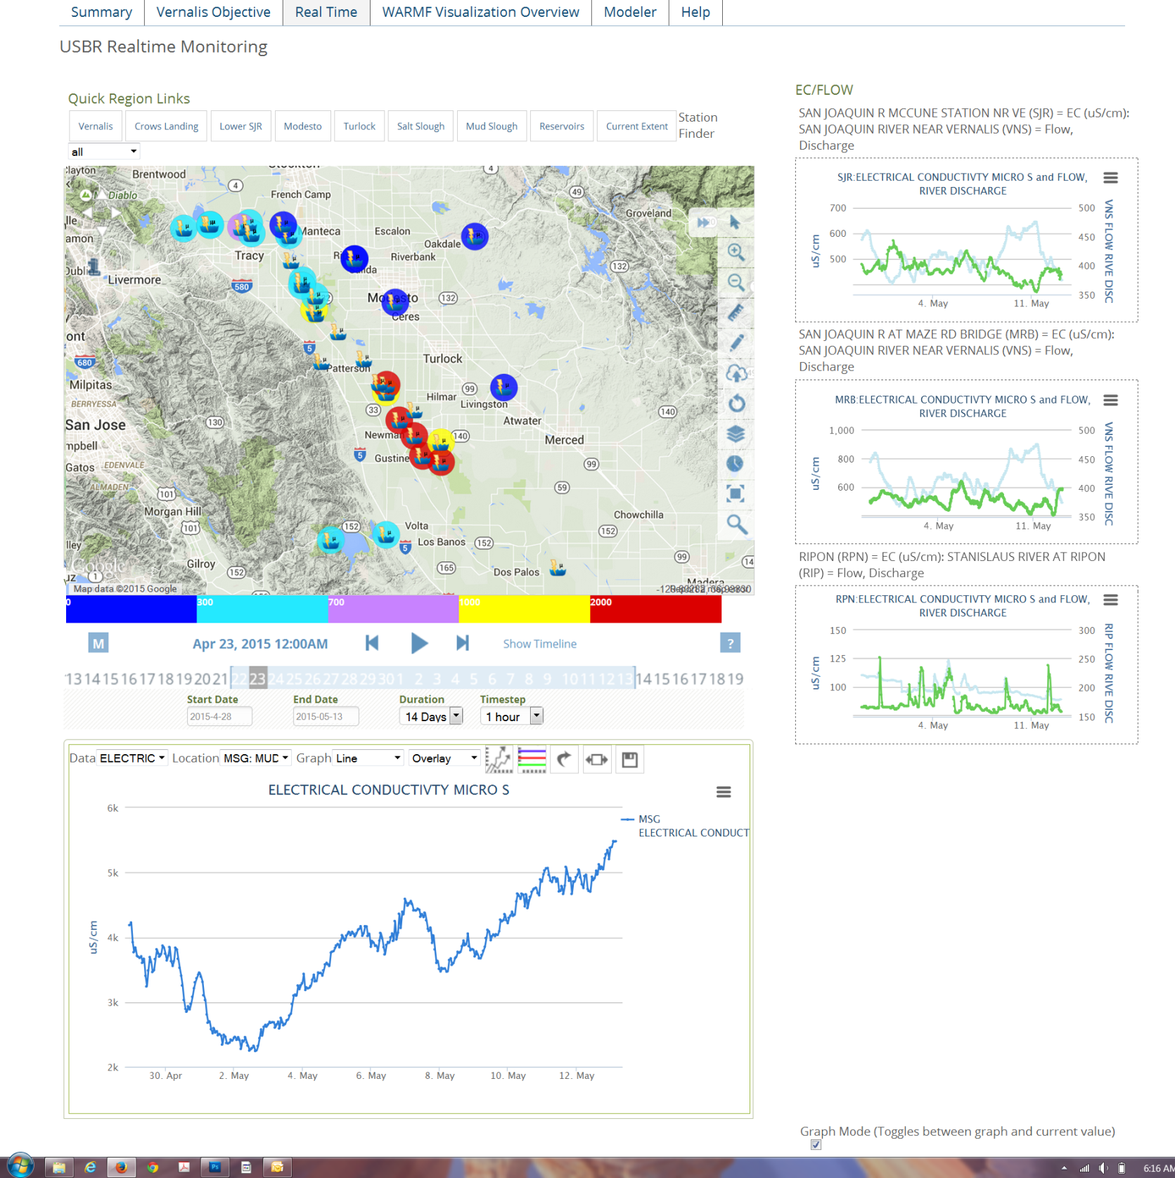
Notes:
Real time data dashboard for SJR stakeholders. Data display is multiparameter

Slide 43
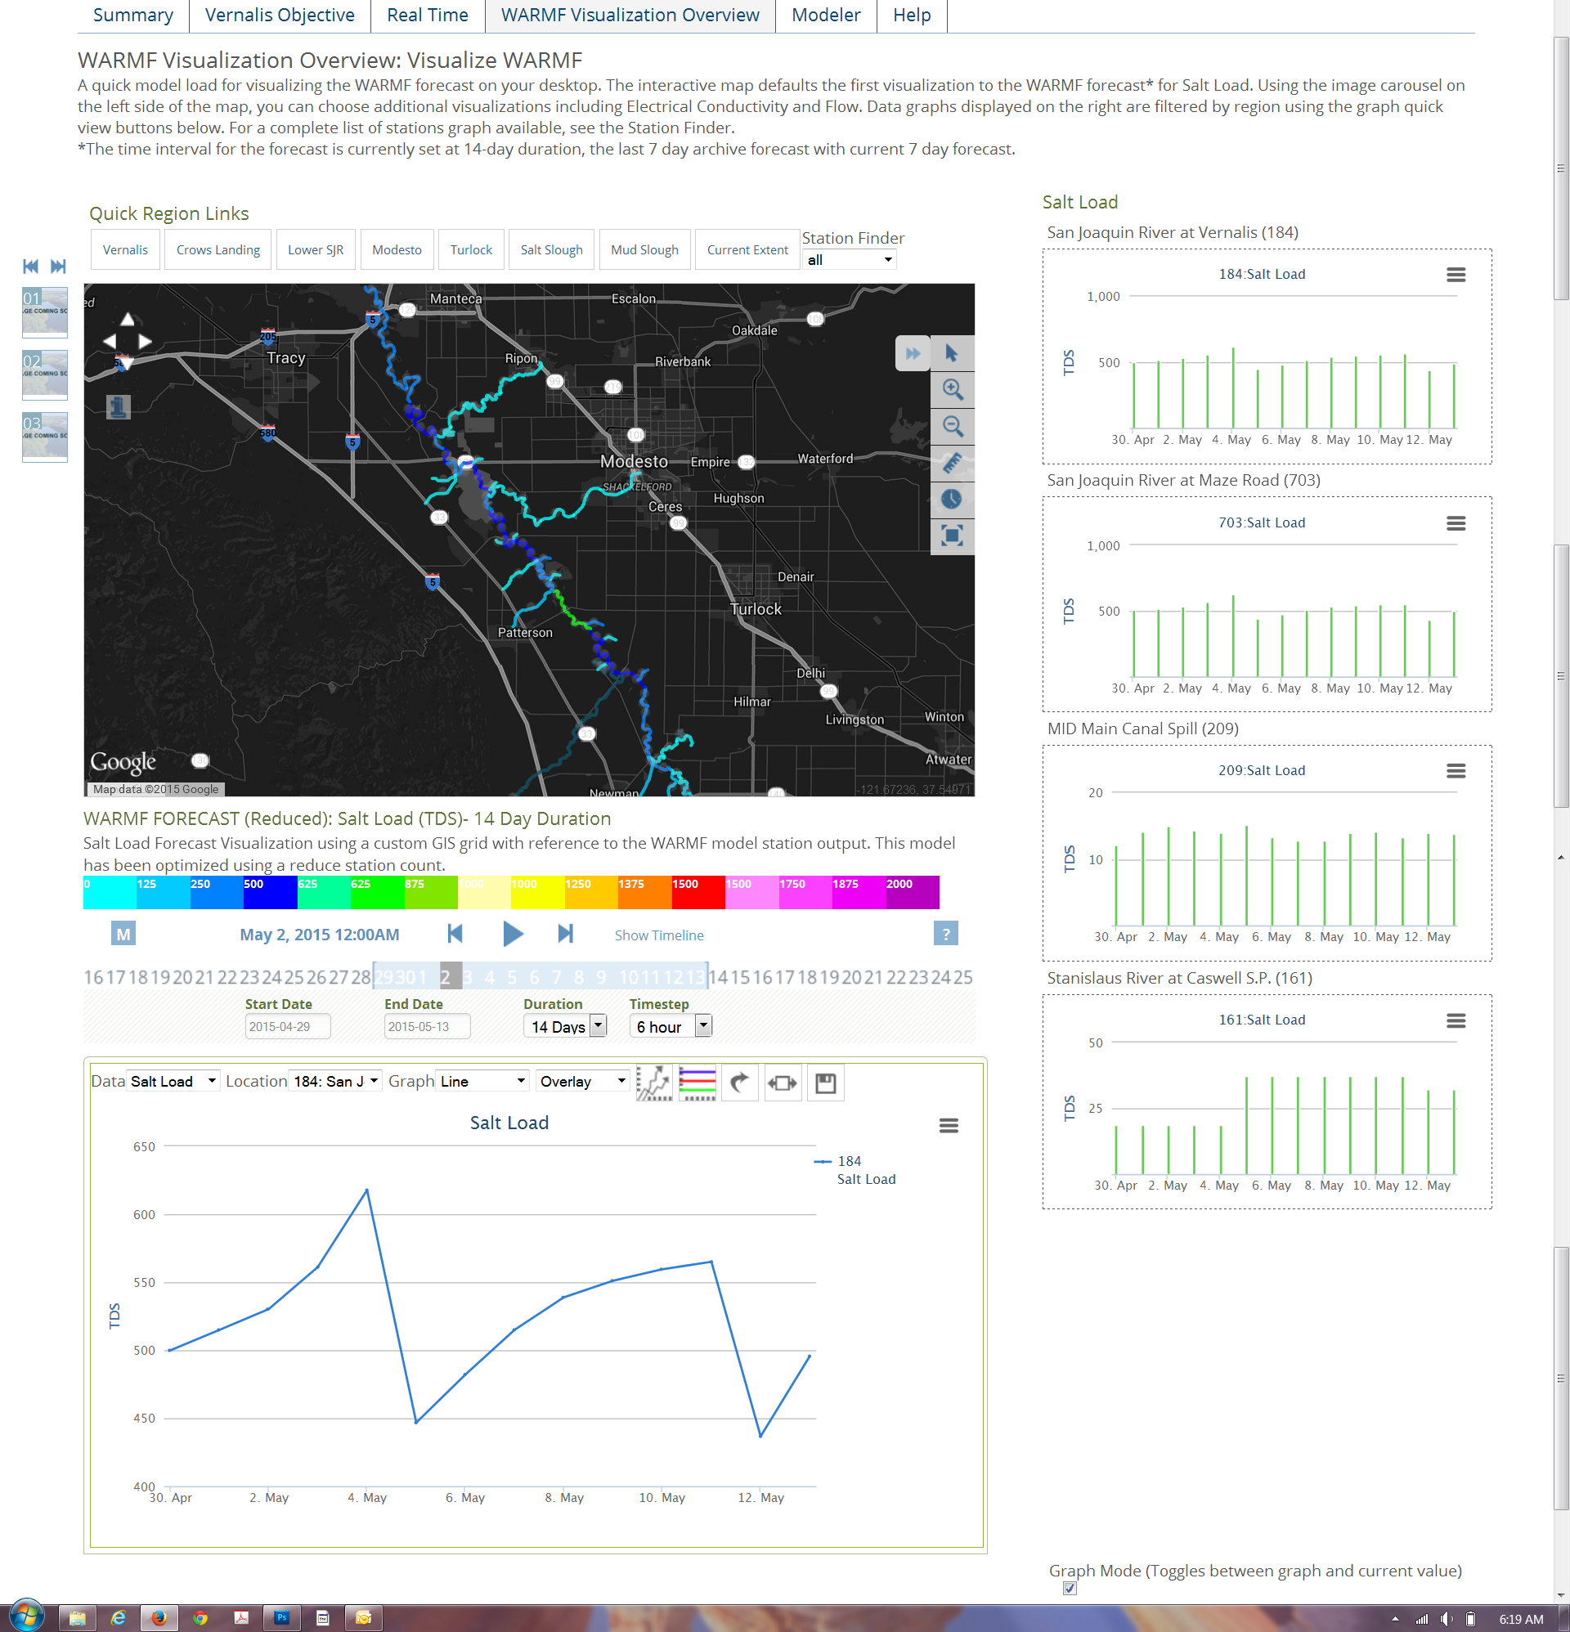
Notes:
Incorporates model forecast results for predictive analysis of SJR Conditions.

Slide 44
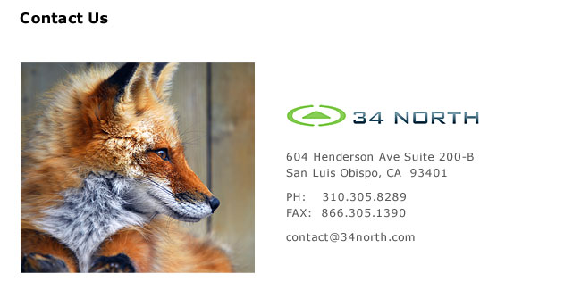
12277 Soaring Way Suite 107
Truckee, Ca 96161
PH: 310.305.8289
FAX: 866.305.1390
contact@34north.com

