Slide 1





WATER QUALITY PORTAL DEVELOPMENT FOR THE SACRAMENTO RIVER WATERSHED
Holly Jorgensen
Amye Osti
Chuck Lundgren
Stephen McCord, Ph.D., P.E.

Slide 2
OVERVIEW: AGENDA
Welcome and Introductions
Current News & Activities
Survey Results
Survey Feedback
Key Topics
Portal Updates
Wrap-Up

Slide 3
OVERVIEW: DEVELOPMENT PROCESS
Stakeholder commitments
Survey stakeholders for key issues, areas of concern, and useful data sets
Identify available information for the Watershed (data, maps, reports, programs, monitoring efforts, photos, etc)
Script analyses & visualizations
Build & host site
Outline future activities

Slide 4
UPDATES: ACTION ITEMS
HJ: Update list of committed SH’s
HJ: Distribute & summarize survey
SM: Upload SRWP data to CEDEN?
Team: Present at SRWP forum
HJ: ID additional stakeholders
SM/AO: Sommer ➔ Dekar (fish data)
SM: Data sources table reviews
SM: Draft storyboards for key topics
Notes:
KW- I did not change this slide, to me it seems like something that can be deleted and just talked about.

Slide 5
UPDATES: CURRENT NEWS
SWAMP: State, Regional
DWR: MWQI, Regions
ILRPs: Sac Valley, Rice
MS4s: Phase I & II
POTWs: CVCWA, indiv.
Riparian & wetland (p)reserves
Sac. Area CMP
Delta programs
CWQMC
  CA Estuaries Mon. WG
  CA Wetland Mon. WG
  Healthy Watersheds Partnership
  Data Man. WG
  BOG WG “Is it safe to eat fish?”
  Collaboration Workgroup
Notes:
KW- Again here I would just delete this slide, seems like it will confuse the audience more than aid with the presentation.

Slide 6
SURVEY: INITIAL RESULTS
Survey given to XX Stakeholders
Top Priorities were…
Or give surveys out at this time and save results for another meeting
Notes:
KW- could include the limited survey responses here or hand out the survey to all attendees. Also, is there a question on the survey asking where/what data the “monitoring committee” members are collecting?

Slide 7
SURVEY: FEEDBACK AND ADDITIONAL COMMENTS
Initial thoughts in response to the Survey
Comments
What data would you like to see on the portal?
What data are you and your program collecting? Would you like to see it on the portal?
Questions
Concerns
Notes:
KW-depending on what route is decided (presenting on initial survey results or reissuing the survey) this slide may be edited or deleted

Slide 8
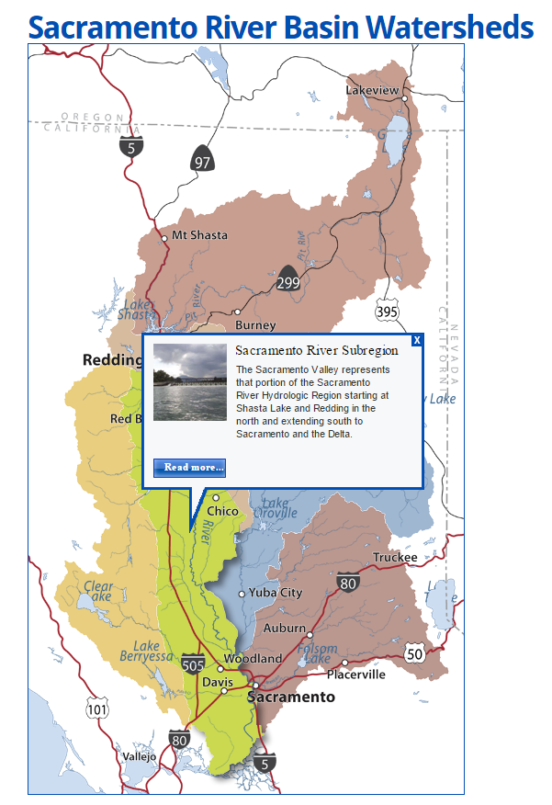
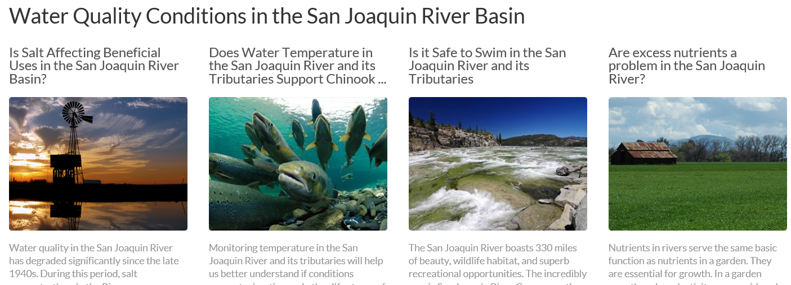
PORTAL TOPICS: WATERSHED INFORMATION
General Watershed Information
Link to sub-watershed pages
Spotlights on areas of concern
“What’s happening in your watershed?”

Slide 9
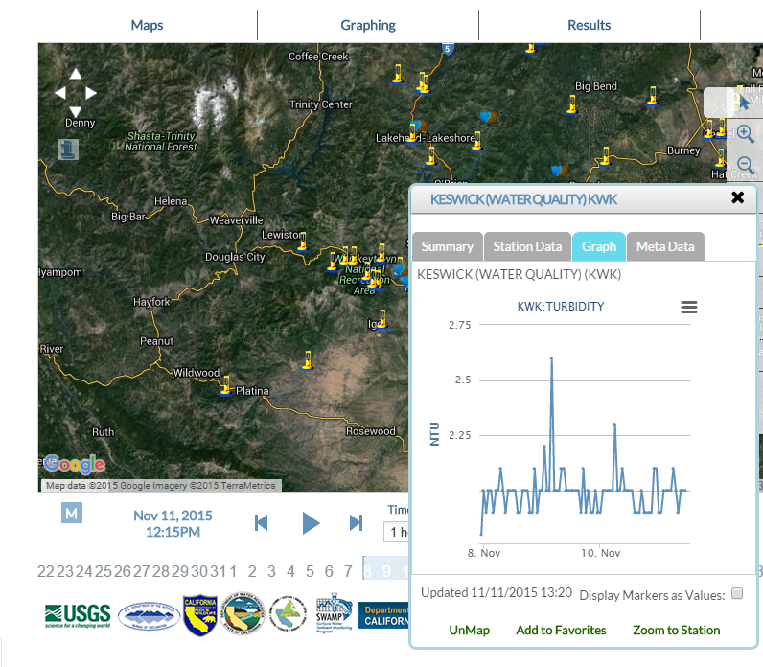
PORTAL TOPICS: REAL TIME DATA
Available Data Sets:
Dissolved Oxygen
Turbidity
River Discharge
Water Temperature
Electrical Conductivity

Slide 10
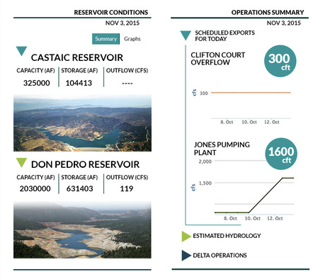
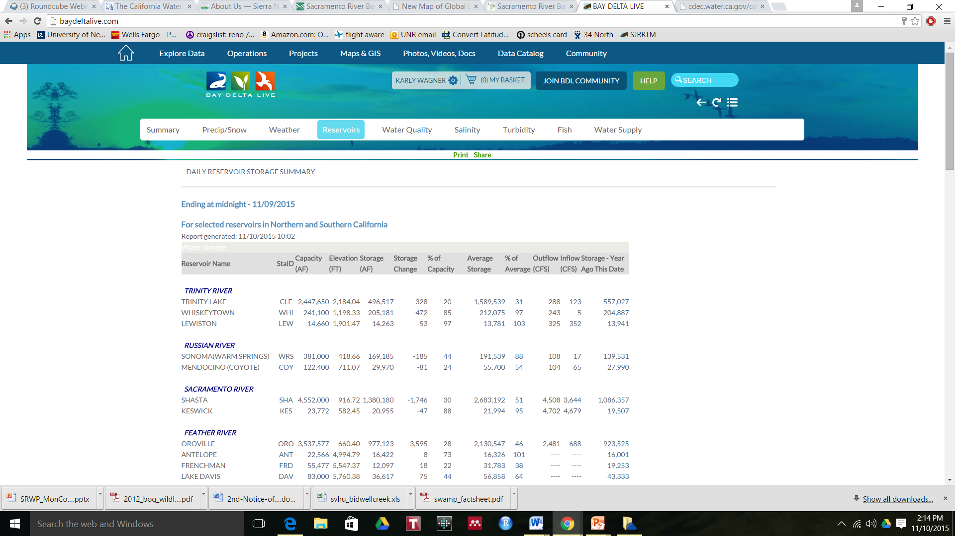
PORTAL TOPICS: RESERVOIR OPERATIONS
Available Information:
Current Storage
Inflow/Outflow
Storage Capacity
Lake Surface Elevation
Scheduled Releases
Gate status
Recent Releases
Comparison to historical data

Slide 11
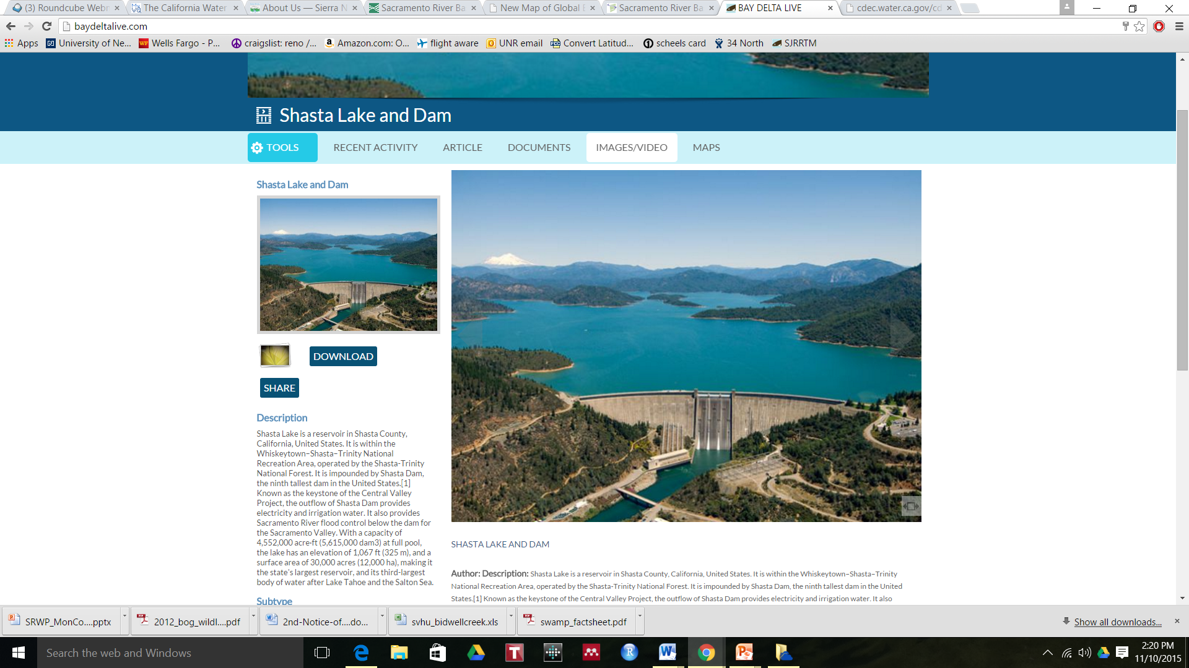
PORTAL TOPICS: LAKE SHASTA
Key Issues:
Cold Water releases for salmonid species
Salmon life stages and water needs
Reservoir Water Quality Concerns and monitoring
Scheduled Releases
Inflow and Outflow
Recreational Activities
Releases for temperature compliance on the Sacramento River
Snowpack (SWE) and snow melt
Lake Elevation

Slide 12
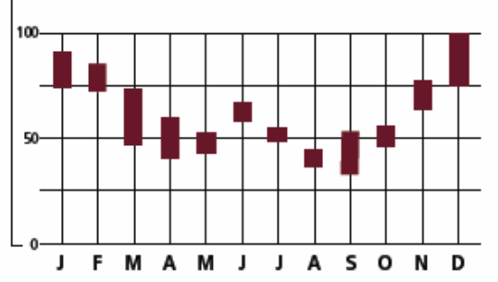
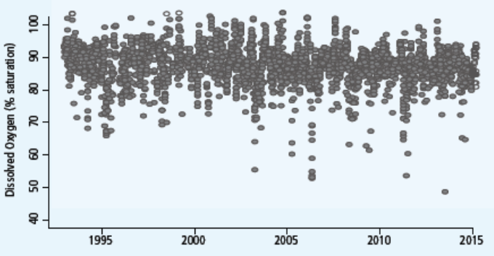
PORTAL TOPICS: NUTRIENTS
Monthly Averages
Are excess nutrients a problem in the watershed?
Nitrate
Ammonia
Phosphorus
Eutropocation Indicators (Chlorophyll a, cyanotoxins)
Time Series
Nutrient Data Sets:
CEDEN
Notes:
http://www2.epa.gov/nutrient-policy-data/nitrogen-and-phosphorus-pollution-data-access-tool, http://www2.epa.gov/nutrientpollution, http://www.sfei.org/projects/satellite-imaging-detect-cyanobacterial-blooms

Slide 13
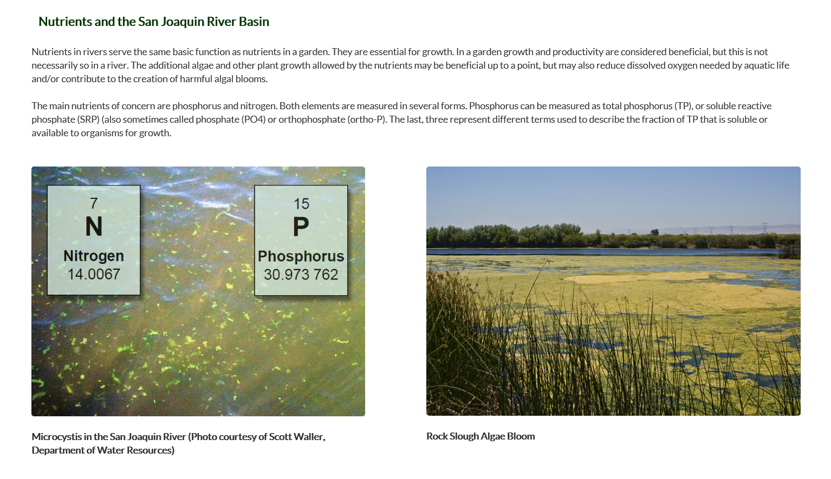
PORTAL TOPICS: NUTRIENT BACKGROUND

Slide 14
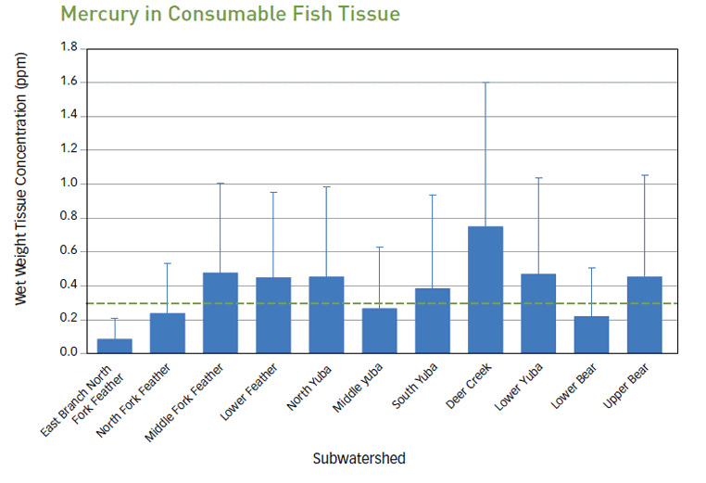
PORTAL TOPICS: MERCURY
Mercury and Fish
Sources of Mercury in the System
Mercury Criteria (fish tissue criterion = 0.3 ppm, THg in water criterion = 50 ng/L)
Methylmercury TMDL
Where is mercury contamination an issue?
Data sets:
  CEDEN
  USGS EMMA (mercury in fish tissue and mercury in stream sediments)
Notes:
KW: need to check Stephens data sets (SRWP data, 1997-2003 [MLML?], SWAMP BOG data [CEDEN], Sac R NAWQA project [NWIS], http://www2.epa.gov/fish-tech/national-lake-fish-tissue-study-reports, http://www.usgs.gov/mercury/)

Slide 15
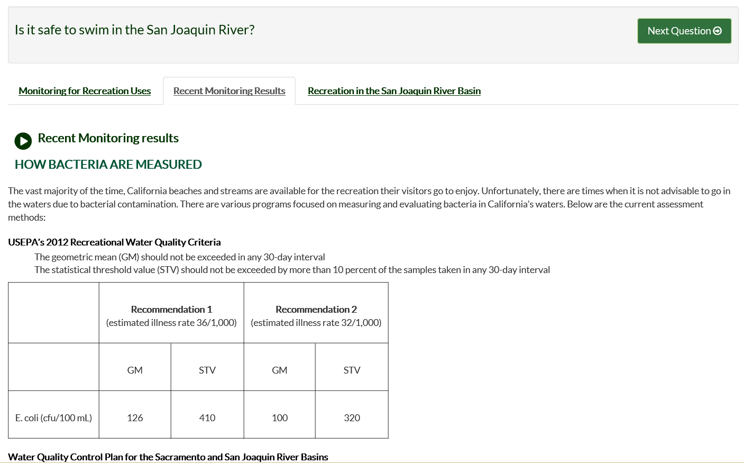
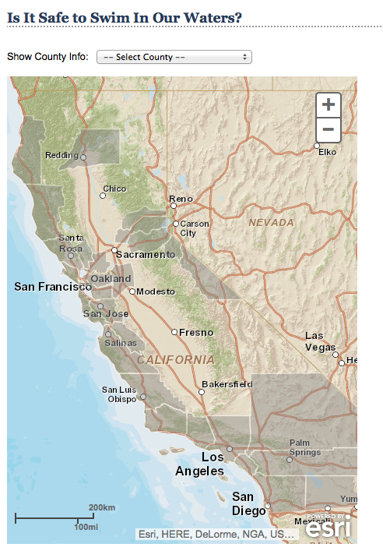
PORTAL TOPICS: SAFE TO SWIM

Slide 16
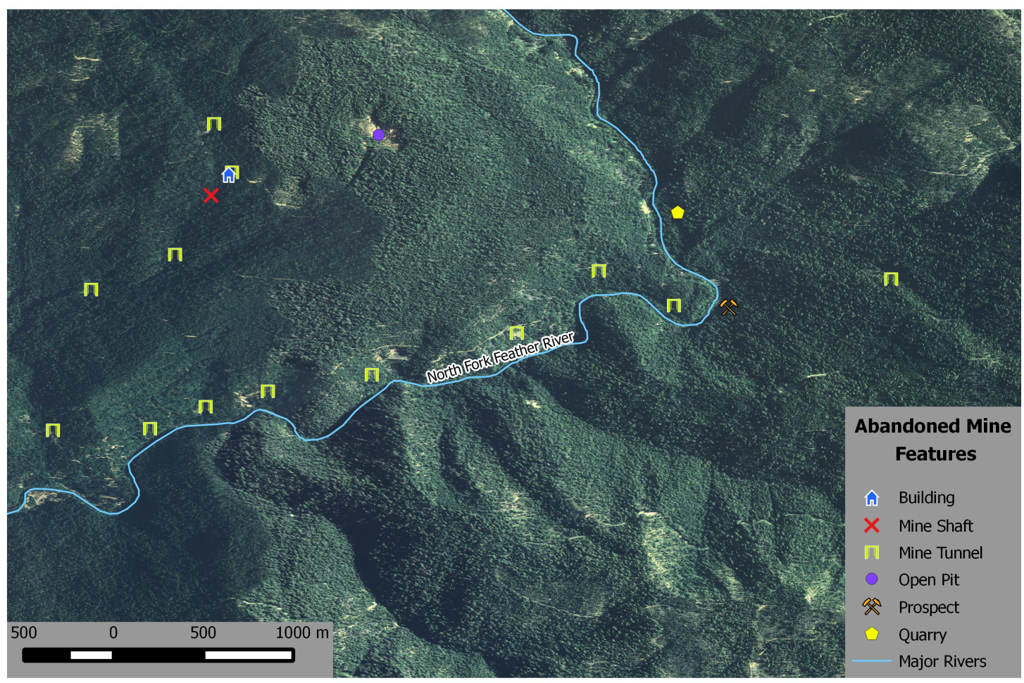
PORTAL TOPICS: ABANDONED MINES
Key Issues:
What are the remediation strategies?
Possible sources of contaminants
Distance to rivers/streams/lakes
Data Set:
GIS layer with mine location and type

Slide 17
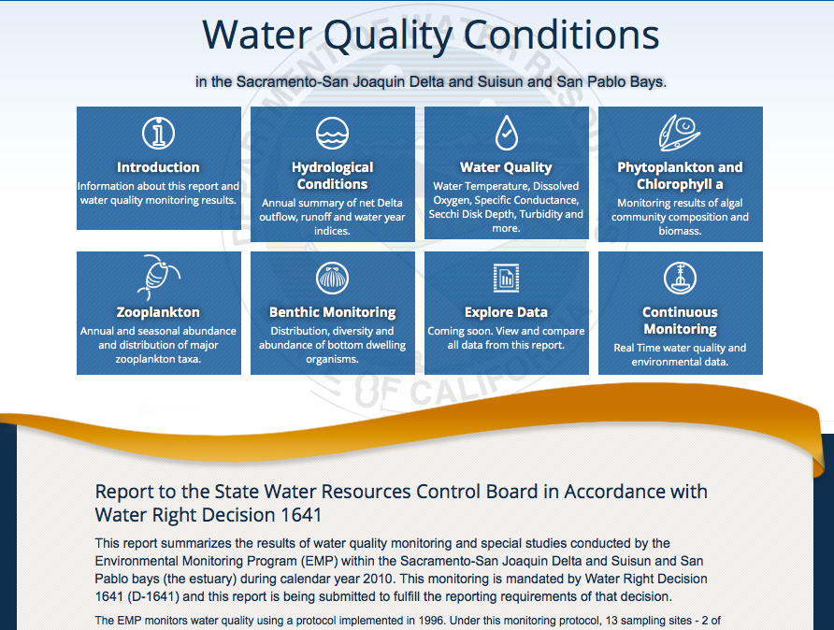
PORTAL TOPICS: 1641 WATER QUALITY CONTROL PLAN

Slide 18
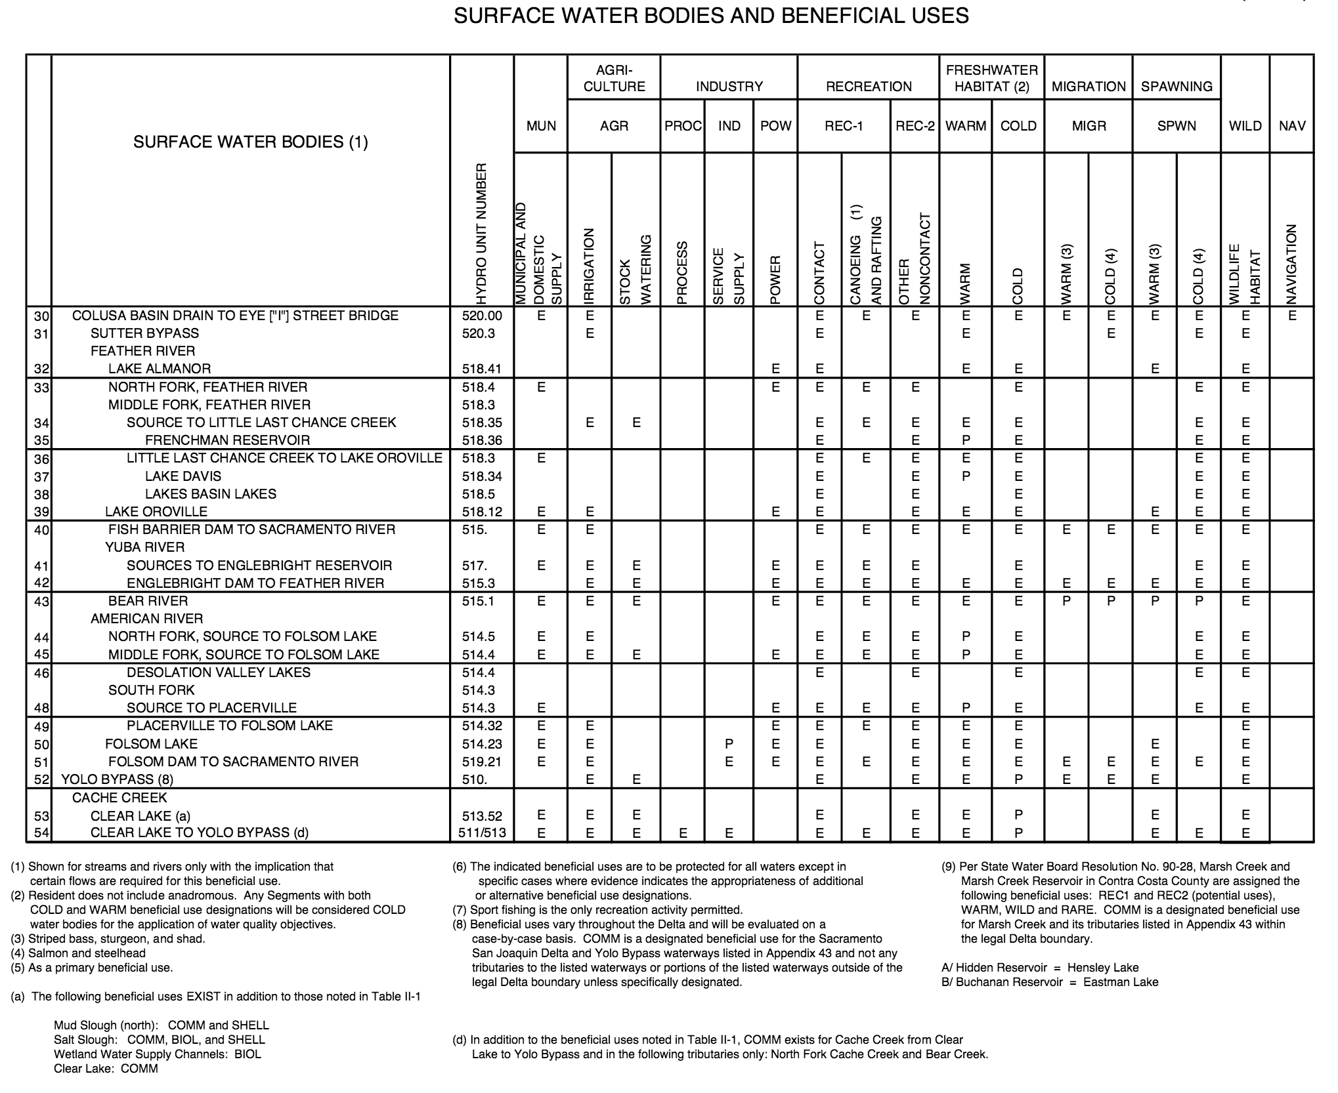
PORTAL TOPICS: BENIFICIAL USES
Questions related to Benificial Use:
What are the beneficial uses in your area?
How is the water managed and monitored for those beneficial uses
What impacts does this have upstream and downstream?

Slide 19
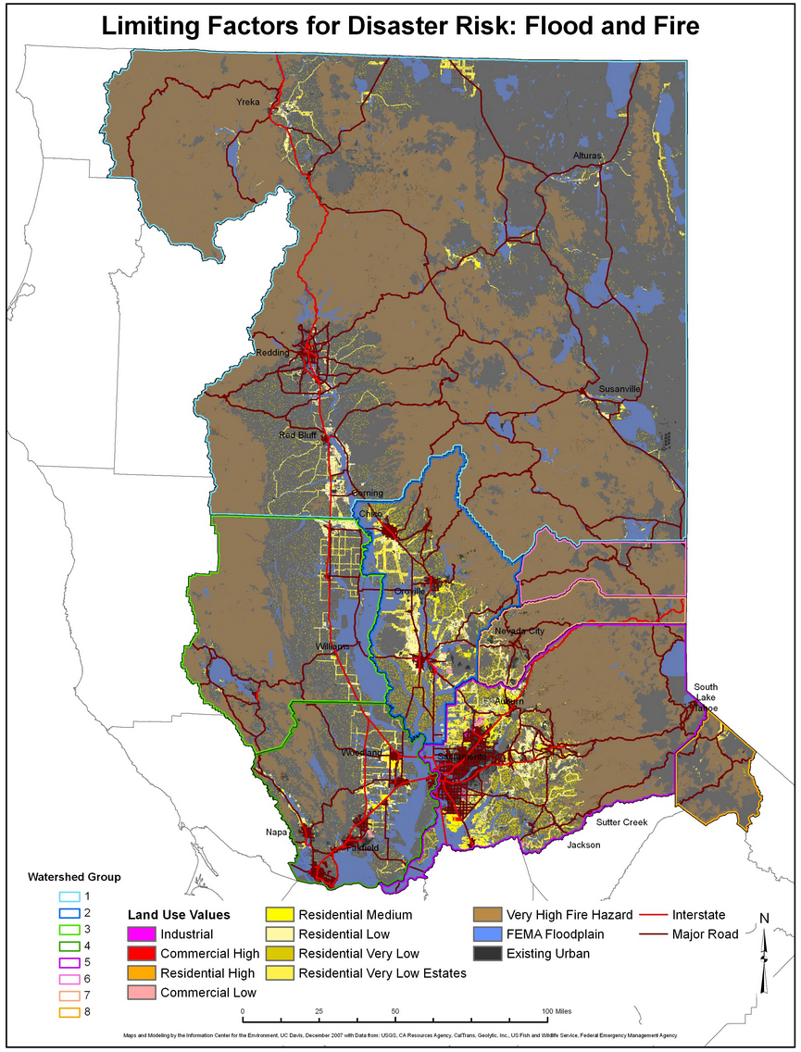
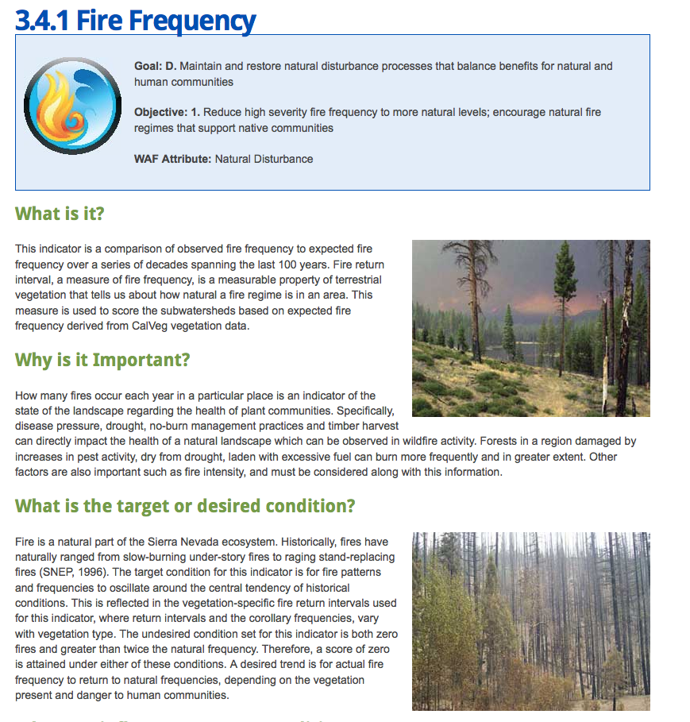
PORTAL TOPICS: FIRE

Slide 20
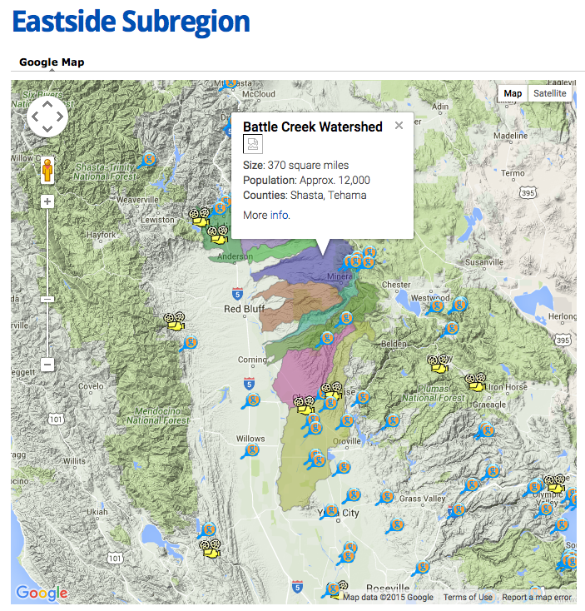
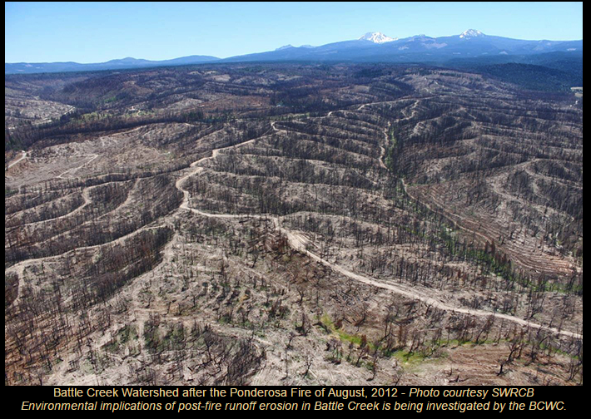
PORTAL TOPICS: BATTLE CREEK
Key Issues:
Sediment Transport
Turbidity
Flood Events
Salmon and Steelhead rearing and spawning habitat
Fire Safe
Restoration Projects

Slide 21
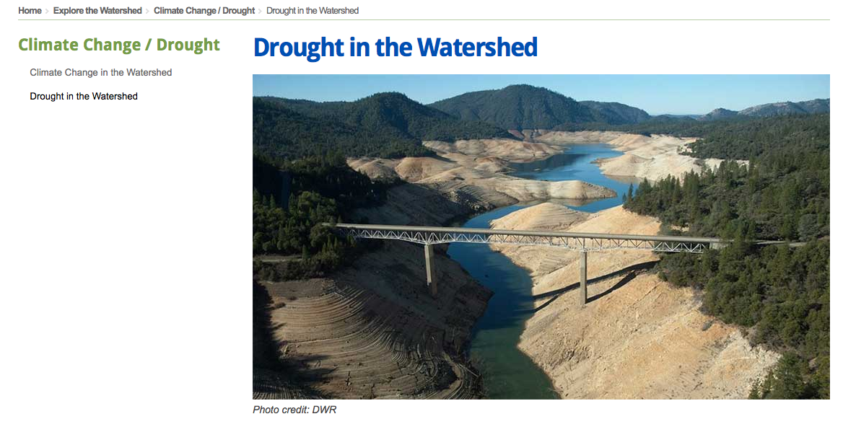
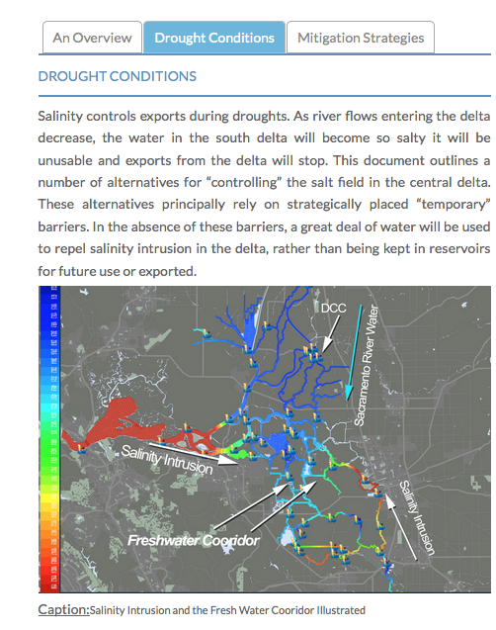
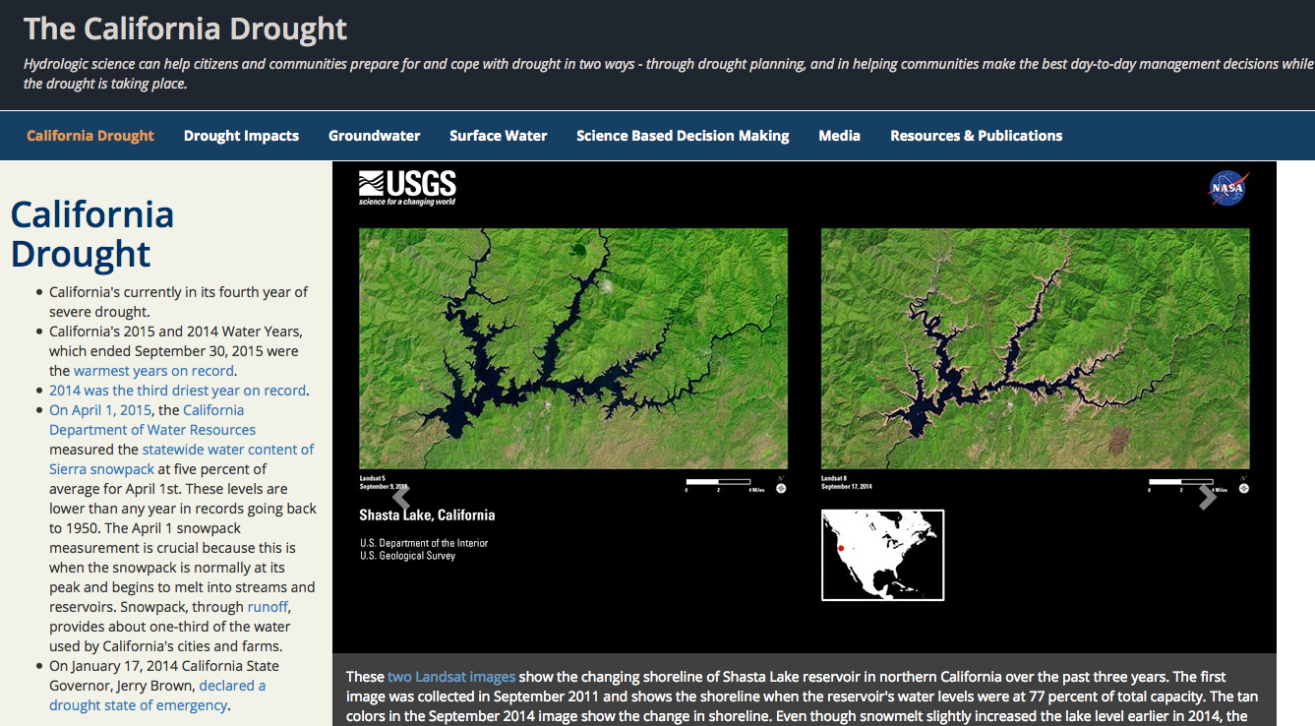
PORTAL TOPICS: DROUGHT MANAGEMENT

Slide 22
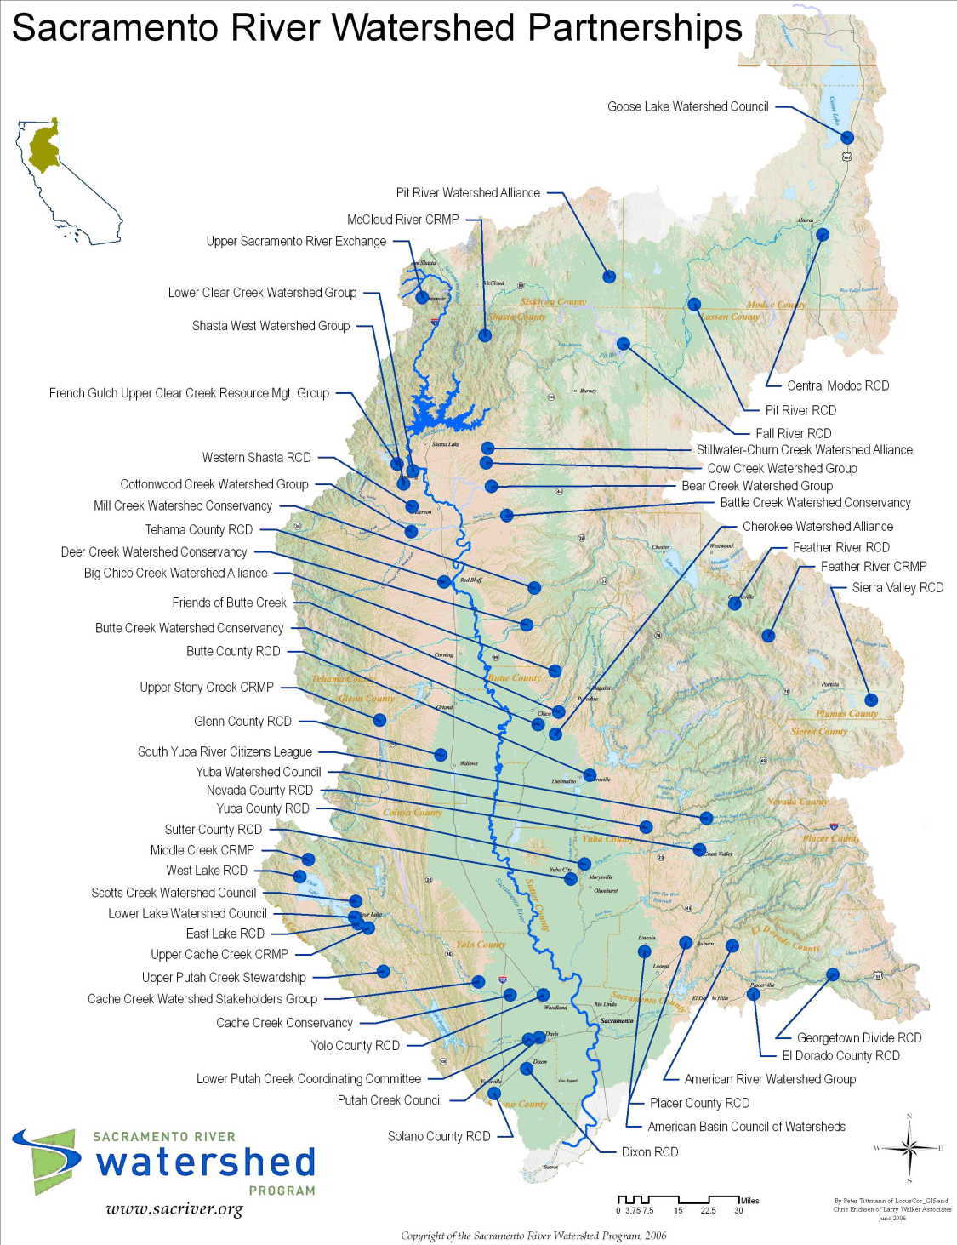
PORTAL TOPICS: COLLABORATION
Who is conducting research in the watershed?
Who is monitoring areas in the watershed?
Do studies overlap?
How do the different groups communicate?

Slide 23
PORTAL CONTENT: AVAILABLE DATA SETS
CDEC: real time water quality and hydrological data
CEDEN: metals, pesticides, nutrients, water quality
USGS NWIS: current and historic water quality data
USGS EMMA: mercury in fish tissue, mercury in stream sediment, mercury in soils, mines (current and historic)
Local data sets (Lake Almanor, Feather River, Dry Creek Area)
CVRWQCB Wetland Database
CRAM Rapid assessment of wetlands and riparian habitats
GIS Data (habitat, fire, streams, watersheds, counties, endangered species, barriers to fish passage, abandoned mines, etc.)
USGS Biodata
PISCES fish distribution data
Notes:
KW: have included data sets in this section which have data that is readily available for download

Slide 24
PORTAL DESIGN: UPDATES
Notes:
Initial layout
KW: has this group seen the other OPENNRM projects? Could also be deleted, was part of original ppt

Slide 25
WRAP-UP: QUESTIONS? COMMENTS?

Slide 26
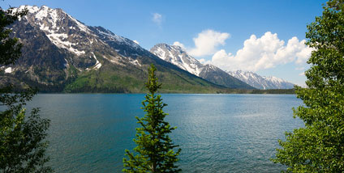
For more information
Stephen McCord
McCord Envir., Inc.
sam@mccenv.com
530-220-3165
www.mccenv.com
Holly Jorgensen
SRWP Exec. Dir.
holly@sacriver.org
530-781-2220
www.sacriver.org

