Slide 1
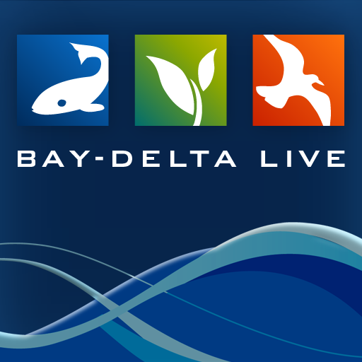
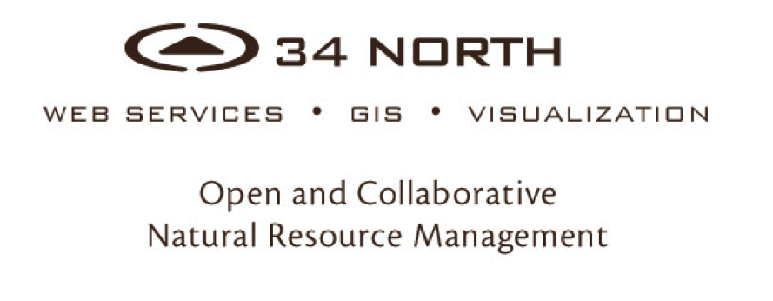

Slide 2
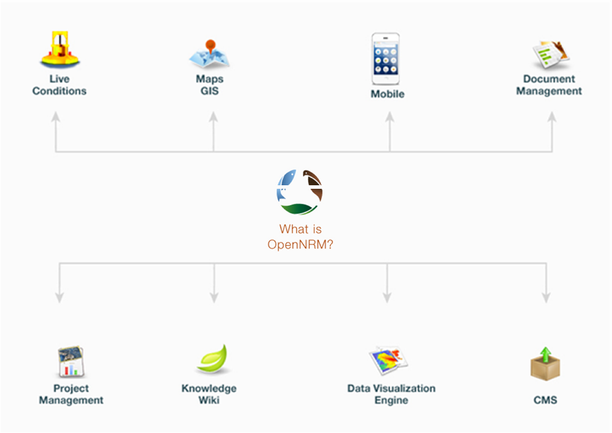
A collaborative resource management workspace and project management application for data collection, analysis, reporting and visualization
Notes:
What is OpenNRM? Built using many of the OS projects you see here this week, OpenNRM is a collection of integrated components to help natural resource managers, scientists, policy makers, conservationists, SEE AND MANAGE THE BIG PICTURE. The platform is made up of: ……

Slide 3
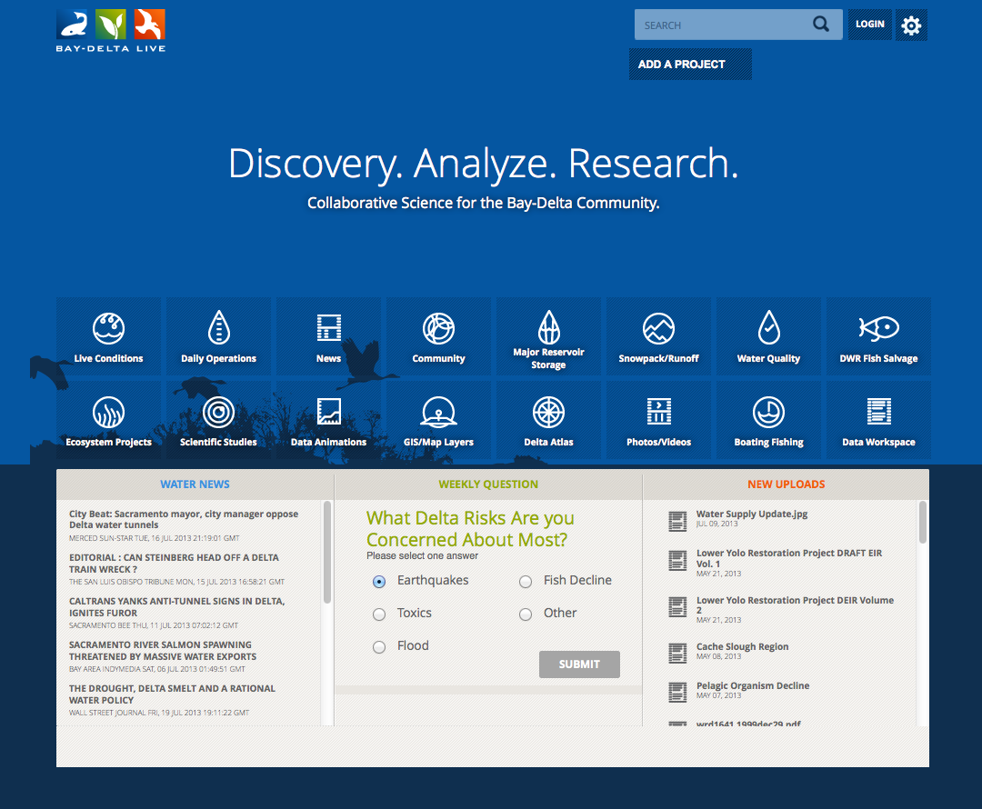
Notes:
Telling the story of a complicated system.
Interpreting results to managers and stakeholders
Easily share data stories, project data, monitoring results, document libraries, interactive maps and datasets.

Slide 4
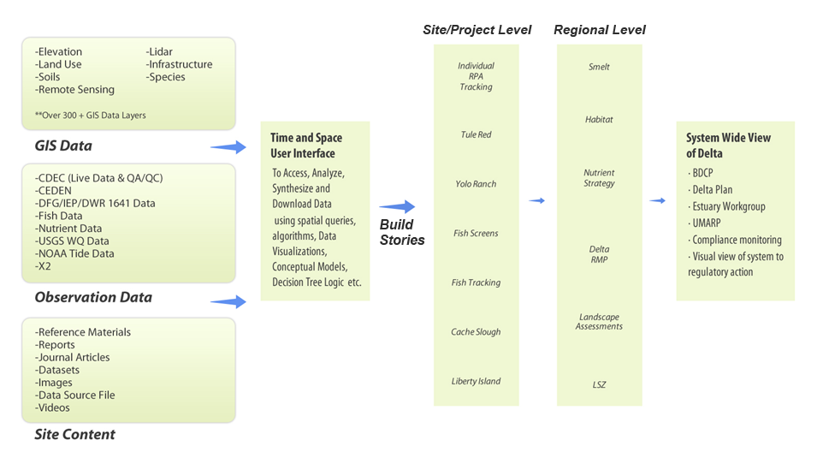
Using OpenNRM content management, start building stories

Slide 5
Build your data stories using:
Document Library-reports, images, video
Interactive Maps
Delta Data-Easy to Access Data
Graphing and Data Interpolation Engine
Real Time Condition Data
Wikis
Project Data
Operations Data
Communications are live and always up to data: synced with the data.
Notes:
What is OpenNRM? Built using many of the OS projects you see here this week, OpenNRM is a collection of integrated components to help natural resource managers, scientists, policy makers, conservationists, SEE AND MANAGE THE BIG PICTURE. The platform is made up of: ……

Slide 6
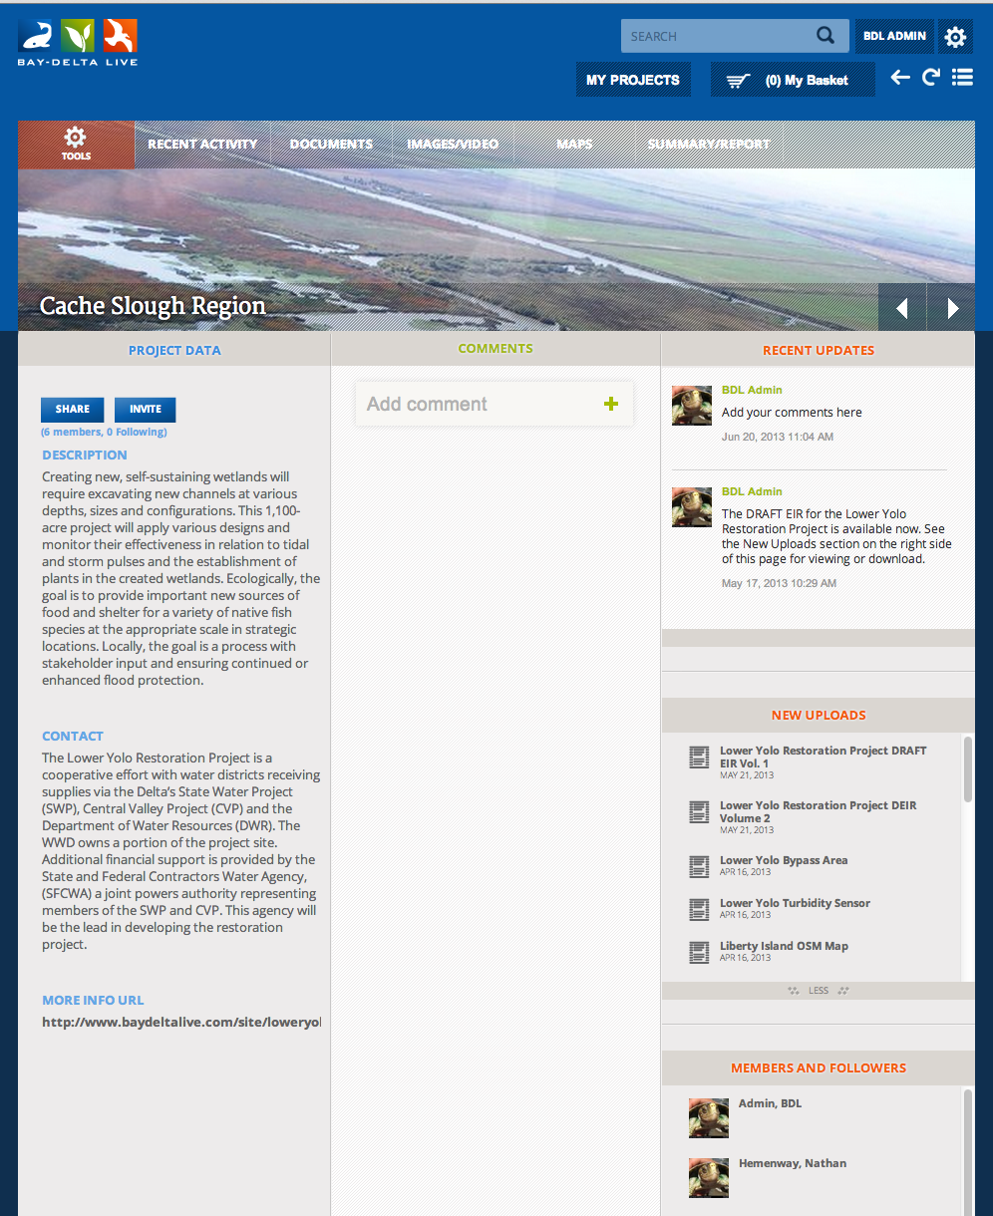
Notes:
What is OpenNRM? Built using many of the OS projects you see here this week, OpenNRM is a collection of integrated components to help natural resource managers, scientists, policy makers, conservationists, SEE AND MANAGE THE BIG PICTURE. The platform is made up of: ……

Slide 7
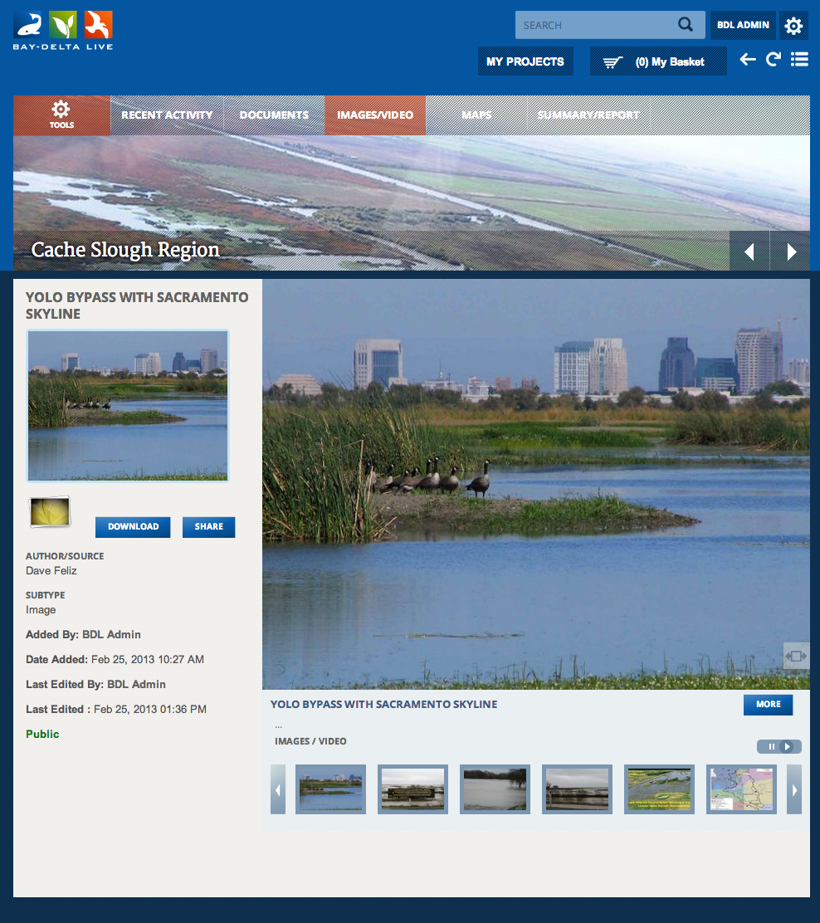
Notes:
What is OpenNRM? Built using many of the OS projects you see here this week, OpenNRM is a collection of integrated components to help natural resource managers, scientists, policy makers, conservationists, SEE AND MANAGE THE BIG PICTURE. The platform is made up of: ……

Slide 8
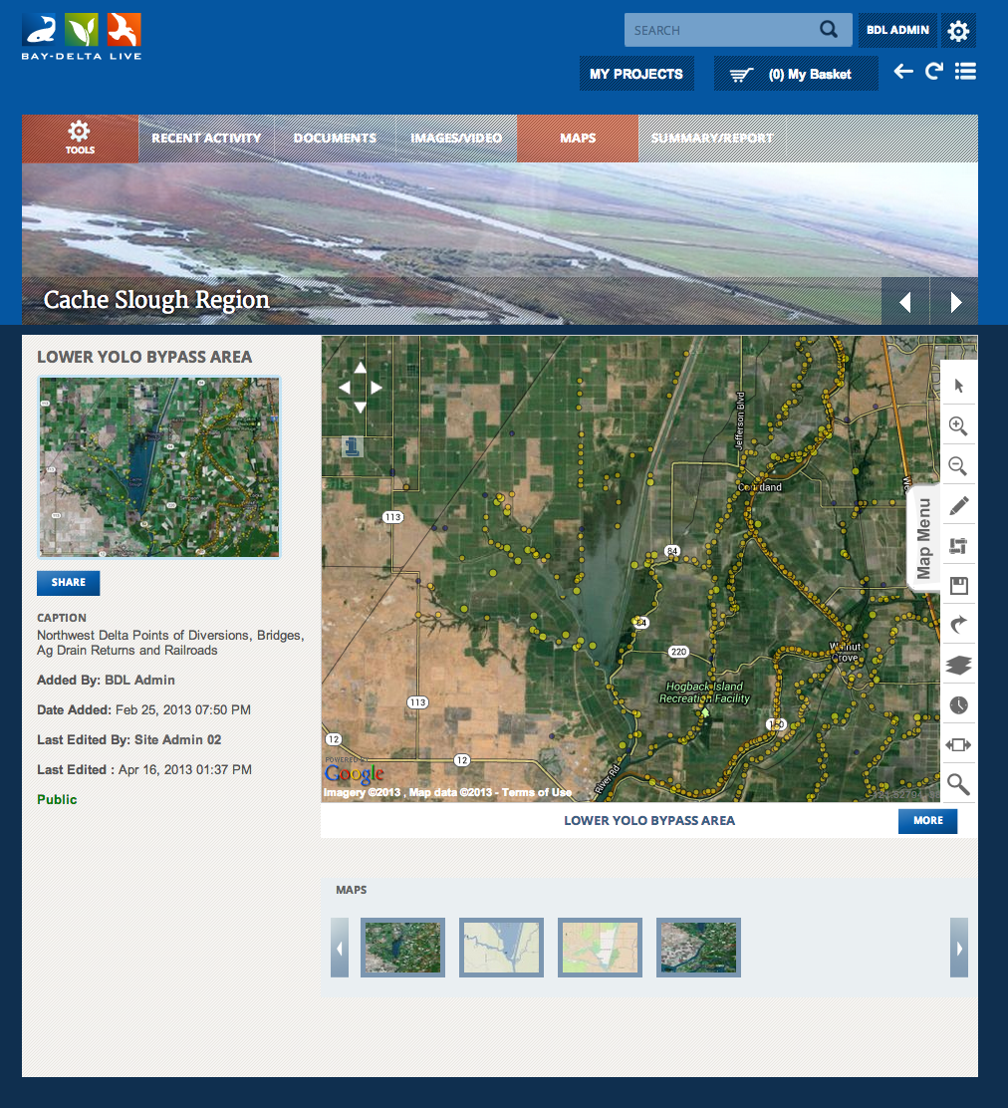
Manage / Upload
Layers And Web Services
Draw, Measure, Query
Save And Share
Associate To Projects,
Documents, Wiki, Anything
Build A Story
Overlay With Datasets
Notes:
What is OpenNRM? Built using many of the OS projects you see here this week, OpenNRM is a collection of integrated components to help natural resource managers, scientists, policy makers, conservationists, SEE AND MANAGE THE BIG PICTURE. The platform is made up of: ……

Slide 9
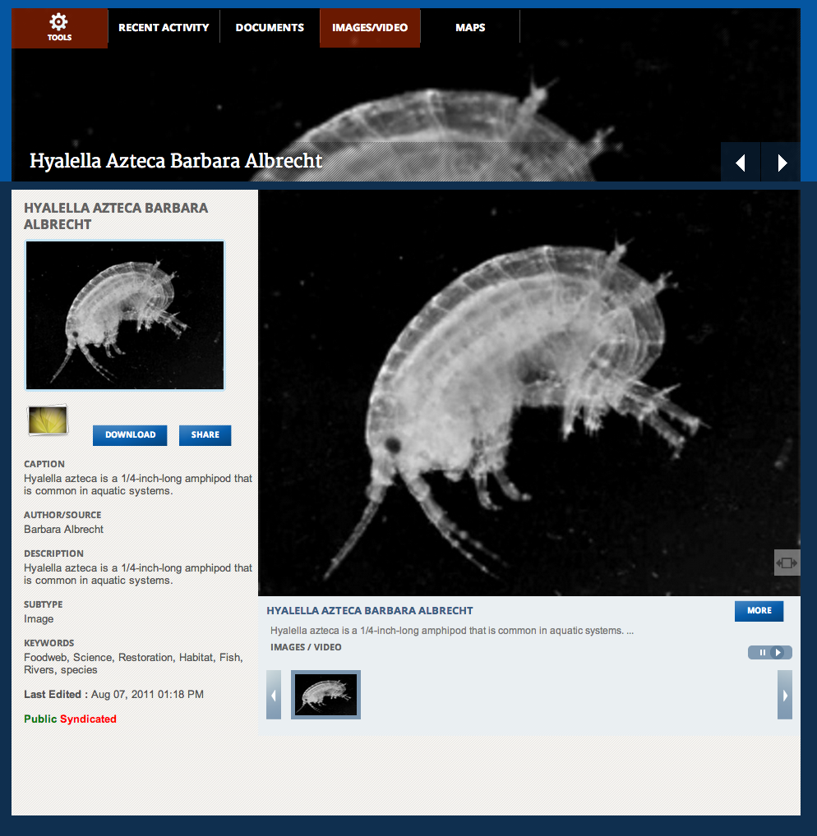
Notes:
What is OpenNRM? Built using many of the OS projects you see here this week, OpenNRM is a collection of integrated components to help natural resource managers, scientists, policy makers, conservationists, SEE AND MANAGE THE BIG PICTURE. The platform is made up of: ……

Slide 10
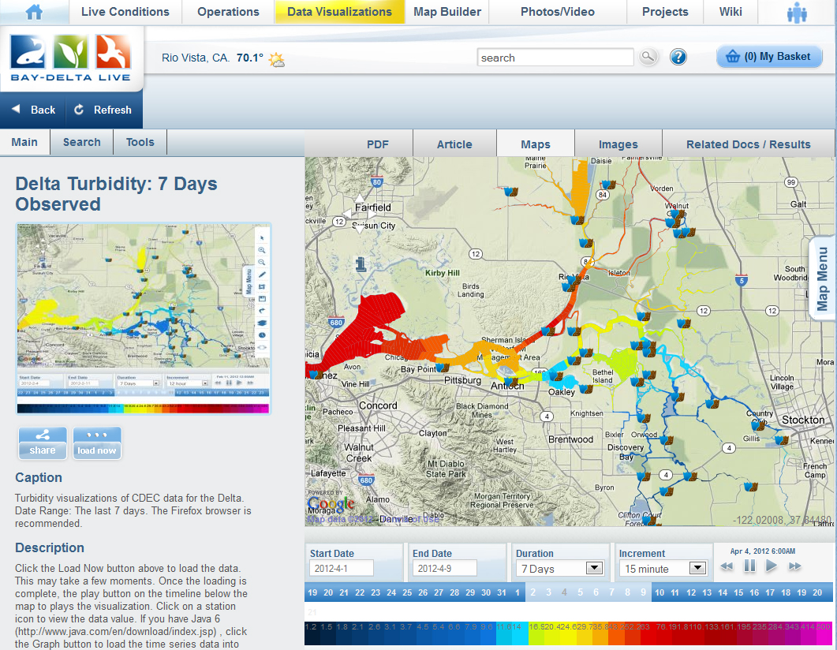
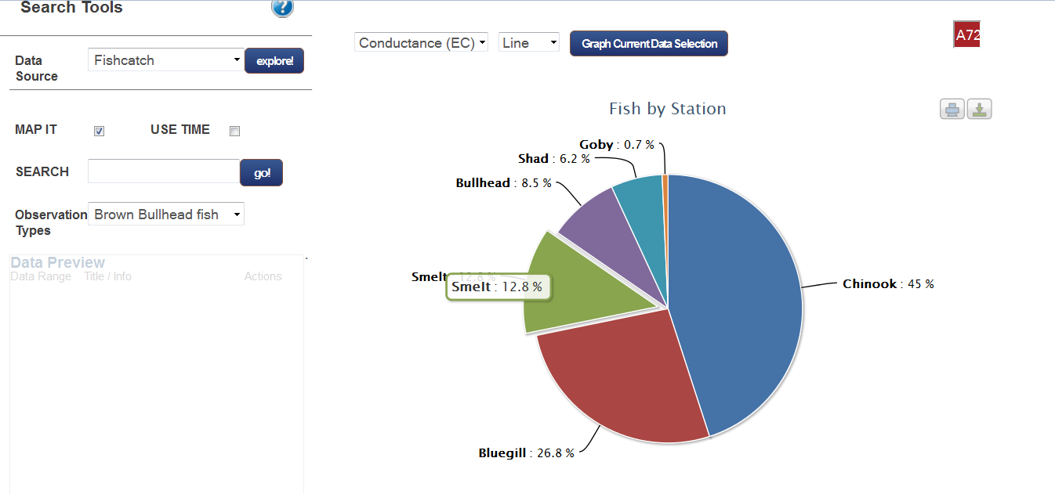
DATA VISUALIZATION TOOLS
Access Data In Time And
Space
Compare Datasets
Save Data Presets
Share Data
Associate To Projects,
Documents, Wiki, Anything
Build A Story
Syndicate Results
Track Lineage
Notes:
What is OpenNRM? Built using many of the OS projects you see here this week, OpenNRM is a collection of integrated components to help natural resource managers, scientists, policy makers, conservationists, SEE AND MANAGE THE BIG PICTURE. The platform is made up of: ……

Slide 11
Notes:
What is OpenNRM? Built using many of the OS projects you see here this week, OpenNRM is a collection of integrated components to help natural resource managers, scientists, policy makers, conservationists, SEE AND MANAGE THE BIG PICTURE. The platform is made up of: ……

Slide 12
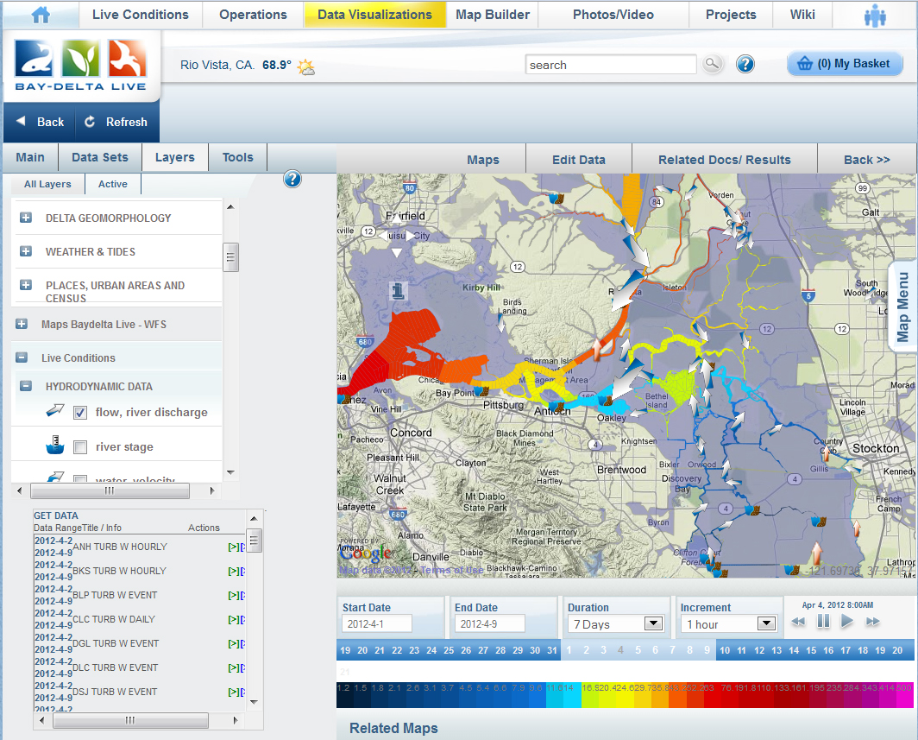
Notes:
What is OpenNRM? Built using many of the OS projects you see here this week, OpenNRM is a collection of integrated components to help natural resource managers, scientists, policy makers, conservationists, SEE AND MANAGE THE BIG PICTURE. The platform is made up of: ……

Slide 13
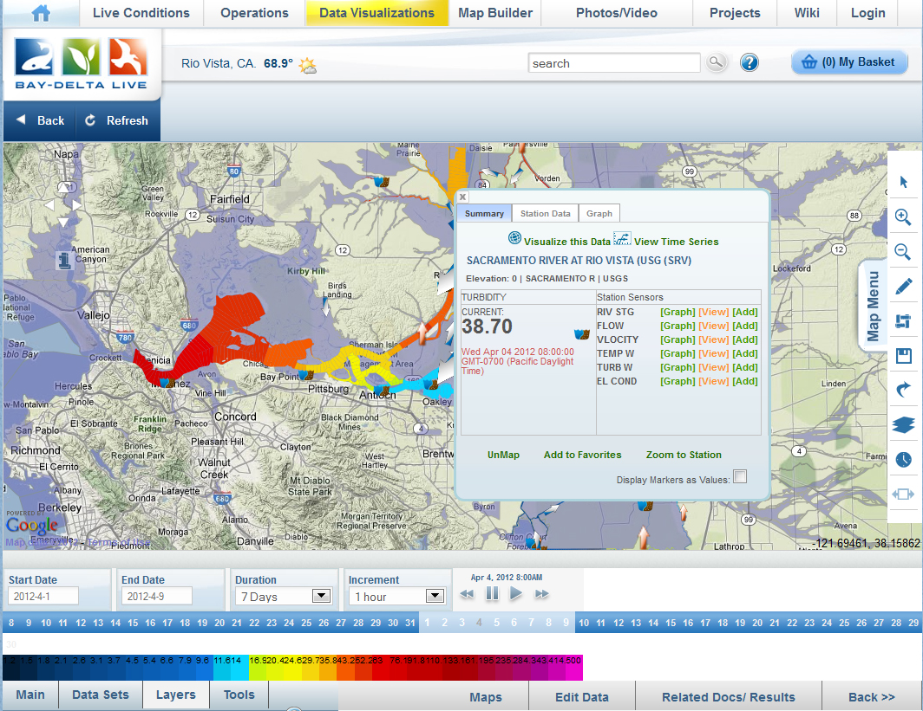
Notes:
What is OpenNRM? Built using many of the OS projects you see here this week, OpenNRM is a collection of integrated components to help natural resource managers, scientists, policy makers, conservationists, SEE AND MANAGE THE BIG PICTURE. The platform is made up of: ……

Slide 14
Communicate with stakeholders by building:
Presentation Pages
Project Management Dashboards
Control Panels
Interactive Reports
Real Time Condition Dashboards
Libraries of Information
Interagency Workspaces
Operational Pictures
Communications are live and always up to data: synced with the data.
Notes:
What is OpenNRM? Built using many of the OS projects you see here this week, OpenNRM is a collection of integrated components to help natural resource managers, scientists, policy makers, conservationists, SEE AND MANAGE THE BIG PICTURE. The platform is made up of: ……

Slide 15
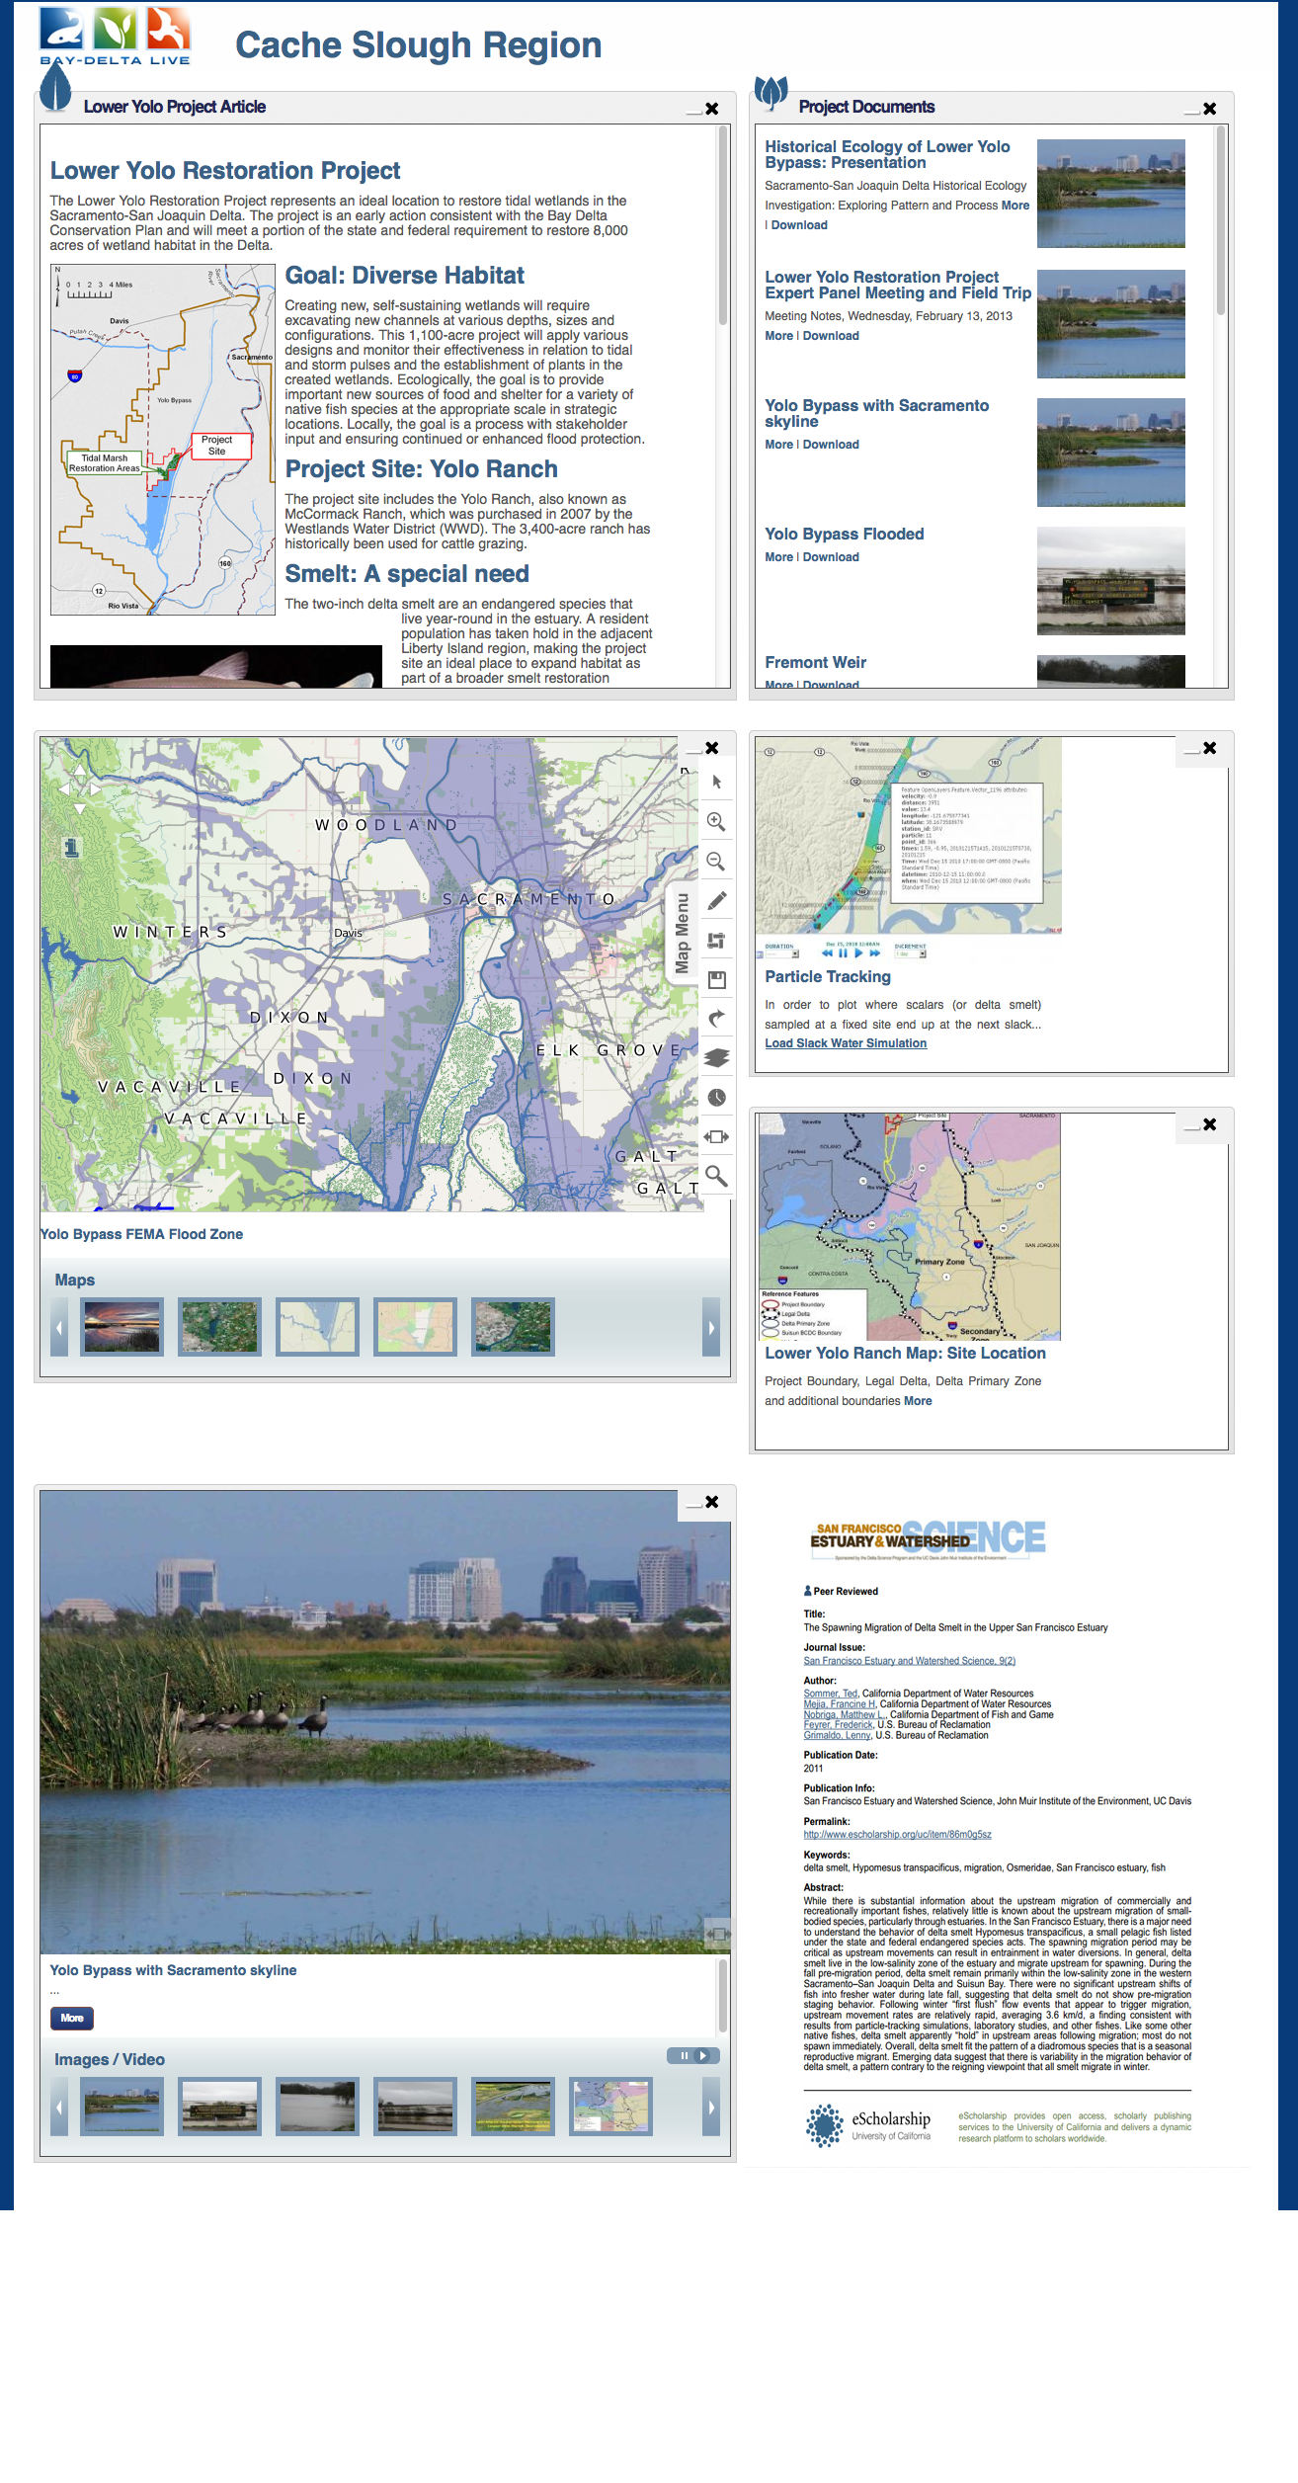
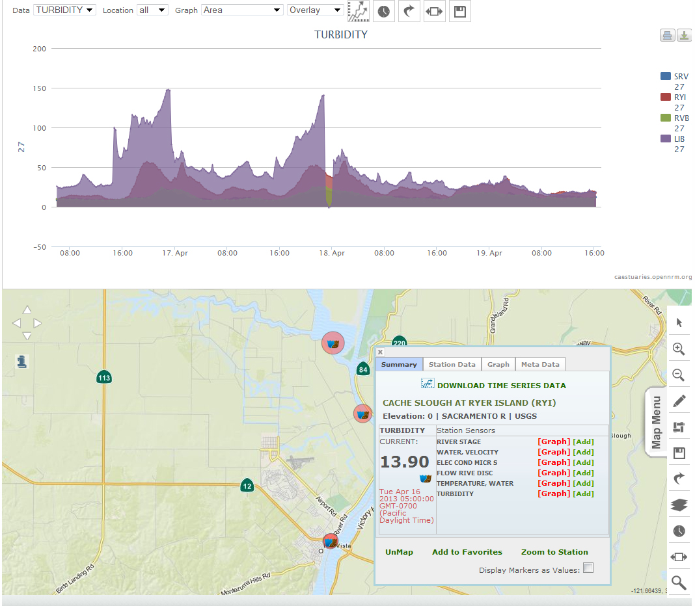
Notes:
What is OpenNRM? Built using many of the OS projects you see here this week, OpenNRM is a collection of integrated components to help natural resource managers, scientists, policy makers, conservationists, SEE AND MANAGE THE BIG PICTURE. The platform is made up of: ……

Slide 16
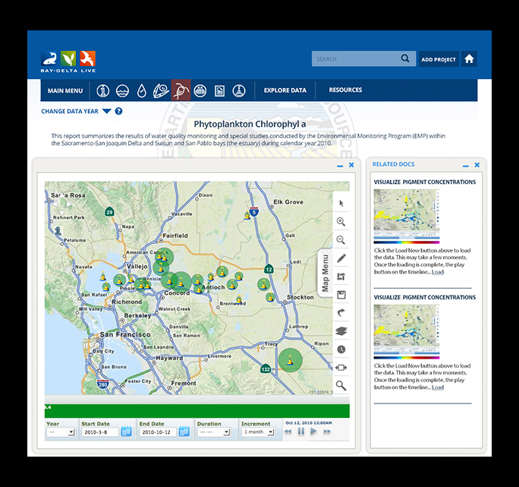
Notes:
What is OpenNRM? Built using many of the OS projects you see here this week, OpenNRM is a collection of integrated components to help natural resource managers, scientists, policy makers, conservationists, SEE AND MANAGE THE BIG PICTURE. The platform is made up of: ……

Slide 17
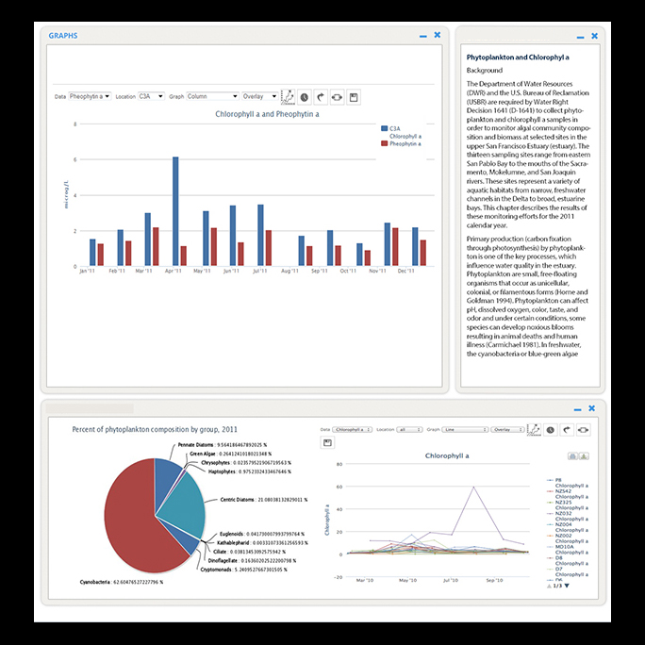
Notes:
What is OpenNRM? Built using many of the OS projects you see here this week, OpenNRM is a collection of integrated components to help natural resource managers, scientists, policy makers, conservationists, SEE AND MANAGE THE BIG PICTURE. The platform is made up of: ……

Slide 18
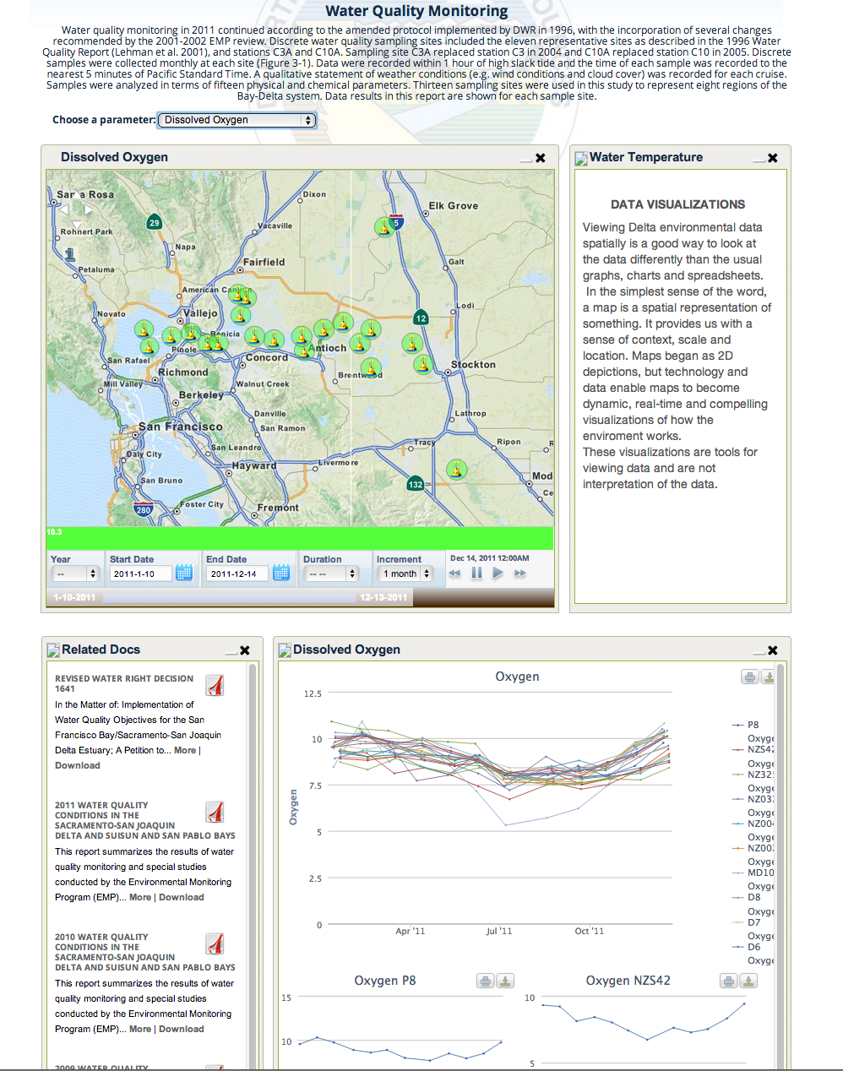
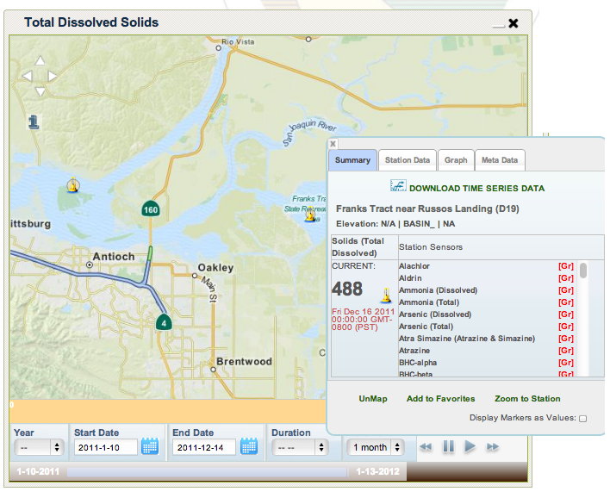
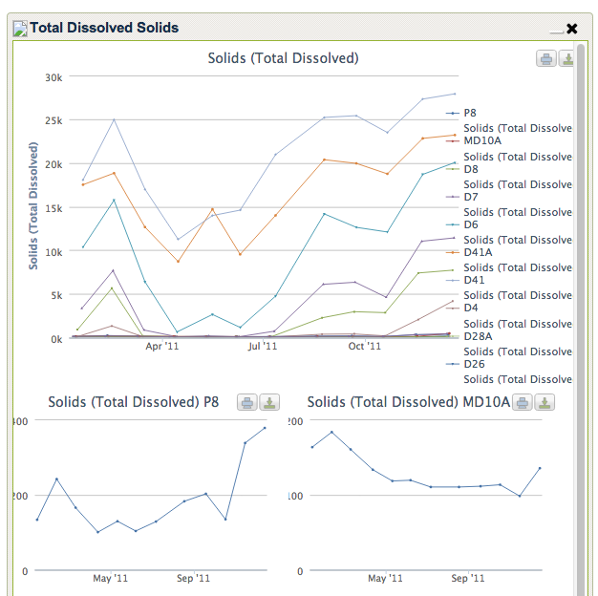
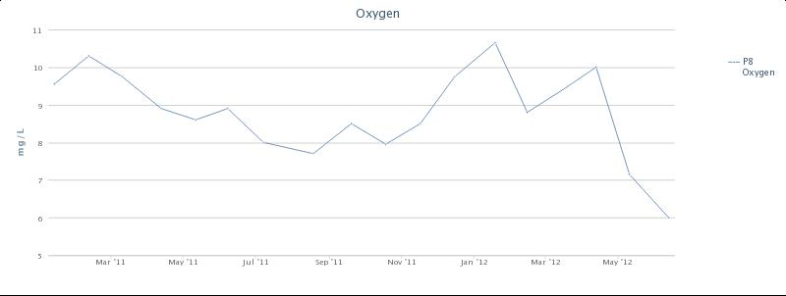
Notes:
What is OpenNRM? Built using many of the OS projects you see here this week, OpenNRM is a collection of integrated components to help natural resource managers, scientists, policy makers, conservationists, SEE AND MANAGE THE BIG PICTURE. The platform is made up of: ……

Slide 19
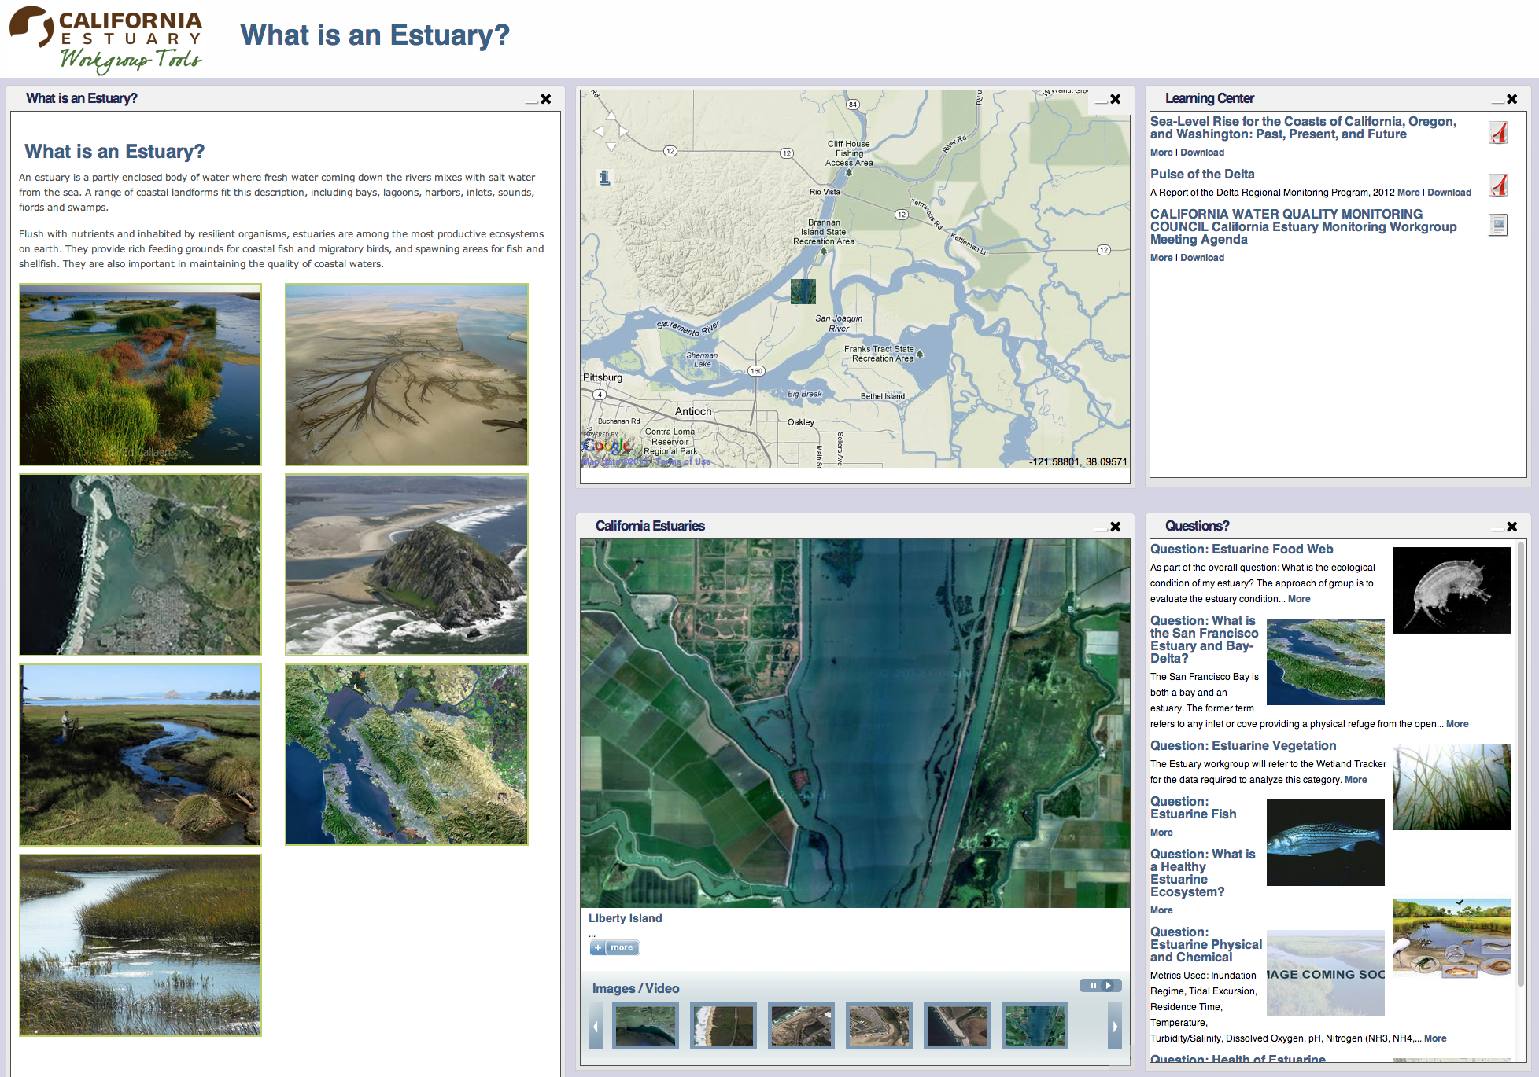
Notes:
What is OpenNRM? Built using many of the OS projects you see here this week, OpenNRM is a collection of integrated components to help natural resource managers, scientists, policy makers, conservationists, SEE AND MANAGE THE BIG PICTURE. The platform is made up of: ……

Slide 20
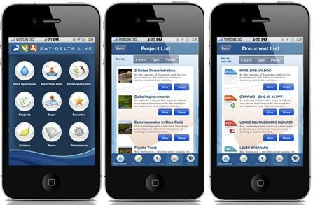
BAYDELTALIVE.COM IPHONE APP
Notes:
What is OpenNRM? Built using many of the OS projects you see here this week, OpenNRM is a collection of integrated components to help natural resource managers, scientists, policy makers, conservationists, SEE AND MANAGE THE BIG PICTURE. The platform is made up of: ……

Slide 21
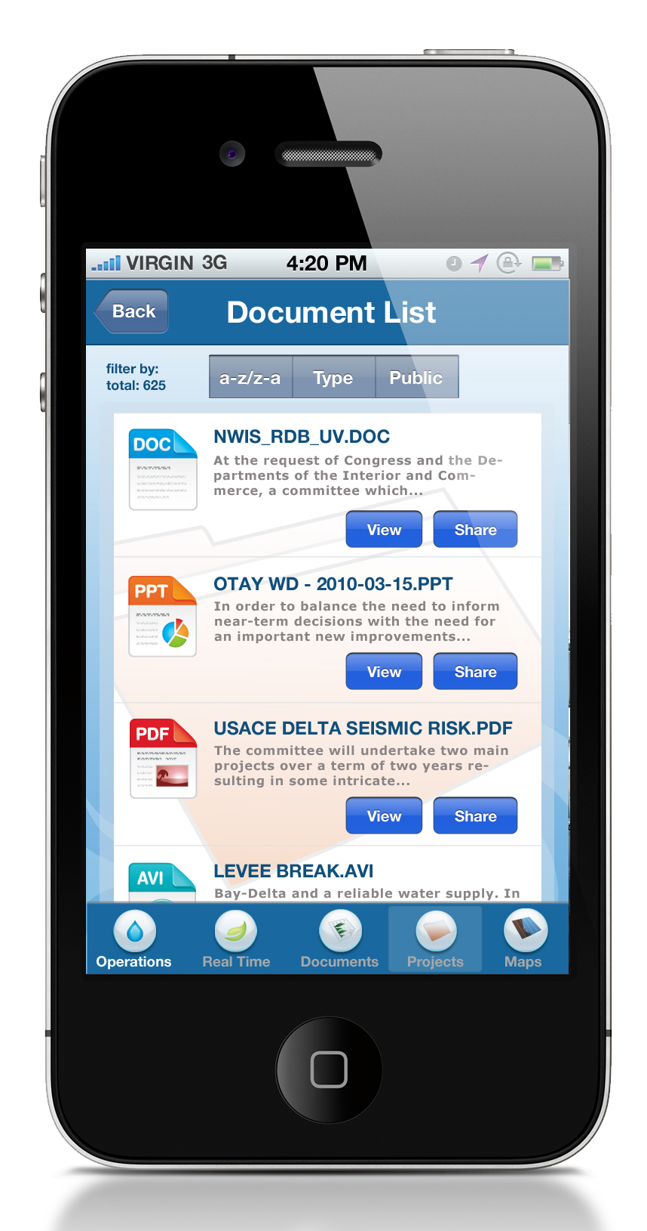
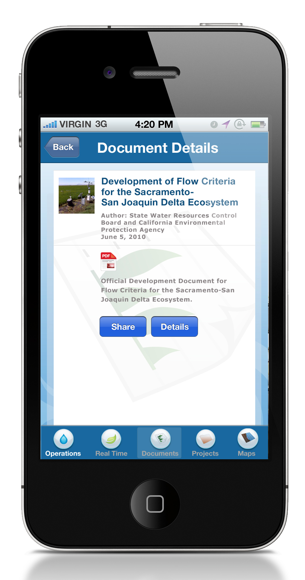
Notes:
What is OpenNRM? Built using many of the OS projects you see here this week, OpenNRM is a collection of integrated components to help natural resource managers, scientists, policy makers, conservationists, SEE AND MANAGE THE BIG PICTURE. The platform is made up of: ……

Slide 22
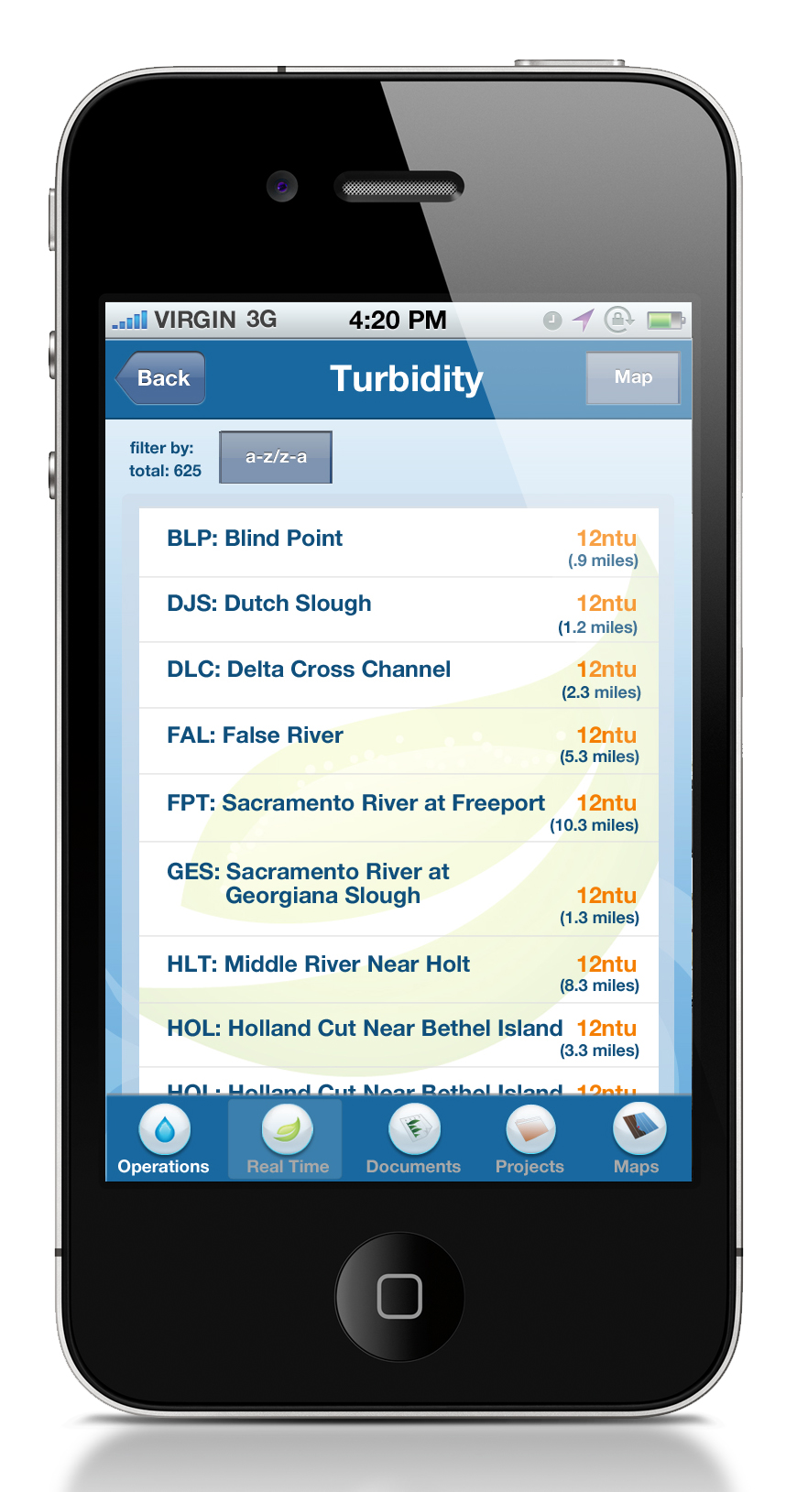
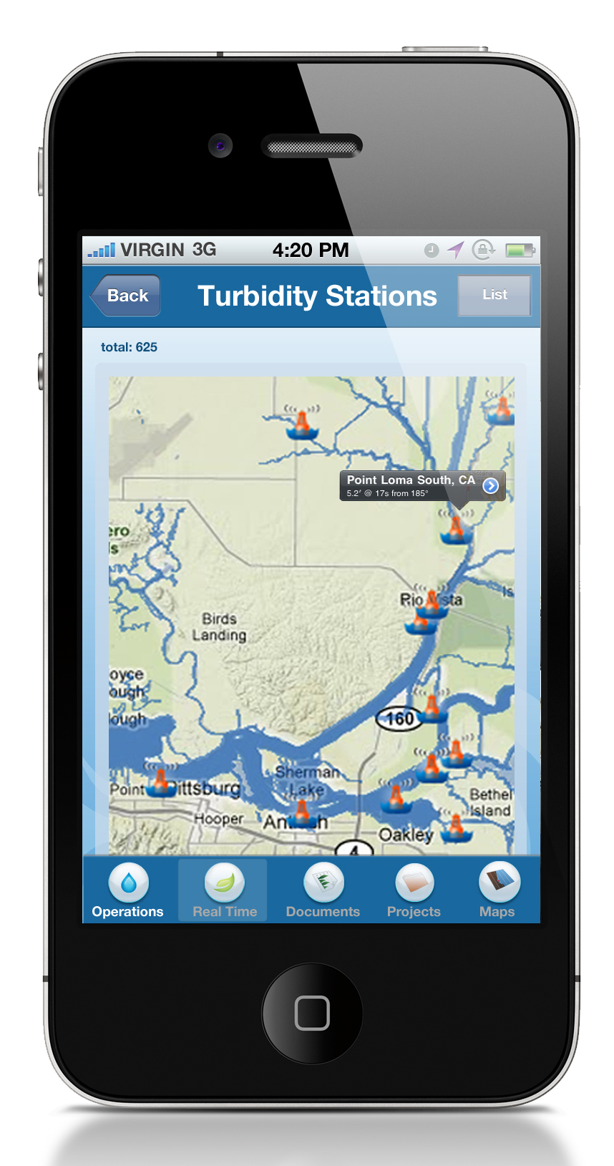
Notes:
What is OpenNRM? Built using many of the OS projects you see here this week, OpenNRM is a collection of integrated components to help natural resource managers, scientists, policy makers, conservationists, SEE AND MANAGE THE BIG PICTURE. The platform is made up of: ……

Slide 23
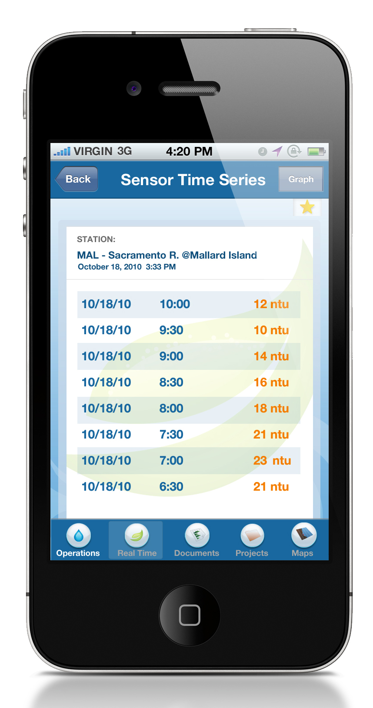
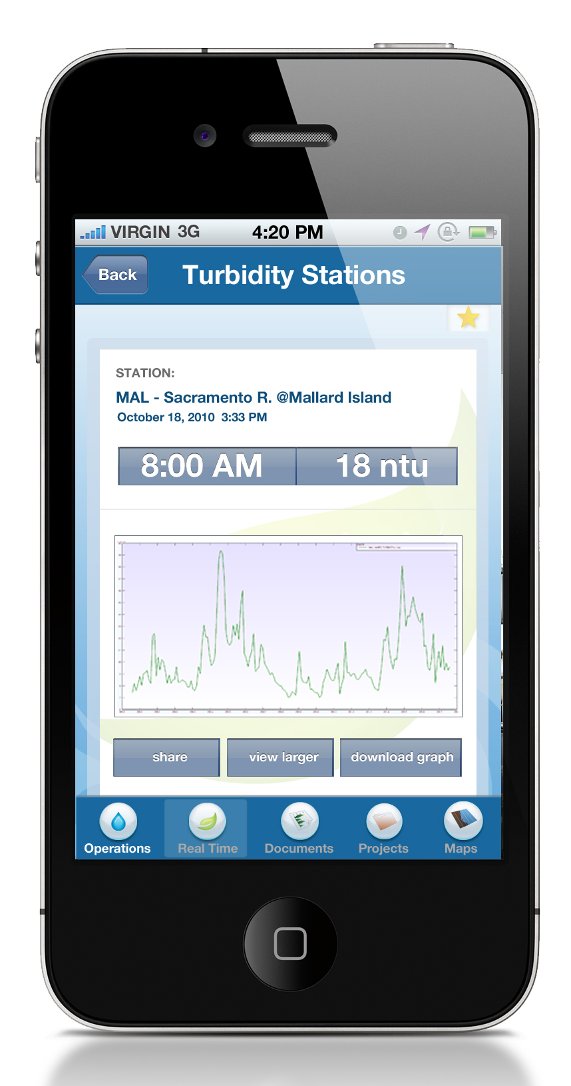
Notes:
What is OpenNRM? Built using many of the OS projects you see here this week, OpenNRM is a collection of integrated components to help natural resource managers, scientists, policy makers, conservationists, SEE AND MANAGE THE BIG PICTURE. The platform is made up of: ……

Slide 24
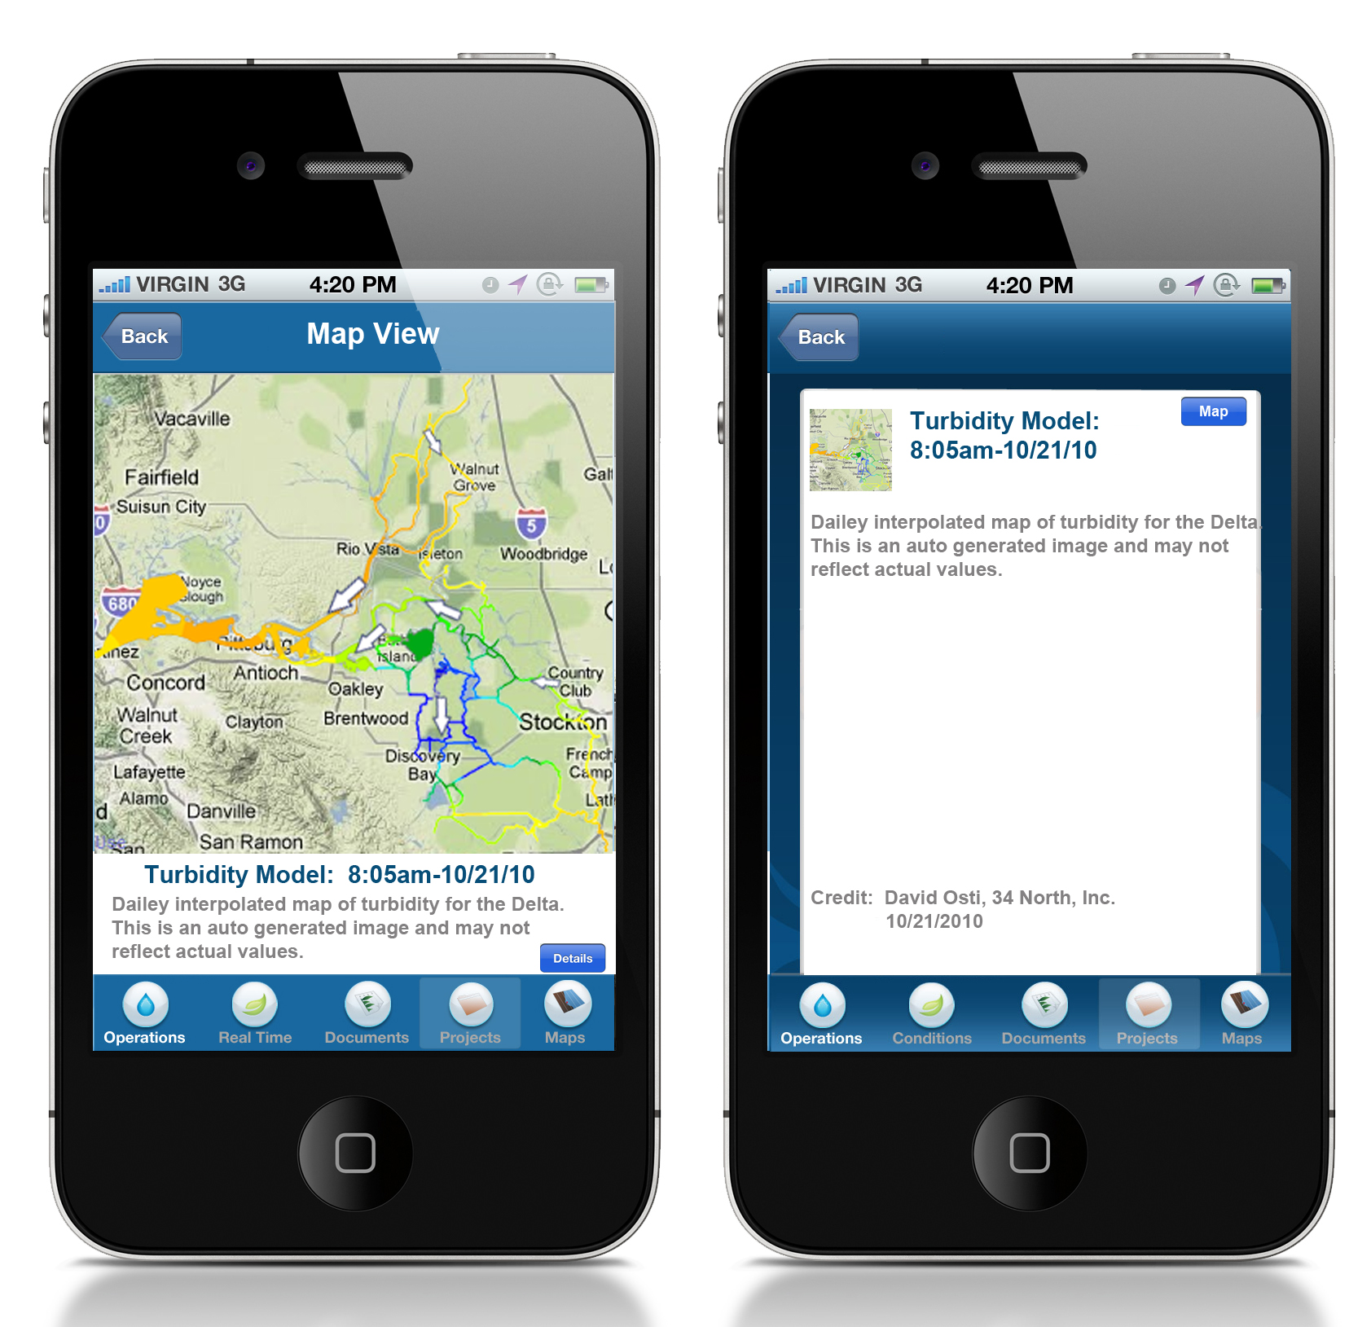
Notes:
What is OpenNRM? Built using many of the OS projects you see here this week, OpenNRM is a collection of integrated components to help natural resource managers, scientists, policy makers, conservationists, SEE AND MANAGE THE BIG PICTURE. The platform is made up of: ……

Slide 25
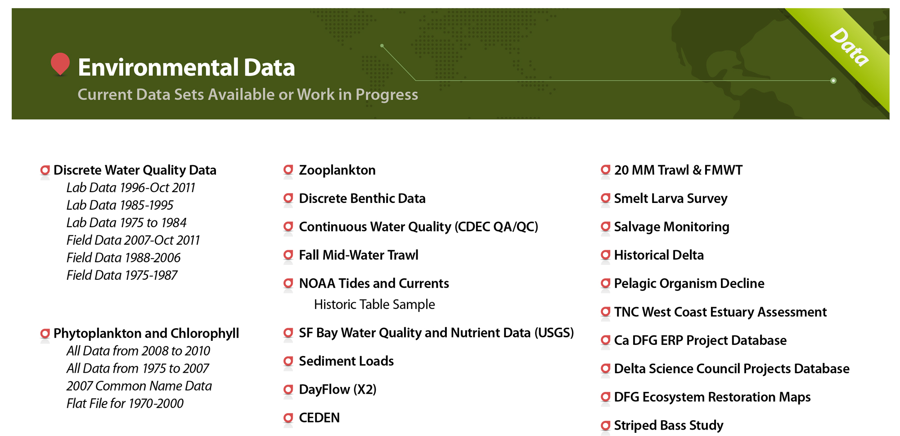
Current datasets or work in progress
Notes:
What is OpenNRM? Built using many of the OS projects you see here this week, OpenNRM is a collection of integrated components to help natural resource managers, scientists, policy makers, conservationists, SEE AND MANAGE THE BIG PICTURE. The platform is made up of: ……

Slide 26
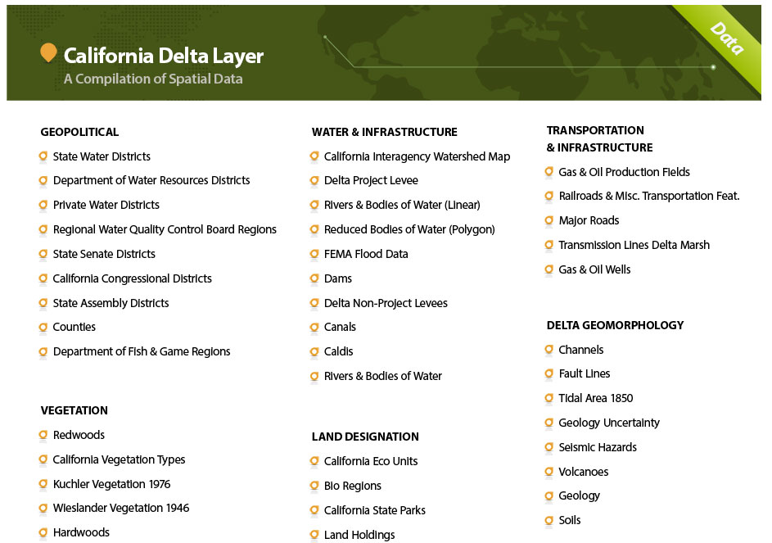
Notes:
What is OpenNRM? Built using many of the OS projects you see here this week, OpenNRM is a collection of integrated components to help natural resource managers, scientists, policy makers, conservationists, SEE AND MANAGE THE BIG PICTURE. The platform is made up of: ……

Slide 27
The benefits of collaborative resource management application:
Organize and report between agencies.
Better understand and communicate real time continuous and discrete data with colleagues and management.
Visualize data live and with as many supporting resources as possible.
Create a workspace where all agencies can better view and comment on data to create reports to operational managers
view and archive data in one common interface
Create a data dashboard where agencies can monitor and comment on water quality in real time
Develop alerts generated from data thresholds and report in real time via apps and web portals
Use BDL to better communicate data and operational decisions to ALL stakeholders

Slide 28
Notes:
What is OpenNRM? Built using many of the OS projects you see here this week, OpenNRM is a collection of integrated components to help natural resource managers, scientists, policy makers, conservationists, SEE AND MANAGE THE BIG PICTURE. The platform is made up of: ……

Slide 29
Notes:
What is OpenNRM? Built using many of the OS projects you see here this week, OpenNRM is a collection of integrated components to help natural resource managers, scientists, policy makers, conservationists, SEE AND MANAGE THE BIG PICTURE. The platform is made up of: ……

Slide 30
Notes:
What is OpenNRM? Built using many of the OS projects you see here this week, OpenNRM is a collection of integrated components to help natural resource managers, scientists, policy makers, conservationists, SEE AND MANAGE THE BIG PICTURE. The platform is made up of: ……

Slide 31
Notes:
What is OpenNRM? Built using many of the OS projects you see here this week, OpenNRM is a collection of integrated components to help natural resource managers, scientists, policy makers, conservationists, SEE AND MANAGE THE BIG PICTURE. The platform is made up of: ……

Slide 32
Notes:
What is OpenNRM? Built using many of the OS projects you see here this week, OpenNRM is a collection of integrated components to help natural resource managers, scientists, policy makers, conservationists, SEE AND MANAGE THE BIG PICTURE. The platform is made up of: ……

