Slide 1
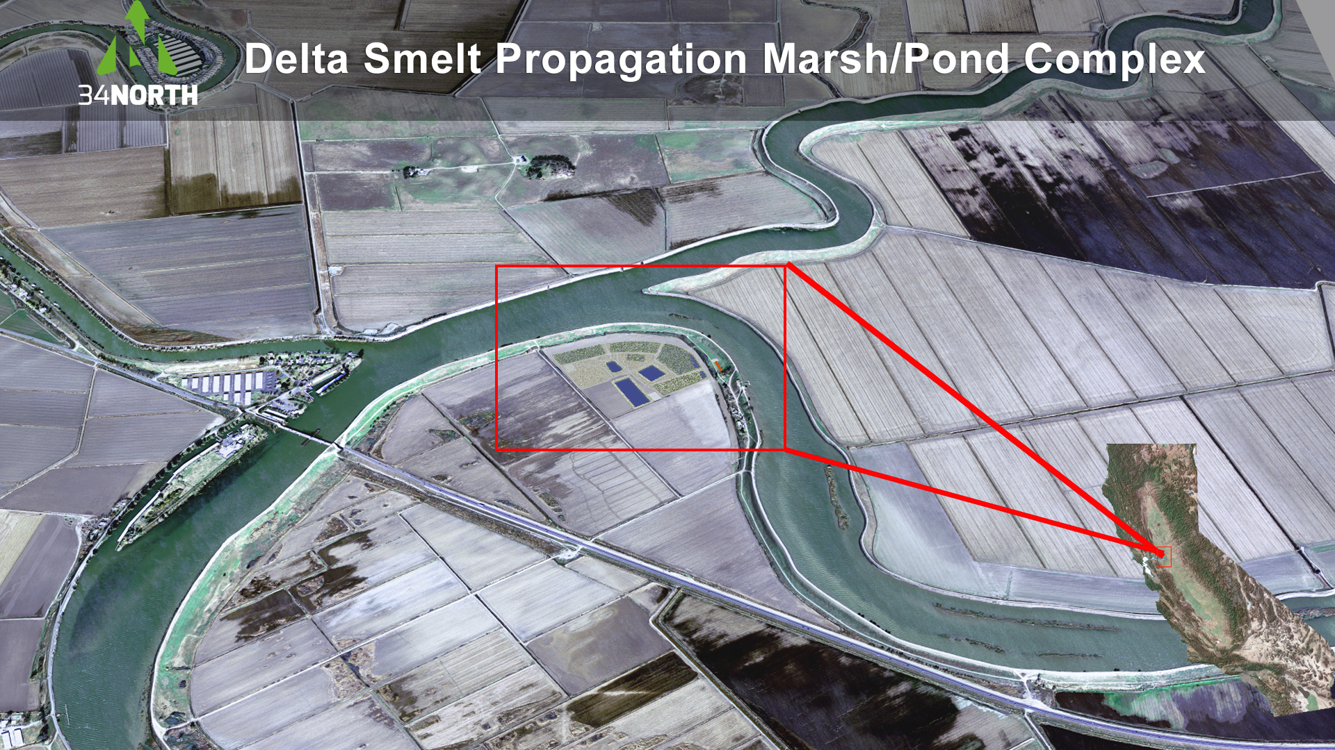

Slide 2
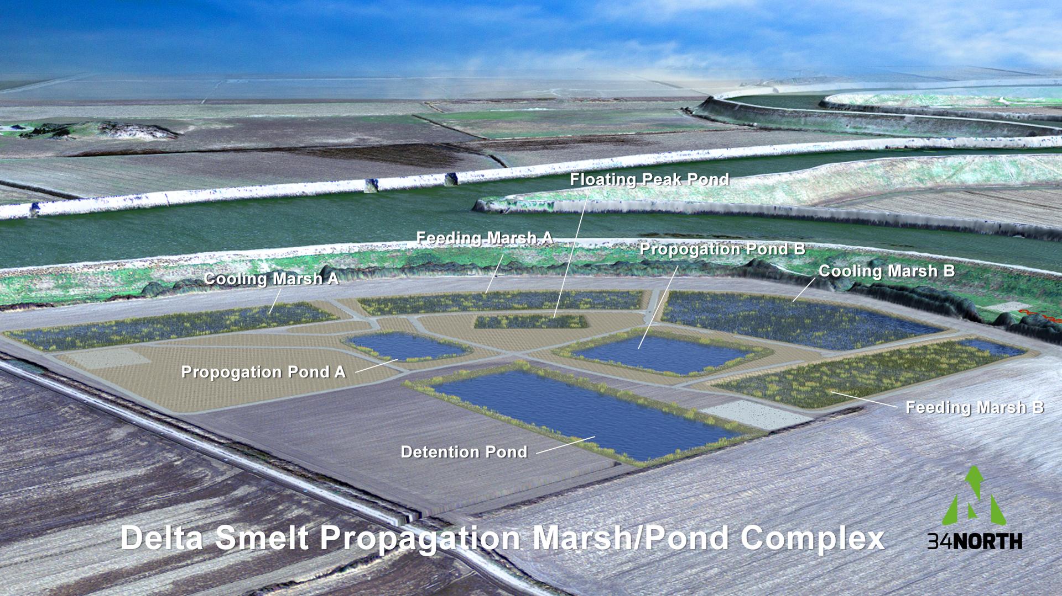
Delta Smelt Propagation Marsh / Pond Complex Model Development
By 34 North

Slide 3
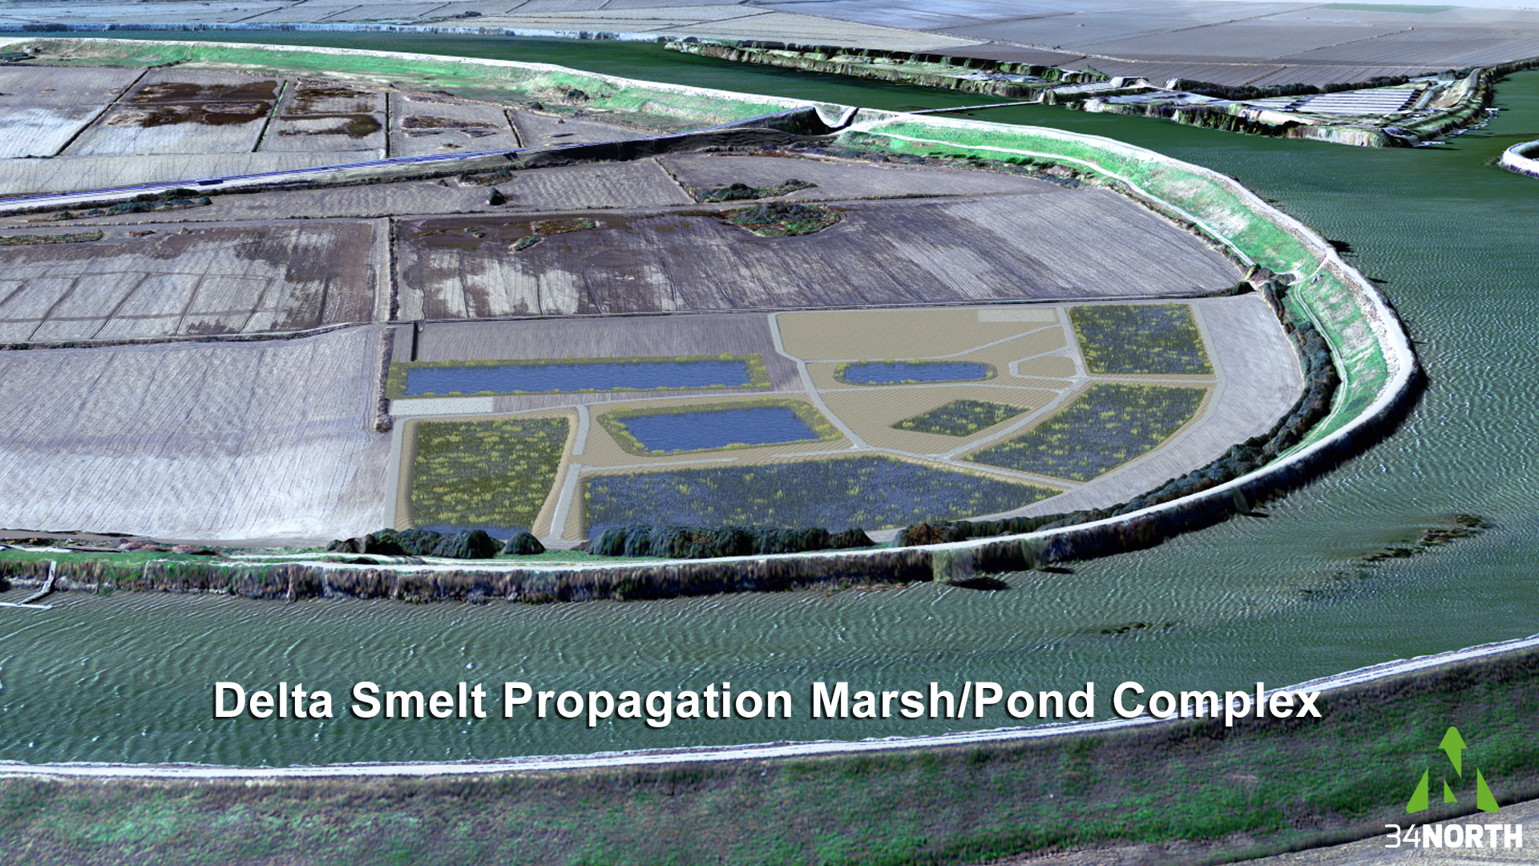
Animate Marsh Functions using post-production techniques in Adobe After Effects

Slide 4
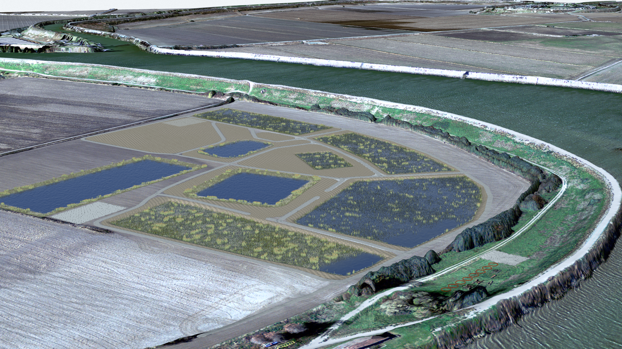
Animate Marsh Functions using post-production techniques in Adobe After Effects

Slide 5
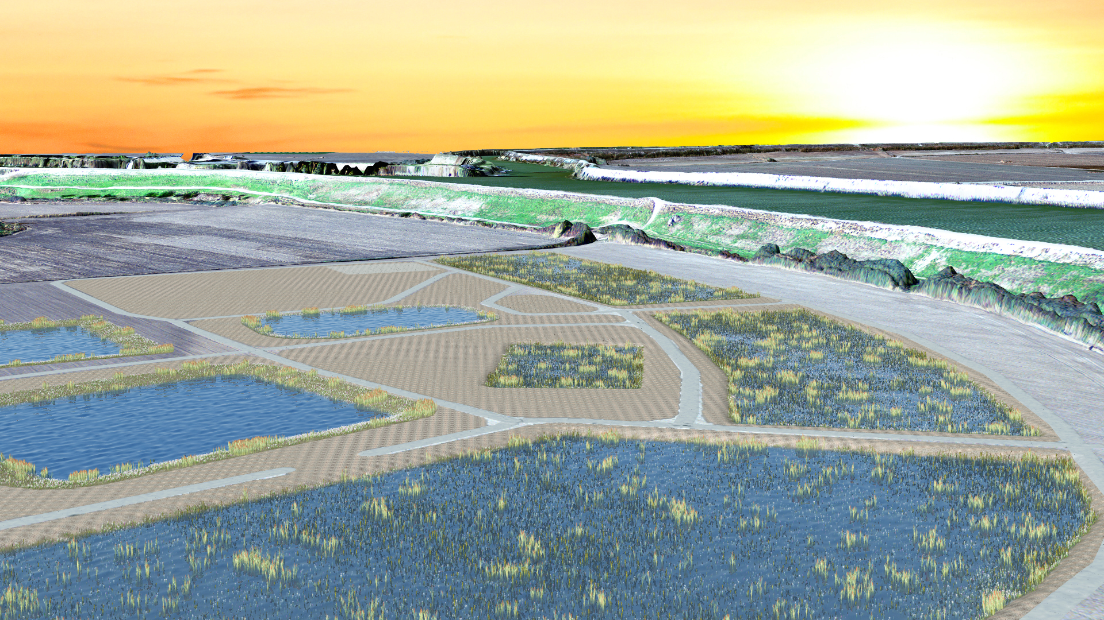
Animate Marsh Functions using post-production techniques in Adobe After Effects

Slide 6
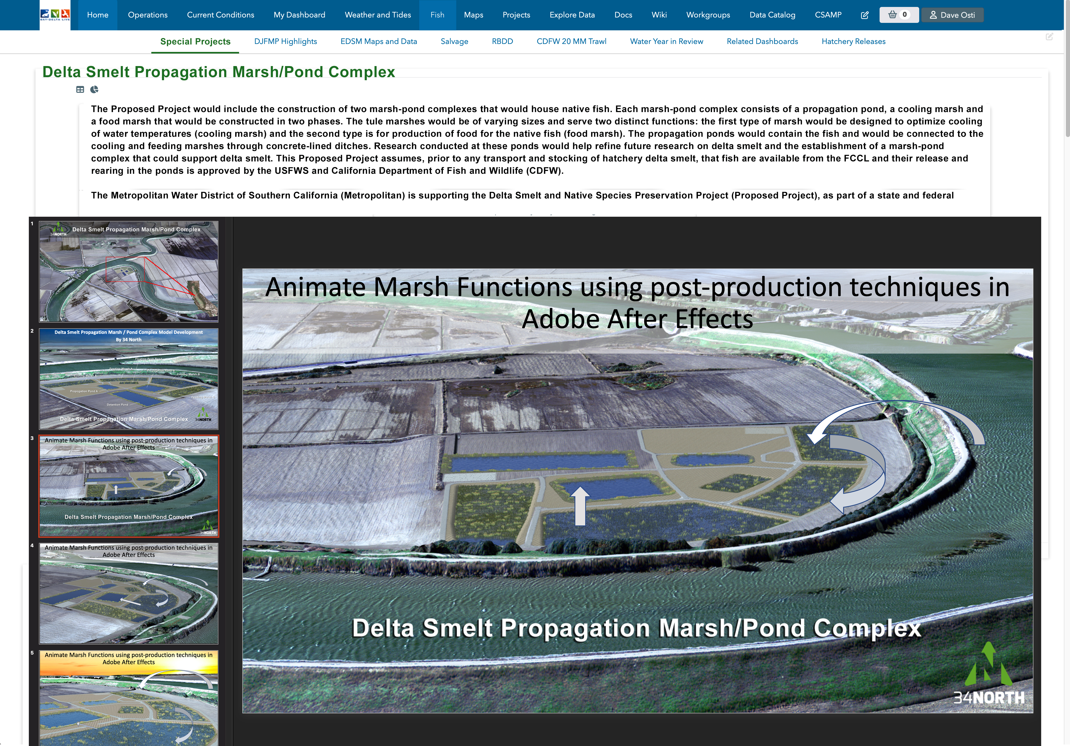
Create an interactive webpage on www.baydeltalive.com to communicate
the environmental process and the benefits. Create a section for project updates and accomplishments

