Slide 1
San Joaquin River Reach
Flood / Ebb Integrate
Flood Excursions

Slide 2
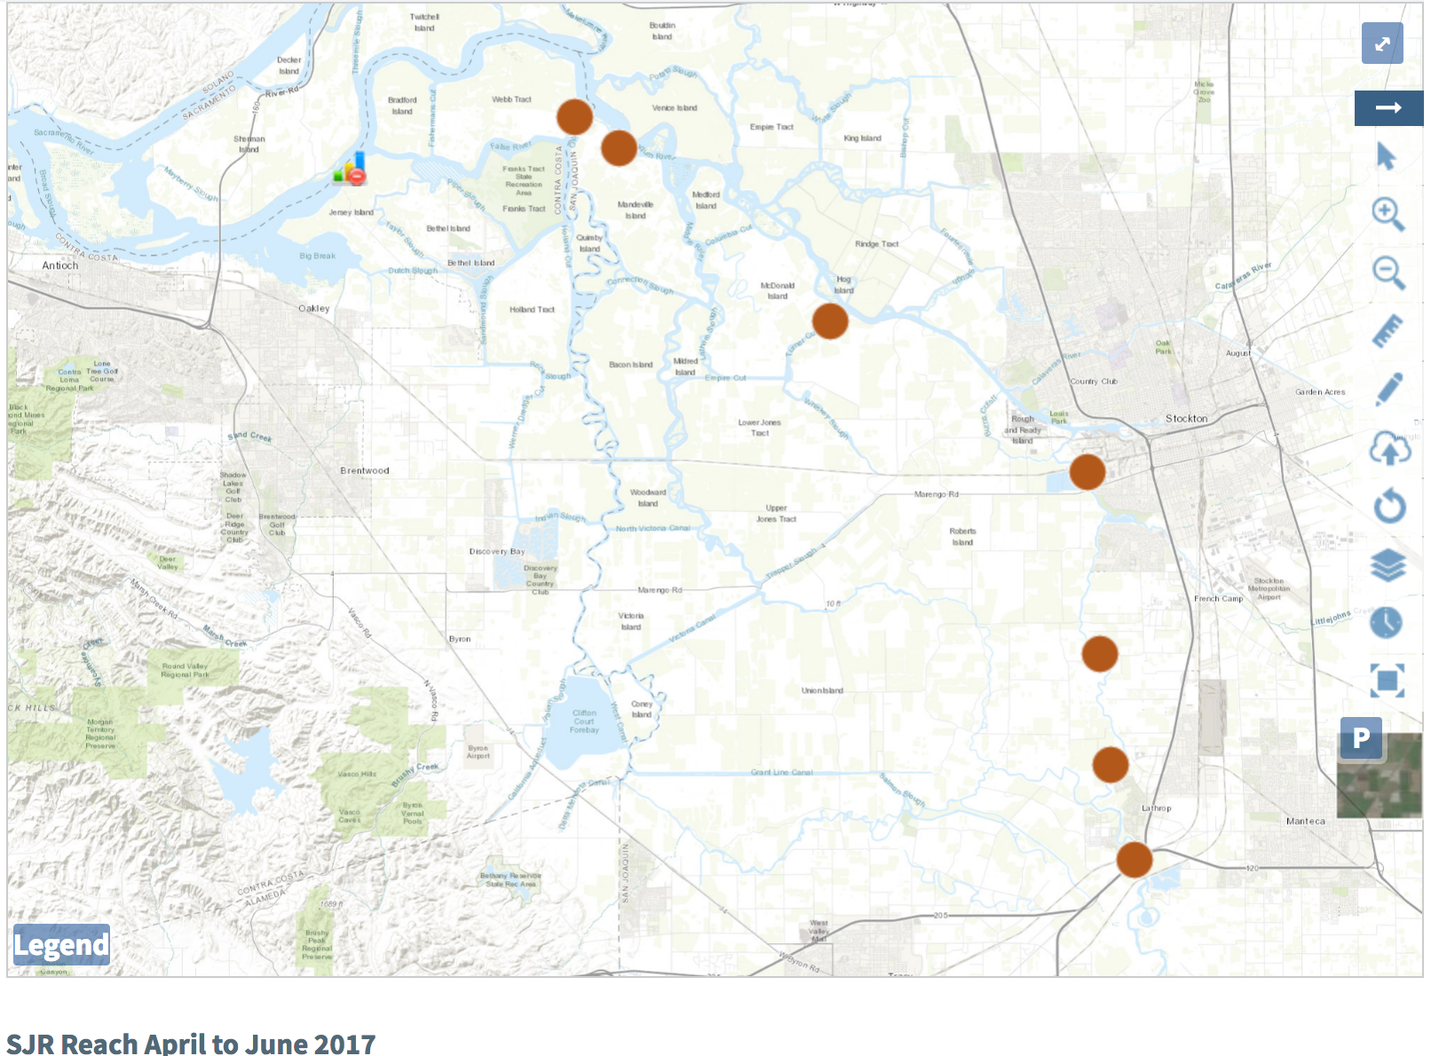
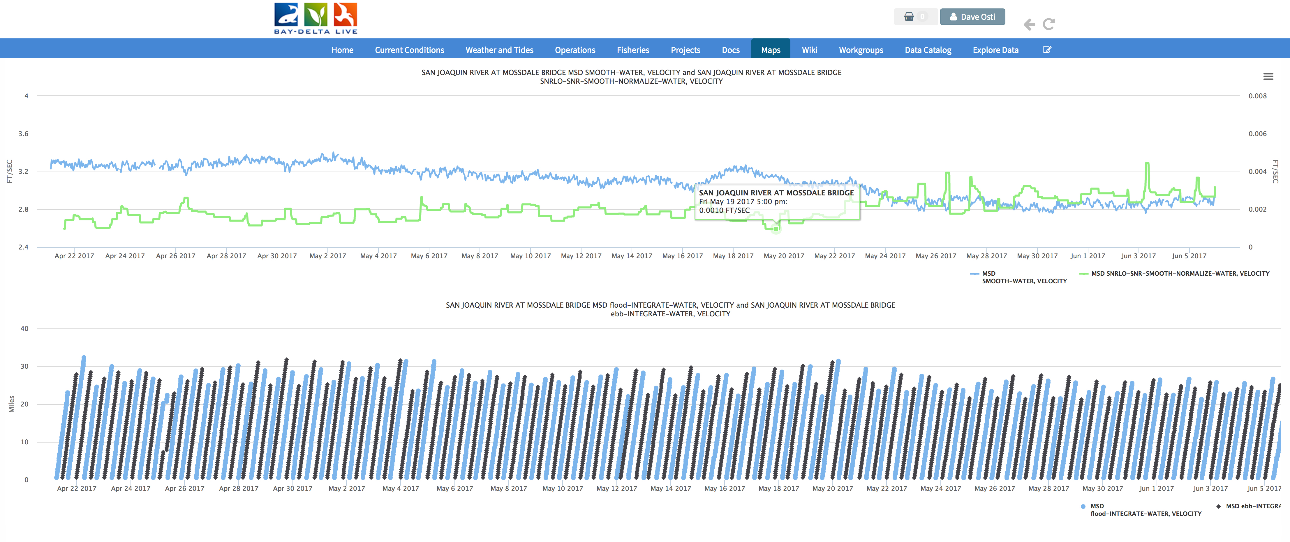
San Joaquin Reach: 4/21/17 to 6/6/17
SJR: SJJ, OSJ, PRI, TRN, SJG, BDT, SJD, MSD
SJJ: Mossdale

Slide 3
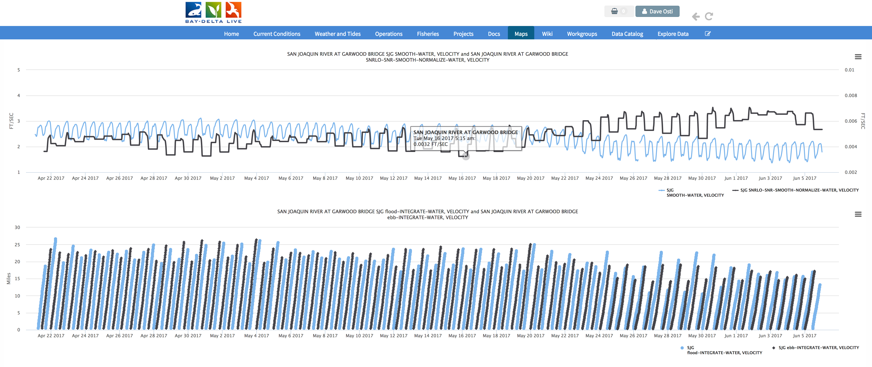
San Joaquin Reach: 4/21/17 to 6/6/17
SJR: SJJ, OSJ, PRI, TRN, SJG, BDT, SJD, MSD
SJJ: Garwood Bridge

Slide 4
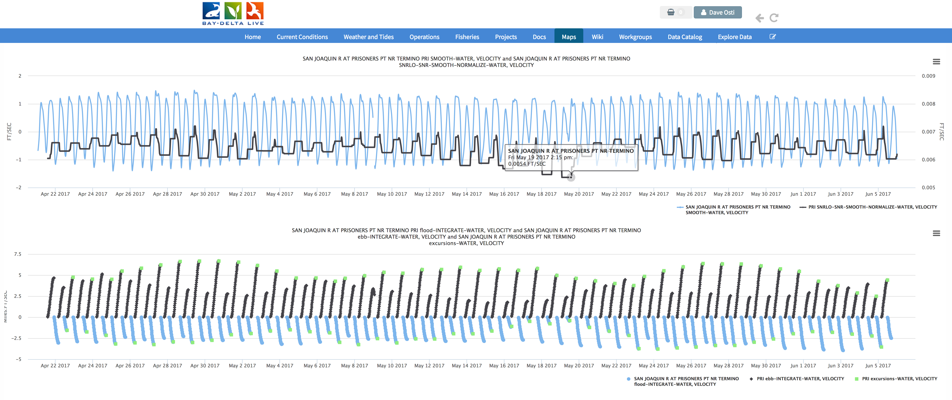
San Joaquin Reach : 4/21/17 to 6/6/17
SJR: SJJ, OSJ, PRI, TRN, SJG, BDT, SJD, MSD
SJJ: Prisoners Point

Slide 5
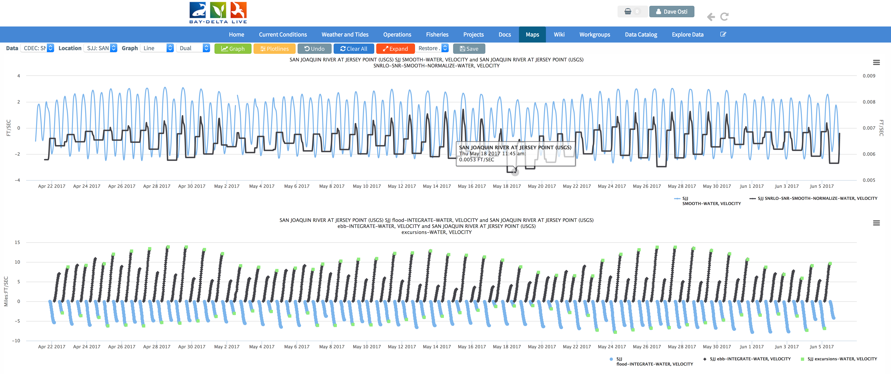
San Joaquin Reach : 4/21/17 to 6/6/17
SJR: SJJ, OSJ, PRI, TRN, SJG, BDT, SJD, MSD
SJJ: San Joaquin R @Jersey PT

Slide 6
Cache Slough Reach
Flood / Ebb Integrate
Flood Excursions

Slide 7
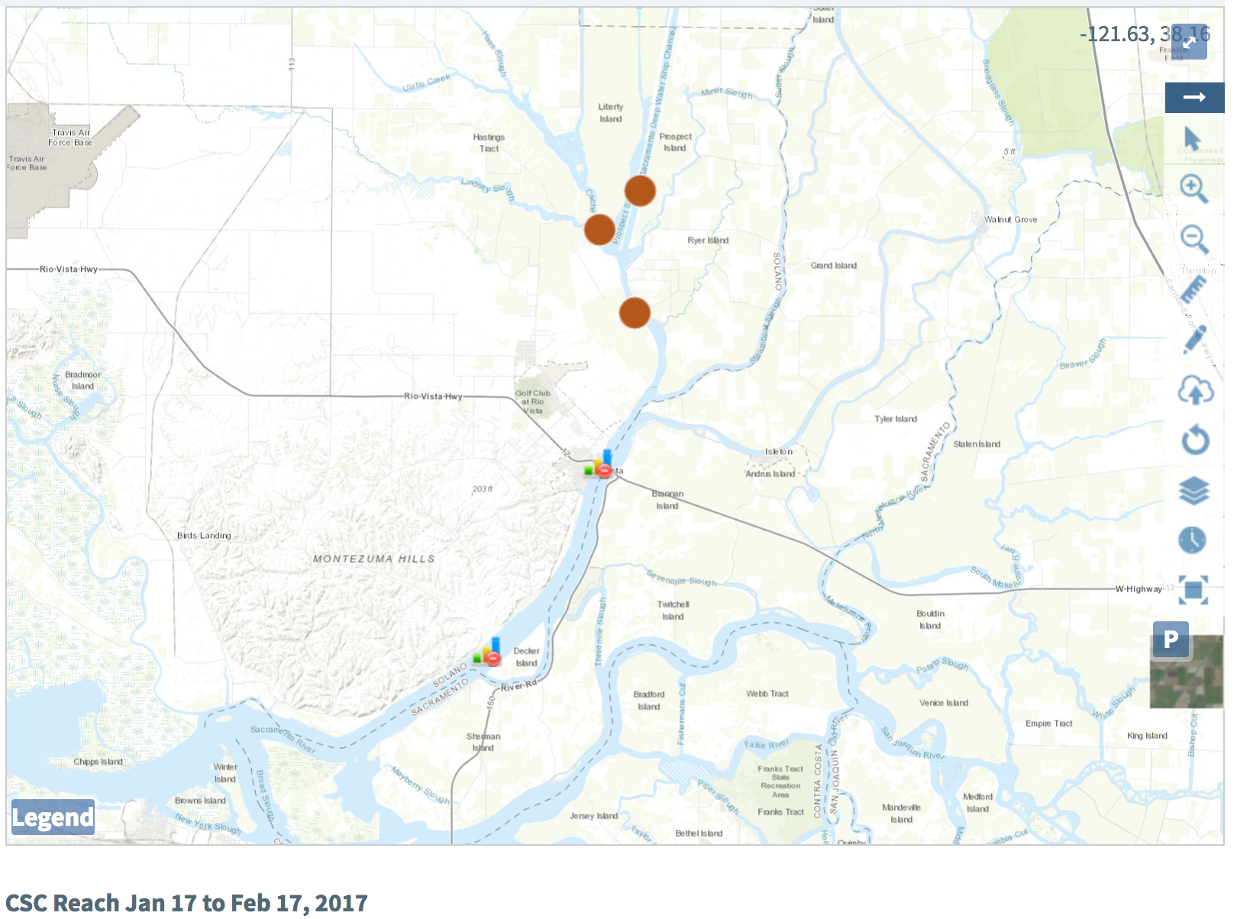
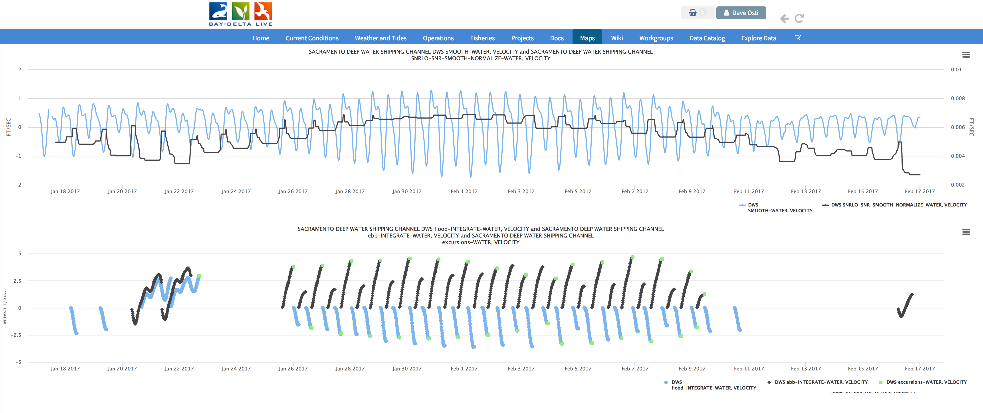
Cache Slough Reach: 1/17/17 to 2/17/17
CSC: SRV, RYI, LIB, DWS
CSC: Sac R Deep Water Ship Channel

Slide 8
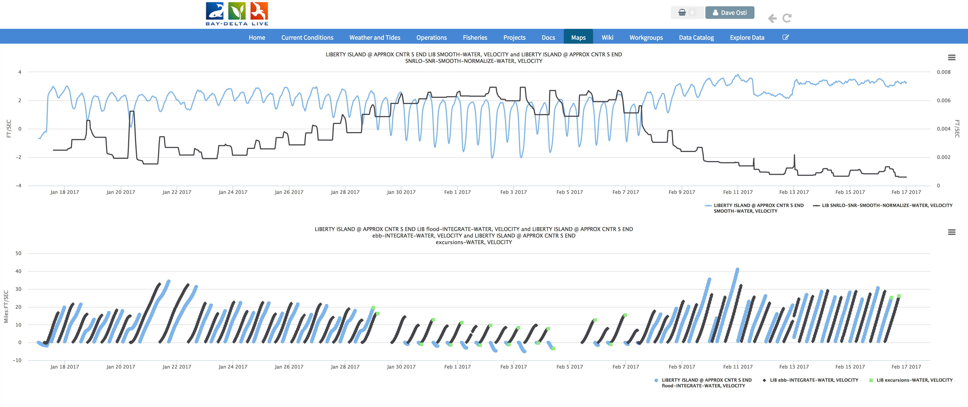
Cache Slough Reach: 1/17/17 to 2/17/17
CSC: SRV, RYI, LIB, DWS
CSC: Liberty Island

Slide 9
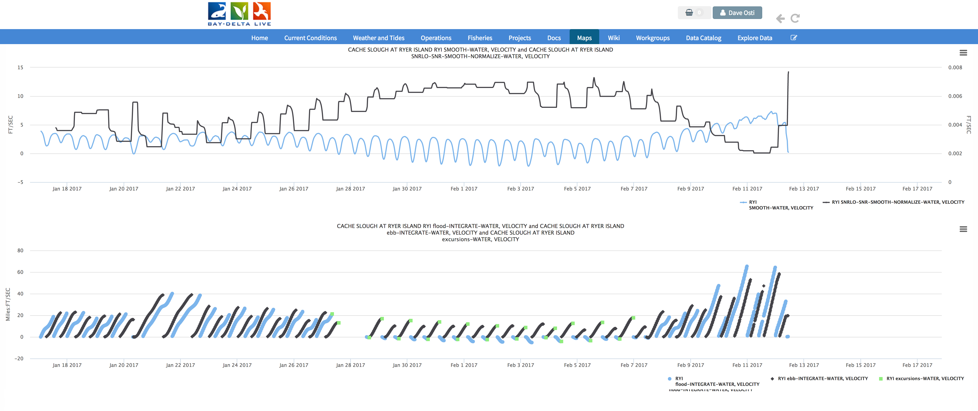
Cache Slough Reach: 1/17/17 to 2/17/17
CSC: SRV, RYI, LIB, DWS
CSC: Cache Slough at Ryer Island

Slide 10
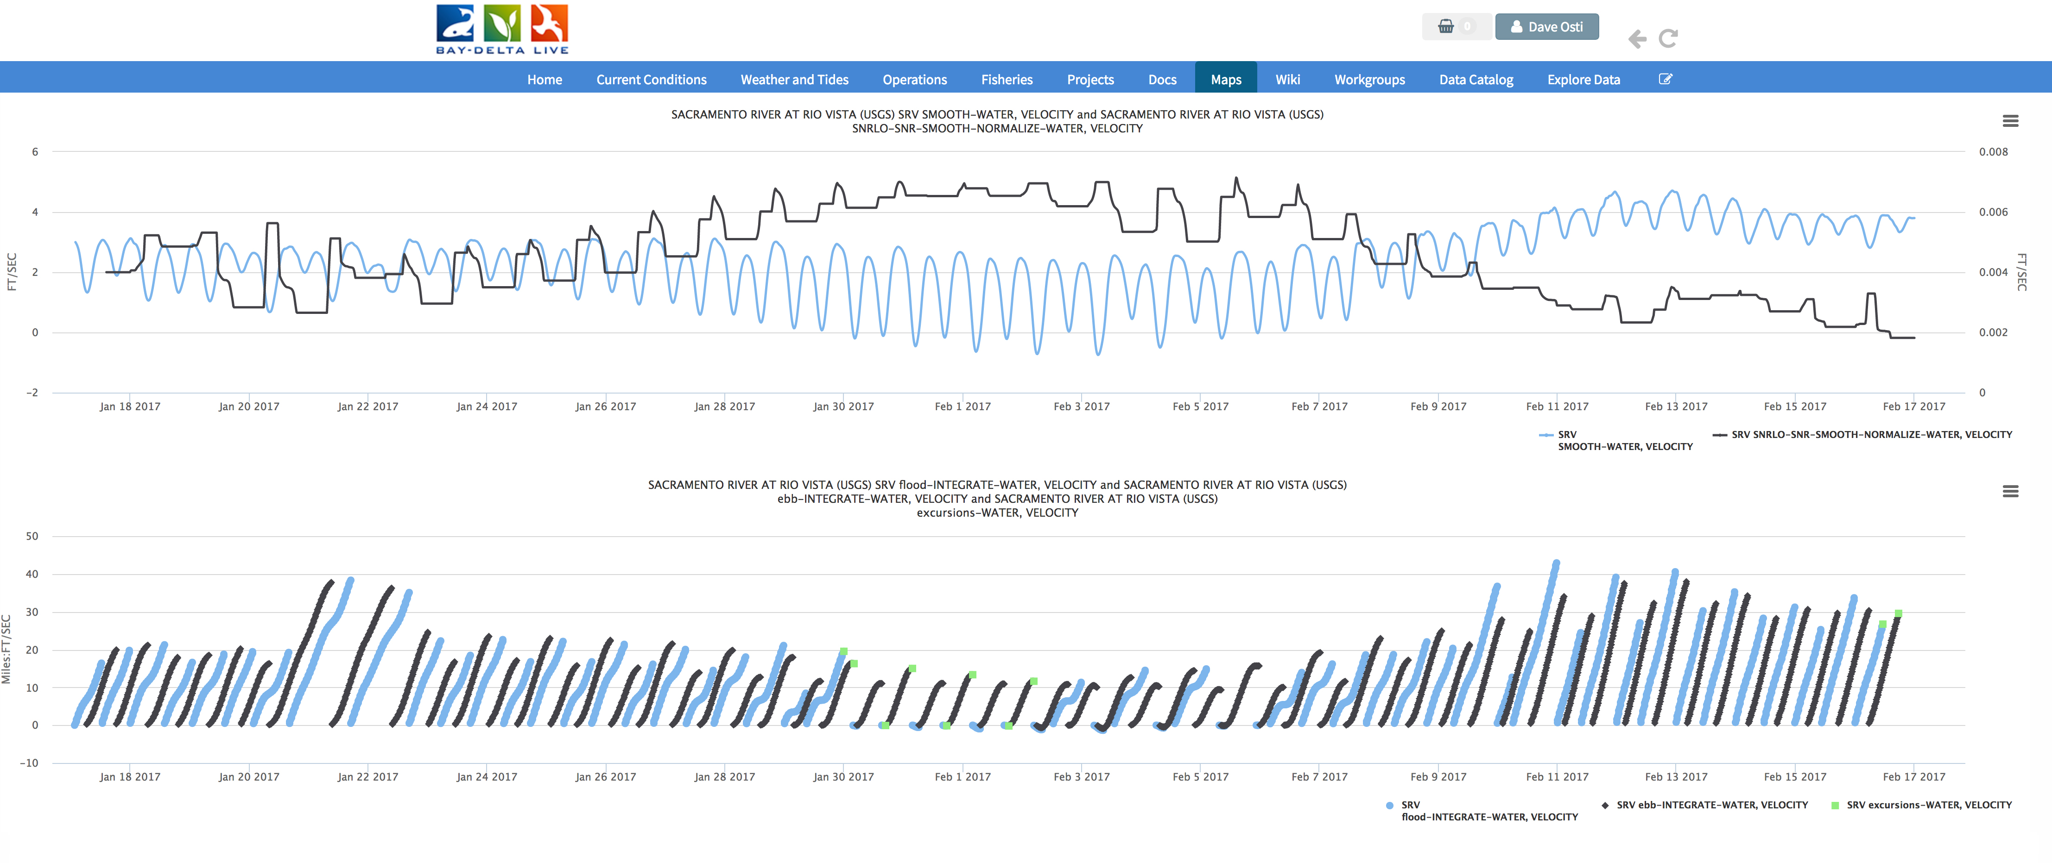
Cache Slough Reach: 1/17/17 to 2/17/17
CSC: SRV, RYI, LIB, DWS
CSC: Sacramento R at Rio Vista

Slide 11
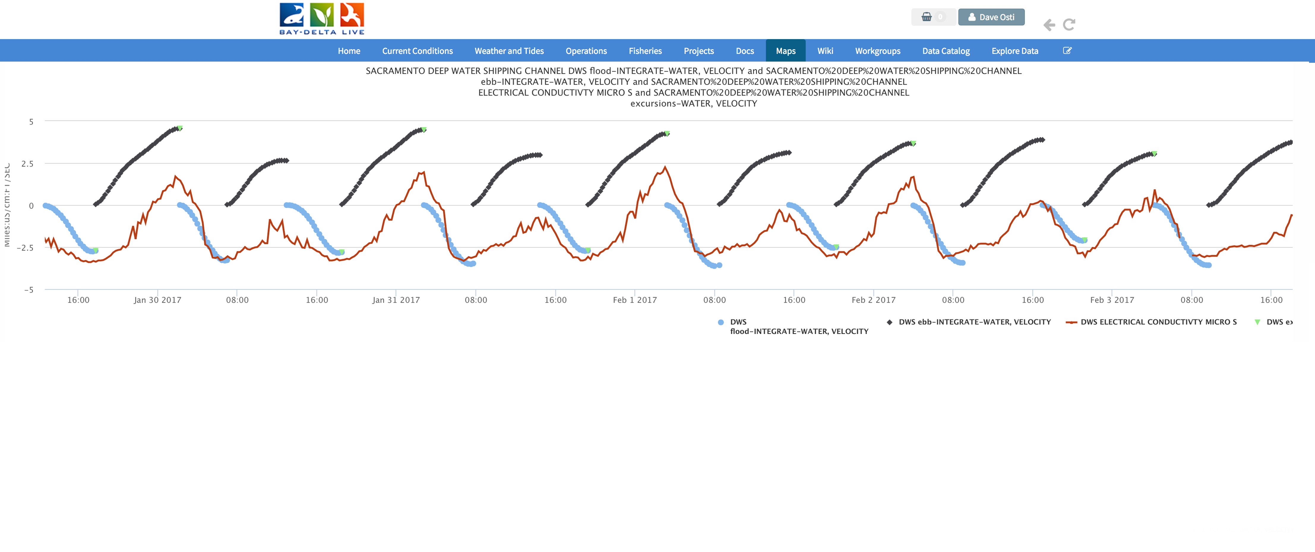
Cache Slough Reach: 1/17/17 to 2/17/17
CSC: SRV, RYI, LIB, DWS
CSC: Sacramento Deep Water Ship Channel – EC + Flood & Ebb

Slide 12
Old River Reach
Flood / Ebb Integrate
Flood Excursions

Slide 13
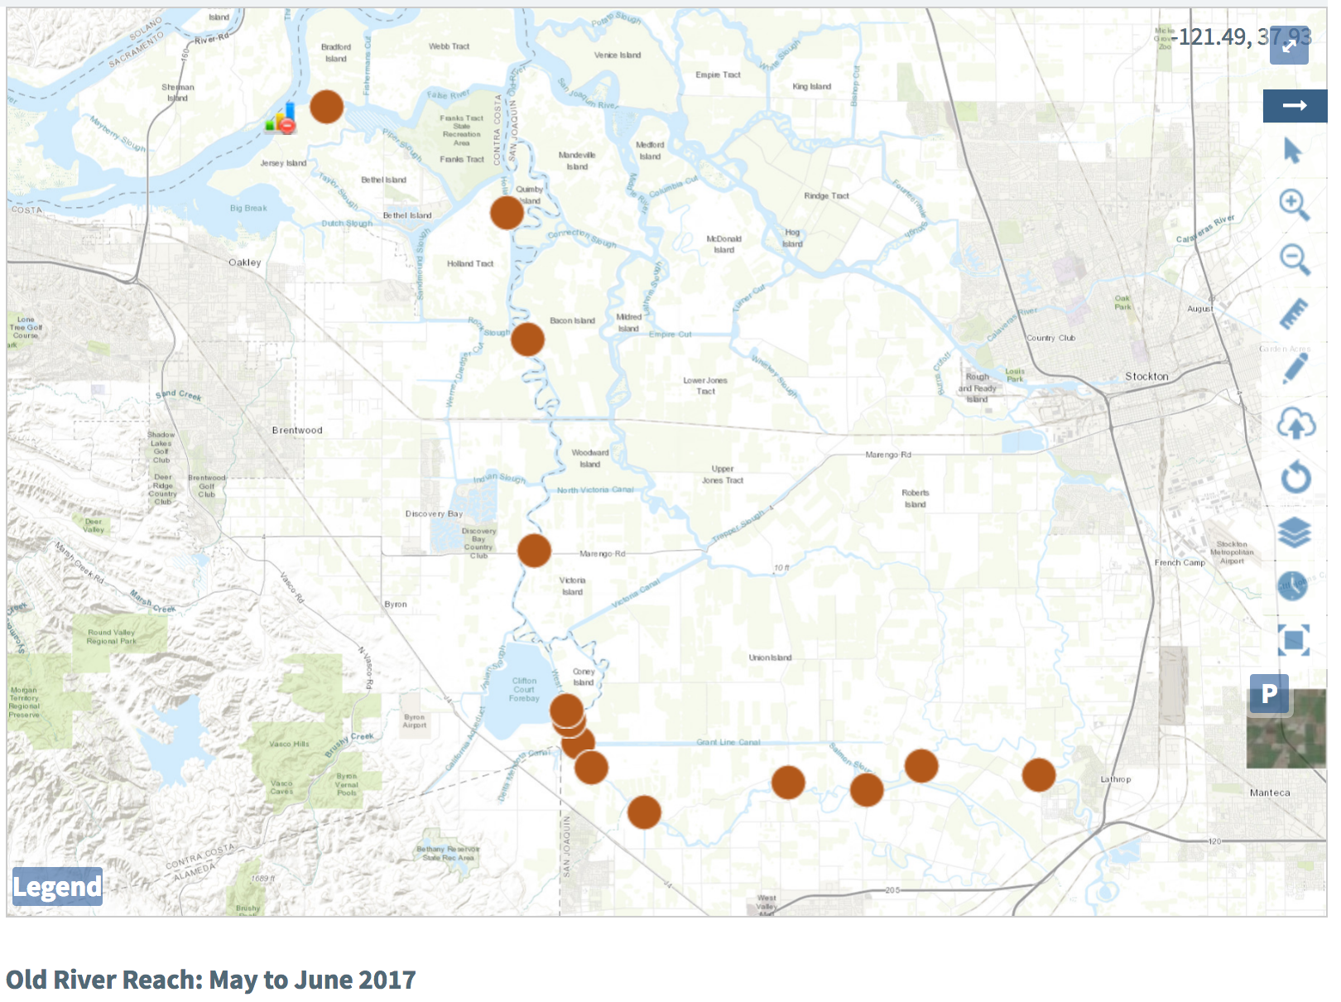
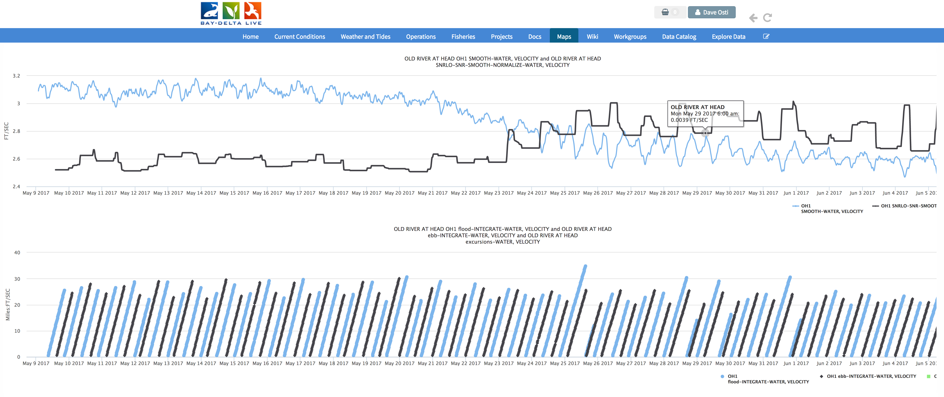
Old River Reach: 5/9/17 to 6/6/17
OLD: SJJ, FAL, HOL, OBI, OH4, WCI, ORI,GLC, ODM, ORM, OLD, PDC, ORX, OH1
OLD: Old River at Head

Slide 14
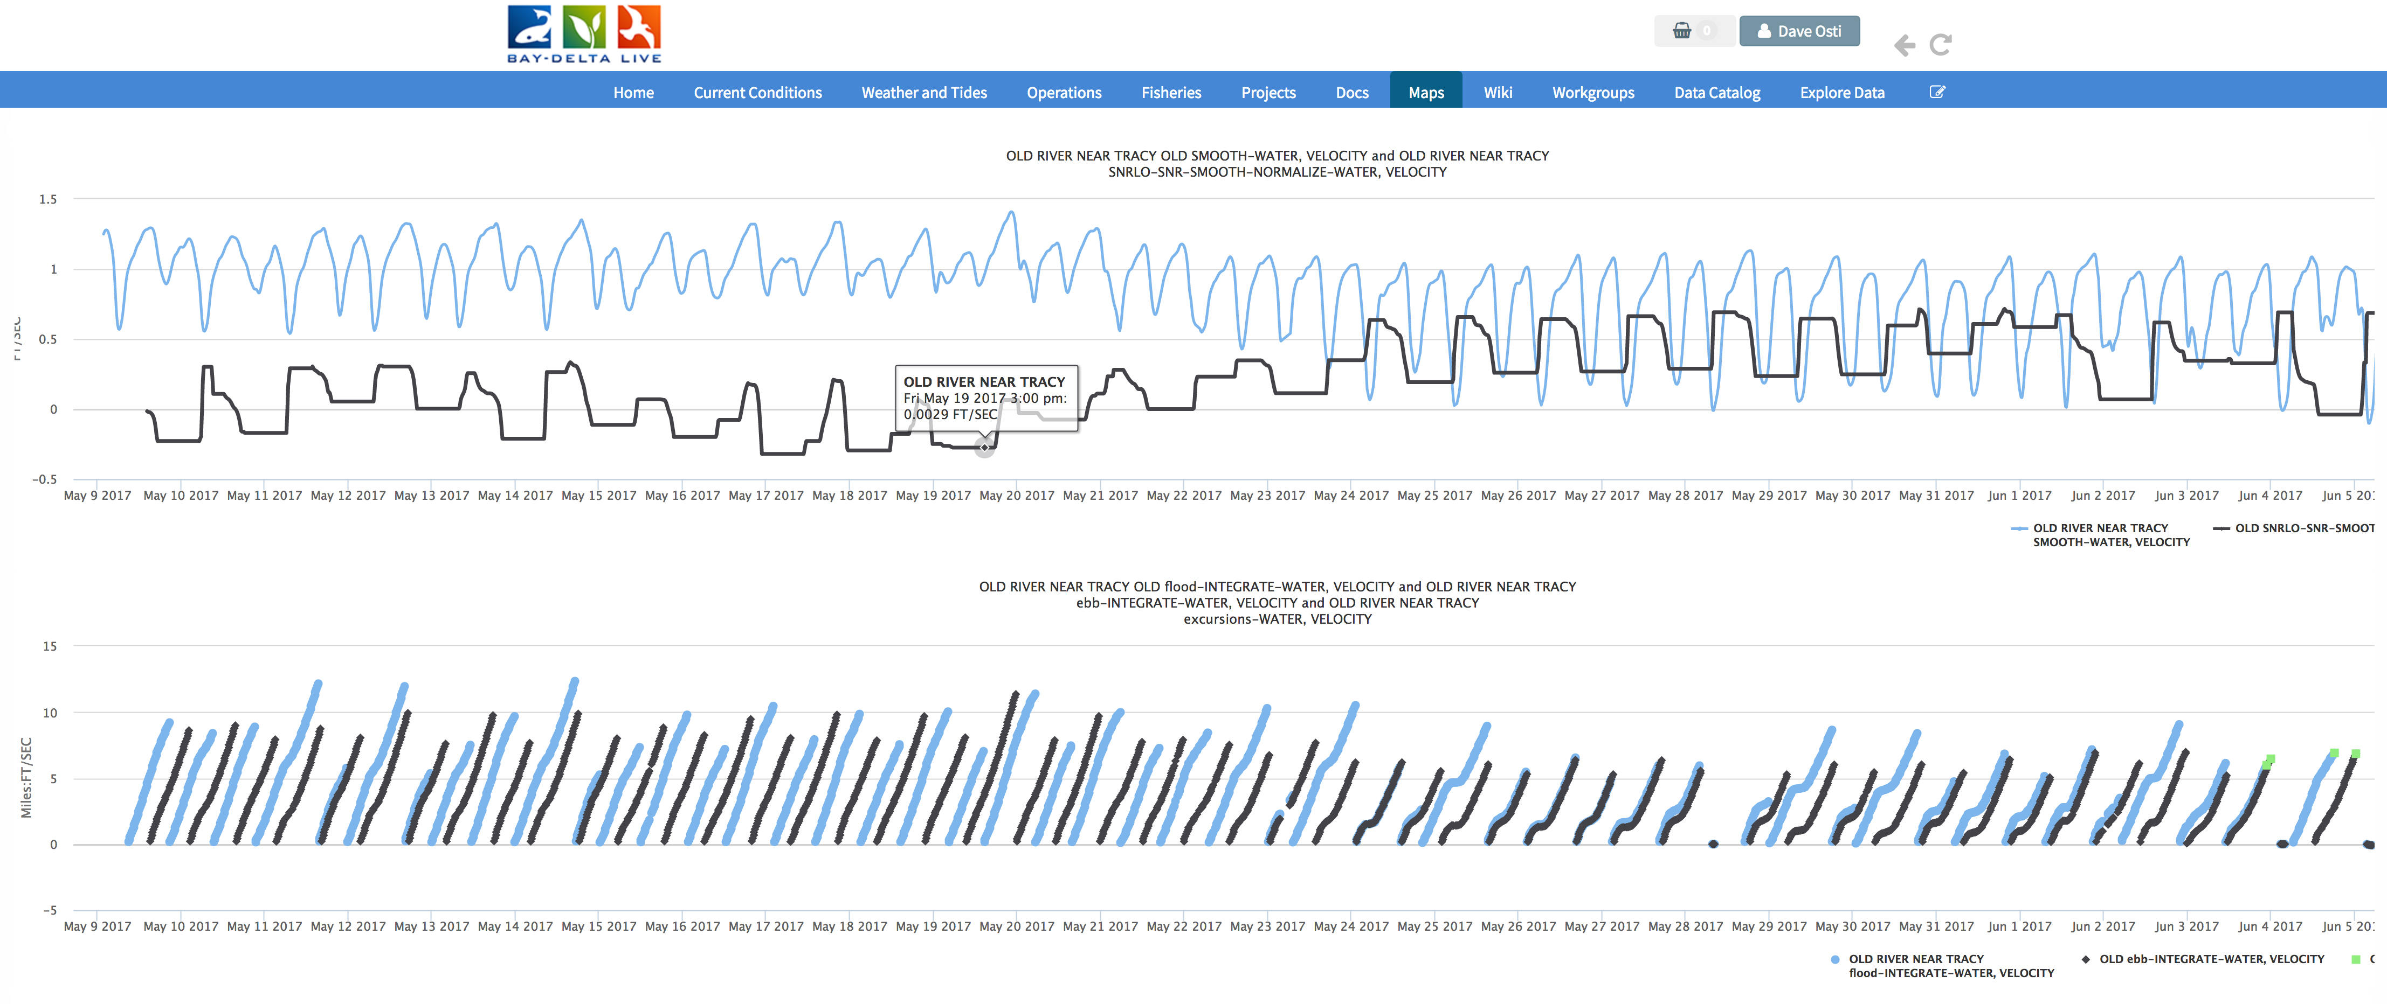
Old River Reach: 5/9/17 to 6/6/17
OLD: SJJ, FAL, HOL, OBI, OH4, WCI, ORI,GLC, ODM, ORM, OLD, PDC, ORX, OH1
OLD: Old River Near Tracy

Slide 15
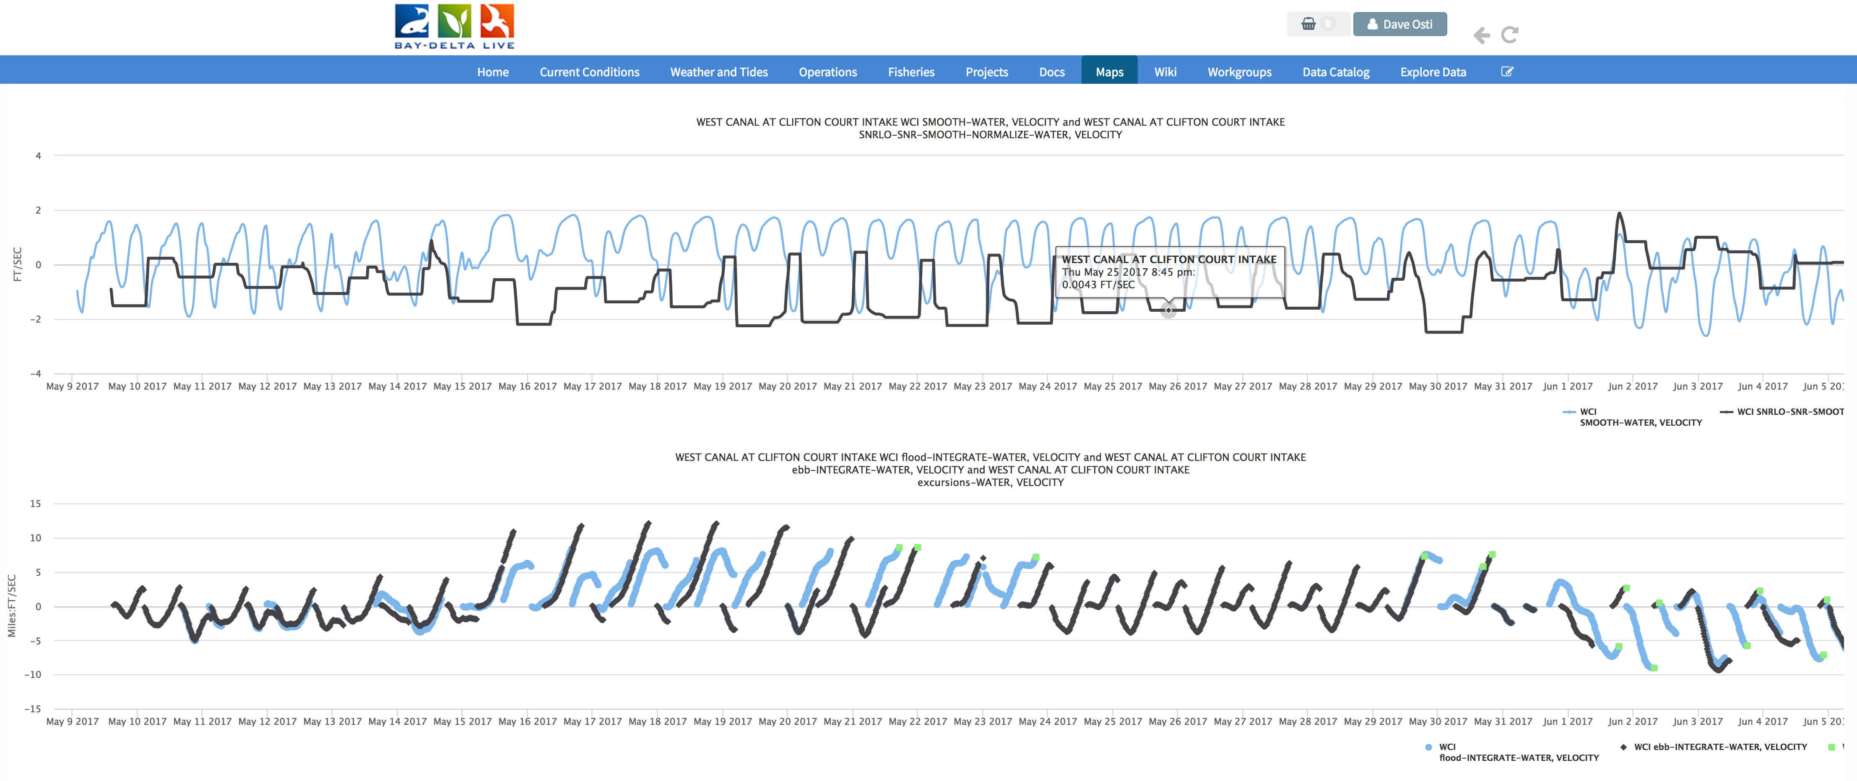
Old River Reach: 5/9/17 to 6/6/17
OLD: SJJ, FAL, HOL, OBI, OH4, WCI, ORI,GLC, ODM, ORM, OLD, PDC, ORX, OH1
OLD: West Canal at Clifton Court

Slide 16
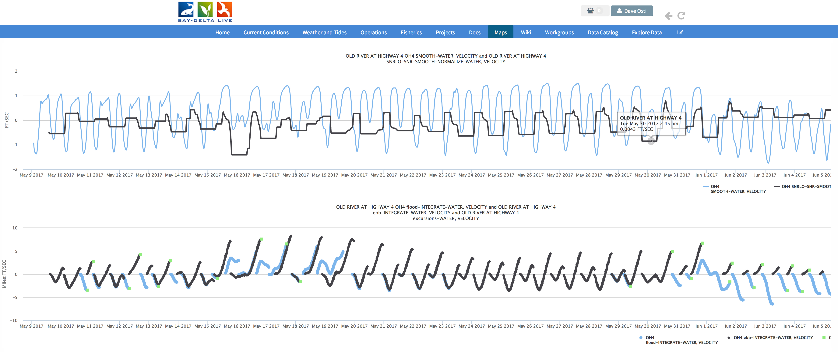
Old River Reach: 5/9/17 to 6/6/17
OLD: SJJ, FAL, HOL, OBI, OH4, WCI, ORI,GLC, ODM, ORM, OLD, PDC, ORX, OH1
OLD: Old River at Hwy 4

Slide 17
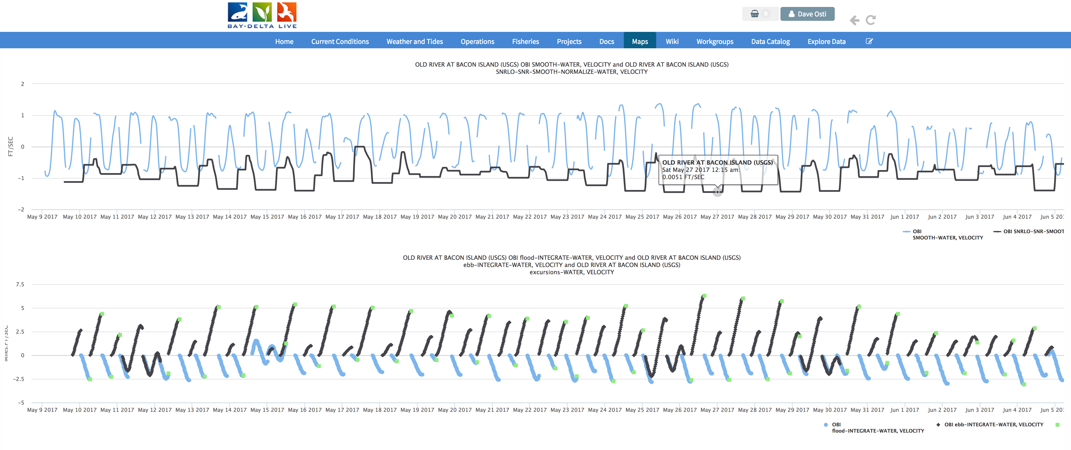
Old River Reach: 5/9/17 to 6/6/17
OLD: SJJ, FAL, HOL, OBI, OH4, WCI, ORI,GLC, ODM, ORM, OLD, PDC, ORX, OH1
OLD: Old River Near Bacon Island

Slide 18
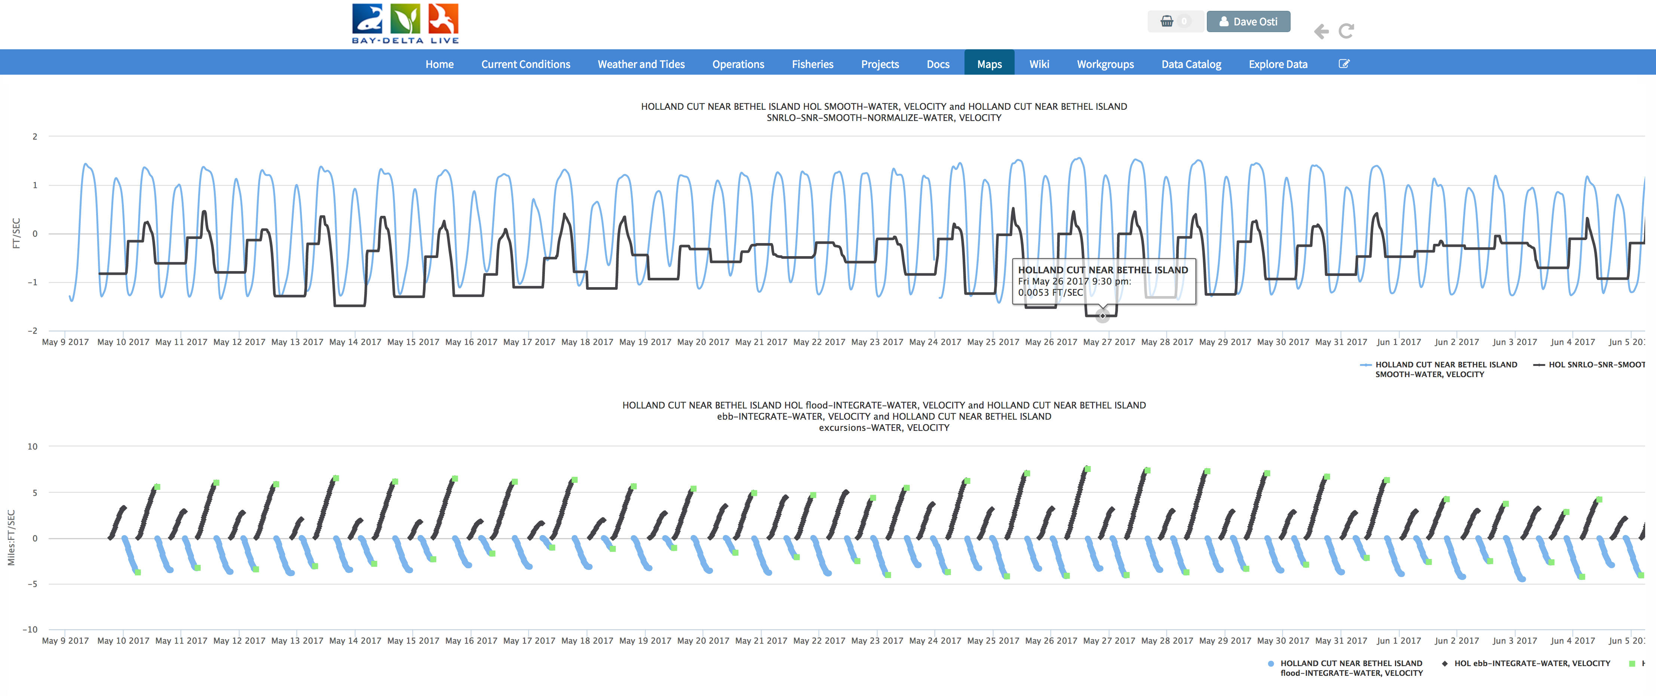
Old River Reach: 5/9/17 to 6/6/17
OLD: SJJ,FAL, HOL, OBI, OH4, WCI, ORI,GLC, ODM, ORM, OLD, PDC, ORX, OH1
OLD: Holland Cut Near Bethel Island

Slide 19
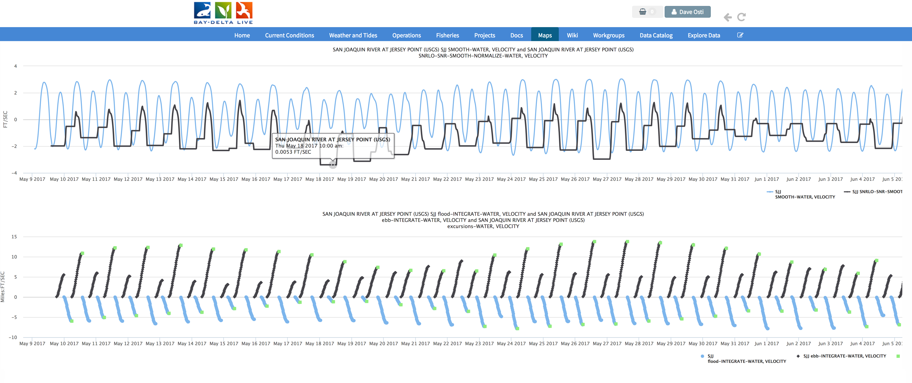
Old River Reach: 5/9/17 to 6/6/17
OLD: SJJ,FAL, HOL, OBI, OH4, WCI, ORI,GLC, ODM, ORM, OLD, PDC, ORX, OH1
OLD: San Joaquin R at Jersey Pt

