Slide 1
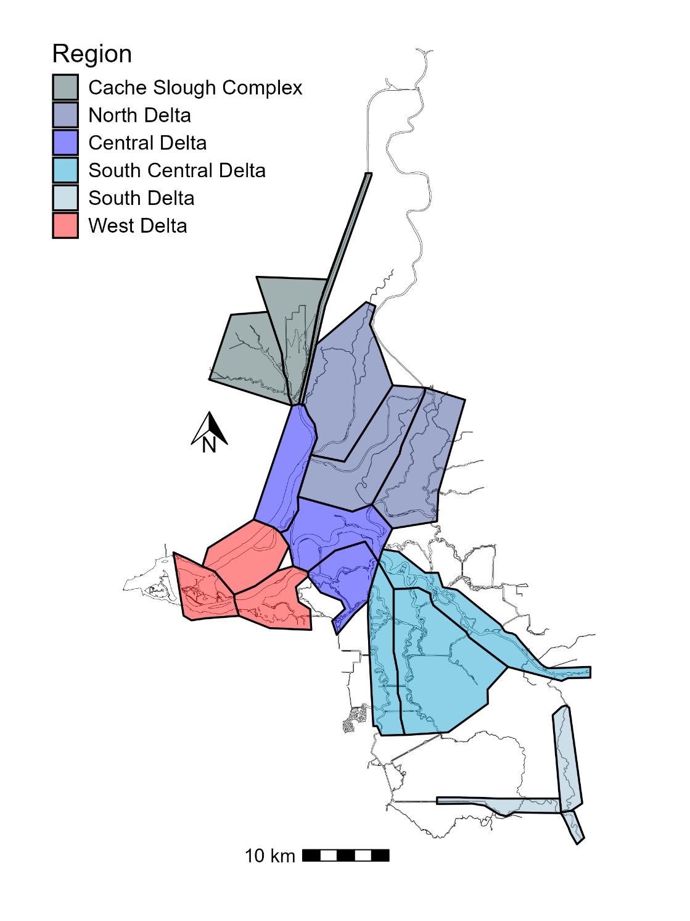
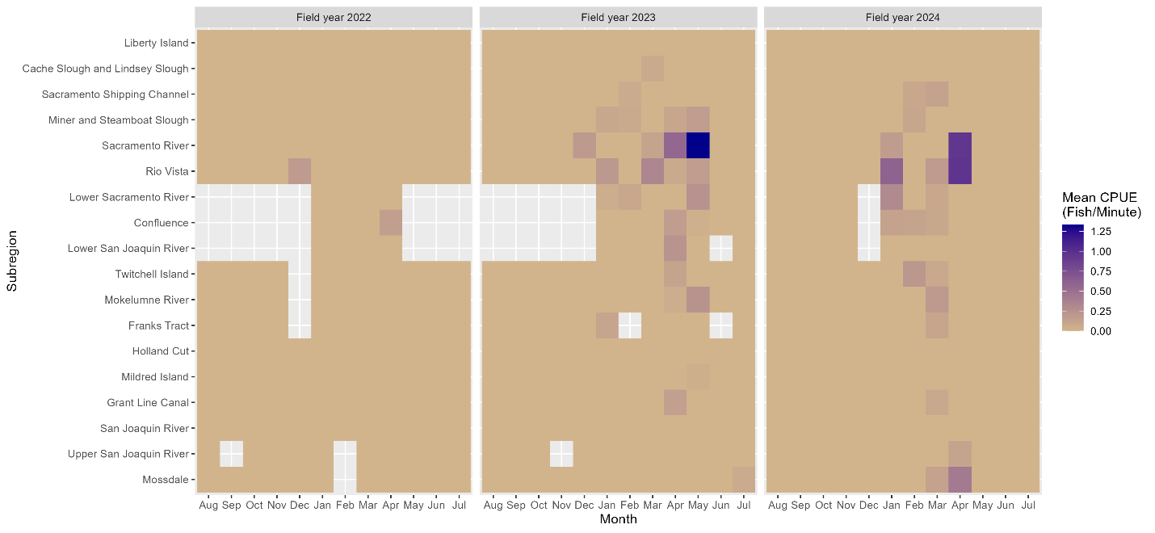
CommonName | TotalCount | MeanCPUE | SDCPUE | PercentCatch
Bluegill | 4526 | 1.93E+00 | 4.79E+00 | 24.22
Largemouth Bass | 4066 | 1.75E+00 | 2.39E+00 | 21.76
Redear Sunfish | 2377 | 1.01E+00 | 2.37E+00 | 12.72
Threadfin Shad | 1984 | 8.82E-01 | 4.01E+00 | 10.62
Hitch | 1168 | 4.83E-01 | 2.09E+00 | 6.25
Mississippi Silverside | 888 | 3.91E-01 | 1.80E+00 | 4.75
Golden Shiner | 649 | 2.66E-01 | 9.95E-01 | 3.47
Tule Perch | 563 | 2.35E-01 | 7.45E-01 | 3.01
Common Carp | 420 | 1.68E-01 | 6.65E-01 | 2.25
Sacramento Pikeminnow | 386 | 1.66E-01 | 4.90E-01 | 2.07
Striped Bass | 297 | 1.26E-01 | 5.43E-01 | 1.59
Sacramento Sucker | 176 | 7.87E-02 | 3.45E-01 | 0.94
Prickly Sculpin | 152 | 6.55E-02 | 2.39E-01 | 0.81
Bigscale Logperch | 126 | 5.75E-02 | 4.30E-01 | 0.67
Yellowfin Goby | 117 | 4.45E-02 | 3.12E-01 | 0.63
Splittail | 113 | 4.44E-02 | 3.06E-01 | 0.60
Warmouth | 94 | 3.80E-02 | 1.87E-01 | 0.50
Black Crappie | 91 | 3.80E-02 | 2.36E-01 | 0.49
Spotted Bass | 77 | 3.46E-02 | 1.87E-01 | 0.41
White Catfish | 62 | 2.61E-02 | 1.97E-01 | 0.33
Chinook Salmon | 61 | 2.78E-02 | 2.10E-01 | 0.33
Shimofuri Goby | 47 | 2.03E-02 | 1.47E-01 | 0.25
American Shad | 35 | 1.65E-02 | 1.31E-01 | 0.19
Sacramento Blackfish | 33 | 1.35E-02 | 1.35E-01 | 0.18
Red Shiner | 31 | 1.37E-02 | 2.95E-01 | 0.17
Goldfish | 30 | 1.23E-02 | 1.68E-01 | 0.16
Wakasagi | 18 | 6.32E-03 | 8.51E-02 | 0.10
Green Sunfish | 15 | 6.68E-03 | 6.70E-02 | 0.08
Brown Bullhead | 14 | 5.93E-03 | 6.37E-02 | 0.07
Black Bullhead | 13 | 4.45E-03 | 5.15E-02 | 0.07
Smallmouth Bass | 12 | 5.85E-03 | 6.45E-02 | 0.06
Bluefin Killifish | 9 | 3.58E-03 | 4.51E-02 | 0.05
Rainwater Killifish | 6 | 2.65E-03 | 4.99E-02 | 0.03
Starry Flounder | 5 | 2.10E-03 | 3.56E-02 | 0.03
White Crappie | 5 | 1.99E-03 | 3.95E-02 | 0.03
Bass Unknown | 4 | 1.71E-03 | 6.44E-02 | 0.02
Channel Catfish | 4 | 1.49E-03 | 2.81E-02 | 0.02
Lamprey ammocoete | 3 | 1.46E-03 | 3.20E-02 | 0.02
steelhead | 3 | 1.45E-03 | 3.18E-02 | 0.02
Delta Smelt | 1 | 1.69E-03 | 6.38E-02 | 0.01
Hardhead | 1 | 4.24E-04 | 1.59E-02 | 0.01
Redeye Bass | 1 | 4.04E-04 | 1.52E-02 | 0.01
Threespine Stickleback | 1 | 4.71E-04 | 1.77E-02 | 0.01
White Sturgeon | 1 | 5.30E-04 | 1.99E-02 | 0.01
Total | 18685
Figure 2. Spatiotemporal distribution heat maps of juvenile Oncorhynchus tshawytscha with color representing mean CPUE in fish per minute, per month (x-axis) of field years 2022 to 2024 for each subregion (y-axis) of the DJFMP boat electrofishing survey.
Figure 1. Map of the San Francisco Estuary depicting the six regions (colors) and 18 subregions (polygons) used in the boat electrofishing survey.
Table 1. Summary of catch collected by the boat electrofishing survey during field year 2024. The table shows the number of each species caught (Total Count), the mean catch per unit effort (CPUE) in fish per minute, the standard deviation of the CPUE, and the percentage of total catch that each species represents.

Slide 2
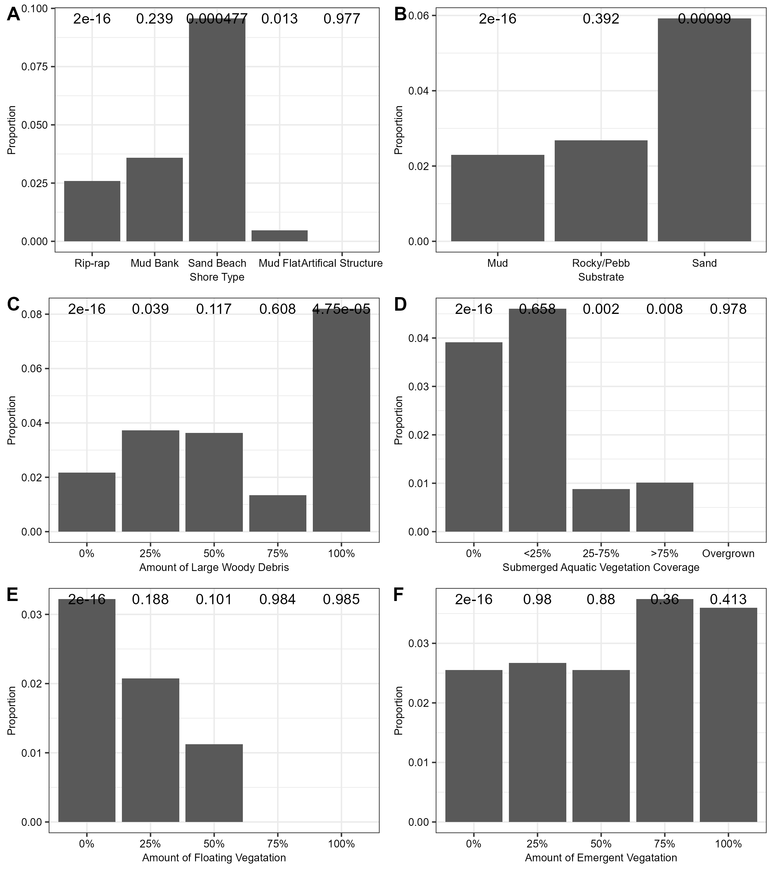
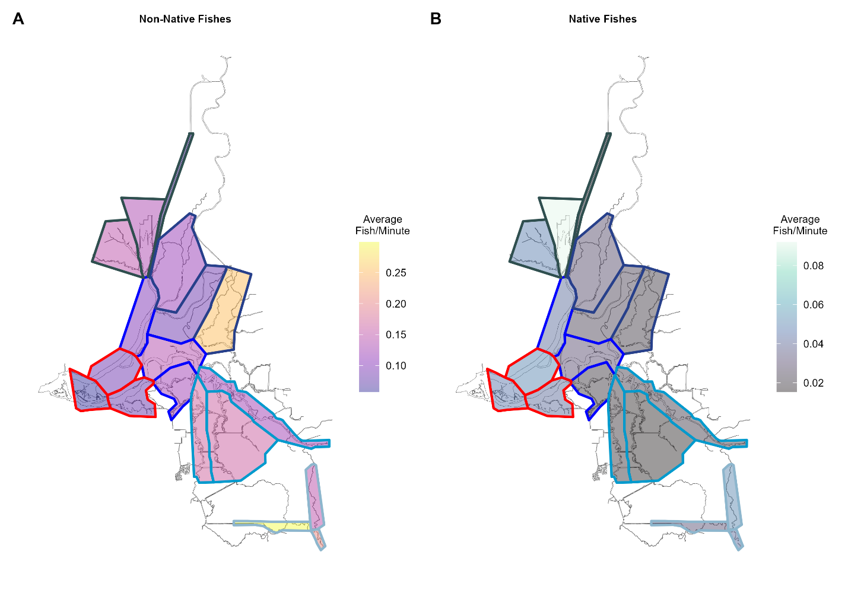
Figure 4. Spatial distribution maps for non-native fishes (A), native fishes (B). CPUE in fish per minute by subregion is averaged over three years (2022-2024).
Figure 3. Bar plots showing the proportion of boat electrofishing segment samples of a given habitat type with positive juvenile Chinook Salmon (Oncorhynchus tshawytscha) catches. The P-values from logistic regression models are shown above each of the corresponding variable levels. Habitat type variables shown are dominant shoreline composition (A), most abundant substrate (B), amount of woody debris (C), percent coverage of submerged aquatic vegetation (D), percent coverage of floating vegetation (E), and percent coverage of emergent vegetation (F).

Slide 3
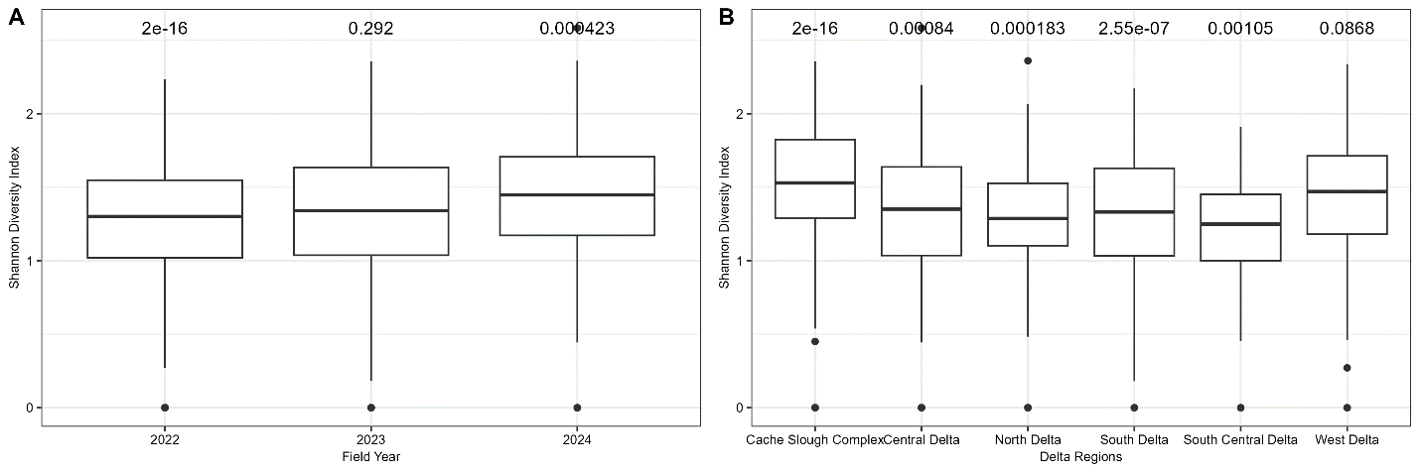
Figure 5. Boxplots of Shannon’s diversity indices calculated by segment and averaged by field year (A), and sampling region (B). P-values from linear regression models are shown above each of the corresponding variables.

