Slide 2
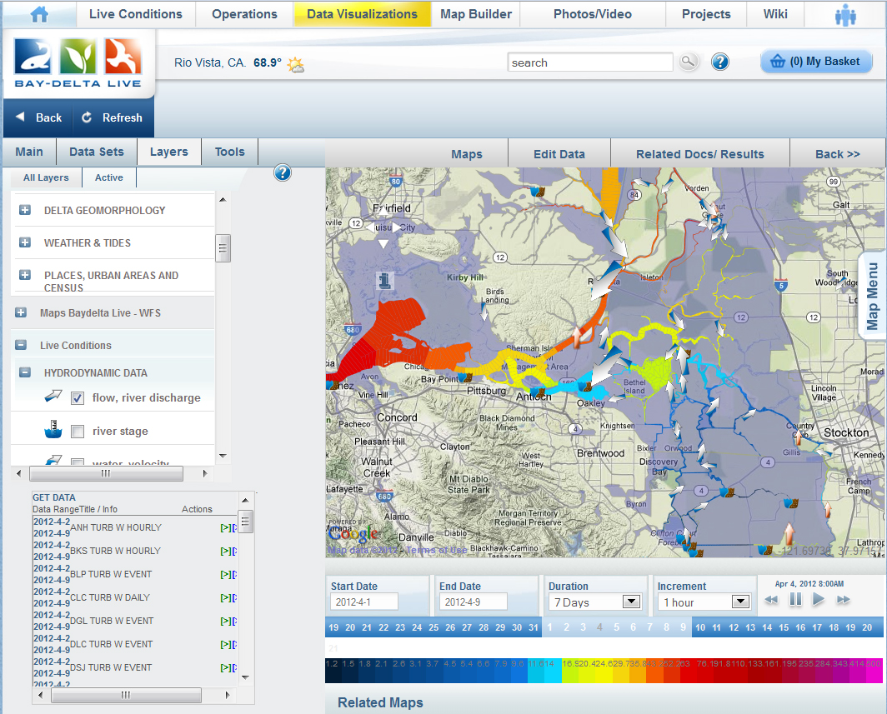

Slide 3
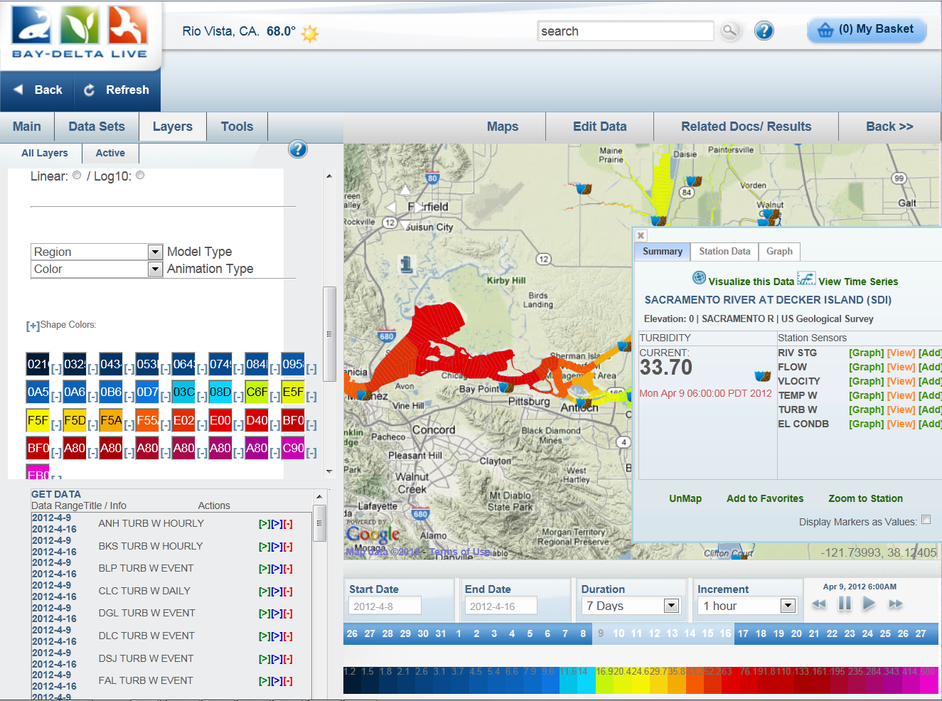
Notes:
Rollover – Graphing – Gr
Model / Build space

Slide 4
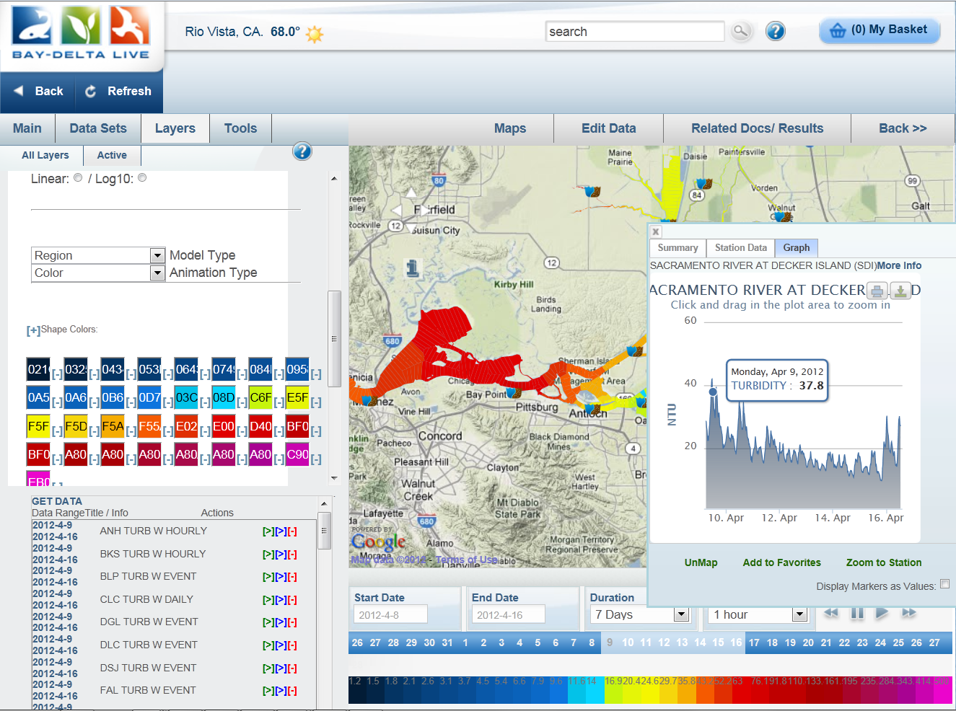

Slide 5
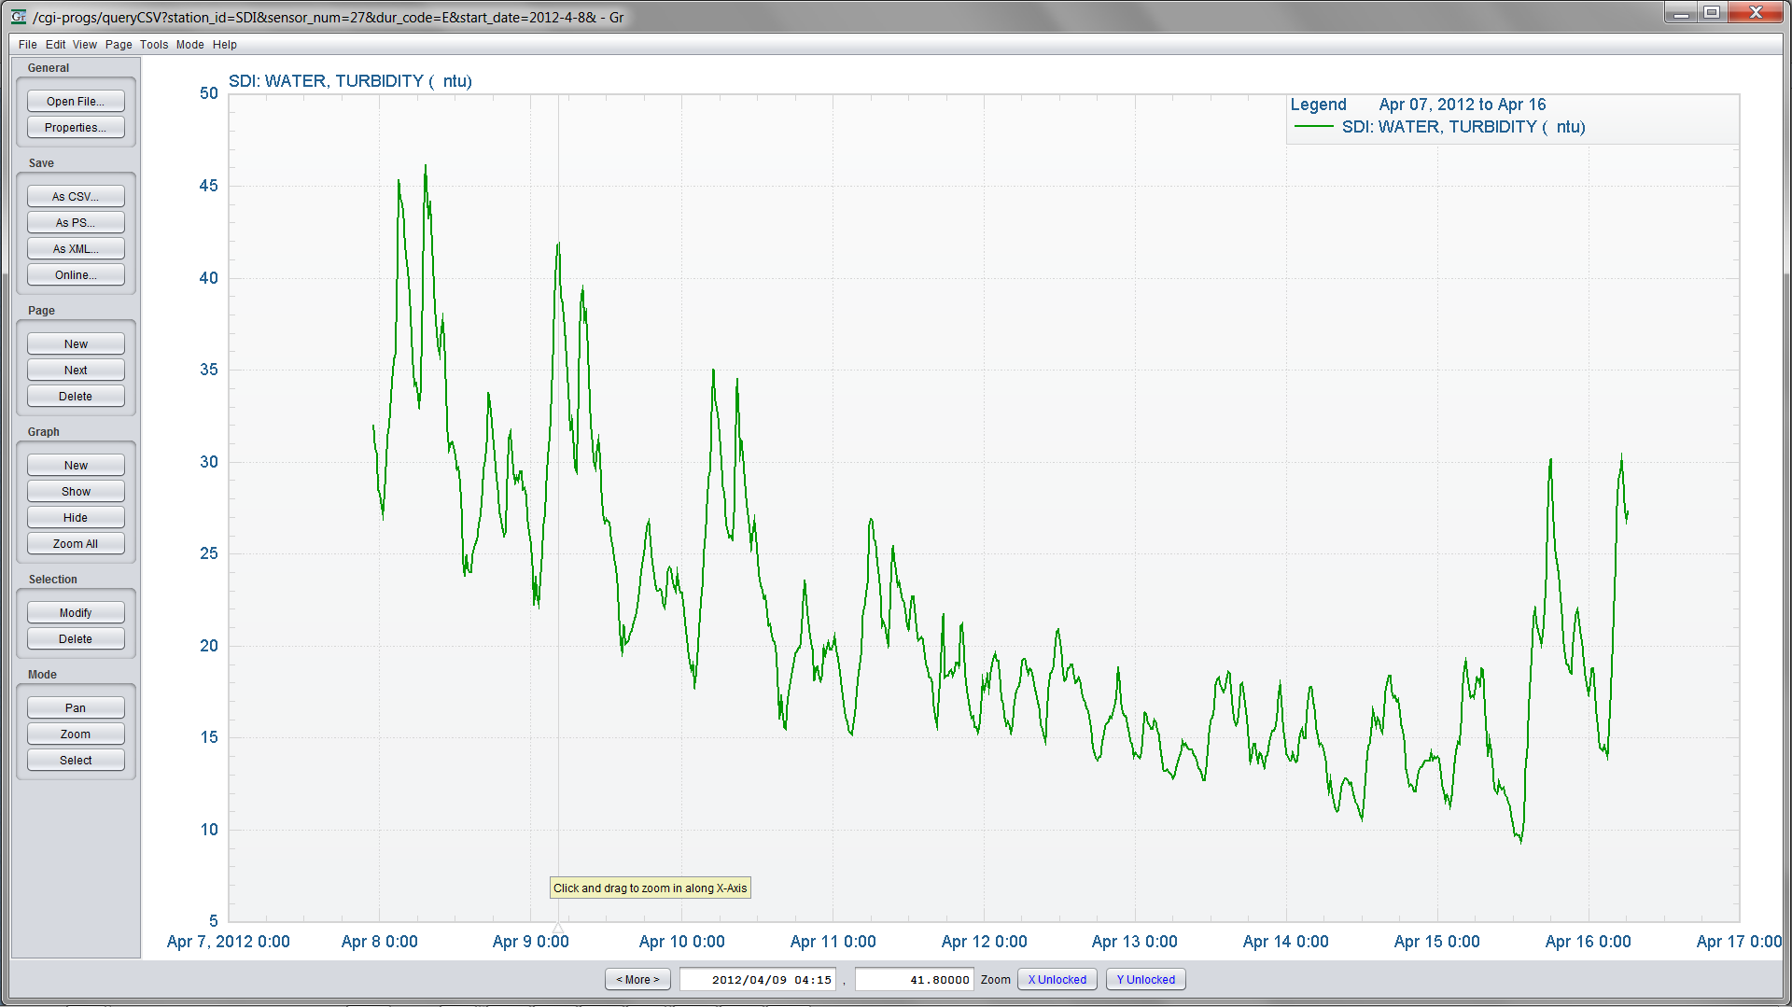
Collaboration with Jon Burau and John Donovan (USGS)

Slide 6
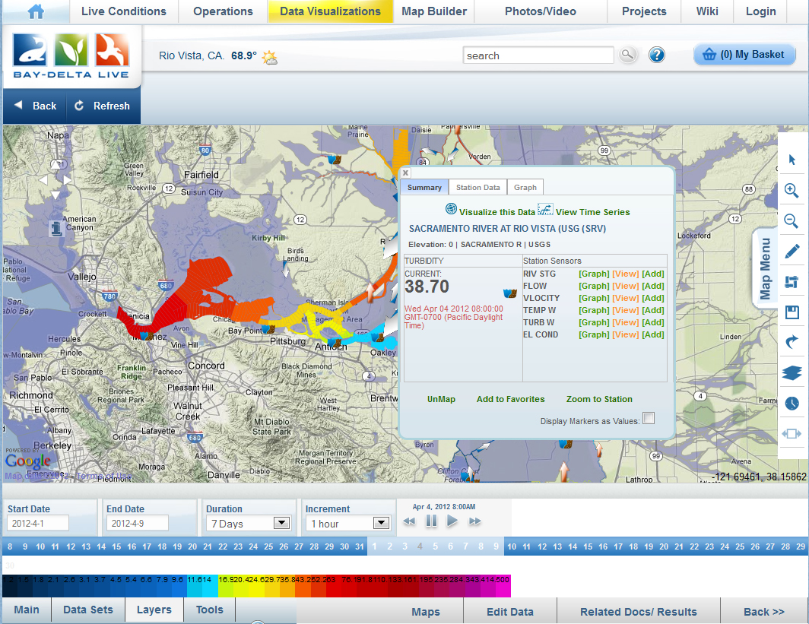
Notes:
A Rich Interactive Visual Experience of Data Visualization

Slide 7
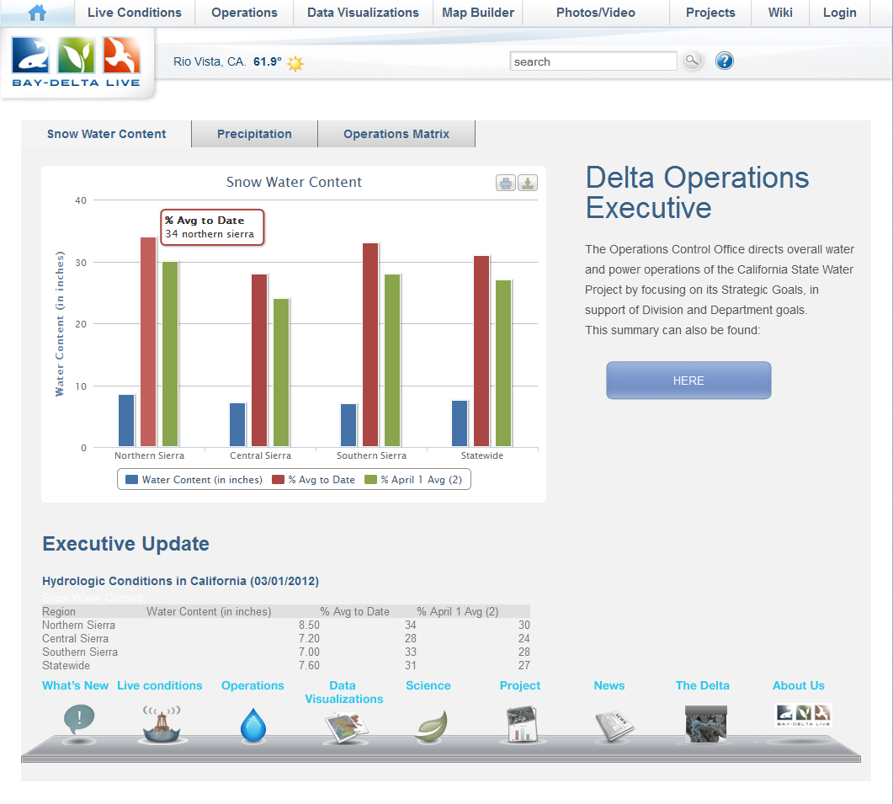

Slide 8
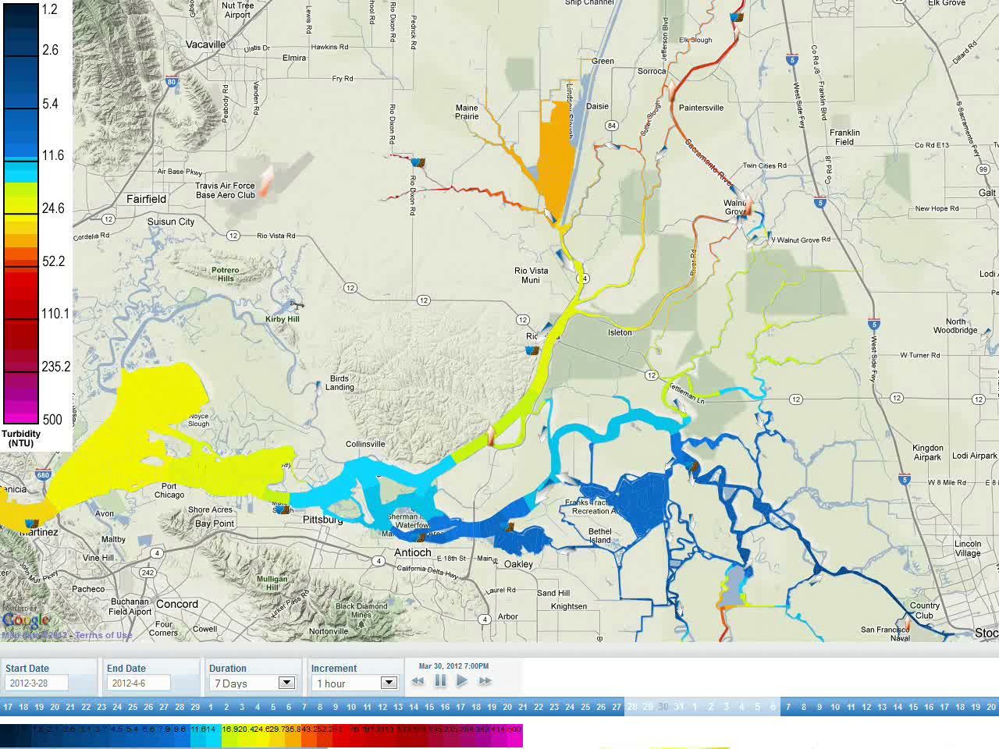
Notes:
Data aggragation
Make sense of it all very , very quickly

