Slide 1
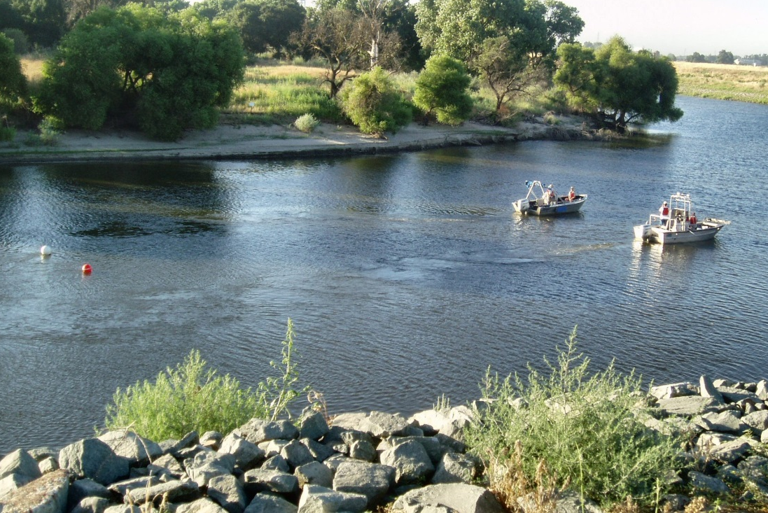
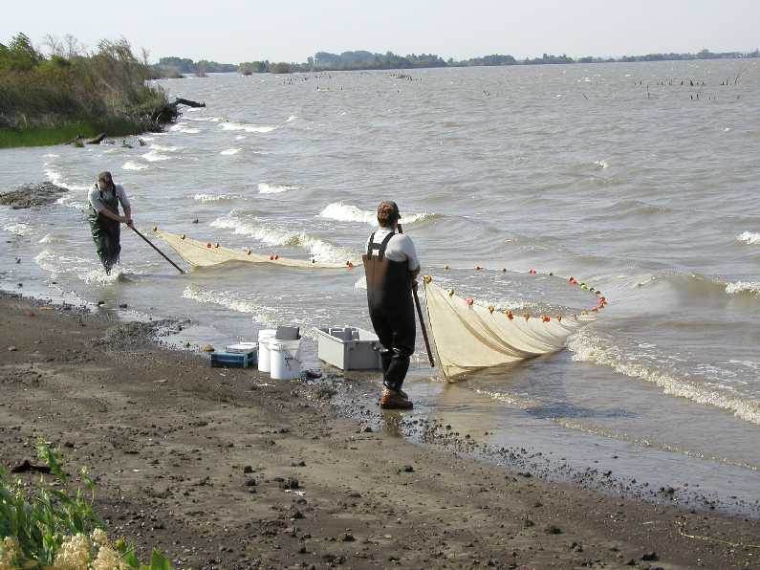


Delta Juvenile Fish Monitoring Program¹
¹U.S. Fish and Wildlife Service, Lodi, CA
California Estuary Monitoring Workgroup, July 9 2014

Slide 2
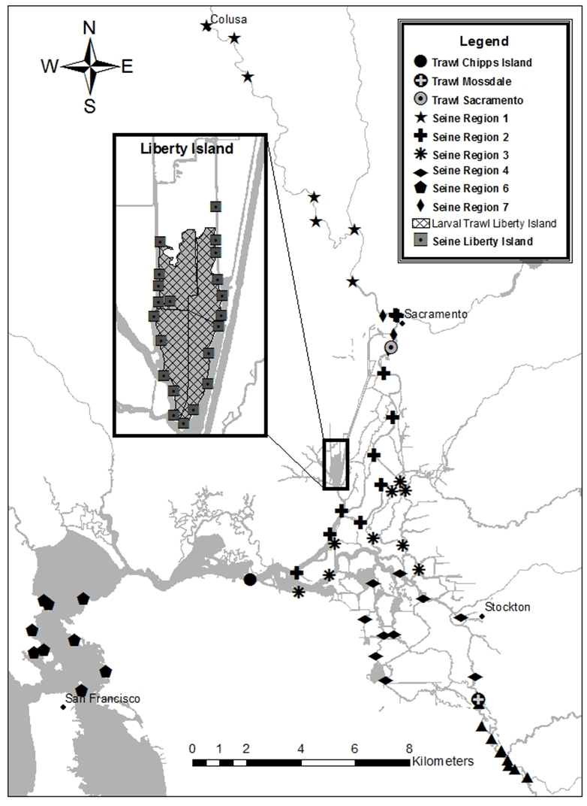
Sampling Frame
Sampling elements:
Beach seine
Mossdale trawl
Sacramento trawl
Chipps Island trawl
Liberty Island trawl

Slide 3
Sampling Matrix (weekly)
Sampling Element | Jan | Feb | Mar | Apr | May | Jun | Jul | Aug | Sep | Oct | Nov | Dec
Sacramento MWT | 0 | 0 | 0 | 3 | 2 | 2 | 3 | 3 | 3 | 0 | 0 | 0
Sacramento KDT | 3 | 3 | 3 | 0 | 0 | 0 | 0 | 0 | 0 | 3 | 3 | 3
Chipps MWT | 3 | 3 | 3 | 3 | 2 | 2 | 3 | 3 | 3 | 3 | 3 | 3
Mossdale KDT | 3 | 3 | 3 | 3 | 3 | 3 | 3 | 3 | 3 | 3 | 3 | 3
Sacramento Seine | 1 | 0 | 0 | 0 | 0 | 0 | 0 | 0 | 0 | 3 | 3 | 3
Lower Sac. Seine | 1 | 1 | 1 | 1 | 1 | 1 | 1 | 1 | 1 | 1 | 1 | 1
North Delta Seine | 1 | 1 | 1 | 1 | 1 | 1 | 1 | 1 | 1 | 1 | 1 | 1
Central Delta Seine | 1 | 1 | 1 | 1 | 1 | 1 | 1 | 1 | 1 | 1 | 1 | 1
South Delta Seine | 1 | 1 | 1 | 1 | 1 | 1 | 1 | 1 | 1 | 1 | 1 | 1
San Joaquin Seine | 1 | 1 | 1 | 1 | 1 | 1 | 1 | 1 | 1 | 1 | 1 | 1
Bay Seine | 0.5 | 0.5 | 0.5 | 0.5 | 0.5 | 0.5 | 0.5 | 0.5 | 0.5 | 0.5 | 0.5 | 0.5
Liberty Seine | 0.25 | 0.25 | 0.25 | 0.25 | 0.25 | 0.25 | 0.25 | 0.25 | 0.25 | 0.25 | 0.25 | 0.25
Liberty LVT | 0 | 0.25 | 0.25 | 0.25 | 0.25 | 0.25 | 0.25 | 0 | 0 | 0 | 0 | 0

Slide 4
Data Summaries
Chinook Salmon and POD species (1978 to present)
DatCall (Delta Operations for Salmonids and Sturgeon)
DJFMP website (http://www.fws.gov/stockton/jfmp/)
Annual reports
California Estuaries Portal

Slide 5
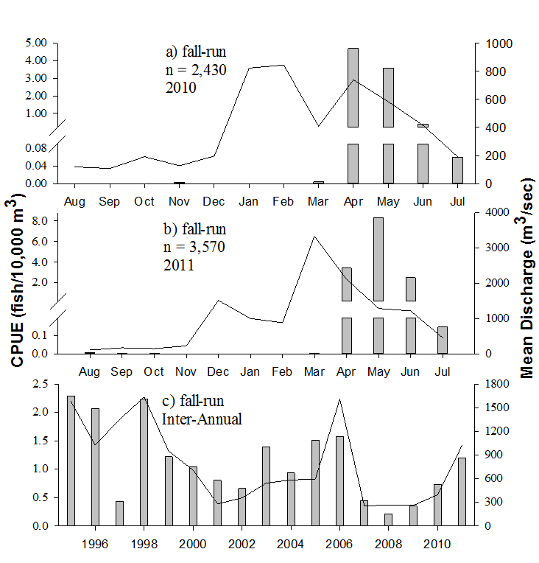
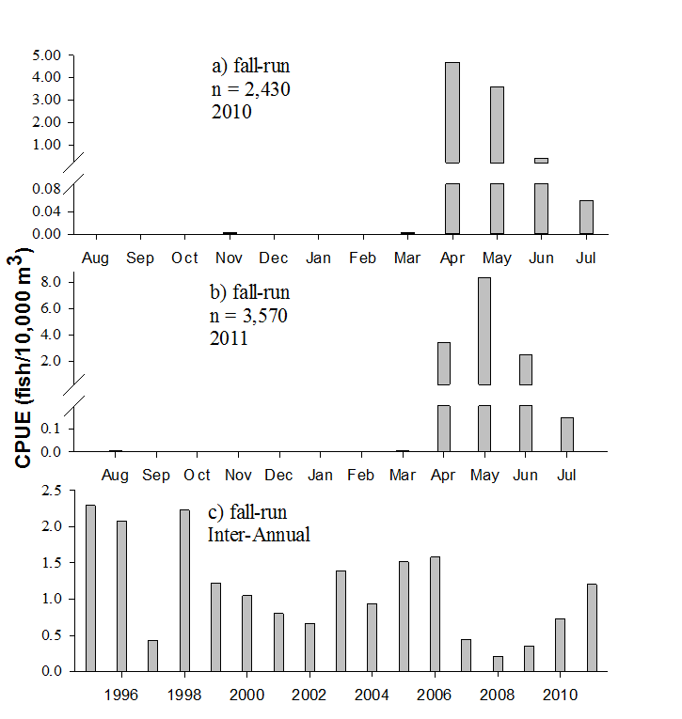
Portal Visualizations (Chipps)
Fig 1. Mean monthly and yearly CPUE of unmarked juvenile fall-run Chinook Salmon at Chipps Island during 2010, 2011, and 1995 through 2011. Delta outflow (mean discharge) calculated from CDWR Dayflow (left panel).

Slide 6
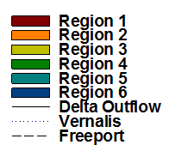
Portal Visualizations (Seine)
Fig 2. Mean monthly and yearly CPUE of Delta Smelt sampled in beach seines (Regions 1‒6) during 2010, 2011, and 2000 through 2011. Sacramento River (Freeport), San Joaquin River (Vernalis) and Delta outflow (mean discharge) are shown on the left panel.

Slide 7
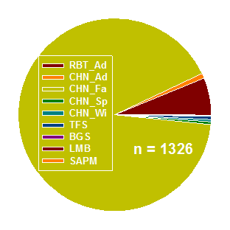
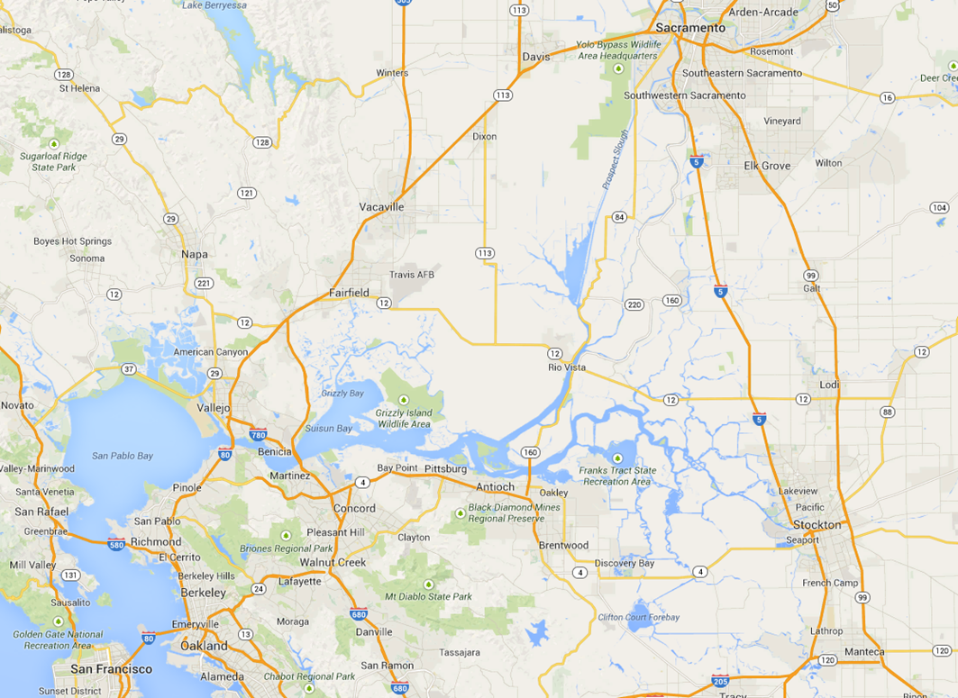
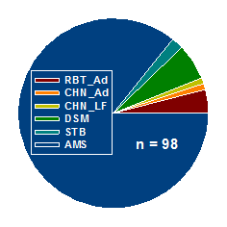
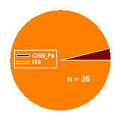
Portal Visualizations (Trawl)
Sacramento
Chipps
Mossdale
Fig 2. Daily CPUE of fish (all species) sampled at Chipps Island (MWT), Sacramento (KDTR), and Mossdale (KDTR) on February 12, 2014. Chinook Salmon raced by length-at-date criteria.

Slide 8
2014 Timeline (LR: Fish)
July: update current pages
August: develop web services for DJFMP
September: develop visualization tools
Fall/winter: develop Delta indicators

