Slide 1
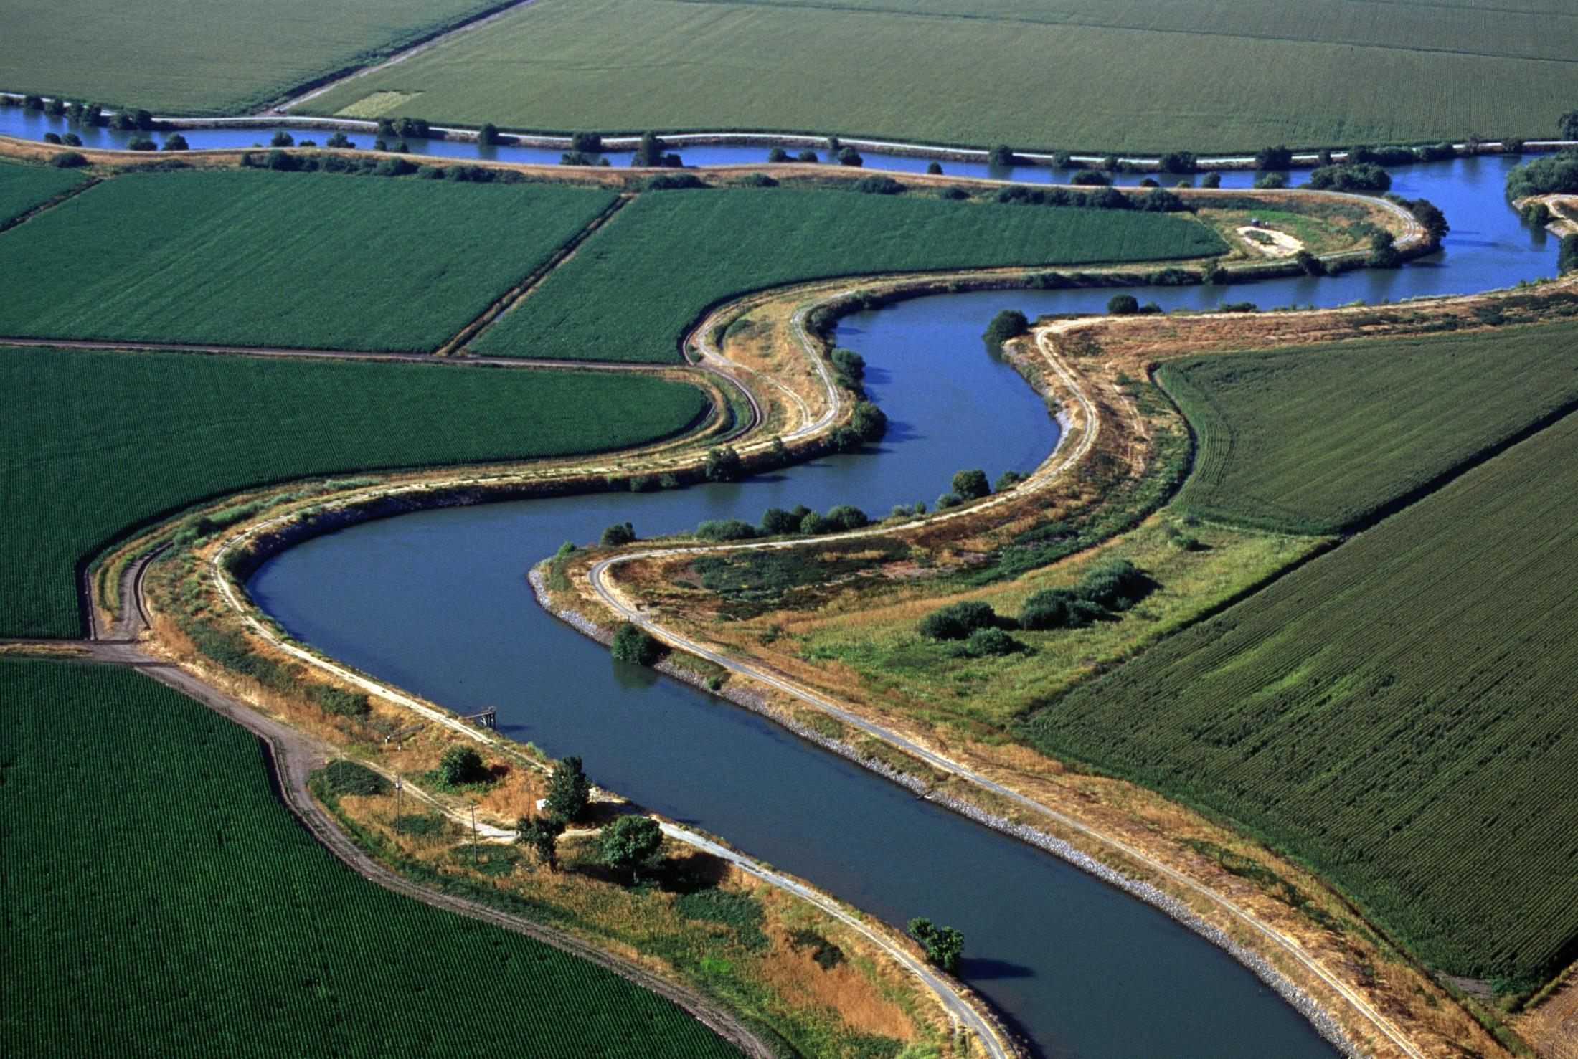
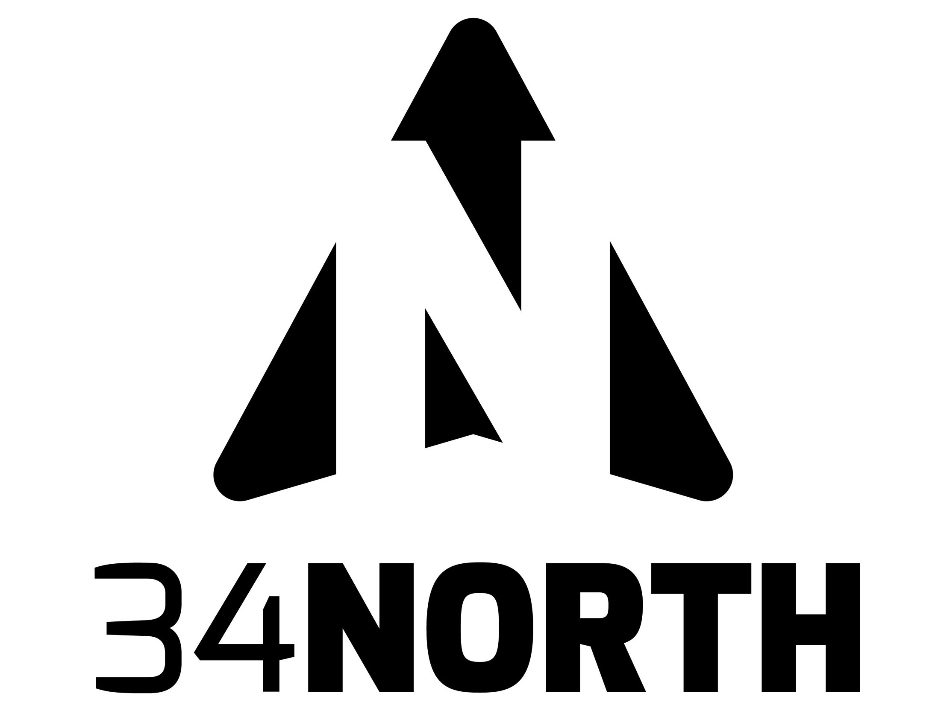
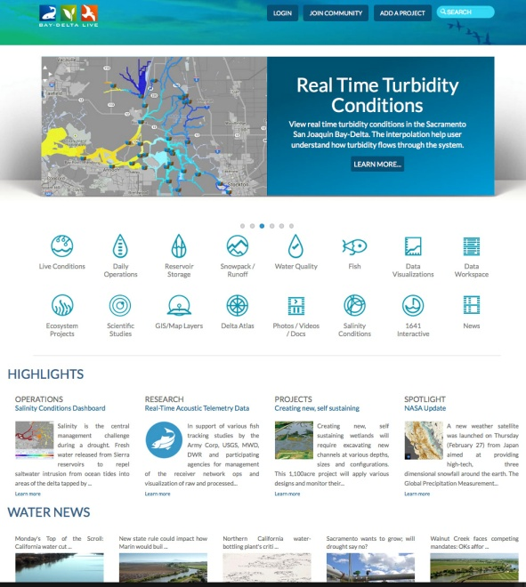
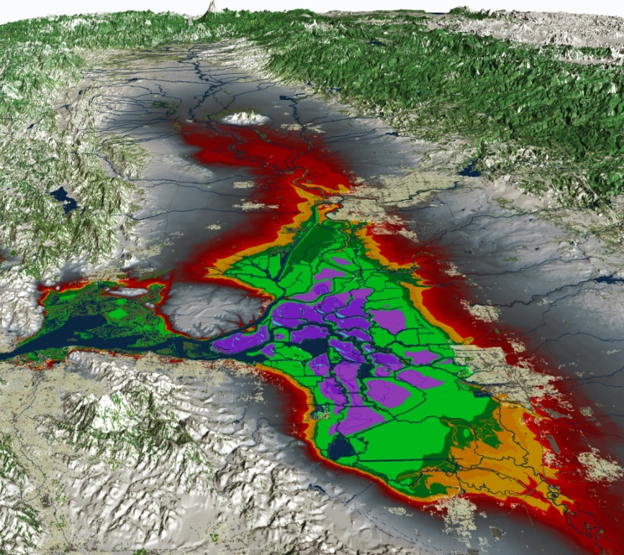
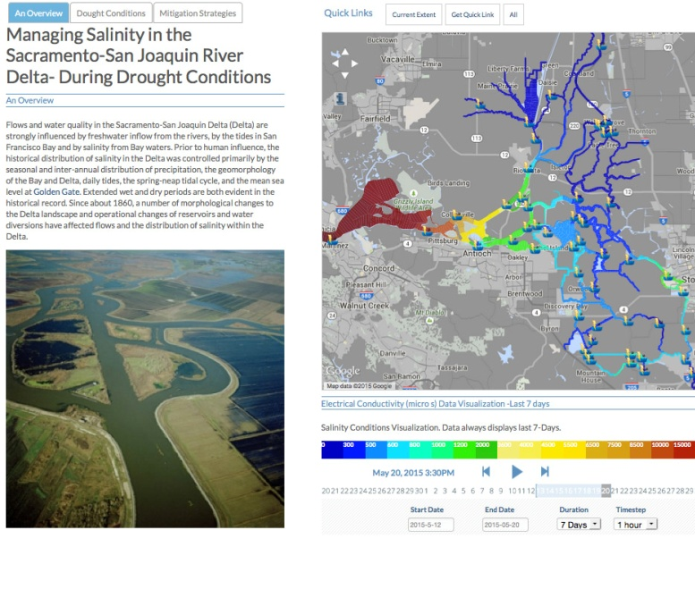

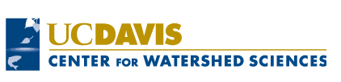


Workshop on Integrated Environmental Modeling of Estuarine Systems
Davis, California, May 21-23, 2015
DAVID OSTI, 34 NORTH
Using OPENNRM : Tell your Data Story
Baydeltalive.com and San Joaquin Real Time Management collaborative resource management web applications and workspaces for data collection, analysis and visualization.
Notes:
In this presentation we will demonstrate www.baydeltalive.com and sjrrtm.opennrm.org to show you how such collaborative efforts are working in the Sacramento San Joaquin Bay-Delta. You will learn how to explore and analyze data (CDEC, NWIS, CIMIS, CEDEN, EMP Monitoring, Operations Data, 200 + GIS Layers and more), visualize data and model output and tell data stories. We will focus on important Delta topics including:
Visualizing Model Output
USFWS Fish Trawls and Water Quality Conditions
USBR and USGS Outmigration Salmon Studies
Visualizing Salinity and Turbidity
Drought Dashboards
Operations Dashboards
Collaborative Ecosystem Project Pages and Dashboards

