Slide 1
California Estuary Portal
California Estuaries | Estuary Health| Estuary Trends| Fixing our Estuaries| About Us
Metadata Feeds and Tool Area:
Thumbnail, title, description, more url
Layer manager
Legend
Content Viewer:
Images, Maps, Related Docs, Visualizations
California Environmental Data Exchange Network (CEDEN)
California Data Exchange Center (CDEC)
-----------------------
My Water Quality Portal
Home
Water Quality Monitoring Council
California Estuary Monitoring Group
Contact Us
Score Card
Highlight/Showcase
Question Highlight or Data Discovery Widget
Twitter Feed
Healthy Waterways Initiative
Partnerships
UMARP Monitoring Framework
Notes:
Create California Estuary Header
Create new main navigation CSS. Secondary navigation example display for California Estuaries= SF Bay Estuary, Morro Bay Estuary, Santa Monica Bay Estuary
Develop new extended viewer with the following combinations: Map as main content, image as main content
Develop some widget layout templates.

Slide 2

Partnership logos

Slide 3
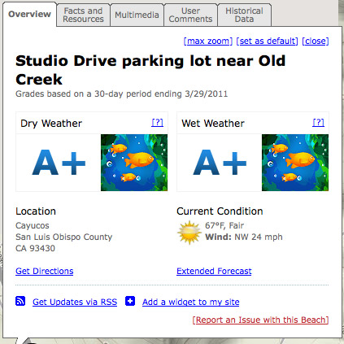
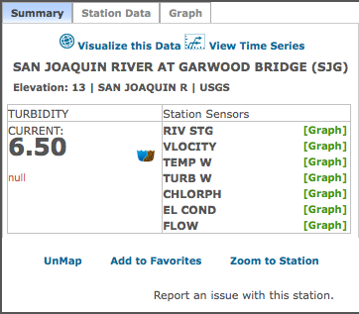
Scorecard

Slide 4


Monitoring Framework Widget
The goal of the assessment activities that might stem from the framework would be to address “Grand Challenges” for monitoring/assessments in the Bay-Delta. Three of the Grand Challenges are:
To understand how the ecosystem is changing in response to changes in infrastructure and water management designed to improve water supply reliability;
To understand how the ecosystem is changing in response to ecosystem restoration activities;
To understand how the ecosystem is changing in response to variability and unidirectional changes in natural processes (driven by climate change or ocean processes, for example).
http://science.calwater.ca.gov/publications/sci_news_1208_sam.html

Slide 5
Twitter.com/aquafornia
Layout feed

Slide 6

Learning from our friends down under:
The Ecosystem Health Monitoring Program (EHMP) is one of the most comprehensive marine, estuarine and freshwater monitoring programs in Australia. It delivers a regional assessment of the ambient ecosystem health (or pulse) for each of South East Queensland's (SEQ) 19 major catchments, 18 river estuaries, and Moreton Bay, highlighting where the health of our waterways is getting better or worse.
http://www.healthywaterways.org/ehmphome.aspx

Slide 7


Access Real Time and Archived Environmental Data

Slide 8
Question Highlight
Add Estuary Pic
What is status of SF Estuary Health?

