Slide 1
Excursion Tracker

Slide 2
Excursion Algorithm (1 of 4)
Get input velocity at station in order from downstream to upstream
Generate a time series of normalized velocity values for each station where each semidiurnal low and high are 0 and 1, respectively
Generate a time series of Signal To Noise Ratio (SNR) for each station
Generate a time series of the lowest SNR for each tidal cycle (snrLo)
Define an object LoToLoCycle that stores the start and end of each tidal cycle
Create a list of LoToLoCycle for each station

Slide 3
Excursion Algorithm (2 of 4)
Loop through the time span of data
Find each tidal cycle low at the most downstream station
For each upstream station
If the SnrLo is good
Find the nearest low velocity (normalized value of 0)
Else
Use the same low time as the downstream station
Find the peak of each cycle

Slide 4
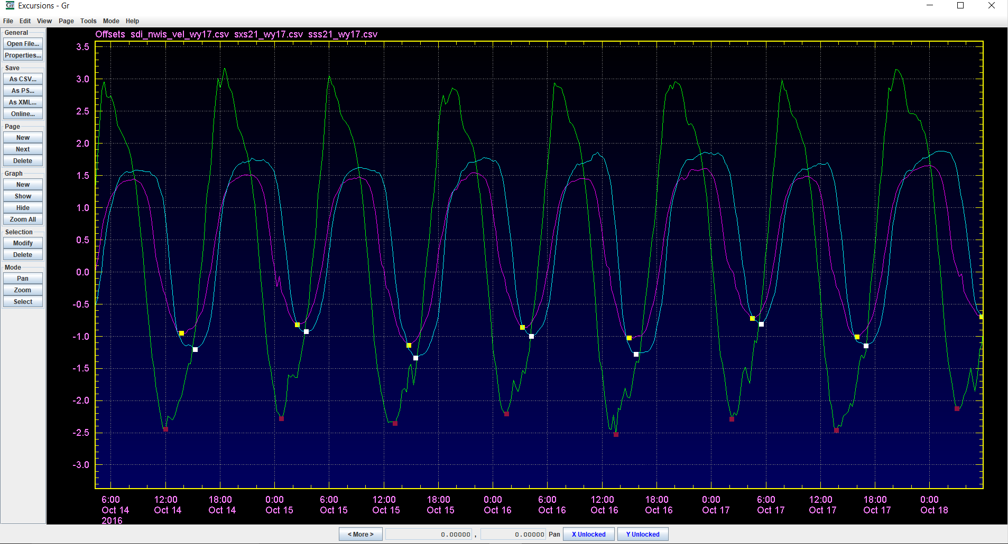
LoToLoCycle

Slide 5
Excursion Algorithm (3 of 4)
Loop through the LoToLoCycle list for each station (in any order)
Identify ebbs from zero-to-zero velocity
(or from low-to-low, if no zero)
Calculate and store excursion track and total
Identify floods from zero-to-zero velocity
(or from peak-to-peak, if no zero)
Calculate and store excursion track and total
Link each ebb to the prev/next ebb and prev/next flood
Calculate the combined total excursion for each pairing of flood and following ebb (prevPairSum)

Slide 6
Excursion Algorithm (4 of 4)
Loop through all ebbs at all stations
If prevPairSum is greater than that of either the previous or next ebb
Select this ebb and the flood that follows it as the largest daily excursion

Slide 7
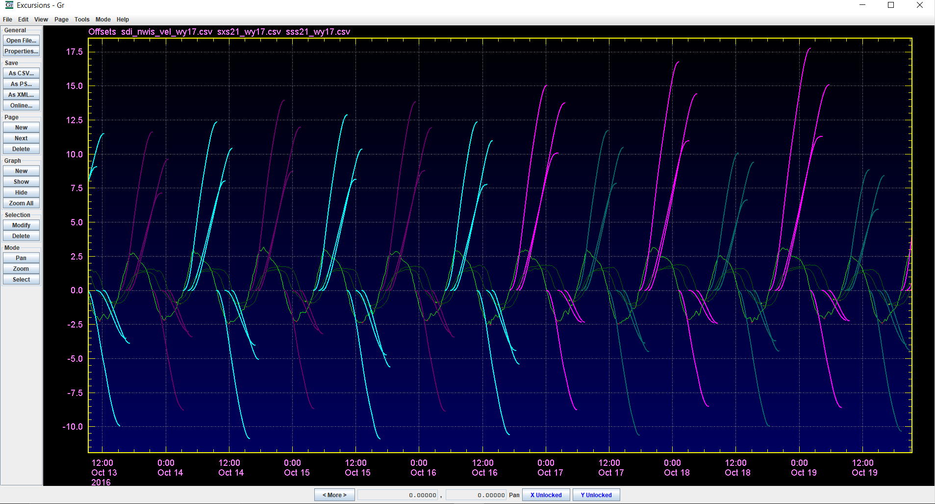
Whisker Plots

