Slide 1
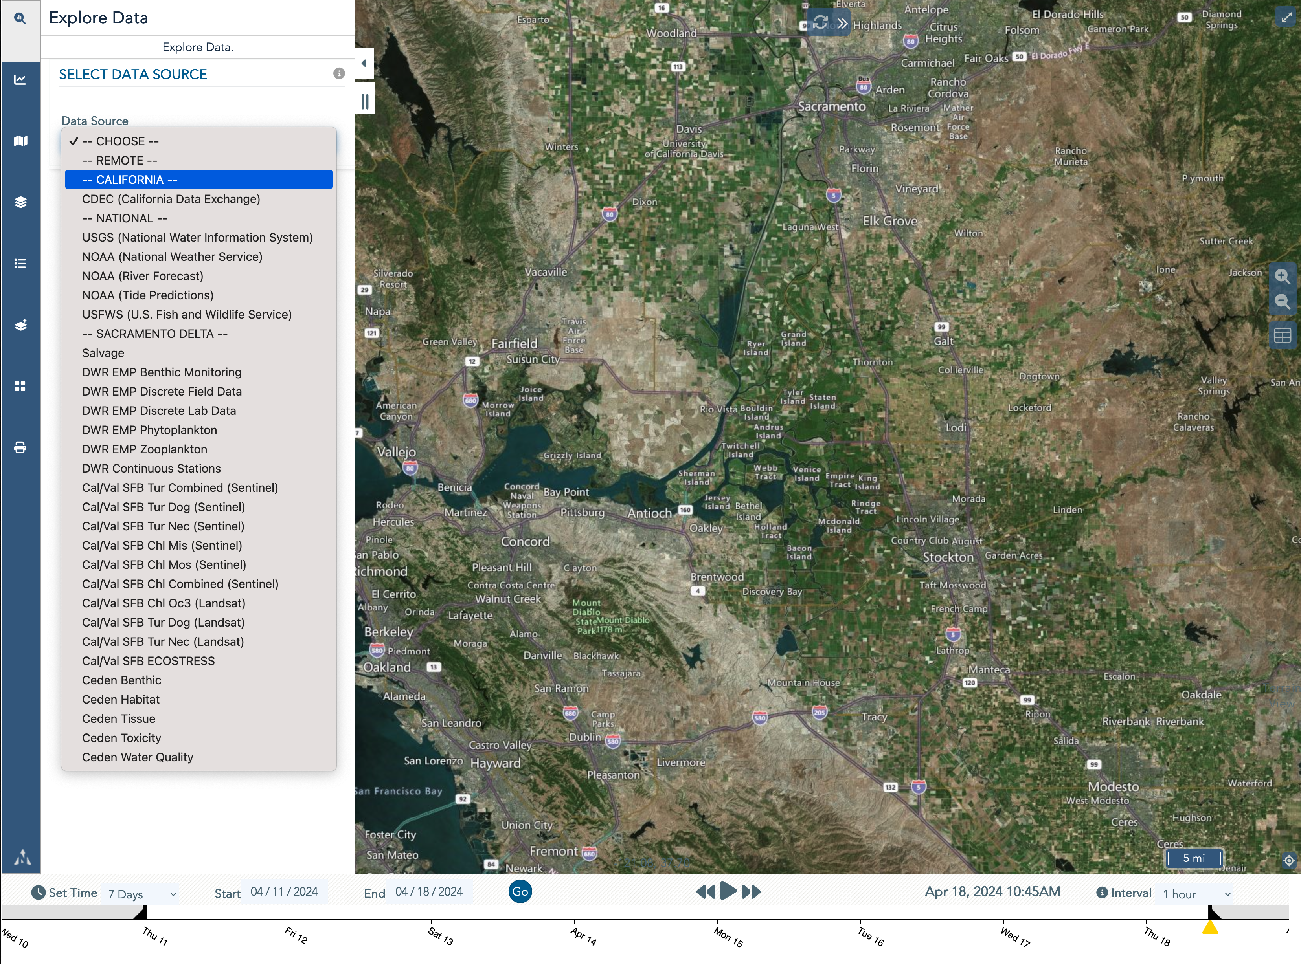

BayDeltaLive– Current Data Access & Download Methods
BDL Explore Data
BDL helps in answering questions to understand an event based scenarios at specific time extents by easy access to multiple database.

Slide 2
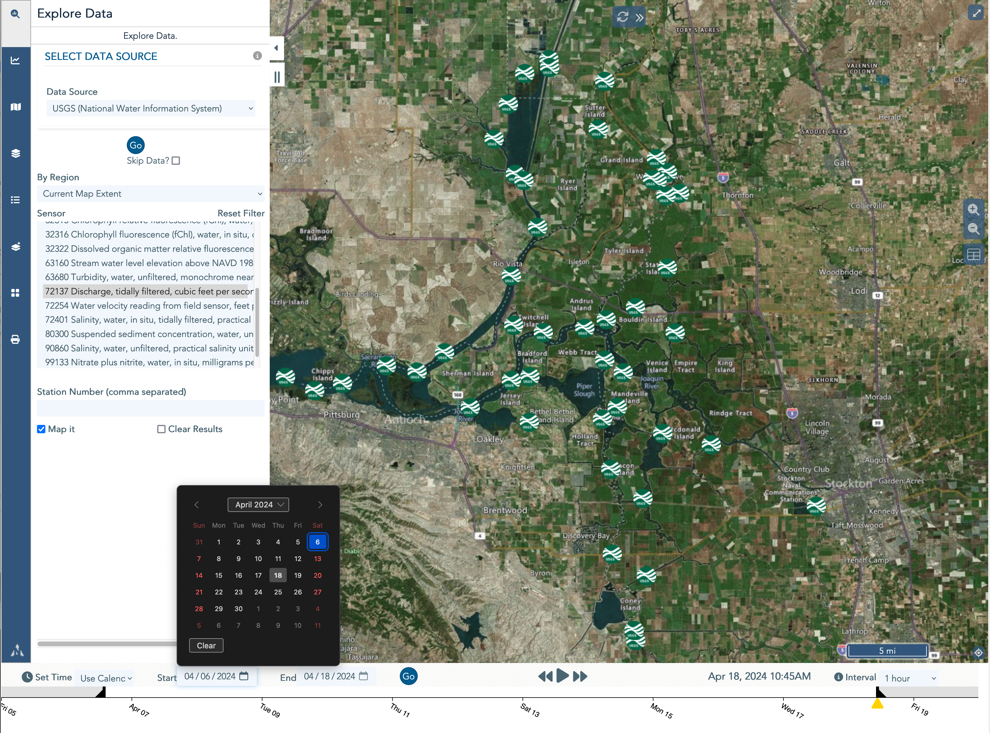
BayDeltaLive– Current Data Access & Download Methods
BDL Explore Data
BDL helps in answering questions to understand an event based scenarios at specific time extents by easy access to multiple database.
Map Stations
Select Timeframe
Select Sensor Types

Slide 3
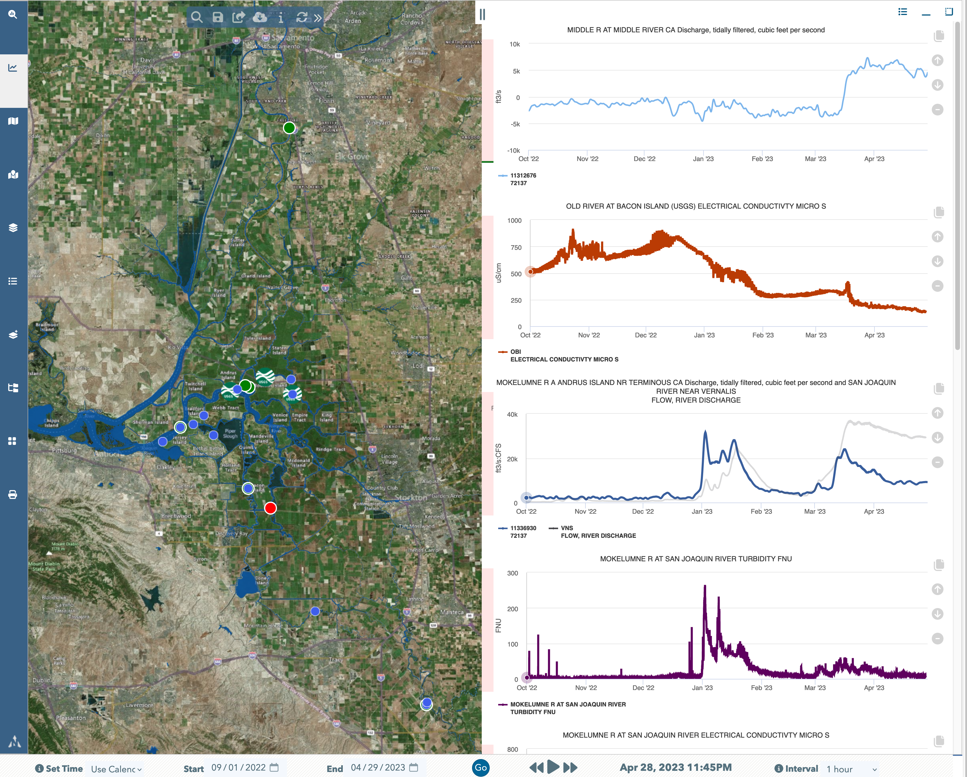
BayDeltaLive– Current Data Access Methods
BDL Explore Data
Choose from a Variety of Databases Using Data API’s
Map & Access Data from NWIS, CDEC, NOAA, EDSMP/DJFMP, EMP, and add GIS Data Services
Use Data Visualization Tools to Draw Time Series Data and Organize to Display Environmental Conditions
Save, Share, Download & Build Data Dashboards
WDL Database will add needed QA/QC’d Data
Tidally Filtered Flow Data @MOK (NWIS)
EC @ Old River (CDEC)
Tidally Filtered Data @MOK (NWIS) & Vernalis (CDEC)
Timeframe: 9/01/22 – 4/29/23
Turbidity @ MOK (CDEC)

Slide 4
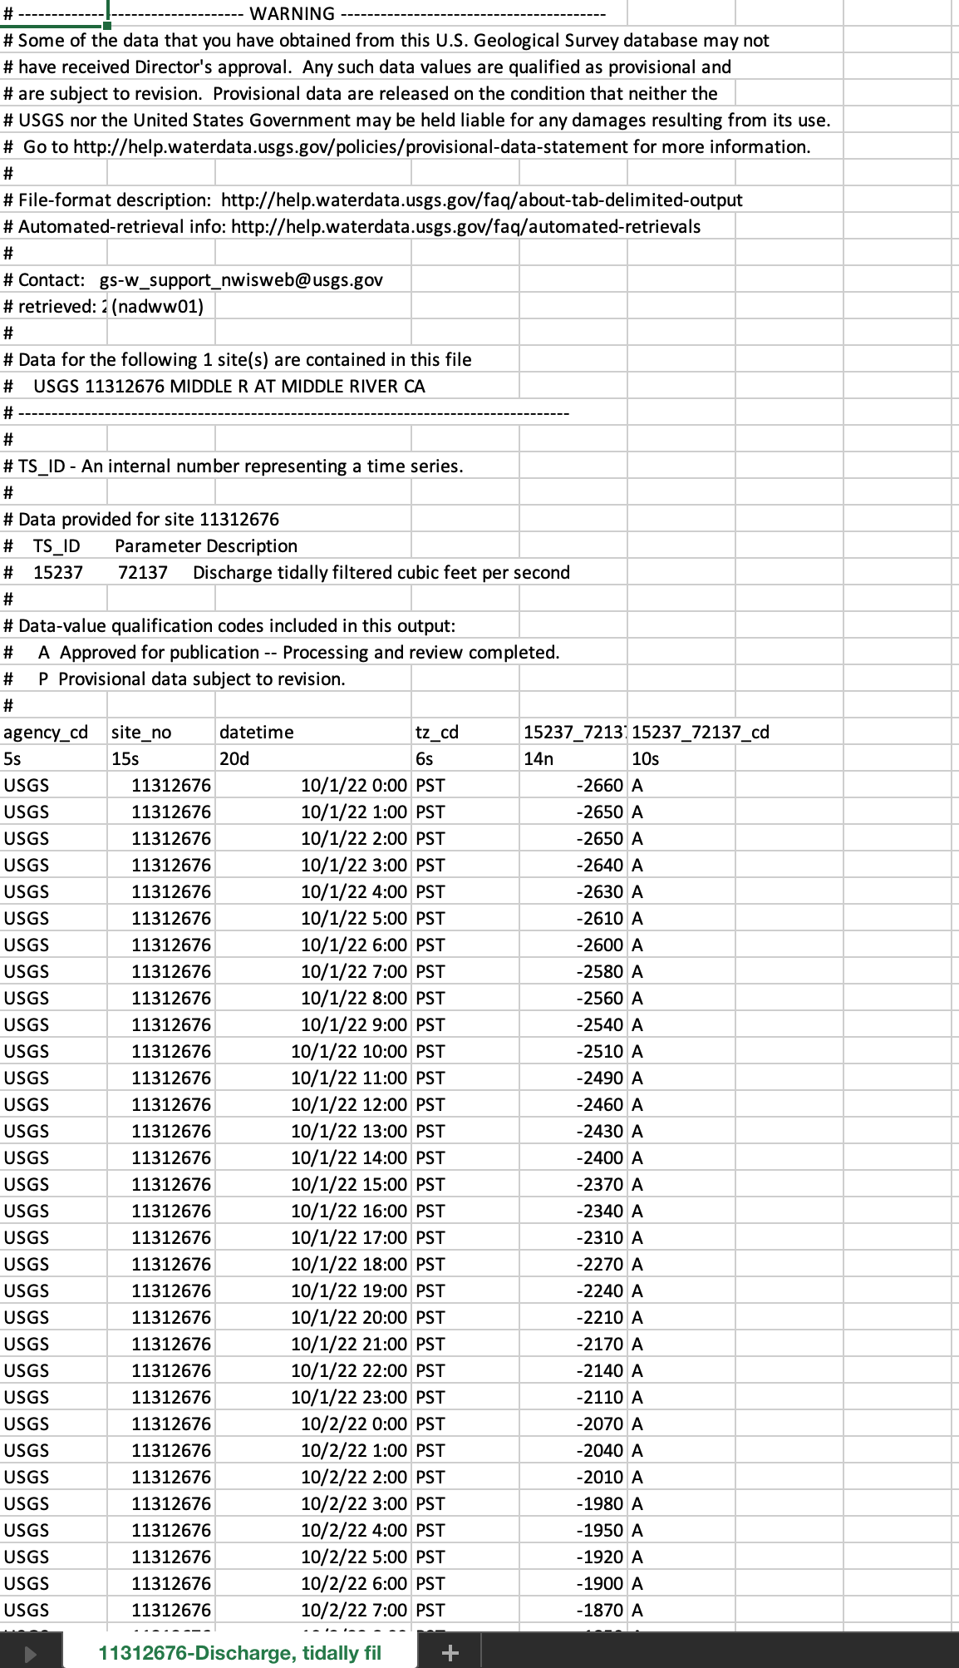
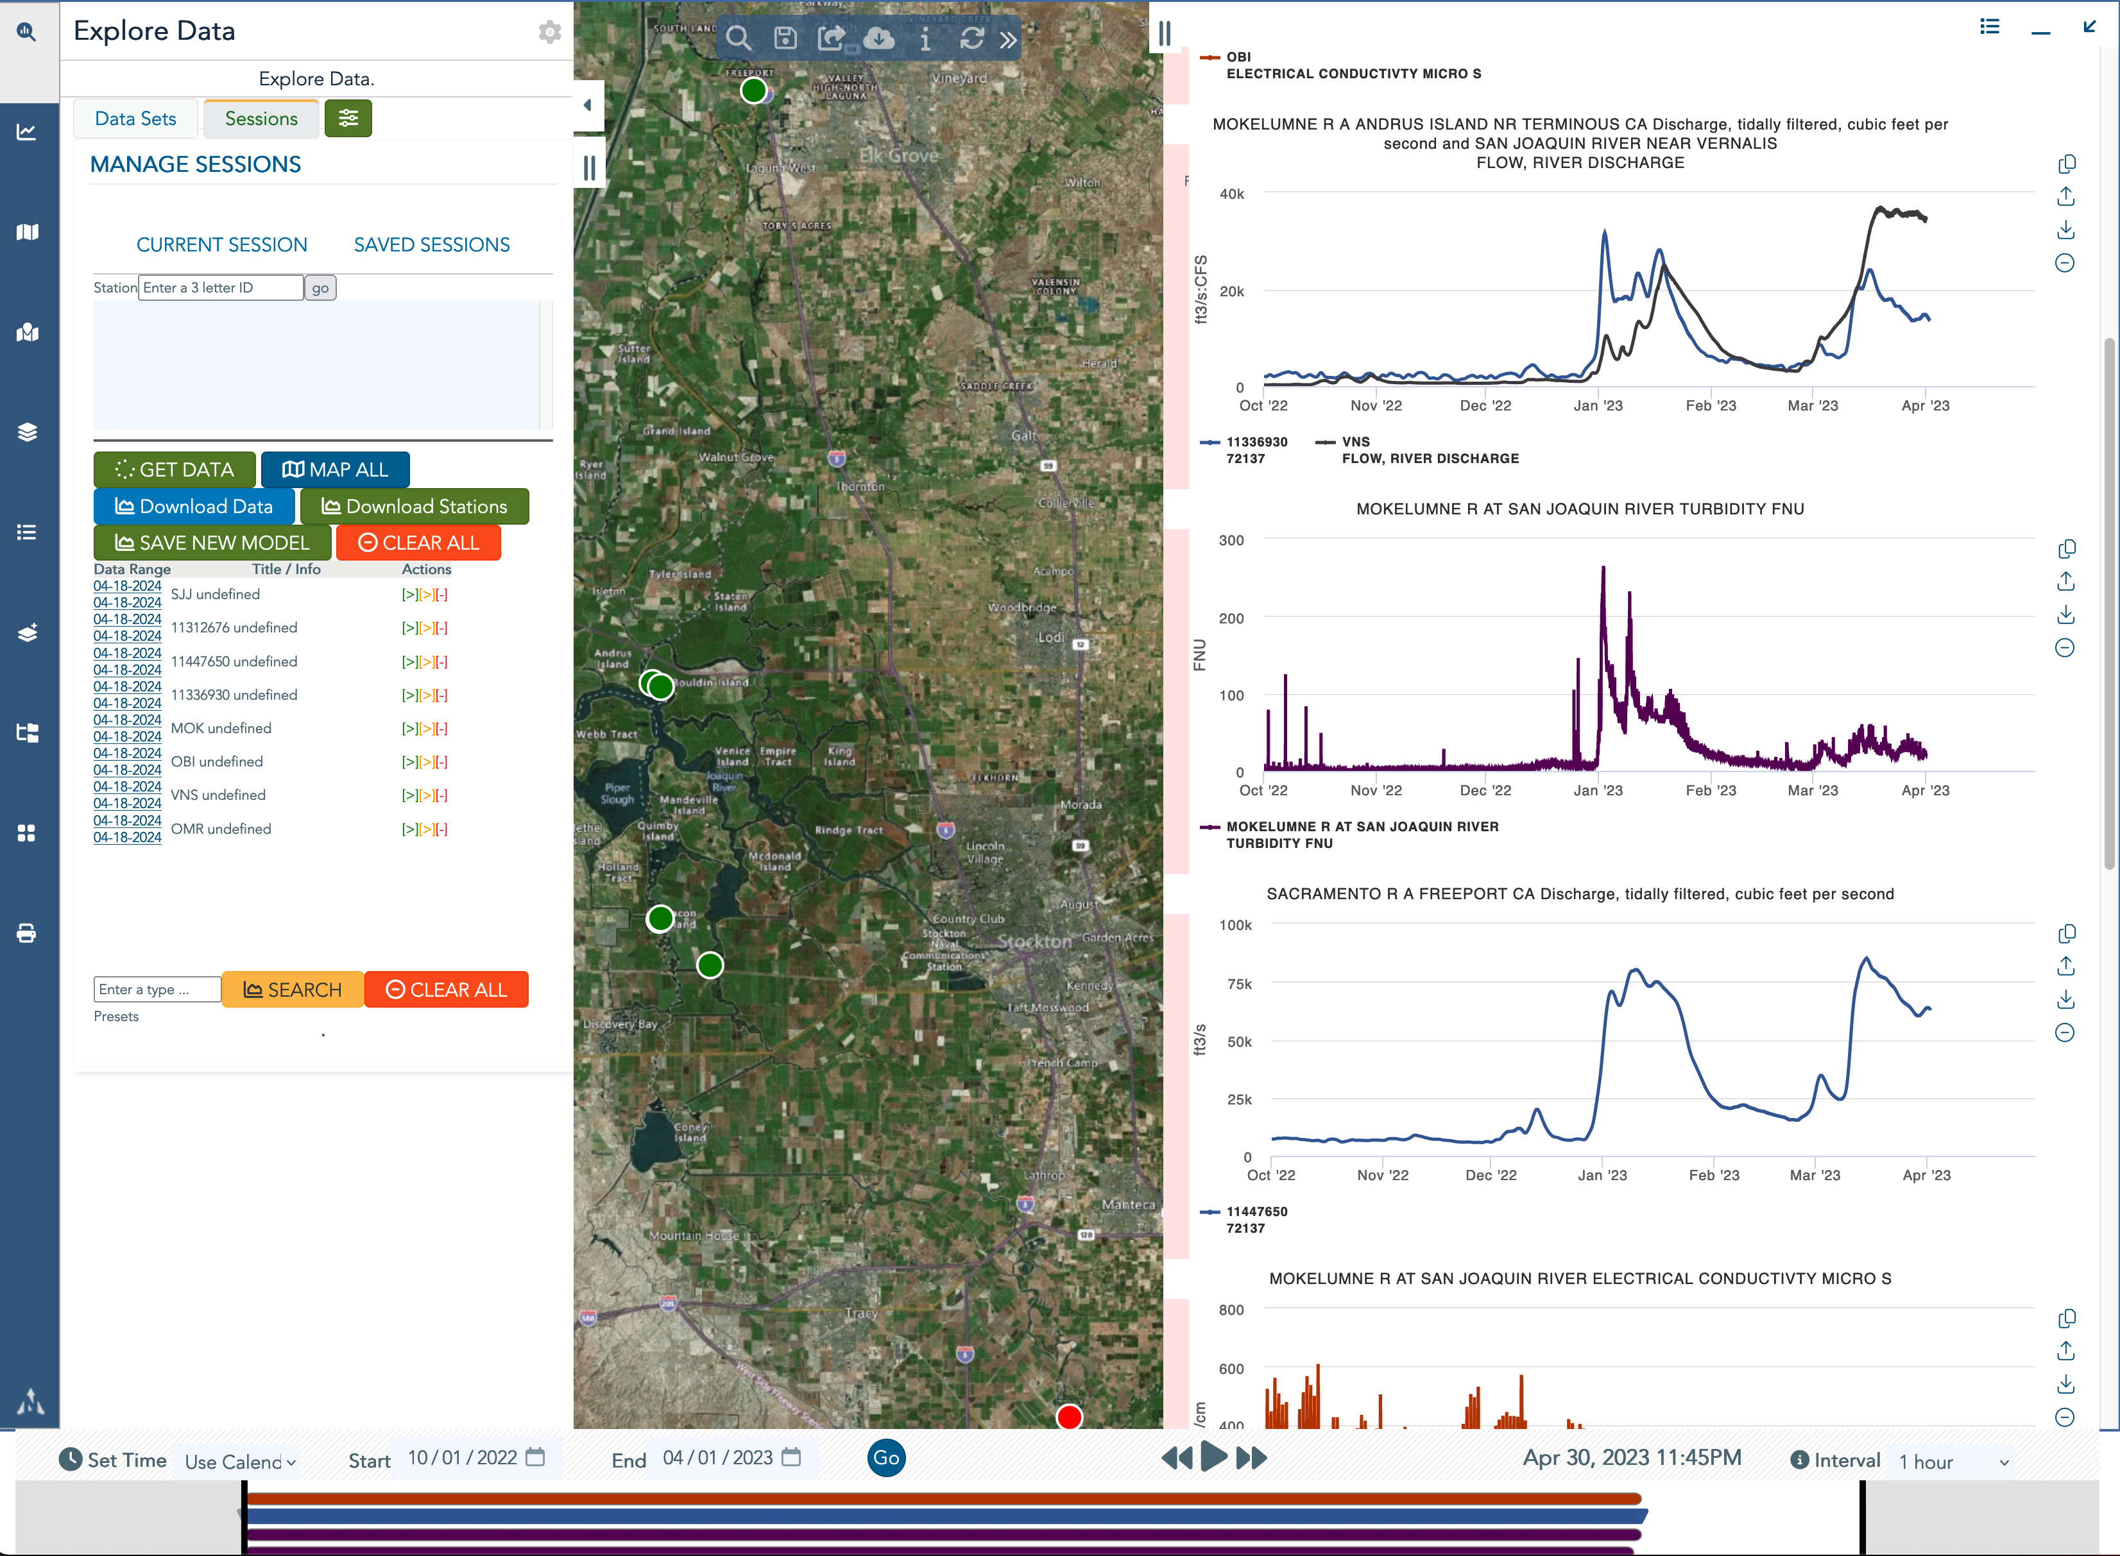
BayDeltaLive– Current Data Access Methods
BDL Explore Data
Choose from a Variety of Databases Using Data API’s
Map & Access Data from NWIS, CDEC, NOAA, EDSMP/DJFMP, EMP, and add GIS Data Services
Use Data Visualization Tools to Draw Time Series Data and Organize to Display Environmental Conditions
Save, Share, Download & Build Data Dashboards
WDL Database will add needed QA/QC’d Data
Tidally Filtered Flow Data @MOK (NWIS)
EC @ Old River (CDEC)
Tidally Filtered Data @MOK (NWIS) & Vernalis (CDEC)
Timeframe: 9/01/22 – 4/29/23
Turbidity @ MOK (CDEC)

Slide 5
BayDeltaLive– Current Data Access Methods
BDL Explore Data
Choose from a Variety of Databases Using Data API’s
Map & Access Data from NWIS, CDEC, NOAA, EDSMP/DJFMP, EMP, and add GIS Data Services
Use Data Visualization Tools to Draw Time Series Data and Organize to Display Environmental Conditions
Save, Share, Download & Build Data Dashboards
WDL Database will add needed QA/QC’d Data
Tidally Filtered Flow Data @MOK (NWIS)
EC @ Old River (CDEC)
Tidally Filtered Data @MOK (NWIS) & Vernalis (CDEC)
Timeframe: 9/01/22 – 4/29/23
Turbidity @ MOK (CDEC)

Slide 6
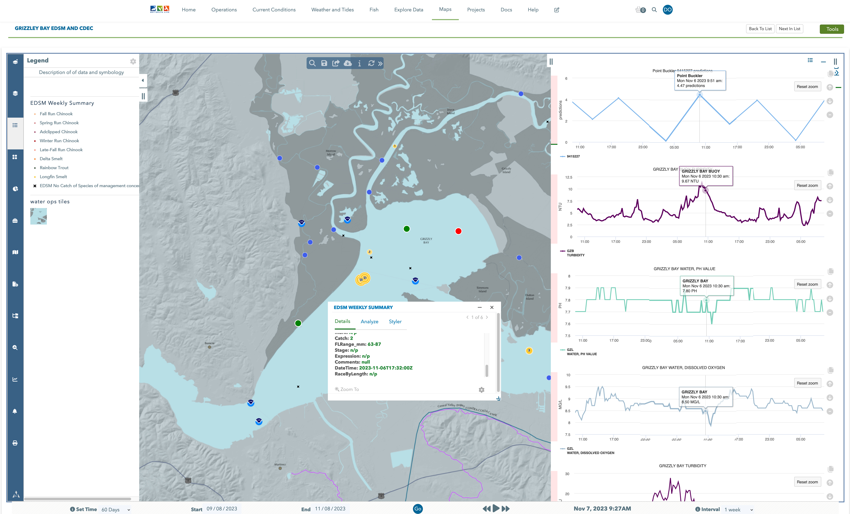
Fisheries Reporting and Delta Operations – EDSM/DJFMP
Compare CDEC/NWIS/NOAA Data to EDSM/DJFMP Data
Notes:
Load EDSM data and Load NOAA and NWIS data to view conditions at the time of catch

