Slide 1
Excursion Tracker

Slide 2
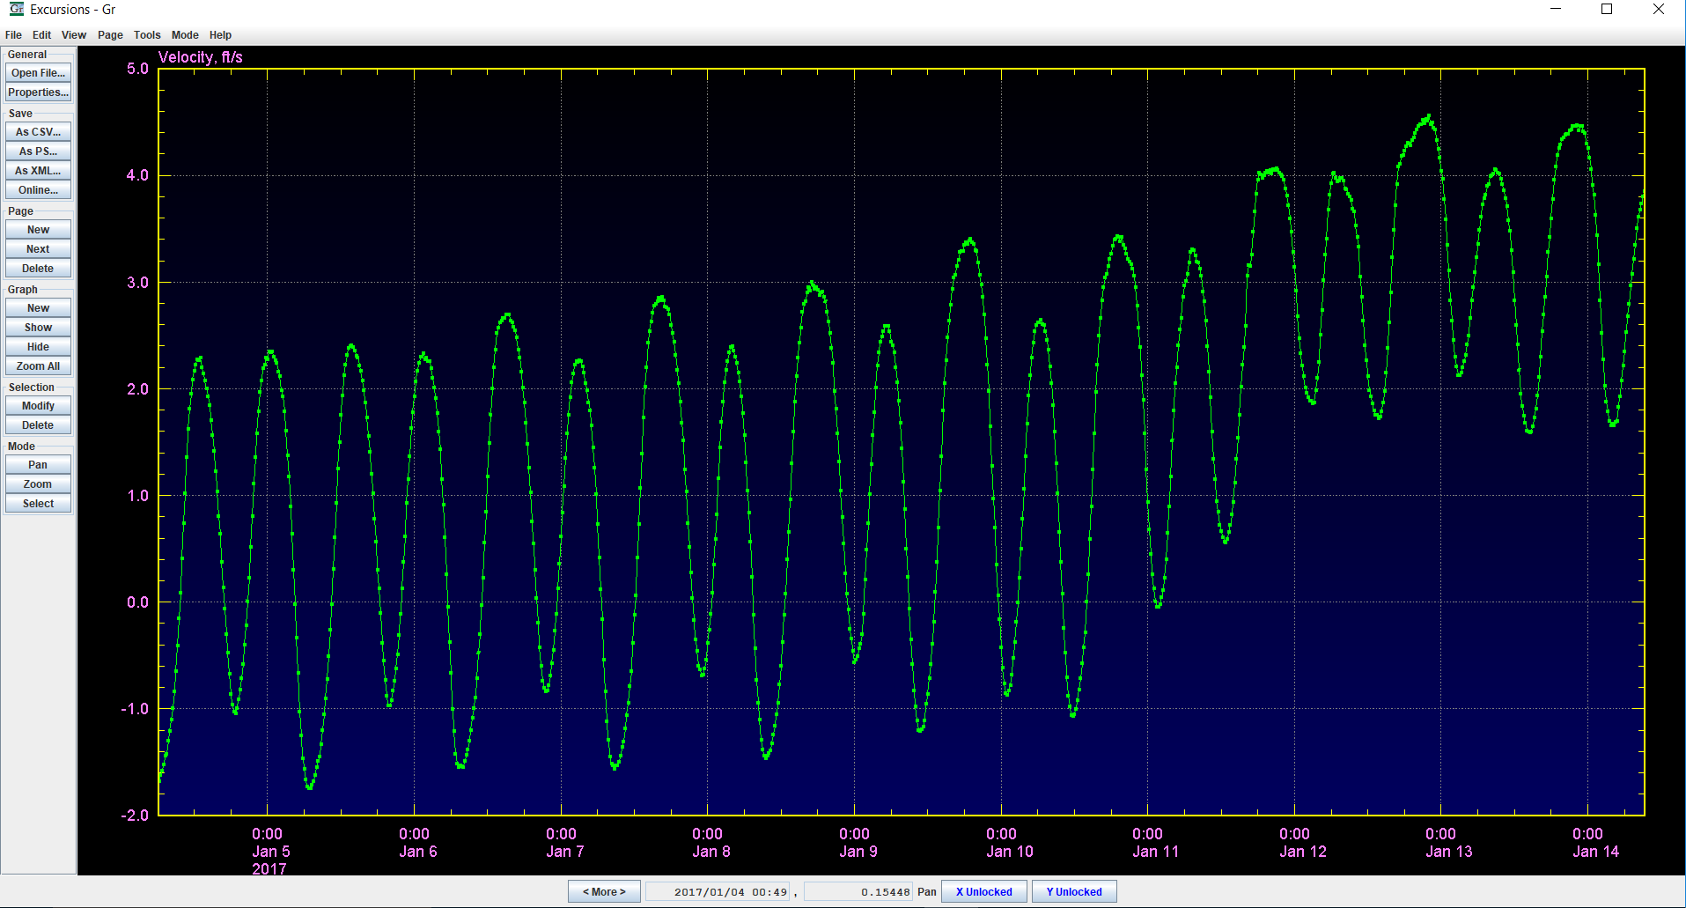
Velocity Input

Slide 3
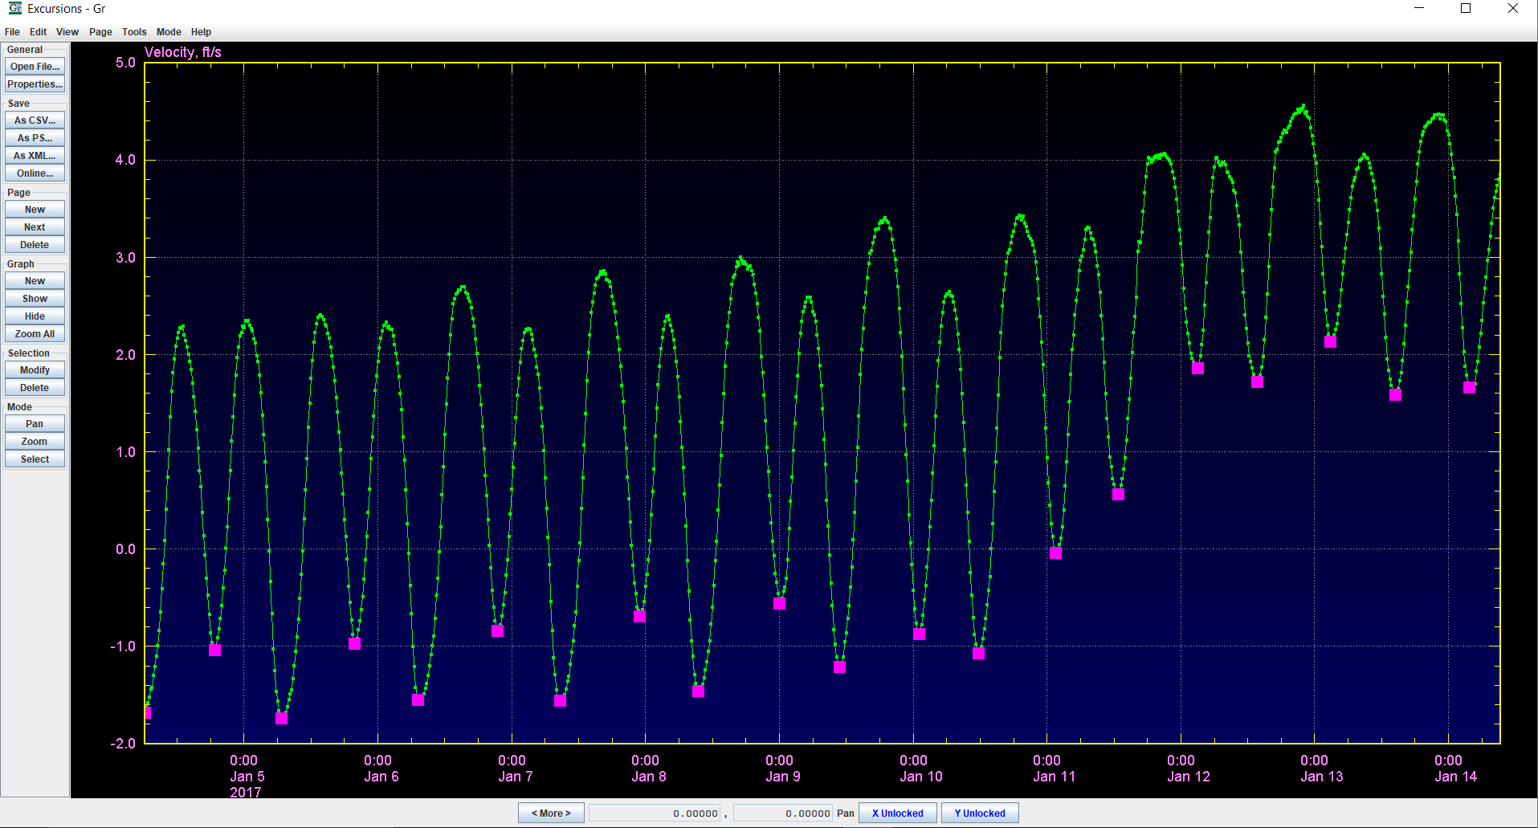
Semidiurnal Cycles (Low to Low)

Slide 4
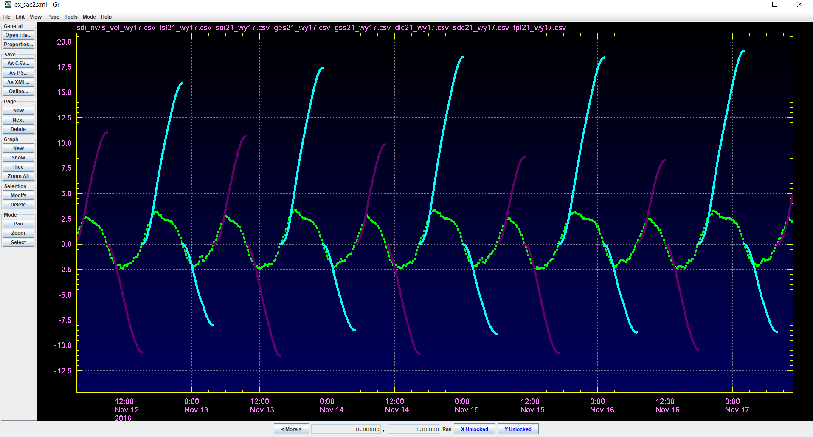
Whisker Plots

Slide 5
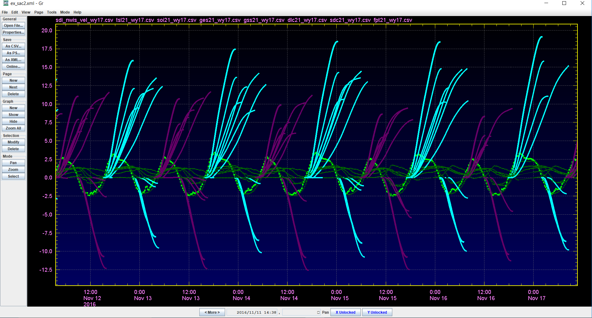
Multiple Stations

Slide 6
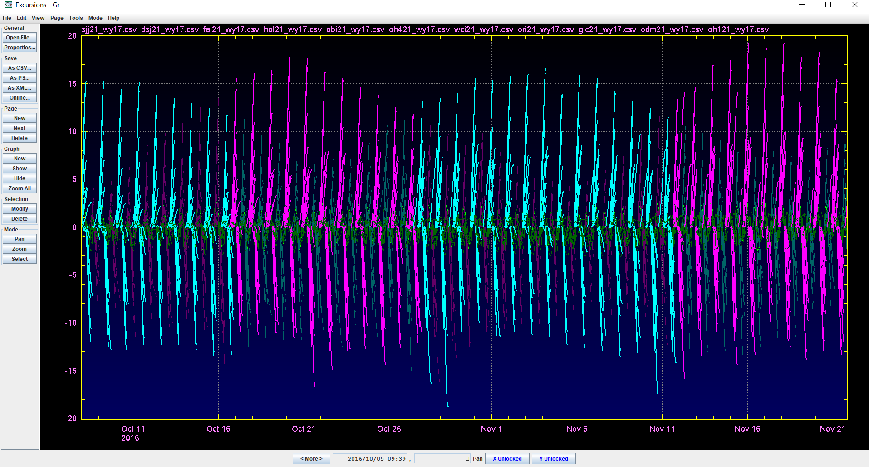
Identifying Largest Excursions

Slide 7
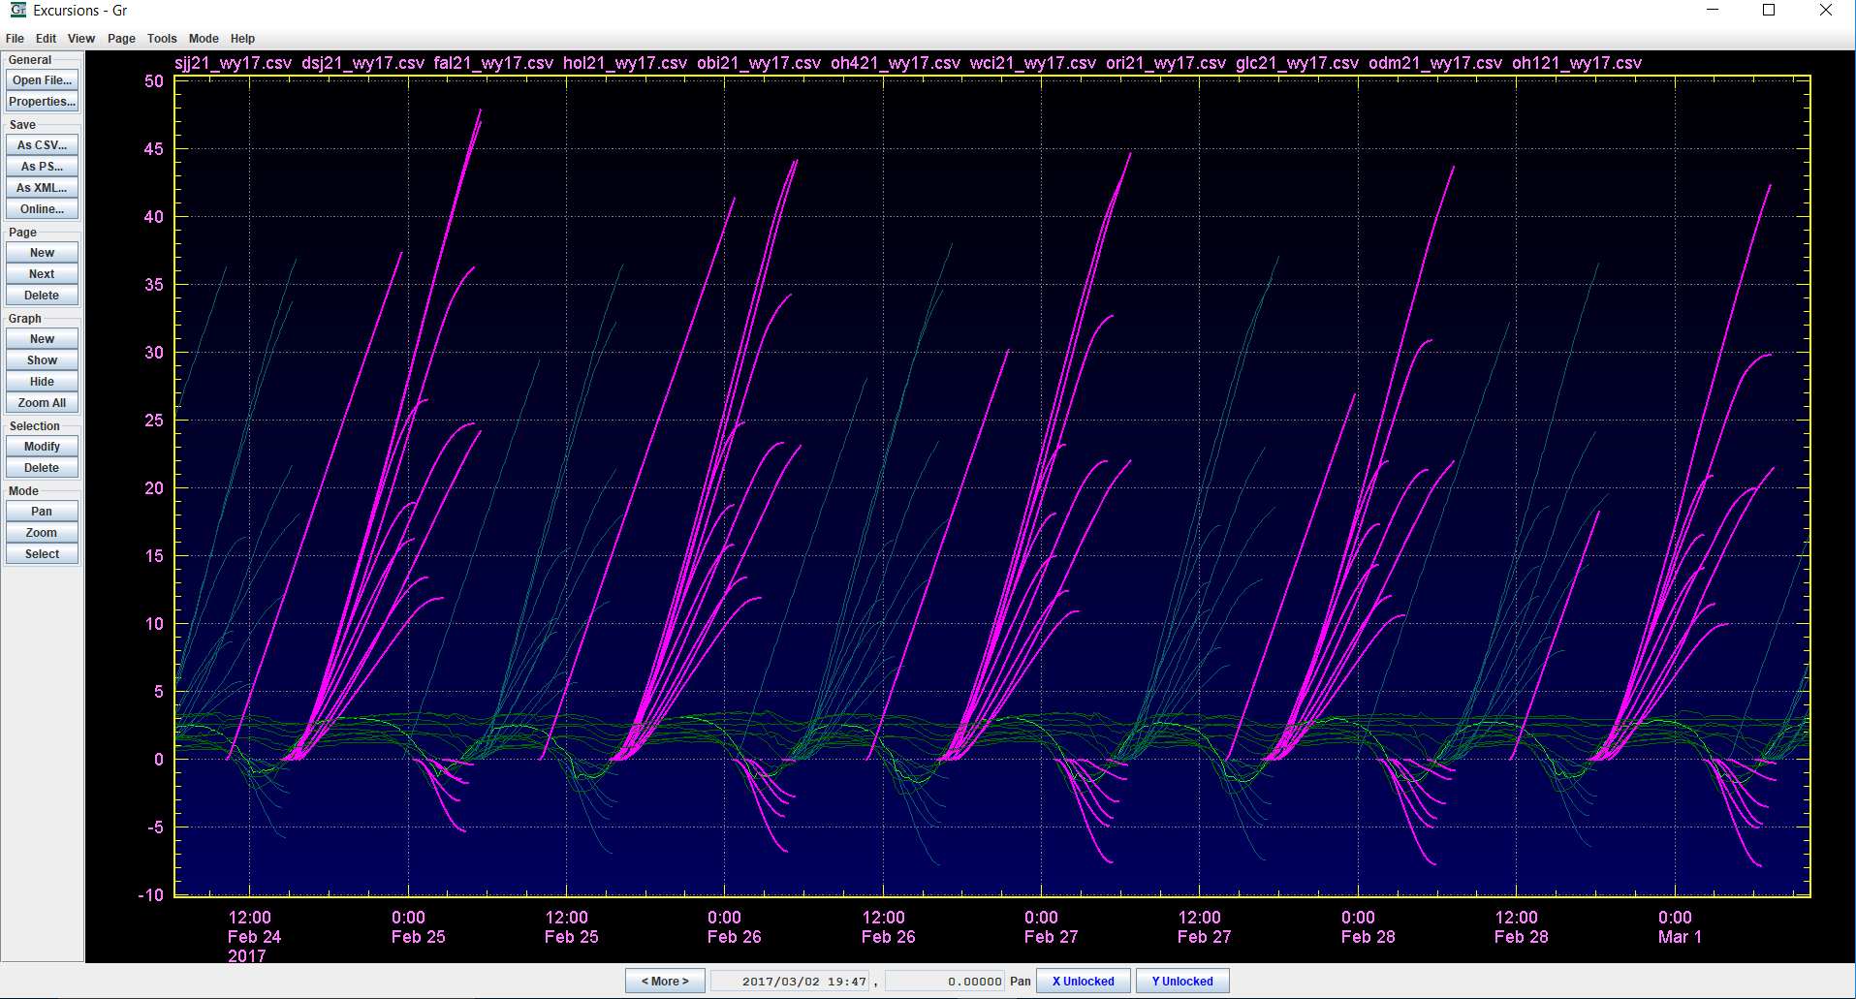
Identifying Mismatched Excursions

Slide 8
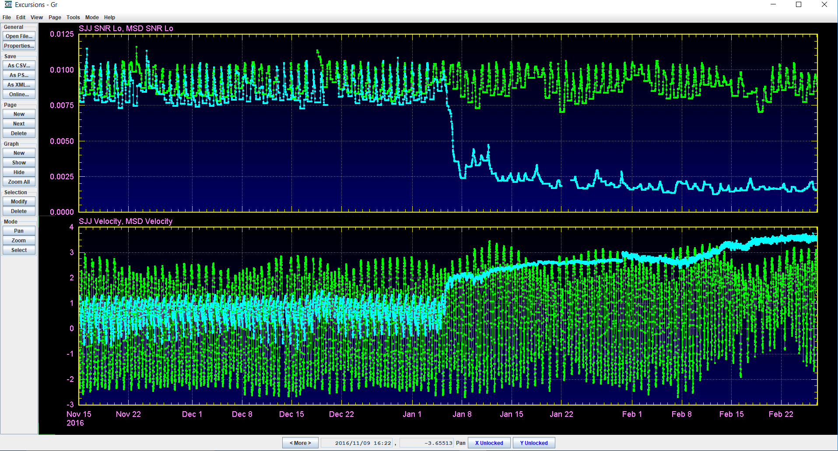
Signal to Noise Ratio

Slide 9
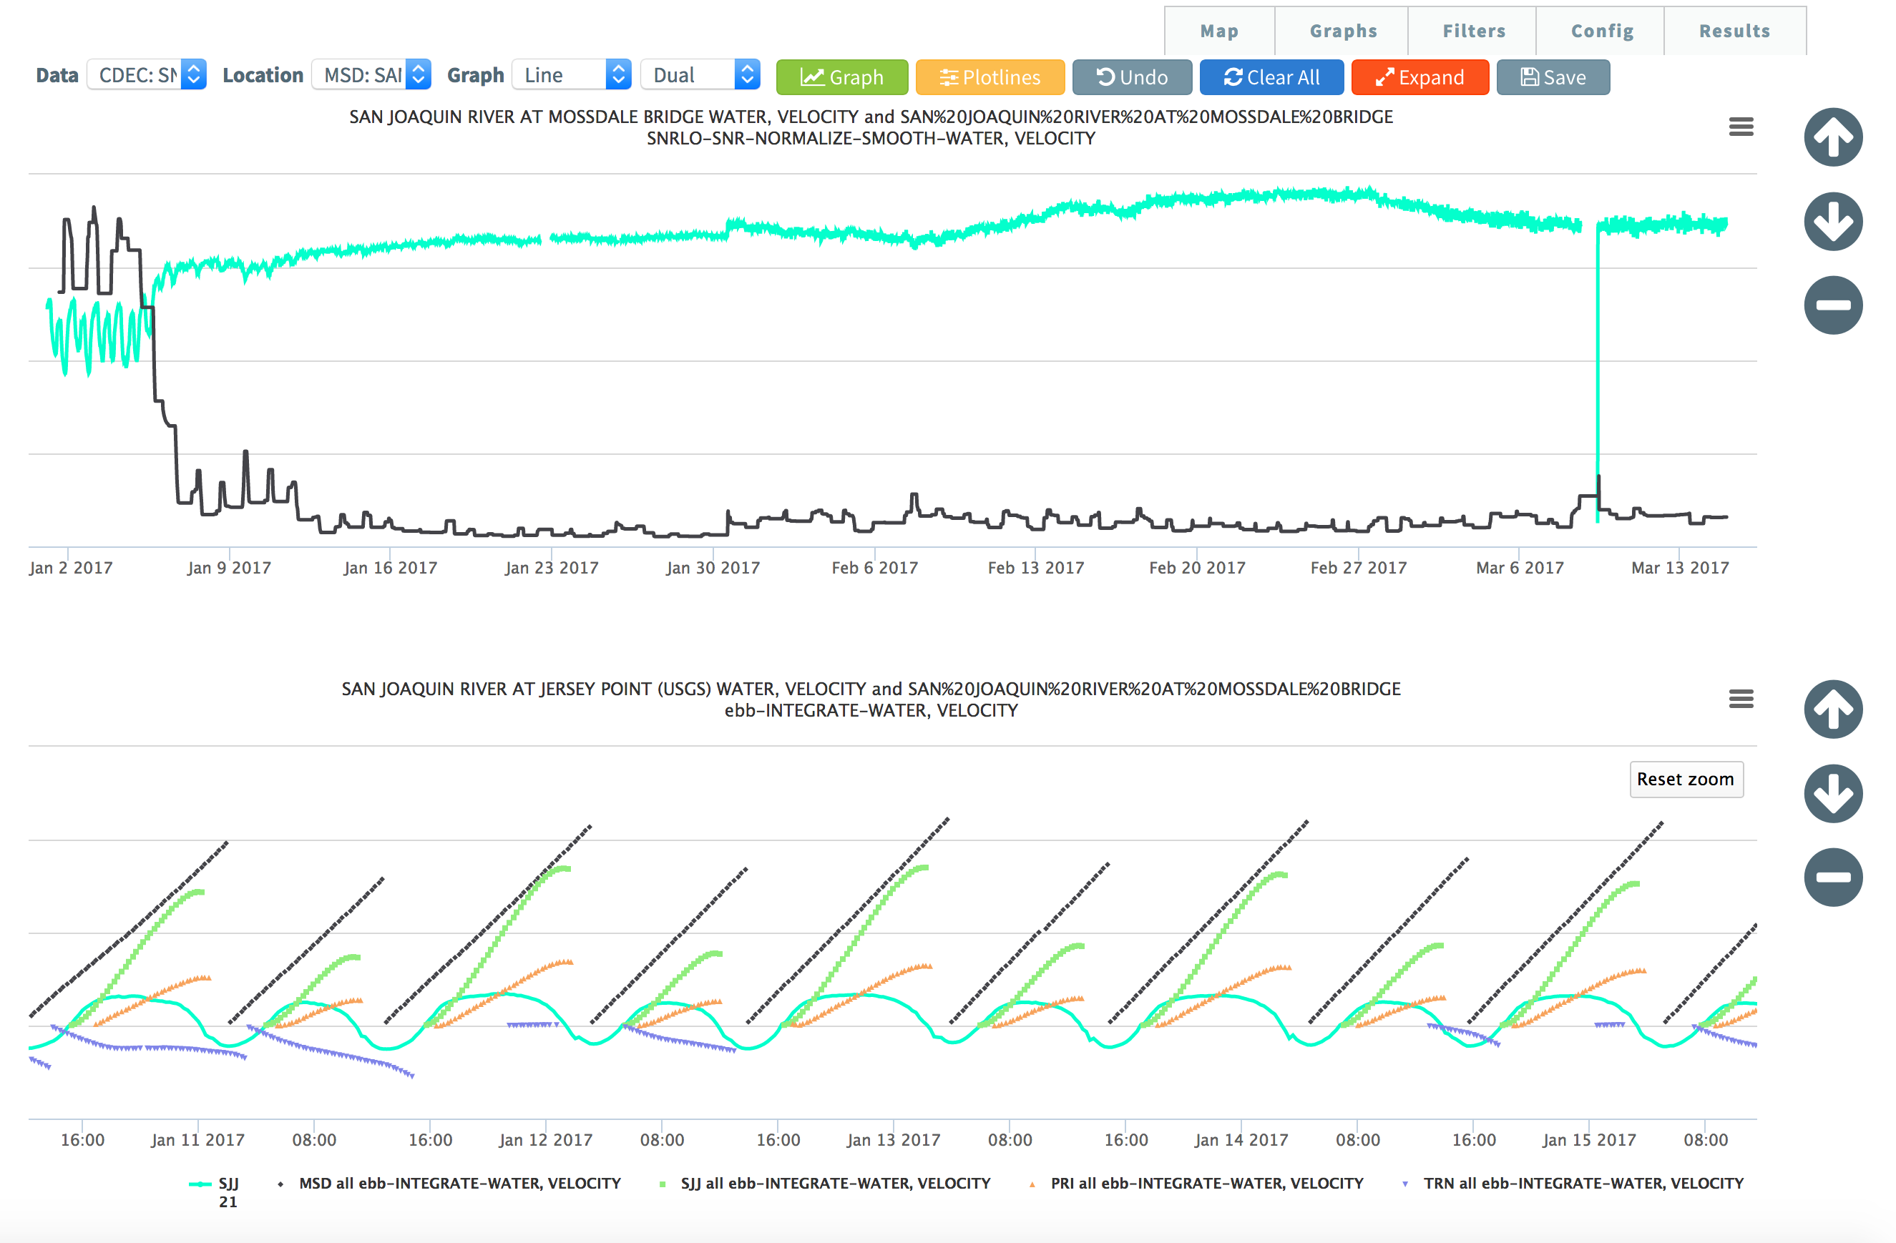

Slide 10
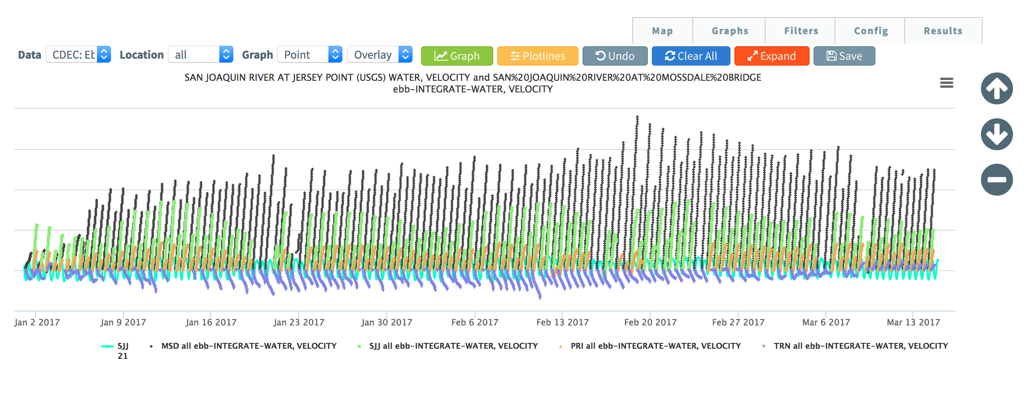
BayDeltaLive Excursions

