Slide 1

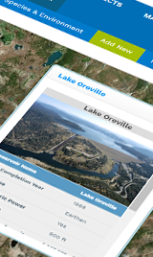
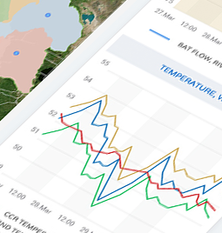
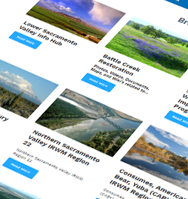
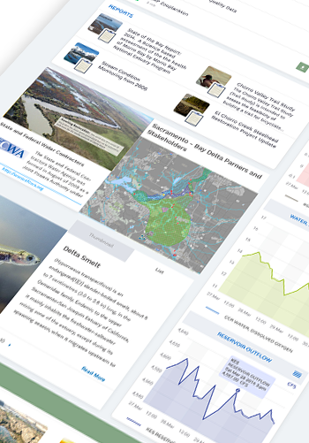
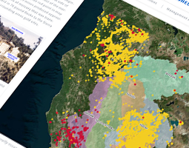
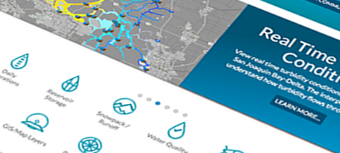

Connecting Scientific Research Projects and Data Through Software
An Opportunity for Collaboration and Data Synthesis
Karly Rodriguez
November 30, 2017

Slide 2

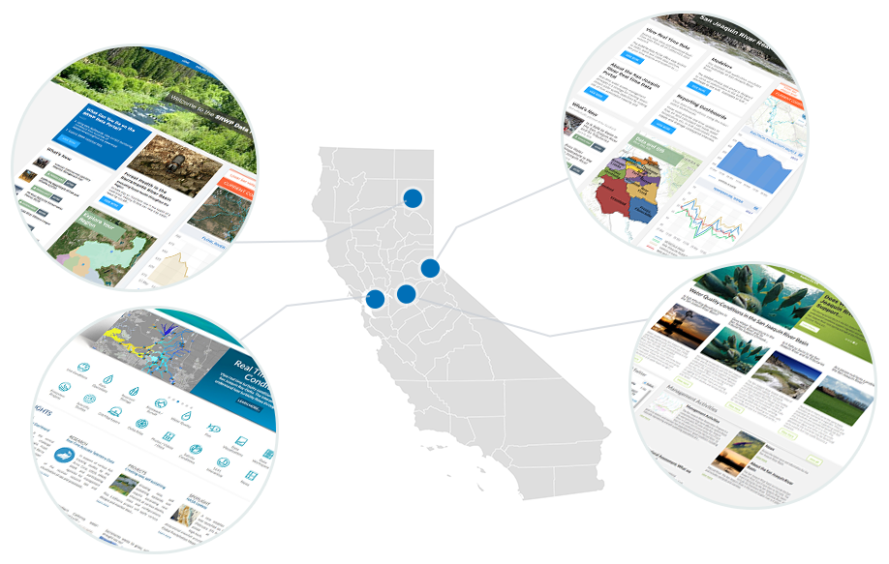
Building on Each Other’s Program
Regional and Statewide Programs
Regional efforts share in investment. Benefit from an open
platform.

Slide 3
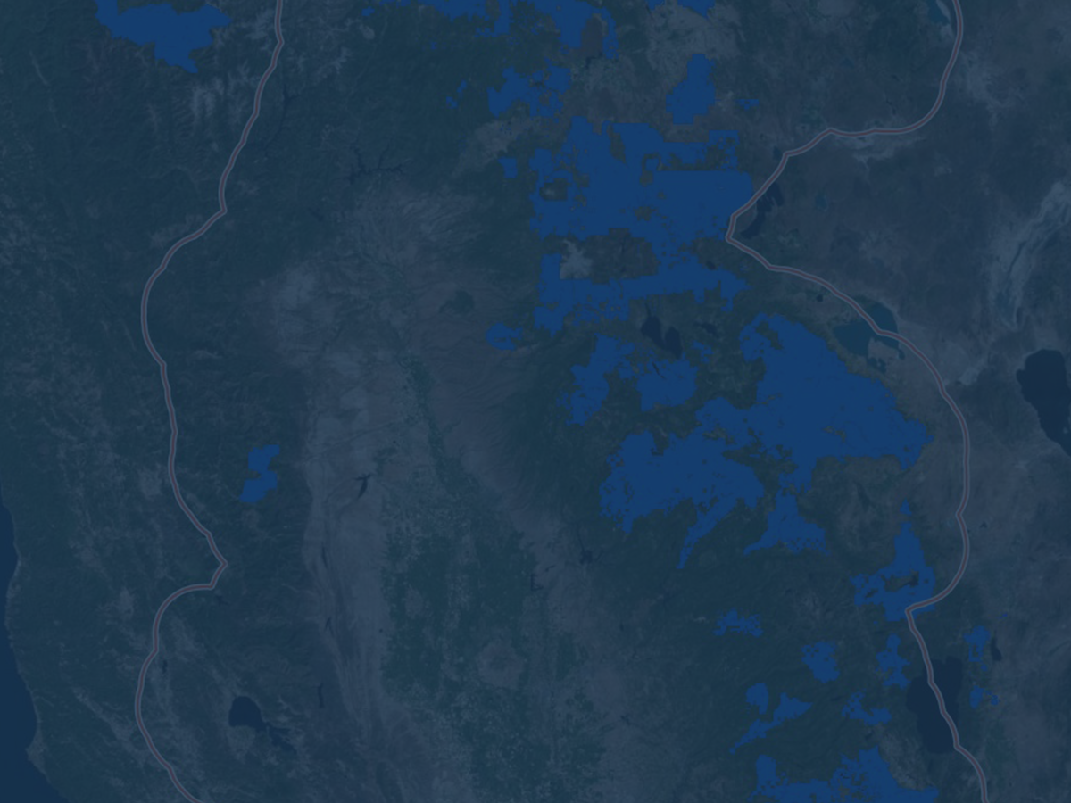








How is the Portal is Organized?
Projects
Explore Data
Catalogs
(Geo-Located
Everything)
Data
Dashboards
Interactive Map
Tools
Data Stories
Community

Slide 4
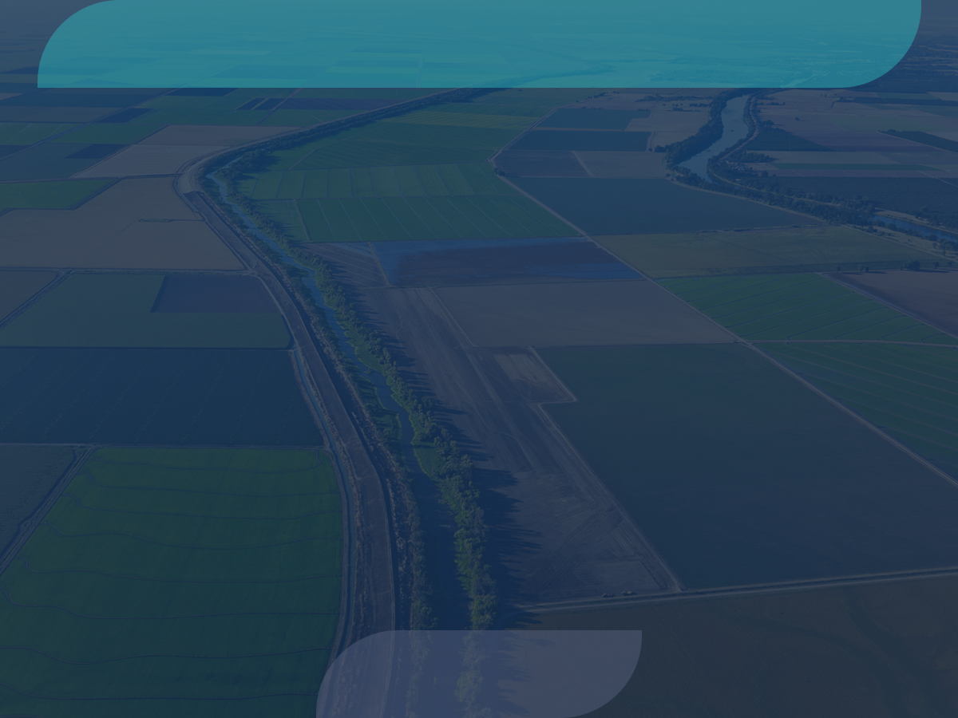











Major Data Providers
Data is aggregated from stakeholders throughout the region:
Hydrologic
Water Quality
Satellite
Meteorological
Terrestrial
Volunteer Sampling

Slide 5
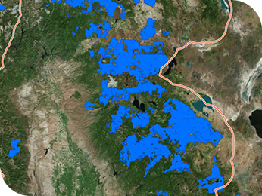
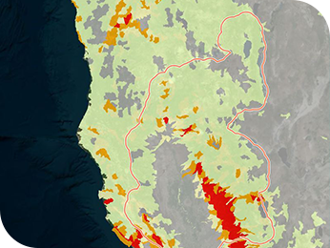
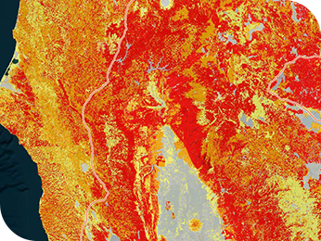
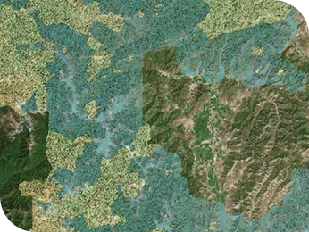
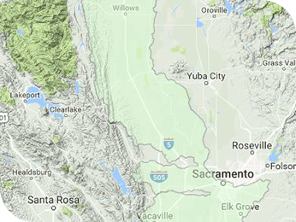
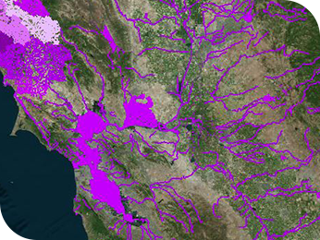
Interactive Map Tools
Tools to explore a region spatially
Layers can be combined

Slide 6
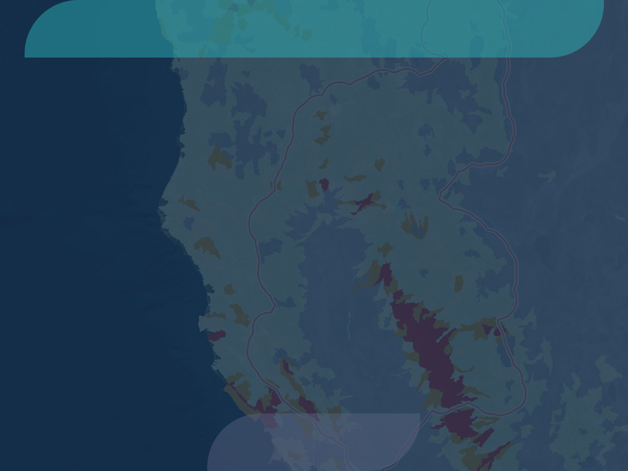
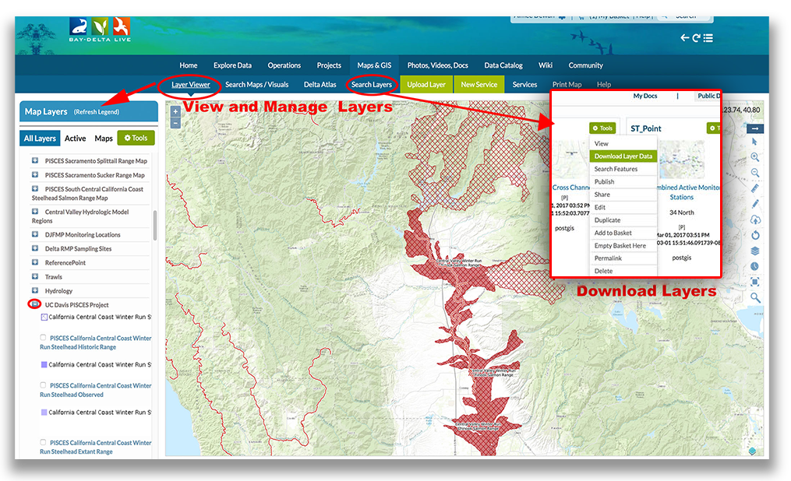
GIS Tools
Build and Share Interactive Maps

Slide 7
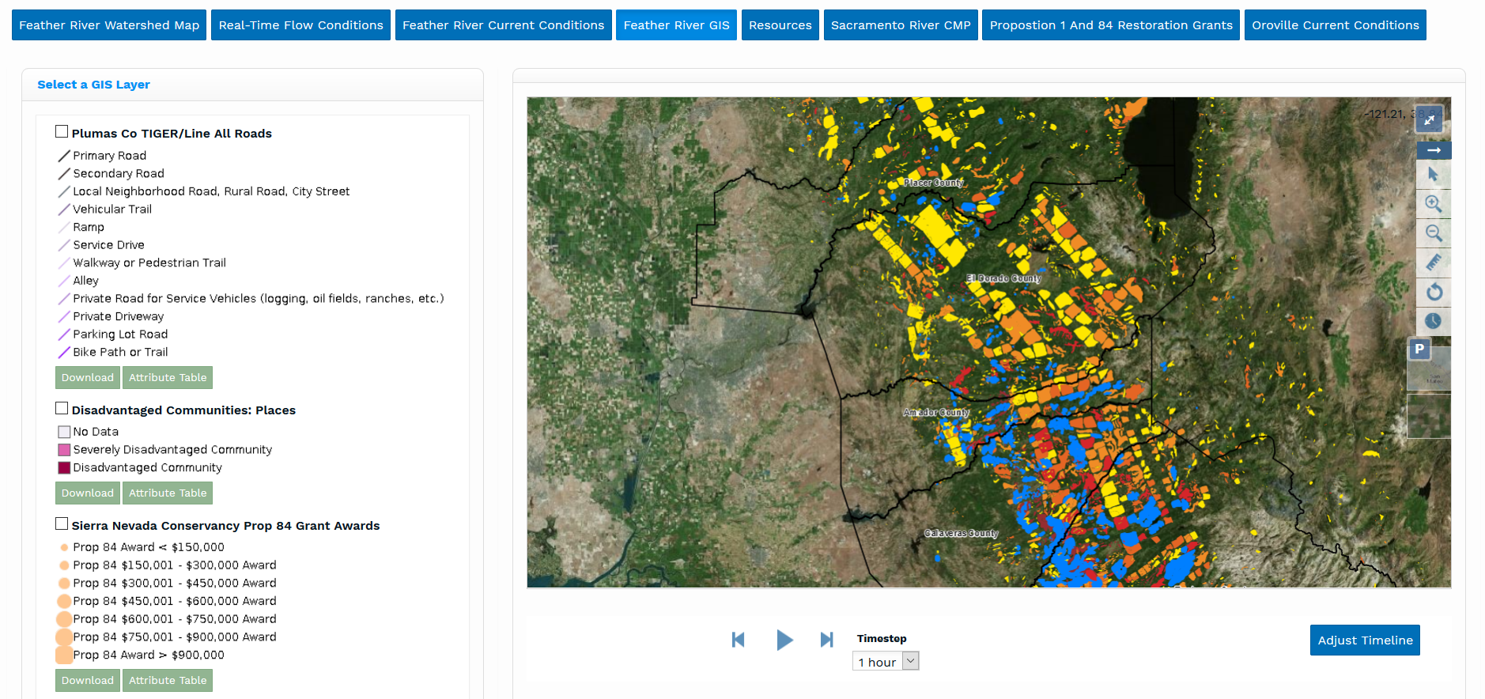
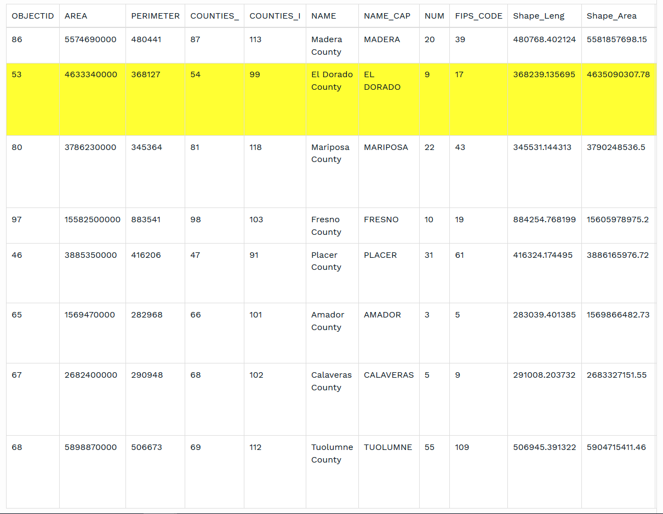
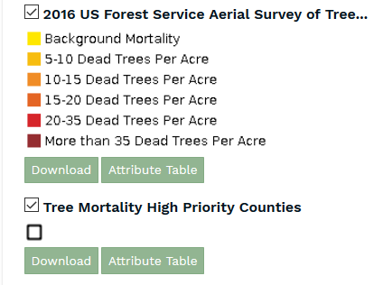
Forest Health Initiative

Slide 8
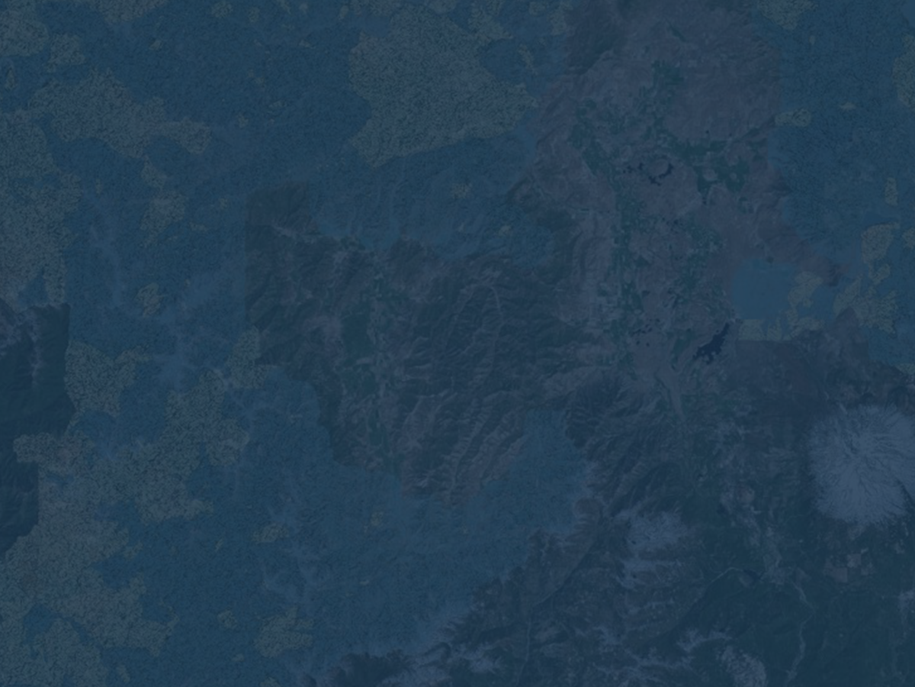
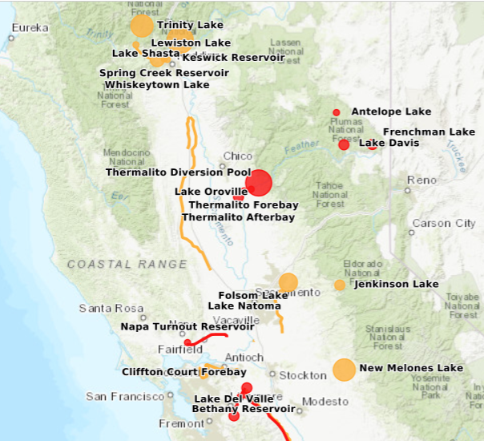
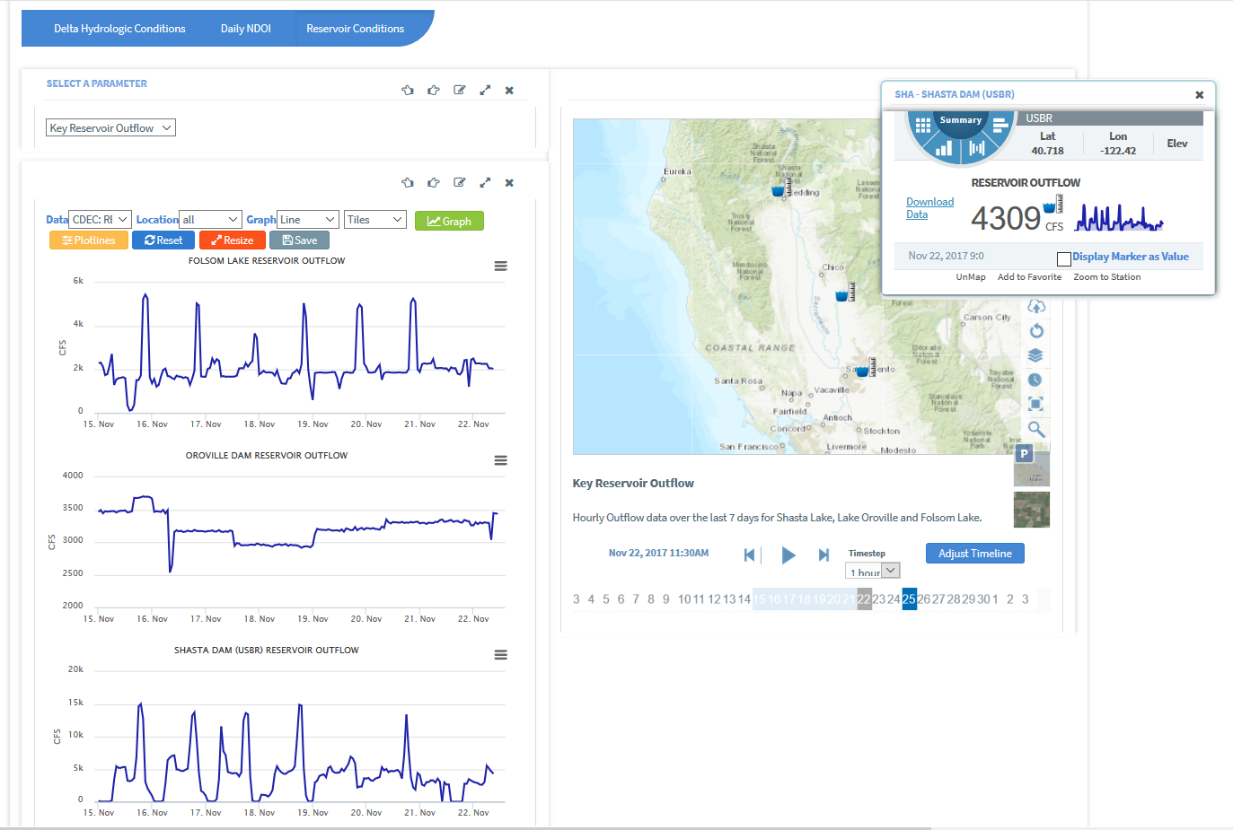
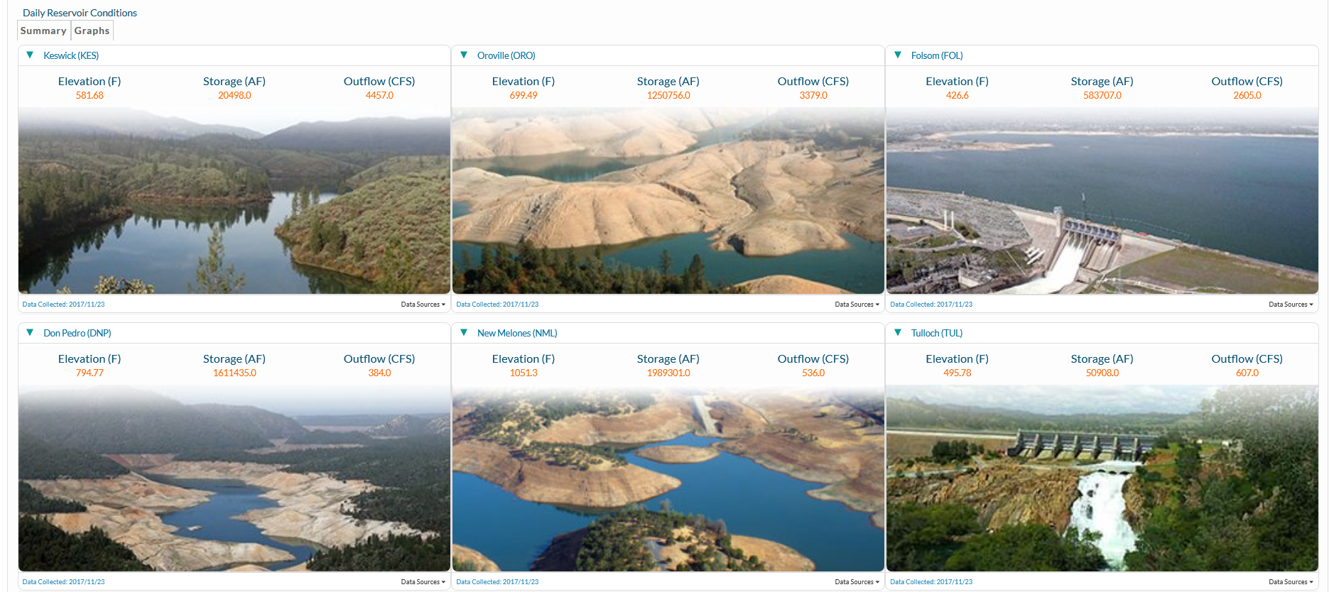
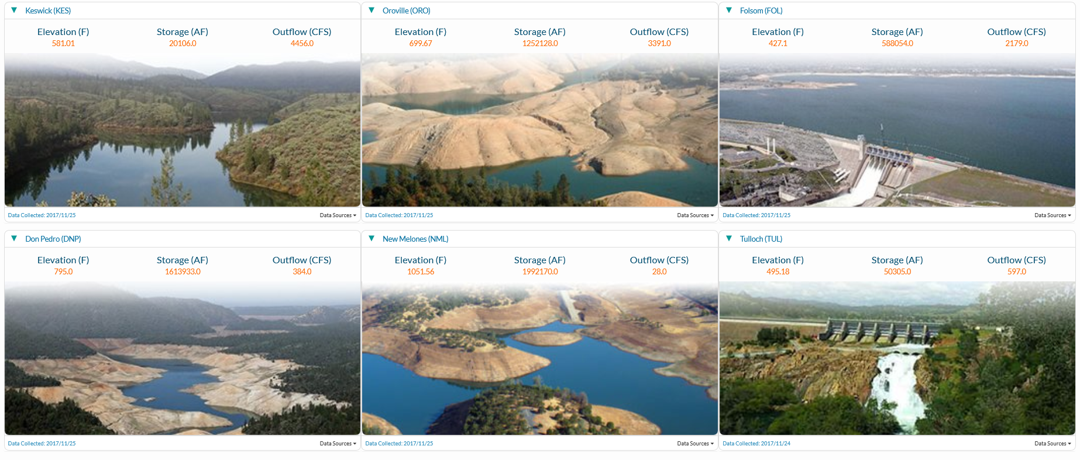
Reservoir Management
Notes:
In California large reservoirs are the starting point for water operations. The timing, temperature, and amount of water released has state-wide impacts.

Slide 9
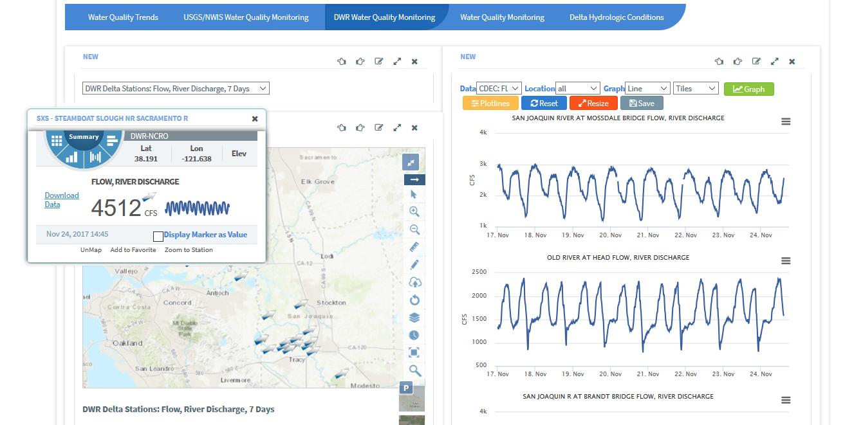
River Conditions

Slide 10
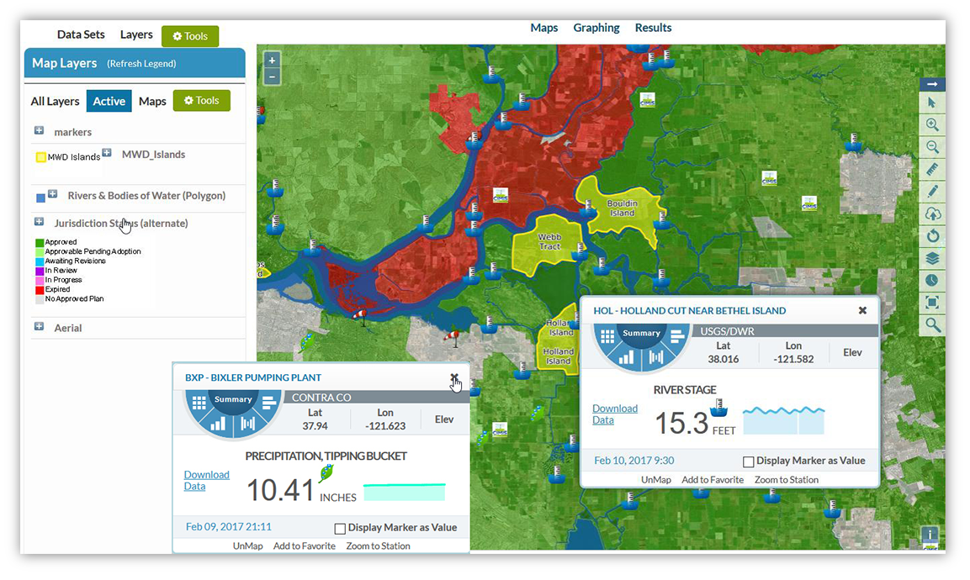
FEMA HMP Status with Real Time Hydrology Conditions

Slide 11
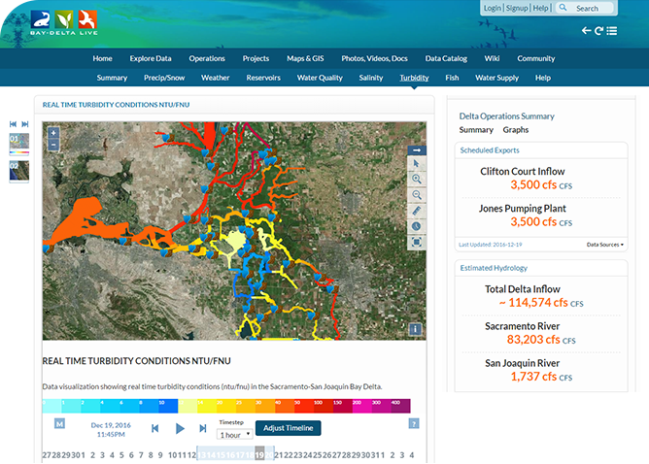
Turbidity Conditions
Turbidity Model displays real-time data from 46 CDEC Stations.
View data at various intervals (15 min, 1 r, 6 hr, 12 hr, 1 day, 1 week, 1 mo, 1 yr).
Data is 15-minute and averaged based on interval.

Slide 12

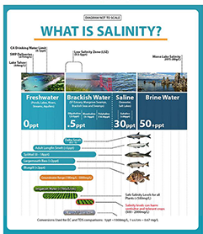
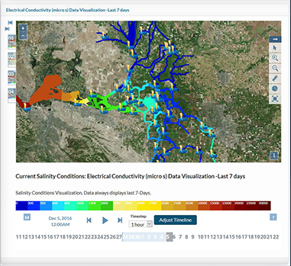
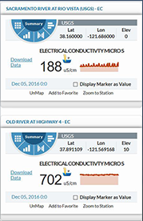
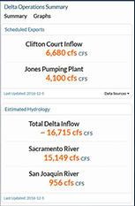
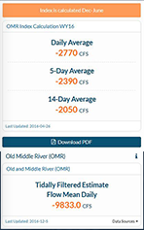
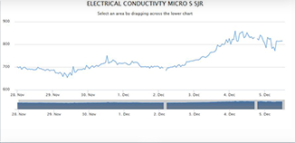
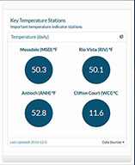
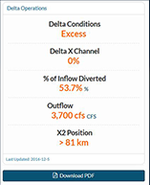
Salinity
www.baydeltalive.com/salinity

Slide 13
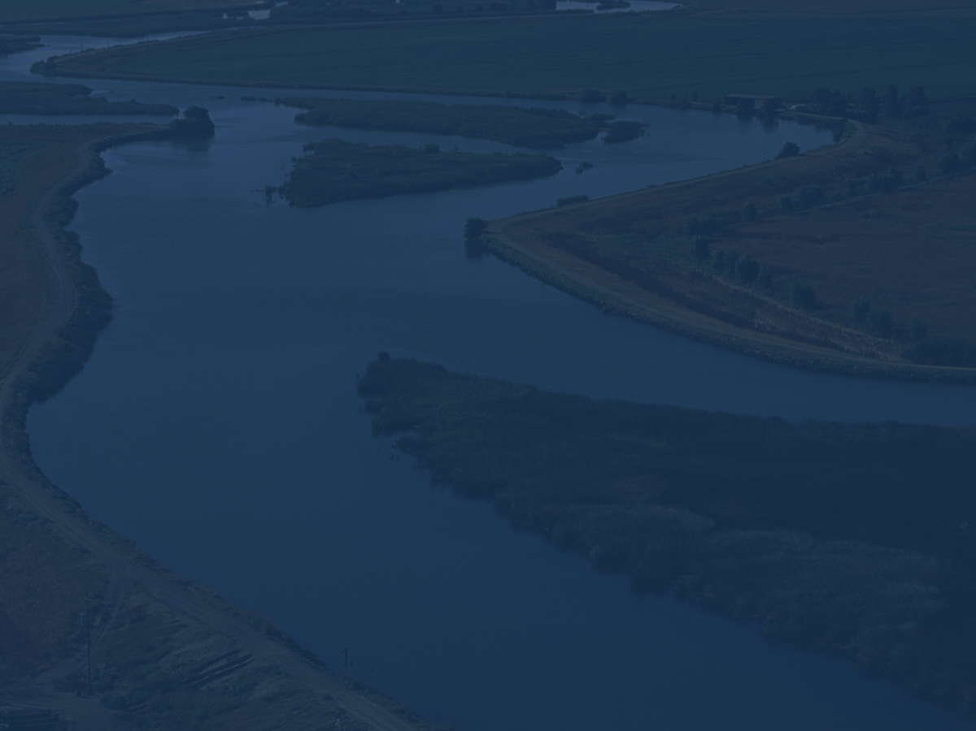
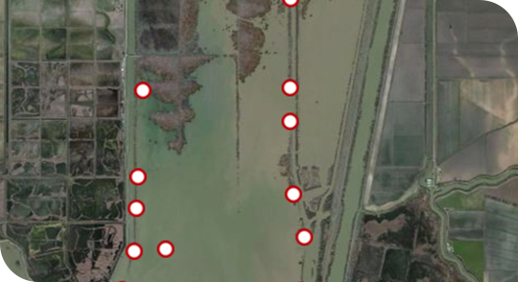
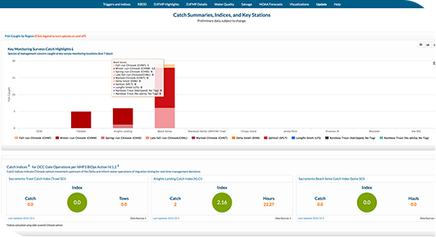
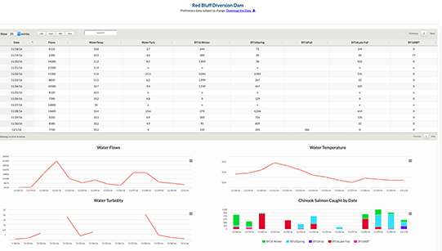
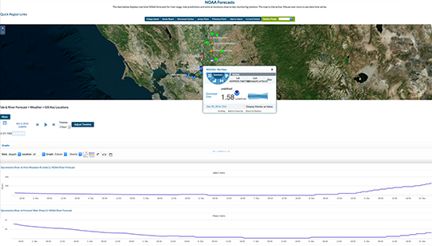
Fisheries
www.baydeltalive.com/fish

Slide 14
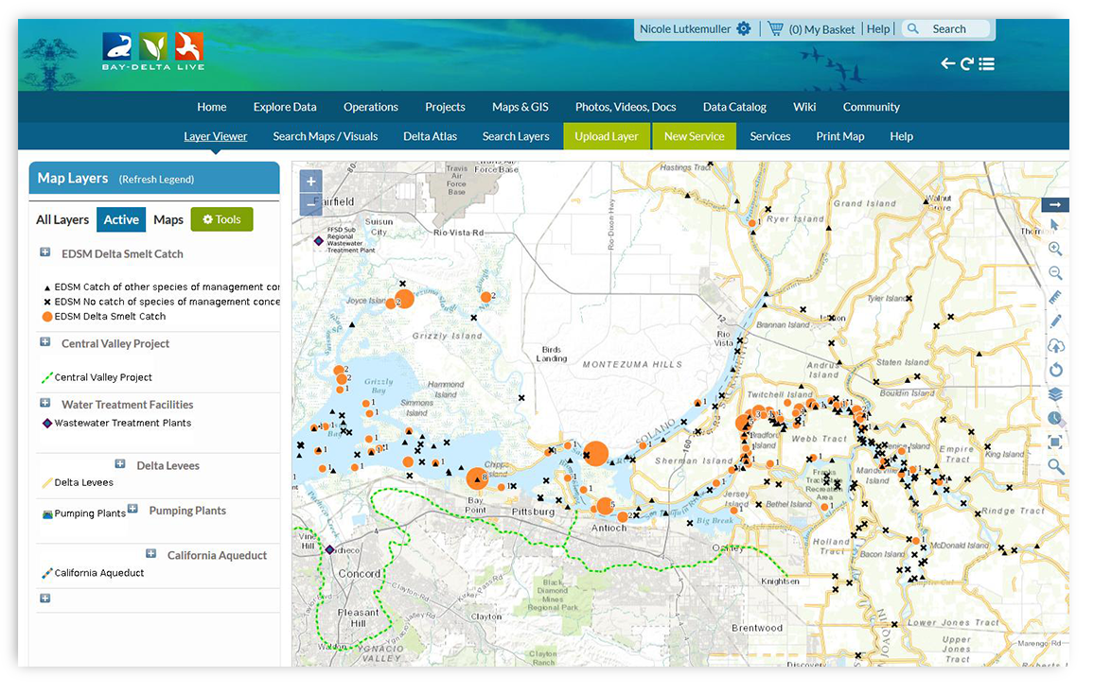
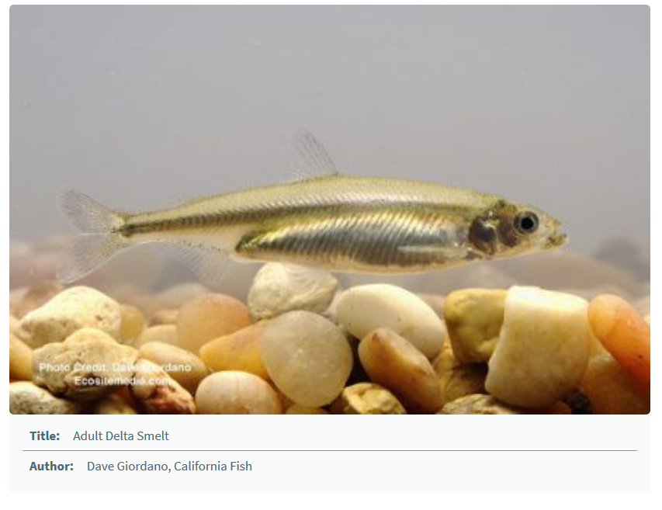
Delta Smelt Monitoring

Slide 15
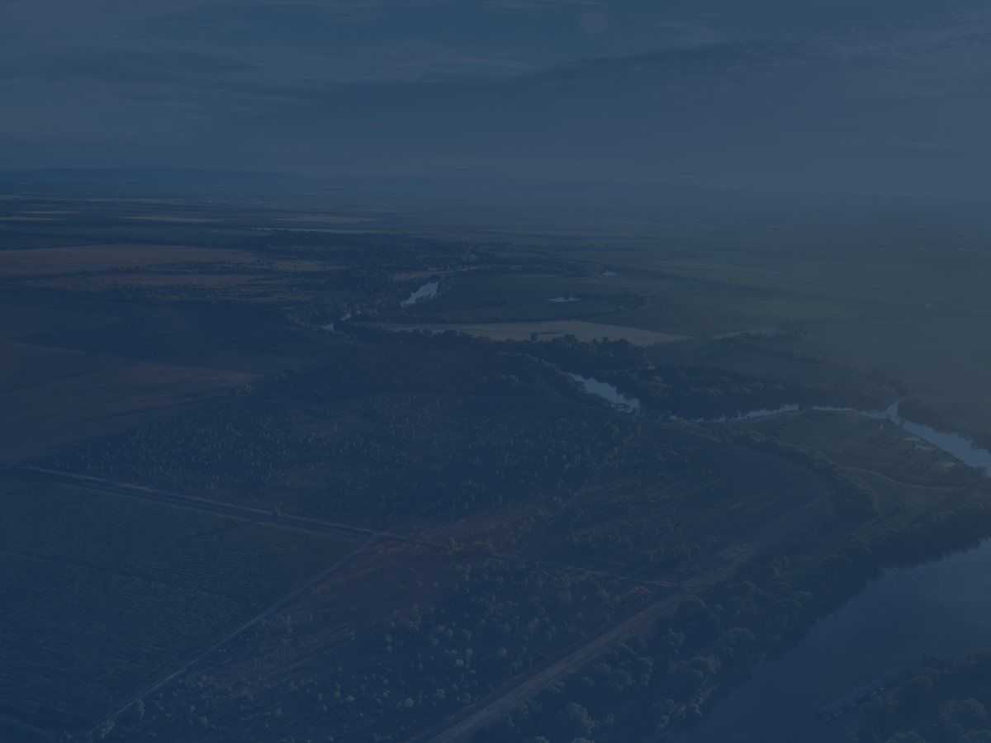
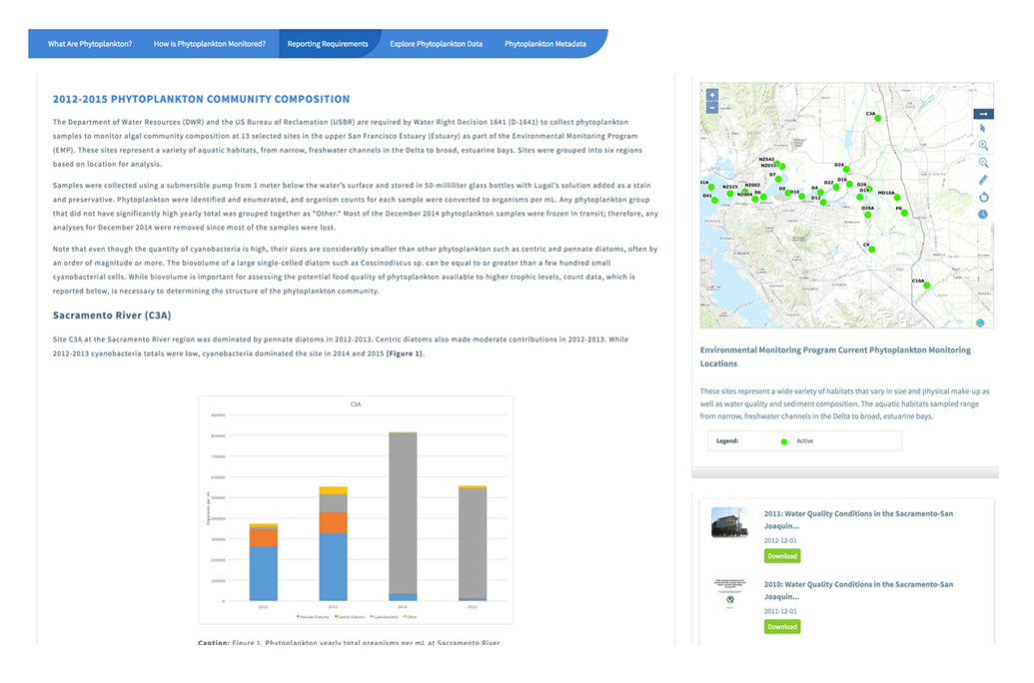
Reporting Requirements

Slide 16

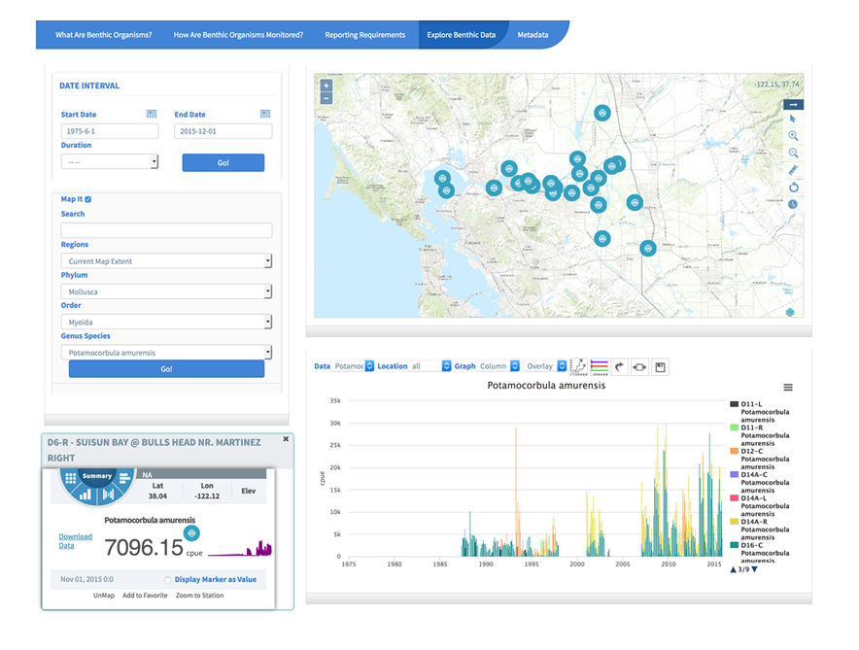
Explore Data

Slide 17
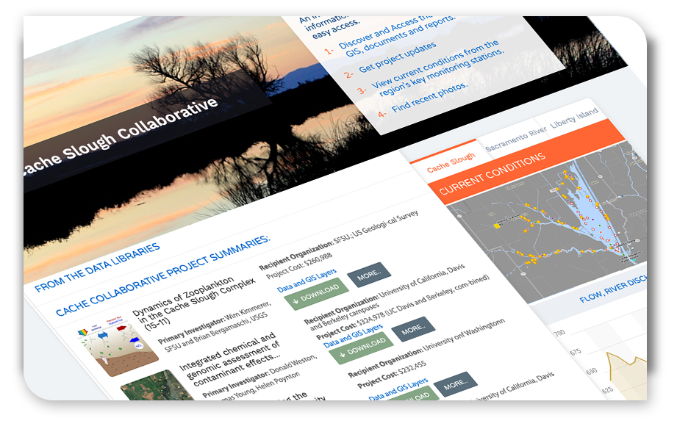
Cache Collaborative: Connecting Ecosystem Research Efforts
Notes:
Prepared a data interoperability report for funder and PI’s. How to connect research efforts in the same location collecting related data but with different goals in mind so tools, sampling effort, data collection frequency, etc are different across programs.

Slide 18
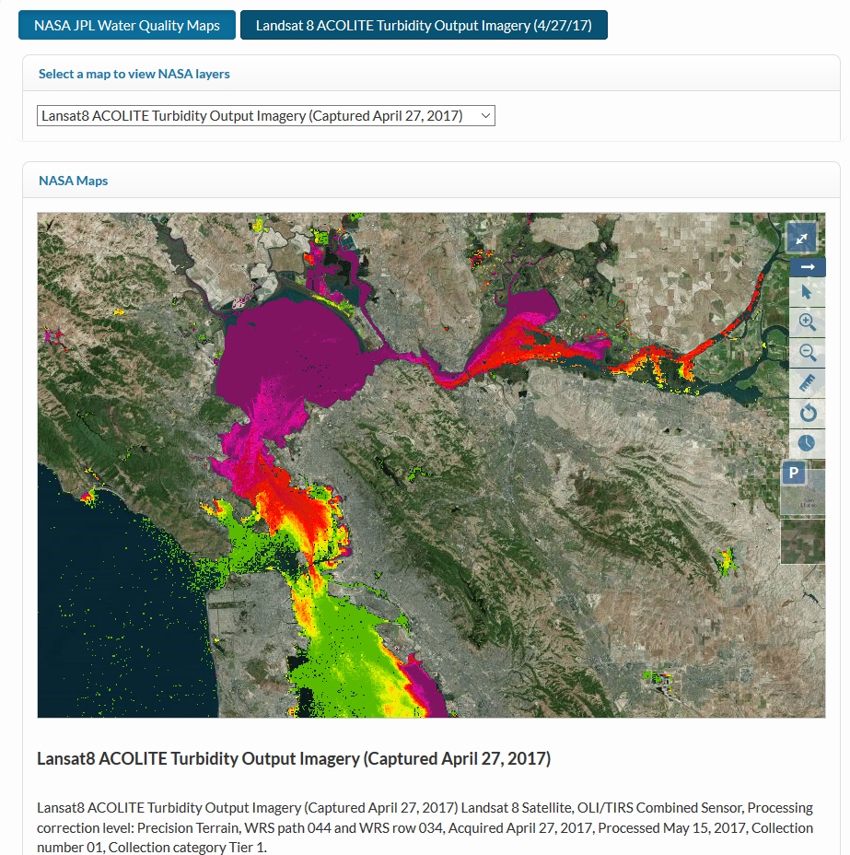
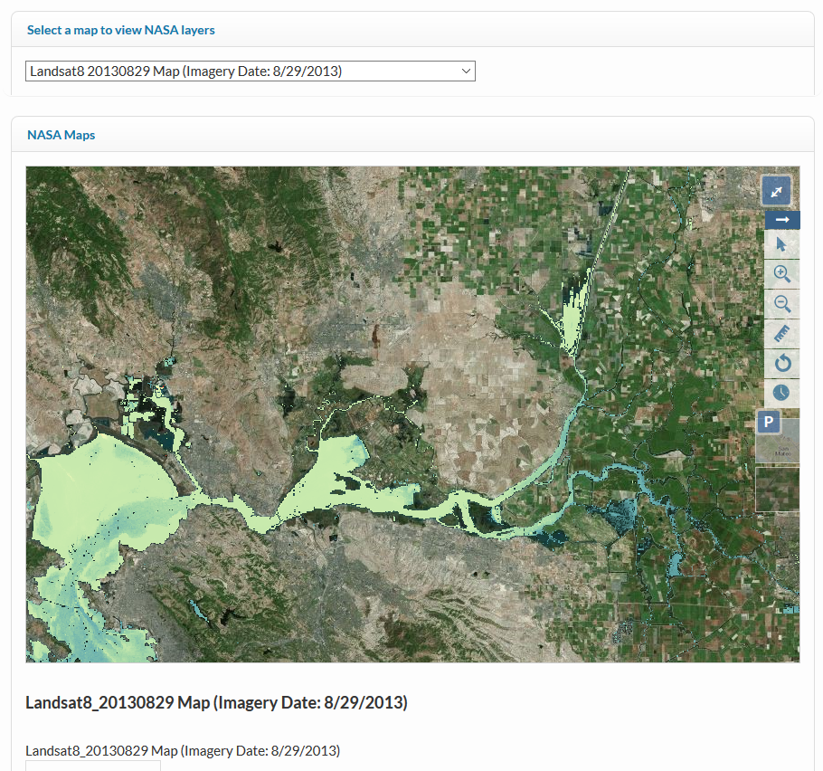
NASA/JPL: Remote sensing to Inform Water Operations
Notes:
Early phase project: using remote sensing data to inform water decisions in the Delta and guide operation decisions. Reduce data collection efforts (often in bad weather) inform the space between in situ sensors, mid channel data.

Slide 19





Data Dashboards and Stories
Bay Delta Live
www.baydeltalive.com
Sacramento River
Watershed Data Portal
data.sacrriver.org
San Joaquin Real Time
Management
sjrrtm.opennrm.org
California Estuary
Portal
www.mywaterquality.ca.gov
San Joaquin River
Monitoring
www.sanjoaquinwaterquality.com
Notes:
Thanks, links to portals

