Slide 1
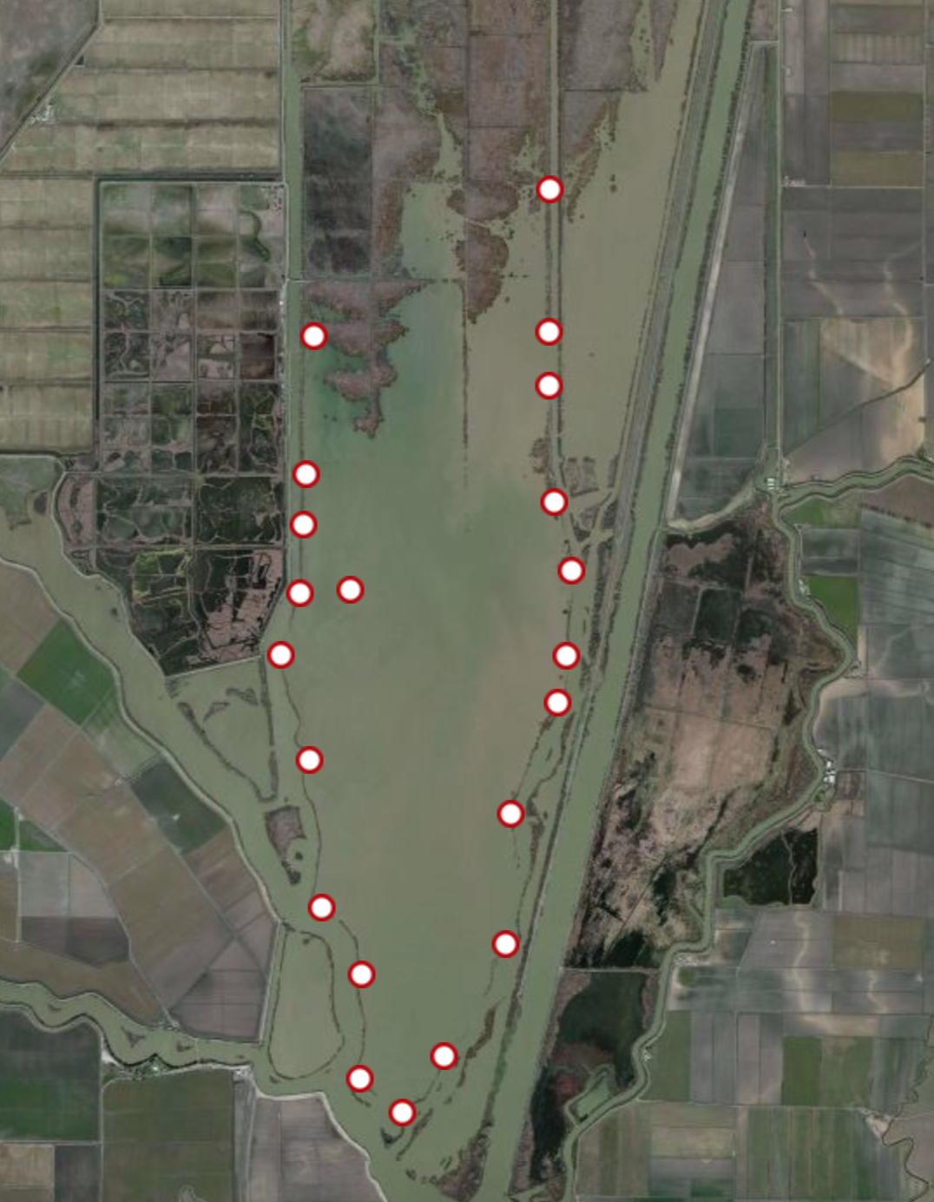
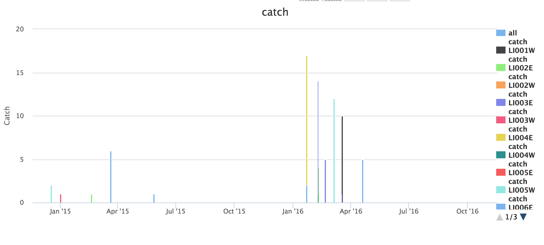
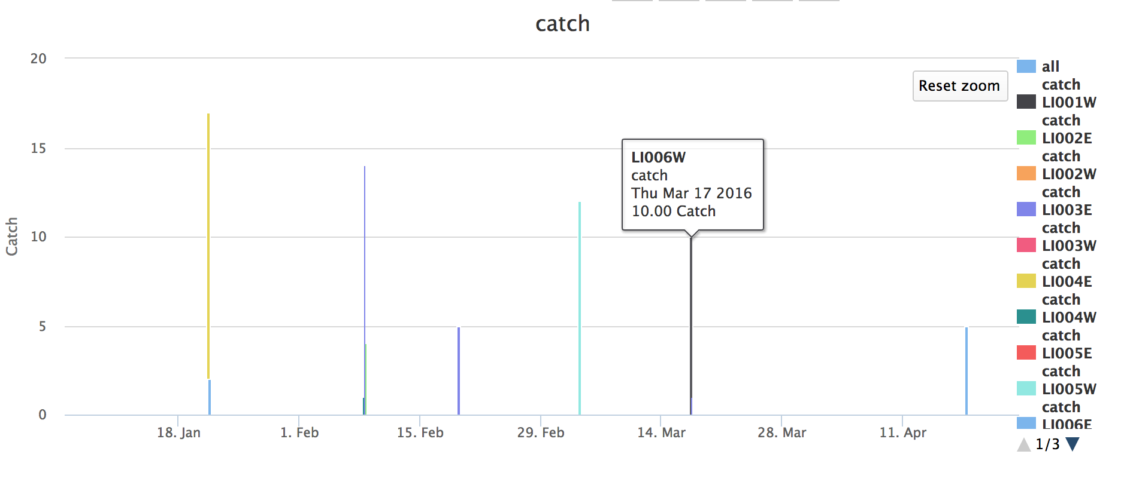
Chinook salmon caught in Liberty Island Beach Seines in the past year
Chinook salmon caught in Liberty Island Beach Seines January 2016-May 2016

Slide 2
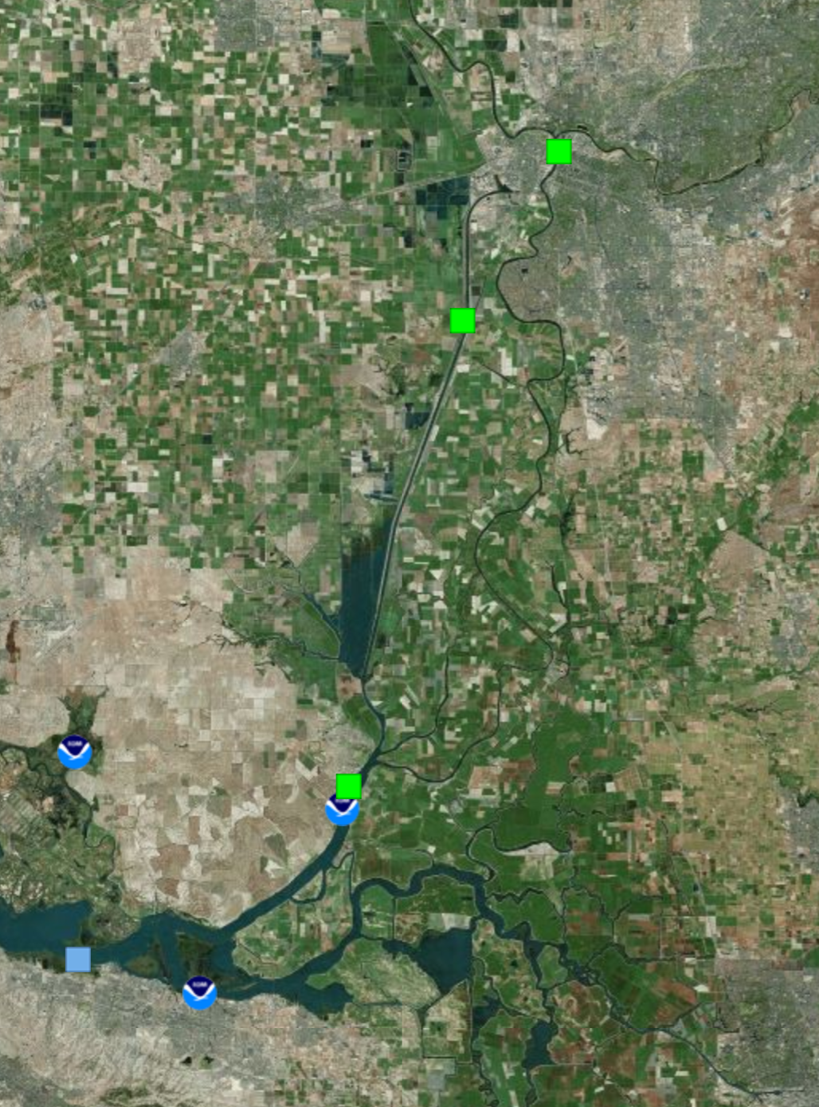
Tide and River Forecast Locations

Slide 3
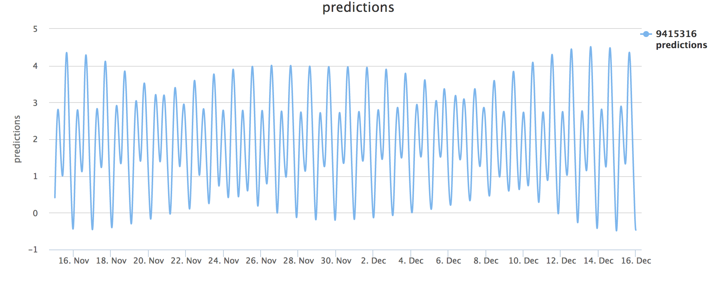
Rio Vista Tide Prediction for the next 30 Days

Slide 4
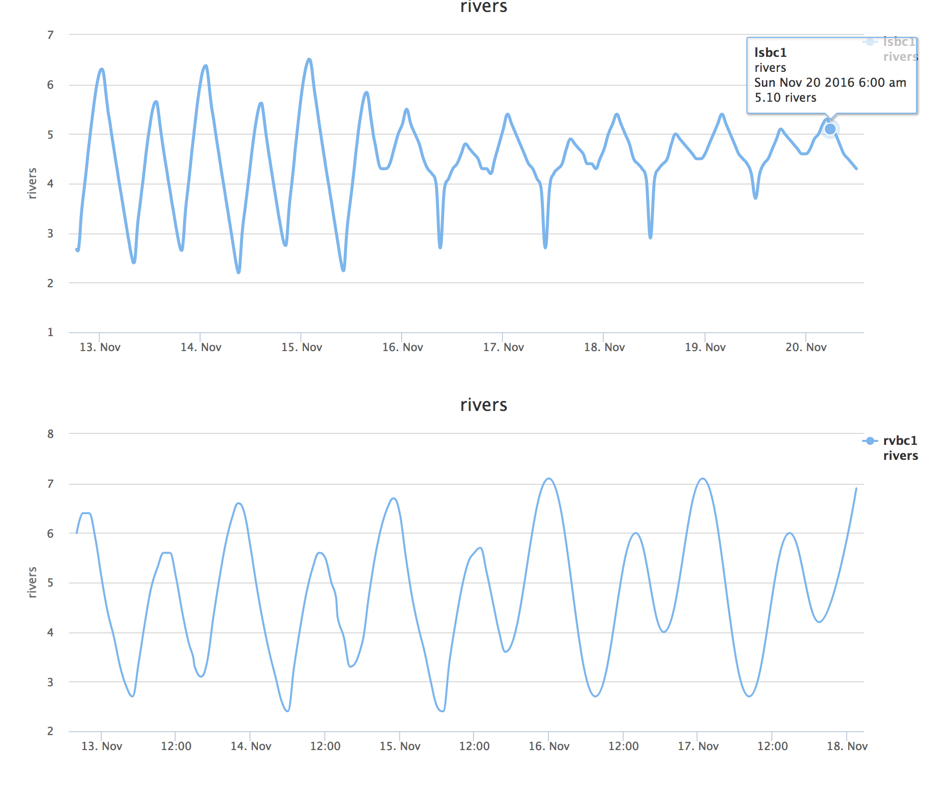
Yolo Bypass River Forecast
Rio Vista River Forecast

Slide 5
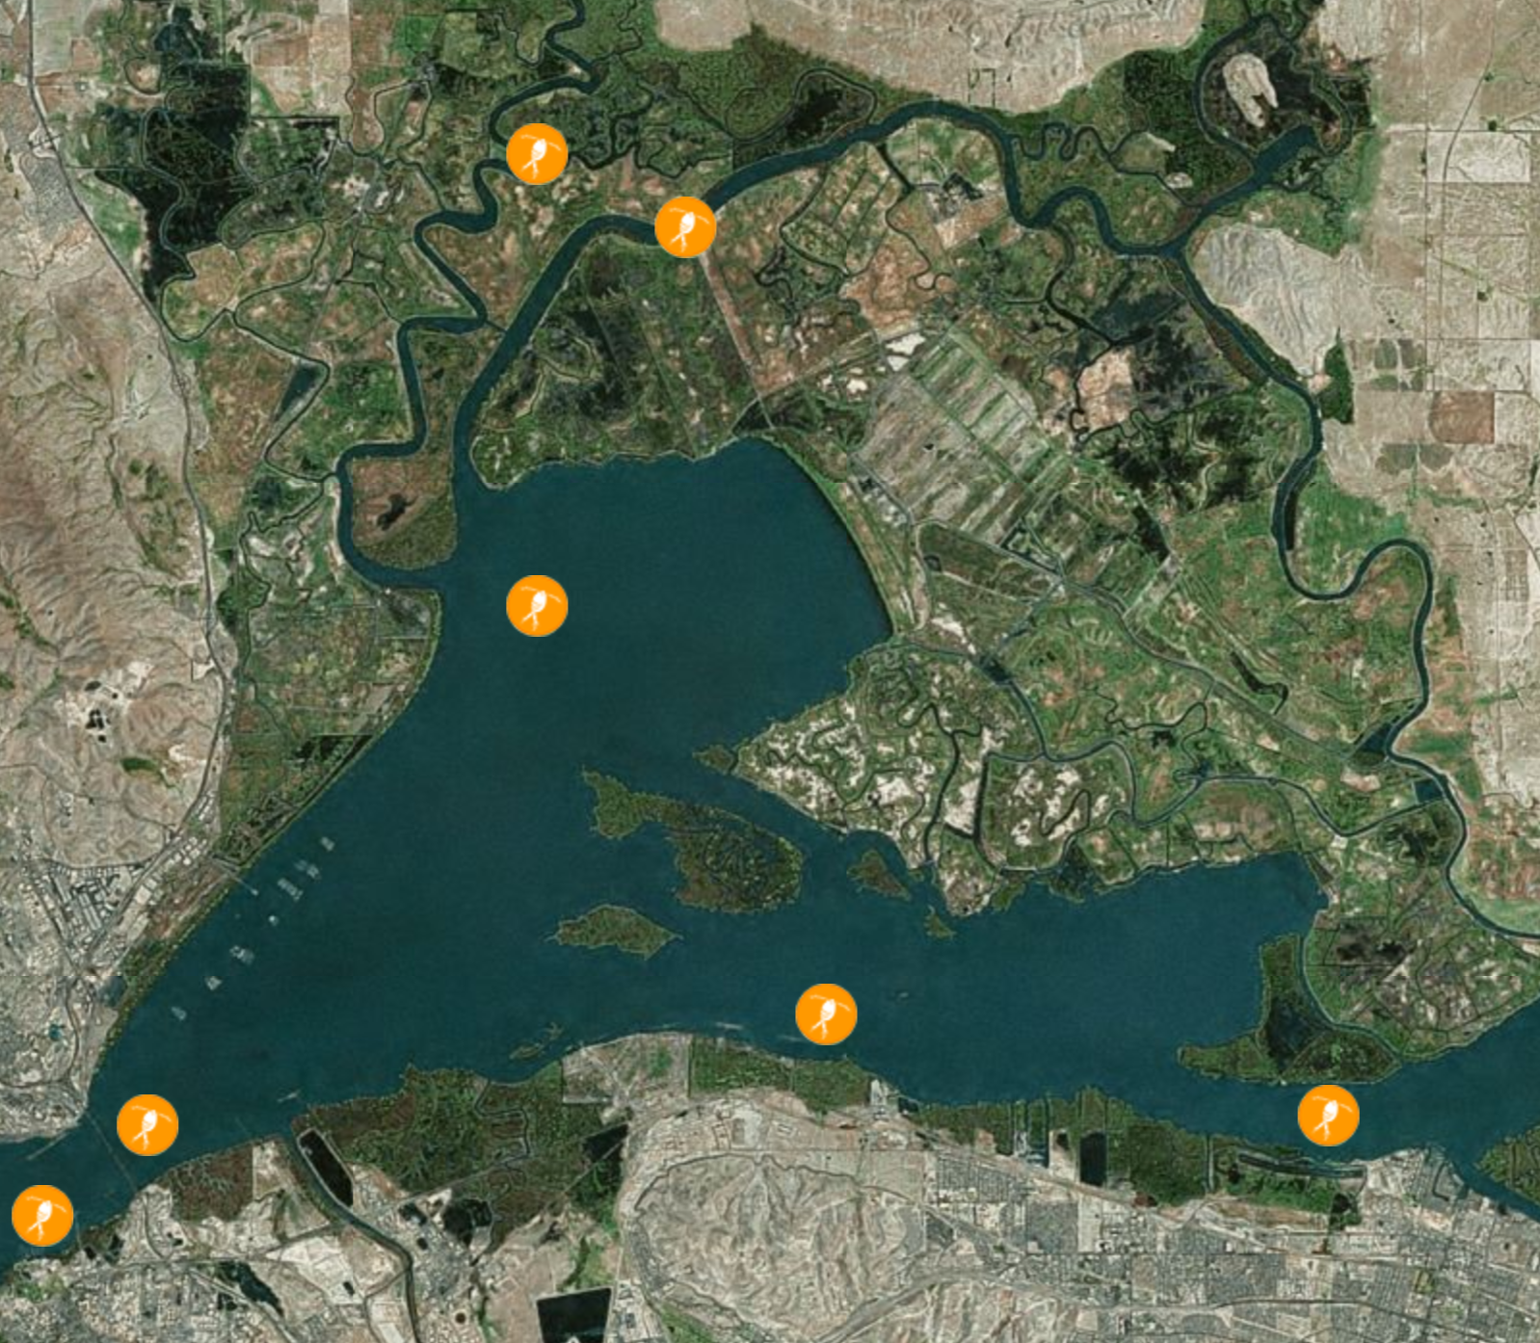

Slide 6
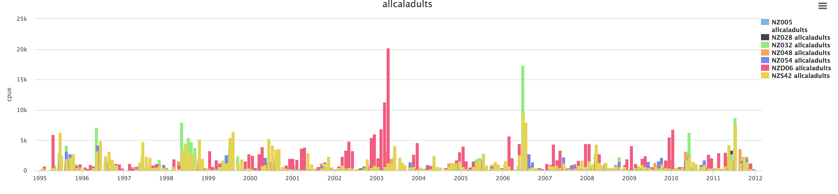
Adult Caleniod Copepod abundance in Suisun Marsh and Surrounding Region 1995-2012

Slide 7
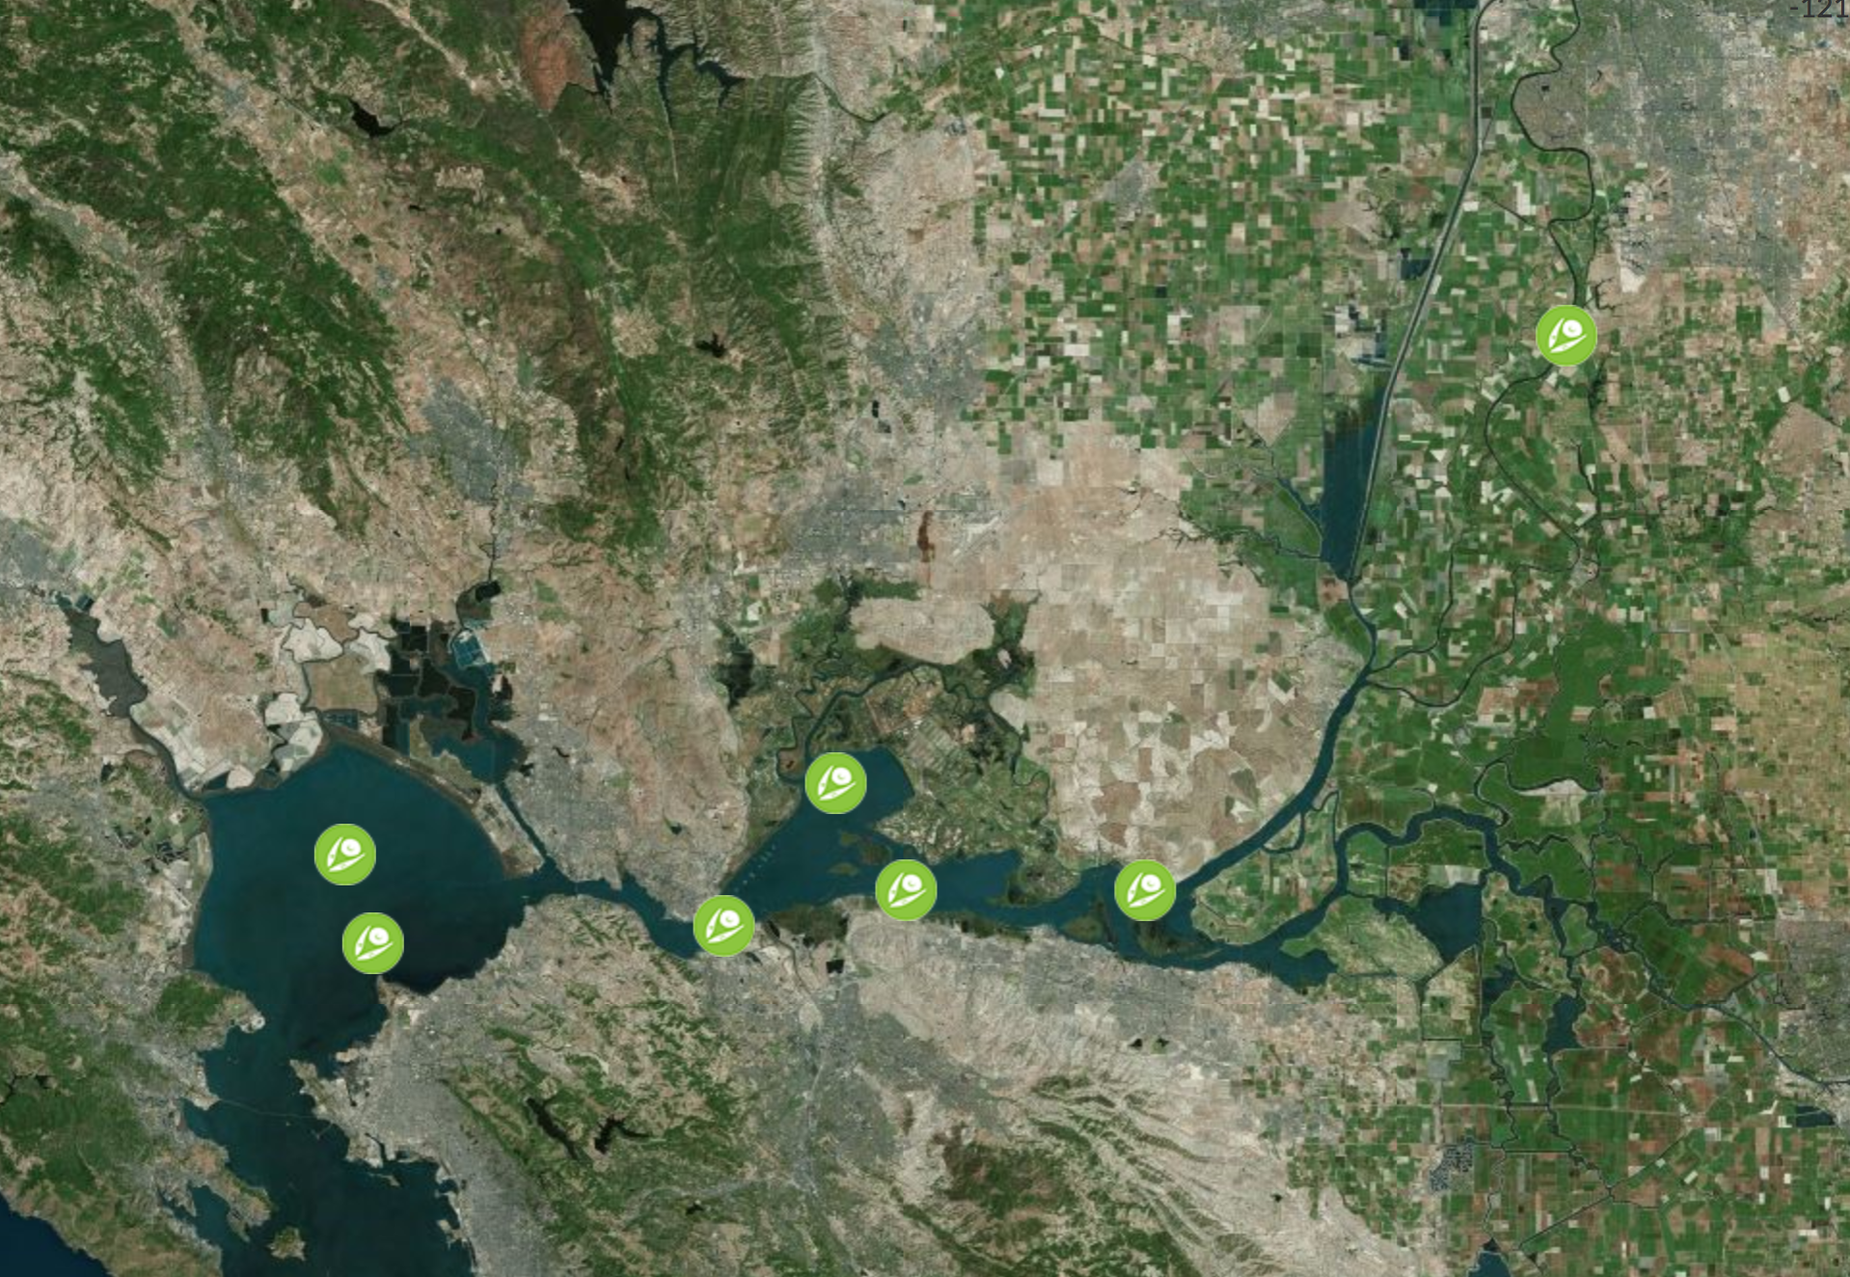
Notes:
Cyanobacteria Trends at Select Locations

Slide 8
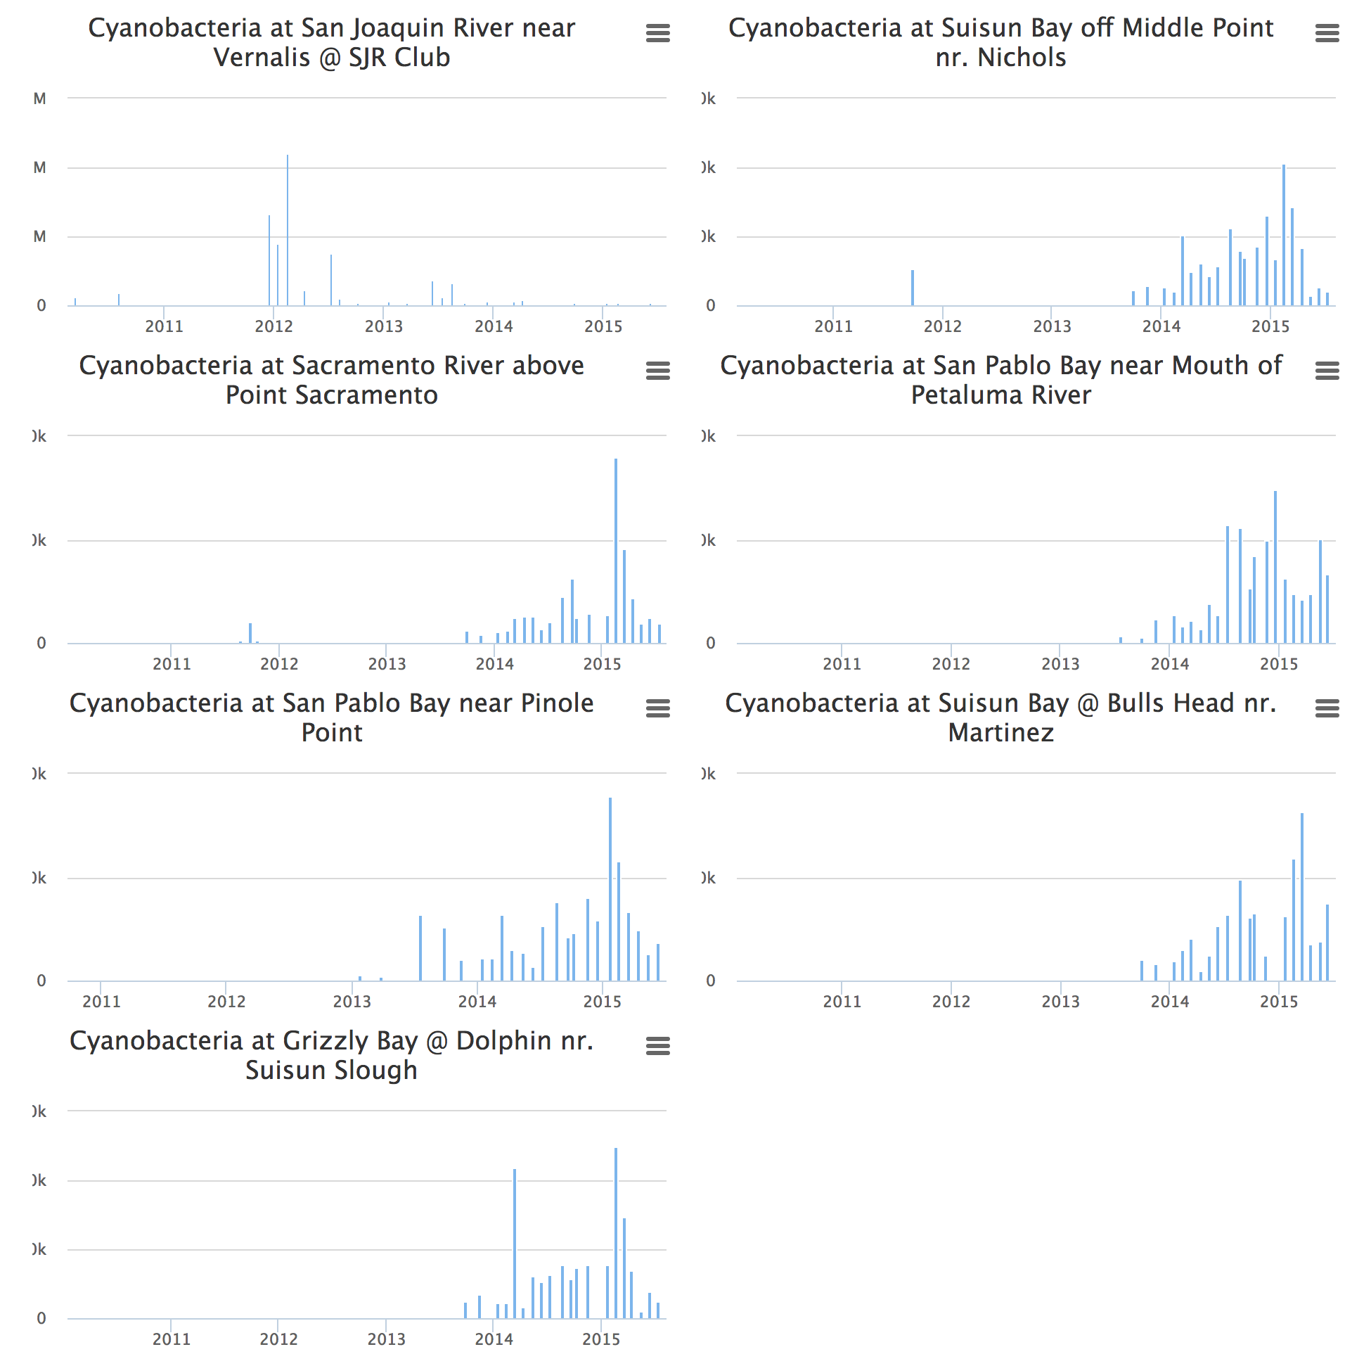
Notes:
Cyanobacteria Trends at EMP Monitoring Stations 2010-2015

