Slide 1
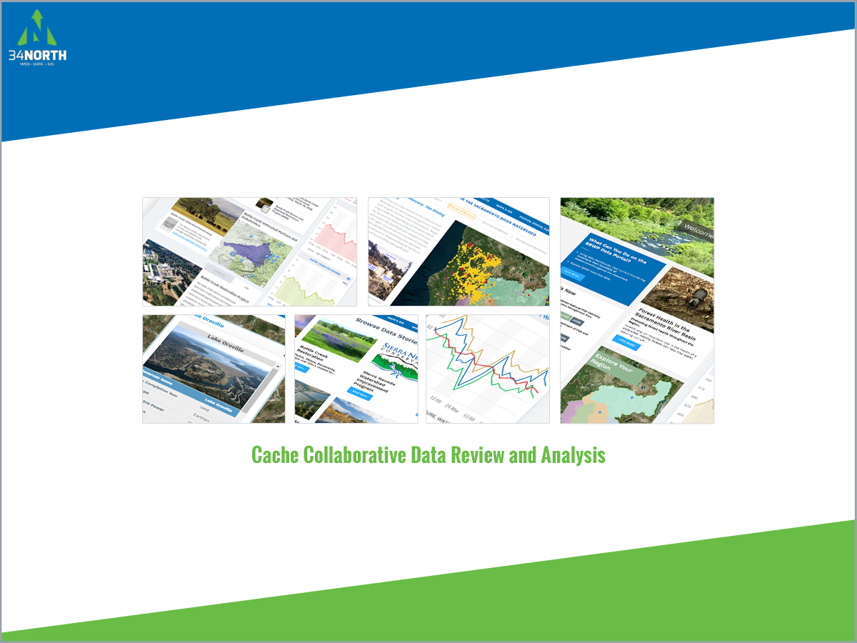

Slide 2

Background
As part of the process to prepare a technical specification for the Cache Collaborative decision support and analysis tool 34 North has developed the following work products:
Cache Complex Monitoring Review Report: A full analysis of current monitoring within the cache region.
Data Integration Plan: Building on the Cache Monitoring Report, 34 North is developing a data integration document and schema that makes recommendations for improved data integration methods for review by project stakeholders.
Custom GIS and Database Access via Baydeltalive.com: Building on the BDL and Ca Estuary data platforms, 34 North is making accessible all monitoring and key data from Cache projects, project areas and other data currently available in the region. This includes custom GIS, project datasets, reports, related projects and real time data.
Custom Project Pages: Project pages for each project that contains project overview, project data, documents, reports, GIS and related projects.
Cache Collaborative Info Hub: A dashboard collective

Slide 3
Data Integration Plan
Development of Cache Data Table
34 North completed a thorough investigation into current data data currently available on BDL/Caestuaries that can be used to support the Cache studies. Datasets are organized by program category; columns of the table identify the role of the data set, main drivers of data collection, parameters collected, and where and how the data is publicly available. This will be included in the Cache Collaborative Document as a synopsis of the current monitoring efforts in the region.
II. Data Set Parameters Table
An extension of the parameters column of the previous table, this is an organization of all of the specific parameters that are part of each data set. It gives a visual of the most commonly collected parameters and those that are not often collected. This table will also be included in the Cache Collaborative Document.
III. Data Comparison: By Organization
Compares the datasets held on BDL with those that are part of the Delta Regional Monitoring Program. This table draws attention to the data that BDL holds that the RMP did not include and also those included in the RMP that may be useful for BDL to acquire.

Slide 4
Data Integration Plan
Data Integration Plan
IV. Data Comparison of the research projects included in the Cache Collaborative project.
This table outlines the geographical extent, time frame, and methods of each study. With the methods, it shows specifically how sampling was conducted for each specific parameter collected. Also included in the table are other research projects being conducted or previously conducted in the area that relate to the project but are not included in the Cache Collaborative.
V. Methods Comparison
Shows how the four Cache Collaborative research projects and the other programs sampling fish, zooplankton, phytoplankton, and water quality (Including CDEC and NWIS) are conducting their sampling, with what frequency, and how they are recording their data. The focus of this table is on data interoperability: how net and mesh sizes vary for different efforts, where units are different and how they may be converted for comparison across all studies.

Slide 5
Data Integration Plan
Data Integration Plan
IV. Data Comparison of the research projects included in the Cache Collaborative project.
This table outlines the geographical extent, time frame, and methods of each study. With the methods, it shows specifically how sampling was conducted for each specific parameter collected. Also included in the table are other research projects being conducted or previously conducted in the area that relate to the project but are not included in the Cache Collaborative.
V. Methods Comparison
Shows how the four Cache Collaborative research projects and the other programs sampling fish, zooplankton, phytoplankton, and water quality (Including CDEC and NWIS) are conducting their sampling, with what frequency, and how they are recording their data. The focus of this table is on data interoperability: how net and mesh sizes vary for different efforts, where units are different and how they may be converted for comparison across all studies.

Slide 6
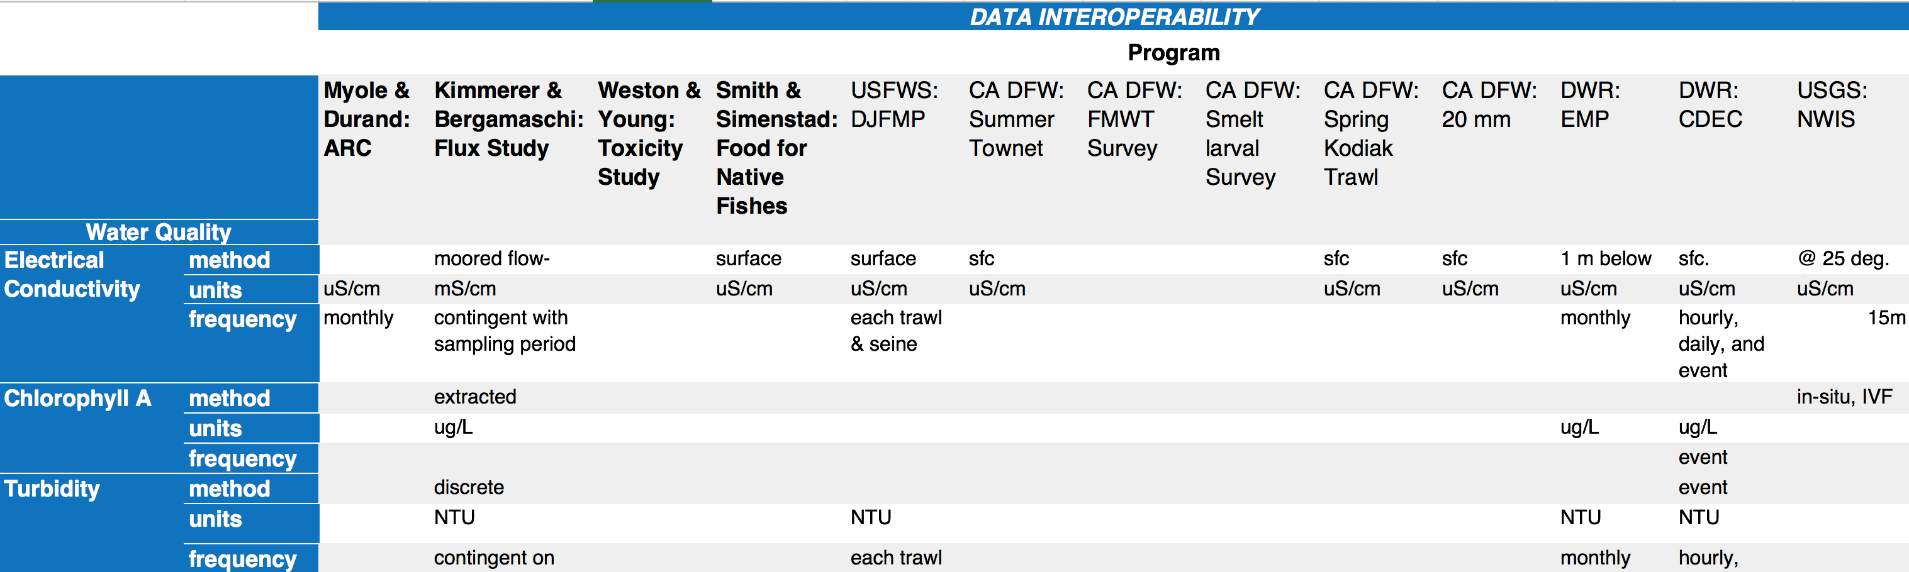
Data Interoperability:
Water Quality

Slide 7
Data Interoperability:
Food Web

Slide 8
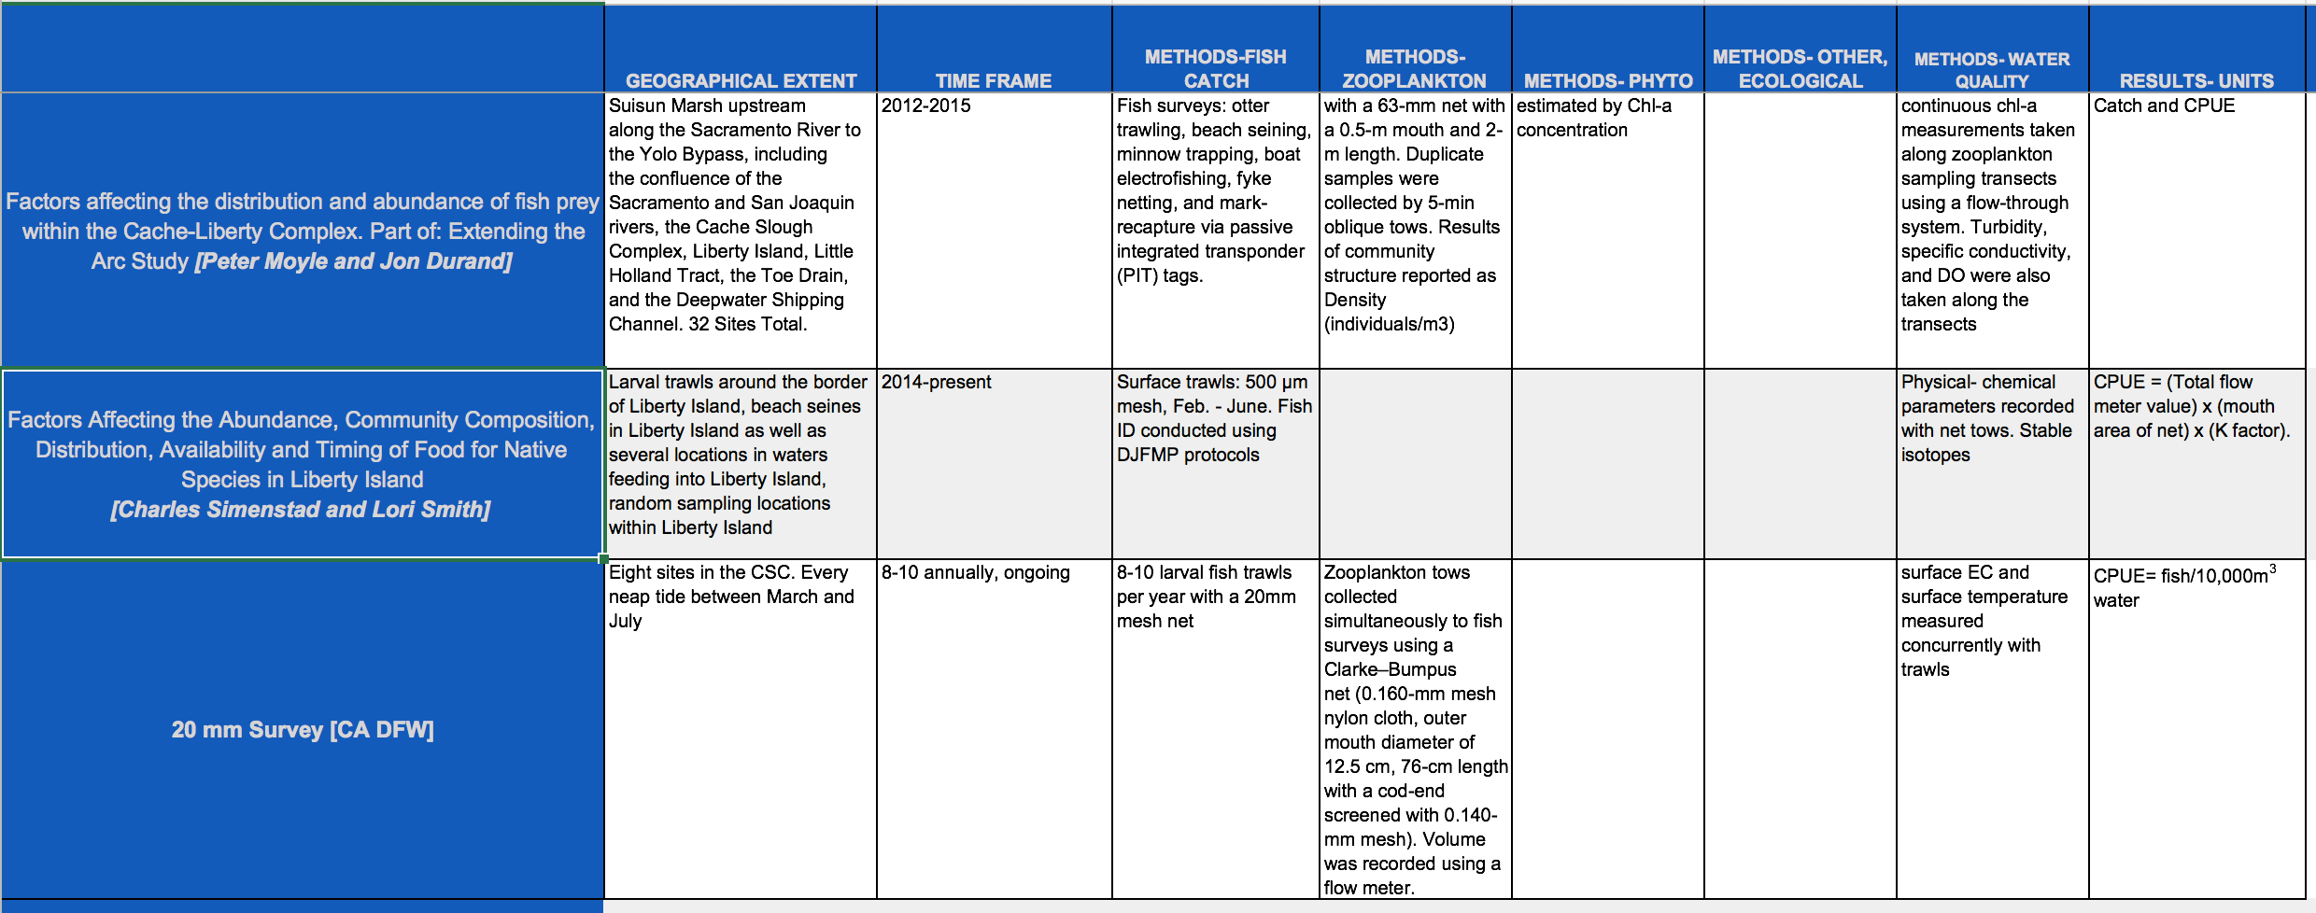
Methods Comparison

Slide 9
Data Set Name | Description | Source
CDEC | Real-time sensor data for key parameters include: Flow, Dissolved Oxygen, Chlorophyll A, River Stage, Turbidity, Electrical Conductivity, and Water Temperature | DWR
CIMIS | California Irrigation Management Information System manages a network of automated weather stations | DWR
NOAA National Weather Service | Weather forecasting stations | NOAA
NOAA River Forecasting | River flow and stage forecasting | NOAA
NOAA Tide Prediction | Tide forecasting stations | NOAA
USFWS DJFMP | Delta Juvenile Fish Monitoring Program recent and historic fish and environmental parameter information for the Delta | USFWS
USGS National Water Information Service | Real-time sensor data for key parameters include: Flow, Dissolved Oxygen, Chlorophyll A, River Stage, Turbidity, Electrical Conductivity, and Water Temperature | USGS
EMP Benthic Monitoring | Recent and historic benthic monitoring and environmental data at discrete locations in the Delta | DWR
Available Data

Slide 10
EMP Zooplankton Monitoring | Recent and historic zooplankton monitoring and environmental data at discrete locations in the Delta | CA DFW
EMP Discrete Water Quality Monitoring | Recent and historic water quality monitoring discrete locations in the Delta (key parameters: Secchi Depth, Temperature, Tide, Wind, Electrical Conductance, and pH) | DWR
CEDEN Benthic |  | CEDEN
CEDEN Habitat |  | CEDEN
CEDEN Water Quality |  | CEDEN
CEDEN Toxicity |  | CEDEN
CEDEN Tissue |  | CEDEN
CA DFW Fish Monitoring | Recent and Historic Catch data (fish and other aquatic organisms) and environmental data from multiple CA DFW Surveys, including: Spring Kodiak Trawl, Fall Midwater Trawl, 20 MM Trawl, Summer Townet, Smelt Larval Survey, and San Francisco Bay Study. | CA DFW
Available Data

Slide 11
Available Data

Slide 12
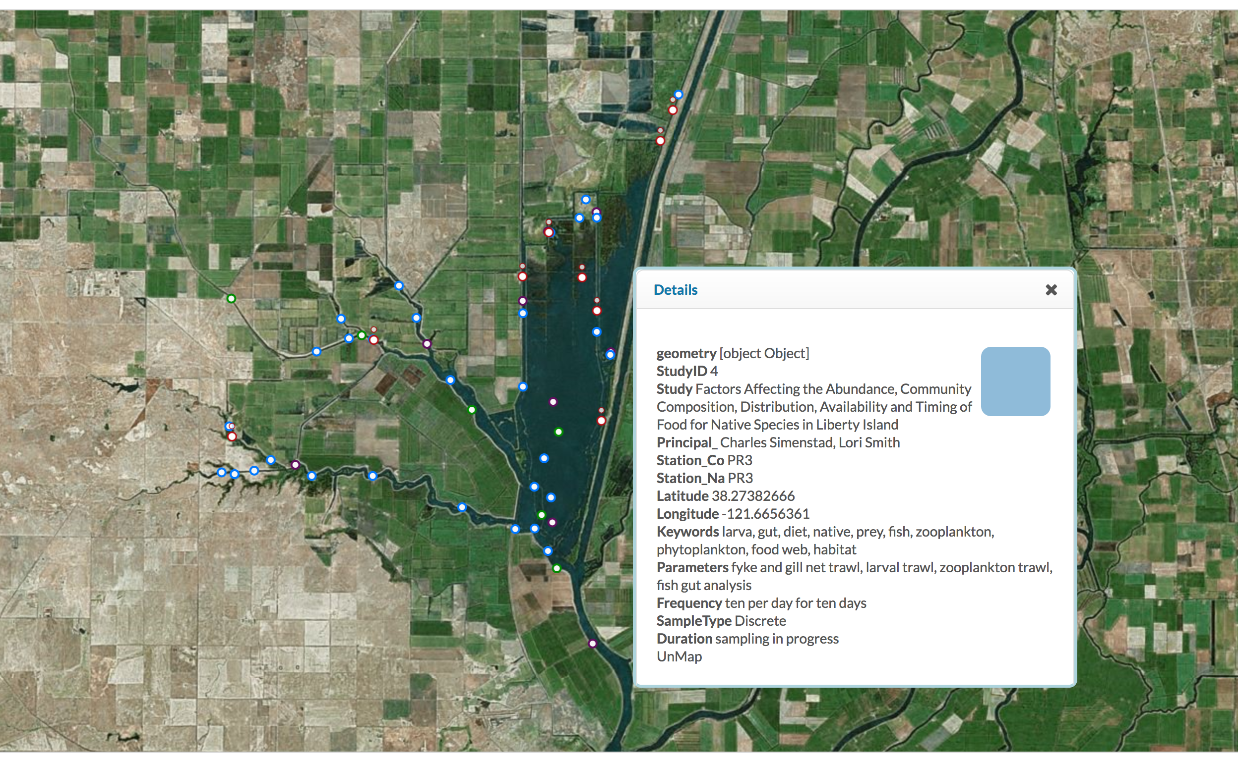
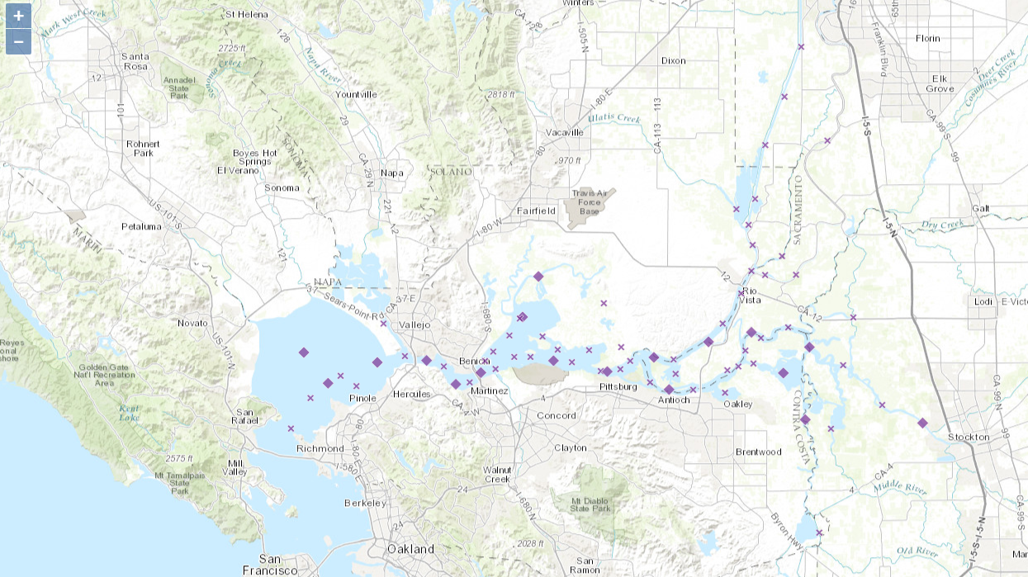
Cache Collaborative Monitoring Locations with Station Metadata

Slide 13
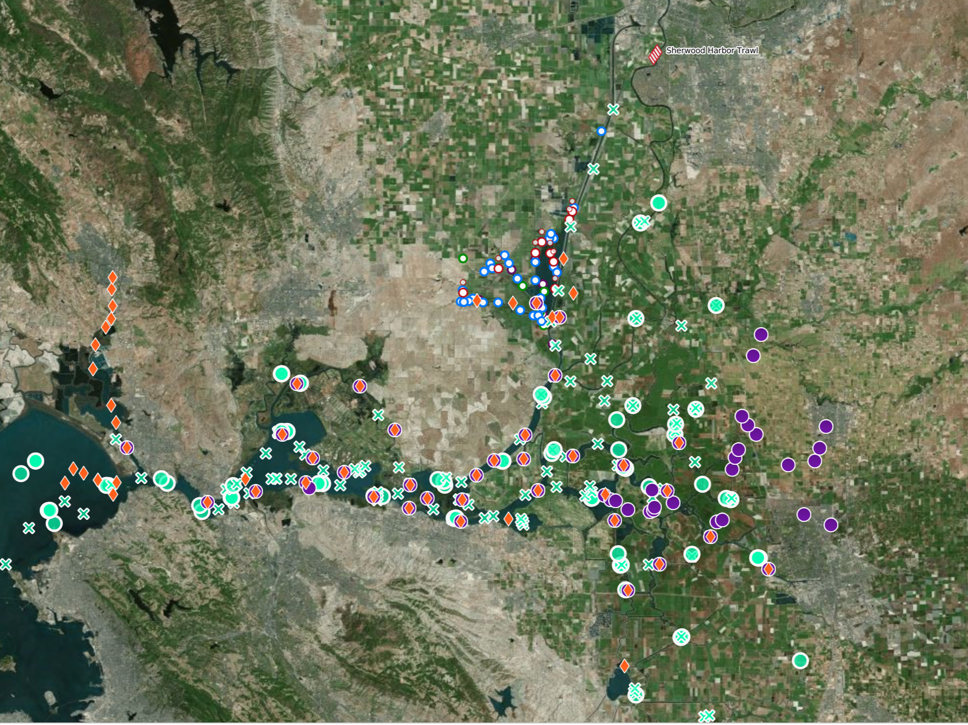
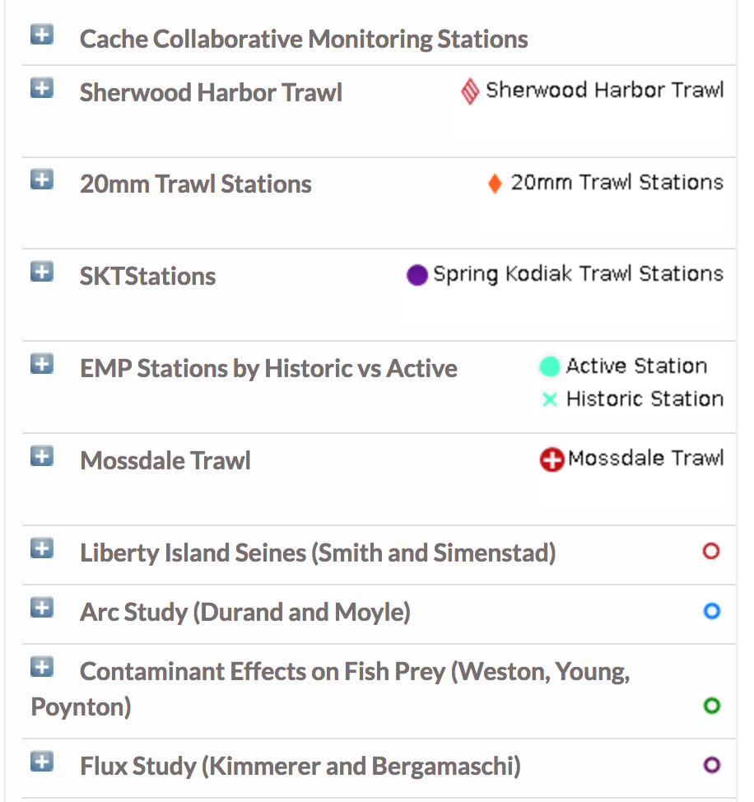
Sampling locations of Programs collecting Biologic Data (Zooplankton, Phytoplankton, Benthic, and Fish)

Slide 14
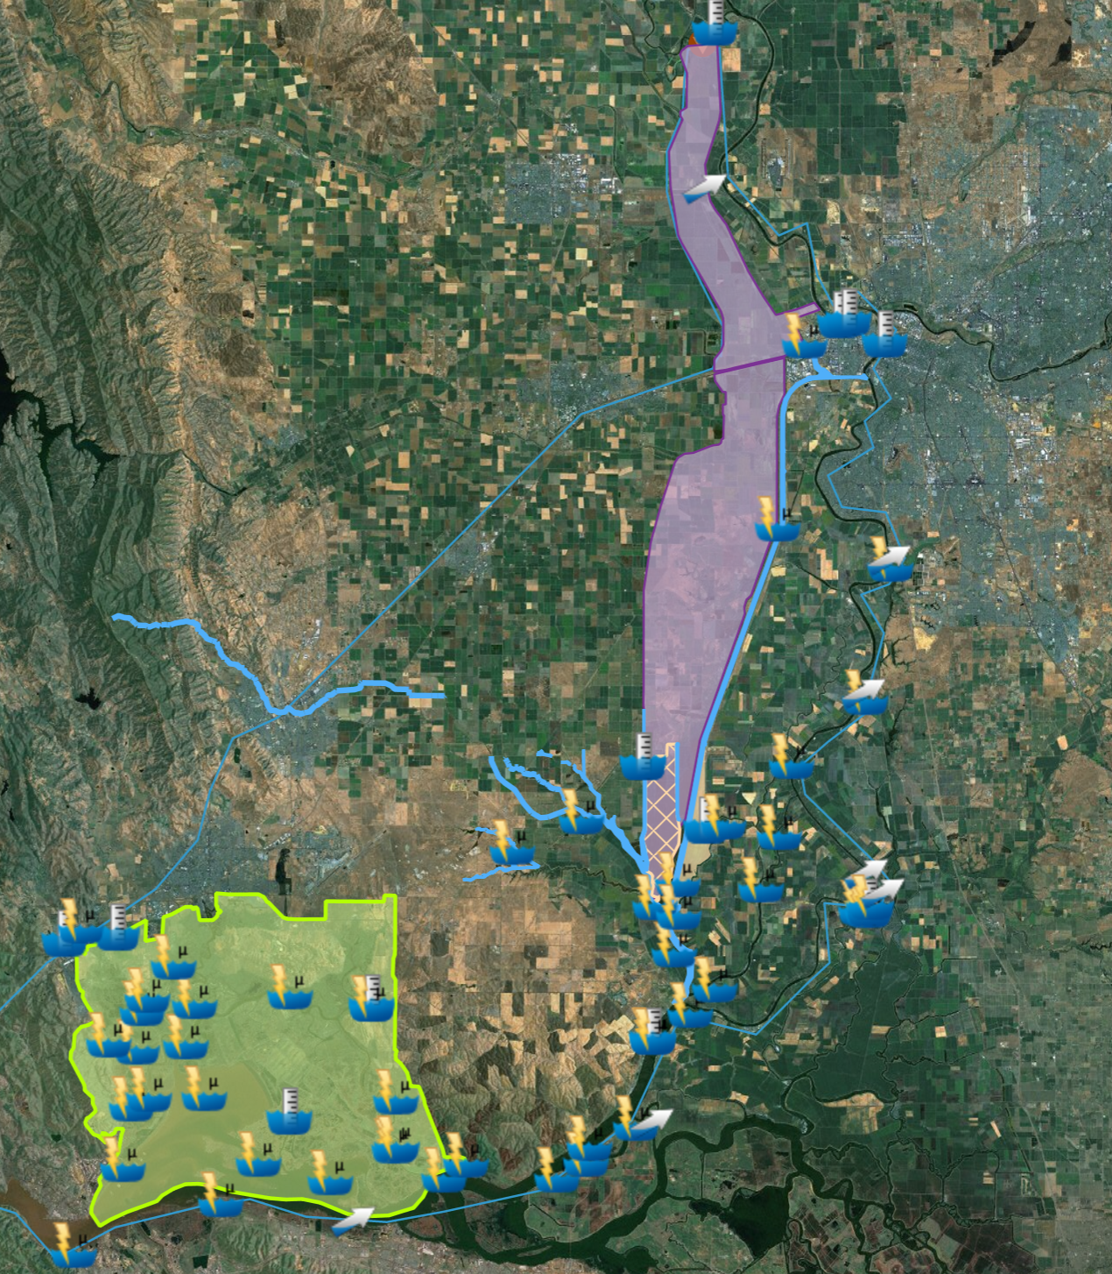
Real-time data collection sensors (Parameters include: Electrical Conductivity, Turbidity, River Stage, Flow, and Water Temperature) mapped with GIS layers of key locations in the Cache Slough Complex and the surrounding areas.

Slide 15
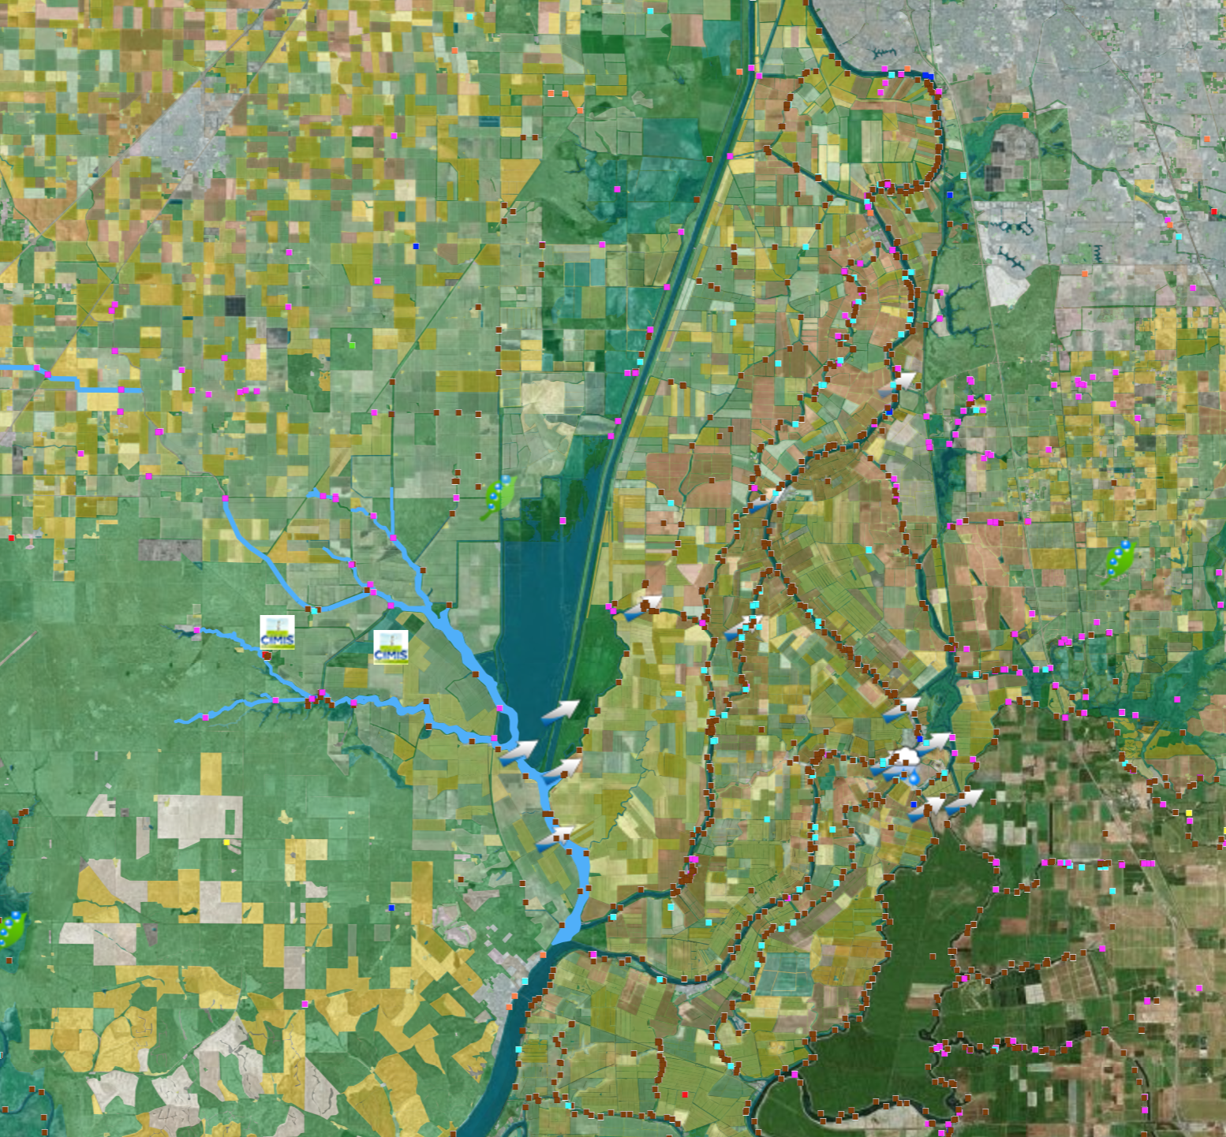
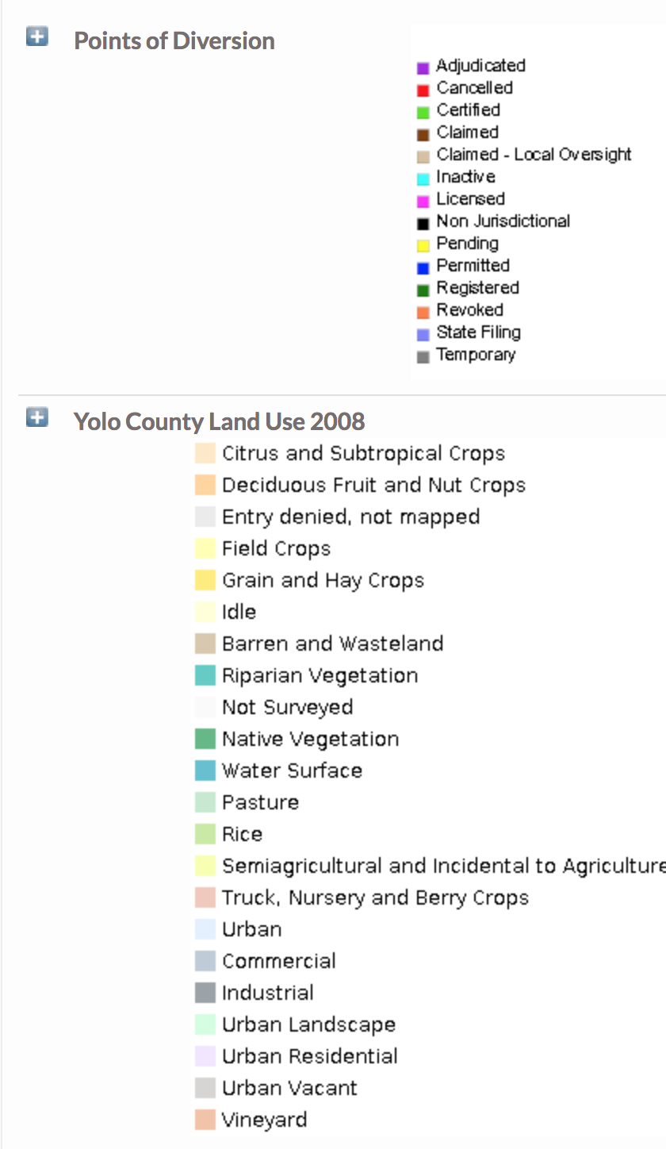
Land Use, Points of Diversion, Flow and Precipitation Data for the Cache Slough Complex

Slide 16
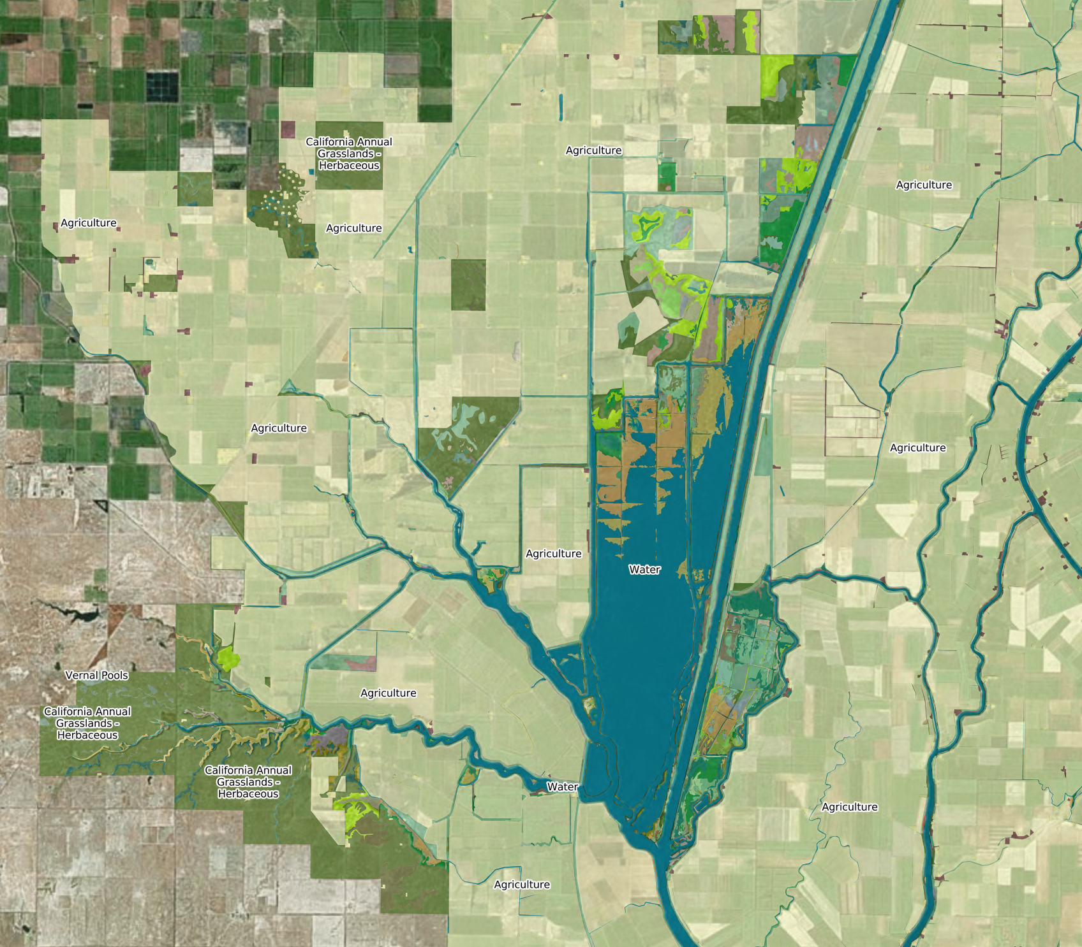
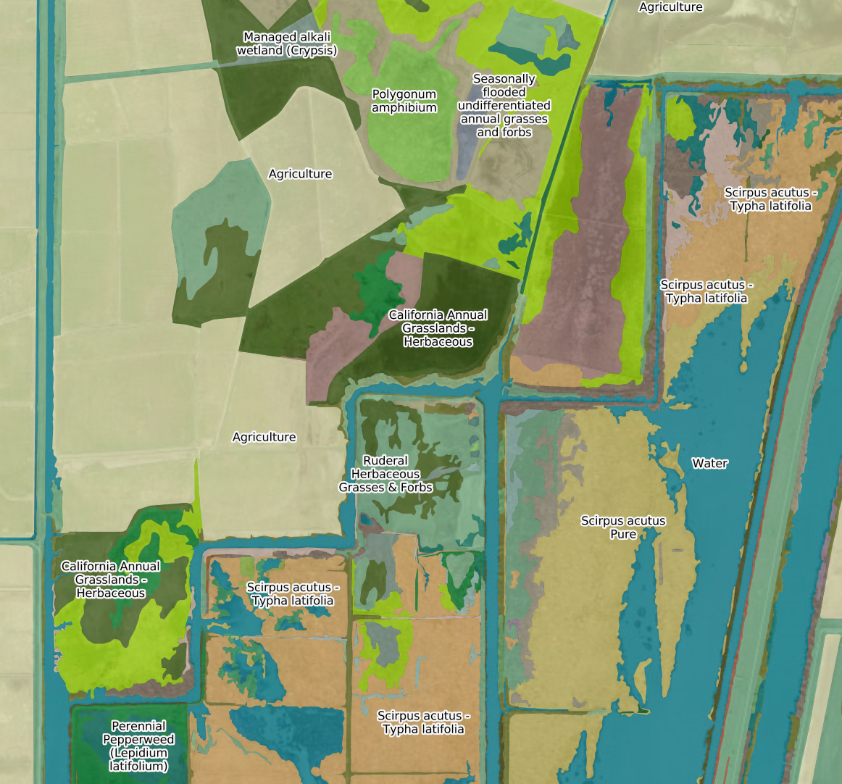
Delta Vegetation
Source: California Department of Fish and Wildlife
Stair-step Vegetation

Slide 17
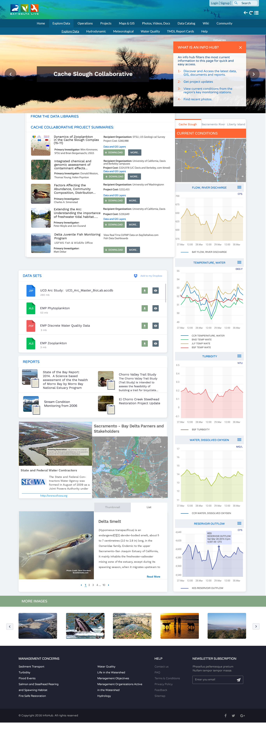

Slide 20
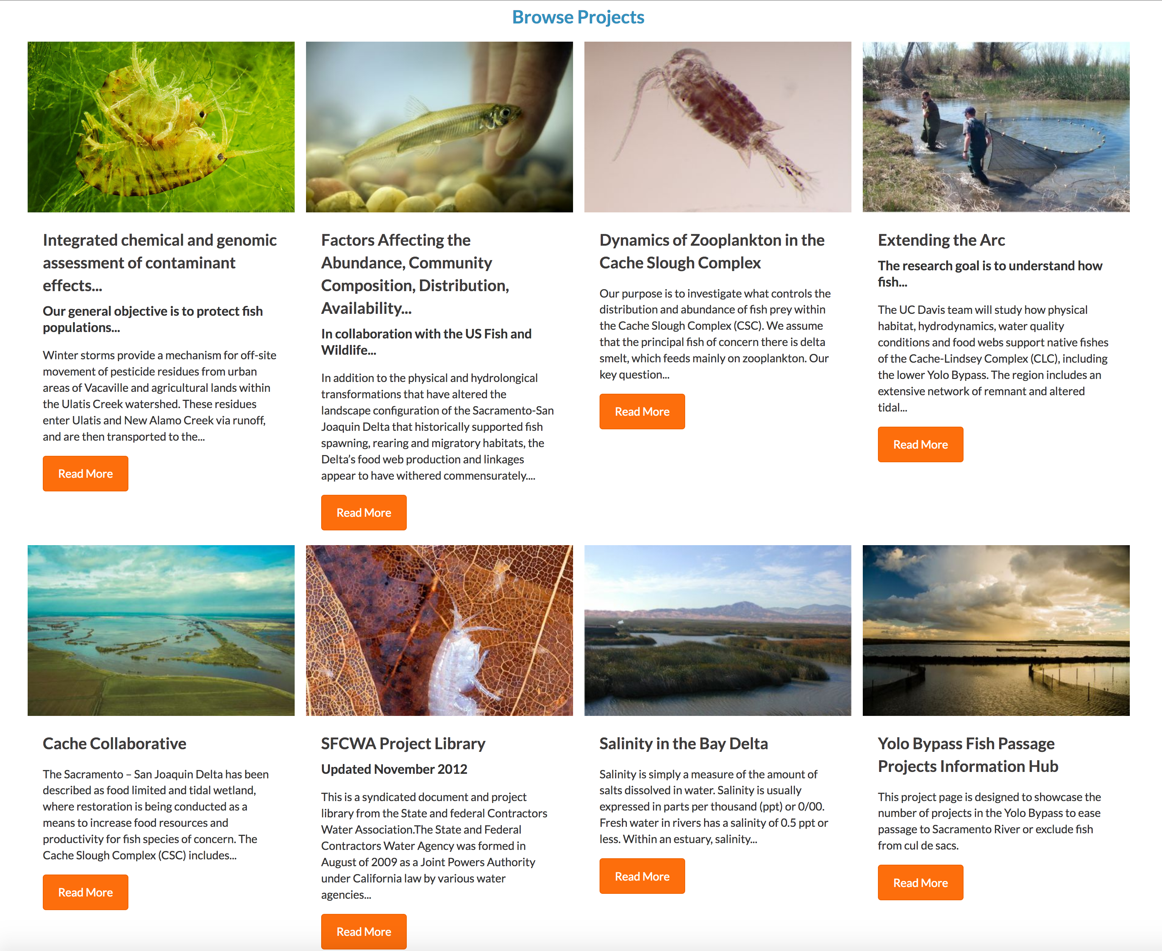
Notes:
Project Catalog

Slide 21
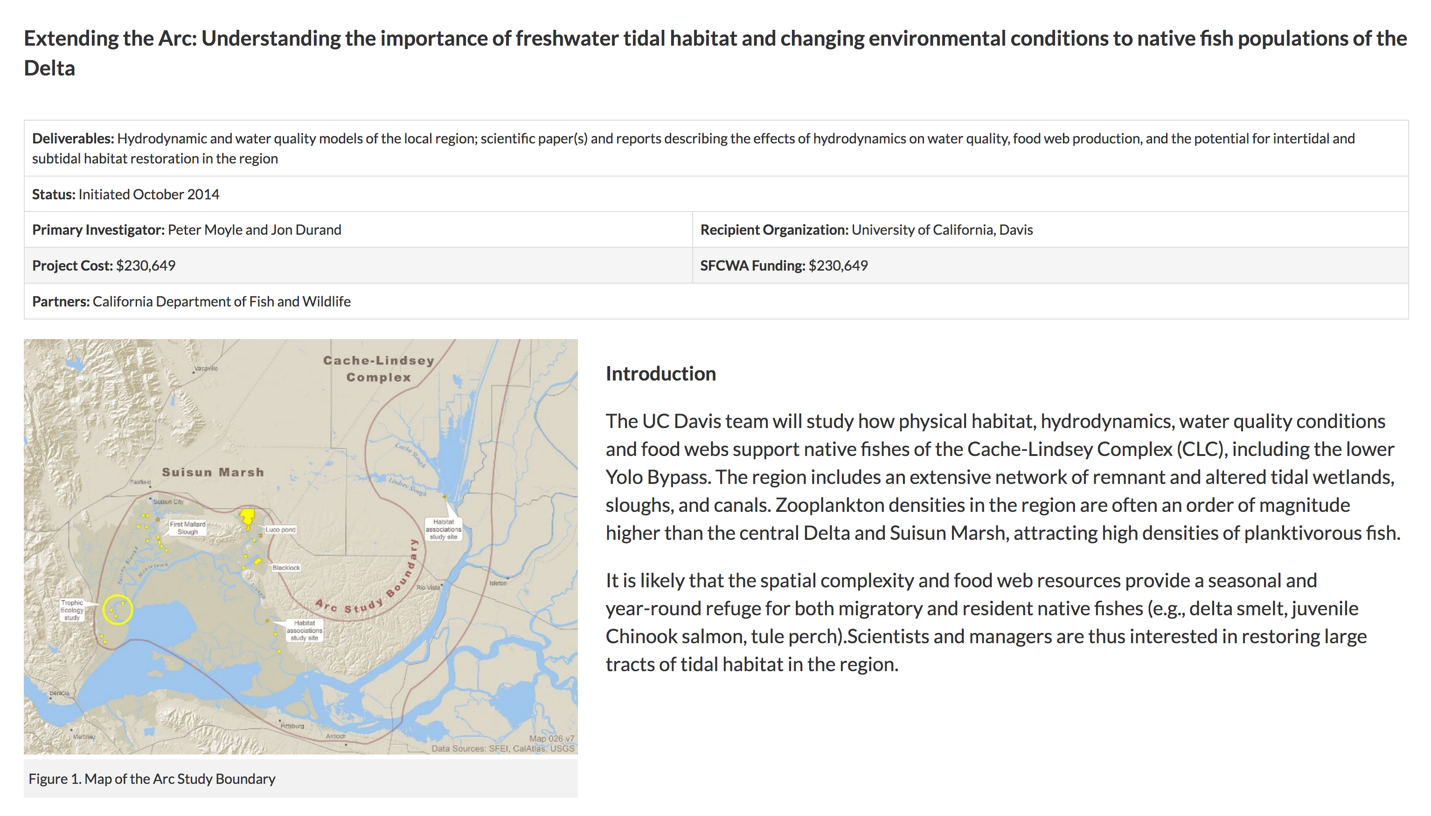
Notes:
Project article

Slide 22
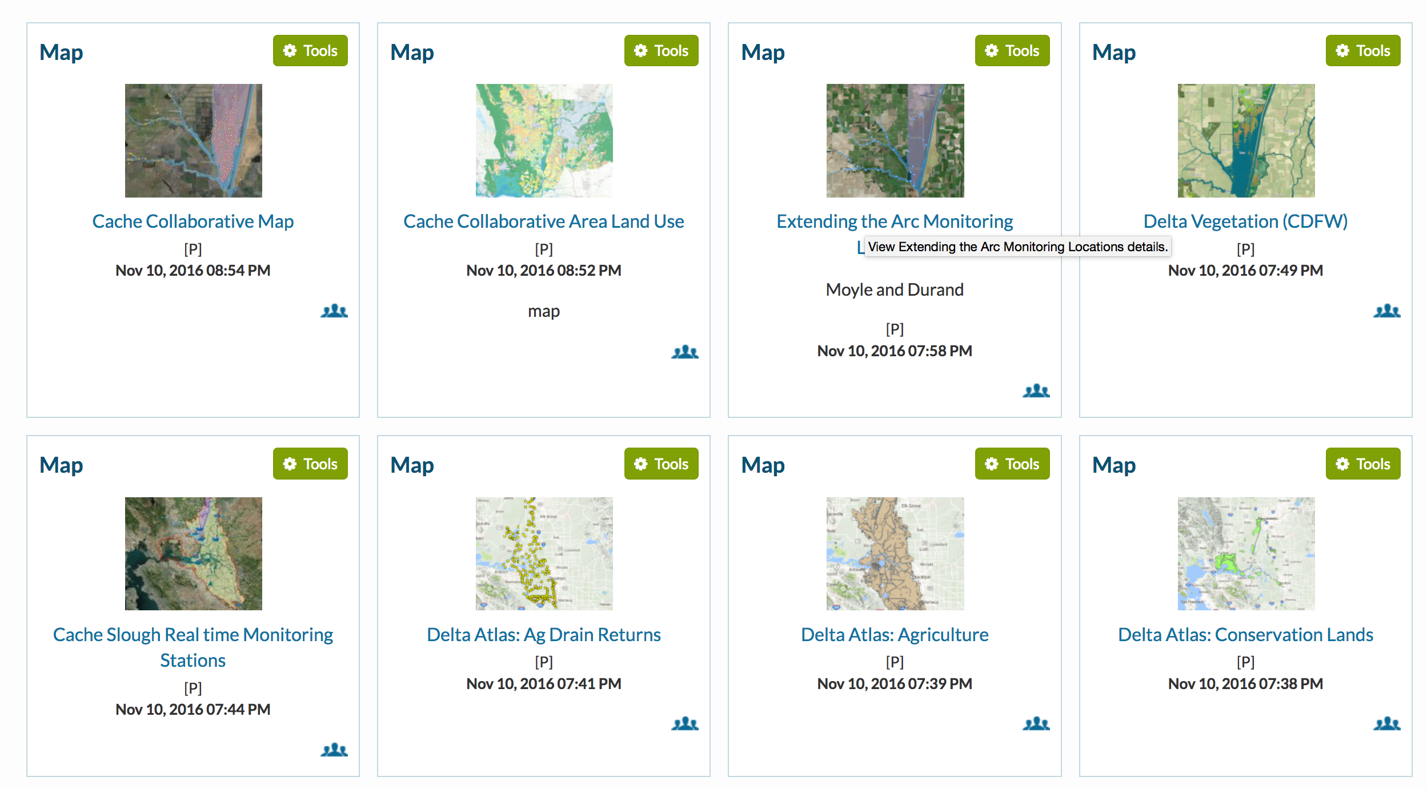
Notes:
Maps and GIS related to the Project

Slide 23
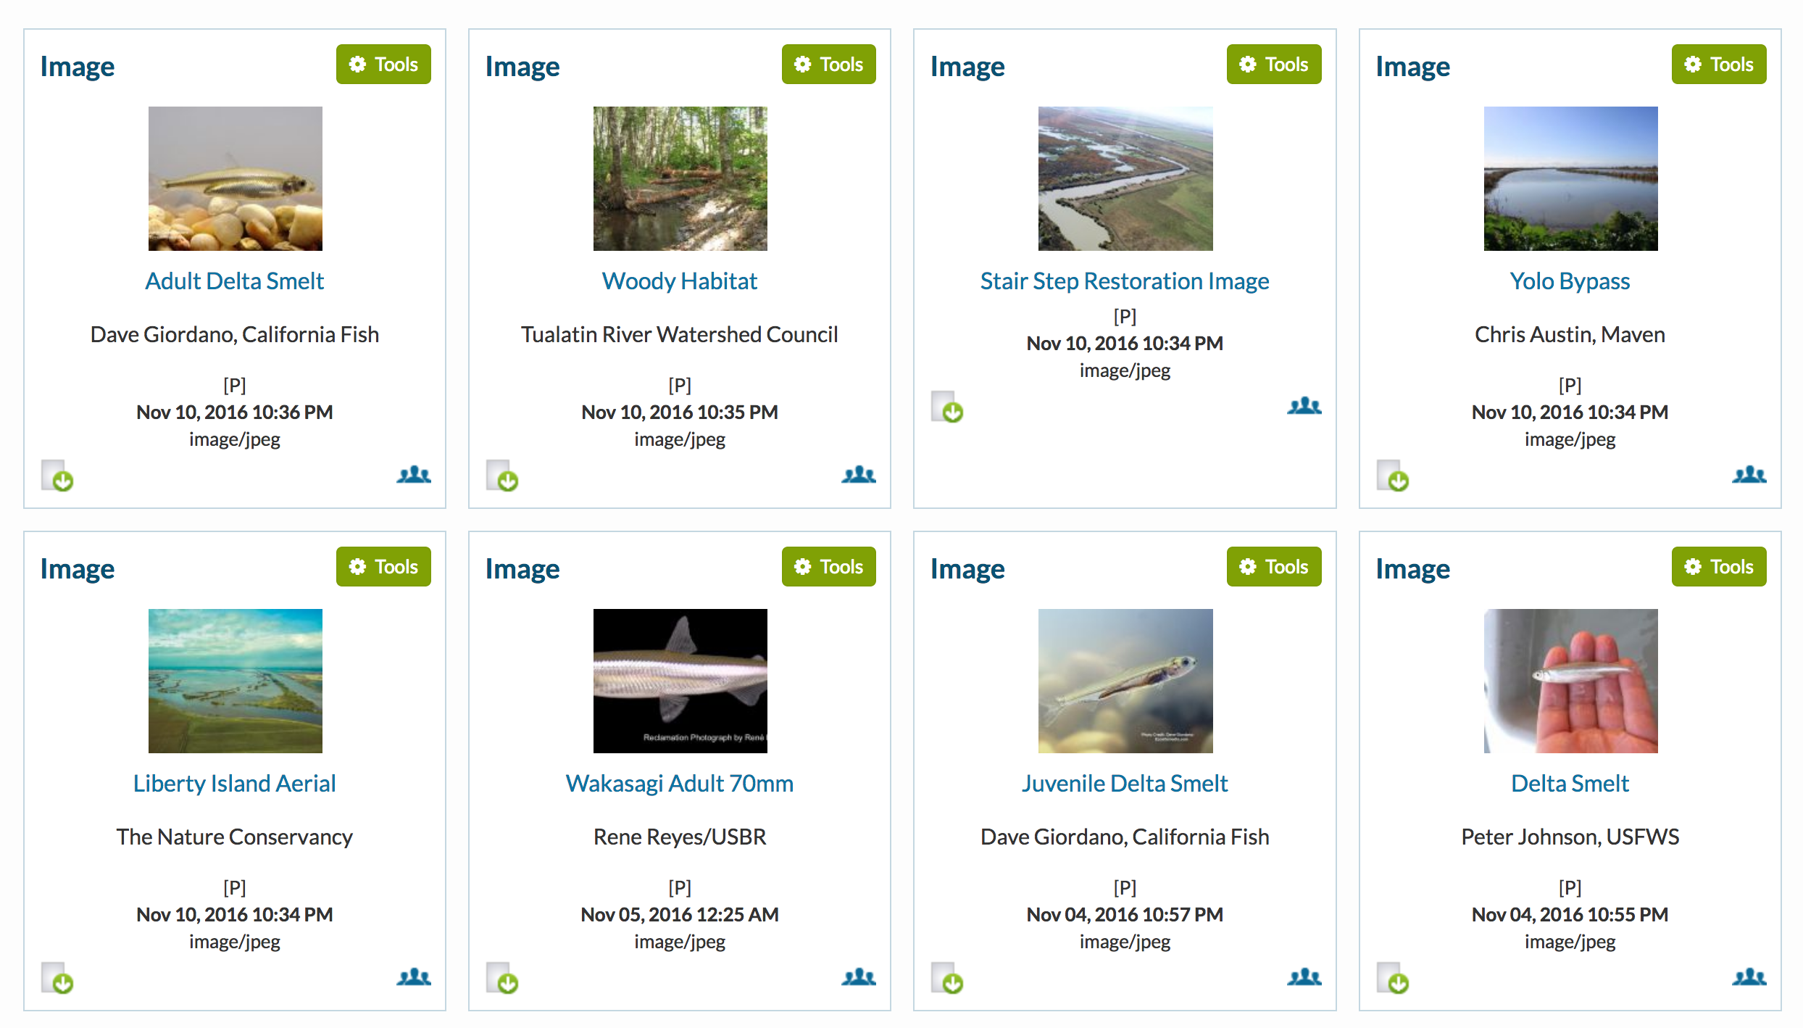
Notes:
Images

Slide 24
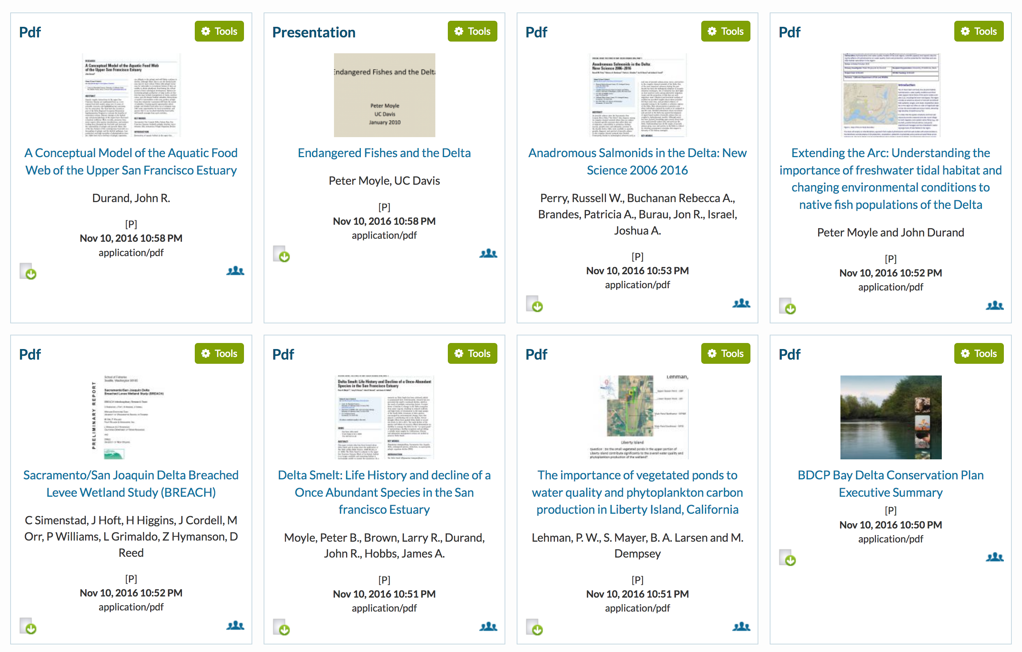

Slide 25
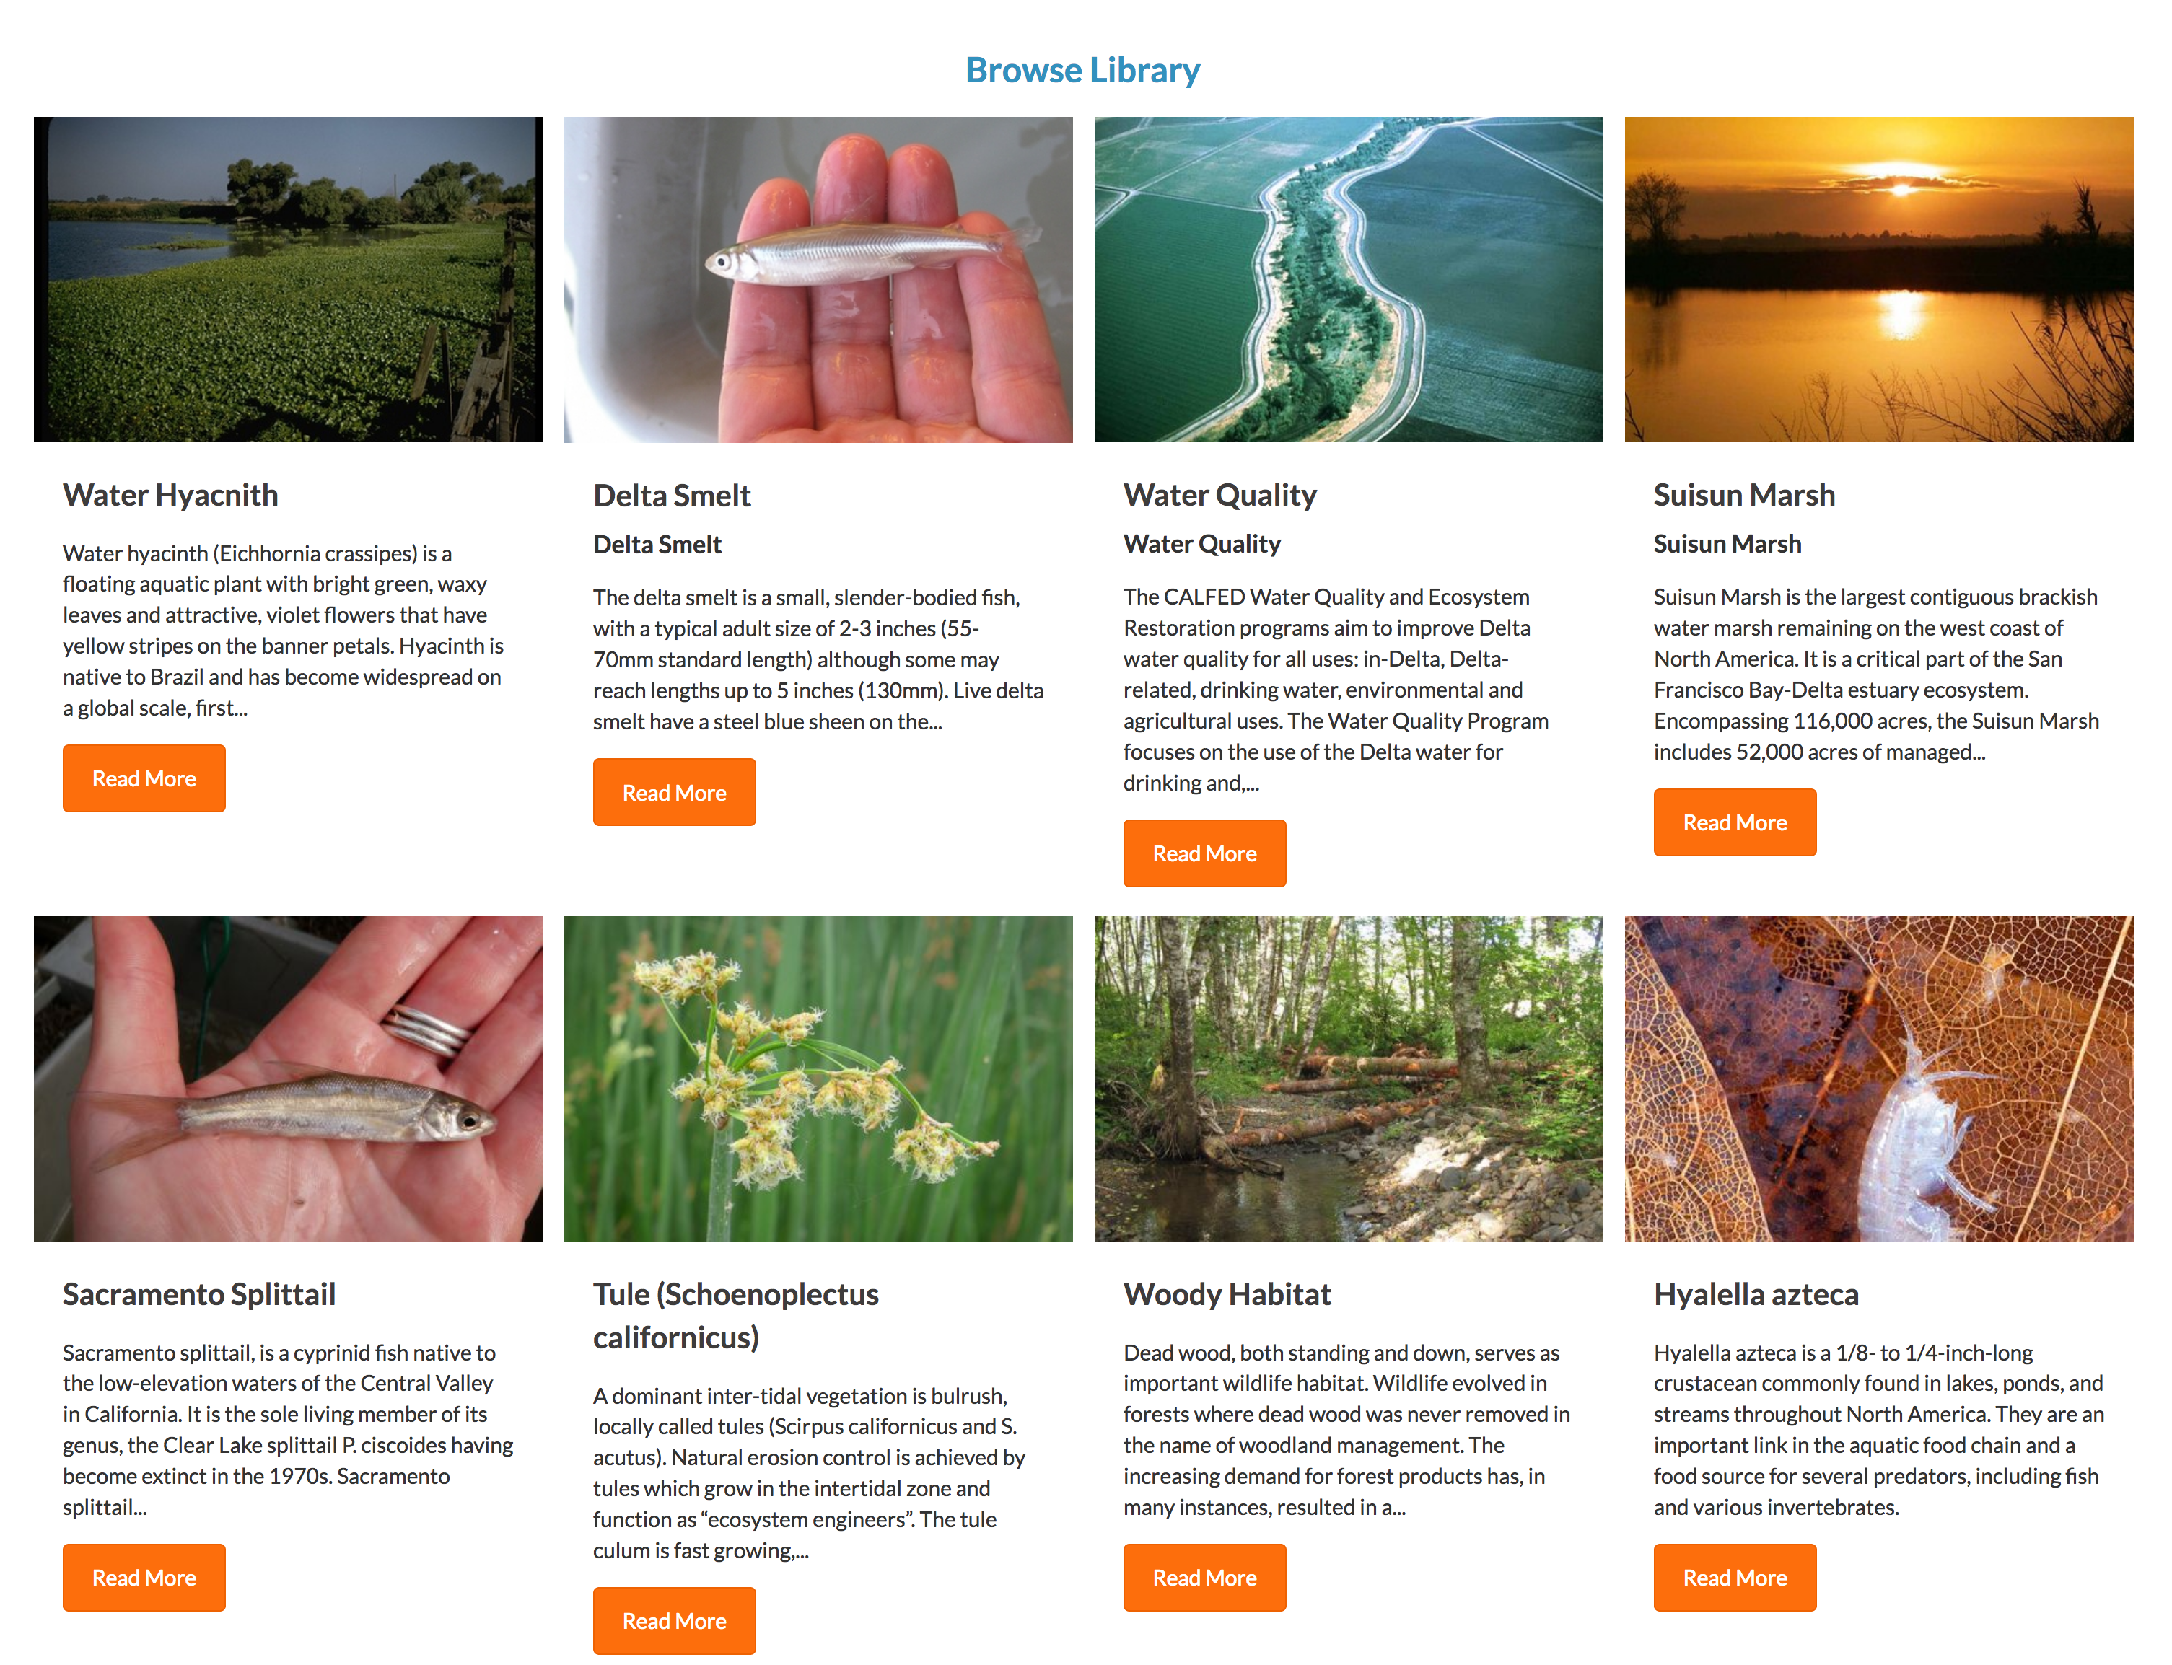
Notes:
Wiki Catalog

