Slide 1
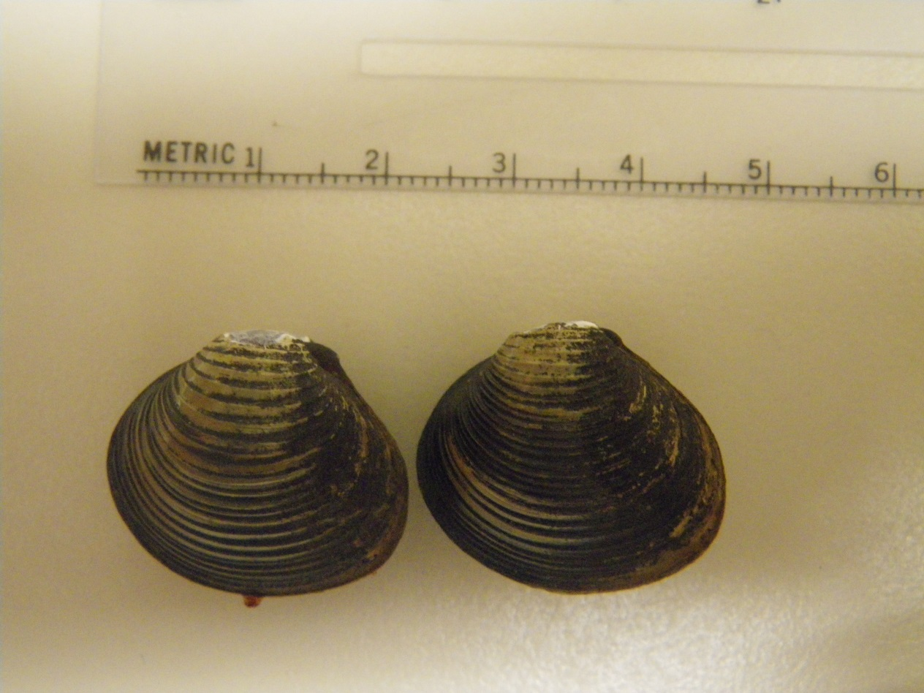
Photo: Betsy Wells
Name: Corbicula fluminea/ Asian clam
Phylum: Molluska, Class: Bivalvia
Origin: Non-native, from East Asia in 1945 (widespread by 1948)
Habitat: freshwater but tolerates salinity up to 17 ppt; fine or coarse clean sand or clay
Size: up to ~ 40 mm shell length
Notes: Filter feeder which can settle in water intake pipes and clog them.

Slide 2
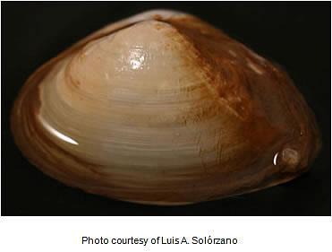
Name: Potamocorbula amurensis/ Asian overbite clam or Asian river clam
Phylum: Molluska, Class: Bivalvia
Origin: Non-native, from East Asia in 1986, probably in ballast water
Habitat: tolerates salinity from almost freshwater (1ppt) and to full marine levels (35 ppt) but in San Francisco Estuary thrives in Suisun and Grizzly Bay at salinity levels around 3-10 ppt; subtidal in muddy or sandy sediment
Size: up to ~25 mm shell length
Notes: A prolific filter feeder which has significantly reduced phytoplankton in the estuary, contributing to the decline of several zooplankton and fish species.

Slide 3
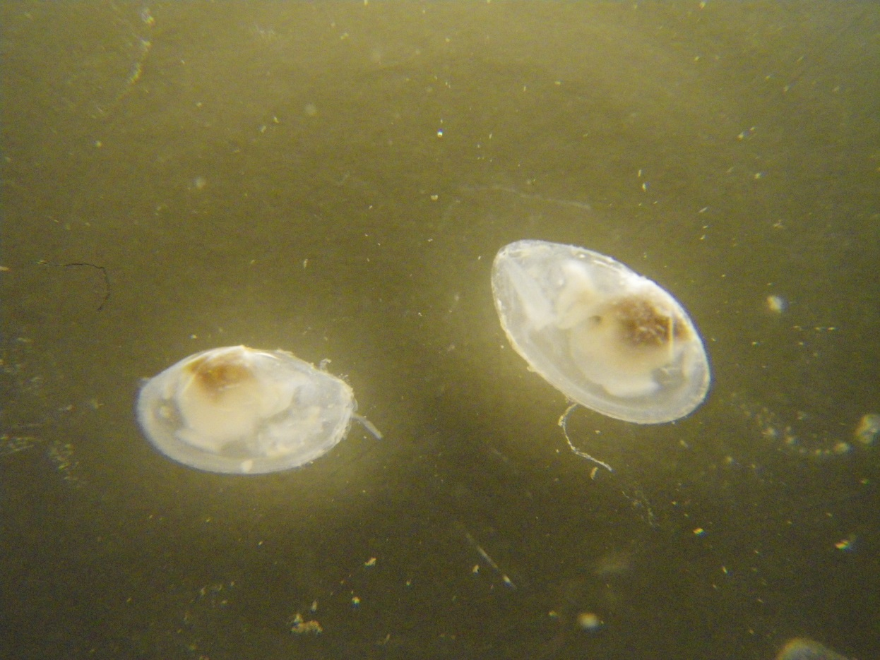
1 cm
Photo: Betsy Wells
Name: Theora lubrica / Asian semele, window shell
Phylum: Molluska, Class: Bivalvia
Origin: Non-native, from Sea of Japan in 1982, probably in ballast water
Habitat: higher salinities, from 18-40 ppt, in subtidal muddy sediment
Size: up to 16 mm shell length
Notes: Considered a pollution indicator because of its tolerance for low oxygen levels and organic-rich sediment. Deposit feeder that consumes benthic detritus and diatoms

Slide 4
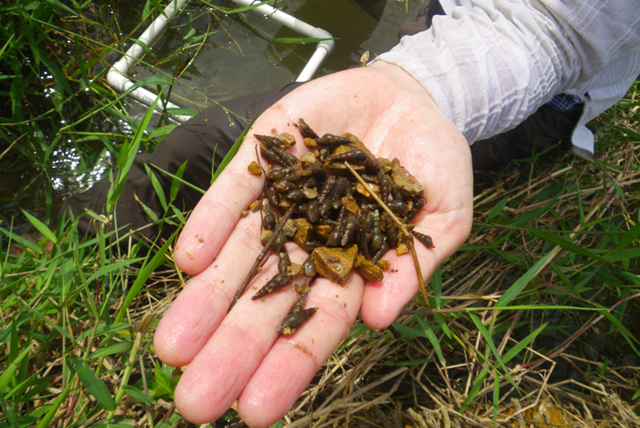
Photo courtesy of Global Invasions Research Coordination Network
Name: Melanoides tuberculata/ Red-rim melania or Malaysian trumpet snail
Phylum: Molluska, Class: Gastropoda
Origin: Non-native, originally found from Northern Africa to Southern Asia; introduced by the aquarium industry to the Delta in 1988
Habitat: freshwater, in sand, mud, and organic detritus
Size: up to 40-80 mm, but usually only 4-5 mm in the Delta
Notes: Grazes on microalgae and detritus and serves as food in turn to crabs, fishes, and birds, passing on the many trematode worms that parasitize it to its own predators.

Slide 5
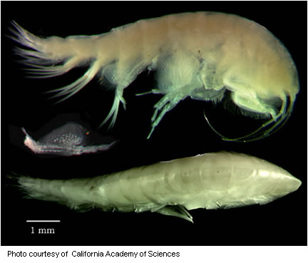
Name: Ampelisca abdita
Phylum: Arthropoda, Class: Amphipoda
Origin: Non-native from East Coast of North America, first observed in San Francisco Estuary in 1954; probably introduced with Eastern oysters transplanted for aquaculture
Habitat: higher salinities of San Pablo and San Franciso Bay; lives in a tube it constructs out of the mud or silt
Size: usually 7-8 mm
Notes: Consumes plankton but is also an opportunistic scavenger, predator, and even cannibal.

Slide 6
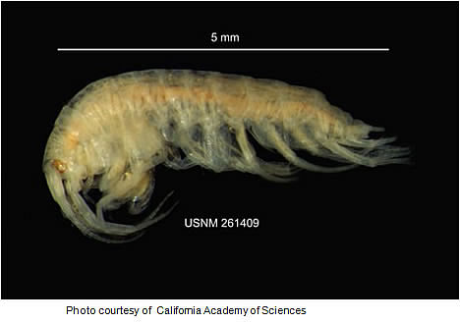
Name: Gammarus daiberi
Phylum: Arthropoda, Class: Amphipoda
Origin: Non-native from East Asia, introduced in 1986
Habitat: muddy sand bottoms from the low salinity zone (1-6 ppt) of Suisun Bay up into freshwater
Size: up to 8 mm
Notes: Grazes on phytoplankton; is a common fish food item; reaches sharp seasonal peaks of density in spring and summer.

Slide 7
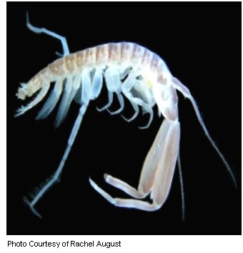
Name: Corophium alienense
Phylum: Arthropoda, Class: Amphipoda
Origin: Likely native to the Pacific Northwest
Habitat: Lives in mud tubes, in brackish water between 5-10 ppt
Size: ???
Notes: Active filter feeder on plankton, and eaten by various fish

Slide 8
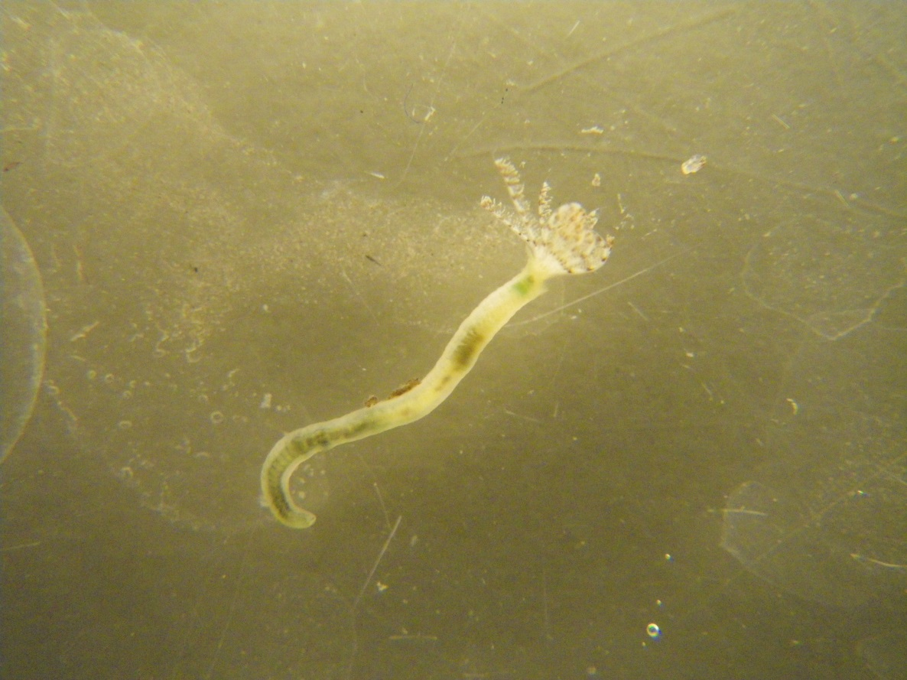
1 cm
Photo: Betsy Wells
Name: Laonome calida
Phylum: Annelida, Class: Polychaeta
Origin: Non-native from Australia, first described in the Delta in 1998
Habitat: Lives in a tube made of mucus and fine sediment particles, common in water 5-10 ppt but tolerates a wide range of salinity.
Size: 9-15 mm long
Notes: L. calida is a sabellid worm, with a crown of feathery tentacles (cirri) that obtain oxygen from the surrounding water and aid in feeding on suspended food particles

Slide 9
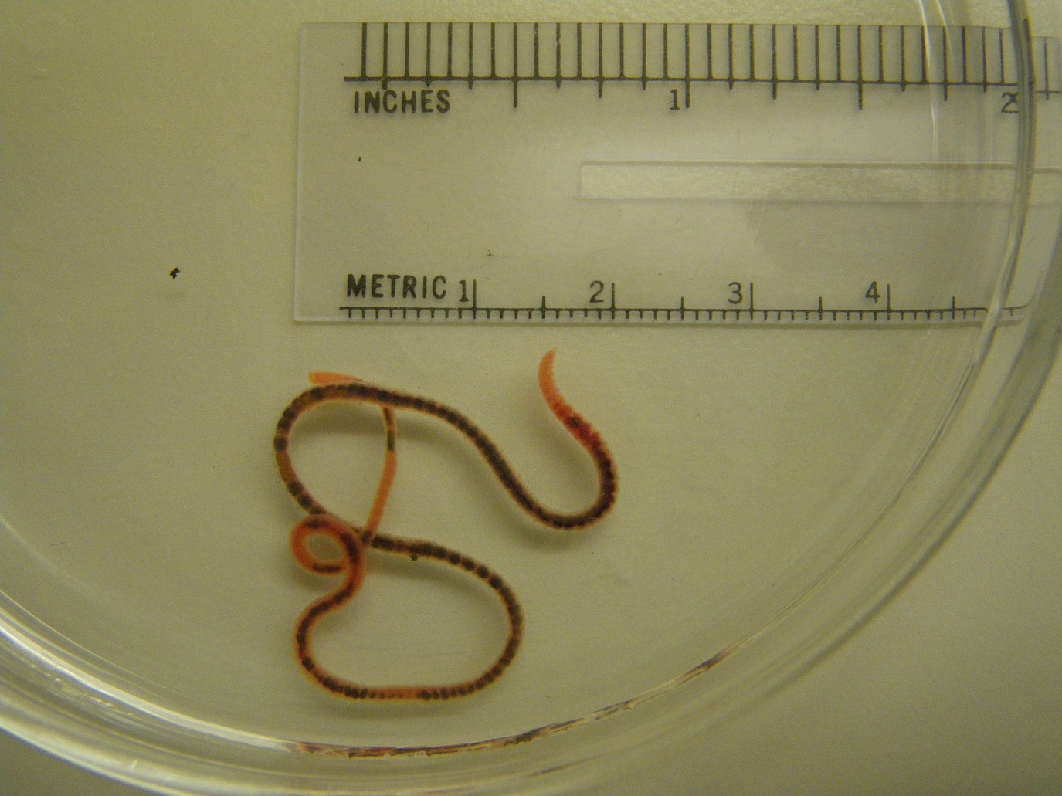
Photo: Betsy Wells
Name: Limnodrilus hoffmeisteri
Phylum: Annelida, Class: Oligochaeta
Origin: Non-native but origin unknown; found worldwide
Habitat: Freshwater, living in a variety of sediments
Size: 15-20 cm or larger
Notes: Deposit feeders that are tolerant of polluted sediments, especially heavy metals.

Slide 10
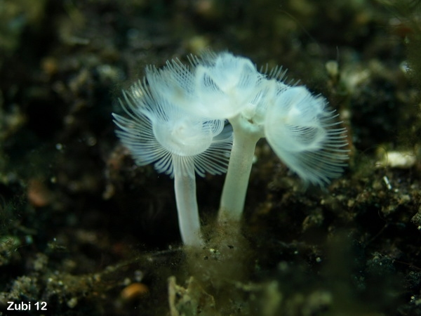
Photo courtesy of Theresa Zubi
Name: Phoronopsis harmeri
Phylum: Phoronida/ horseshoe worm.
Origin: Native
Habitat: Marine (water 25 ppt or higher), living in tubes they construct
Size: 20-? mm long
Notes: Filter-feeders with a U-shaped crown of tentacles called a lophophore; can reach high densities in San Pablo Bay in the fall and early winter of dry years, but do not tolerate influxes of fresh water.

