Slide 1
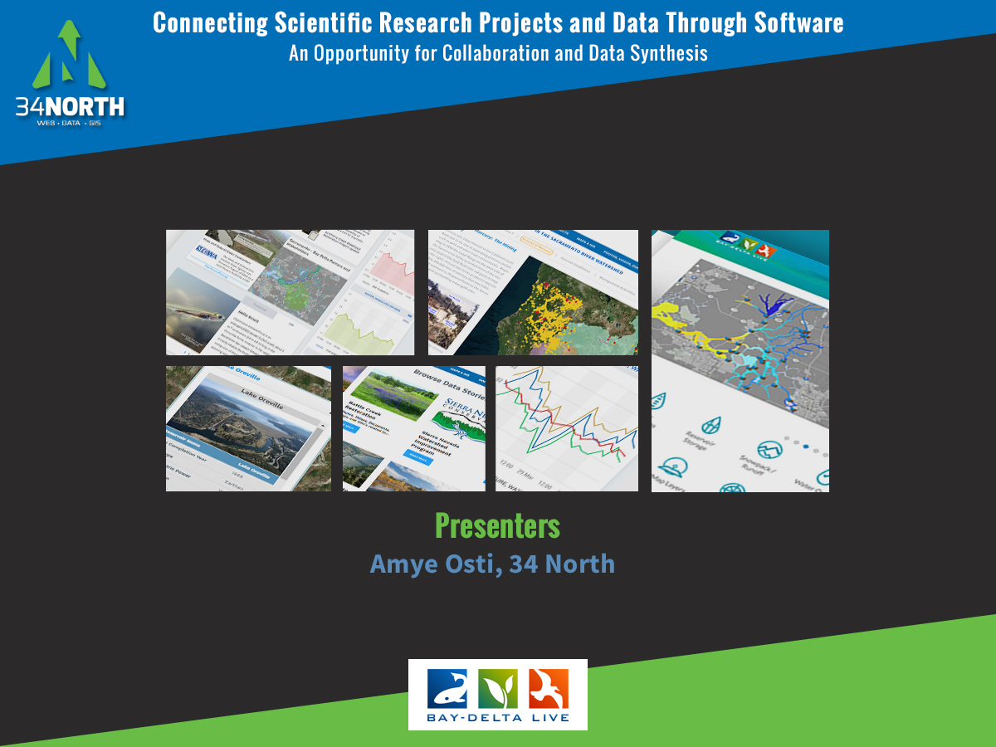
Notes:
Thank you for joining us this afternoon. Today I am going to talk about “Connecting Scientific Research Projects and Data Through Software. An Opportunity for Collaboration and Data Synthesis.

Slide 2
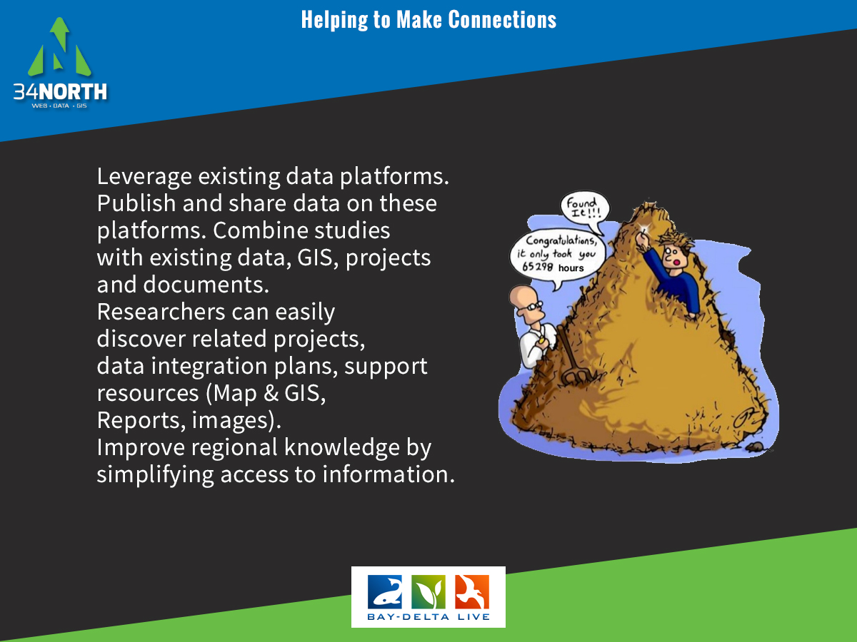
Notes:
So how can we work to connect more research? Well, we can leverage existing platforms and share data within the community. Using existing platforms allows the community to access your data and information. As well as provides you with an archive of related data, research, reports, maps, related project data, documents for your consumption. If we can simplify access to information, we can improve regional knowledge.

Slide 3
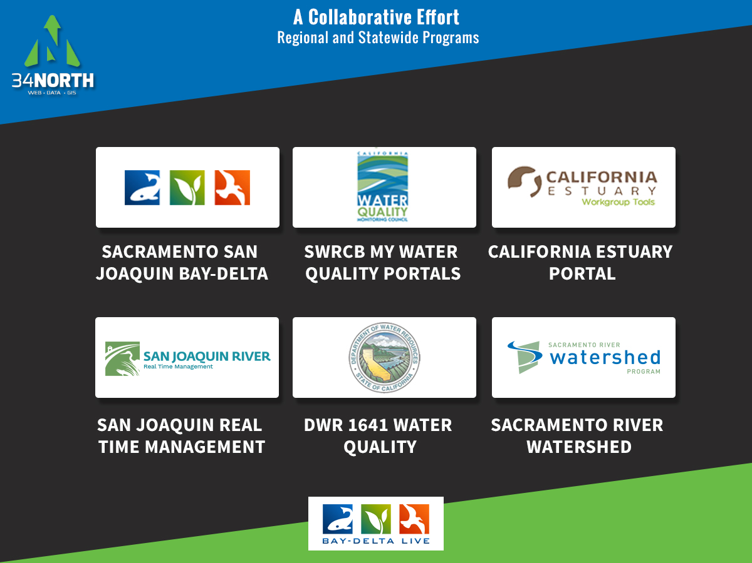
Notes:
This project I am going to show you today, builds on the above collaborative efforts. Each effort has contributed significantly to the overall data platform including improving access to data, regional and system wide datasets, expanding on information libraries, developing dashboards and much more.

Slide 4
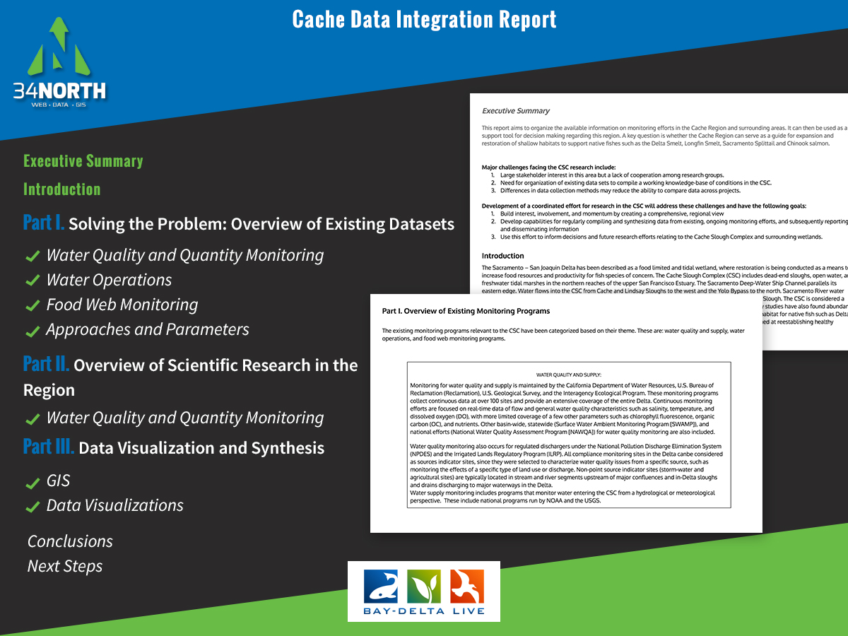
Notes:
Screenshots of report with list of what the report contains

Slide 5
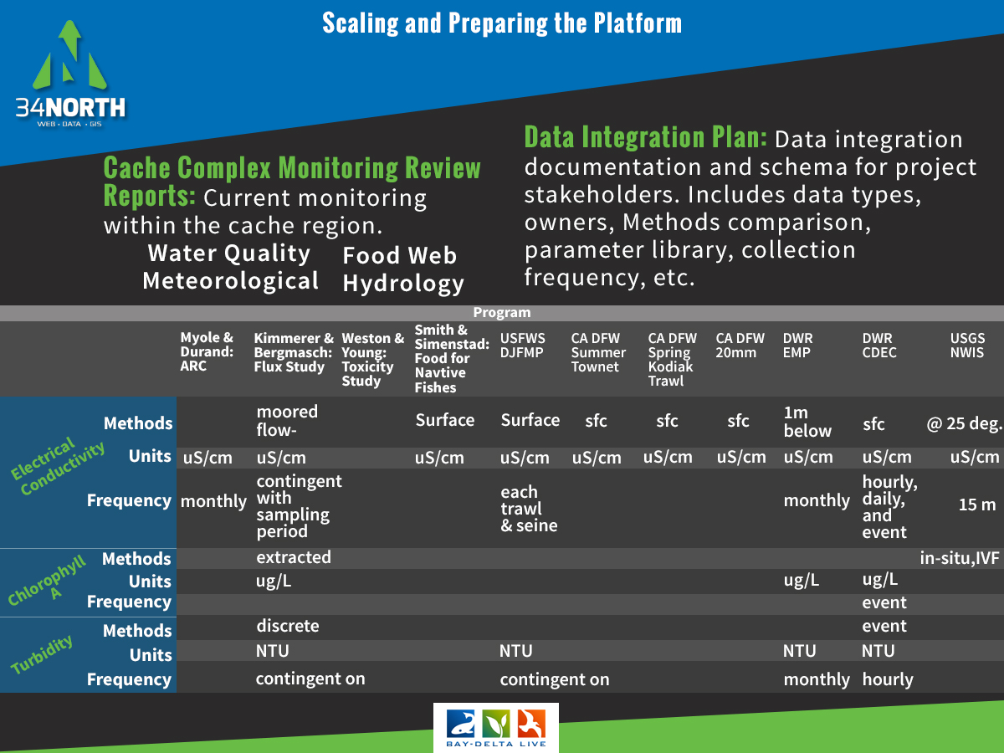
Notes:
The first task started to build this collaborative workspace was to develop a monitoring report for the region as well as a data integration plan. We review all exisiting data (data already on the portal) and data for the studies.

Slide 6
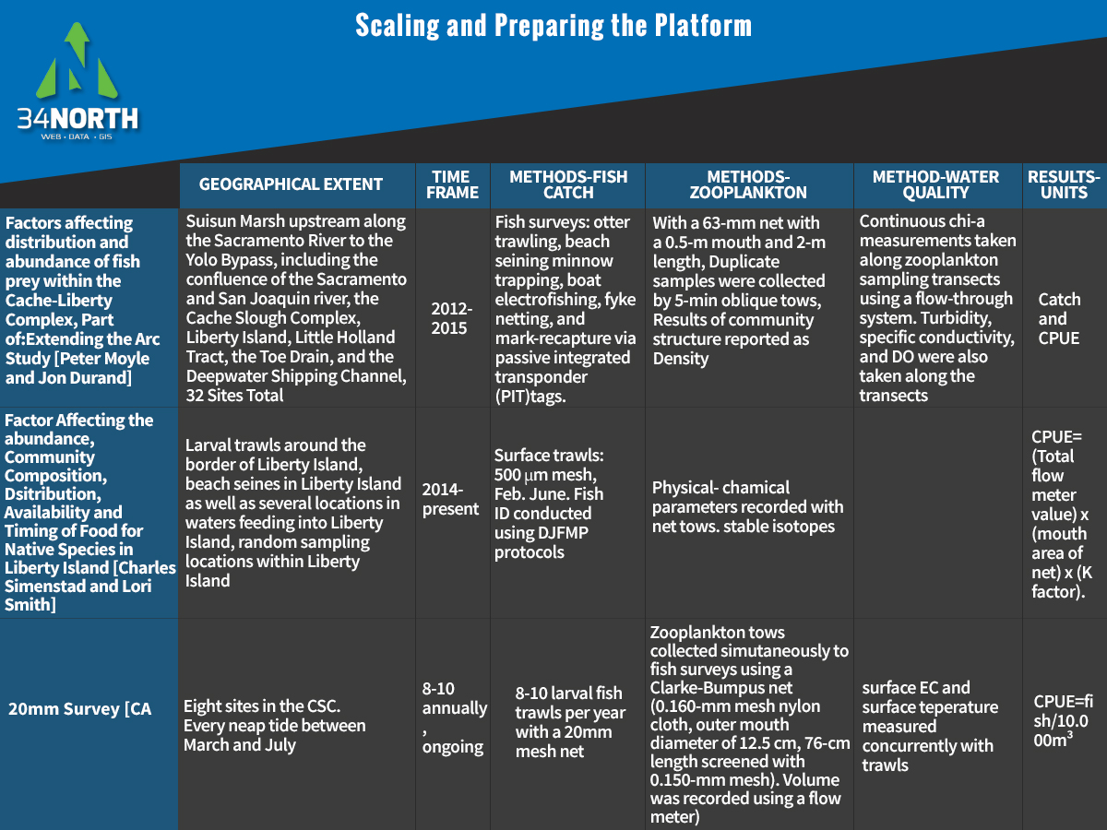
Notes:
Next we completed a methods comparison to make sure data would be compatible and make recommendations to Pis when needed.

Slide 7
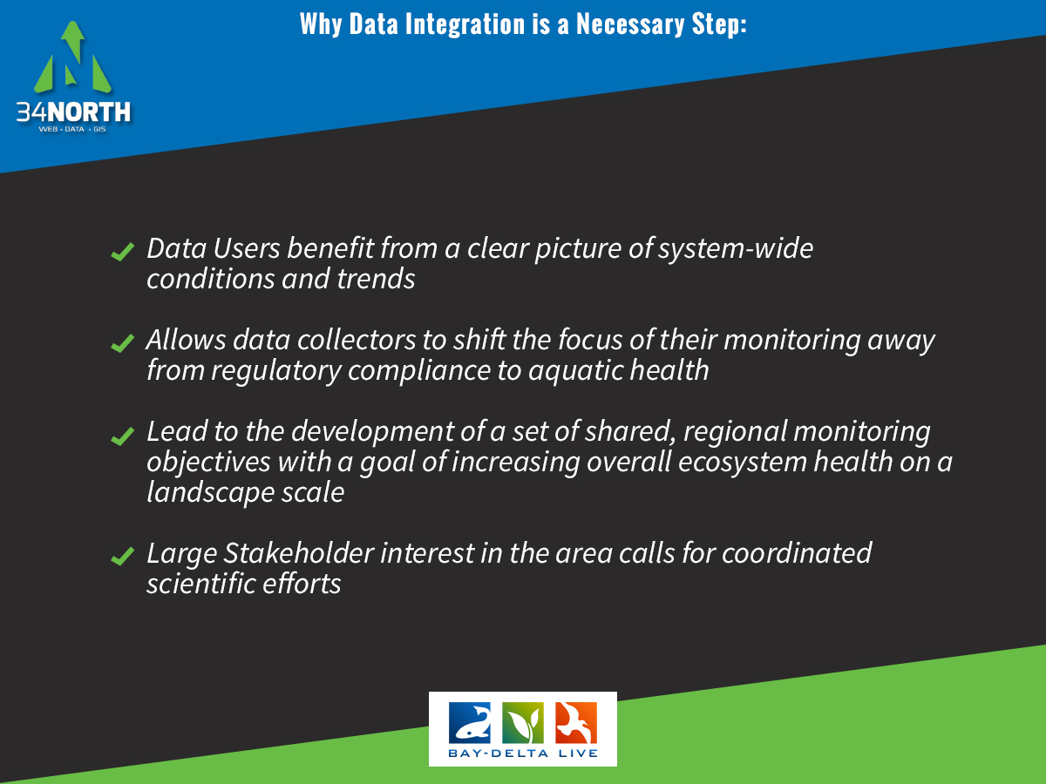

Slide 8
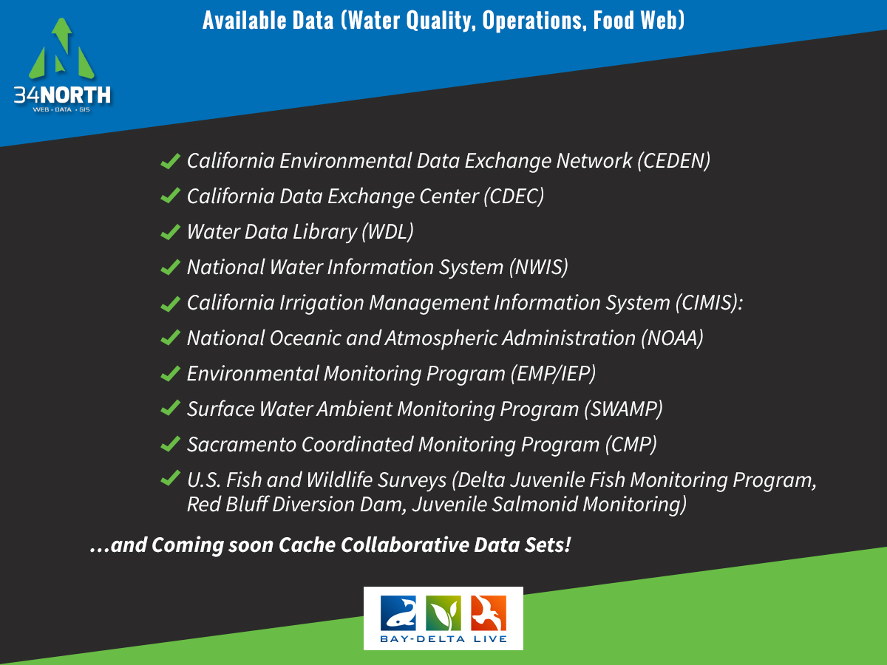

Slide 9
