Slide 1
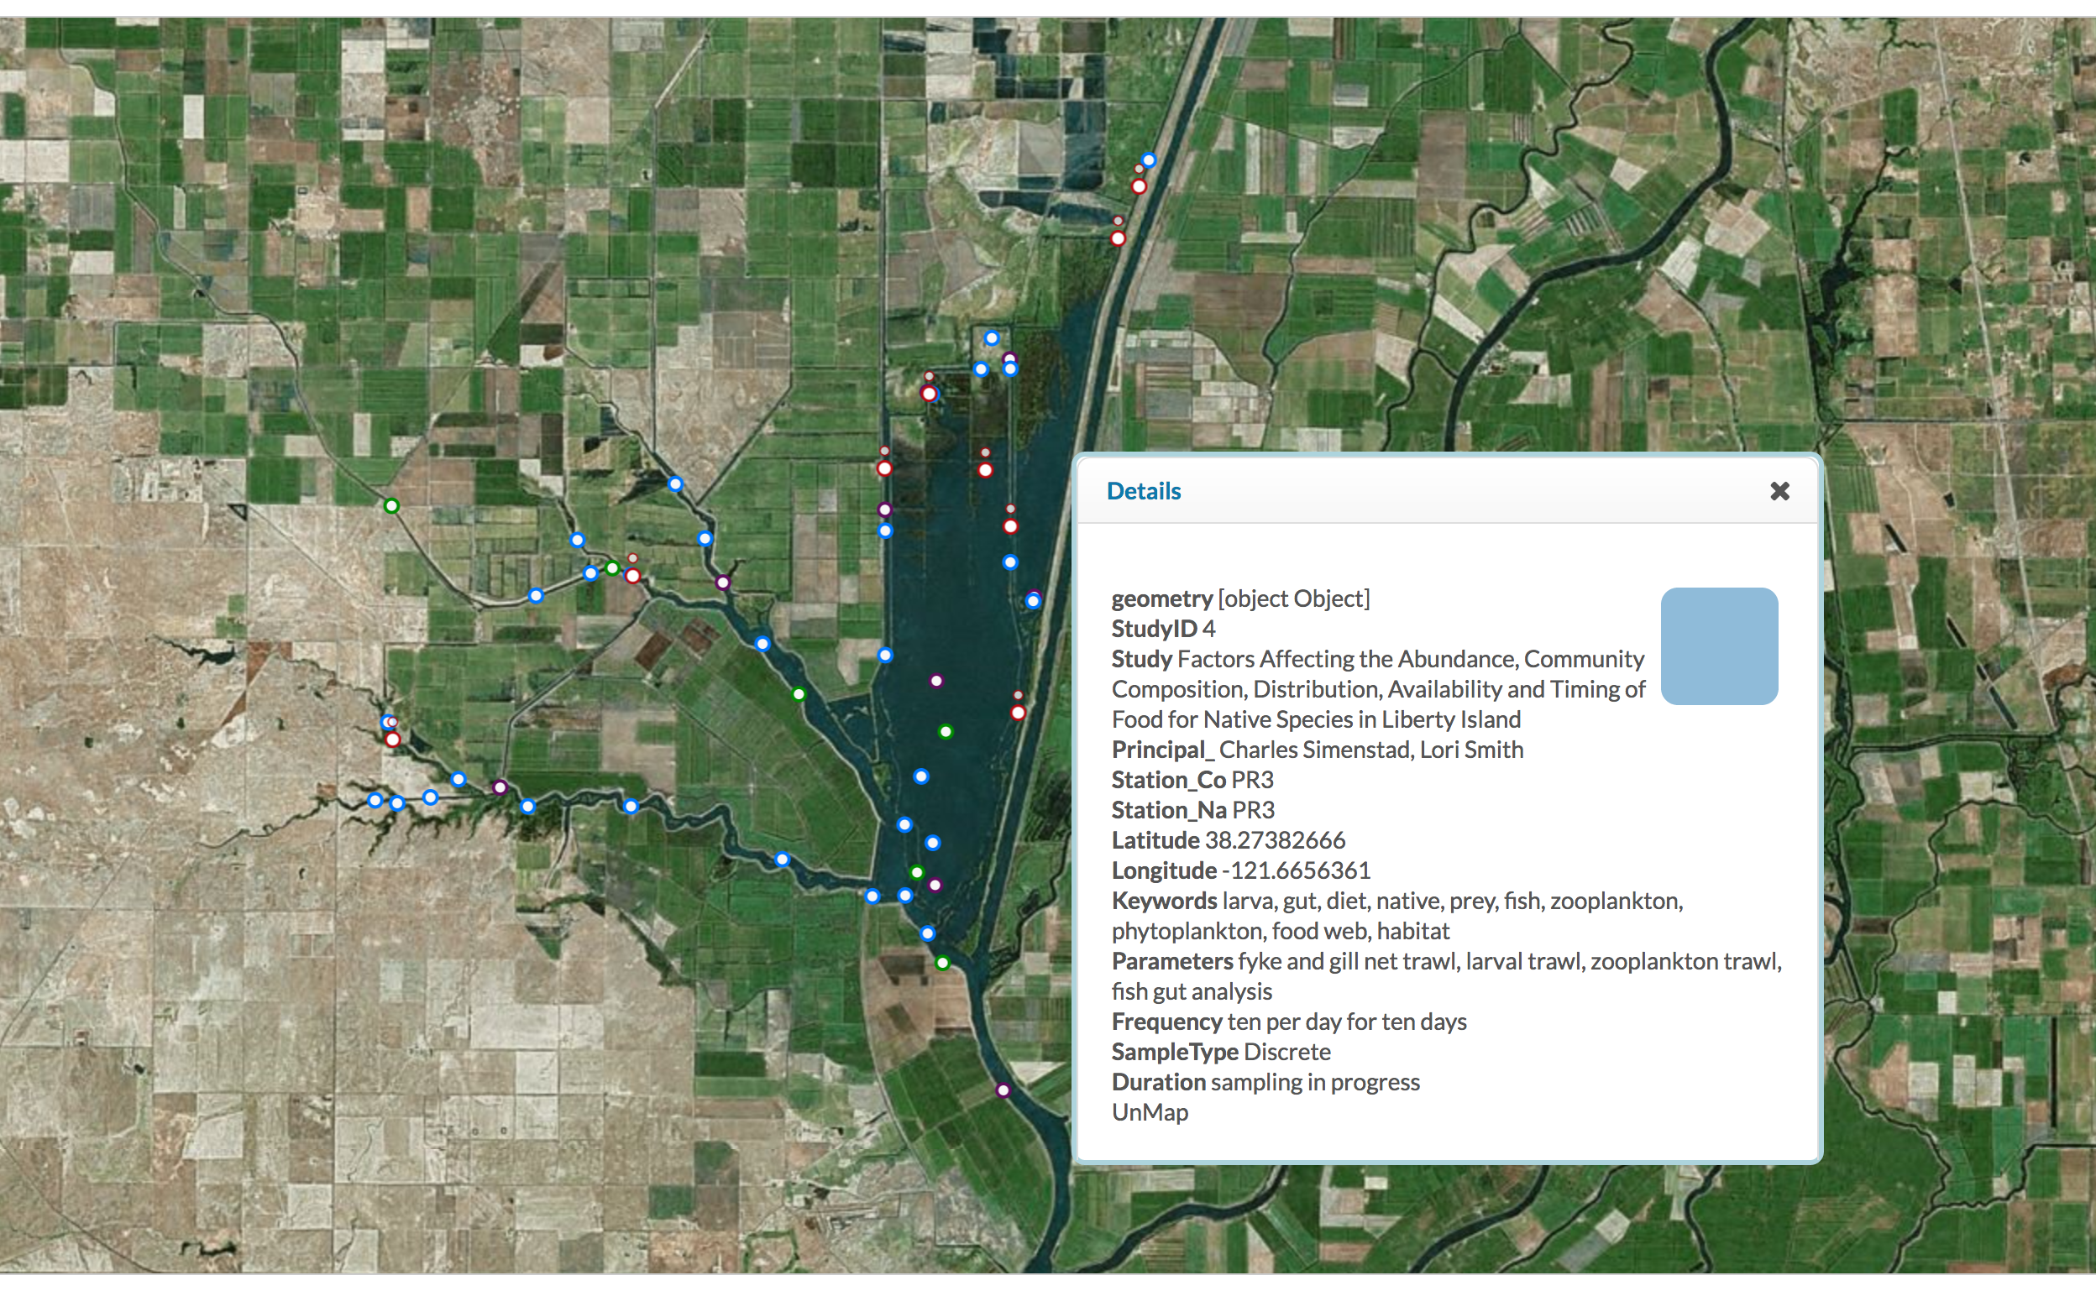
Cache Collaborative Monitoring Locations with Station Metadata

Slide 2
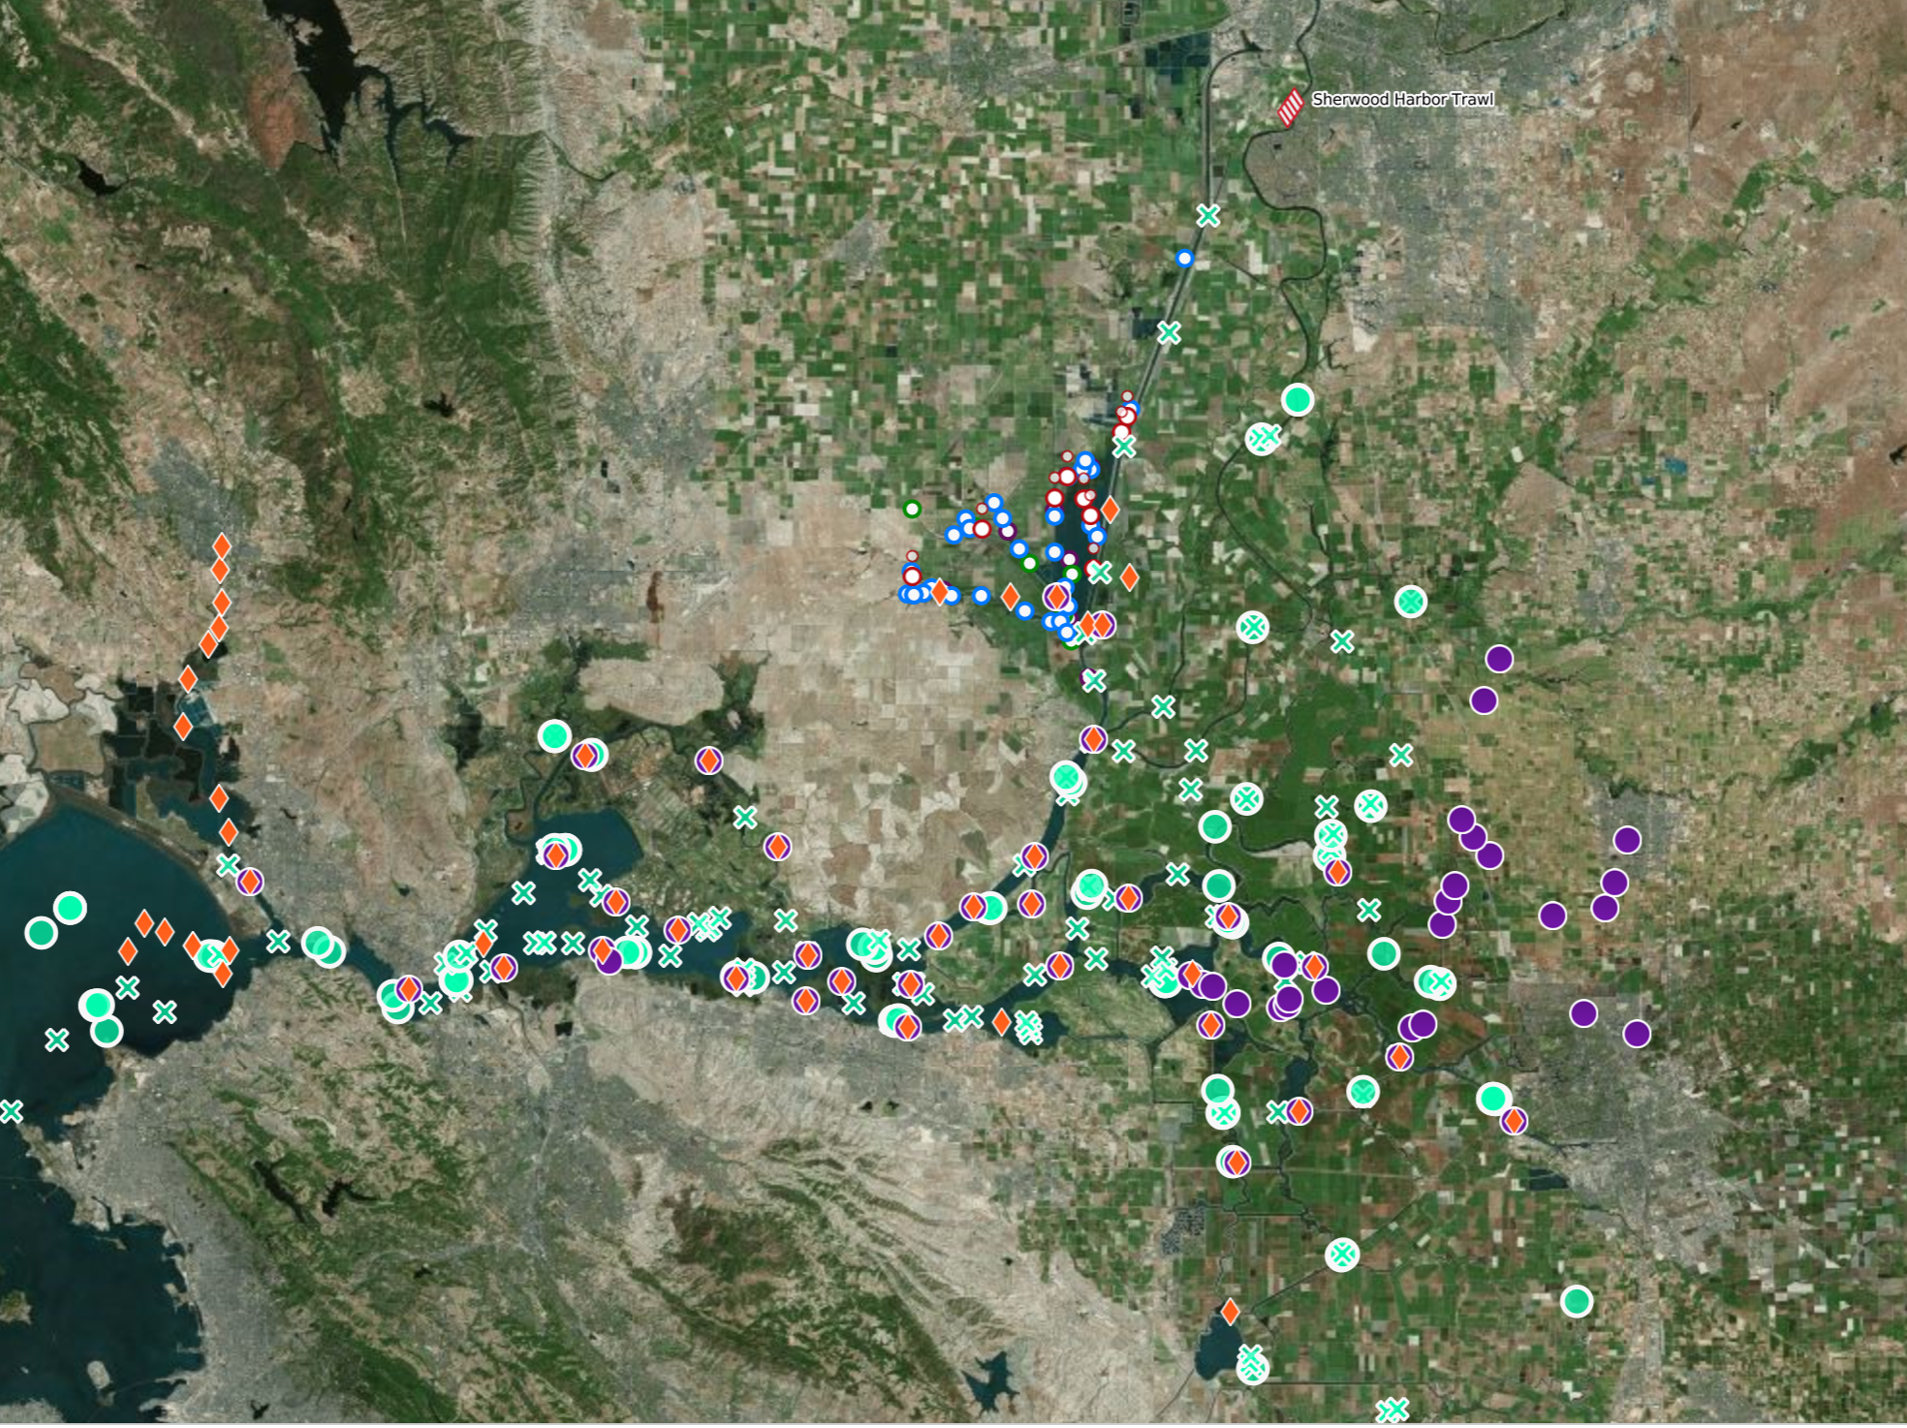
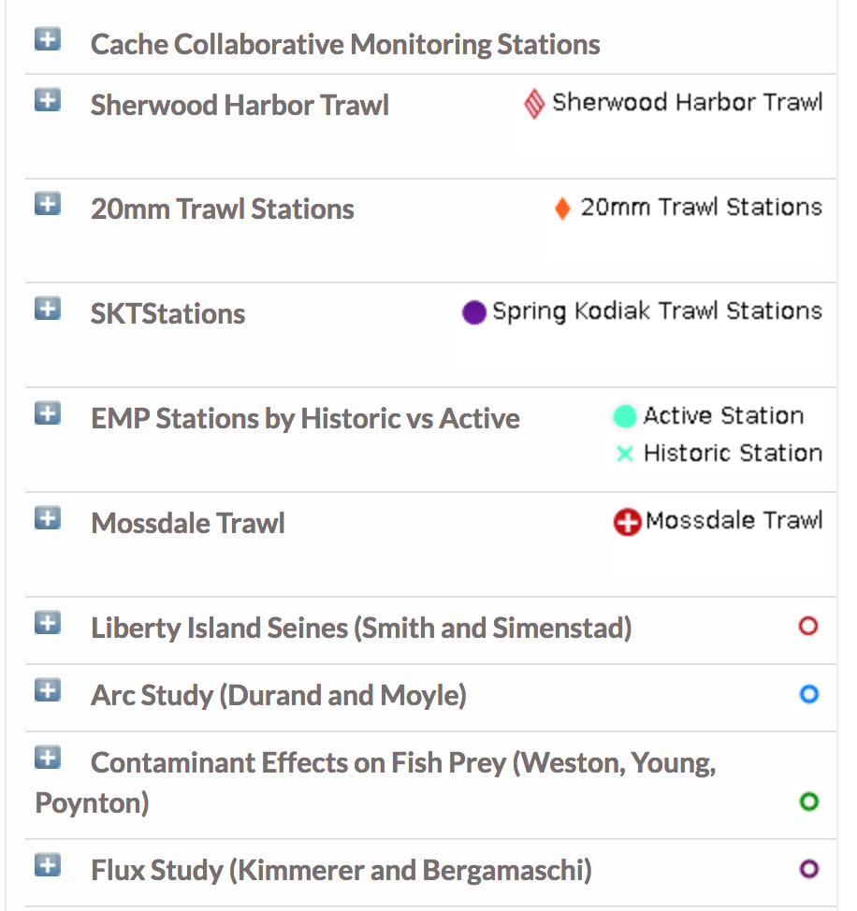
Sampling locations of Programs collecting Biologic Data (Zooplankton, Phytoplankton, Benthic, and Fish)

Slide 3
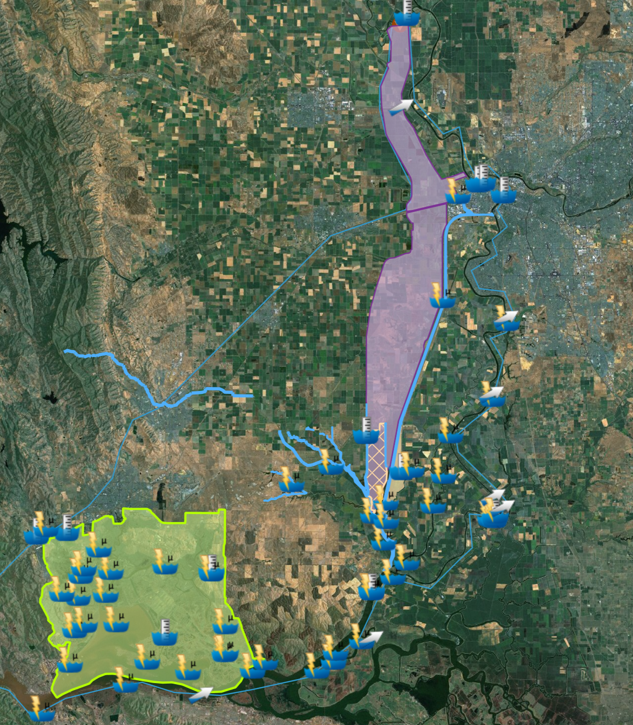
Real-time data collection sensors (Parameters include: Electrical Conductivity, Turbidity, River Stage, Flow, and Water Temperature) mapped with GIS layers of key locations in the Cache Slough Complex and the surrounding areas.

Slide 4
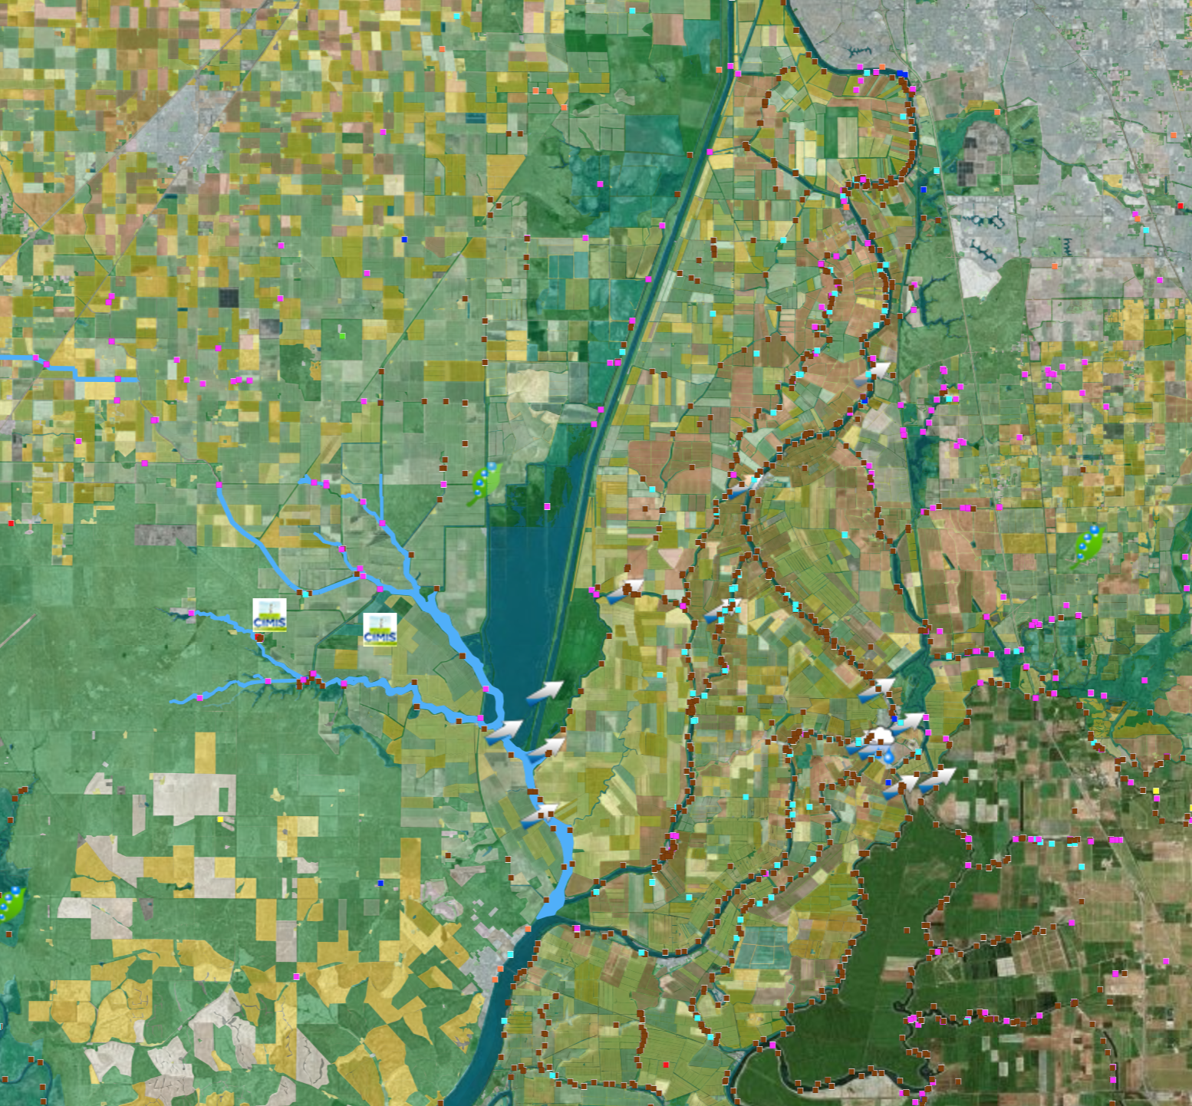
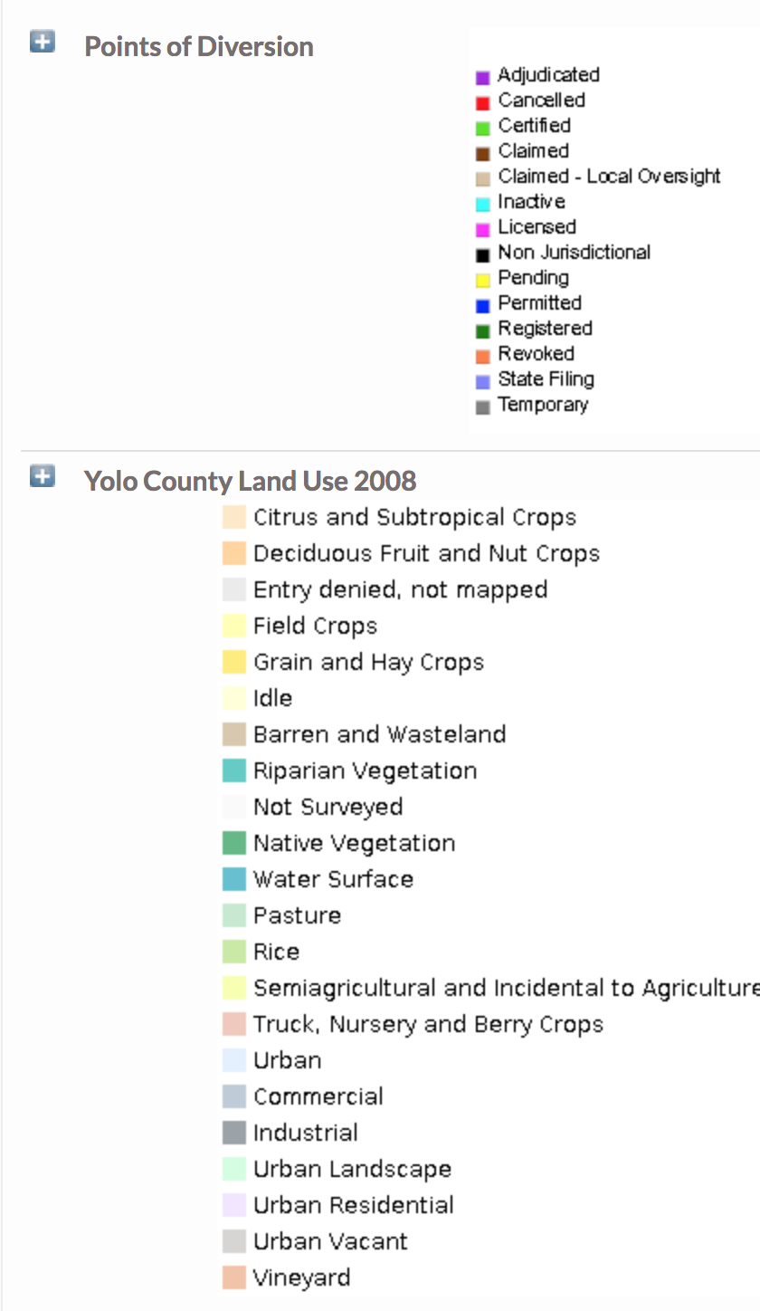
Land Use, Points of Diversion, Flow and Precipitation Data for the Cache Slough Complex

