Slide 1
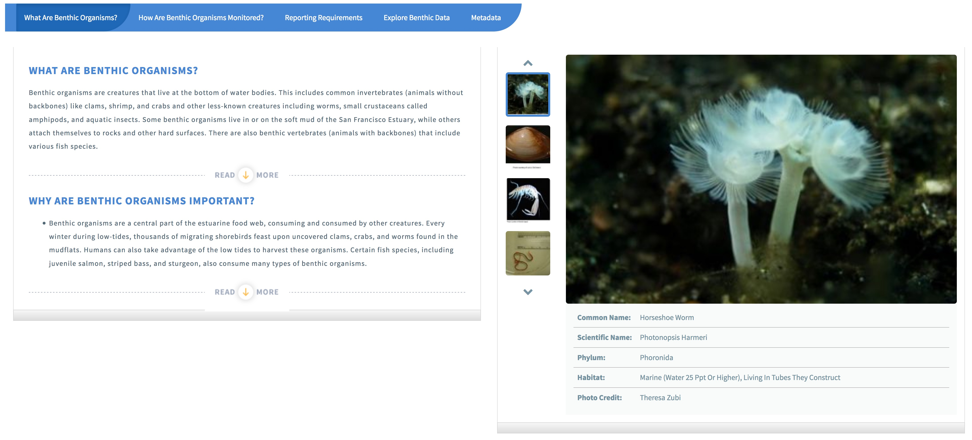
Notes:
The first tab of each of the 6 living resource projects gives a general overview of Program. Here we have an example from the Benthic Monitoring Section. This Tab, What Are Benthic Organisms?, gives the user a general description of benthic organisms and their ecological importance. The Photo carousel highlights important species and gives general information about each organism. Here we have a picture of the Horseshoe worm.

Slide 2
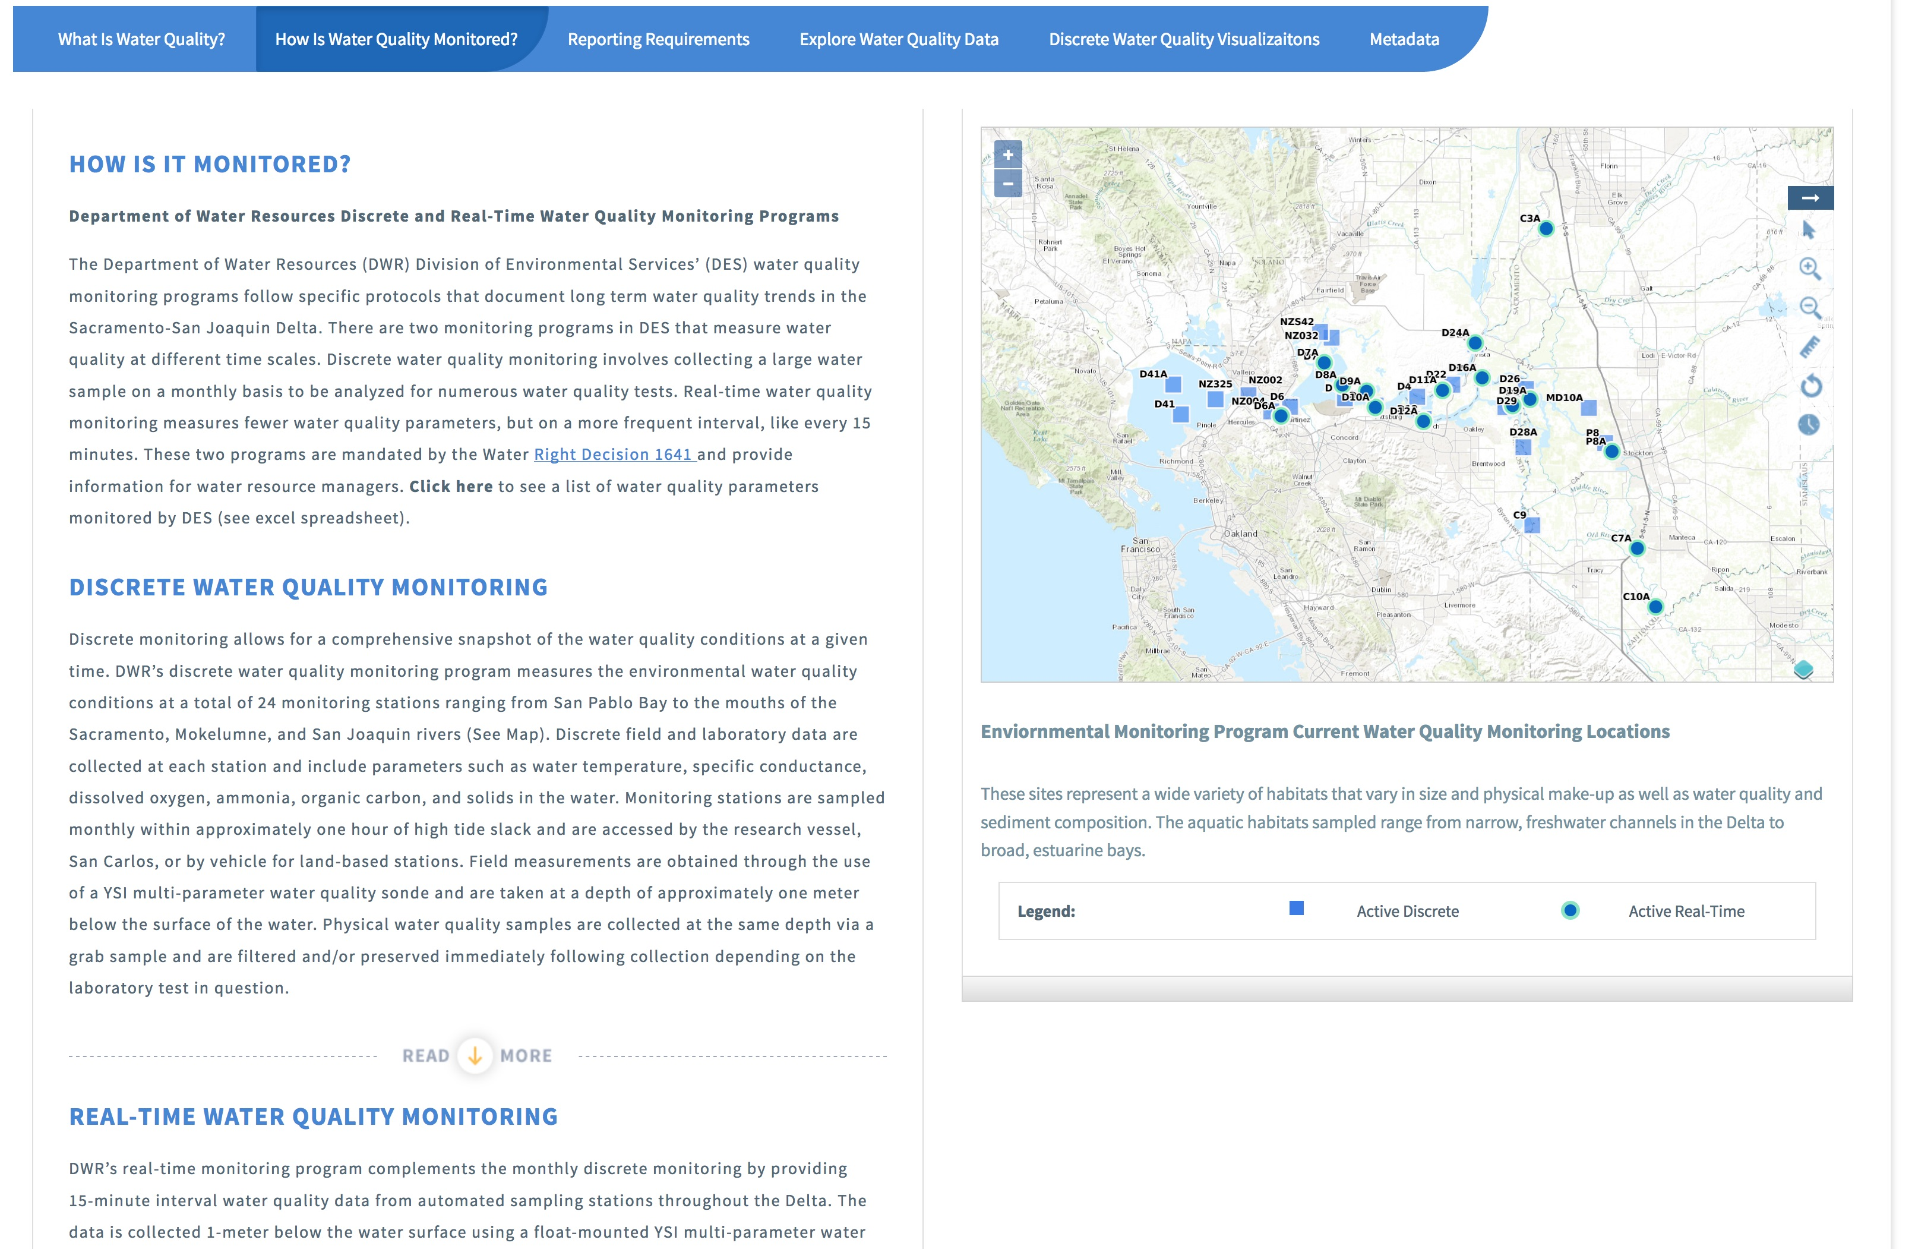
Notes:
The second tab of each program details how the data is collected. In this example of water quality we have text descriptions of both the discrete and continuous water quality monitoring programs. The interactive map with custom gis on the right displays all active discrete and continuous water quality monitoring locations. The gis files, as well as all other gis files, can be downloaded as a zip file with all components you would need to then upload that data into your desktop gis program such as ARCGIS or QGIS

Slide 3
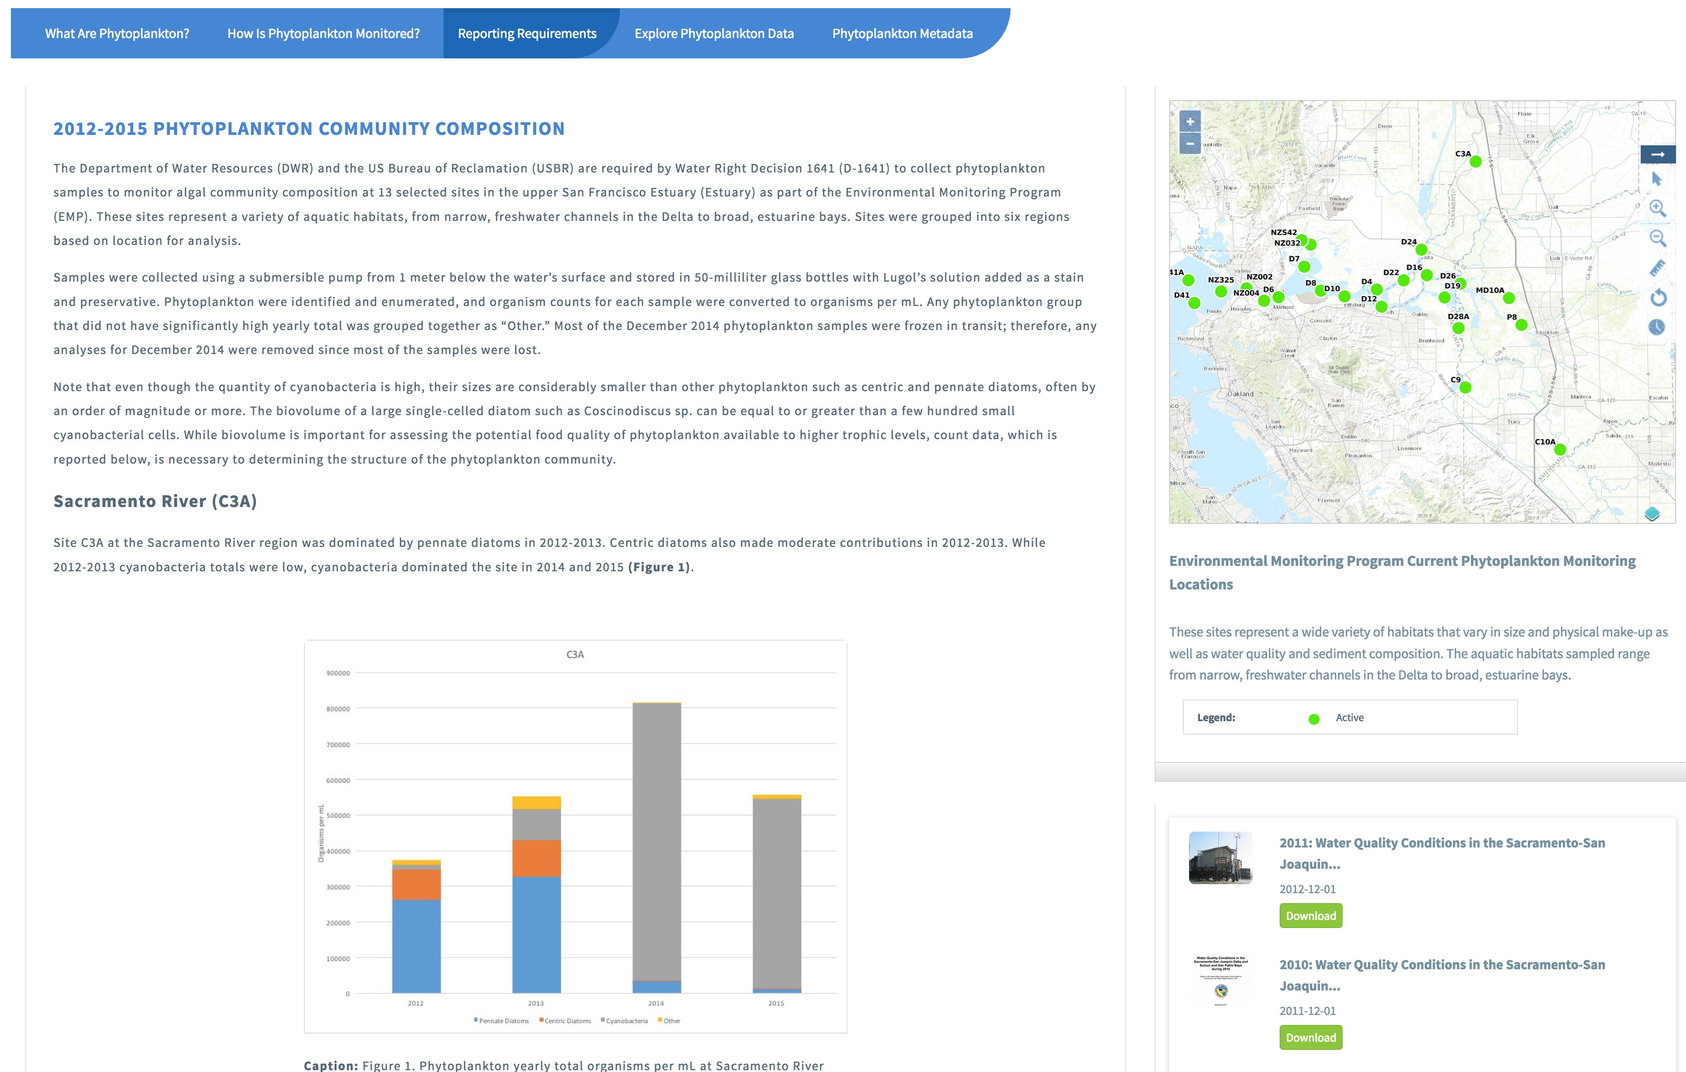
Notes:
Using our content management system the program leads are able to customize a reporting requirement tab. This example showcases the Phytoplankton reporting tab. The last Water Quality Report was published in 2011 and this reporting tab shows the conditions and trends in the time since that last report, 2012-2015 (2016 data is still being processed in the lab). For reference we have also included a map with sampling locations and an archive of the previous water quality reports that can be downloaded from the site.

Slide 4
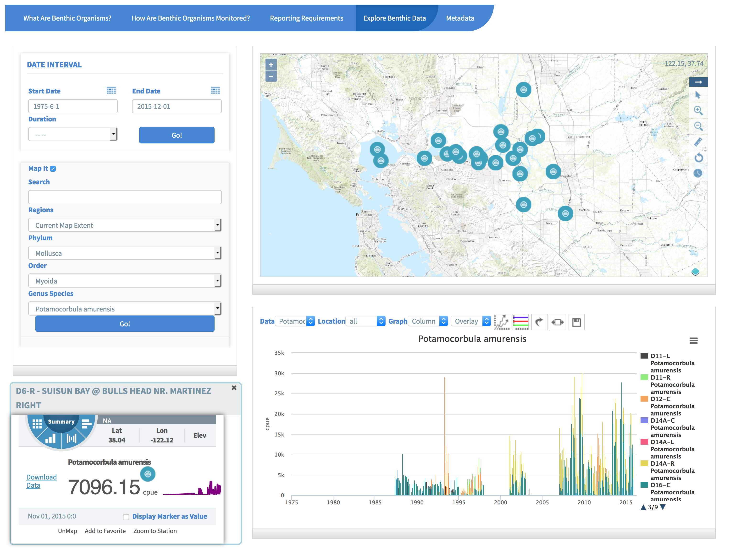
Notes:
Using the dynamic explore data filters we can select a species of interest. Here period of record data is displayed for the overbite clam. The graph units on the y axis are CPUE and the time scale is in months, due to the large amount of data only the year markers are showing on the x axis. In the graph you can see the periods of increased invasion of the clam. In the interactive map you can click on an individual station to see the most recent CPUE value as well as a sparkline of trends over time.

Slide 5
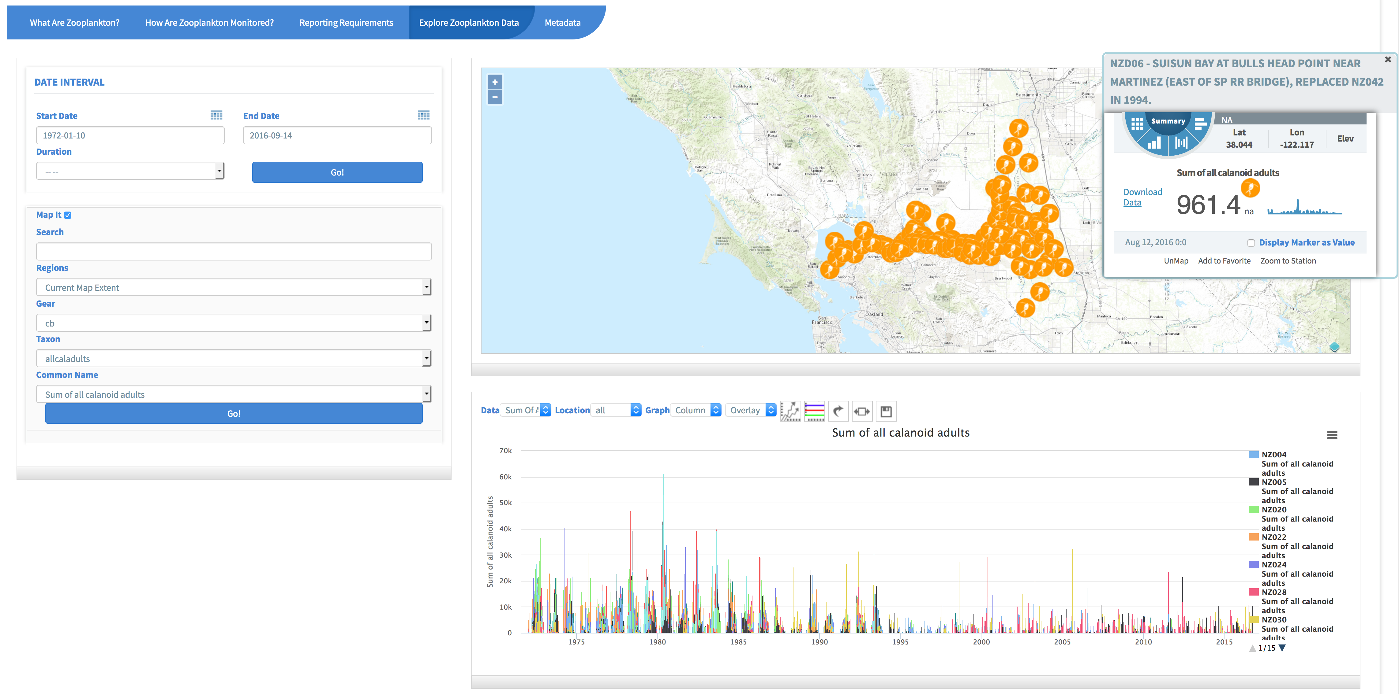
Notes:
Corresponding with the introduction and subsequent invasion of the overbite clams was a decline in abundance of calanoid copepods, which is shown here through the explore data in the zooplankton section of the data platform. The custom filters reflect the data structure of zooplankton data where the first filter is to select a gear type then a taxon or common name. Each of the items in the graph can be turned off or on with a click and all data and graph images can be downloaded.

