Slide 1

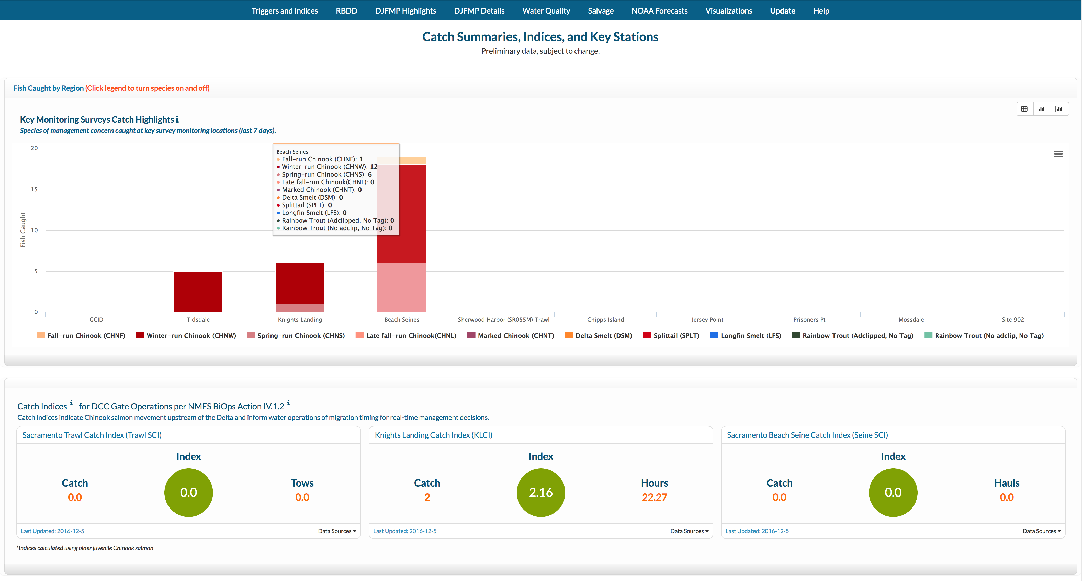
These components aggregates current conditions pertaining to the Reasonable and Prudent Alternatives of the Long-Term Biological Opinions.

Slide 2
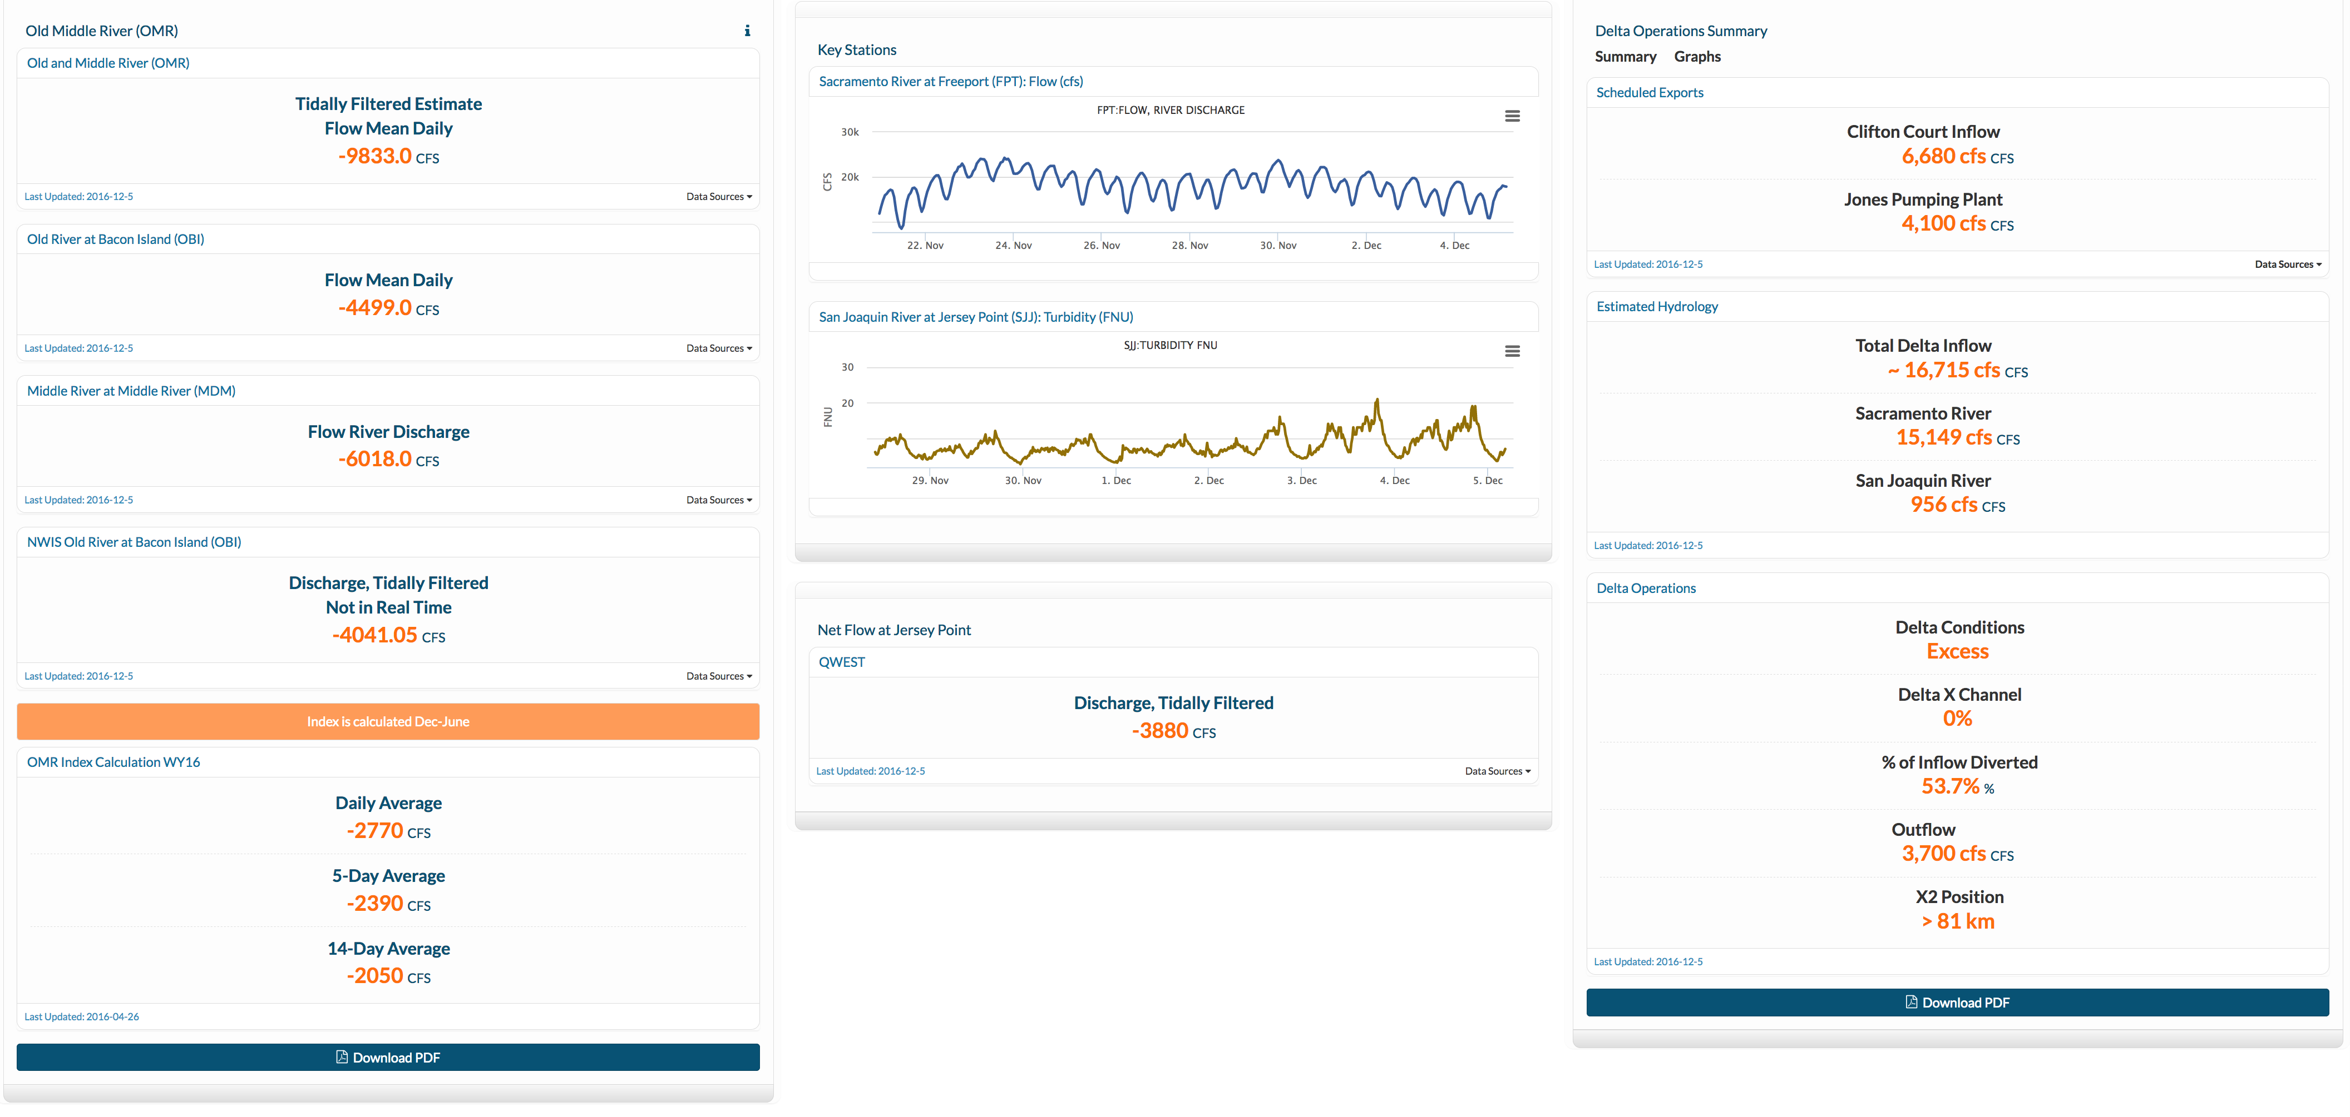
Delta Conditions to inform real-time management decisions: Old and Middle River Flow conditions flow and turbidity at Key Stations; and current Delta Conditions.

Slide 3
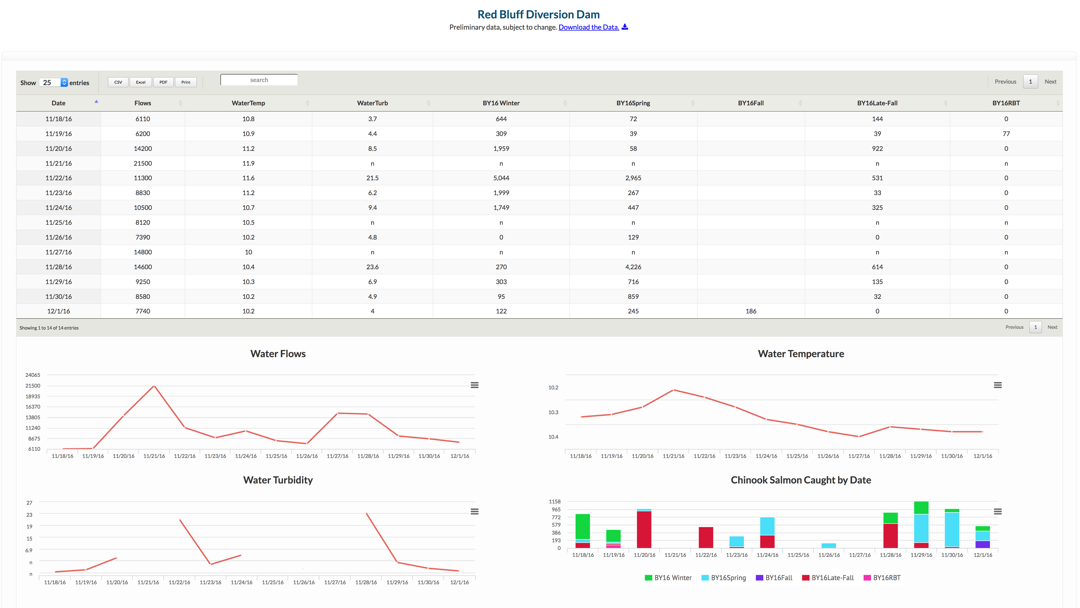
A summary of Juvenile Salmonid migration and environmental conditions at the Red Bluff Diversion Dam Rotary Screw Trap.

Slide 4
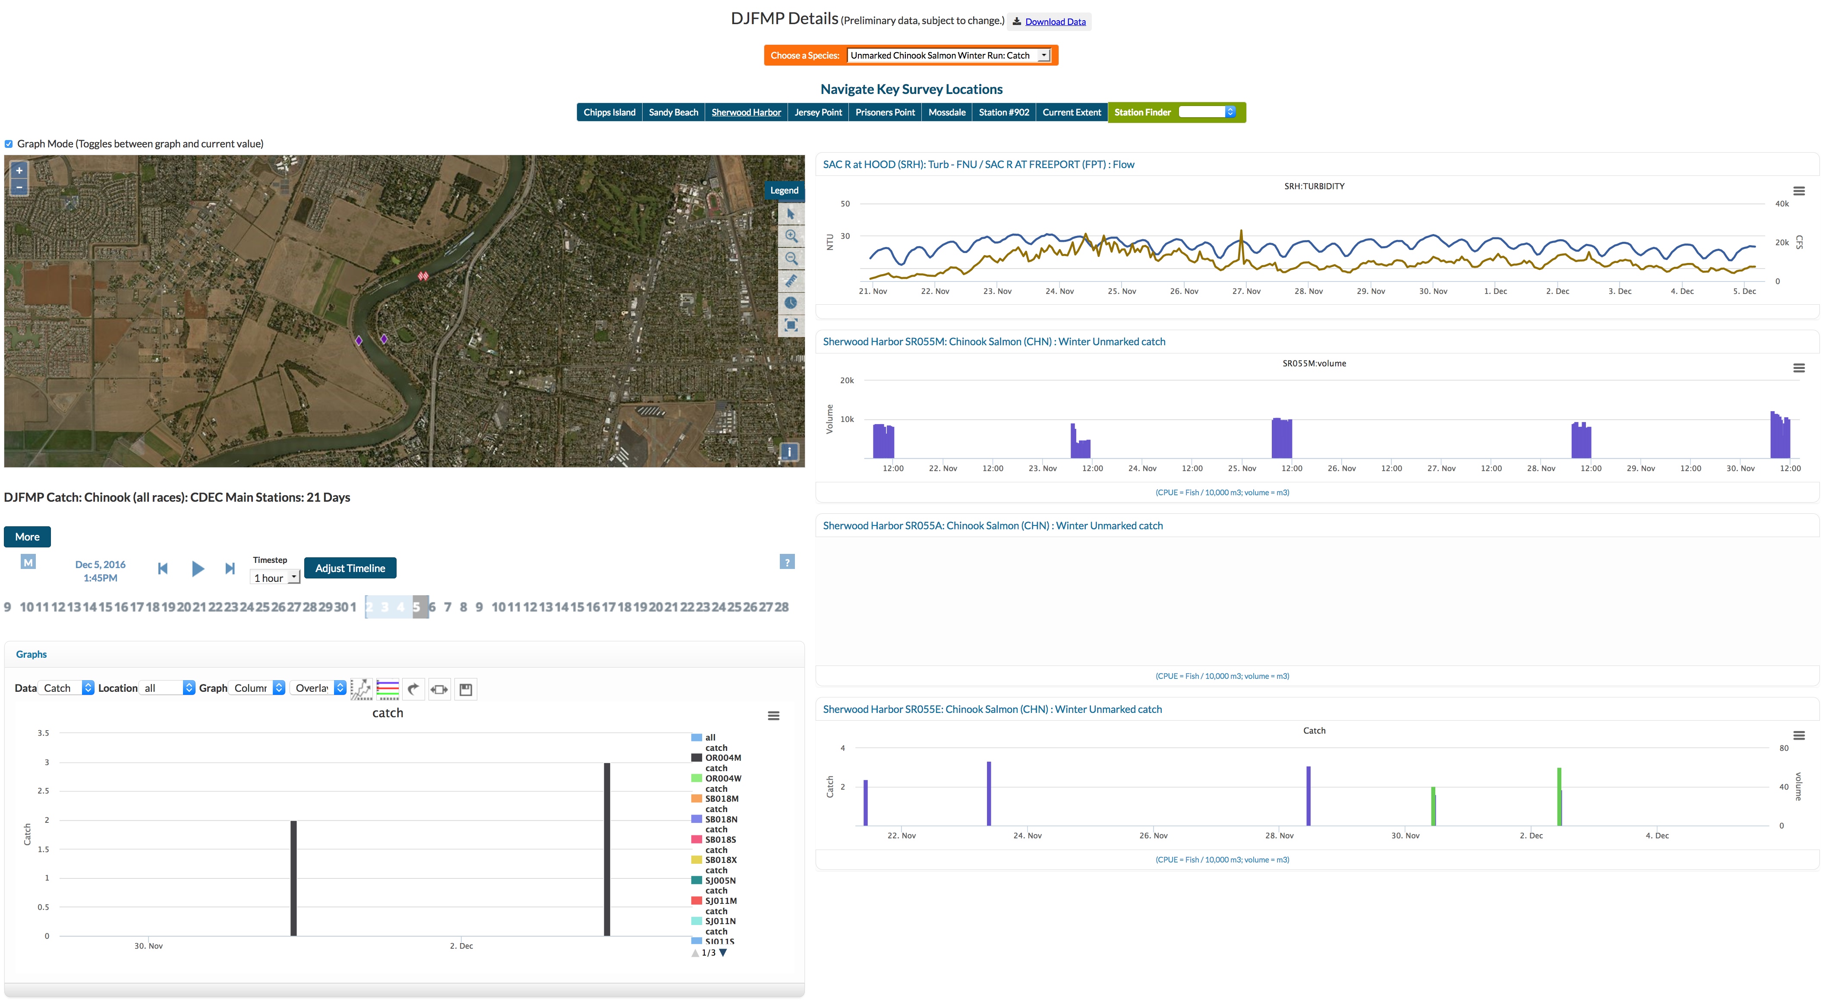
Salmonid catch and effort (volume) for unmarked winter-run Chinook salmon. Catch data is paired with current flow and turbidity at near-by CDEC station.

Slide 5
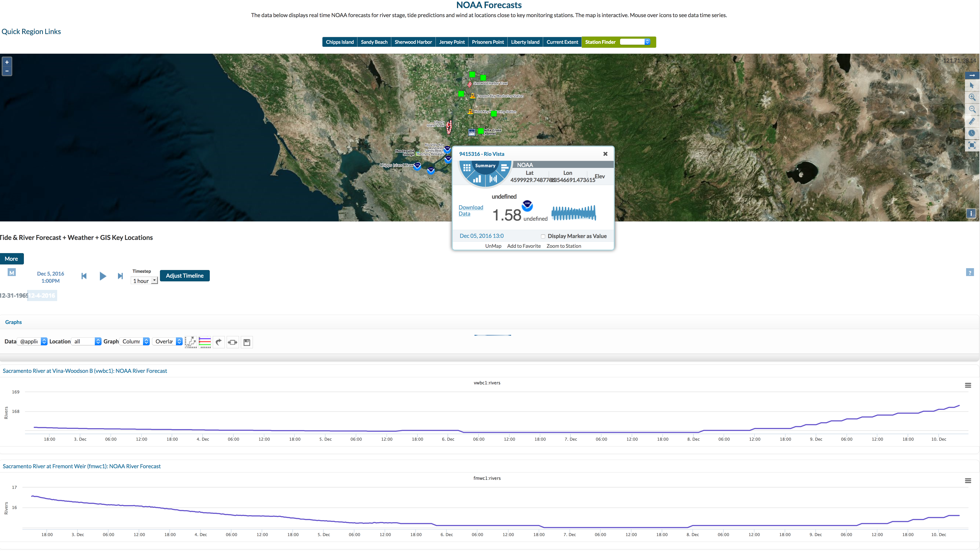
NOAA River and Tide forecast information. Data can be viewed graphically or numerically on the map and in the series of graphs below the map.

