Slide 1
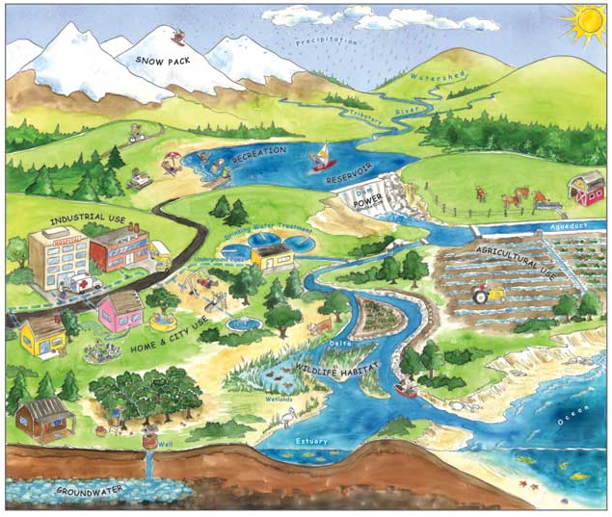
http://www.water.ca.gov/education/wffcatalog.cfm
How many ways do you see water being used?
Each water use requires a certain quality of water. The quality of our water is linked to the ecosystem because the same water is used for many purposes. Aquatic organisms require dissolved oxygen to breathe, and humans need freshwater to drink. Water quality monitoring is an important management tool to understand the health of our aquatic ecosystem.

Slide 2
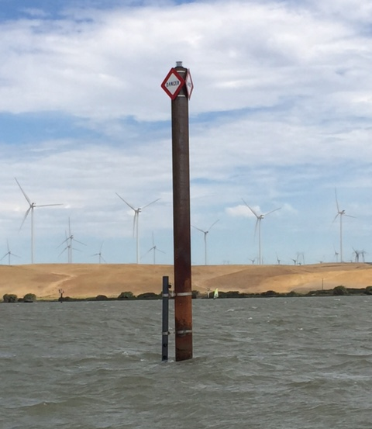
Sacramento River at Sherman Island (SSI) Station
Description: The SSI station is representative of the six pile stations maintained by Real-Time Monitoring. Inside the grey pipe is a single multi-parameter sonde floating 1.5-meters below the water surface. Every 15-minutes, the sonde records water quality values (i.e. temperature, pH, and dissolved oxygen) and transmits the results to the accessible DWR CDEC website.

Slide 3
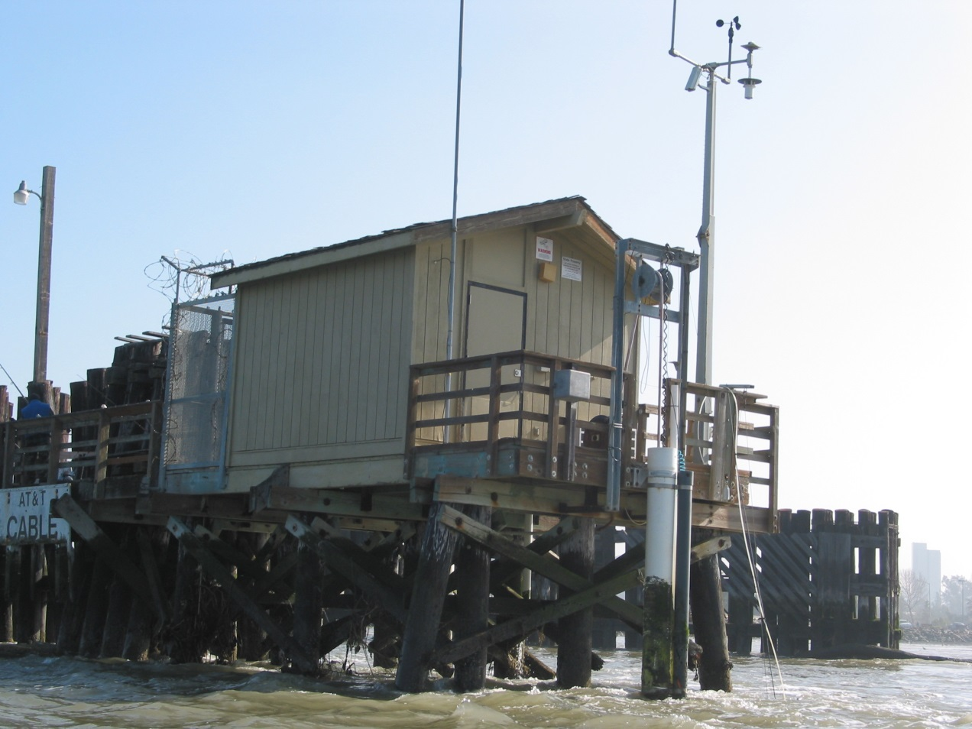
Martinez (MRZ) Station
Description: The MRZ station is representative of the nine land-accessible stations maintained by Real-Time Monitoring. The white PVC, shown above, contains two multi-parameter sondes floating 1.5-meters below the water surface. Present at only four stations, the attached grey PCV contains one sonde floating 5-meters below the water surface that tracks temperature and conductivity. Environmental data is measured at six stations, including MRZ. All instruments record and transmit data every 15-minutes to the DWR CDEC website.

Slide 4
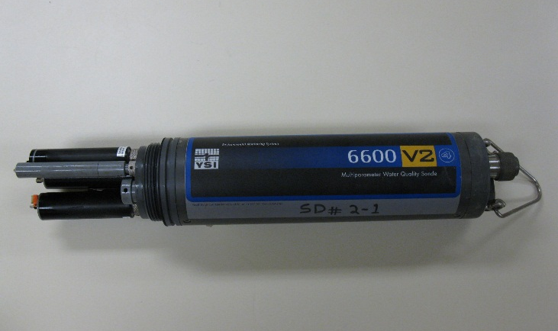
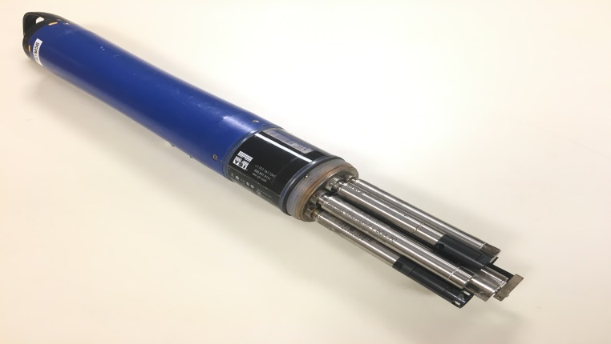
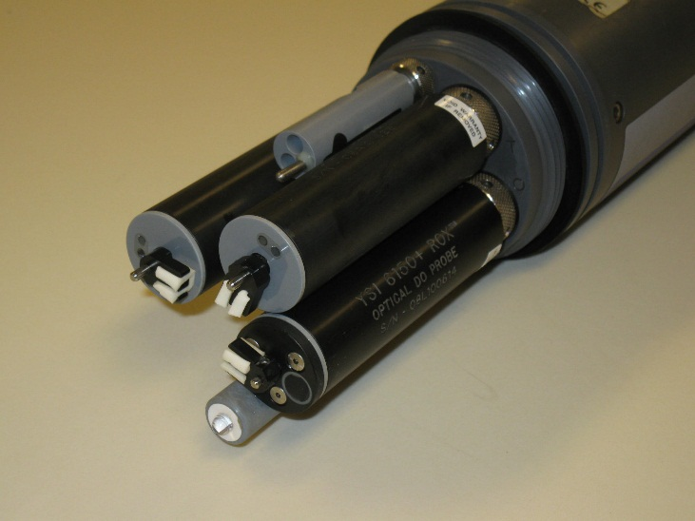
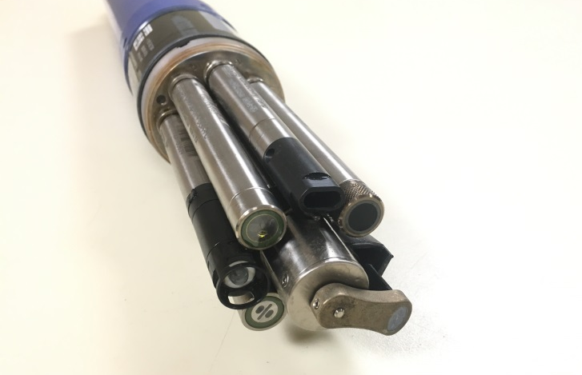
Multi-parameter sondes
Description: Real-time and discrete water quality monitoring programs both use a YSI multi-parameter sonde at each station. The surface sondes record time, water temperature, specific conductivity, chlorophyll, pH, turbidity, and dissolved oxygen. In addition, the bottom sondes record time, water temperature, and specific conductivity.

Slide 5
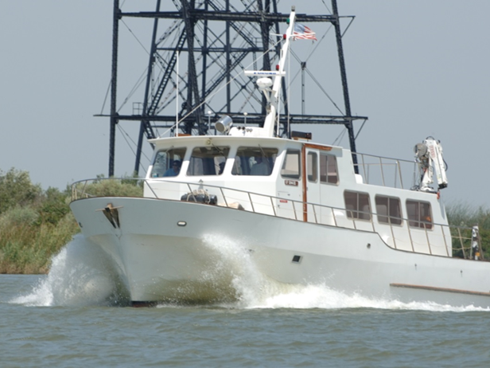
R/V San Carlos
Description: The Discrete Water Quality Monitoring Program visits monthly stations via the R/V San Carlos. The San Carlos is equipped with a laboratory for DWR staff to filter and preserve grab water quality samples immediately. It is also equipped with a multi-parameter sonde to record: water temperature, dissolved oxygen, specific conductance, pH, turbidity, and chlorophyll.

