Slide 1
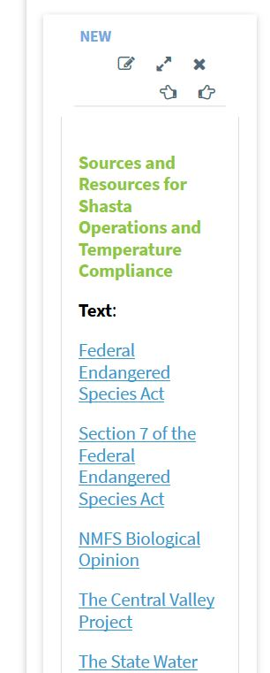
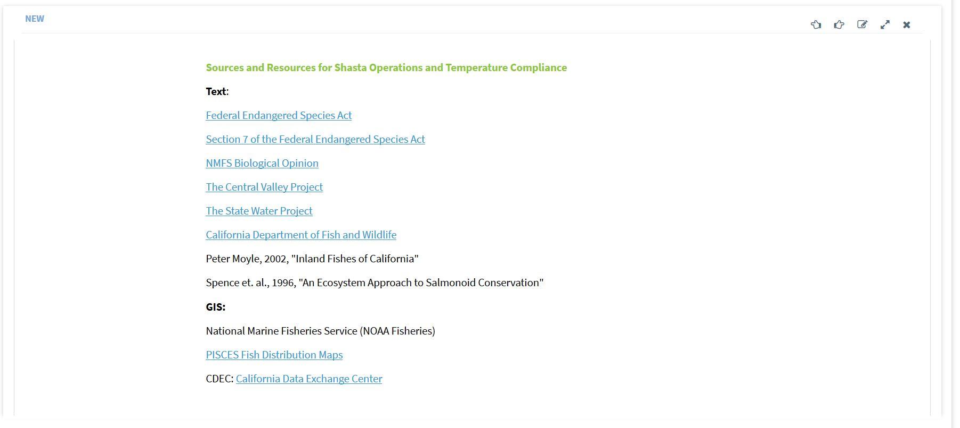
Article and Article Scroll
Across all platforms

Slide 2
Lists
SRWP has the option to have a list link to object page or slide out, can this be an option across all platforms?

Slide 3
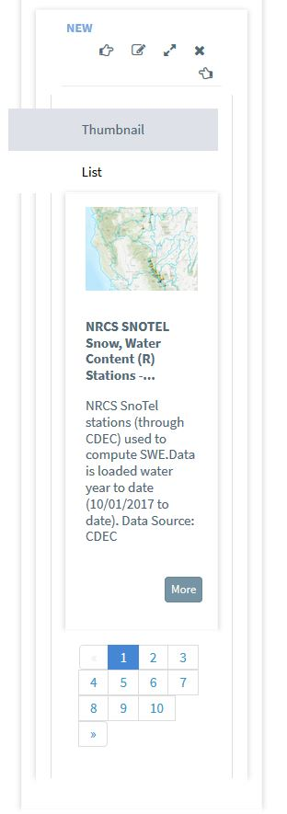
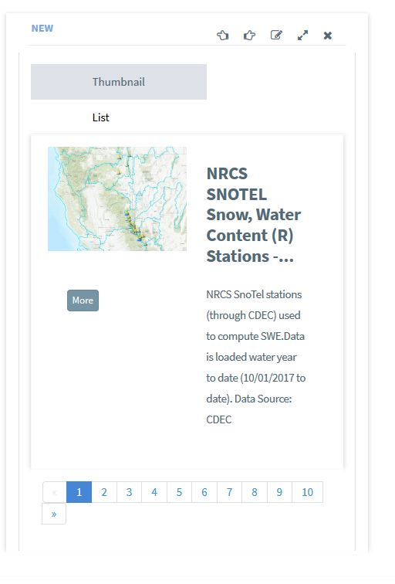
Featured List
Across all platforms

Slide 4
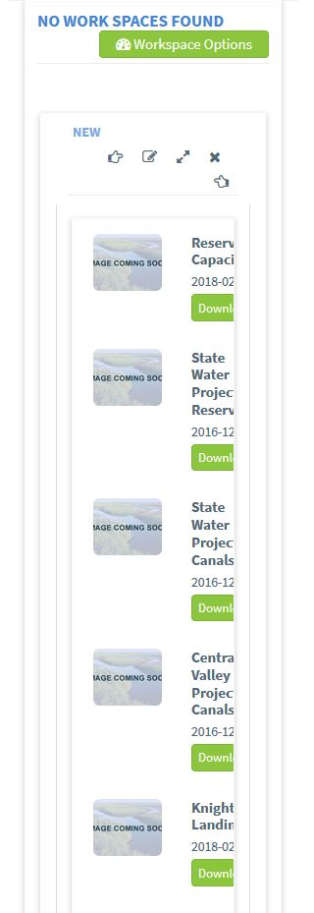
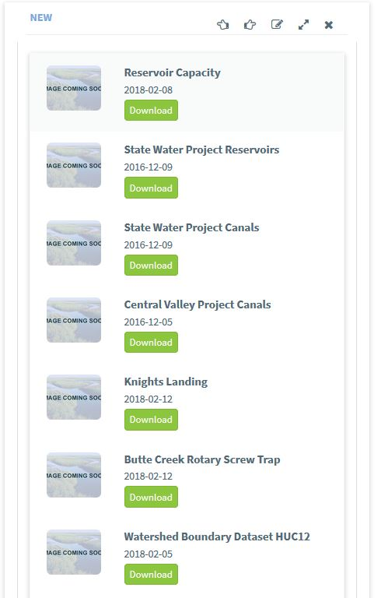
Basic List
Across all platforms

Slide 5
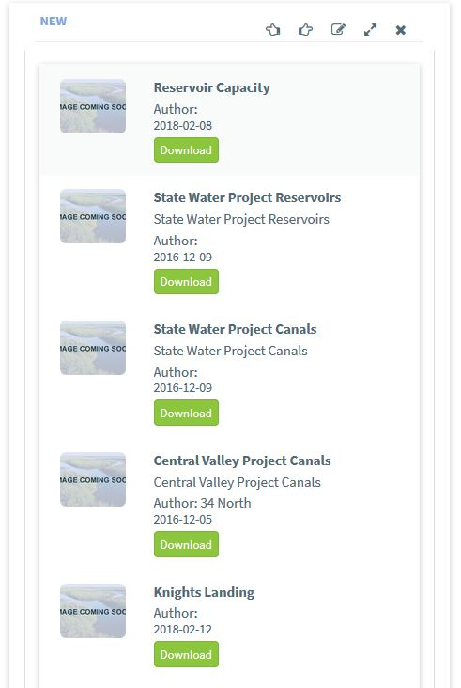
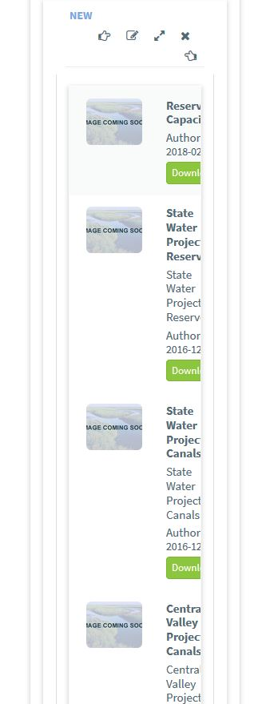
Descriptive List
Across all platforms

Slide 6
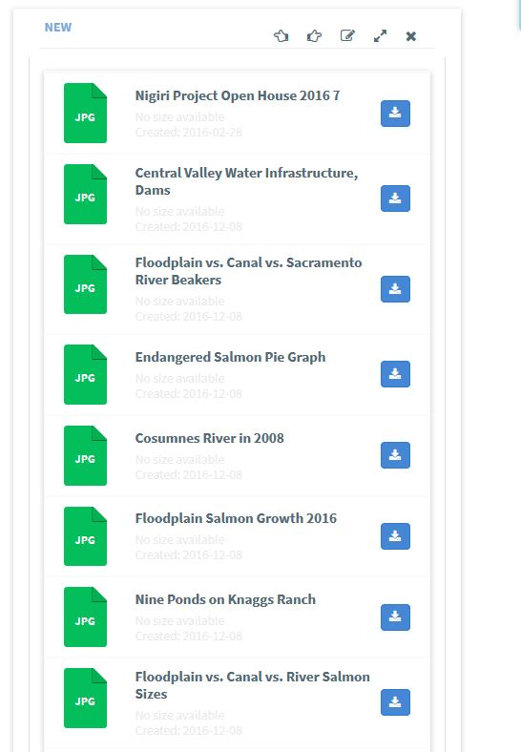
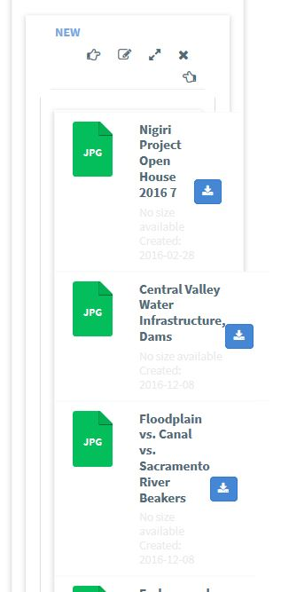
File List
Across all platforms

Slide 7
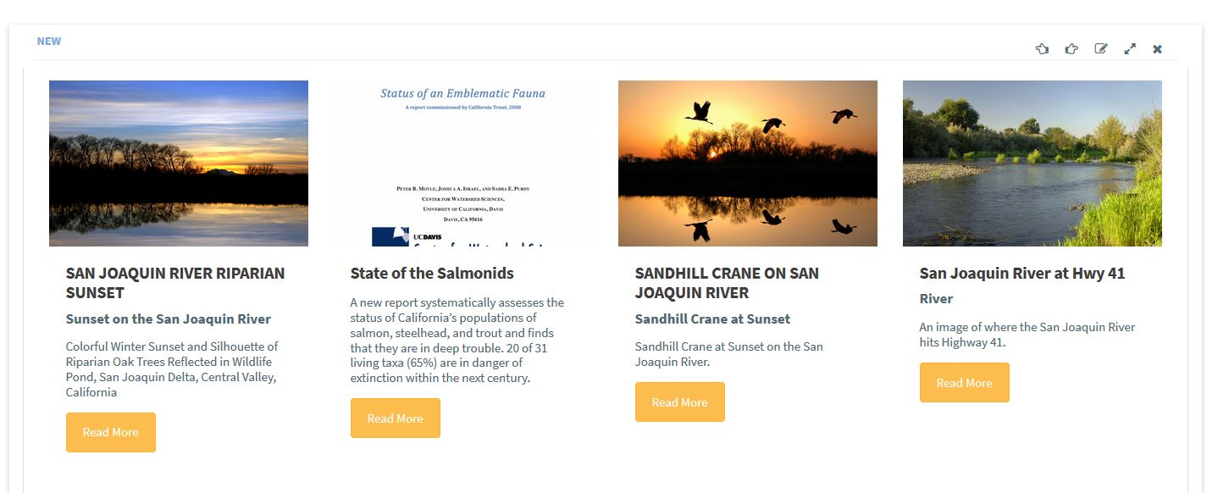
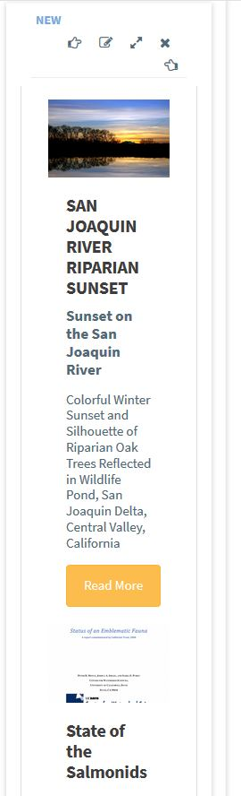
Card List

Slide 8
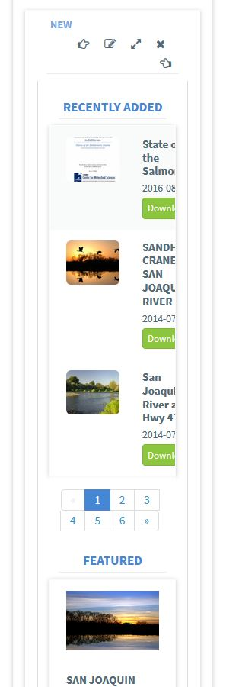
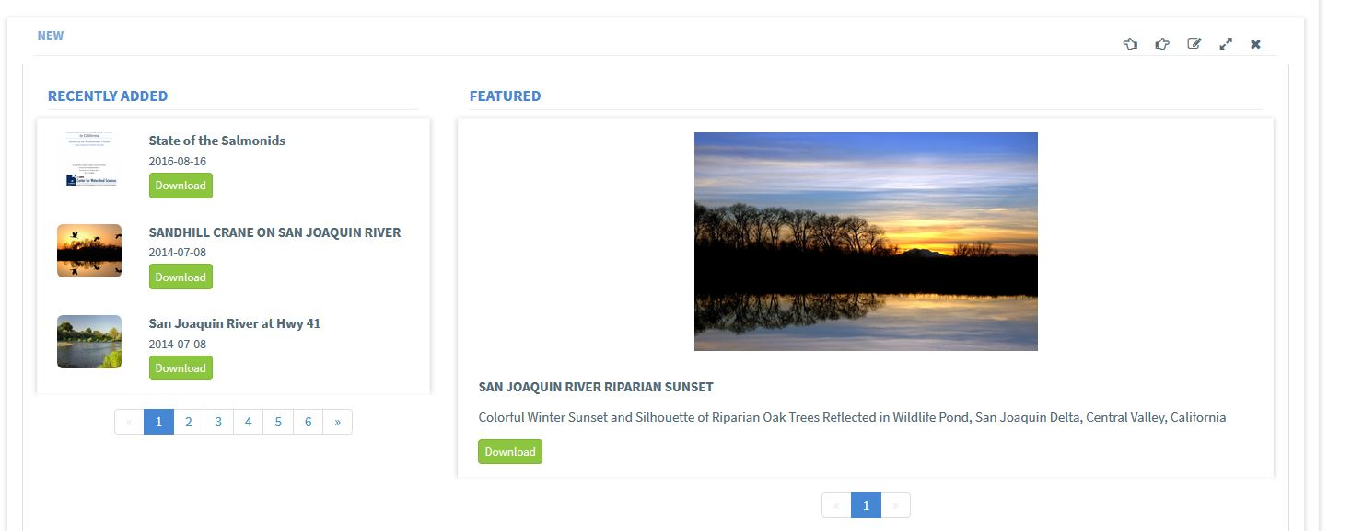
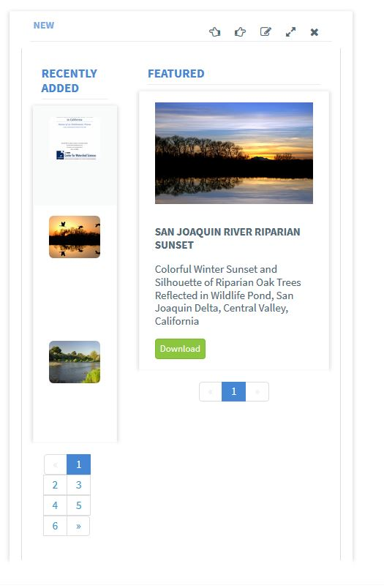
Listing/Stacked
Across all platforms

Slide 9
Maps
Would be nice to set the zoom level for a map used as a basemap. Current process is to save a base map with the zoom extent desired then use that map on the workspace. By being able to set a zoom level in a workspace we would have less of these saved basemaps in the catalogs

Slide 10
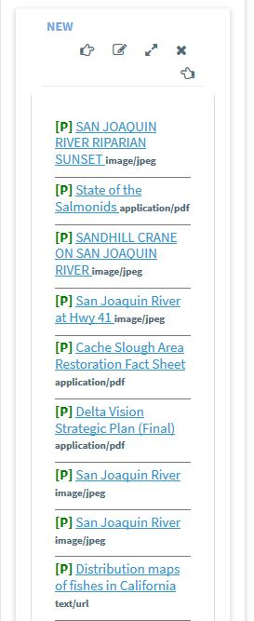
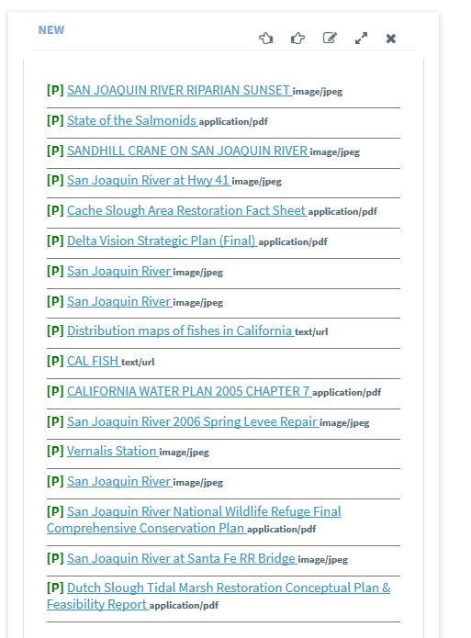
Listing/Map Roll
Across all platforms

Slide 11
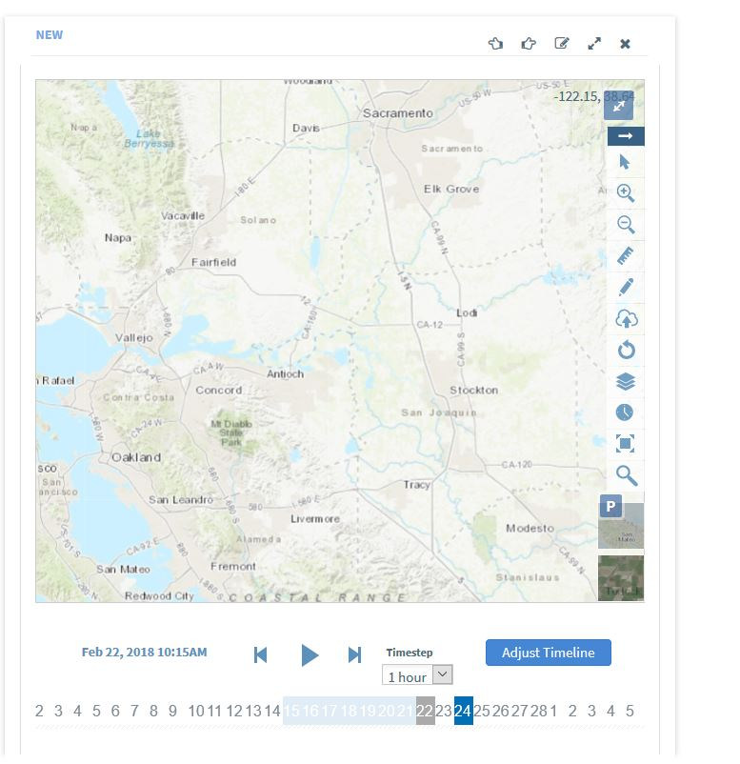
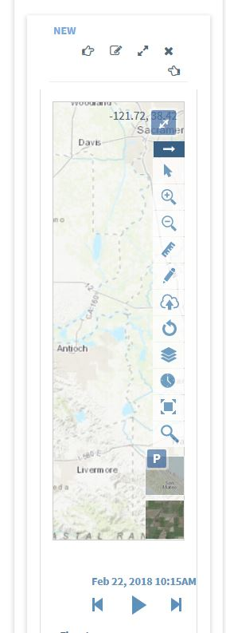
Map Types: map, map/short, map/tall, map/short/time
Across all platforms

Slide 12
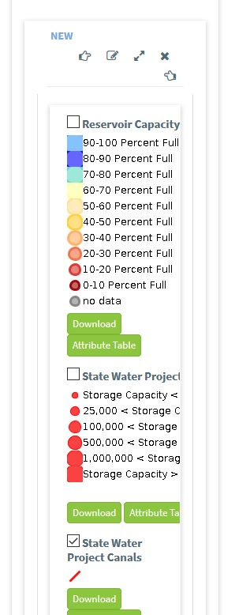
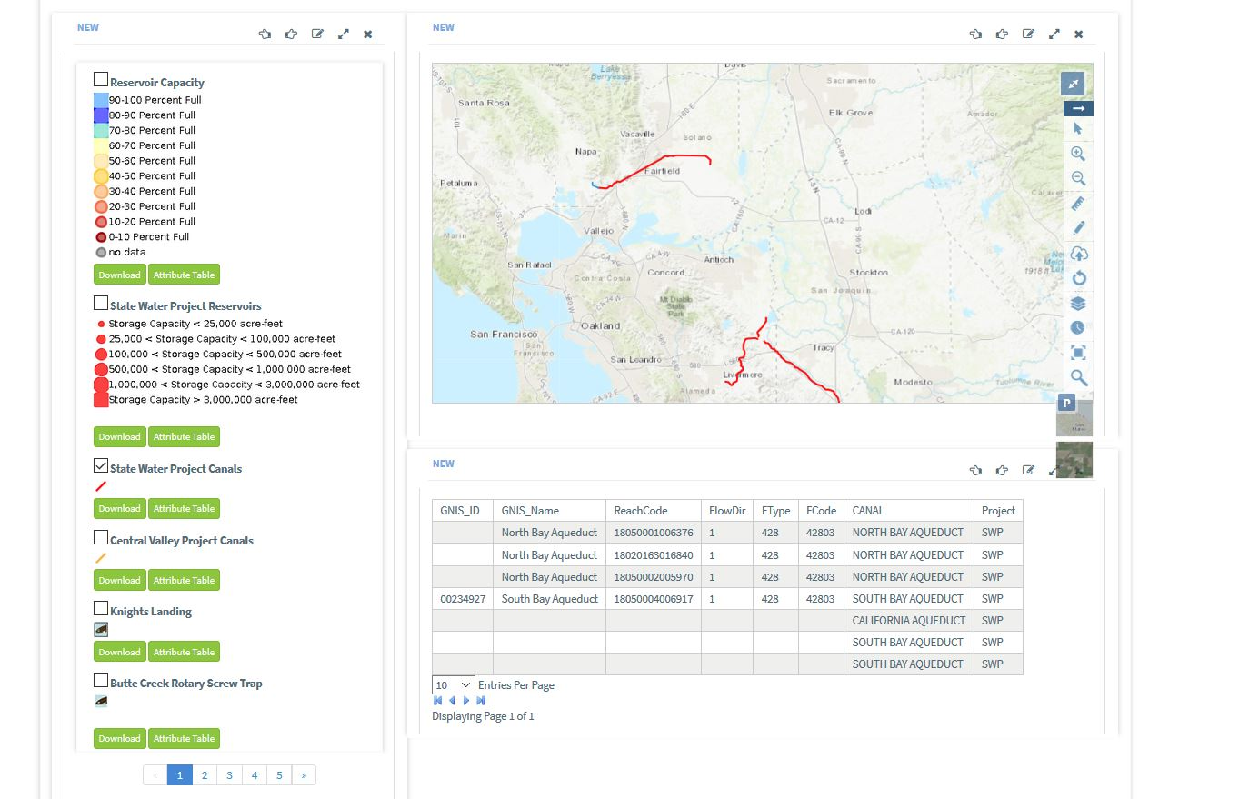
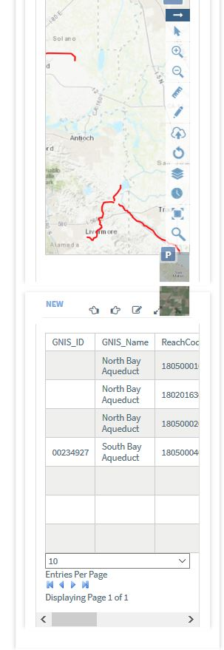
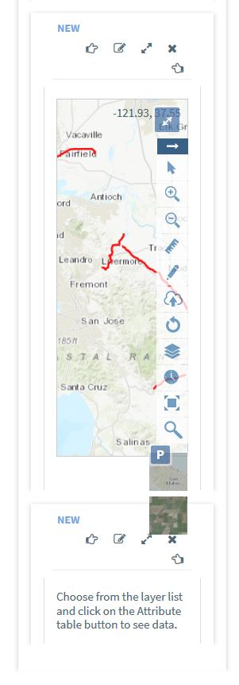
Layer List, Map, Layer Attribute Combo
Across all platforms

Slide 13
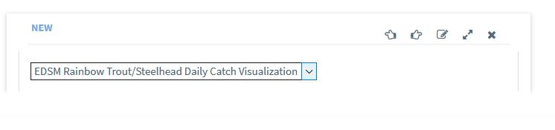
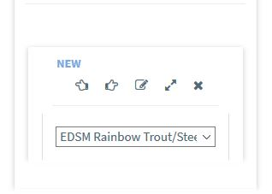
Map selector
Across all platforms

Slide 14
Templates
New Template Groupings:
Default
Site
DOSS
Operations
My Templates

Slide 15
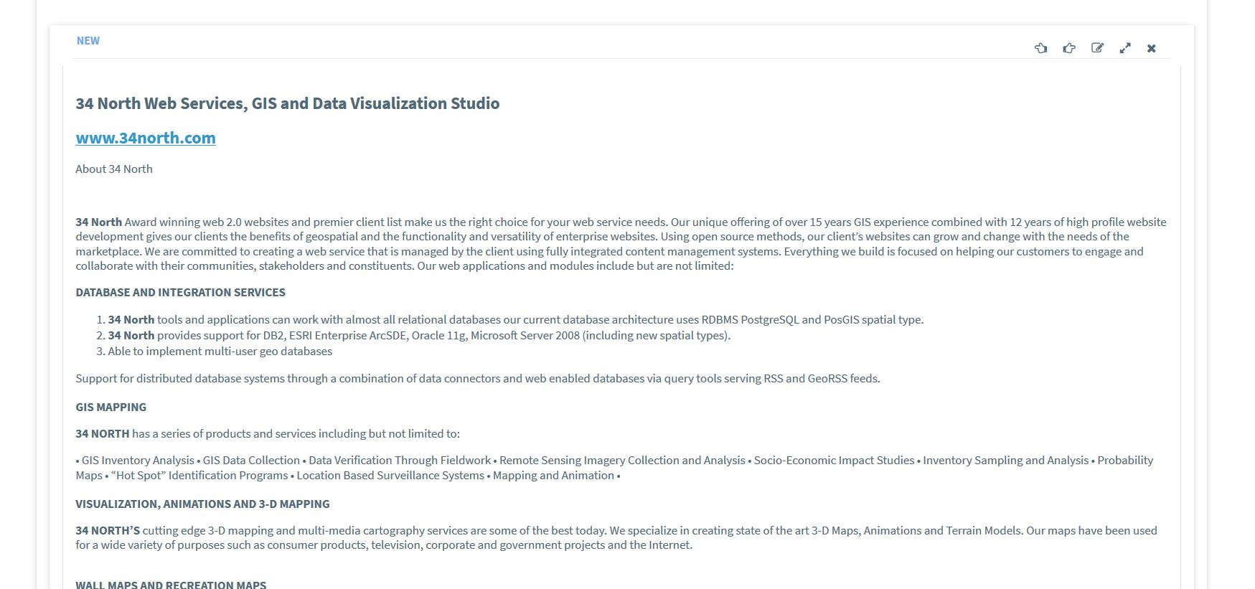
Site-credits.tpl (hard coded, EMP)

Slide 16
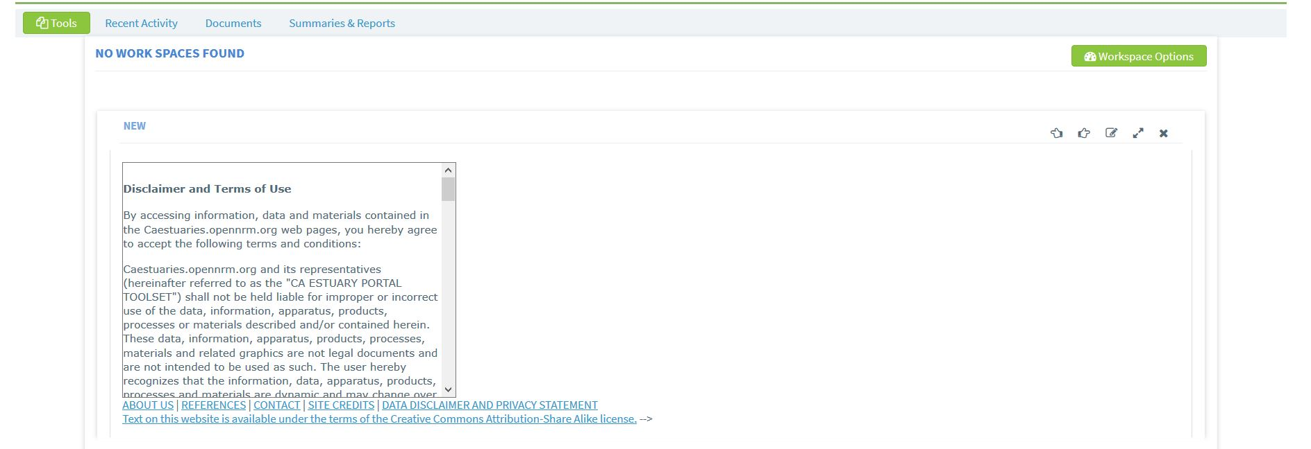
Disclaimer.tpl (Hard coded EMP)

Slide 17
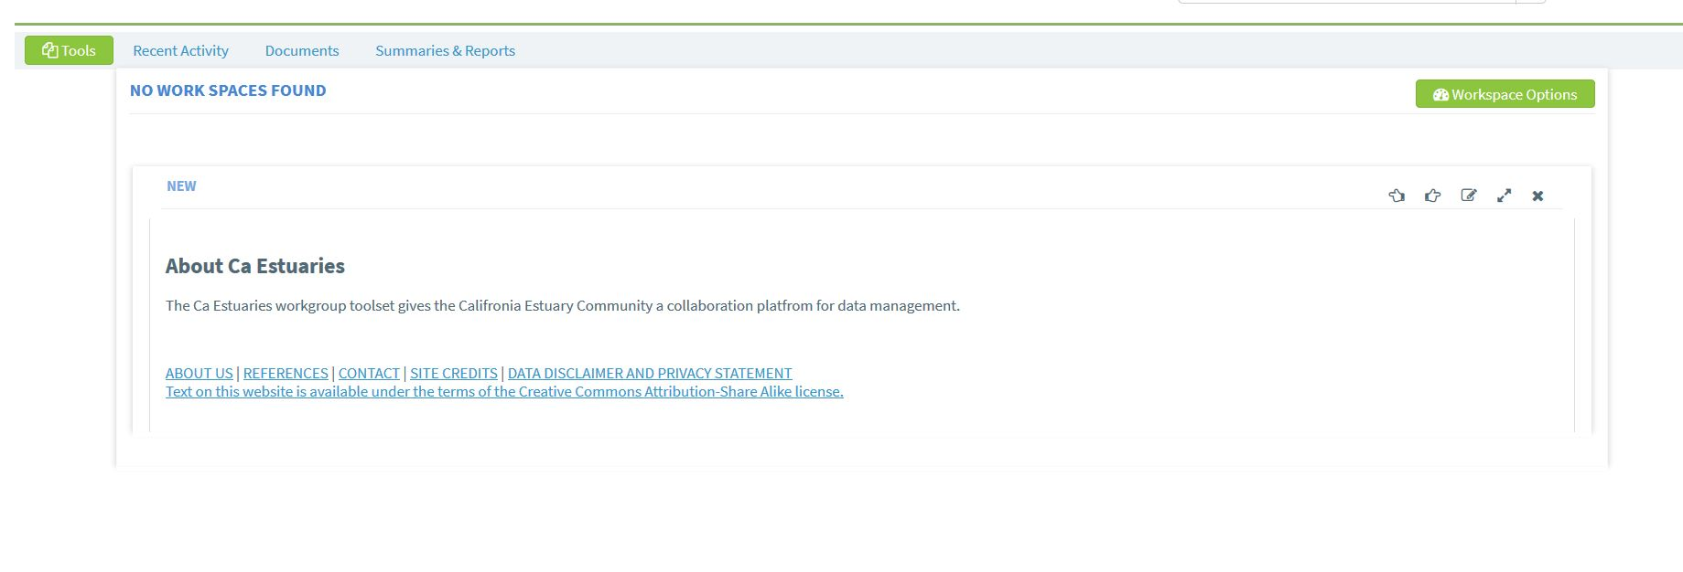
Mission.tpl (Hard coded EMP)

Slide 18
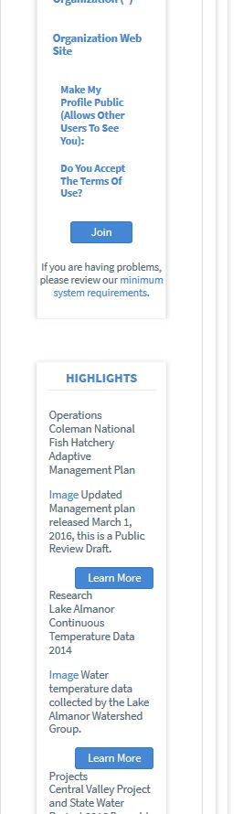
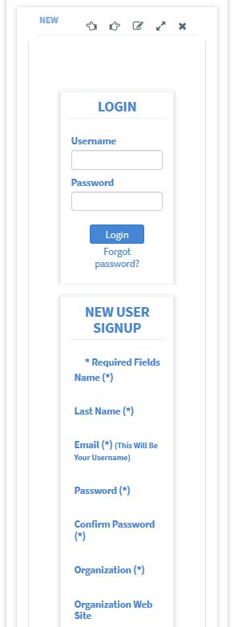
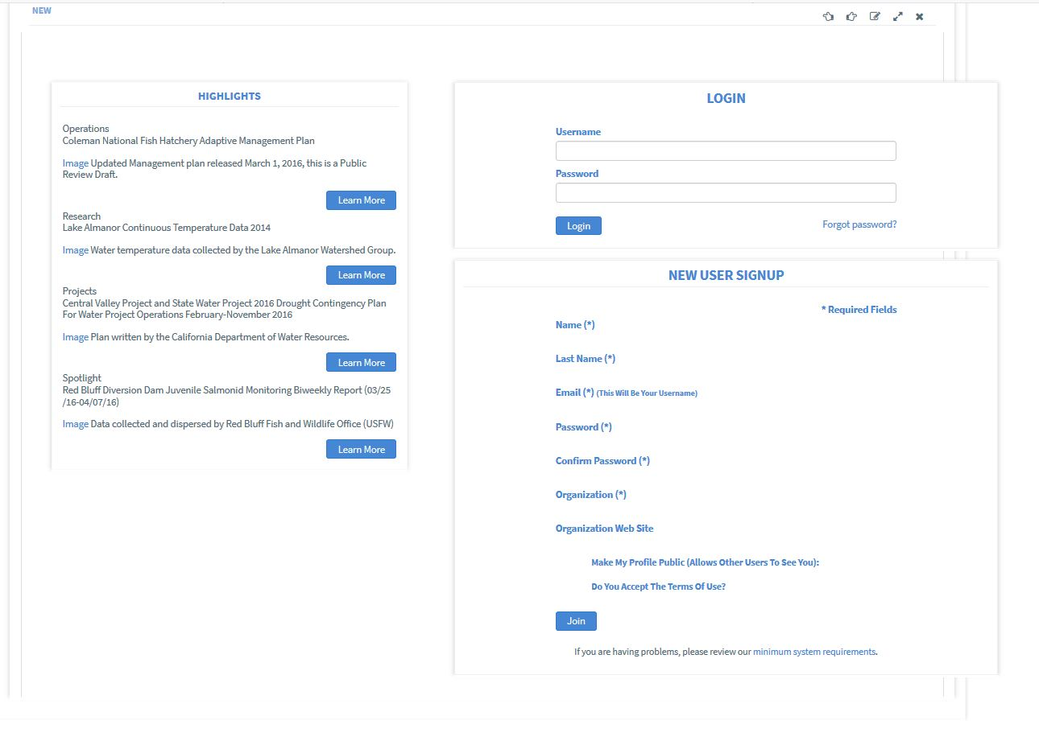
Signup.bdl.tpl (Hard coded, BDL, EMP

Slide 19
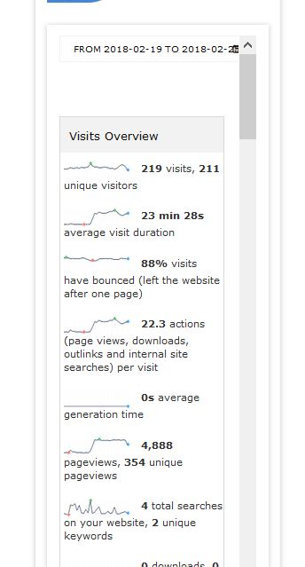
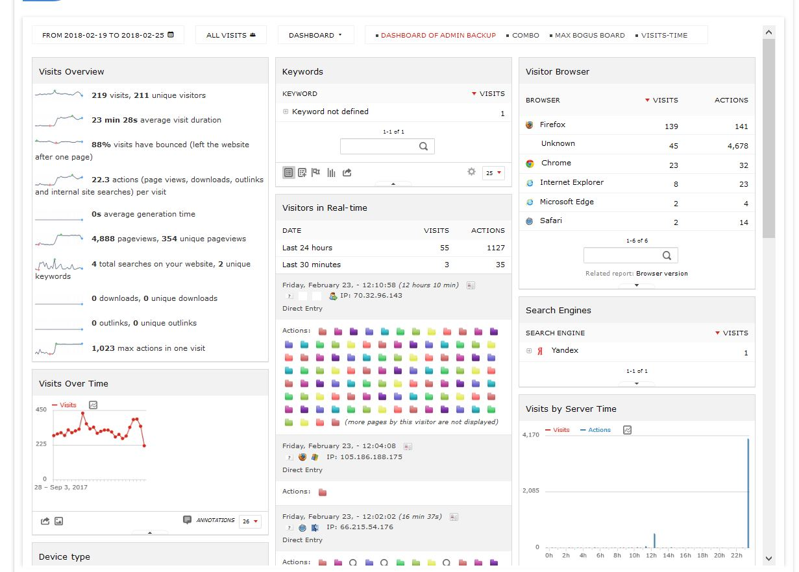
Stats.tpl (site specific: BDL, EMP

Slide 20
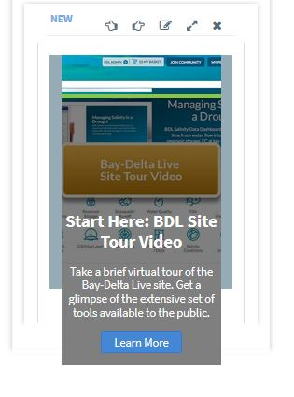
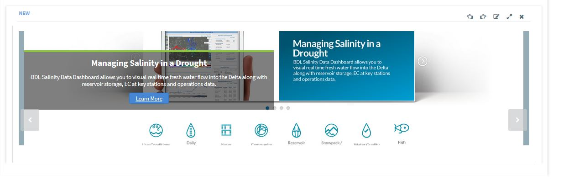
Image.slideshow.tpl (runs off of content published to the homepage via asset BDL, EMP) same as bdl.image.slideshow.tpl?

Slide 21
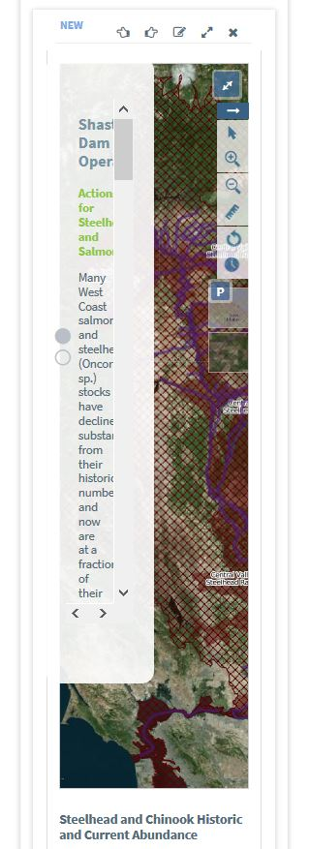
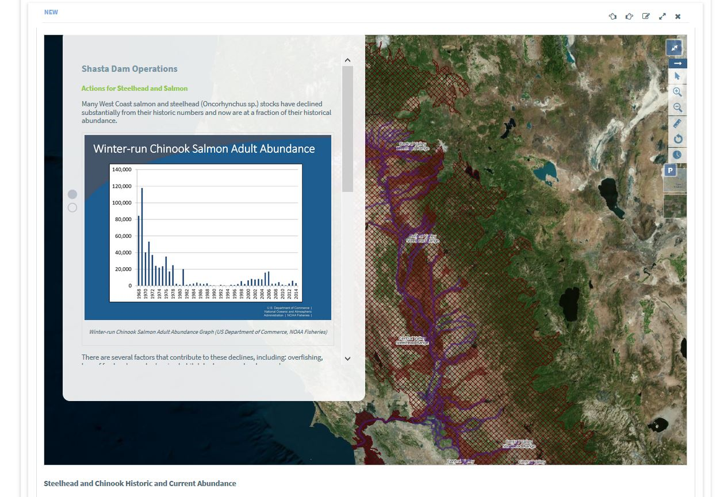
Map.article.full.tpl
Across all platforms

Slide 22
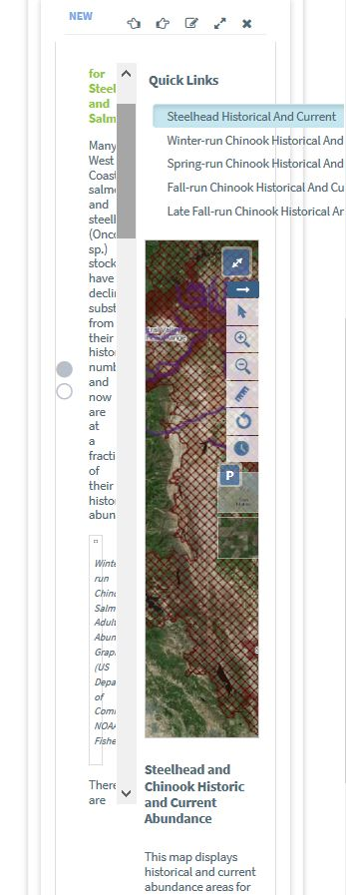
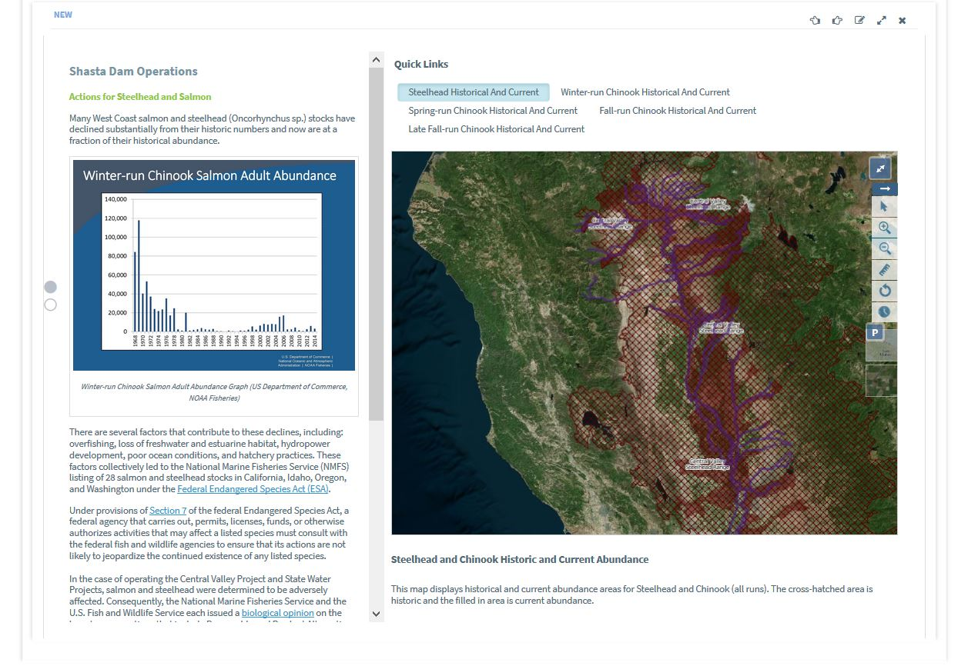
Map.article.tpl
Across all platforms

Slide 23
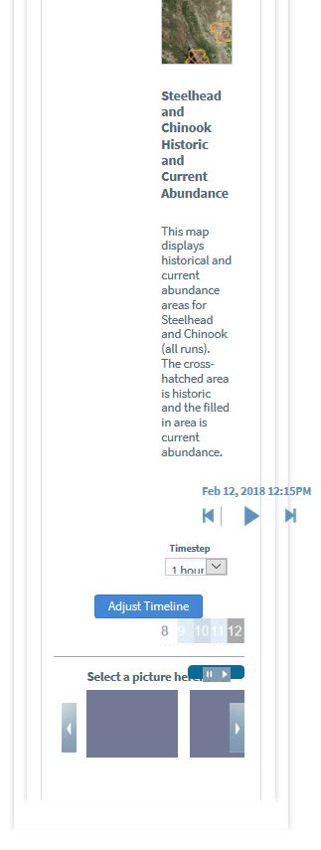
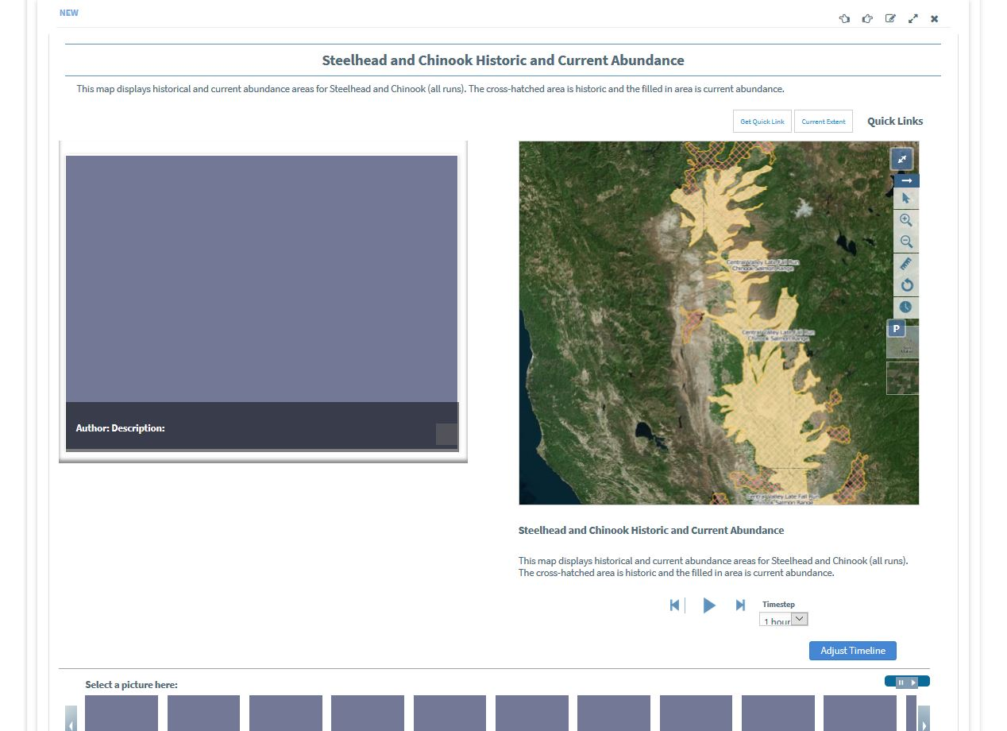
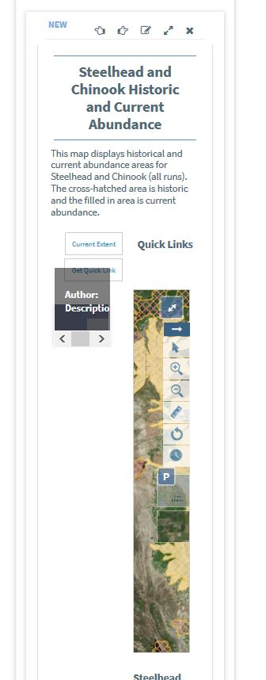
Map.viewer.tpl (not sure what would fill blanks, images? Images associated with the map asset)
Across all platforms

Slide 24
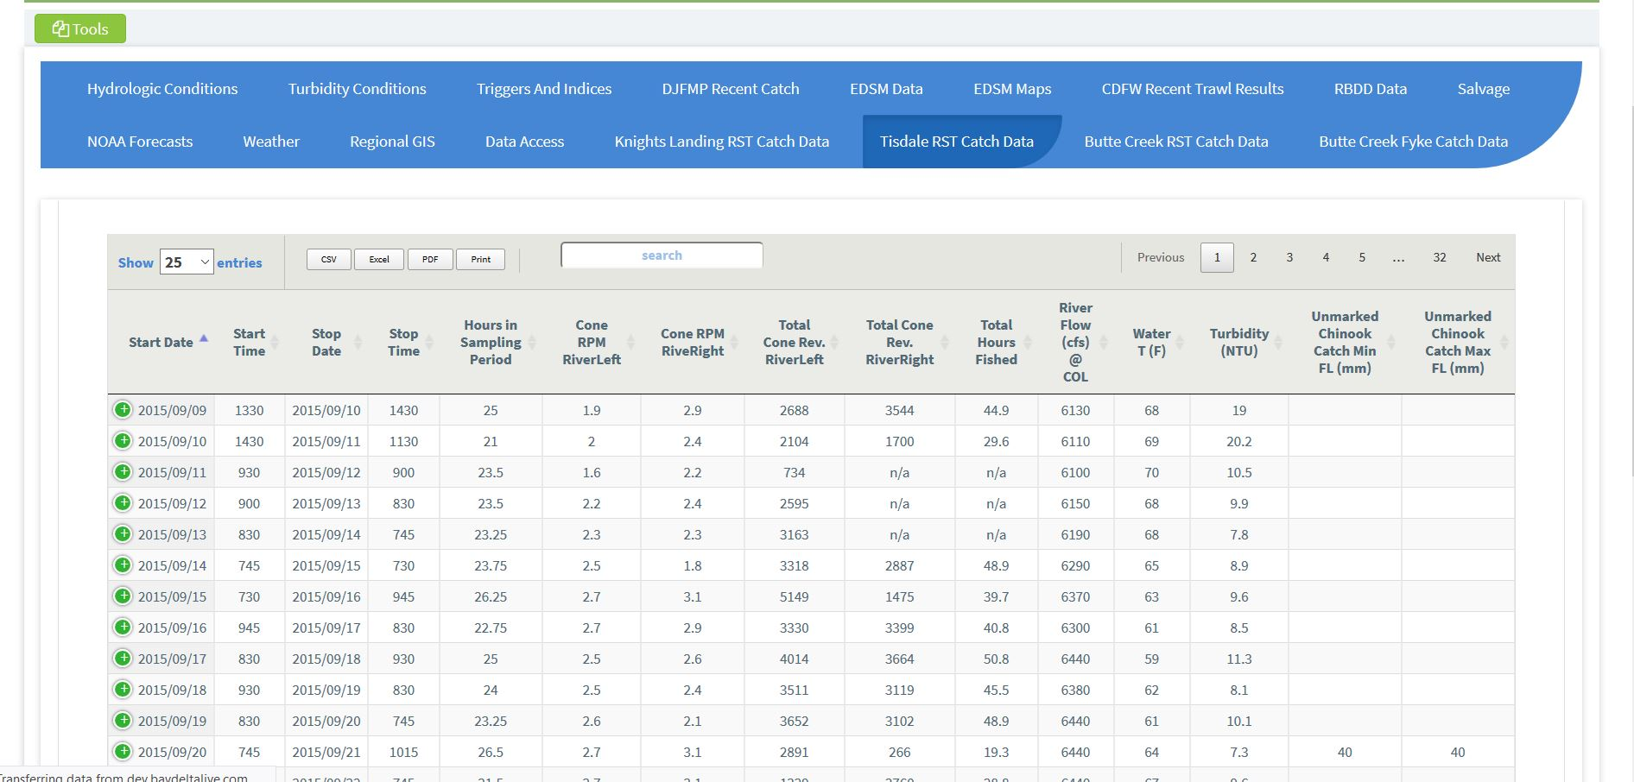
Table Viewer (Created using csv input data request or site upload, BDL, EMP
Would like to be able to add: Table Header, Table description, agency, other relevant metadata to this widget
Would that be best as a new widget (text box widget suggested) or as add ons to this widget
Could be fields you fill in when you are creating the workspace

Slide 25
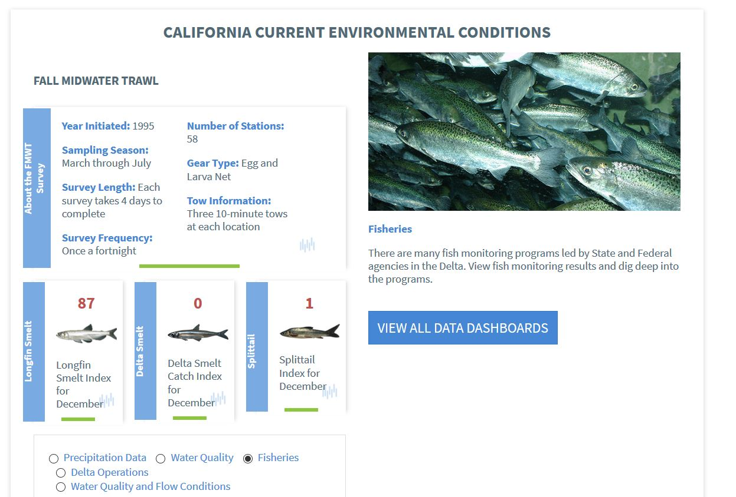
Conditions.environment.tpl (fisheries (FMWT, EDSM, SKT, operations, precipitation, water supply)
Specific to BDL, values are MemCached
Remove radio buttons at bottom of widget
Additional Widget Ideas: Salvage, Reservoirs, Turbidity

Slide 26
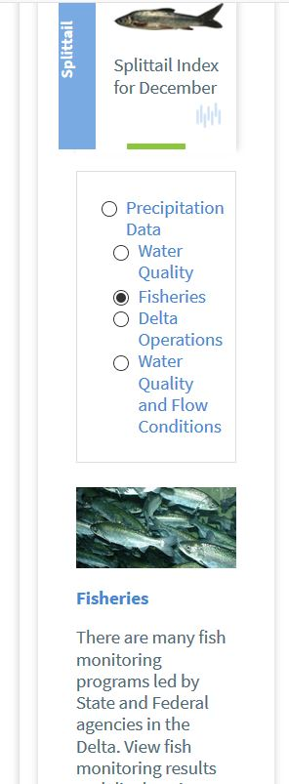
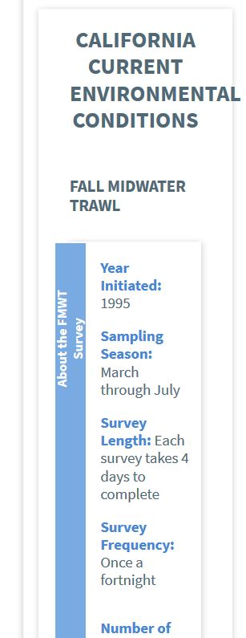
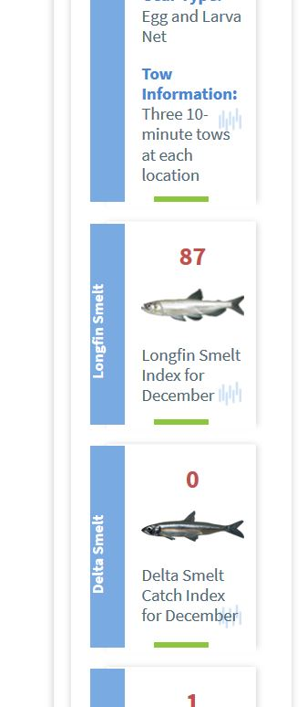
Conditions.environment (fisheries, operations, precipitation, water supply) PHONE
Specific to BDL, values are MemCached

Slide 27
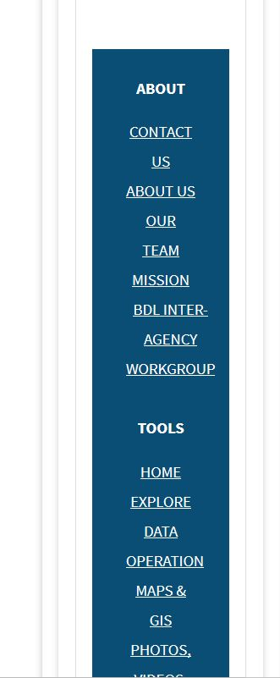
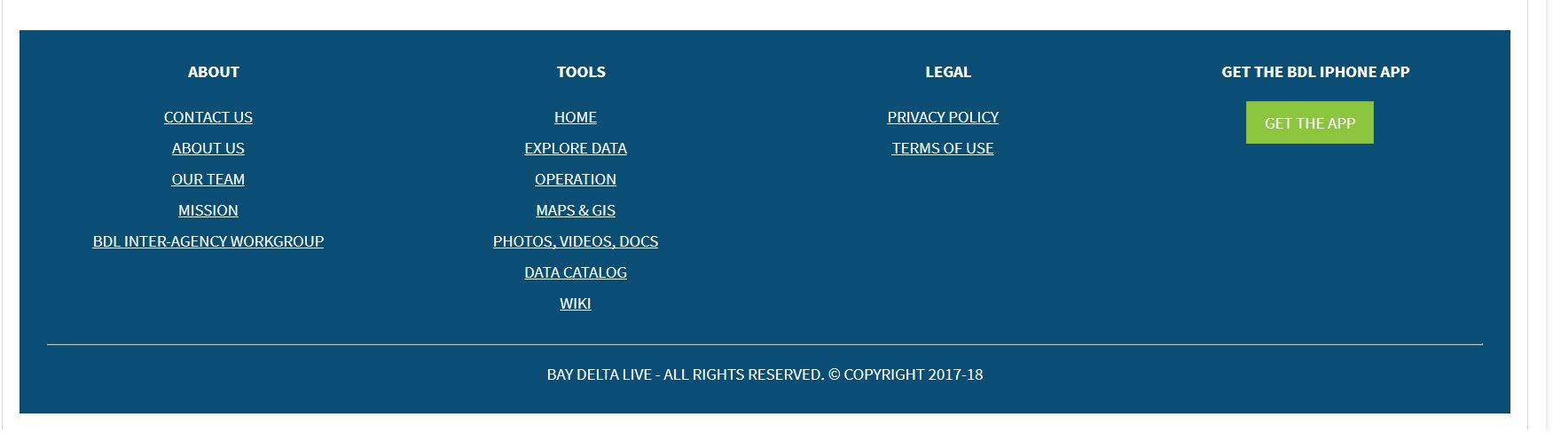
BDL Footer

Slide 28
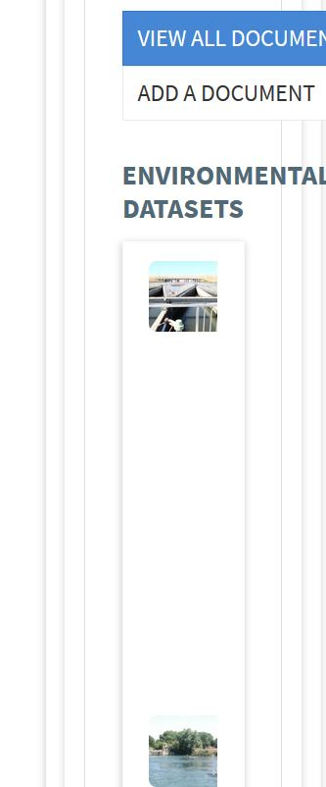


Bdl.list.basic.promo.tpl
BDL Homepage Specific Hard Coded
Would be good as a content driven list widget

Slide 29



bdl.list.card.tpl (hardcoded, BDL specific)
New List type: Card List, has same design

Slide 30


Bdl.sign.up.tpl (Hardcoded, BDL Specific)

Slide 31


Bdl.whats.new.image.tpl (Hardcoded,
BDL Specific)

Slide 32
Home.bdl.dev (one large template for homepage, still in use? Previous templates in this list are the individual components of homepage)
Should this template be retired?

Slide 33


Login-notices.bdl.tpl (Hard coded)
For new sites and new nav builder this would be a nice component to turn into content driven

Slide 34


Nav.dev

Slide 35


Djfmp.highlights.tpl (Hard Coded, all platforms)

Slide 36
Djfmp.triggers-indices.tpl and ops.mibile.fish.tpl are duplicates
Loads entire Triggers and Indices tab
Hard Coded
All widgets are full width (Triggers and Indices tab has columns in lower half of the page)

Slide 37


Djfmp.water-quality.tpl and doss.dashboard.water-quality-concern-stations.tpl appear to be the same(Hard Coded, all platforms)

Slide 38


Djfmp.weather.model.tpl (Hard Coded, all platforms)

Slide 39


Djfmp.weather.tpl and doss.dashboard.weather-forecast.tpl appear to be duplicates (Hard coded, out of date, not used anywhere currently, all platforms)

Slide 40

Doss.dashboard.catch.highlights.tpl (hard coded, all platforms)

Slide 41

Doss.dashboard.environmental-indicators-of-fish-migration.tpl (Hard Coded, all platforms)

Slide 42

Doss.dashboard.key-stations.tpl (hard coded, all platforms)
Could we edit this template to be able to put in our own stations/graph types?

Slide 43

Doss.dashboard.key-temp-stations.tpl (Hard Coded, all platforms)

Slide 44


Doss.dashboard.omr.flows.tpl (Hard Coded, all platforms)

Slide 45

Doss.dashboard.qwest.tpl (Hard Coded, all platforms)

Slide 46

Doss.dashboard.reservoirs.tpl (Hard coded, all platforms)
Note: We could change the parameters here to inflow, outflow, and storage

Slide 47


Doss.dashboard.salvage.tpl (Hard coded, all platforms)

Slide 48

Doss.dashboard.trawl-indices.tpl (Hard Coded, all platforms)

Slide 49

Doss.dashboard.trawl-results-table.tpl (hard coded, all platforms)

Slide 50

Doss.dashboard.trawl-snapshot-table.tpl (hard coded, all platforms)

Slide 51

Edsm.tables.tpl (Hard coded, all platforms)

Slide 52


Rbdd.tpl (hard coded, all platforms)

Slide 53


Ats.story.tpl (hard coded, all platforms)

Slide 54

Daily.reservoir.tpl (Hard Coded, all platforms)

Slide 55


Execsum.tpl and ops.mobile.precip.sonw.tpl are duplicates(Hard Coded, all platforms)

Slide 56

Ops.dashboard.bass.tpl (hard coded, all platforms) says bass in tpl title but shows steelhead data

Slide 57

Ops.dashboard.hydrology.tpl and ops.mobile.hydrology.tpl are duplicates (Hard Coded, all platforms)

Slide 58

Ops.dashboard.key.tpl duplicate of ops.dashboard.summary.tpl (Hard Coded, all platforms)

Slide 59

Ops.dashboard.reservoir.images.tpl (Hard Coded, all platforms) carousel of key CDEC reservoir images

Slide 60

Ops.dashboard.reservoir.tpl (Hard Coded, all platforms)

Slide 61

Ops.dashboard.salmon.tpl (Hard Coded, all platforms)
Salvage data

Slide 62

Ops.dashboard.smelt.tpl (Hard Coded, all platforms)

Slide 63

Ops.matrix.tpl (Hard Coded, all platforms, Out of date

Slide 64


Ops.mobile.summary.tpl (Hard coded, all platforms)

Slide 65

Ops.salvage.tpl (Hard coded, all platforms)

Slide 66


Ops.tpl (hard coded, all platforms)

Slide 67


Ops.water.supply.tpl and water.supply.tpl are duplicates (hard coded, all platforms)

Slide 68

Ops.weather.tpl (Hard coded, all platforms)

Slide 69

Region.map.links.tpl (hard coded, all platforms)

Slide 70

Snow.pack.tpl (URL used in widget no longer correct)

Slide 71


Water.quality.tpl (hard coded, all platforms)

Slide 72

Weather.central.tpl (hard coded, all platforms)

Slide 73

Weather.south.tpl (hard coded, all platforms)

Slide 74

Weather.north.tpl (hard coded, all platforms)

Slide 75

Contact.tpl (hard coded, EMP)

Slide 76

Mobile.wms.tpl (EMP)

Slide 77

References.tpl (Hard coded EMP)

Slide 78

List.card.tpl (hard coded, EMP and BDL)

Slide 79

D3.svg.emp.tpl (hard coded, EMP)

Slide 80
D3.svg.partners.tpl (Hard coded, EMP)

Slide 81

Dwr_search_ui_discrete_field.tpl (Hard Coded EMP)

Slide 82

Subnav.buttons.emp.tpl

Slide 83

Dwr_search_ui_discrete_lab.tpl (Hard Coded EMP)

Slide 84

Dwr_search_ui_phytoplankton.tpl (Hard Coded EMP)

Slide 85

Estuaries.tpl same as list Type Card List (content driven, EMP)

Slide 86

Estuary.explore.data.and.tools.tpl (hard coded EMP)

Slide 87

Estuary.partner.data.tpl (Hard Coded, EMP)

Slide 88

Estuary.where.are.ca.estuaries.tpl (hard coded, EMP)

Slide 89

Footer.opennrm.tpl (Hard coded EMP)

Slide 90

Header.opennrm.tpl (Hard coded, EMP)

Slide 91

Home.learn.issues.tpl (Hardcoded EMP)

Slide 92

Home.video.tpl (Hard coded, EMP)

Slide 93

Homepage.opennrm.tpl (retire?)

Slide 94

Image.slideshow.new2017.tpl

Slide 95

List.card.estuary.tpl same as list type Card List (Hard coded, EMP)

Slide 96

Nav.emp.tpl (EMP)

Slide 97

Subnav.buttons.hydrology.tpl (EMP)

Slide 98

Welcome.estuary.tpl (Hard Coded, EMP)

Slide 99

Home.bdl.nasa.tpl (new NASA homepage, fed from project page)

Slide 100

Add_wq_data.tpl (West Yost)

Slide 101

Home.westyost.tpl (west Yost, would be good addition on other sites as well)

Slide 102

Login.westyost.tpl (Hard Coded, West Yost)

Slide 103

Subnav.buttons.lc.tpl (West Yost)

Slide 104

Subnav.buttons.maps.tpl (West Yost)

Slide 105

Subnav.buttons.vs.tpl (West Yost)

Slide 106

Subnav.buttons.wiki.tpl (West Yost)

Slide 107
Viewers

Slide 108


Viewer/Carousel and Carousel/Slides Seem to be the same widget (Content driven, all platforms)

Slide 109

Horizontal Image Viewer (Content driven, all platforms)

Slide 110

Vertical Image Viewer (content driven, all platforms)

Slide 111
Explore Data

Slide 112

Explore All

Slide 113

NOAA (National Weather Service)

Slide 114

NOAA (River Forecast)

Slide 115

NOAA (Tide Predictions)

Slide 116

USFWS (U.S. Fish and Wildlife Service)

Slide 117

USGS (National Water Information System)

Slide 118

CDEC (California Data Exchange Center)

Slide 119

CIMIS (California Irrigation Management Information system)

Slide 120

DWR EMP Benthic Monitoring (duplicate from the template section on EMP)

Slide 121

DWR EMP Discrete Field Data(duplicate from the template section on EMP)

Slide 122

DWR EMP Discrete Lab Data(duplicate from the template section on EMP)

Slide 123

DWR EMP Phytoplankton (duplicate from the template section on EMP)

Slide 124

DWR EMP Zooplankton (duplicate from the template section)

Slide 125
Data Graphing

Slide 126

Graph Panel

Slide 127
Graph Panel: No Options
Defaults back to Column Stacked and Tile despite saving to a different format

Slide 128
Dual Axis Panel: Has Map?
Does not work, I believe this is in JIRA and in progress

Slide 129
Data Figures
Max out a 4 values on width=huge, could we add more
Ability to order how the figures draw?
Arrow notes:
  The initial purpose of the arrows (triangles) was for them to change direction based on a threshold value. I think we have several use cases where this would be a very useful tool (Salvage, Sac River Temp, Turbidity)

Slide 130

Stacked: Has Data?

Slide 131

Circles: Has Data?

Slide 132

Arrows: Has Data

Slide 133
Messaging
Within messaging there is a button for a comments widget? Cannot get this to work

Slide 134
JSON and Cache
Last 2 sections of the widget selector options, unsure of their purpose.

Slide 135
Widgets that Load another Widget
Doss.dashboard.tides.tpl loads djfmp.weather.tpl
Doss.dashboard.river-forecast.tpl loads djfmp.weather.tpl
Djfmp.salvage.tpl loads same template as djfmp.highlights.tpl

Slide 136
Widgets not working (could be user error)
Single list
Map carousel
Map tabs
Contact.tpl
Disclaimer.tpl
Mission.tpl
Mobile.news.tpl
References.tpl
Mobile.wms.tpl
Site-credits.tpl
Map.assets.tpl
Map.tabs.tpl
Story.article.tpl (same as article?)
Bdl.conditions. Environment.fisheries.edsm
Djfmp.details.tpl
Djfmp.rbdd.tpl
Djfmp.retrospective.tpl
Doss.dashboard.rbdd.tpl
Doss.dashboard.summary.tpl
Doss.dashboard.table.tpl
Doss.stations.legend.tpl
Ats.tpl
Ats.v2.tpl
Ats.v3.tpl
Ats.v4.tpl
Ats.v5.tpl
Ats.v6.tpl
Djfmp.Memcached.tpl
Ops.dashboard.data.tpl
Ops.dashboard.fishdata.tpl
Ops.mobile.fish.V1.tpl
Ops.mobile.salinity.tpl (data not loading)
Ops.mobile.turbidity.tpl (data not loading)
Ops.mobile.turbidity1.tpl (data not loading)
Roll.sensor.tpl
EMP_Hydrology.tpl
Footer.nasa.tpl
Header.nasa.tpl
Footer.westyost.tpl
Header.westyost.tpl
Image viewer
Explore DWR EMP Benthic
Explore DWR EMP Discrete Field
Explore DWR EMP Discrete Lab
Explore DWR EMP Phytoplankton
Explore DWR EMP Zooplankton

Slide 137
Widget Comments
Highlight Template/widget selected when in place on page
New widget size to fit with widget size tiny
Default widget header text to blank not New
Ability to add assets using asset ID (can be difficult to find asset in dropdown list)
Add left to right scroll bar on table template (and remove green plus circle to see hidden rows)
Text box widget, place to add descriptions and or instructions without creating an asset for the text, HTML ability
How to deal with widgets sizing (ex 3 card widgets when it was originally built for 4)
Widget naming conventions are not always clear (ex. Estuaries.tpl)
Like the new selections for templates, I think we could be more descriptive with these categories
EMP UI options for explore data show up in the template section as well as the explore data section

Slide 138
New image slider widget that is not driven off content published to the homepage (pulling from an asset in the catalog?)
When a content driven template/widget type is created based on a hard coded template (Ex. Card List and estuaries.tpl or bdl.list.card.tpl) should the hard coded template be archived/retired?
Can there be a template section for “hard coded templates” or something along those lines.
What is the function of check box “Allow Tabbing”
What will live in “My Templates”?
Overlap in template type “Default” and “Site” templates
Many similar in content Ops summary widgets with slightly different layouts, should we standardize and archive the rest?

Slide 139
Hard Coded Widgets that Would be good additions as Content Driven Widgets
Bdl.list.basic.promo.tpl
Bdl.whats.new.image.tpl (BDL) and estuary.where.are.ca.estuaries.tpl (EMP) 2 hard coded templates that are very similar
Djfmp.weather.tpl (this is an old, shane era? ,tpl that I think would be good for us to revive? Would need to come up with a use case of how best to fill this with data
Doss.dashboard.key-stations.tpl
Home.learn.issues.tpl (EMP)

