Slide 1
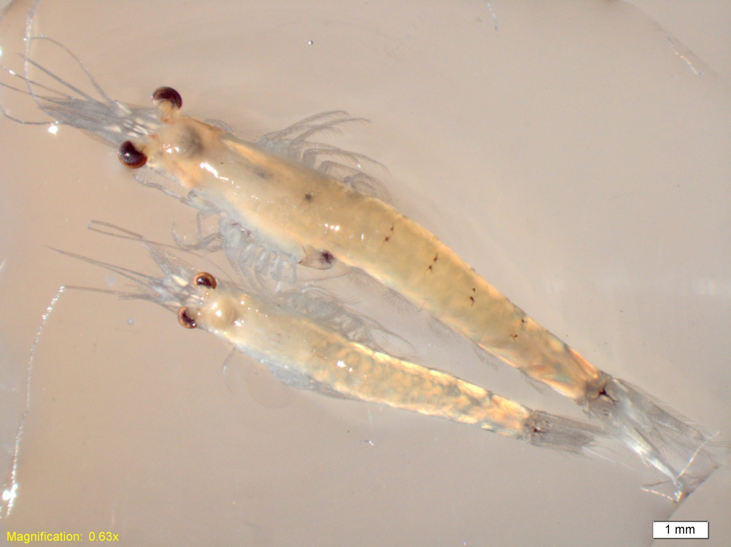
The historically abundant native mysid Neomysis mercedis (top), and the introduced Hyperacanthomysis longirostris (bottom, formerly Acanthomysis bowmani) now the most common mysid in the upper San Francisco Estuary. Pictured above is the average size of each adult species, illustrating that the introduced H. longirostris is smaller than the historically abundant native N. mercedis. Photo courtesy of Tricia Bippus, CDFW.

Slide 2
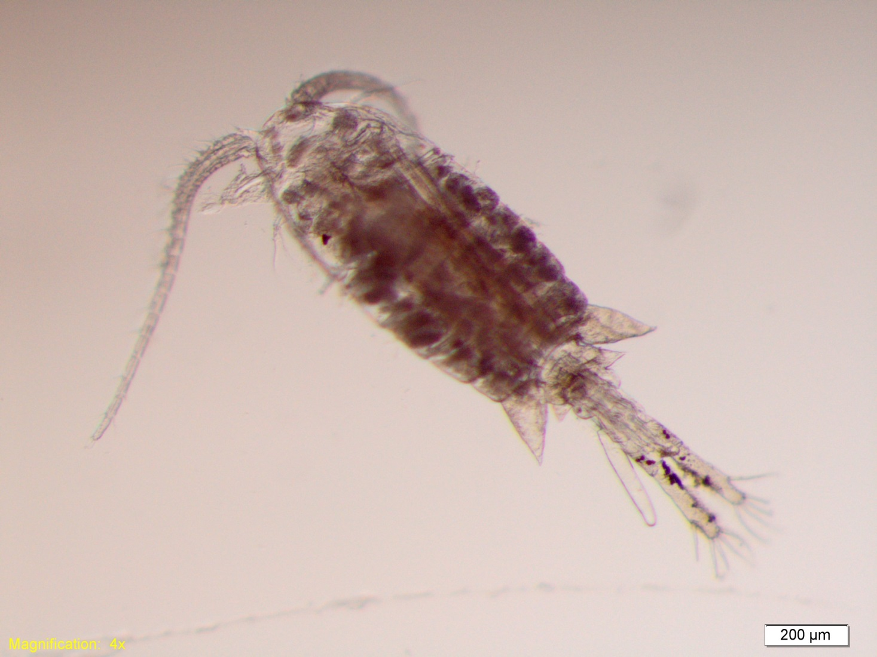
The historically abundant calanoid copepod Eurytemora affinis was an important food resource for pelagic fish in the low salinity zone of the upper San Francisco Estuary. Since monitoring of zooplankton began in the 1970s, abundance of E. affinis has declined. In part this decline has been attributed to competition with and predation from introduced species, including the clam Potamocorbula amurensis and several copepod species. Photo courtesy of Tricia Bippus, CDFW.

Slide 3
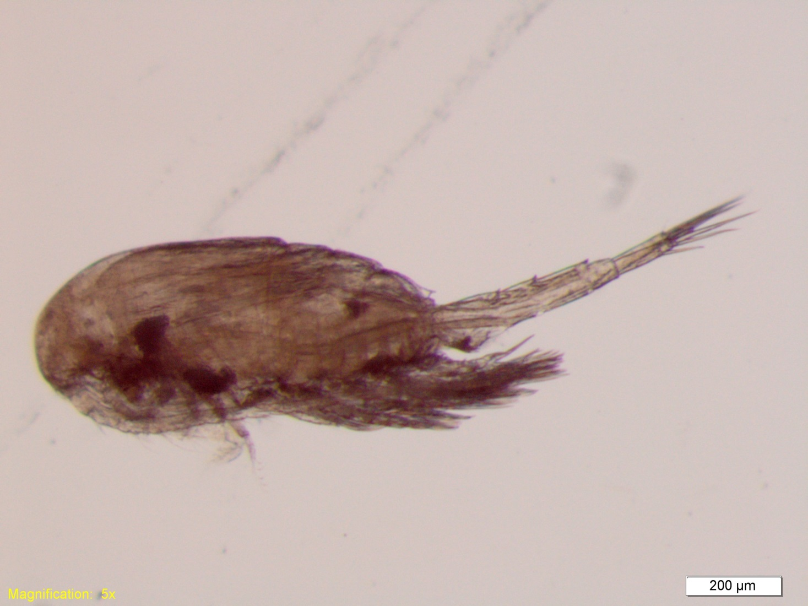
The introduced calanoid copepod Pseudodiaptomus forbesi has replaced the historically common Eurytemora affinis as the most abundant calanoid copepod of the upper San Francisco Estuary. Although abundance of P. forbesi is much lower than E. affinis was historically, it is an important food resource for many pelagic fishes including Delta Smelt and Longfin Smelt. Photo courtesy of Tricia Bippus, CDFW.

Slide 4
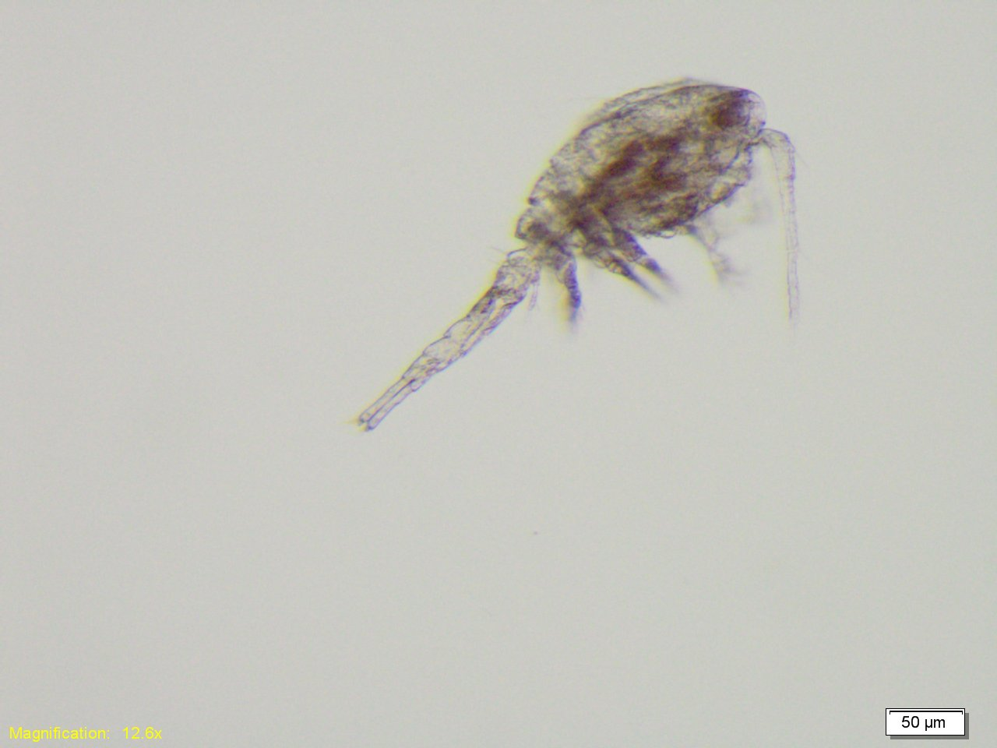
The introduced cyclopoid copepod Limnoithona tetraspina is more abundant than any copepod has ever been in the upper San Francisco Estuary. Although it is abundant, its small size and relatively motionless behavior make it difficult for visual predators like fish to detect and therefore consume. Photo courtesy of Tricia Bippus, CDFW.
Notes:
I’ll see if I can get a better Limno picture from my lab folks, maybe something that can show relative size next to a Pseudo or Eury.

Slide 5
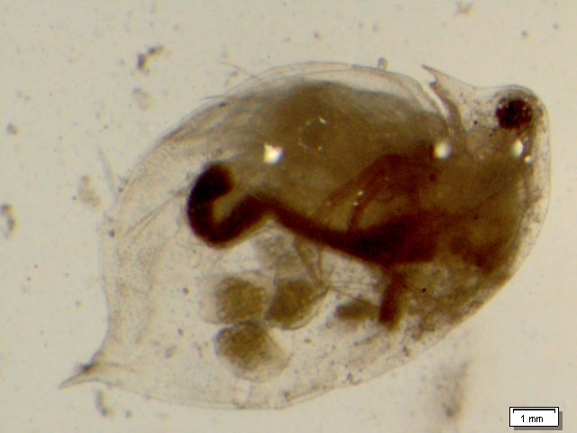
Several cladocerans of the genus Daphnia are common in the upper San Francisco Estuary. Seasonally, cladocerans are important food for pelagic fish species. Photo courtesy of Tricia Bippus, CDFW.

Slide 6
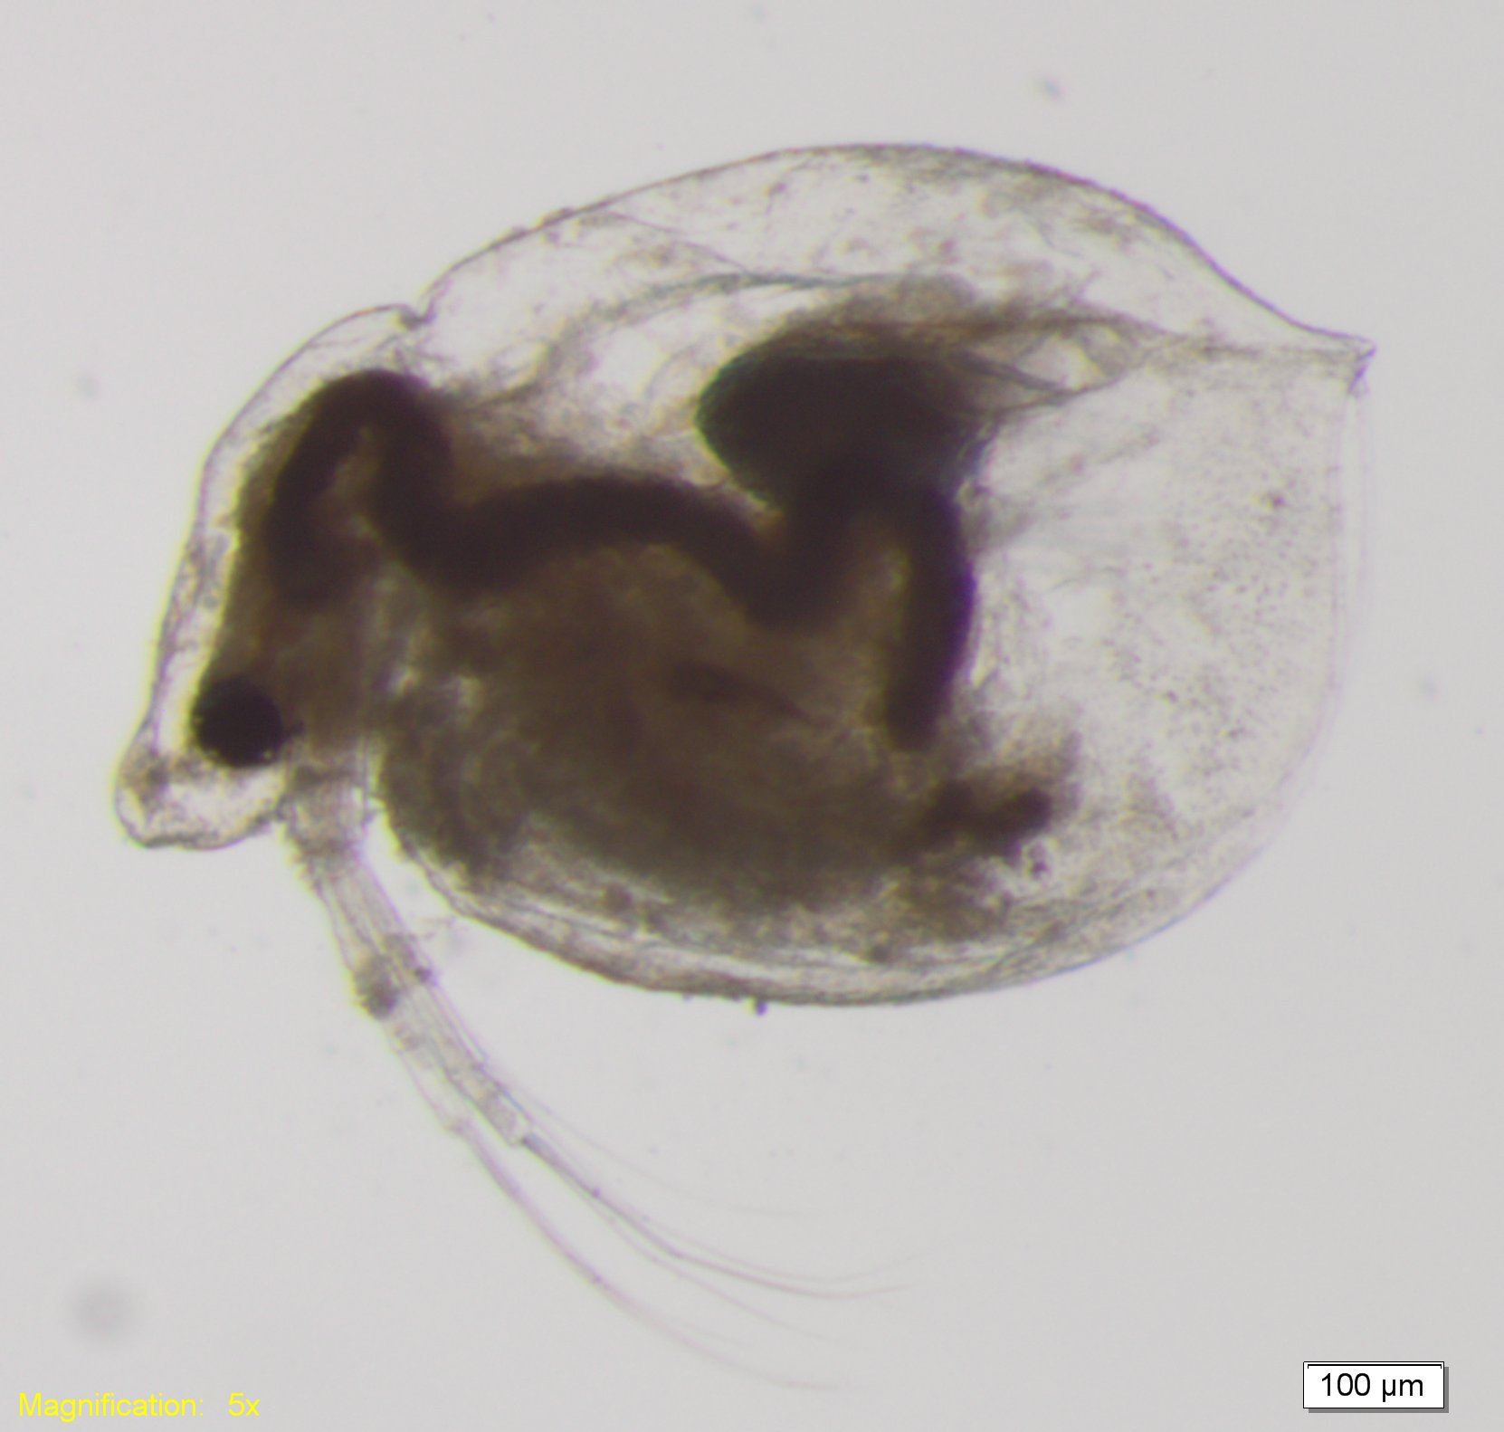
The cladoceran Ceriodaphnia dubia (pictured above) is common in the upper San Francisco Estuary. Seasonally, cladocerans are important food for pelagic fish species. Photo courtesy of Tricia Bippus, CDFW.

Slide 7
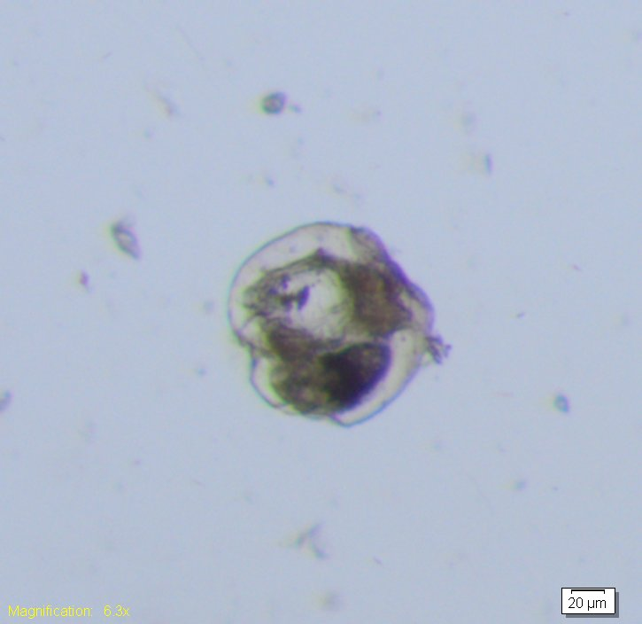
Rotifers, like this Synchaeta, are some of the smallest zooplankton in the upper San Francisco Estuary. Photo courtesy of Tricia Bippus, CDFW.

Slide 8
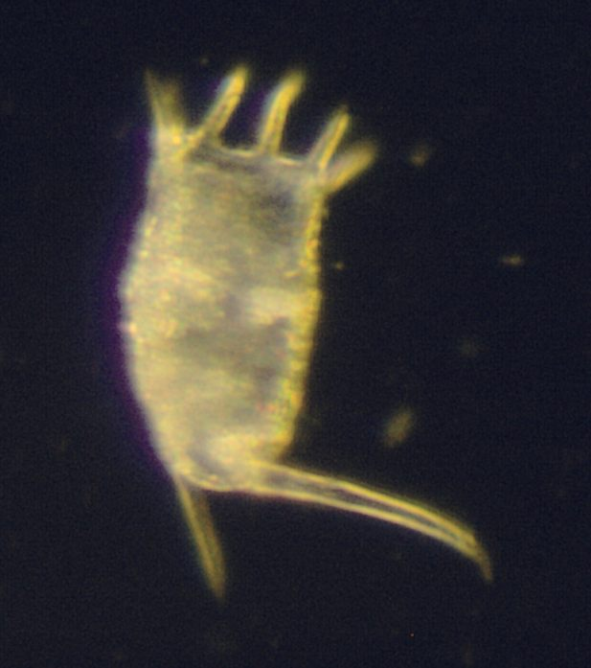
Rotifers, like this Keratella, are some of the smallest zooplankton in the upper San Francisco Estuary. Photo courtesy of Tricia Bippus, CDFW.

Slide 9
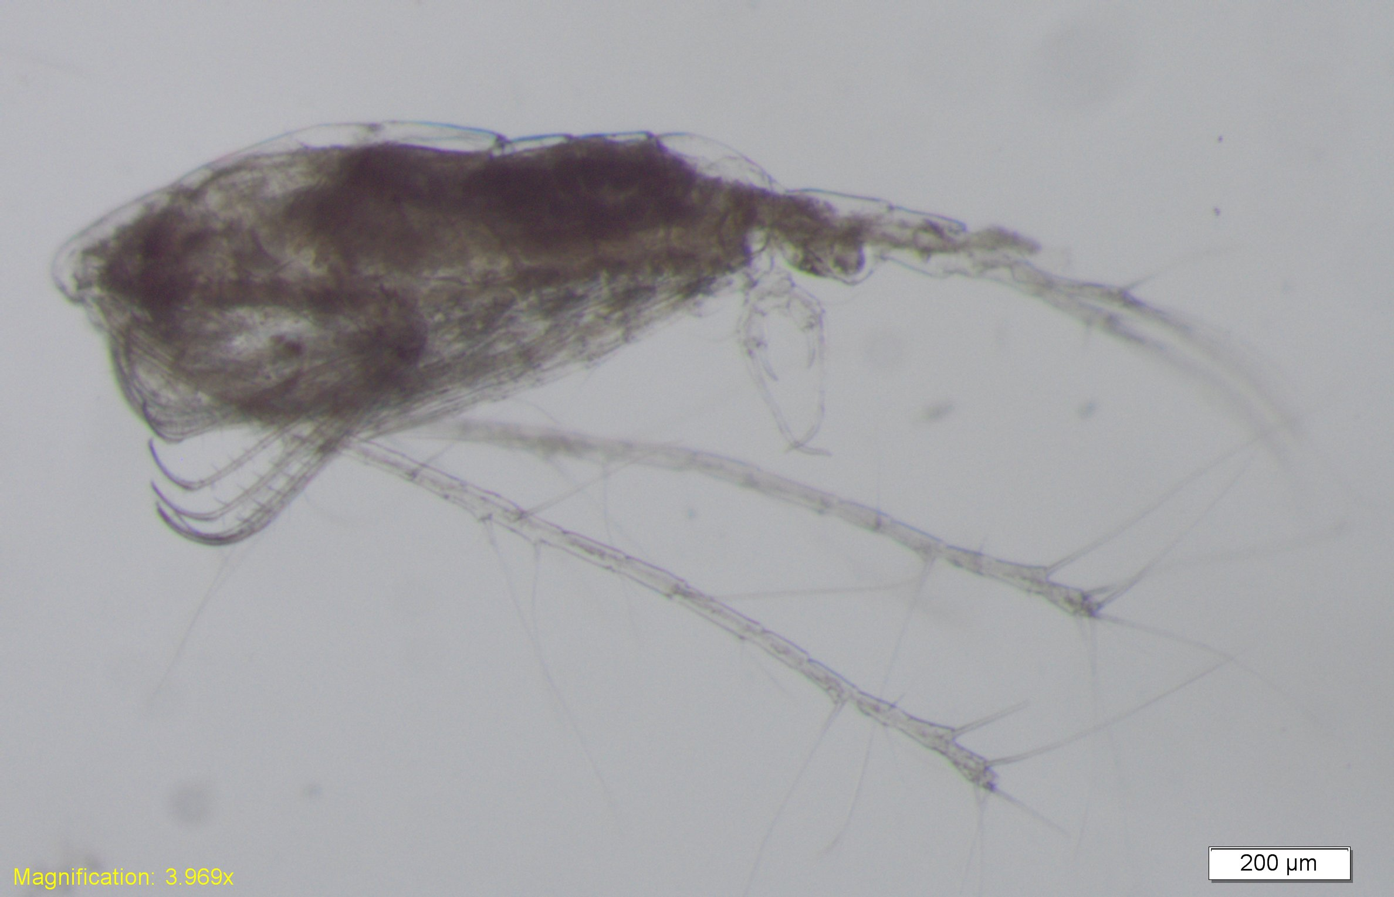
The introduced calanoid copepod, Acartiella sinensis, is a predatory copepod that eats other zooplankton. The effects of these predatory copepods on native zooplankton species in the upper San Francisco Estuary is largely unknown. Photo courtesy of Tricia Bippus, CDFW.

Slide 10
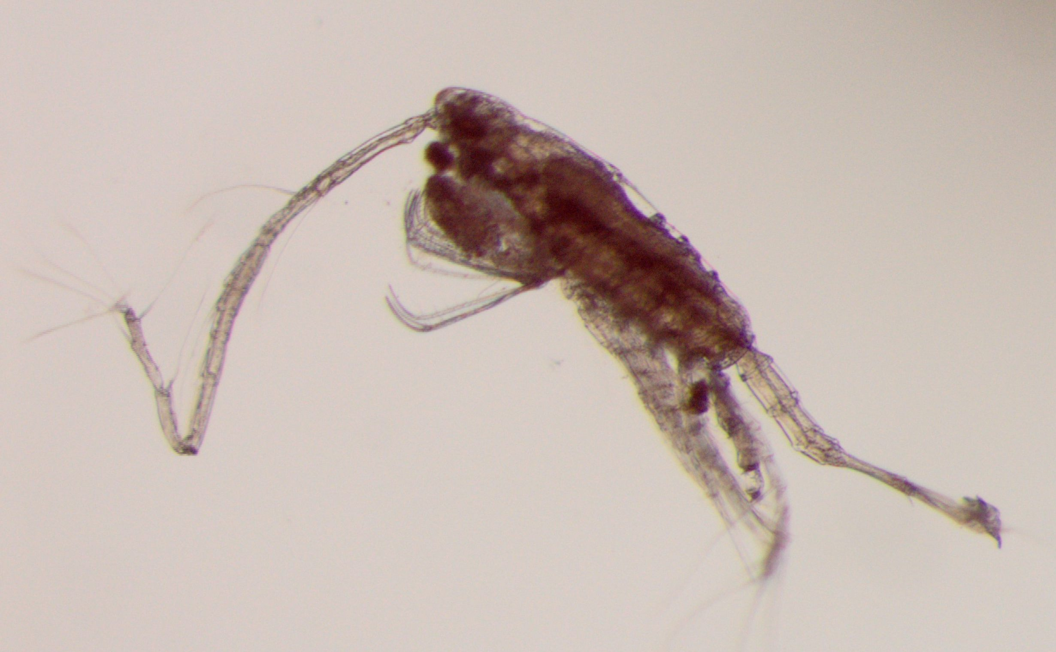
The introduced calanoid copepod, Acartiella sinensis, is a predatory copepod that eats other zooplankton. Here it is seen eating the small non-native cyclopoid copepod Limnoithona tetraspina. Photo courtesy of Tricia Bippus, CDFW.

Slide 11
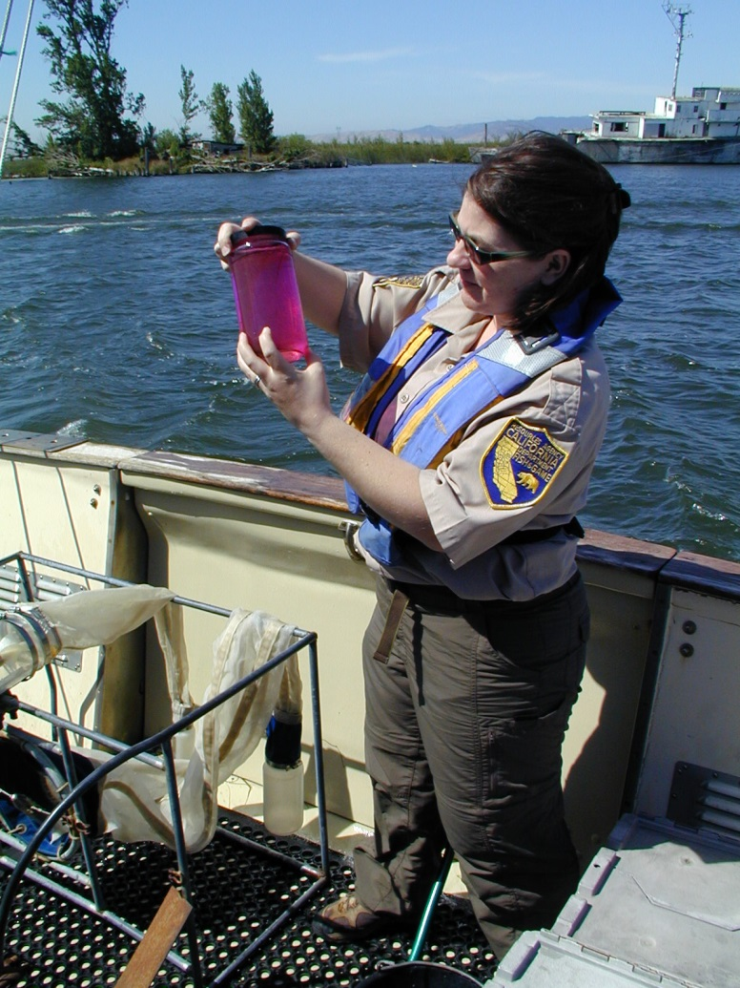
Zooplankton sample stained with Rose Bengal dye (pink) preserved in a sample jar with 10% formalin after collection. Photo courtesy of April Hennessy, CDFW.

Slide 12
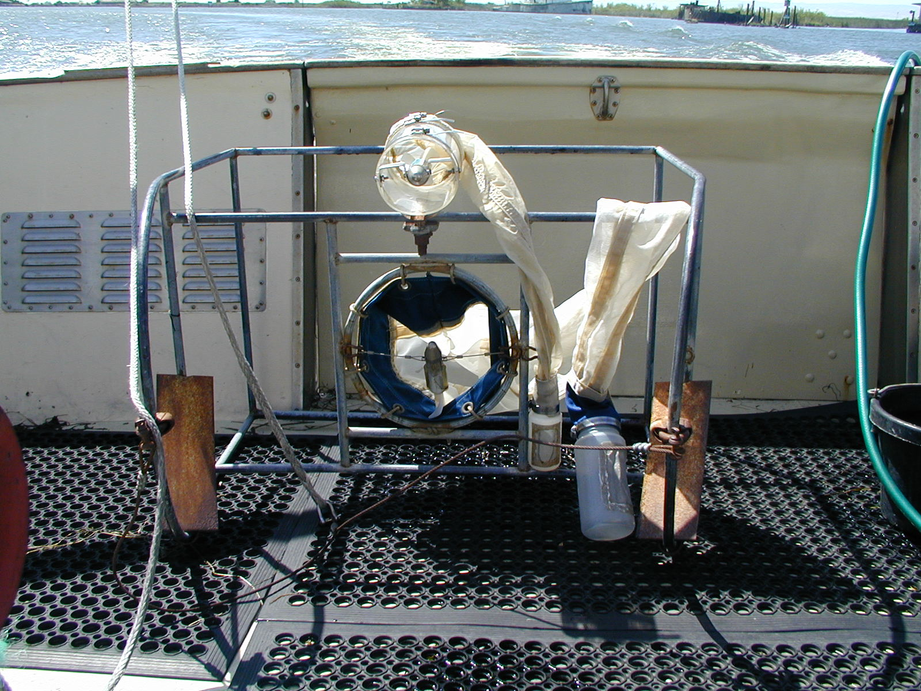
Zooplankton sampling sled with mesozooplankton or “CB” net (160 micron mesh) mounted above macrozooplankton or “mysid” net (505 micron mesh). Photo courtesy of April Hennessy, CDFW.

