Slide 1
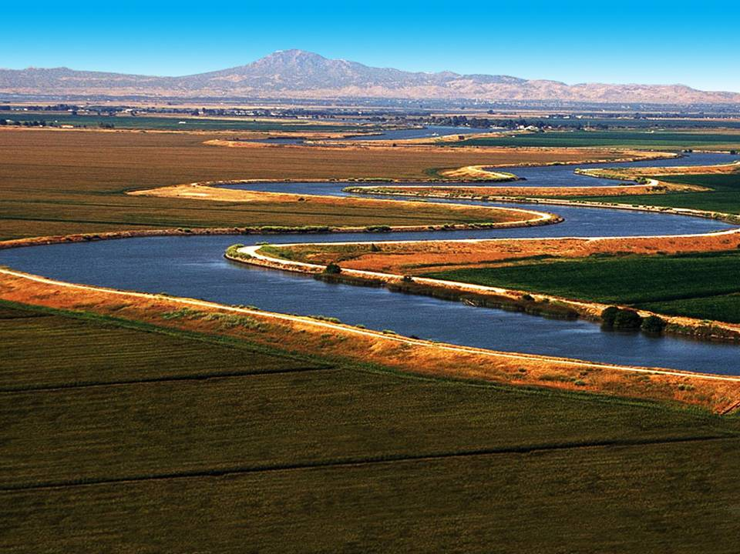
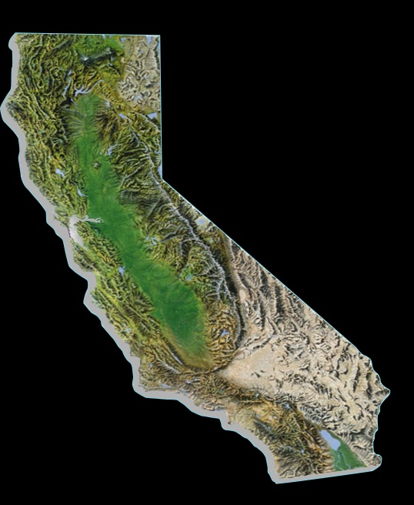
Bay-Delta
Supplies Bay Area, Central Valley & Southern Cal
Bay Area – 33%
Some regions up to 100% dependent
Central Valley – 23 to 90%
State Water Project
Southern Cal – 30%
Notes:
The Bay Delta is where the rivers of the Sierra merge before heading west toward San Francisco Bay.
It is the home of two large water projects, the State Water Project, which supplies mostly urban regions from the Bay area to San Diego, and the federal Central Valley Project, which supplies the state’s agricultural region in the Delta.
All told, water directly from the Delta helps to sustain 25 million Californians – statewide – and some of the nation’s most productive farm land.
As noted, water that travels through the Delta provides 33% to Northern California, 23 to 90% in Central Valley and 30% to Southern California.

Slide 2

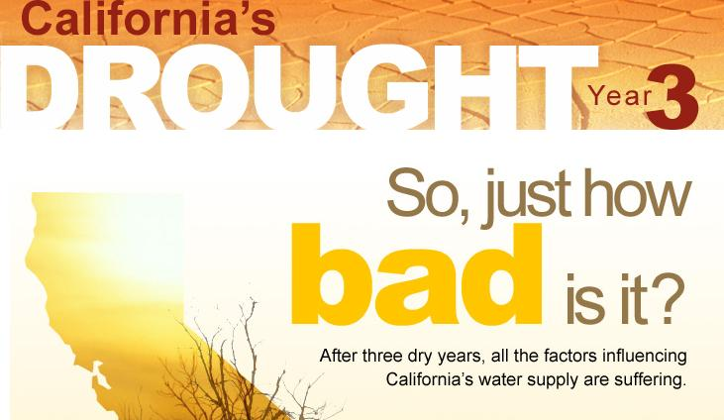
Southern California's
Water Reserve Levels
FULL
2006
2007
2008
NOW
EMPTY
2010 ?

Slide 3
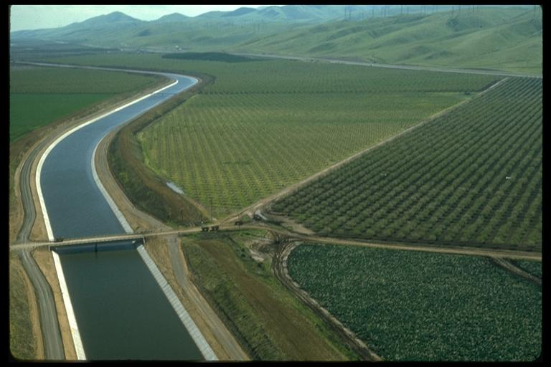

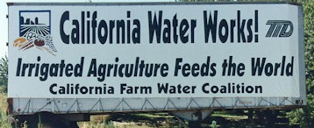
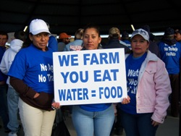
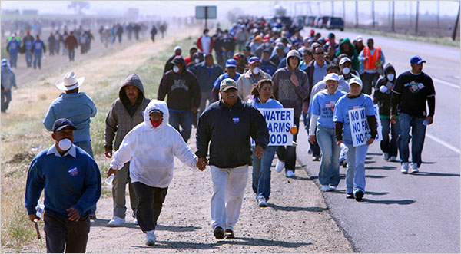
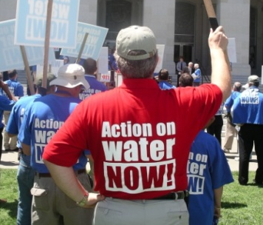
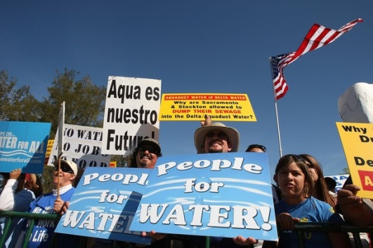
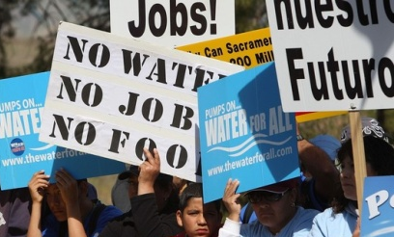
California’s Water Crisis
8,000 people march

Slide 4
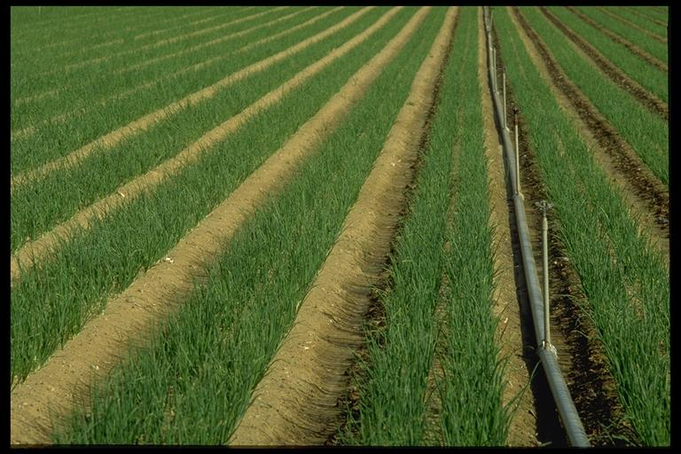
Agricultural Impacts
1 out of 3 acres without project water
1 million acres effected (size of Delaware)
40,000 workers face unemployment
$1.4 billion in Central Valley impacts
* Information from farmwater.org 6/01/2009
Notes:
1 million acres effected (size of Delaware);
average California farm = 350 acres
40,000 workers face unemployment
$1.4 billion in Central Valley impacts
Total Farms
United States 1997 2002 % change
Total farms 2,215,876 2,128,982 -3.9
Land in farms (1000 acres) 954,753 938,279 -1.7
Average size per farm (acres) 431 441 2.3
Sales ($ million) 201,380 200,646 -0.4
Average sales per farm ($) 90,880 94,245 3.7
California
Total farms 87,991 79,631 -9.5
Land in farms (1000 acres) 28,796 27,589 -4.2
Average size per farm (acres) 327 346 5.8
Sales ($ million) 23,280 25,737 10.6
Average sales per farm ($) 264,574 323,205 22.2

Slide 5
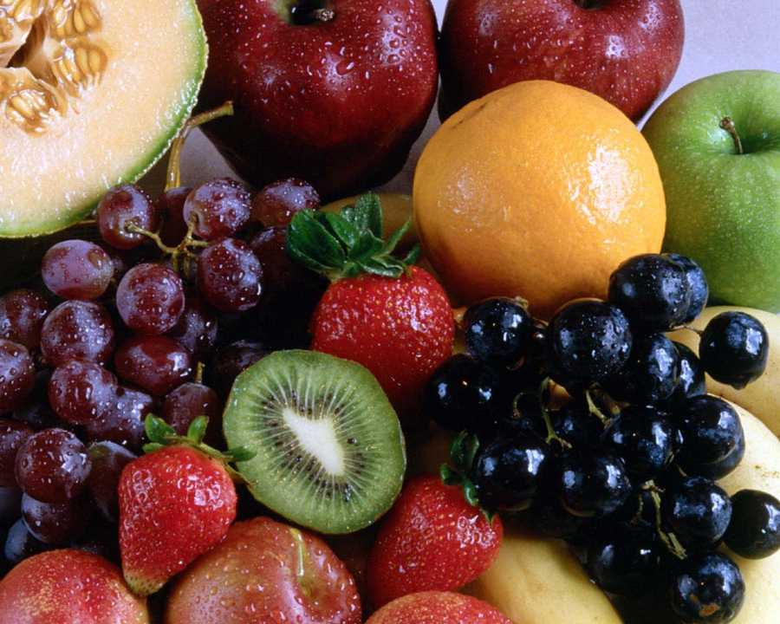
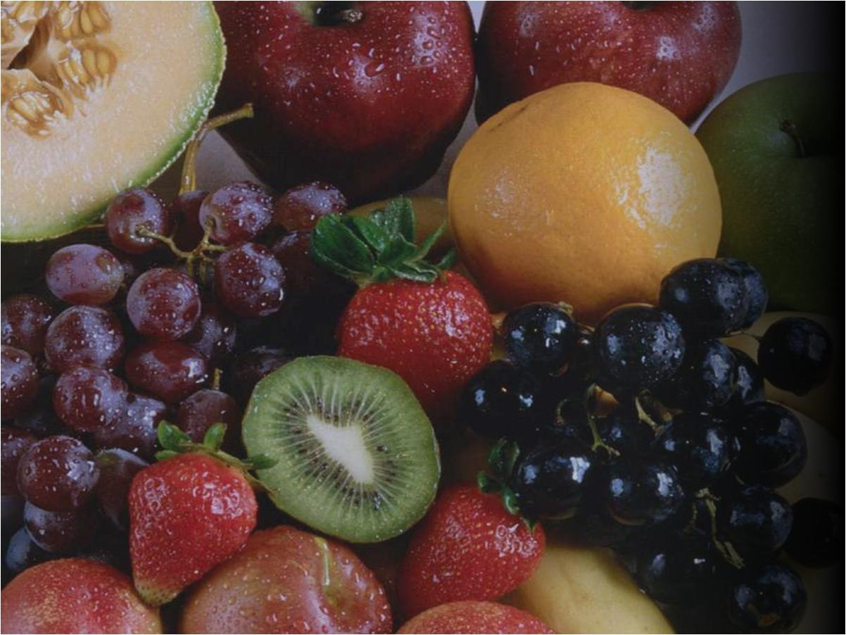
Cantaloupe: 54 %
Asparagus: 55 %
Honeydew: 73 %
Peaches: 76 %
Lettuce: 78 %
Dates: 82 %
Avocados: 84 %
Garlic: 86 %
Grapes: 88 %
Lemons: 89 %
Carrots: 89 %
Strawberries: 90 %
Broccoli: 93 %
Celery: 94 %
Nectarines: 93 %
Plums: 93 %
Tomatoes: 94 %
Apricots: 95 %
Pistachios: 96 %
Kiwi: 97 %
Figs: 98 %
Walnuts: 99 %
Almond: 99 %
Olives: 100 %
California –
America’s Fruit Basket
> 50% of US vegetables, fruits & nuts are California grown
Notes:
Source: California Department of Agriculture

Slide 6
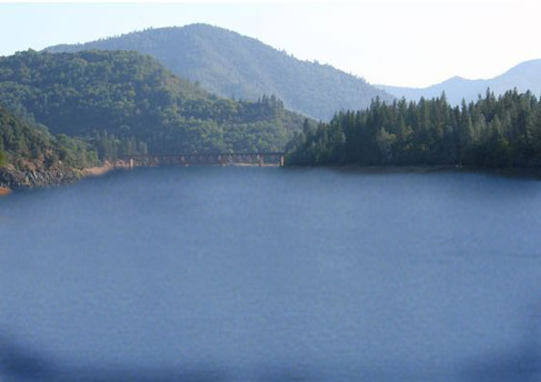
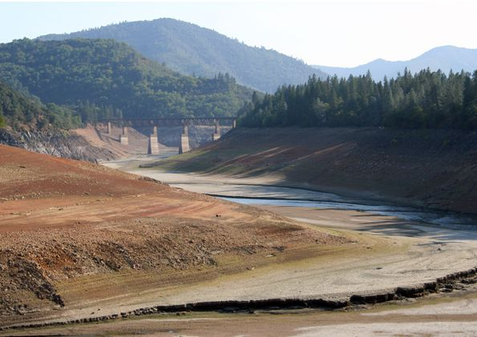
Shasta Reservoir
Sacramento River
1995
2008

Slide 7
Lake Oroville
Feather River
2005
2008
Notes:
Lake Oroville-Nov 2008 - 29% of capacity

Slide 8
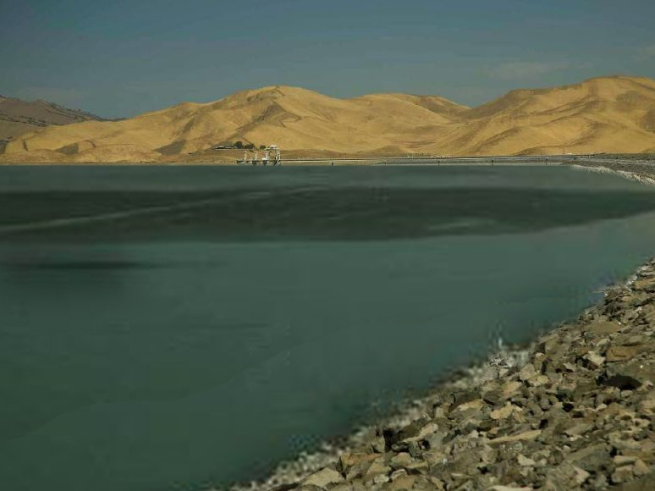
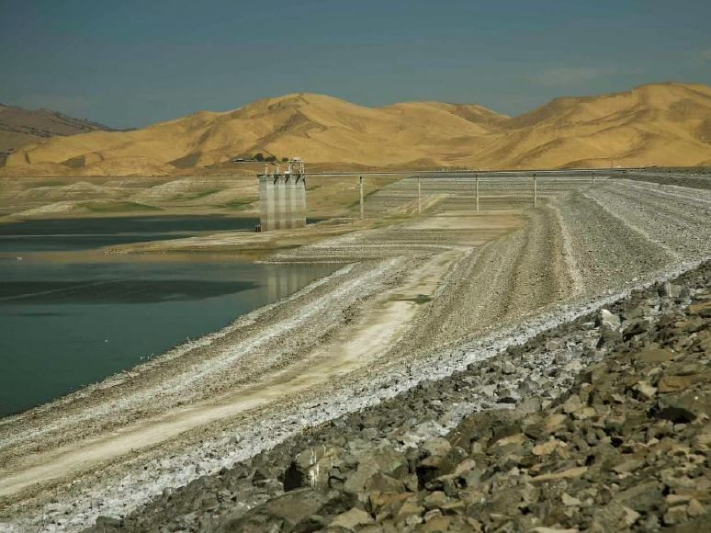
San Luis Reservoir
western San Joaquin Valley
1995
2008

Slide 9
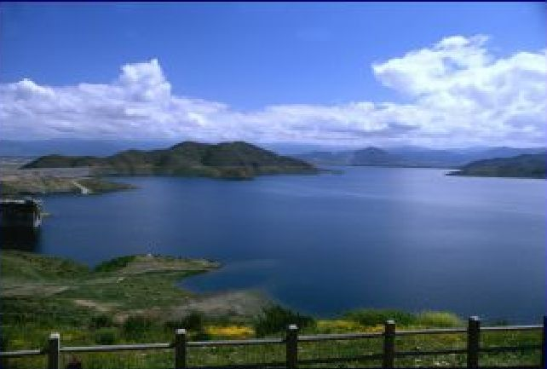
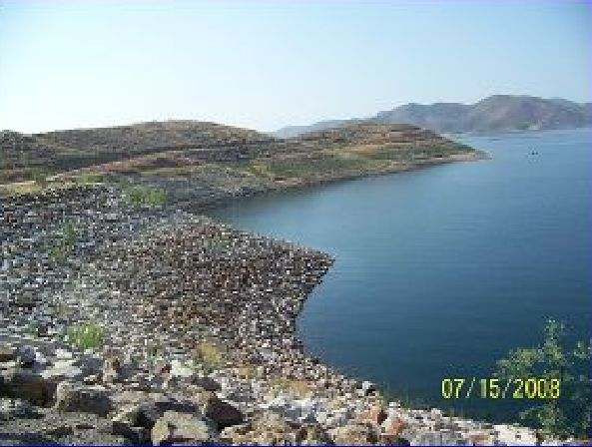
Diamond Valley Lake
Southern California
2006
2008
Notes:
Confluence of Colorado and Dirty Devil Rivers

Slide 10
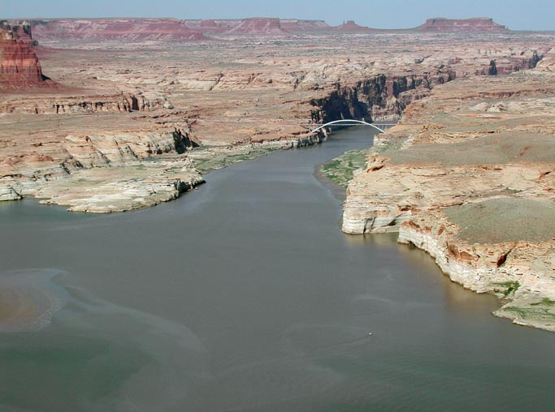
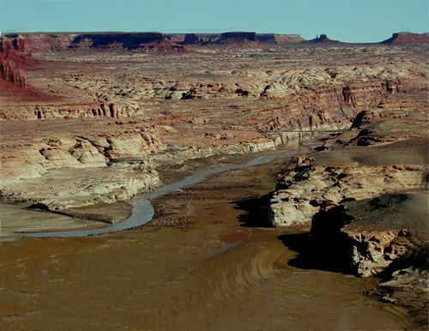
Lake Powell
Colorado River
2002
2008
Notes:
Confluence of Colorado and Dirty Devil Rivers

Slide 11

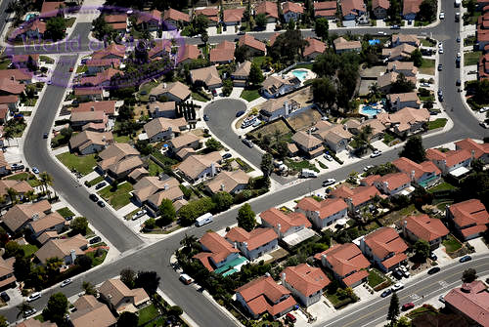
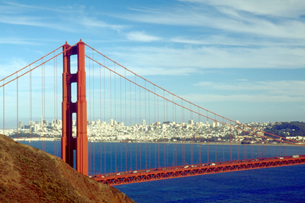

How much water have we lost?
Regulatory actions since 1992
3.4 million acre-ft cumulative impact
Supply needs for 7 million homes
(San Francisco population ~ 0.8 million)

Slide 12
How much water have we lost?
Regulatory actions since 1992
Regulatory Actions | Water (af)
Shasta Reservoir - Cold Water Pool | 500,000
Central Valley Project Improvement Act "B(2)“ Supplies | 800,000
CVPIA "Level 2" Refuge Supply | 422,000
CVPIA Trinity River Restoration | 400,000
Water Quality Control Plan | 100,000
2008 Fish & Wildlife Service "Delta Smelt" Biological Opinion | 750,000
2009 National Marine Fisheries Service "Salmon" Bio Opinion | 450,000
Cumulative Impact (State & fed projects) | 3.4 million
Equivalent to the supply needs for 7 million homes

Slide 13
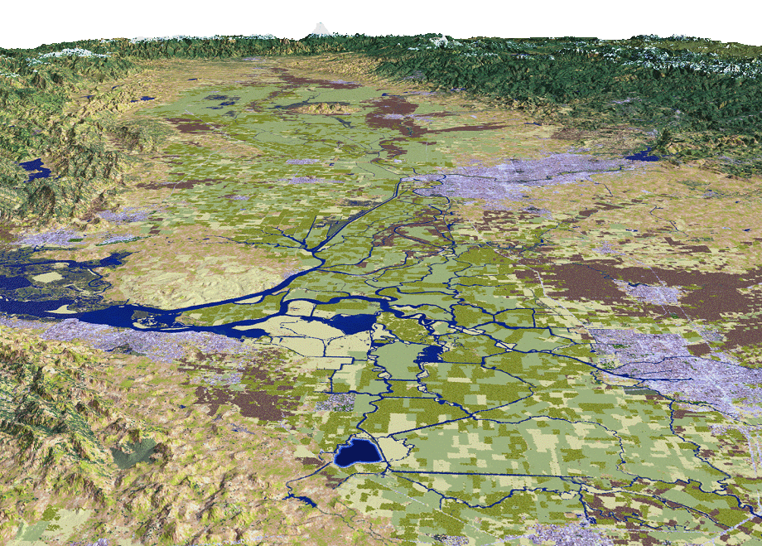
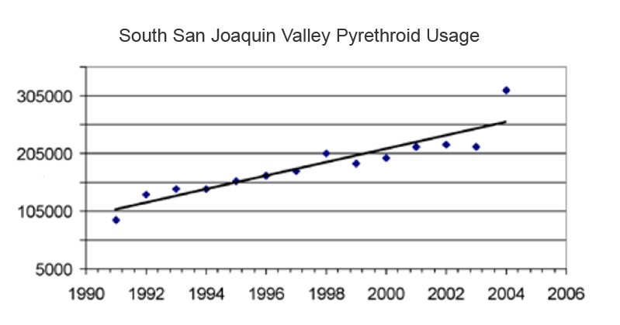
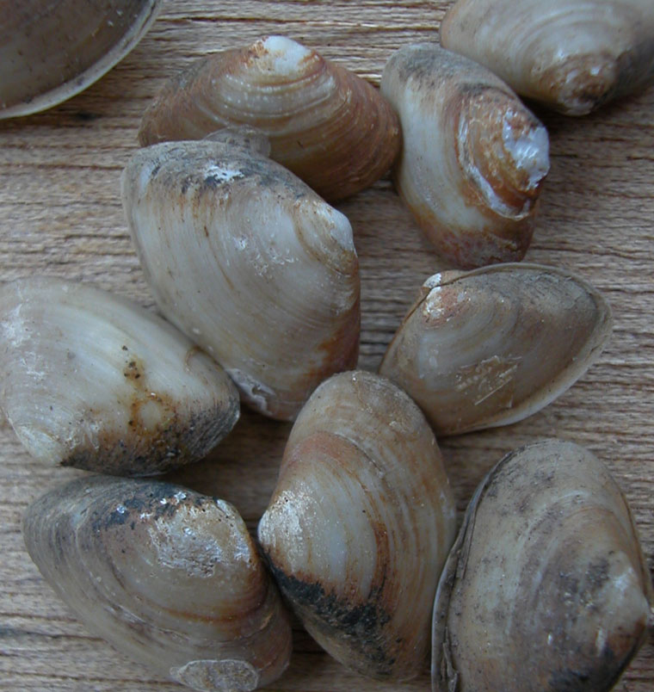
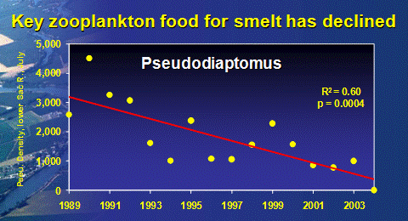
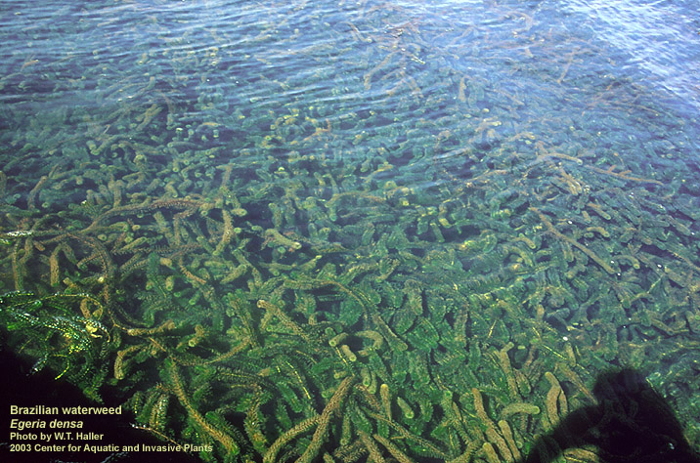
Other Stressors
Toxics, Unscreened Diversions, etc.
Corbula amurensis
(Overbite clam)
Sac River
Egeria densa
(Brazilian Waterweed)
Stockton
Notes:
13
MWD BOARD -- BAY-DELTA WORKSHOP (7-24-2007)

Slide 14
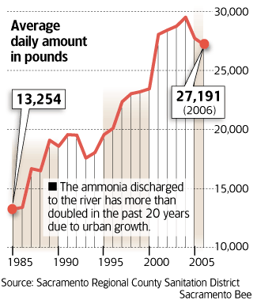
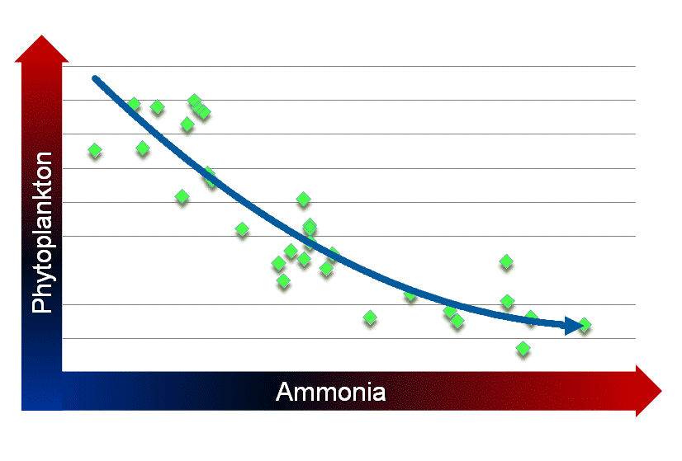
Delta Near-Term Measures
Ammonia Research
Ammonia discharges doubled
Ammonia tied to food web decline
Notes:
ln (Suisun Bay Phyto Density July to Sept) v June - August Ammonia Loading at Hood
Joint SWP/CVP research . Includes Nitrogen model; isotope analysis to determine the source of the nitrogen; and studies of the relationship between nutrients generally and the food chain
Hired Dr. Pat Glibert of U. of Maryland. Internationally recognized expert in nutrient impacts on ecosystems
Here initial review implicates not merely ammonium, but the nutrient balance between nitrogen and phosphorus. Such nutrient impacts are seen in many estuaries throughout the world.
Models ammonia, nutrients & temperature
Independent technical advisory review
Anticipated completion Jan 2010

Slide 15

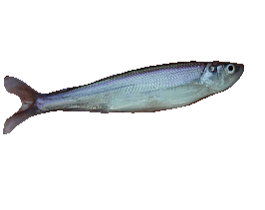
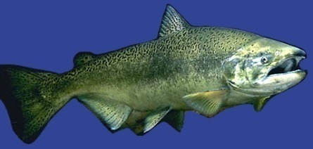
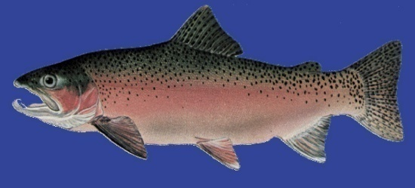
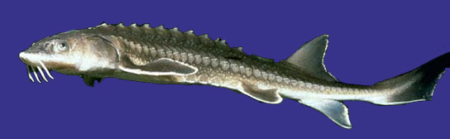
Endangered Species Act
Regulations
Re: SWP & CVP Operations
Delta smelt
Longfin smelt
Delta Smelt
– USFWS released Bio Opinion (Dec ‘08)
Longfin Smelt
– Listed as threatened (Jun ‘09)
Chinook Salmon/Steelhead/Green Sturgeon/Southern Resident Orca
– NMFS released Bio Opinion (Jun ‘09)
Chinook Salmon
Steelhead
Green Sturgeon
Notes:
12-15-08 – USFWS issued delta smelt BiOp
4-9-09 – USFWS concludes longfin smelt due not warrant listing under federal CESA; Bay-Delta population is not distinct from the longfin smelt that is abundant is other parts of the Pacific Coast
6-25-09 – DFG Commission listed longfin as threatened; DFG issued a 10-year 2081 Permit to California
6-4-09 – NMFS issued BiOp for spring run, winter run, steelhead, green sturgeon, southern resident pop of killer whale

Slide 16
Water Usage Comparison

Slide 17
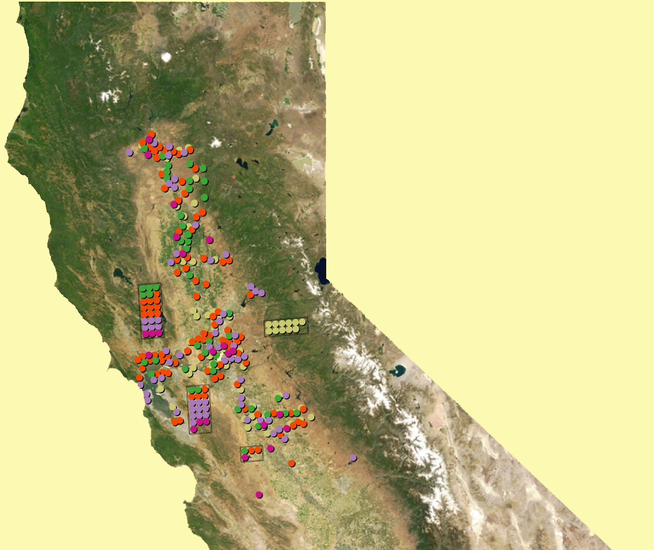
Reliability Actions
Support ecosystem restoration
Notes:
650M since 2000
$282M pre-ROD
400+ eco projects

Slide 18
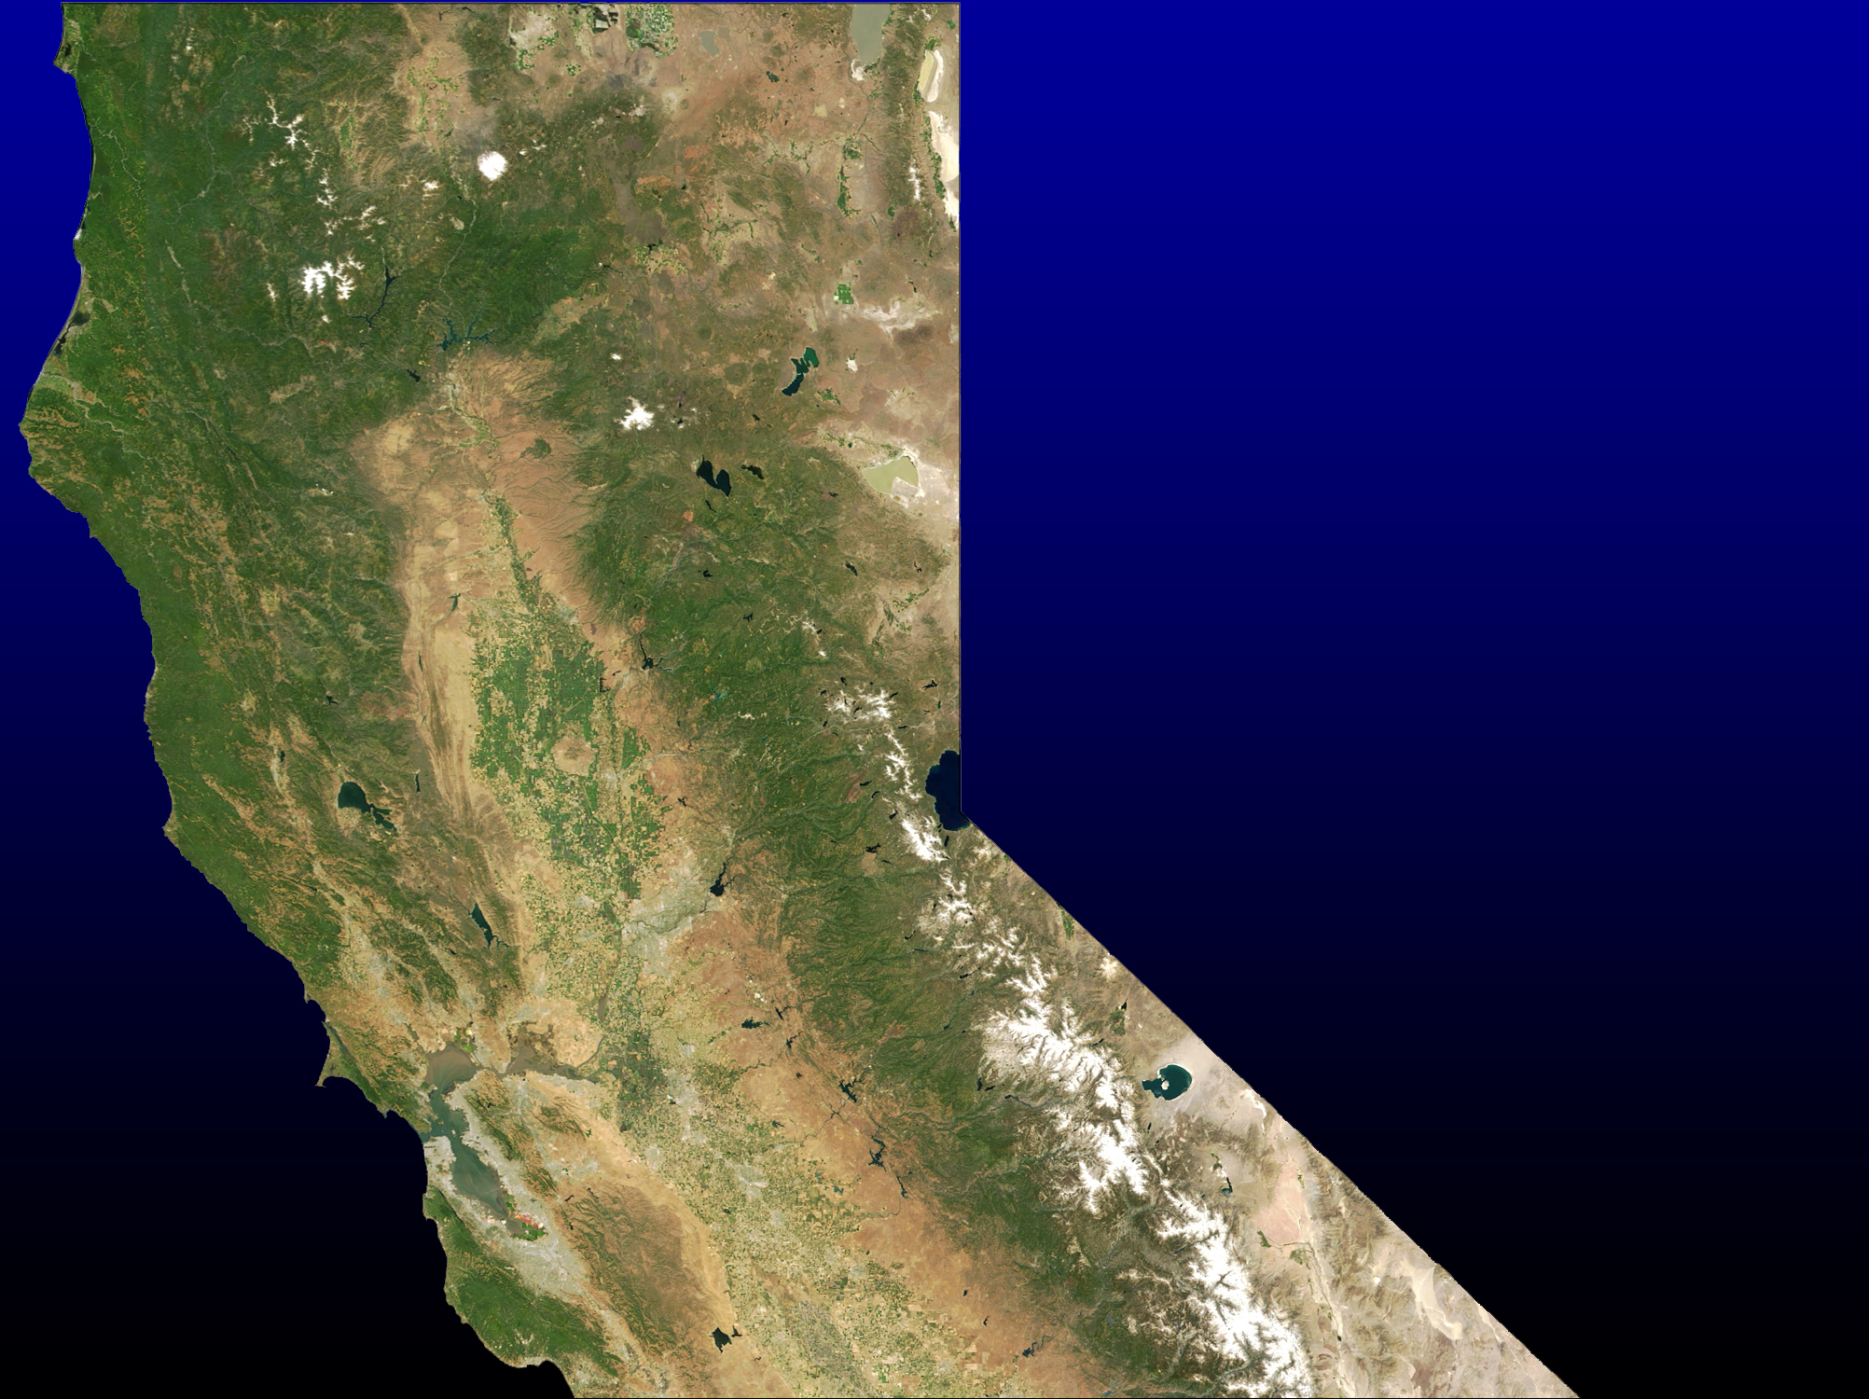
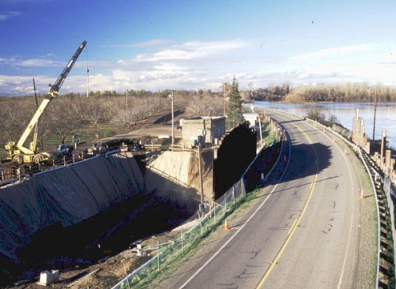
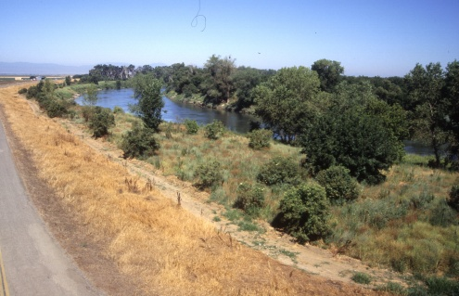
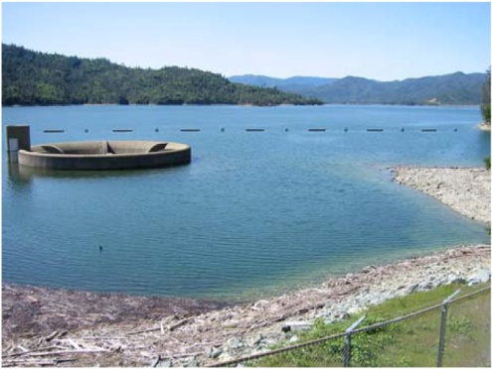
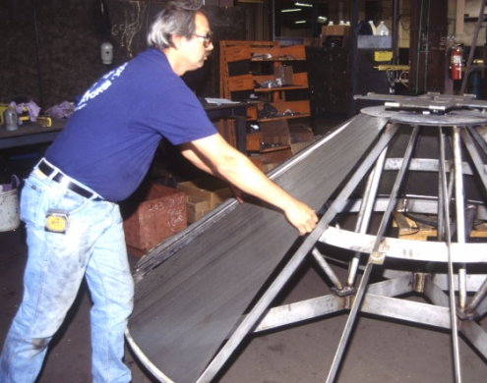
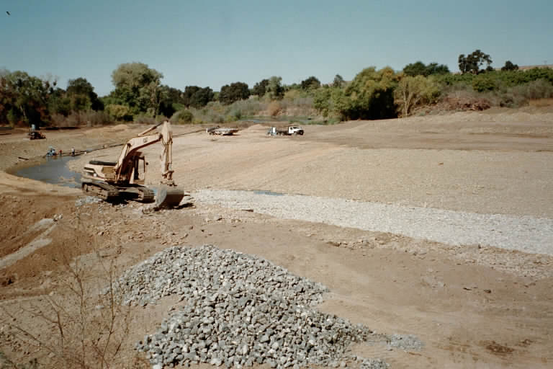
Implemented Environmental Projects
Lake Shasta / Sac. River Temperature Control
Sac. River Riparian Restoration
Clear Creek Watershed Management
Butte Creek Dam Removal
Cosumnes River Preserve
Suisun Marsh Fish Screens
Tuolumne River Gravel Restoration

Slide 19
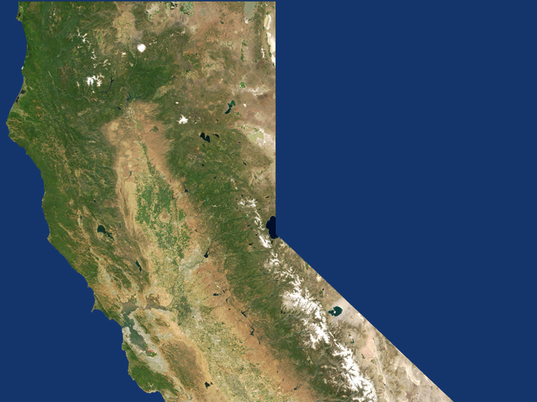
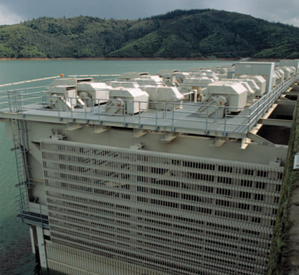
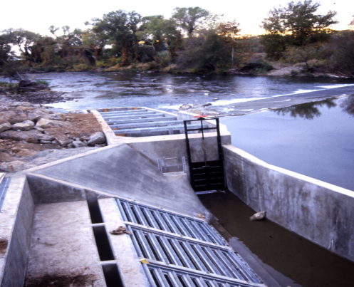
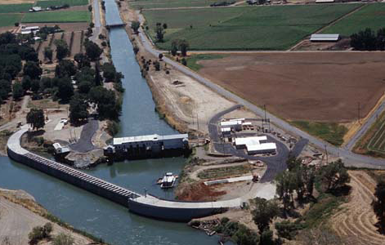
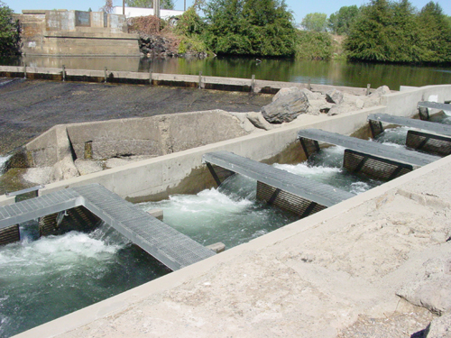
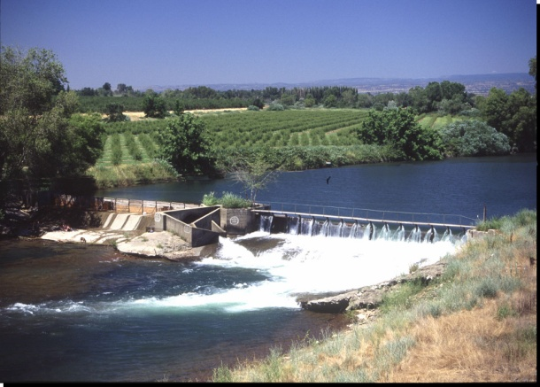

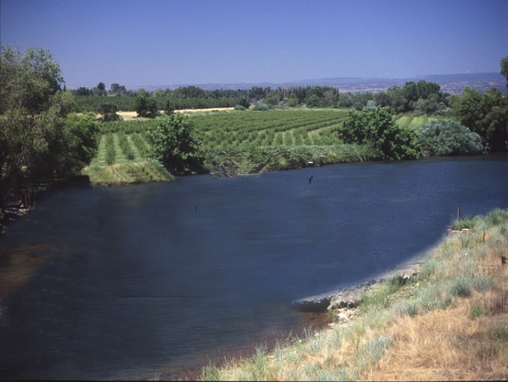
The CALFED Decade: 1995-2005
Successes: Environmental Restoration
Battle Creek
Screen & Ladder
Shasta Temp Control Device
GCID Fish Screens
Durham Mutual
Fish Ladder
Butte Creek Before …
Suisun Marsh
Fish Screens
… Butte Creek After

Slide 20
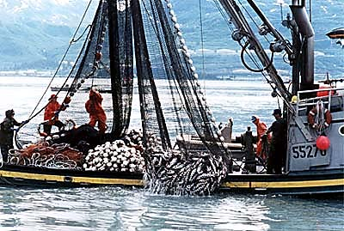
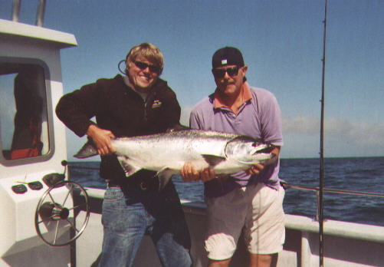

Delta Interim Opportunities
Mark-Select Salmon Fishery
All hatchery fish marked & can be retained
Commercial & recreational fisheries
Benefit = 10,875 winter-run at year 12
Reduces commercial harvest by ~ 20%
Cost ~ $5 million/yr; 10 cents per fish
Adipose fin clip

Slide 21

Delta Interim Opportunities
Mark-Select Salmon Fishery
States & provinces implementing total salmon marking programs

Slide 22

Fish Salvage vs. Ocean Harvest
(Total equivalent adult salmon captured from 1995-2006)
Fall-Run Salmon
Late-Fall Run Salmon
2.8 million
150,000
19,000
350
Winter-Run Salmon
Spring-Run Salmon
44,000
69,000
4,000
14,000
Notes:
Introduction
We compared takes of Central Valley Chinook salmon runs captured at the State Water Project (SWP) and Central Valley Project (CVP) salvage Delta water export facilities based on fish salvage data, with those in ocean fisheries. Because the salvage facilities capture primarily juvenile salmon and the ocean fisheries harvest largely adult fish, we converted these to the equivalent number of adults that would have returned to Central Valley rivers and streamsthe mouth of the Sacramento River in the absence of these takes.
Methods
We summed daily expanded losses of Chinook salmon by race (Fall, Late Fall, Winter, or Spring) at the SWP and CVP salvage export facilities (available at ftp://ftp.delta.dfg.ca.gov/salvage) to obtain juvenile take estimates from 1996-2007 (Table 1). We assumed that these were smolts that would have emigrated to the ocean that year (1995-2006 brood years). Note that these losses included an accounting for indirect losses due to predation in SWP’s Clifton Court Fthe facilities forebay. We assumed that these were smolts that would have emigrated to the ocean that year (1995-2006 brood years). We then calculated the equivalent number of adults and jacks? from each cohort that would have returned to the Sacramento RiverCentral Valley to spawn in the absence of salvage and ocean harvest. To do this, we used rates of survival and maturity for each age as shown in Table 2. We also converted ocean fishery landings to adult equivalents because many of the fish caught were not yet mature and would have remained in the ocean for at least another year. Converting losses at the salvage export facilities and in ocean landings to adult equivalents ensures that the different takes are comparable.
We estimated harvest each year, 1996-2007, from total actual landings of all runs and ages of Chinook at ocean ports in California, as reported by the Pacific Fishery Management Council (PFMC 2008). Estimates by age and race are not currently provided by the PFMC. Total ocean landings south of Point Arena are assumed to be primarily Central Valley Chinook salmon (PFMC 2008).
Ocean landings of Central Valley Chinook salmon by age were derived using different methodologies for each race. Total ocean landings south of Point Arena are assumed to be primarily Central Valley Chinook salmon as reported by the Pacific Fishery Management Council (PFMC 2008). However, estimates by age and race are not currently provided by the PFMC. We used models to apportion the landings into race, and then into age groups for Central Valley Chinook salmon. The model used in the retrospective analysis of mark selective fisheries was used to derive ocean landings of Fall and Late Fall run Chinook salmon[please briefly describe the algorithms, or reference or attach text for each of these models]. The Fall run was assumed to comprise 90%, and the Late Fall run 5% of the landings. Winter and Spring run landings were hindcast using the Integrated Modeling Framework (IMF) for Sacramento River Winter run and Spring run Chinook salmon, respectively. Using model generated estimates also allowed us to project future landings of older aged fish to complete brood year comparisons (for example age 3 fish from brood year 2005 will be harvested in 2008). Therefore, ocean landings of 2005 and 2006 broods are based largely on predictions of future landings. The resultant estimates of ocean landings by brood year and age for each race are provided in Table 3. In order to make these landings comparable with salvage losses, we calculated the equivalent number of adults that would have returned to the Sacramento River to spawn in subsequent years, using parameters found in Table 2.

Slide 23
Fish Salvage vs. Ocean Harvest
(Total equivalent adult salmon captured from 1995-2006)
Winter-Run Salmon

Slide 24
Delta Interim Opportunities
Preliminary research indicates ammonia tied to food web decline
Ammonia Increase
Phytoplankton Decrease
Notes:
ln (Suisun Bay Phyto Density July to Sept) v June - August Ammonia Loading at Hood

Slide 25



Why don't we just replace the Delta water supplies with desalination?
35-70 new desalination plants
Every 2-4 miles from LA to San Diego
400 additional windmills (3 MW)
Increase from $250 to $1,500 per acre-foot
Notes:
Desalting Plants (for new water supply)
Carlsbad (Poseidon) = 50 mgd or 56,000 af/yr (proposed)
Tampa = 25 mgd or 28,000 af/yr
Replacing MWD’s share of the SWP (2 maf/yr) = 36 to 72 desalting plants
1 plant every 2 – 4 miles from LA to San Diego
Wind Mills (for extra energy needed)
SWP deliveries cost ~ 3,200 kwh/af [From Warren Teitz 8-4-2009 email reference CEC]
Desal energy cost ~ 4,400 kwh/af [From Warren Teitz 8-4-2009 email reference CEC]
Additional incremental energy need is ~1,200 kwh/af or 1.2 MWh/af
Total incremental energy need is ~ 2.4 million MWh/yr (1.2 MWh/af x 2 million af/yr)
Larger windmills turbine ~ 1 to 6 MW (assume 3MW for analysis)
Typical windmill capacity factors worldwide are 13–25% (US average in 2008 = 23.5%)
Output ~ 6,200 MWh (3MW x 24hr/day x 365 days/yr x 23.5%)
387 windmills to produce additional incremental energy (2.4 million MWh/yr / 6,200 MWh)
Water Cost Increase (using San Diego & Orange County desal estimates)
Orange County estimate ~ $1,300/af
San Diego estimate ~ $2,000/af
SWP existing estimate ~ $250/af
SUMMARY
2 million acre-feet/year replaced
36 – 72 new desalting plants
1 plant every 2 – 4 miles from LA to San Diego
387 new windmills additional energy need
Water cost increase ~ $250 to $1,500/af (6X)

