Slide 1

Water is jobs
Water is crops
Water is life
California’s Water Crisis
Developing Solutions

Slide 2
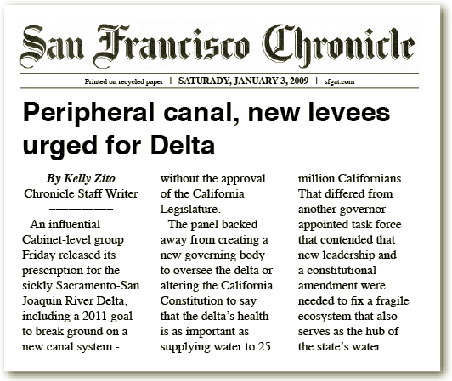
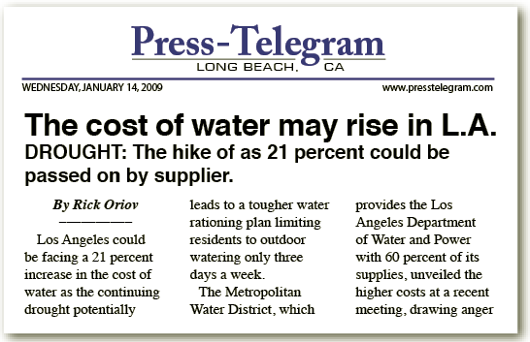
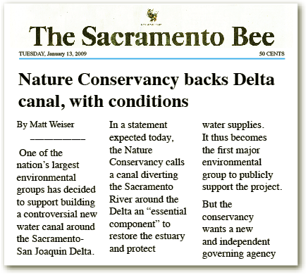
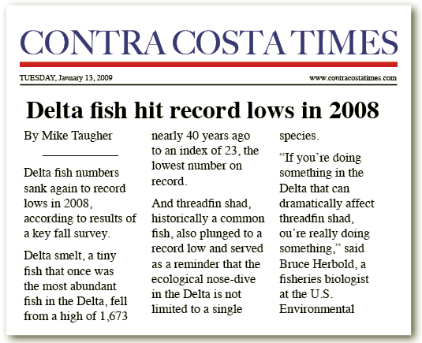
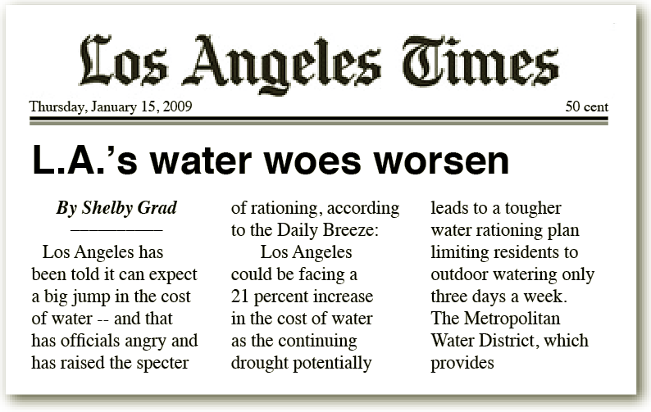
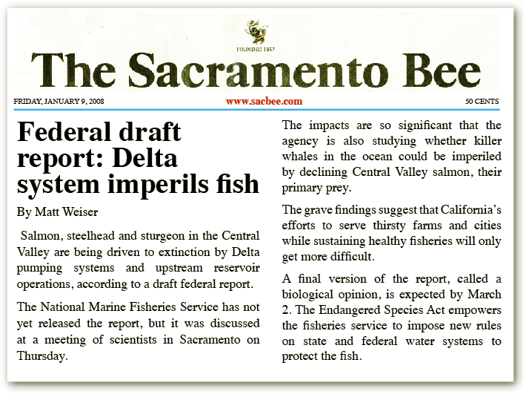
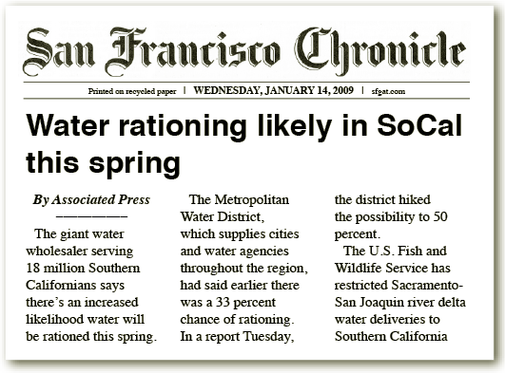
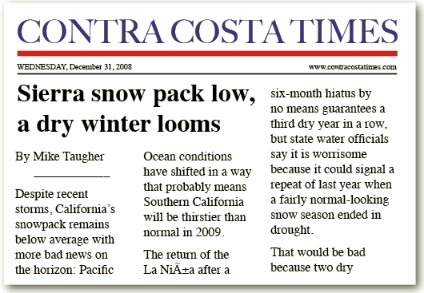
Newpaper Headlines

Slide 3

“These storms may have left consumers with the misperception that the water supply problems are over. Nothing, however, could be further from the truth.”
− Jeffrey Kightlinger, General Manager (Jan 25, 2010)

Slide 4
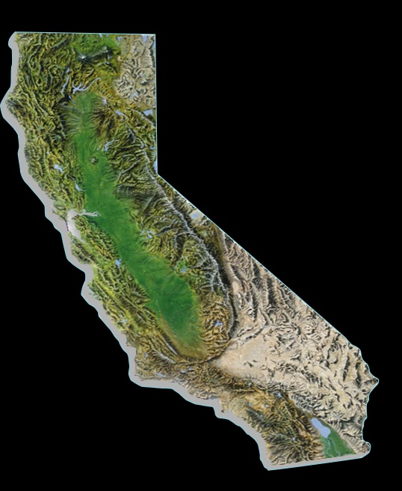

Reservoir & Snowpack Conditions
March 7, 2010
Donner Summit
84%
78%
Shasta
Mammoth
Pass
96%
Upper Colorado Basin
83%
41%
Oroville
45%
75%
San Luis
Lake Mead
48%
Diamond Valley
Notes:
California is entering its fourth year of a drought, and the Colorado River basin, which also supplies Southern California, just came out of an 8-year drought.
This slide illustrates current water levels in several key reservoirs.
More important for water supply projects is the snowpack conditions in our mountains and the Rockies.
Snow is nature’s reservoir, which replenishes our lakes and rivers as it melts throughout the year. We will need greater than average snowfall to replenish our water supplies.
Earlier this year, the State Department of Water Resources issued a 5% initial State Water Project allocation, the lowest initial allocation on record.
With the recent rains, that allocation moved up to 15%.
At the end of the rain season in April, we will have a better understanding of our water supply situation, and whether there has been enough rain and snow to begin replenishing the groundwater basins and reservoirs that have been drawn down over the past four years. For now, State officials are cautioning that the recent rains may not mean an end to the drought.
Additional Reference
5% initial State Water Project allocation (raised to 15% in Feb. 2010 or 315,840 AF of Table A)
Lowest initial allocation on record
Previous low was 10% in 1993
Final allocation was 100%
2009 initial allocation was 15%
Final allocation was 40%
What happens if 5% allocation remains?
Demands met through Colorado River deliveries, storage reserves, water transfers, purchases

Slide 5
Supply Outlook
Mar. 2010
Storage, Transfers, Supply Restrictions
764,000 AF
Colorado River
1,050,000 AF
State Water Project
316,000 AF
State Water Project
  15% SWP allocation – current estimate
  5% CVP agriculture allocation – current estimate
Colorado River
  86% of full Colorado River Aqueduct
Local
  Groundwater drawdowns, ag/urban rationing, transfers
Notes:
15% SWP allocation – current estimate
- Estimated final allocation – less than 45%
5% CVP agriculture allocation – current estimate
- Estimated final allocation – less than 30%

Slide 6
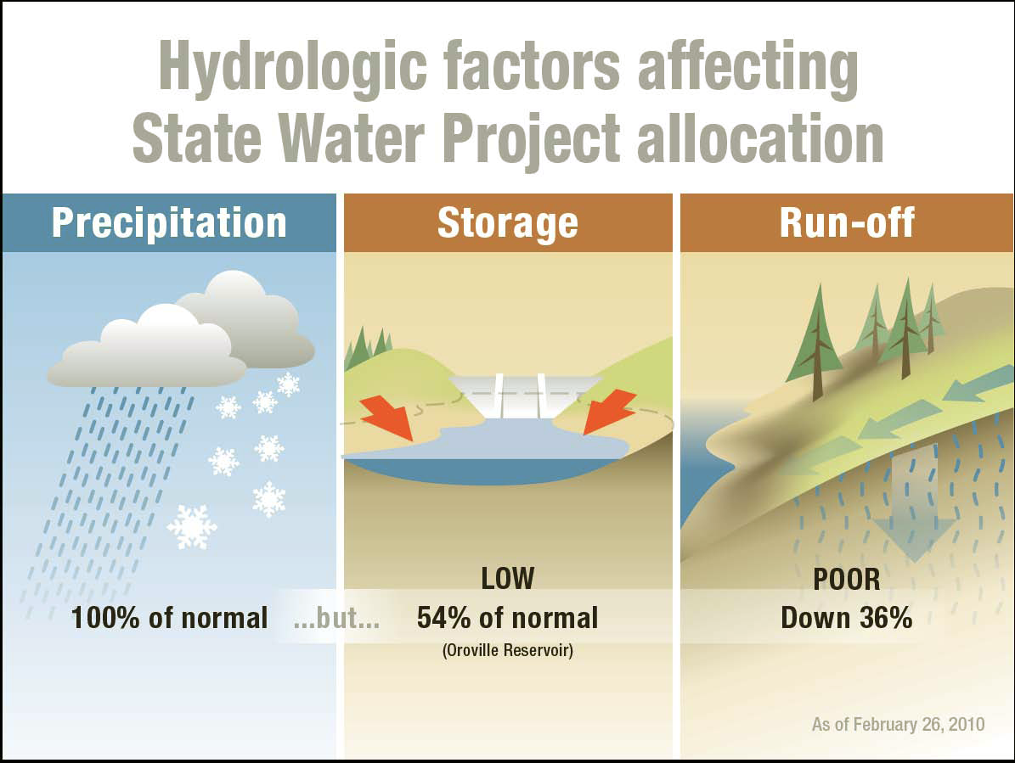

Slide 7
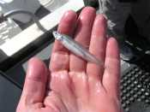
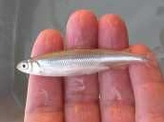
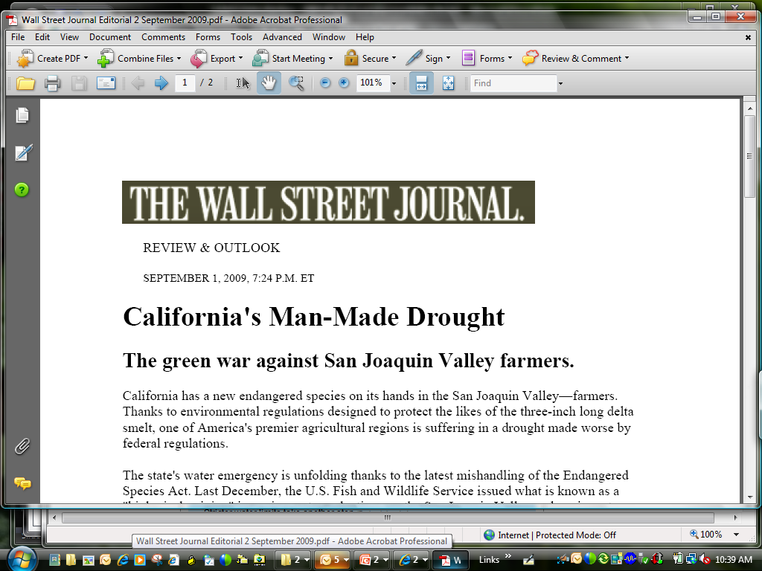
… the Cause of Statewide Water Rationing?
Delta Smelt

Slide 8

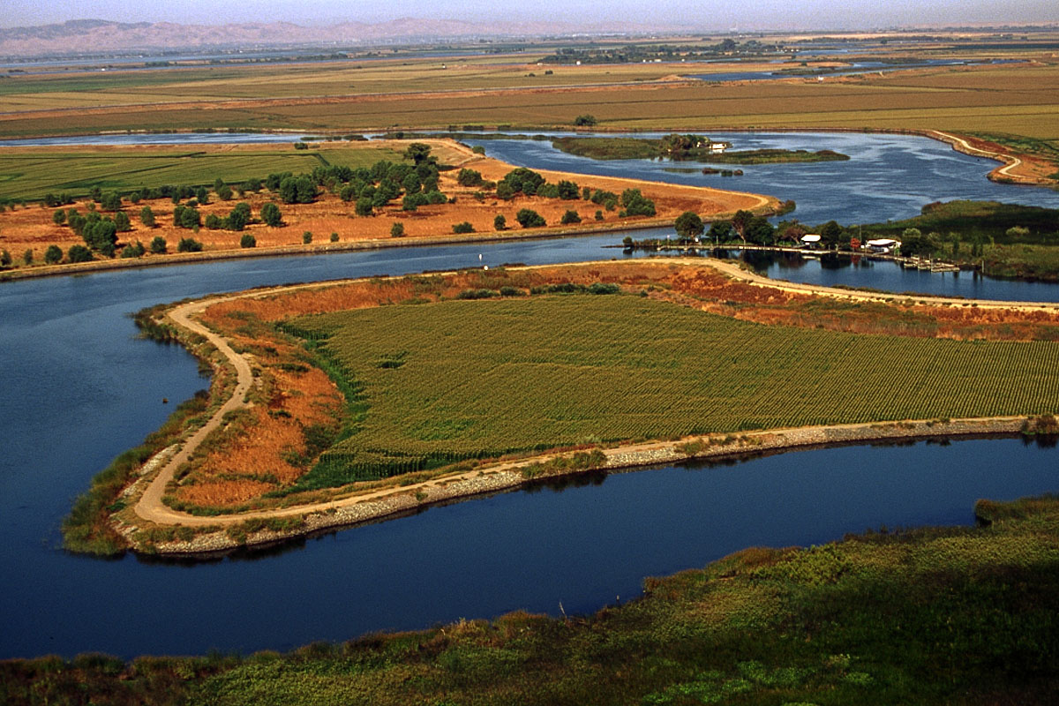
California Bay-Delta

Slide 9
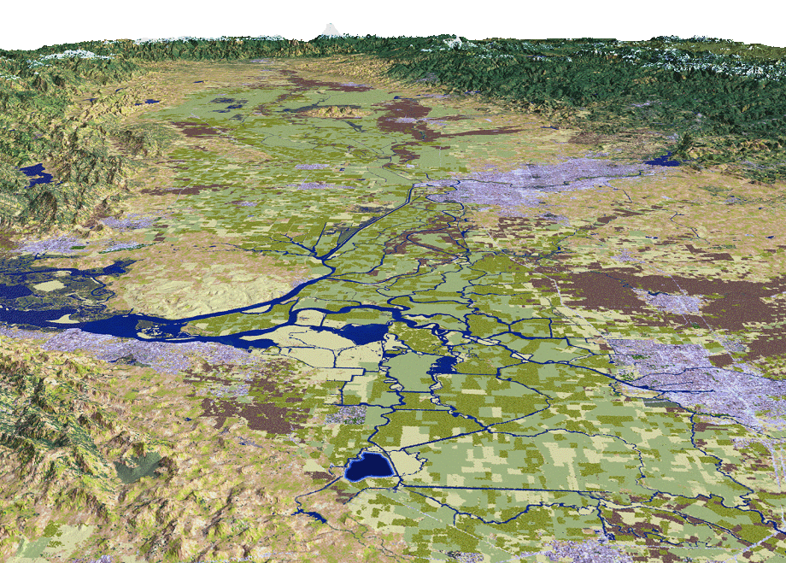
Biological Ops Restrict Southerly Flows
Delta Smelt
Sacramento
Stockton
SWP Pumps
CVP Pumps
9
Notes:
9
The flows from the rivers and tributaries flowing east to west is continually being pushed back and forth tidally (east & west), which provides varying salinity throughout the Delta.
The recent biological opinions have significantly restricted water supply flows southerly.

Slide 10
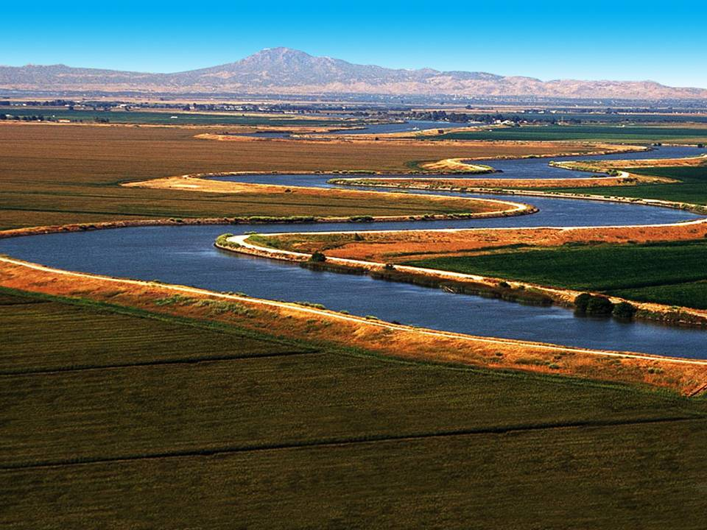
Bay-Delta
Supplies Bay Area, Central Valley & Southern Cal
Bay Area – 33%
Some regions up to 100% dependent
Central Valley – 23 to 90%
State Water Project
Southern Cal – 30%
Notes:
The Bay Delta is where the rivers of the Sierra merge before heading west toward San Francisco Bay.
It is the home of two large water projects, the State Water Project, which supplies mostly urban regions from the Bay area to San Diego, and the federal Central Valley Project, which supplies the state’s agricultural region in the Delta.
All told, water directly from the Delta helps to sustain 25 million Californians – statewide – and some of the nation’s most productive farm land.
As noted, water that travels through the Delta provides 33% to Northern California, 23 to 90% in Central Valley and 30% to Southern California.

Slide 11
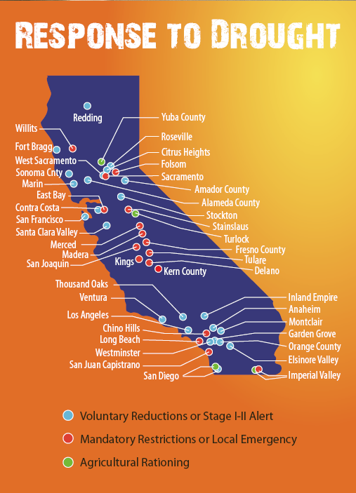
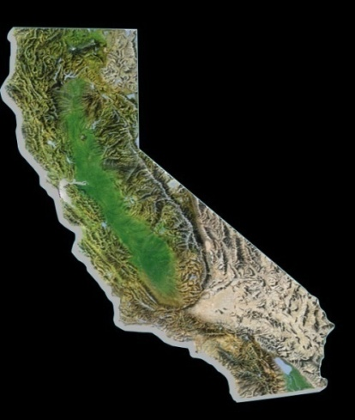
Mandatory Conservation (38 agencies)
Voluntary Conservation (60 agencies)
Antioch
Carlsbad
Chino Hills
Delano
Fallbrook
Folsom
Fresno
Glendora
Imperial ID
Long Beach
Pittsburgh
Pleasant Hill
Crescenta Valley
East Bay
Eastern MWD
Imperial ID
Kern County
Las Virgenes
Los Angeles
Monte Vista
Moulton Niguel
North Marin
Orange County
Padre Dam
Rancho California
Redwood Valley
San Diego County
San Juan WD
Santa Clara Valley
Santa Cruz
Santa Fe
Simi Valley
Valley Center
Ventura County
Vista
West Basin MWD
Westlands
Notes:
Slide updated as of 6/11/09 from ACWA website

Slide 12
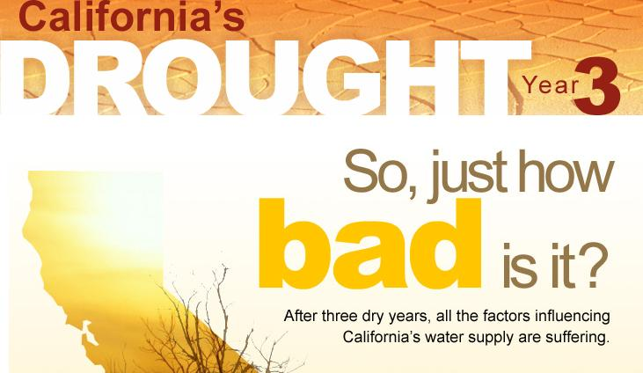
Southern California's
Water Reserve Levels
FULL
2006
2007
2008
NOW
EMPTY
2010 ?

Slide 13
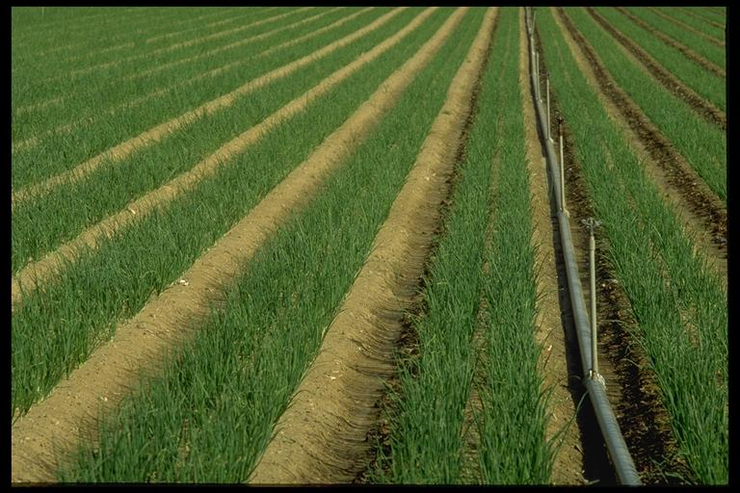
Agricultural Impacts
1 out of 3 acres without project water
1 million acres effected (size of Delaware)
40,000 workers face unemployment
$1.4 billion in Central Valley impacts
* Information from farmwater.org 6/01/2009
Notes:
1 million acres effected (size of Delaware);
average California farm = 350 acres
40,000 workers face unemployment
$1.4 billion in Central Valley impacts
Total Farms
United States 1997 2002 % change
Total farms 2,215,876 2,128,982 -3.9
Land in farms (1000 acres) 954,753 938,279 -1.7
Average size per farm (acres) 431 441 2.3
Sales ($ million) 201,380 200,646 -0.4
Average sales per farm ($) 90,880 94,245 3.7
California
Total farms 87,991 79,631 -9.5
Land in farms (1000 acres) 28,796 27,589 -4.2
Average size per farm (acres) 327 346 5.8
Sales ($ million) 23,280 25,737 10.6
Average sales per farm ($) 264,574 323,205 22.2

Slide 14
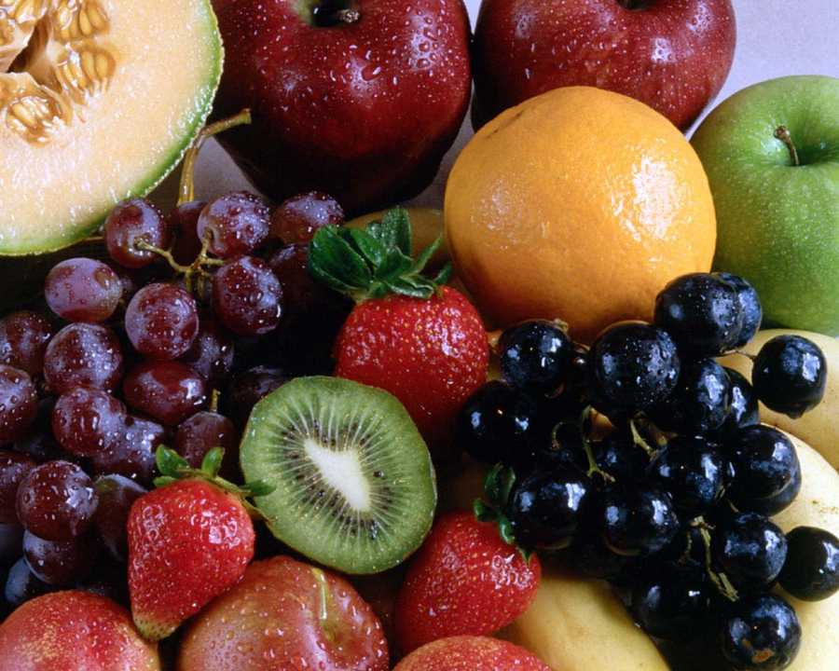
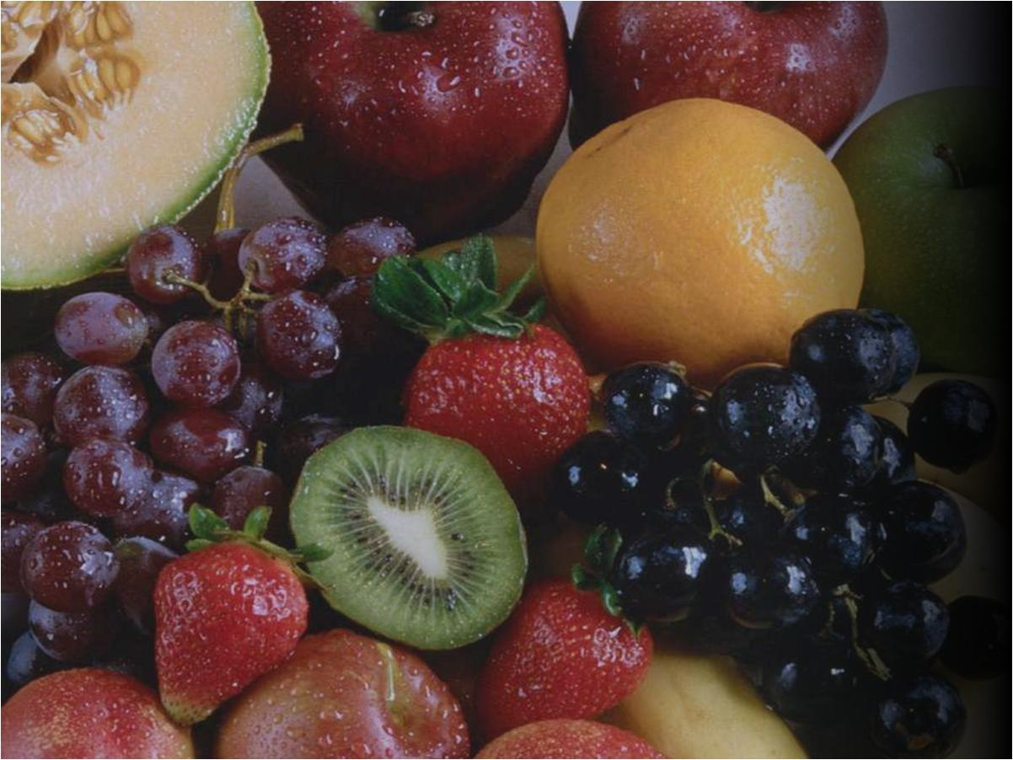
Cantaloupe: 54 %
Asparagus: 55 %
Honeydew: 73 %
Peaches: 76 %
Lettuce: 78 %
Dates: 82 %
Avocados: 84 %
Garlic: 86 %
Grapes: 88 %
Lemons: 89 %
Carrots: 89 %
Strawberries: 90 %
Broccoli: 93 %
Celery: 94 %
Nectarines: 93 %
Plums: 93 %
Tomatoes: 94 %
Apricots: 95 %
Pistachios: 96 %
Kiwi: 97 %
Figs: 98 %
Walnuts: 99 %
Almond: 99 %
Olives: 100 %
California –
America’s Fruit Basket
> 50% of US vegetables, fruits & nuts are California grown
Notes:
Source: California Department of Agriculture

Slide 15
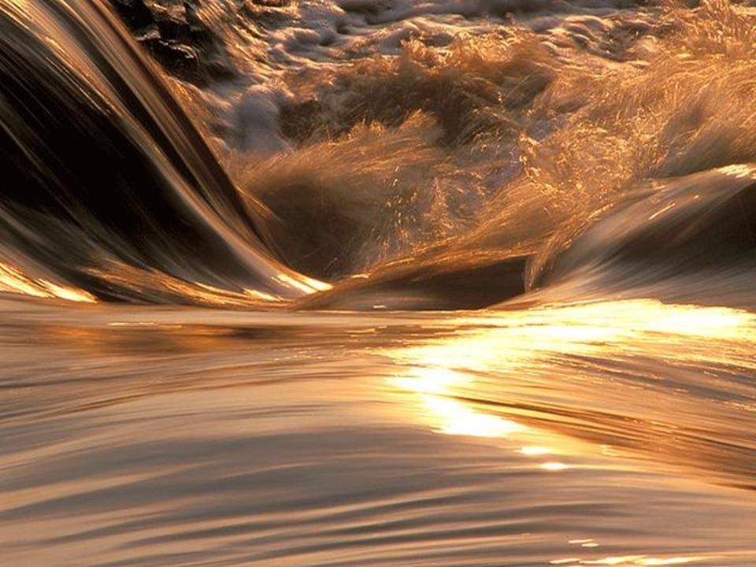
Bottom Line
Regulations significantly lowers supplies
Storage reserves dropping
Rationing in 2010 … future?
Notes:
Regulatory cutbacks significantly lowers water supply
Increased pressure on storage reserves
Large withdrawals anticipated for 2009
Additional need for maintaining reserves for 2010
Likelihood of rationing in 2009
> 50% chance
Chances increase with ongoing dry conditions
Does not factor additional fisheries impacts

Slide 16
Improvement Actions
California’s Water Crisis
Developing Solution

Slide 17

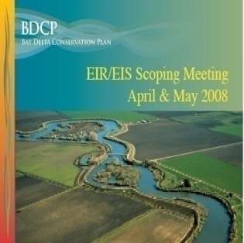
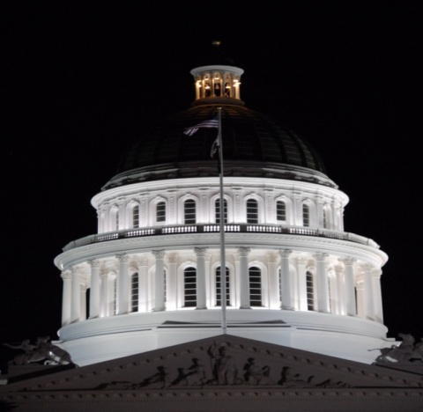


Reliability Improvement Plan
Resource/Regulatory Strategy
  Near-Term Measures
  Bay-Delta Conservation Plan
Bay-Delta Conservation Plan
Statewide Policy Strategy
  Delta policy bills
  Bond measure
Notes:
The bottom line is that the Delta as it exists today is unsustainable.
Threats to the economy, the environment and the ecosystem are so great that the Governor and the California Legislature last fall took a series of historic actions.
I’d like to walk through the overall action plan based on two broad approaches: one via the Legislature, as I just mentioned, and another working directly with state and federal agencies, the regulatory path.

Slide 18

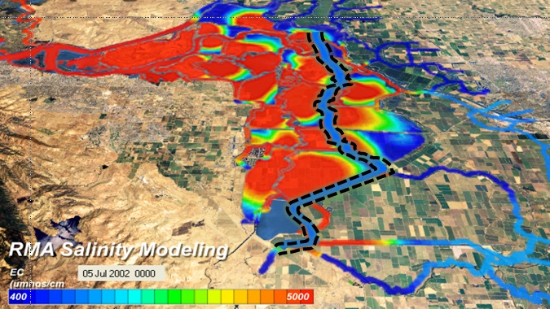
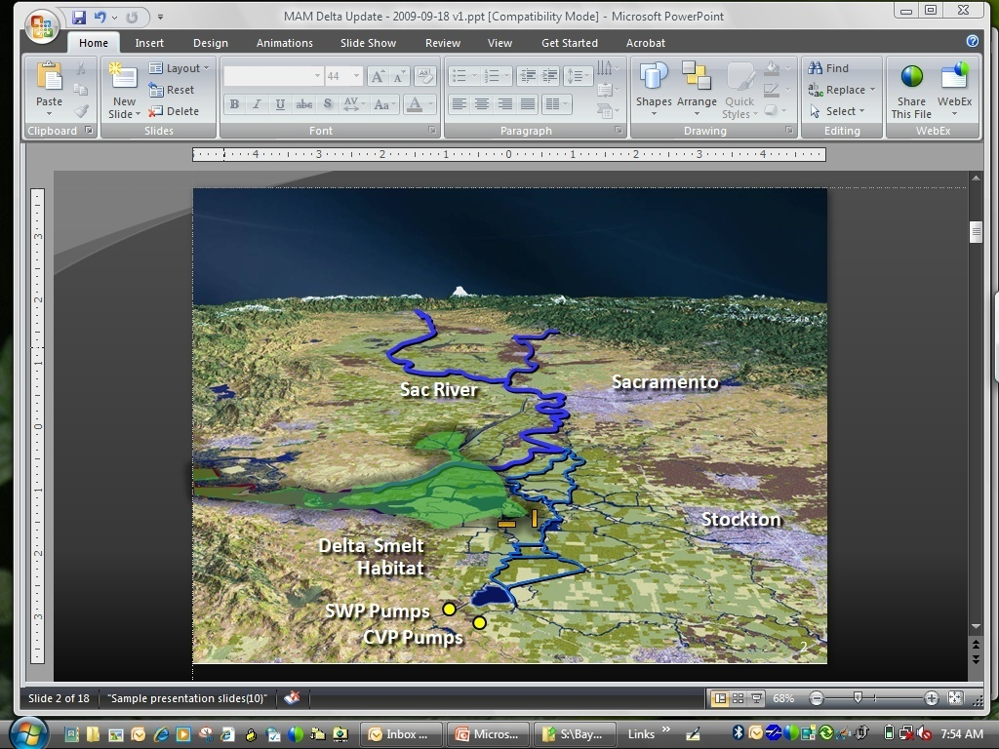
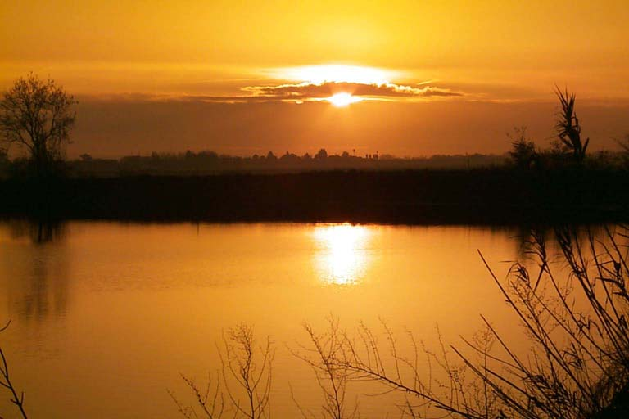
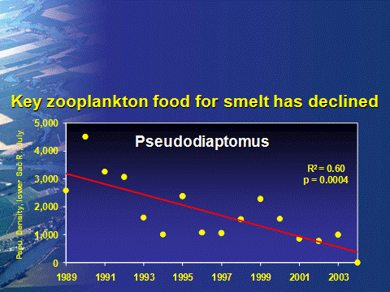
Near-Term Measures
Emergency Response
Operational
Habitat Restoration
Other
Stressors

Slide 19
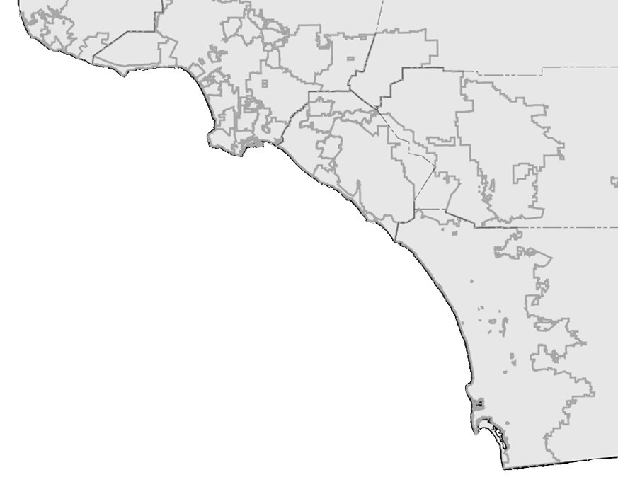
Commitment to Regional Investments
Conservation: $234 million
Desalination: 5 proposed projects
Recycling: 59 projects, $138 million
New LRP Programs: 13 proposed projects
Groundwater Recovery: 18 projects, $49 million
2025: Total Projected Savings > 2.1 million AF/yr
Notes:
Prop. 204 provides $60 million in loans for recycling, supplemented by $40 M from Prop. 13
Prop. 13 provides $235 million to Santa Ana Water Project Authority
Non-MWD funded projects produces 138,000 AFY of recycled and recovered water.
Local agencies such as San Diego, MWDOC have additional funding programs to increase incentives for using recycled water.
M.A. Desalination Proposals Yield (AFY)
Long Beach Water Dept. 10,000
Los Angeles DWP 12,000
MWDOC 28,000
SDCWA 56,000
West Basin MWD 20,000
Total 126,000

Slide 20

Meeting Future Demand Increases Through “Local” Resources
SAVINGS = 1 billion gal/day (1.1 million AF/yr)
=

Slide 21
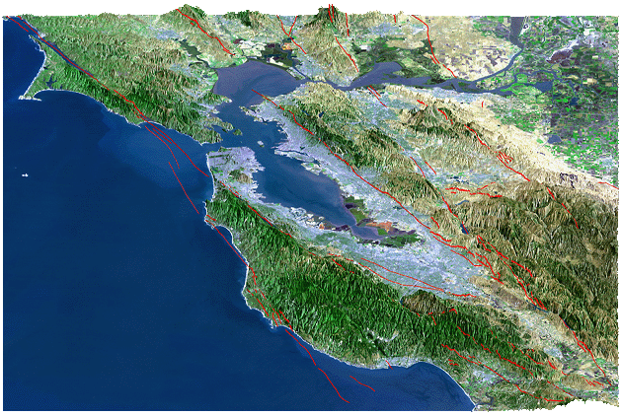
Seismic Vulnerability
Rodgers Crk
Concord
Vaca-Kirby
4%
Midland
San Andreas
Antioch
Hayward
Greenville
21%
27%
3%
San Gregorio
11%
Calaveras
10%
%
66% probability of > 6.5
magnitude earthquake by 2032
Bay-Delta Region Major Faults
Notes:
Information from DWR’s Delta Risk Management Study

Slide 22
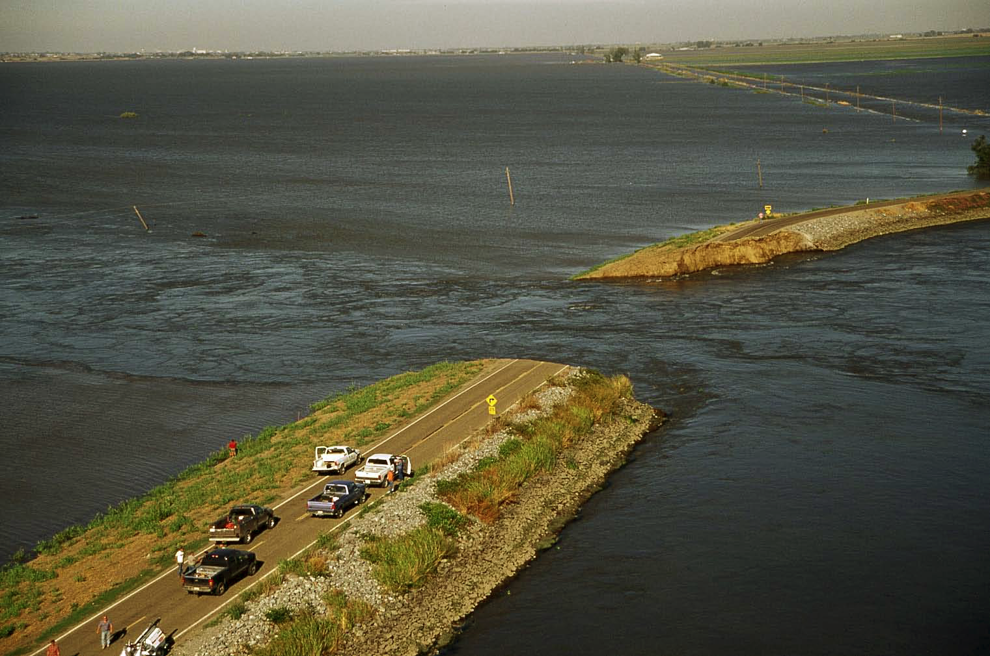

Slide 23
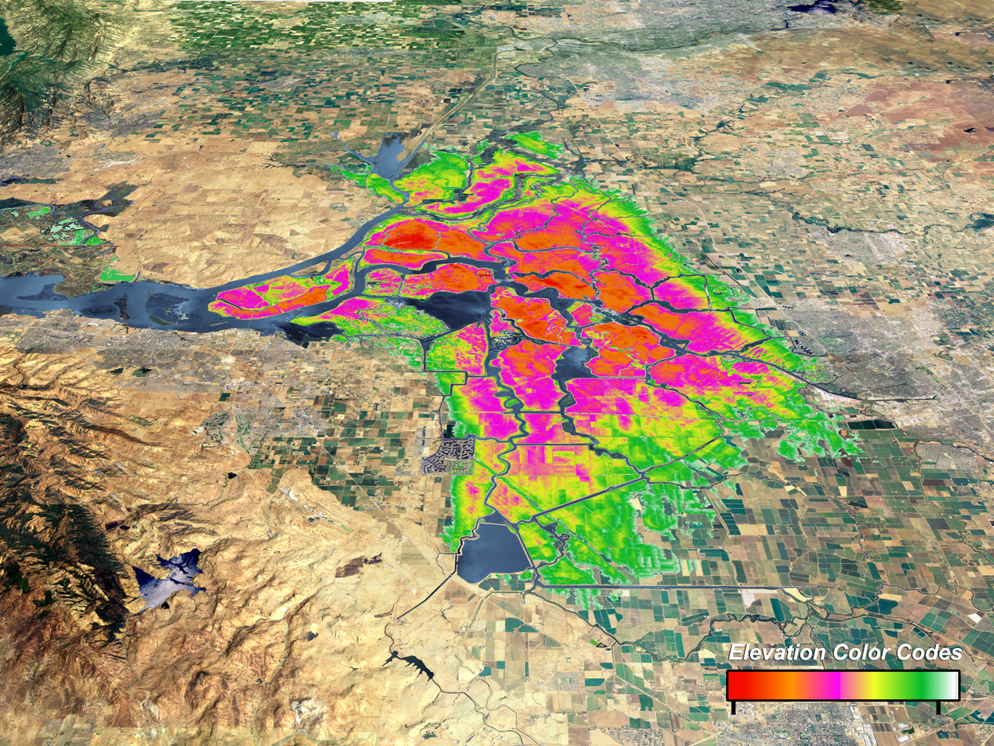
Water Supply Pathway
(Island subsidence between 10-30 ft. deep)
- 30 ft.
- 20 ft.
- 5 ft.
SWP Pumps
CVP Pumps
- 30 feet
Sea Level
Notes:
Existing levee improvement costs = $5 to 90 million per mile; Excavation of peat over 20’ depth (requiring soil mixing) costs $90 million/mile

Slide 24
6.5 Magnitude Earthquake causing 20-island failure
Islands flood with fresh water
0 – 6 hours:
Salt water intruding into Delta
12 – 24 hours:
Salt water throughout Delta
1 – 7 days:

Slide 25
Emergency Pathway
Requiring breach closures & slump restoration
Allows repair in vs. 3 years
6 months
Notes:
Emergency Stockpiling -- Status of Activities
2008 − Prop 84 ($10M) funding for rock stockpile
(240,000 tons) & loading facilities
2009 − Draft Emergency Response & Ops Plan
(integrated local, state, fed processes)
2010 − $35M additional material stockpiles
Final Emergency Response & Ops Plan
Facility --Total Quantity of Rock
[Tons] Contracted Delivery Date
Rio Vista 100k Mar. 3, 2008
Hood 10k Mar. 13, 2008
Port of Stockton 130k Jun. 27, 2008
Total 240k
The San Rafael Rock Quarry has been contracted to construct a complete conveyor system at the Port of Stockton that will be capable of transferring large rock from either the above referenced stockpiles or directly from trucks to barges. The construction and demonstration of this conveyor should be completed in Mar. 2008. Although located at the Port, the conveyor will be owned and operated by the Department

Slide 26
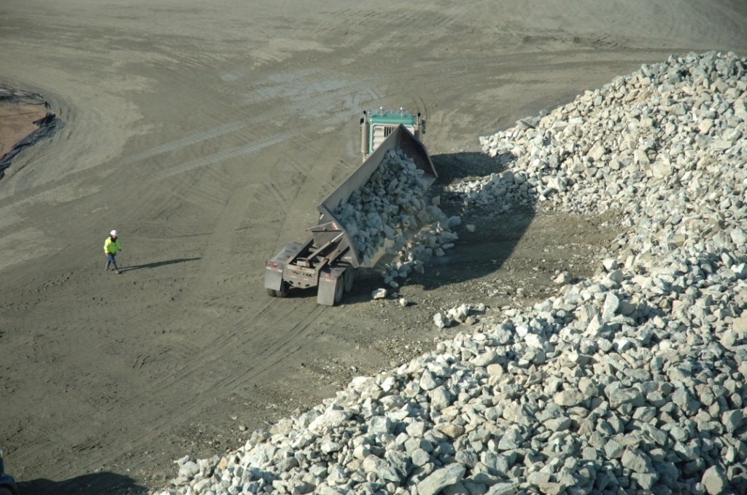
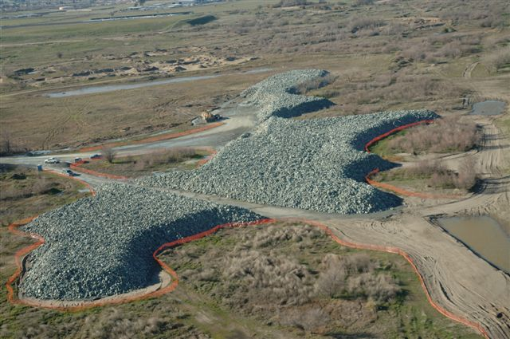
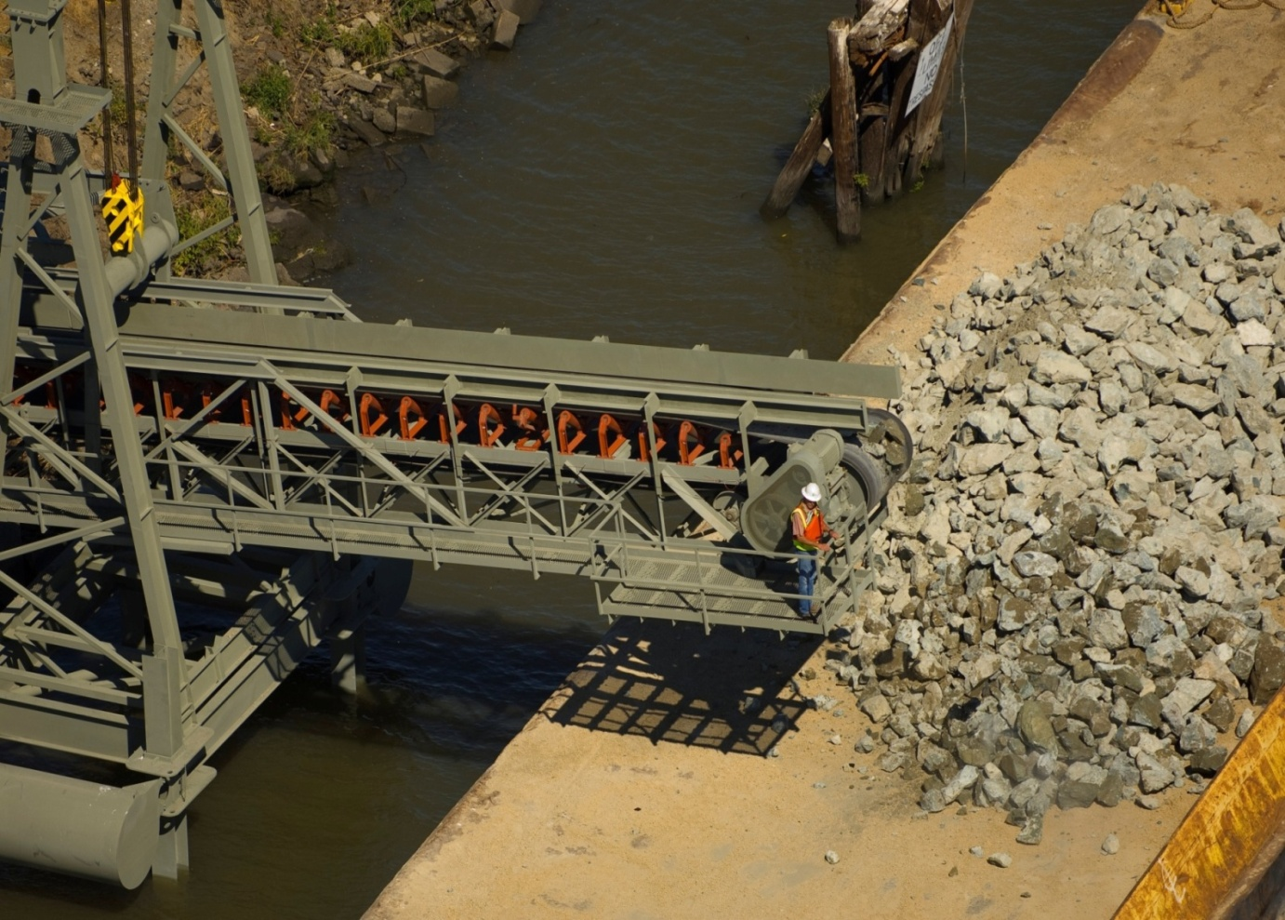
Delta Near-Term Measures
Emergency Stockpiling & Levee Improvements
Sac River
Sacramento
Hood
Rio Vista
Stockton
Port of Stockton
12” - 24” rock diameter
240,000 tons of rock stockpile
SWP Pumps
SJ River
Port of Stockton Loading Facility
CVP Pumps
Notes:
Emergency Stockpiling -- Status of Activities
2008 − Prop 84 ($10M) funding for rock stockpile
(240,000 tons) & loading facilities
2009 − Draft Emergency Response & Ops Plan
(integrated local, state, fed processes)
2010 − $35M additional material stockpiles
Final Emergency Response & Ops Plan
Facility --Total Quantity of Rock
[Tons] Contracted Delivery Date
Rio Vista 100k Mar. 3, 2008
Hood 10k Mar. 13, 2008
Port of Stockton 130k Jun. 27, 2008
Total 240k
The San Rafael Rock Quarry has been contracted to construct a complete conveyor system at the Port of Stockton that will be capable of transferring large rock from either the above referenced stockpiles or directly from trucks to barges. The construction and demonstration of this conveyor should be completed in Mar. 2008. Although located at the Port, the conveyor will be owned and operated by the Department

Slide 27
Delta Near-Term Measures
2-Gate Fish Protection Project
Sac River
Sacramento
Stockton
Delta Smelt Habitat
SWP Pumps
CVP Pumps
Notes:
27
2-Gates Demonstration Project -- Status of Activities
Jul ‘09 − Engineering design complete
Nov ‘09 − Final Environmental Assessment & Biological
Opinion; Notice to proceed with fabrication
Jul ‘10 − Begin in-water gate installation
Nov ‘10 − In-service target

Slide 28
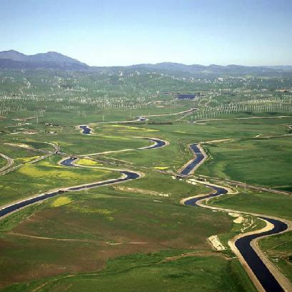
Delta Near-Term Measures
CVP/SWP Intertie Project
Sac River
Sacramento
Stockton
SWP Pumps
CVP Pumps
SWP/CVP Intertie
Notes:
28
Jul-Aug ‘09 − Draft Environmental Impact Statement
released; Public hearings
Dec 2009 − Final EIS
Apr 2010 − Construction begins
The Bureau of Reclamation, in partnership with the Western Area Power Administration, has released a Draft Environmental Impact Statement (Draft EIS) for the Delta-Mendota Canal (DMC)/California Aqueduct (CA) Intertie (Intertie). The Intertie would connect the DMC and the CA via a new pipeline and pumping plant to help meet current water supply demands, allow for maintenance and repair activities, and provide the flexibility to respond to Central Valley Project and State Water Project emergencies. The project was identified as a proposed action in the August 2000 CALFED Bay-Delta Program Programmatic Record of Decision.

Slide 29
Delta Near-Term Measures
Habitat Restoration
Yolo Bypass
Sacramento
Cache Slough
Suisun Marsh
8,000 acres by 2019
Bio Opinion Requirement
Stockton
Dutch Slough
SWP Pumps
CVP Pumps
Notes:
OCAP Delta Smelt biological opinion requires 8,000 acres of habitat restoration by 2019
Priority locations include the Yolo Bypass, Cache Slough, Suisun Marsh

Slide 30
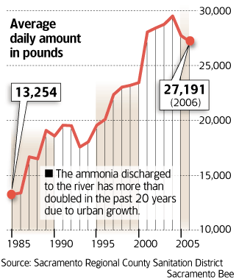
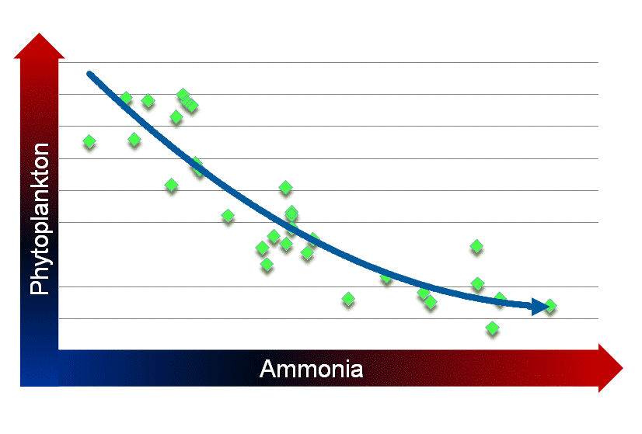
Delta Near-Term Measures
Ammonia Research
Ammonia discharges doubled
Ammonia tied to food web decline
Notes:
ln (Suisun Bay Phyto Density July to Sept) v June - August Ammonia Loading at Hood
Joint SWP/CVP research . Includes Nitrogen model; isotope analysis to determine the source of the nitrogen; and studies of the relationship between nutrients generally and the food chain
Hired Dr. Pat Glibert of U. of Maryland. Internationally recognized expert in nutrient impacts on ecosystems
Here initial review implicates not merely ammonium, but the nutrient balance between nitrogen and phosphorus. Such nutrient impacts are seen in many estuaries throughout the world.
Models ammonia, nutrients & temperature
Independent technical advisory review
Anticipated completion Jan 2010

Slide 31
Bay-Delta Conservation Plan
Overview
Multi-species approach to endangered species protection
Includes habitat conservation, conveyance improvements, other invasive species control
Bay-Delta Conservation Plan

Slide 32
Bay-Delta Conservation Plan
Steering Committee
Bay-Delta Conservation Plan
Fed & State Agencies
  Cal Bay-Delta Authority
  The Resource Agency
  US Bureau of Reclamation *
  Cal. Dept. of Water Resources *
  State Water Res. Control Board
  US Corps of Engineers
Fish Agencies
  Cal Dept. of Fish & Game
  US Fish & Wildlife Service
  National Marine Fisheries Service
Other Organizations
  Cal Farm Bureau Federation
  Mirant Delta *
Water Agencies
  Contra Costa Water District
  Kern County Water Agency *
  Metropolitan Water District *
  North Delta Water Agency
  San Luis & Delta Mendota WA *
  Santa Clara Valley Water Dist. *
  Westlands Water District *
  Zone 7 Water Agency *
Environmental Org.
  American Rivers
  Defenders of Wildlife
  Environmental Defense
  Natural Heritage Institute
  The Bay Institute
  The Nature Conservancy
* Potentially Regulated Entities
Notes:
Potentially regulated entities include
Fed & State Agencies
US Bureau of Reclamation
Cal. Dept. of Water Resources
Water Agencies
Kern County Water Agency
Metropolitan Water District
North Delta Water Agency
San Luis & Delta Mendota WA
Santa Clara Valley Water Dist.
Westlands Water District
Zone 7 Water Agency
Others
Mirant Delta (a power company operating within the Bay-Delta)

Slide 33

Bay-Delta Conservation Plan
Ecosystem Restoration Target Areas
Yolo Bypass
Sacramento
Cache Slough
Suisun Marsh
Consumnes
Dutch Slough
SWP Pumps
CVP Pumps

Slide 34
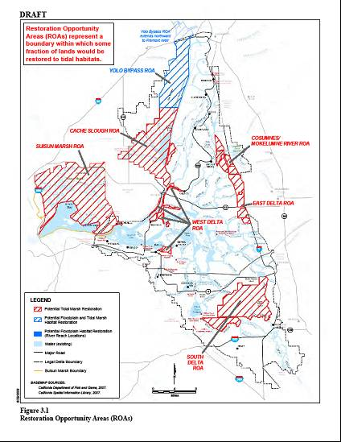
Ecosystem Restoration Targets
Restoration | Targets | Costs
Tidal Marsh | 65,000 ac | $1.3 – 2.3 billion
Seasonal Floodplain | 10,000 ac | $434 million
Riparian Habitat | 5,000 ac | $100 million
River Channel Margin | 20 mi | $57 million
TOTAL | 80,000 ac | ~ $2 – 3 billion
Ecosystem Restoration Target = Twice the size of Washington DC
Notes:
Public funding 2010 bond (SB 1) has $1.5 bilion; Prop 1e has money for river channel margin
Restoration Target: 80,000 acres = 125 square miles
Washington DC = 68 sq. mi.
Las Vegas = 113 sq mi
Sacramento = 97 sq mi
Restoration Targets Yr 10 Yr 15 Yr 40
Tidal Marsh 14,000 25,000 65,000 acres
Seasonal Floodplain 0 1,000 10,000 acres
Riparian Habitat 1,300 2,300 5,000 acres
TOTAL 15,300 28,300 80,000

Slide 35

Bay-Delta Conservation Plan
Thru-Delta Conveyance
Sac River
Sacramento
Stockton
SWP Pumps
SJ River
CVP Pumps
35
Notes:
35

Slide 36
Bay-Delta Conservation Plan
Dual-Conveyance − East Alignment
Sac River
Sacramento
Stockton
SWP Pumps
SJ River
CVP Pumps
36
Notes:
36
EAST-SIDE ALIGNMENT OPTION
Washington Group International report to SWC to answer due diligence questions regarding cost of project & other ROW questions Facility studied = 15,000 cfs
Pumping plant = 15 ft lift (indicated by yellow triangle on map located near intake)
Canal length = 46 mi
Inverted Siphons under streams/rivers = 11 crossings
Estimated construction costs (2006 dollars) = $3.3 to 3.7 billion (includes 30% contingences and 35% planning, design, legal & project mgmt. costs)
Intake screens = $25,000 per cfs or $1.3 billion
Peat soil depth = 0 to 10 ft.; this will require removal, dewatering, and replacement
Bottom Width = 340 ft (at 15,000 cfs); 140 ft. (at 10,000 cfs)
Top Width = 500 to 700 ft.
Overall Width = 1000 ft includes maintenance roads, etc.
Design velocity = 1.6 fps
Siphons = 11; Box culvert for 15,000 cfs = 6 boxes at 30’x30’ (2,500 cfs each box)
Existing levee improvement costs = $5 to 90 million per mile; Excavation of peat over 20’ depth (requiring soil mixing) costs $90 million/mile
Land costs in secondary zone estimated at $50,000 to $200,000 per acre
Land costs in primary zone estimated at $7,000 per acre
Urban levee standards (200 yr level of protection) = $13-36 million per mile
Delta levees are designed for overtopping & seepage, not earthquake

Slide 37
Bay-Delta Conservation Plan
Dual-Conveyance − West Alignment
Sac River
Sacramento
Stockton
SWP Pumps
SJ River
CVP Pumps
37
Notes:
37
WEST-SIDE ALIGNMENT OPTION
Washington Group International report to SWC to answer due diligence questions regarding cost of project & other ROW questions Facility studied = 15,000 cfs
Pumping plant = 15 ft lift; located near intake
Pipeline from intake to siphon under Sac & SJ Rivers = 10 miles length
Open channel from Franks Tract to Clifton Court Forebay = 27 miles length
Overall Canal length = 4X mi
Inverted Siphons under streams/rivers = 4 crossings (including tunnel under Sac & SJ)
Estimated construction costs (2006 dollars) = $6.4 to 7.5 billion (includes 30% general contingences and 35% planning, design, legal & project mgmt. costs)
Long tunnel cost = $2.3 B (13 miles) ; short tunnel cost = 1.4 billion (8 miles); soft soil tunneling by TBM
Intake screens = $25,000 per cfs or $1.3 billion
Peat soil depth = 0 to 10 ft.; this will require removal, dewatering, and replacement
Bottom Width = 340 ft (at 15,000 cfs); 140 ft. (at 10,000 cfs)
Top Width = 500 to 700 ft.
Overall Width = 1000 ft includes maintenance roads, etc.
Design velocity = 1.6 fps
Box culvert for 15,000 cfs = 6 boxes at 30’x30’ (2,500 cfs each box)
Existing levee improvement costs = $5 to 90 million per mile; Excavation of peat over 20’ depth (requiring soil mixing) costs $90 million/mile
Land costs in secondary zone estimated at $50,000 to $200,000 per acre
Land costs in primary zone estimated at $7,000 per acre
Urban levee standards (200 yr level of protection) = $13-36 million per mile
Delta levees are designed for overtopping & seepage, not earthquake

Slide 38
Bay-Delta Conservation Plan
Dual-Conveyance − Central Tunnel
Sac River
Sacramento
Stockton
SWP Pumps
SJ River
CVP Pumps
38
Notes:
38

Slide 39
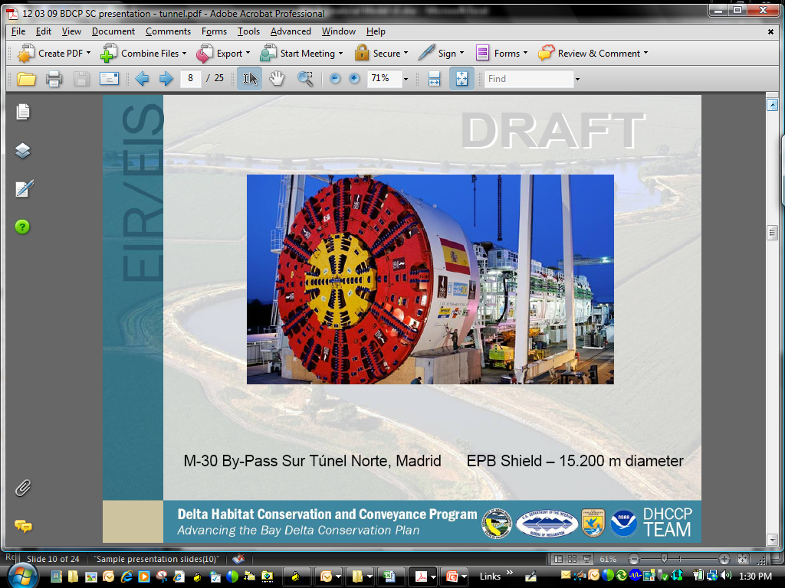
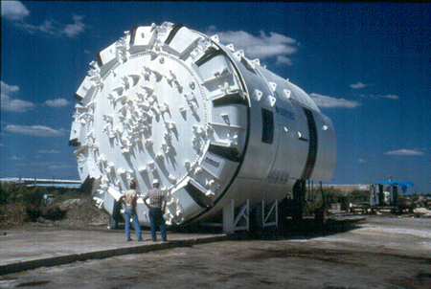
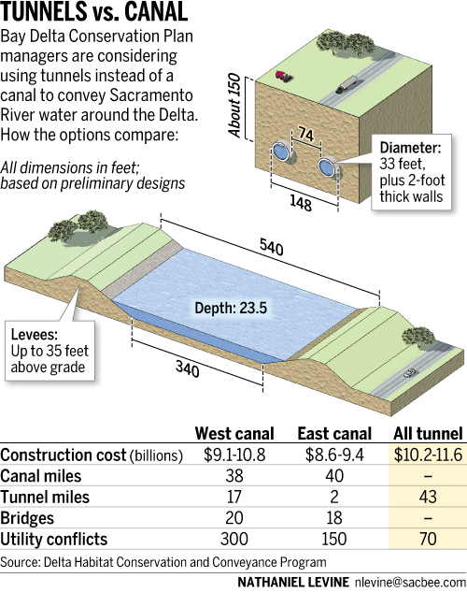
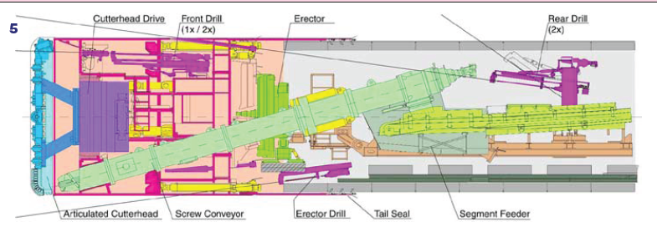
Tunnel Boring Machine
Inland Feeder Tunnel
  12 ft diameter = 1,000 cfs
Delta Tunnel
  2 @ 37 ft. diameter = 15,000 cfs
Notes:
Inland Feeder = 14ft diameter
Picture (in slide) = 26 ft diameter
Delta PC = 33 ft diameter
Estimated Capital Costs
All Tunnel Alignment: $10.3B – $11.7B

Slide 40
New Delta Conveyance Cost
Bay-Delta Conservation Plan
Open Canal ~ $8-9 billion *
All Tunnel ~ $10-11 billion *
* DWR cost estimates

Slide 41
Water Supply Benefits
2010 deliveries
Bay-Delta Conservation Plan
2010
  30 – 50%: expected Table A deliveries
  600,000 – 1,000,000 AF: expected MWD deliveries
Notes:
2005 SWP Reliability (Pre-Bio Opinions)
68% − Average Table A deliveries
260,000 AF − Average Article 21
2009 SWP Reliability (Post-Bio Opinions)
60% − Average Table A deliveries
85,000 AF − Average Article 21
2010
30 – 50%: expected Table A deliveries
0 af: expected Article 21
600,000 – 1,000,000 AF: expected MWD deliveries

Slide 42
Water Supply Benefits
Bio Opinions vs Conservation Plan
Bay-Delta Conservation Plan
Without Improved Conveyance
  60% − average SWP Table A deliveries
  1.2 million AF − average MWD deliveries
With Improved Conveyance
  80% − average SWP Table A deliveries
  1.6 million AF − average MWD deliveries
Notes:
2005 SWP Reliability (Pre-Bio Opinions)
68% − Average Entitlement (Table A)
260,000 AF − Average Surplus (Article 21)
2009 SWP Reliability (Post-Bio Opinions)
60% − Average Entitlement (Table A)
85,000 AF − Average Surplus (Article 21)
2010
30 – 50%: expected deliveries (Table A)
0 af: expected Article 21

Slide 43
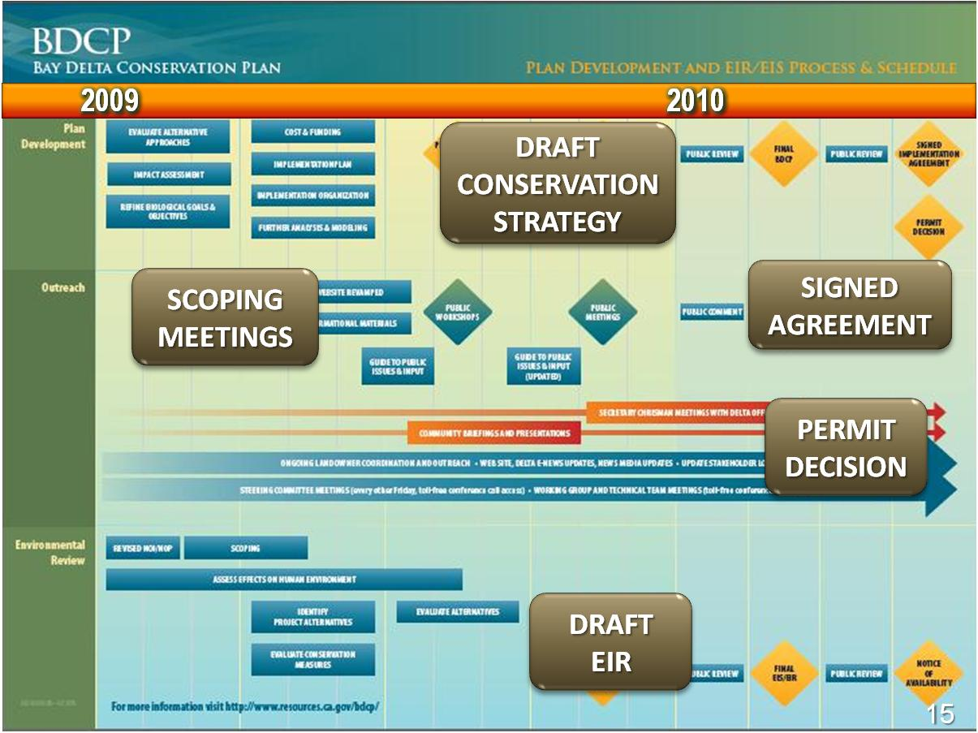
Schedule
End of 2010
  Draft Conservation Plan
  Draft EIR/S
End of 2011
  Final EIR/S
  Permits
43

Slide 44

Historic Comprehensive Water Package
44

Slide 45

Water Policy Package
Nov 2009
Four policy bills
  Delta policy, plan and governance
  Groundwater monitoring & reporting
  Conservation
  Surface water measurement
$11 billion water bond
45
Notes:
45
This package has five major components.
There is legislation to improve the governance in the Delta, legislation to increase water conservation statewide, legislation to expand groundwater monitoring statewide and legislation to expand the measurement of surface water diversions.
On the financial side, the Legislature also approved an $11.14 billion water bond scheduled to be placed on the November ballot, and we’ll go into those details later.
Policy Bills – Delta Specific
Commits to co-equal water supply & environment goals
Improved governance
Requires Delta Plan
Policy Bills – Statewide
Mandates statewide conservation & water use efficiency
Enhances groundwater monitoring & water use reporting
Finance
$11.14 billion G.O. bond for public share
Consistent with beneficiaries-pay principal
Funds Drought Relief, Regional Supply, Delta, Storage, Watershed & Water Quality, Groundwater, Recycling

Slide 46
Water Bond - 2009
$11.14 billion
Groundwater
Protection
$1.0 B
Drought
Relief
$0.5 B
Recycling & Conservation
$1.25 B
Regional
Supply
$1.4 B
Watershed &
Water Quality
$1.7 B
Delta Sustainability
$2.25 B
Water Storage
$3.0 B
Notes:
SBX 7-2 (Cogdill et al): Senate vote 27-8 passed; Assembly vote 54-19 passed
Description SBX 7-2
Drought Relief (Chapter 5) $0.455B
Regional Supply (Chapter 6) $1.40B
Delta (Chapter 7) $2.25B
Statewide Flexibility/Storage (Chapter 8) $3.0B
Watershed & WQ (Chapter 9) $1.785B
Groundwater (Chapter 10) $1.00B
Recycling (Chapter 11) $1.25B
Total (General Obligation Bonds) $11.14 B

Slide 47
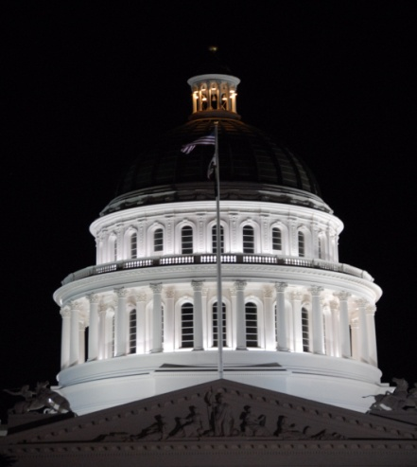
Water Bond
Southern Cal Benefits
Outside
$1.9 B
Statewide
$5.9 B
Delta
$2.3 B
So Cal
$1.0 B
$7 B − Southern Cal Eligible Grants
  $5.9 B − Statewide Grants
  $1.0 B − Southern Cal specific
$2.3 B − Delta Sustainability
  Investments to ease pumping restrictions
  Essential for improved conveyance
Notes:
SBX 7-2 (Cogdill et al): Senate vote 27-8 passed; Assembly vote 54-19 passed
Description SBX 7-2
Drought Relief (Chapter 5) $0.455B
Regional Supply (Chapter 6) $1.40B
Delta (Chapter 7) $2.25B
Statewide Flexibility/Storage (Chapter 8) $3.0B
Watershed & WQ (Chapter 9) $1.785B
Groundwater (Chapter 10) $1.00B
Recycling (Chapter 11) $1.25B
Total (General Obligation Bonds) $11.14 B

Slide 48
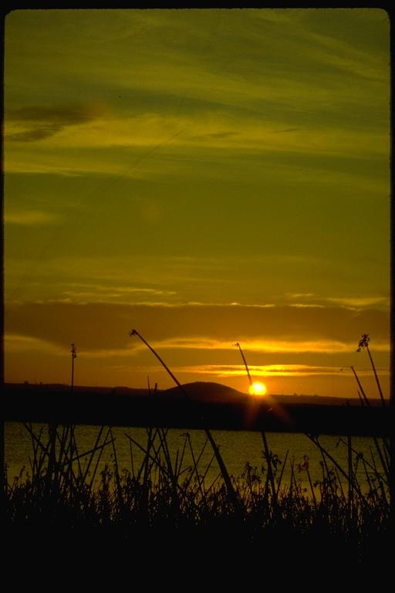
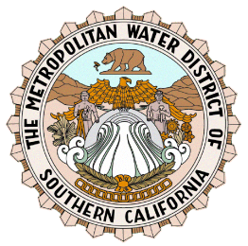

Randall D. Neudeck
(213) 217-7537
rneudeck@mwdh2o.com
www.bewaterwise.com
An electronic copy of this presentation is located at:
“ftp://blizzard.mwdh2o.com/baydelta/presentations”

Slide 49
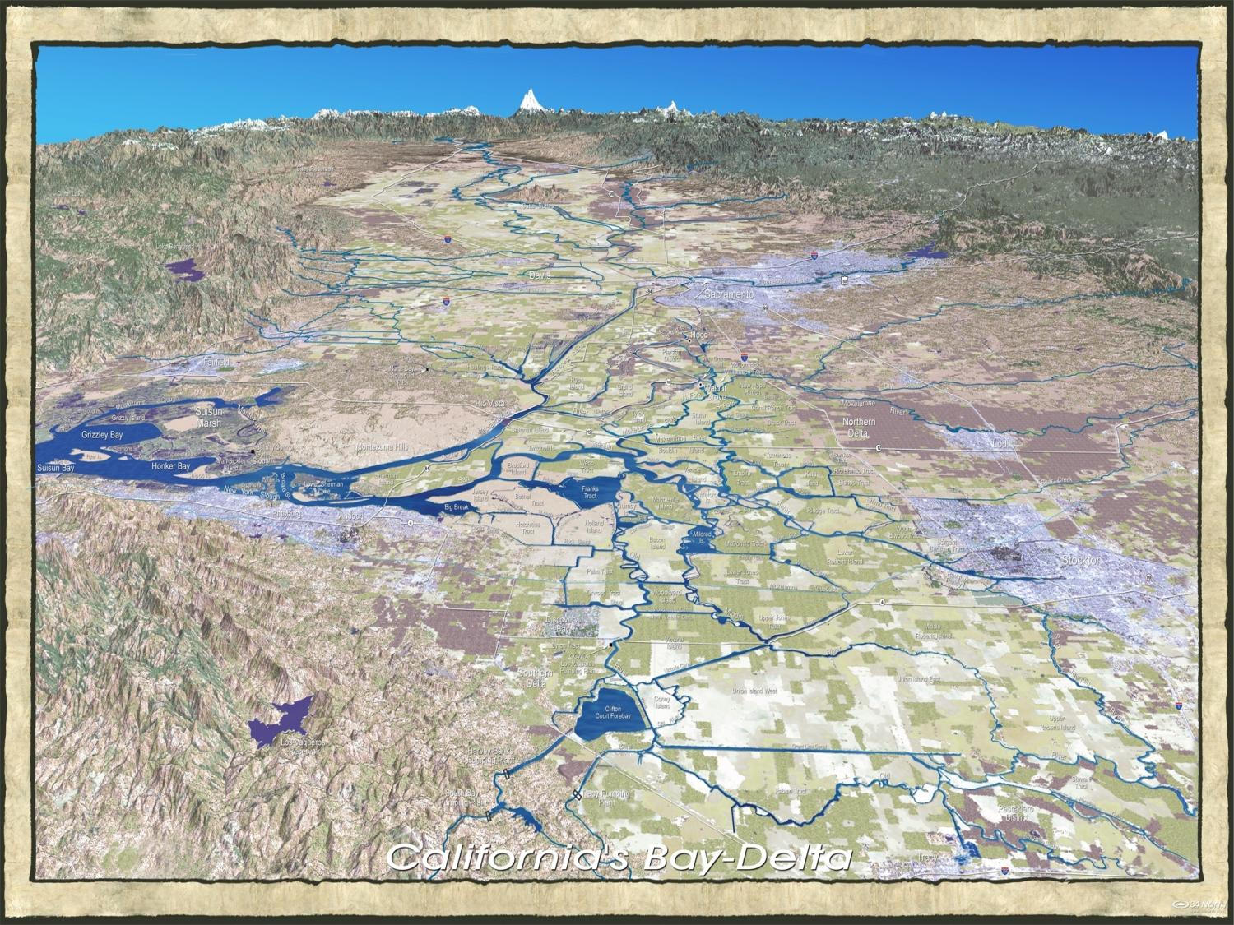
The Delta
Sacramento
Suisun Bay
Stockton
State & Federal Pumping Plants

Slide 50
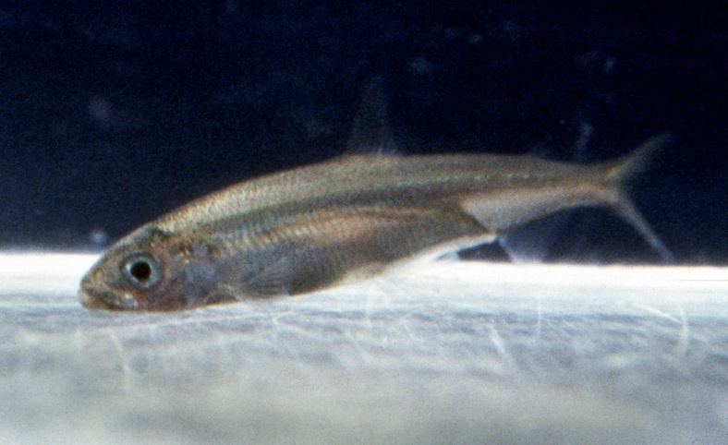

  Legislative Pathway
  2010 Water Bond
Delta Sustainability - $ 2.25 billion
Public share of eco-restoration
  $ 1.5 billion ecosystem
  $ 750 million Delta counties/cities
Photo Courtesy of DWR
50
Notes:
50
Water districts like Metropolitan are prepared to make the investments necessary to improve the water conveyance system in the Delta.
What is missing is the necessary funding to restore the Delta ecosystem.
The goal is not bare-bones compliance with the Endangered Species Act but a plan that can lead to the recovery of species.
Metropolitan believes that a healthy ecosystem is a key to reliable water supplies.
This money goes toward ecosystem restoration and addressing impacts for Delta communities.

Slide 51
Water Bond
Funding for Specific Southern Cal Projects *
Total Southern Cal Bond Specific*
Drought Relief − $0.455 B
  Specific Southern Cal Projects $128 M
Water Supply Reliability − $1.4 B
  Six-county region (IRWMP) > $460 M
Delta Sustainability − $2.25 B
Surface & Groundwater Storage − $3.0 B
Watersheds & Water Quality − $1.75 B
  Specific Southern Cal projects > $435 M
Recycling & Conservation − $1.25 B
Groundwater Cleanup − $1.0 B
~ $11 billion ~ 1 billion*
* Southern Cal can also apply for $5.94 billion in Statewide eligible funding
Notes:
SBX 7-2 (Cogdill et al): Senate vote 27-8 passed; Assembly vote 54-19 passed
Description SBX 7-2
Drought Relief (Chapter 5) $0.455B
Regional Supply (Chapter 6) $1.40B
Delta (Chapter 7) $2.25B
Statewide Flexibility/Storage (Chapter 8) $3.0B
Watershed & WQ (Chapter 9) $1.785B
Groundwater (Chapter 10) $1.00B
Recycling (Chapter 11) $1.25B
Total (General Obligation Bonds) $11.14 B

