Slide 1
Review of Delta Biological Opinions and Water Supply Impacts

Slide 2

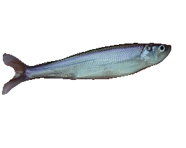
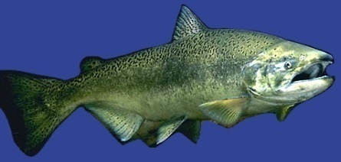
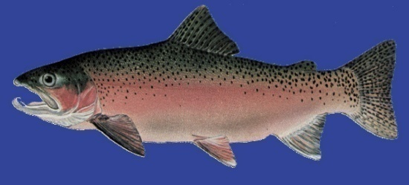
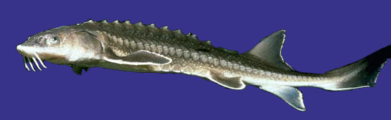
Endangered Species Act
Regulations
Re: SWP & CVP Operations
Delta smelt
Longfin smelt
Delta Smelt
– USFWS released Bio Opinion (Dec ‘08)
Longfin Smelt
– Listed as threatened (Jun ‘09)
Chinook Salmon/Steelhead/Green Sturgeon/SE Orca
– NMFS released Bio Opinion (Jun ‘09)
Chinook Salmon
Steelhead
Green Sturgeon

Slide 3
Pumping Flexibility Reduced
Window restricted even during wet years
Regulatory Pumping Restrictions
JAN FEB MAR APR MAY JUN JUL AUG SEP OCT NOV DEC
Salmon
No
Restrictions
Delta Smelt
Longfin Smelt

Slide 4
SWP Water Deliveries
Smelt & Salmon Biological Opinion Impacts
SWP Contract Entitlement (Table A) = 4.1 million acre-ft
Baseline
Smelt BiOp
Smelt & Salmon

Slide 5
SWP Reliability Curve
with Smelt & Salmon Biological Opinions
SWRCB Baseline
Regulatory Restrictions
USFWS Smelt
50% of time = 2.3 million AF
NMFS Salmon
Wet
Dry

Slide 6
SWP Reliability Curve
with Smelt & Salmon Biological Opinions
Aggressive Demand Management
Regulatory Restrictions
NMFS Salmon
Wet
Dry

Slide 7
Delta Interim Opportunities
Other Stressors
Mark-select hatchery
Ammonia research & model development
Invasive species & predator control
  Bubble & strobe light curtains
  Ageria control
  others

Slide 8
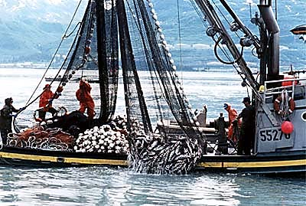
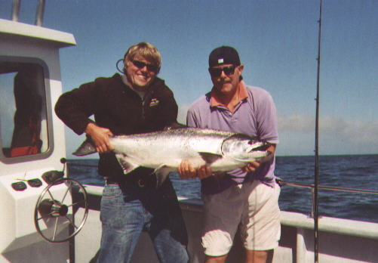
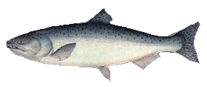
Delta Interim Opportunities
Mark-Select Salmon Fishery
All hatchery fish marked & can be retained
Commercial & recreational fisheries
Benefit = 10,875 winter-run at year 12
Reduces commercial harvest by ~ 20%
Cost ~ $5 million/yr; 10 cents per fish
Adipose fin clip

Slide 9
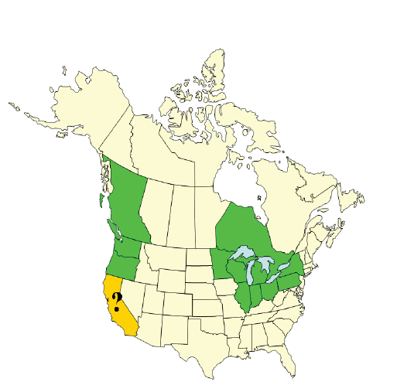
Delta Interim Opportunities
Mark-Select Salmon Fishery
States & provinces implementing total salmon marking programs

Slide 10

Fish Salvage vs. Ocean Harvest
(Total equivalent adult salmon captured from 1995-2006)
Fall-Run Salmon
Late-Fall Run Salmon
2.8 million
150,000
19,000
350
Winter-Run Salmon
Spring-Run Salmon
44,000
69,000
4,000
14,000
Notes:
Introduction
We compared takes of Central Valley Chinook salmon runs captured at the State Water Project (SWP) and Central Valley Project (CVP) salvage Delta water export facilities based on fish salvage data, with those in ocean fisheries. Because the salvage facilities capture primarily juvenile salmon and the ocean fisheries harvest largely adult fish, we converted these to the equivalent number of adults that would have returned to Central Valley rivers and streamsthe mouth of the Sacramento River in the absence of these takes.
Methods
We summed daily expanded losses of Chinook salmon by race (Fall, Late Fall, Winter, or Spring) at the SWP and CVP salvage export facilities (available at ftp://ftp.delta.dfg.ca.gov/salvage) to obtain juvenile take estimates from 1996-2007 (Table 1). We assumed that these were smolts that would have emigrated to the ocean that year (1995-2006 brood years). Note that these losses included an accounting for indirect losses due to predation in SWP’s Clifton Court Fthe facilities forebay. We assumed that these were smolts that would have emigrated to the ocean that year (1995-2006 brood years). We then calculated the equivalent number of adults and jacks? from each cohort that would have returned to the Sacramento RiverCentral Valley to spawn in the absence of salvage and ocean harvest. To do this, we used rates of survival and maturity for each age as shown in Table 2. We also converted ocean fishery landings to adult equivalents because many of the fish caught were not yet mature and would have remained in the ocean for at least another year. Converting losses at the salvage export facilities and in ocean landings to adult equivalents ensures that the different takes are comparable.
We estimated harvest each year, 1996-2007, from total actual landings of all runs and ages of Chinook at ocean ports in California, as reported by the Pacific Fishery Management Council (PFMC 2008). Estimates by age and race are not currently provided by the PFMC. Total ocean landings south of Point Arena are assumed to be primarily Central Valley Chinook salmon (PFMC 2008).
Ocean landings of Central Valley Chinook salmon by age were derived using different methodologies for each race. Total ocean landings south of Point Arena are assumed to be primarily Central Valley Chinook salmon as reported by the Pacific Fishery Management Council (PFMC 2008). However, estimates by age and race are not currently provided by the PFMC. We used models to apportion the landings into race, and then into age groups for Central Valley Chinook salmon. The model used in the retrospective analysis of mark selective fisheries was used to derive ocean landings of Fall and Late Fall run Chinook salmon[please briefly describe the algorithms, or reference or attach text for each of these models]. The Fall run was assumed to comprise 90%, and the Late Fall run 5% of the landings. Winter and Spring run landings were hindcast using the Integrated Modeling Framework (IMF) for Sacramento River Winter run and Spring run Chinook salmon, respectively. Using model generated estimates also allowed us to project future landings of older aged fish to complete brood year comparisons (for example age 3 fish from brood year 2005 will be harvested in 2008). Therefore, ocean landings of 2005 and 2006 broods are based largely on predictions of future landings. The resultant estimates of ocean landings by brood year and age for each race are provided in Table 3. In order to make these landings comparable with salvage losses, we calculated the equivalent number of adults that would have returned to the Sacramento River to spawn in subsequent years, using parameters found in Table 2.

Slide 11
Fish Salvage vs. Ocean Harvest
(Total equivalent adult salmon captured from 1995-2006)
Winter-Run Salmon

Slide 12

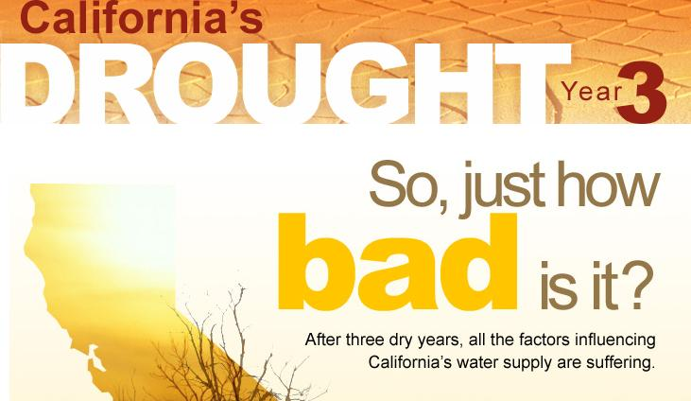
Southern California's
Water Reserve Levels
FULL
2006
2007
2008
NOW
EMPTY
2010 ?

Slide 13
Extra Slides

Slide 14
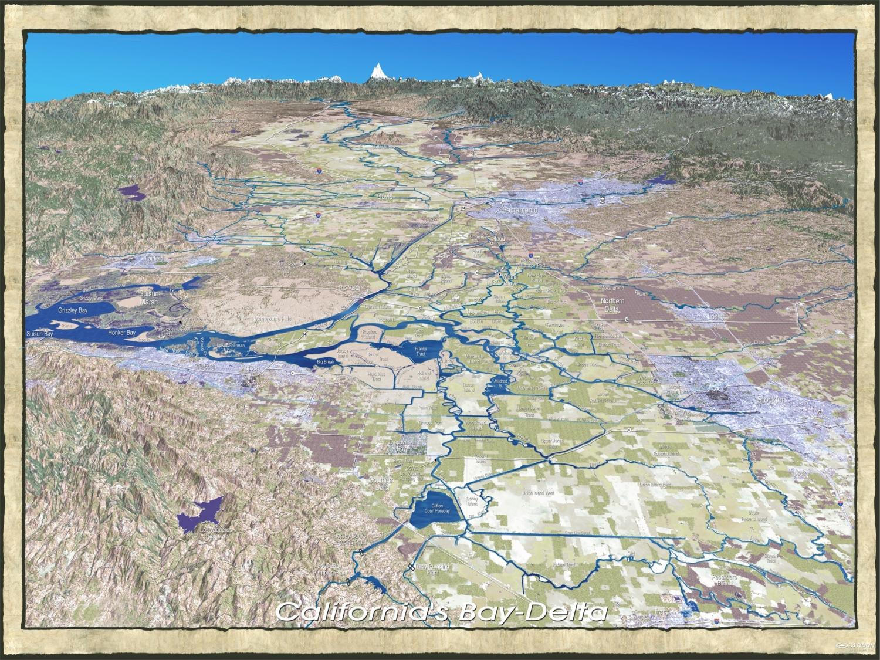
The Delta
Sacramento
Suisun Bay
Stockton
State & Federal Pumping Plants

Slide 15
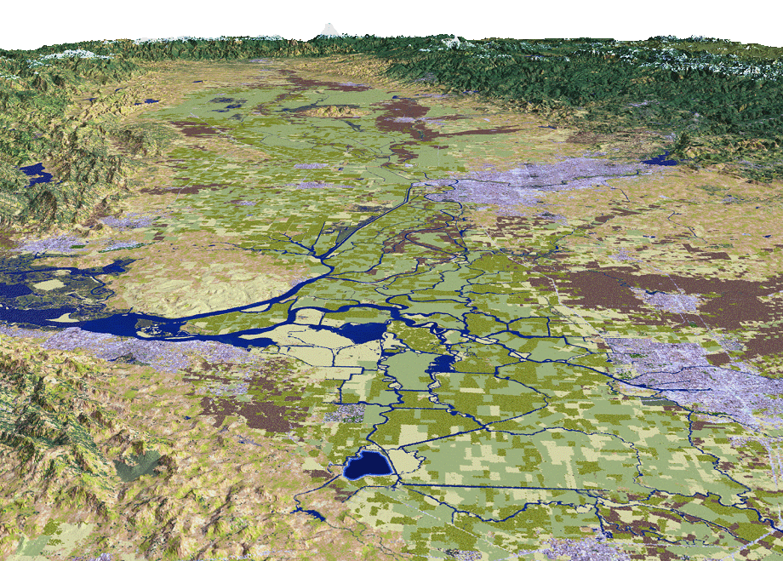
Biological Ops Restrict Southerly Flows
Delta Smelt
Sacramento
Stockton
SWP Pumps
CVP Pumps
15
Notes:
15
The flows from the rivers and tributaries flowing east to west is continually being pushed back and forth tidally (east & west), which provides varying salinity throughout the Delta.
The recent biological opinions have significantly restricted water supply flows southerly.

Slide 16
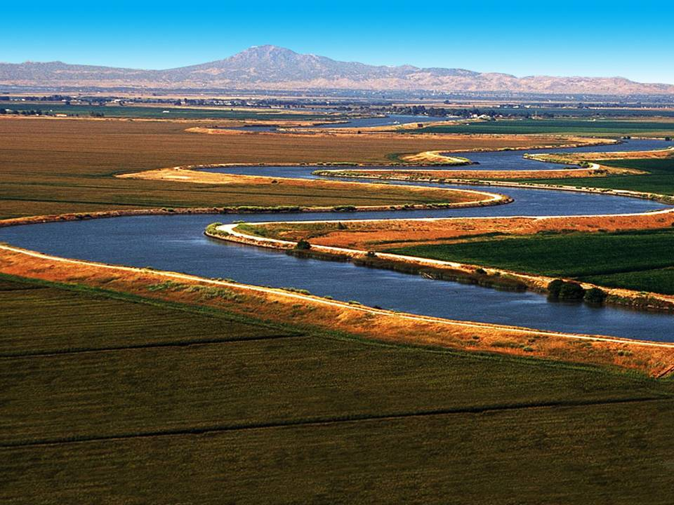
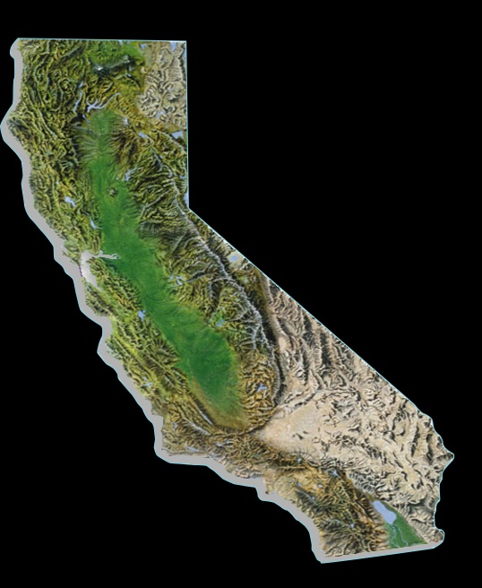
Bay-Delta
Supplies Bay Area, Central Valley & Southern Cal
Bay Area – 33%
Some regions up to 100% dependent
Central Valley – 23 to 90%
State Water Project
Southern Cal – 30%
Notes:
The Bay Delta is where the rivers of the Sierra merge before heading west toward San Francisco Bay.
It is the home of two large water projects, the State Water Project, which supplies mostly urban regions from the Bay area to San Diego, and the federal Central Valley Project, which supplies the state’s agricultural region in the Delta.
All told, water directly from the Delta helps to sustain 25 million Californians – statewide – and some of the nation’s most productive farm land.
As noted, water that travels through the Delta provides 33% to Northern California, 23 to 90% in Central Valley and 30% to Southern California.

Slide 17
Delta Fisheries
A Downturn for Delta Smelt & Salmon
Winter-Run Salmon
Delta Smelt

Slide 18

Recent Regulatory Restrictions
Causing Supply Cutbacks to State/Fed Contractors
1.5 million AF
(20%)
2.5 million AF
(40%)
Notes:
Regulations Avg. Yr. * Critical Yr. * Above Normal Yr. **
Delta Smelt (Courts) 770,000 af 330,000 af 1,260,000 af
Delta Smelt (USFWS) 500,000 af 120,000 af 1,110,000 af
Longfin Smelt (DFG) 0 af 0 af 0 af
Chinook Salmon (NMFS) 260,000 af 60,000 af 180,000 af
TOTAL 1,530,000 af (27%) 510,000 af (19%) 2,550,000 af (39%)
SWRCB D-1641 Baseline = 5.7 maf (average yr); 2.7 maf (critical yr); 6.5 maf (above normal yr)
* MWD’s “Most Likely” USFWS Delta Smelt scenario assumed
** MWD’s “High Impact” USFWS Delta Smelt scenario assumed

Slide 19
Delta Interim Opportunities
Preliminary research indicates ammonia
tied to food web decline
Ammonia Increase
Phytoplankton Decrease
Notes:
ln (Suisun Bay Phyto Density July to Sept) v June - August Ammonia Loading at Hood

Slide 20
SWP Reliability Curve
with Smelt & Salmon Biological Opinions
Demand Management
Regulatory Restrictions
Assure Supply Reliability
  Implement 2-Gates Project
  Implement Bay-Delta Conservation Plan
Wet
Dry

