Slide 1

Water is jobs
Water is crops
Water is life
California’s Water Crisis
Developing Solutions

Slide 2

“These storms may have left consumers with the misperception that the water supply problems are over. Nothing, however, could be further from the truth.”
− Jeffrey Kightlinger, General Manager (Jan 25, 2010)

Slide 3
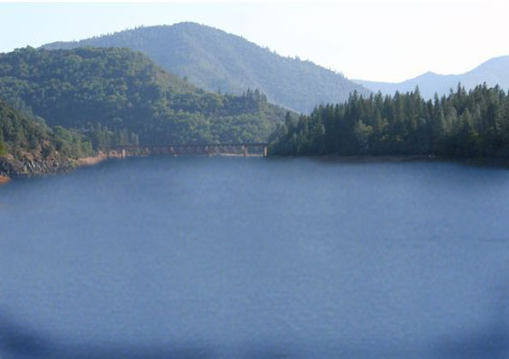
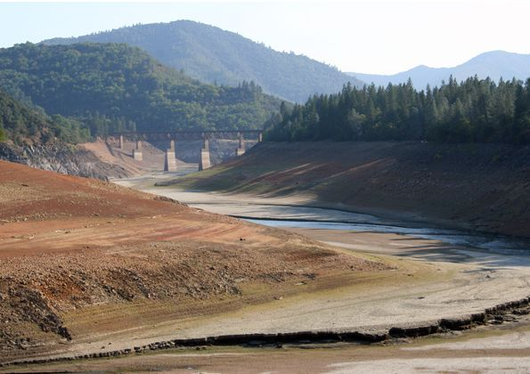
Shasta Reservoir
Sacramento River
1995
2009

Slide 4
Lake Oroville
Feather River
2005
2009
Notes:
Lake Oroville-Nov 2008 - 29% of capacity

Slide 5
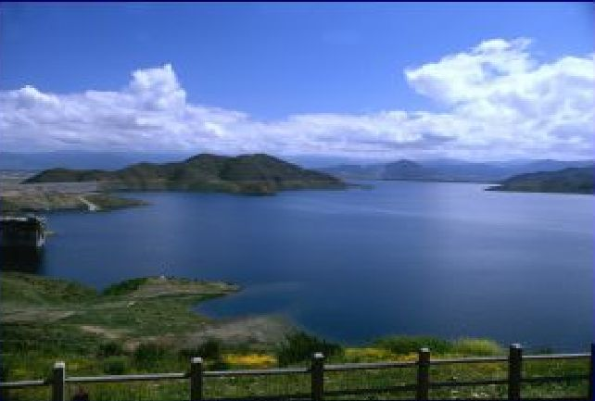
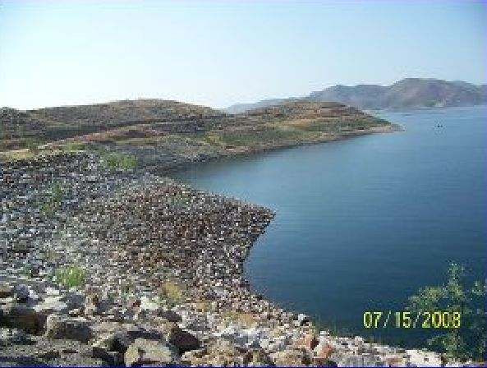
Diamond Valley Lake
Southern California
2006
2009
Notes:
Confluence of Colorado and Dirty Devil Rivers

Slide 6
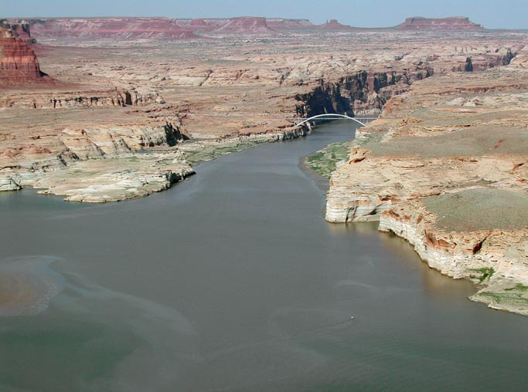
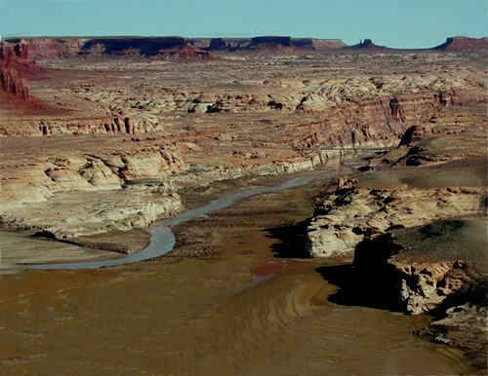
Lake Powell
Colorado River
2002
2009
Notes:
Confluence of Colorado and Dirty Devil Rivers

Slide 7

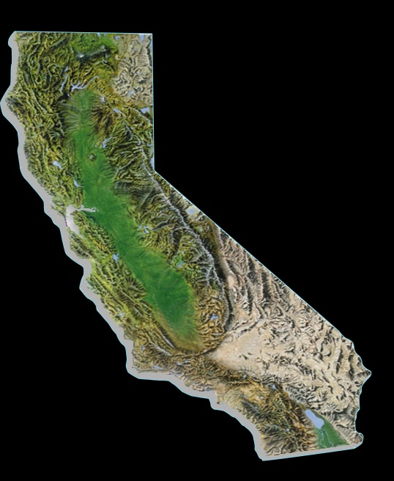
Reservoir & Runoff
Conditions
(Jan. 24, 2010)
NorCal
87%
32%
Oroville
Owens Valley
82%
Upper Colorado
84%
32%
San Luis
43%
Lake Mead
48%
Diamond Valley

Slide 8
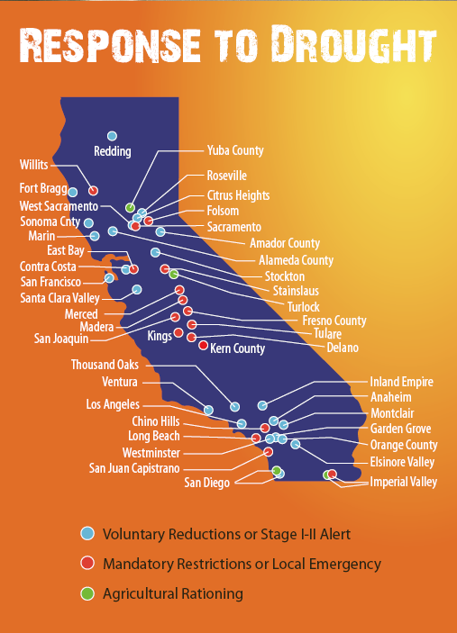
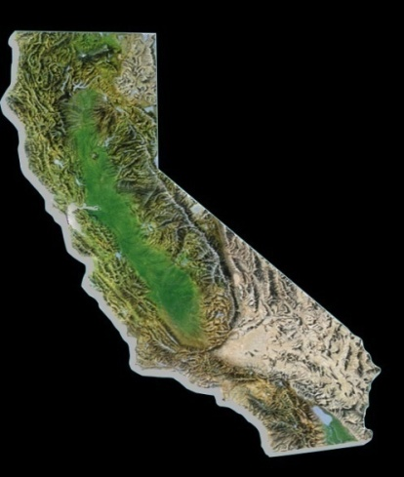
Mandatory Conservation (38 agencies)
Voluntary Conservation (60 agencies)
Antioch
Carlsbad
Chino Hills
Delano
Fallbrook
Folsom
Fresno
Glendora
Imperial ID
Long Beach
Pittsburgh
Pleasant Hill
Crescenta Valley
East Bay
Eastern MWD
Imperial ID
Kern County
Las Virgenes
Los Angeles
Monte Vista
Moulton Niguel
North Marin
Orange County
Padre Dam
Rancho California
Redwood Valley
San Diego County
San Juan WD
Santa Clara Valley
Santa Cruz
Santa Fe
Simi Valley
Valley Center
Ventura County
Vista
West Basin MWD
Westlands
Notes:
Slide updated as of 6/11/09 from ACWA website

Slide 9

MWD Water Supply
2010 Initial Outlook
Storage, Transfers, Supply Restrictions
824,000 AF
Colorado River
1,200,000 AF
Initial 5% SWP Allocation
  Lowest initial allocation
  Previous low was 10% in 1993
  2009 Initial Allocation was 15%
  Final allocation increased to 40%
  What if 5% allocation remains?
  Demands met through Colorado River, storage reserves, supplemental transfers, and continuation of rationing
State Water Project
106,000 AF
Notes:
Welcome and Introduction

Slide 10
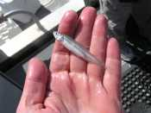
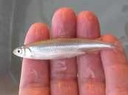
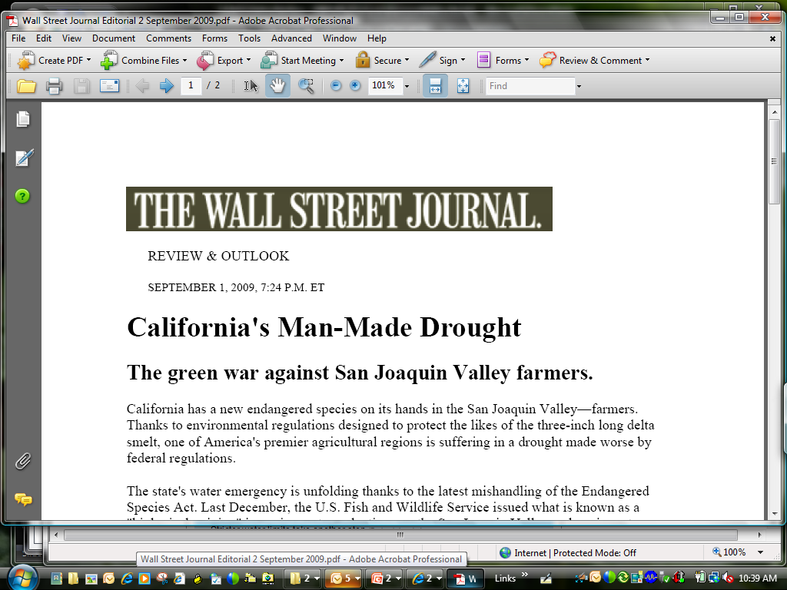
… the Cause of Statewide Water Rationing?
Delta Smelt

Slide 11

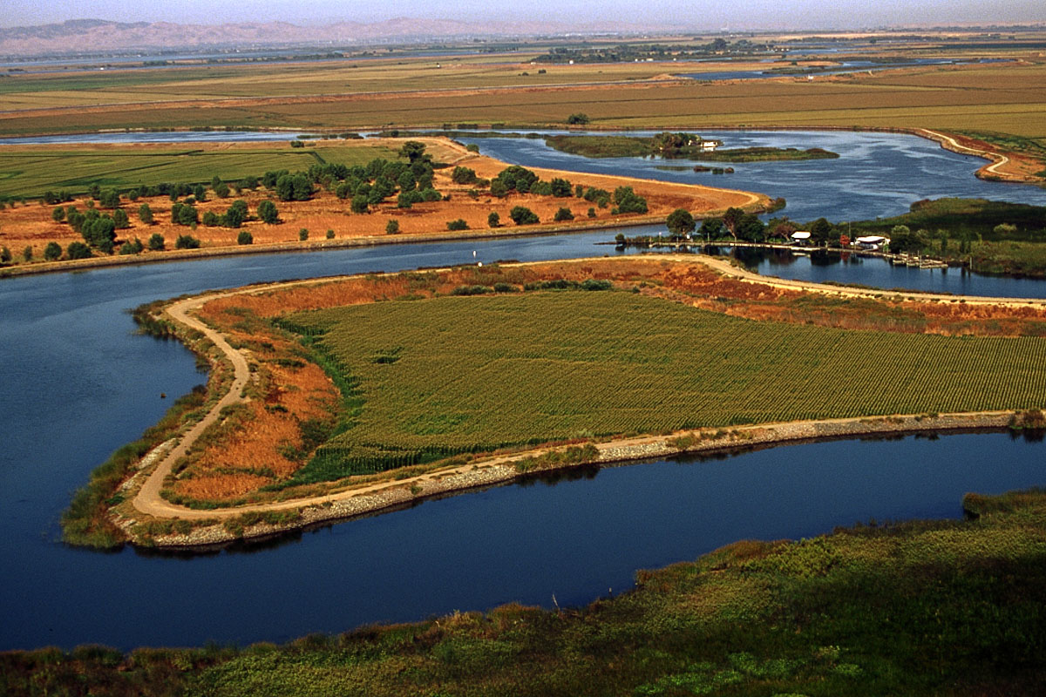
California Bay-Delta

Slide 12

Southern California's
Water Reserve Levels
FULL
2006
2007
2008
NOW
EMPTY
2010 ?

Slide 13
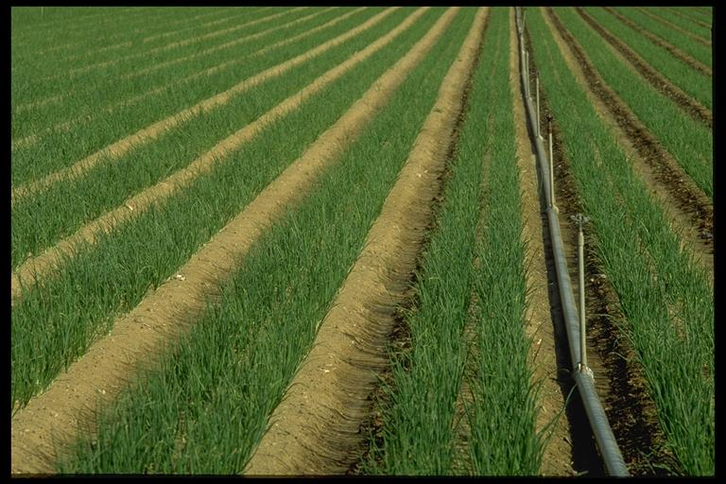
Agricultural Impacts
1 out of 3 acres without project water
1 million acres effected (size of Delaware);
average California farm = 350 acres
40,000 workers face unemployment
$1.4 billion in Central Valley impacts
* Information from farmwater.org 6/01/2009
Notes:
Total Farms
United States 1997 2002 % change
Total farms 2,215,876 2,128,982 -3.9
Land in farms (1000 acres) 954,753 938,279 -1.7
Average size per farm (acres) 431 441 2.3
Sales ($ million) 201,380 200,646 -0.4
Average sales per farm ($) 90,880 94,245 3.7
California
Total farms 87,991 79,631 -9.5
Land in farms (1000 acres) 28,796 27,589 -4.2
Average size per farm (acres) 327 346 5.8
Sales ($ million) 23,280 25,737 10.6
Average sales per farm ($) 264,574 323,205 22.2

Slide 14
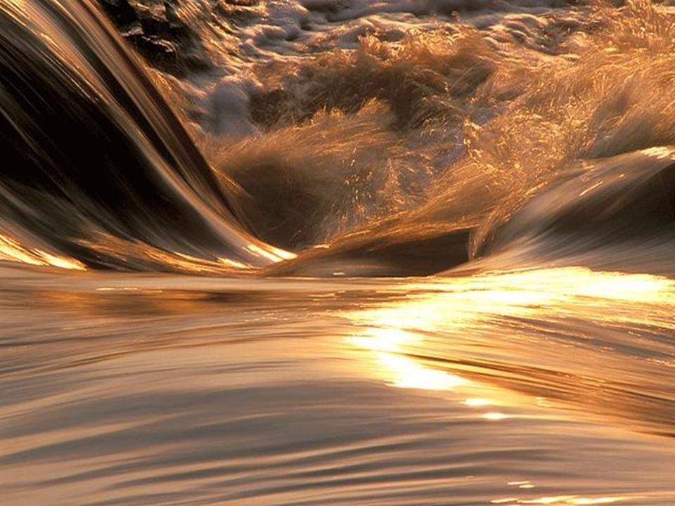
Bottom Line
Regulations significantly lowers supplies
Storage reserves dropping
Rationing in 2009 … future?
Notes:
Regulatory cutbacks significantly lowers water supply
Increased pressure on storage reserves
Large withdrawals anticipated for 2009
Additional need for maintaining reserves for 2010
Likelihood of rationing in 2009
> 50% chance
Chances increase with ongoing dry conditions
Does not factor additional fisheries impacts

Slide 15
Improvement Actions
California’s Water Crisis
Developing Solution

Slide 16
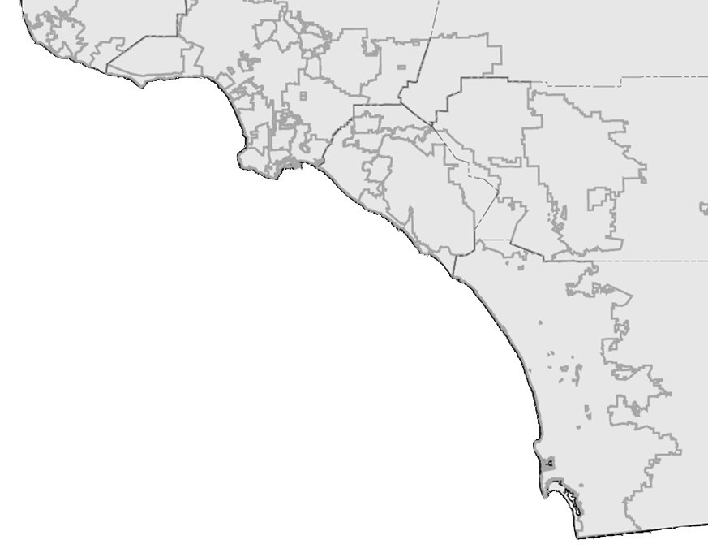
Commitment to Regional Investments
Conservation: $234 million
Desalination: 5 proposed projects
Recycling: 59 projects, $138 million
New LRP Programs: 13 proposed projects
Groundwater Recovery: 18 projects, $49 million
2025: Total Projected Savings > 2.1 million AF/yr
Notes:
Prop. 204 provides $60 million in loans for recycling, supplemented by $40 M from Prop. 13
Prop. 13 provides $235 million to Santa Ana Water Project Authority
Non-MWD funded projects produces 138,000 AFY of recycled and recovered water.
Local agencies such as San Diego, MWDOC have additional funding programs to increase incentives for using recycled water.
M.A. Desalination Proposals Yield (AFY)
Long Beach Water Dept. 10,000
Los Angeles DWP 12,000
MWDOC 28,000
SDCWA 56,000
West Basin MWD 20,000
Total 126,000

Slide 17

Meeting Future Demand Increases Through “Local” Resources
SAVINGS = 1 billion gal/day (1.1 million AF/yr)
=

Slide 18
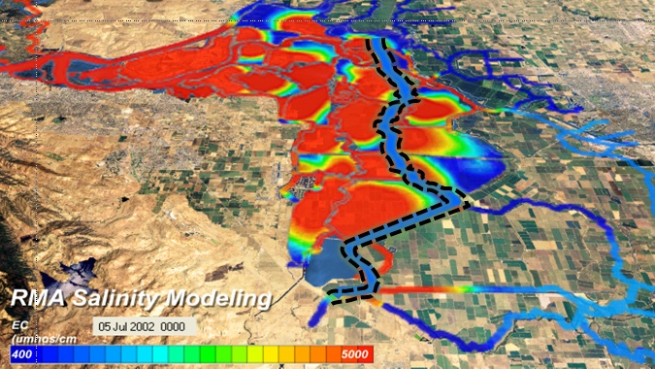
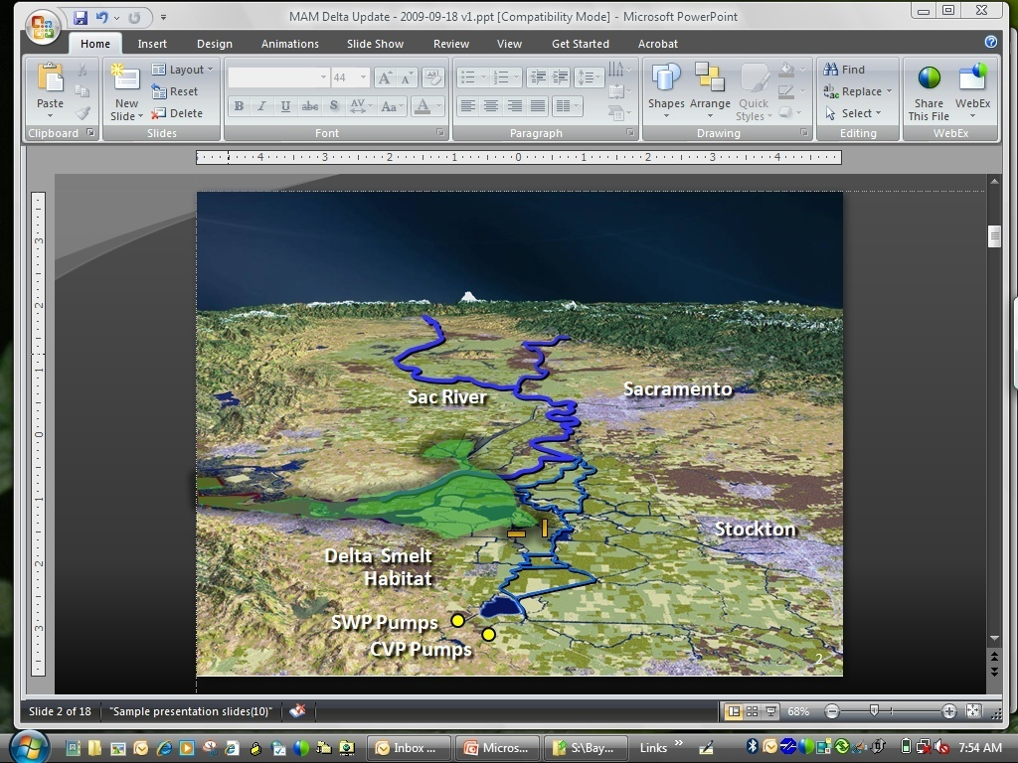
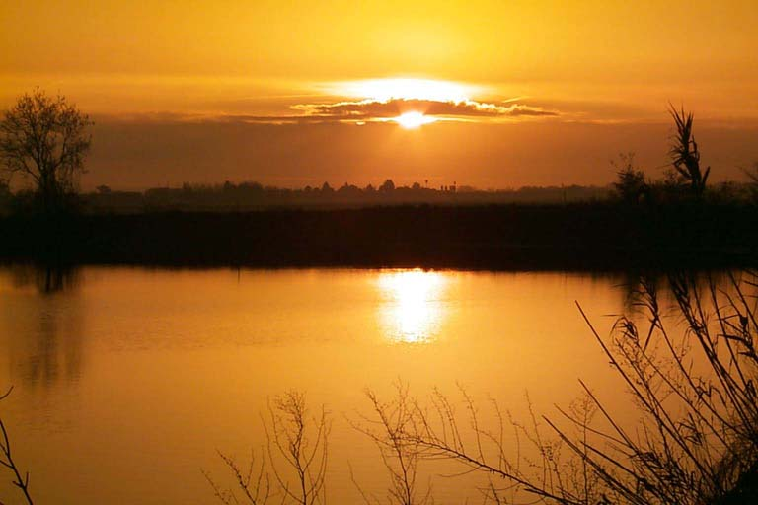
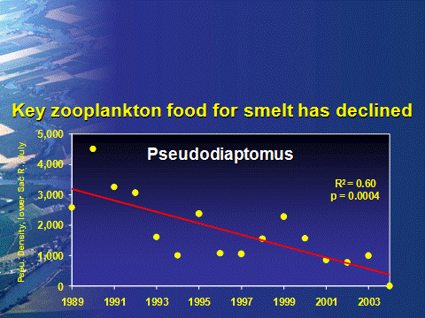
Delta Near-Term Measures
Emergency Response
Operational
Habitat Restoration
Other
Stressors

Slide 19
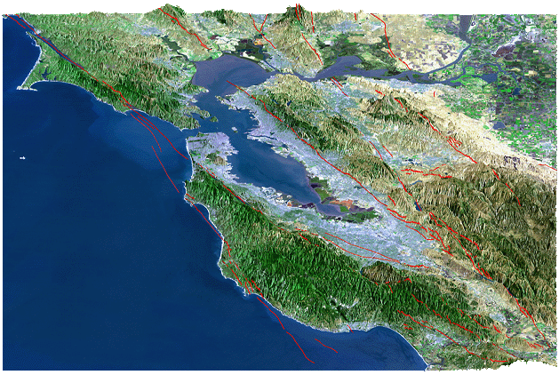
Seismic Vulnerability
Rodgers Crk
Concord
Vaca-Kirby
4%
Midland
San Andreas
Antioch
Hayward
Greenville
21%
27%
3%
San Gregorio
11%
Calaveras
10%
%
66% probability of > 6.5
magnitude earthquake by 2032
Bay-Delta Region Major Faults
Notes:
Information from DWR’s Delta Risk Management Study

Slide 20
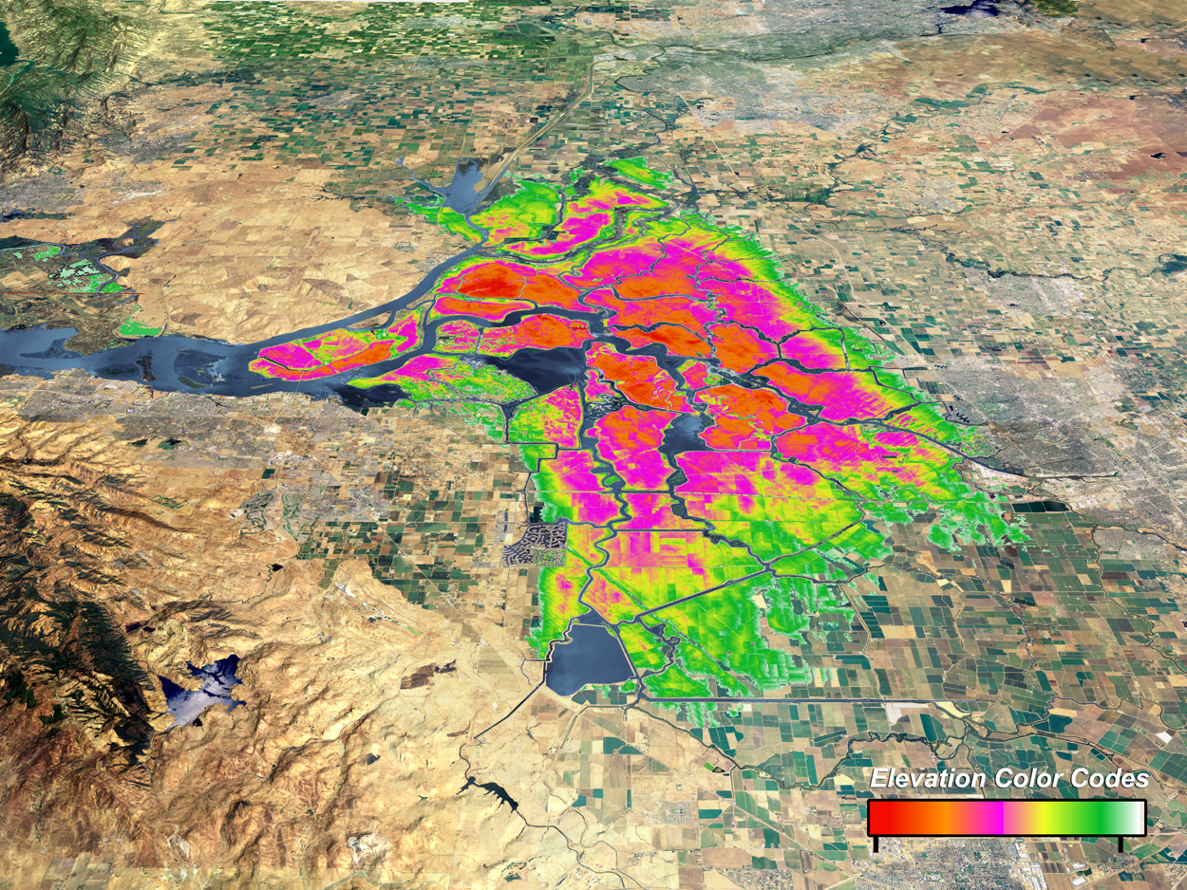
Water Supply Pathway
(Island subsidence between 10-30 ft. deep)
- 30 ft.
- 20 ft.
- 5 ft.
SWP Pumps
CVP Pumps
- 30 feet
Sea Level
Notes:
Existing levee improvement costs = $5 to 90 million per mile; Excavation of peat over 20’ depth (requiring soil mixing) costs $90 million/mile

Slide 21
6.5 Magnitude Earthquake causing 20-island failure
Islands flood with fresh water
0 – 6 hours:
Salt water intruding into Delta
12 – 24 hours:
Salt water throughout Delta
1 – 7 days:

Slide 22
Emergency Pathway
Requiring breach closures & slump restoration
Allows repair in vs. 3 years
6 months
Notes:
Emergency Stockpiling -- Status of Activities
2008 − Prop 84 ($10M) funding for rock stockpile
(240,000 tons) & loading facilities
2009 − Draft Emergency Response & Ops Plan
(integrated local, state, fed processes)
2010 − $35M additional material stockpiles
Final Emergency Response & Ops Plan
Facility --Total Quantity of Rock
[Tons] Contracted Delivery Date
Rio Vista 100k Mar. 3, 2008
Hood 10k Mar. 13, 2008
Port of Stockton 130k Jun. 27, 2008
Total 240k
The San Rafael Rock Quarry has been contracted to construct a complete conveyor system at the Port of Stockton that will be capable of transferring large rock from either the above referenced stockpiles or directly from trucks to barges. The construction and demonstration of this conveyor should be completed in Mar. 2008. Although located at the Port, the conveyor will be owned and operated by the Department

Slide 23
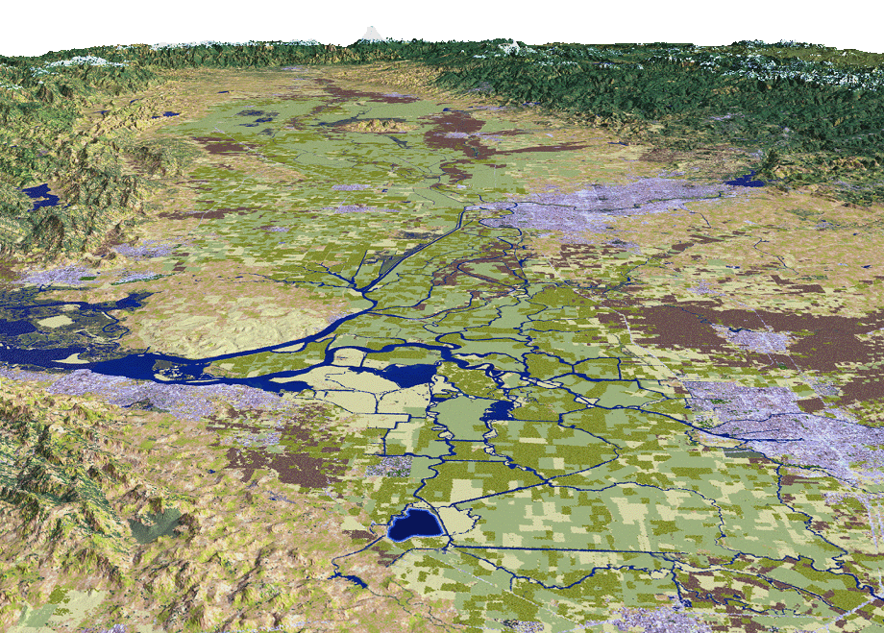
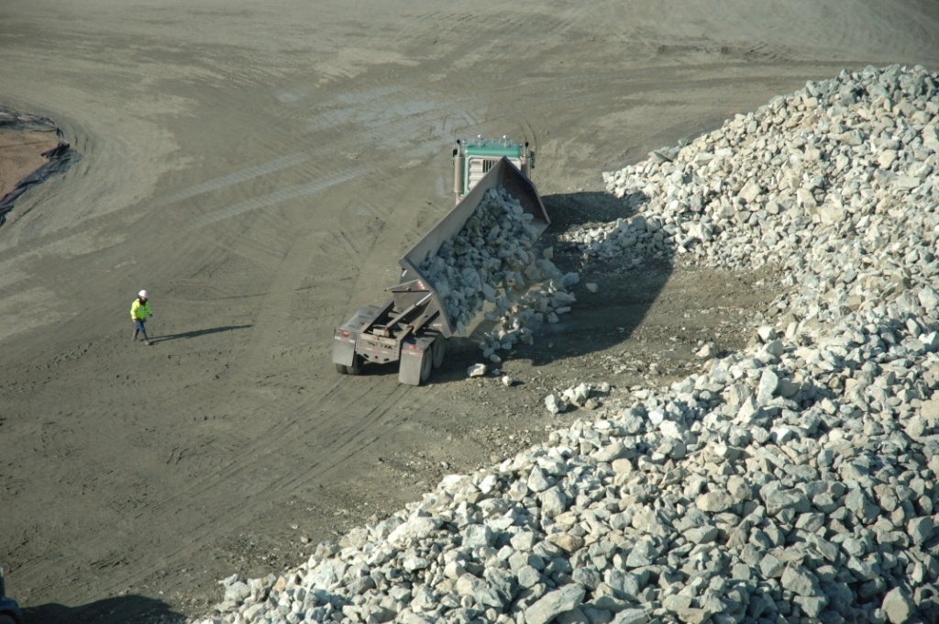
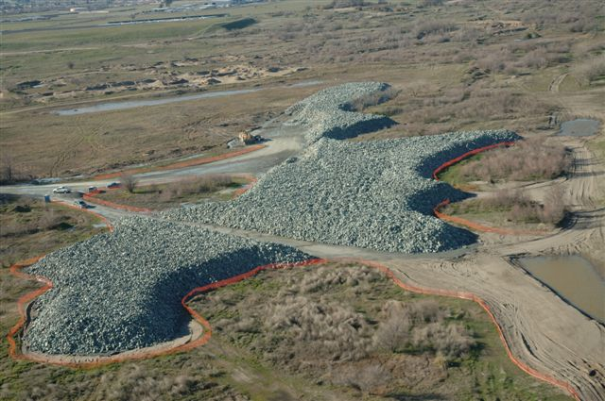
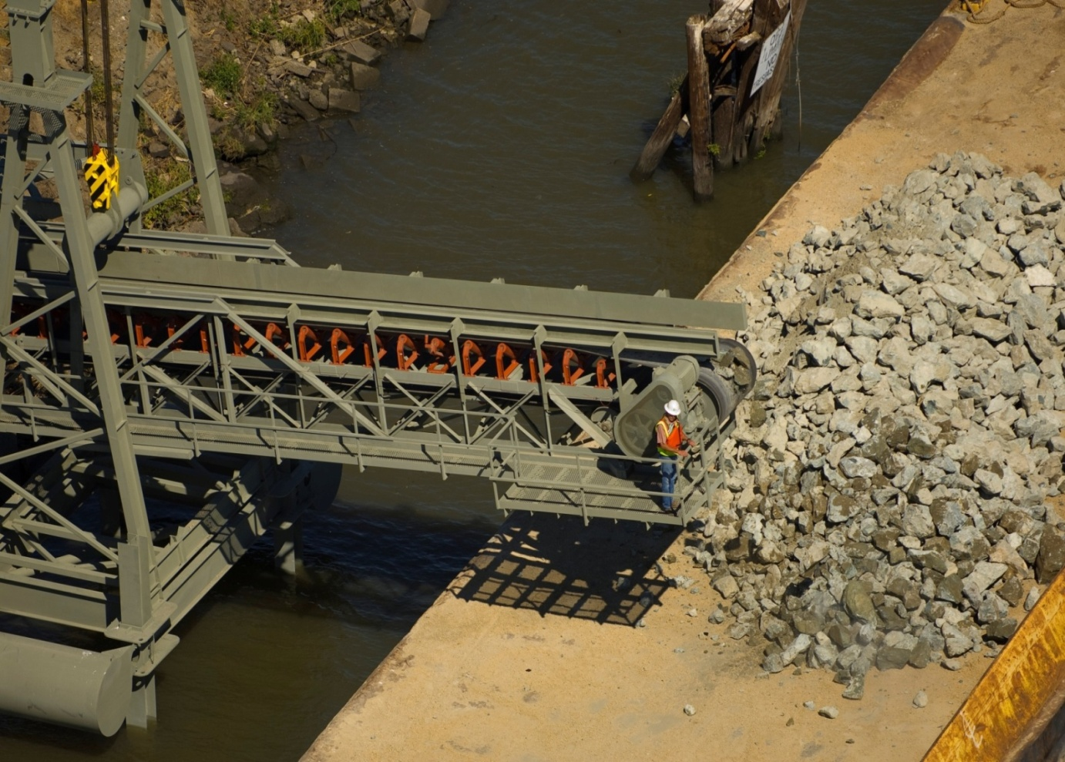
Delta Near-Term Measures
Emergency Stockpiling & Levee Improvements
Sac River
Sacramento
Hood
Rio Vista
Stockton
Port of Stockton
12” - 24” rock diameter
240,000 tons of rock stockpile
SWP Pumps
SJ River
Port of Stockton Loading Facility
CVP Pumps
Notes:
Emergency Stockpiling -- Status of Activities
2008 − Prop 84 ($10M) funding for rock stockpile
(240,000 tons) & loading facilities
2009 − Draft Emergency Response & Ops Plan
(integrated local, state, fed processes)
2010 − $35M additional material stockpiles
Final Emergency Response & Ops Plan
Facility --Total Quantity of Rock
[Tons] Contracted Delivery Date
Rio Vista 100k Mar. 3, 2008
Hood 10k Mar. 13, 2008
Port of Stockton 130k Jun. 27, 2008
Total 240k
The San Rafael Rock Quarry has been contracted to construct a complete conveyor system at the Port of Stockton that will be capable of transferring large rock from either the above referenced stockpiles or directly from trucks to barges. The construction and demonstration of this conveyor should be completed in Mar. 2008. Although located at the Port, the conveyor will be owned and operated by the Department

Slide 24
Delta Near-Term Measures
2-Gate Fish Protection Project
Sac River
Sacramento
Stockton
Delta Smelt Habitat
SWP Pumps
CVP Pumps
Notes:
24
2-Gates Demonstration Project -- Status of Activities
Jul ‘09 − Engineering design complete
Nov ‘09 − Final Environmental Assessment & Biological
Opinion; Notice to proceed with fabrication
Jul ‘10 − Begin in-water gate installation
Nov ‘10 − In-service target

Slide 25
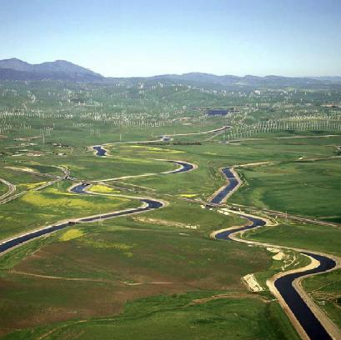
Delta Near-Term Measures
CVP/SWP Intertie Project
Sac River
Sacramento
Stockton
SWP Pumps
CVP Pumps
SWP/CVP Intertie
Notes:
25
Jul-Aug ‘09 − Draft Environmental Impact Statement
released; Public hearings
Dec 2009 − Final EIS
Apr 2010 − Construction begins
The Bureau of Reclamation, in partnership with the Western Area Power Administration, has released a Draft Environmental Impact Statement (Draft EIS) for the Delta-Mendota Canal (DMC)/California Aqueduct (CA) Intertie (Intertie). The Intertie would connect the DMC and the CA via a new pipeline and pumping plant to help meet current water supply demands, allow for maintenance and repair activities, and provide the flexibility to respond to Central Valley Project and State Water Project emergencies. The project was identified as a proposed action in the August 2000 CALFED Bay-Delta Program Programmatic Record of Decision.

Slide 26
Delta Near-Term Measures
Habitat Restoration
Yolo Bypass
Sacramento
Cache Slough
Suisun Marsh
8,000 acres by 2019
Bio Opinion Requirement
Stockton
Dutch Slough
SWP Pumps
CVP Pumps
Notes:
OCAP Delta Smelt biological opinion requires 8,000 acres of habitat restoration by 2019
Priority locations include the Yolo Bypass, Cache Slough, Suisun Marsh

Slide 27
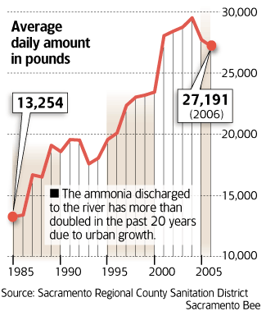
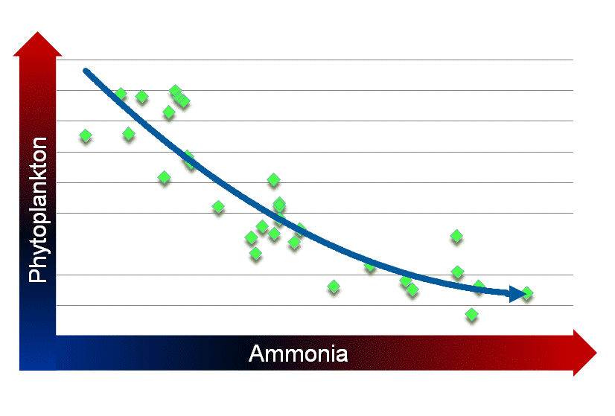
Delta Near-Term Measures
Ammonia Research
Ammonia discharges doubled
Ammonia tied to food web decline
Notes:
ln (Suisun Bay Phyto Density July to Sept) v June - August Ammonia Loading at Hood
Joint SWP/CVP research . Includes Nitrogen model; isotope analysis to determine the source of the nitrogen; and studies of the relationship between nutrients generally and the food chain
Hired Dr. Pat Glibert of U. of Maryland. Internationally recognized expert in nutrient impacts on ecosystems
Here initial review implicates not merely ammonium, but the nutrient balance between nitrogen and phosphorus. Such nutrient impacts are seen in many estuaries throughout the world.
Models ammonia, nutrients & temperature
Independent technical advisory review
Anticipated completion Jan 2010

Slide 28
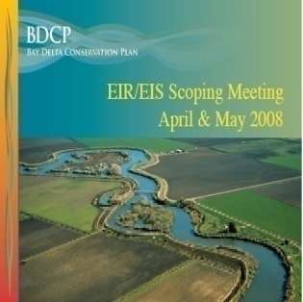
Bay-Delta Conservation Plan
Overview
Multi-species approach to endangered species protection
Includes habitat conservation, conveyance improvements, other invasive species control
Bay-Delta Conservation Plan

Slide 29

Bay-Delta Conservation Plan
Steering Committee
Bay-Delta Conservation Plan
Fed & State Agencies
  Cal Bay-Delta Authority
  The Resource Agency
  US Bureau of Reclamation
  Cal. Dept. of Water Resources
  State Water Res. Control Board
  US Corps of Engineers
Fish Agencies
  Cal Dept. of Fish & Game
  US Fish & Wildlife Service
  National Marine Fisheries Service
Other Organizations
  Cal Farm Bureau Federation
  Mirant Delta
Water Agencies
  Contra Costa Water District
  Kern County Water Agency
  Metropolitan Water District
  North Delta Water Agency
  San Luis & Delta Mendota WA
  Santa Clara Valley Water Dist.
  Westlands Water District
  Zone 7 Water Agency
Environmental Org.
  American Rivers
  Defenders of Wildlife
  Environmental Defense
  Natural Heritage Institute
  The Bay Institute
  The Nature Conservancy

Slide 30
Bay-Delta Conservation Plan
Habitat Restoration Opportunities
Yolo Bypass
Sacramento
Cache Slough
Suisun Marsh
Stockton
Dutch Slough
SWP Pumps
CVP Pumps

Slide 31
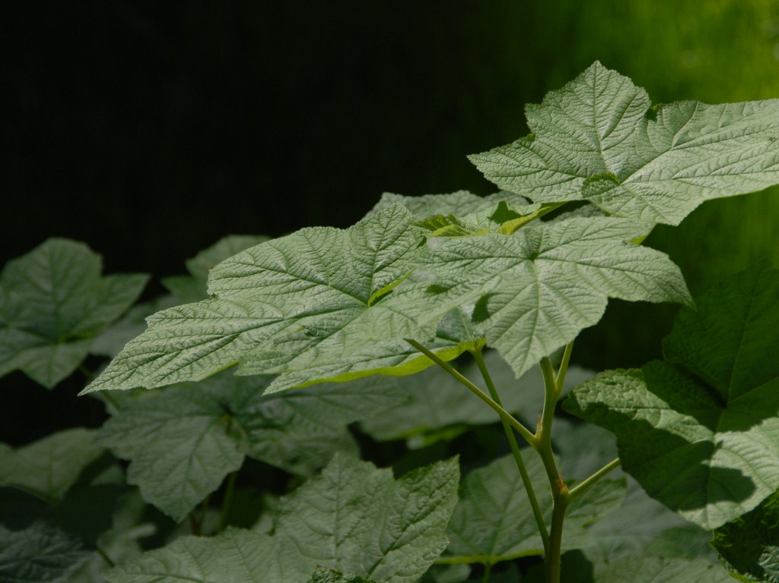
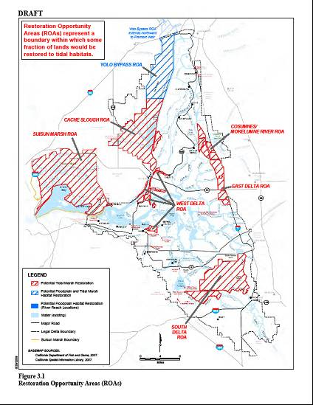
Ecosystem Restoration Targets
Restoration Targets | Year 10 Target | Year 15 Target | Year 40 Target
Tidal Marsh | 14,000 | 25,000 | 65,000
Seasonal Floodplain | 0 | 1,000 | 10,000
Riparian Habitat | 1,300 | 2,300 | 5,000
TOTAL (acreage) | 15,300 | 28,300 | 80,000
Ecosystem Restoration Target = Twice the size of Washington DC
Notes:
80,000 acres = 125 square miles
Washington DC = 68 sq. mi.
Las Vegas = 113 sq mi
Sacramento = 97 sq mi

Slide 32
Bay-Delta Conservation Plan
Dual-Conveyance − Central Tunnel Alignment
Sac River
Sacramento
Stockton
SWP Pumps
SJ River
CVP Pumps
32
Notes:
32
WEST-SIDE ALIGNMENT OPTION
Washington Group International report to SWC to answer due diligence questions regarding cost of project & other ROW questions Facility studied = 15,000 cfs
Pumping plant = 15 ft lift; located near intake
Pipeline from intake to siphon under Sac & SJ Rivers = 10 miles length
Open channel from Franks Tract to Clifton Court Forebay = 27 miles length
Overall Canal length = 4X mi
Inverted Siphons under streams/rivers = 4 crossings (including tunnel under Sac & SJ)
Estimated construction costs (2006 dollars) = $6.4 to 7.5 billion (includes 30% general contingences and 35% planning, design, legal & project mgmt. costs)
Long tunnel cost = $2.3 B (13 miles) ; short tunnel cost = 1.4 billion (8 miles); soft soil tunneling by TBM
Intake screens = $25,000 per cfs or $1.3 billion
Peat soil depth = 0 to 10 ft.; this will require removal, dewatering, and replacement
Bottom Width = 340 ft (at 15,000 cfs); 140 ft. (at 10,000 cfs)
Top Width = 500 to 700 ft.
Overall Width = 1000 ft includes maintenance roads, etc.
Design velocity = 1.6 fps
Box culvert for 15,000 cfs = 6 boxes at 30’x30’ (2,500 cfs each box)
Existing levee improvement costs = $5 to 90 million per mile; Excavation of peat over 20’ depth (requiring soil mixing) costs $90 million/mile
Land costs in secondary zone estimated at $50,000 to $200,000 per acre
Land costs in primary zone estimated at $7,000 per acre
Urban levee standards (200 yr level of protection) = $13-36 million per mile
Delta levees are designed for overtopping & seepage, not earthquake

Slide 33
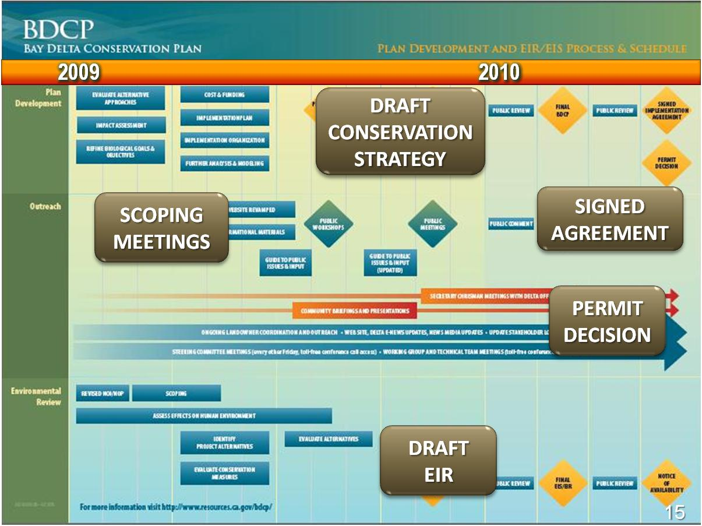
Schedule
Sep 2010
  Draft Conservation Plan
  Draft EIR/S
33
Notes:
Will be updated pending review by DWR’s new project manager

Slide 34
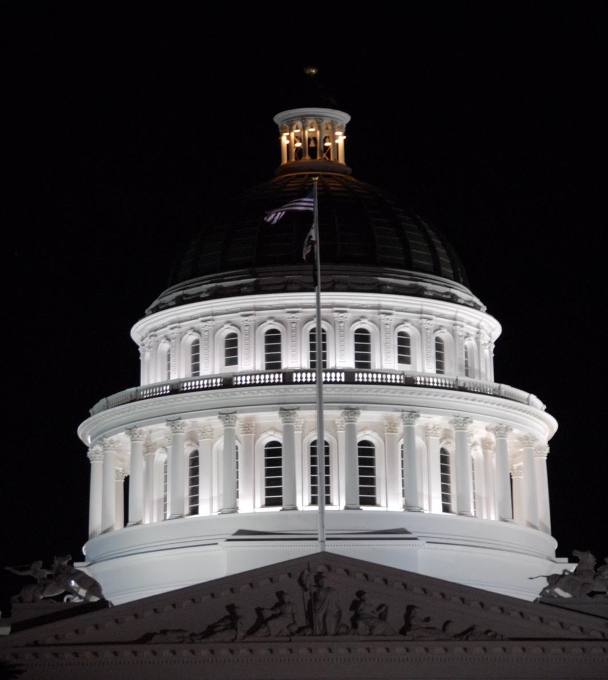
Historic Comprehensive Water Package
34

Slide 35

Water Package − Elements
Policy Bills – Delta Specific
  Commits to co-equal water supply & environment goals
  Improved governance (establishes Delta Stewardship Council, Delta Conservancy & Watermaster; revises Delta Protection Commission)
  Integrates Bay-Delta Conservation Plan habitat & conveyance actions
  Requires Delta Plan
Policy Bills – Statewide
  Mandates statewide conservation & water use efficiency
  Enhances groundwater monitoring & water use reporting
Finance
  $11.14 billion G.O. bond for public share
  Consistent with beneficiaries-pay principal
  Drought Relief, Regional Supply, Delta, Storage, Watershed & Water Quality, Groundwater, Recycling

Slide 36
Water Bond - 2009
$11.14 billion
Groundwater
Protection
$1.0 B
Drought
Relief
$0.5 B
Recycling & Conservation
$1.25 B
Regional
Supply
$1.4 B
Watershed &
Water Quality
$1.7 B
Delta Sustainability
$2.25 B
Water Storage
$3.0 B
Notes:
SBX 7-2 (Cogdill et al): Senate vote 27-8 passed; Assembly vote 54-19 passed
Description SBX 7-2
Drought Relief (Chapter 5) $0.455B
Regional Supply (Chapter 6) $1.40B
Delta (Chapter 7) $2.25B
Statewide Flexibility/Storage (Chapter 8) $3.0B
Watershed & WQ (Chapter 9) $1.785B
Groundwater (Chapter 10) $1.00B
Recycling (Chapter 11) $1.25B
Total (General Obligation Bonds) $11.14 B

Slide 37
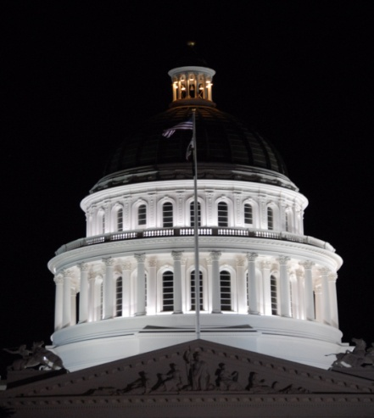
Water Bond
Southern Cal Benefits
Outside
$1.9 B
Statewide
$5.94 B
Delta
$2.25 B
So Cal
$1.02 B
$2.25 B − Delta Sustainability
  Investments to ease pumping restrictions
  Essential for new improved conveyance
$6.96 B − Southern Cal Projects Eligible
  $5.94 B − Statewide
  $1.02 B − Southern Cal specific
Notes:
SBX 7-2 (Cogdill et al): Senate vote 27-8 passed; Assembly vote 54-19 passed
Description SBX 7-2
Drought Relief (Chapter 5) $0.455B
Regional Supply (Chapter 6) $1.40B
Delta (Chapter 7) $2.25B
Statewide Flexibility/Storage (Chapter 8) $3.0B
Watershed & WQ (Chapter 9) $1.785B
Groundwater (Chapter 10) $1.00B
Recycling (Chapter 11) $1.25B
Total (General Obligation Bonds) $11.14 B

Slide 38
Water Bond
Funding for Specific Southern Cal Projects *
Drought Relief − $0.455 B
  Specific Southern Cal Projects $128 M
Water Supply Reliability − $1.4 B
  Six-county region (IRWMP) > $460 M
Delta Sustainability − $2.25 B
Surface & Groundwater Storage − $3.0 B
Watersheds & Water Quality − $1.75 B
  Specific Southern Cal projects > $435 M
Recycling & Conservation − $1.25 B
Groundwater Cleanup − $1.0 B
* Southern Cal can also apply for $5.94 billion in Statewide eligible funding
Notes:
SBX 7-2 (Cogdill et al): Senate vote 27-8 passed; Assembly vote 54-19 passed
Description SBX 7-2
Drought Relief (Chapter 5) $0.455B
Regional Supply (Chapter 6) $1.40B
Delta (Chapter 7) $2.25B
Statewide Flexibility/Storage (Chapter 8) $3.0B
Watershed & WQ (Chapter 9) $1.785B
Groundwater (Chapter 10) $1.00B
Recycling (Chapter 11) $1.25B
Total (General Obligation Bonds) $11.14 B

Slide 39
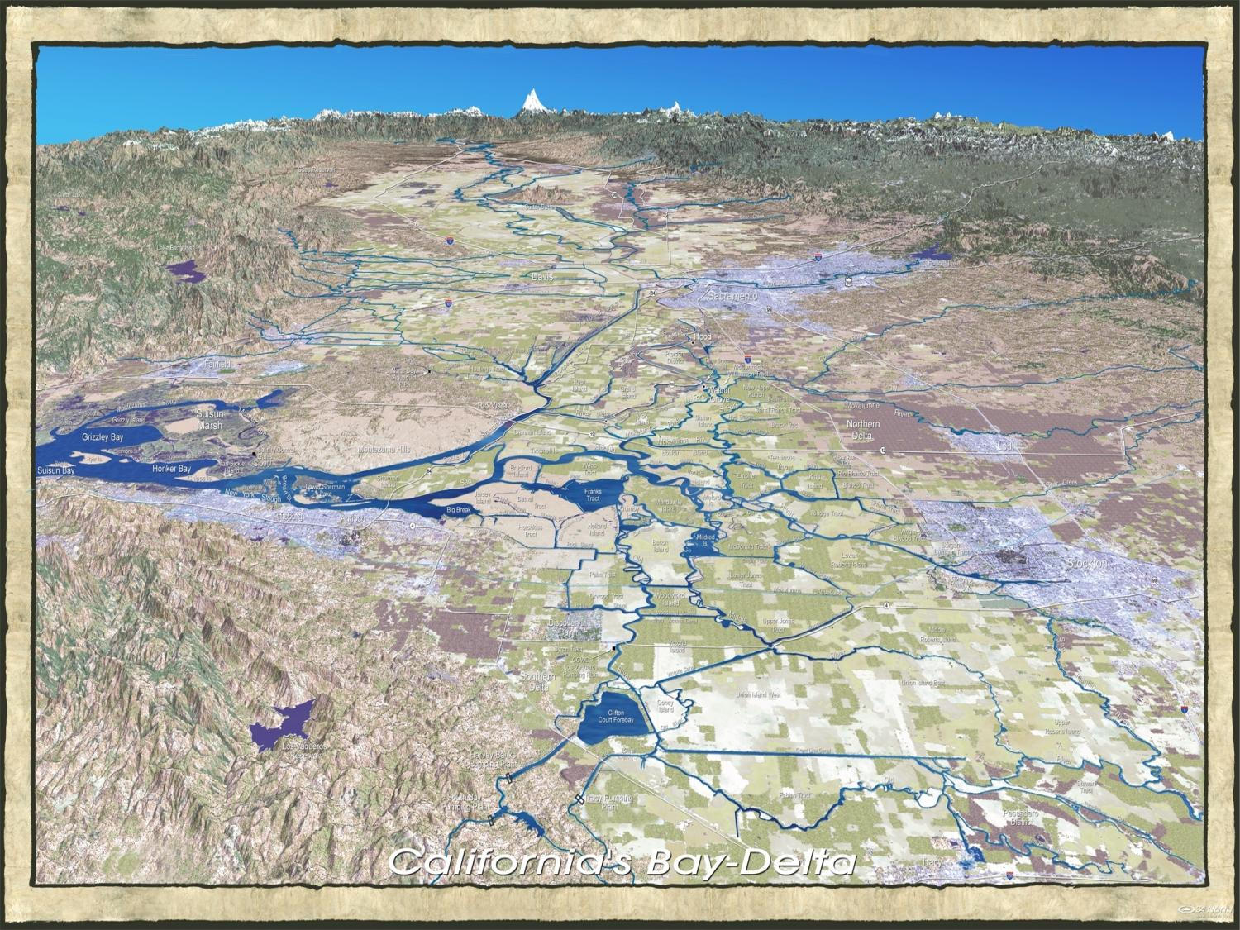
The Delta
Sacramento
Suisun Bay
Stockton
State & Federal Pumping Plants

Slide 40
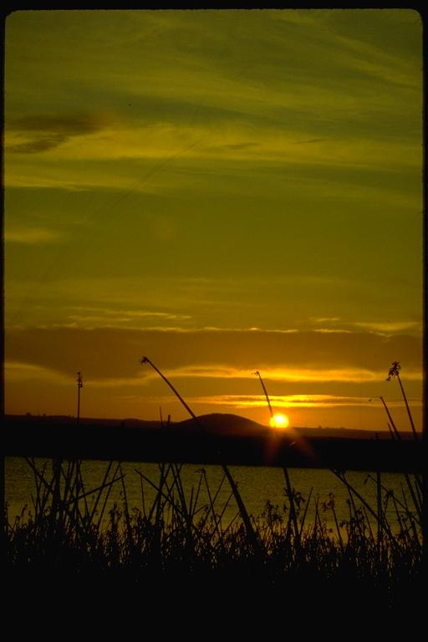


Randall D. Neudeck
(213) 217-7537
rneudeck@mwdh2o.com
www.bewaterwise.com
An electronic copy of this presentation is located at:
“ftp://blizzard.mwdh2o.com/baydelta/presentations”

