Slide 1

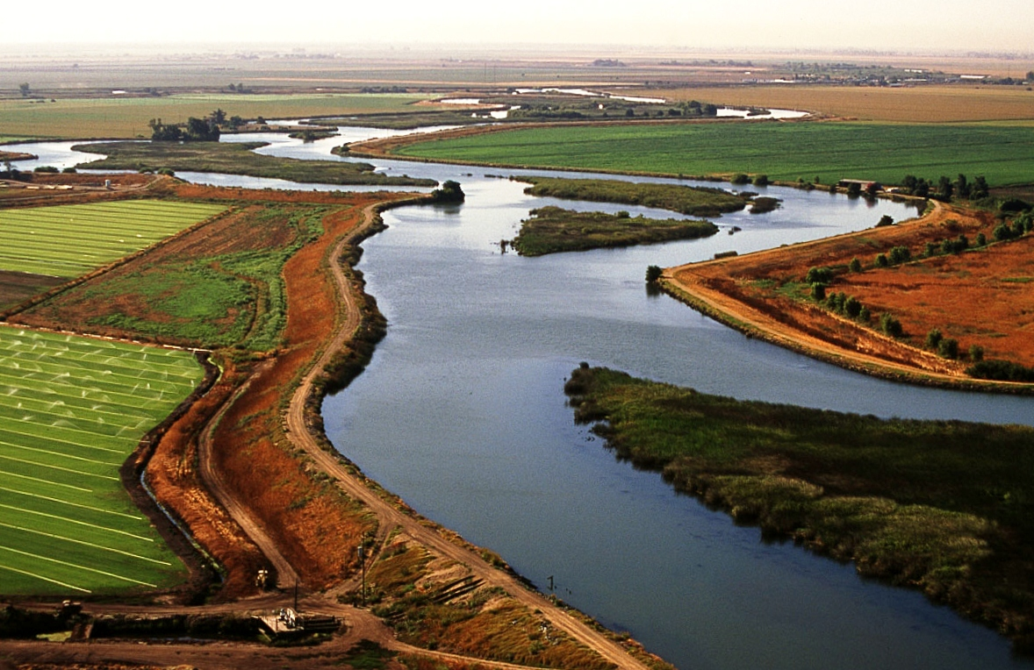
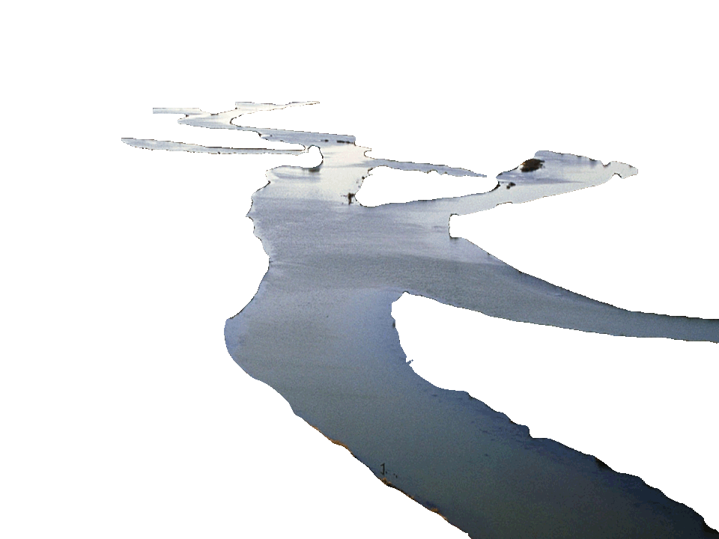
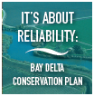
Water . . .
Shaping a Sustainable Future

Slide 2
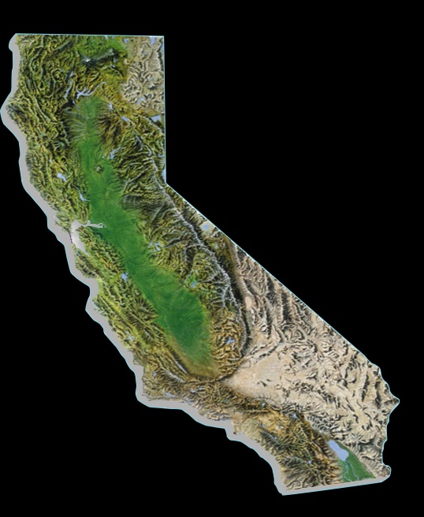
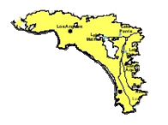
Metropolitan Water District
of Southern California
Regional water wholesaler
Serves 6 counties, 19 million people
Growth: 170,000 people/yr.
$1 trillion regional economy
50%+ of region’s supply
(4 million acre-ft/yr)
2
Notes:
First, some background on Metropolitan.
We are the importer of surface water supplies from the Colorado River and Northern California for a six-county service area in Southern California that serves 19 million people.
We don’t serve individual customers directly, but we do supply water to local water agencies that deliver water to your homes and businesses.
And ,that water helps sustain an $1 trillion economy.
2

Slide 3


Southern California’s Diverse Water Supplies
25% – Colorado River
30% – State Water Project (Delta)
45% – Local Supplies
  Los Angeles Aqueduct
  Conservation
  Recycling
  Groundwater
  Desalination
State Water Project
LA Aqueduct
Colorado River Aqueduct
Conservation, Recycling, Groundwater
3
Notes:
First, some background on Metropolitan.
We are the importer of surface water supplies from the Colorado River and Northern California for a six-county service area in Southern California that serves 19 million people.
We don’t serve individual customers directly, but we do supply water to local water agencies that deliver water to your homes and businesses.
And ,that water helps sustain an $1 trillion economy.
3

Slide 4
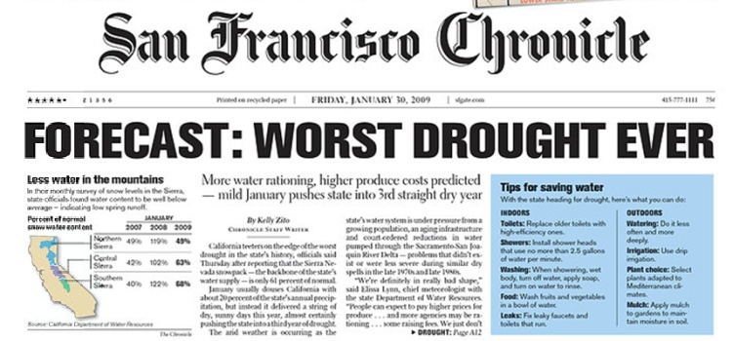
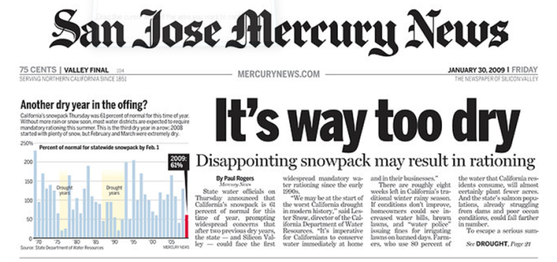
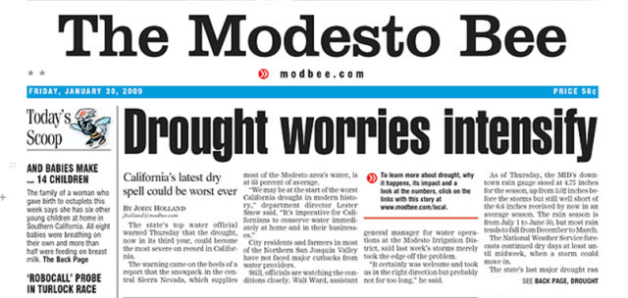
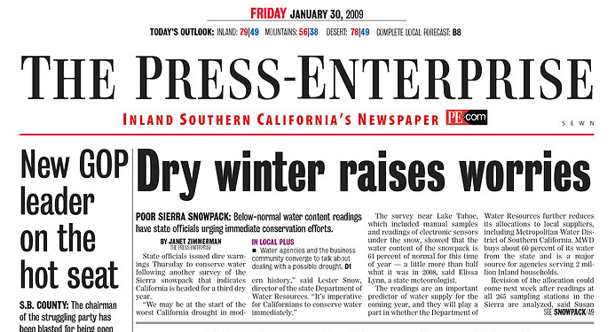
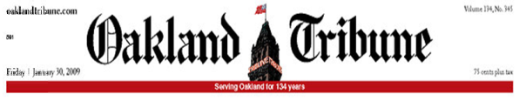
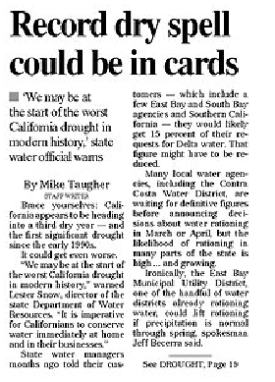
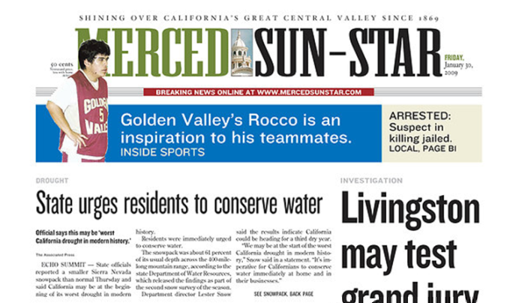

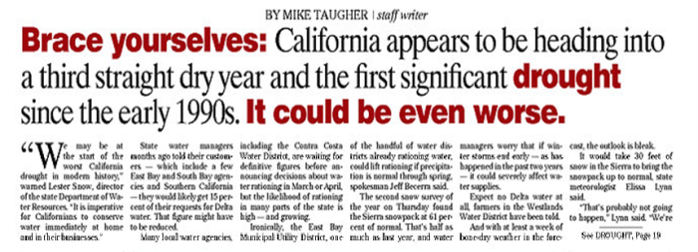
Newspaper Headlines – 2009

Slide 5
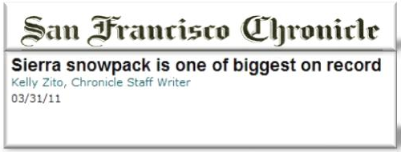
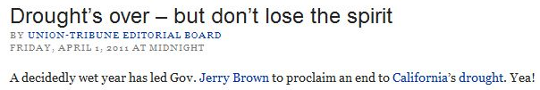
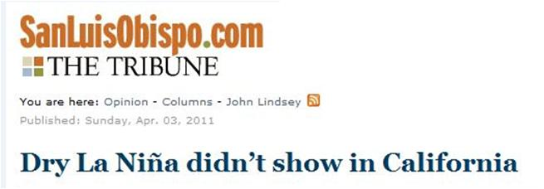
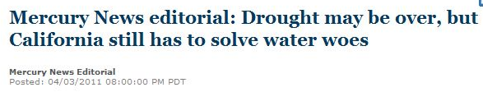
Newspaper Headlines – 2011

Slide 6
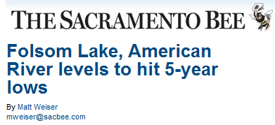
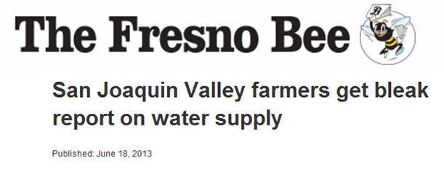
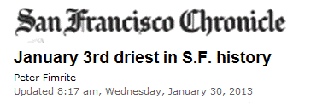
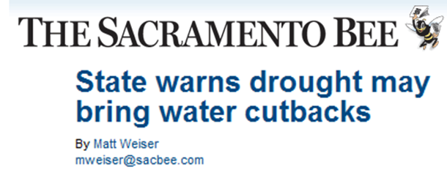
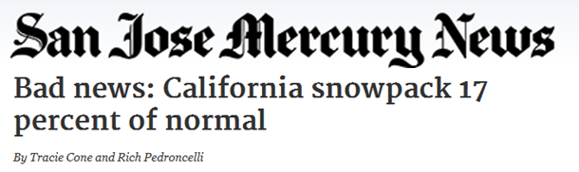
Newspaper Headlines – 2013

Slide 7
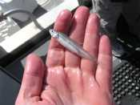
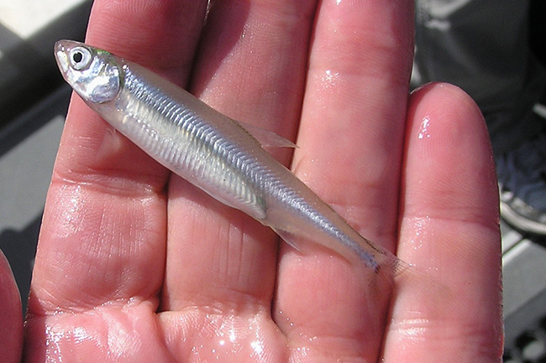
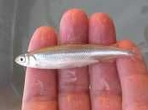
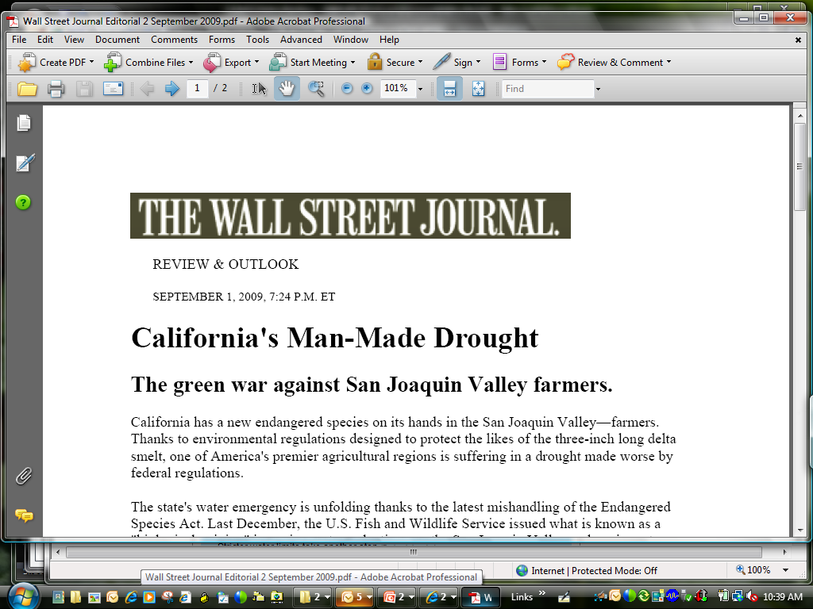
… the Cause of Statewide Water Problems?
Delta Smelt

Slide 8
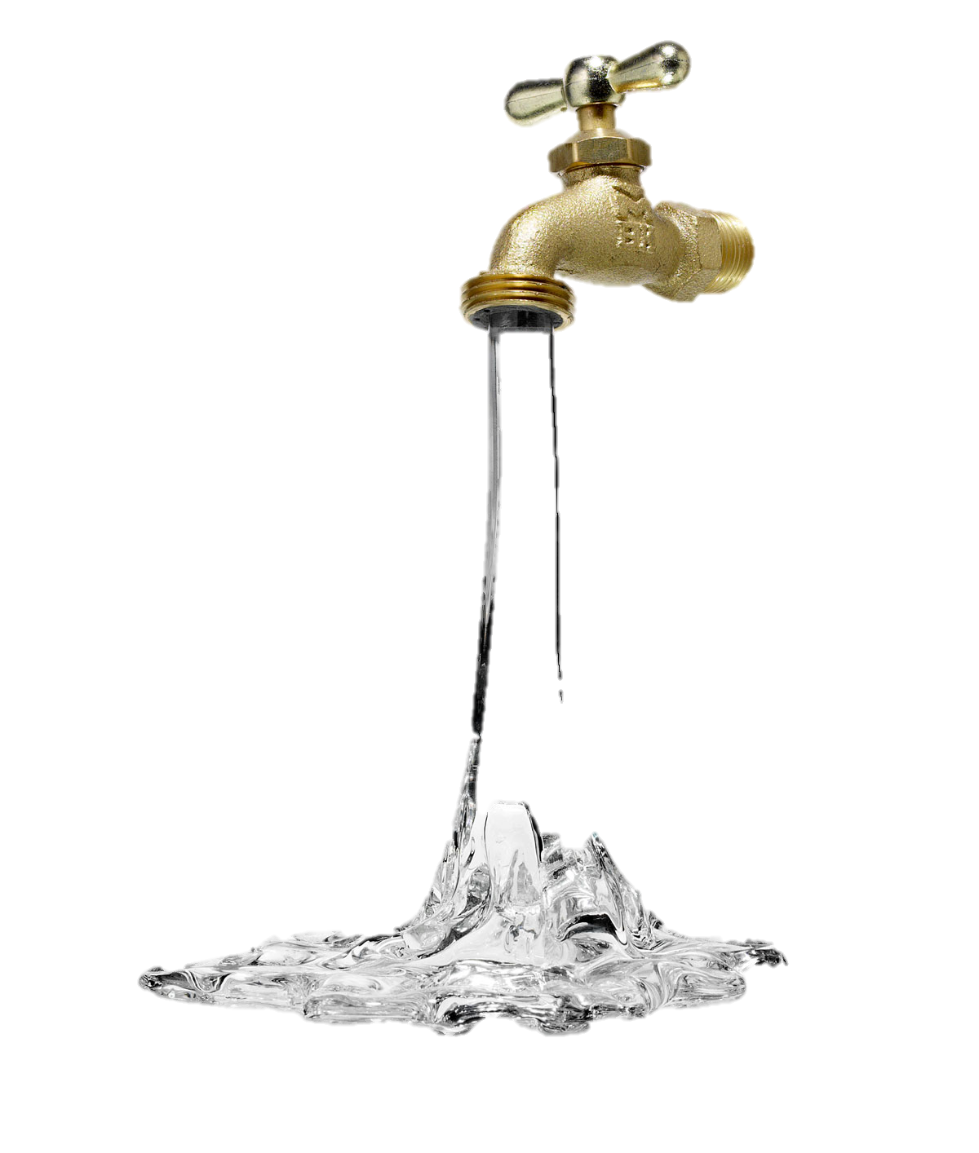
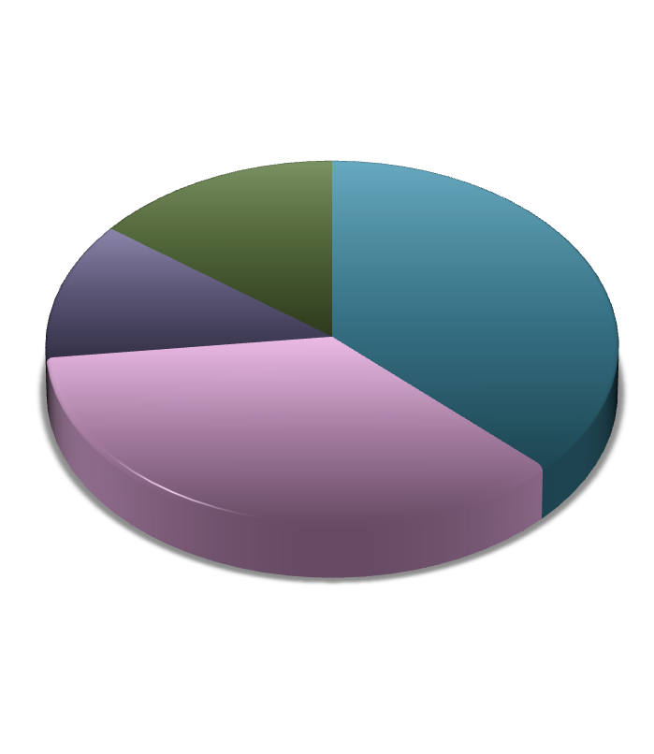
A Sustainable Future …
Diversified Portfolio Approach
Southern California has been a leader in this strategy for over 20 years
Storage & Local Project Improvements
Local storage increased by 14X to manage “big gulp/little sip”
1.0 million acre-feet of new conservation/recycling projects planned
Stable & Reliable Imported Supplies
Implement Bay Delta Conservation Plan improvements
Notes:
Southern California has been the leader in a diversified portfolio approach for over 20 years
1.4 million ac-ft. from water use efficiency projects
Additional 1.0 million ac-ft. planned to meet yr. 2030 needs
Foundational action funding for continued reduced reliance on imports
Increased local storage by 14X to manage “big gulp/little sip”
Stable imported supplies are needed for reliability

Slide 9
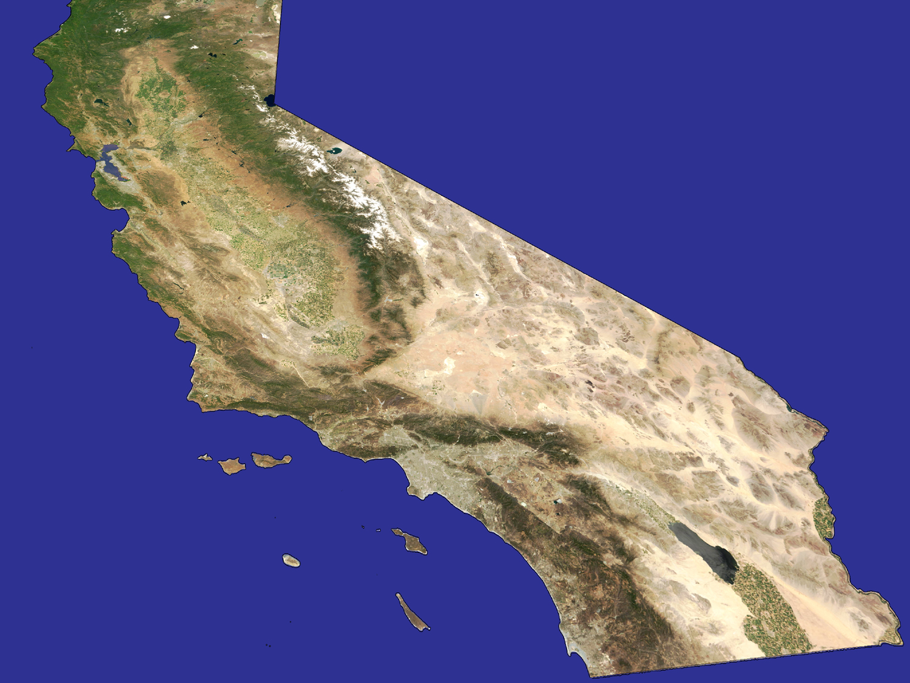
Regional Investment Portfolio
Existing
Groundwater Banking
Semitropic
Kern Delta
Arvin-Edison
Mojave W.A.
San Bernardino Valley
Arizona Banking
Local
Hayfield Basin
Conservation: 900,000 af/yr
Recycling: 335,000 af/yr
Coachella Valley
Palo Verde
Groundwtr Recovery: 111,000 af/yr
Imperial
Seawater: 46,000 af/yr
Notes:
Water Portfolio 2015 2035
Water Use Efficiency 1.6 maf/yr 2.2 maf/yr
Local Supplies (Grdwtr/LA Aqued) 2.1 maf/yr 2.1 maf/yr
Imported 1.8 maf/yr 1.6 maf/yr
TOTAL 5.6 maf/yr 5.8 maf/yr

Slide 10

Meeting Future Demand Increases
Through “Local” Resources
Current Savings = > 1.2 billion gal/day
(1.4 million acre-ft for ~ 8 million people/yr)
=
1 billion gal/day = 1.1 million AF/yr
Notes:
To put our conservation investments in perspective, the amount of water we’re saving as a region from direct conservation programs and plumbing code reforms such as those low-flow toilets are creating an equivalent supply every year to run the cities of San Francisco, Los Angeles and San Diego combined. Our plan is to double the water saved from conservation in the coming two decades.
(updated 11/28/11)
Conservation savings includes: Metropolitan’s Conservation Credits Program, code-base, system losses/unmetered, price effect and pre-1990.
Recycling and GW recovery 394,000 AF include 189 TAF of local agency production
The total savings, local project production and groundwater storage supplies reduce the total demand by about 22%.
Data AF
Conservation 916,000
Recycling & GW Recovery (incl. non-LRP)394,000
GW Storage Take (Conjunctive Use) 48,000
Total: 1.36 MAF
Sacramento + San Francisco + Los Angeles + San Diego = approximately 1.37 MAF
Total Regional Demand (without conservation) is 4.266 MAF
FY10/11 demand = 3.35 MAF
Conservation=0.916 MAF
Regional Demand (w/o conservation)=4.266 MAF
FY 2010/11 sales = 1.584 MAF
(updated 11/29/11)
GRAPH shows Active Conservation only (does not include passive originated as active)
Data below and in the report include active and passive originated as active.
Water Savings – 916,000 AF
Incentives Programs — 156,000 AF
Plumbing Code and Other — 760,000 AF
Investment — $30 million
CCP investment — $31 million (includes $15 million member agency investment)
Outreach Campaign — $0.1 million
Cumulative
Incentives investment to date —$309 million
Incentives conservation to date — 1,569,000 AF
Agency Population AF/YR
Sacramento (City) 450,000 145,600
Contra Costa WD 550,000 115,360
Alameda County 330,000 56,000
Zone 7 200,000 -
East Bay MUD 1,300,000 212,800
Santa Clara VWD 1,800,000 430,080
Los Angeles 4,000,000 693,728
San Francisco 770,000 302,400
MWDOC 1,440,000 358,400
San Diego (City) 1,300,000 235,200
Sub -- Bay Area 4,180,000 814,240
Sub -- So Cal 7,510,000 1,589,728
TOTAL 12,140,000 2,549,568

Slide 11
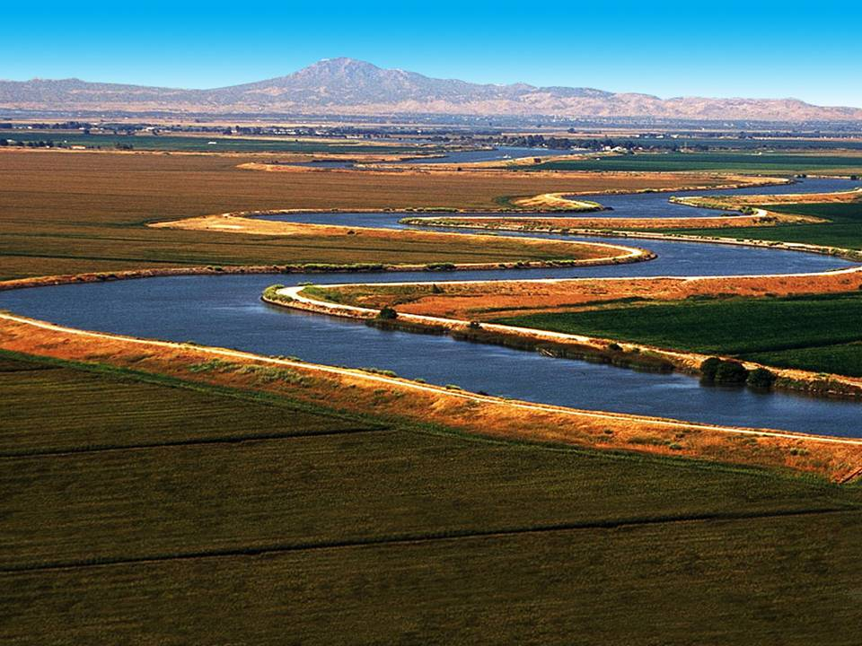
Bay-Delta
… the Hub of California’s Water
Notes:
The Bay Delta is where the rivers of the Sierra merge before heading west toward San Francisco Bay.
It is the home of two large water projects, the State Water Project, which supplies mostly urban regions from the Bay area to San Diego, and the federal Central Valley Project, which supplies the state’s agricultural region in the Delta.
All told, water directly from the Delta helps to sustain 25 million Californians – statewide – and some of the nation’s most productive farm land.
As noted, water that travels through the Delta provides 33% to Northern California, 23 to 90% in Central Valley and 30% to Southern California.

Slide 12
The Bay-Delta
Hub of California’s Water
Some regions up to 100% dependent
Bay Area – 33%
Central Valley – 23 to 90%
Los Angeles Aqueduct
State Water Project
Southern Cal – 30%
Colorado River Aqueduct
Local
Notes:
The Bay Delta is where the rivers of the Sierra merge before heading west toward San Francisco Bay.
It is the home of two large water projects, the State Water Project, which supplies mostly urban regions from the Bay area to San Diego, and the federal Central Valley Project, which supplies the state’s agricultural region in the Delta.
All told, water directly from the Delta helps to sustain 25 million Californians – statewide – and some of the nation’s most productive farm land.
As noted, water that travels through the Delta provides 33% to Northern California, 23 to 90% in Central Valley and 30% to Southern California.

Slide 13
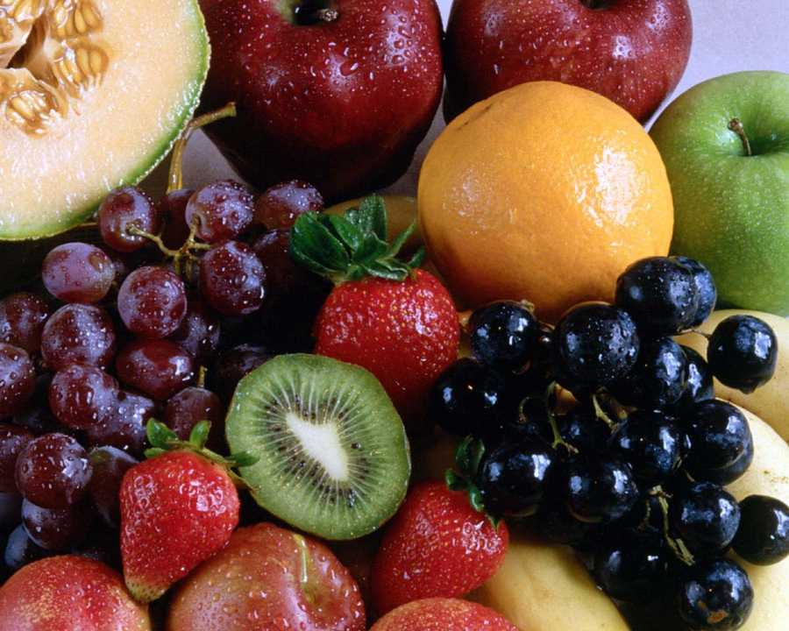
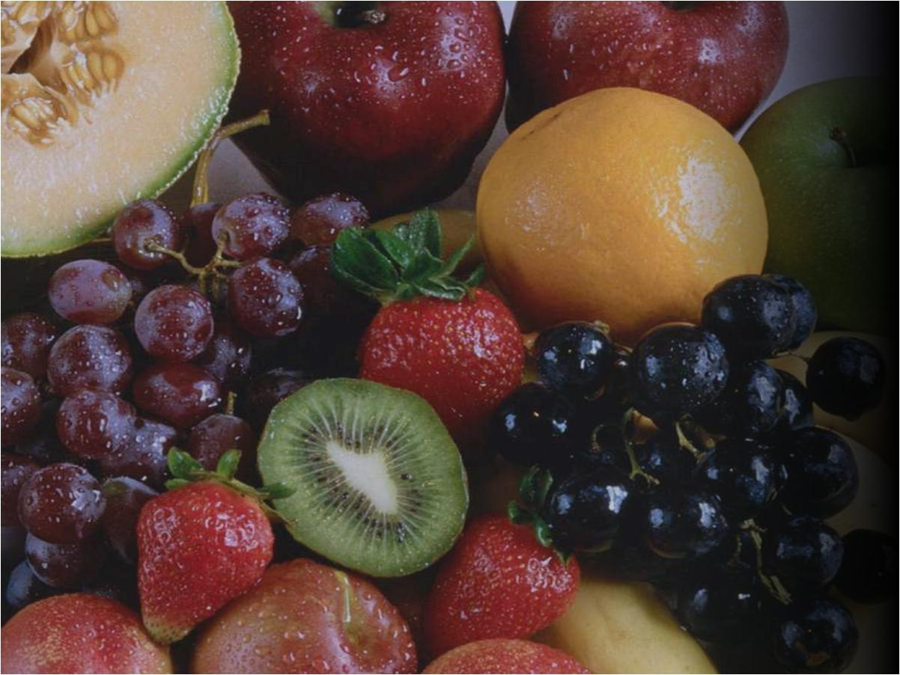
Cantaloupe: 54 %
Asparagus: 55 %
Honeydew: 73 %
Peaches: 76 %
Lettuce: 78 %
Dates: 82 %
Avocados: 84 %
Garlic: 86 %
Grapes: 88 %
Lemons: 89 %
Carrots: 89 %
Strawberries: 90 %
Broccoli: 93 %
Celery: 94 %
Nectarines: 93 %
Plums: 93 %
Tomatoes: 94 %
Apricots: 95 %
Pistachios: 96 %
Kiwi: 97 %
Figs: 98 %
Walnuts: 99 %
Almond: 99 %
Olives: 100 %
California –
America’s Fruit Basket
> 50% of US vegetables, fruits & nuts are California grown
Notes:
Source: California Department of Agriculture

Slide 14
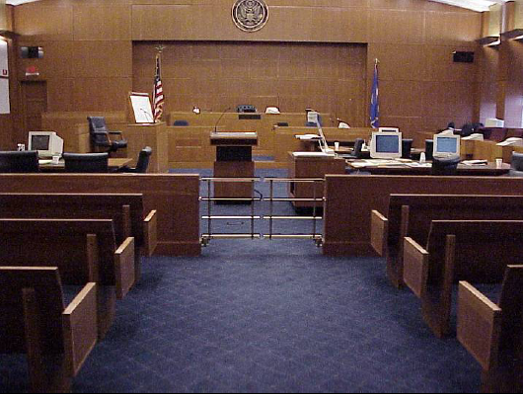
Impacts of Regulation
On California’s Water Supply
Up to 25-30% cutbacks
7 out of 10 years in drought conditions
Notes:
2008 impact = 670,000 acre-ft ( ~$201 million)
2009 impact = 619,000 acre-ft ( ~$186 million)
2010 impact = 1,043,000 acre-ft ( ~$313 million)
Smelt Bio Op = 20-33% cut annually
Salmon Bio Op = additional 10% cut

Slide 15

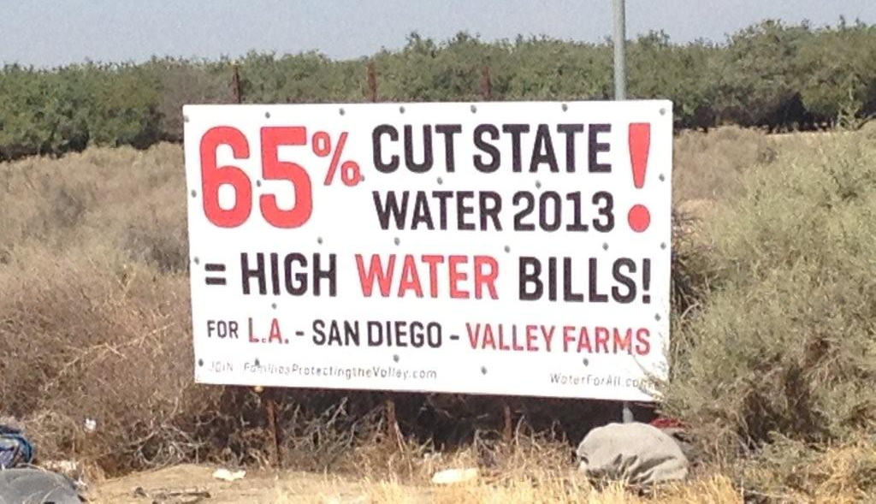
California Water Farm Coalition
Impacts of Water Cuts …
Notes:
Feb 2013 – Information produced by the California Farm Water Coalition (www.farmwater.org)
… the cause 228 Delta Smelt
Supply for 4.2 million homes
Non-Irrigated Acreage due to Water Cuts
260,000 acres = 406 square miles (i.e. an area of 20 mi. x 20 mi.)
8x the size of San Francisco
Washington DC = 68 sq. mi. (8 mi x 8 mi. square)
Las Vegas = 113 sq mi. (11 mi x 11 mi. square)
Sacramento = 97 sq mi. (10 mi x 10 mi. square)
Agency Population AF/YR
Sacramento (City) 450,000 145,600
Contra Costa WD 550,000 115,360
Alameda County 330,000 56,000
Zone 7 200,000 -
East Bay MUD 1,300,000 212,800
Santa Clara VWD 1,800,000 430,080
Los Angeles 4,000,000 693,728
San Francisco 770,000 302,400
MWDOC 1,440,000 358,400
San Diego (City) 1,300,000 235,200
Sub -- Bay Area 4,180,000 814,240
Sub -- So Cal 7,510,000 1,589,728
TOTAL 12,140,000 2,549,568

Slide 16
California Water Farm Coalition
Impacts of Water Cuts …
728,000 acre-feet lost
12,386 Ag Jobs Lost
Annual food supply for 726,000 people
260,000 acres non-irrigated (26x26 mi²)
50% of annual supply for …
Sacramento
+ San Francisco
+ Los Angeles
+ San Diego
Notes:
Feb 2013 – Information produced by the California Farm Water Coalition (www.farmwater.org)
… the cause 228 Delta Smelt
Supply for 4.2 million homes
Non-Irrigated Acreage due to Water Cuts
260,000 acres = 406 square miles (i.e. an area of 20 mi. x 20 mi.)
8x the size of San Francisco
Washington DC = 68 sq. mi. (8 mi x 8 mi. square)
Las Vegas = 113 sq mi. (11 mi x 11 mi. square)
Sacramento = 97 sq mi. (10 mi x 10 mi. square)
Agency Population AF/YR
Sacramento (City) 450,000 145,600
Contra Costa WD 550,000 115,360
Alameda County 330,000 56,000
Zone 7 200,000 -
East Bay MUD 1,300,000 212,800
Santa Clara VWD 1,800,000 430,080
Los Angeles 4,000,000 693,728
San Francisco 770,000 302,400
MWDOC 1,440,000 358,400
San Diego (City) 1,300,000 235,200
Sub -- Bay Area 4,180,000 814,240
Sub -- So Cal 7,510,000 1,589,728
TOTAL 12,140,000 2,549,568

Slide 17
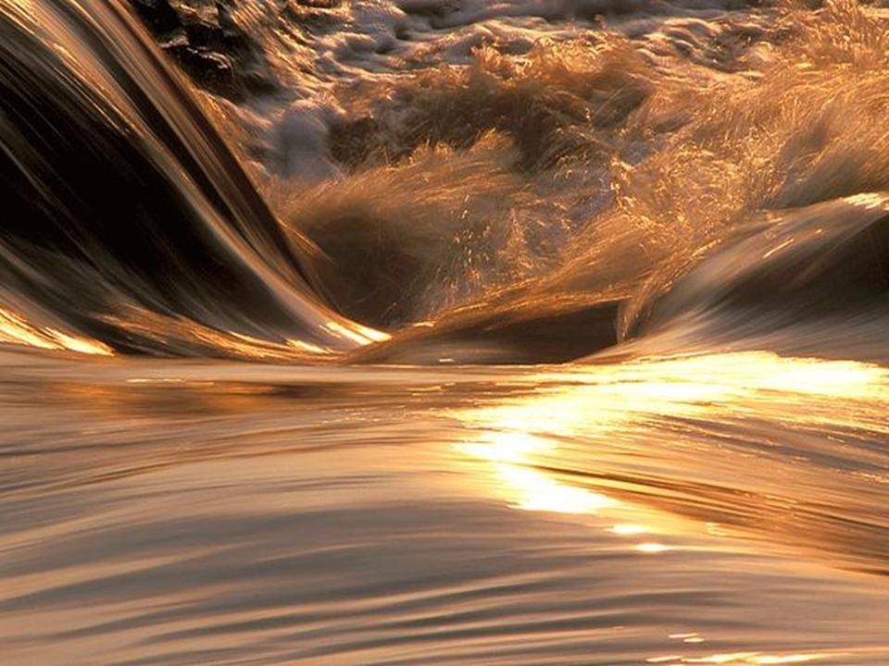
Bottom Line
Regulations will continue to impose supply restrictions during normal and dry years
Notes:
Regulatory cutbacks significantly lowers water supply
Increased pressure on storage reserves
Large withdrawals anticipated for 2009
Additional need for maintaining reserves for 2010
Likelihood of rationing in 2009
> 50% chance
Chances increase with ongoing dry conditions
Does not factor additional fisheries impacts

Slide 18
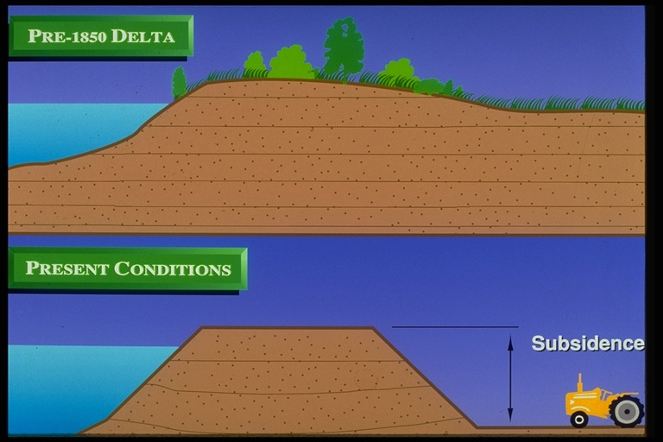

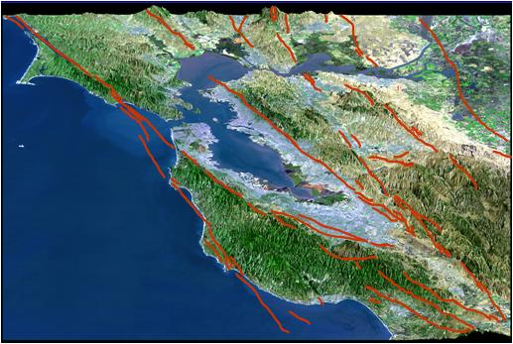
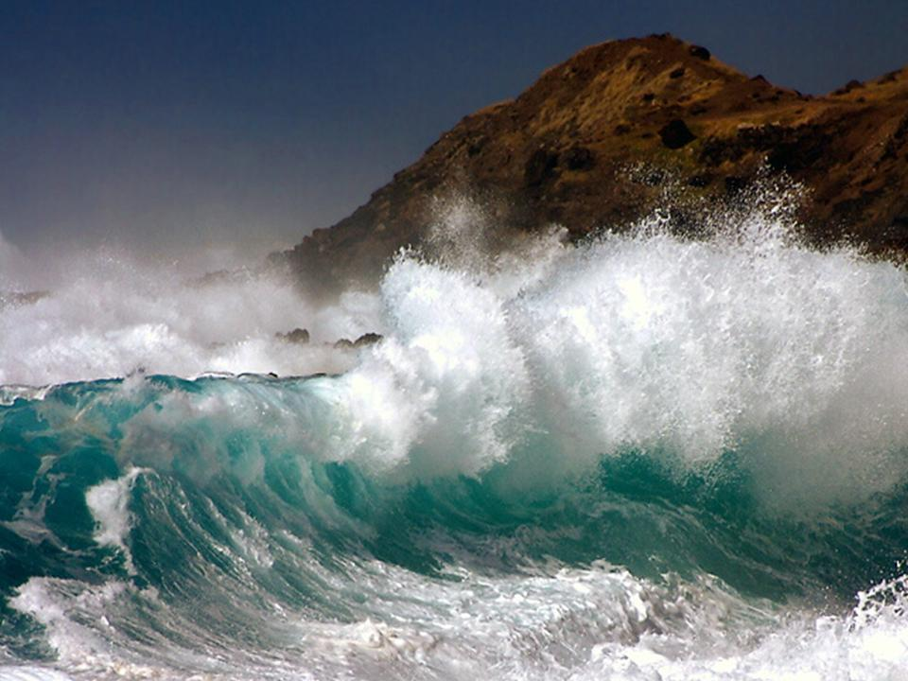
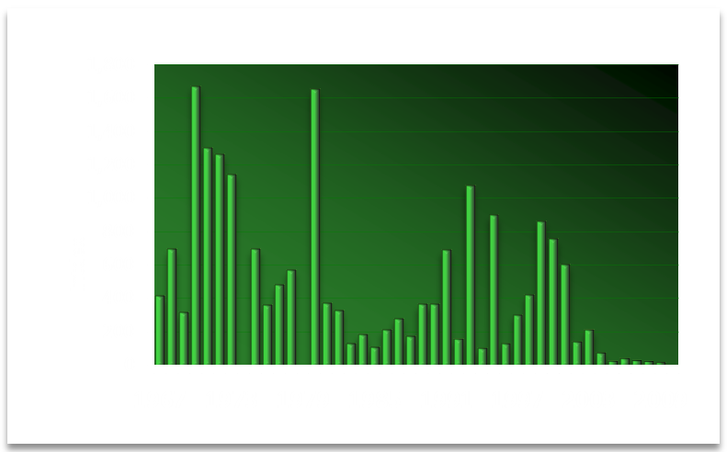
Key Delta Risks
Fishery Declines Delta smelt
Subsidence
Sea Level Rise
Seismic Risk
Bay Area Faults

Slide 19
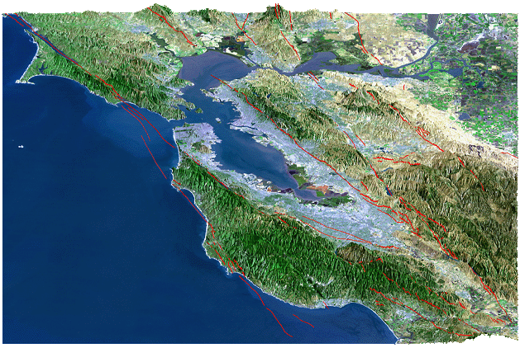
Seismic Vulnerability
Rodgers Crk
Concord
Vaca-Kirby
Midland
San Andreas
Antioch
Hayward
Greenville
San Gregorio
Calaveras
63% probability of > 6.5
magnitude earthquake by 2032
Bay-Delta Region Major Faults
Notes:
Seismic Vulnerability & Emergency Response Efforts
This information is from the State Department of Water Resources reports entitled Delta Risk Management Strategy Report (http://www.water.ca.gov/floodmgmt/dsmo/sab/drmsp/phase1_information.cfm) and Delta Seismic Risk Report (http://www.water.ca.gov/floodmgmt/dsmo/sab/drmsp/docs/Delta_Seismic_Risk_Report.pdf). These reports were prepared by DWR’s consultants including Jack Benjamin and Associates, Resource Management Associates, URS Corporation, and Economic Insights. Other information on seismic vulnerability is from the Public Policy Institute of California in their reports entitled “Envisioning Futures for the Sacramento-San Joaquin Delta” (http://www.ppic.org/main/publication.asp?i=671) and “California Water Myths” (http://www.ppic.org/main/publication.asp?i=890).
Additional information on the freshwater pathway emergency response approach was developed by the Metropolitan Water District in cooperation with the Department of Water Resources, the State Water Contractors, and the Central Valley Water Project Contractors.
__________________________________________
Background: DWR and USGS have identified a significant seismic risk to Delta life, property and services from nearby faults. Reports have articulated an unacceptable risk of wide spread liquefaction which could flood more than 30 islands that are currently well below sea level. As a result of quickly filling this large void, salt water from the San Francisco Bay will likely rush into the central and south Delta in a scene not too unlike the tsunami in northern Japan. While most subsided islands are sparsely populated, there could be significant loss of life on a few islands such as Bethel and Sherman Islands. In addition, this in-rush of salt water is likely to render major Delta water supplies unusable as a freshwater source for many years.
The south Delta is a significant component of the state’s water infrastructure, servicing two-thirds of California’s residents, which includes the Bay Area, Central Valley and Southern California. The Delta provides irrigation for 45% of the fruits and vegetables produced in the nation, as well as providing habitat for 500 species. Submerging many Delta islands would disrupt critical goods movement as well as natural gas and power transmission lines which traverse the Delta. In short, the Delta supports nearly half of California’s $1.6 trillion economy.
Emergency Response: In an approach to help insulate the Delta water supplies from such catastrophic events, State Water Contractor agencies have worked together with DWR and USACE staff to explore all options to preserve Delta water conveyance. Through extensive modeling and study, an emergency freshwater “Pathway” plan was formulated, which could be implemented following catastrophic multi-island failures from severe earthquake or flood events. The plan, which includes the use of existing Middle River levees, incorporates the ability to be implemented within a reasonable time-frame using cost-effective means; ensuring applicability under a full range of hydrologic and seismic conditions; minimizing reservoir releases as a means to neutralize salinity intrusion; and applying reasonable response priorities benefiting life and property.
Feasibility analyses indicate that pre-positioning of materials and equipment is a prudent way to reduce the time needed to restore critical water supplies, since many of the severe economic consequences of a Delta disaster are related to the duration of an outage. Therefore, in 2007, DWR stockpiled initial rock materials for emergency operations which would be supplemented from outside sources during emergency flood fight operations. Advance placement of additional emergency material stockpiles are in planning and implementation stages. In addition, MWD has performed geotechnical stability analyses of pathway levee and encouraged measures to reduce levee slumping and levee breach repair time along the freshwater Pathway. While the emergency preparedness plan cannot, nor was it designed to, provide a long-term solution for the Delta, it is nonetheless necessary to ensure that California is able to preserve an important portion of statewide water supplies following a catastrophic seismic event.
Research: DWR has installed 4 deep seismographic arrays in the Delta and Suisun Marsh. Each array has a deep seismograph installed at about 300-500 feet, another one installed beneath the peaty organic soils beneath the levee, another one installed above the peaty organic soil beneath the levee, and another one installed on the levee crown. DWR also has strong motion instruments at Clifton Court Forebay in the Delta, and at the Harvey O. Banks Delta Pumping Plant. In addition, DWR has sponsored research at U C Davis into the dynamic properties of organic soils and their abilities to amplify ground motions. This research indicates that the peaty organic soils appear to amplify low ground motions as was also found for San Francisco Bay mud.

Slide 20
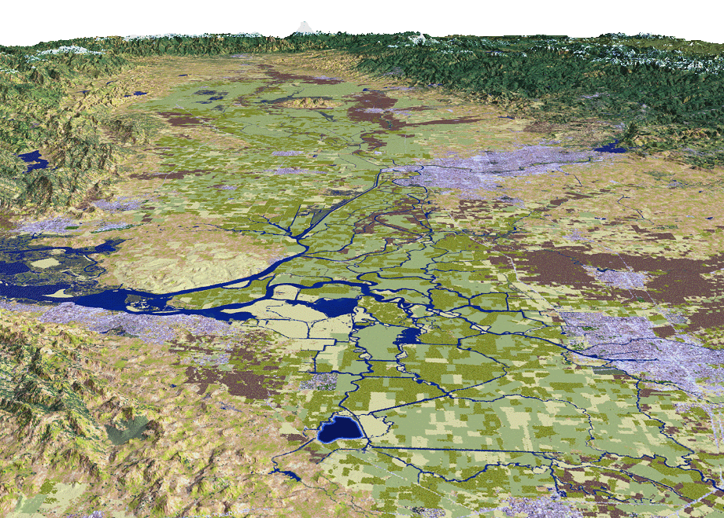
Seismic Vulnerability
Sac River
Sacramento
Vaca-Kirby
Midland
Stockton
Antioch
6.5 earthquake
SWP Pumps
50 levee breaks
CVP Pumps
20 islands flooded
20
Notes:
20

Slide 21
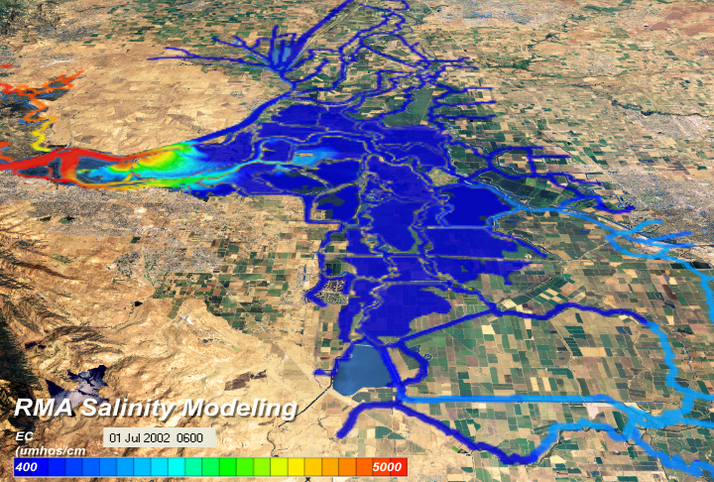
6.5 Magnitude Earthquake causing 20-island failure
Islands flood with fresh water
0 – 6 hours:

Slide 22
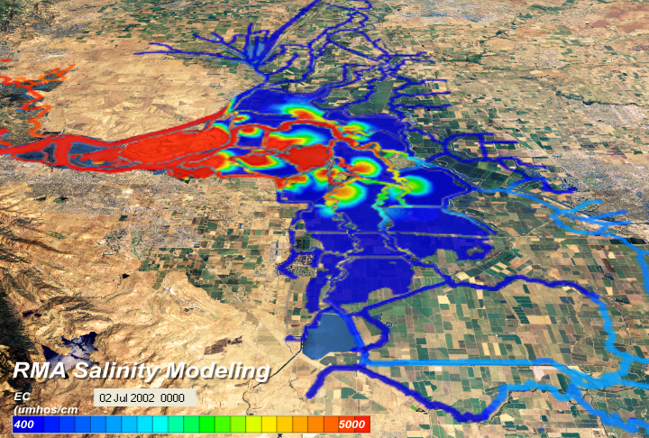
6.5 Magnitude Earthquake causing 20-island failure
Salt water intruding into Delta
12 – 24 hours:

Slide 23
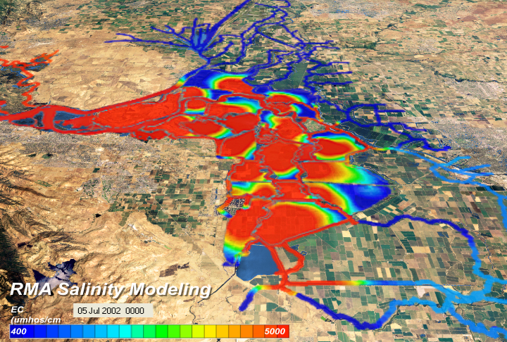
6.5 Magnitude Earthquake causing 20-island failure
Salt water throughout Delta
1 – 7 days:

Slide 24
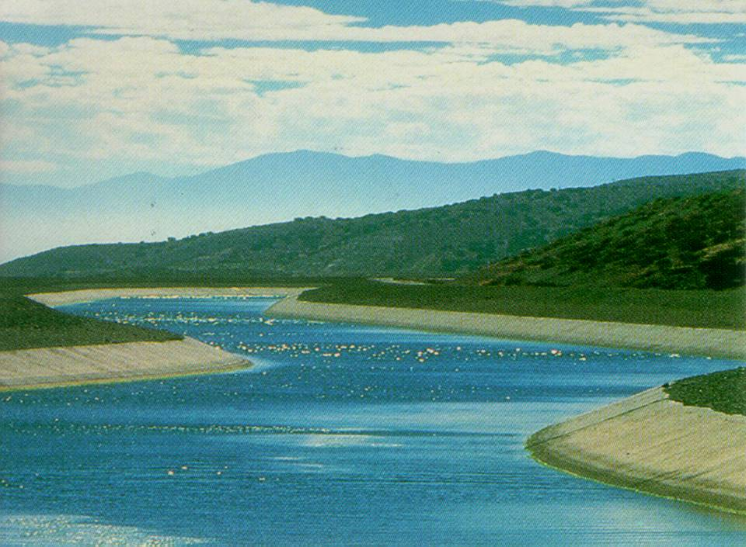
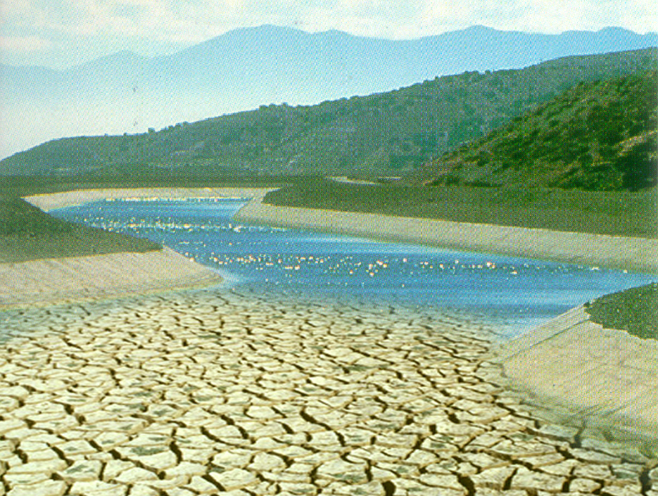
6.5 Magnitude Earthquake
Causing an estimated 1.5 to 3 year outage

Slide 25
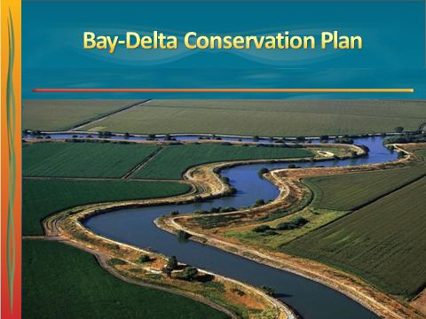
Bay-Delta Conservation Plan
Overview
Multi-species protection
Upfront regulatory assurances
Habitat conservation, conveyance improvements, and stressors control
Notes:
Supports co-equal goals of “Delta Vision”
Delta ecosystem restoration
Water supply reliability
Ecosystem Improvement
Comprehensive multi-species/ecosystem approach to endangered species protection
Habitat & flow improvements
Conveyance Improvements
Dual-intake approach
Other Stressors Control
Invasive species, toxics, unscreened diversions
Regulatory assurances
Long-term operations permit
Coverage for existing & future listed species
Future regulatory obligation defined upfront
Here is the main website for information related to development of a long-term solution in the Delta (http://baydeltaconservationplan.com/Home.aspx). The BDCP Working Draft, dated November 18, 2010, is a good (but long) document detailing elements of the plan. Due to the size of the document, it can be downloaded from the following link (http://baydeltaconservationplan.com/BDCPPlanningProcess/DocumentsAndDrafts.aspx).

Slide 26
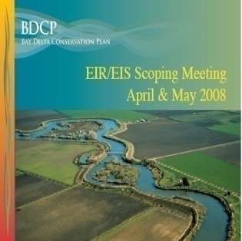
Bay-Delta Conservation Plan
Steering Committee
Bay-Delta Conservation Plan
Fed & State Agencies
  Cal Bay-Delta Authority
  The Resource Agency
  US Bureau of Reclamation
  Cal. Dept. of Water Resources
  State Water Res. Control Board
  US Corps of Engineers
Fish Agencies
  Cal Dept. of Fish & Game
  US Fish & Wildlife Service
  National Marine Fisheries Service
Other Organizations
  Cal Farm Bureau Federation
  Mirant Delta
Water Agencies
  Contra Costa Water District
  Kern County Water Agency
  Metropolitan Water District
  North Delta Water Agency
  San Luis & Delta Mendota WA
  Santa Clara Valley Water Dist.
  Westlands Water District
  Zone 7 Water Agency
Environmental Org.
  American Rivers
  Defenders of Wildlife
  Environmental Defense
  Natural Heritage Institute
  The Bay Institute
  The Nature Conservancy

Slide 27
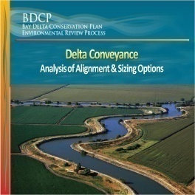
Bay-Delta Conservation Plan
Conveyance Options
Sac River
Sacramento
West Canal
East Canal
Tunnels
Stockton
SJ River
SWP Pumps
CVP Pumps
Preliminary Subject to Revision
27
Notes:
27
Here is the main website for information related to development of a long-term solution in the Delta (http://baydeltaconservationplan.com/Home.aspx). The BDCP Working Draft, dated November 18, 2010, is a good (but long) document detailing elements of the plan. Due to the size of the document, it can be downloaded from the following link (http://baydeltaconservationplan.com/BDCPPlanningProcess/DocumentsAndDrafts.aspx).

Slide 28
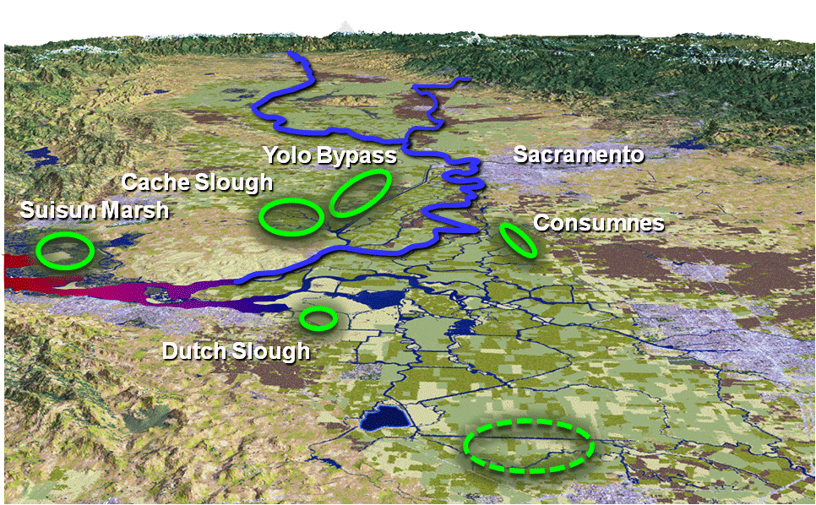



Ecosystem Restoration & Preservation
Restoration & Preservation | Targets
New Floodplain | 10,000 acres
Tidal Habitat | 65,000 acres
Channel Margin | 20 levee miles
Riparian | 5,000 acres
Grassland | 10,000 acres
Other Habitats | 5,000 acres
Managed Wetlands | 6,500 acres
Cultivated Lands | ~45,000 acres
Enhanced Yolo Bypass floodplain habitat
TOTAL | Up to 145,000 acres
Biological goals/objectives for 57 species
Accelerated habitat restoration
Notes:
Public funding 2010 bond (SB 1) has $1.5 bilion; Prop 1e has money for river channel margin
Restoration Target: 145,000 acres = 227 square miles (or approx. 15 miles by 15 miles square)
Washington DC = 68 sq. mi. (8 mi x 8 mi. square)
Las Vegas = 113 sq mi. (11 mi x 11 mi. square)
Sacramento = 97 sq mi. (10 mi x 10 mi. square)
Los Angeles = 469 sq. mi.
San Diego =
Long Beach = 50 sq. mi.
Glendale = 30 sq. mi
Pomona = 23 sq. mi.
Santa Clarita
Manhattan (NY) = 23 sq mi.
Restoration Targets Yr 10 Yr 15 Yr 40
Tidal Marsh 14,000 25,000 65,000 acres
Seasonal Floodplain 0 1,000 10,000 acres
Riparian Habitat 1,300 2,300 5,000 acres
TOTAL 15,300 28,300 80,000
Preservation Targets: 41,340 acres (22,202 ac within 10 years)
Info from the BDCP Working Draft, Nov 18, 2010 (http://baydeltaconservationplan.com/BDCPPlanningProcess/DocumentsAndDrafts.aspx).
Restoration & Preservation Targets
Tidal Marsh 65,000 ac
Seasonal Floodplain 10,000 ac
Riparian Habitat 5,000 ac
River Channel Margin 20 mi
Grassland 10,000 ac
Wetlands & Vernal Pools 1,300 ac
Agricultural Habitat 16,620 - 32,640 ac
TOTAL Acres 108,000 - 124,000

Slide 29

Ecosystem Restoration & Preservation
Restoration & Preservation | Targets
New Floodplain | 10,000 acres
Tidal Habitat | 65,000 acres
Channel Margin | 20 levee miles
Riparian | 5,000 acres
Grassland | 10,000 acres
Other Habitats | 5,000 acres
Managed Wetlands | 6,500 acres
Cultivated Lands | ~45,000 acres
Enhanced Yolo Bypass floodplain habitat
TOTAL | Up to 145,000 acres
Biological goals/objectives for 57 species
Accelerated habitat restoration
Habitat Restoration Size Comparison = 145,000 acre or 227 sq. miles
Notes:
Restoration Target: 145,000 acres = 227 square miles (or approx. 15 miles by 15 miles square)
Washington DC = 68 sq. mi. (8 mi x 8 mi. square)
Las Vegas = 113 sq mi. (11 mi x 11 mi. square)
Sacramento = 97 sq mi. (10 mi x 10 mi. square)
Los Angeles = 469 sq. mi.
San Diego = 372 sq. mi.
Long Beach = 50 sq. mi.
Glendale = 30 sq. mi
Pomona = 23 sq. mi.
Manhattan (NY) = 23 sq mi.
Public funding 2010 bond (SB 1) has $1.5 bilion; Prop 1e has money for river channel margin

Slide 30





Reducing Environmental Stressors
Toxic pollutants, Invasive Species, etc.
Pollutants
Sacramento
Sac River
Predator Control
Ammonia
Invasive Species
(Corbula amurensis clam)
Stockton
Illegal Poaching
Hatchery Practices
Notes:
30
Other Environmental Stressors (not listed)
Ocean Conditions
Food Web (Nitrogen vs Phosphorous)
Unscreened diversionsw

Slide 31

Bay Delta Joint Recommendation
Announced July 25, 2012
Gov Brown & Obama Admin Outline Path Forward for Bay Delta Conservation Plan
John Laird, California Secretary for Natural Resources
Jerry Brown, California Governor
Ken Salazar, United States Secretary of the Interior
Eric Schwaab, Assistant Administrator, NOAA Fisheries (not pictured)

Slide 32

Bay-Delta Joint Recommendation
“…big idea for a big state…”

Slide 33

Bay-Delta Joint Recommendation
“… analysis paralysis is not why I came back”
33

Slide 34
Bay-Delta Conservation Plan
Preliminary Cost Analysis
Improvements | Capital | O&M (Total 50 Years) | Funding Source
Conveyance | $14.5 billion | $1.5 billion | Water Contractors
Eco-Restoration & Other Stressors | $5.2 billion | $3.3 billion | Fed/State/Water Contractors/Other
TOTAL Capital/O&M | $19.7 billion | $4.8 billion
TOTAL BDCP | $24.5 billion
Users pay for new conveyance facility & mitigation
Beneficiaries pay for habitat conservation & state-wide benefits
$5 - 6/month per household for Southern Californians
Metropolitan’s share is approximately 25 percent
Estimated costs from BDCP Administrative Draft Chapter 8 (May 2013) in undiscounted 2012 dollars.
34
Notes:
BDCP ADMIN DRAFT PAGE 8-14
Table 8‐7. Cost 1 Estimate for Water Facility Construction
Capital $14.50b
O&M $1.456b
BDCP ADMIN DRAFT PAGE 8-69
Table 8‐37. Undiscounted Capital Costs by Plan Implementation Phase and Element
CM1 $14.509
CM 2-22 $5.084b
Changed Circumstances and $0.3199
EIR/EIS migration measures not counted elsewhere)
BDCP ADMIN DRAFT PAGE 8-70
Table 8‐38. Undiscounted O&M 1 Costs by Plan Implementation Phase and Element
Conveyance CM 1 $1.456 0b
CM 2-22 only those elements with O&M costs $2.0683 b
Administration, monitoring and research $1.2497 b

Slide 35
A Sustainable Future …
Commitment to Local & Delta Improvements
$700 -
3,500+/AF
$1,600 -
3,500+/AF
$600 -
2,600/AF
$1,600 -
2,300/AF
Local Supply Avg. ~ $1,500/AF
Metropolitan’s Water Rate (Tier 1 - Treated) ~ $850/AF
Ranges based on representative sample of existing and future projects within Metropolitan’s service area.
Costs may vary for end-users due to local retailer delivery costs.
35

Slide 36
MWD Water Supply Strategy
“Average” Year Water Supply – 1990 vs. 2035
Conservation & Recycling
(7%)
Colorado (14%)
Colorado (27%)
Conservation & Recycling
(33%)
Local Supply (34%)
State WP (22%)
State WP (33%)
Local Supply (31%)
Yr. 1990 – 41% Local
Yr. 2035 – 64% Local
Heavy dependence on
imported supplies
Emphasis on conservation, recycling, & local supplies

Slide 37




What is the Per-Capita Cost of
Other Supply Improvement Projects?
* Per-Capita Cost = Total Capital Cost / Population Served
37
Notes:
Project Cost /AF Capital Cost/AF Cost Share Total Cost Deliveries Population Served
San Francisco $ ___ /AF $ 18,400 /AF $ 4,600,000,000 $ 4,600,000,000 250,000 AF/Yr 2,400,000
East Bay $ ___/AF $ 26,606 /AF $ 439,000,000 $ 900,000,000 16,500 AF/Yr 1,400,000
Delta - MWD $ ___/AF $ 2,190 /AF $ 3,422,650,000 $ 12,700,000,000 1,562,000 AF/Yr 19,000,000
EBMUD
*Annual delivery from this project is unknown and based on hydrology: However, EBMUD has stated an expected need for Freeport in only three out of every 10 years and has a contract limiting withdrawals to no more than 165,000 over a three-year period. That extrapolates to an average delivery of 16,500 a year.
(EBMUD source of estimating need for Freeport water three out of every 10 years
ftp://ftpdpla.water.ca.gov/users/prop50/10018_RWA/Project%2001%20-%20Freeport%20Regional%20Water%20Project-FRWA/07.%20Freeport%20FINAL%20BROCHURE%2010%2019%2005.pdf
EBMUD’s contract with Bureau limits Freeport withdrawals to no more than 165,000 over a three-year period. Some details in new draft UWMP.
http://www.ebmud.com/sites/default/files/pdfs/UWMP-2010-Revised-draft-web.pdf)
Official cost for EBMUD is $439 million ( this includes treatment, it appears)
http://www.msa.saccounty.net/scwa/news/20020214%20Sac%20&%20East%20Bay%20Partnership.pdf
SFPUC
Source materials: Annual deliveries: Approx 250,000 a/f (http://www.bayeconfor.org/pdf/hetchhetchyfinal2.pdf)
Upgrade Cost: Approx $4.6 billion (no information on costs could be found on SFPUC web site)
http://www.bizjournals.com/sanfrancisco/stories/2010/07/26/focus1.html

Slide 38

Groundwater Benefits
Sylmar
Las Posas
East San
Fernando
Verdugo
Raymond
Six Basins
Cuchamonga
Main
San Gabriel
Chino
San Jacinto
Orange
County
Upper San Juan
Elsinore
San Mateo & San Onofre
Warner Valley
State Water Project provides high quality water essential for blending with other sources and developing local resource programs
38
Notes:
Supply Salt (TDS mg/l) Salt (Lbs / acre ft)
Colorado River ~ 500 to 700 mg/l 1,360 to 1,900 lbs/af
Bay Delta (current) ~ 300 mg/l 700 lbs/af
Bay Delta (new conveyance) ~ 200 mg/l 470 lbs/af
Objectives
Improve export quality to meet Public Health standards & reduce treatment costs
Support actions to minimize salinity imports
Meet 500 mg/l blending goal
Some Basin Plans have low TDS objectives that could restrict extended recharge of high salinity Colorado River water *
Salinity Management Policy (Board Policy March 1999)
Protect imported quality and seek salinity reductions
Establish total dissolved solids objective of < 500 (mg/L)
Optimize the long-term use of Colorado River water in conjunction with State Water Project supplies
Make the Salinity Management Action Plan the primary strategy to carry out this policy
Support actions to minimize salinity imports to enhance groundwater and recycled water programs
Regional Board Basin Plans have TDS water quality objectives for groundwater. Raymond and Main San Gabriel Basins objectives are at 450 mg/L TDS, the eastern portions of San Fernando Basin range from 400 to 600 mg/L. Some parts of Chino Basin have TDS objectives in the 200-300 mg/L range. Central Basin is higher at 700 mg/L. Orange Co Basin is 580 mg/L.

Slide 39
The Risk of Doing Nothing …
Continued Decline in Delta Water Supplies
South Delta Intake
MWD share ~ 25%
Minimal exports 1.5 to 3 years after earthquake
1.0 - 1.5
SWP & CVP Water Supply Analysis in 2025
Notes:
Status Quo
Ecosystem decline
Pumping restrictions (supply reduced 30%)
Major Levee Failure
Up to three-year disruption of water deliveries
$40 billion estimated impact to California’s economy

Slide 40

The Risk of Doing Nothing …
San Luis Reservoir will Rarely Fill
NRDC = Natural Resource Defense Council

Slide 41
BDCP Project Schedule
Draft BDCP & EIR/EIS Oct 1, 2013
Final BDCP and ROD Spring 2014
Habitat Restoration 2010-2050
Tunnel Construction 2016-2026

Slide 42
What can you do?
Distribute informational materials
Host a briefing
  Contacts to request a speaker on BDCP for your group
  Ann Newton: 818-760-2121 at Southern California Water Committee
  Nathan Purkiss: 213-217-6323 at Metropolitan Water District
Publish a newsletter article
Post BDCP video on website, social media platforms
Submit letters to the editor, op-eds
Notes:
You can be part of the solution by
Being Informed ...
Knowing the Facts ...
Getting Involved ...
The Future of the state and one of the largest economies in the world depends on It.
Distribute BDCP informational materials to your membership
Latest News: http://baydeltaconservationplan.com/News/News.aspx
Background Fact Sheet: http://baydeltaconservationplan.com/Libraries/Dynamic_Document_Library/BDCP_Overview_Brochure_3-14-13.sflb.ashx
Host a briefing for your leadership and/or members on BDCP
Contacts to request a speaker on BDCP for your group
Ann Newton: 818-760-2121 at Southern California Water Committee
Nathan Purkiss: 213-217-6323 at Metropolitan Water District
Publish a newsletter article in your organization’s newsletter
Post BDCP video on website, social media platforms
http://www.youtube.com/watch?v=LkEzTuxVCyA
Submit letters to the editor, op-eds to local news outlets

Slide 43

Randall D. Neudeck
(213) 709-1303
rneudeck@mwdh2o.com
The Delta
Sacramento
Suisun Bay
Stockton
State & Federal Pumping Plants

