Slide 1

Water is jobs
Water is crops
Water is life
California’s Water Crisis
Developing Solutions

Slide 2
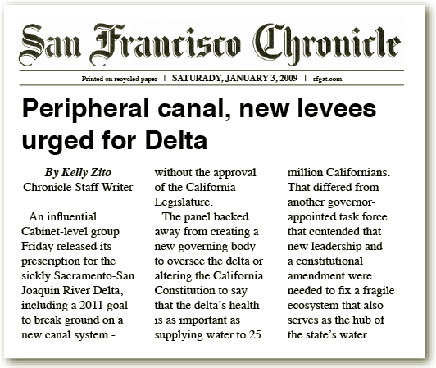
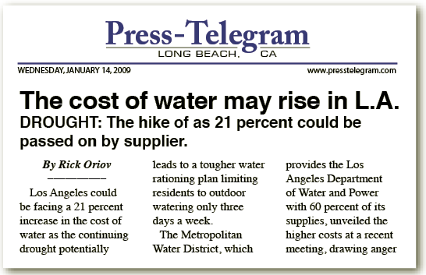
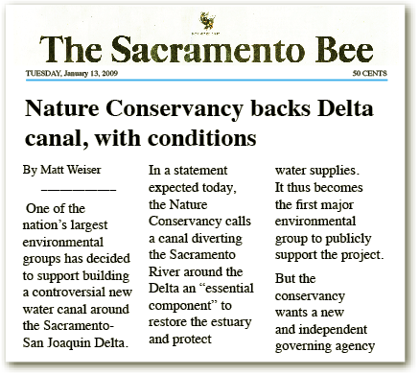
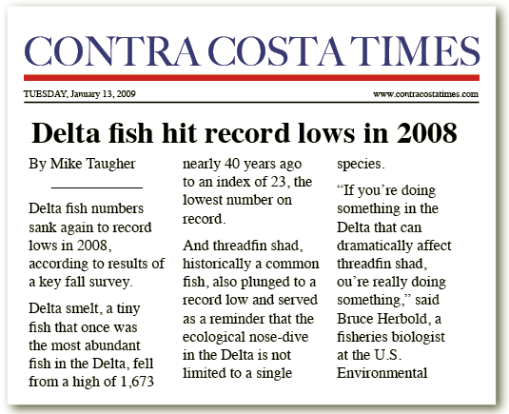
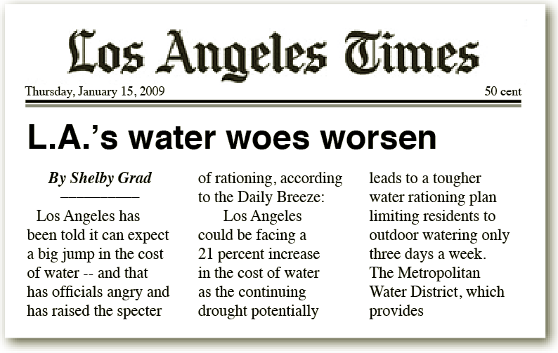
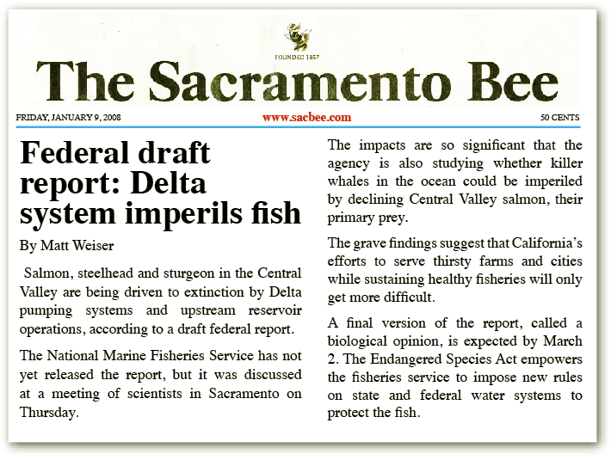
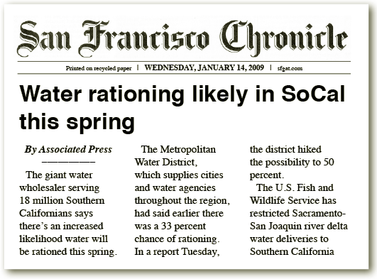
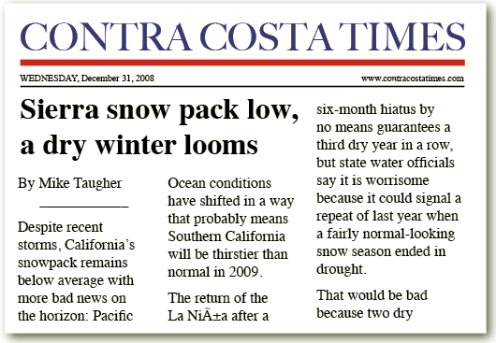
Newpaper Headlines

Slide 3
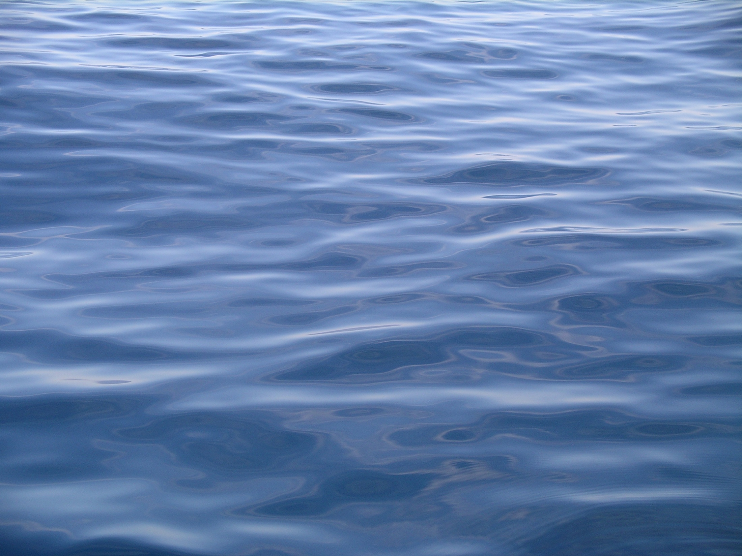
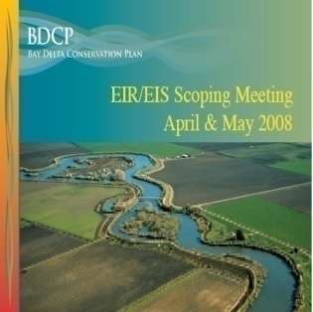
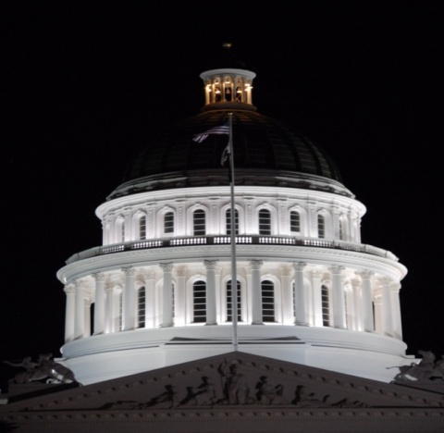


Delta Improvement Strategy
Resource/Regulatory Strategy
  Near-Term Measures
  Bay-Delta Conservation Plan
Bay-Delta Conservation Plan
Legislative Framework
  Delta policy bills
  Bond measure
Notes:
Two-Pronged Approach

Slide 4
Resource/Regulatory Strategy
Bay-Delta Conservation Plan
Bay-Delta Conservation Plan
Supports co-equal goals of “Delta Vision”
  Delta ecosystem restoration
  Water supply reliability
Ecosystem Improvement
  Comprehensive multi-species/ecosystem approach
  Habitat & flow improvements
Conveyance Improvements
  Dual-intake approach
Other Stressors Control
  Invasive species, toxics, unscreened diversions

Slide 5
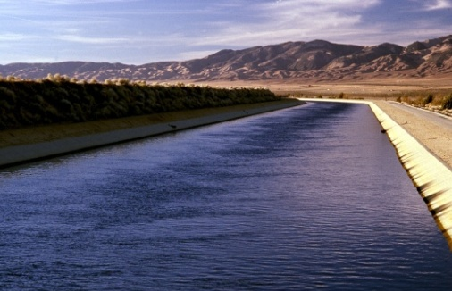
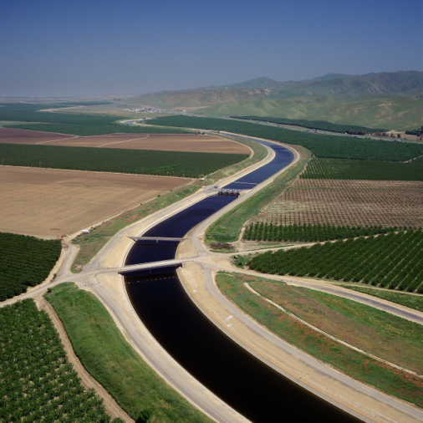
Bay-Delta Conservation Plan
Questions Everyone Wants Answers to
Bay-Delta Conservation Plan
What will the project look like?
  Where is the project?
  How would it operate?
What will it cost?
  How do we finance the costs?
  How do we split the costs?
What are the benefits & risks?
  What size should the project be?
  What can be delivered with new conveyance?
  What can be delivered without?
Notes:
There are three primary questions that we are continually asked by our policy people. They are:
What will a new conveyance facility cost me?
What will I get for my money?
What if I can’t afford to participate or others can’t afford, what can I expect in terms of future water supply and costs?

Slide 6
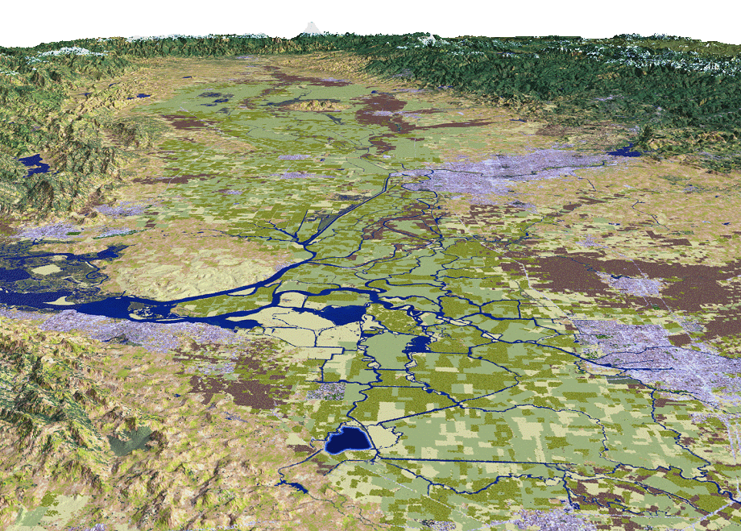

Bay-Delta Conservation Plan
Thru-Delta Conveyance
Bay-Delta Conservation Plan
Conveyance Options
Two 3,000 cfs
intakes, screens, pumps
Sac River
Sacramento
66 mi. existing levee retrofit
12 mi. open canal
9 to 11 operable barriers
2 tunnels (4.5 mi. length)
Stockton
New fish salvage facility
SWP Pumps
SJ River
CVP Pumps
6
Notes:
6

Slide 7
Bay-Delta Conservation Plan
Dual-Conveyance − East Alignment
Five 3,000 cfs
intakes, screens, pumps
Sac River
Sacramento
40 mi. open canal
8 siphons; Pump #6
4 tunnels under rivers;
2.2 mi. total length
Additional forebay
Stockton
SWP Pumps
SJ River
CVP Pumps
7
Notes:
7
EAST-SIDE ALIGNMENT OPTION
Washington Group International report to SWC to answer due diligence questions regarding cost of project & other ROW questions Facility studied = 15,000 cfs
Pumping plant = 15 ft lift (indicated by yellow triangle on map located near intake)
Canal length = 46 mi
Inverted Siphons under streams/rivers = 11 crossings
Estimated construction costs (2006 dollars) = $3.3 to 3.7 billion (includes 30% contingences and 35% planning, design, legal & project mgmt. costs)
Intake screens = $25,000 per cfs or $1.3 billion
Peat soil depth = 0 to 10 ft.; this will require removal, dewatering, and replacement
Bottom Width = 340 ft (at 15,000 cfs); 140 ft. (at 10,000 cfs)
Top Width = 500 to 700 ft.
Overall Width = 1000 ft includes maintenance roads, etc.
Design velocity = 1.6 fps
Siphons = 11; Box culvert for 15,000 cfs = 6 boxes at 30’x30’ (2,500 cfs each box)
Existing levee improvement costs = $5 to 90 million per mile; Excavation of peat over 20’ depth (requiring soil mixing) costs $90 million/mile
Land costs in secondary zone estimated at $50,000 to $200,000 per acre
Land costs in primary zone estimated at $7,000 per acre
Urban levee standards (200 yr level of protection) = $13-36 million per mile
Delta levees are designed for overtopping & seepage, not earthquake

Slide 8
Bay-Delta Conservation Plan
Dual-Conveyance − West Alignment
Five 3,000 cfs
intakes, screens, pumps
Sac River
Sacramento
28 mi. open canal;
12 siphons
Pumping plant #6
Two 17 mi. tunnels
(37 ft. diameter)
10 mi. open canal
Stockton
Addl. forebay
SWP Pumps
SJ River
CVP Pumps
8
Notes:
8
WEST-SIDE ALIGNMENT OPTION
Washington Group International report to SWC to answer due diligence questions regarding cost of project & other ROW questions Facility studied = 15,000 cfs
Pumping plant = 15 ft lift; located near intake
Pipeline from intake to siphon under Sac & SJ Rivers = 10 miles length
Open channel from Franks Tract to Clifton Court Forebay = 27 miles length
Overall Canal length = 4X mi
Inverted Siphons under streams/rivers = 4 crossings (including tunnel under Sac & SJ)
Estimated construction costs (2006 dollars) = $6.4 to 7.5 billion (includes 30% general contingences and 35% planning, design, legal & project mgmt. costs)
Long tunnel cost = $2.3 B (13 miles) ; short tunnel cost = 1.4 billion (8 miles); soft soil tunneling by TBM
Intake screens = $25,000 per cfs or $1.3 billion
Peat soil depth = 0 to 10 ft.; this will require removal, dewatering, and replacement
Bottom Width = 340 ft (at 15,000 cfs); 140 ft. (at 10,000 cfs)
Top Width = 500 to 700 ft.
Overall Width = 1000 ft includes maintenance roads, etc.
Design velocity = 1.6 fps
Box culvert for 15,000 cfs = 6 boxes at 30’x30’ (2,500 cfs each box)
Existing levee improvement costs = $5 to 90 million per mile; Excavation of peat over 20’ depth (requiring soil mixing) costs $90 million/mile
Land costs in secondary zone estimated at $50,000 to $200,000 per acre
Land costs in primary zone estimated at $7,000 per acre
Urban levee standards (200 yr level of protection) = $13-36 million per mile
Delta levees are designed for overtopping & seepage, not earthquake

Slide 9
Bay-Delta Conservation Plan
Dual-Conveyance − Central Tunnel
Five 3,000 cfs
intakes, screens, pumps
Sac River
Sacramento
Regulating forebay
(18,000 acres)
Pumping plant #6
Two 35 mi. tunnels
(37 ft diameter)
Stockton
Additional forebay
SWP Pumps
SJ River
CVP Pumps
9
Notes:
9

Slide 10
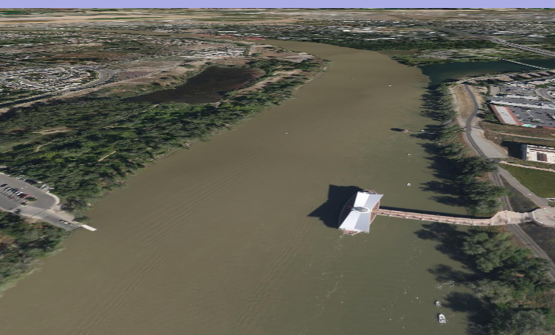
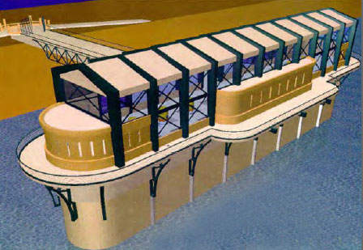
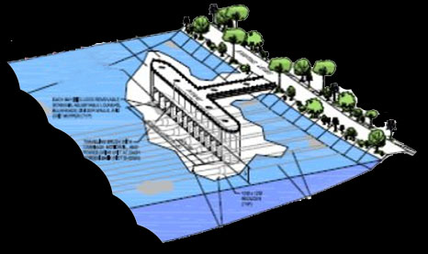
Bay-Delta Conservation Plan
Dual-Conveyance − Intake Options
Sac River
Sacramento
In-River Screen Option
Stockton
SWP Pumps
SJ River
CVP Pumps
10
Notes:
10
BDCP is looking at four basic ways of moving water supplies around, under or through the Delta to avoid the conflicts with fish. There are two peripheral canals under investigation, the traditional route along the eastern Delta and an alternate to the west. There is also serious consideration of a tunnel from the northern Delta to the existing water projects to the south. Construction costs may be higher but may prove more benign from an environmental perspective given its lessened footprint. There is also a look at how to continue to move water through the Delta. BDCP will have to exhaustively look at a variety of alternatives to meet legal requirements for a thorough environmental review.

Slide 11
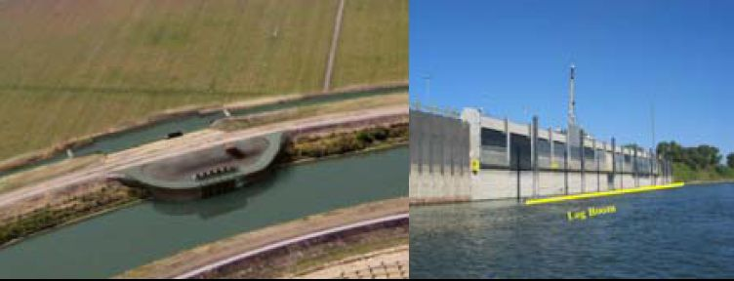
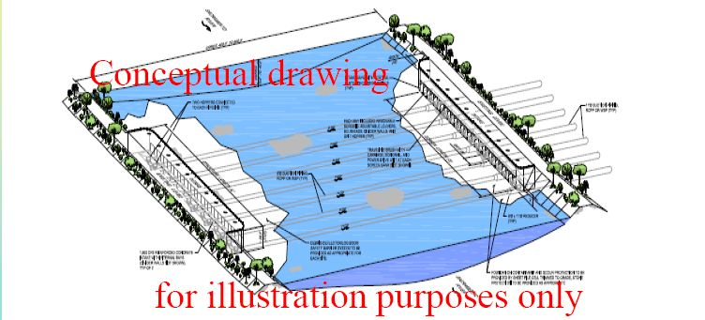
Bay-Delta Conservation Plan
Dual-Conveyance − Intake Options
Sac River
Sacramento
On-Bank Screen Option
Stockton
SWP Pumps
SJ River
CVP Pumps
11
Notes:
11

Slide 12
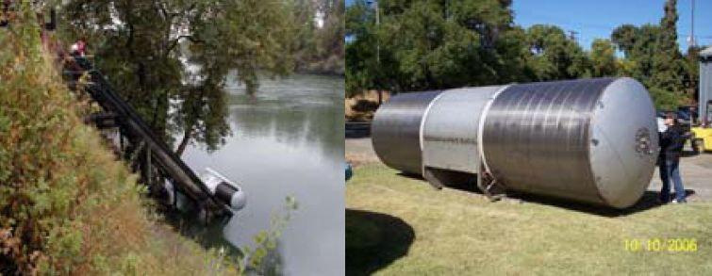
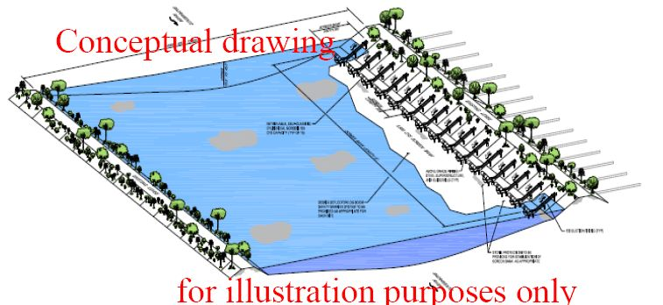
Bay-Delta Conservation Plan
Dual-Conveyance − Intake Options
Sac River
Sacramento
Cylindrical Screen Option
Stockton
SWP Pumps
SJ River
CVP Pumps
12
Notes:
12

Slide 13
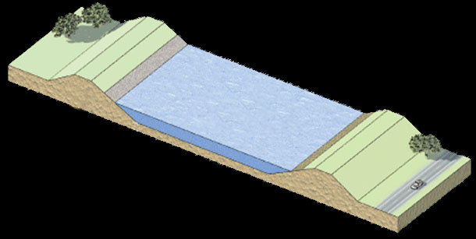
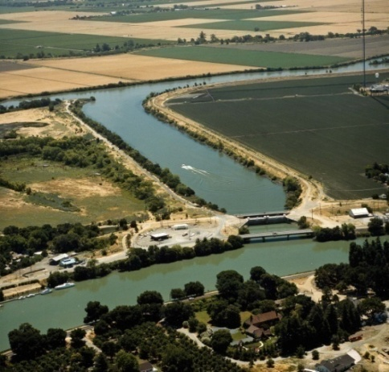
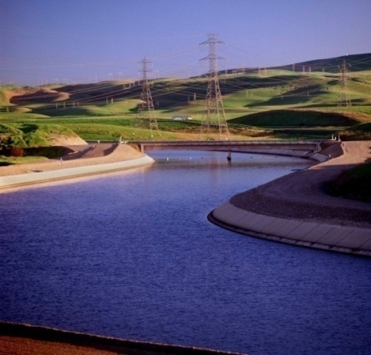
Bay-Delta Conservation Plan
Open Canal Proposal
700 ft.
~24 ft. depth
1,400 ft.
Levees
Up to 35 ft high
Delta Cross Channel
(500’ wide x 15’ deep)
California Aqueduct
(200’ wide x 30’ deep)
Notes:
Note: Delta Cross channel is 370 ft wide at water level; 500 ft at top of levee;
Cal Aqueduct is 110 ft wide at water level; 200 ft wide at top of levee
Unlined = 1.6 fps
SWP lined = xx fps

Slide 14
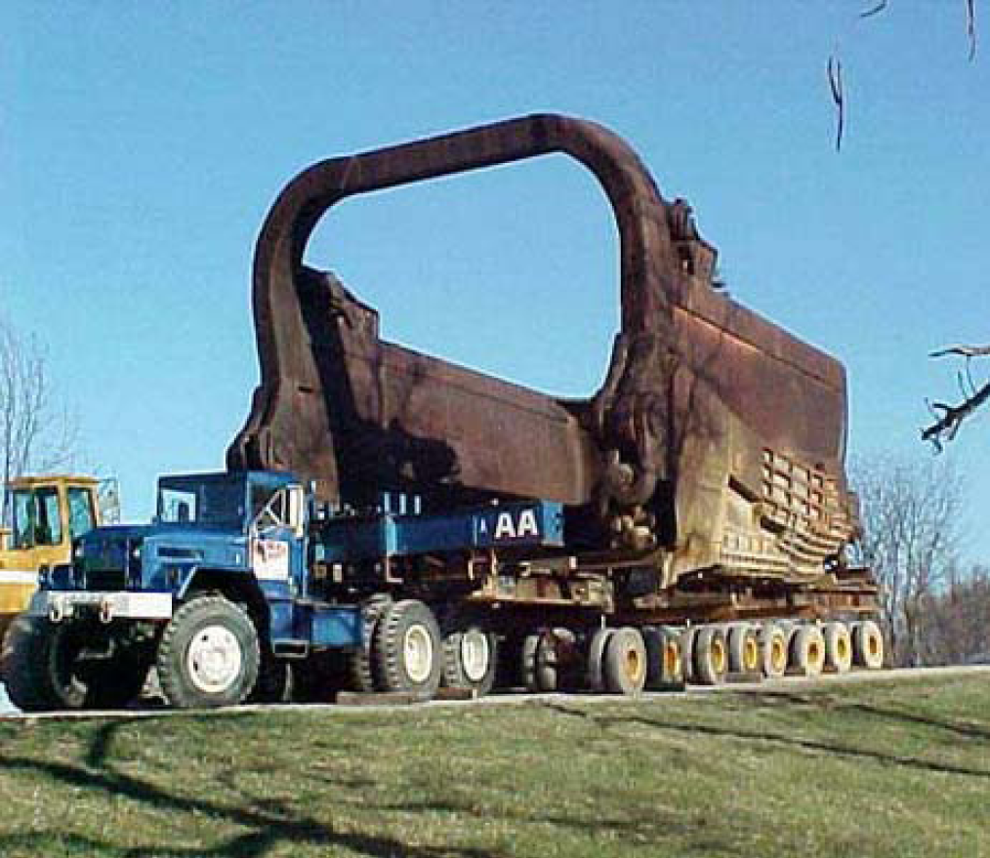
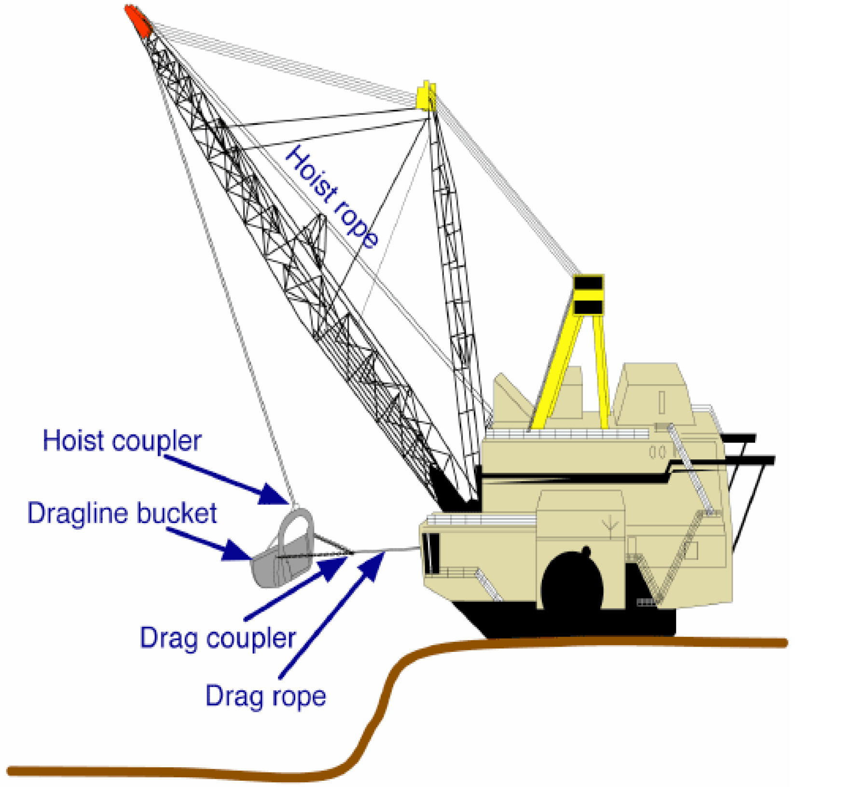
Canal Dredging
Walking Dragline

Slide 15
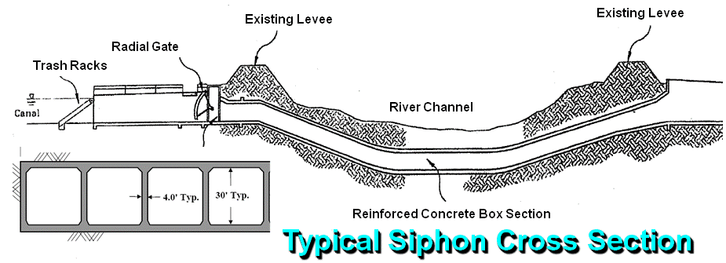
Siphon Section
River
Isolated Facility
182 ft.
4.0’
26'
4.0’
26'
30'
30'
34 ft.
Notes:
EAST-SIDE ALIGNMENT OPTION
Washington Group International report to SWC to answer due diligence questions regarding cost of project & other ROW questions Facility studied = 15,000 cfs
Pumping plant = 15 ft lift; located midway down the canal, near Disappointment Slough
Canal length = 46 mi
Inverted Siphons under streams/rivers = 11 crossings
Estimated construction costs (2006 dollars) = $3.3 to 3.7 billion (includes 30% contingences and 35% planning, design, legal & project mgmt. costs)
Peat soil depth = 0 to 10 ft.; this will require removal, dewatering, and replacement
Bottom Width = 340 ft (at 15,000 cfs); 140 ft. (at 10,000 cfs)
Top Width = 500 to 700 ft.
Overall Width = 1000 ft includes maintenance roads, etc.
Design velocity = 1.6 fps
Siphons = 11; Box culvert for 15,000 cfs = 6 boxes at 30’x30’ (2,500 cfs each box)
Existing levee improvement costs = $5 to 90 million per mile; Excavation of peat over 20’ depth (requiring soil mixing) costs $90 million/mile
Land costs in secondary zone estimated at $50,000 to $200,000 per acre
Land costs in primary zone estimated at $7,000 per acre
Urban levee standards (200 yr level of protection) = $13-36 million per mile
Delta levees are designed for overtopping & seepage, not earthquake

Slide 16
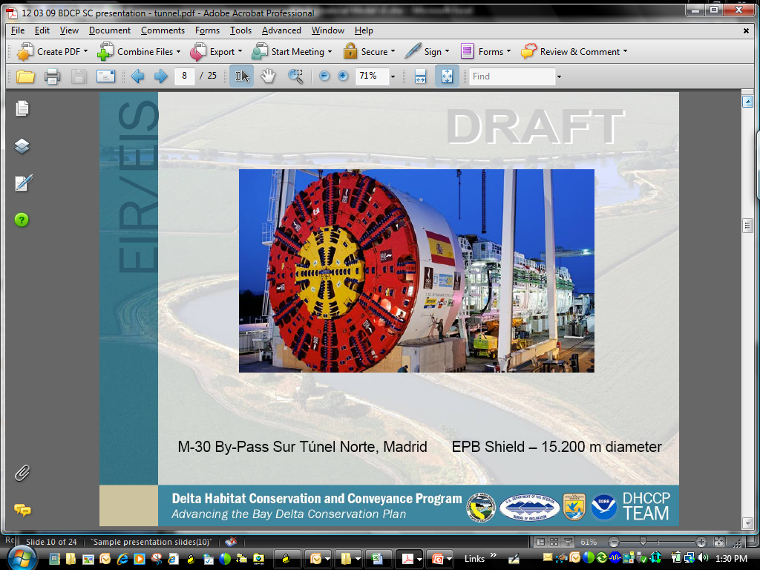
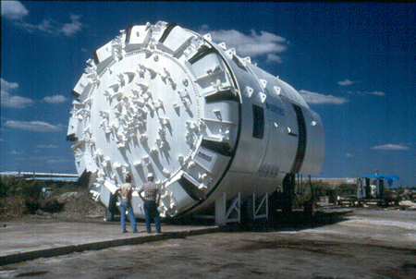
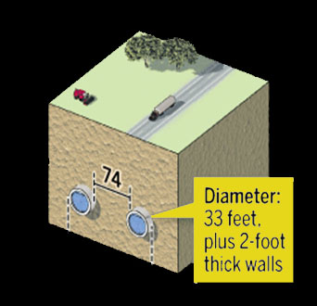
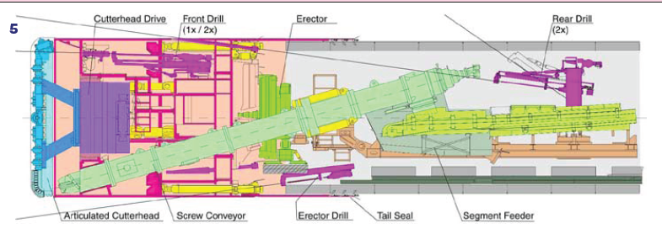
Tunnel Boring Machine
Inland Feeder Tunnel
  12 ft diameter = 1,000 cfs
Delta Tunnel
  2 @ 37 ft. diameter = 15,000 cfs
Notes:
Inland Feeder (Arrowhead Tunnel)= 14ft diameter
Picture (in slide) = 26 ft diameter
Delta PC = 37 ft outside diameter; 33 ft inside

Slide 17
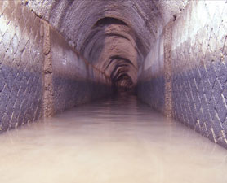
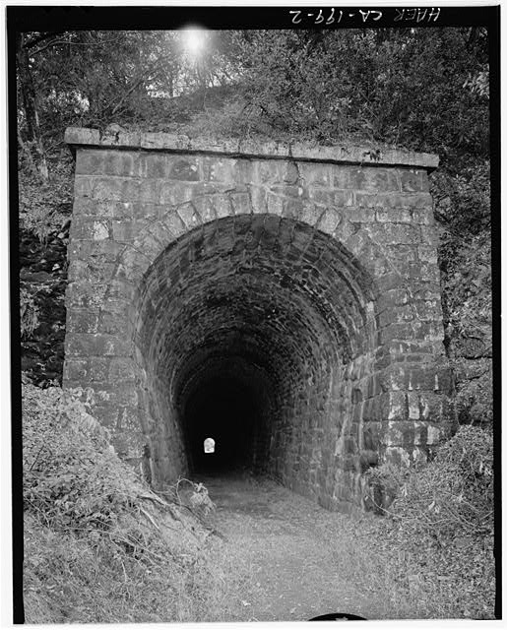
History of Tunneling
Roman Aqueduct
Transcontinental Railroad
Notes:
Roman aqueduct is still in use today

Slide 18
Tunnel Boring Machine
Types
Application | Machine Type
Hard Rock | Open, main beam
Mixed Ground | Double Shield
Soft Ground | Earth Pressure Balance (Clays & Mud) Slurry Shield (Sands & Gravel)

Slide 19
Evolution of
Tunnel Boring Machine Types
1856 – Early TBMs
1952 – Hard rock
1962 – Pressure bulkhead
1964 – Full-face slurry
1966 – Earth pressure balance
1972 – Double shield

Slide 20
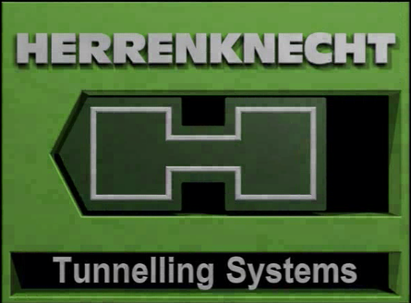
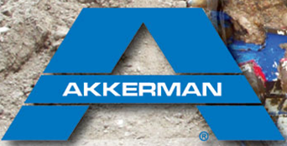








Tunnel Boring Machine
Manufacturers
Notes:
Lovat – Canada
Terratec – Australia
NFM – France
KHI – Japan *
Herrenknecht – Germany *
Robbins – USA *
Jarva – USA
Atlas Copco – Sweden
Habegger – Wohlmeyer – Switzerland
Boretec – USA
Kumatsu – Japan *
Mitsubishi – Japan *
Hughes Tool Co – USA
Wirth – Germany *
Demag – Germany
Voest Alpine
Construction & Tunneling Services – USA
Bade – Germany
Bouygues-Montachie – France
Calweld-Smith – USA
Dresser -- USA
Ingersoll-Rand Lawrence – USA
Krupp – Germany
National Coal Board – GB
Priestly – GB
Subterranean Tools – GB
Thyssen – GB
USSR

Slide 21
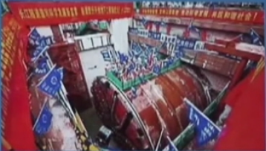
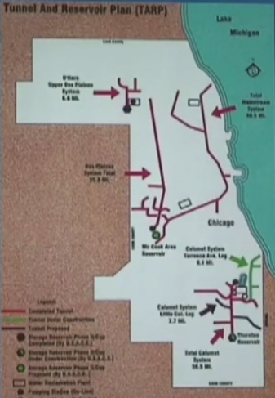
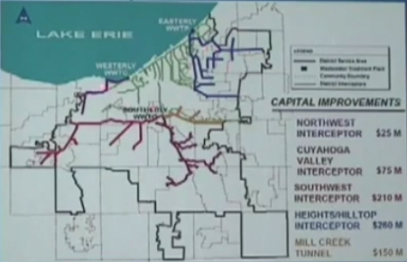
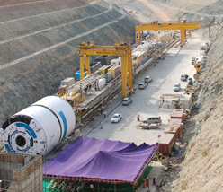
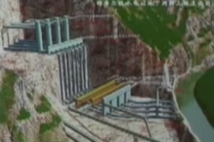
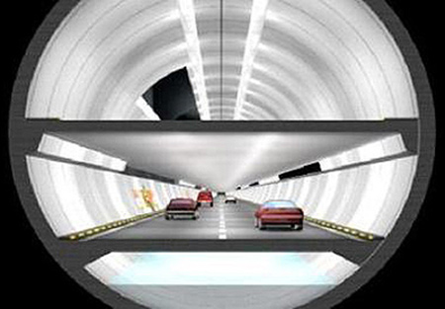
Large Diameter Tunnels
51 ft. – Shanghai, China
Yangtze River highway tunnel; 2 bores
30 ft. – Chicago, USA
109 mile sewer overflow tunnel
30 tunnel boring machines
24 to 45 ft. – Cleveland, USA
Sewer overflow tunnels
33 ft. – Nagarjuna Sagar NP, India
27 mile water supply tunnels
41 ft. – Jinping, China
40 mile hydroelectric tunnels
44 ft. – Kuala Lumpur, Malaysia
Dual-deck transportation/stormwater
Notes:
Other tunnels: 51 ft. – Shanghai, China Yangtze River highway tunnel; 2 bores
Chicago tunnels address combined sewer and runoff overflow from being dumped (and polluting) Lake Michigan. EPA rule requires they hold the water and run it through their treatment plant. The 109 miles of 30 foot tunnels and smaller tunnels are used as a storage reservoir until it can be treated. Robbins Company had 18 TBMs out of the 30 TBMs in Chicago. Chicago soil is all limestone
Cleveland tunnels 1997 to 2008
Alp Transit Tunnels – 2 bores; 30 ft diameter; 56 miles long; High speed rail; 5 TBMs

Slide 22
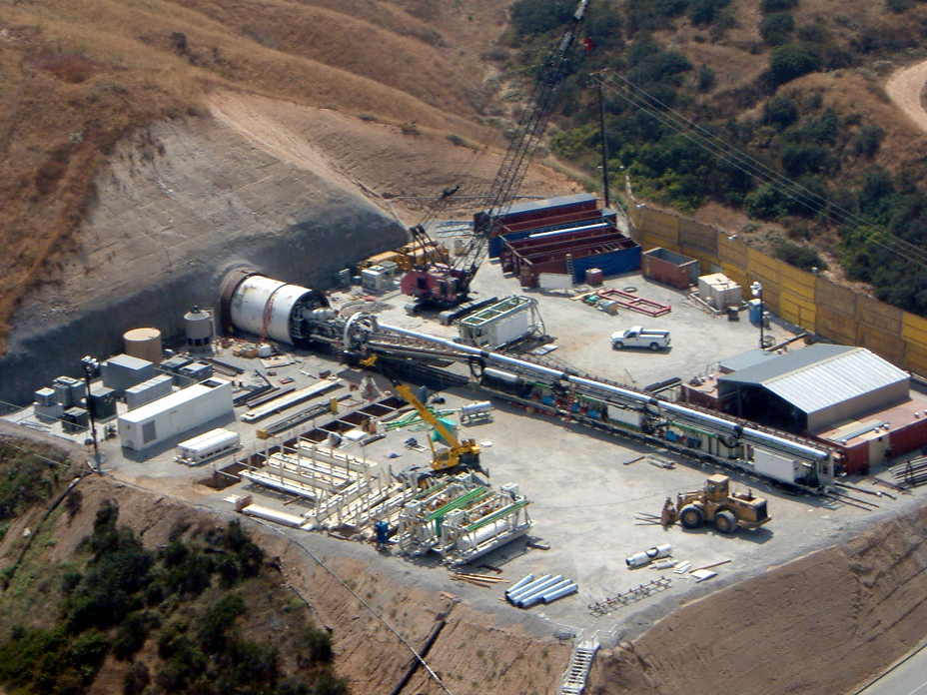
Tunnel Boring Machine
Size
600 ft. length
37 ft. diameter
8,000 hp engine
40 ft per day
$45 – 50 M each
20-25 crew per shift; 3 shifts/day
600 ft. length

Slide 23
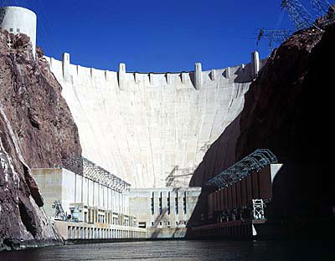
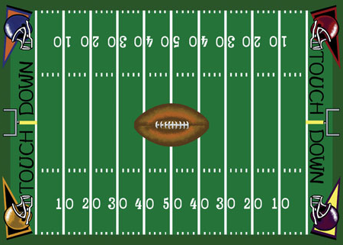
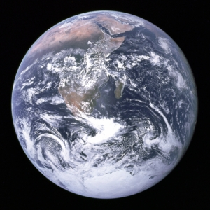
New Delta Conveyance
Tunnel Facts
3.4 million cubic yards of concrete
  Hoover Dam 3.25 million cy
15 million cubic yards of tunnel muck
  1000 story football field
  3.8 million muck car trips
260 million feet of reinforcing steel
  2 times around the world
Notes:
3.4 million cubic yards of concrete
Hoover Dam 3.25 million cy
Segments stacked 3 high require 1 sq mile
15 million cubic yards of tunnel muck
1000 story football field
3.8 million muck car trips
260 million feet of reinforcing steel
2 times around the world

Slide 24
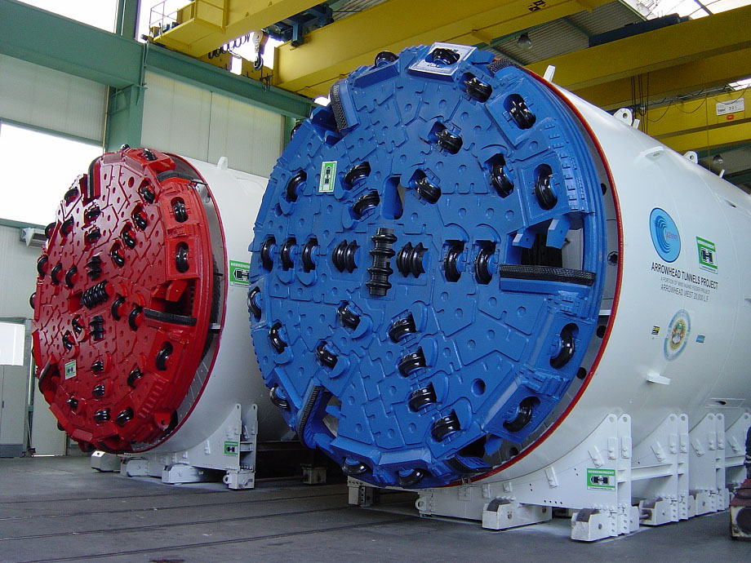
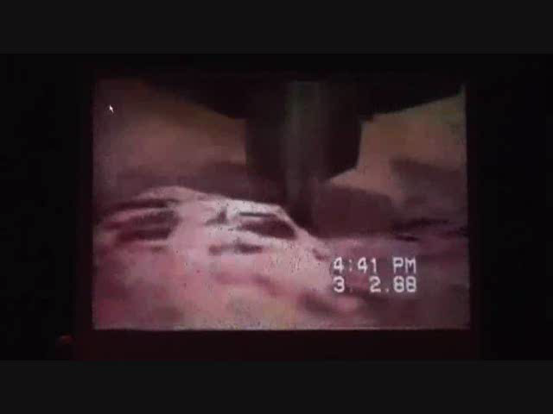
Tunnel Boring … how does it work?
Cutting through the Soil/Rock

Slide 25
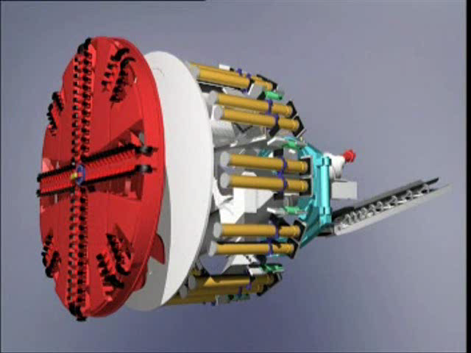
Tunnel Boring … how does it work?
Earth Pressure Balance TBM

Slide 26
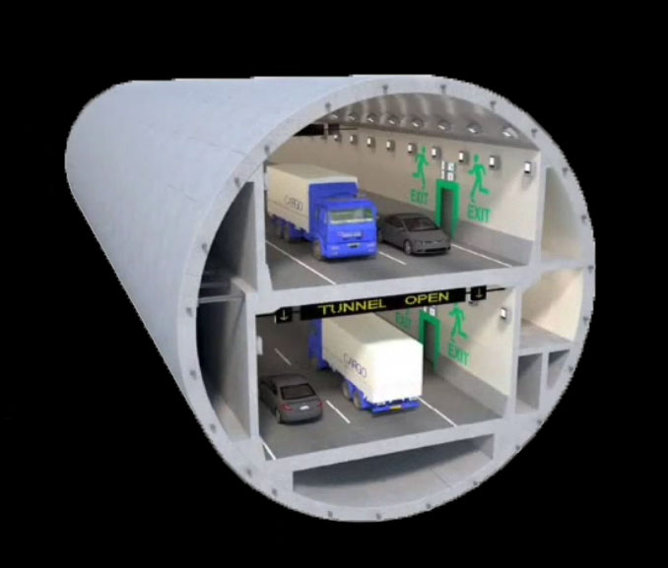
Tunnel Boring … how does it work?
Earth Pressure Balance TBM
Alaska Viaduct
54 ft. diameter
2001– 2016
Notes:
2 mi. length

Slide 27
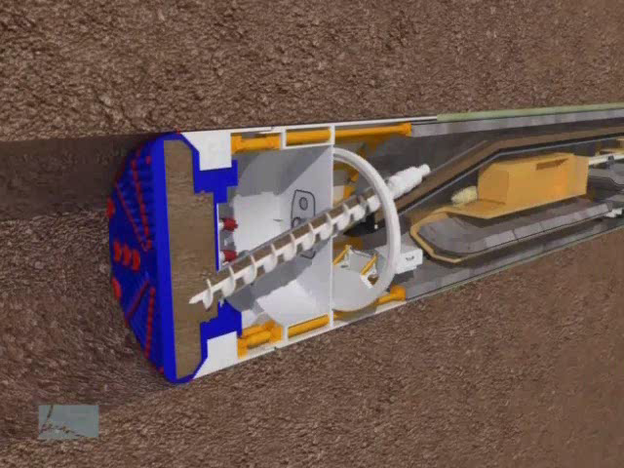
Tunnel Boring … how does it work?
Concrete Tunnel Segment Installation

Slide 28


Tunnel Shaft Construction
Initial Soil Stabilization
Soil Stabilization
Tunnel
Shaft
High Pressure Jet Grouting
Shaft Construction
Notes:
Air, water, cement mixture to fill the voids to make it more stable to excavate.

Slide 29




Tunnel Shaft Construction
Water Table Surface
150 ft.
Tunnel
Tunnel
Tunnel Shaft Construction

Slide 30

Tunnel Shaft Construction
Water Table
150 ft.
Tunnel
Concrete

Slide 31

New Delta Conveyance
Cost Analysis
Bay-Delta Conservation Plan
East Canal ~ $8 billion *
West Canal ~ $9 - 11 billion *
All Tunnel ~ $10 -12 billion *
* URS developed initial cost estimates; Second independent expert cost analysis from 5RMK Inc completed in Jan. 2010.
* Includes 35% construction contingency on tunnel (25% on non-tunnel) and 18% for engineering/project management.
Preliminary Subject to Revision

Slide 32
New Delta Conveyance
Water Supply Benefit Analysis
Bay-Delta Conservation Plan
2010 Deliveries
  30 – 50%: expected Table A deliveries
  600,000 – 1,000,000 AF: expected MWD deliveries
Preliminary Subject to Revision
Notes:
2005 SWP Reliability (Pre-Bio Opinions)
68% − Average Table A deliveries
260,000 AF − Average Article 21
2009 SWP Reliability (Post-Bio Opinions)
60% − Average Table A deliveries
85,000 AF − Average Article 21
2010
30 – 50%: expected Table A deliveries
0 af: expected Article 21
600,000 – 1,000,000 AF: expected MWD deliveries

Slide 33
New Delta Conveyance
Water Supply Benefit Analysis
Bay-Delta Conservation Plan
Without Improved Conveyance
  60% − average SWP Table A deliveries
  1.2 million AF − average MWD deliveries
With Improved Conveyance
  80% − average SWP Table A deliveries
  1.6 million AF − average MWD deliveries
Preliminary Subject to Revision
Notes:
2005 SWP Reliability (Pre-Bio Opinions)
68% − Average Entitlement (Table A)
260,000 AF − Average Surplus (Article 21)
2009 SWP Reliability (Post-Bio Opinions)
60% − Average Entitlement (Table A)
85,000 AF − Average Surplus (Article 21)
2010
30 – 50%: expected deliveries (Table A)
0 af: expected Article 21

Slide 34
New Delta Conveyance
Cost per Acre-Feet
Bay-Delta Conservation Plan
 | Total SWP-CVP Water Supply | Cost per Acre-ft
East | 6.27 million AF | ~ $82/AF
West | 6.27 million AF | ~ $100/AF
Tunnel | 6.27 million AF | ~ $119/AF
Preliminary Subject to Revision
Preliminary Subject to Revision

Slide 35



New Delta Conveyance
Other Benefits
Bay-Delta Conservation Plan
Water Quality
  Reduced salinity, organic carbon, bromides
  Reduced water treatment costs
Improved Reliability
  Avoids seismic risks of levee failure
  Avoids potential future regulatory restrictions
Preliminary Subject to Revision

Slide 36
New Delta Conveyance
Risk Assessment Workshop
Bay-Delta Conservation Plan
Over 100 technical experts
  Planning & Permitting
  Engineering & Operations
  Procurement & Construction
  Management & Oversight
  Public Perception
  Land Use
Reps from state, feds, water contractors & others
Focus on cost & schedule risks

Slide 37

New Delta Conveyance
Risk Assessment Results
Bay-Delta Conservation Plan
Top Cost Risks
  Differing geotech conditions
  (during construction)
  Differing geotech conditions
  (during design)
  Potential habitat mitigation (terrestrial)
  Available tunnel contractor pool
  Inability to adjust construction activities to avoid delay

Slide 38

New Delta Conveyance
Risk Assessment Results
Bay-Delta Conservation Plan
Top Schedule Risks
  Pump & valve procurement
  Lawsuits
  401 certification from State Water Board
  Changes in alignment due to external pressures
  Federal 'Nexus' in construction projects

Slide 39

Schedule
End of 2010
  Draft Conservation Plan
  Draft EIR/S
End of 2011
  Final EIR/S
  Permits
2022
  Construction complete
Preliminary Subject to Revision
39

Slide 40



Randall D. Neudeck
(213) 217-7537
rneudeck@mwdh2o.com
www.bewaterwise.com
An electronic copy of this presentation is located at:
“ftp://blizzard.mwdh2o.com/baydelta/presentations”

Slide 41

The Delta
Sacramento
Suisun Bay
Stockton
State & Federal Pumping Plants

