Slide 1
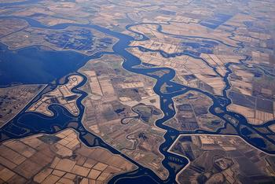
What is CSAMP?
Collaborative Science and Adaptive Management Program
A collaboration of:
  state and federal resource agencies;
  public water agencies; and
  non-governmental organizations
  focused on science and adaptive management associated with water project operations and species recovery in the Delta

Slide 2
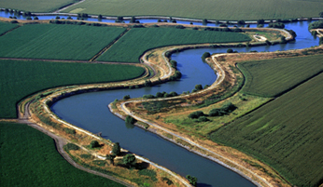
Origins of CSAMP
Outgrowth of BiOp Litigation
Initiated in April 2013
In 2015, all parties agreed to continue the Program after final judgements were issued by the Ninth Circuit
In 2018, CSAMP was expanded to include additional NGOs, upstream and in-Delta PWAs

Slide 3
CSAMP Participants
CA Department of Water Resources
CA Department of Fish and Wildlife
CA State Water Resources Control Board
Coalition for a Sustainable Delta
Contra Costa Water District
Defenders of Wildlife
Friant Water Authority
Golden Gate Salmon Assoc. and Water4Fish
Kern County Water Agency
Metropolitan Water District of Southern California
National Marine Fisheries Service
Natural Resources Defense Council
Pacific Coast Federation of Fishermen's Associations
San Luis Delta Mendota Water Authority
Santa Clara Valley Water Agency
The Bay Institute
The Nature Conservancy
U.S. Bureau of Reclamation
U.S. Fish and Wildlife Service
Westlands Water District

Slide 4
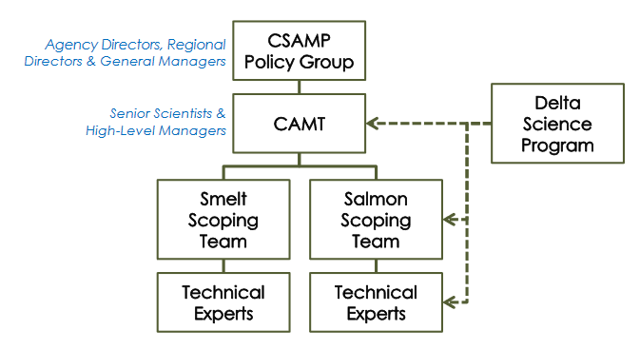
CSAMP Structure

Slide 5
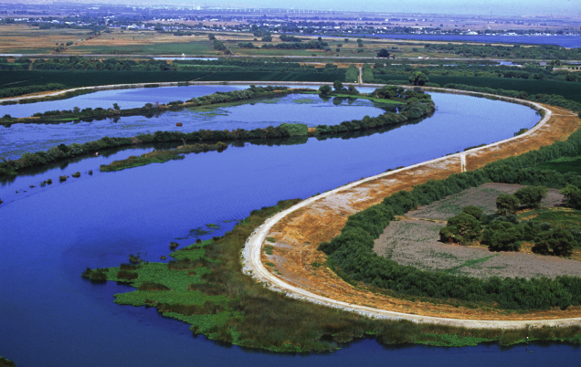
Mission Statement
Work with a sense of urgency to collaboratively evaluate current hypotheses and management actions associated with protection and restoration of species of concern, current and future federal and state regulatory authorizations for the SWP and CVP, and other local and state management actions, to improve performance from both biological and water supply perspectives.

Slide 6
Approach
Provide a FORUM for communication among the agencies, NGOs and PWAs;
Act as a CATALYST to address the most contentious and urgent management relevant science issues; and
COMPILE AND DISSEMINATE INFORMATION for decision makers on contentious and urgent science issues in a timely fashion.

Slide 7
CSAMP Priorities (2019-2020)
Complete current CAMT investigations and communicate findings
Support implementation of resiliency strategies for Delta Smelt and Sacramento Valley salmonids
Support additional near-term, no regrets salmon actions
Improve coordination of salmonid research in the delta and support development of an integrated central valley science plan for salmonids
Initiate conversation regarding oversight, guidance, and feedback on monitoring schemes targeting the delta's natural resources
Advance decision support tools

Slide 8
CSAMP Technical Studies
Completed
Effects of Water Project Operations on Salmon Behavior and Survival
Review of Delta Smelt Survey Data
Ongoing
Delta Smelt Entrainment Studies
Fall Outflow Studies
Delta Salmon Rearing Habitat Study
Delta Smelt Science Plan Implementation
Planned
Structured Decision Making for Delta Smelt
Coordinated Salmon Science Plan for the Delta

Slide 9
Capital Expenditures ($)
Activity | 2016 | 2017 | 2018 | Total
Management and Facilitation | 392,700 | 425,800 | 357,900 | 1,176,400
Sponsored Participants | 153,300 | 280,900 | 179,000 | 613,200
Technical Studies | 1,240,900 | 780,300 | 503,200 | 2,524,400
Total | 1,786,900 | 1,487,000 | 1,040,100 | 4,314,000

Slide 10
Expenditures by Entity (2016-2018)
Entity | Amount ($)
NMFS | 167,800
FWS | 64,700
USBR¹ | 1,205,700
CDFW | 125,000
DSP | 141,600
DWR¹ | 1,771,500
PWA² | 837,700
Total | 4,314,000
^{[1]} A portion of the expenditures contributed by federal and state agencies is money collected from public water agencies.
^{[2]} CCWD, MWD, SFCWA, SLDMWA, SWC

Slide 11
2019 Budget and Commitments
 | 2019 Budget |  |  | 2019 Commitments
Activity | Budget | Committed | Shortfall | SWC | CCWD | DWR | USBR | NMFS | DSP
Management and Facilitation | 420,000 | 295,000 | 125,000 | 125,000 |  | 80,000 | 90,000
Sponsored Participants | 200,000 | 200,000 |  |  |  | 170,000 |  | 30,000
Technical Studies | 1,080,000 | 1,080,000 |  | 185,000 | 20,000 |  | 725,000 | 50,000 | 100,000
Total | 1,700,000 | 1,575,000 | 125,000 | 310,000 | 20,000 | 250,000 | 815,000 | 80,000 | 100,000

