Slide 1
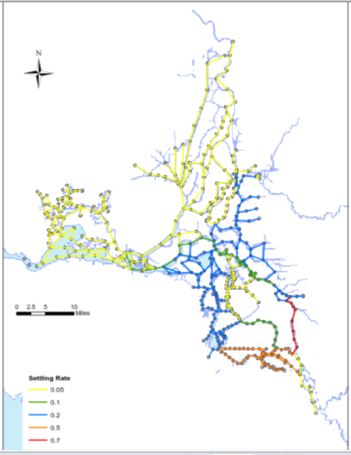

Forecasting Delta Turbidity Conditions with Artificial Neural Networks
7th Biennial Bay-Delta Science Conference
October 18, 2012
Paul Hutton, Ph.D., P.E.

Slide 2

Forecasting Delta Turbidity Conditions
with Artificial Neural Networks
Background
Model Description
Sample Results
Next Steps

Slide 3
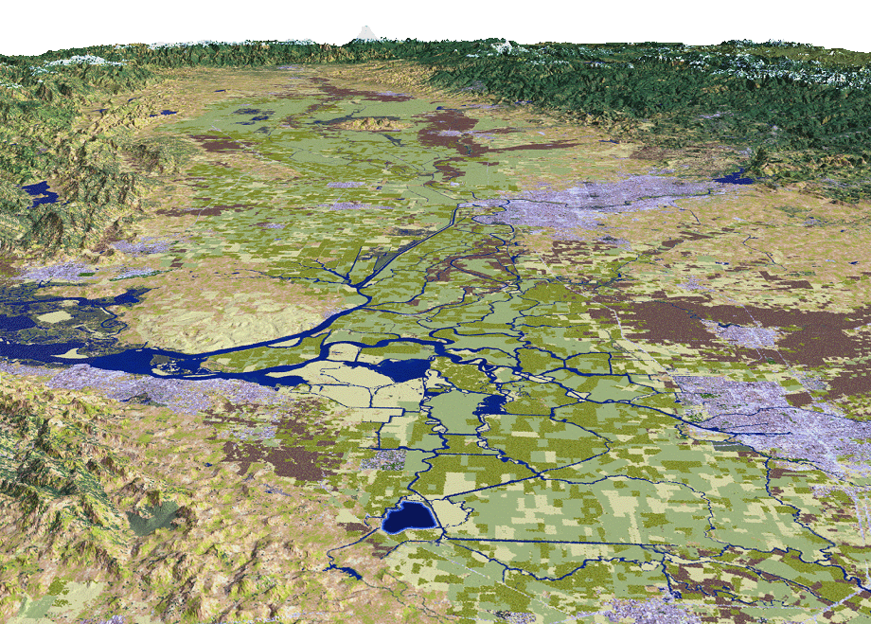
Biological Opinion “First Flush” Action
Restricts Pumping Operations
Sacramento
Stockton
SWP Pumps
CVP Pumps
Notes:
3

Slide 4
Forecasting Process
Monitoring Data
(Initial Conditions)
Hydrodynamics
Water Quality
USGS; DWR
Delta Turbidity Fate & Transport
Delta Hydrodynamic & Constituent Transport Modeling
Delta Inflow Turbidity Forecast
Watershed Modeling
Data Dissemination: Monitoring & Forecast Data
BayDeltaLive.com
Forecast Data
(Boundary Conditions)
Reservoir Operations
Meteorology
DWR; NWS
Forecast Data
(Boundary Conditions)
Astronomical Tides
Delta Inflow & Export Rates
Delta Net Channel Depletions
DWR
Scenario Analysis
DASM-T

Slide 5
Forecasting Process
Monitoring Data
(Initial Conditions)
Hydrodynamics
Water Quality
USGS; DWR
Delta Turbidity Fate & Transport
Delta Hydrodynamic & Constituent Transport Modeling
Delta Inflow Turbidity Forecast
Watershed Modeling
Data Dissemination: Monitoring & Forecast Data
BayDeltaLive.com
Forecast Data
(Boundary Conditions)
Reservoir Operations
Meteorology
DWR; NWS
Forecast Data
(Boundary Conditions)
Astronomical Tides
Delta Inflow & Export Rates
Delta Net Channel Depletions
DWR
Scenario Analysis
DASM-T

Slide 6
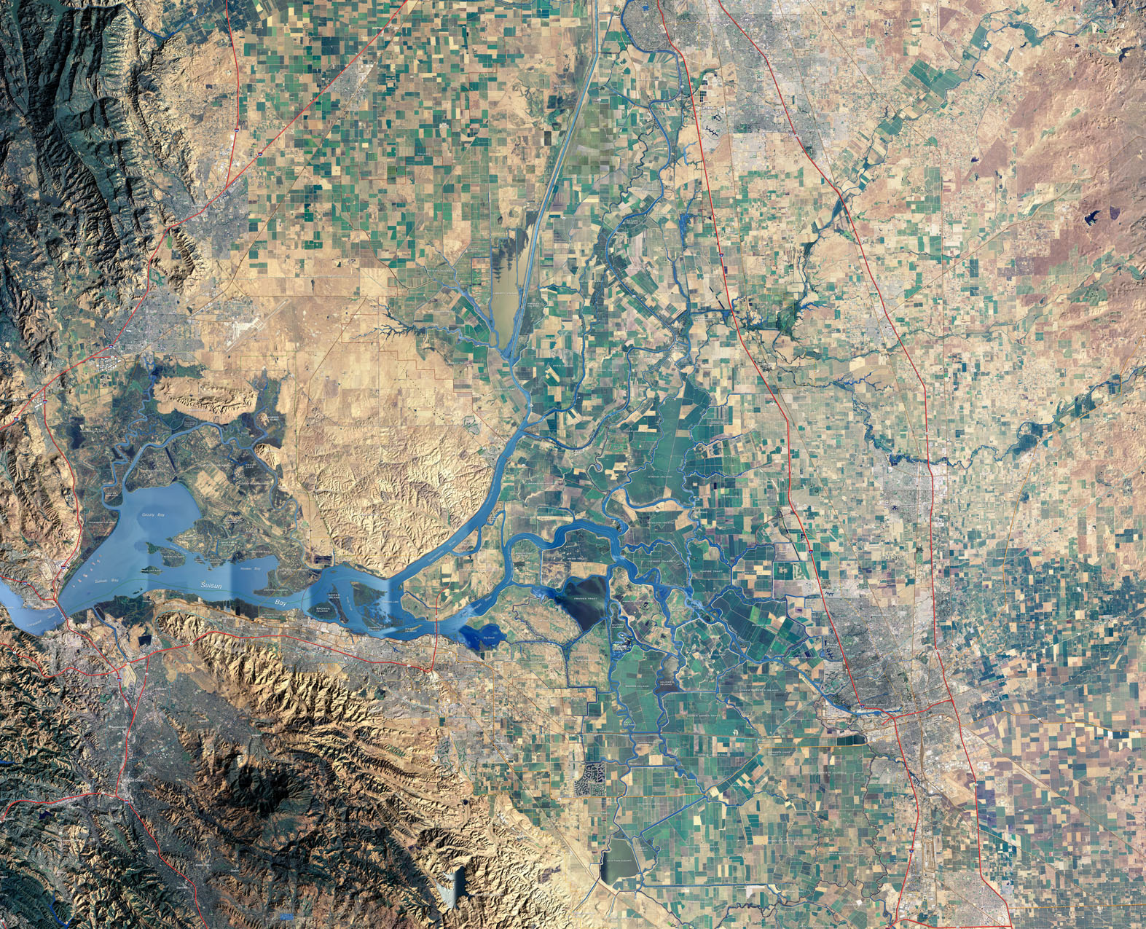
Prisoner’s Point
Turbidity
Monitoring
Sites
Holland Cut
Victoria Canal

Slide 7
Forecasting Process
Monitoring Data
(Initial Conditions)
Hydrodynamics
Water Quality
USGS; DWR
Delta Turbidity Fate & Transport
Delta Hydrodynamic & Constituent Transport Modeling
Delta Inflow Turbidity Forecast
Watershed Modeling
Data Dissemination: Monitoring & Forecast Data
BayDeltaLive.com
Forecast Data
(Boundary Conditions)
Reservoir Operations
Meteorology
DWR; NWS
Forecast Data
(Boundary Conditions)
Astronomical Tides
Delta Inflow & Export Rates
Delta Net Channel Depletions
DWR
Scenario Analysis
DASM-T

Slide 8
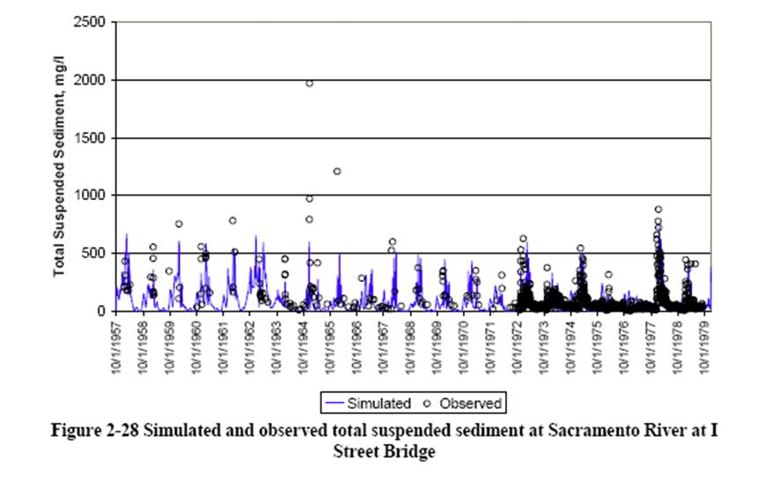
Delta Inflow Turbidity Forecast
Sacramento River & Yolo Bypass

Slide 9
Forecasting Process
Monitoring Data
(Initial Conditions)
Hydrodynamics
Water Quality
USGS; DWR
Delta Turbidity Fate & Transport
Delta Hydrodynamic & Constituent Transport Modeling
Delta Inflow Turbidity Forecast
Watershed Modeling
Data Dissemination: Monitoring & Forecast Data
BayDeltaLive.com
Forecast Data
(Boundary Conditions)
Reservoir Operations
Meteorology
DWR; NWS
Scenario Analysis
DASM-T
Forecast Data
(Boundary Conditions)
Astronomical Tides
Delta Inflow & Export Rates
Delta Net Channel Depletions
DWR

Slide 10

Delta Turbidity Fate & Transport

Slide 11
Forecasting Process
Monitoring Data
(Initial Conditions)
Hydrodynamics
Water Quality
USGS; DWR
Delta Turbidity Fate & Transport
Delta Hydrodynamic & Constituent Transport Modeling
Delta Inflow Turbidity Forecast
Watershed Modeling
Data Dissemination: Monitoring & Forecast Data
BayDeltaLive.com
Forecast Data
(Boundary Conditions)
Reservoir Operations
Meteorology
DWR; NWS
Forecast Data
(Boundary Conditions)
Astronomical Tides
Delta Inflow & Export Rates
Delta Net Channel Depletions
DWR
Scenario Analysis
DASM-T

Slide 12
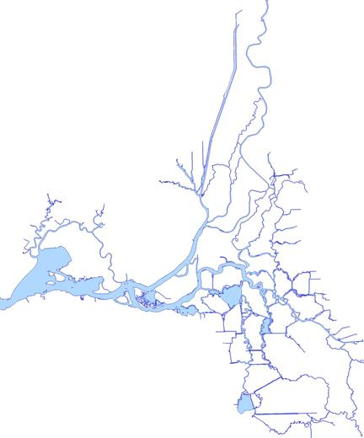
Delta Turbidity Forecasting
Scenario Analysis
Observed
Forecast
Delta Map
Turbidity
Scenario C
Scenario B
Prisoner’s Point
Time
Scenario A
Holland Cut
Increasing
Exports
Victoria Canal
Notes:
In addition to showing agency managers that these cutting edge tools have strong predictive capability,
We also showed them how the tools could be used in a transparent manner to evaluate alternative pumping scenarios.
First we can show how turbidity will change over time under planned operations.
In this illustration, as is typically the case, planned operations are overly conservative in response to imposed BiOp regulations – as is demonstrated by the large gap between forecasted turbidity and the regulatory limit. Regulatory compliance is measured at these 3 locations in the Delta.
Then we can show that, even under a variety of higher pumping scenarios, turbidity can be maintained below regulatory limits, a clear water zone can be maintained in the central Delta, and smelt can be protected from entrainment.

Slide 13
Forecasting Delta Turbidity Conditions
with Artificial Neural Networks
Background
Model Description
Sample Results
Next Steps

Slide 14
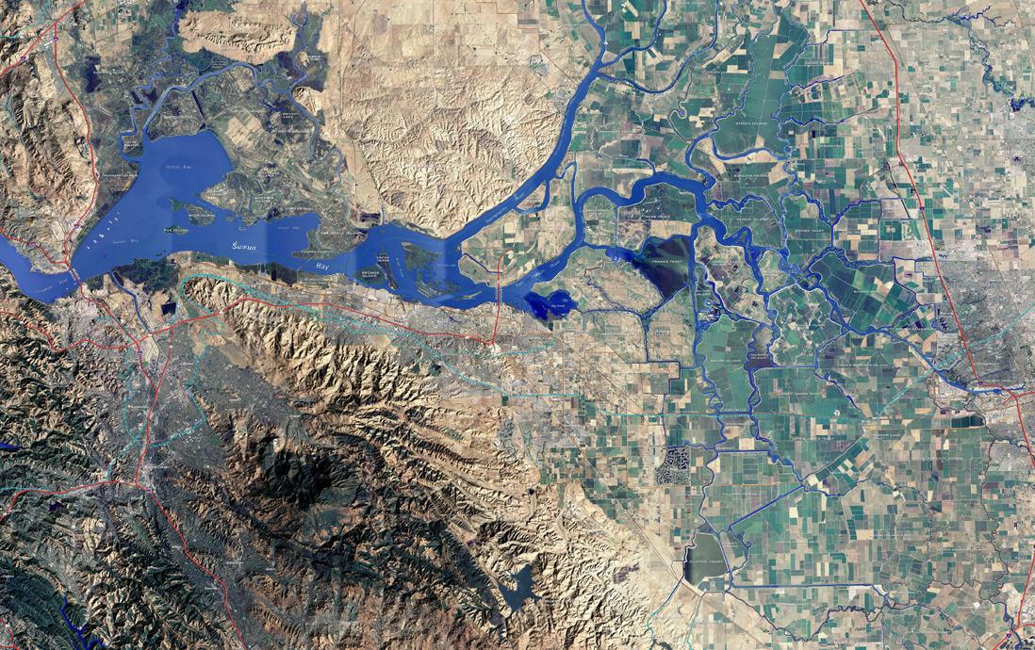
North Delta
Inflow &
Turbidity
(Freeport & Yolo Bypass)
East Side
Inflow & Turbidity
OMR Flow Index
Model Inputs
Vernalis Turbidity

Slide 15
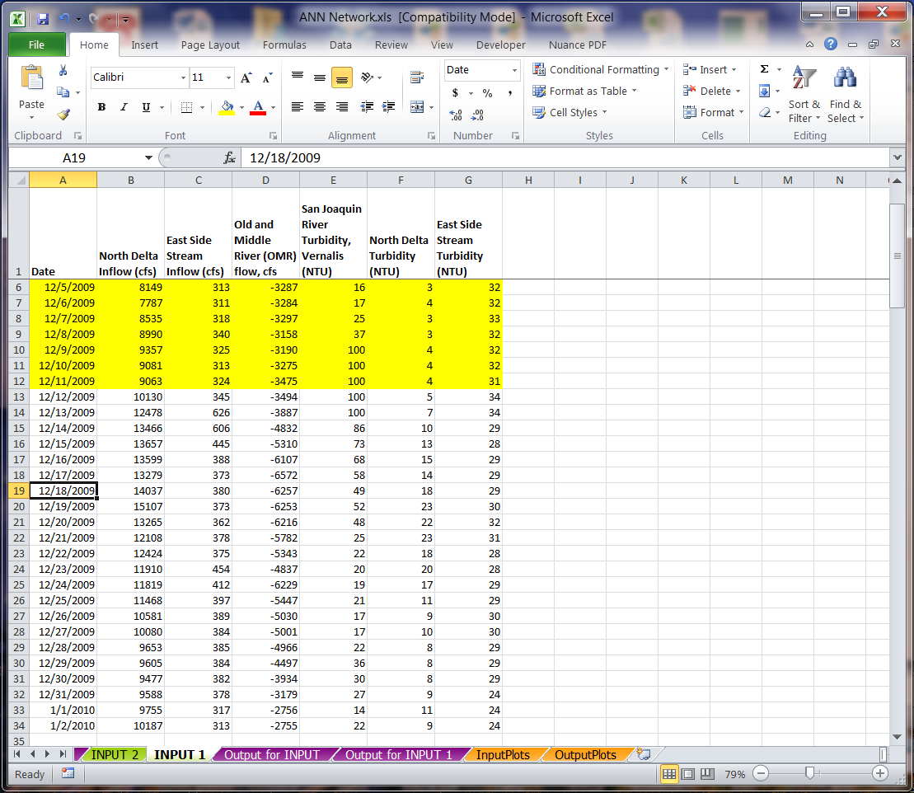
DASM-T Sample Input File

Slide 16
1
2
3
4
West Delta Output Locations
Rio Vista
Decker Island
San Joaquin River @ 3-Mile Slough
Jersey Point
1
2
3
4

Slide 17
Central Delta Output Locations
Prisoners Point
Holland Cut
Quimby Island
Bacon Island
Middle River @ Holt
Middle River @ Bacon Island
Turner Cut
1
1
3
2
2
5
7
3
4
4
6
5
6
7

Slide 18
South Delta Output Locations
Old River @ Highway 4
Clifton Court Forebay Intake
Victoria Canal
Middle River @ Union Island
Grant Line Canal @ Tracy
San Joaquin River @ Garwood
1
2
6
3
1
4
3
5
2
4
6
5

Slide 19
DASM-T Model Description
Neural network trained to emulate DSM2 turbidity fate and transport
Training data developed from 12 DSM2 simulations – 36 years (water years 1976-2011)
Applicable for adult smelt pre-spawning period (December-February). Assumes DCC gates are closed and south Delta barriers not installed.
Training process: 60% calibration; 20% validation; 20% testing

Slide 20
Forecasting Delta Turbidity Conditions
with Artificial Neural Networks
Background
Model Description
Sample Results
Next Steps

Slide 21
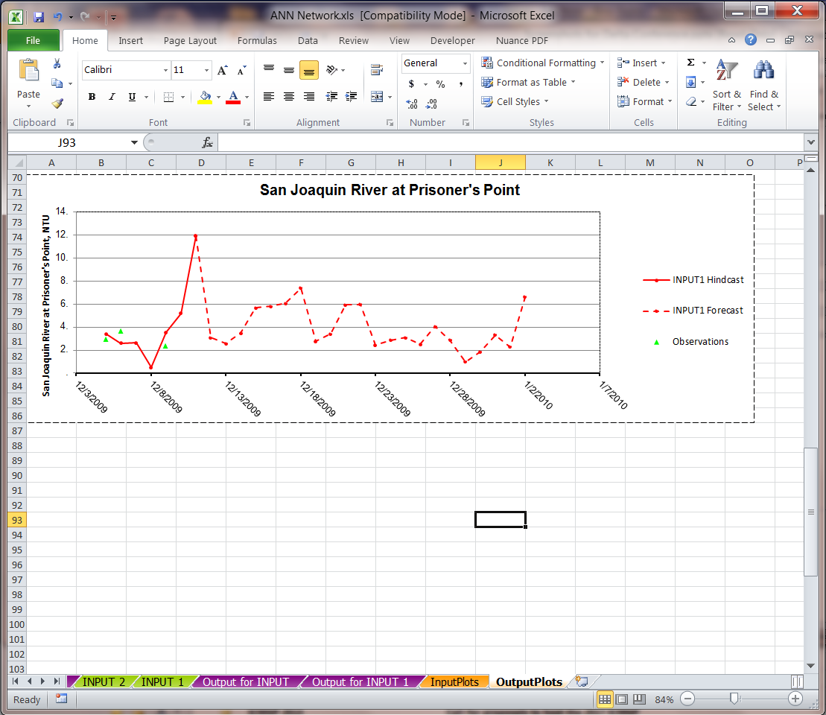
DASM-T Sample Output File

Slide 22
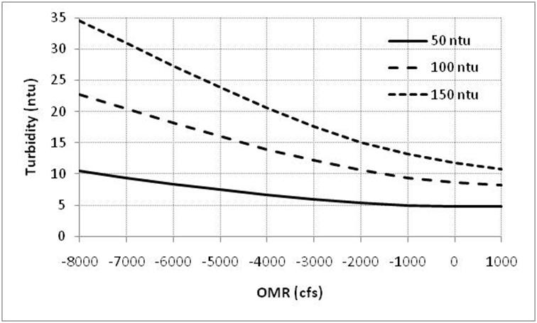
Steady State Flow-Turbidity Relationship as a Function of North Delta Turbidity
San Joaquin River @ Prisoner’s Point
Steady State Assumptions
North Delta Flow = 30,000 cfs
East Side Flow = 1500 cfs
Vernalis Turbidity = 30 ntu
East Side Turbidity = 30 ntu

Slide 23
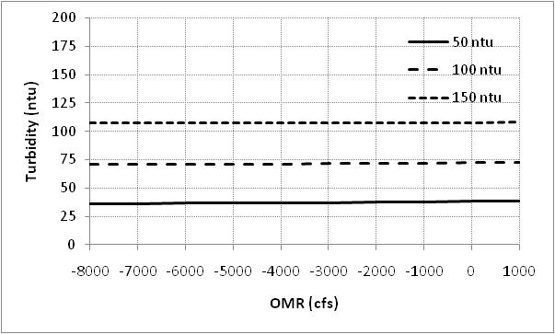
Steady State Flow-Turbidity Relationship as a Function of North Delta Turbidity
Sacramento River @ Rio Vista
Steady State Assumptions
North Delta Flow = 30,000 cfs
East Side Flow = 1500 cfs
Vernalis Turbidity = 30 ntu
East Side Turbidity = 30 ntu

Slide 24
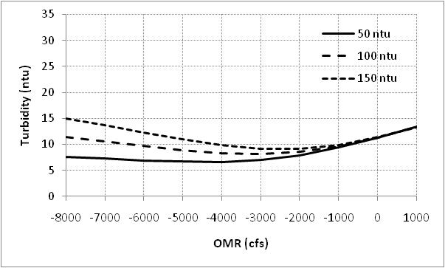
Steady State Flow-Turbidity Relationship as a Function of North Delta Turbidity
Clifton Court Forebay Entrance
Steady State Assumptions
North Delta Flow = 30,000 cfs
East Side Flow = 1500 cfs
Vernalis Turbidity = 30 ntu
East Side Turbidity = 30 ntu

Slide 25
Forecasting Delta Turbidity Conditions
with Artificial Neural Networks
Background
Model Description
Sample Results
Next Steps

Slide 26
Next Steps
DASM-T will be integrated into tools suite during the pilot forecasts beginning this winter.
DASM-T will be publically available.
DWR has tentatively agreed to pilot the forecasting procedure this winter.
We encourage USFWS staff, as well as the DSWG, to pilot DASM-T.

Slide 27
Acknowledgements
Dr. Sujoy Roy, Tetra Tech, Inc.
Dr. Limin Chen, Tetra Tech, Inc.

Slide 28

Paul Hutton, Ph.D., P.E.
phutton@mwdh2o.com

Slide 29
EXTRA SLIDES

Slide 30
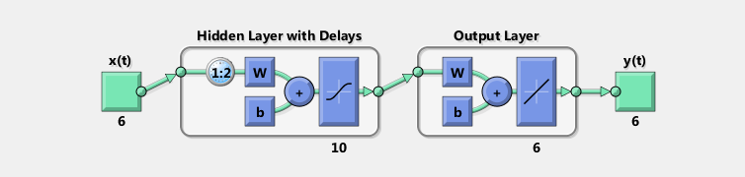
ANN Model Structure
Matlab Feed Forward
y(t) = f(x(t-1), …., x(t-d))
Inputs = 6 boundaries (3 flow & 3 turbidity)
Hidden Neurons = 10
Time delay = 1-2 days
Outputs: turbidity at 6 locations

Slide 31
ANN Model Structure
Training Process
DSM2 data points are randomly assigned:
  Training 60%
  Validation 20%
  Testing 20%
Training data are used to compute network parameters. Intermediate results are iteratively compared with validation data until residual error is minimized.
Testing data are independent of training and validation data and are used to evaluate network predictive power.

Slide 32
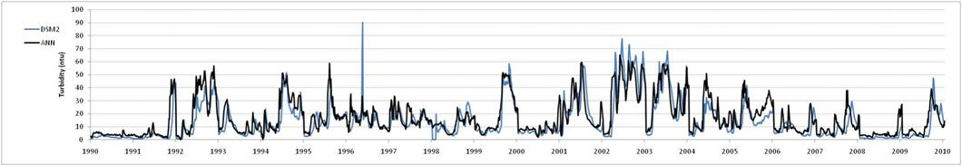
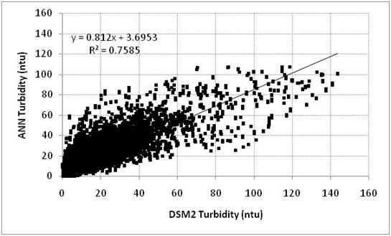
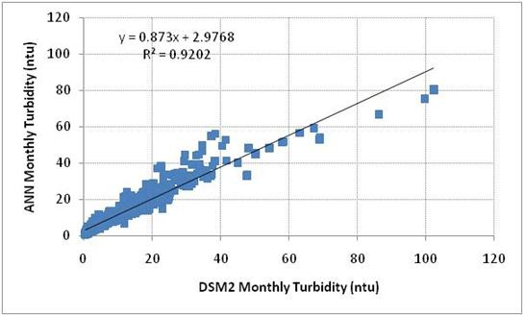
Model Results
San Joaquin River @ Prisoner’s Point (Dec-Feb)

Slide 33
Model Results: Summary Statistics
ANN Turbidity (ntu) = Ф1 + Ф2 * DSM2 Turbidity (ntu)
Location | Daily |  |  | Monthly
 | Ф₁ | Ф₂ | R² | Ф₁ | Ф₂ | R²
Sacramento River @ Rio Vista | 3.5 | 0.97 | 0.94 | 1.1 | 1.01 | 0.99
Old River @ Quimby Island | 2.0 | 0.89 | 0.83 | 1.7 | 0.91 | 0.96
Old River @ Bacon Island | 1.8 | 0.82 | 0.78 | 1.5 | 0.85 | 0.93
San Joaquin River @ Prisoner’s Point | 3.7 | 0.81 | 0.76 | 3.0 | 0.87 | 0.92
Middle River @ Holt | 2.0 | 0.76 | 0.69 | 1.7 | 0.82 | 0.89
Clifton Court Forebay Entrance | 3.1 | 0.75 | 0.73 | 1.3 | 0.90 | 0.91

