Slide 1

The Delta Salinity Gradient (DSG) Model
Bay-Delta Science Conference
October 28, 2014
Paul Hutton, Ph.D., P.E.
Metropolitan Water District

Slide 2
The Delta Salinity Gradient (DSG) Model
Introduction
Formulation/Calibration/Validation
Perturbation Analysis & Possible Next Steps

Slide 3
Definition of
Low Salinity Zone
The “Low Salinity Zone” occurs at the inland edge of estuaries where average daily salinities range from 1 to 6 practical salinity units.

Slide 4
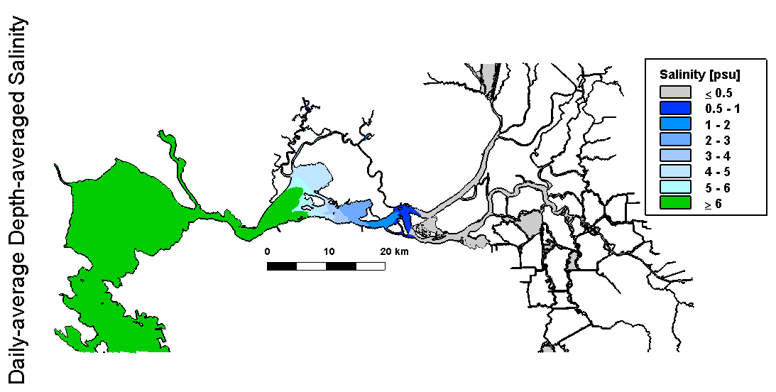
Predicting Spatial Extent of the
Low Salinity Zone
(from MacWilliams 2014)

Slide 5
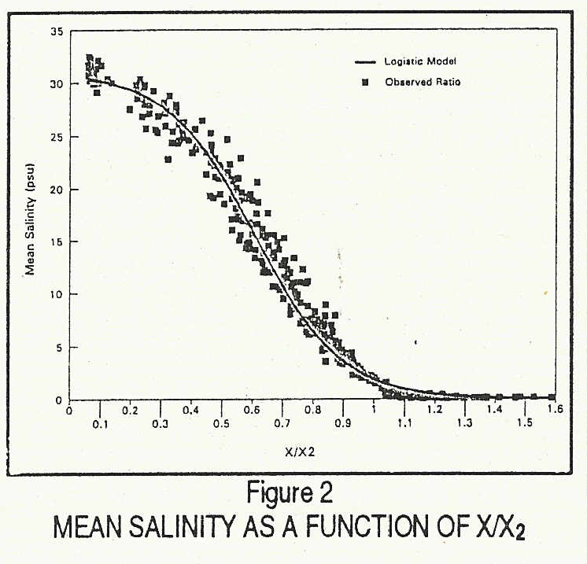

$X=X2∗\left[ln{\left(\frac{31−S}{515.67∗S}\right)}^{\frac{1}{7}}+1.5\right]$
S = 6 ppt
X/X2 ≈ 0.81
X ≈ 0.81 * X2
From Unger (1994)

Slide 6
Point San Pablo
Carquinez
Martinez
Port Chicago
10.0 mS/cm
6 ppt surface
6.8 mS/cm
4 ppt surface
2.64 mS/cm
X2
Collinsville
70.9 km
G Model
Denton (1994)
75.9 km
Emmaton
81.8 km
Rio Vista

Slide 7
The Delta Salinity Gradient (DSG) Model
Introduction
Formulation/Calibration/Validation
Perturbation Analysis & Possible Next Steps

Slide 8
DSG Model Formulation
Advantages
Speed and simplicity – spreadsheet application
Parsimony – 5 fitting parameters
Robustness – valid under extremely low outflow conditions

Slide 9
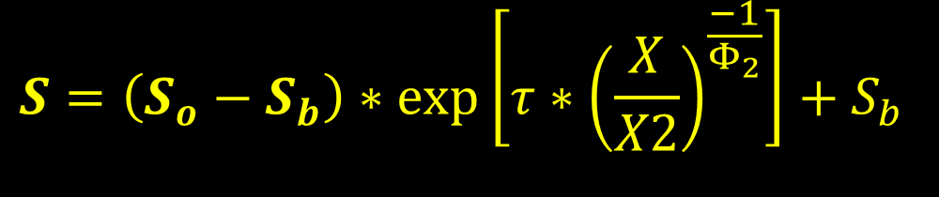
DSG Model Formulation
$$S=\left(S_{o}−S_{b}\right)∗\exp\left[τ∗{\left(\frac{X}{X2}\right)}^{\frac{−1}{Φ_{2}}}\right]+S_{b}$$
The DSG model requires specification of Delta outflow & five (5) model parameters:
  β: calculate antecedent outflow as a function of Delta outflow
  Φ₁ and Φ₂: calculate X2 as a function of antecedent outflow
  γ and δ: calculate S_{o} as a function of X2

Slide 10
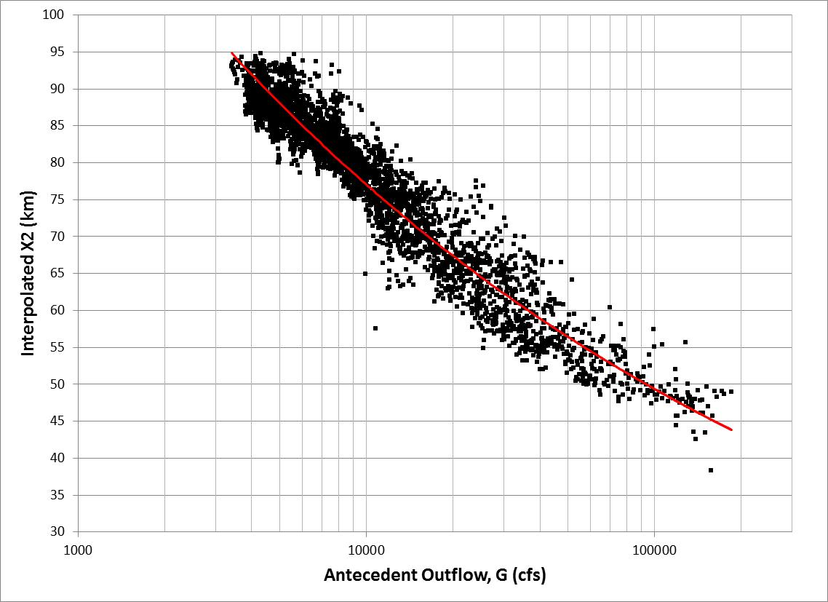


DSG Model Formulation (cont’d)
X2 vs. Antecedent Outflow
$$X2\left(t\right)=Φ_{1}∗{G(t)}^{Φ_{2}}$$
$$\frac{∂G}{∂t}=\frac{\left(Q−G\right)∗G}{β}$$

Slide 11
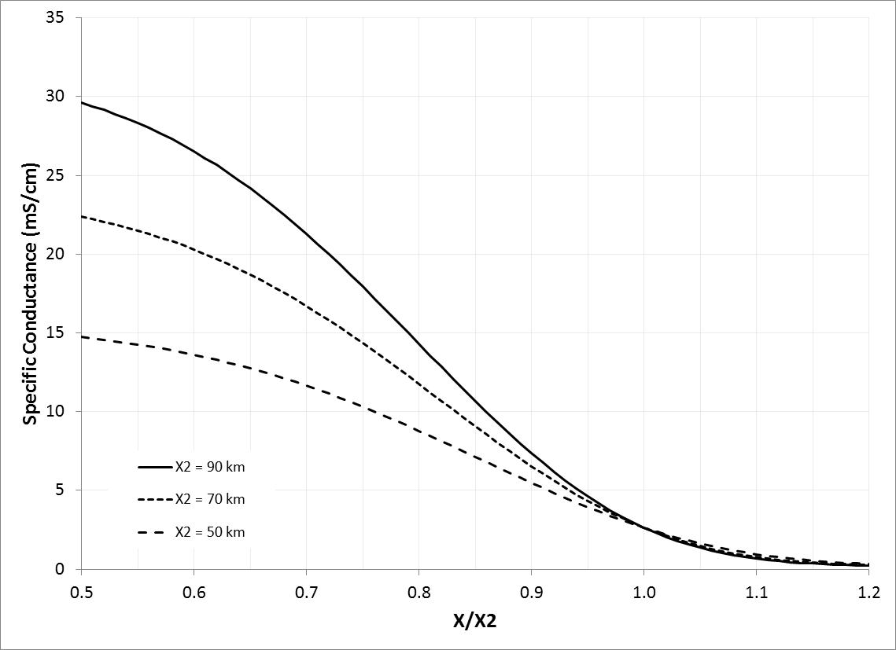
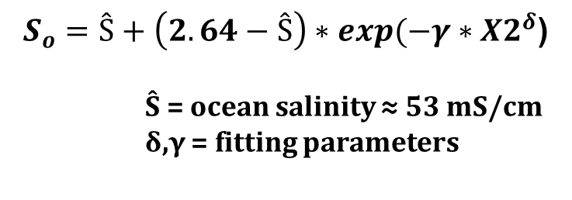
DSG Model Formulation (cont’d)
$S_{o}=Ŝ+\left(2.64−Ŝ\right)∗exp(−γ∗{X2}^{δ}$)
Ŝ = ocean salinity ≈ 53 mS/cm
δ,γ = fitting parameters

Slide 12
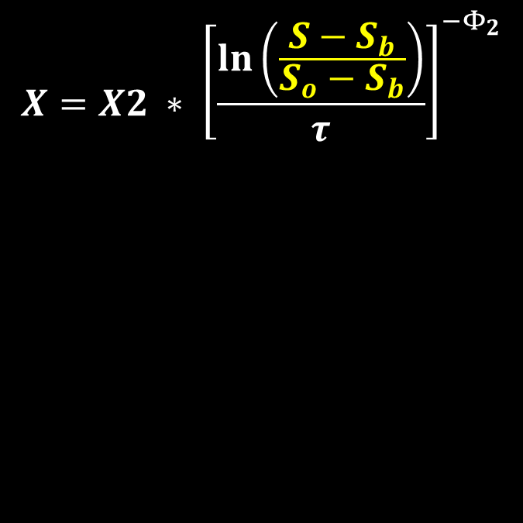
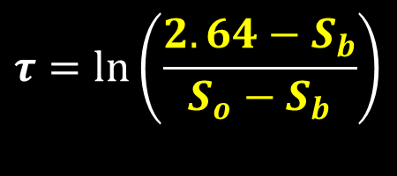
DSG Model Formulation (cont’d)
Normalized isohaline salinity
X = isohaline distance from Golden Gate
X2 = distance of 2 ppt bottom isohaline = f(G)
S = isohaline salinity (mS/cm)
S_{b} = upstream salinity
S_{o} = downstream salinity = f(X2)
Φ₂ = fitting parameter
Normalized index salinity

Slide 13
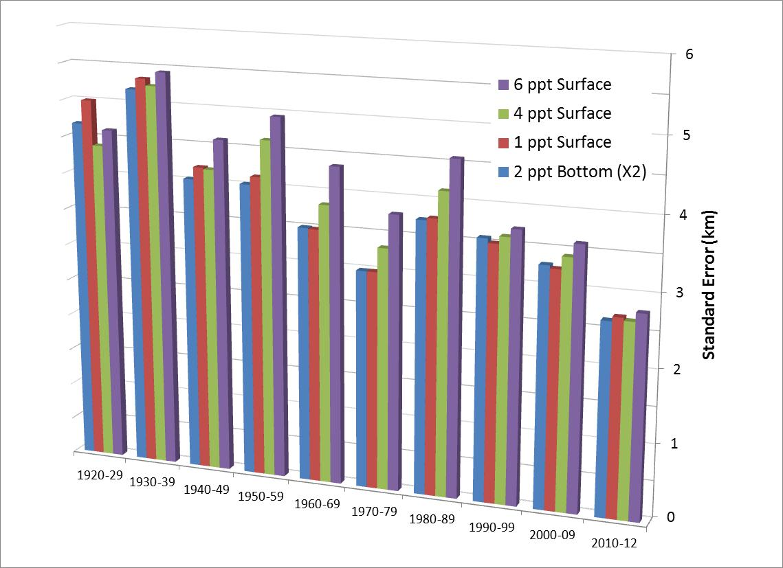
Model Calibration/Validation

Slide 14
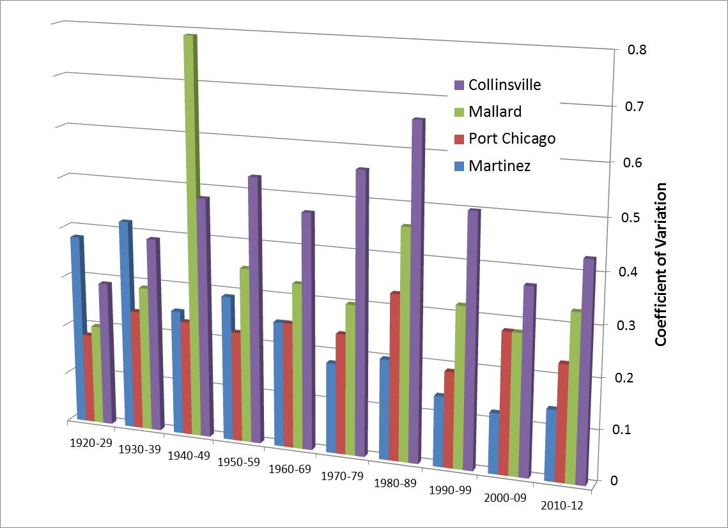
Model Calibration/Validation (cont’d)

Slide 15
The Delta Salinity Gradient (DSG) Model
Introduction
Formulation/Calibration/Validation
Perturbation Analysis & Possible Next Steps

Slide 16
Perturbation Analysis
X (km) | Difference with Baseline (%)
 | β |  | Φ₁ |  | Φ₂ |  | γ |  | δ
 | -10% | +10% | -10% | +10% | -10% | +10% | -10% | +10% | -10% | +10%
54 | 0.4% | -0.4% | -27.8% | 26.1% | 55.4% | -47.9% | -5.4% | 5.0% | -36.7% | 40.9%
64 | 0.7% | -0.7% | -40.9% | 43.4% | 95.4% | -62.9% | -4.4% | 4.0% | -31.4% | 32.1%
75 | 1.5% | -1.4% | -58.2% | 80.0% | 185.1% | -77.0% | -2.8% | 2.5% | -20.8% | 18.9%
81 | 2.0% | -1.9% | -66.3% | 113.2% | 272.8% | -81.1% | -1.5% | 1.4% | -11.6% | 10.1%
92 | 2.9% | -2.8% | -64.2% | 193.7% | 526.6% | -69.9% | 1.2% | -1.1% | 12.0% | -6.4%

Slide 17
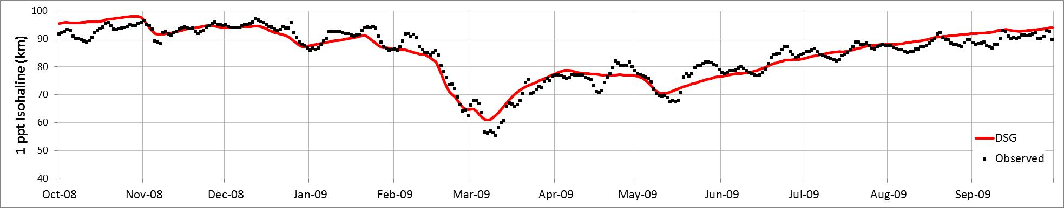
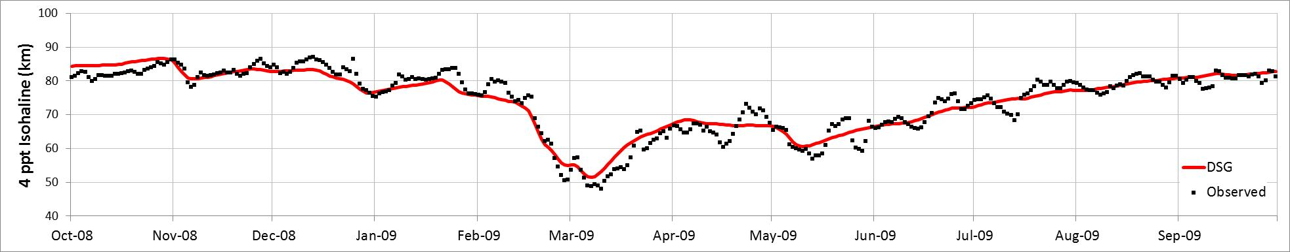
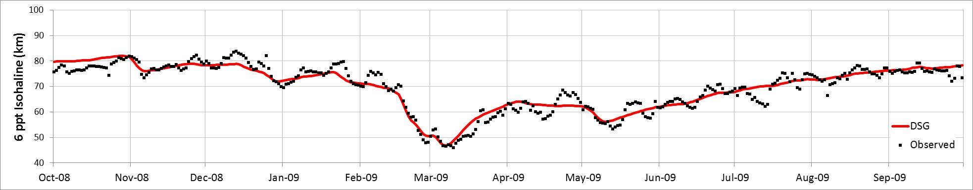
DSG Isohaline Position Estimates with Calculated X2: Water Year 2009

Slide 18
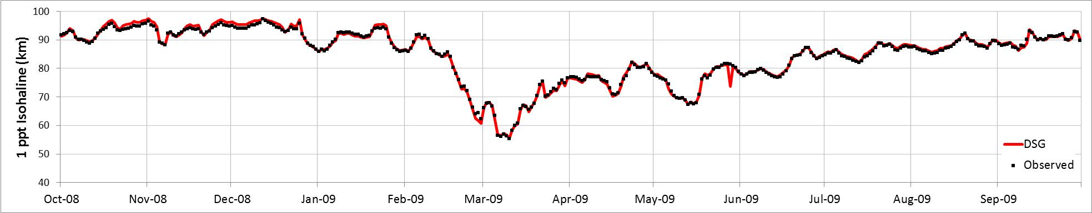
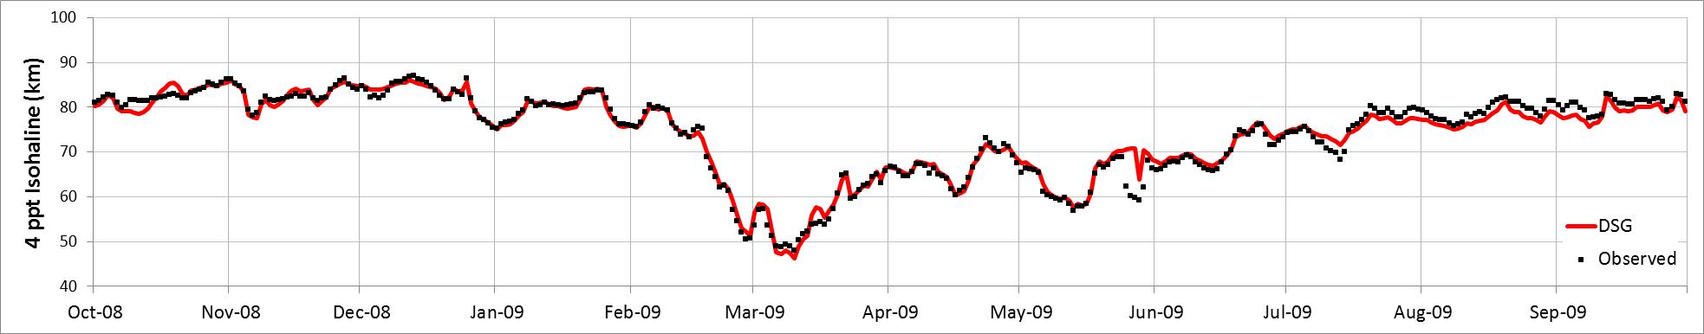
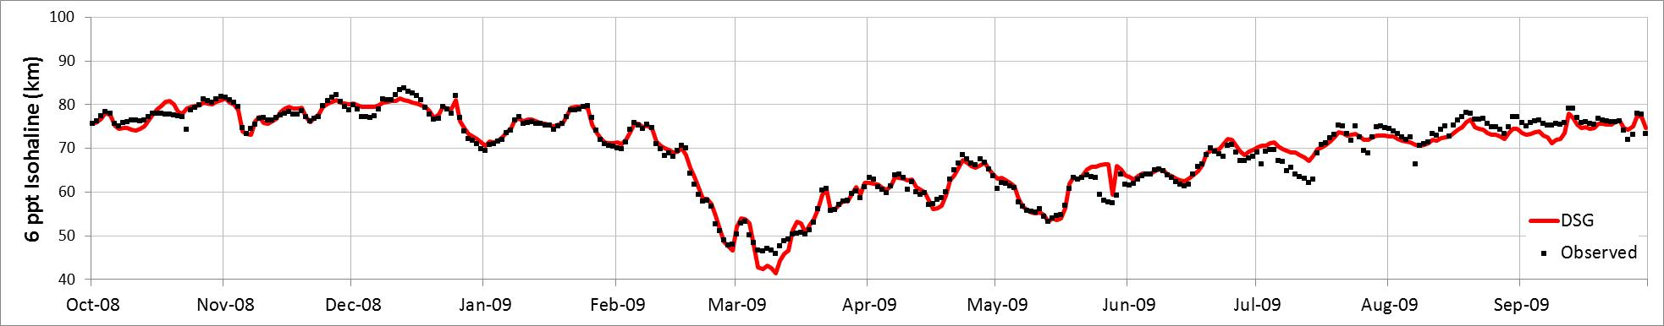
DSG Isohaline Position Estimates with Interpolated X2: Water Year 2009

Slide 19
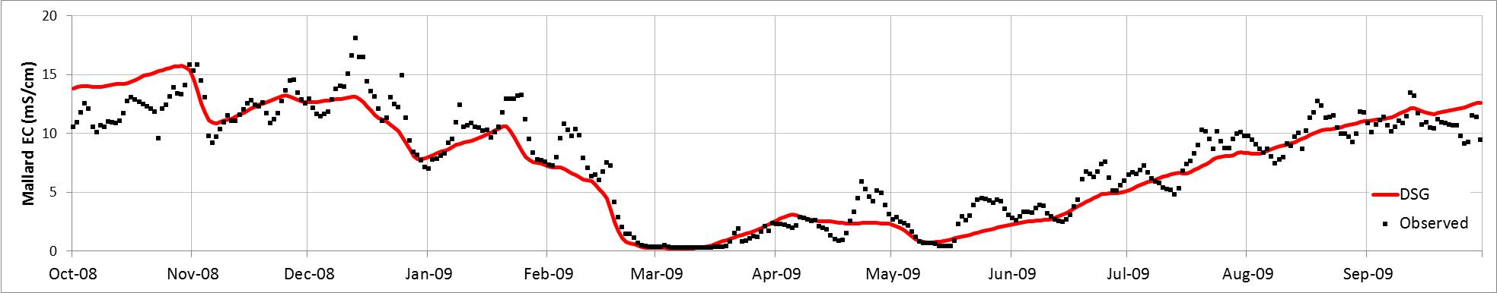
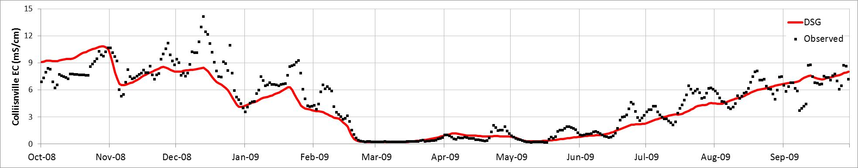
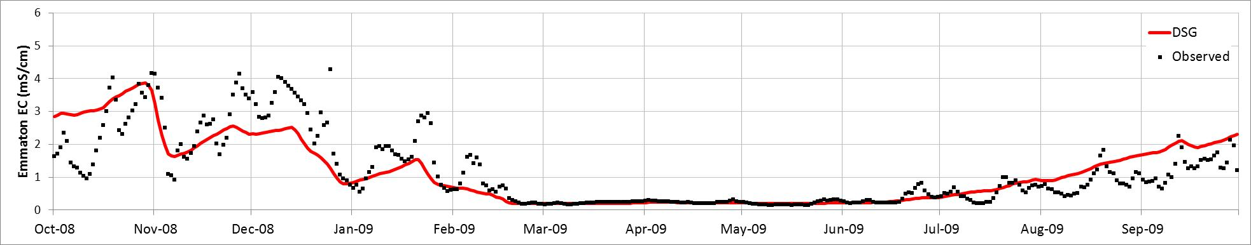
DSG Salinity Estimates with Calculated X2: Water Year 2009

Slide 20
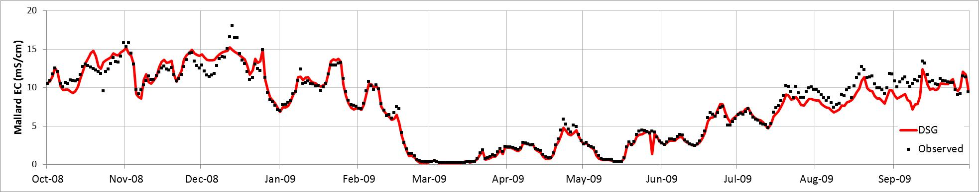
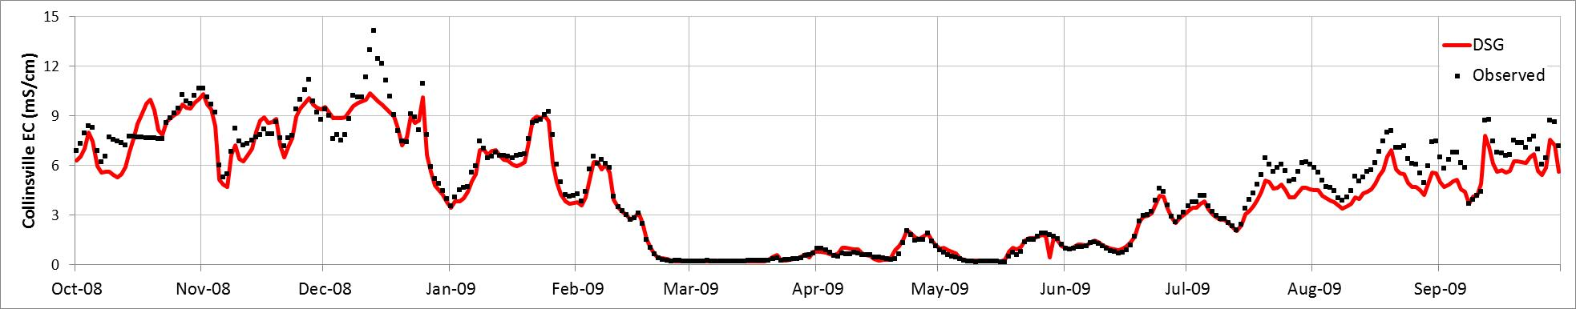
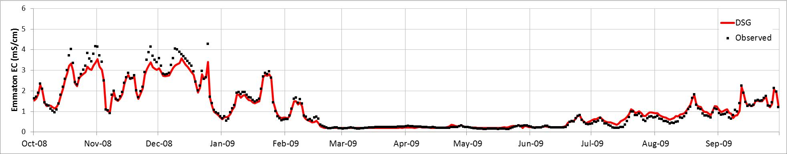
DSG Salinity Estimates with Interpolated X2: Water Year 2009

Slide 21
Possible Next Steps
Re-calibrate existing X2 formulation
  Include pre-Project data
  Piece-wise fit
Modify existing X2 formulation to increase degrees of freedom
  Include a tidal term
  Include a “QWEST” term

Slide 22
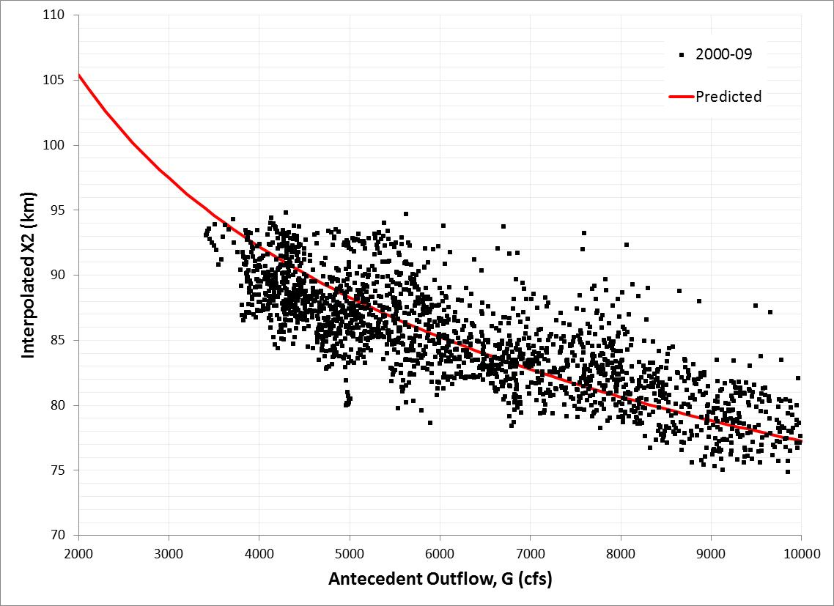

Possible X2 Re-calibration
Sacramento X2 vs. Antecedent Outflow 2000-09

Slide 23
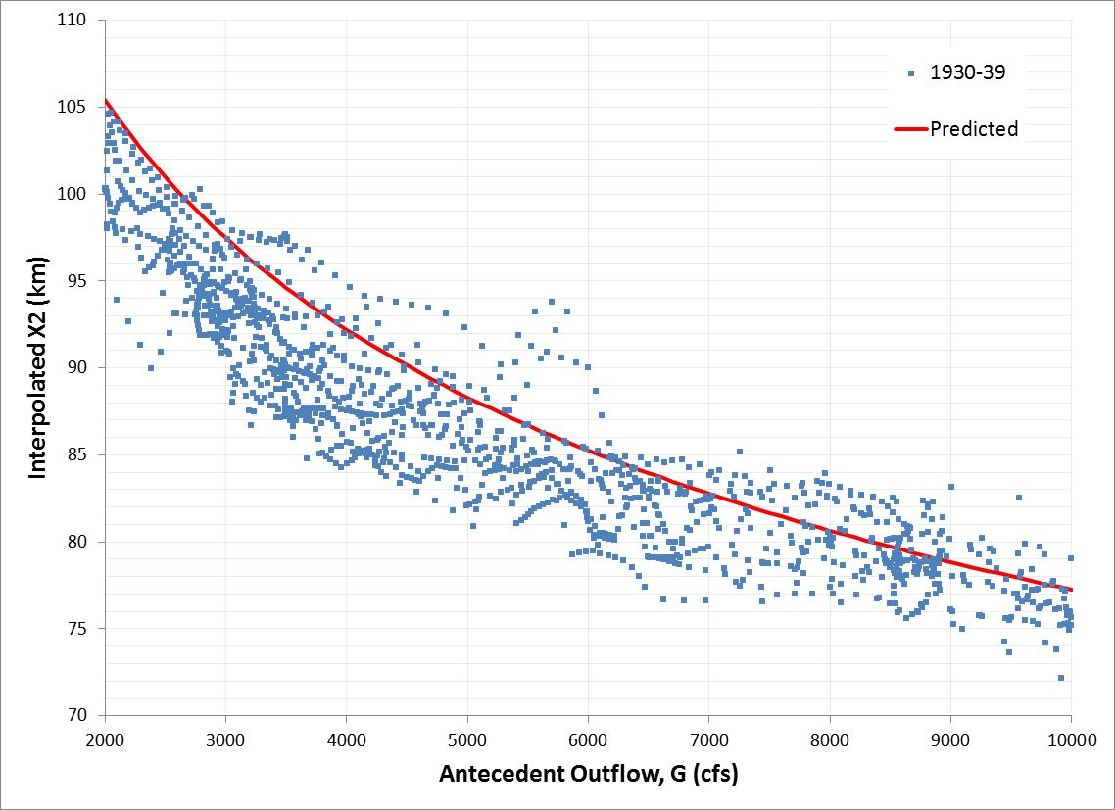
Possible X2 Re-calibration
Sacramento X2 vs. Antecedent Outflow 1930-39
Over-estimates X2 under low flow conditions

Slide 24
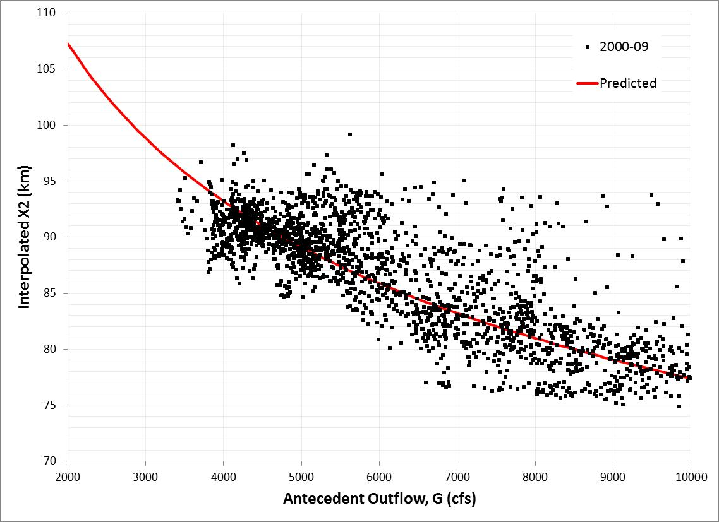
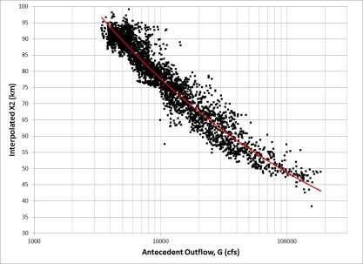
Possible X2 Re-calibration
San Joaquin X2 vs. Antecedent Outflow 2000-09

Slide 25
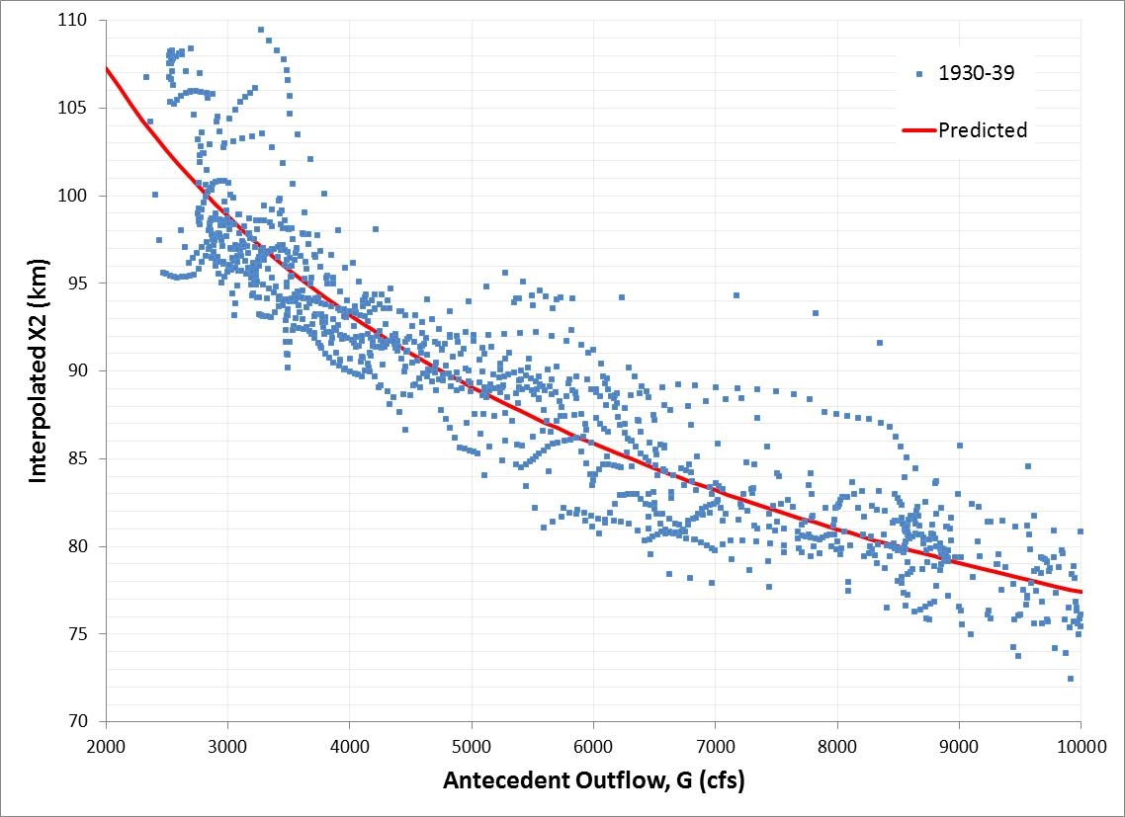
Possible X2 Re-calibration
San Joaquin X2 vs. Antecedent Outflow 1930-39
Reasonable fit under low flow conditions

Slide 26
Possible Next Steps
Re-calibrate existing X2 formulation
  Include pre-Project data
  Piece-wise fit
Modify existing X2 formulation to increase degrees of freedom
  Include a tidal term
  Include a “QWEST” term
Explore use of artificial neural networks within DSG framework

Slide 27

Paul Hutton, Ph.D., P.E.
phutton@mwdh2o.com

