Slide 1
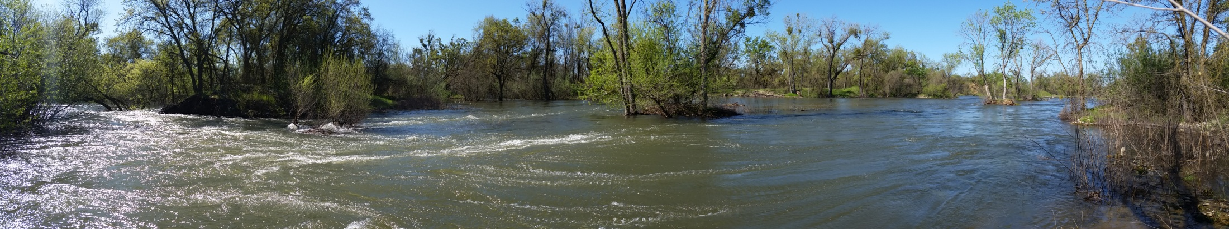

Rescaling Central Valley Rivers: Reconciling Theory with Practice
Rocko Brown, PhD
Protecting, Connecting, and Re-imagining Floodplain Habitat: Strategies for Restoring the Benefits of Floodplains to Juvenile Salmon
35th Annual Salmonid Restoration Conference
April 01, 2017
Notes:
Welcome and thank you for the opportunity be here.
I would like to take a moment to thank Dana and all of SRF for putting the conference together.
I would also like to thank Corey and Brian for putting together a great session with a really diverse range of speakers.
The purpose of my talk is to share ideas will peers and our community about our rivers and where their evolution is tending.

Slide 2
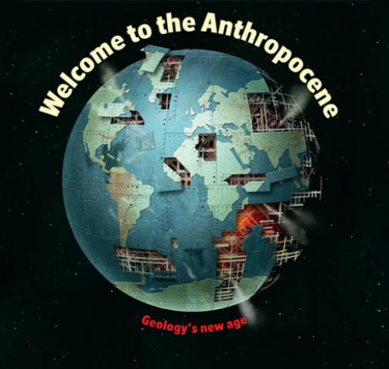
Notes:
We are in the Anthropocene, and this is becoming a funky geologic period where people are responsible for as much or even more change in the environment than natural processes.

Slide 3
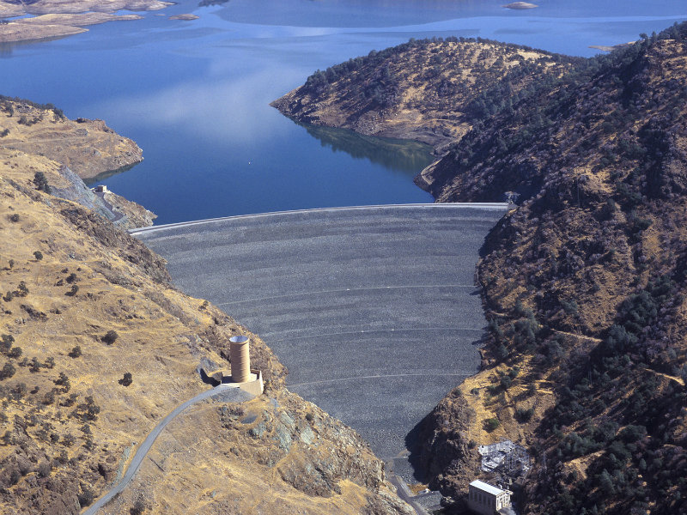
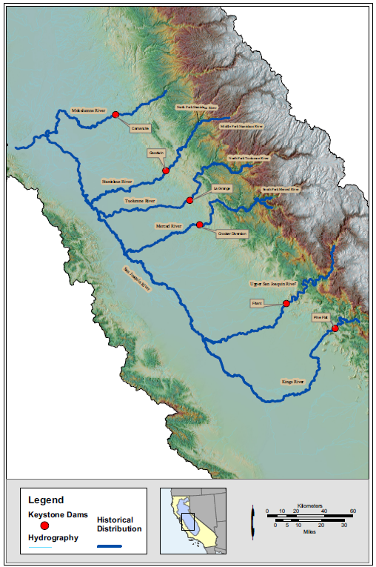
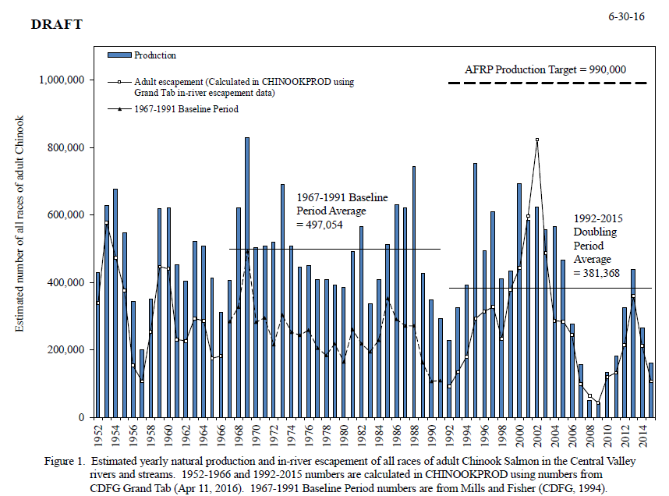
Dams are now apart of the DNA of our Central Valley Rivers
Historical and current mainstem habitat in southern Central valley. NOAA, 2005
Notes:
The Central Valley has seen significant changes to flow and the form of river systems.
Efforts are underway to enhance, restore, and/or naturalize rivers below dams for salmon.
Due to asynchronous alterations of flow and river corridor topography many rivers have to be rescaled with flow releases, management and land use changes
Lastly, make no mistake that fish are a big part of envisioning restored river corridors, and they need us to get it right.

Slide 4
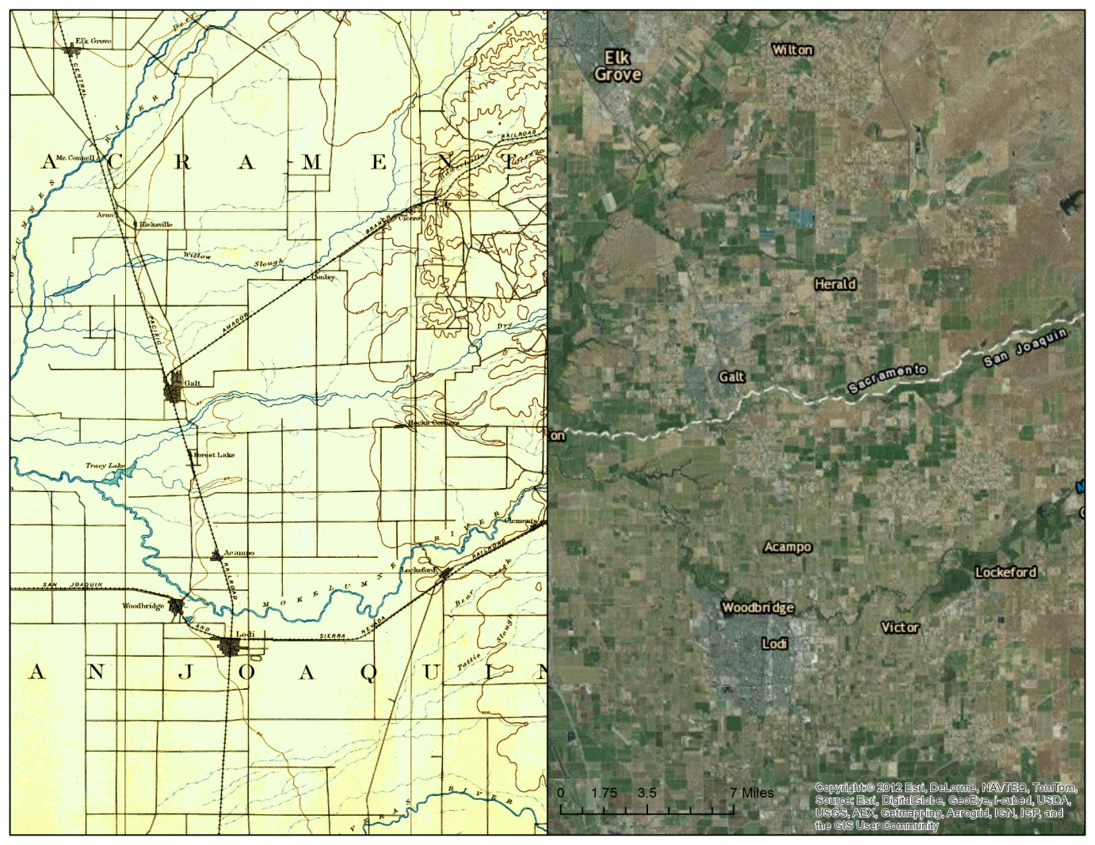
Morphogenesis of flow and form
1894
2017
2100
?
Notes:
As we restore rivers below dams, often rescaling them, I think we need to be mindful of our past, present and future thinking.
Efforts are underway to address flow through SWQCB recommended instream flow.
However, form does not follow flow in the Anthropocene, necessitating human intervention
As we are in the anthropocene we get to decide how we want to manage our rivers and that requires us to understand how much active versus passive work we can do for sustainable salmon and a healthy river corridor, and whether these timescales are suitable for salmon.

Slide 5
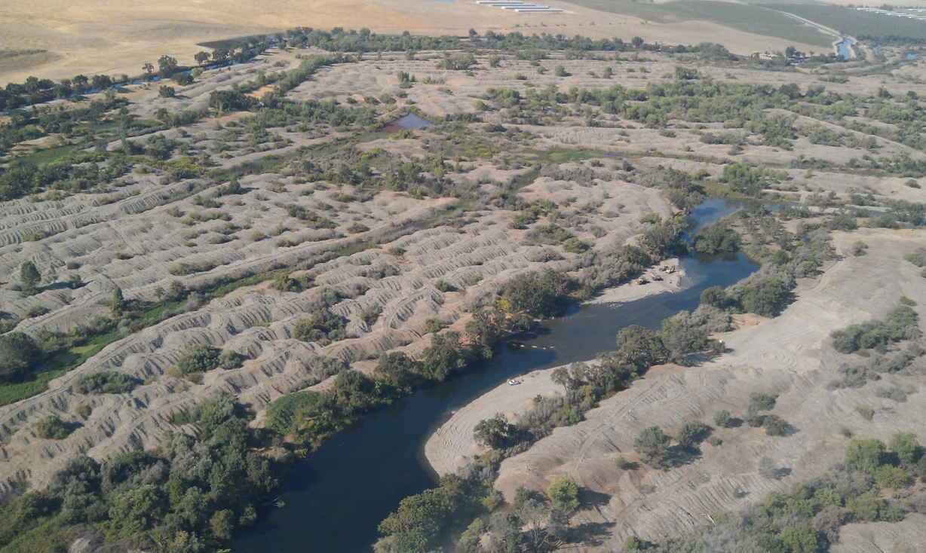
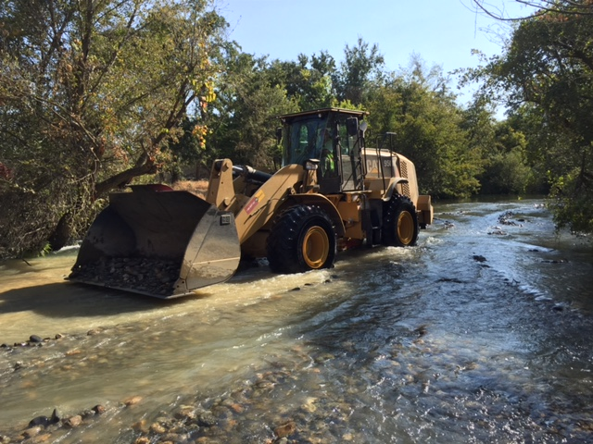
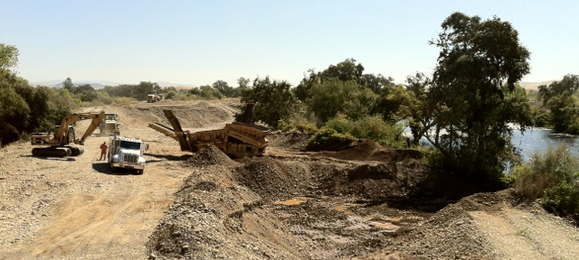
Rescaling means reshaping channels and floodplains
How much should we prescribe through moving dirt and rocks versus letting the river “work?
Notes:
In practice rescaling rivers means reshaping channels and floodplains by altering their topography.
Generally, we raise river beds by adding gravel and shrink river width. and lower floodplains. This is because current water releases generally do not have enough energy or space to naturally reset the river corridor.

Slide 6
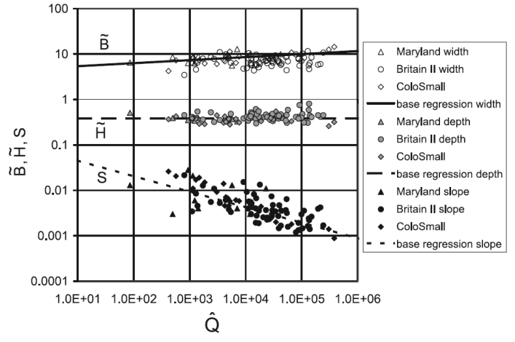
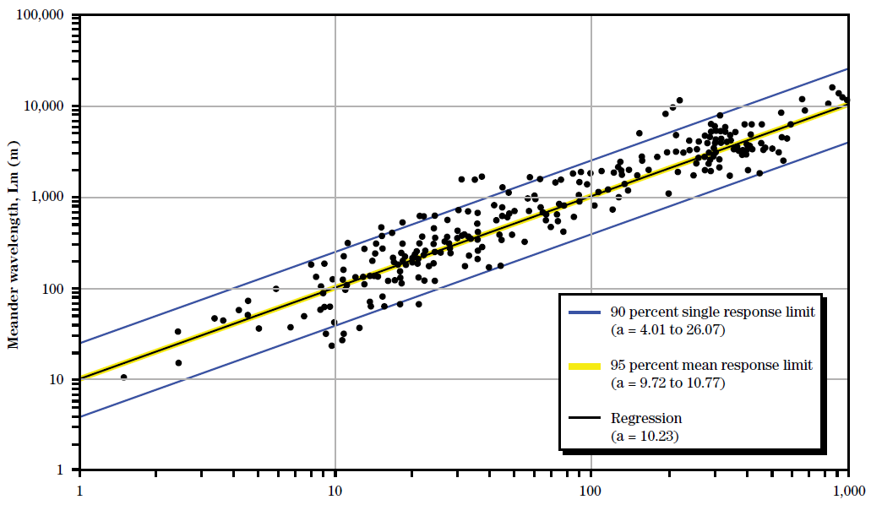
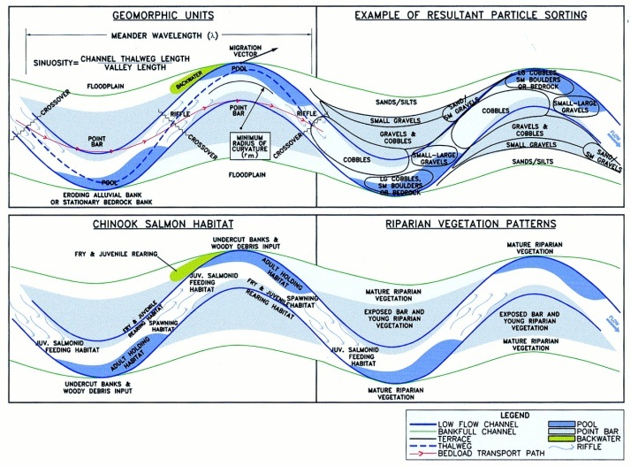
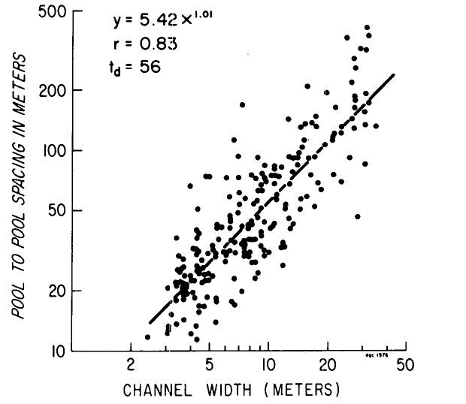
Knowing/assuming a “channel forming” flow, and some extrinsic reach properties we can calculate stuff
Dimensionless bankfull width ~B, dimensionless bankfull depth ~H , and down-channel bed slope S as functions of dimensionless bankfull discharge ^Q
(Parker et al., 2007. Physical basis for quasi-universal relations describing bankfull hydraulic geometry of single-thread gravel bed rivers)
Meander wavelength as a function of channel width for 438 locations (NEH 654, Ch12)
Pool spacing as a function of channel width (Keller and Melhorn, 1978. Rhythmic spacing and origin of pools and riffles)
Ideal relationships between form, sediment, plants and fish
Notes:
There are numerous hydrogeomorphic “predictors” that use the concept of a bankfull discharge and bankfull channel dimensions. These can allow further prediction of things like the reach-average planform typology and bedform spacing
While the theory behind rescaling may seem simple, in practice its much more difficult because many rivers aren’t blank slates, having multiple anthropogenic constraints as well as existing biological resources.

Slide 7
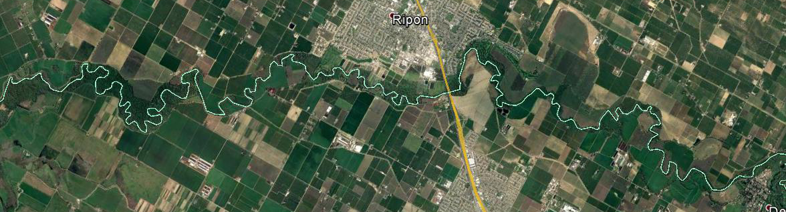
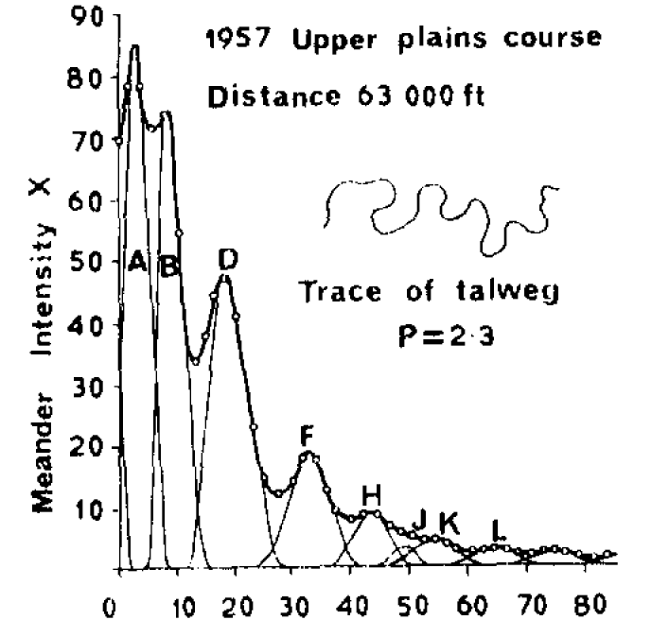
Rivers shapes are defined by variability
Meanders have multiple frequencies of oscillation, even altered systems
λ=aW
Typical meander wavelength equations are monochromatic, but real rivers are not
Meander spectrum for section of the Angabunga River
(Speight, 1965. MEANDER SPECTRA OF THE ANGABUNGA RIVER)
Notes:
Both flow and form have important variability beyond average conditions that creates the foundation for salmonid habitat in rivers.
Ironically, to understand rivers we simplified and deconstructed variability, but more information beyond averages is needed for ecological function.

Slide 8
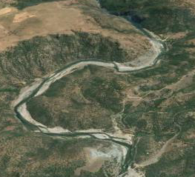
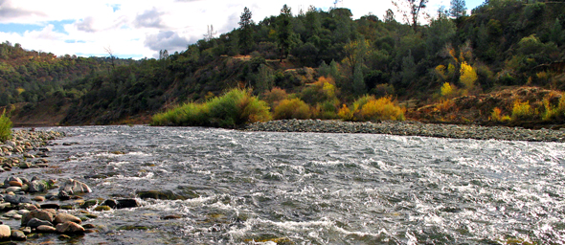
Rivers shapes are defined by variability
Timbuctoo Bend of LYR,
S = 0.002
Dd₅₀= 164 mm
Qbf=142
Notes:
This is an example of a geomorphic covariance structure analysis. The top left is a bed profile of the Timbuctoo Bend of the Lower Yuba River, the right plot is a flow width series for the bankfull flood of 142 m3/s. Taking the slope out of both yields the detrended series in the lower panel. Taking the product of the resdiuals gives you then red line, which is the geomorphic covariance structure of bed and width for the bankfull flow.
Note that there are areas that are relatively wide and shallow, and relatively narrow and deep, that create positive spikes.

Slide 9
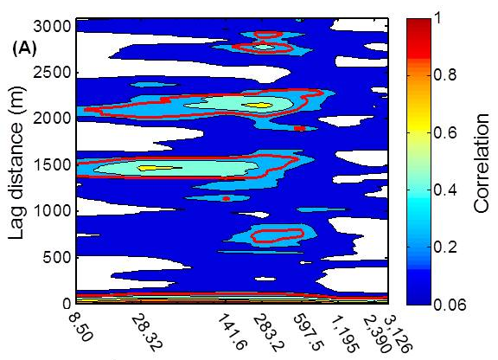
Rivers shapes are defined by variability
Autocorrelation of joint bed and width oscillations for LYR Timbuctoo Bend
Width and depth covary
and oscillate quasi-periodically, structured
at several scales at channel forming flows
W=aQ^{0.5}
Brown, R. A. and Pasternack, G. B.: Bed and width oscillations form coherent patterns in a partially confined, regulated gravel–cobble-bedded river adjusting to anthropogenic disturbances, Earth Surf. Dynam., 5, 1-20, doi:10.5194/esurf-5-1-2017, 2017.
Notes:
If we analyze the GSC series we find there is a reach statistical structure that shows that width and bed elevation variability is jointly linked.
This is a completely different view of a river’s geometry than classical hydraulic geometry.

Slide 10
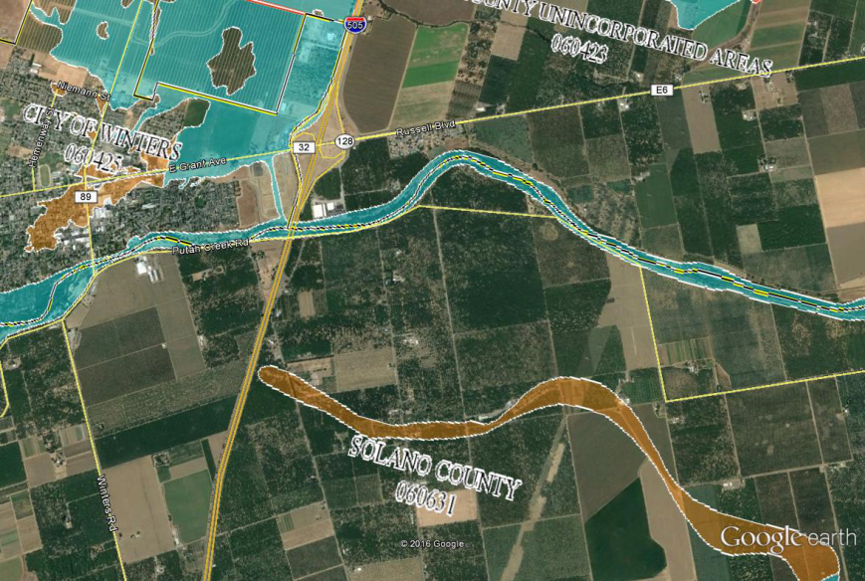
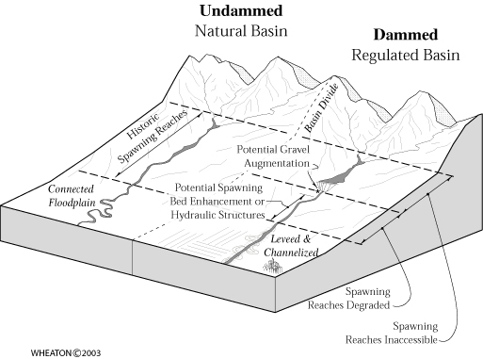
Channel rescaling is simple, but not for floodplains
Space for a channel is preserved through flood control, so infilling is typical to the extent that it does not raise base flood elevations
Several factors make it difficult to restore floodplains
  Rivers have incised
  Flows are reduced
  Levees
  Former floodplains now have other uses

Slide 11
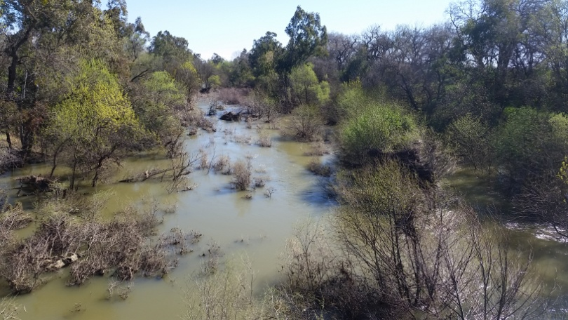
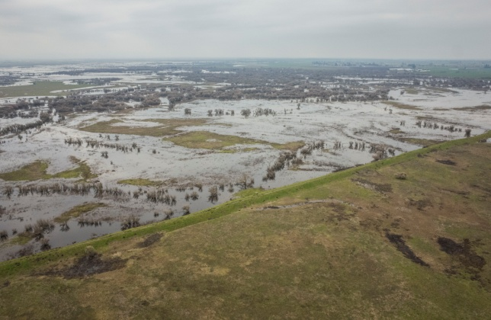
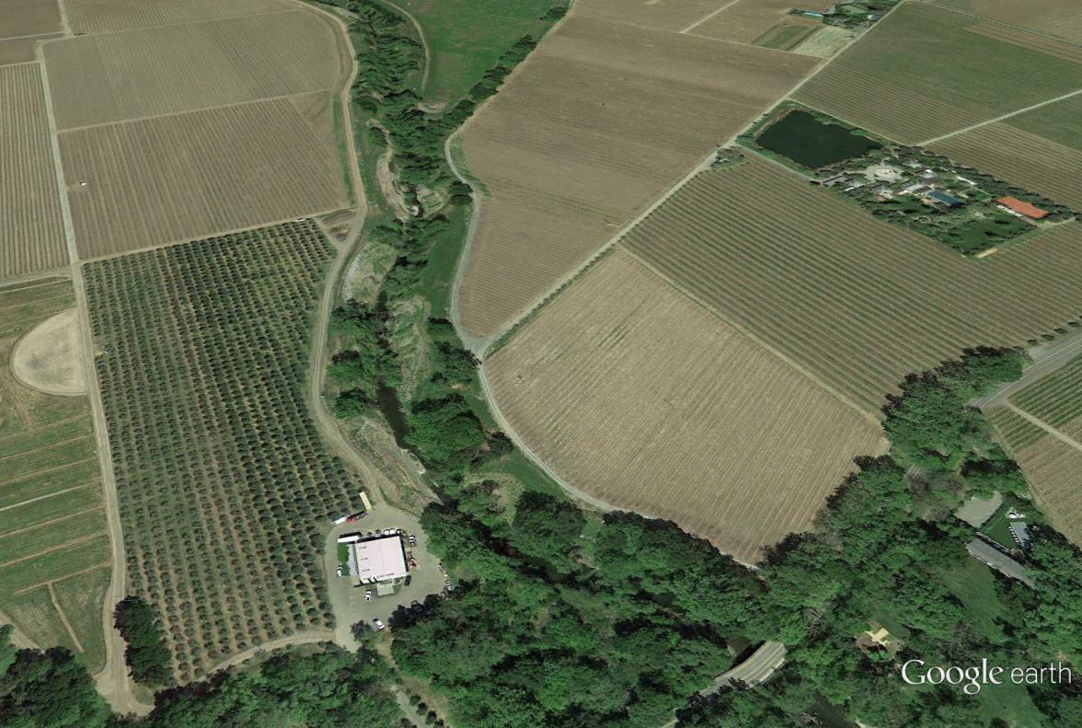
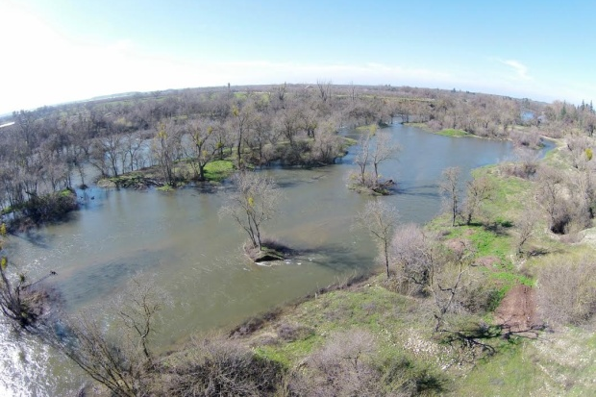
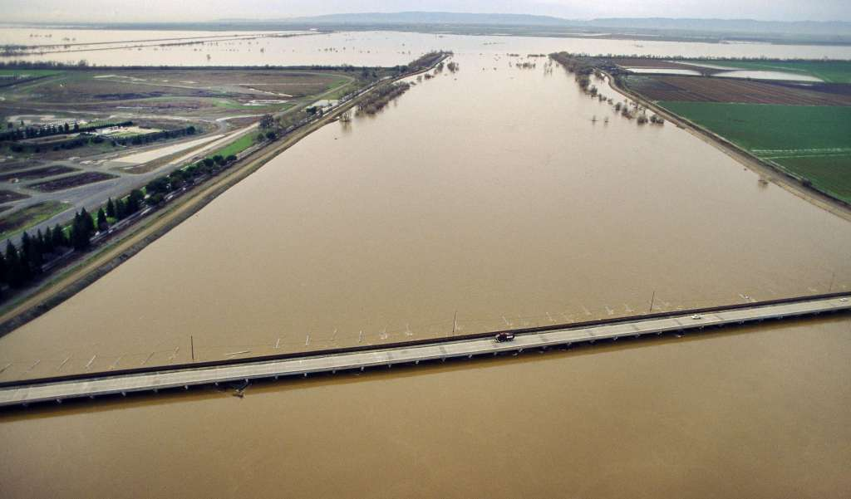
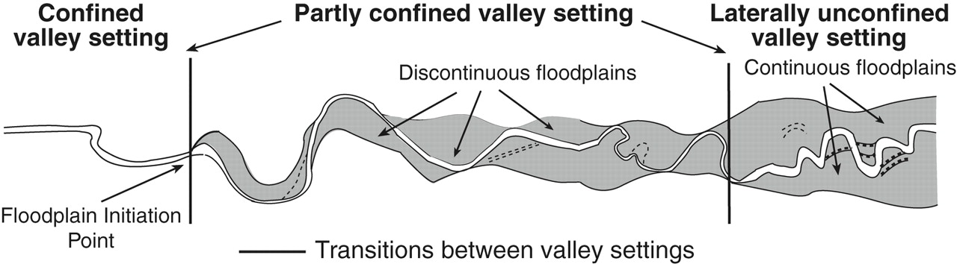
Anthropocene floodplains in space
Local
widening
Putah Creek
San Joaquin River (Daniel Nylen)
Napa River (Google)
Yolo bypass (SACBEE)
Merced River
Fryirs & Brierley. 2013
Notes:
Floodplain restoration varies in space, and it usually probably should
Are we restoring these at a rate that is meaningful to fish considering status?
But when we cant blow a levee or use an agricultural field how do we justify the space needed given limited water?

Slide 12
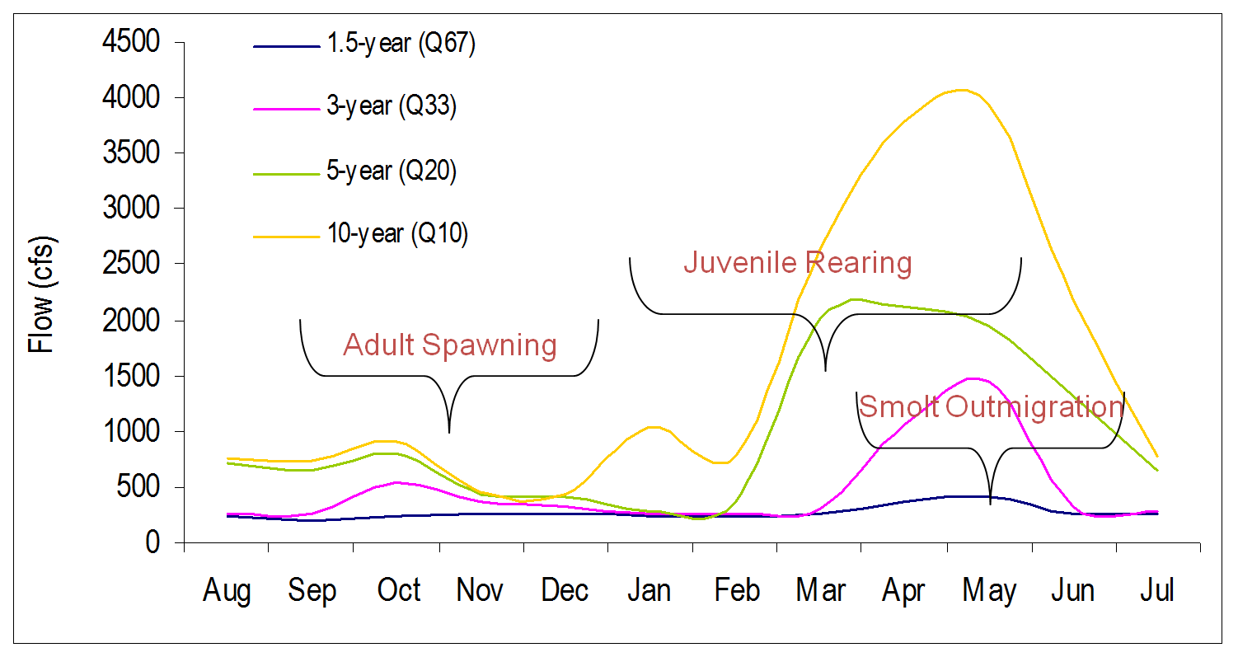
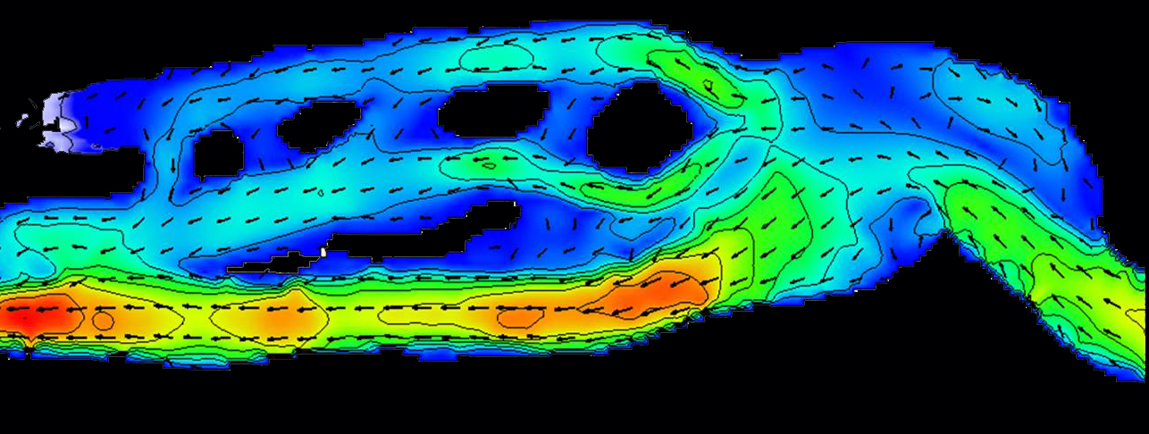
Designing and optimizing water and floodplains for fish habitat
Ecohydrology of when and how long fish utilize habitat
Ecohydraulics for what fish need when they are there
Numerical model of predicted hydraulics for design conditions
Does “work” yield an increase in habitat?
Notes:
We’re actually very sophisticated in our tools and approaches for analyzing fish habitat.
The ecohydraulic approach shown on this slide has progressed over the past 30 years.
We also should design so that landforms are compatible with processes that form and maintain features, necessitating geomorphic inquiry into the sustainability of suitable habitats.

Slide 13
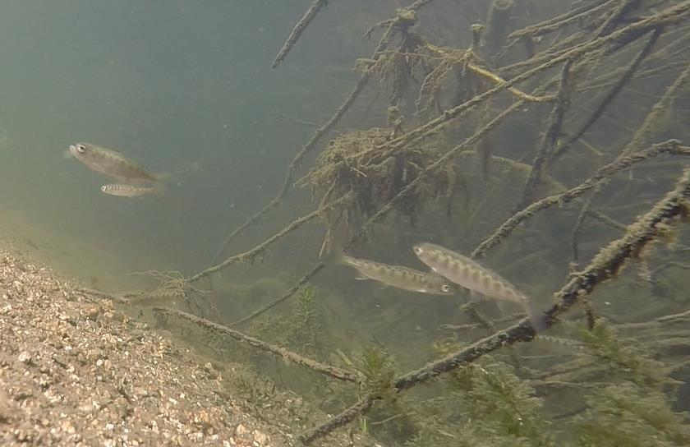
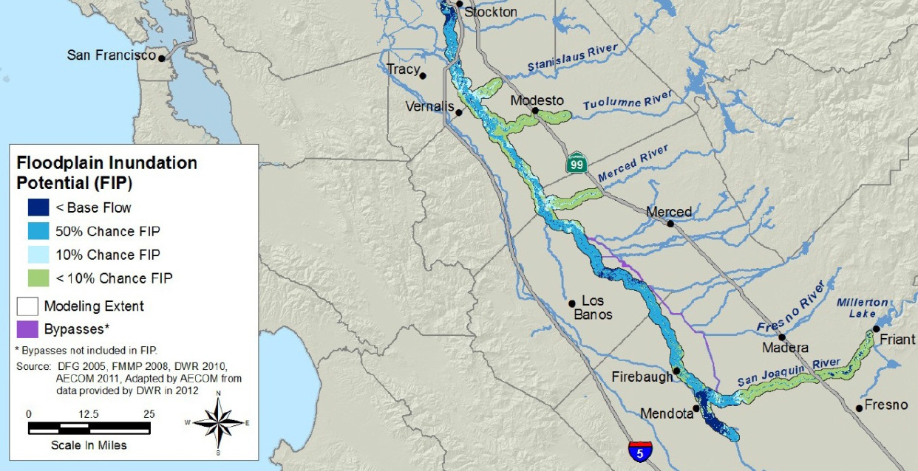
Beyond habitat suitability to populations
See talk by Travis M. Hinkelman, Ph.D.
Emigrating Salmonid Habitat Estimation (ESHE): A Modeling Framework for Estimating Habitat Needs for Outmigrating Juvenile Salmonids
Habitat capacity
= Available suitable habitat
territory size
CVFPP Conservation, DWR 2016
Notes:
We can even go beyond suitability to populations associated with habitat

Slide 14
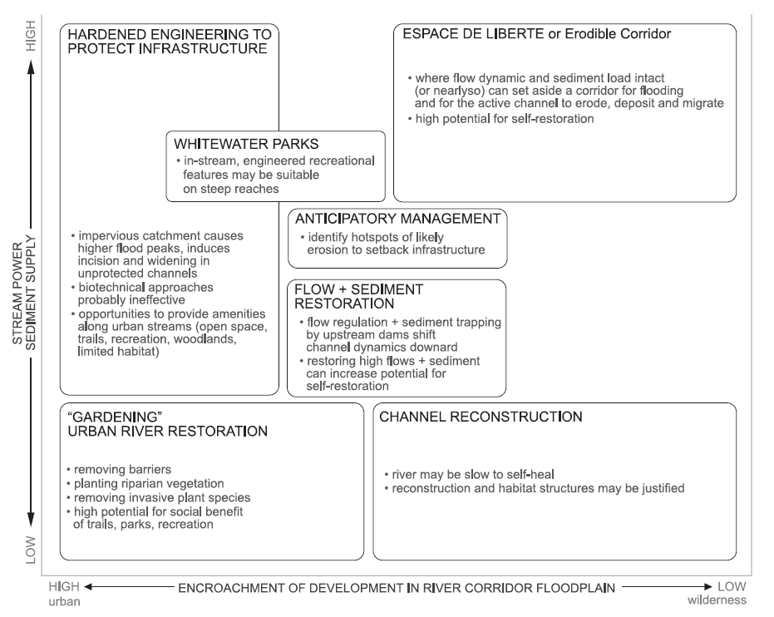
When can a river heal itself?
Kondolf et al. SETTING GOALS IN RIVER RESTORATION
Notes:
We’ve talked about theory so far, and hopefully you can appreciate that tools exist, but they have limitations.
So the next question is how much we should prescribe the form of a channel and floodplain versus letting flow do the work. This is a graph by Kondolf related to setting goals in restoration. The concept of this graph is important, although as there are no values on the axis’ the utility may be limited. For example, how do you know whether you have “enough” or “too much” stream power and sediment supply?

Slide 15
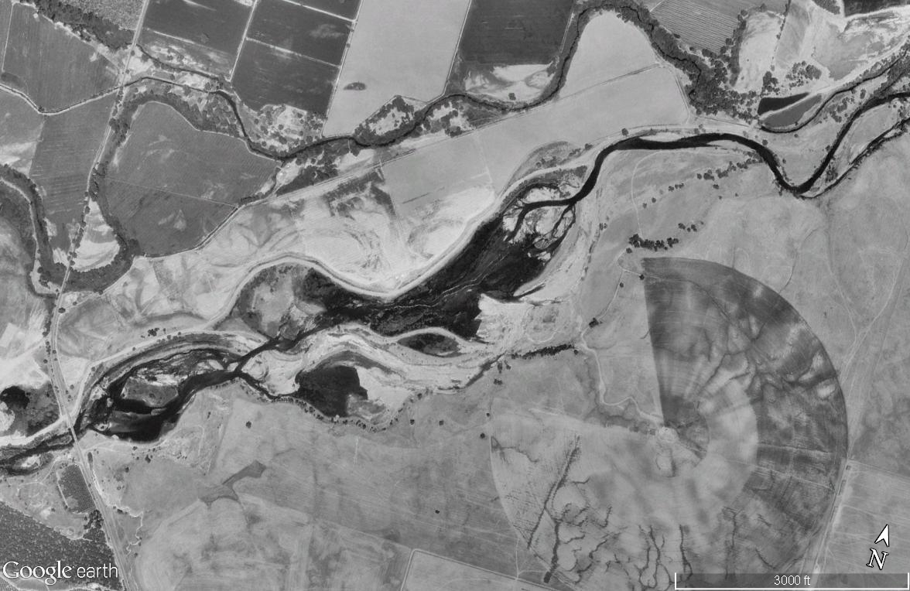
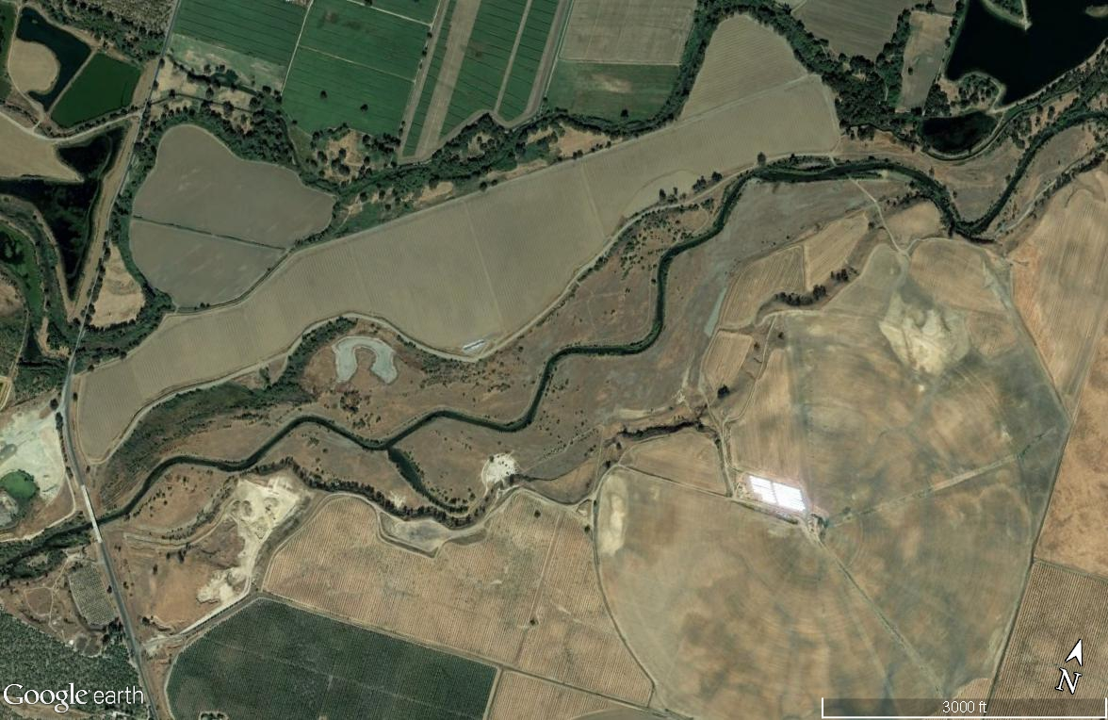
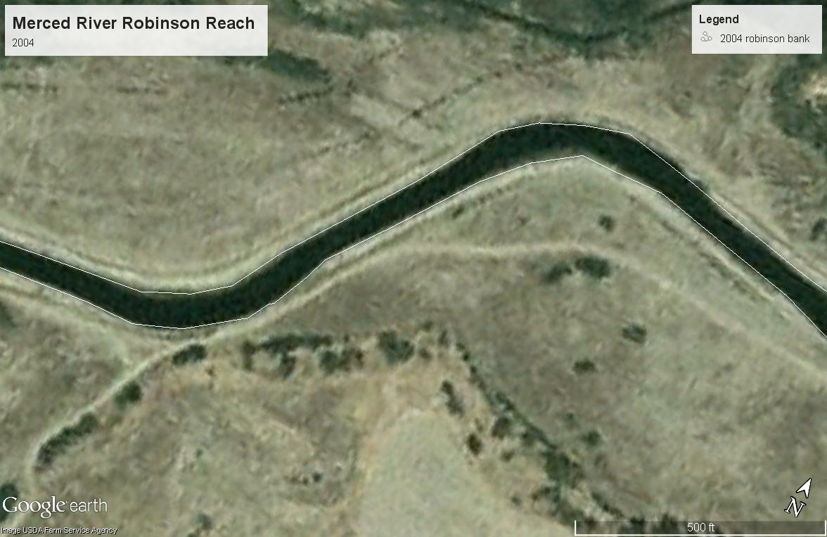
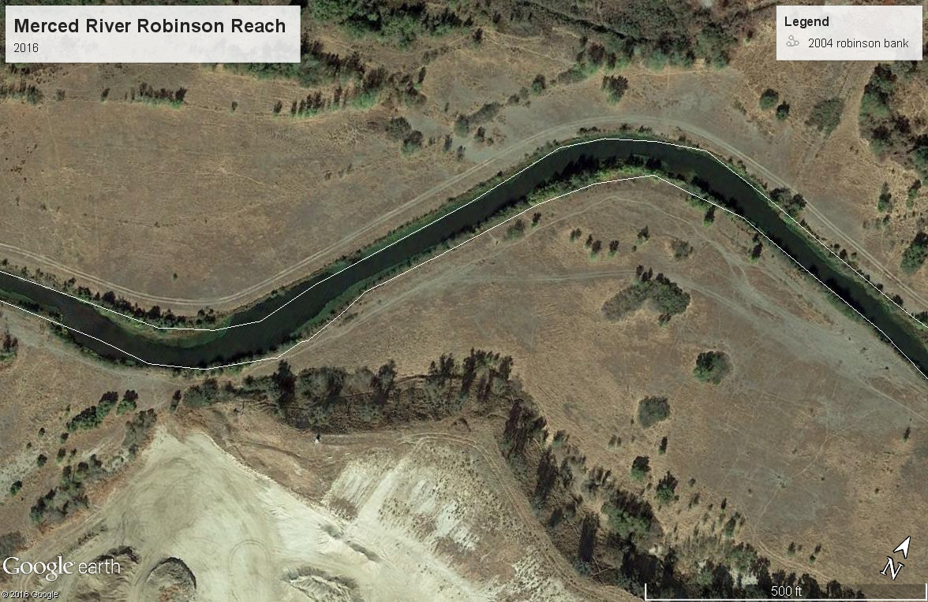
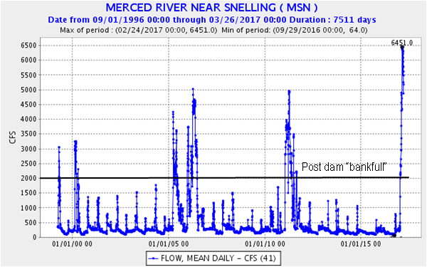
Hitting reset
Robinson Reach of the Merced River
1998
2017
Point bar and chute formation occurring, but very slowly
Notes:
Here is an example of a case where we hit reset on the landscape and entirely reconfigured the landscape.
The Robinson Phase of the project began construction in July, 2001 and was completed in February, 2002. Approximately 1,000,000 tons of material was moved in reconfiguring the project site. In addition, more than 10,000 feet of channel was created, improved or modified, and several ponds were eliminated.

Slide 16
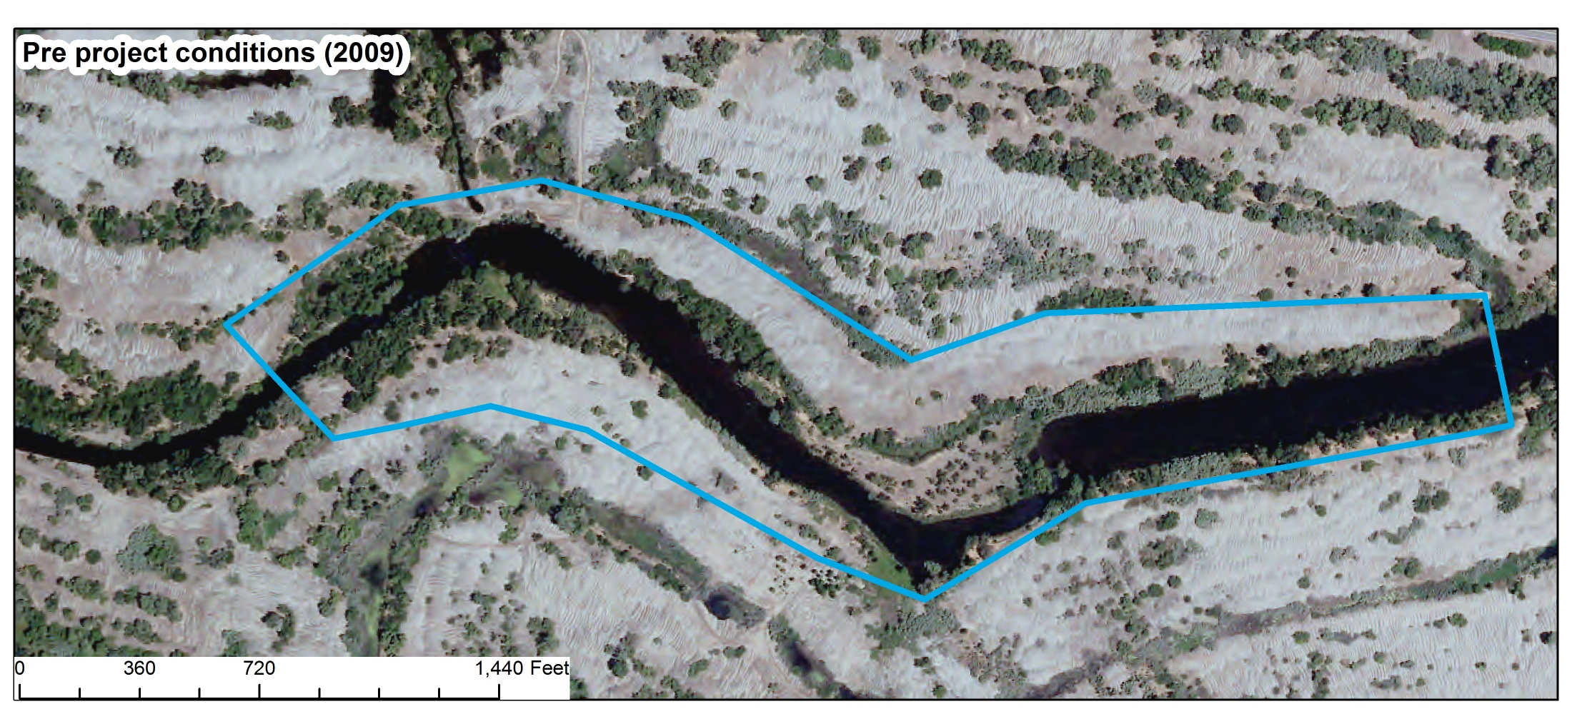
Merced River Ranch
Notes:
Here is the River Ranch on the Merced River. NOAA and CDFW had the foresight and initiative to purchase property for restoration and a source of gravel.
Our task was to restore a channel and floodplain, but minimizing impacts on vegetation. Since the Merced gets very warm (it was the southern most extent for Chinook salmon in the world while the SJR was dry)

Slide 17
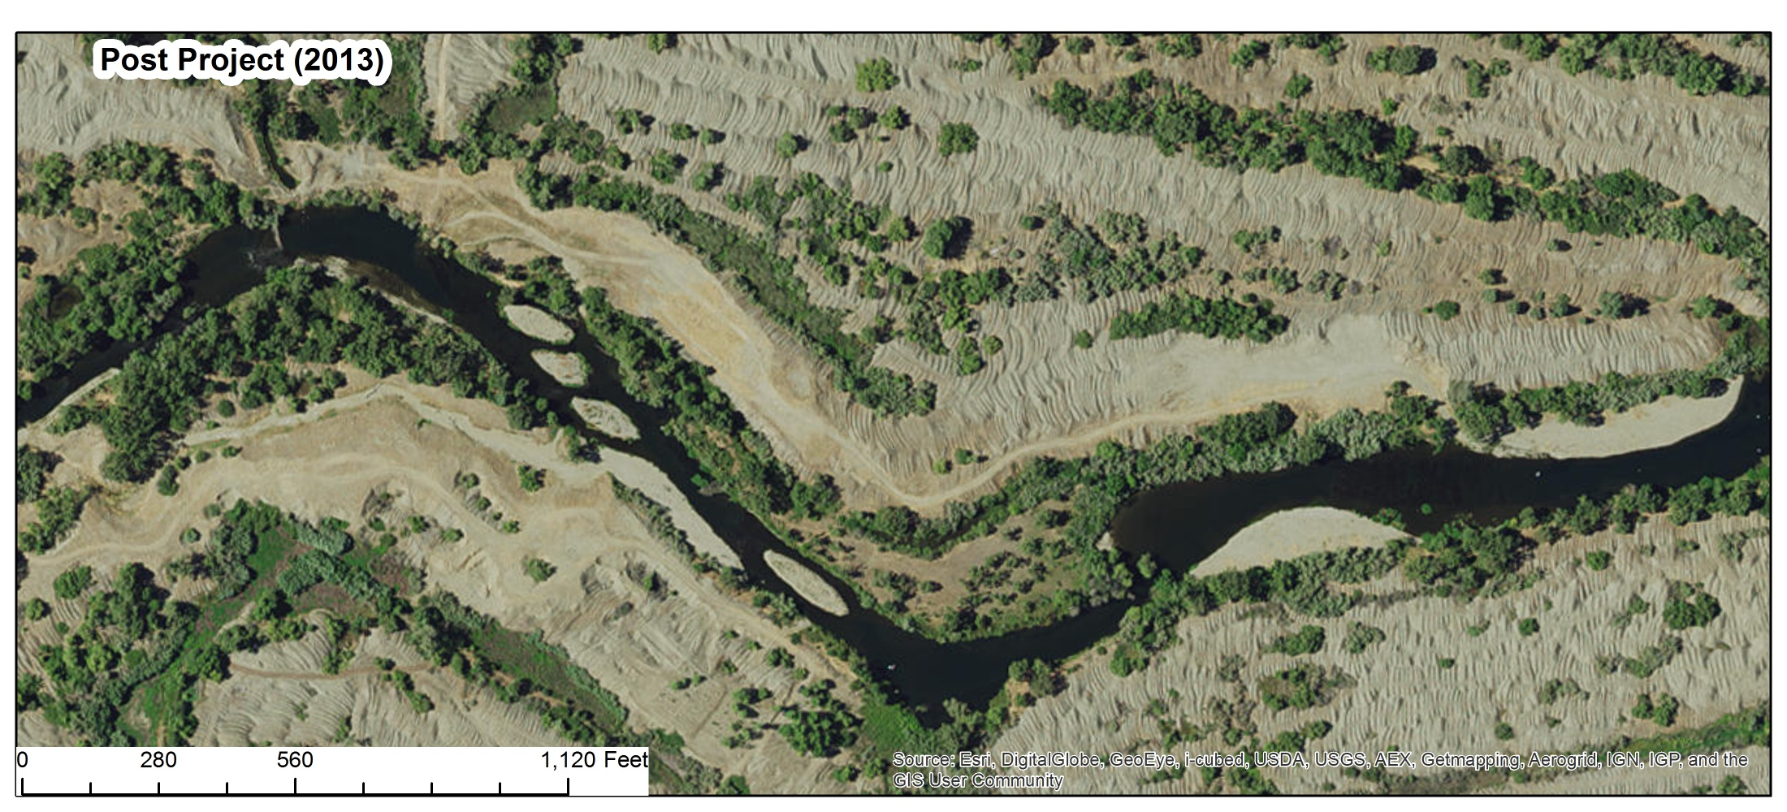
Merced River Ranch
Notes:
A greater diversity of river planforms exist, and plants play a large role
Planform discriminate functions can guide geomorphic potential
Features are scaled to flow regime and topographic regime
This photo shows the project after construction, and yes, some of the features didn’t “look” great

Slide 18
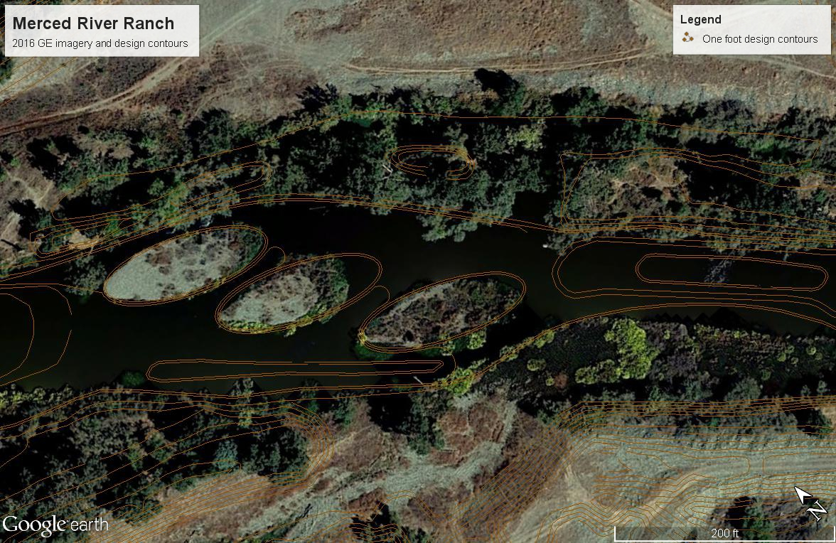
How much to prescribe through design versus letting river “do it’s thing”?
Simple shapes evolve into fluvial forms with flow
Increased stabilization of bars from vegetation growth during drought
Notes:
This raises a good question for funders and designers.
How much money and effort do we put into features versus setting them up to act dynamically with flow?

Slide 19
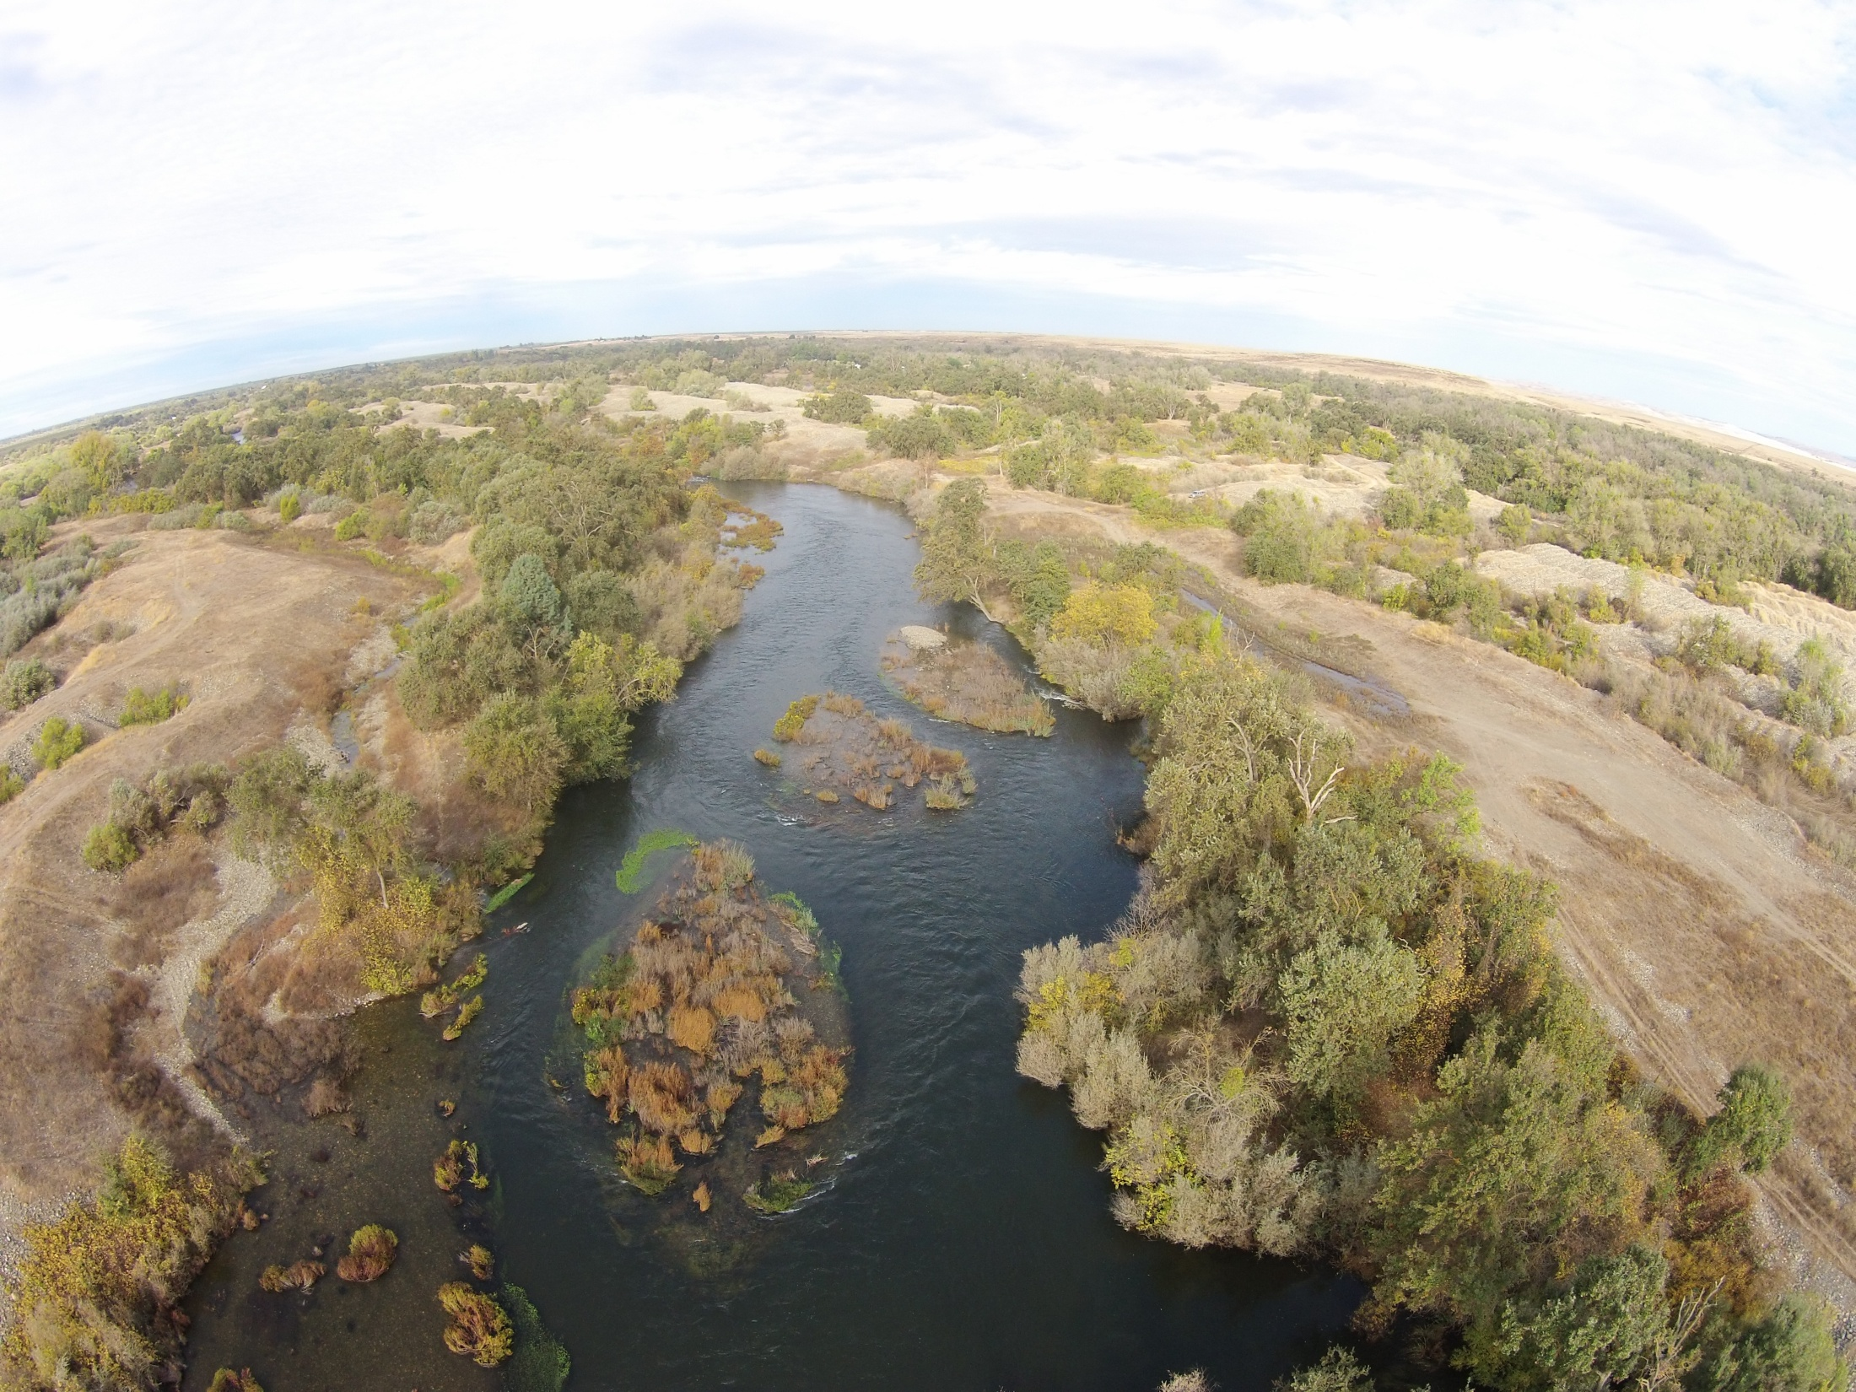
River islands as rearing habitat
Notes:
River islands are not part of the traditional menu of geomorphic features for fish habitat.
They are important because they can provide greater edge habitat at small to moderate floods, rearing or refugia on the island during moderate floods, and refugia in island vegetation during larger foods. Other benefits include the fact that they provide greater diversity of hydraulics.

Slide 20
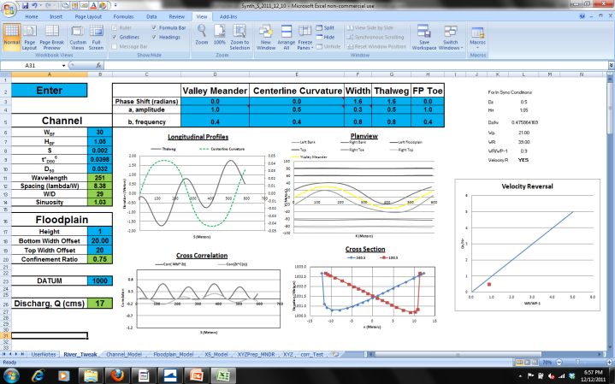
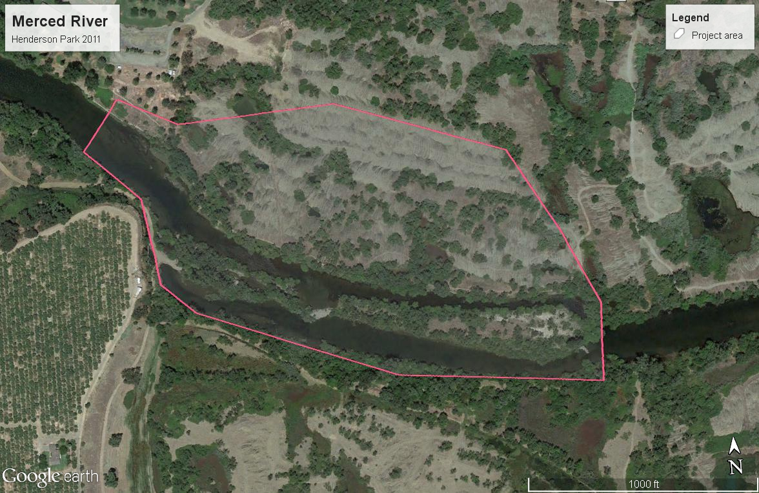
Merced River Henderson Park
Hit reset and let it evolve?

Slide 21
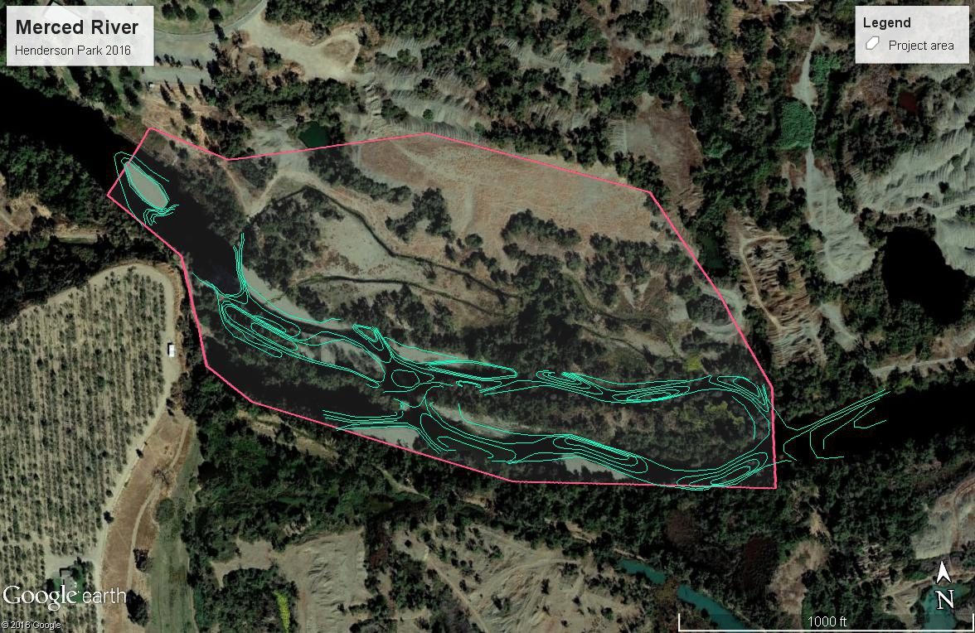
Merced River Henderson Park
Nest channel geomorphic features within larger river island –> greater variability & preserve biological resources

Slide 22
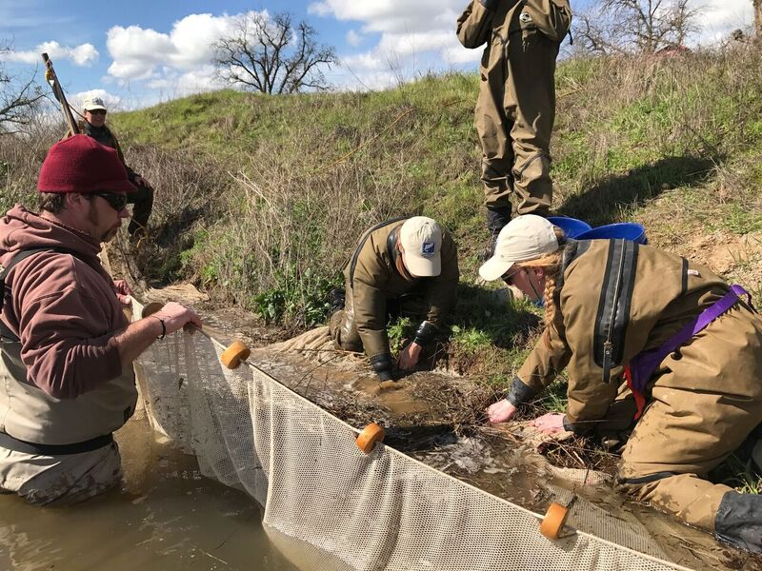
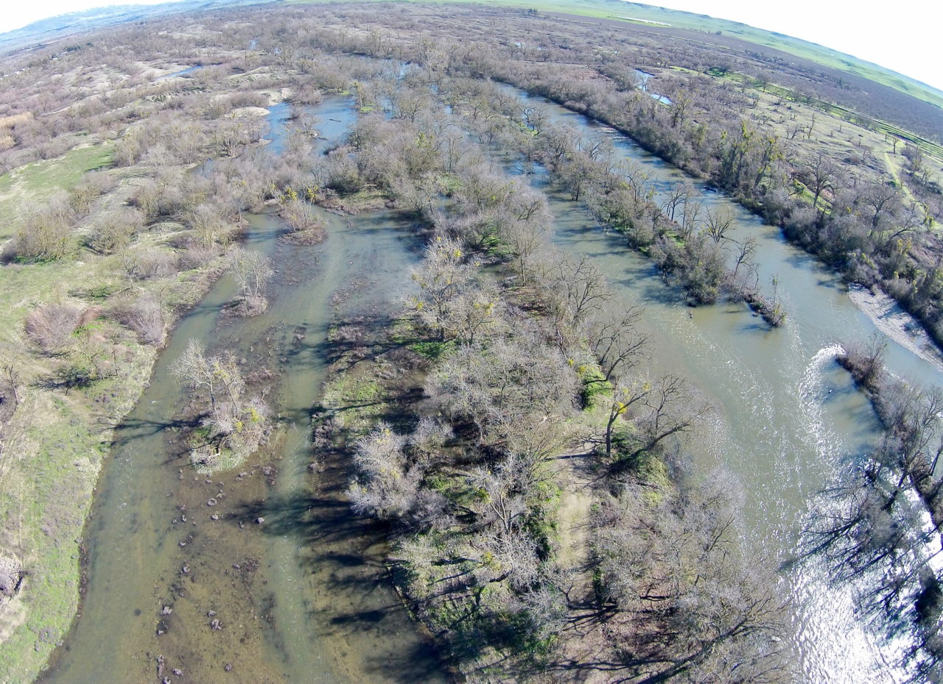
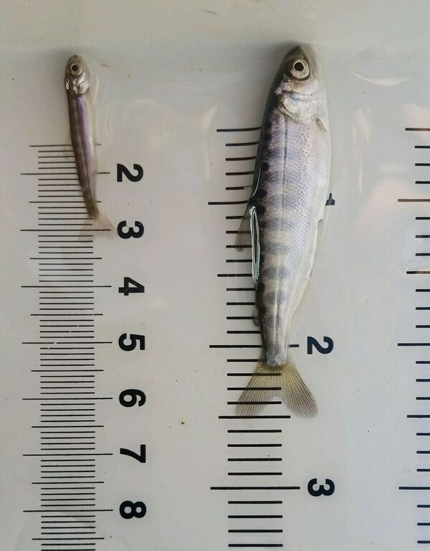
Merced River Henderson Park
Initially flat floodplain with proto channels now evolving with flow, sediment and biogeomorphic feedbacks
Monitoring is ongoing

Slide 23
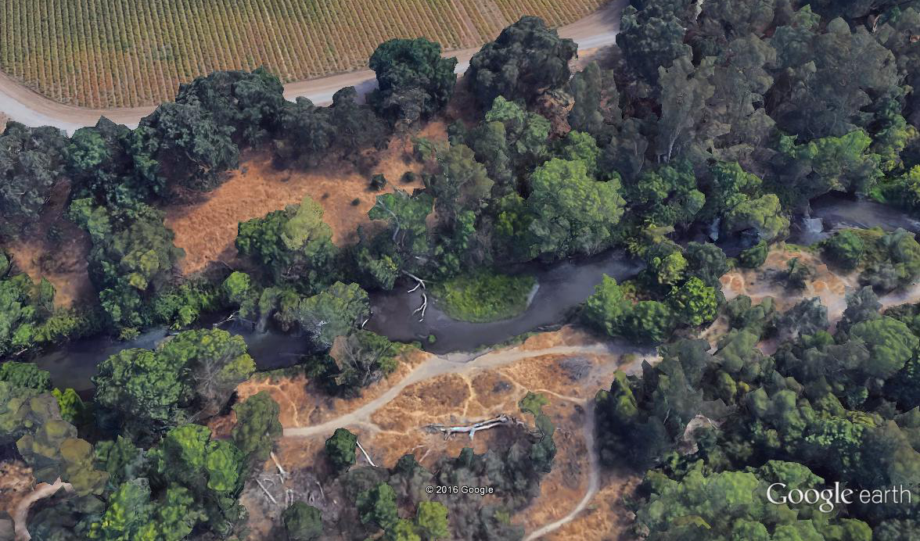
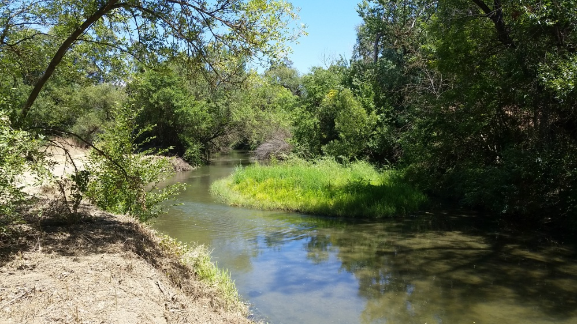
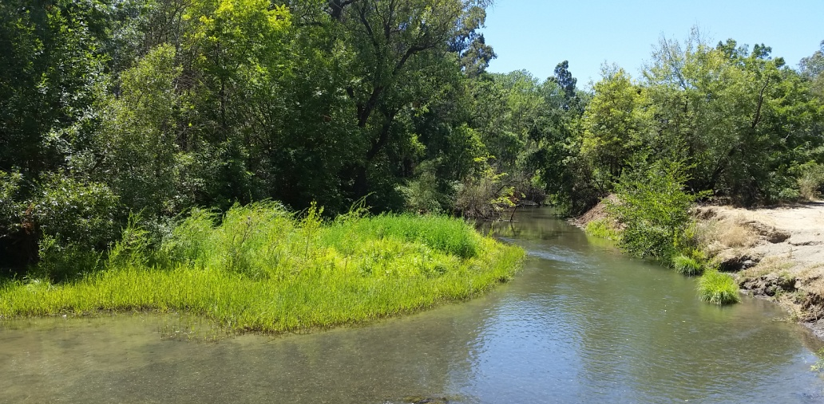
Natural morphogenesis on Putah Creek
Island and point bar evolution on Putah Creek break up oversized bathtub sections
Deposition during floods in winter, colonization during summer
Initial island appears to be setting up meandering
Notes:
Parts of our rivers have begun the process of building of inset floodplains that will be valuable habitat now and into the future for fish

Slide 24
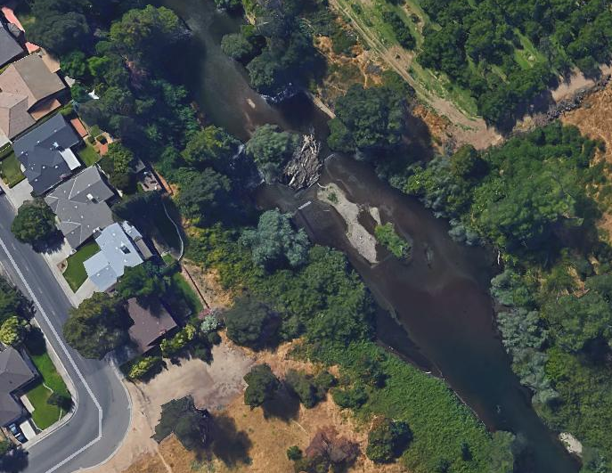



Natural morphogenesis on the Stanislaus River
Island formation on Stanislaus River
Flow splits help sort sediment
Notes:
When can this occur naturally, how much we need to help and intervene, and what the benefits are is a key question as we look forward

Slide 25


Looking forward…with eyes wide open
Process-form dynamics that introduce potential complexities in the temporal evolution of landforms. Geomorphic systems retain a memory of past processes, but interpreting process history from form is non-trivial. James. 2015
Those who cannot remember the past are condemned to repeat it
- George Santayana
Notes:
And as we look forward we should be mindful that rivers evolve and things, such as our thinking change.
We have no excuse to not understand and plan for change, to allow it in a way that can help support our coexistence with salmon
Those who cannot remember the past are condemned to repeat it
- George Santayana

Slide 26






Acknowledgements
The opportunity and content associated with this talk is due to A LOT of people

