Slide 1
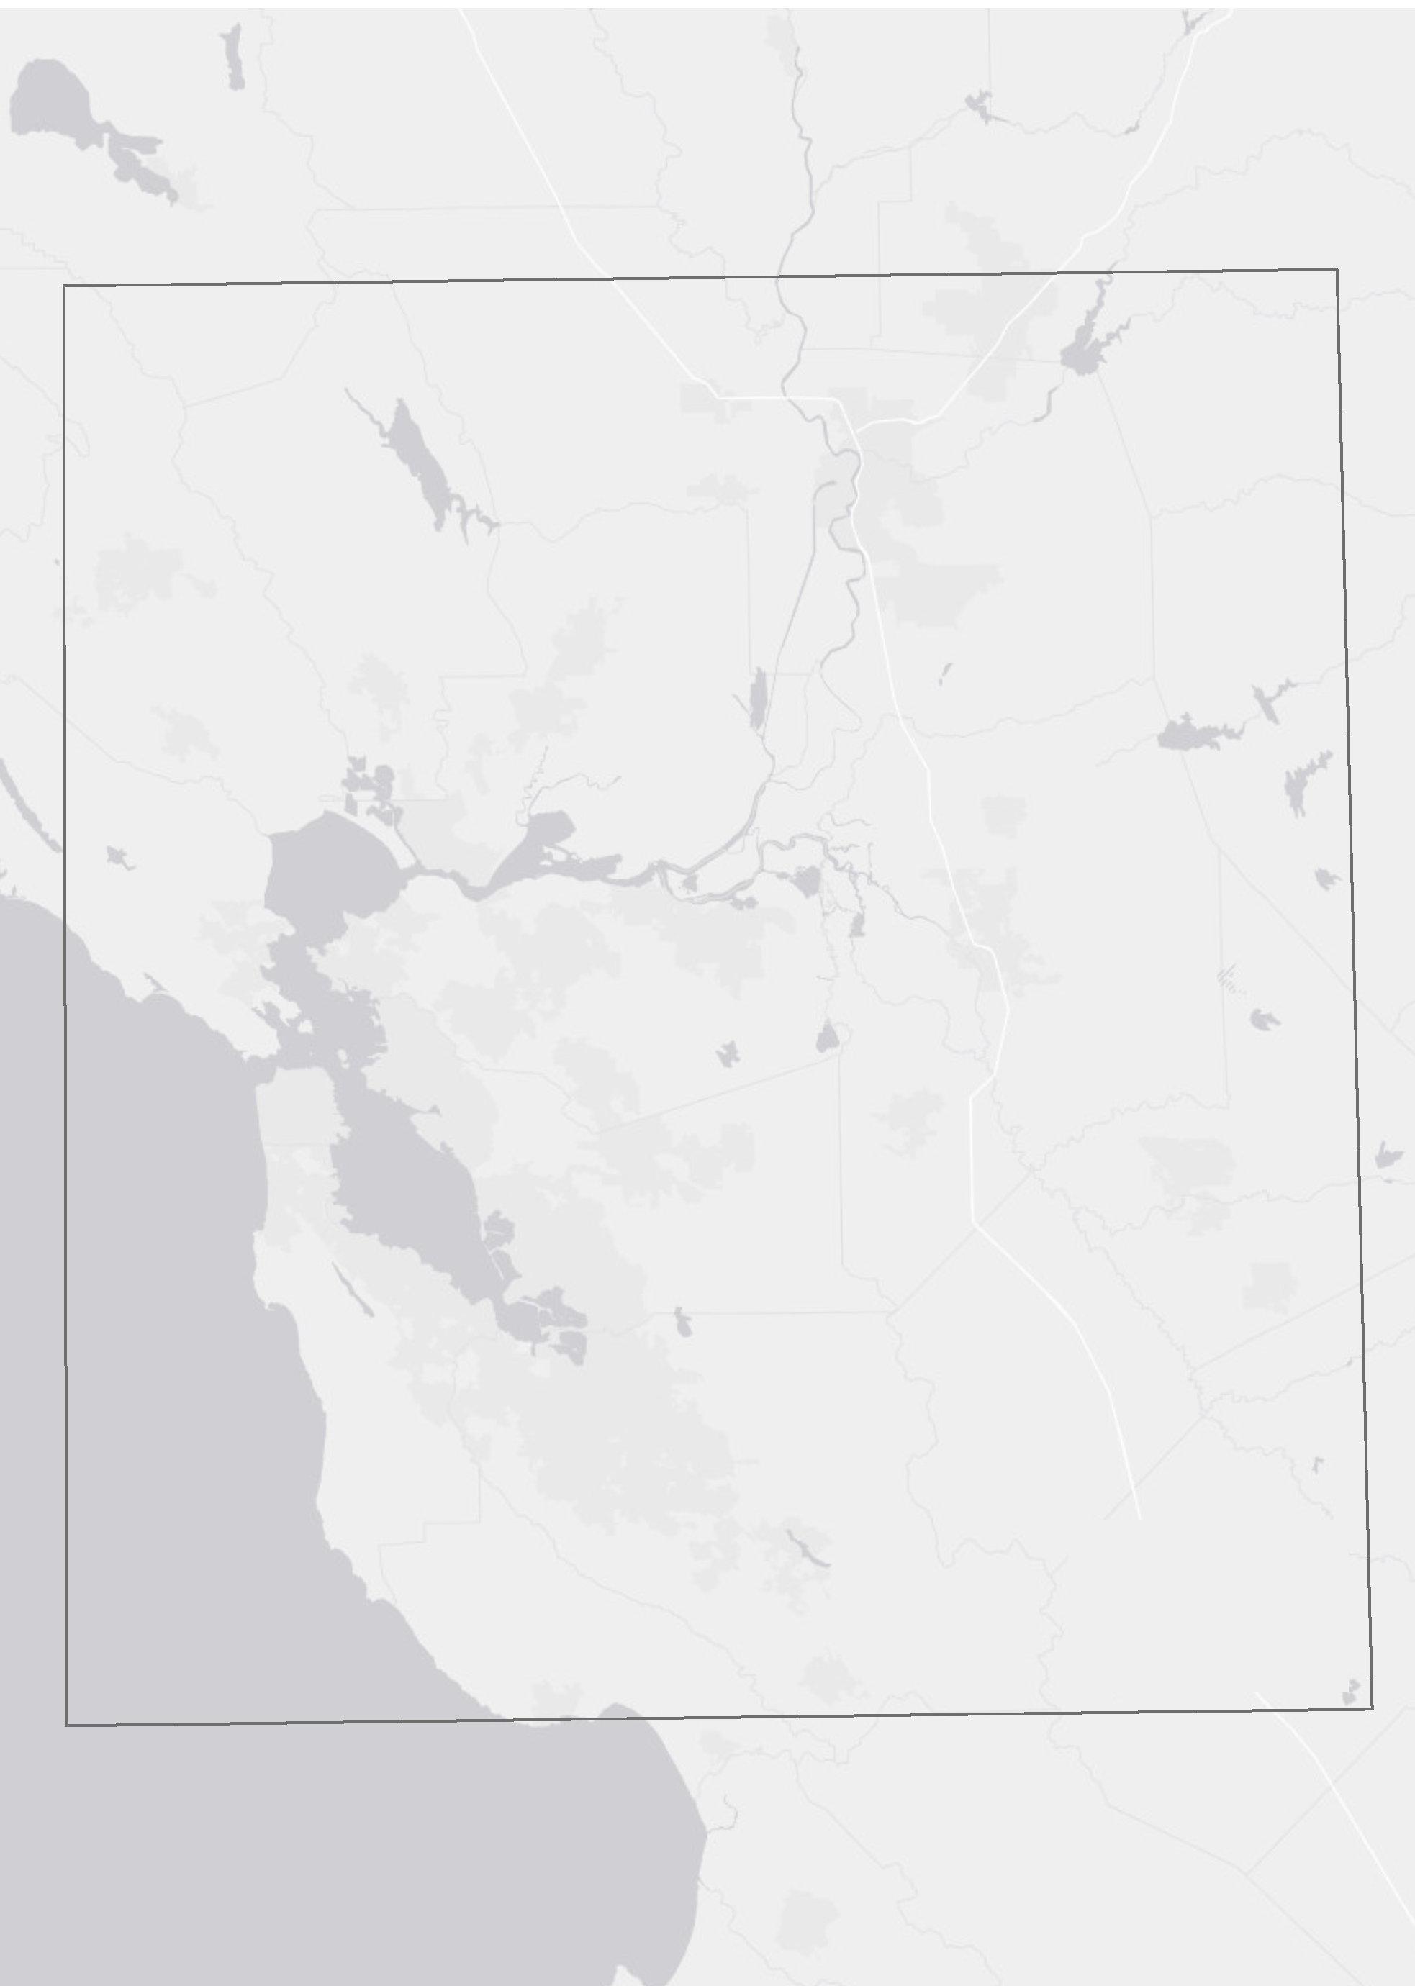



National Aeronautics and
Space Administration
San Francisco Bay Delta Water Resources
Utilizing NASA and ESA Earth Observations to Monitor Turbidity Distribution in the San Francisco Bay-Delta
Katherine Cavanaugh (Project Lead)
Leah Kucera
Molly Spater
NASA Jet Propulsion Laboratory
2017 Summer
Notes:
Hello! My name is Kate Cavanaugh and I’m the Project Lead on the SF Bay Delta Water Resources Team. I graduated from Gettysburg College last year with a degree in Environmental Science. Hi I’m Leah Kucera, I graduated from Washingtion University with a degree in Environmental Earth Science. Hi I’m Molly Spater I graduated from UCLA with a degree in Geography.

Slide 2
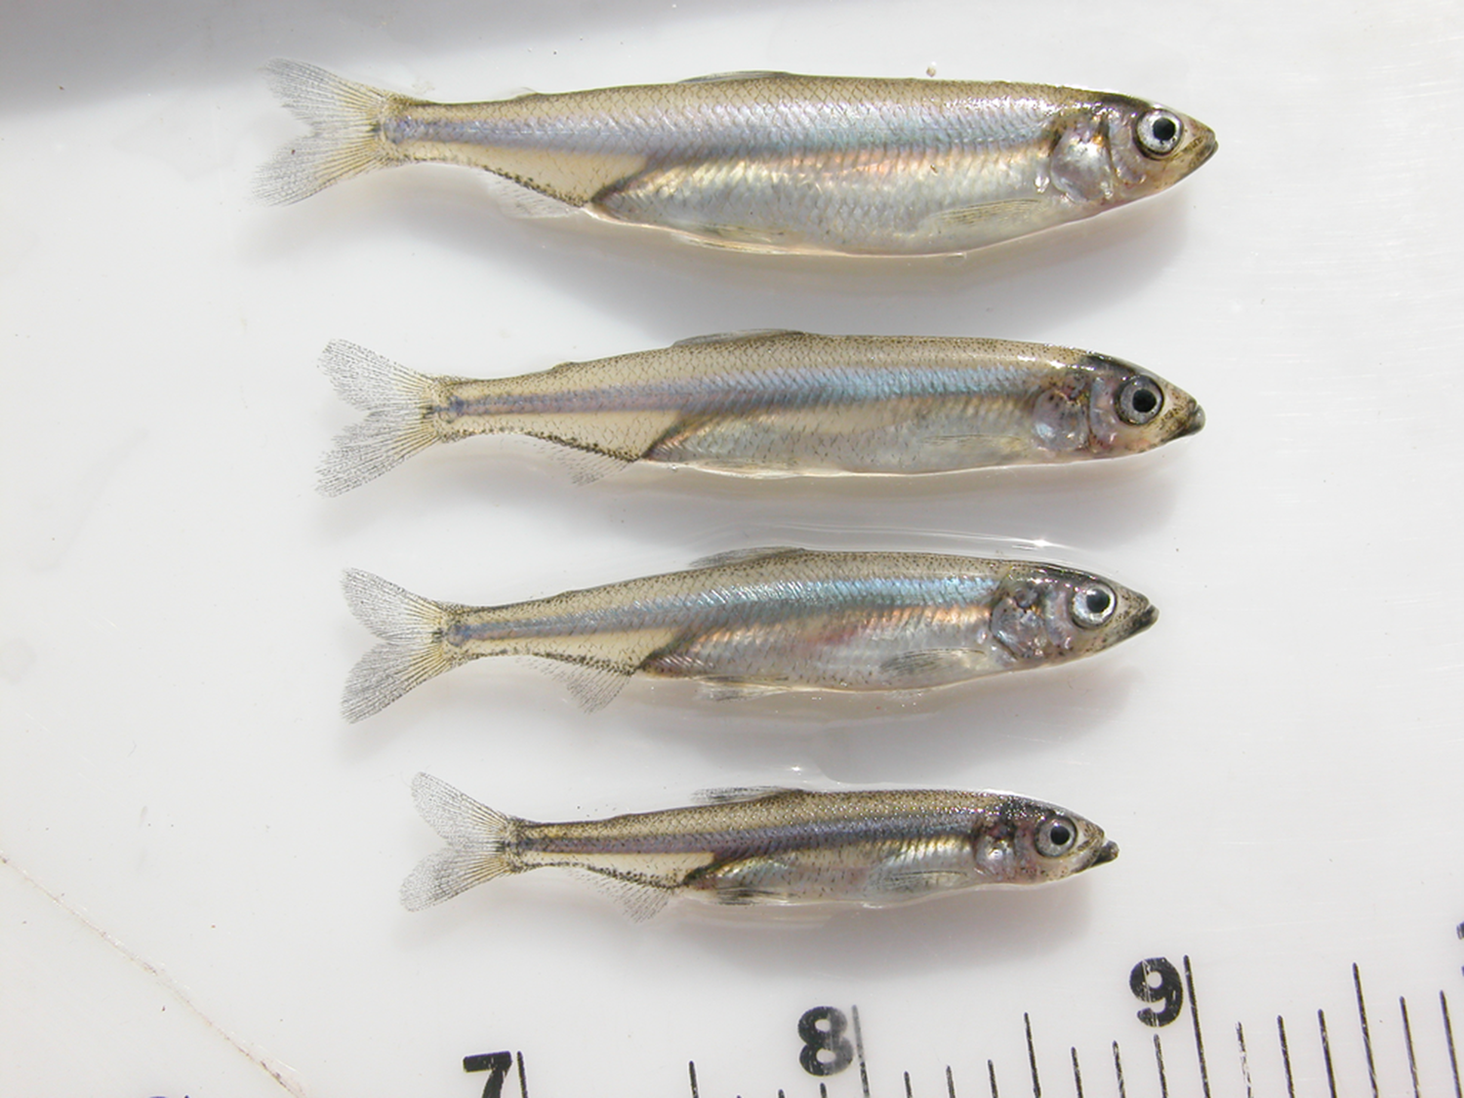
Overview
Community Concerns
Partners
Objectives
Study Area & Period
Methodology
Results & Limitations
Conclusion & Future Work
Image: Wikimedia
Notes:
To give an overview of our presentation, we will start with the community concern that brought about the project. We will then discuss our project partners and objectives, followed by an overview of the study area and study period. We will then move into the methodology, results and limitations, and conclusion/ future work.
Image Source: http://commons.wikimedia.org/wiki/File:Claude_Monet_-_The_Magpie_-_Google_Art_Project.jpg

Slide 3




Community Concerns
Increased demand for Bay-Delta water resources
Agricultural and municipal water comes at the expense of the Delta smelt
Demand for turbidity data in areas not monitored by in situ stations
Water from the Delta supports:
25 million Californians
7000 mi² of agriculture
10 endangered
species
Notes:
25 million Californians as well as 7000 square miles of agriculture depend on a steady supply of water exported from pumping stations in the south Bay Delta. Population growth and the recent drought is continuing to increase demand. 10 endangered species, including the Delta Smelt, a small fish that happens to smell like cucumbers that this project focus on, call the Delta home. The Delta Smelt’s population has been on the decline in recent decades, and is now on the brink of extinction. Delta smelt prefer turbid waters as it is easier for them to feed and hide from predators. When the water export pumps are in operation during periods of high turbidity, smelt seeking to move towards favorable feeding and spawning areas can become disoriented by the disruptions to natural currents. This can lead to fish entrainment and mortality in the pumping mechanisms. Pumps must be shut off in fact if certain turbidity thresholds are met to protect the species. Considering the existence of the species all together is at risk, the questions is how can resource managers better meet demand for water while minimizing harm to the delta smelt?

Slide 4
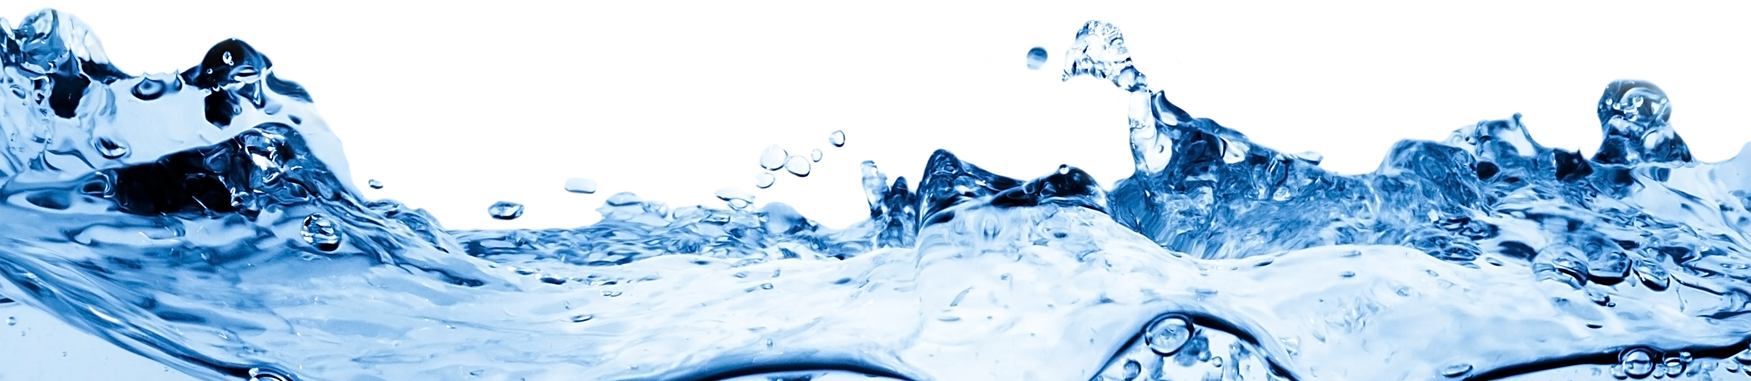
Partners
Metropolitan Water District of California (MWD)
Largest distributor of treated drinking water in the United States
Supply water to 19 million people in Los Angeles, Orange, Riverside, San Bernardino, San Diego, and Ventura Counties.
Support research efforts to balance water resource needs with proper ecosystem functioning
Image Credit: MWD
Image: Oregon Environmental Council
Notes:
We partnered with the Metropolitan Water District of CA (MWD) for this project. MWD is the largest distributor of drinking water in the US, supplying 19 million people across southern CA counties. MWD focuses on providing municipal resources while minimizing damage to aquatic ecosystems
Image Source: http://www.oeconline.org/safe-drinking-water/

Slide 5
Partners
34 North
Anchor QEA
Application and Software Development
Graphic and user experience design
Provide MWD with website and data analysis and visualization support
Planning, Cleanup, Development and Restoration efforts
Focus on aquatic landscapes
Provide MWD with turbidity modelling within the Bay Delta
Image: Oregon Environmental Council
Notes:
We also received support from partners of MWD; 34 North, an Application and Software Development firm, and Anchor QEA, which focuses on planning, cleanup, development and restoration.
Image Source: http://www.oeconline.org/safe-drinking-water/

Slide 6





Objectives
Satellite
In Situ
Support the development of MWD’s turbidity model by providing satellite data for validation
Compare turbidity values derived from Landsat 8, Sentinel-2, Sentinel 3
Turbidity
Explore the interchangeable use of satellite data and in situ data for model validation
0 FNU
250 FNU
Notes:
Our top objective was to support the development of MWD’s turbidity model by evaluating remotely sensed products that could be used in model validation. To do so we compared the capacity and accuracy of turbidity values derived from Landsat 8, Sentinel-2, Sentinel-3 with in situ data. We explored what regions of the Bay Delta satellite data was highly correlated with in situ data so as to utilize satellite data where in situ data was lacking.
Image Source: http://commons.wikimedia.org/wiki/File:Claude_Monet_-_The_Magpie_-_Google_Art_Project.jpg

Slide 7
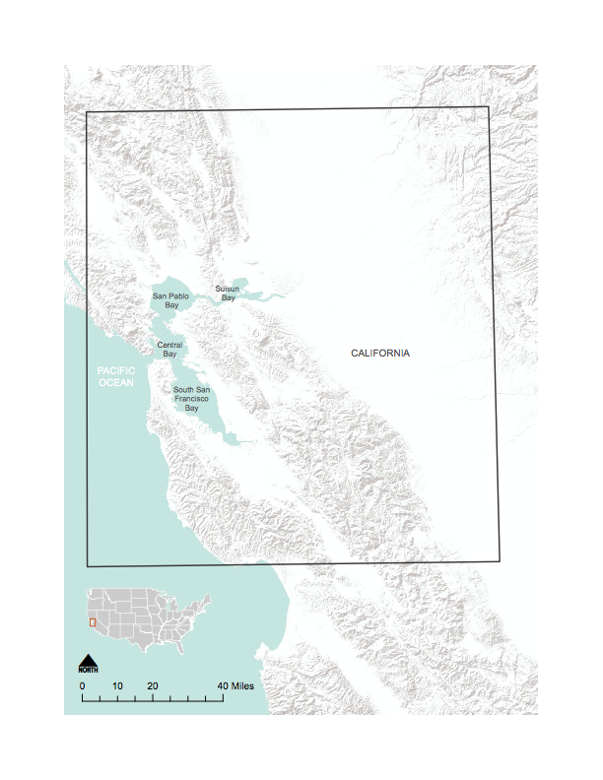
Study Area
Western portion of the Bay Delta Watershed
    San Pablo Bay
    Central Bay
    South Bay
    Suisun Bay
    Tributaries of the Sacramento and San Joaquin Rivers
Notes:
The study area of this project encompassed the Western portion of the Bay Delta Watershed, including the San Pablo Bay, Central Bay, South Bay, Suisun Bay, as well as the Tributaries of the Sacramento and San Joaquin Rivers.
NOTE: For every image on the slide include an image source in the speaker notes (ex. URL; Name, Affiliation, etc.)
Landsat 8 April 2013 to present
Sentinel 2 January 2016 to present
Sentinel 3 december 2016 to present
Image Source: http://commons.wikimedia.org/wiki/File:Claude_Monet_-_The_Magpie_-_Google_Art_Project.jpg

Slide 8

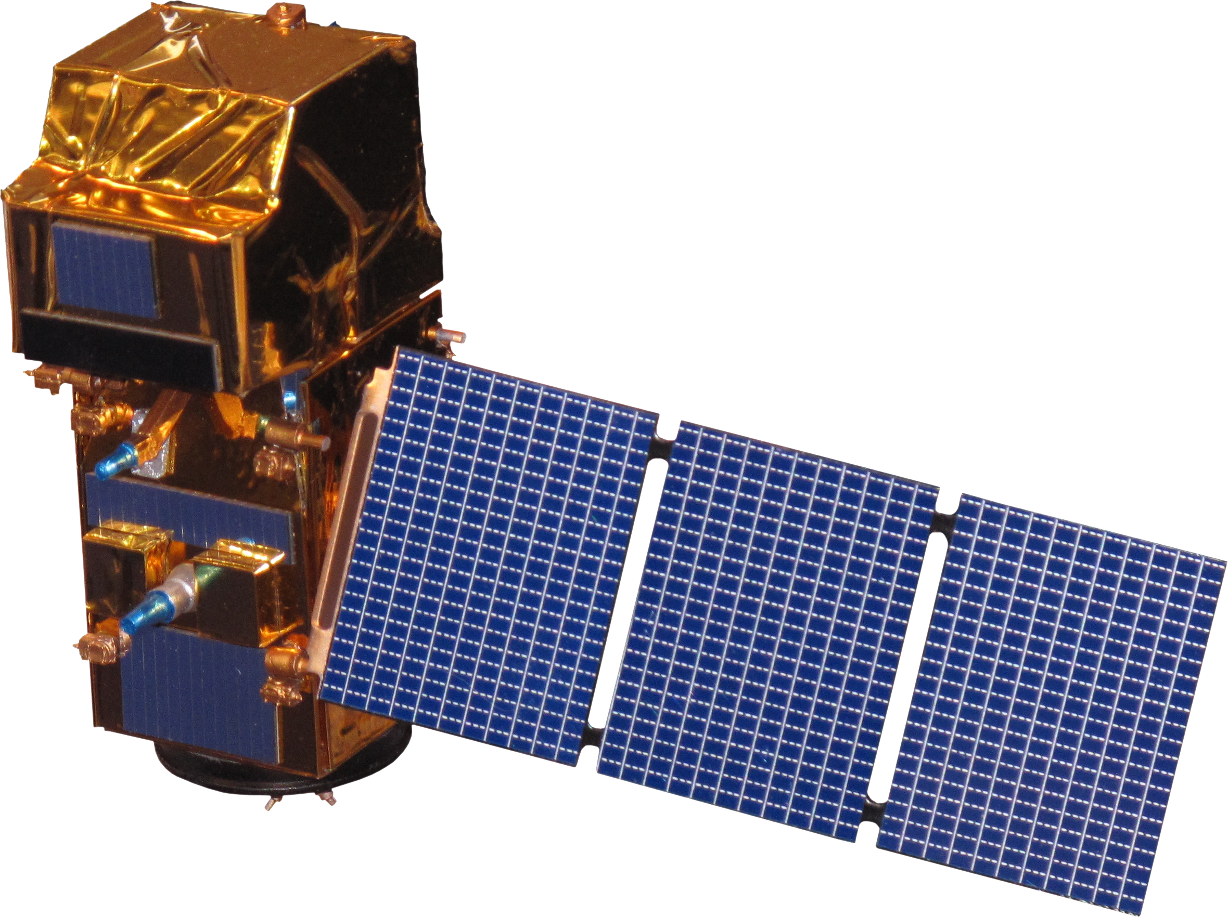
Study Period
Sentinel-2
January 2016
Present
Landsat 8
April 2013
Present
Image: NASA/ESA, Oregon Environmental Council
Notes:
The Study Period was determined by available satellite data. Data from Landsat 8 was collected from April 2013 to Present. Data from Sentinel-2 was collected from January 2016 to present. We wrote a methodology for processing Sentinel 3 as software to do so is still in development, but did not have time within the 10 weeks to go through the same analysis.
Landsat 8 April 2013 to present
Sentinel 2 January 2016 to present
Sentinel 3 december 2016 to present
Image Source: http://www.oeconline.org/safe-drinking-water/
Image Source: DEVELOPedia

Slide 9
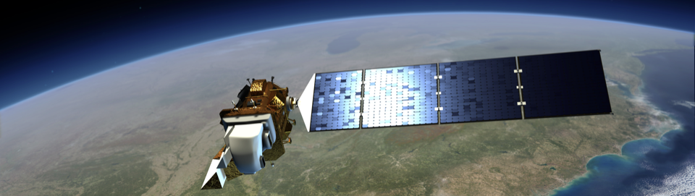
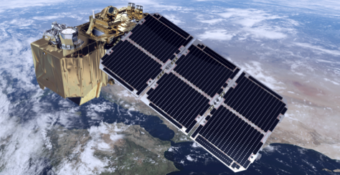
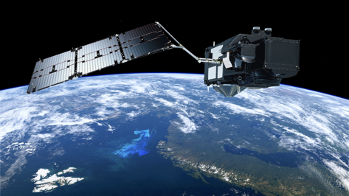
Satellites & Sensors Used
Landsat 8:
Launched February 11, 2013
16 day orbit
30 m resolution
Operational Land Imager (OLI)
Sentinel-2:
Launched June 23, 2015
10 day orbit
10 - 20 m resolution
Multispectral Imager (MSI)
Sentinel-3:
Launched February 16, 2016
2 - 4 day orbit
300 m resolution
Ocean and Land Colour Instrument (OLCI)
Images: NASA, ESA
Notes:
Landsat 8 launched in early 2013 and has a temporal resolution of 16 days and spatial resolution of 30 m. Sentinel 2 launched in mid 2015 with a temporal resolution of 10 days with 10-20 m spatial resolution. Sentinel 3 launched in early 2016 with a 2-4 day orbit and 300 m spatial resolution
Image Credit:
Landsat 8: https://www.nasa.gov/sites/default/files/578319main_20110809-ldcm-lrg.jpeg
Sentinel 2: http://www.esa.int/var/esa/storage/images/esa_multimedia/images/2014/07/sentinel-2_brings_land_into_focus/14622582-1-eng-GB/Sentinel-2_brings_land_into_focus.jpg
Sentinel 3: http://spaceflight101.com/copernicus/wp-content/uploads/sites/35/2016/02/Sentinel-3-4-1.jpg

Slide 10
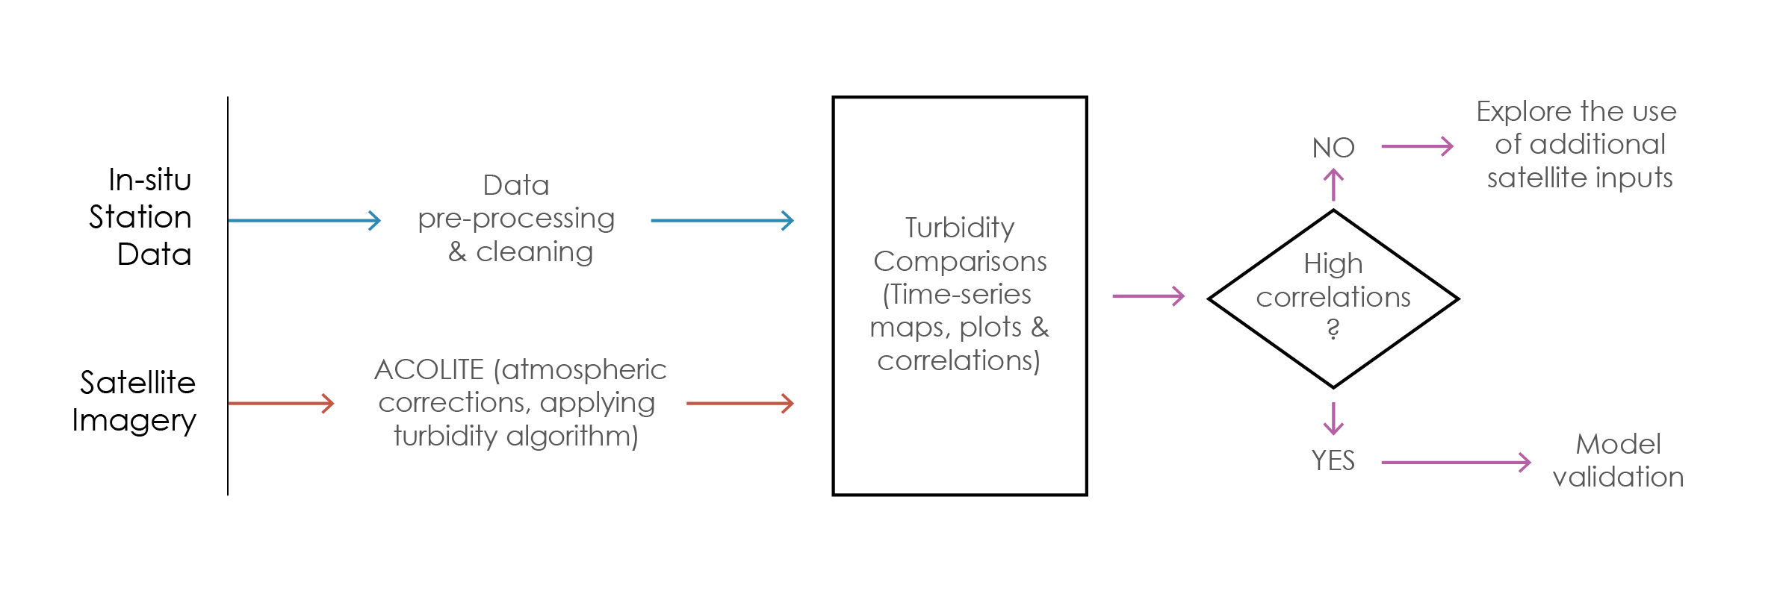
Methodology
Image: Oregon Environmental Council
Notes:
To accomplish our project objectives, we began first with preprocessing and cleaning our in situ data, meaning removal of bad data values and reorganizing the data into a workable format. We then took our raw downloaded satellite imagery and ran it through ACOLITE software. ACOLITE applies atmospheric corrections to the images to correct for any errors caused by clouds or aerosols for example, and then utilizes the T. Dogliotti algorithm to derive turbidity. Next, we generated time series maps as well as performed statistical analyses. If satellite derived turbidity was highly correlated with in situ data we deemed it acceptable for use in model validation. If not, we deemed in unacceptable and in need of further exploration.
Image Source: http://www.oeconline.org/safe-drinking-water/

Slide 11
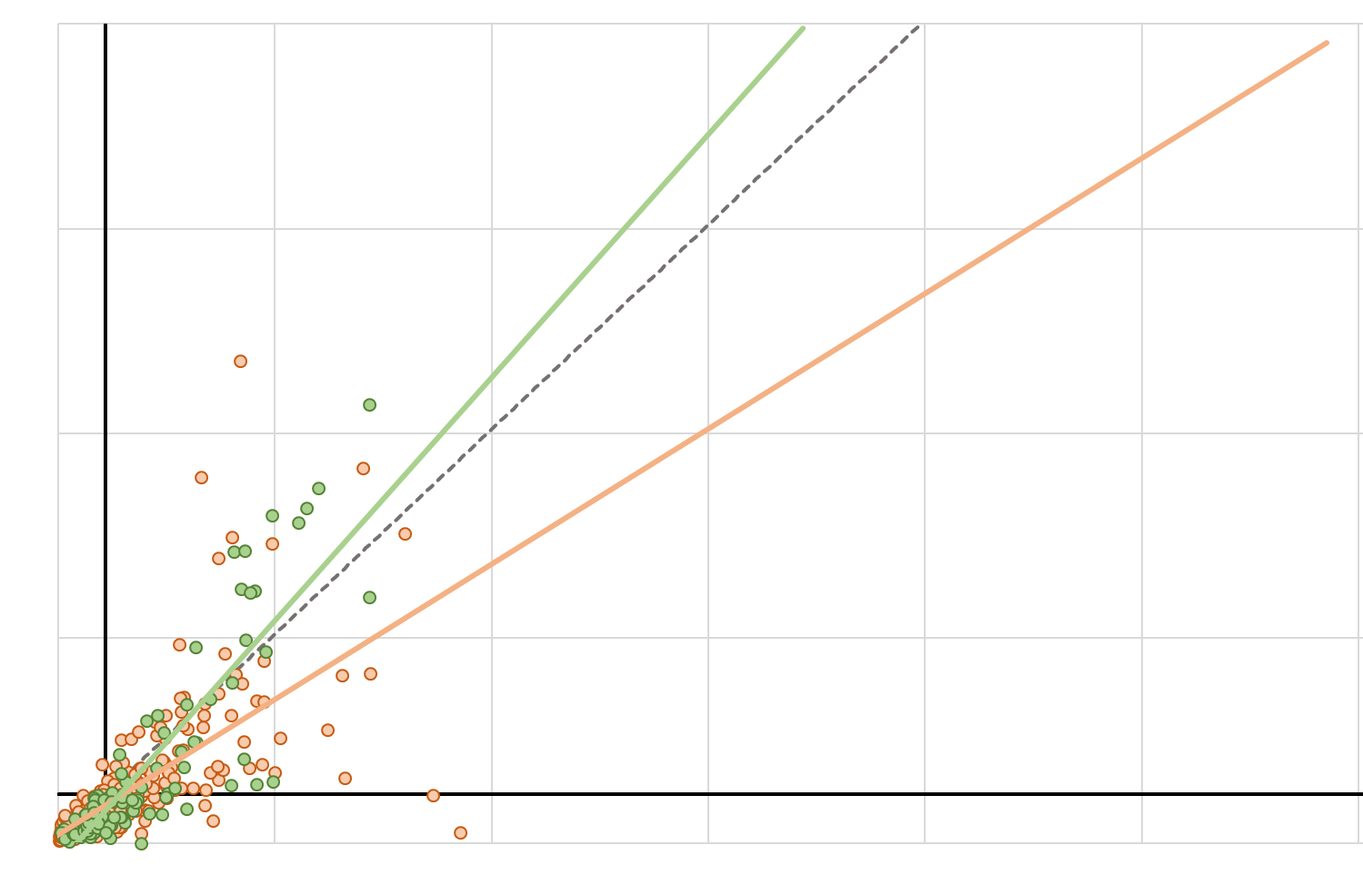
Results: Landsat 8 vs Sentinel-2
200
Landsat 8 ~ In Situ:
                r² = 0.474
              ^{y= 0.6604x + 1.4888}
Sentinel-2 ~ In Situ:
r² = 0.767
^{y= 1.187x – 6.1963}
Satellite(FNU)
50
0
50
300
In Situ (FNU)
* Without North and South Bay
Sentinel-2
Landsat 8
12 FNU
1:1 Ratio
Notes:
Looking at the region as a whole, excluding the North and South Bay, both satellites had relatively strong relationships with in situ data, especially Sentinel 2 which has both a higher spatial and temporal resolution. The slope of near 1 in the relationship between Sentinel 2 and in situ data indicates an almost 1:1 relationship. In situ data within the bays is particularly sparse which could explain the poorer performance in these regions.

Slide 12
Results: Landsat 8 vs Sentinel-2
Tributaries
Suisun Bay
Landsat 8: r² = 0.71 y = 0.6359x + 1.1669
Landsat 8: r² = 0.53 y = 0.5731x +4.7338
Sentinel-2: r² = 0.83 y = 1.1757x – 4.1283
Sentinel-2: r² = 0.86 y = 1.429x – 9.2892
150
150
0
100
0
100
Sentinel-2
Landsat 8
S2 Outlier
L8 Outlier
12 FNU
1:1 Ratio
Notes:
Results from our analysis revealed regional differences in the strength of relationships between satellite and in situ data. For example, within the graphs displayed, Landsat 8 performed better in the Tributaries with an r2 of 0.71 than the Suisun Bay with an r2 of 0.83, while the opposite held true for Sentinel-2 which had an r2 of 0.86 in the Suisan Bay and an r2 of 0.83 in the Tributaries.

Slide 13
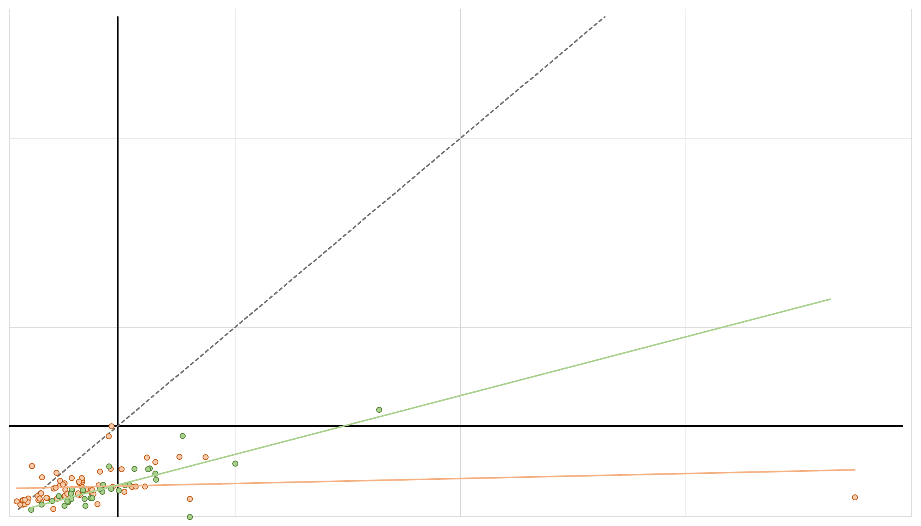
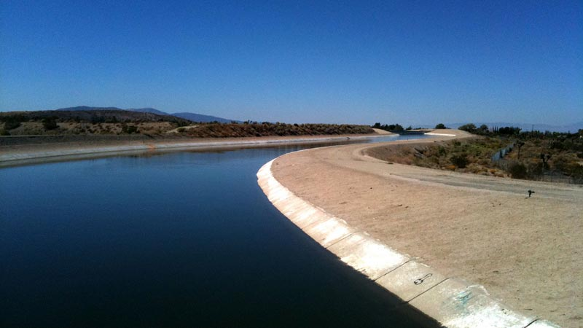
Results – Clifton Court Forebay
75
Landsat 8 ~ In Situ:
                r² = 0.0209
              ^{y= 0.0259x + 3.7599}
Sentinel-2 ~ In Situ:
r² = 0.6541
^{y= 0.3104x + 0.4832}
Satellite(FNU)
25
0
25
100
In Situ (FNU)
Image: Marianne Muegenburg Cothern
Sentinel-2
Landsat 8
12 FNU
1:1 Ratio
Notes:
Focusing on the Clifton Court Forebay, which is the starting point of the California Aqueduct and location of 11 huge water pumps, our analysis reveals that Sentinel-2 yet again outperforms Landsat 8 in capturing turbidity patterns. This area is essential to both maintaining the stability of water flow to meet demand and a dangerous area for smelt populations due to the pumps.
Image Credit: https://www.kcet.org/redefine/single-tunnel-option-not-a-quick-fix-for-the-delta

Slide 14
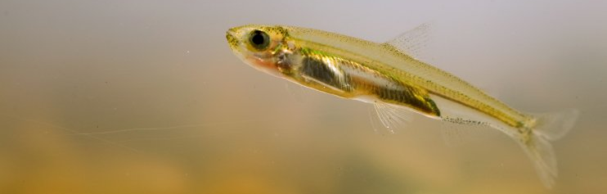
Limitations
Data availability due to temporal resolution
T. Dogliotti turbidity algorithm is global rather than regional
In Situ monitoring sites are shoreline
Image: Maven
Notes:
One limitation to this research is the temporal coverage of satellite imagery. Turbidity varies on a daily timeframe and can change rapidly in flush events after storms. With a single overpass time every 10 for Sentinel and 16 for Landsat, high turbidity events can go undetected. The presence of clouds further limits available satellite data as well. Another limitation is that the turbidity algorithm we utilized is global rather than regional, meaning it is not tuned specifically to the environmental conditions of the region which might impact the accuracy of satellite derived turbidity values. A final limitation is that in situ monitoring stations are located on the shorelines of the bays and smaller channels. This means that turbidity values are not reflective of the central portions of water bodies in the Delta.
Image: https://mavensnotebook.com/wp-content/uploads/2015/03/Delta-smelt-sliderbox.jpg

Slide 15
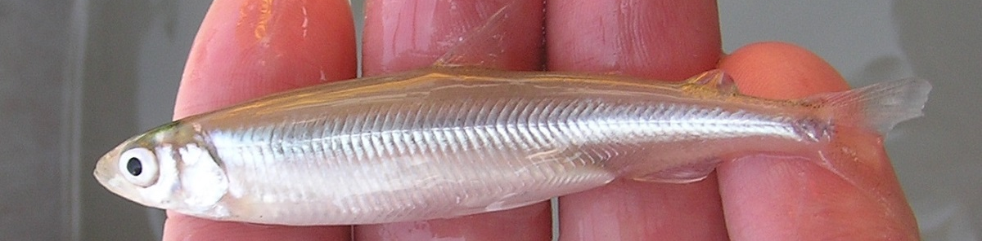
Conclusions
The accuracy of Sentinel-2 and Landsat 8 derived turbidity varies regionally, but is a promising method for filling in data gaps between in situ monitoring sites
The relative strength of correlations between both satellites and in situ data might allow incorporation of both in models to allow for greater temporal coverage
Image: FWS
Notes:
In conclusion, the accuracy of Sentinel-2 and Landsat 8 derived turbidity varies regionally throughout the Delta. However, the strength of correlations make it a promising way to fill in current data gaps caused by insufficient in situ monitoring sites. Incorporation of data from both satellites will increase the temporal coverage remote sensing technologies have to offer turbidity modelling within the bay to better track smelt while meeting water demands.
Image: https://www.fws.gov/sfbaydelta/EndangeredSpecies/Species/Accounts/DeltaSmelt/Images/DeltaSmeltInHand-2UsfwsPeterJohnsenCropped.jpg

Slide 16
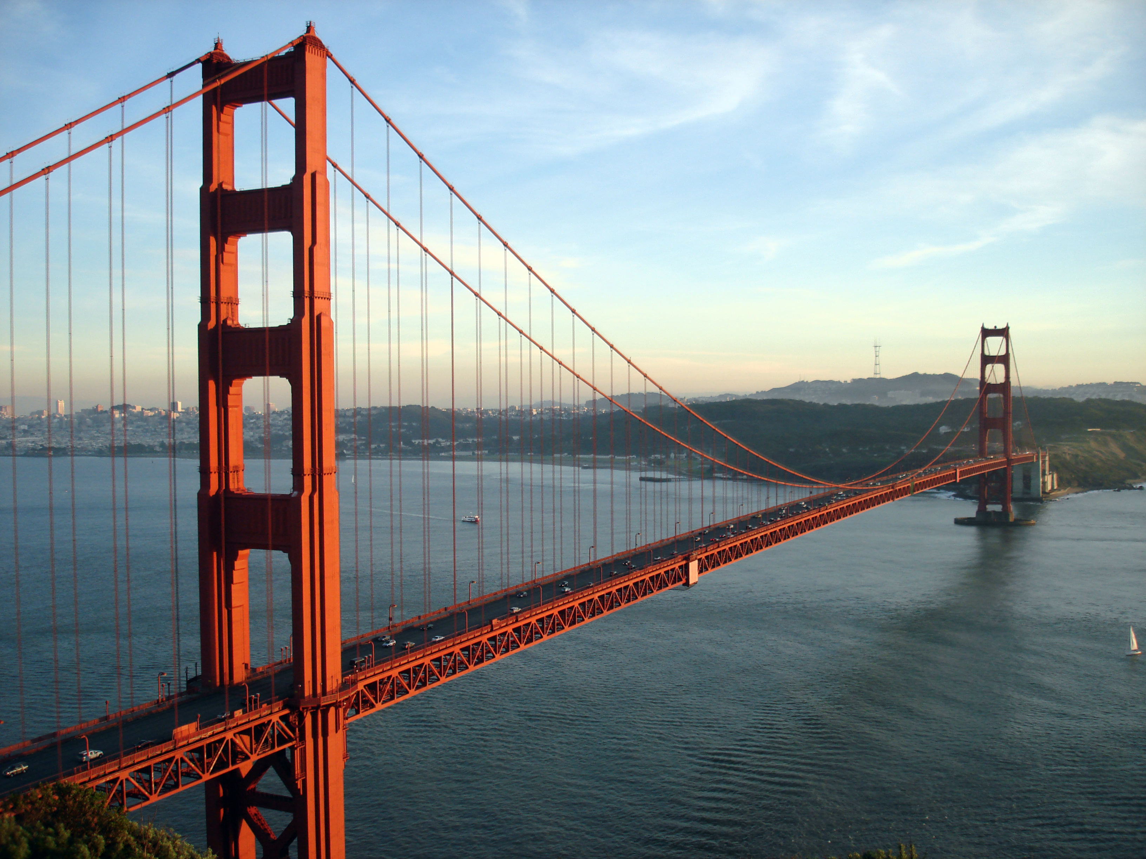
Future Work
San Fransisco Bay Delta Water Resources II – Fall 2017
  Evaluate water quality through the use of hyperspectral imagery (AVIRIS and PRISM)
San Fransisco Bay Delta Water Resources III – Spring 2018
  Evaluate the benefits of hyperspectral vs. multispectral for water quality monitoring
Image: Wikimedia
Notes:
Two future DEVELOP teams will continue the investigation into turbidity modelling in the Bay Delta. Part II will commence in the Fall of 2017 and evaluate the use of hyperspectral imagery. Part III which will be in Spring of 2018 with compare the use of hyperspectral and multispectral imagery for monitoring water quality within the Bay Delta.
Image Credit: https://upload.wikimedia.org/wikipedia/commons/0/0c/GoldenGateBridge-001.jpg

Slide 17
Acknowledgements
We’d like to thank our partners at the MWD - David Fullerton, Russ Ryan, and Sean Acuna - for their input and guidance. We’d also like to thank Amye Osti and David Osti from 34 North, and Michael McWilliams of Anchor QEA.
We’d like to thank our science advisors - Michelle Gierach and Christine Lee - for their continued support and encouragement throughout the term.
We’d like to thank Ben Holt & the whole Summer DEVELOP team for the opportunity and the completion of a great term!
Image: Oregon Environmental Council
Notes:
We would like to thank several people for their support throughout the term. First, our partners at MWD, David Fullerton, Russ Ryan, and Sean Acuna. Also our partners Amye Osti and David Osti of 34 North and Michael McWilliams of Anchor QEA. We’d like to give a huge thank you to our science advisors Michelle Gierach and Christine Lee for their encouragement and support. Also to Ben Holt and the DEVELOP crew here that make all of this possible.
Thank you!

