Slide 1
Data Update Instructions for BDL
Reference Project: Fisheries Rebuild Fall 2018
https://www.baydeltalive.com/projects/18199
Notes:
Karly’s Login if anything is private:
Karly@34north.com
34north

Slide 2
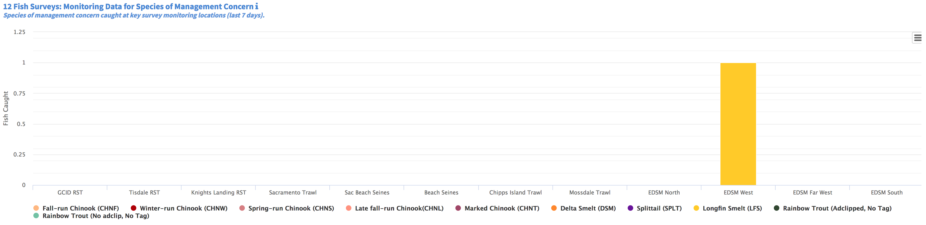
Triggers and Indices Tab: 12 Fish Survey bar chart
Components :
GCID (slide 3-4)
Tisdale RST (slide 5)
Knights Landing RST (slide 5)

Slide 3
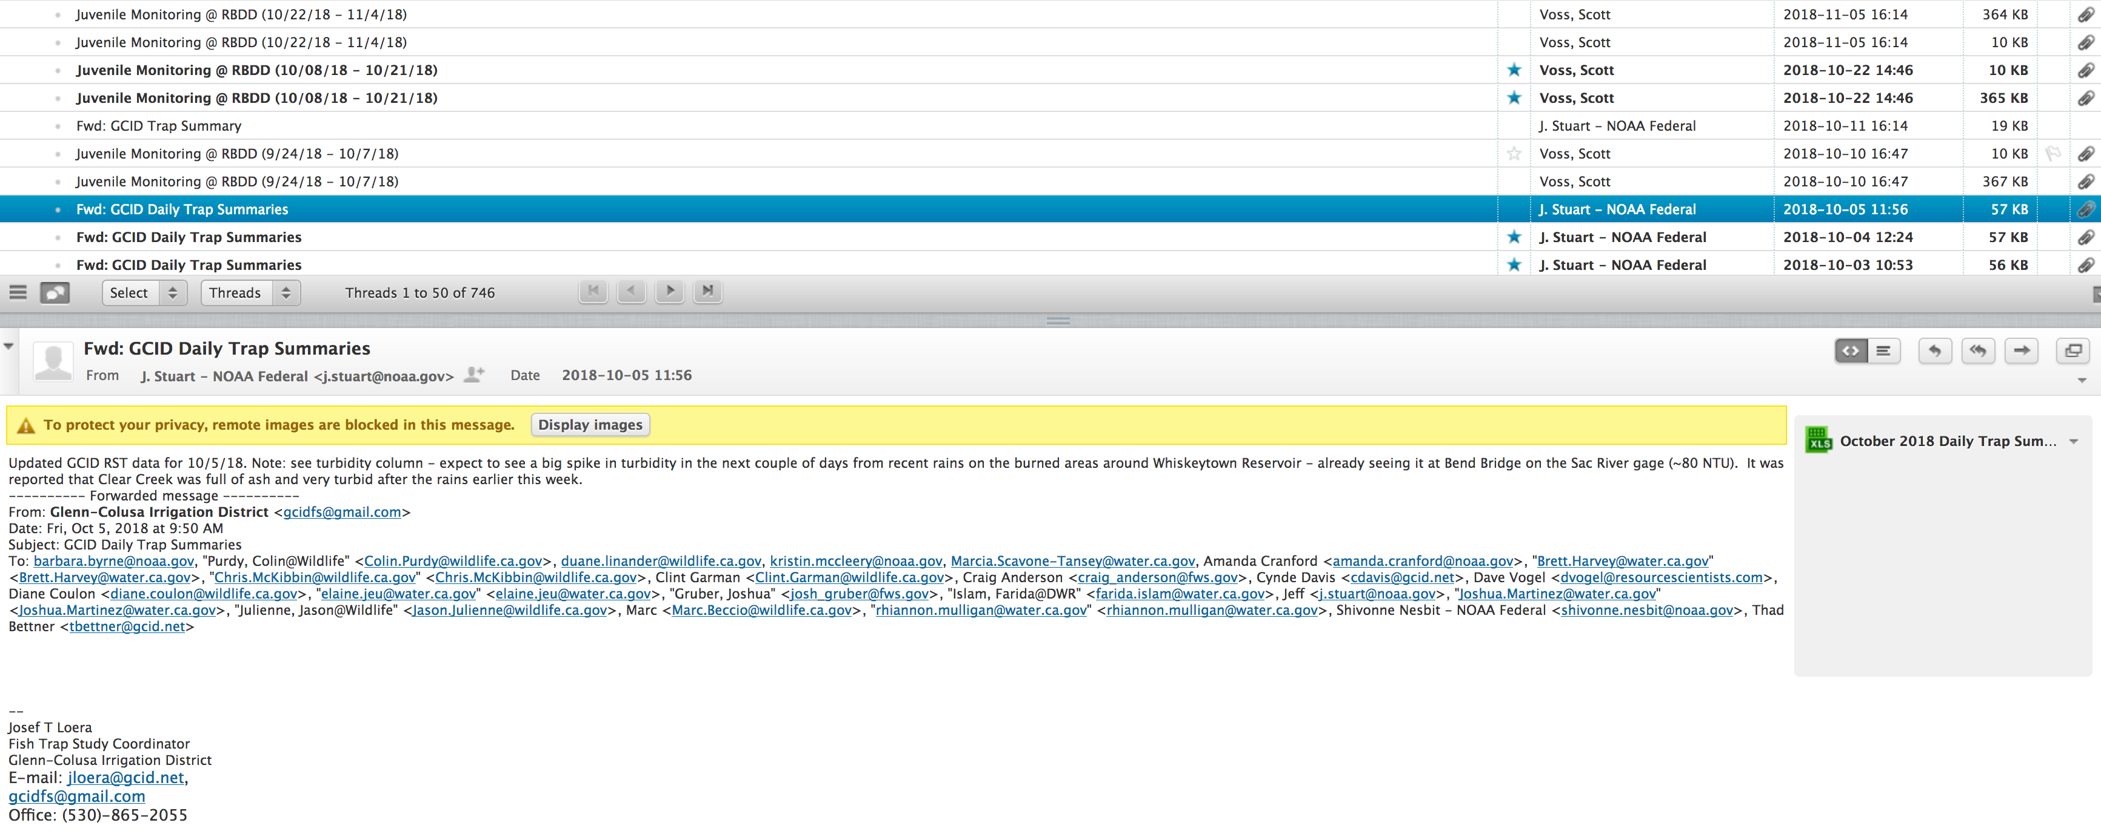
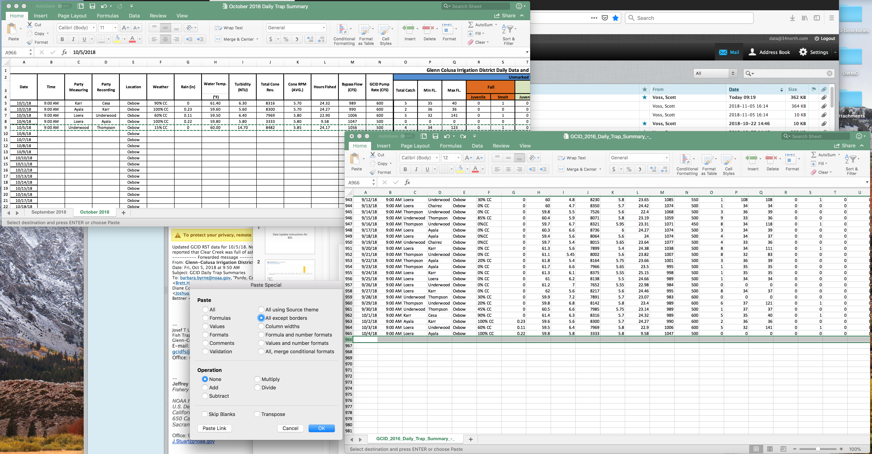
GCID : csv emailed to data@34north
Log on to data@34north.com through roundcube (password: 34N0rth34!)
Look for most recent email from J. Stuart, entitled, “GCID Daily Trap Summaries”
Download spreadsheet and open
4. Open longterm GCID spreadsheet entitled GCID_2016_Daily_Trap_Summary_-_
5. Copy and paste over rows with new dates:
- Right click before pasting and choose “Paste Special” and then choose the option:
“All except borders”

Slide 4
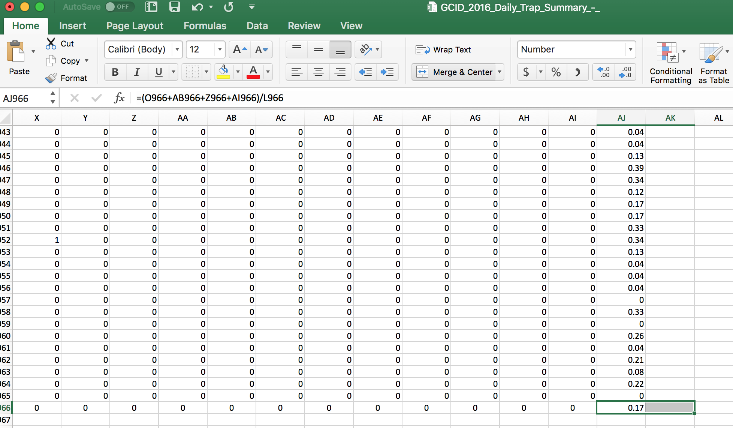
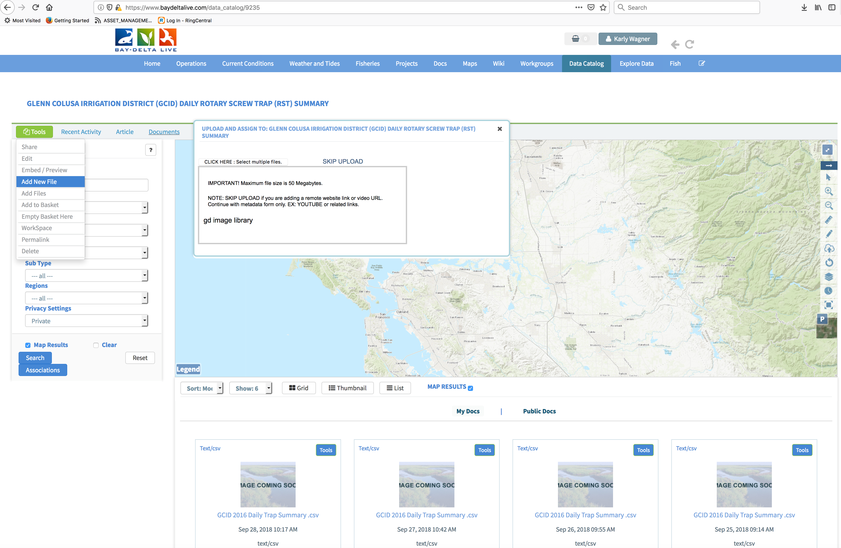
6. Make sure to unmerge and center the last column (so that the amount of columns matches the previous import)
7. Save with the same name and as .csv
IMPORTANT : THE NAME OF THE CSV NEEDS TO REMAIN THE SAME ( GCID_2016_Daily_Trap_Summary_-_ ) OTHERWISE THE SCRIPT WILL NOT RECOGNIZE THE DATA. ALSO MAKE SURE THERE ARE NO EXTRA BLANK ROWS AND TO SAVE AS A .CSV
8. Upload the updated csv to the data catalog on BDL:
https://www.baydeltalive.com/data_catalog/9235
9. To do this, make sure to be logged in and on the right asset page. In the Tools menu, click “Add New File” then “CLICK HERE: Select Multiple Files” and find the correct csv to upload
10. Make the new csv “Public” and delete the last csv to be uploaded

Slide 5
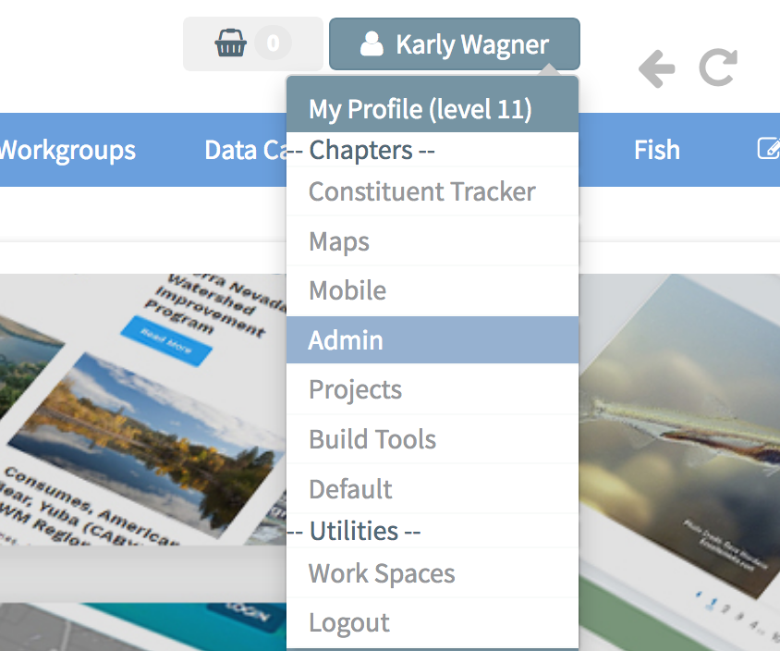
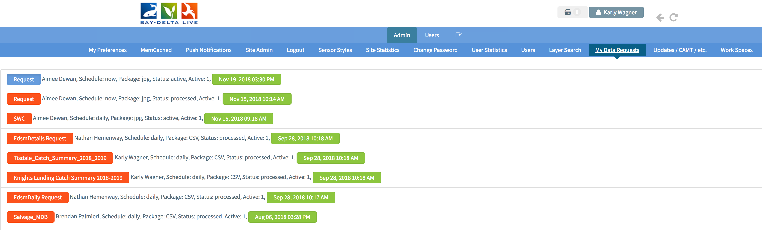
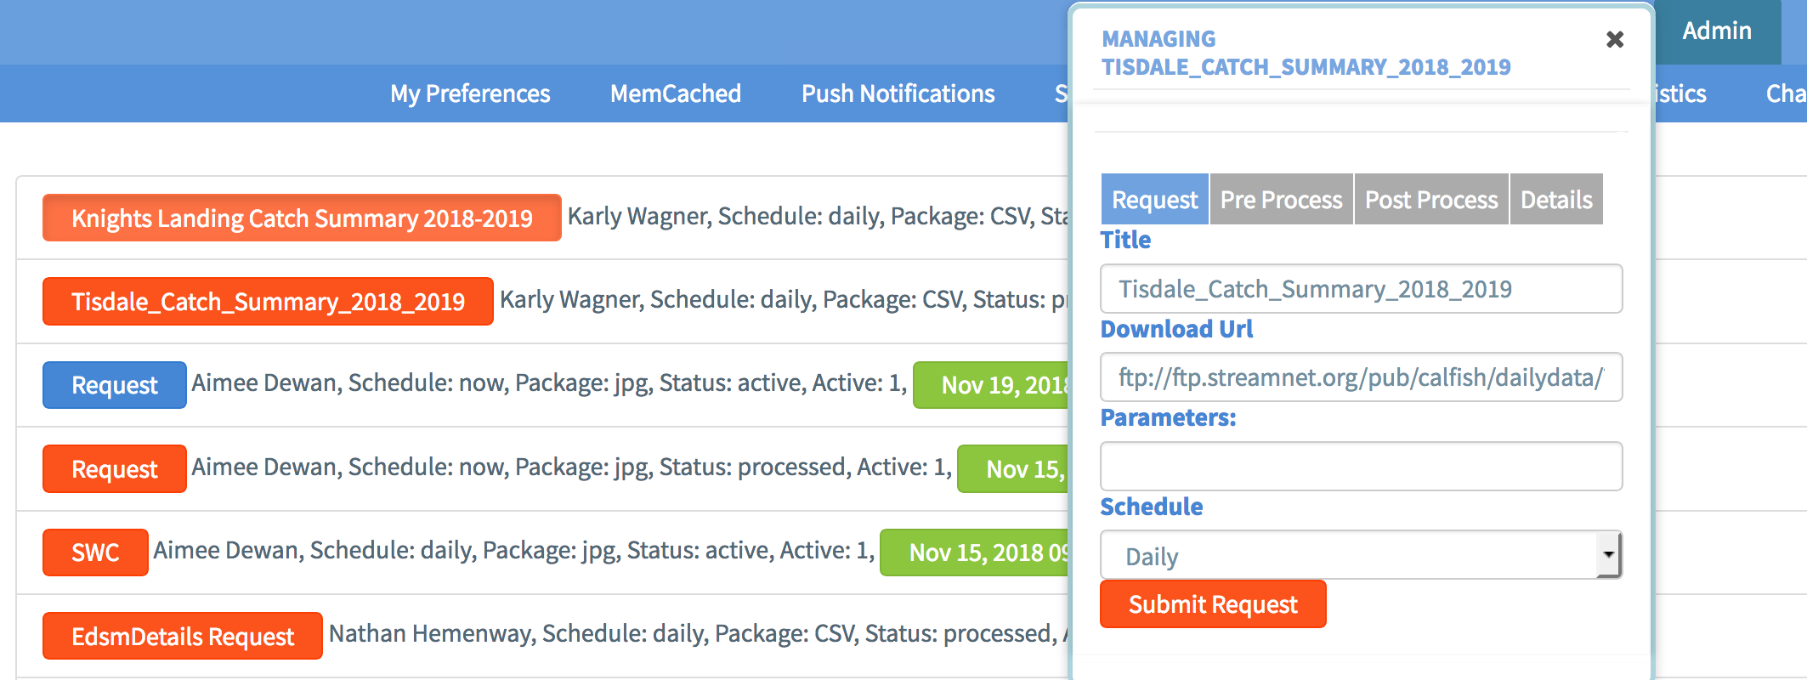
Tisdale and Knights Landing RST: Data Request
Submit a data request through the Admin panel.
Click on Admin from the drop-down menu under your username
Click on My Data Requests in the sub-navigation.
Find and click on the Red button on the far left labeled:
“Knights Landing Catch Summary 2018-2019”
4. Click on the red Submit Request button in the resulting pop-up window.
5. Repeat for Tisdale Catch Summary 2018-2019
Notes:
Download URLs for Reference/QAQC
ftp://ftp.streamnet.org/pub/calfish/dailydata/Tisdale_RST_Catch_Data_2018-2019.csv
ftp://ftp.streamnet.org/pub/calfish/dailydata/Knights_Landing_RST_Catch_Data_2018-2019.csv

Slide 6
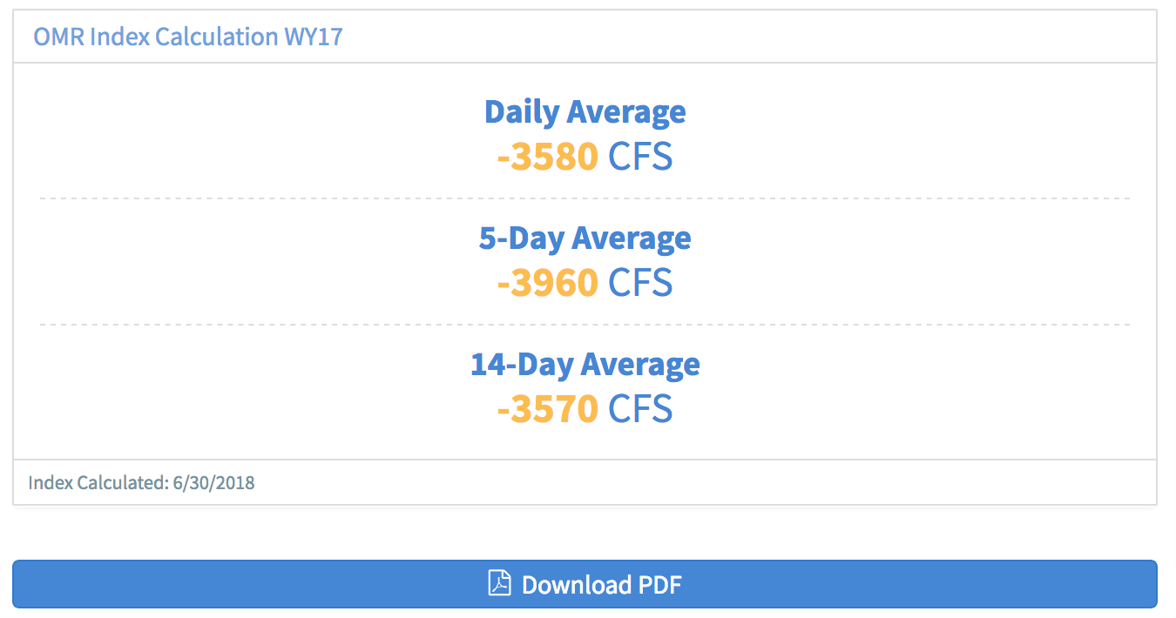
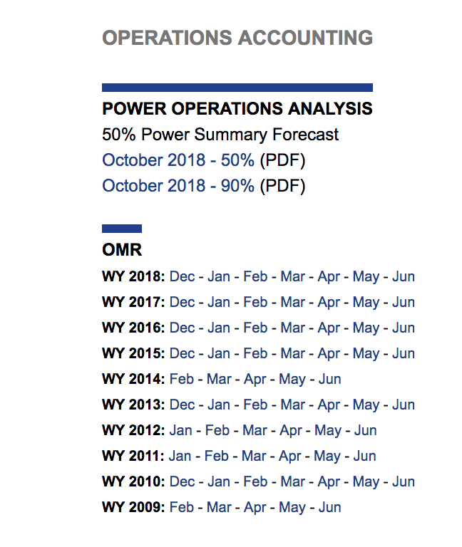
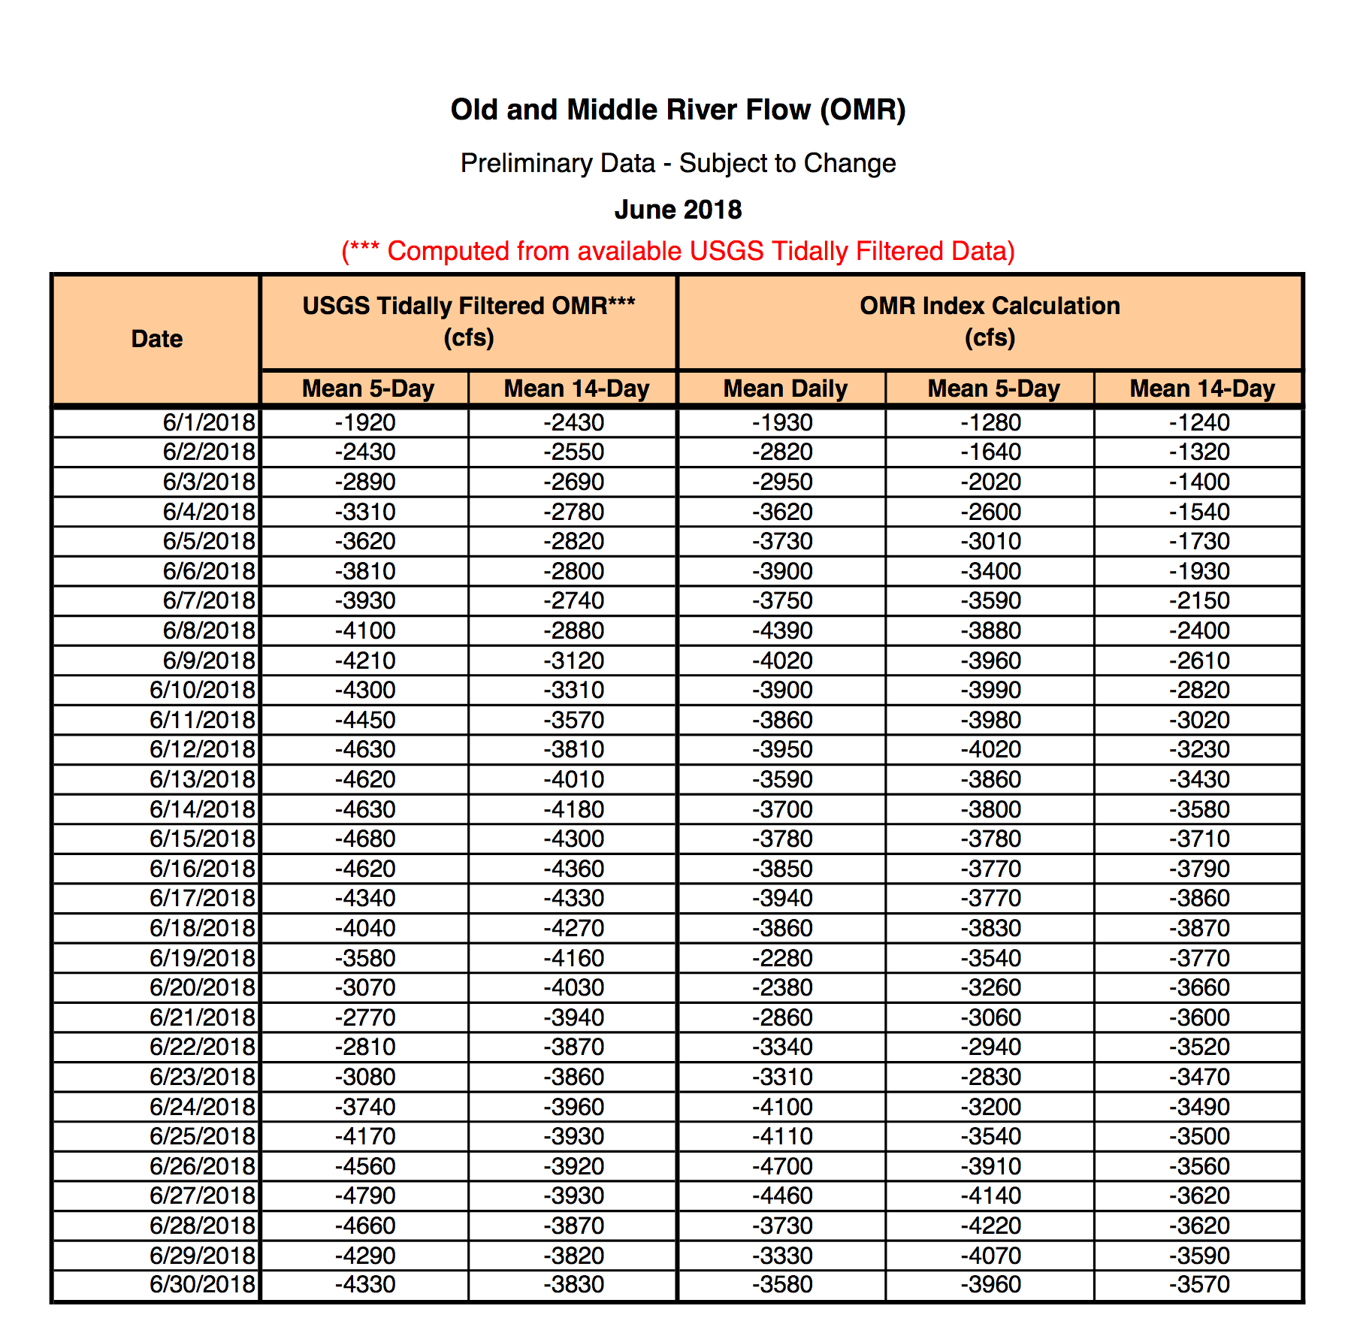
OMR: Index Calculation Widget
Directions Overview: PDF to Memcache
Find the OMR widget and click on the blue button to download the PDF
2. You will be taken to the USBR CVO site. Scroll down until you see the OMR section (shown to the right). Click on the most recent water year (WY 2019) and month.
3. You will be taken to a pdf. Copy the most recent values for the calculated OMR Index (Mean Daily, Mean 5- Day, Mean 14-Day)

Slide 7
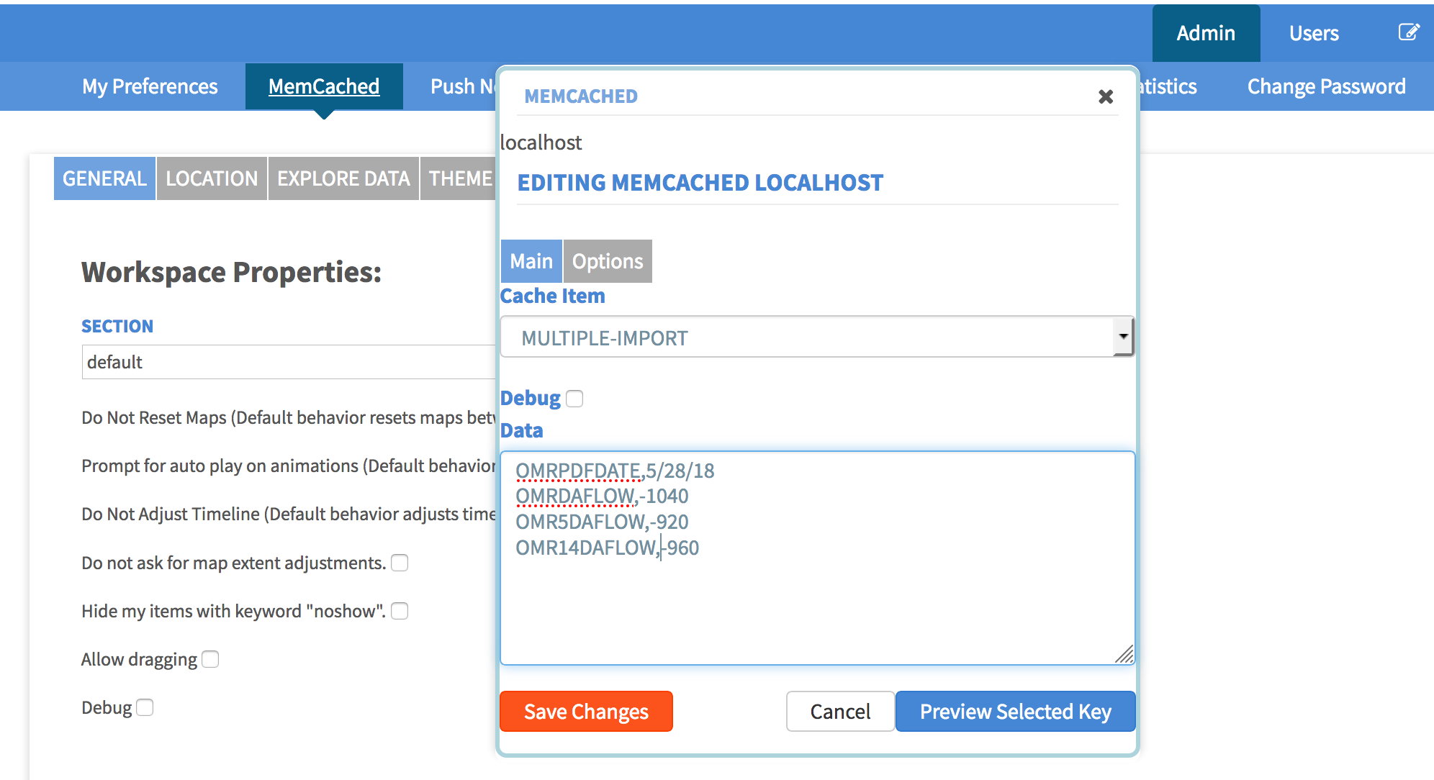
4. These values will be added to the memcache.
5. Navigate to the Admin section and click on the memcache link in the sub-navigation.
6. Choose MULTIPLE-IMPORT from the Cache Item drop-down menu.
7. Paste in the OMR values all in one, as shown to the right.
MAKE SURE THERE IS ONLY A ”,” INBETWEEN THE KEY AND THE VALUE.
8. Click Save Changes
Notes:
KEY,VALUE:
OMRPDFDATE,5/28/18
OMRDAFLOW,-1040
OMR5DAFLOW,-920
OMR14DAFLOW,-960

Slide 8
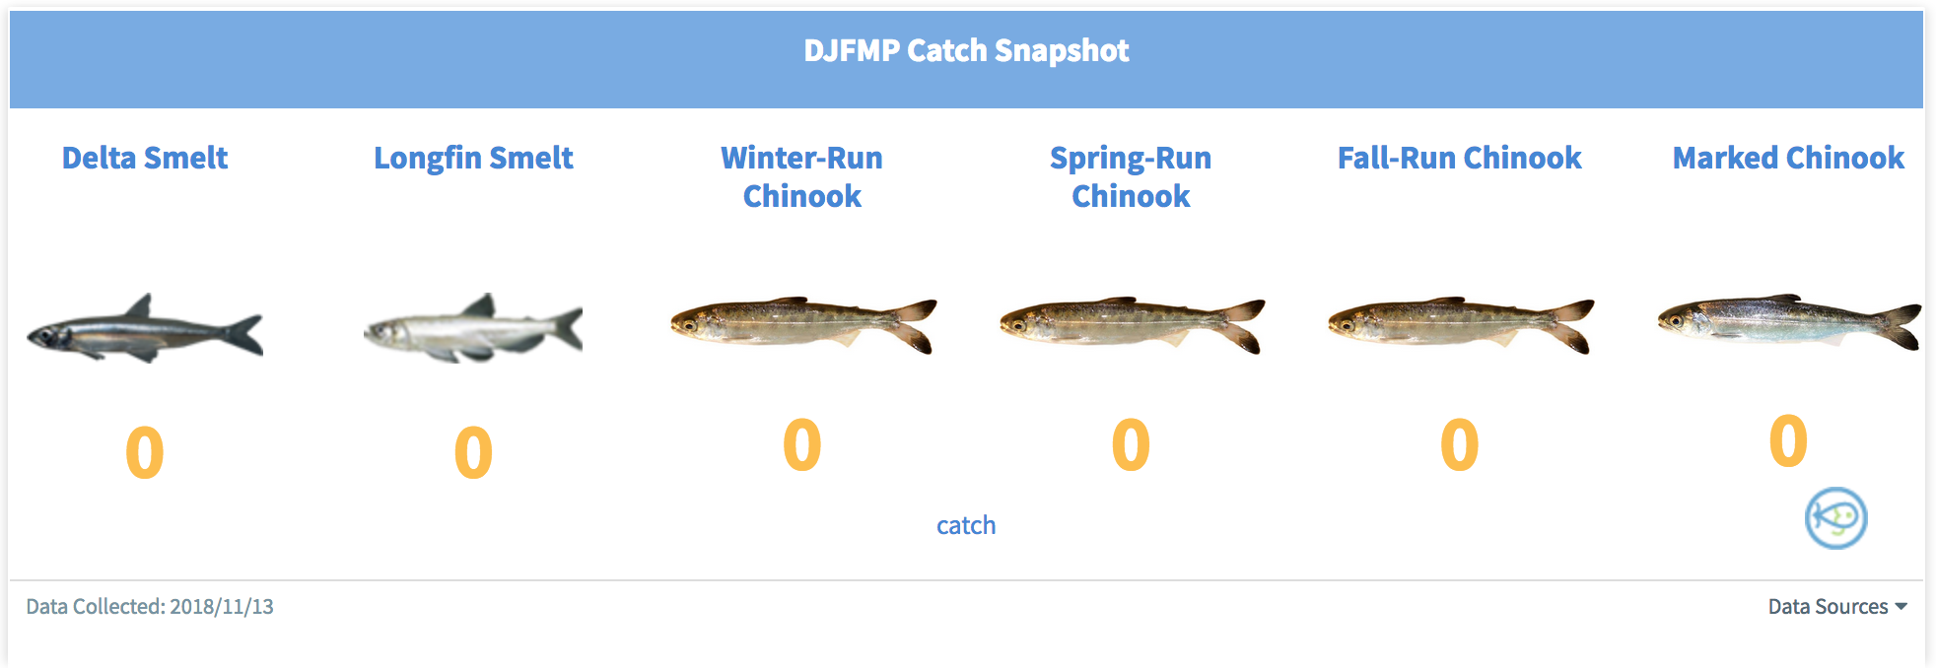
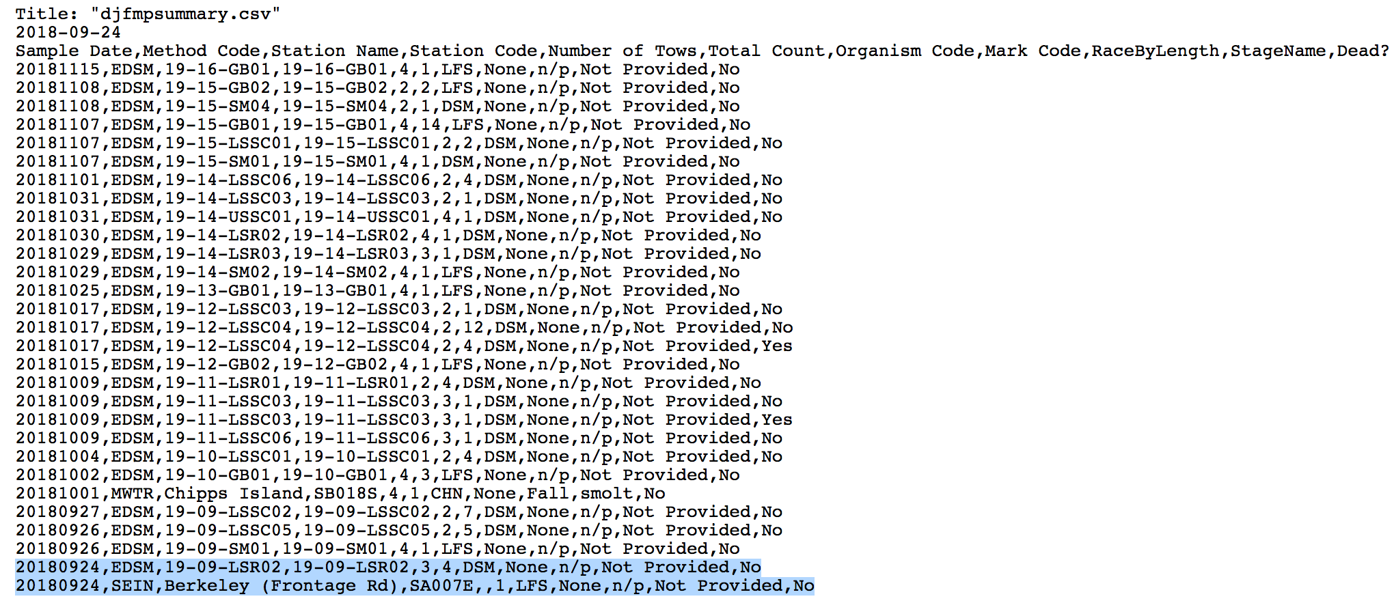
DJFMP Highlights: Catch Snapshot Widget
Directions Overview: URL to Memcache
Get catch values from djfmp summary URL: (CHANGE START DATE TO PREVIOUS DAY’S DATE)
view-source:https://systems.fws.gov/djfmp/service/getData.do?regionCode=3&sensorNum=djfmpsummary&startDate=2018-08-17&organismCode=CHN,DSM,LFS,
2. If there is data for the previous day, copy species and catch number to be put into memcache. BUT ignore all entries with the Method Code EDSM as those values will be accounted for differently.
For Example- the following image is an output starting 9/24 until recent. If I am looking for todays date (2018-11-20), there would be no data to update, as there was no catch the previous day (2018-11-19).
IF I was looking at the date 2018-09-24 (highlighted), I would ignore the entry with EDSM as the method and only look at the entry with SEIN. I would only update the data to show 1 LFS was caught.
3. Go into your Admin panel and then memcache. Using MULTIPLE IMPORT, paste DJFMP_LFS_CATCH,1 in the Data section.
Notes:
Memcache Keys:
DJFMP_DSM_CATCH
DJFMP_LFS_CATCH
DJFMP_WINTER_CHN_CATCH
DJFMP_SPRING_CHN_CATCH
DJFMP_FALL_CHN_CATCH
DJFMP_MARKED_CHN_CATCH

Slide 9
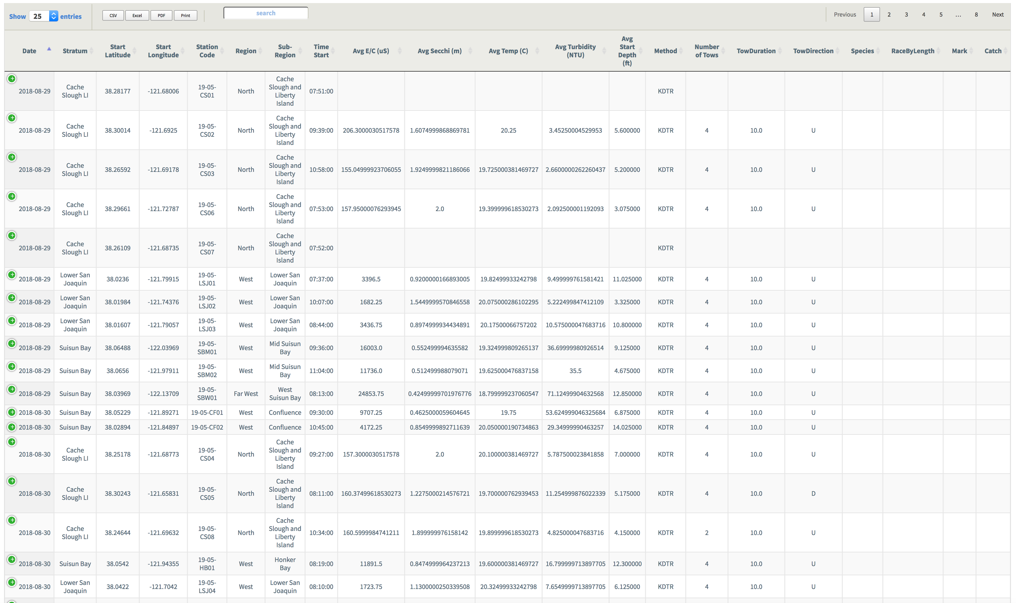
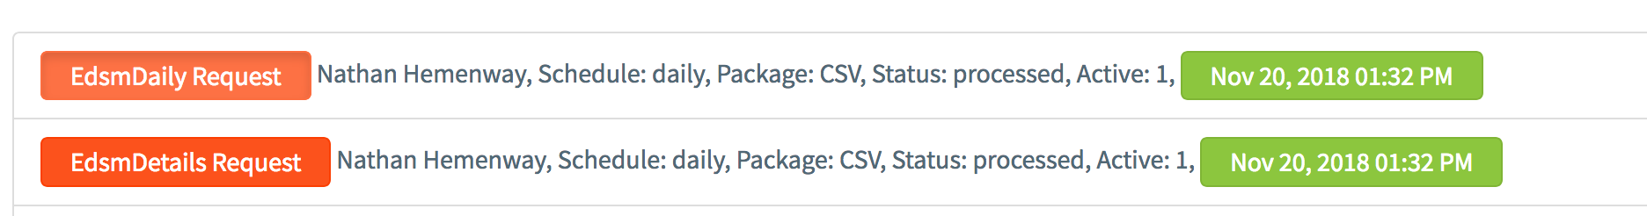
EDSM: Summary Tables
Directions Overview: Data Request
1. Navigate to the Admin panel and then Data Requests
2. Click on the red buttons on the far left for the EDSM tables and click Submit Request:
- EdsmDaily Request
- EdsmDetails Request

Slide 10
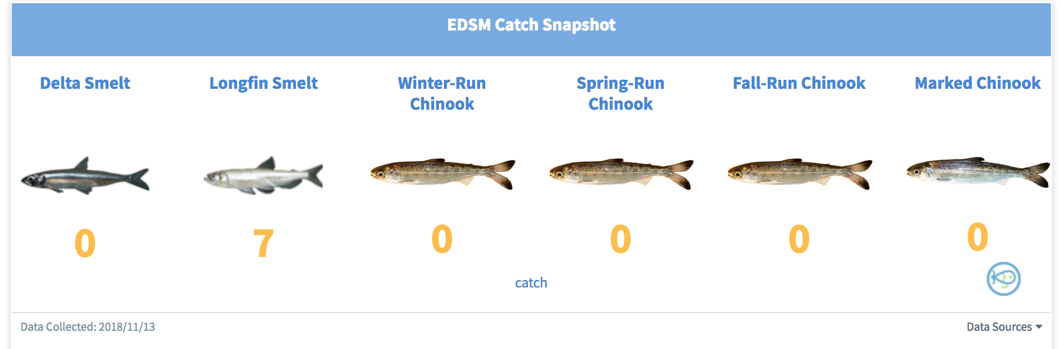
EDSM: Catch Snapshot Widget
Directions Overview: Pull numbers from URL and add in Memcache
Navigate to (change date as before for DJFMP): view-source:https://systems.fws.gov/djfmp/service/getData.do?sensorNum=edsmDaily&startDate=2018-08-17
Look for catch of species within the date requested.
If there are too many entries, copy and paste into excel. Go into Data and click on Text to Column, and Delimited by commas.
Go into memcache through your Admin panel.
Select Multiple Import as the Cache Item
Add in the correct keys and matching values from the EDSM output.
Click Save Changes
Notes:
Keys for EDSM:
EDSM_DSM_CATCH
EDSM_LFS_CATCH
EDSM_WINTER_CHN_CATCH
EDSM_SPRING_CHN_CATCH
EDSM_FALL_CHN_CATCH
EDSM_MARKED_CHN_CATCH

Slide 11
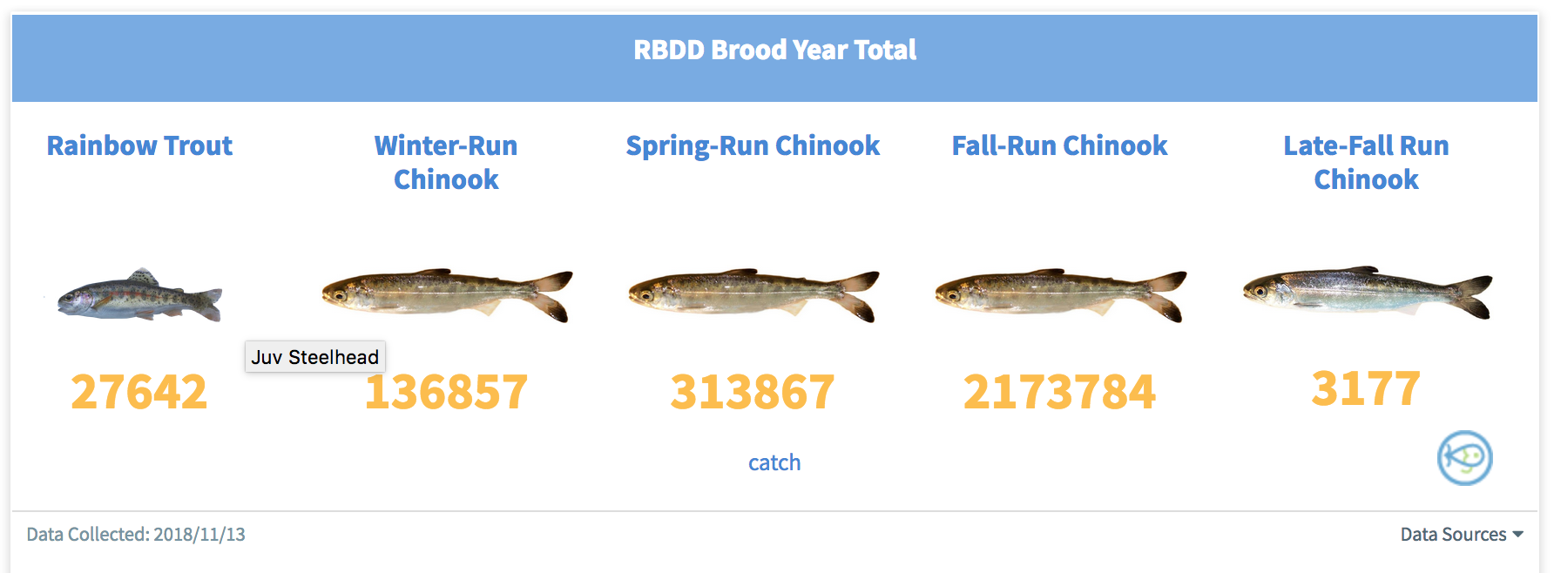
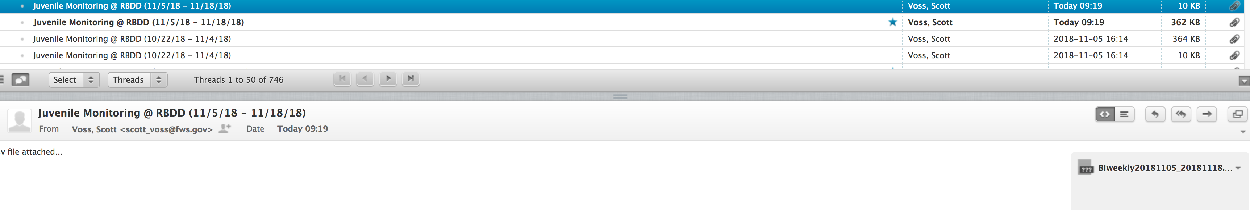
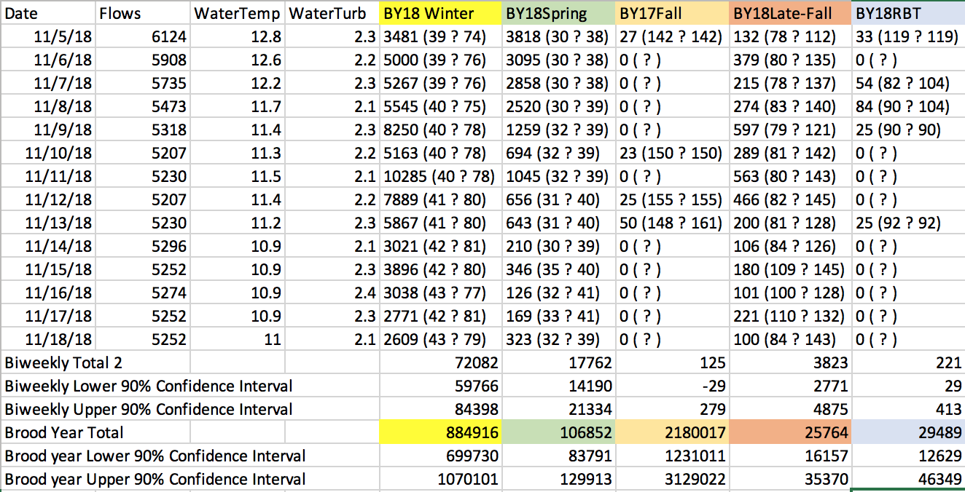
RBDD: Brood Year Total Widget
Directions Overview: csv from email and memcache
(Only updates every other week)
1. From the data@34north.com email, download the Biweekly csv from Voss, Scott
2. Copy the Brood Year Totals for each respective run and match the values to the key names. (Values and Headers are in the same color)
Keys:
RBDD_RBT_CATCH (pull from header BY18RBT)
RBDD_WINTER_CHN_CATCH (pull from header BY18 Winter)
RBDD_SPRING_CHN_CATCH (pull from header BY18 Spring)
RBDD_FALL_CHN_CATCH (pull from header BY17 Fall)
RBDD_LATE_FALL_CHN_CATCH (pull from header BY18Late-Fall)
RBDD_DATE (pull most recent date)
Notes:
RBDD_RBT_CATCH
RBDD_WINTER_CHN_CATCH
RBDD_SPRING_CHN_CATCH
RBDD_FALL_CHN_CATCH
RBDD_LATE_FALL_CHN_CATCH
RBDD_DATE

Slide 12
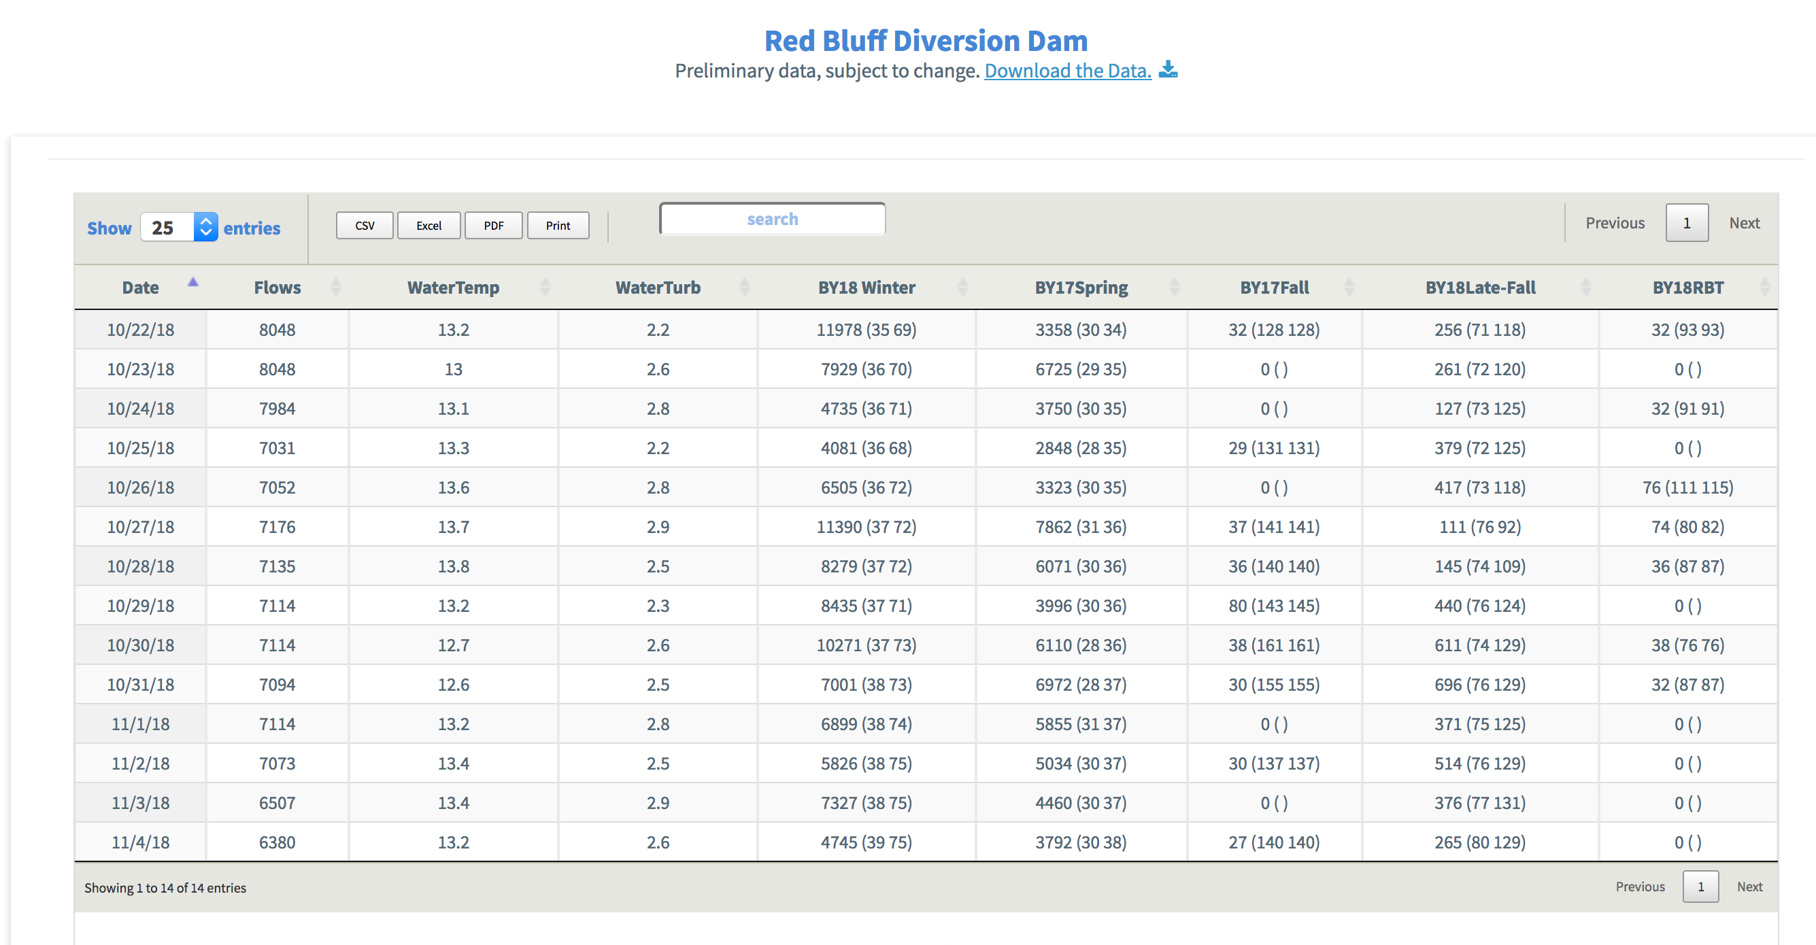
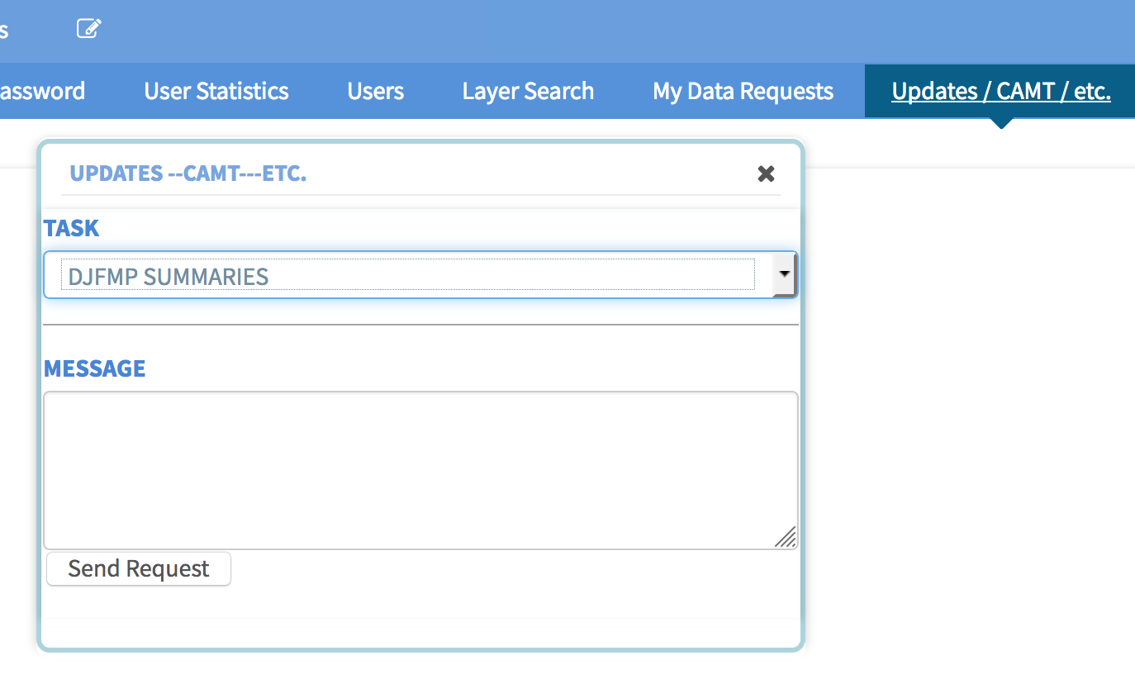
RBDD: Table Widget
Directions Overview: csv to Data Catalog
Save the new spreadsheet (downloaded from the email) as:
RBDD_Biweekly_Data
THE NAME OF THE SPREADSHEET HAS TO MATCH
2. Navigate to the RBDD asset in the data catalog:
https://www.baydeltalive.com/data_catalog/10816
3. Upload the new csv to the asset. Through the tools menu, click ”Add a new File”. Find the csv on your computer and click Upload.
4. Go to the Admin Panel and click on the Updates /CAMT / etc. button.
Choose DJFMP SUMMARIES from the Task drop-down menu.
Click Send Request.
Notes:
I can only get this to work when logged in as Karly.
Replace the ? With – until USFWS does it on their end.

Slide 13
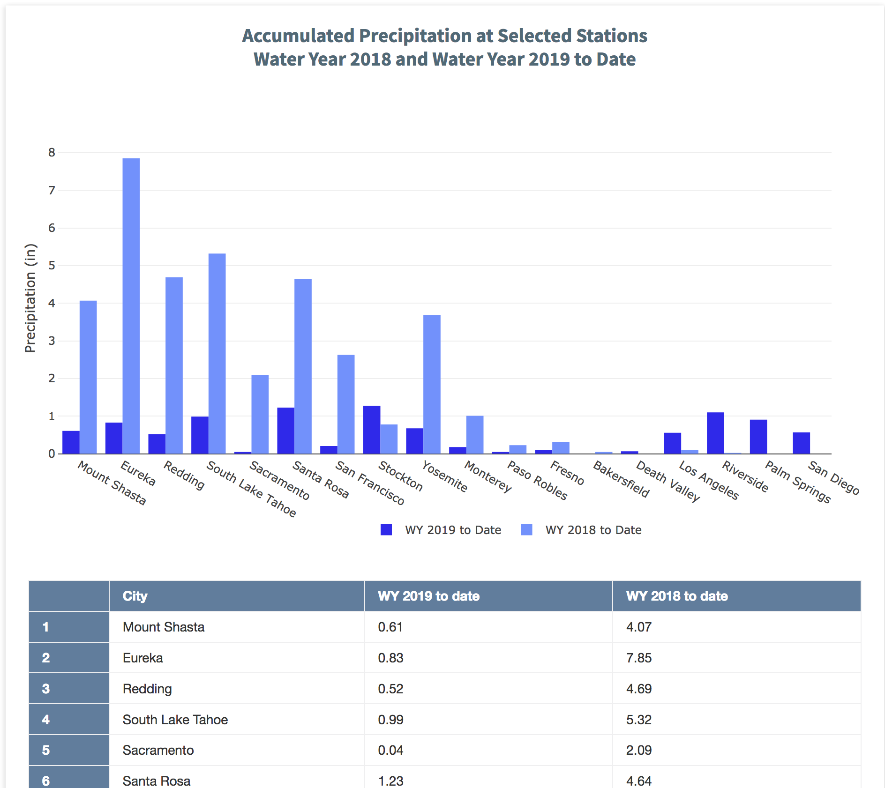
Accumulated Precipitation at Select Cities: Chart and Table
Directions Overview: Copy and Paste data from CDEC into Plotly
Go to http://cdec.water.ca.gov/reportapp/javareports?name=DROUGHTSUM
Copy the data from the last table (Daily Precipitation (In Inches) for Select Cities
Paste into an Excel spreadsheet
Delete the 3rd column
Copy the first three columns (so you are only grabbing the columns for Station, Oct 1 to Date and Season to Date)
Navigate to plotly: https://plot.ly/create/?fid=34north%3A60
7. Replace the old data with the new data in the grid
Make sure to click the Save button

