Slide 1
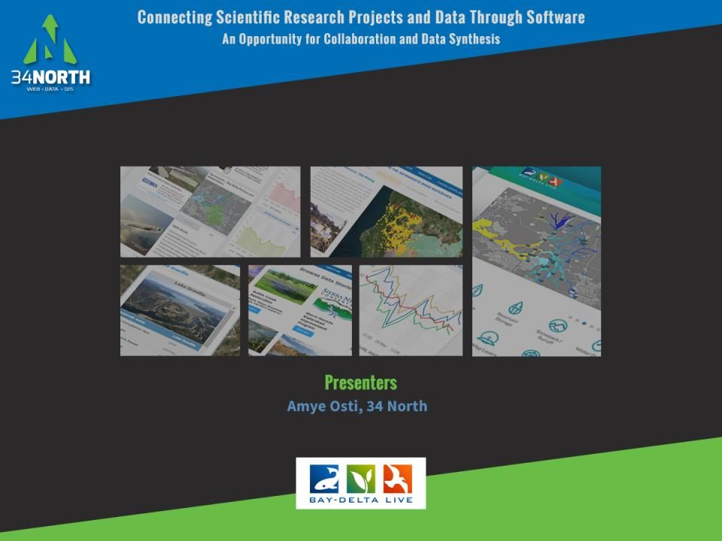
Notes:
Thank you for joining us this afternoon. Today I am going to talk about “Connecting Scientific Research Projects and Data Through Software. An Opportunity for Collaboration and Data Synthesis.

Slide 2
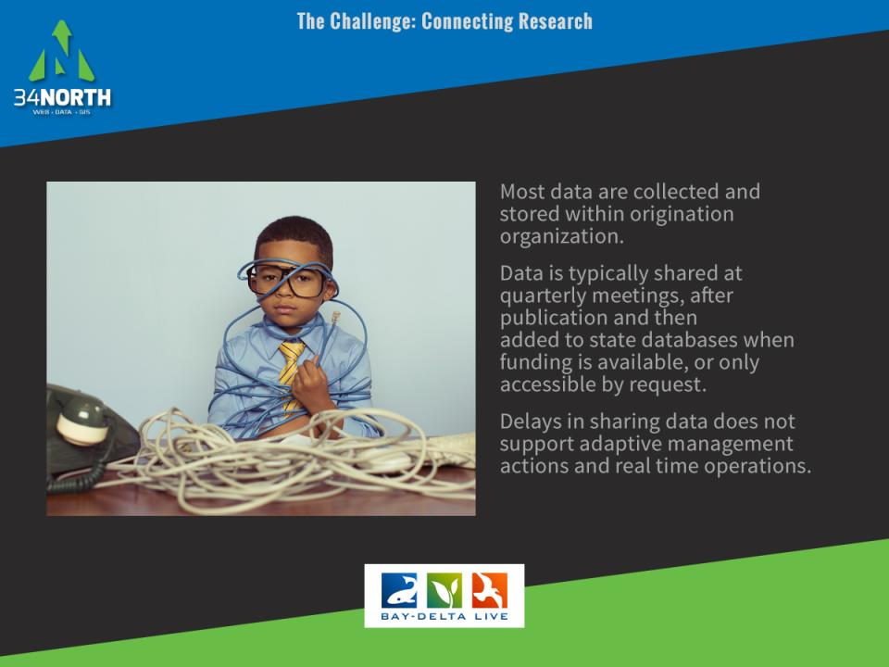
Notes:
The Challenge: Connecting research is a challenge in the Delta is a challenge and has been for a long time. While we can discuss many aspects of connecting research, I’m going to focus on the sharing of data and research results. As we all know from experience, most data are collected and stored within the source organization. These data are then shared at quarterly meetings, after publication or only accessible by request. While this type of data sharing environment works for some it does not support adaptive management actions or real time operations. Something the community has been charged with improving. As we have seen by the passage of new data sharing legislation AB 1070 and 1755

Slide 3
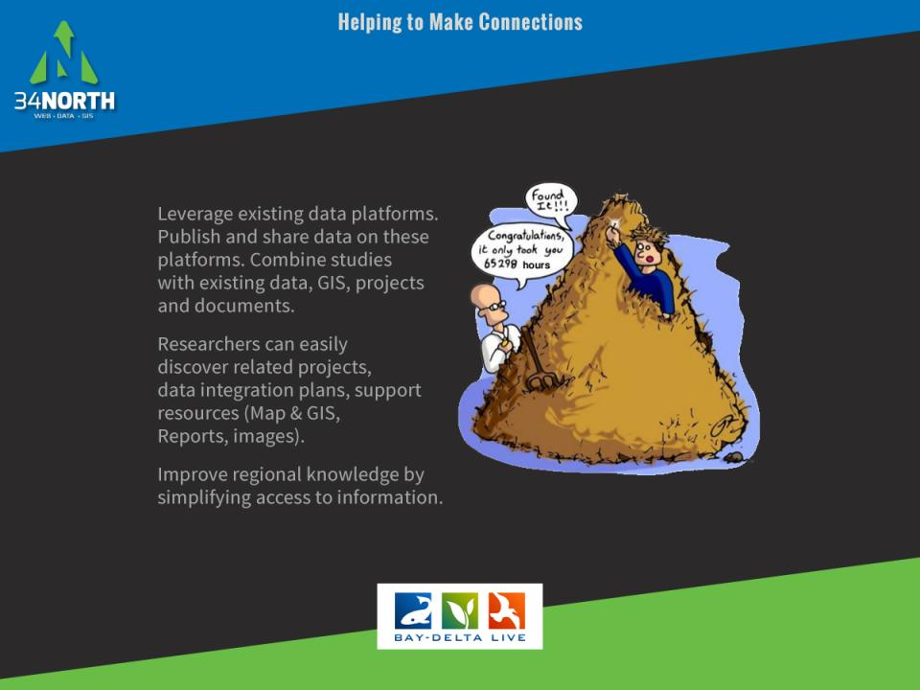
Notes:
So how can we work to connect more research? Well, we can leverage existing platforms and share data within the community. Using existing platforms allows the community to access your data and information. As well as provides you with an archive of related data, research, reports, maps, related project data, documents for your consumption. If we can simplify access to information, we can improve regional knowledge.

Slide 4
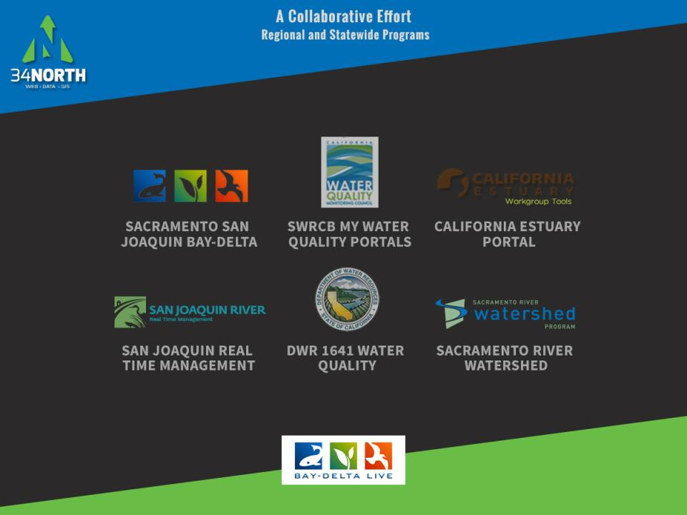
Notes:
This project I am going to show you today, builds on the above collaborative efforts. Each effort has contributed significantly to the overall data platform including improving access to data, regional and system wide datasets, expanding on information libraries, developing dashboards and much more.

Slide 5
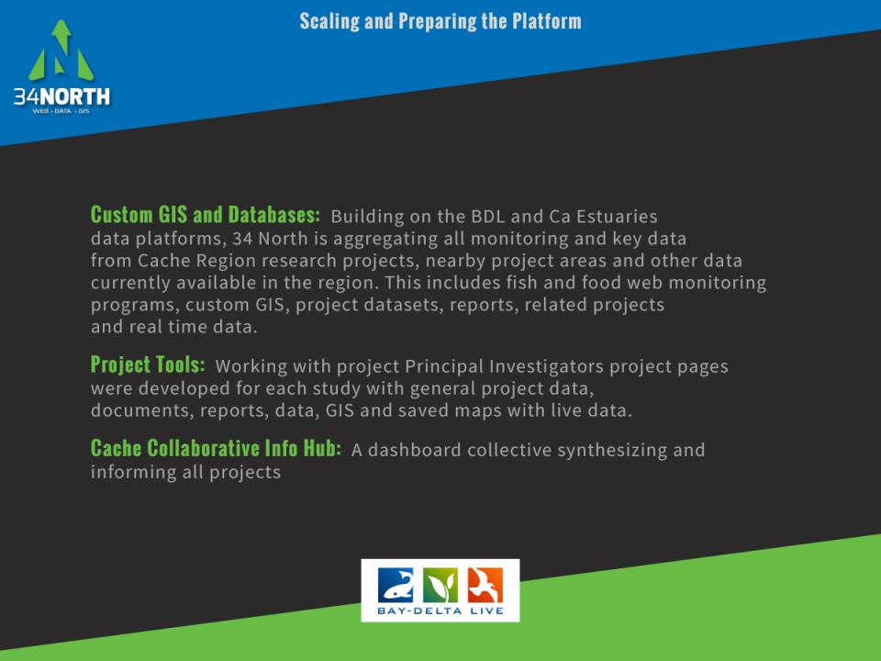
Notes:
The Cache region workspace is built on BDL using data and information shared by the California Estuary Portal and Sacramento River Watershed Portal. Data is not duplicated but federated. 34 North was tasked aggregating all monitoring and key data within the region, organizing resource libraries to reflect the cache studies, create project pages for each PI and develop a collective dashboard or info hub that brings together all projects data, information, images, documents GIS etc to one place for all stakeholders to discover and use.

Slide 6
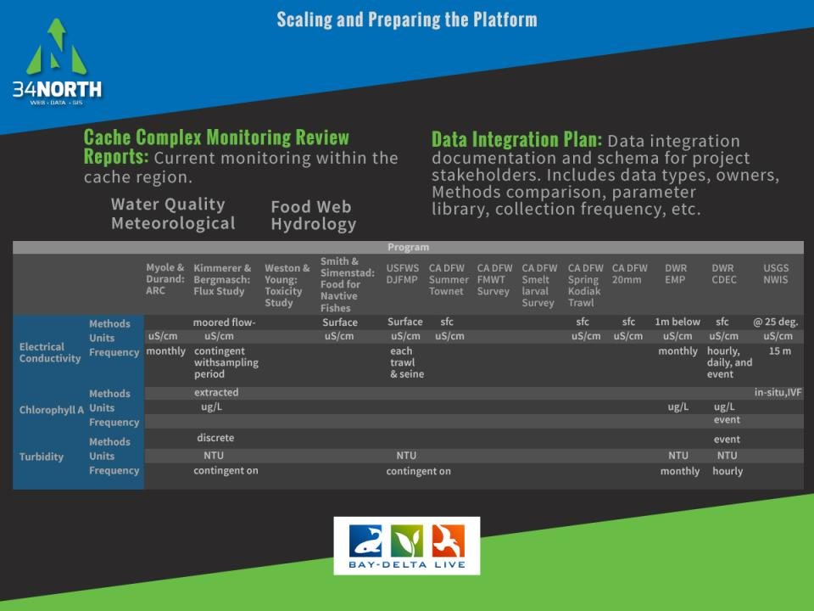
Notes:
The first task started to build this collaborative workspace was to develop a monitoring report for the region as well as a data integration plan. We review all exisiting data (data already on the portal) and data for the studies.

Slide 7
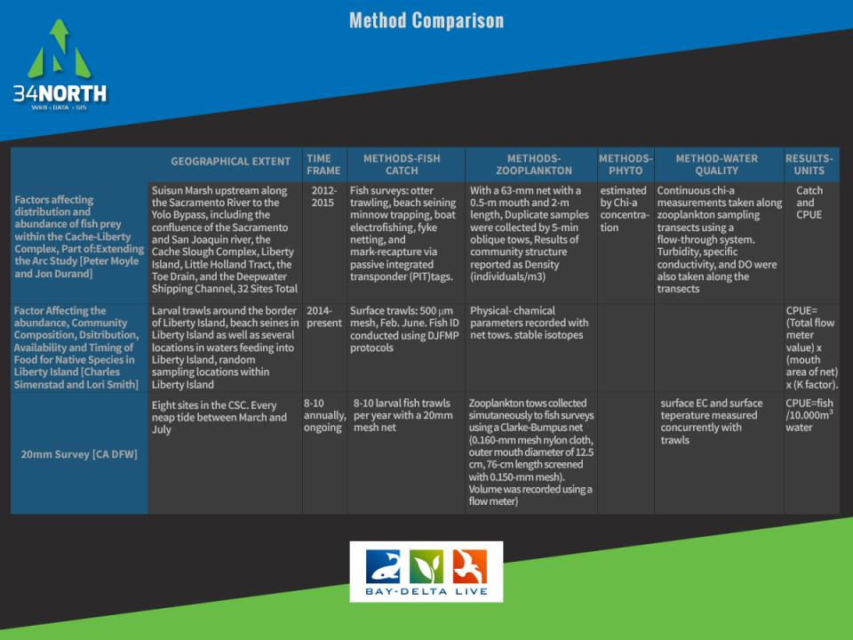
Notes:
Next we completed a methods comparison to make sure data would be compatible and make recommendations to Pis when needed.

Slide 8
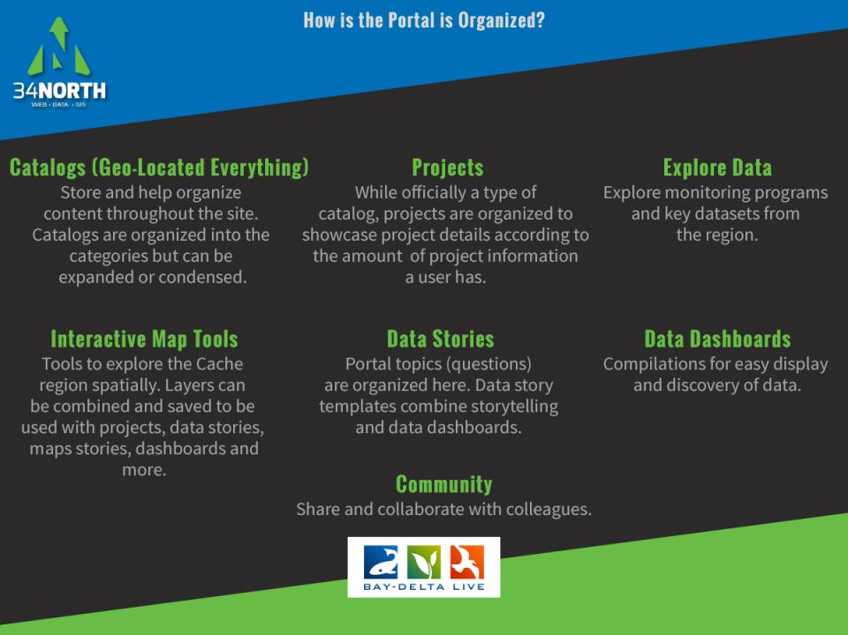
Notes:
Now that we have the data and GIS for the I will show you how it is integrated into the larger platform.

Slide 9
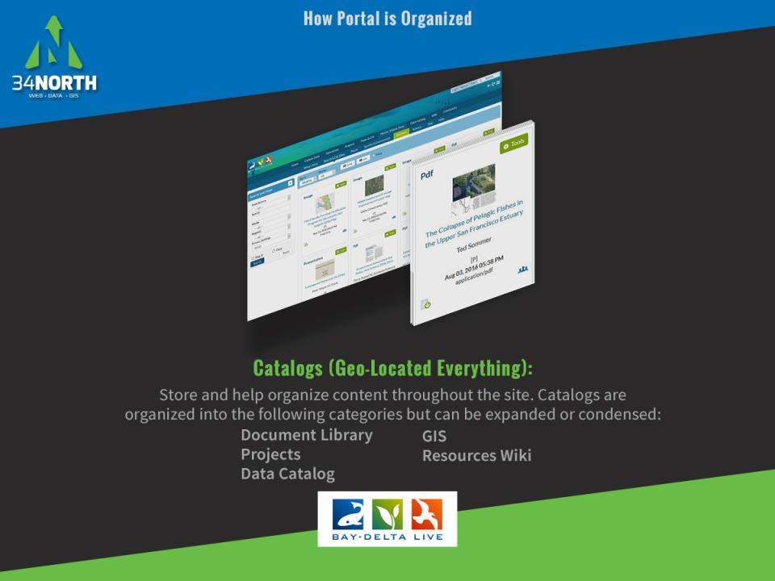

Slide 10
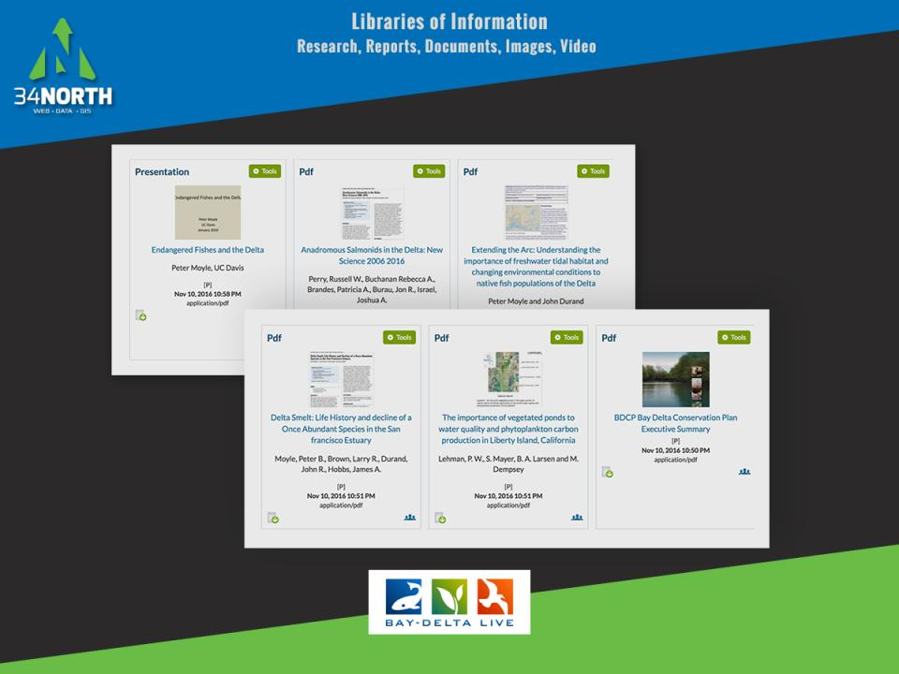
Notes:
The cache doc and report library is comprehensive with more that 300 reference docs for the region

Slide 11
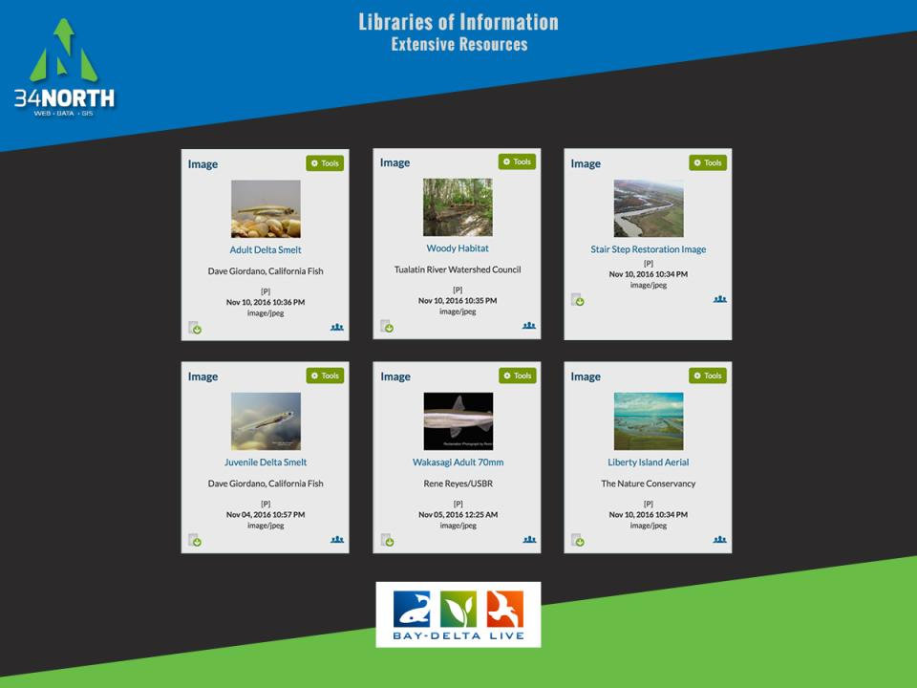
Notes:
All food web, fish data, vegetation data is referenced with images in the library for visuals.

Slide 12
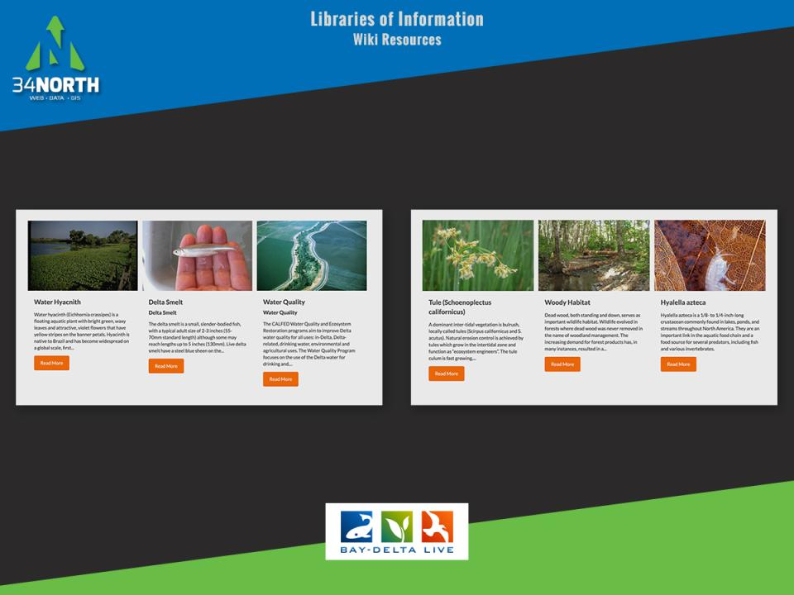
Notes:
All topics have wiki resources for reference. These references refer users to the abundance of information provided by government agencies, non-profits, consulting groups…

Slide 13
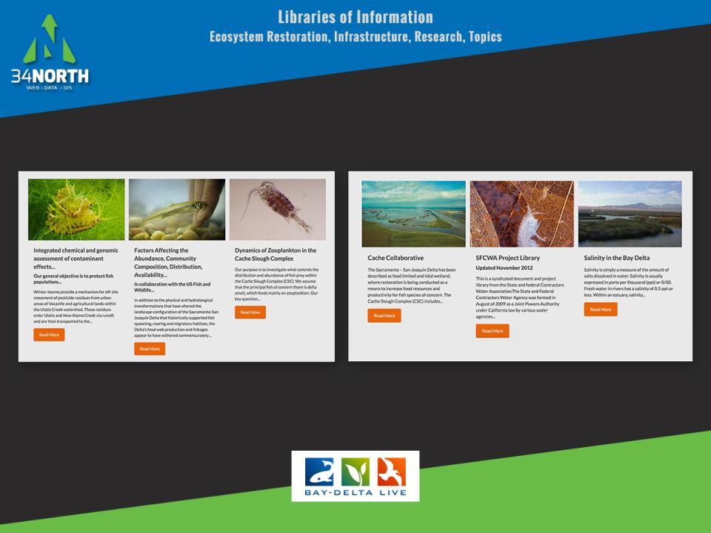
Notes:
Projects Catalog

Slide 14
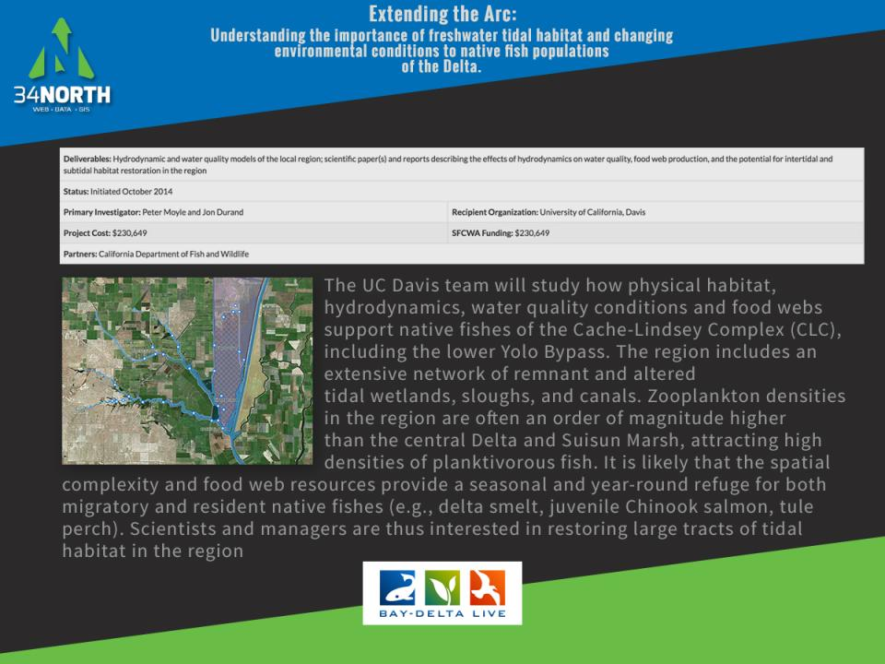

Slide 15
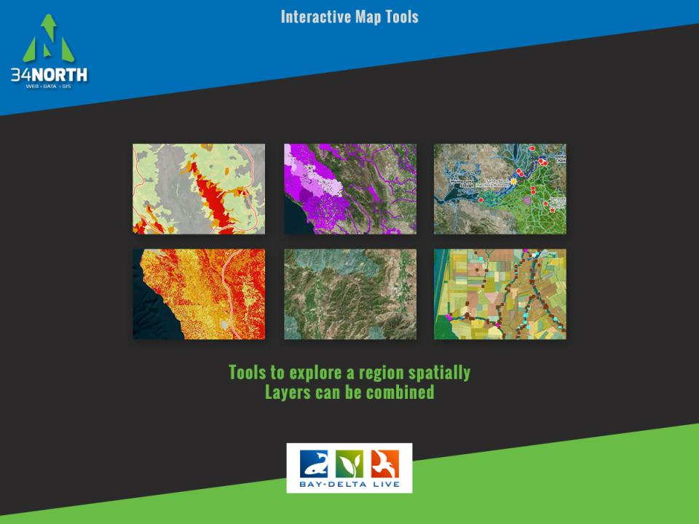
Notes:
Cache, Barker, Hass, Prospect, Shag and Lindsey Slough, Yolo Bypass, Liberty Island, Prospect Island, Delta Cross Channel, Fremont Weir, Sacramento Deep Water Ship Channel, Ulatis Creek, Suisun Marsh Salinity Control Gates, X2 Key Locations, Delta Vegetation, Sacramento, Yolo and Solano Counties Land Use, Legal Delta Suisun Boundary, Arc Sampling Sites, Arc Study Monitoring Locations (Durand and Moyle), Contaminant Effects on Fish Prey Monitoring Locations (Weston, Young, Poynton), Flux Study Monitoring Locations (Kimmerer and Bergamaschi), Liberty Island Seines Monitoring Locations and Random Sampling Locations (Smith and Simenstad), Liberty Island Larval Trawls.

Slide 16
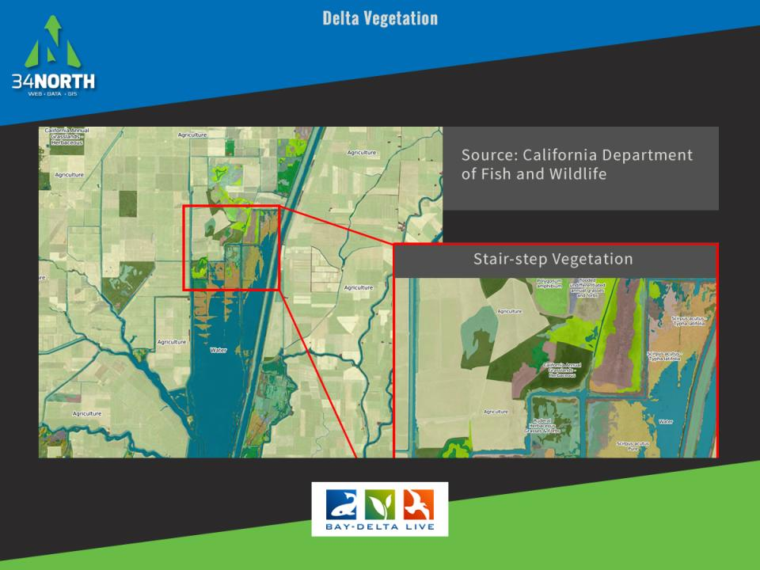
Notes:
Detailed Vegetation from CaDFW

Slide 17
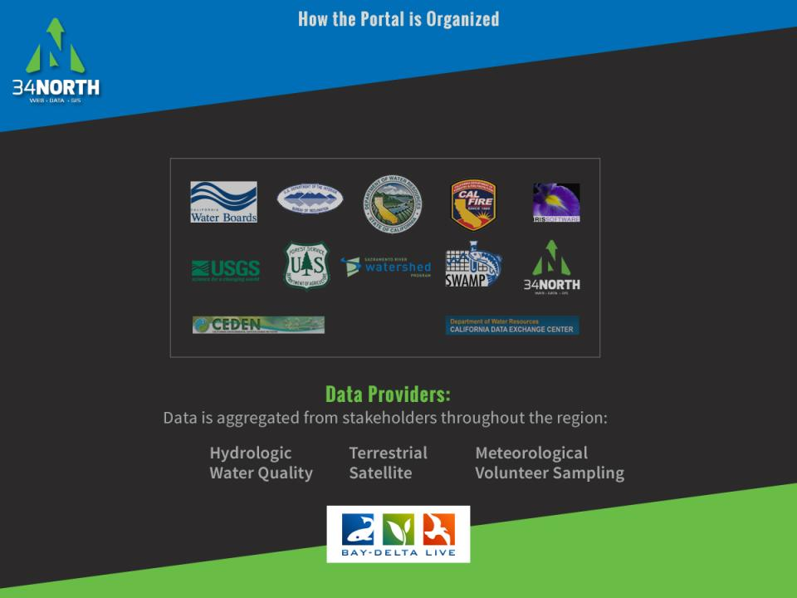
Notes:
Data is federated by the regional portal efforts underway. Data providers include agencies, universities, NGOS and stakeholders. Data includes access to hydrologic, terrestrial, meteorological, water quality, satellite, special studies, food web and volunteer sampling.

Slide 18
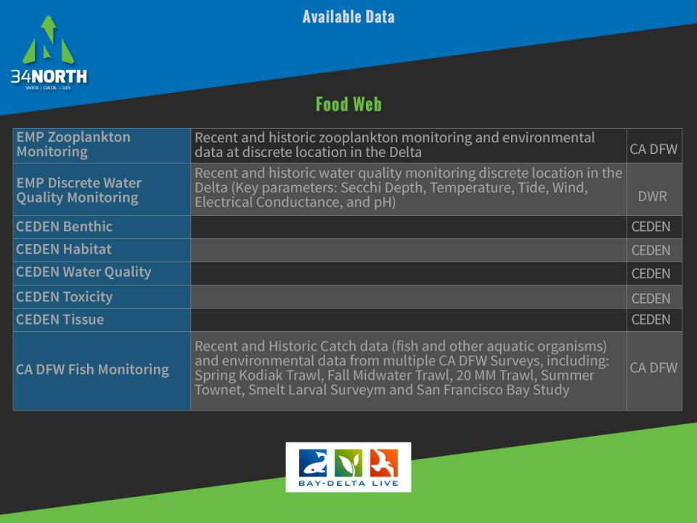

Slide 19
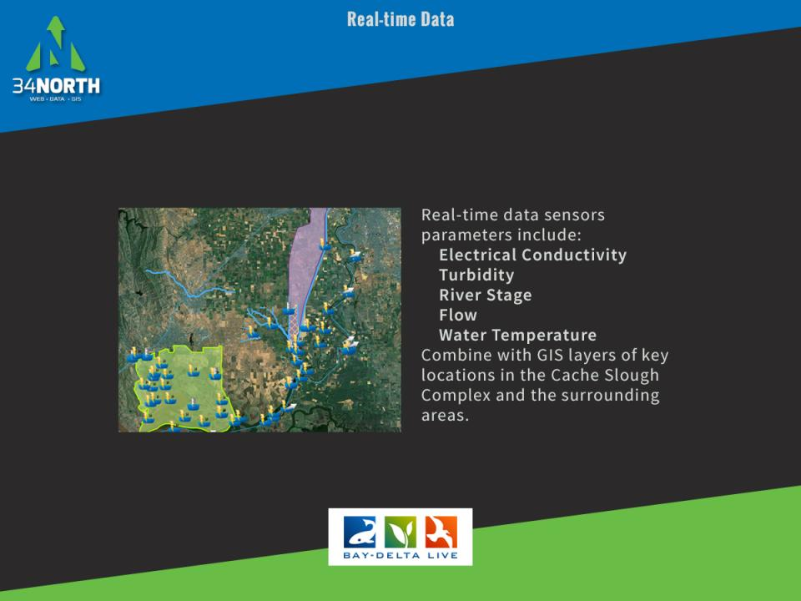

Slide 20
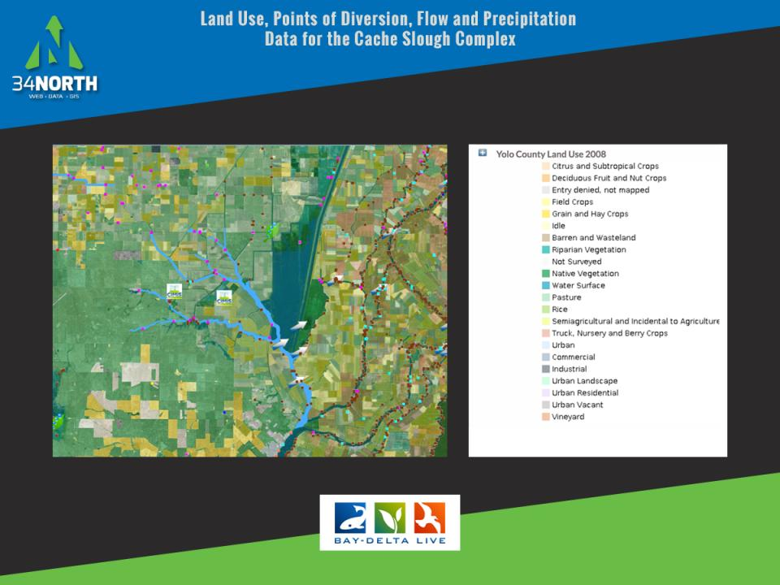
Notes:
Researchers can combine GIS, study data and real time data

Slide 21
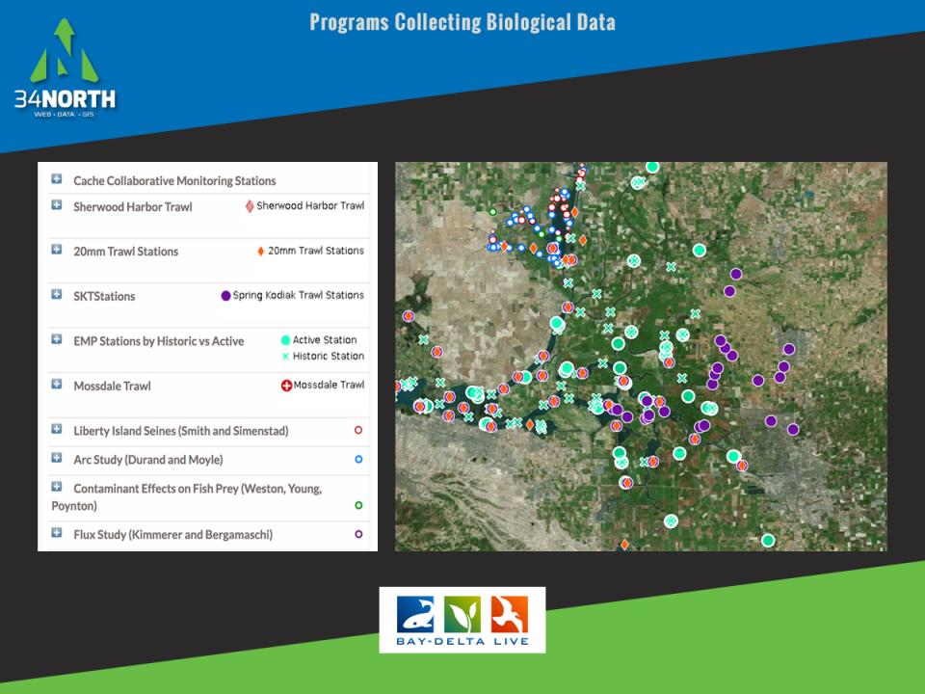
Notes:
Add and analyze biological data

Slide 22
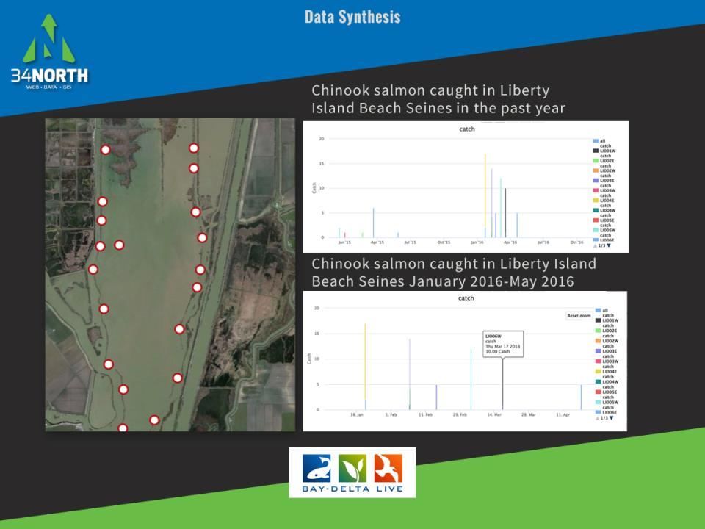

Slide 23
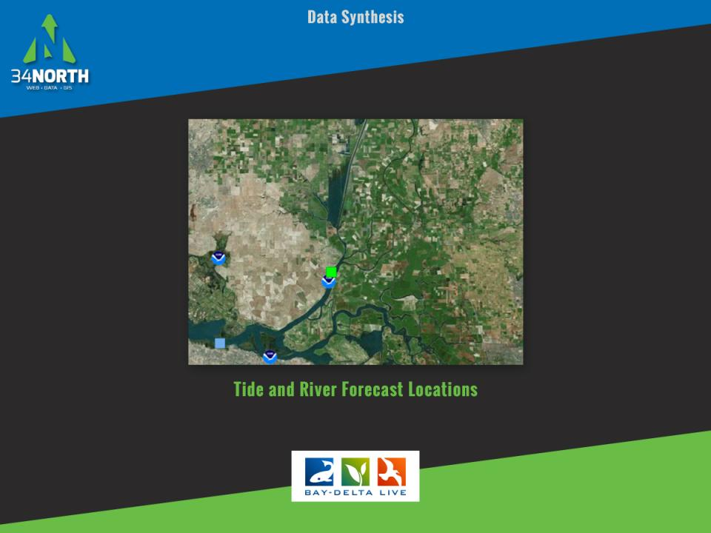

Slide 24
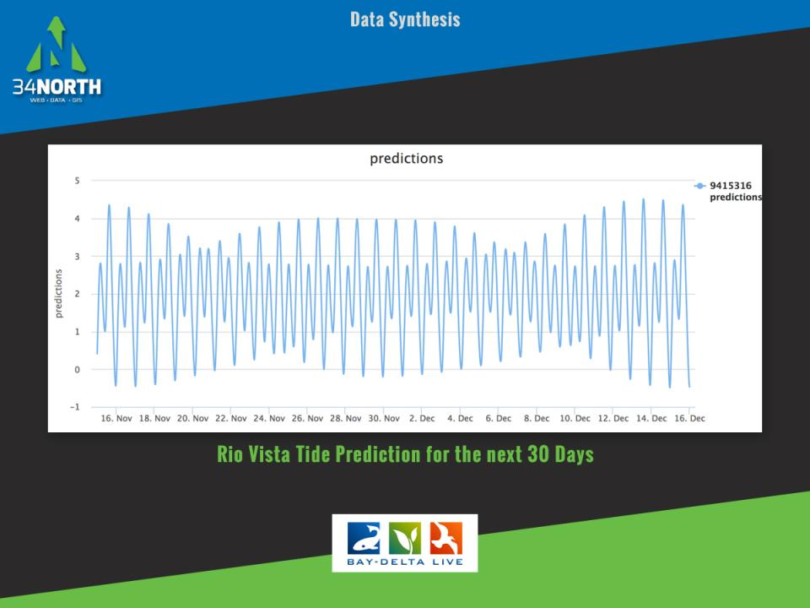

Slide 25
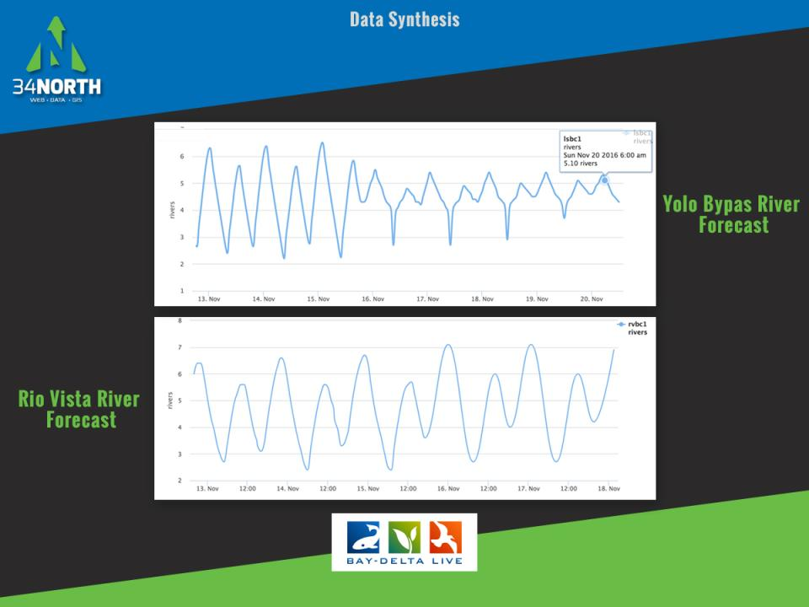

Slide 26
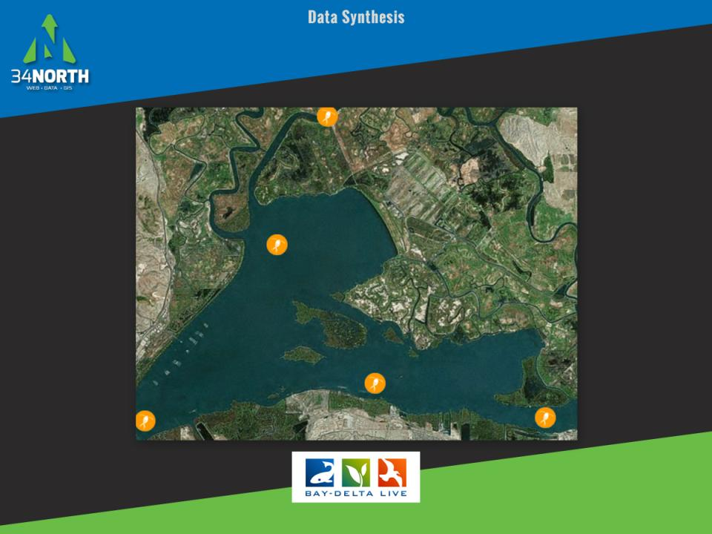

Slide 27
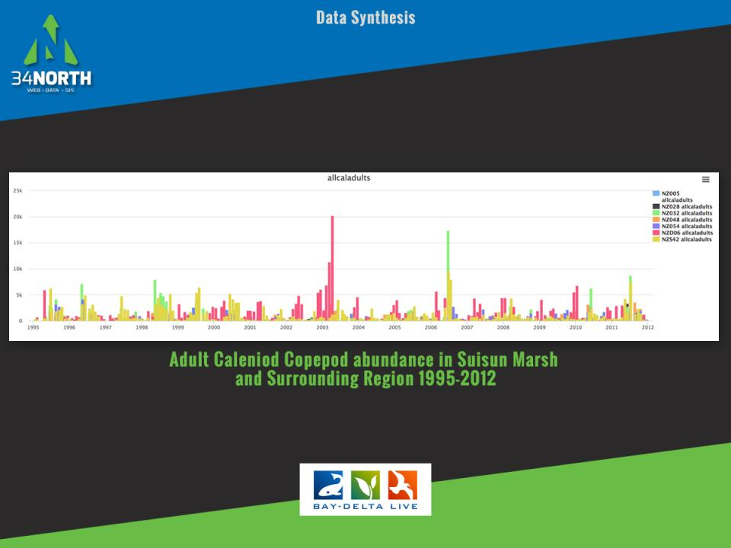

Slide 28
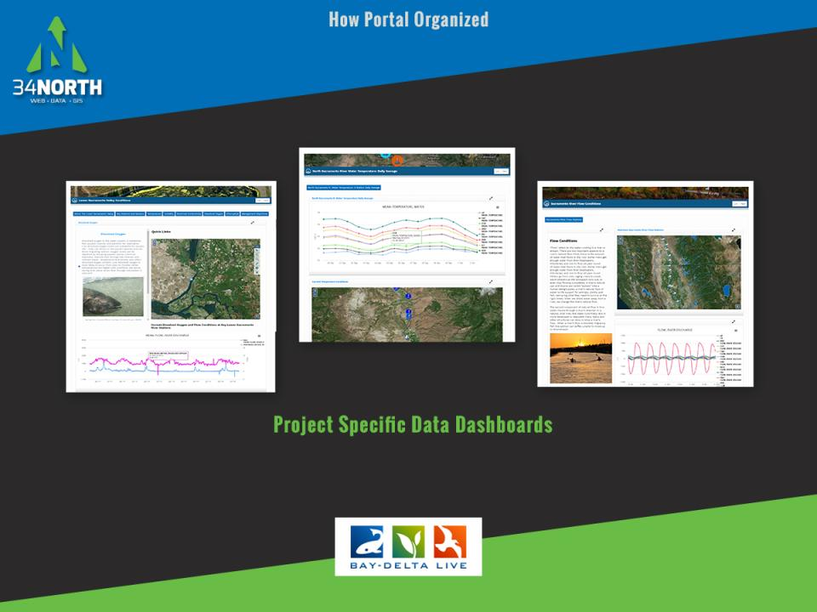
Notes:
A data dashboard is being developed for each study and monitoring programs

Slide 29
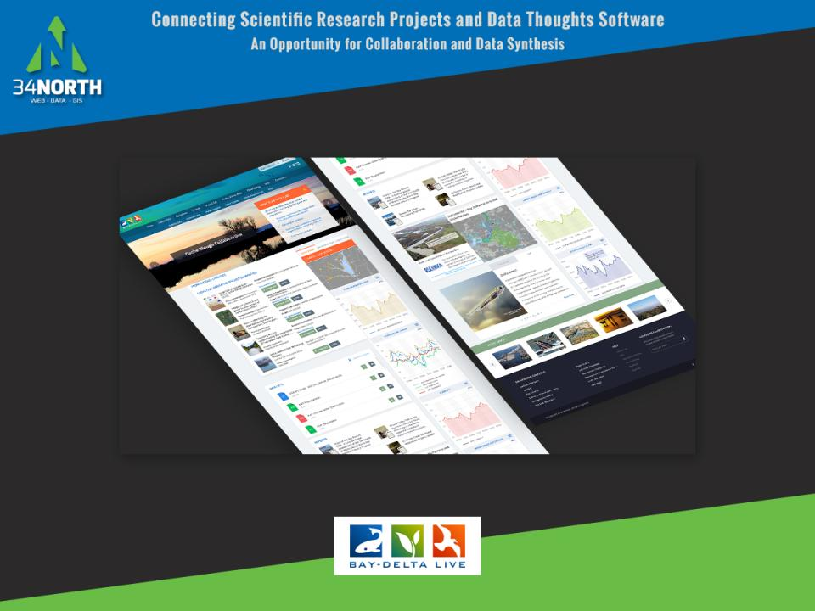

Slide 30
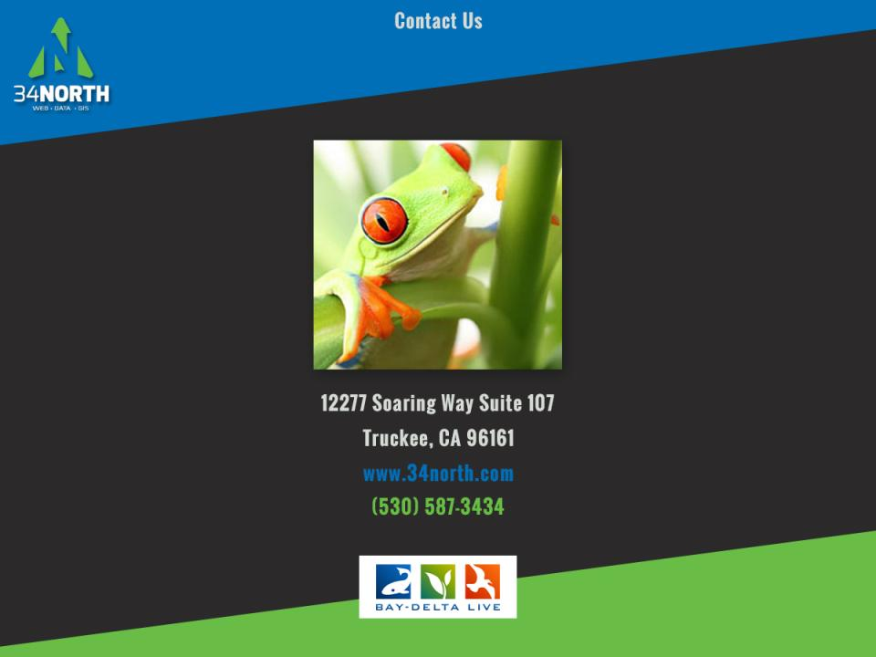

Slide 31
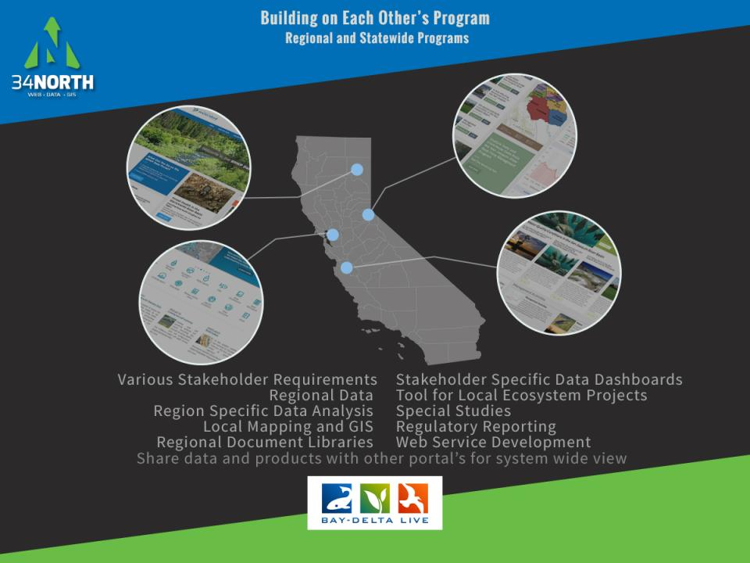
Notes:
These efforts are successful because each region has different stakeholder requirements, data specific to their region, region specific data analysis, local mapping, regional doc libraries ,stakeholder specific data dashboards, local project management and regulatory reporting. But each portal has access to each other’s information for improved watershed management and system wide views.

