Slide 1
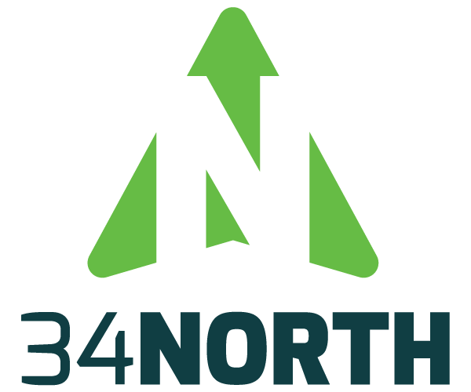

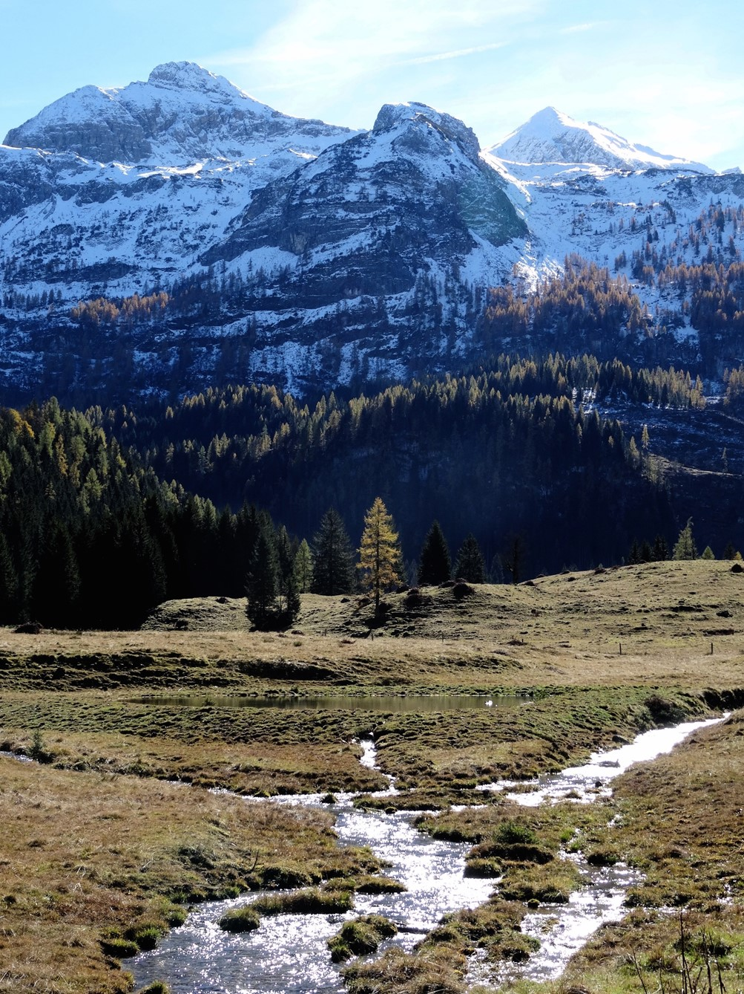
OUR PRODUCTS
34 North is the developer of BayDeltaLive.com and the Bay-Delta Live Mobile Application. 34 North is an innovator in collaborative natural resource management technologies and data solutions, with over two decades of experience. Their team of scientists, engineers and programmers are experts in web and mobile technologies, GIS, data management (including open data initiatives), analytics and visualizations. 34 North works to transform data into useful information that can guide science based management of our natural resources. If you have questions or comments about BayDeltaLive.com, the BDL App, or 34 North

Slide 2
OUR PRODUCTS
34 North is the developer of BayDeltaLive.com and the Bay-Delta Live Mobile Application. 34 North is an innovator in collaborative natural resource management technologies and data solutions, with over two decades of experience. Their team of scientists, engineers and programmers are experts in web and mobile technologies, GIS, data management (including open data initiatives), analytics and visualizations. 34 North works to transform data into useful information that can guide science based management of our natural resources. If you have questions or comments about BayDeltaLive.com, the BDL App, or 34 North
WHAT’S NEW
New Features
New Fisheries UI

Slide 3
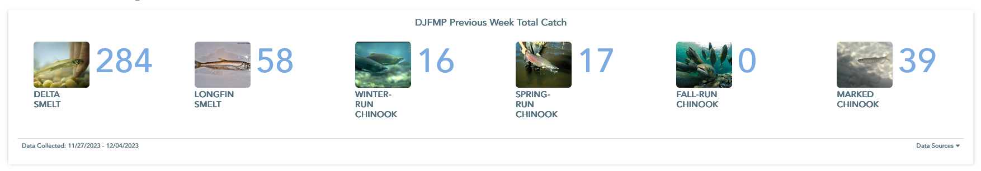
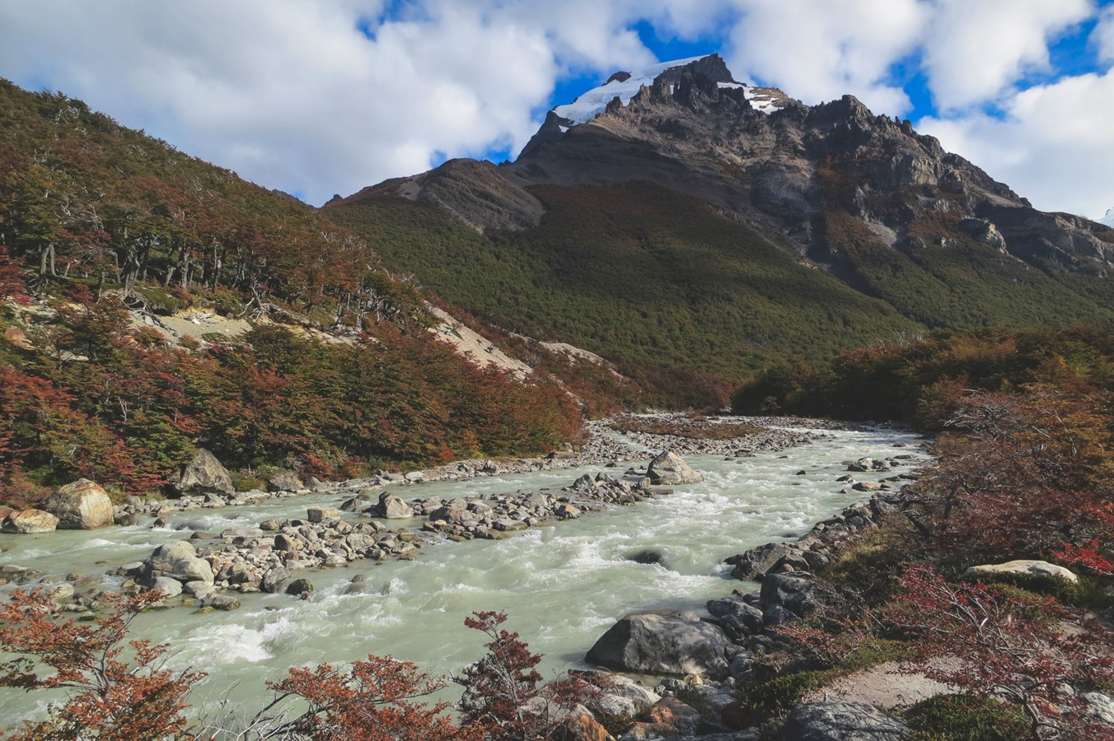
Fish Imagery
Fish Catches
OUR PRODUCTS
34 North is the developer of BayDeltaLive.com and the Bay-Delta Live Mobile Application. 34 North is an innovator in collaborative natural resource management technologies and data solutions, with over two decades of experience. Their team of scientists, engineers and programmers are experts in web and mobile technologies, GIS, data management (including open data initiatives), analytics and visualizations. 34 North works to transform data into useful information that can guide science based management of our natural resources. If you have questions or comments about BayDeltaLive.com, the BDL App, or 34 North
WHAT’S NEW
New Features
New Fisheries UI
Species Type

Slide 4
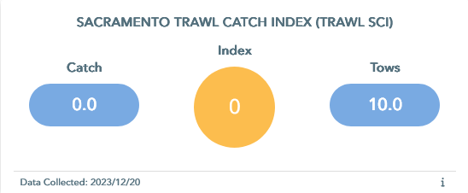
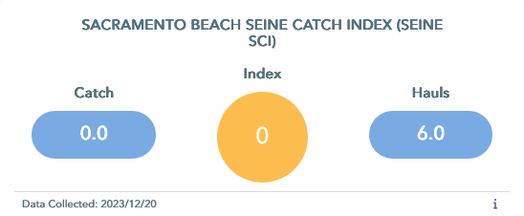
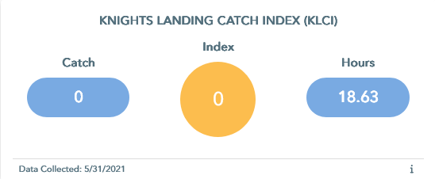
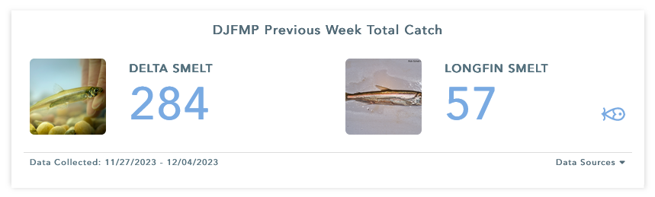
OUR PRODUCTS
34 North is an innovator in collaborative natural resource management technologies and data solutions. Our unique software platform, OpenNRM, is designed to help our clients turn data into valuable information.
Fish Imagery
Fish Catches
Species Type

Slide 5
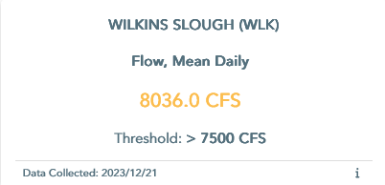
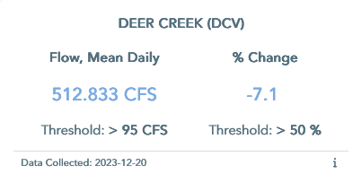
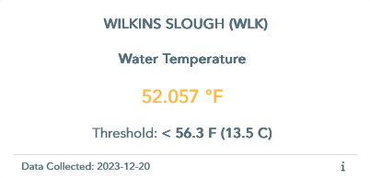
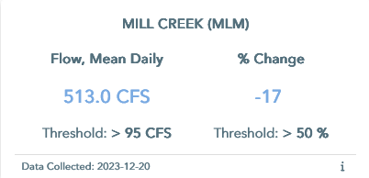
Fish Imagery
Fish Catches
Species Type

Slide 6
