Slide 1
Scroll Spy

Slide 2
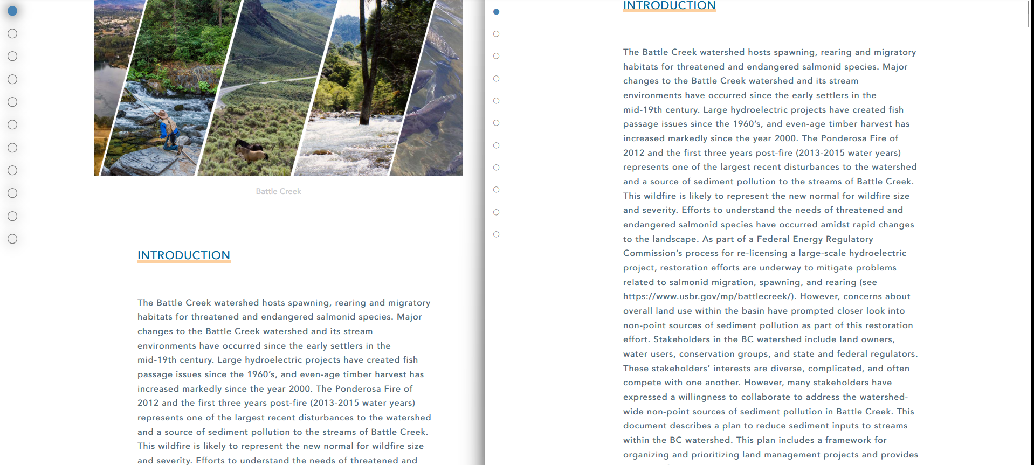
Scroll Spy V1

Slide 3
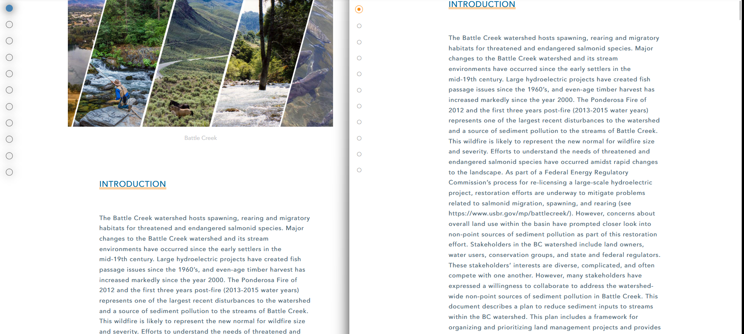
Scroll Spy V2

Slide 4
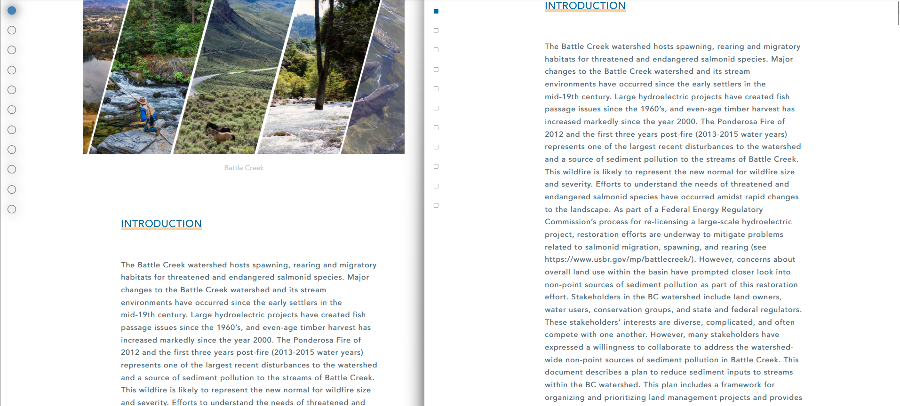
Scroll Spy V3

Slide 5
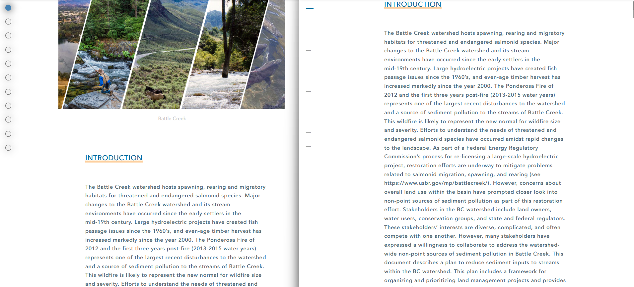
Scroll Spy V4

Slide 6
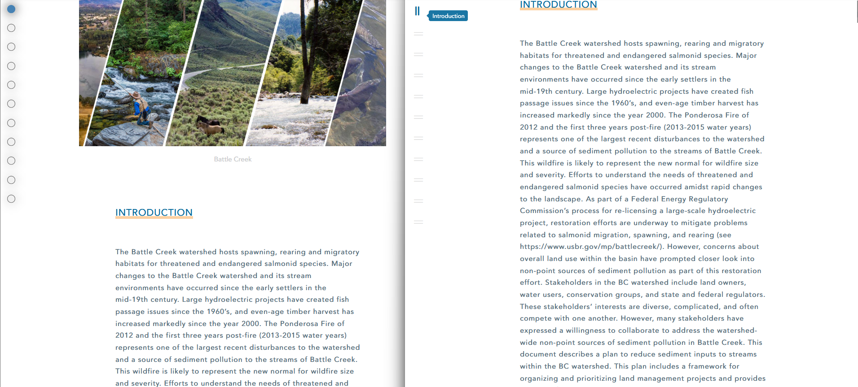
Scroll Spy V5

Slide 7

Scroll Spy V6

Slide 8
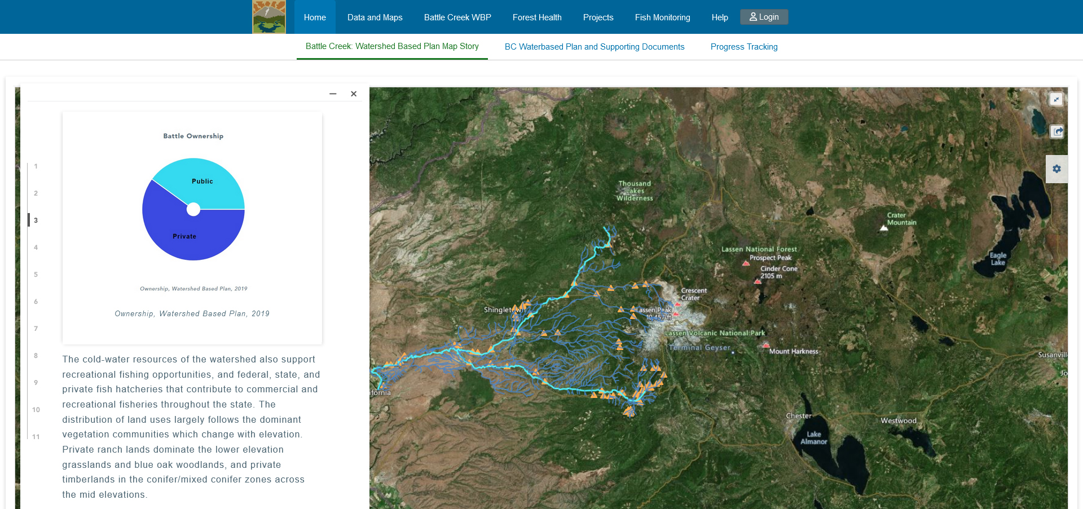
Scroll Spy V6

Slide 9
Legend & Scale

Slide 10
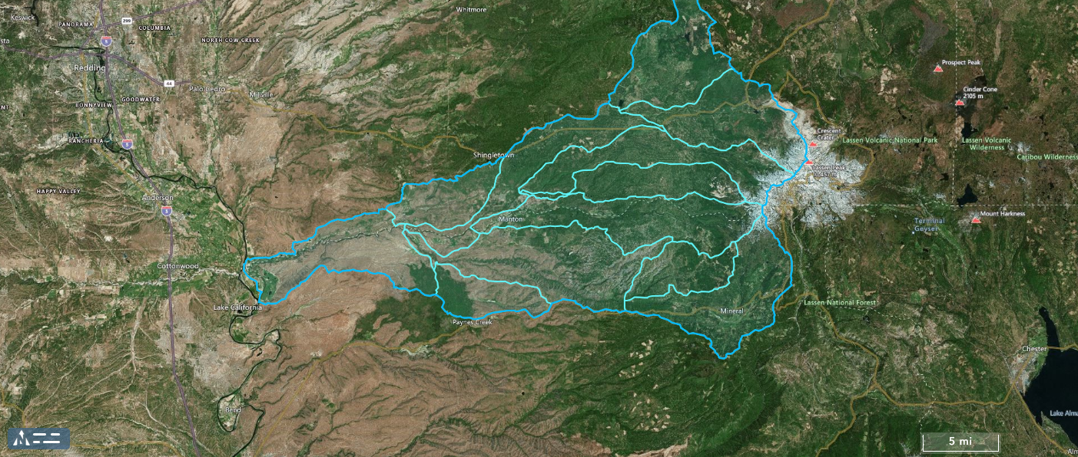
Legend & Scale V1

Slide 11
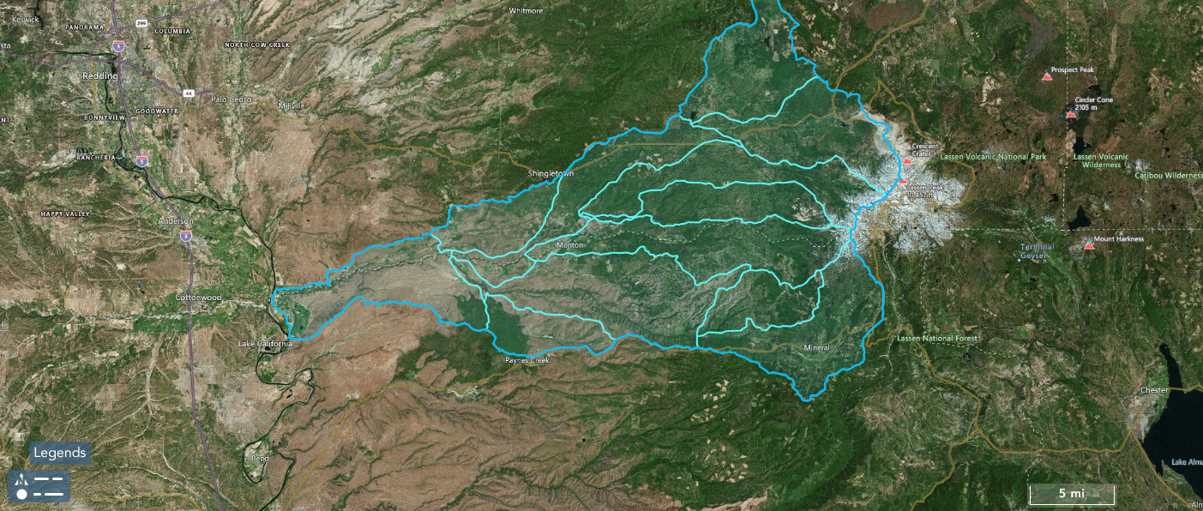
Legend & Scale V2

Slide 12

Legend & Scale V3

Slide 13

Legend & Scale V4

Slide 14
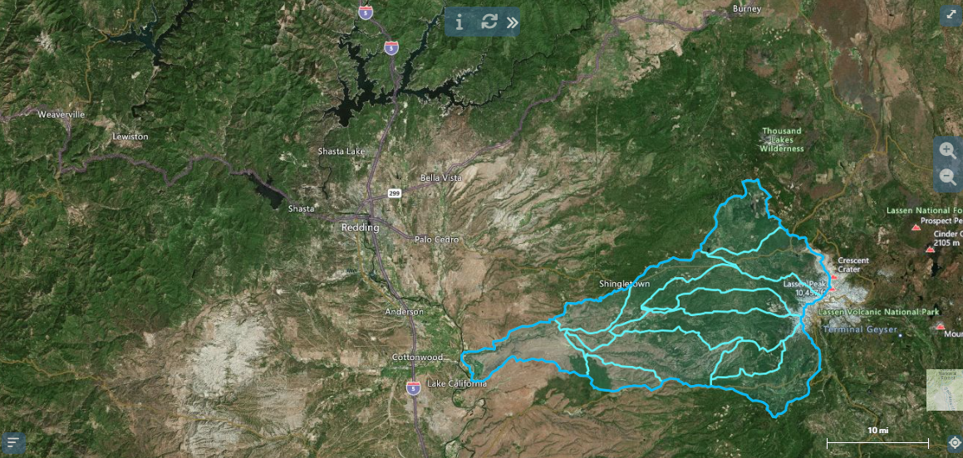
Scale V1

Slide 15
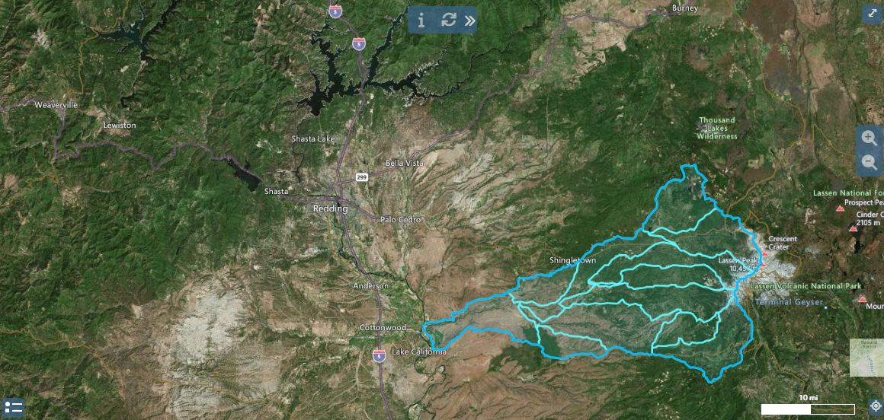
Scale V2

Slide 16
Legend & Scale
Background Colors

Slide 17
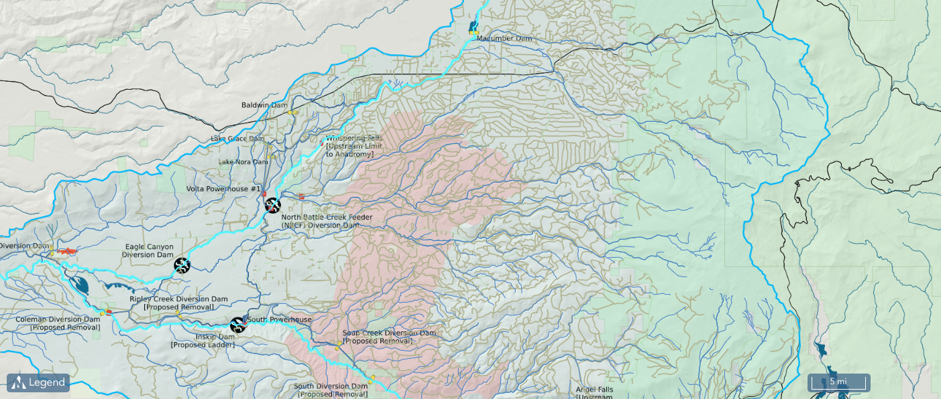
Blue Background

Slide 18
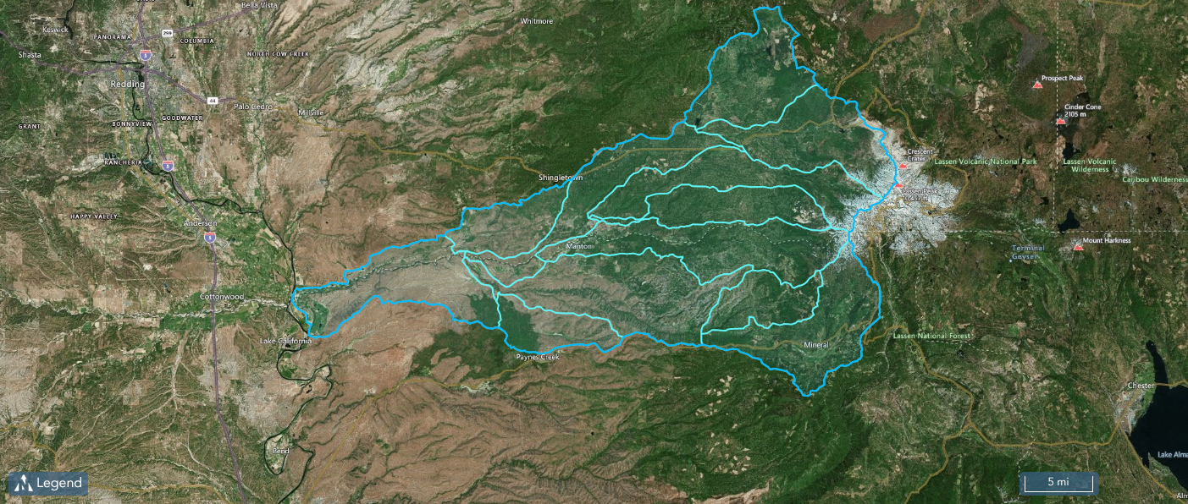
Blue Background

Slide 19
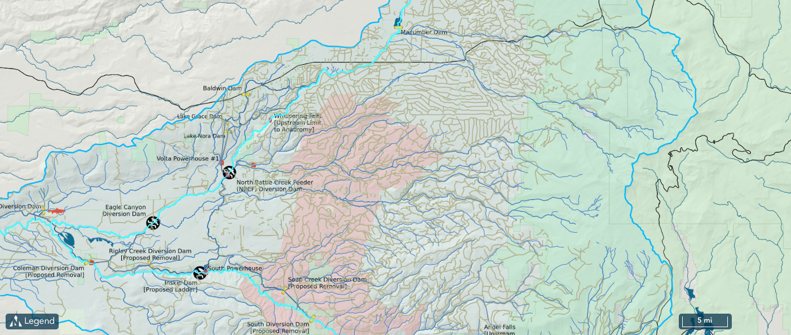
Dark Blue Background

Slide 20
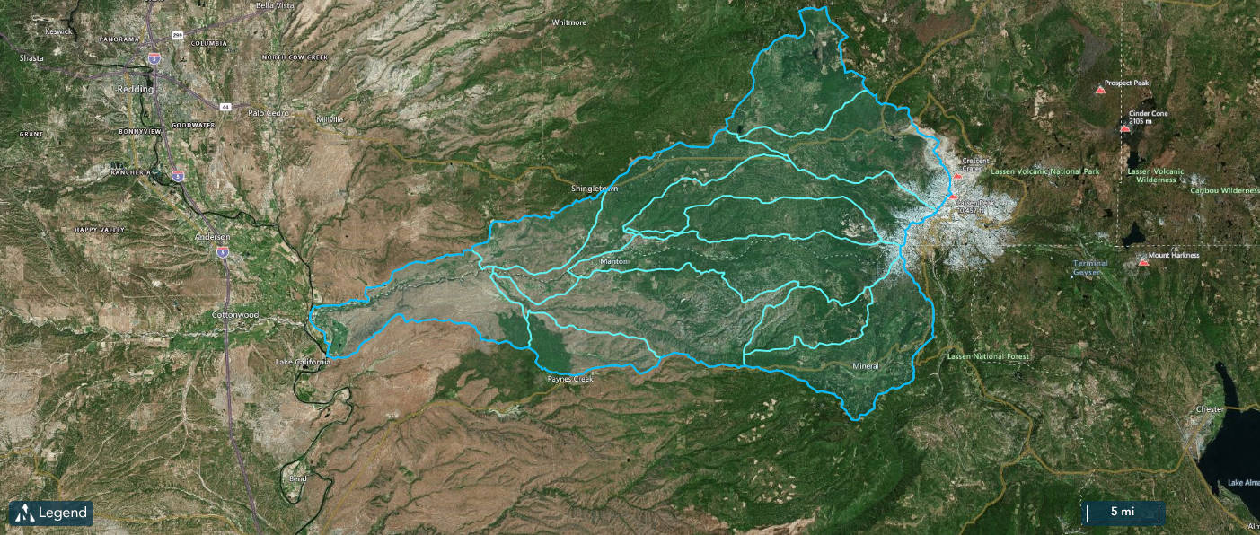
Dark Blue Background

Slide 21
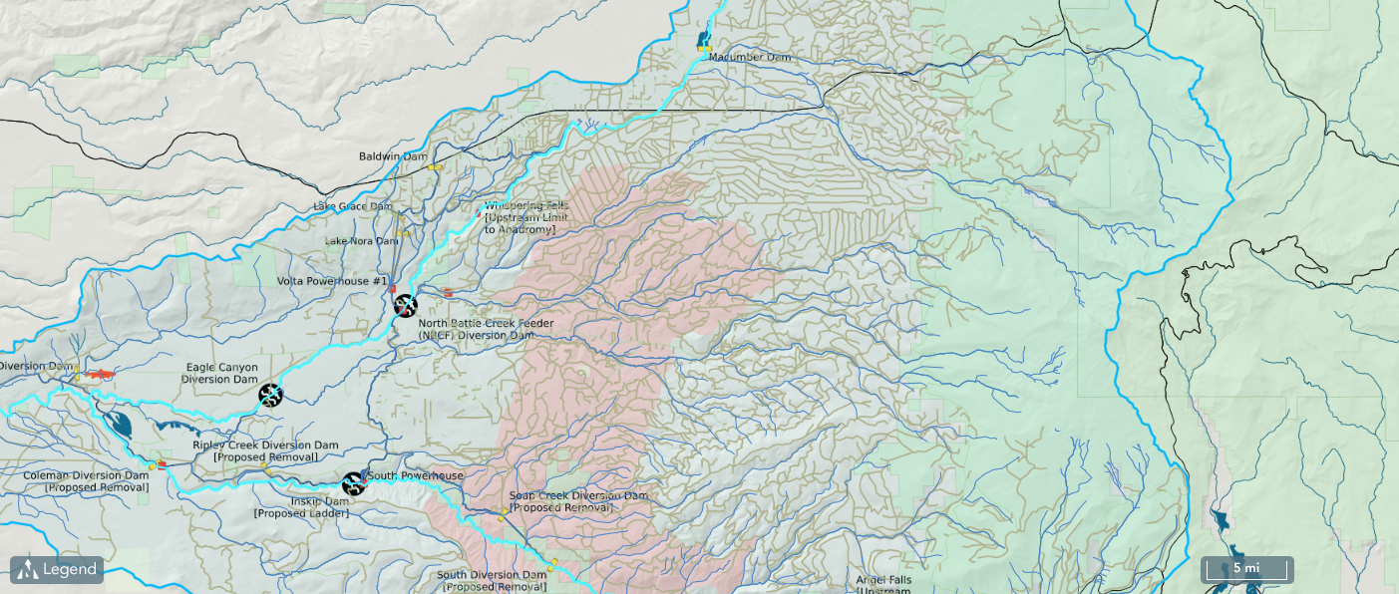
Dark Grey Background

Slide 22
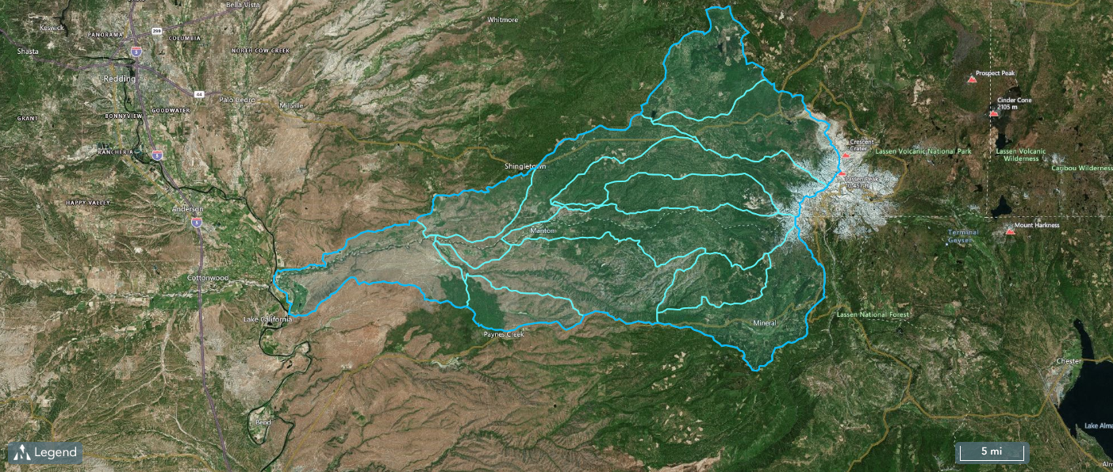
Dark Grey Background

Slide 23
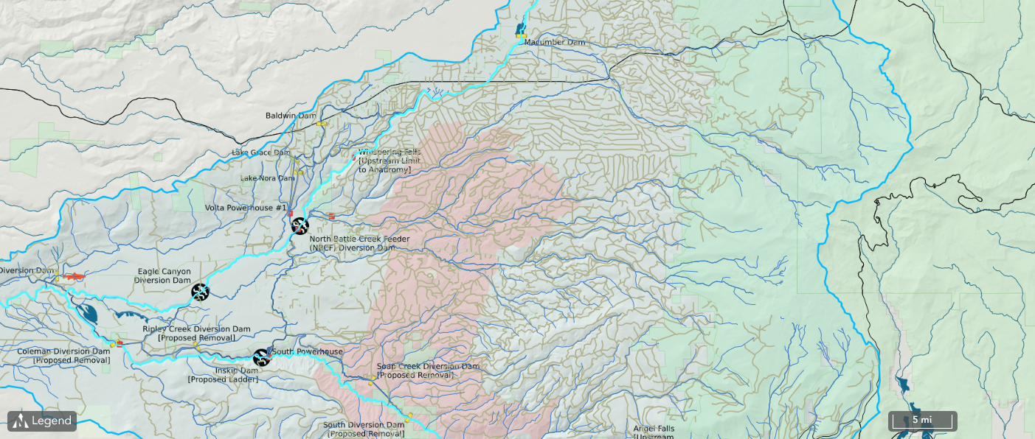
Darker Grey Background

Slide 24
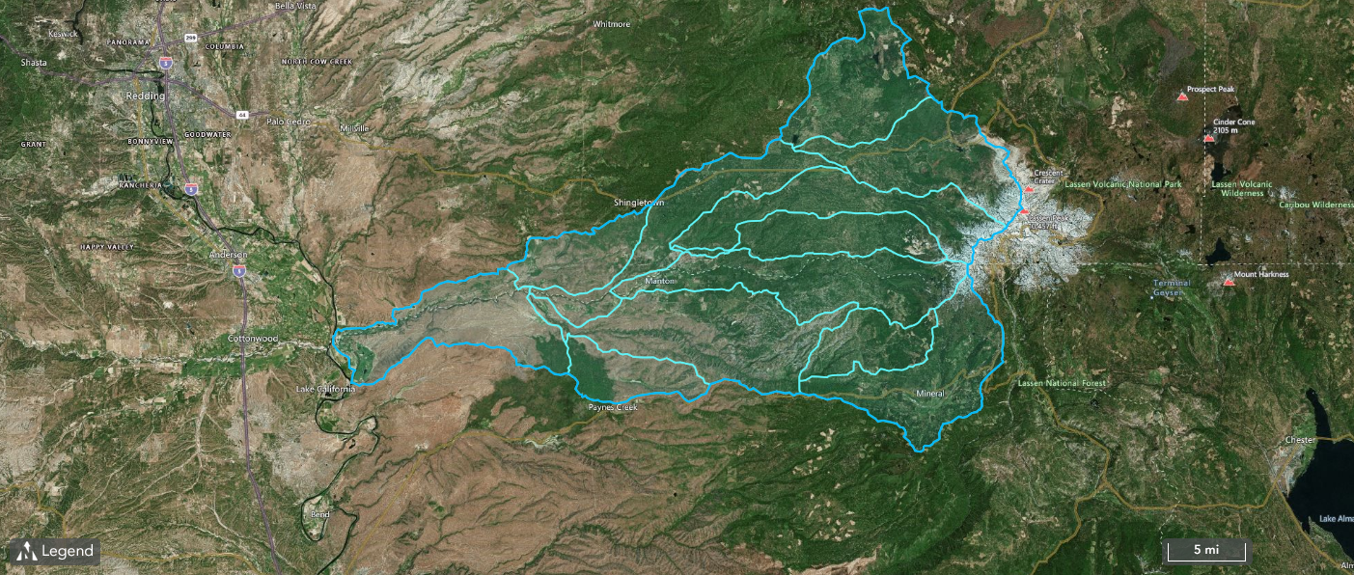
Darker Grey Background

Slide 25
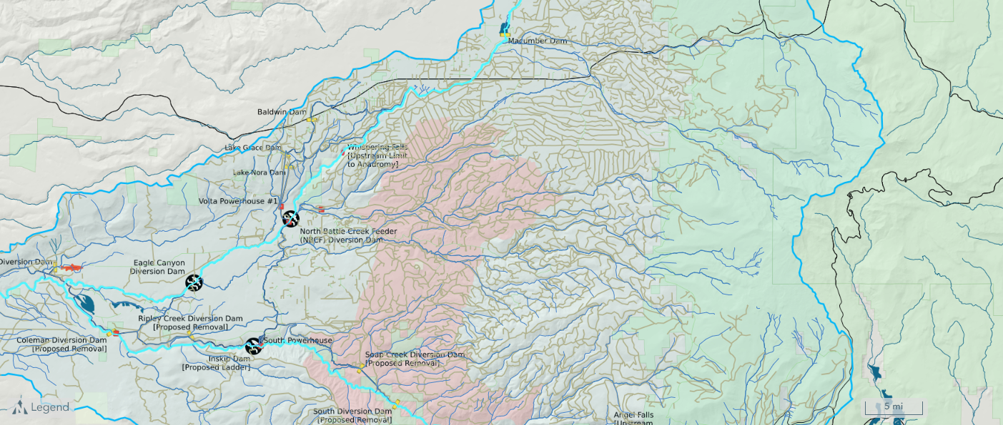
Grey Background

Slide 26
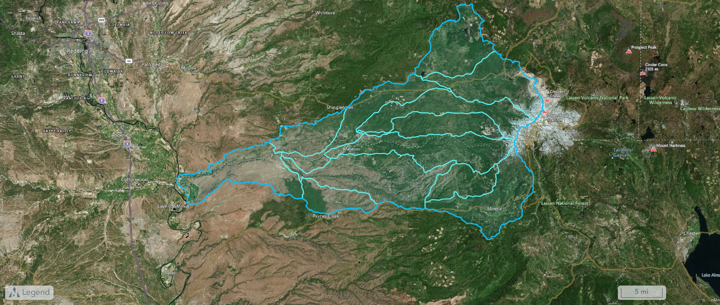
Grey Background

Slide 27
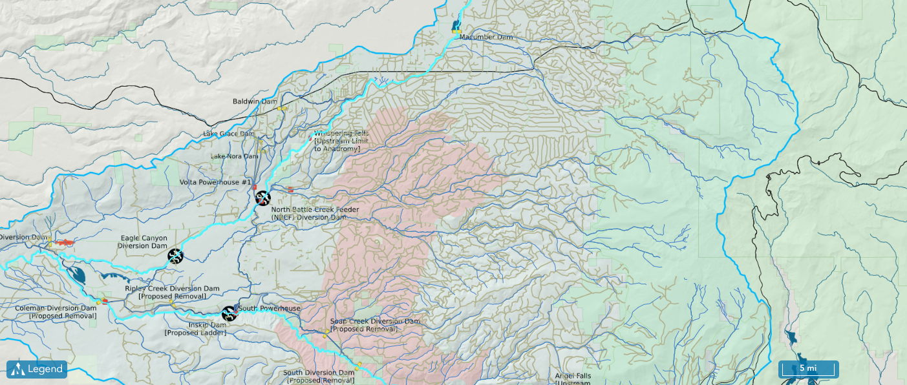
Blue Background

Slide 28

Blue Background

Slide 29
Map Markers

Slide 30
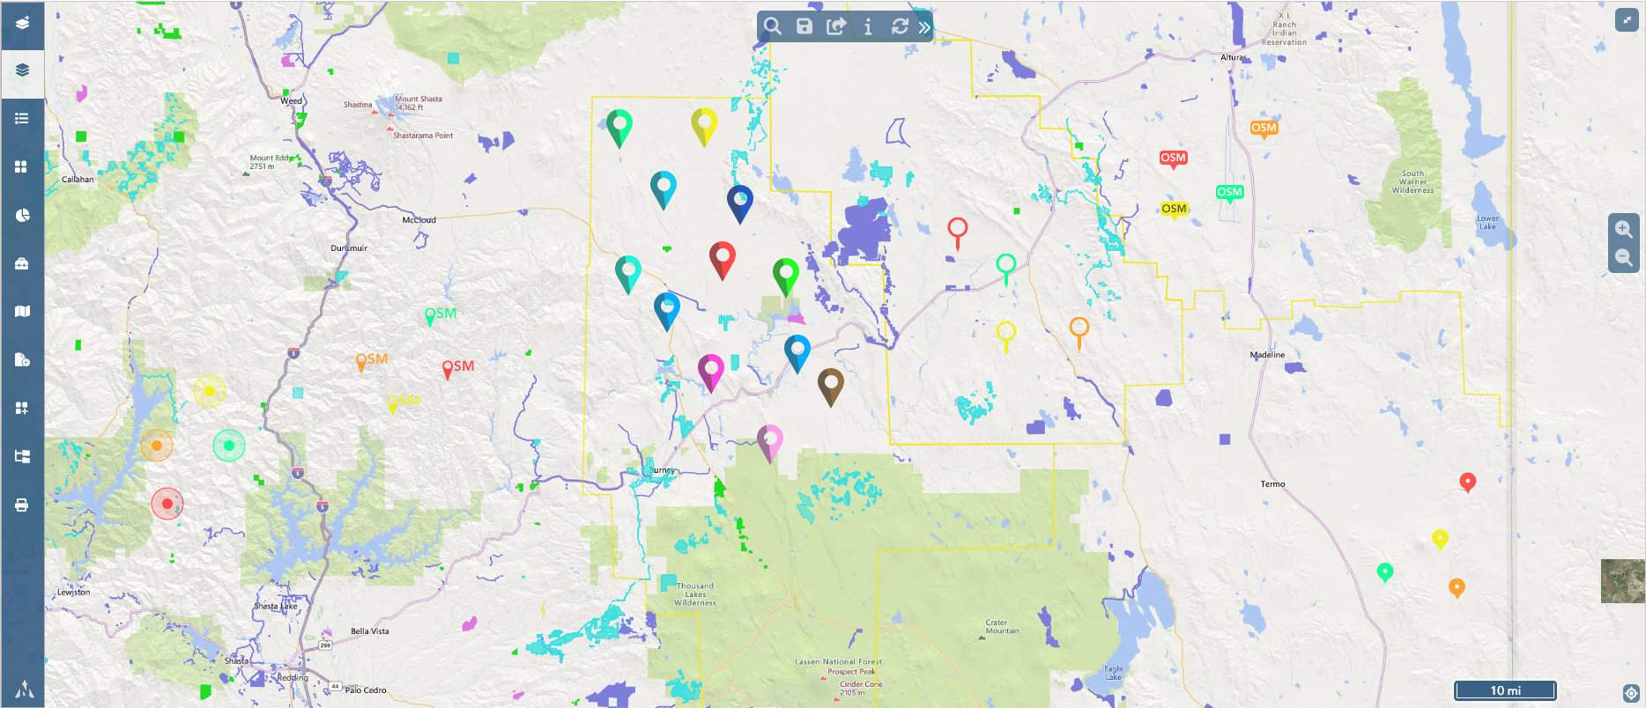
Map Markers

Slide 31
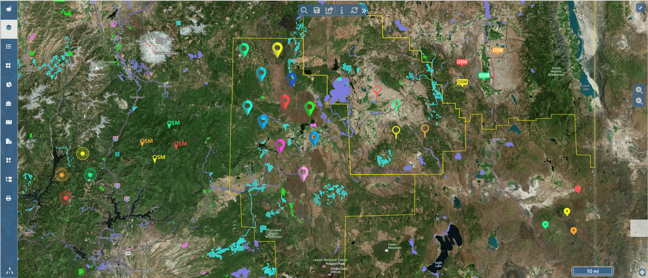
Map Markers

Slide 32
Result Not Found

Slide 33
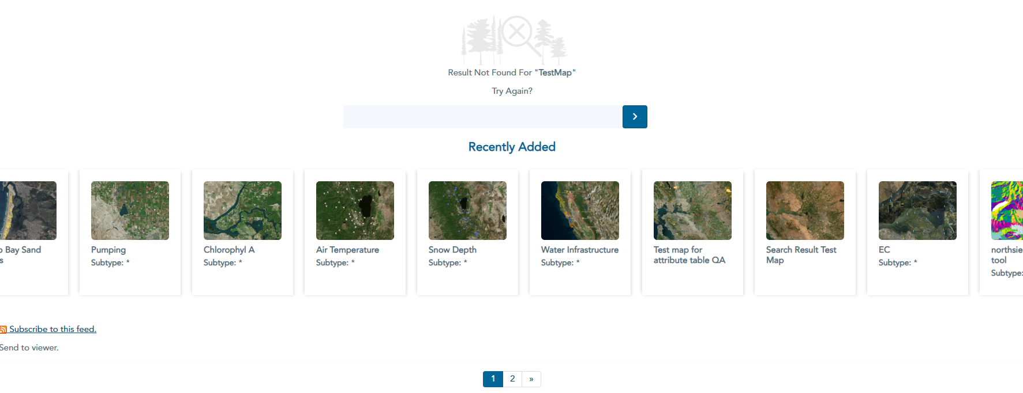
Result Not Found

Slide 34
Mobile Map Build

Slide 35
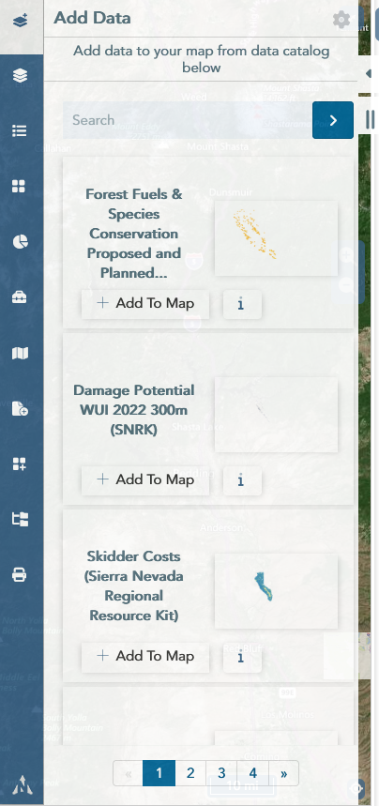
Max Width

Slide 36
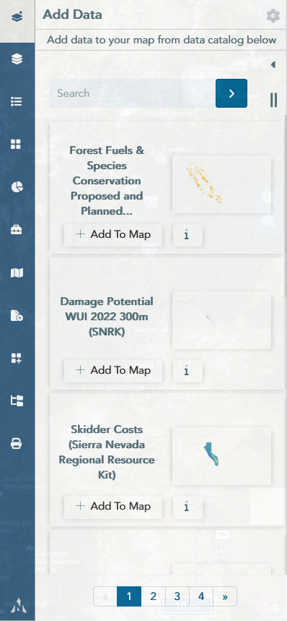
Media Query

Slide 37
Nav Search

Slide 38
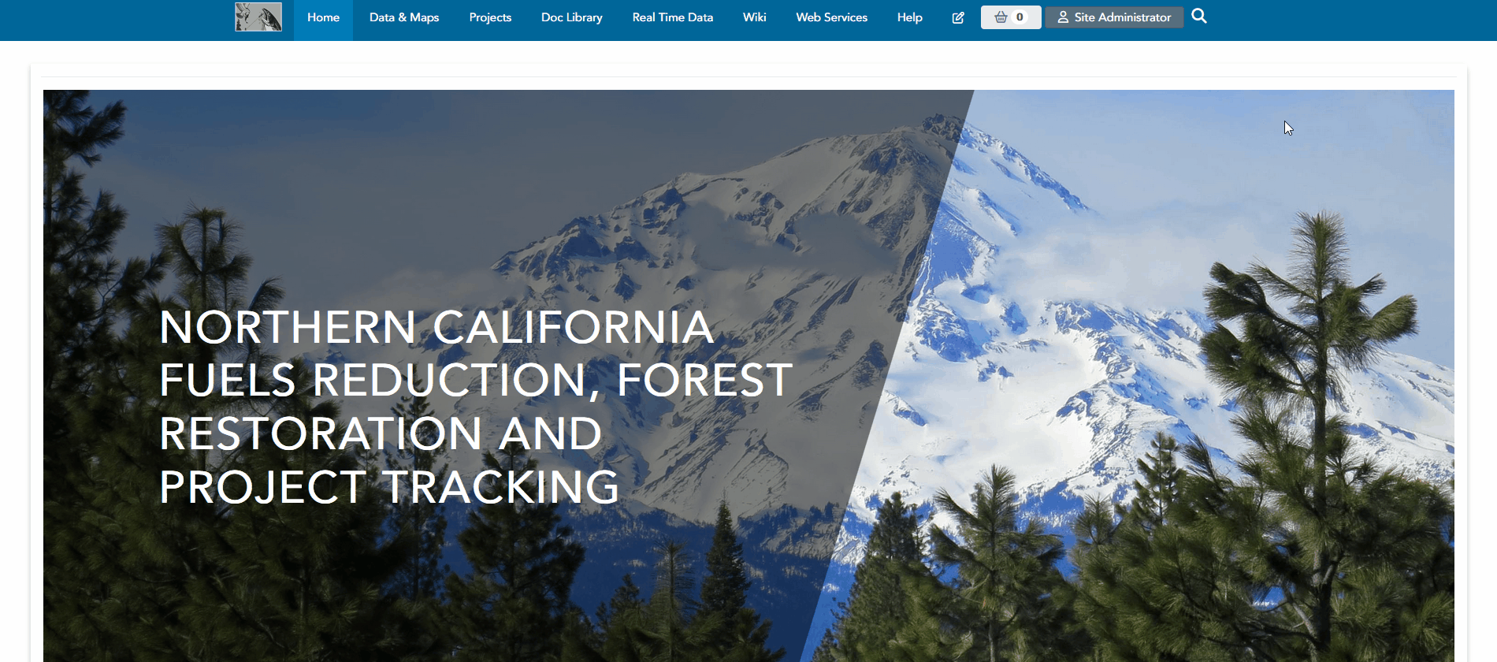
On the nav

Slide 39

Below the nav

Slide 40

Below the nav with button

Slide 41

Below the nav with button (Cool Effect)

