Slide 1
Scroll Spy

Slide 2
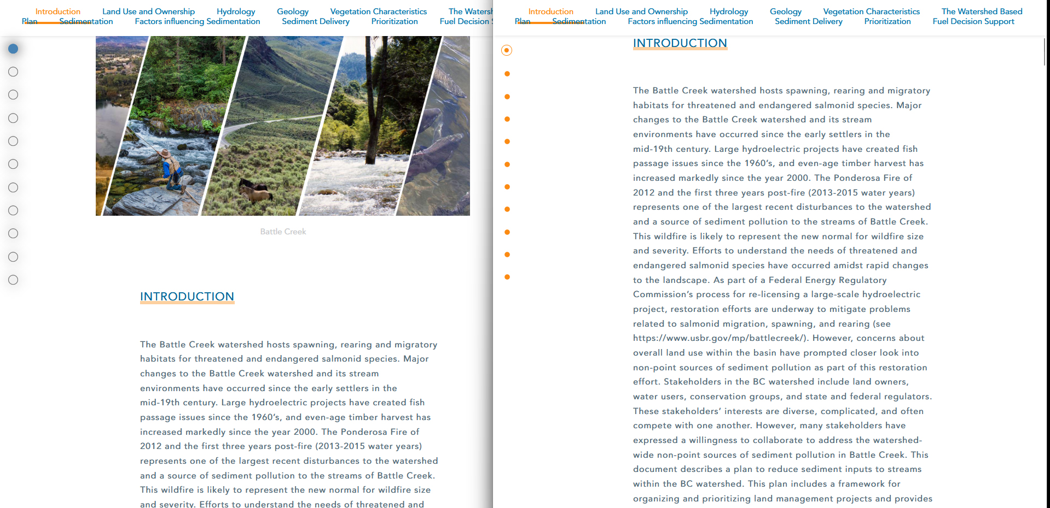
Scroll Spy V1

Slide 3

Scroll Spy V2

Slide 4

Scroll Spy V3

Slide 5

Scroll Spy V4

Slide 6

Scroll Spy V5

Slide 7

Scroll Spy V6

Slide 8
Legend & Scale

Slide 9
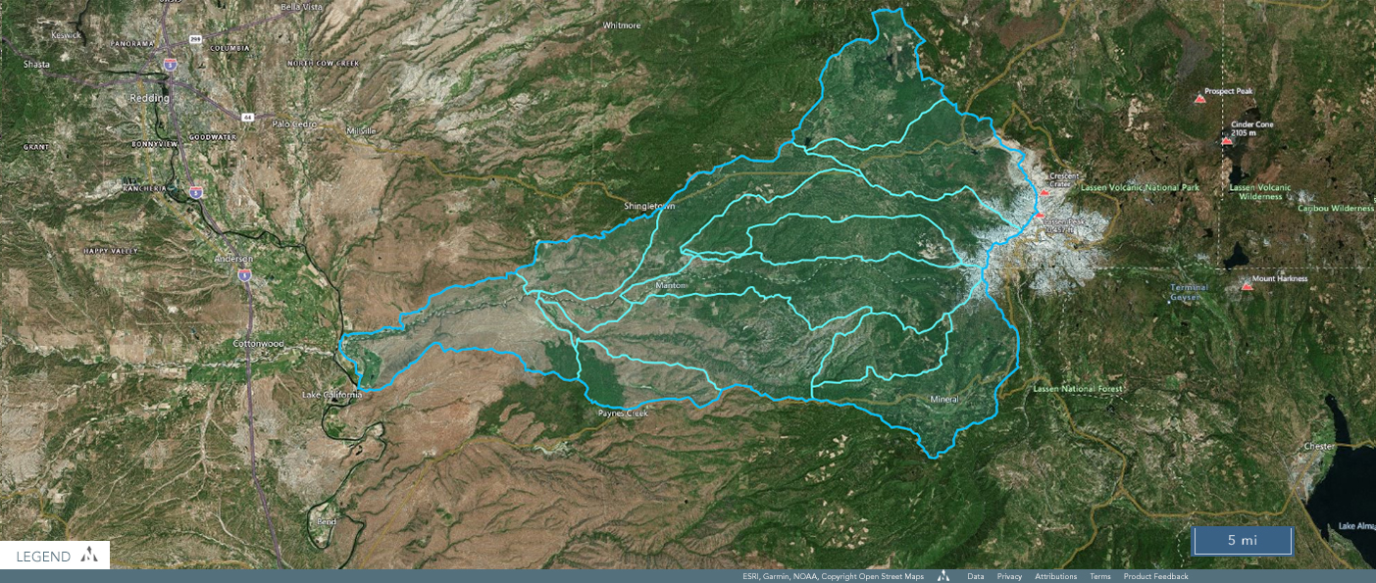
Legends and Attributions v1

Slide 10
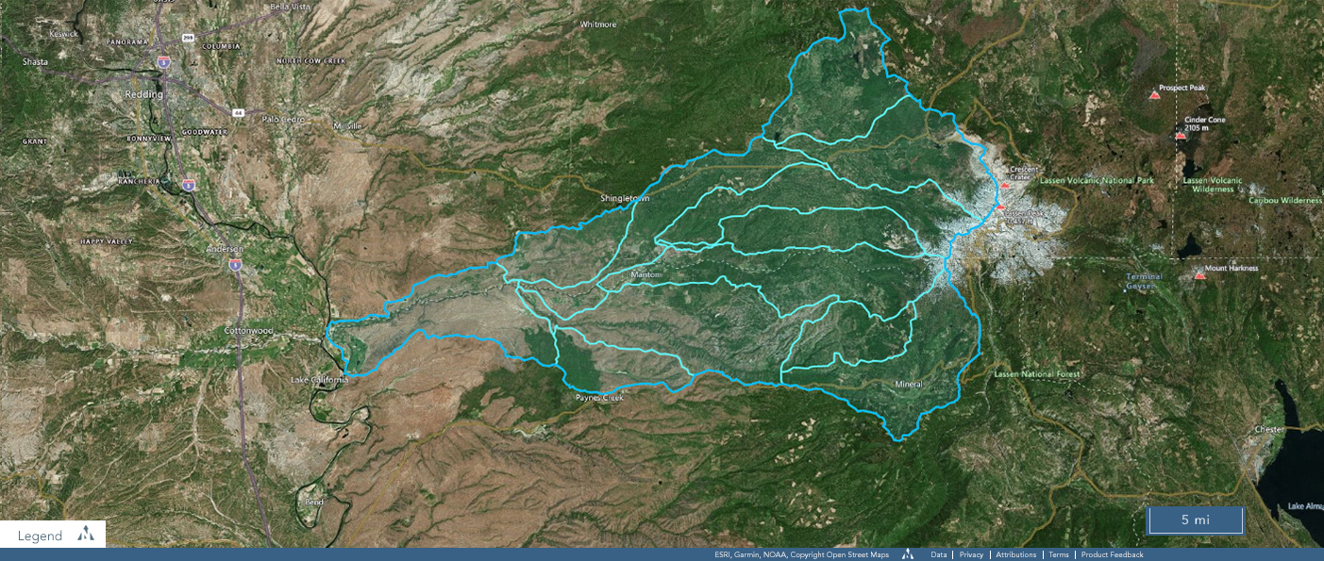
Legends and Attributions v2

Slide 11
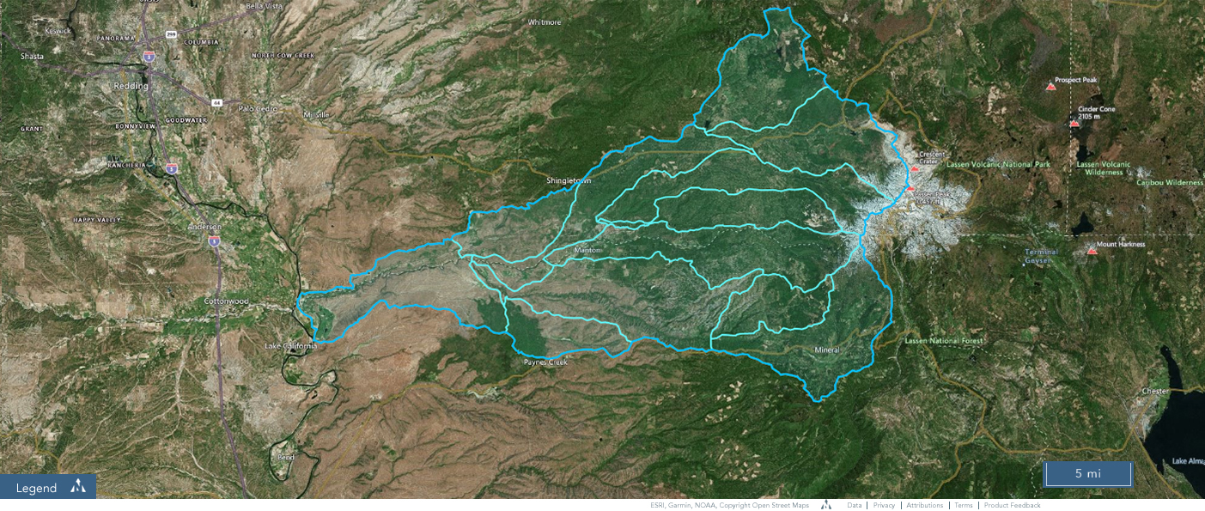
Legends and Attributions v3

Slide 12
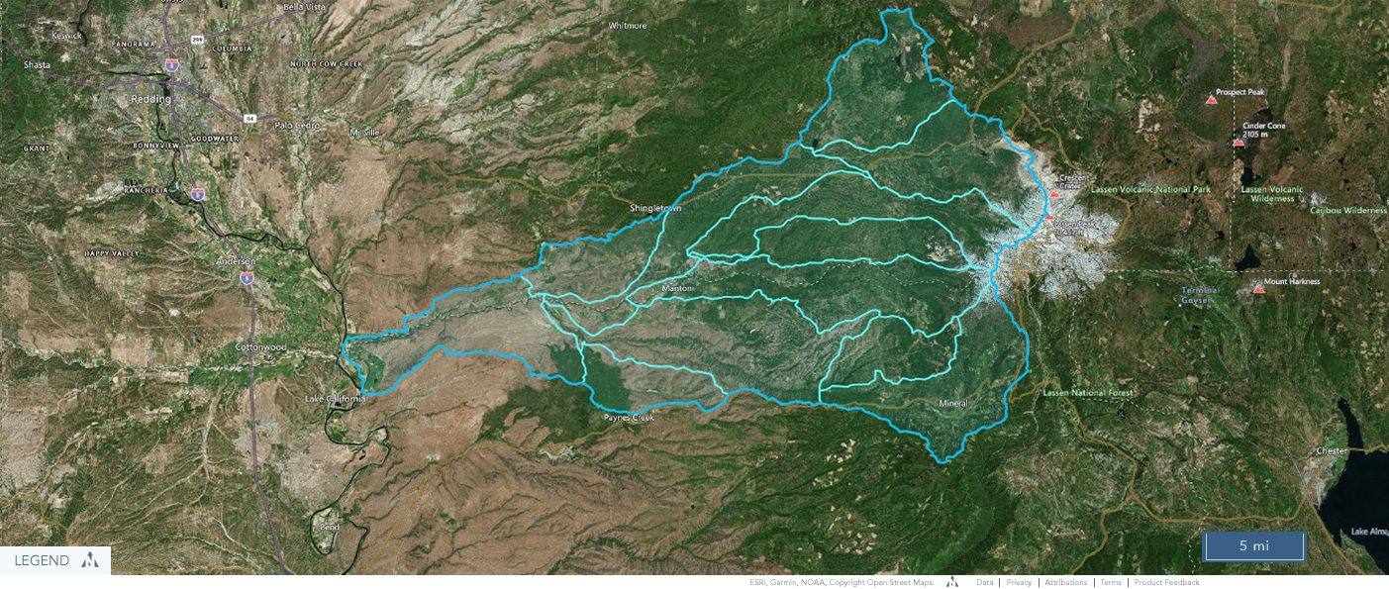
Legends and Attributions v4

Slide 13

Legends and Attributions v5 (Caps)

Slide 14

Legends and Attributions v5 (No Caps)

Slide 15

Legends and Attributions v5 (Caps Bold)

Slide 16

Legends and Attributions v5 (No Caps Bold)

Slide 17

Legends and Attributions v6 (Caps)

Slide 18

Legends and Attributions v6 (No Caps)

Slide 19

Legends and Attributions v6 (Caps Bold)

Slide 20

Legends and Attributions v6 (No Caps Bold)

Slide 21
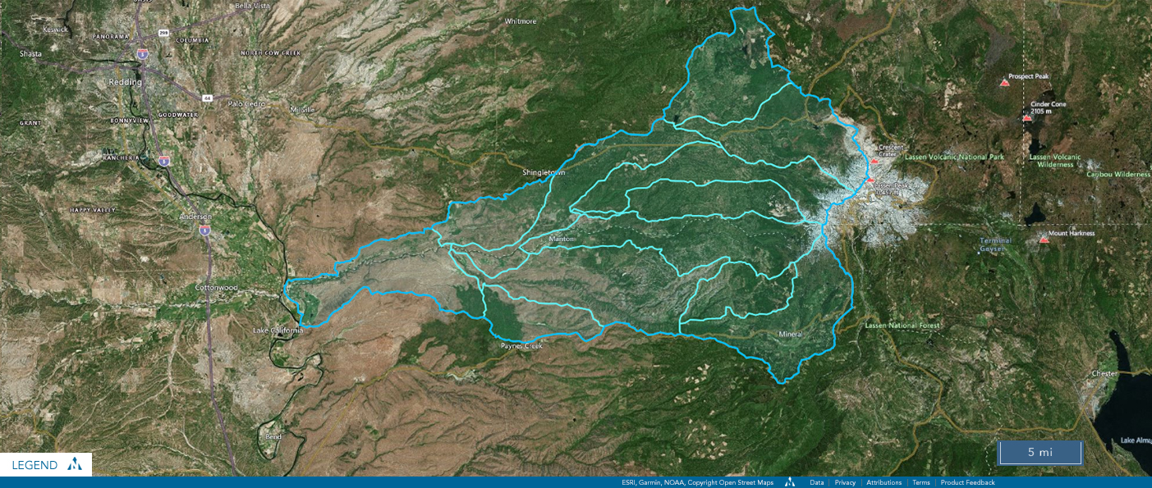
Legends and Attributions v7 (Caps)

Slide 22

Legends and Attributions v7 (No Caps)

Slide 23

Legends and Attributions v7 (Caps Bold)

Slide 24

Legends and Attributions v7 (No Caps Bold)

Slide 25
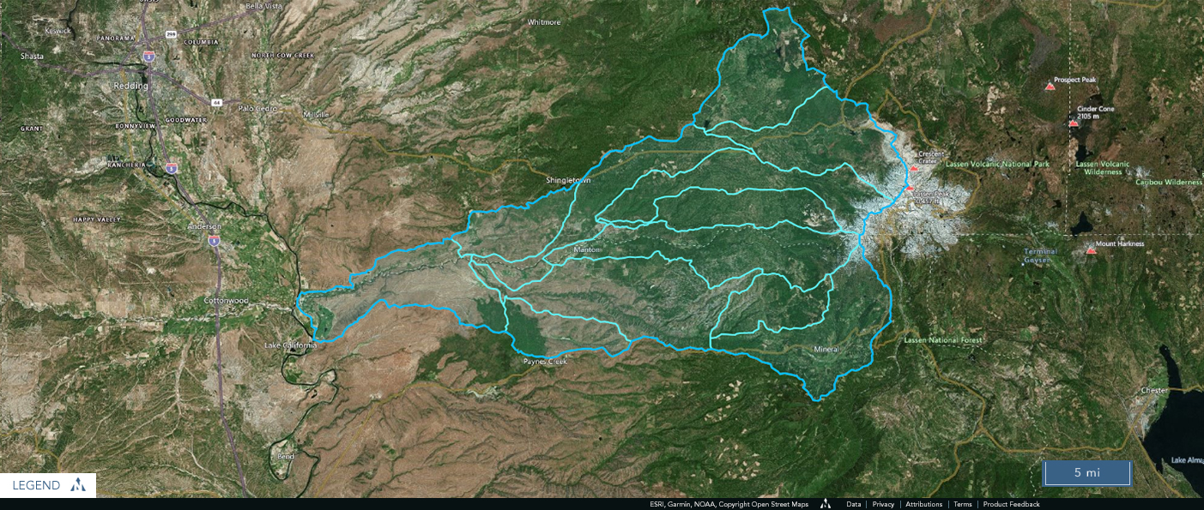
Legends and Attributions v8 (Caps)

Slide 26

Legends and Attributions v8 (No Caps)

Slide 27

Legends and Attributions v8 (Caps Bold)

Slide 28

Legends and Attributions v8 (No Caps Bold)

Slide 29
Result Not Found

Slide 30
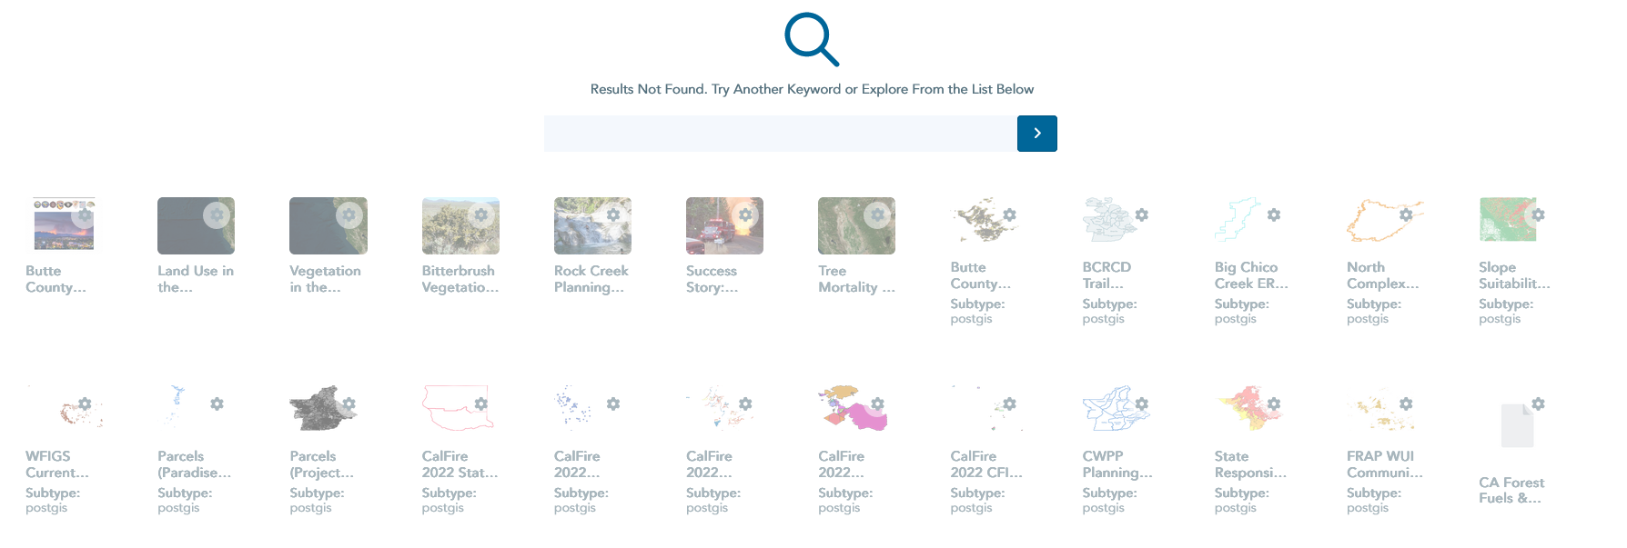
Result Not Found

Slide 31
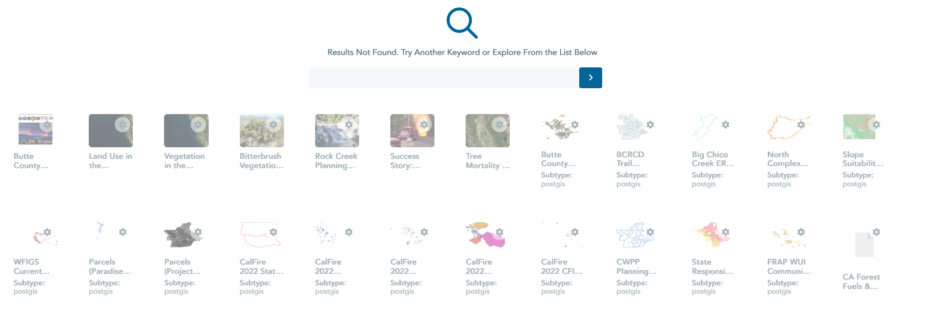
Result Not Found v2 (One px larger font)

Slide 32
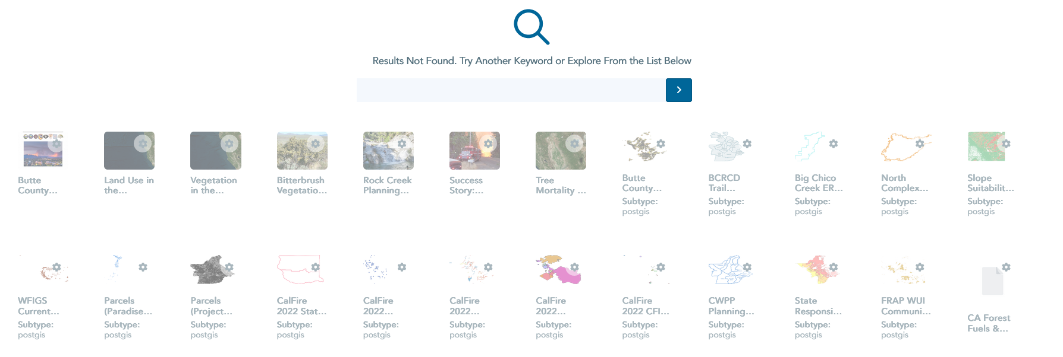
Result Not Found v3 (two and a half px larger font)

Slide 33
Nav Search

Slide 34
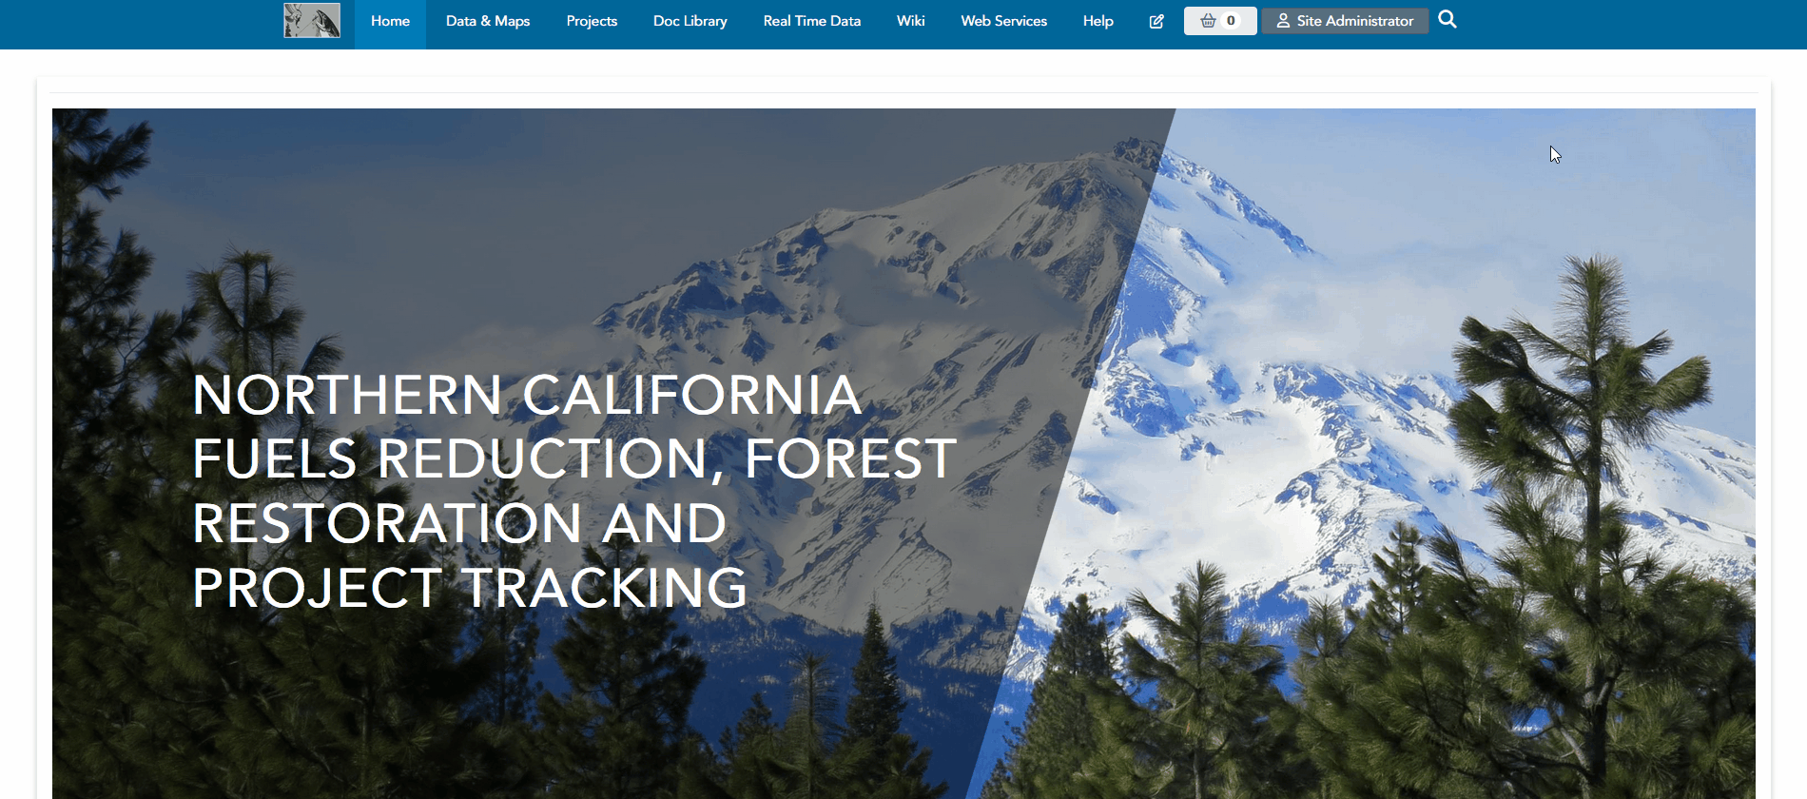
On the nav

Slide 35

Below the nav

Slide 36

Below the nav with button

Slide 37

Below the nav with button (Cool Effect)

