Slide 1
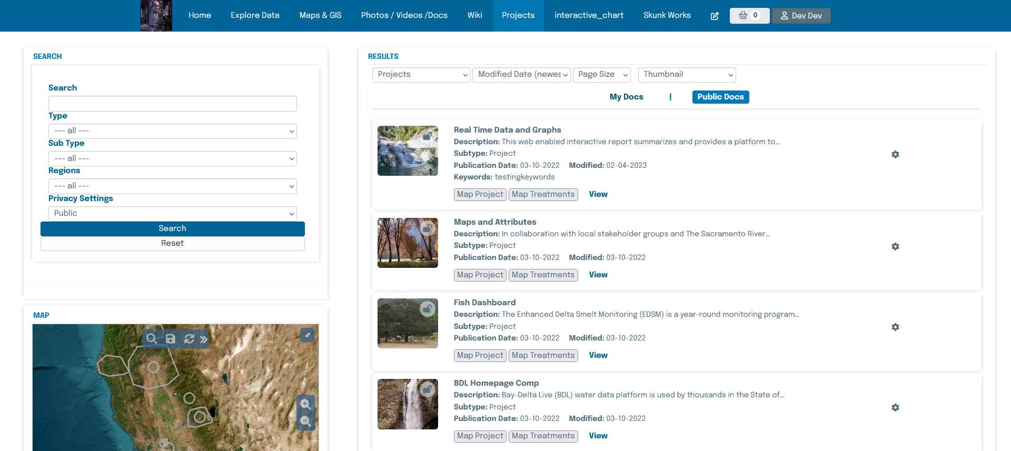
Epilogue

Slide 2
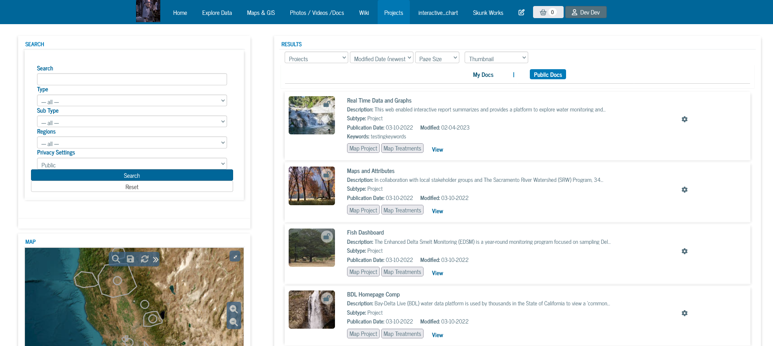
News Cycle

Slide 3
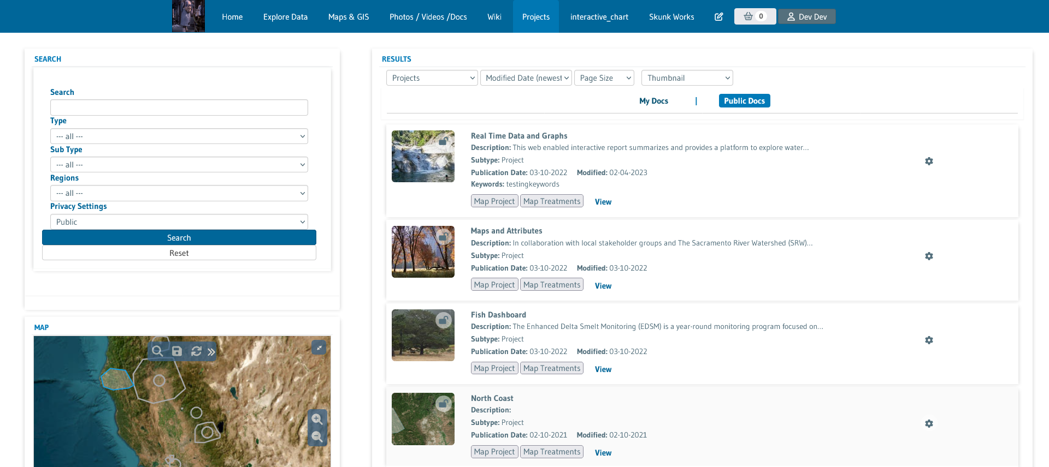
Gudea

Slide 4
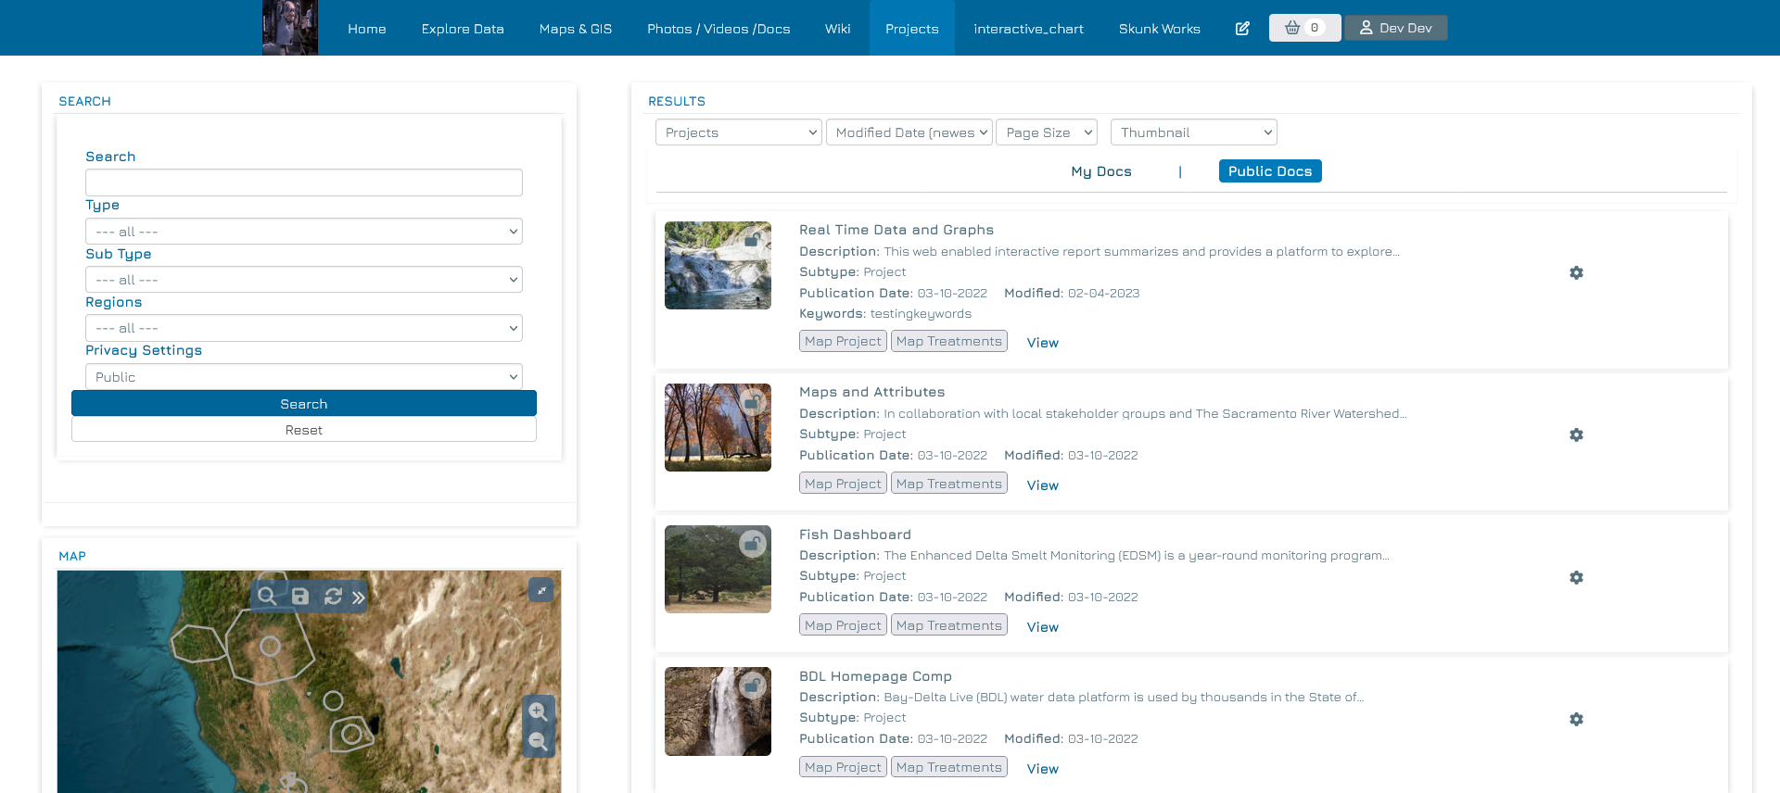
Jura

Slide 5
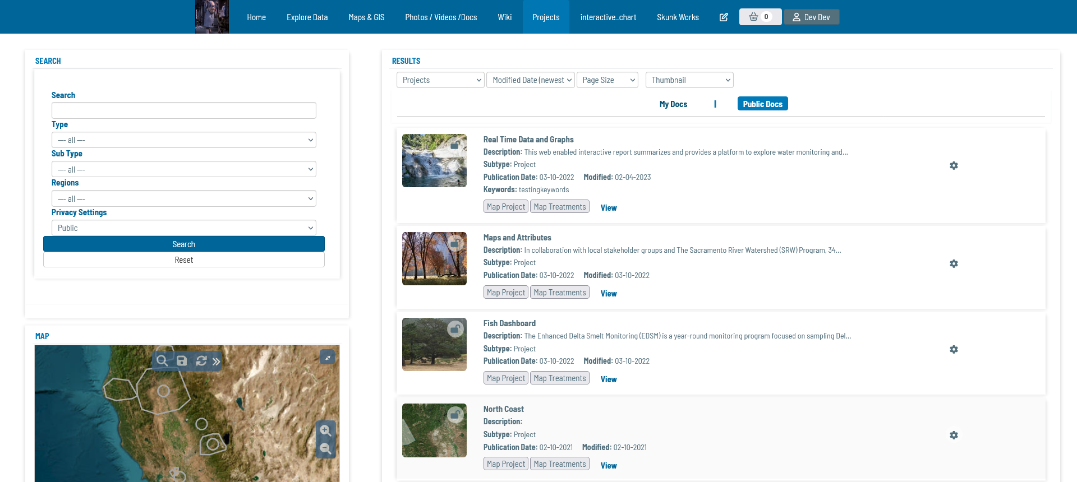
Barlow Semi Condensed

Slide 6
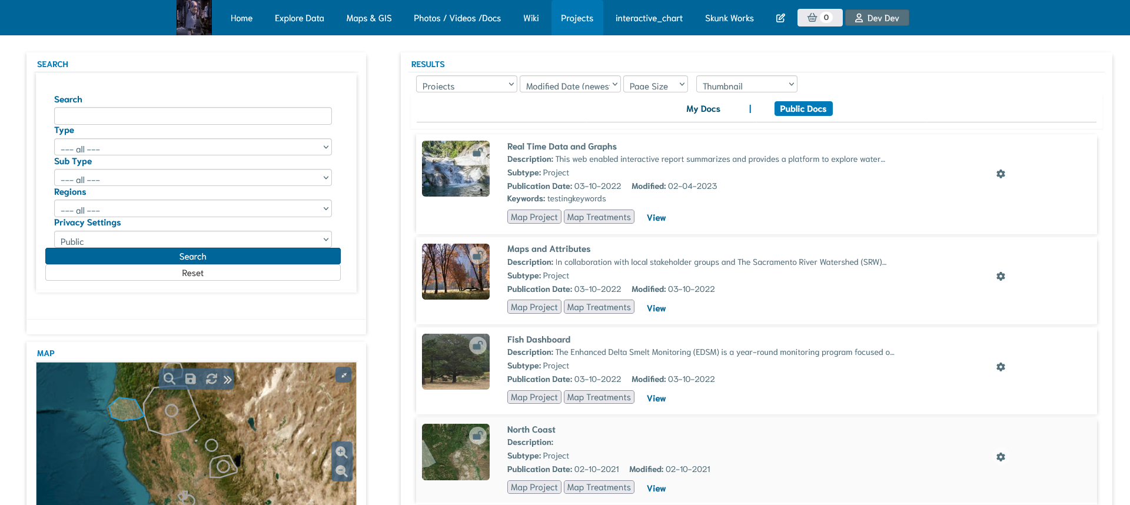
Niramit

Slide 7
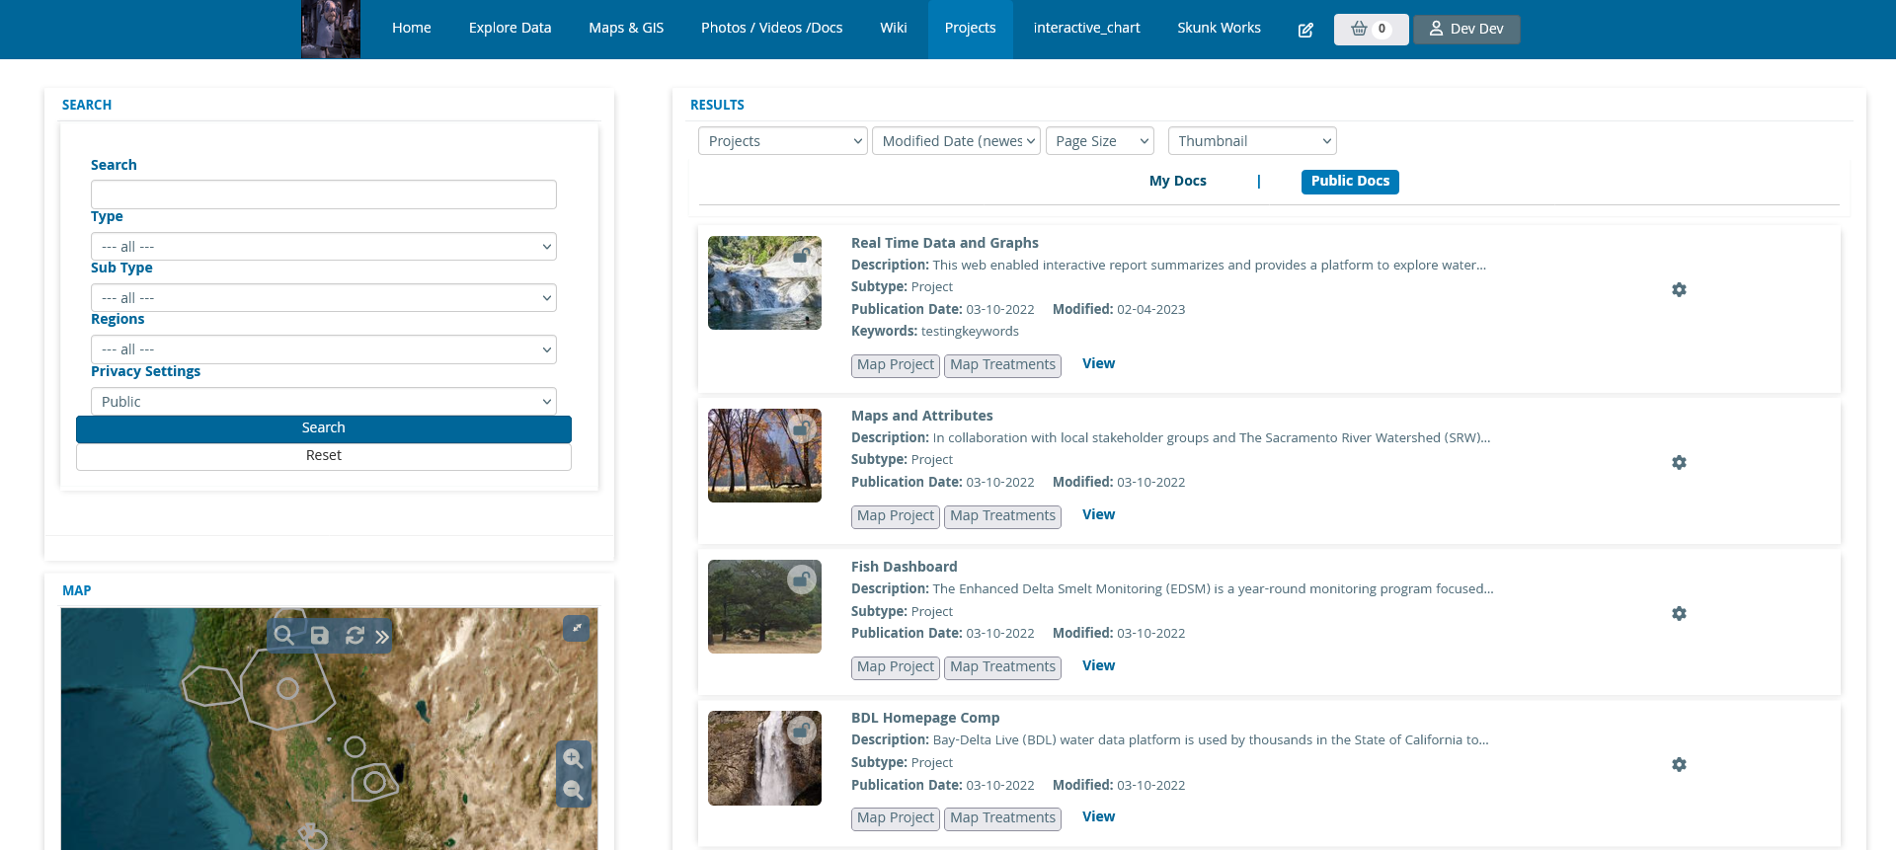
Khula

Slide 8
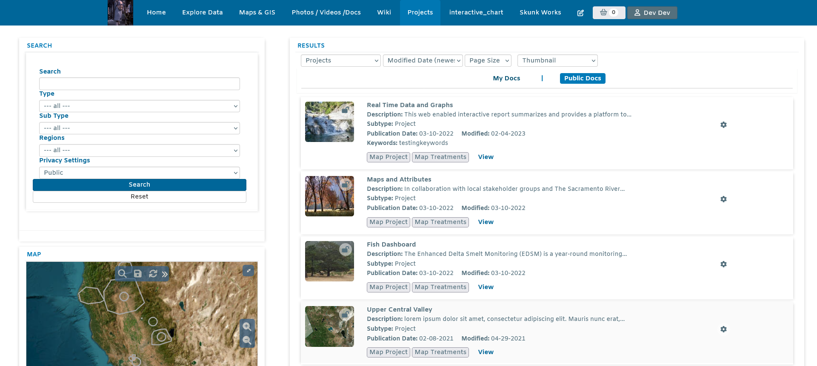
Amiko

Slide 9

Sunflower

Slide 10

Molengo

Slide 11

Cambay

Slide 12

Hanken Grotesk

Slide 13

Metrophobic

Slide 14

Andika

Slide 15

Inder

Slide 16

Mako

Slide 17

Orienta

Slide 18

Gowun Dodum

Slide 19

Anek Devanagari

Slide 20

Kantumruy Pro

Slide 21
New Fonts

Slide 22
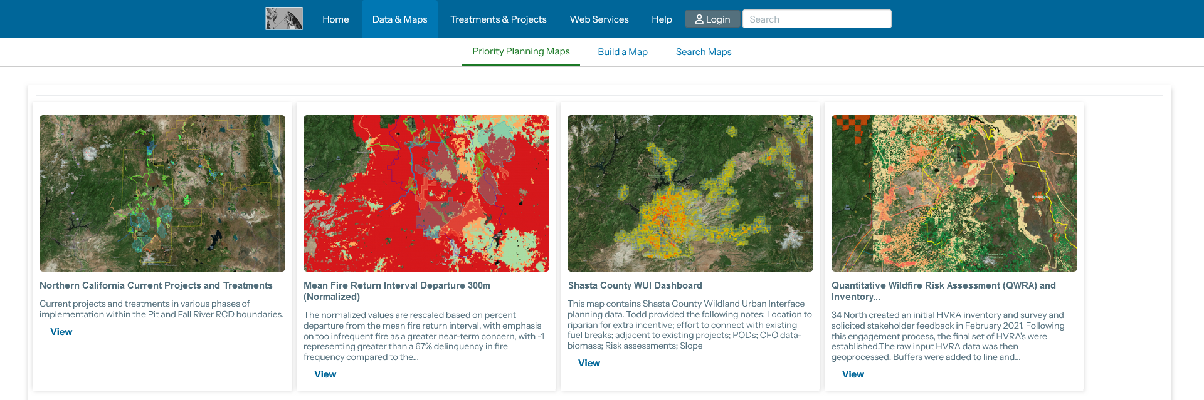
Instrument Sans (Have Our List New List View CSS)

Slide 23
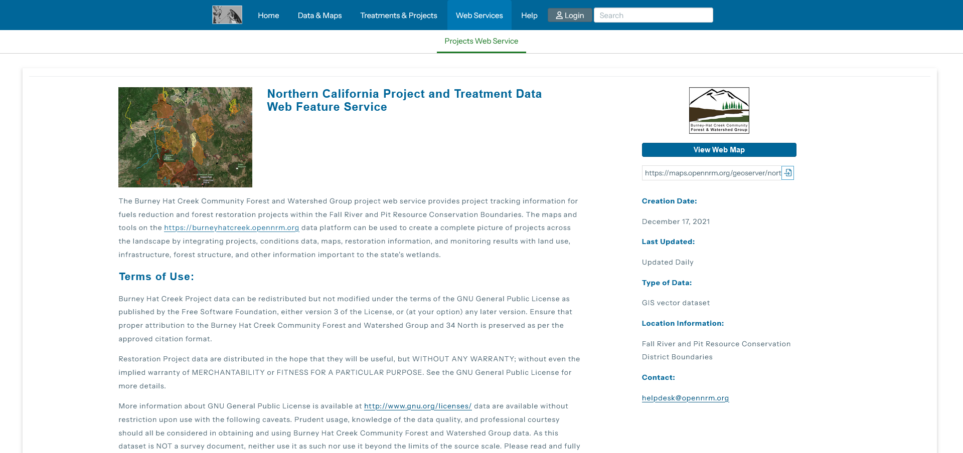
Instrument Sans (Have Section CSS which Includes line-height, letter-spacing and font-size of 14px)

Slide 24
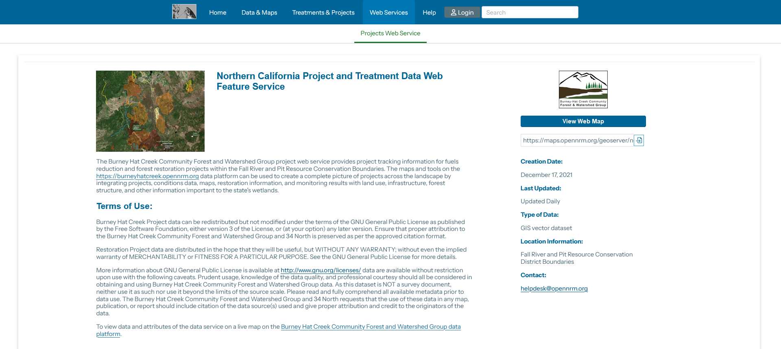
Instrument Sans (No Section CSS)

Slide 25

Nunito (Have Our List New List View CSS)

Slide 26

Nunito (Have Section CSS which Includes line-height, letter-spacing and font-size of 14px)

Slide 27

Nunito (No Section CSS)

Slide 28

Mukta (Have Our List New List View CSS)

Slide 29

Mukta (Have Section CSS which Includes line-height, letter-spacing and font-size of 14px)

Slide 30
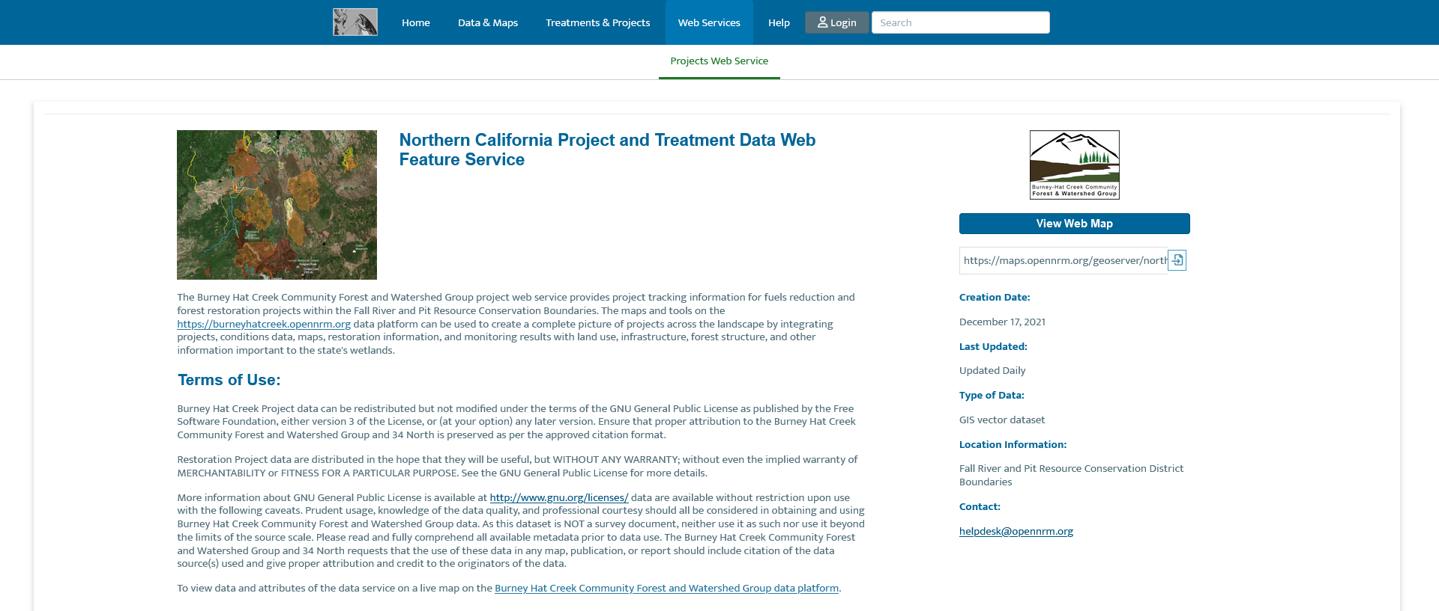
Mukta (No Section CSS)

Slide 31
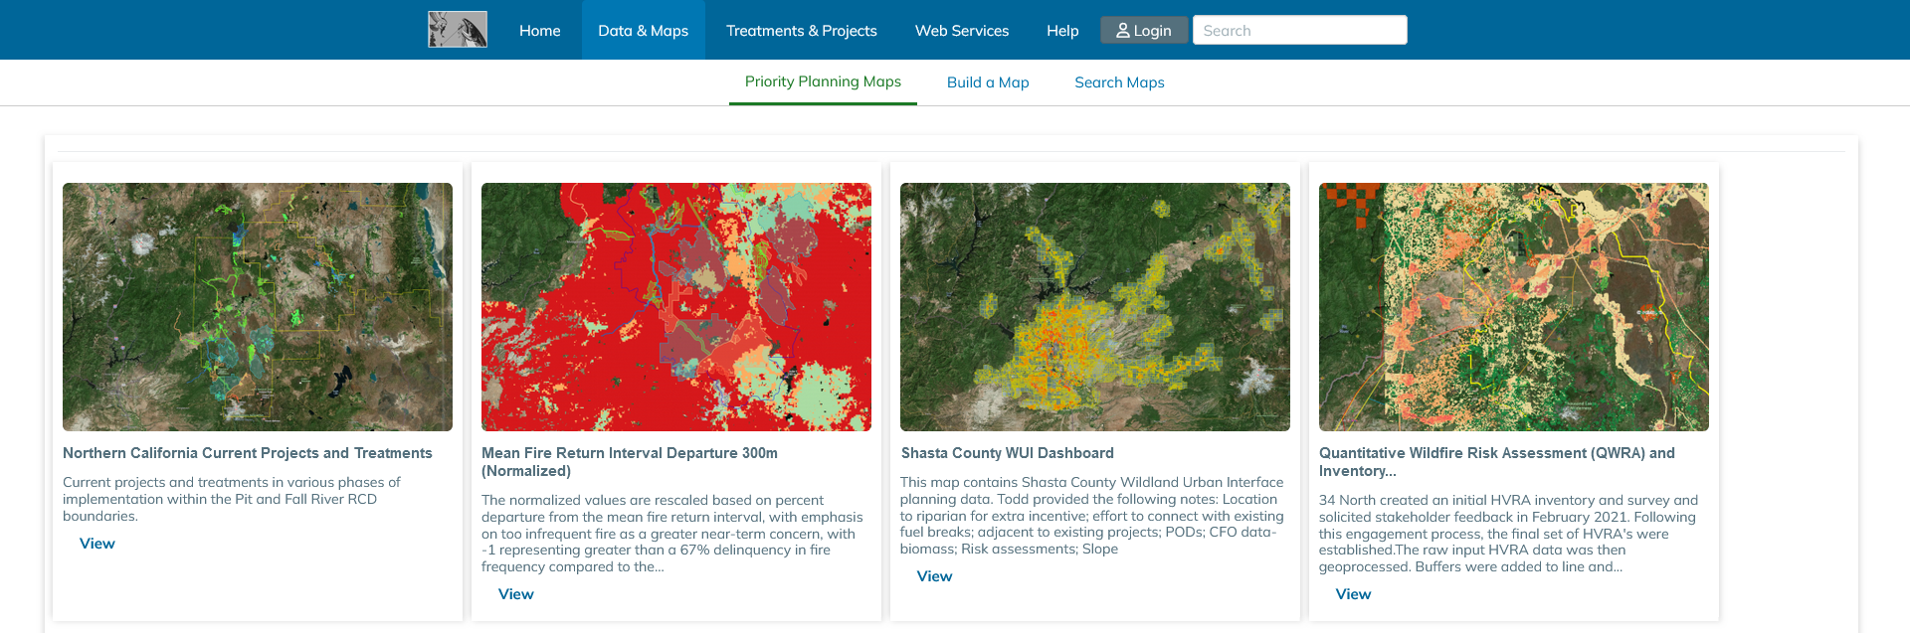
Mulish (Have Our List New List View CSS)

Slide 32

Mulish (Have Section CSS which Includes line-height, letter-spacing and font-size of 14px)

Slide 33

Mulish (No Section CSS)

Slide 34
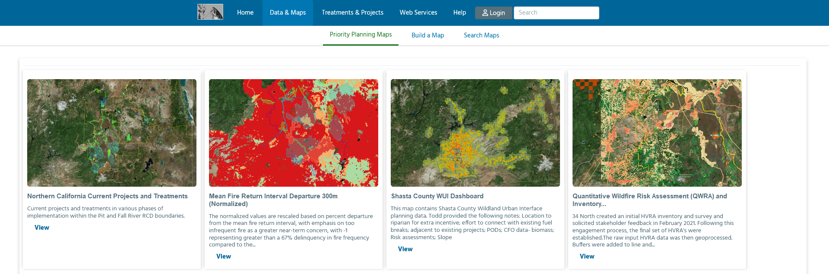
Hind (Have Our List New List View CSS)

Slide 35

Hind (Have Section CSS which Includes line-height, letter-spacing and font-size of 14px)

Slide 36

Hind (No Section CSS)

Slide 37

Jost (Have Our List New List View CSS)

Slide 38

Jost (Have Section CSS which Includes line-height, letter-spacing and font-size of 14px)

Slide 39

Jost (No Section CSS)

Slide 40

Assistant (Have Our List New List View CSS)

Slide 41
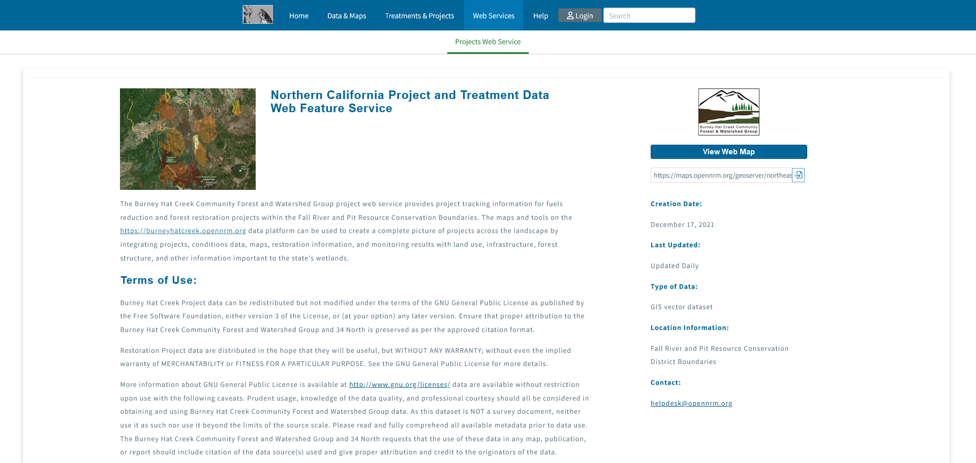
Assistant (Have Section CSS which Includes line-height, letter-spacing and font-size of 14px)

Slide 42

Assistant (No Section CSS)

Slide 43

Tajawal (Have Our List New List View CSS)

Slide 44
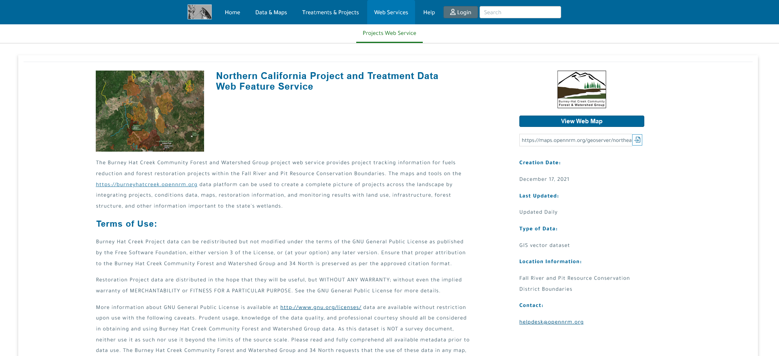
Tajawal (Have Section CSS which Includes line-height, letter-spacing and font-size of 14px)

Slide 45

Tajawal (No Section CSS)

Slide 46

Catamaran (Have Our List New List View CSS)

Slide 47

Catamaran (Have Section CSS which Includes line-height, letter-spacing and font-size of 14px)

Slide 48

Catamaran (No Section CSS)

Slide 49

Sarabun (Have Our List New List View CSS)

Slide 50

Sarabun (Have Section CSS which Includes line-height, letter-spacing and font-size of 14px)

Slide 51

Sarabun (No Section CSS)

Slide 52

Ysabeau (Have Our List New List View CSS)

Slide 53

Ysabeau (Have Section CSS which Includes line-height, letter-spacing and font-size of 14px)

Slide 54

Ysabeau (No Section CSS)

Slide 55

Gudea (Have Our List New List View CSS)

Slide 56

Gudea (Have Section CSS which Includes line-height, letter-spacing and font-size of 14px)

Slide 57

Gudea (No Section CSS)

Slide 58

Mukta Malar (Have Our List New List View CSS)

Slide 59

Mukta Malar (Have Section CSS which Includes line-height, letter-spacing and font-size of 14px)

Slide 60

Mukta Malar (No Section CSS)

Slide 61

League Spartan (Have Our List New List View CSS)

Slide 62

League Spartan (Have Section CSS which Includes line-height, letter-spacing and font-size of 14px)

Slide 63
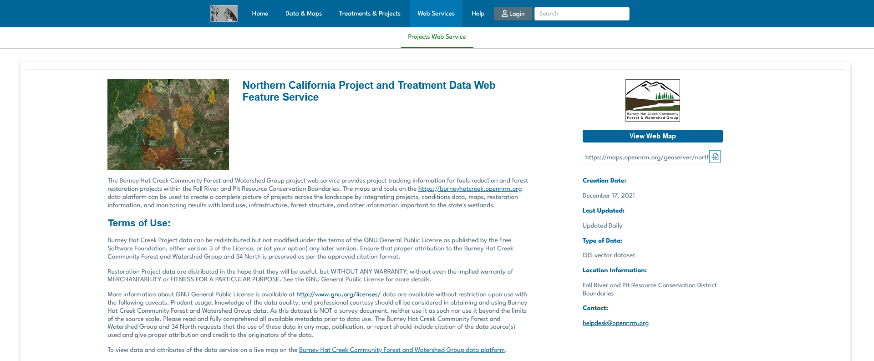
League Spartan (No Section CSS)

Slide 64

Schibsted Grotesk (Have Our List New List View CSS)

Slide 65

Schibsted Grotesk (Have Section CSS which Includes line-height, letter-spacing and font-size of 14px)

Slide 66

Schibsted Grotesk (No Section CSS)

