Slide 1
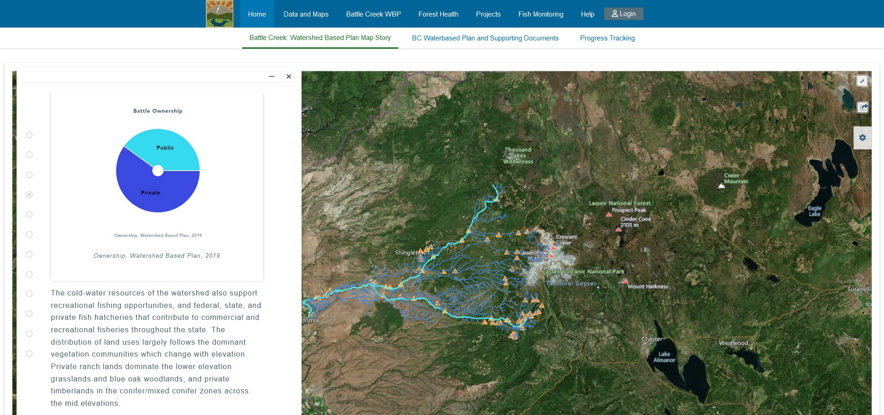
Version 1

Slide 2

Version 1.1

Slide 3

Version 1.2

Slide 4

Version 1.3

Slide 5

Version 2

Slide 6

Version 3

Slide 7

Version 4

Slide 8

Version 5

Slide 9

Version 6

Slide 10

Version 7

Slide 11

Version 8

