Slide 1

Bay-Delta Live Redesign Homepage Concept Review
March 13, 2013

Slide 2
CONCEPT 1
MODERN, FLEXIBLE, FRESH, RELEVANT IMAGERY

Slide 3
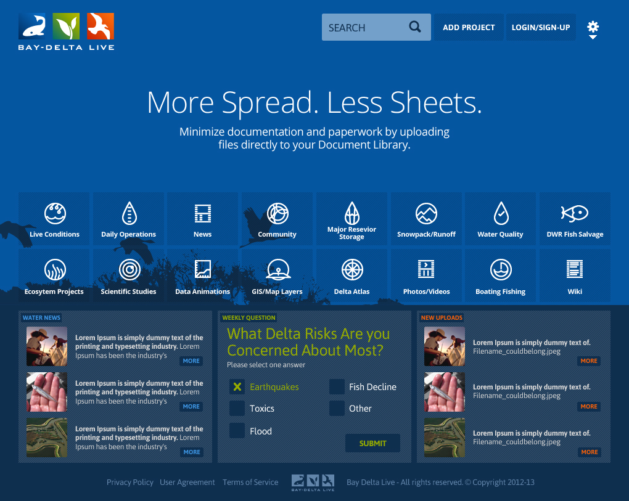

Slide 4
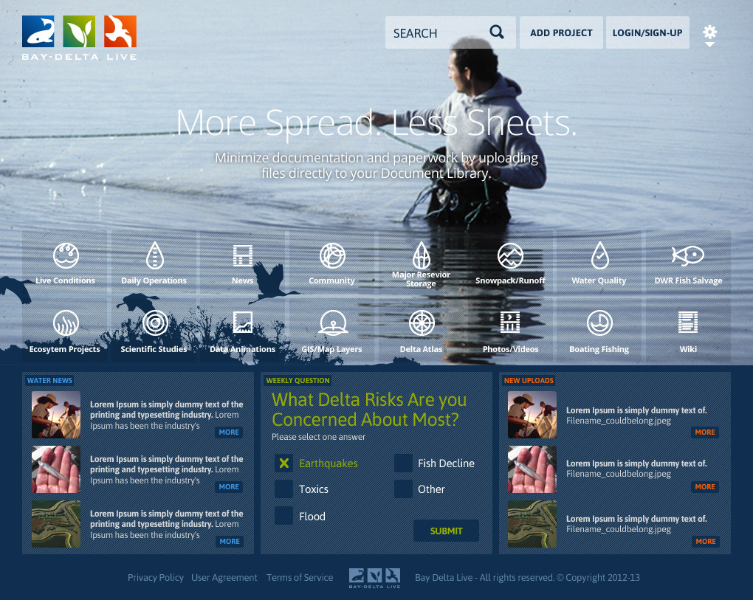

Slide 5
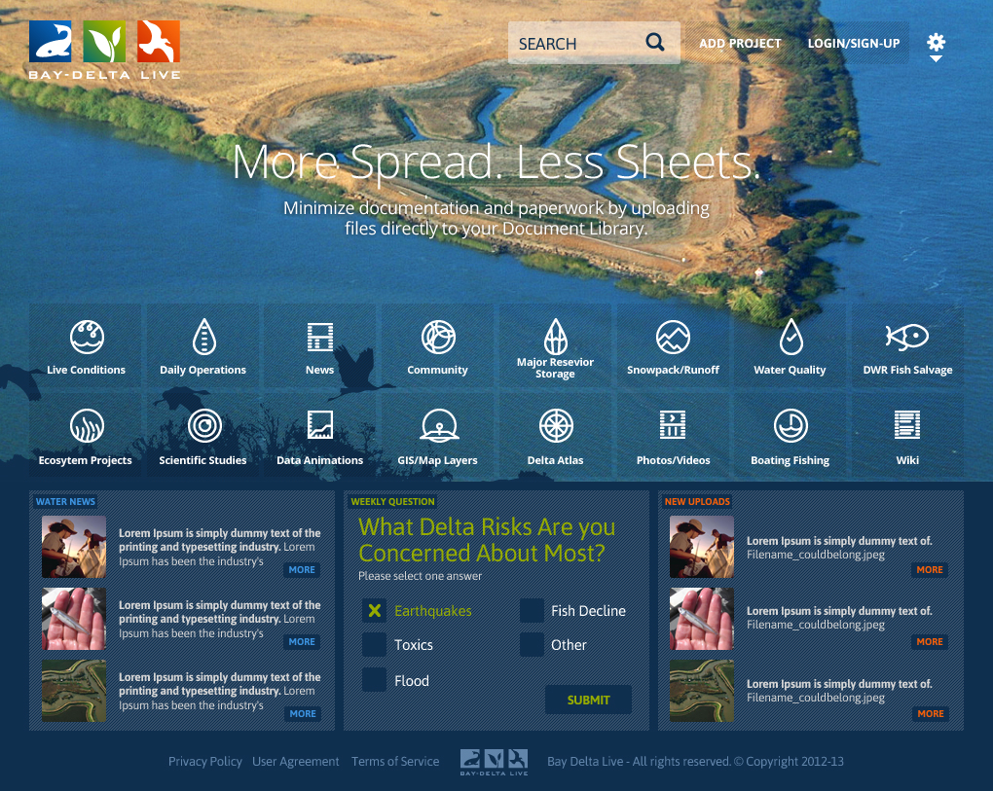

Slide 6
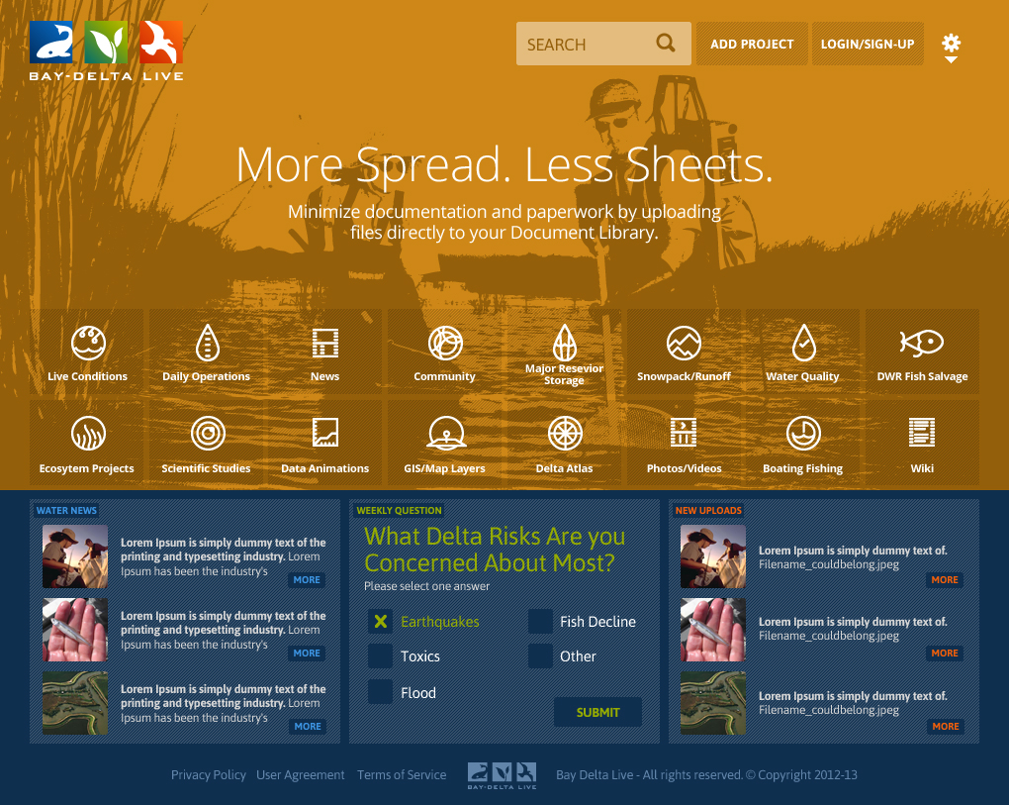

Slide 7
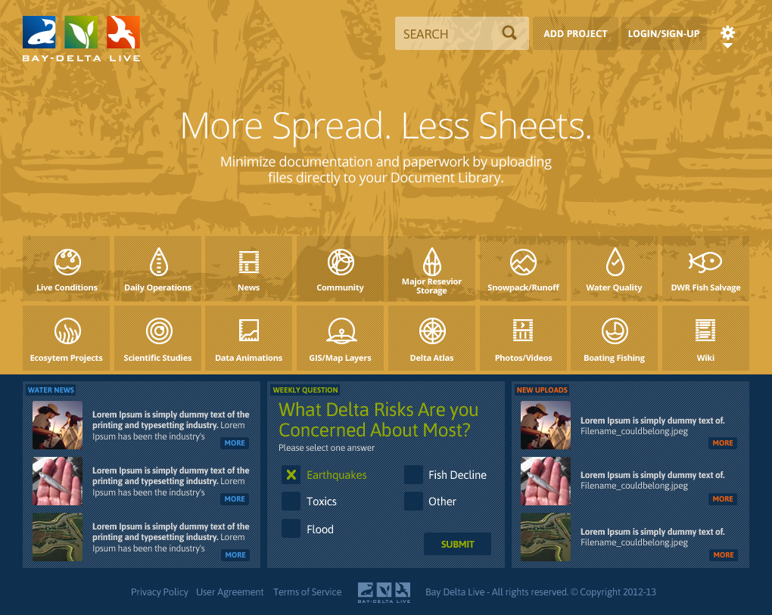

Slide 8
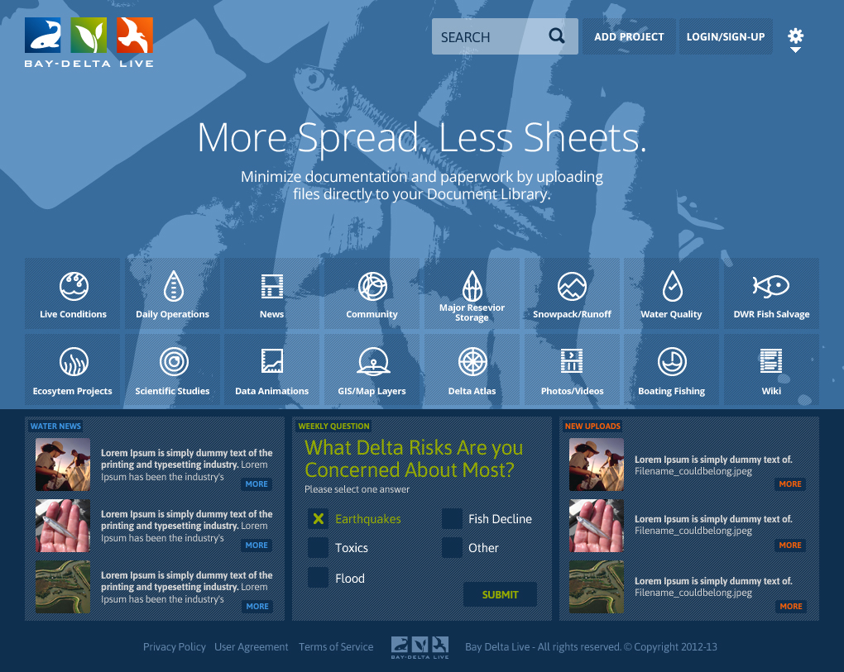

Slide 9
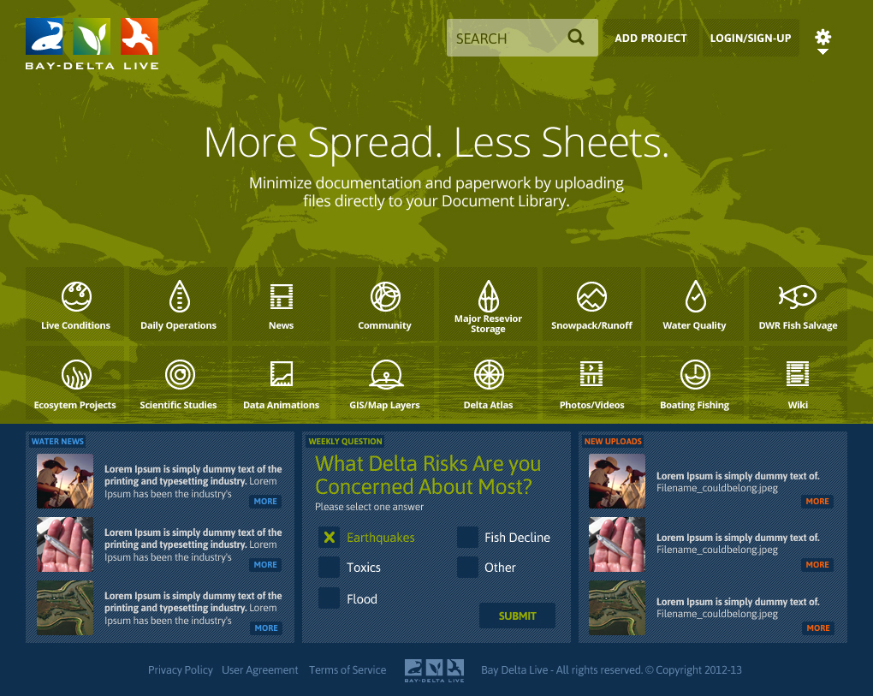

Slide 10
CONCEPT 2
MODERN, FLEXIBLE, LARGE

Slide 11
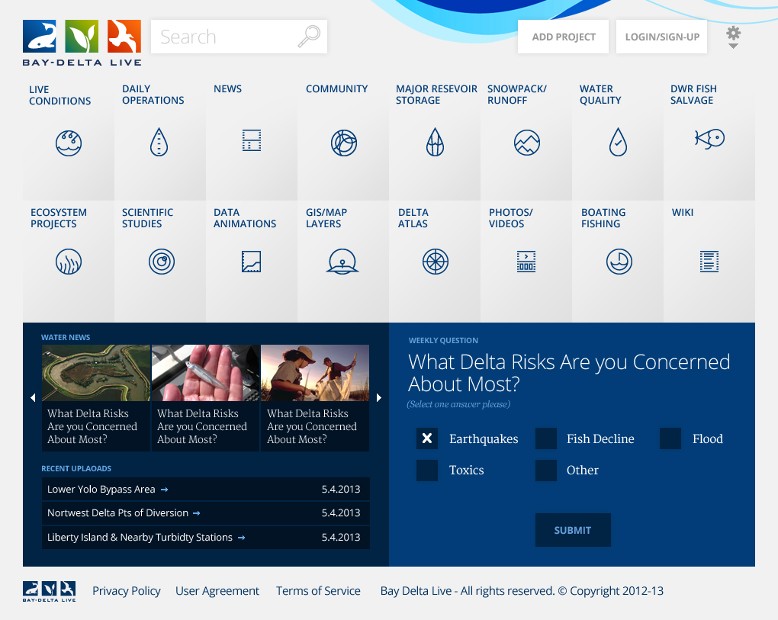

Slide 12
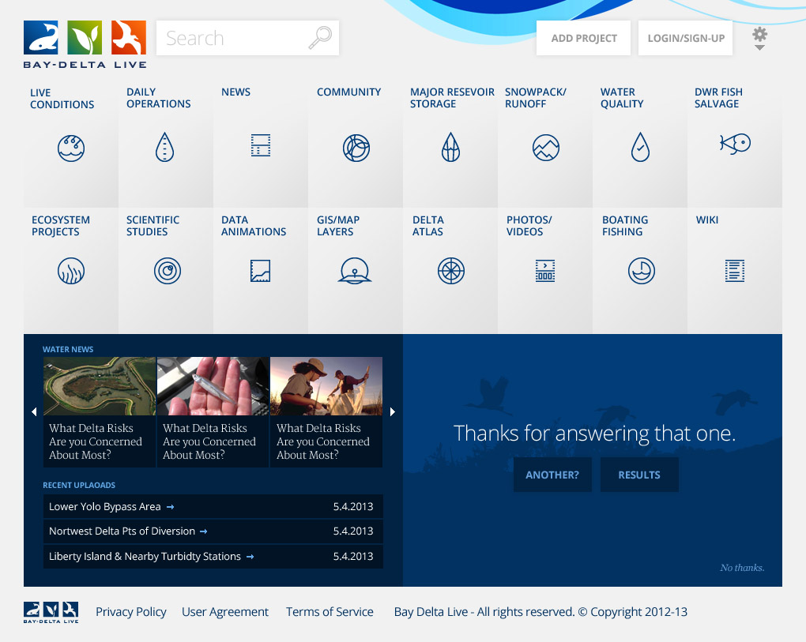

Slide 13
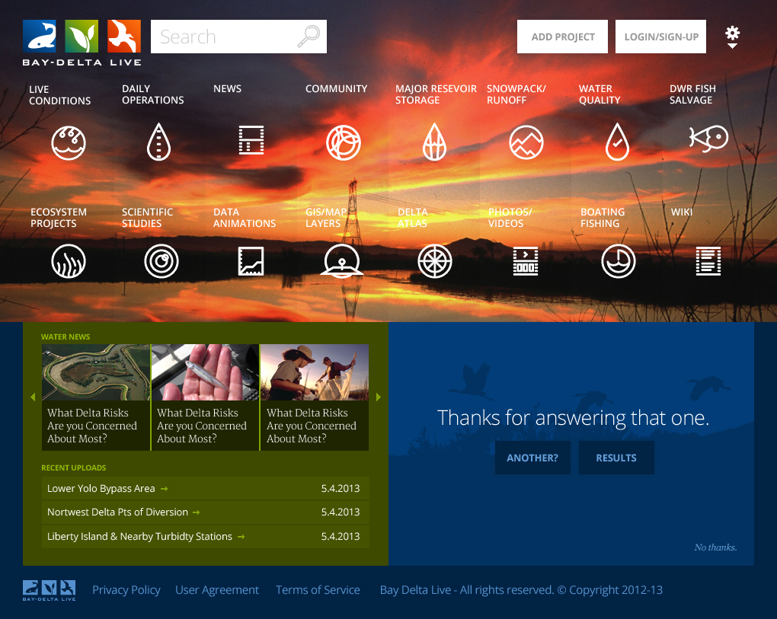

Slide 14
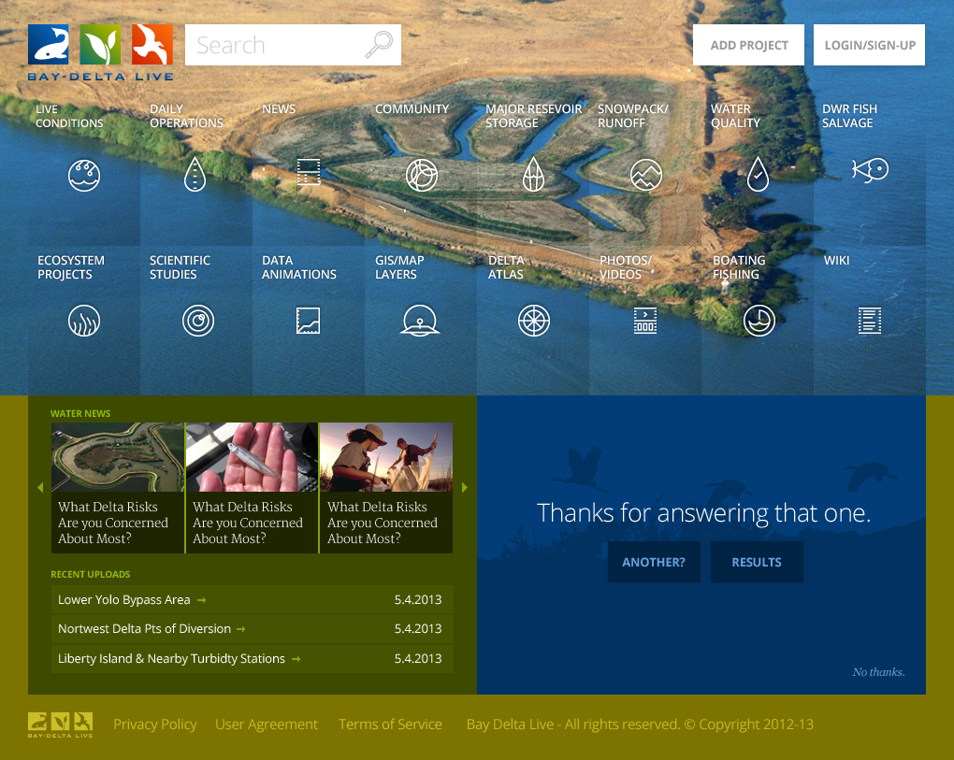

Slide 15
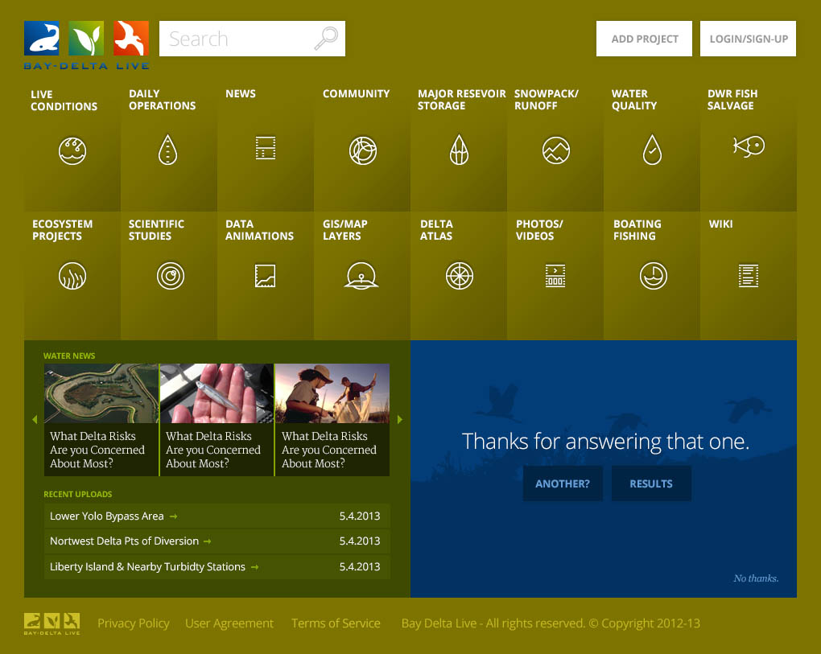

Slide 16
CONCEPT 3
FAMILIAR, CLEAN, SIMPLE, BRANDED

Slide 17
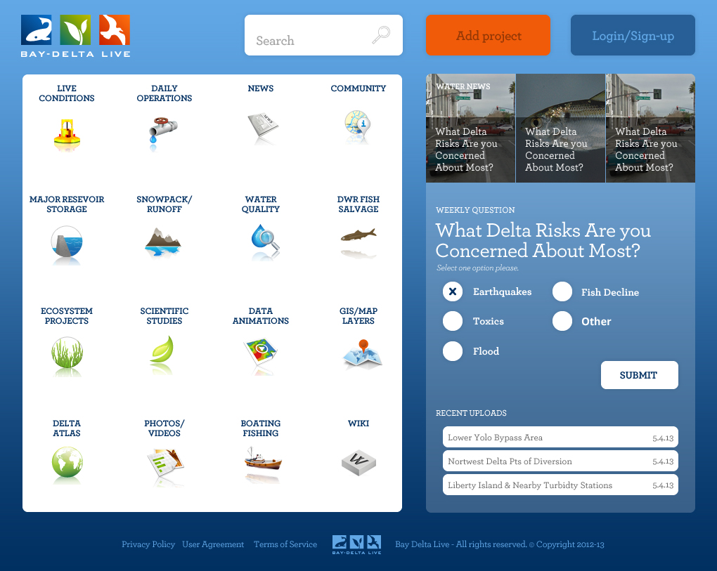

Slide 18
INITIAL PROJECT PAGE CONCEPTS

Slide 19
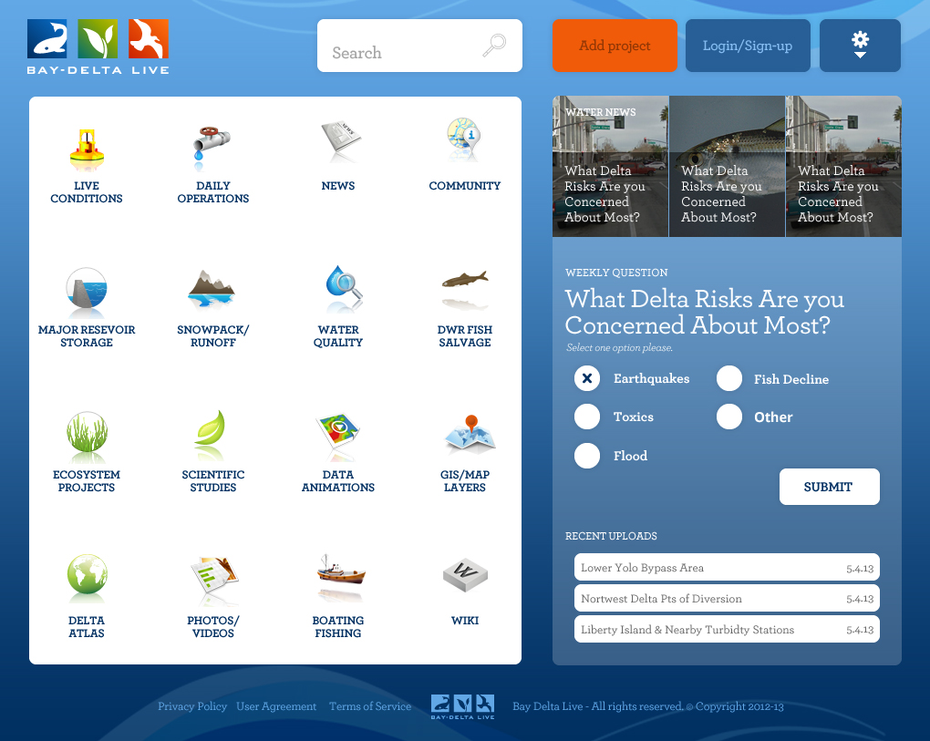

Slide 20
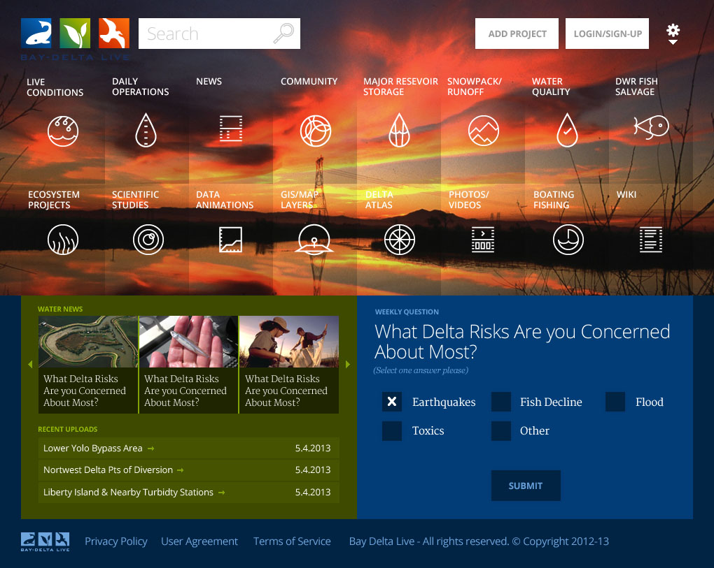
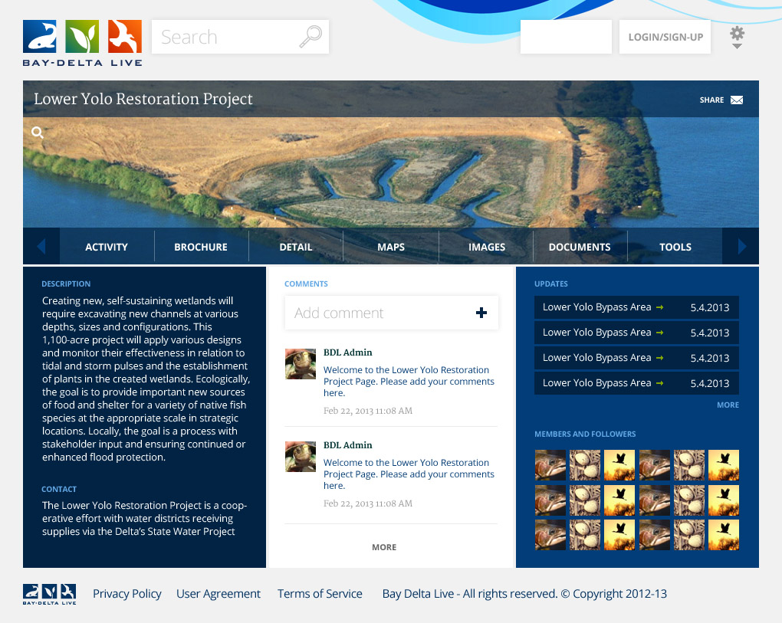

Slide 21
