Slide 1
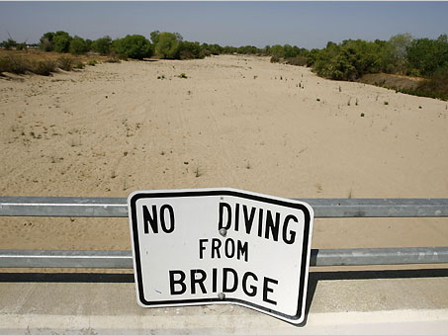

Headline News
Across California
"I Have Not Seen A More Serious Water Situation In My Career"
-- Tim Quinn, Executive Director , Assoc. of Calif. Water Agencies
Notes:
On the Record:
Association of California Water Agencies Executive Director Timothy Quinn - "I Have Not Seen A More Serious Water Situation In My Career": "I have not seen a more serious water situation in my career, and I've been doing this 30 years...This is a harbinger of relatively tough times, not just for this year but for a set of years." (Deborah Schoch, "Water shortage worst in decades, official says," Los Angeles Times, 5/2/08)
Los Angeles Department Of Water And Power General Manager H. David Nahai - "We're All Facing A Worrisome Water Picture": "Los Angeles traditionally has gotten 30% to 60% of its water from the Eastern Sierra via the Los Angeles Aqueduct, but it still buys water imported from the north and east. ‘I think we're all facing a worrisome water picture,' said H. David Nahai, general manager of the Los Angeles Department of Water and Power." (Deborah Schoch, "Water shortage worst in decades, official says," Los Angeles Times, 5/2/08)
East Bay Municipal Utility District - "Mandatory Water Rationing Is Now In Effect": "Two dry winters have resulted in the biggest water supply threat to EBMUD in nearly 20 years. The District received roughly half of its normal runoff this year and projects its water storage will be over 200,000 acre-feet short of the water desired by October 1 of this year (the beginning of a new rain year). To safeguard its shrinking supply, EBMUD has declared a severe water shortage emergency. Mandatory water rationing is now in effect." (East Bay Municipal Water District, "EBMUD Adopts Drought Management Program: Mandatory Rationing in Effect," Website, 5/13/08)
East Bay Municipal Utility District Spokesman Brian McCrea - "This Is The Worst Situation We've Seen In Almost 20 Years" (Ryan Flinn, "California Utility Imposes First Water Rationing in 16 Years," Bloomberg, 5/14/08)
Metropolitan Water District Of Southern California Spokesman Bob Muir - "If Water Use Is Not Cut... The Region Will More Likely Be In A Shortage And Instituting Rationing": "The agency that provides about half of the 720 billion gallons of water consumed in Orange County each year is considering issuing a water supply alert, a step toward possible water rationing...‘A ‘water supply alert' does not mean less water being supplied; it means that the water being supplied is severely depleting reserves, and that if water use is not cut to help balance the use of reserves, the region will more likely be in a shortage and instituting rationing,' Bob Muir, an MWD spokesman, said in an e-mail." (Gary Robbins, "O.C. could face water rationing next year," Orange County Register, 5/29/08)
Westlands Water District General Manger Tom Birmingham - "This Is A Crisis That Has To Be Fixed Now": "‘Half the people in this room are going to go broke,' said at a meeting that drew about 400 to the fairgrounds in Los Banos. ‘This is a crisis that has to be fixed now.'" (Dennis Pollock, "Feds reduce water to Valley farms," Fresno Bee, 6/2/08

