Slide 1
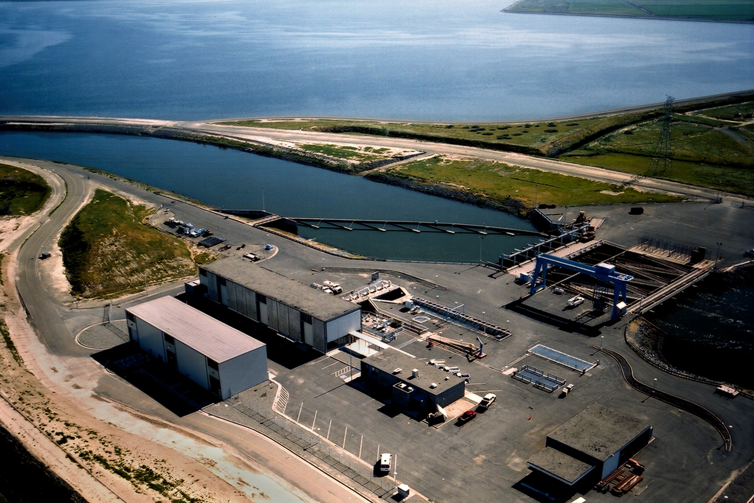
Low-flow Intake Technical Analysis
Zaffar Eusuff
E-mail: meusuff@water.ca.gov
Ph: (916) 651-9239
Bay-Delta Office
California Department of Water Resources
August 13, 2009

Slide 2
Background
Low-flow Screen as A “Delta Near-term Action” Item
  Governor’s list of Interim Delta Actions dated July, 2007
  California Urban Water Agencies position paper dated July, 2008
DWR Low-flow Intake (LFI) Initiative
  Preliminary investigation
  Low-flow: 2,000 cfs capacity
  Consultants: CH2M HILL and MWH Americas
  Study kicked off in November, 2008 and completed in June, 2009
  Budget: $105,000
  Product: Administrative Draft “Low-flow Intake Technical Analysis”

Slide 3
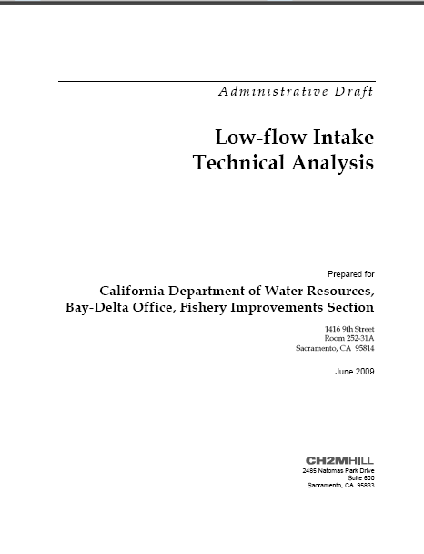

Slide 4
Scope of LFI Technical Analysis
Review of previous efforts/initiatives/concepts of screening CCF: About 60 items of different types
Overview of available existing technical information
  Geotechnical, Bathymetric, Hydrodynamic, Water Quality, and CCF configuration
Summary of biological factors that may affect the design and operation of a screened intake
  Fish temporal distribution, life history, and predation information

Slide 5
Scope of LFI Technical Analysis (contd)
Development of Low-flow Intake (LFI) alternatives
Conceptual-level construction cost estimates for the alternatives: Comparison purpose ONLY
Identification of additional data needs necessary for further investigation of the alternatives in greater detail

Slide 6
LFI Alternatives – Development
Selection of diversion capacity – 2,000 cfs
  Provides reliability in terms of pumping units at Banks
  Based on South Delta Program’s hydraulic analysis
General Principles
  Use best available information – Biological, Geotechnical, Bathymetric, Hydrodynamic, Water Quality, and CCF configuration
  Provide a physical fish screen barrier in front of the LFI
  Comply with fish screen design criteria for delta smelt
  Use the most biologically protective fish screen concepts
    Avoid the need to collect, handle, and transport fish
    Avoid areas where potential predation may occur

Slide 7
LFI Alternatives – Development (contd.)
Key factors
  Operating period: April - June
  Site location: Desirable hydraulic characteristics, minimize bypass distance
  Screen technology: Flat panel, V screen, Cone screen
  Conveyance option: Through CCF, isolating CCF

Slide 8
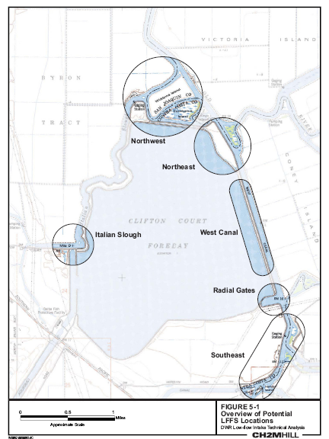
LFI Alternatives – Potential Locations

Slide 9
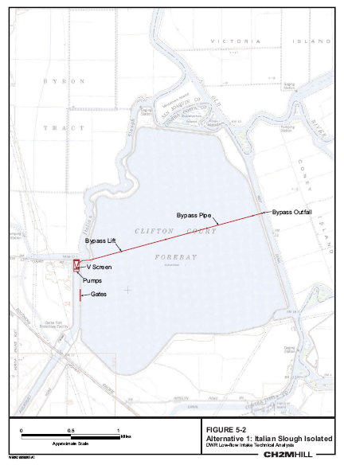
LFI Alternative 1 – Italian Slough (Isolated)

Slide 10

LFI Alternative 2A – NW Byron Tract (Isolated)

Slide 11
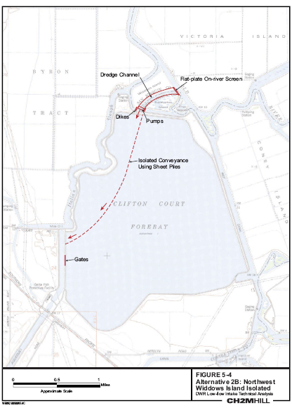
LFI Alternative 2B – NW Widdows Island (Isolated)

Slide 12
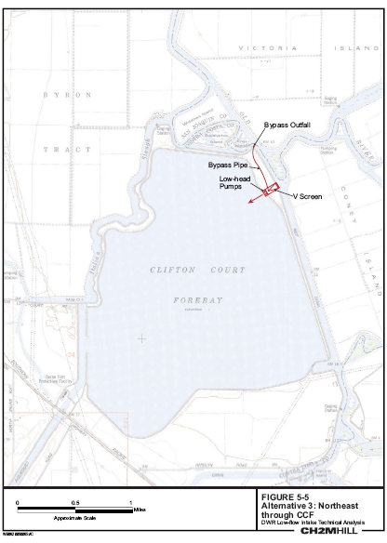
LFI Alternative 3 – NE Through CCF

Slide 13

LFI Alternative 4 – West Canal Through CCF

Slide 14

LFI Alternative 5 – Radial Gates Through CCF

Slide 15
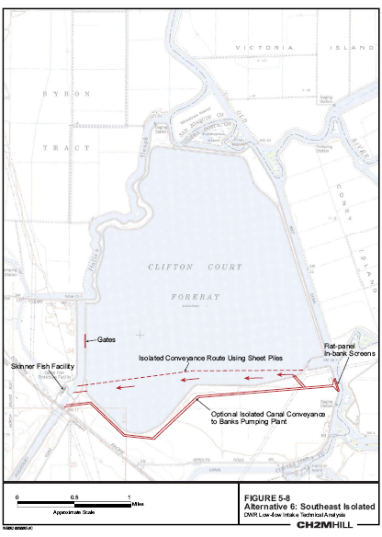
LFI Alternative 6 – SE of CCF (Isolated)

Slide 16
Conceptual Cost Estimate
Comparative purpose ONLY
Cost Elements and Basis:
Element | Basis (Project) | Unit cost (in 2009 $)
V screen w/ pumped bypass | Banta Carbona | $45,000/cfs
Flat screen | CCWD Old River Intake | $50,000/cfs
Pump station | CCWD Old River Intake | $56,000/cfs
Box siphon | Red Bluff (proposed) | $27,000/ft
Sheet pile | Red Bluff (proposed) | $5,000/ft
Gate | SDIP-Grant Line Canal (proposed) | $5,000/sft

Slide 17
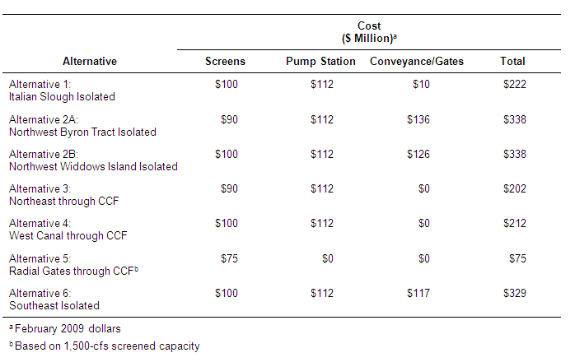
Comparative Cost Summary

Slide 18
Next Steps
Share this Technical Analysis with other interested stakeholders
Undertake a Feasibility study following approval by DWR Management and State Water Contractors

Slide 19
Questions?

