Slide 1
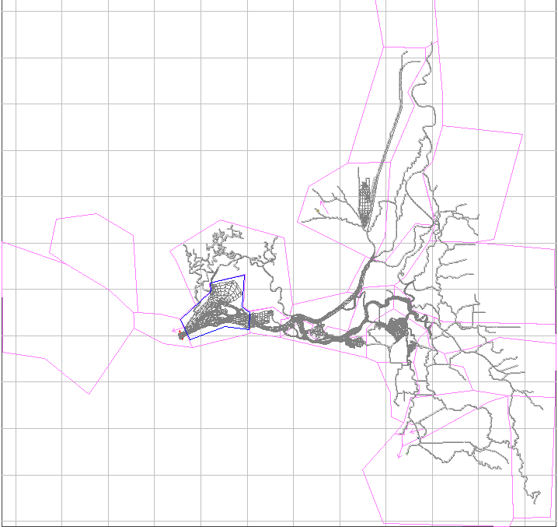
sacramento_
above_
American
sacramento_
ship_channel
upper_sacramento
san_joaquin_
at_false_river
upper_
mokelumne
cache_
slough_and_
liberty_island
san_joaquin_
at_old_river
napa
suisun_marsh
mid_sacramento
south_fork_
mokelumne
lower_
sacramento
san_pablo_bay
suisun
honker_
bay
carquinez
franks_
tract
disappointment
san_joaquin_
near_confluence
san_joaquin_
at_stockton
old
middle
victoria
upper_
san_joaquin
grant_line_and_old

