Slide 1

San Luis & Delta-Mendota Water Authority
November 7, 2013
Notes:
Initial discussion about the effort historically
This effort began roughly five years ago when it was known that publically held databases existed in different locations throughout the state. With the assistance of our consultant (34 North), a web-based tool to access, analyze and visualize these databases was developed as www.baydeltalive.com.
Some of the databases that we are talking about include CDEC (California Data Exchange Center), CEDEN (Database for environmental information), IEP (Interagency Ecological Program), and databases from other agencies such as the USGS.
The website is robust enough to incorporate future databases that will, no doubt, be created as the BDCP and Habitat Restoration move into the implementation/construction phases.
I’m going to go over the benefits for this concept using the website and iphone applications and then show you a few examples of the tools that can be accessed through Bay-Delta Live.

Slide 2

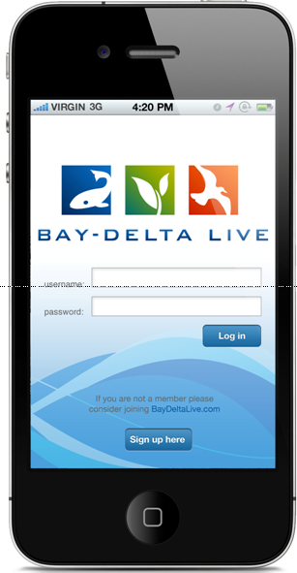
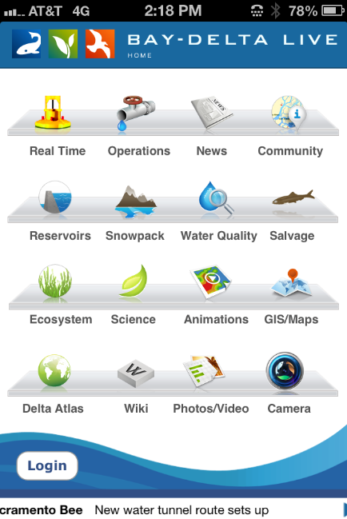
BAY-DELTA LIVE
One-stop easy access to data
Daylights data & studies not online
Future access to BDCP habitat restoration & implementation updates
Online collaborative science project pages
Visual dashboard of project operations
Notes:
Serves multiple platforms (web site/iPhone, iPad application)
Design to organization’s specifications & needs
Collaborative capabilities (public/secured)
Maintain full control over data (secured/unsecured)
SLDMWA
View daily operational decisions
Query existing station real-time data
Discuss/view same data with others
Develop/Manage Project Pages
Other uses

Slide 3









Irrigated Lands Regulatory Program (ILRP)

Slide 4
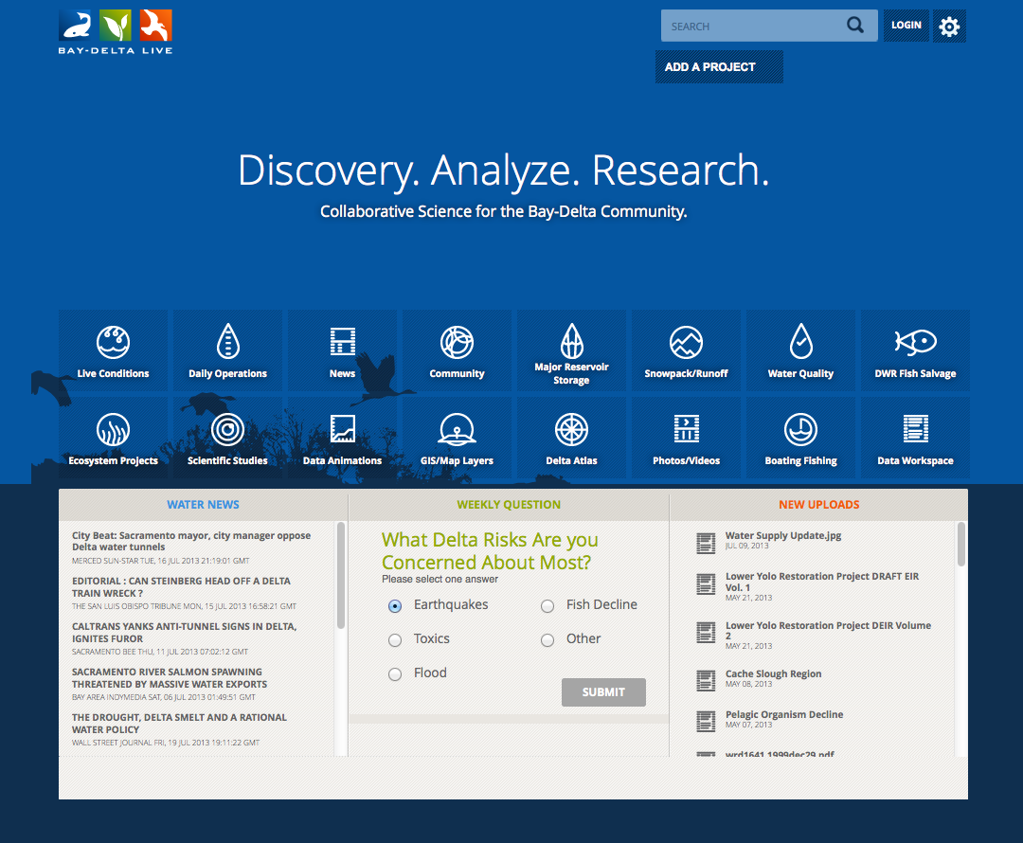
www.baydeltalive.com
Notes:
Telling the story of a complicated system.
Interpreting results to managers and stakeholders
Easily share data stories, project data, monitoring results, document libraries, interactive maps and datasets.

Slide 5
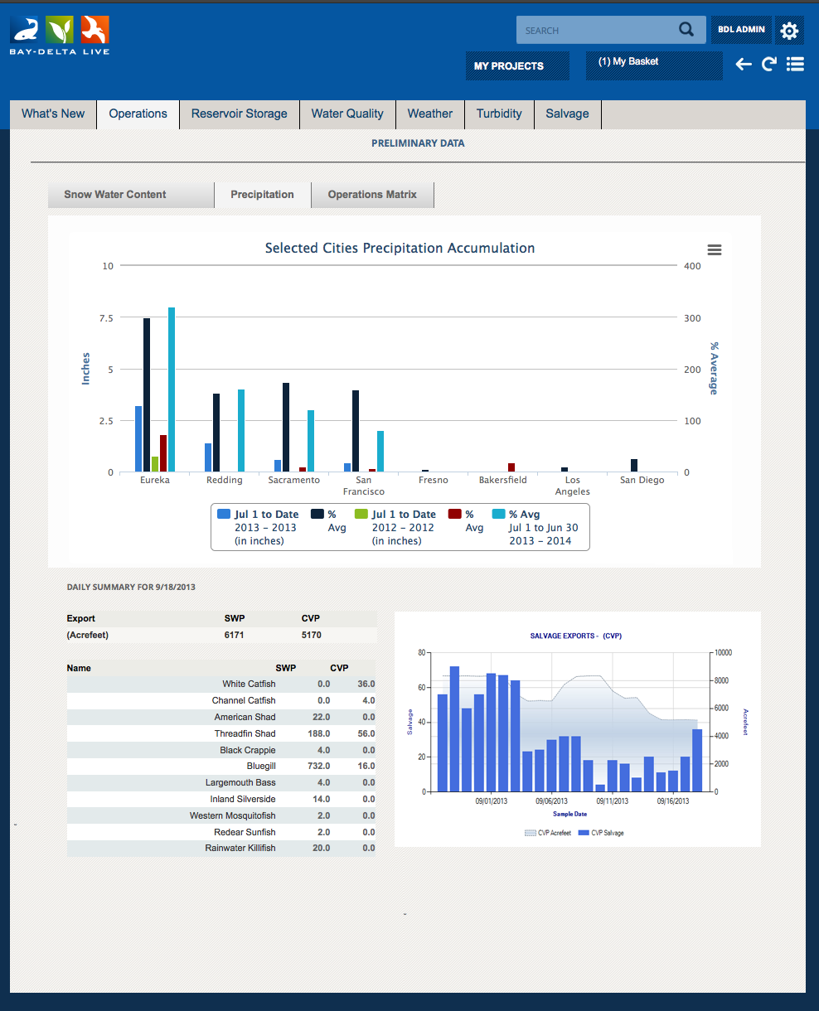

OPERATIONS DASHBOARD

Slide 6
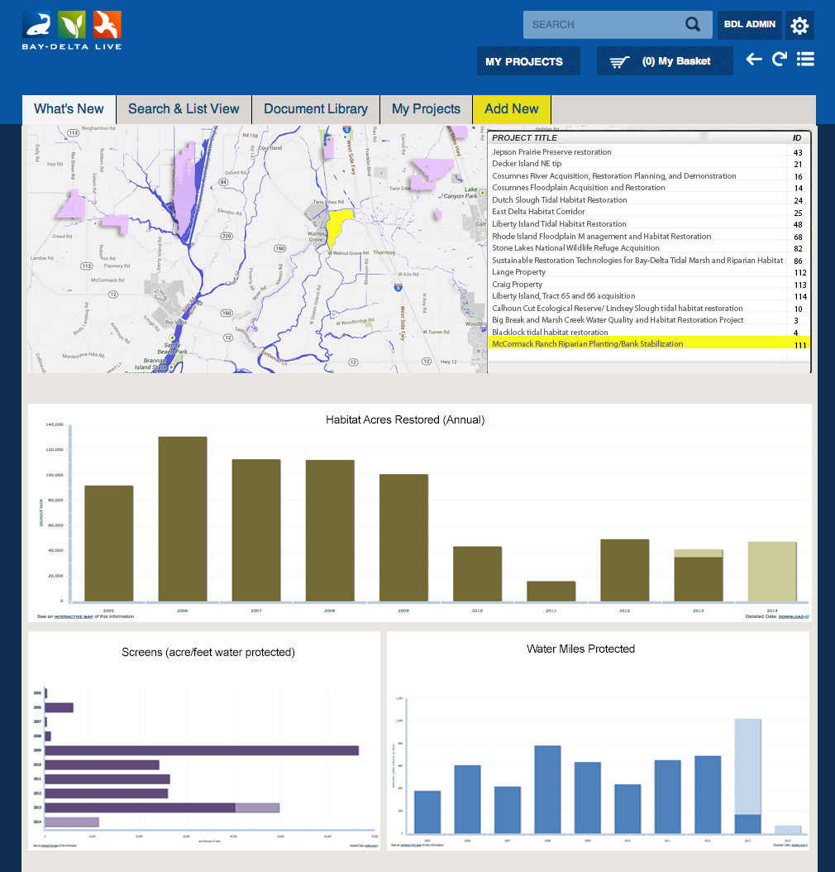
PROJECTS DASHBOARD

Slide 7
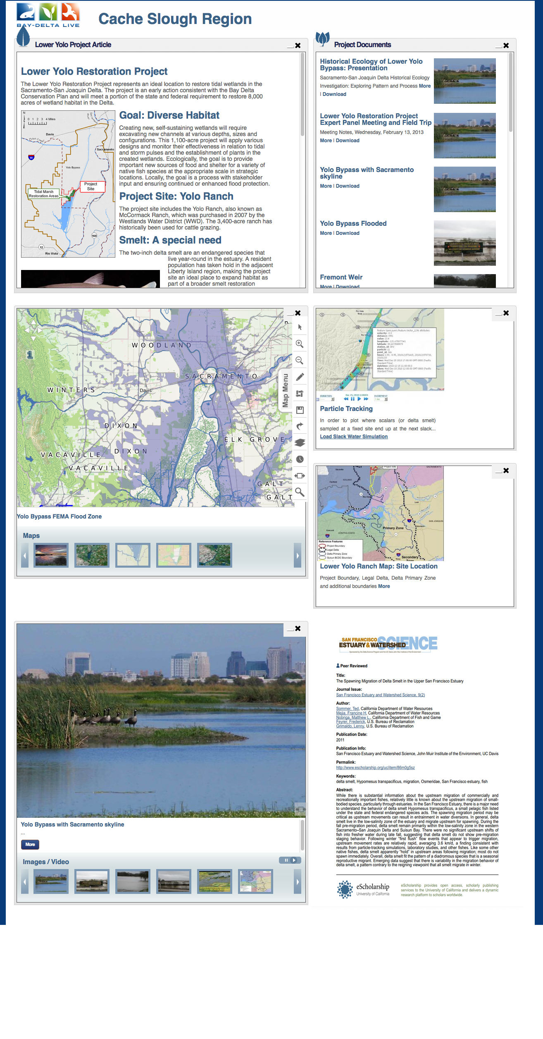
PROJECTS

Slide 8
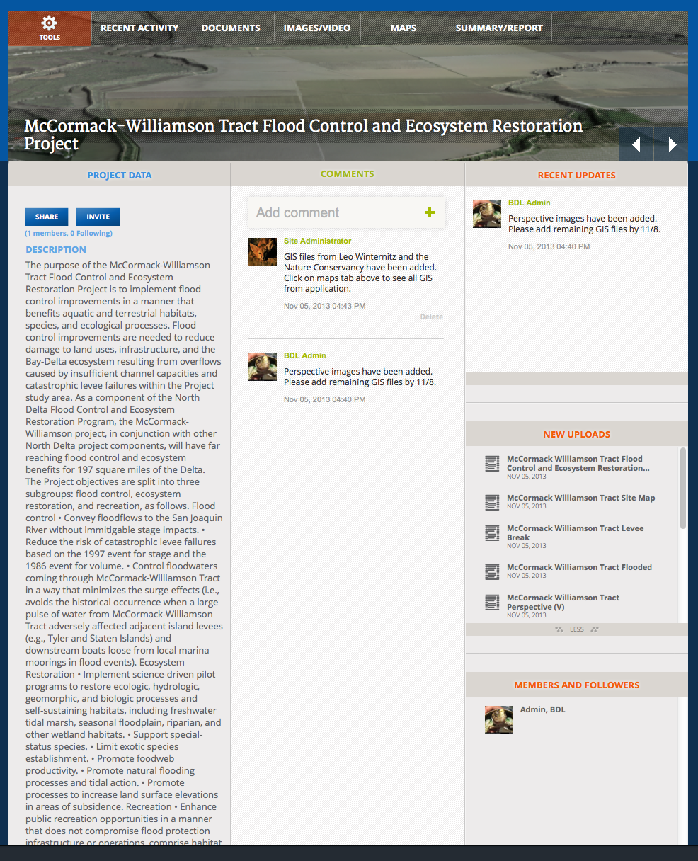
COLLABORATE

Slide 9
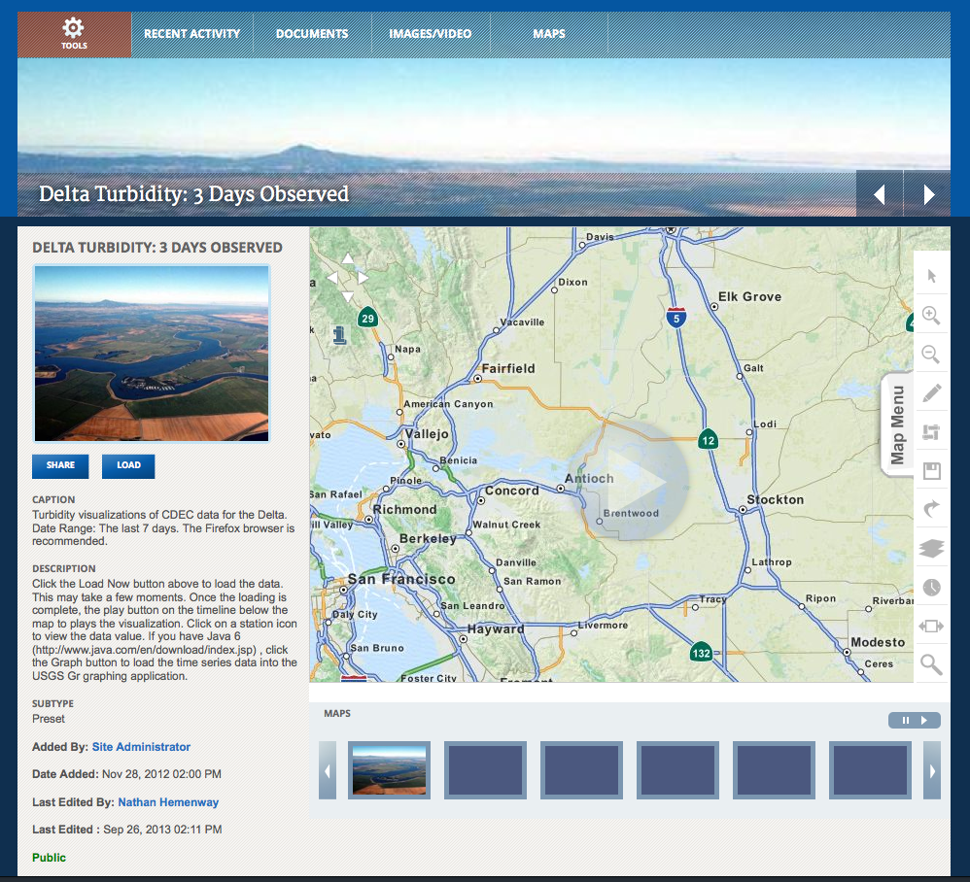

DATA ANALYSIS

Slide 10
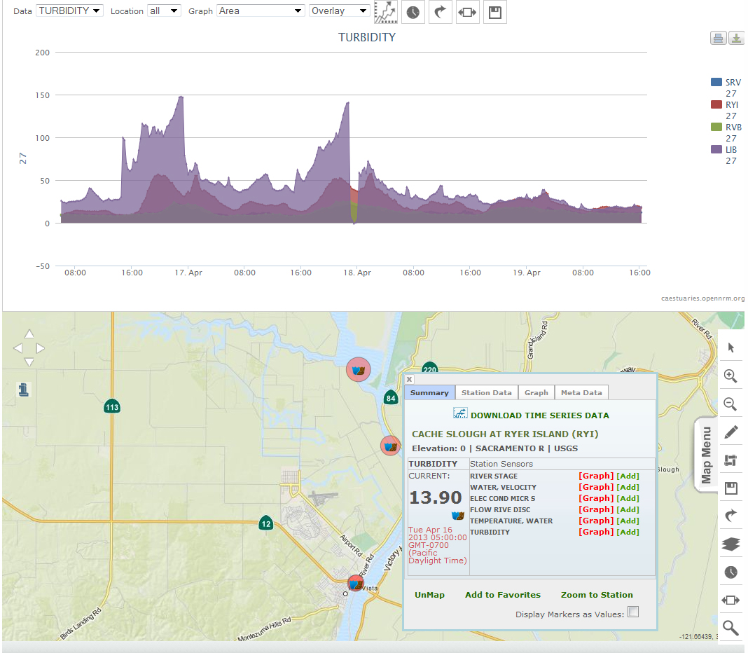
DATA ANALYSIS

Slide 11
BAY-DELTA LIVE
NEXT STEPS
Create Steering Committee
Create new log-in accounts
www.baydeltalive.com
Staff follow-up meetings

Slide 12
BAY-DELTA LIVE
BACKUP SLIDES

Slide 13
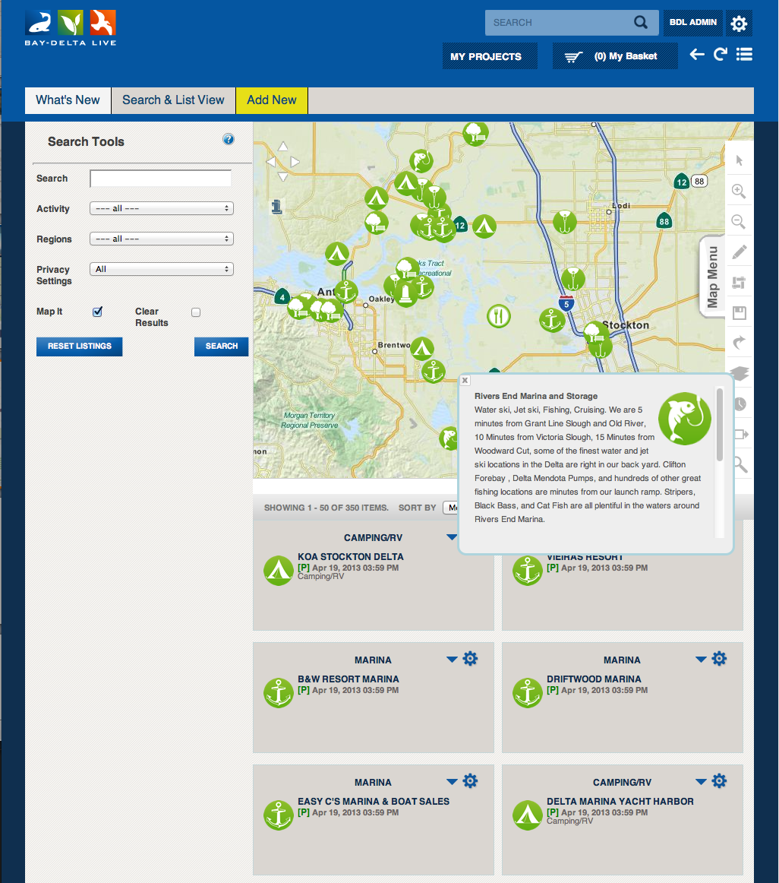
DELTA COMMUNITY

Slide 14
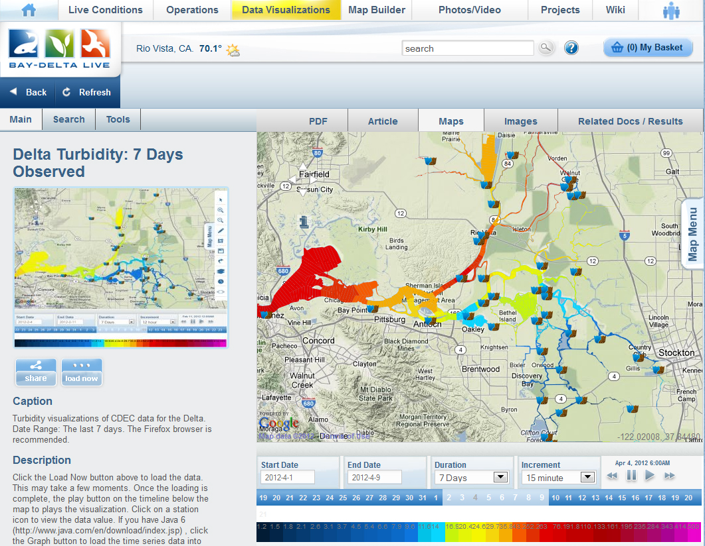
BAY-DELTA LIVE
DATA VISUALIZATION TOOLS
Access real-time data
Visualization tool
Compare datasets
Save data presets
Share data
Associate to projects,
Access/share documents
Access/share pictures/videos
Create a project page
Publish results
Notes:
Here’s an example of the data animation visualization tool that looks at the levels of turbidity (as recorded by station for a given day and time) over several days. The end user can vary the amount of hours or days for which the data covers in the visualization.

Slide 15
Notes:
This is a clearer representation of the previous page.

Slide 16
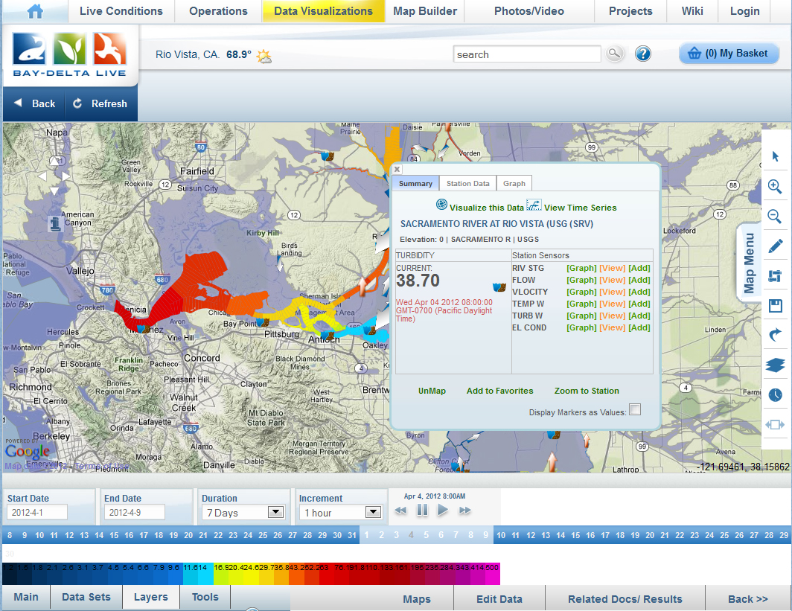
BAY-DELTA LIVE
Notes:
Here you can access the various stations (and the station parameters) in the Delta with just a click of the button. The information could be real-time or historic as well.

Slide 17
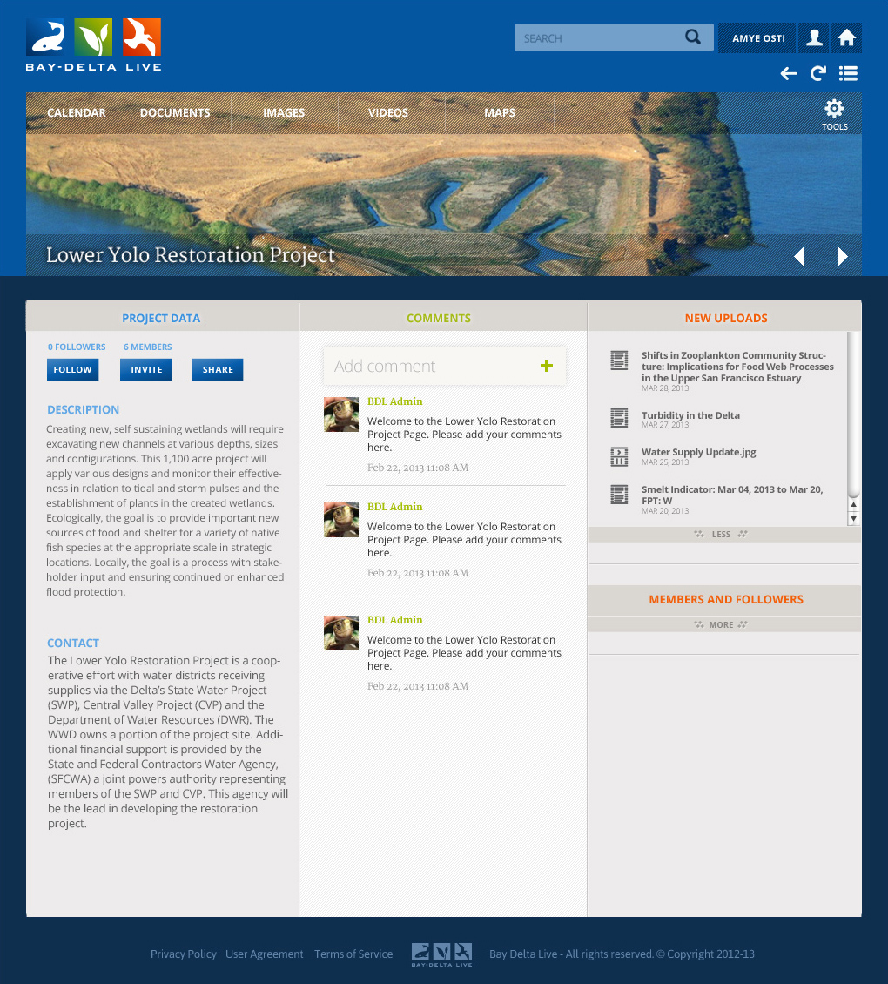
BAY-DELTA LIVE
Sample Project-Page Concept
Notes:
This is an example of a Project Page called “The Lower Yolo Restoration Project”.

Slide 18
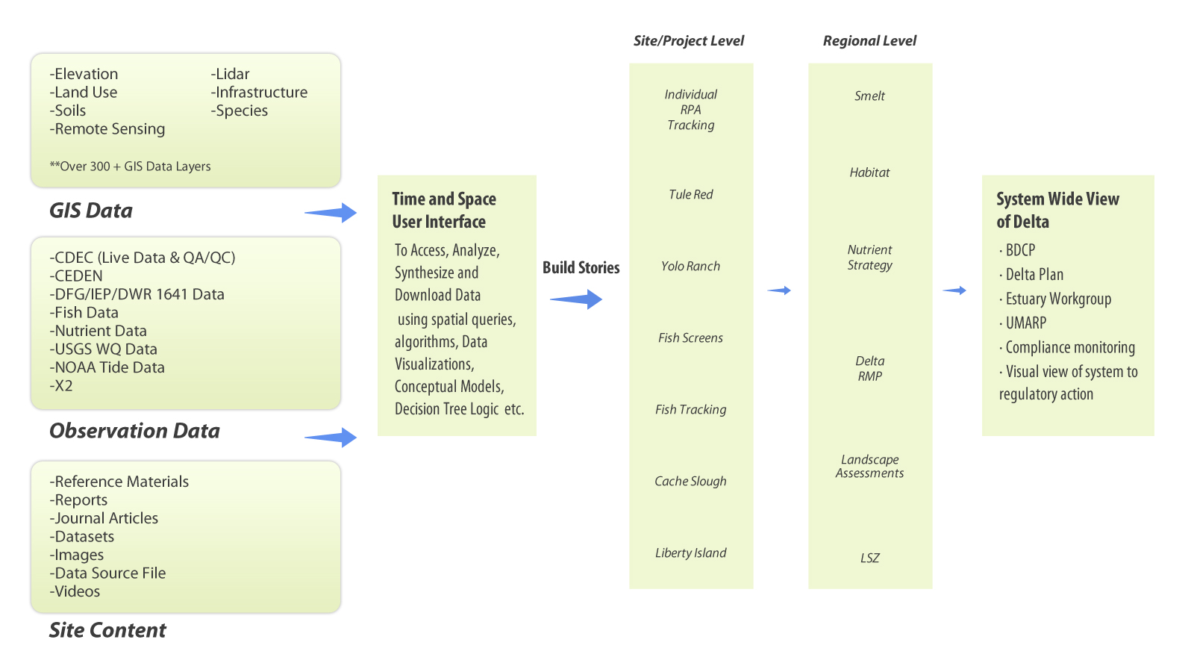
BAY-DELTA LIVE
Project Management Tool

