Slide 1
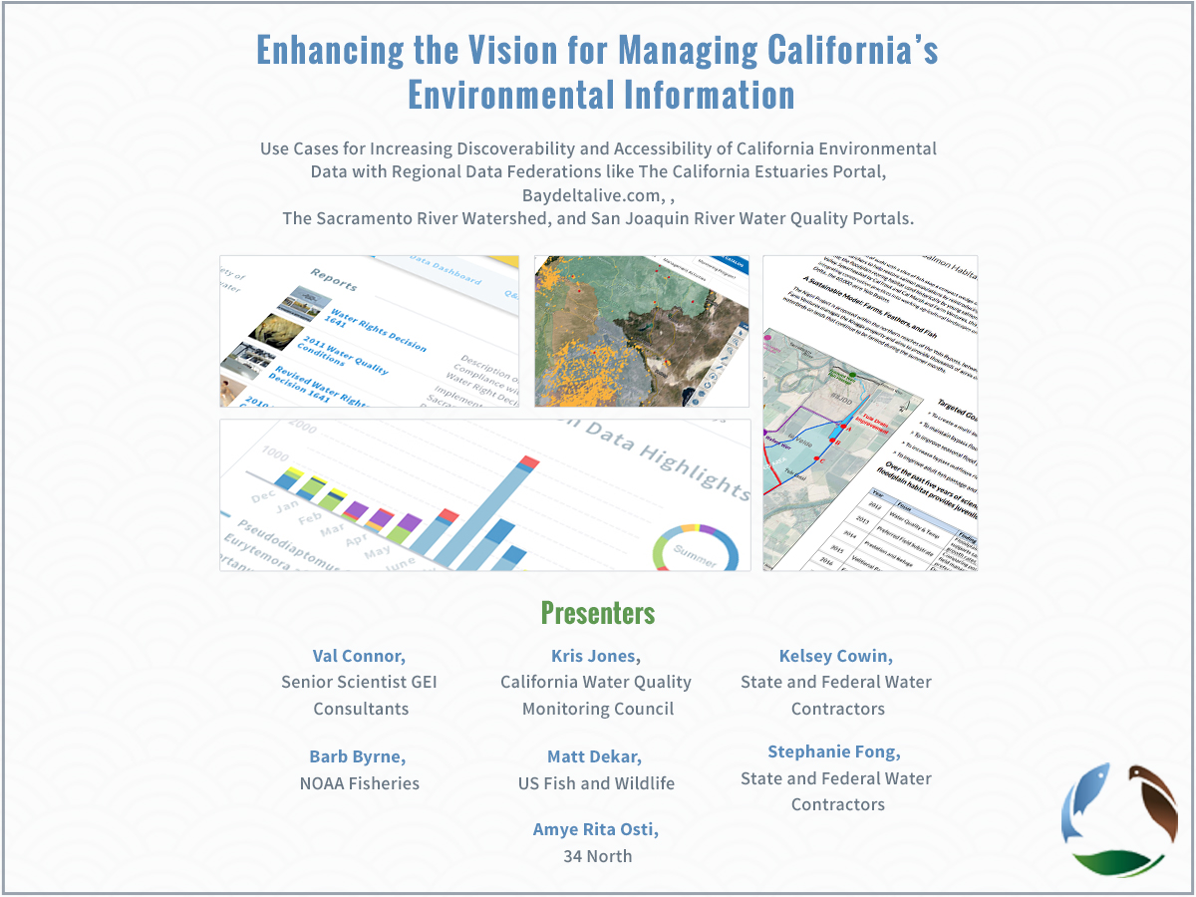

Slide 2
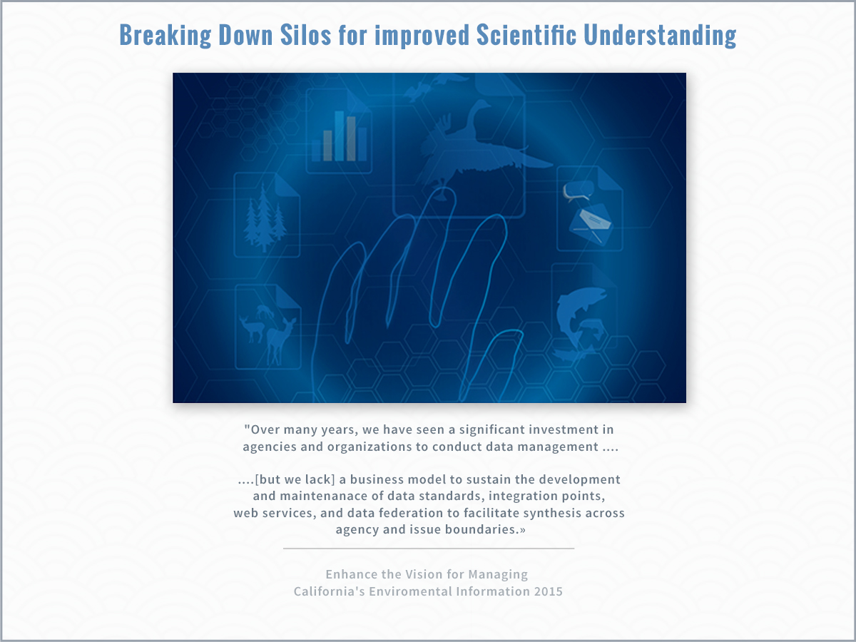

Slide 3
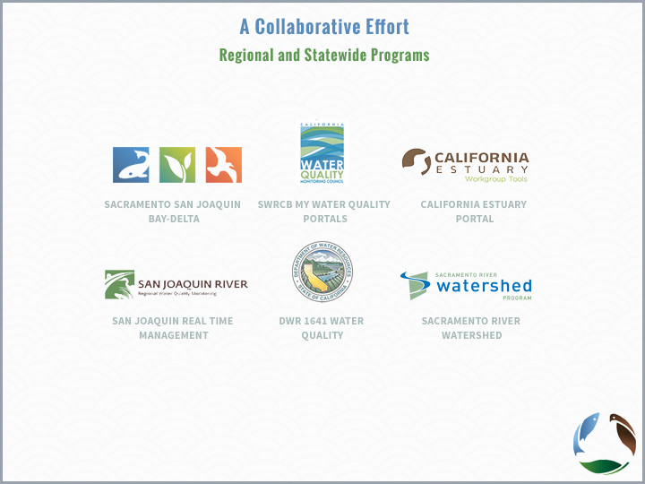

Slide 4
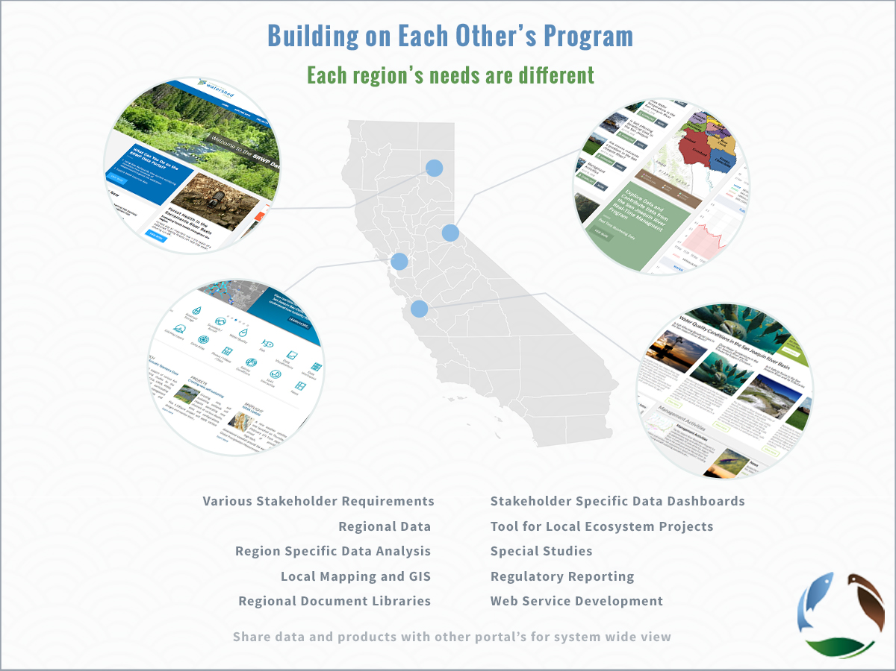

Slide 5
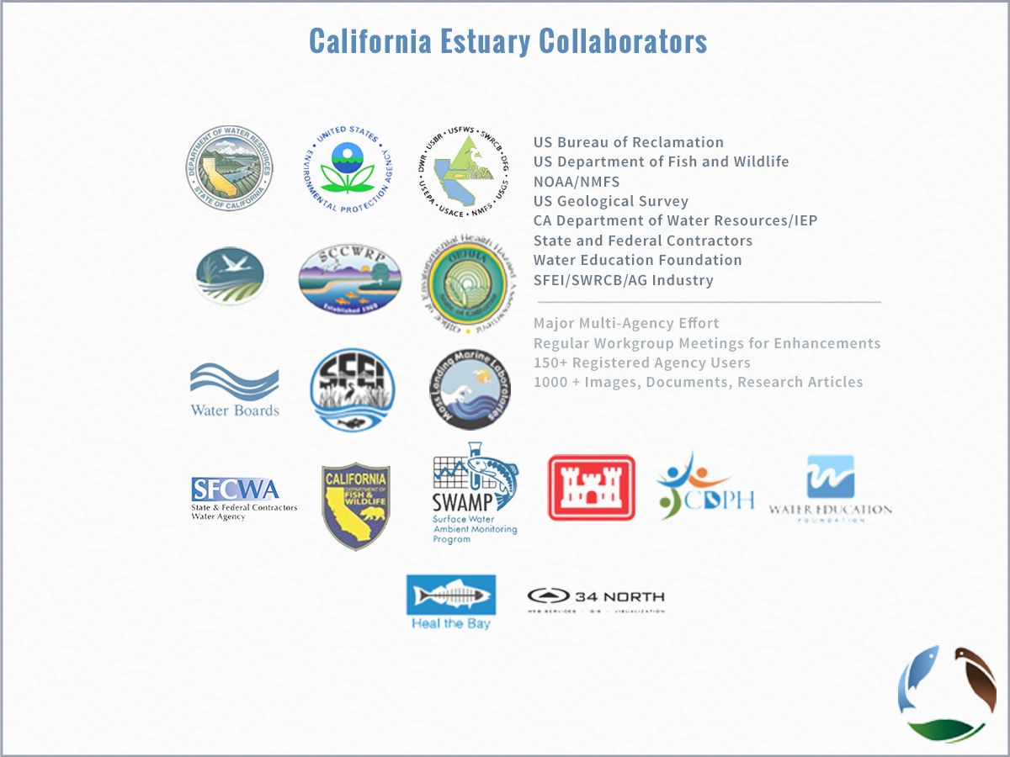

Slide 6
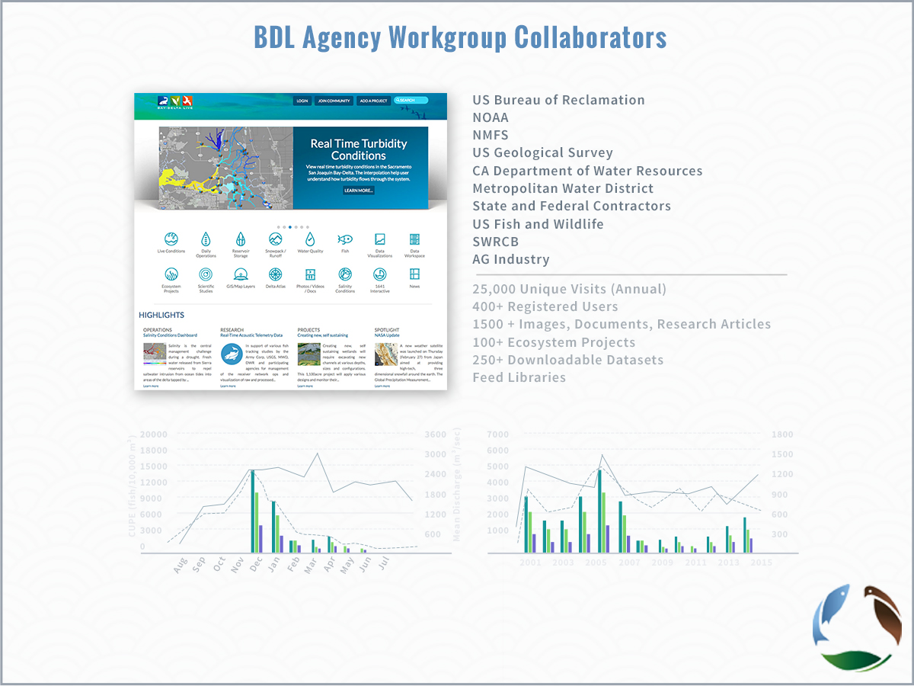

Slide 7
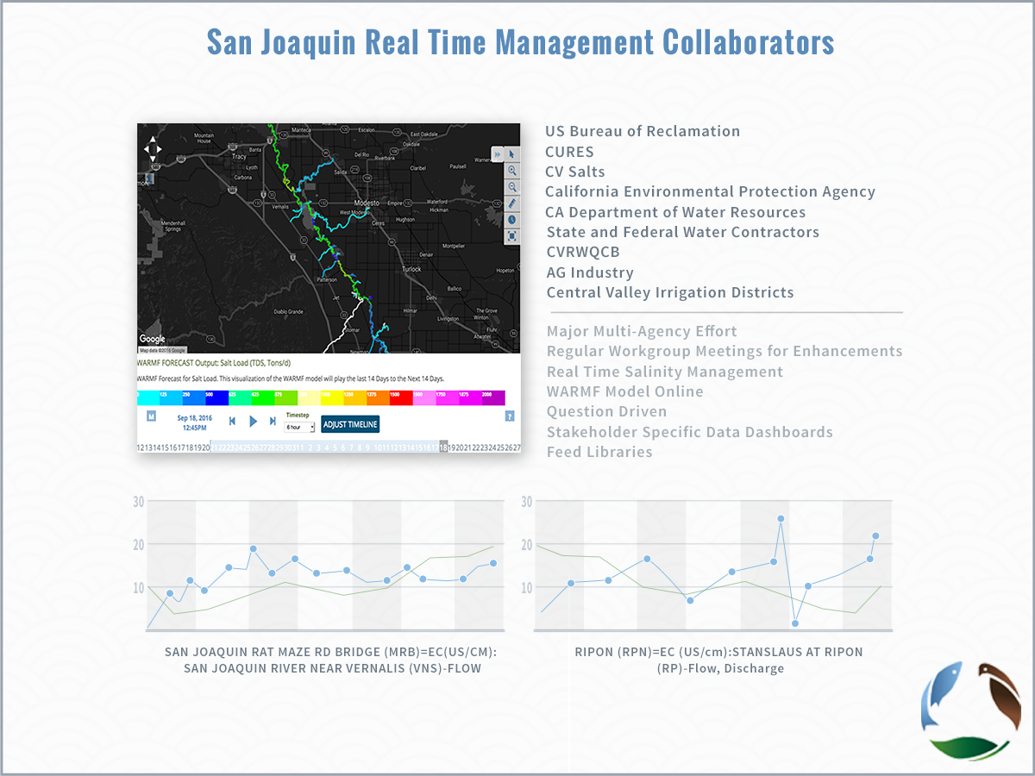

Slide 8
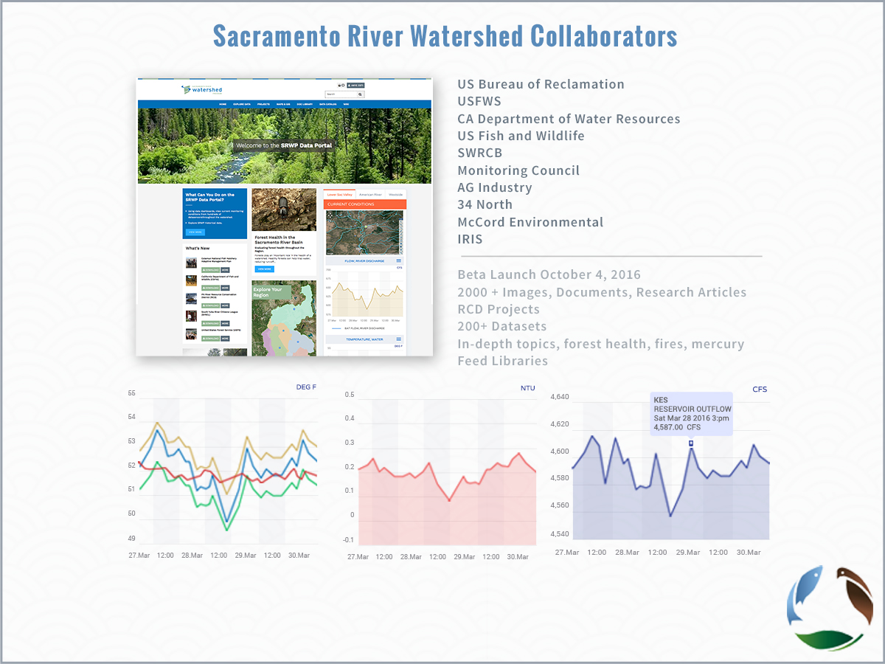
SRWP Collaborators

Slide 9
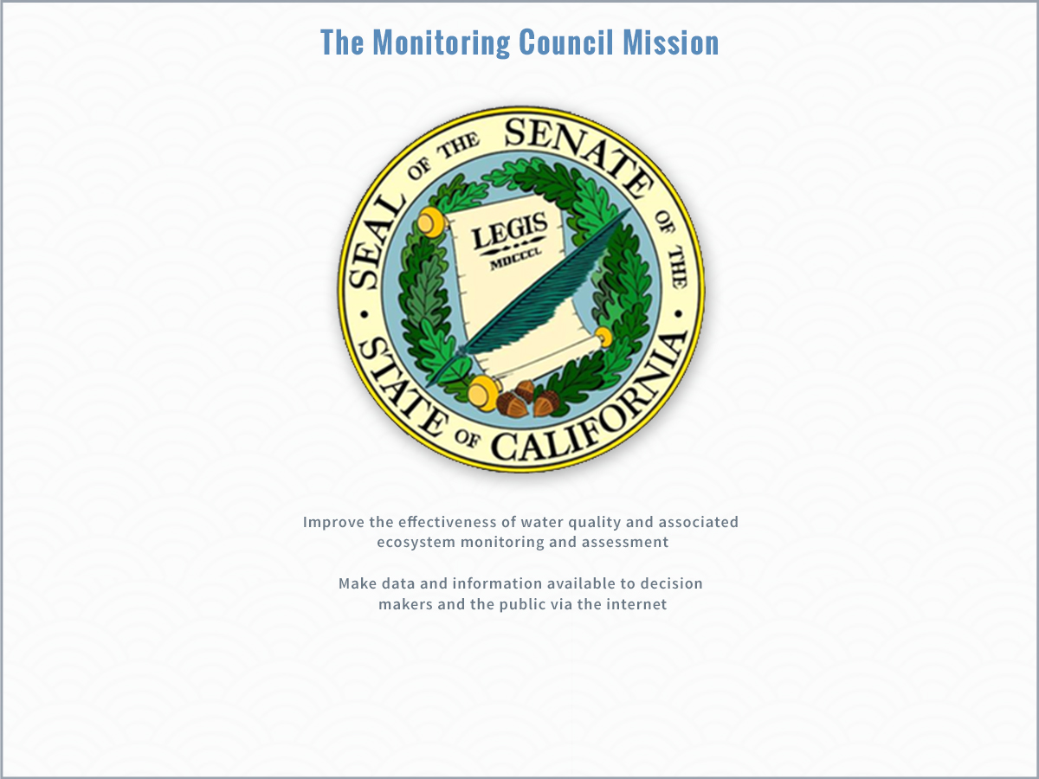

Slide 10
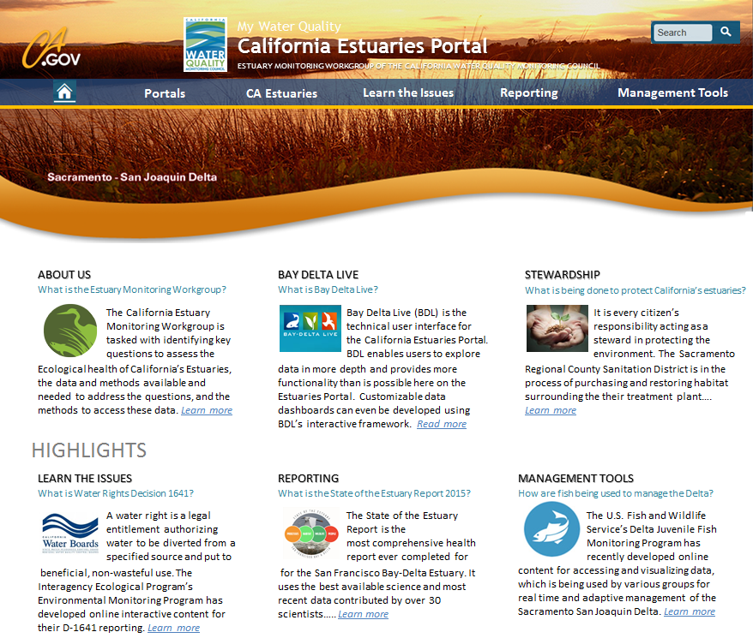
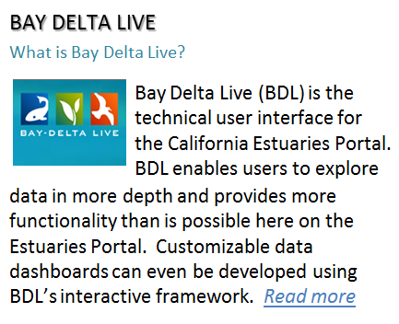
New California Estuaries Portal Design

Slide 11
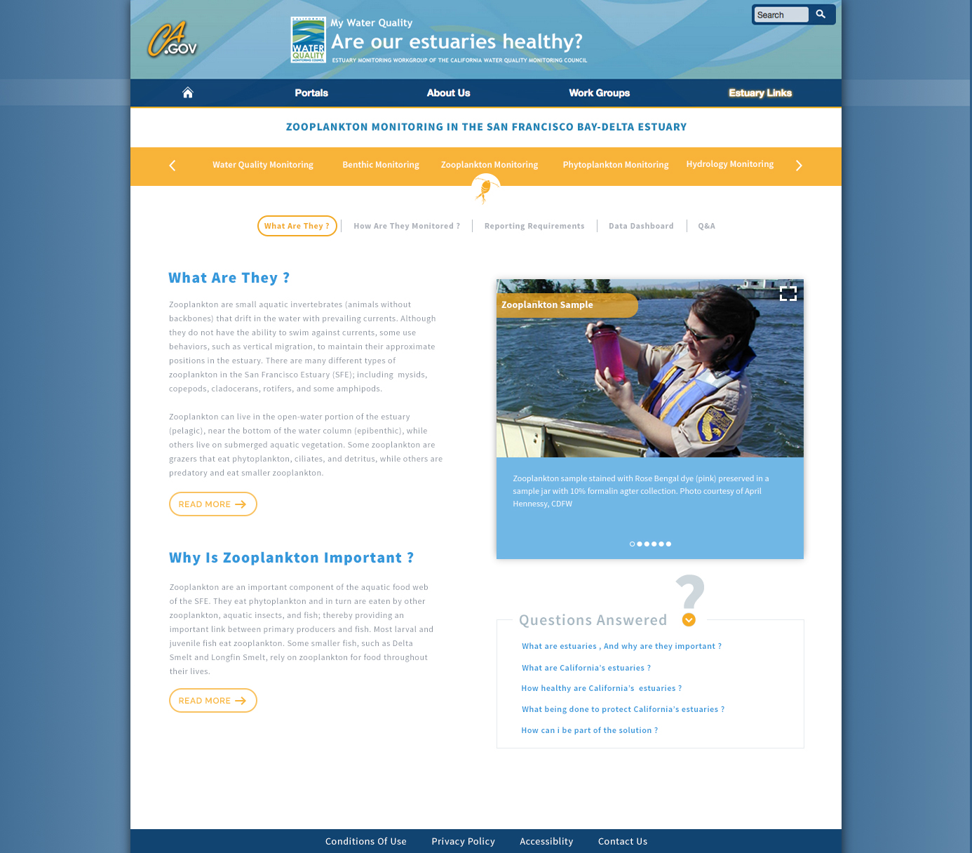
What is Zooplankton?

Slide 12
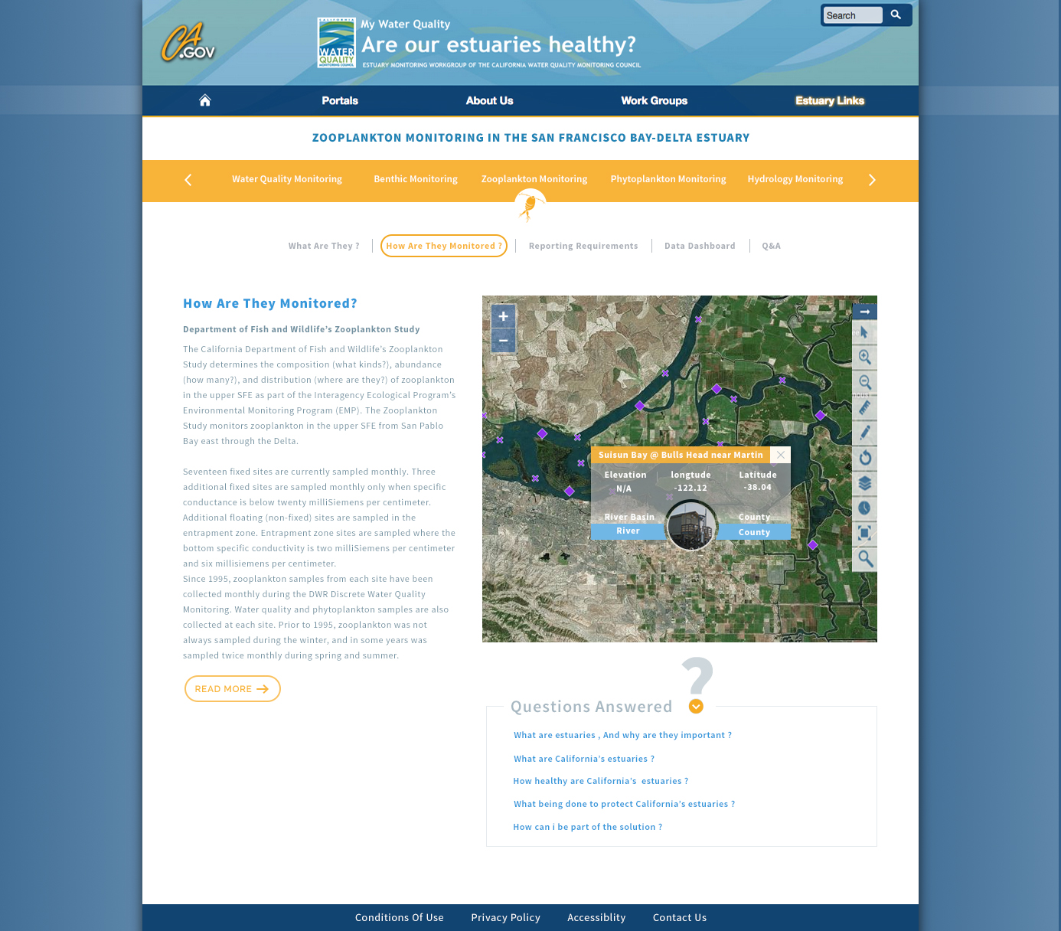
How is it Monitored?

Slide 13
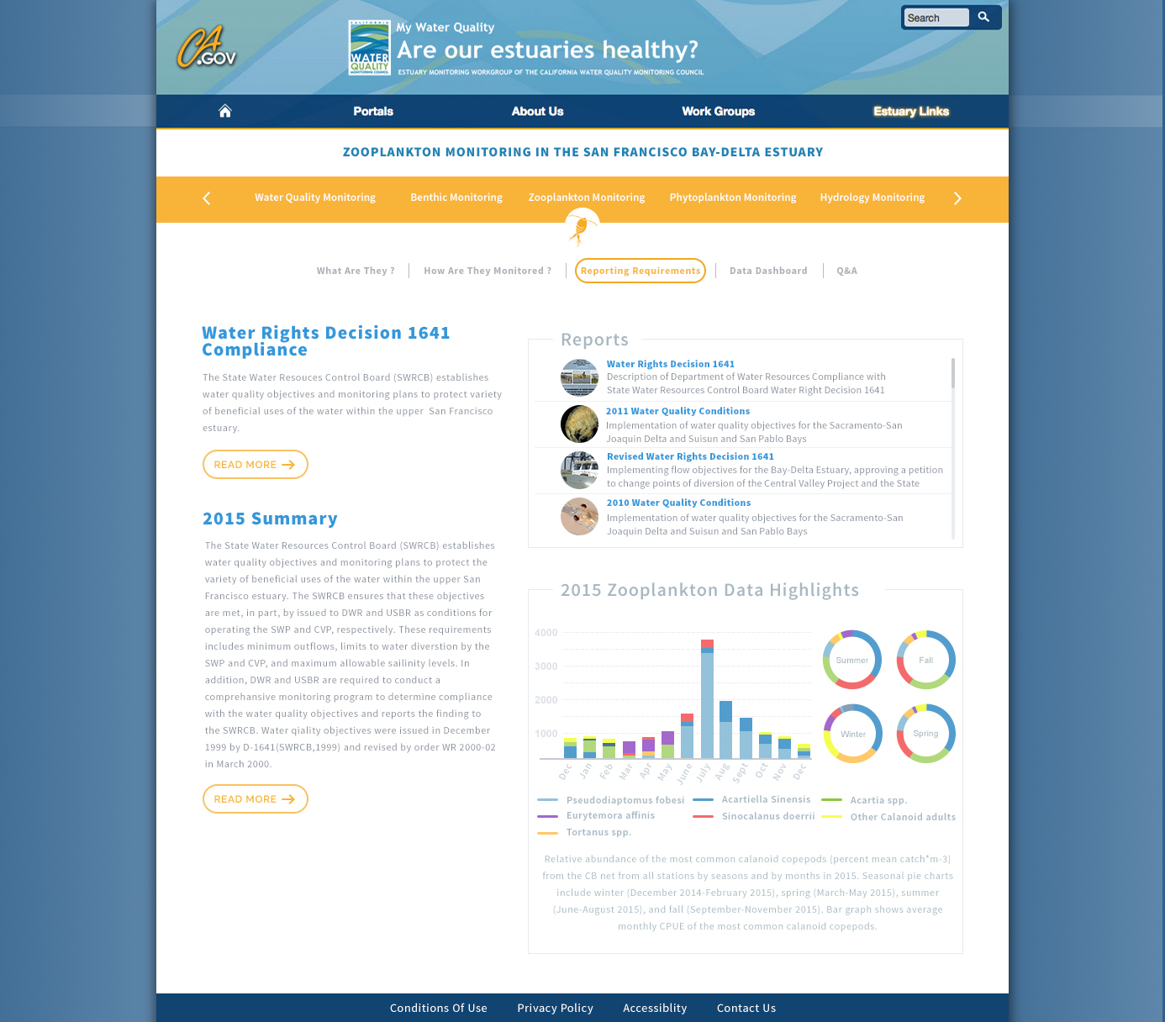
Zooplankton Reporting

Slide 14
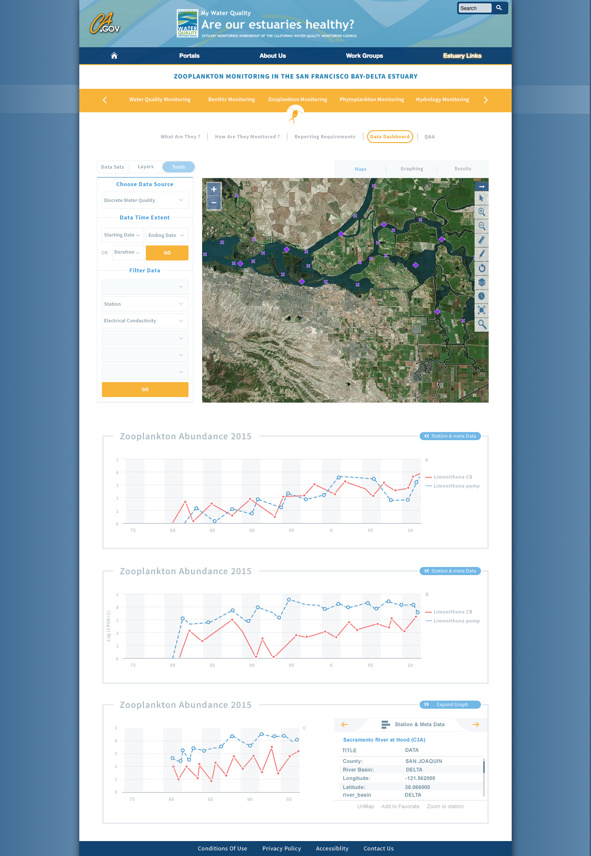
Zooplankton Dashboard

Slide 15
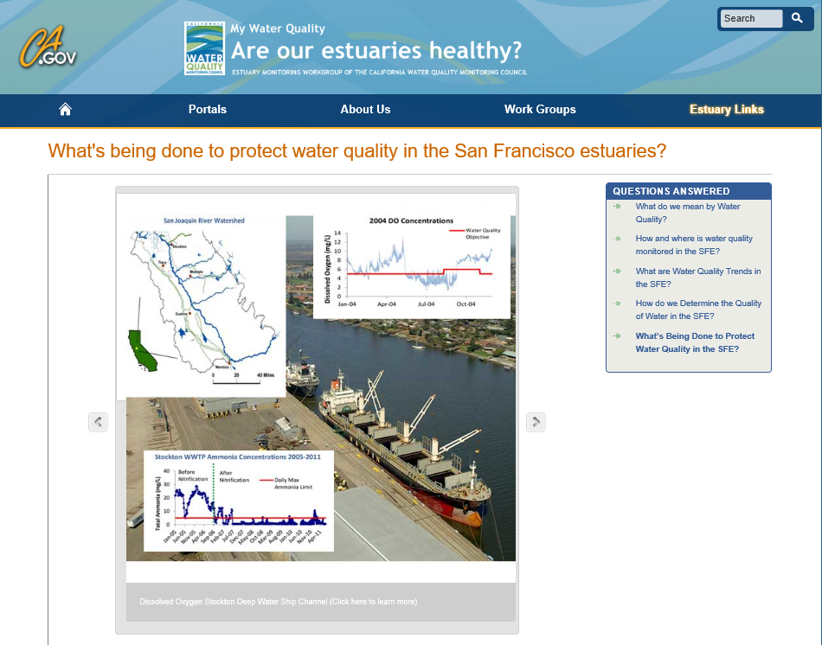
Notes:
In our first effort to present performance measures, we worked closely with Water Board and EPA staff to develop pages for the existing Total Maximum Daily Loads, and I’ll detail the Stockton Deep Water Shipping Channel Dissolved Oxygen TMDL to give you an idea of the types of performance measure tracking presented on the Estuaries Portal

Slide 16
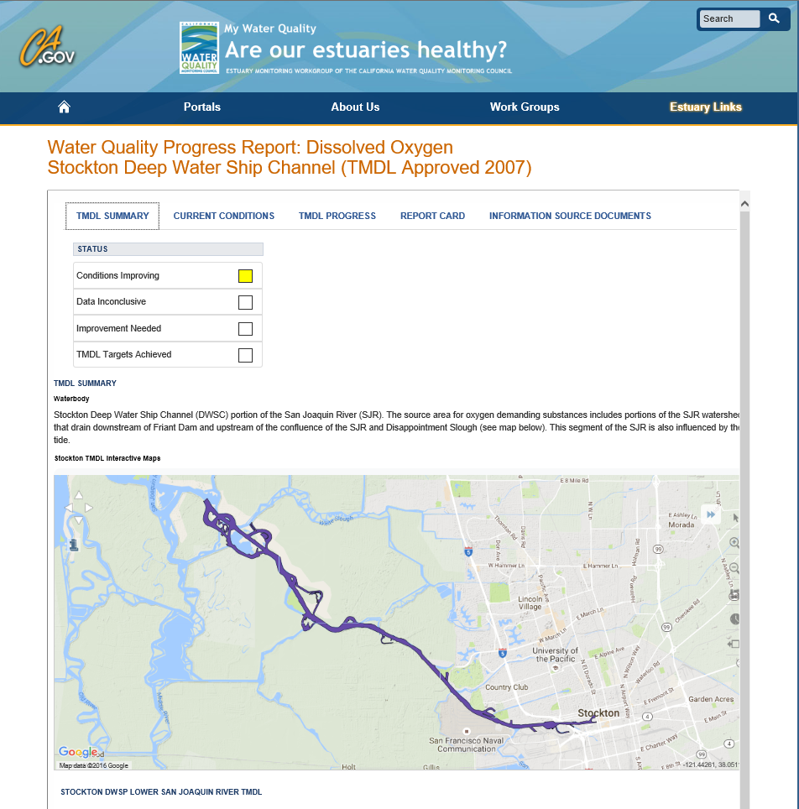
Notes:
The TMDL summary starts with a very simple assessment of where we are with the TMDL. In this case, conditions are improving. The summary tab also includes a map of the impaired reach and a couple larger-scale maps to give people who aren’t familiar with the area some frame of reference.
As you scroll down, you can get more information like what the goal is for the particular pollutant, why the TMDL was necessary, sources, loading allocation, and the timeline for attainment.

Slide 17
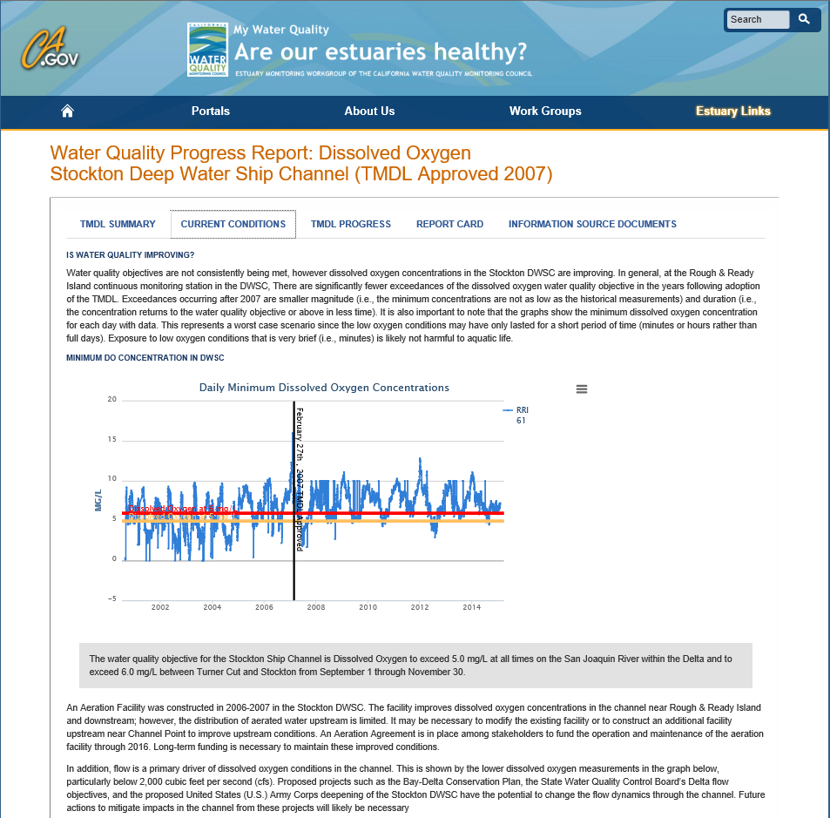
Notes:
We also have a tab for Current Conditions that gives you text explaining what’s being presented and why that information is important

Slide 18
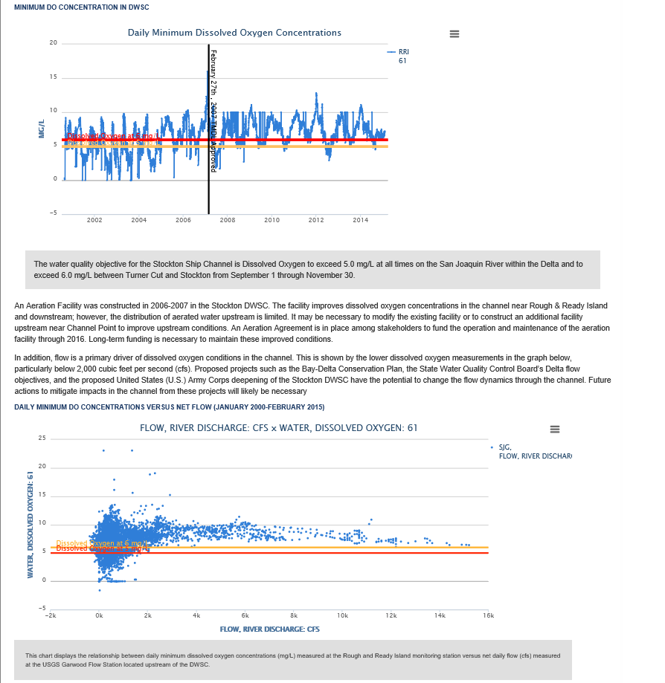
Notes:
In this particular case, there are plots of the dissolved oxygen over time as well as flow, and because the TMDL Objective is different in different parts of the year, both limits are reflected as the red and yellow lines on these graphs. As you can see from the top graph, shortly after the TMDL was approved, there were fewer exceedances and the exceedances themselves were of lesser magnitude

Slide 19
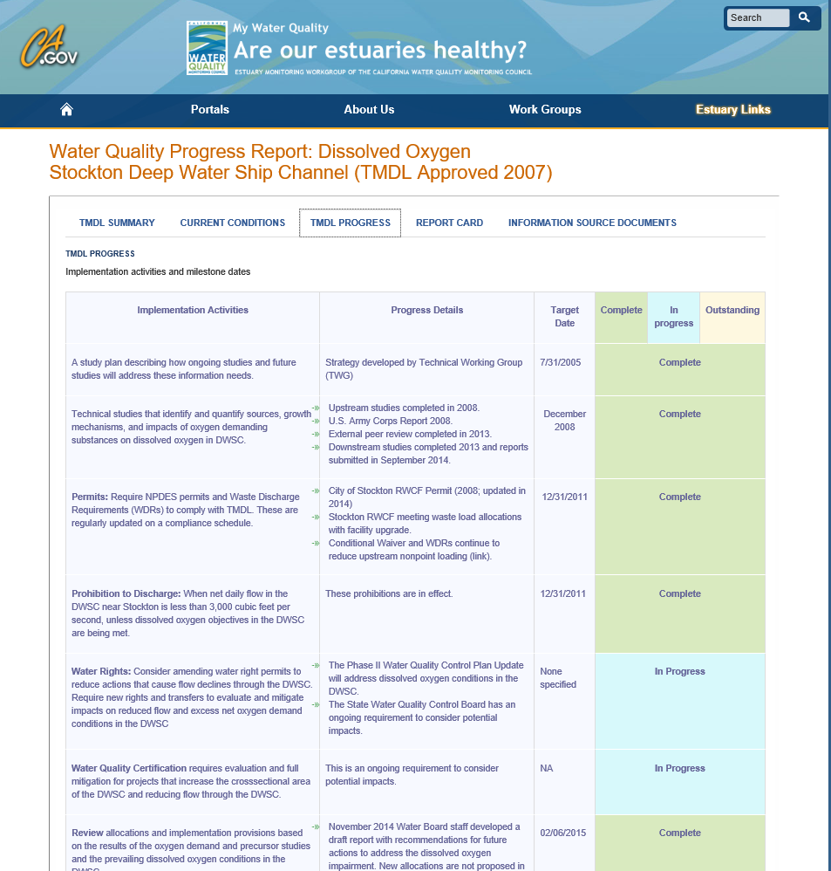
Notes:
The TMDL Progress tab was something important to EPA. They really wanted to visualize the different timelines involved and where they were on implementing those milestones

Slide 20
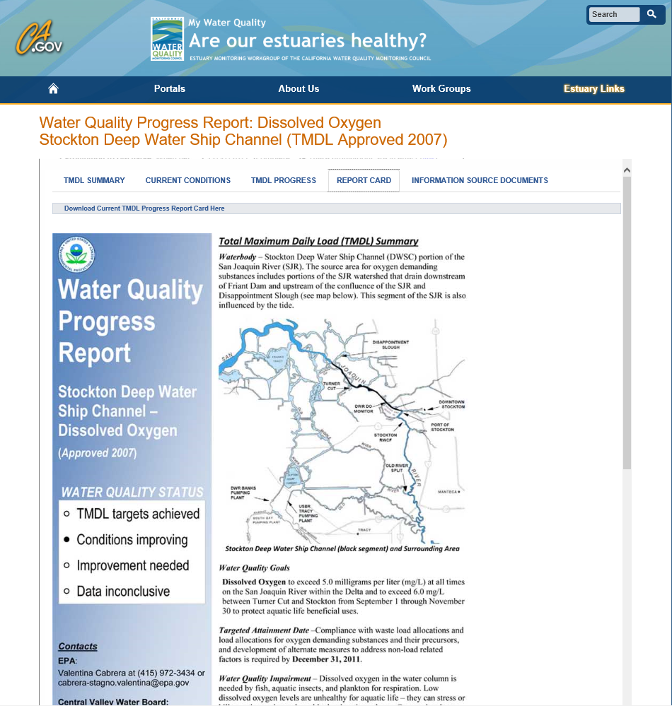
Notes:
The Report Card is formatted after the reporting required from the Water Board to EPA and gives you much more detailed information that is summarizes on the TMDL Summary tab, and it provides you with additional links

Slide 21
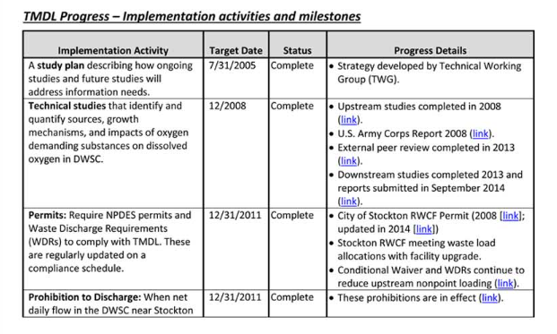
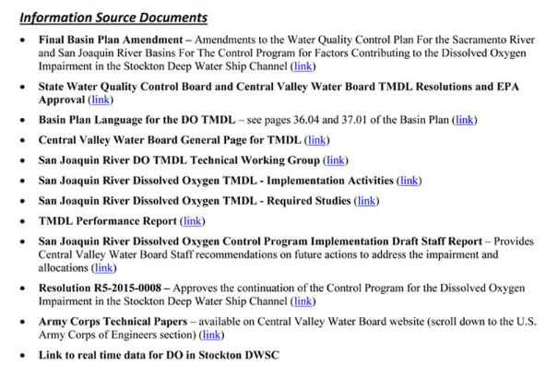
Notes:
To documents and deliverables

Slide 22
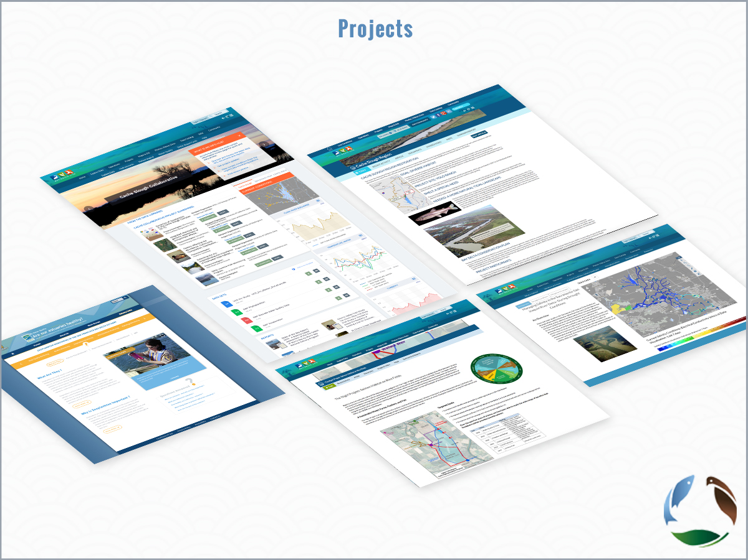

Slide 23
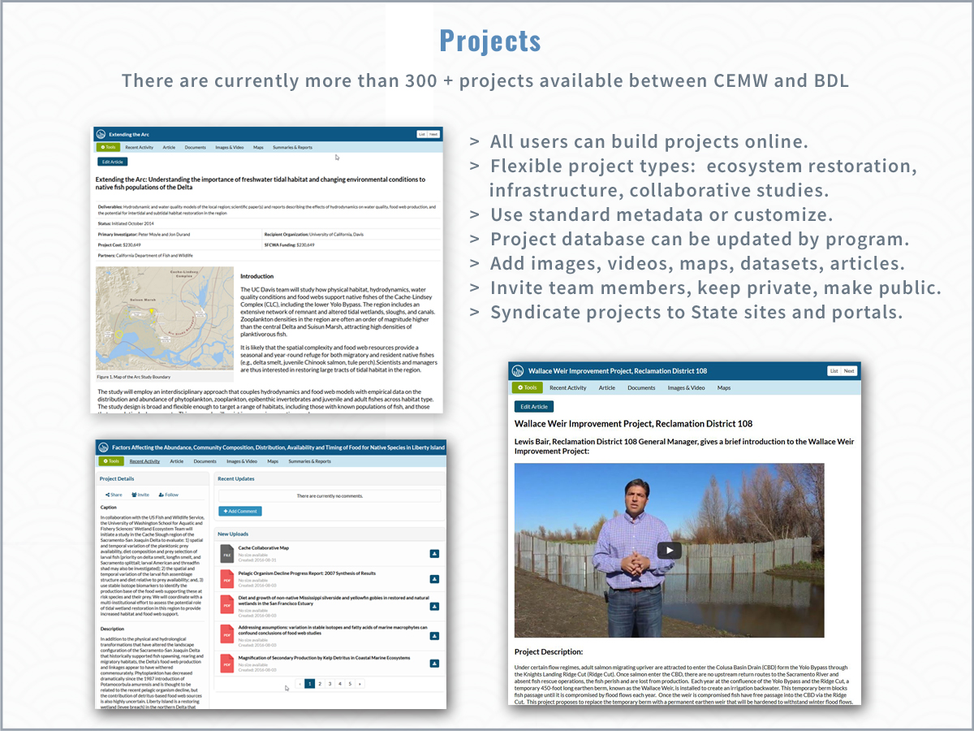

Slide 24
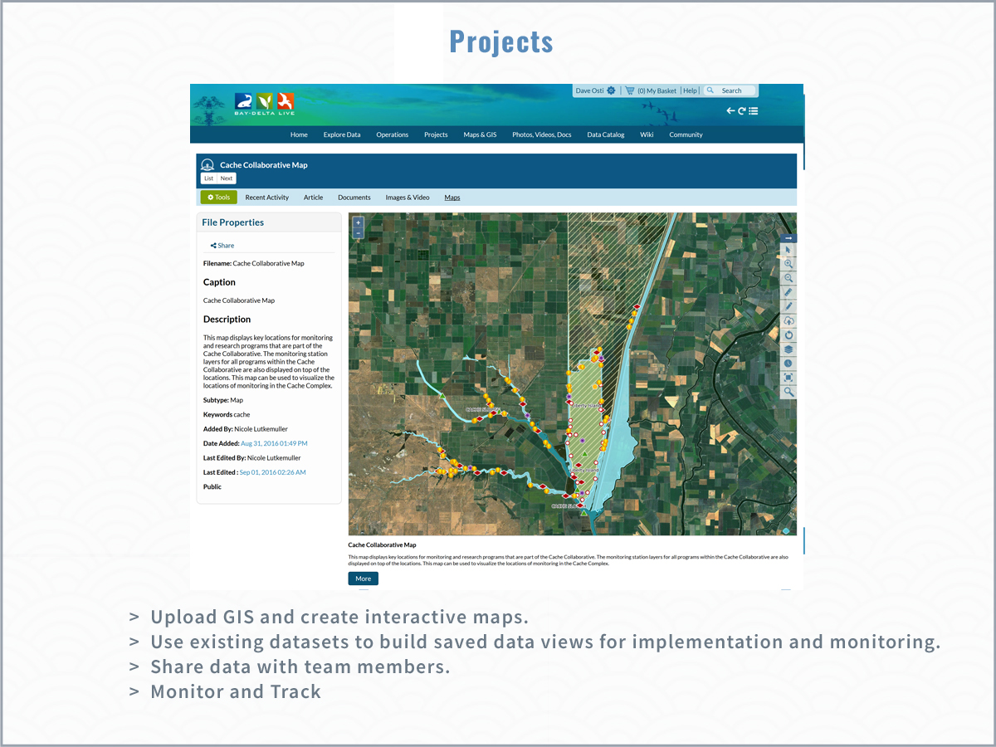

Slide 25
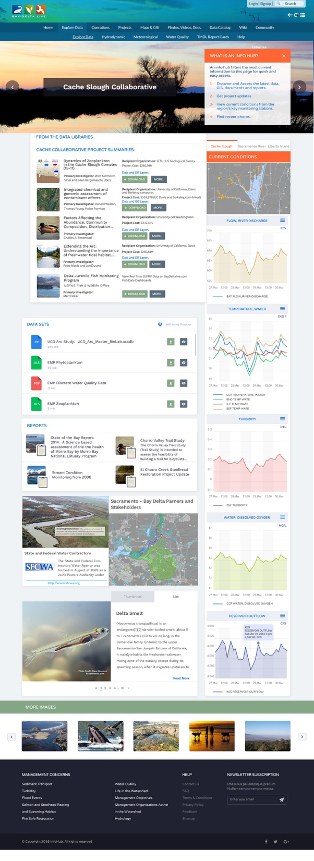
Project Info hubs

Slide 26
Project Info hubs

Slide 27
IEP and Delta Juvenile Fish Program Data
Water Quality
Phytoplankton
Zooplankton
Benthics
Fish

Slide 28
Comparability across multiple scales and programs
Research Studies
Regional (IAMIT)
IEP- Delta Wide
Restoration Site (FRPA)
Compliance Data
Indicator
Methods
Measurement Quality Objectives
Data Quality Objectives
Data Management

Slide 29
Reconciling Approaches and Getting to Comparability
Options:
Consistent Methodology
Performance Based Approach
Inter-calibration
This will require multi-agency participation, time, special studies, and a commitment to the value of comparability

Slide 30
Explore Data
  Creating the baseline, effort toward transparency
  Review Current Datasets: Discuss data integration, interoperability, techniques, transformation and portability
  Reporting back to agencies and data owners for improved data quality
  Demo exploring and graphing key datasets
  Data federation: querying aggregated data (status and goals).
  Linking: BDL: SRWP, Caestuaries and SJR Real Time Management portals.

Slide 31
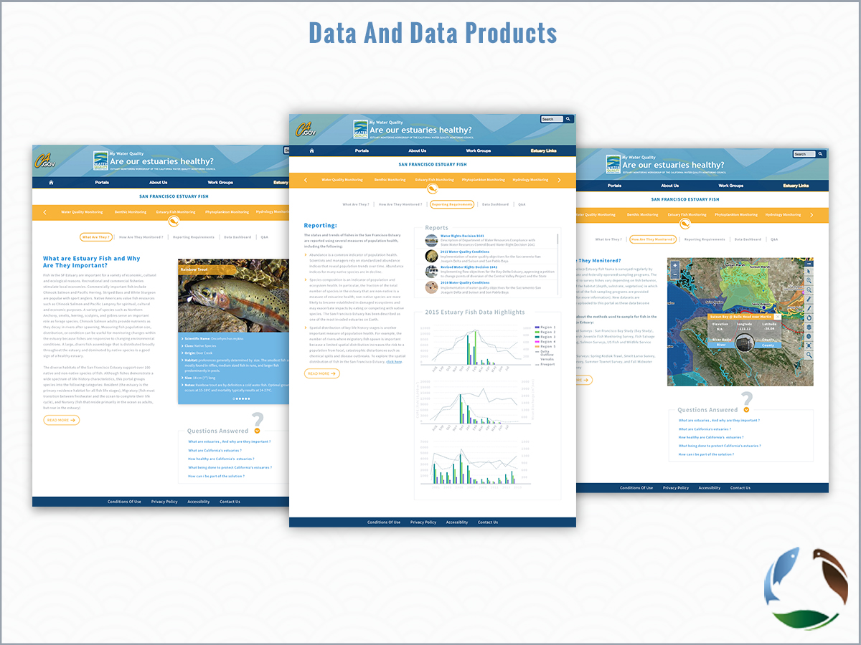
Notes:
My Water Quality Portals, Report Card and TMDLs
Demo DOSS/CAMT/ DJFMP, discuss phase 2
- DCT Salinity/Turbidity (Val)
By the Numbers (TBD)
Build your own Dashboard

Slide 32
Notes:
In our first effort to present performance measures, we worked closely with Water Board and EPA staff to develop pages for the existing Total Maximum Daily Loads, and I’ll detail the Stockton Deep Water Shipping Channel Dissolved Oxygen TMDL to give you an idea of the types of performance measure tracking presented on the Estuaries Portal

Slide 33
Notes:
The TMDL summary starts with a very simple assessment of where we are with the TMDL. In this case, conditions are improving. The summary tab also includes a map of the impaired reach and a couple larger-scale maps to give people who aren’t familiar with the area some frame of reference.
As you scroll down, you can get more information like what the goal is for the particular pollutant, why the TMDL was necessary, sources, loading allocation, and the timeline for attainment.

Slide 34
Notes:
We also have a tab for Current Conditions that gives you text explaining what’s being presented and why that information is important

Slide 35
Notes:
In this particular case, there are plots of the dissolved oxygen over time as well as flow, and because the TMDL Objective is different in different parts of the year, both limits are reflected as the red and yellow lines on these graphs. As you can see from the top graph, shortly after the TMDL was approved, there were fewer exceedances and the exceedances themselves were of lesser magnitude

Slide 36
Notes:
The TMDL Progress tab was something important to EPA. They really wanted to visualize the different timelines involved and where they were on implementing those milestones

Slide 37
Notes:
The Report Card is formatted after the reporting required from the Water Board to EPA and gives you much more detailed information that is summarizes on the TMDL Summary tab, and it provides you with additional links

Slide 38
Notes:
To documents and deliverables

Slide 39
Zooplankton Reporting

Slide 40
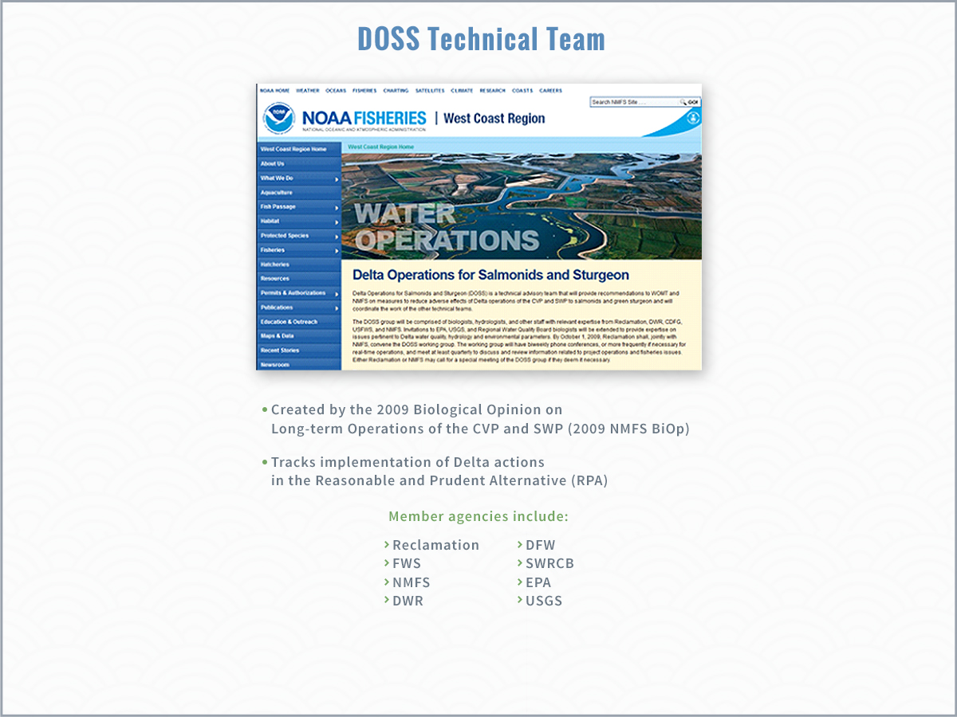

Slide 41
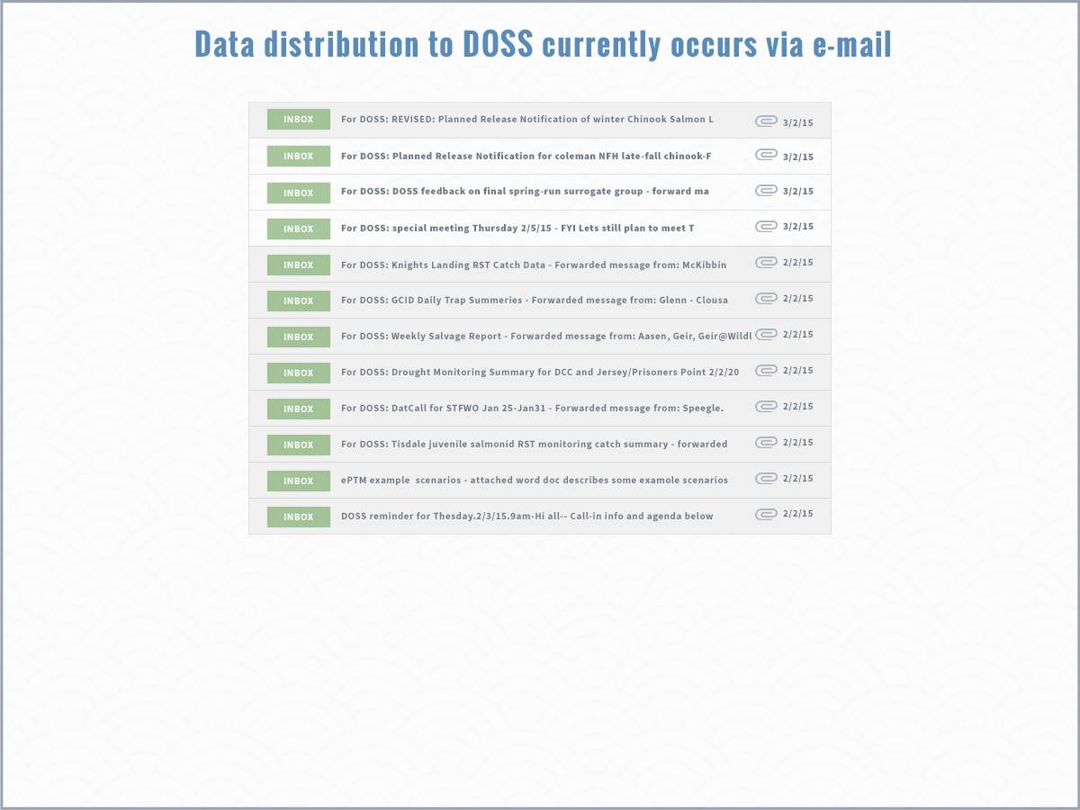

Slide 42
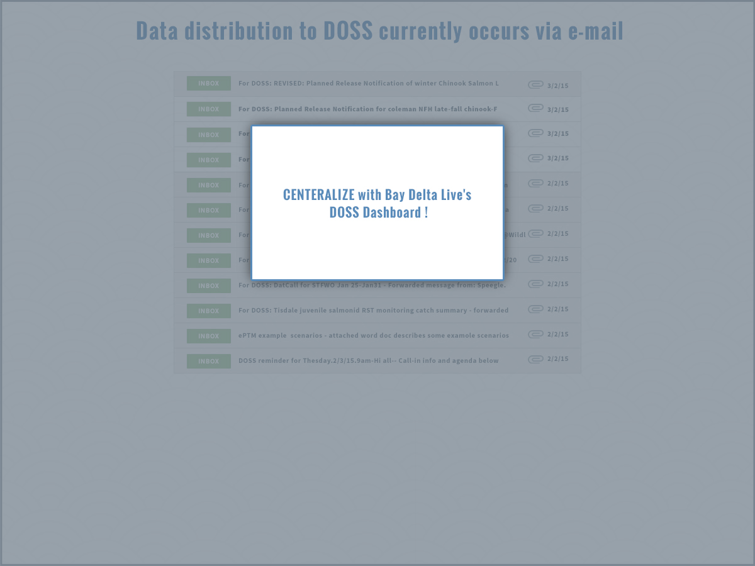

Slide 43
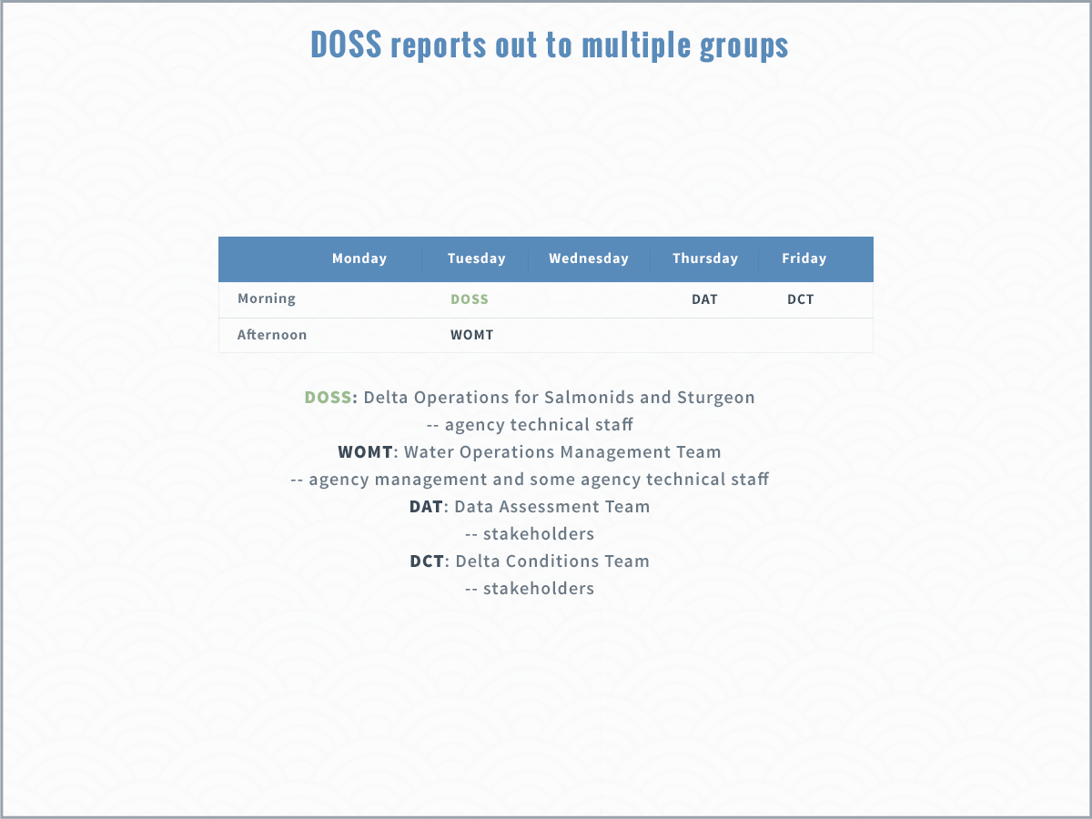

Slide 44
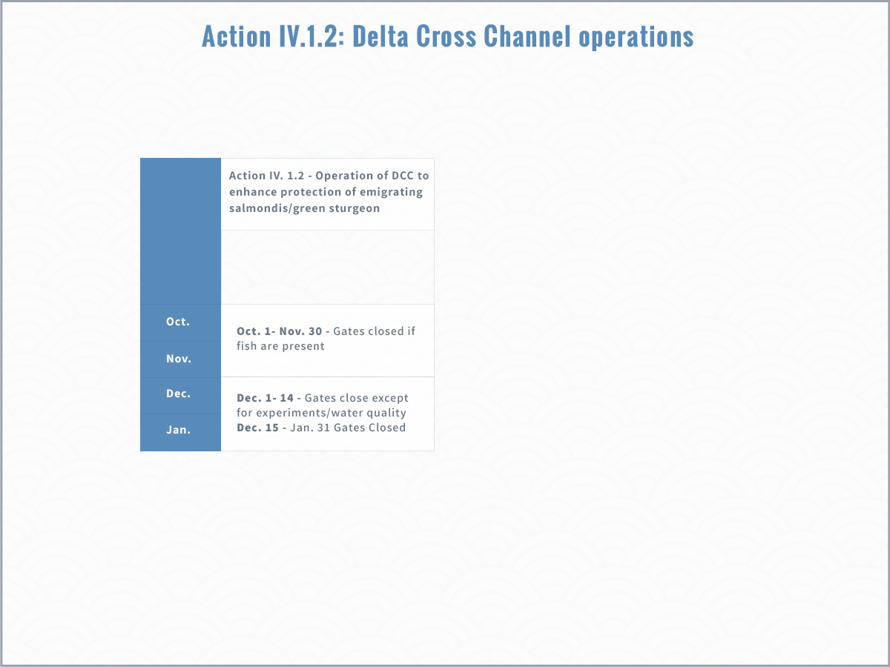
Notes:
Action IV.1.2 of the RPA provides guidelines for Delta Cross Channel operations. Before Dec 15th, the DCC gates may be open unless certain conditions are met. DOSS tracks those conditions, which consist of a set of “alerts” and also a set of triggers that may require DCC closure.

Slide 45
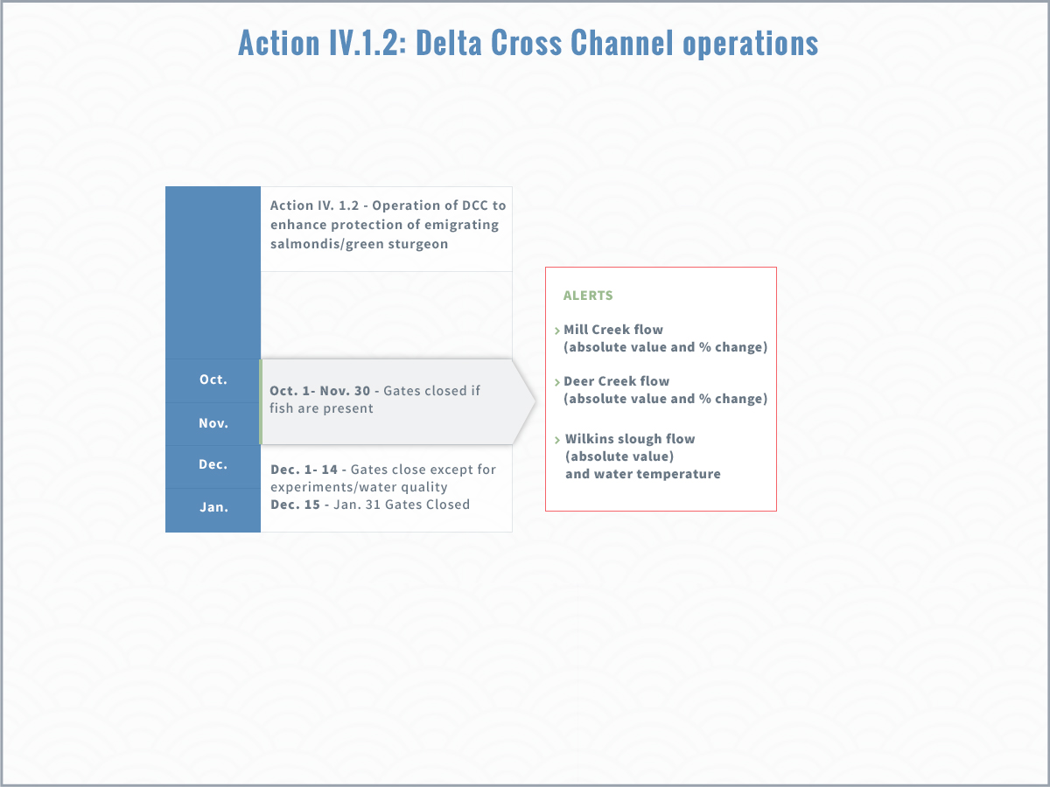

Slide 46
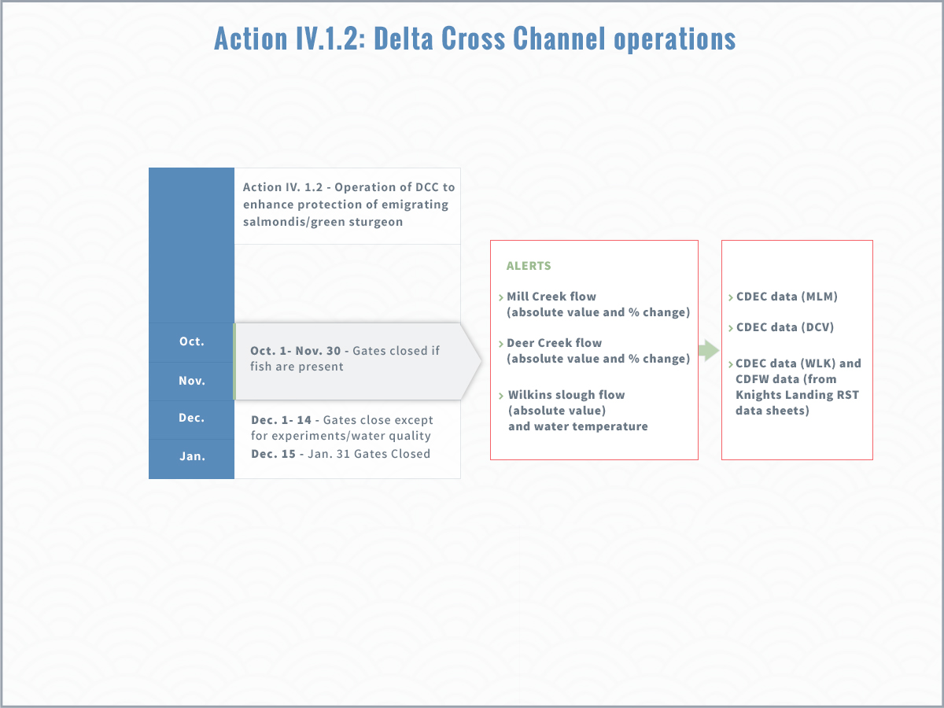
Notes:
The triggers that may require DCC gate closure rely on fish catch at several key monitoring locations, and on WQ conditions. The catch info comes from KL, the Sac Trawl, and the beach seines. WQ conditions are monitored by the Projects, not by DOSS, and relate to requirements in D-1641.

Slide 47
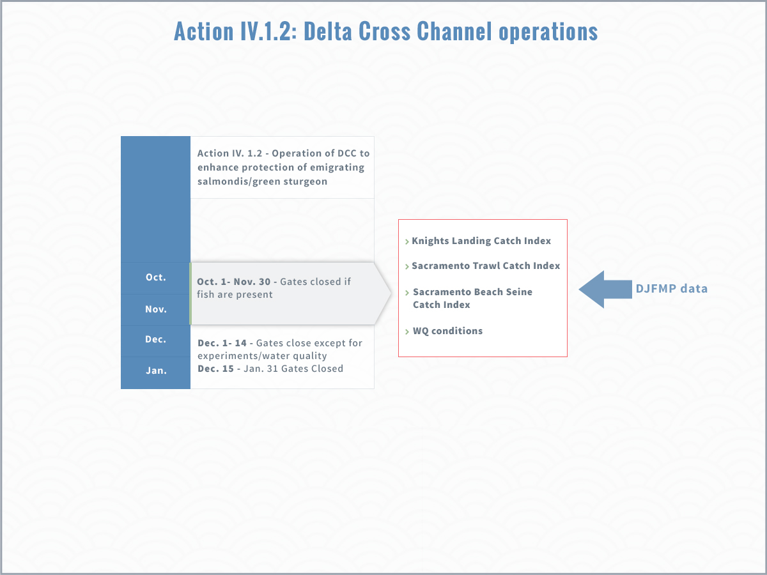
Notes:
Note that these two monitoring locations rely on DJFMP data.

Slide 48
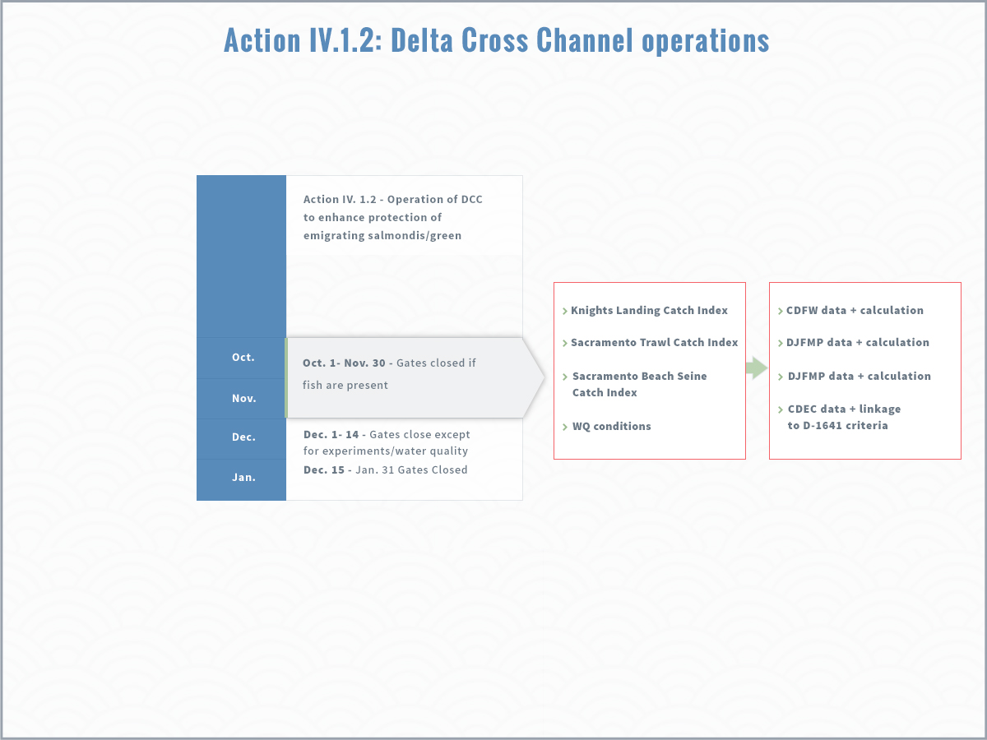
Notes:
As for the alerts, Bay Delta Live pulls data from these listed sources and summarizes on the DOSS Dashboard <go to BDL to show>

Slide 50
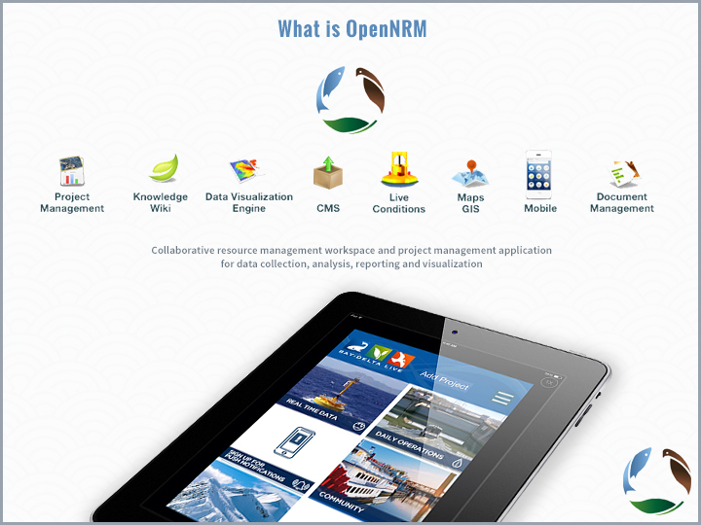

Slide 51
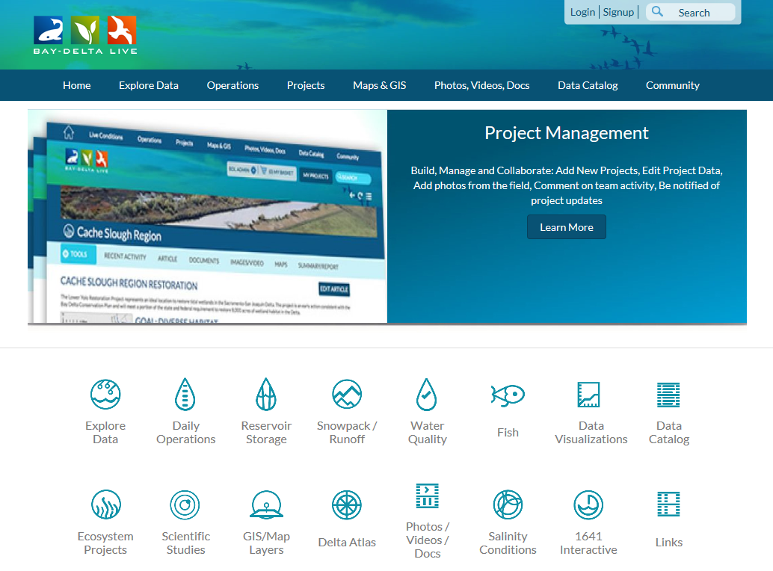
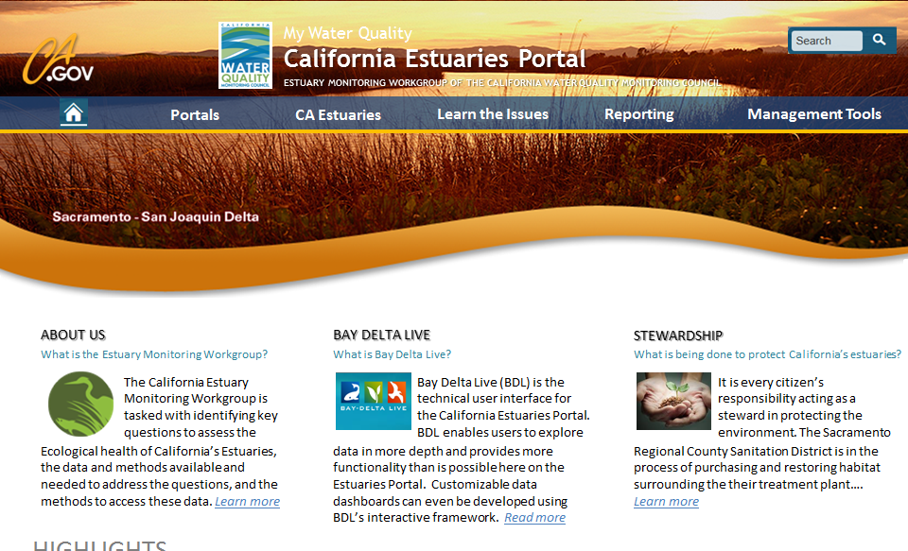

California Estuaries Portal
A product of the California Water Quality Monitoring Council’s Estuary Monitoring Workgroup, the California Estuaries Portal presents information on the health of California’s estuaries, with an initial emphasis on the San Francisco Estuary. While Bay Delta Live (BDL) serves as the technical user interface, the California Estuaries Portal brings data and information together in a single location and in an easy to understand manner for the public, environmental organizations, and water quality professionals. The goal is to make this information as timely and user-friendly as possible.

Slide 52
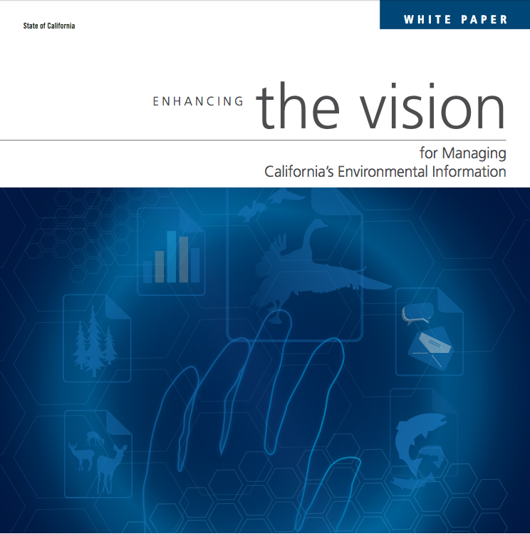
Breaking Down Silos for Improved Scientific Understanding
“Over many years, we have seen a significant investment in agencies and organizations to conduct their data management….
….[but we lack] a business model to sustain the development and maintenance of data standards, integration points, web services, and data federation to facilitate synthesis across agency and issue boundaries.”
Enhancing the Vision for Managing California’s Environmental Information 2015
Notes:
In recent years, we have recognized that to make informed management decisions, we need access to data.
These points were highlighted in the Data Summit White Paper, which emphasized that to enable synthesis across agencies and issue boundaries—a federated data system is key.

Slide 53
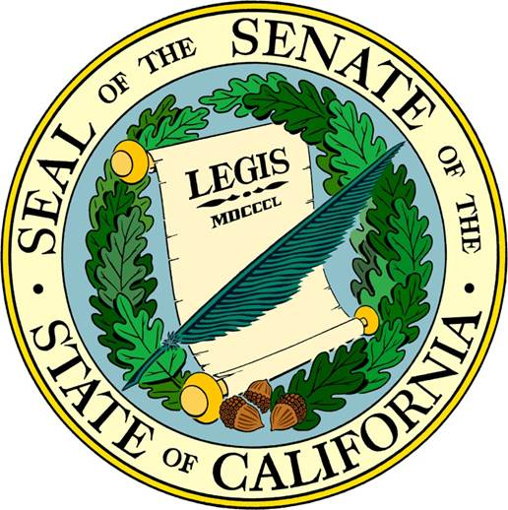
The Monitoring Council’s Mission
Improve the effectiveness of water quality and associated ecosystem monitoring and assessment
Make data and information available to decision makers and the public via the internet
Notes:
The Monitoring Council was formed in response to legislation--SB 1070, back in 2006--to address growing concerns regarding access to Water Quality and Ecosystem Health data.
In addition to data access, there was also an interest to improve coordination and to increase efficiencies among monitoring efforts in California.

Slide 54
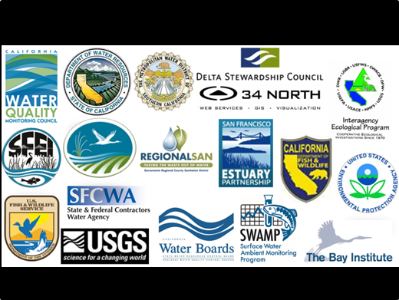
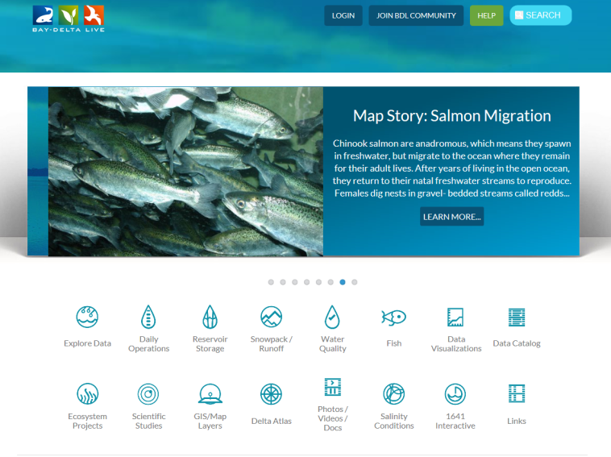
Estuaries Portal vs. Bay Delta Live?
Estuaries Portal
Information and data for various users
Make information available to the public, environmental organizations, and water quality professionals etc.
Bay Delta Live
Provides for technical user interface for the Estuaries Portal
Allows users to explore science-based data in more depth—BDL provides more functionality than is possible on the Estuaries Portal
Notes:
So what is the relationship between the Estuary Workgroup, the Estuaries Portal and Bay Delta Live?
These two efforts began independently, but have considerable overlap
Deciding to reduce redundancies and build on existing efforts, these two groups recently decided to merge efforts back in spring 2016.
How this takes shape is still to be determined; however, the Agency Working Collaboration Team has agreed to bring the Bay Delta Live effort into the existing California Estuary Monitoring Workgroup. (Slide with Umbrella, slide 6).
Moving forward, these portals will still exist separately….
The Estuaries Portal will focus on making information and data available for various users.
While BDL will really focus on publically available science-based data, real-time visual/analytical tools accessible through hand-held devices (e.g.: iPhone) and the building block for multi-agency interaction and policy decisions based on best available science.
For both efforts, the data is maintained by the originating source entity.

Slide 55
Val:
Not sure if like the title of umbrella as it
suggests that BDL is a subset of Estuary
Monitoring Group. They are linked to each
other w/differing goals as stated.
Estuary Monitoring Workgroup
Estuaries Portal
Information and data for various users
Make information available to the public, environmental organizations, and water quality professionals etc.
Bay Delta Live
Provides for technical user interface for the Estuaries Portal
Allows users to explore science-based data in more depth—BDL provides more functionality than is possible on the Estuaries Portal

Slide 56
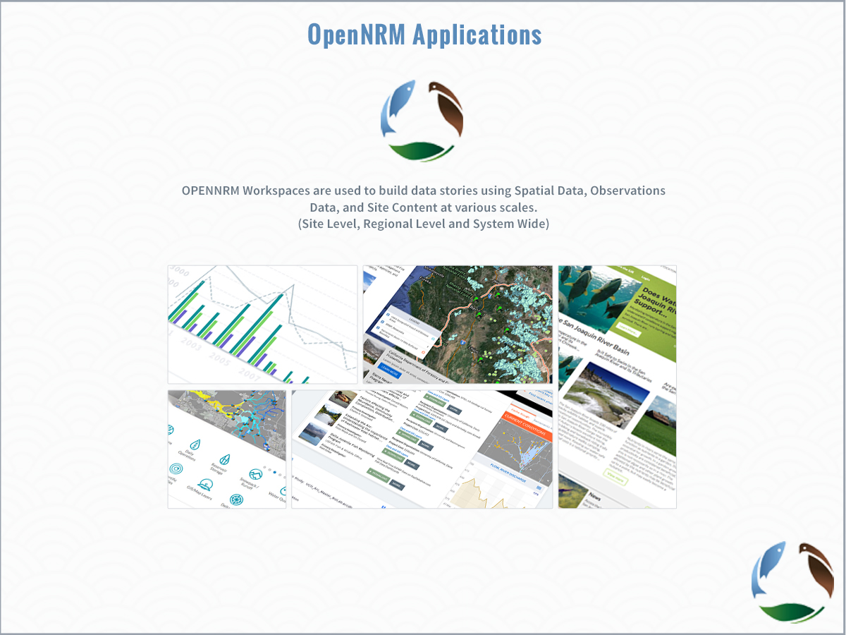

Slide 57
Projects
Projects:
  200 Projects, geo-located with key data, documents, images, videos and GIS.
  Demonstrate Cache Collaborative Projects, Info Hub and Current Conditions. *Info hub and key aspects of this project are scheduled for release at Delta Science conference 11/15.
  Plans for the future: moving from project tracking to implementation.
  BDL/CEMW repository for images, reports, documents, GIS.
  Show how to search, access, add

Slide 58
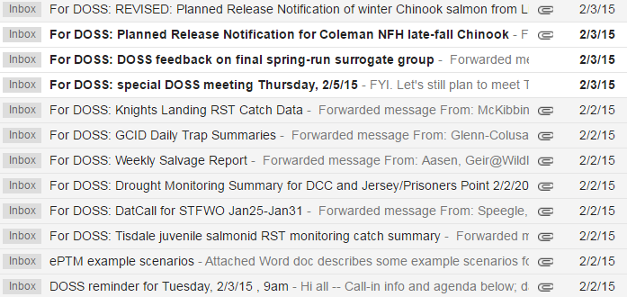


Data distribution to DOSS currently occurs via e-mail
Notes:
Because of the many different sources of data currently reviewed by DOSS, and because many of the monitoring data are prelim data shared by e-mail and not posted online, current data distribution to DOSS is via a batch of e-mails sent on Monday afternoons before the Tuesday DOSS meeting. This is functional, but could be more efficient.

Slide 59
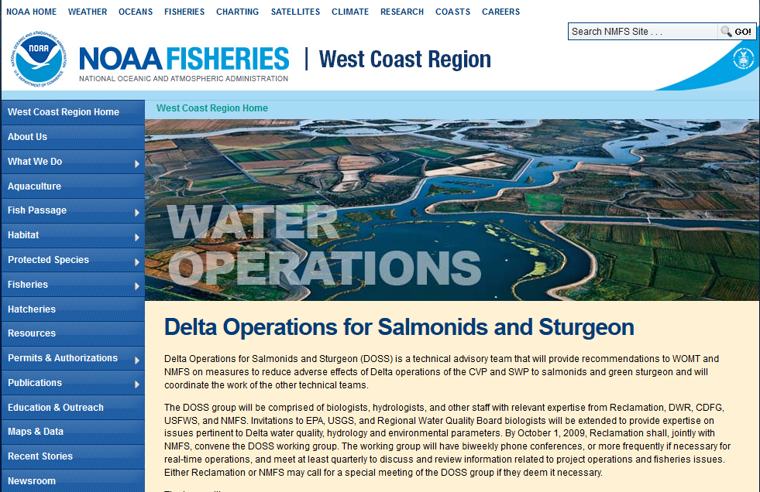
DOSS Technical Team
Created by the 2009 Biological Opinion on Long-term Operations of the CVP and SWP (2009 NMFS BiOp)
Tracks implementation of Delta actions in the Reasonable and Prudent Alternative (RPA)
Member agencies include:
    Reclamation
    FWS
    NMFS
    DWR
    DFW
    SWRCB
    EPA
    USGS
http://www.westcoast.fisheries.noaa.gov/central_valley/water_operations/doss.html
Notes:
DOSS was created by the 2009 NMFS BiOp, and this technical team tracks Delta RPA actions and provides advice as needed. DOSS includes participants from 8 member agencies; I am the DOSS lead for NMFS.

Slide 60
Data distribution to DOSS currently occurs via e-mail
CENTRALIZE with Bay Delta Live’s DOSS Dashboard!
Notes:
Bay Delta Live provides a centralized location for all data streams and provides key summary measures relevant for 2009 NMFS BiOp implementation.
This centralization and summarization is also of value for groups other than DOSS.

Slide 61
Projects
There are currently more than 300 + projects available between CEMW and BDL.
Build projects online
  Using standard metadata
  Project database can be updated by program
Add images, videos, maps, datasets, articles.
Invite team members, keep private, make public.
Syndicate projects to state sites and other portals.

Slide 62
Projects
Upload GIS and create interactive maps.
Use existing datasets to build saved data views for implementation and monitoring.
Share data with team members.
Monitor and Track

Slide 63
DOSS reports out to multiple groups
 | Monday | Tuesday | Wednesday | Thursday | Friday
Morning |  | DOSS |  | DAT | DCT
Afternoon |  | WOMT
DOSS: Delta Operations for Salmonids and Sturgeon
-- agency technical staff
WOMT: Water Operations Management Team
-- agency management and some agency technical staff
DAT: Data Assessment Team
-- stakeholders
DCT: Delta Conditions Team
-- stakeholders
Notes:
This table shows the typical schedule of Delta ops-related meetings during Oct – June, which is the period of highest activity for DOSS (is when ESA-listed species under NMFS jurisdiction are likely to be present in the Delta).
I provide a verbal or written DOSS report to the three meetings that happen after DOSS, listing any alerts or action responses triggered and presenting the highlights of the various DOSS data streams. Detailed data is available to participants only if they receive the data via e-mail, or if they go seek it out, e.g. on CDEC. SO, having a common data hub that allows interested parties to see all the data reviewed by DOSS is very useful and improves efficiency for agency staff and stakeholders.
Before we demo the BDL website, I want to provide a specific example of a data-intensive RPA action for which the DOSS Dashboard provides streamlining.

Slide 64
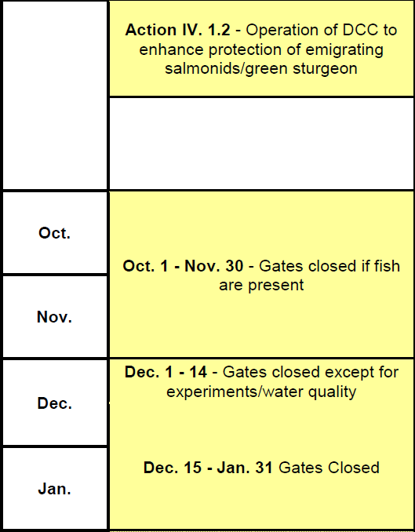
Action IV.1.2: Delta Cross Channel operations
Notes:
Action IV.1.2 of the RPA provides guidelines for Delta Cross Channel oeprations. Before Dec 15th, the DCC gates may be open unless certain conditions are met. DOSS tracks those conditions, which consist of a set of “alerts” and also a set of triggers that may require DCC closure.

Slide 65
Action IV.1.2: Delta Cross Channel operations
ALERTS
Mill Creek flow (absolute value and % change)
Deer Creek flow (absolute value and % change)
Wilkins slough flow (absolute value) and water temperature
Notes:
During this fall period, there are various alerts that are considered indicators of potential fish movement and “alert” mangers that DCC operations might be necessary in the near future. The alerts include Deer Creek and Mill Creek flows, as well as Wilkins slough flow and KL temps.

Slide 66
Action IV.1.2: Delta Cross Channel operations
ALERTS
Mill Creek flow (absolute value and % change)
Deer Creek flow (absolute value and % change)
Wilkins slough flow (absolute value) and water temperature
CDEC data (MLM)
CDEC data (DCV)
CDEC data (WLK) and CDFW data (from Knights Landing RST data sheets)
Notes:
Bay Delta Live pulls data from these listed sources and summarizes on the DOSS Dashboard <go to BDL to show>

Slide 67
Action IV.1.2: Delta Cross Channel operations
Knights Landing Catch Index
Sacramento Trawl Catch Index
Sacramento Beach Seine Catch Index
WQ conditions
Notes:
The triggers that may require DCC gate closure rely on fish catch at several key monitoring locations, and on WQ conditions. The catch info comes from KL, the Sac Trawl, and the beach seines. WQ conditions are monitored by the Projects, not by DOSS, and relate to requirements in D-1641.

Slide 68
Action IV.1.2: Delta Cross Channel operations
Knights Landing Catch Index
Sacramento Trawl Catch Index
Sacramento Beach Seine Catch Index
WQ conditions
DJFMP data
Notes:
Note that these two monitoring locations rely on DJFMP data.

Slide 69
Action IV.1.2: Delta Cross Channel operations
Knights Landing Catch Index
Sacramento Trawl Catch Index
Sacramento Beach Seine Catch Index
WQ conditions
CDFW data + calculation
DJFMP data + calculation
DJFMP data + calculation
CDEC data + linkage to D-1641 criteria
Notes:
As for the alerts, Bay Delta Live pulls data from these listed sources and summarizes on the DOSS Dashboard <go to BDL to show>

Slide 70
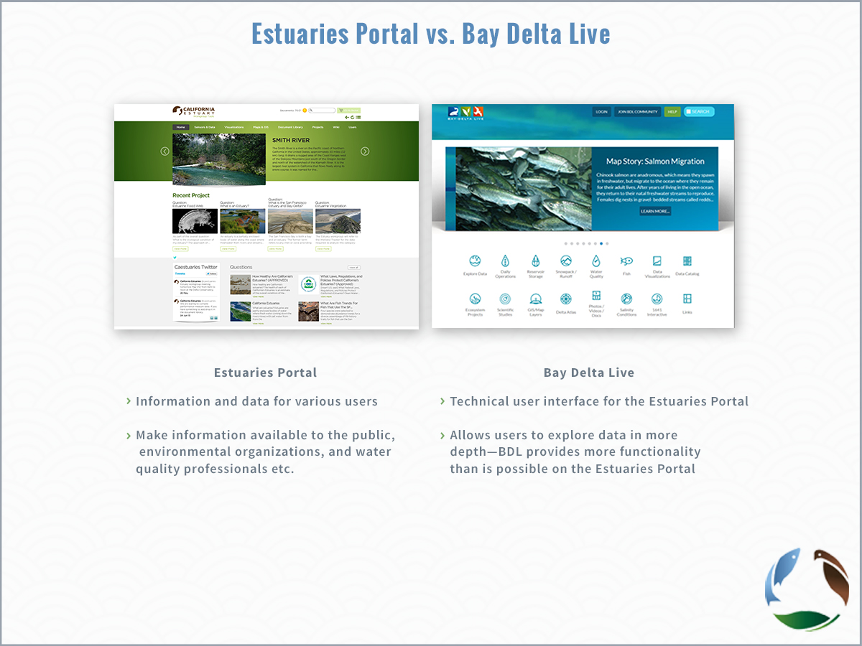

Slide 71
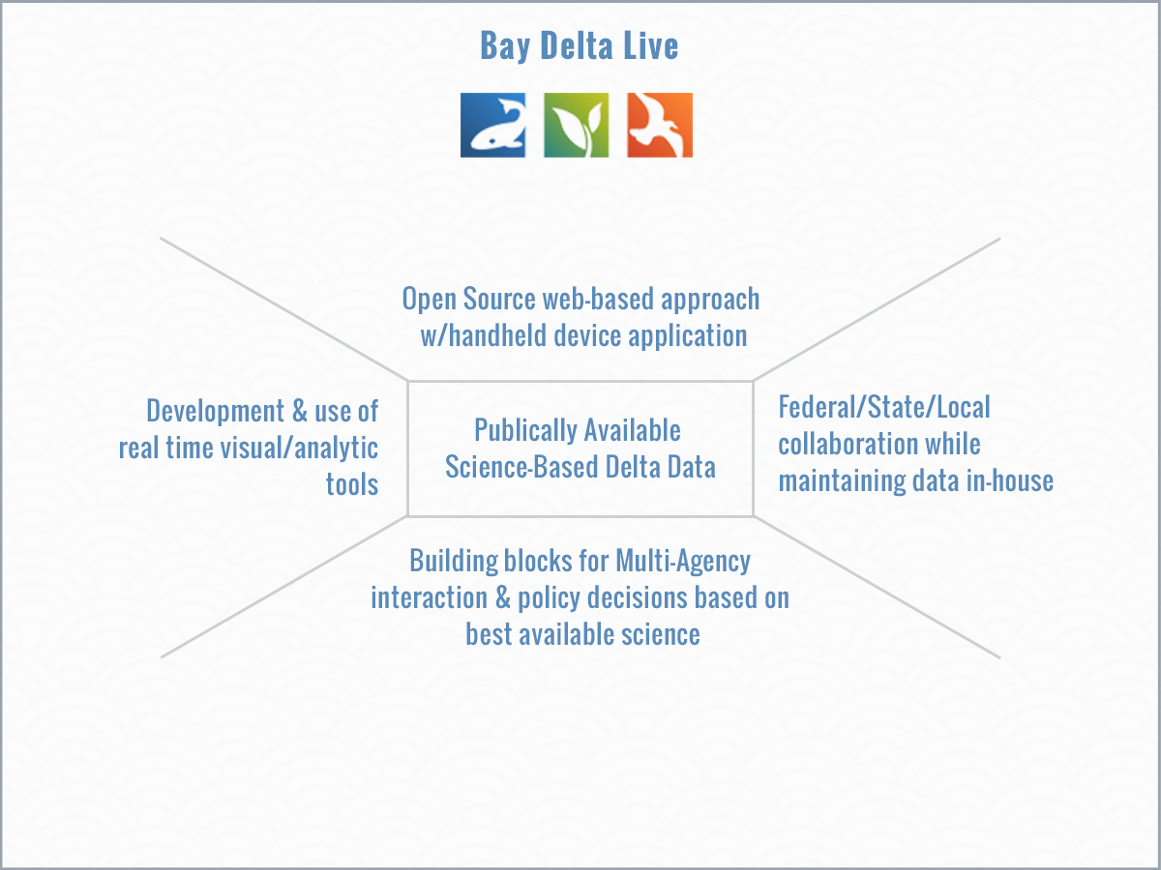

Slide 72

Notes:
As most of you already know, the Monitoring Council has created a number of theme specific portals that seek to make publically published data available to decision makers—focusing on topics such as….. (see slide)
For the purpose of today’s presentation, we’ll focus on those efforts relevant to the Bay Delta—specifically those toolsets developed by 34North for the California Estuaries Portal and Bay Delta Live.

