Slide 1
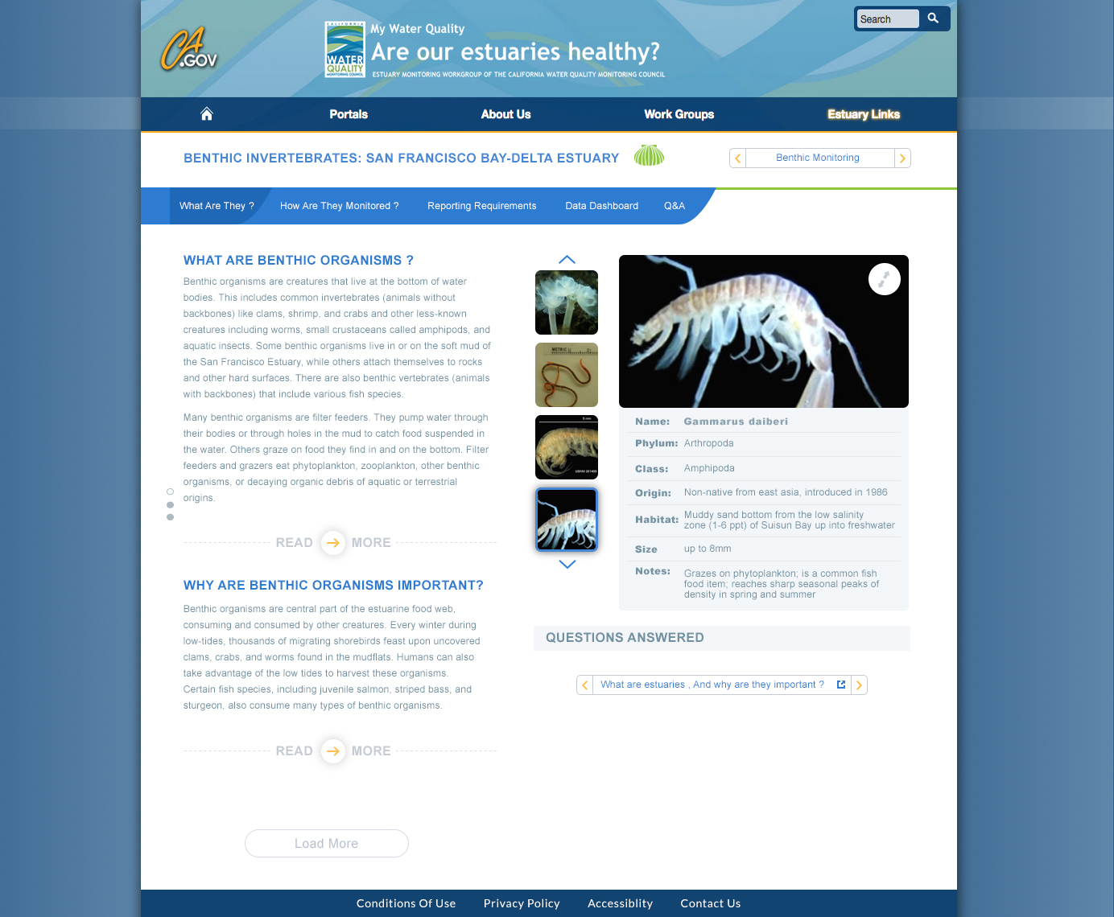
Design 1: Benthic What? (A)
Notes:
Set up a species database for the viewer widget

Slide 2
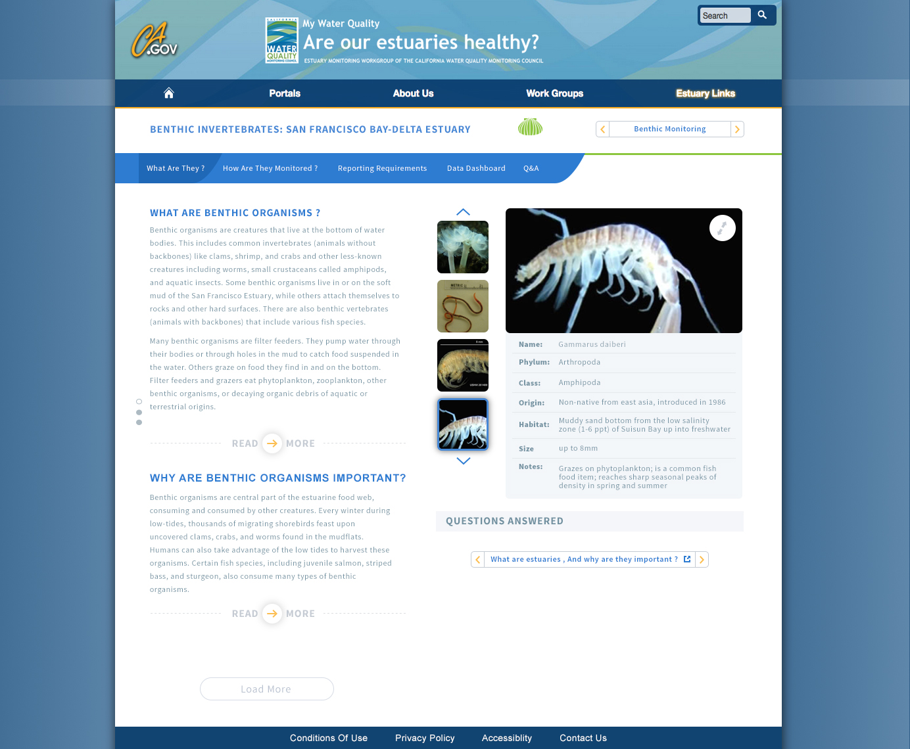
Design 1: Benthic What? (P)
Notes:
Set up a species database for the viewer widget

Slide 3
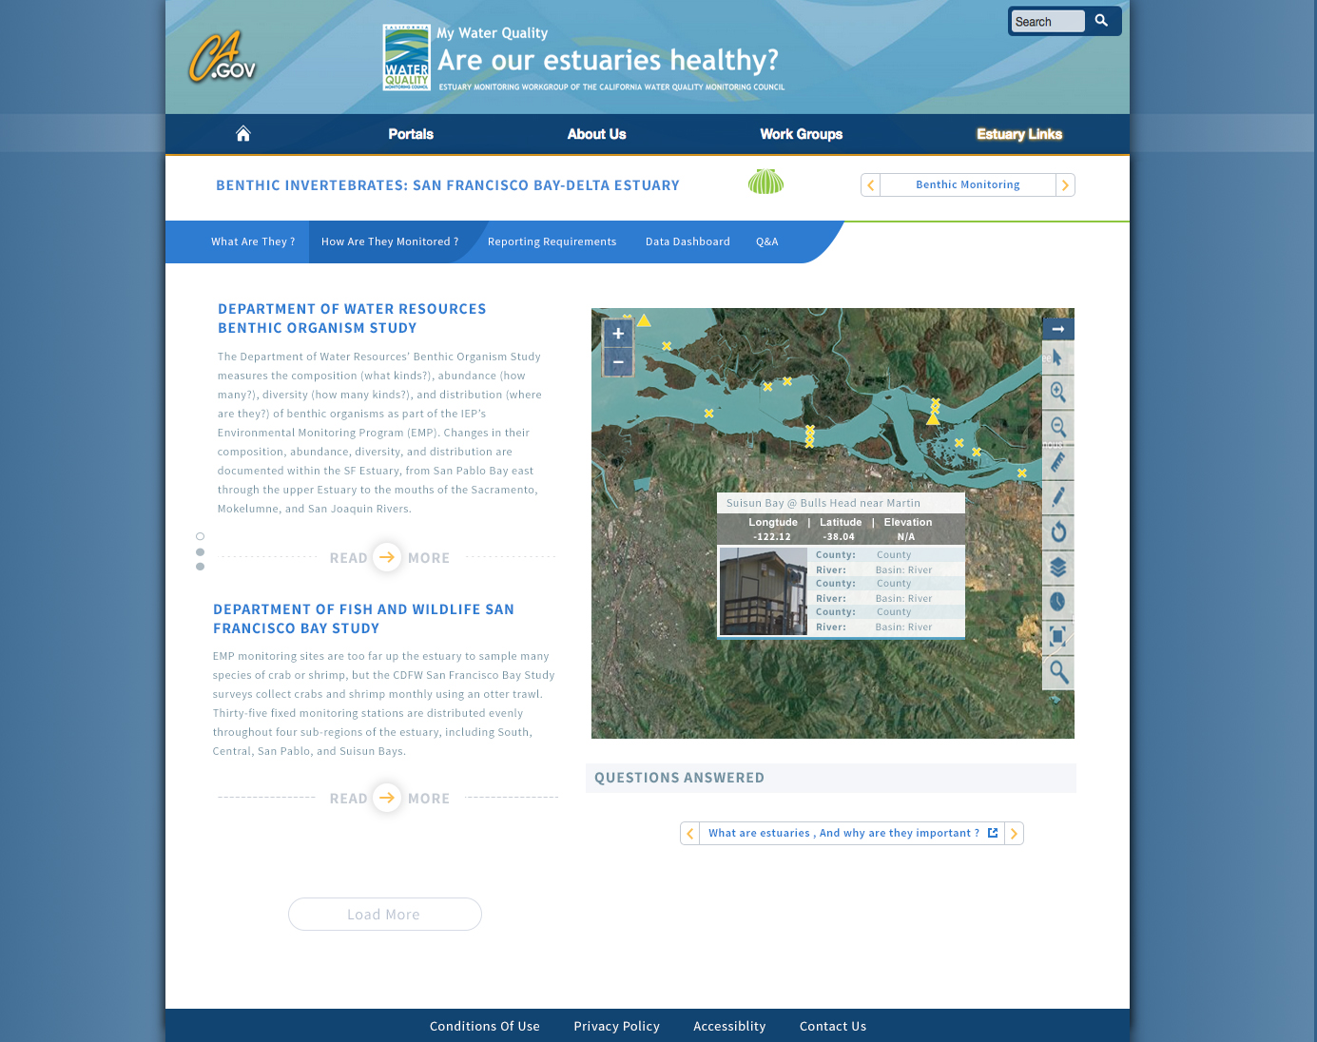
Design 1: Benthic How?

Slide 4
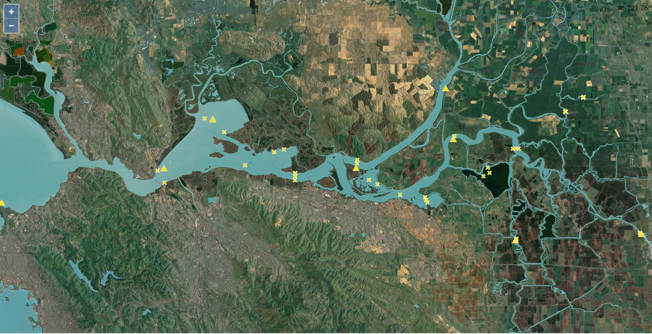
EMP: Benthic

Slide 5
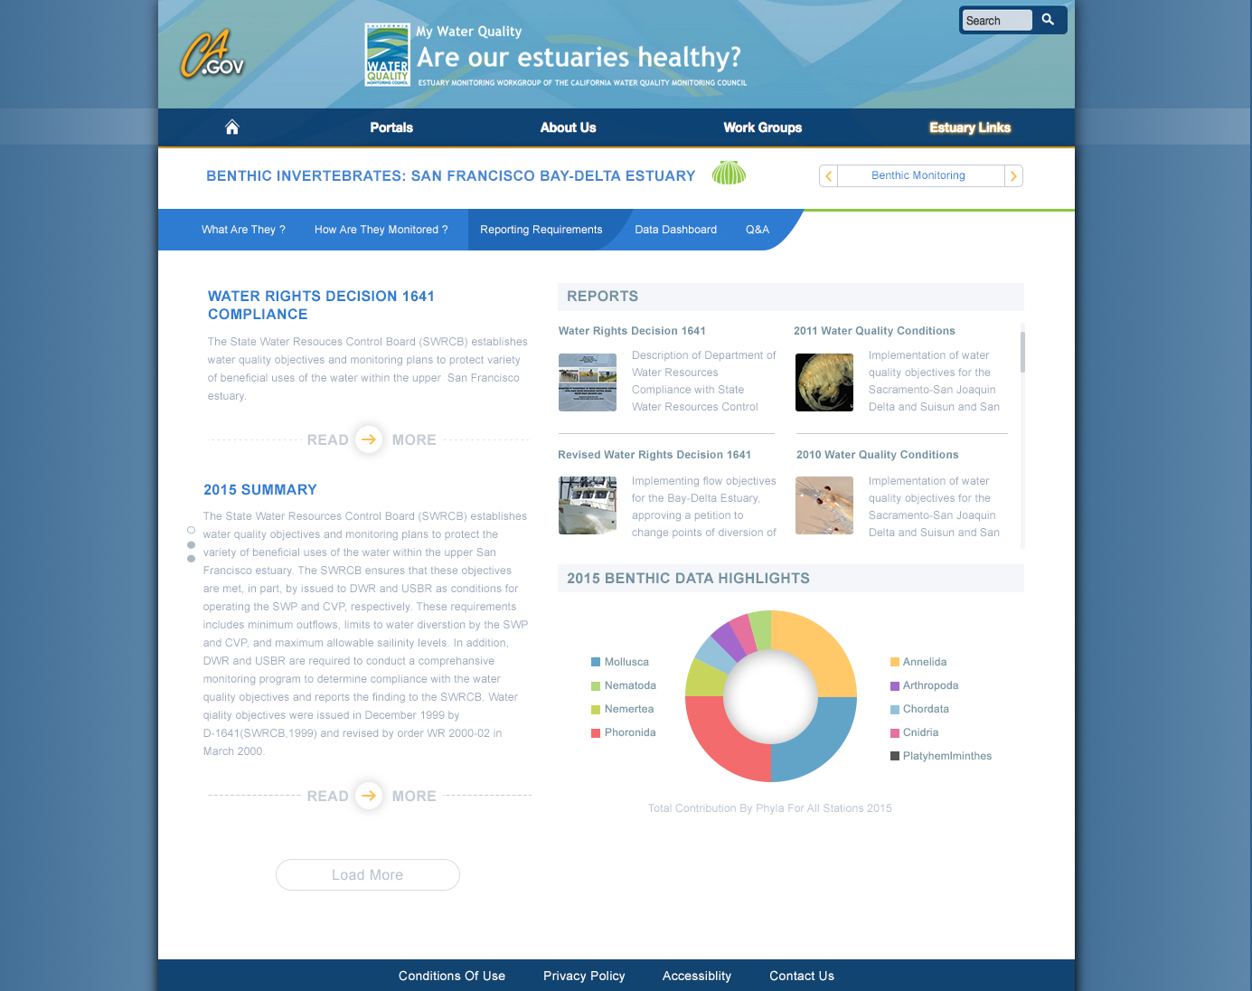
Design 1: Benthic Reporting? (PS)
Notes:
Pro-Source Sans

Slide 6

Design 1: Benthic Reporting (A)
Notes:
Arial

Slide 7
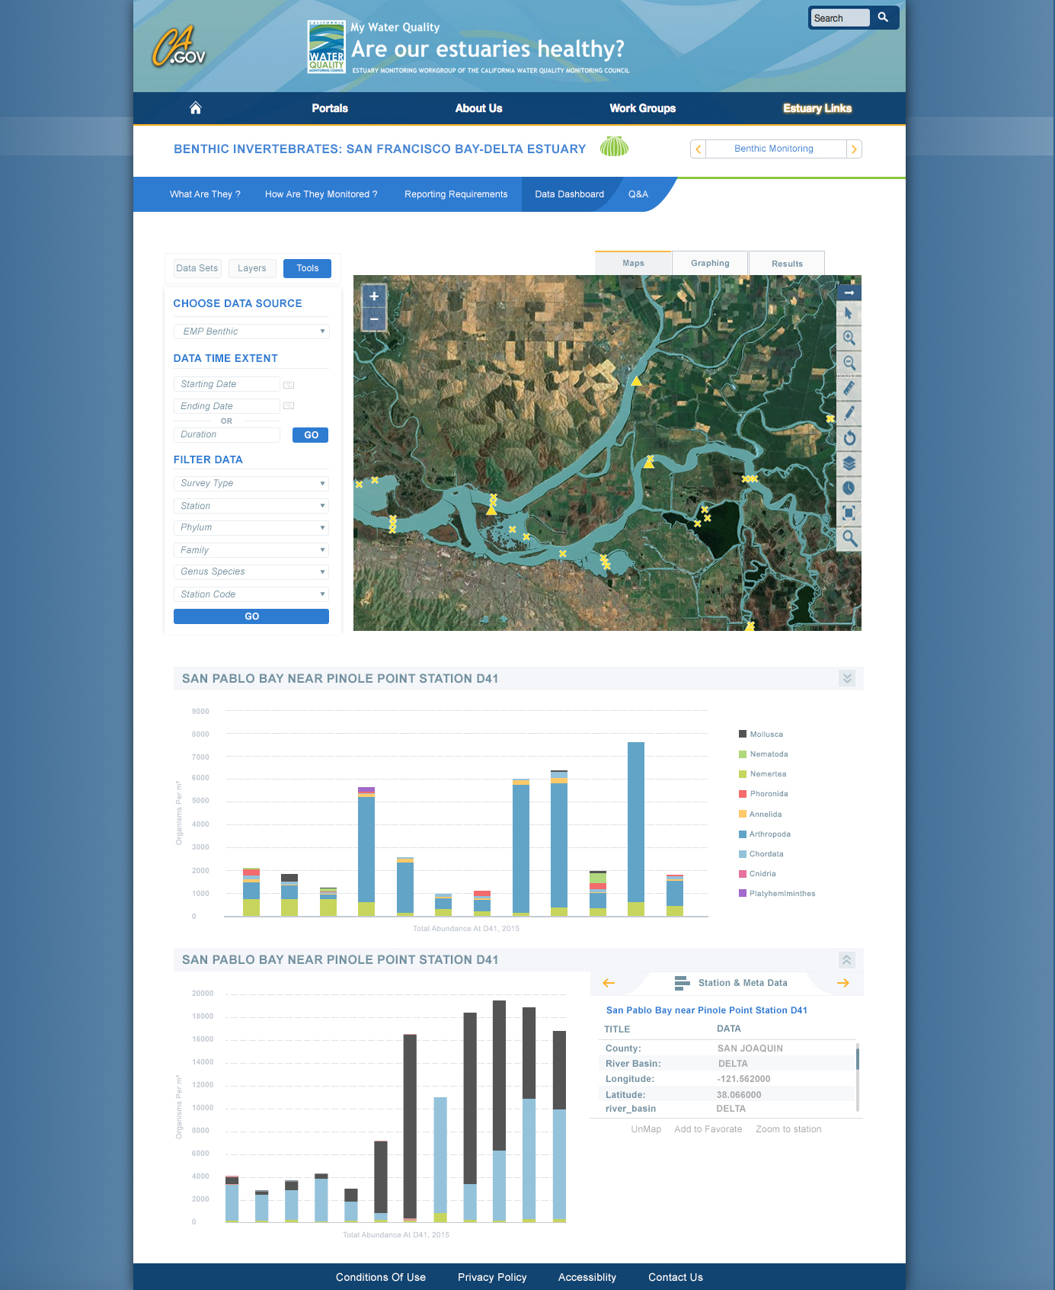
Design 1: Benthic Dashboard

Slide 8
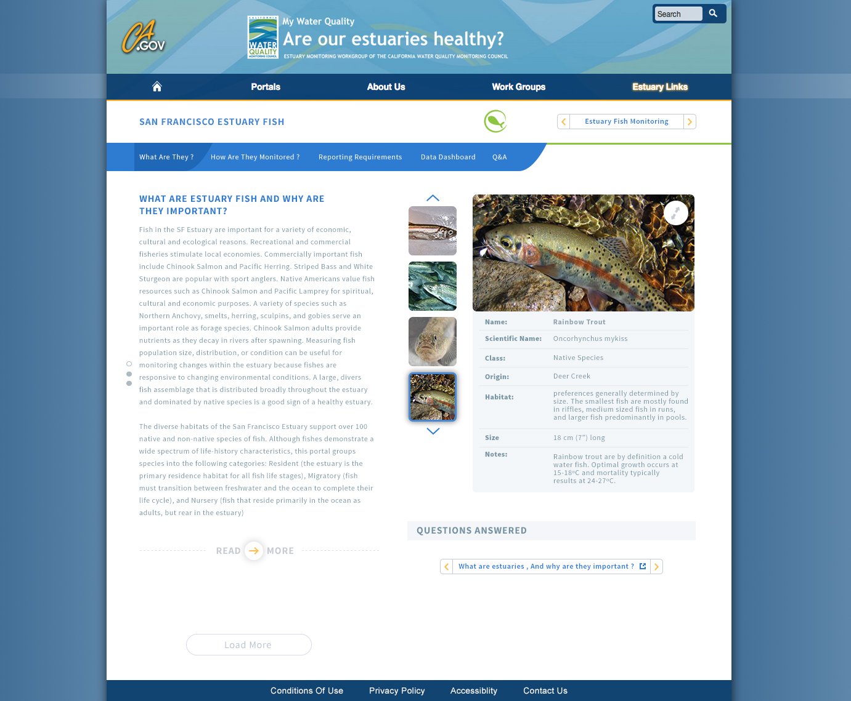
Design 1: Fish What?

Slide 9
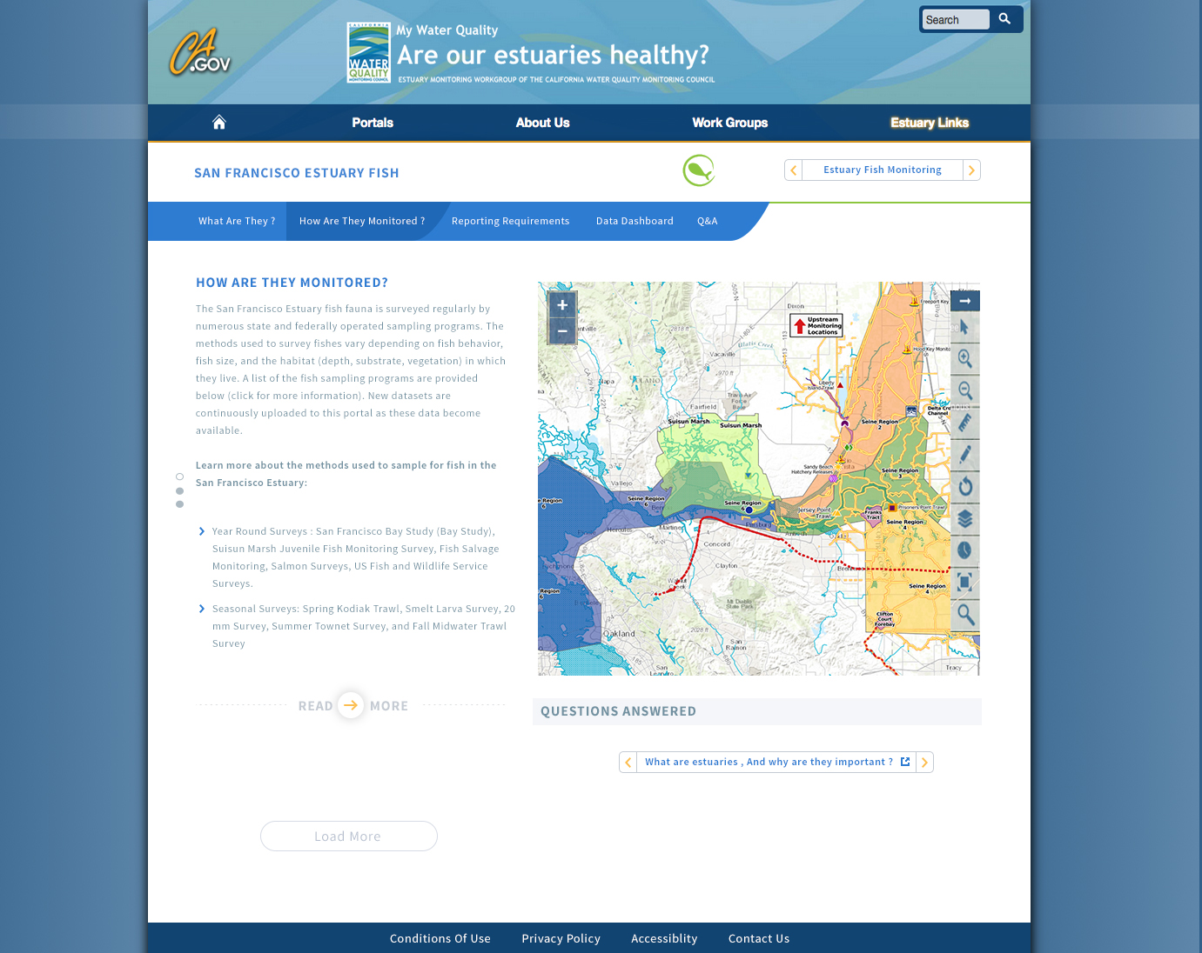
Design 1: Fish How?

Slide 10
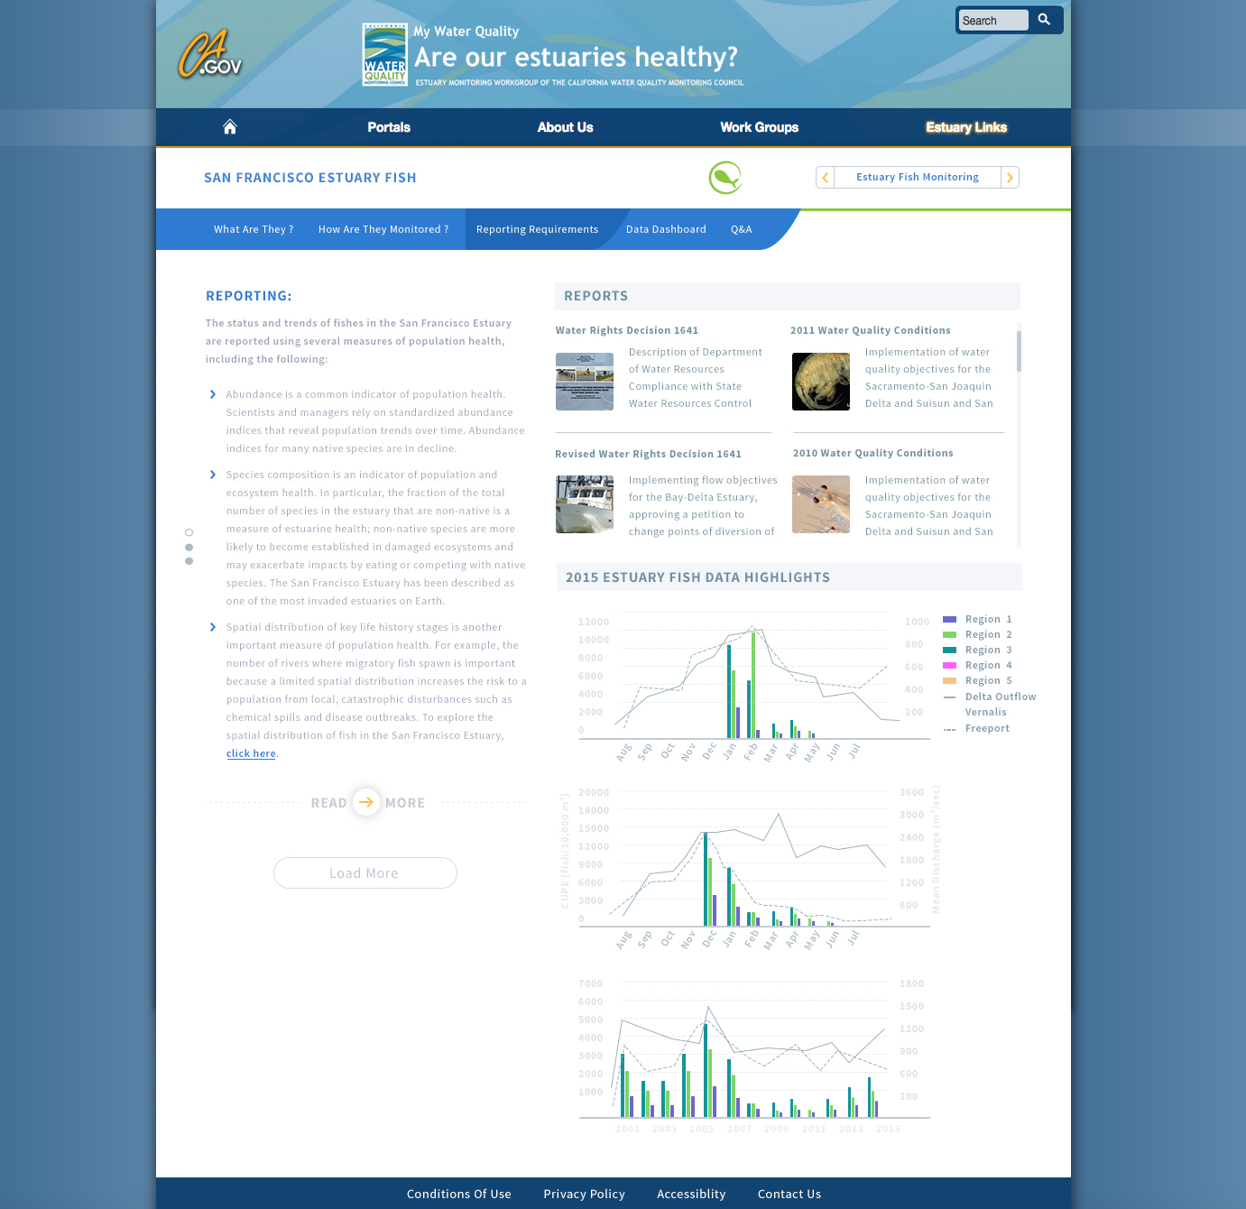
Design 1: Fish Reporting?

Slide 11
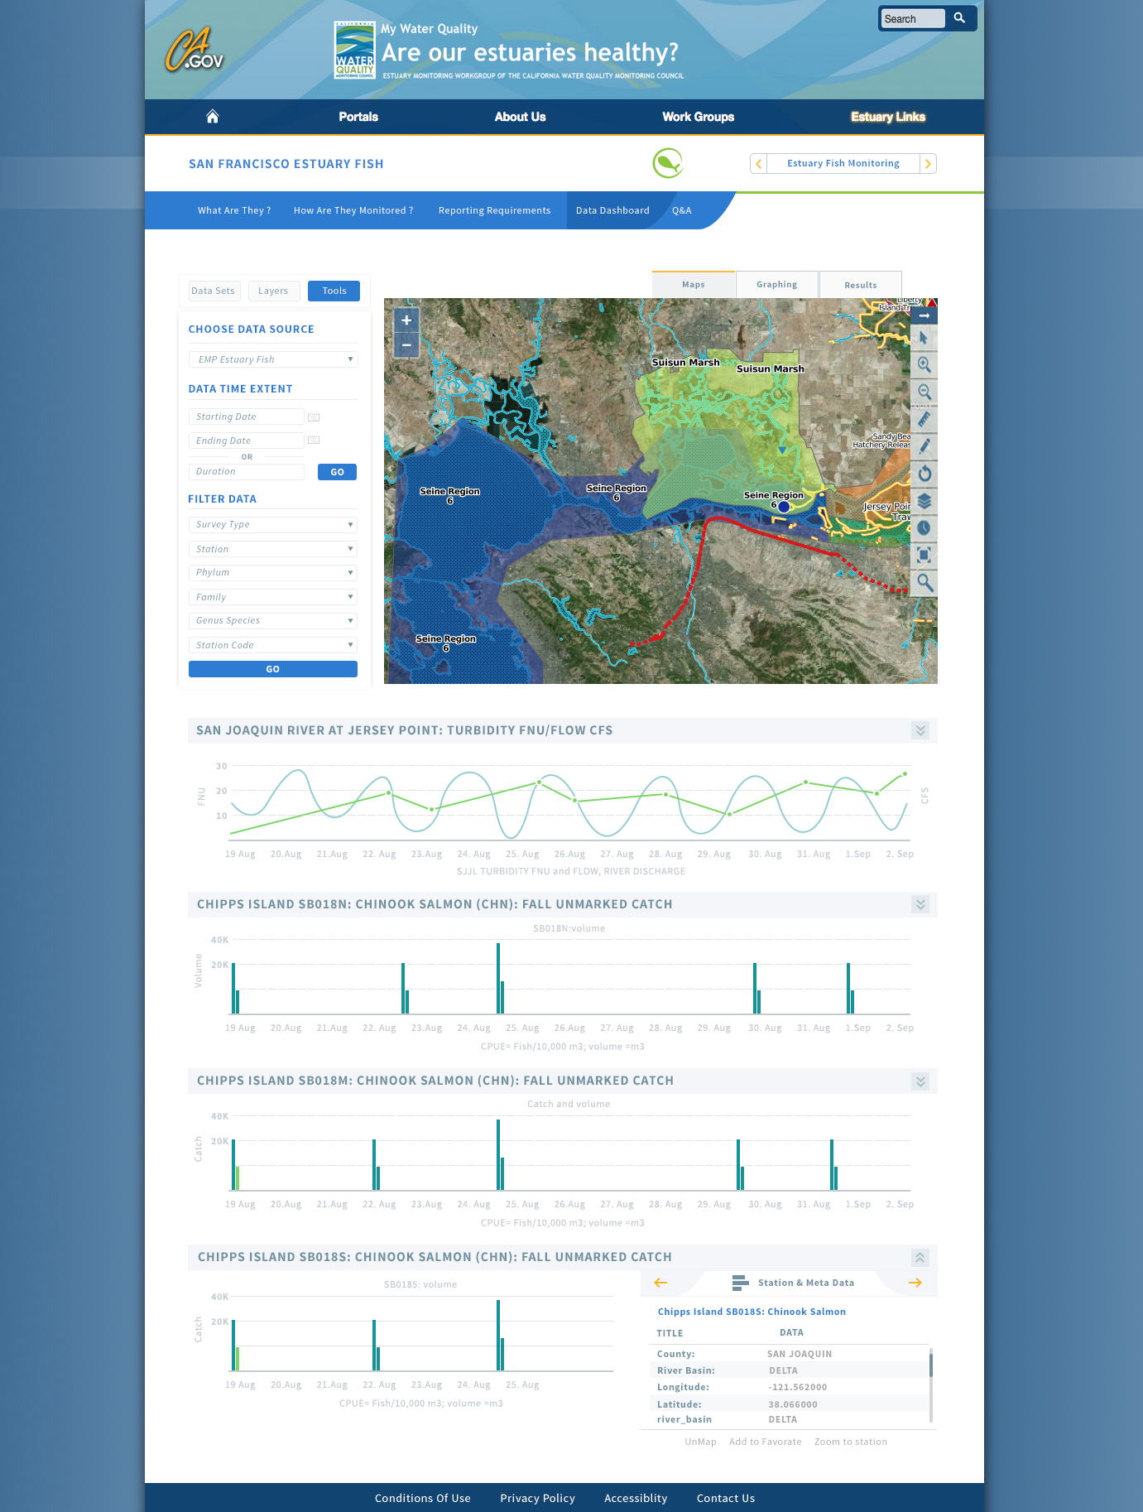
Design 1: Dashboard

Slide 12
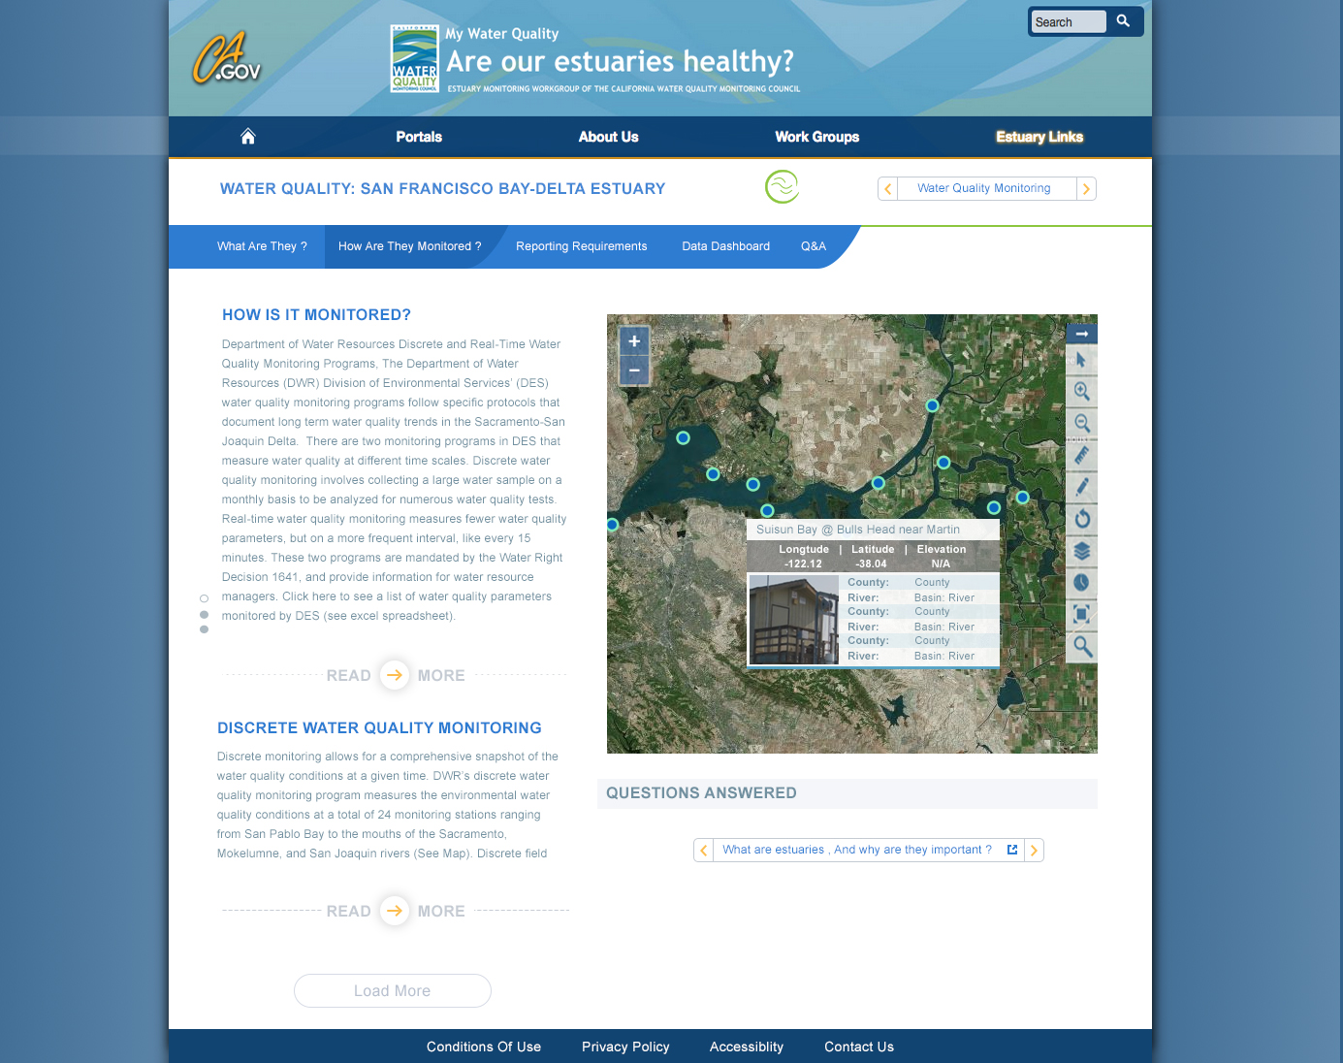
Design 1: WQ How?

Slide 13
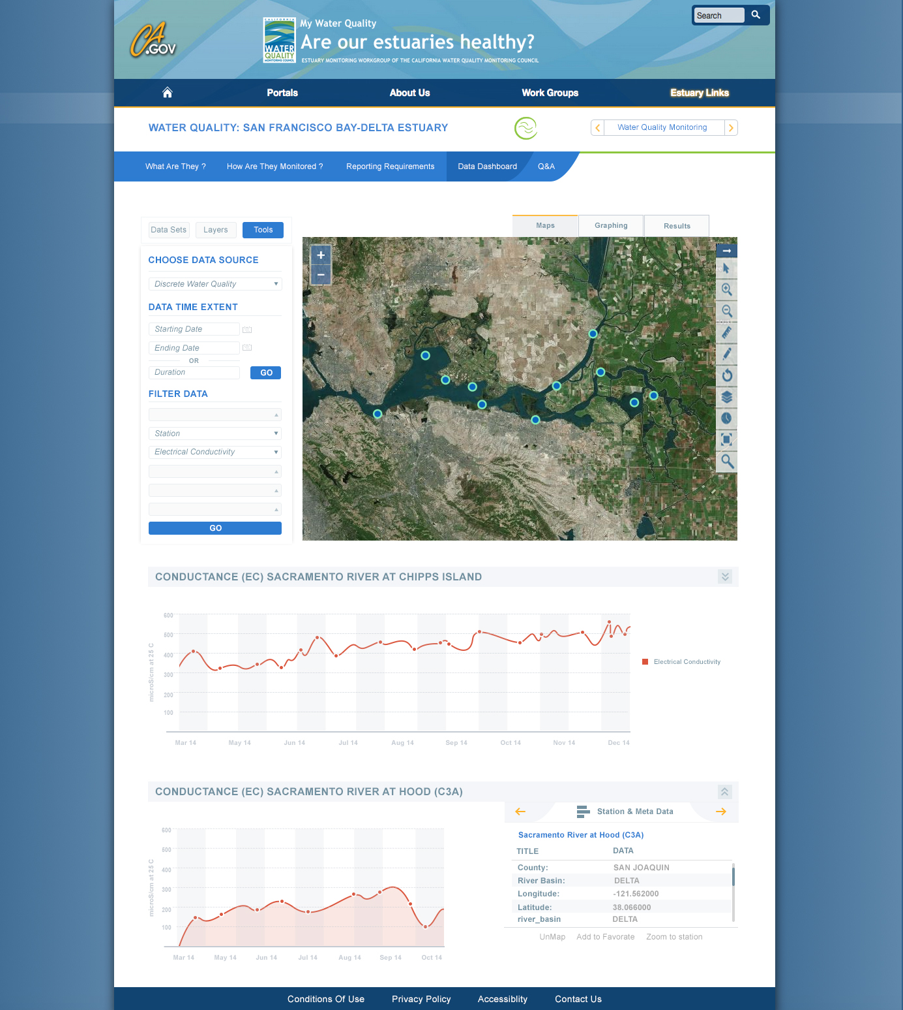
Design 1: WQ Dashboard?

