Slide 1
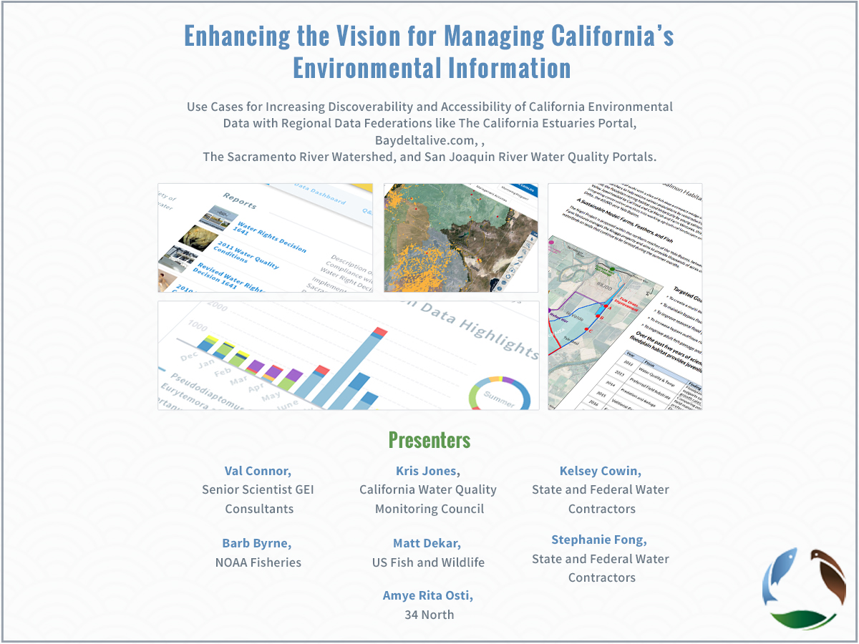

Slide 2
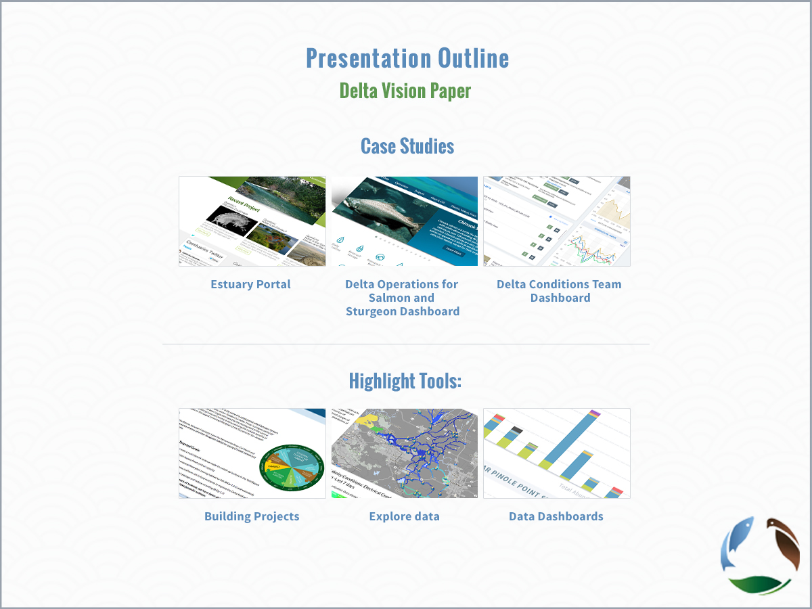

Slide 3
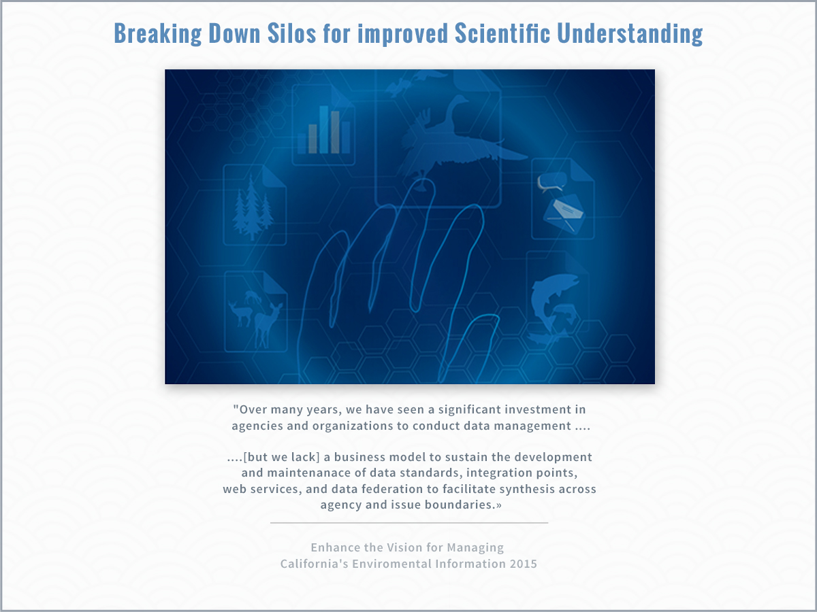

Slide 4
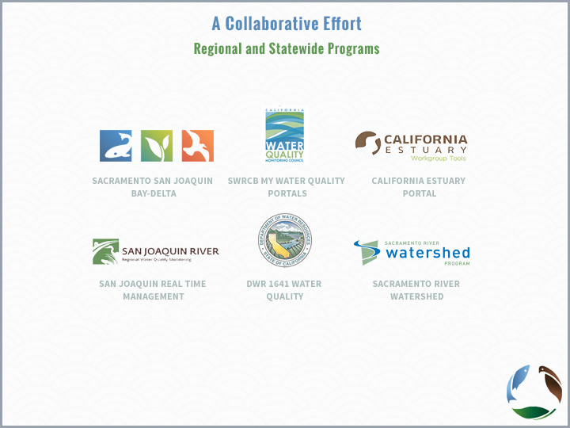

Slide 5
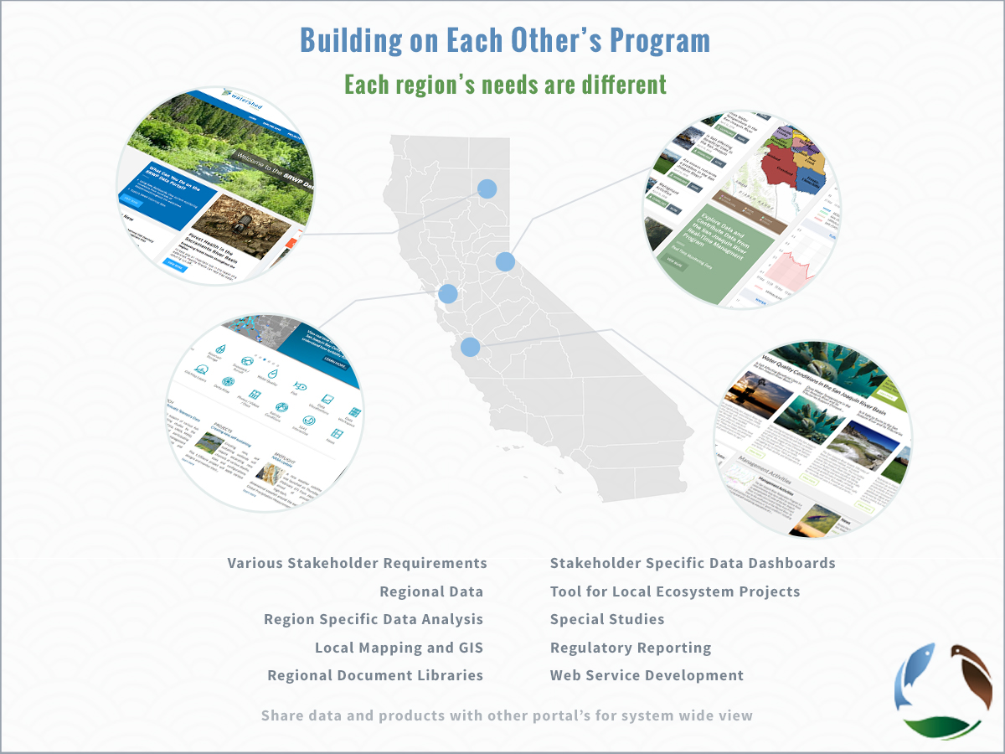

Slide 6
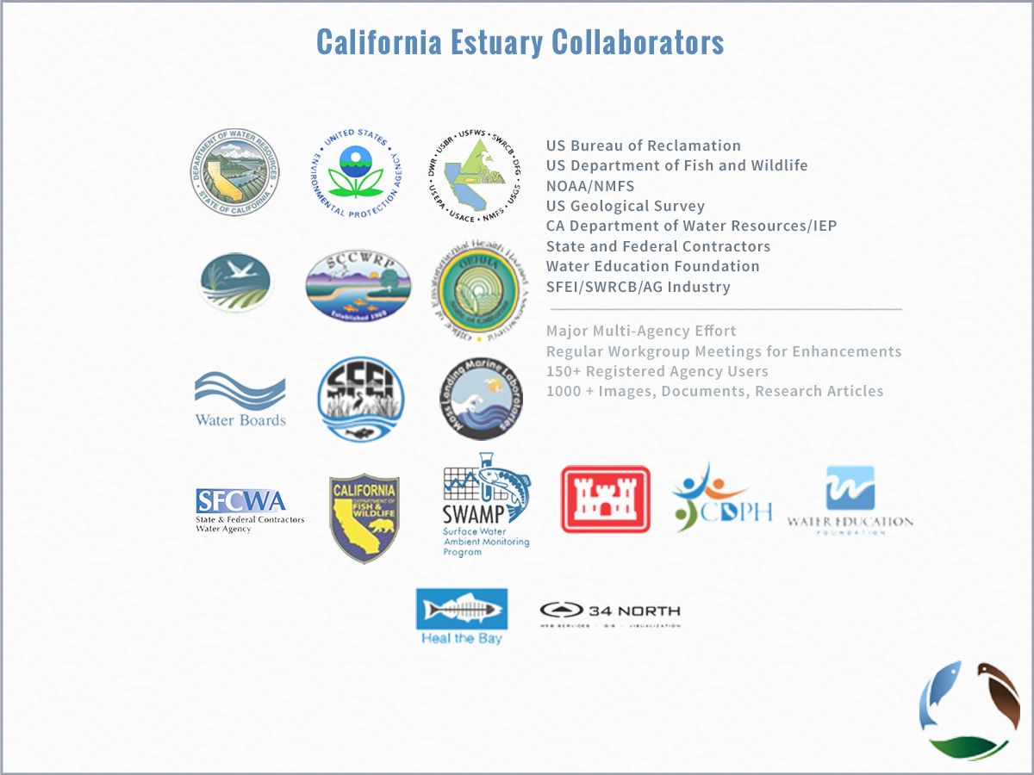

Slide 7
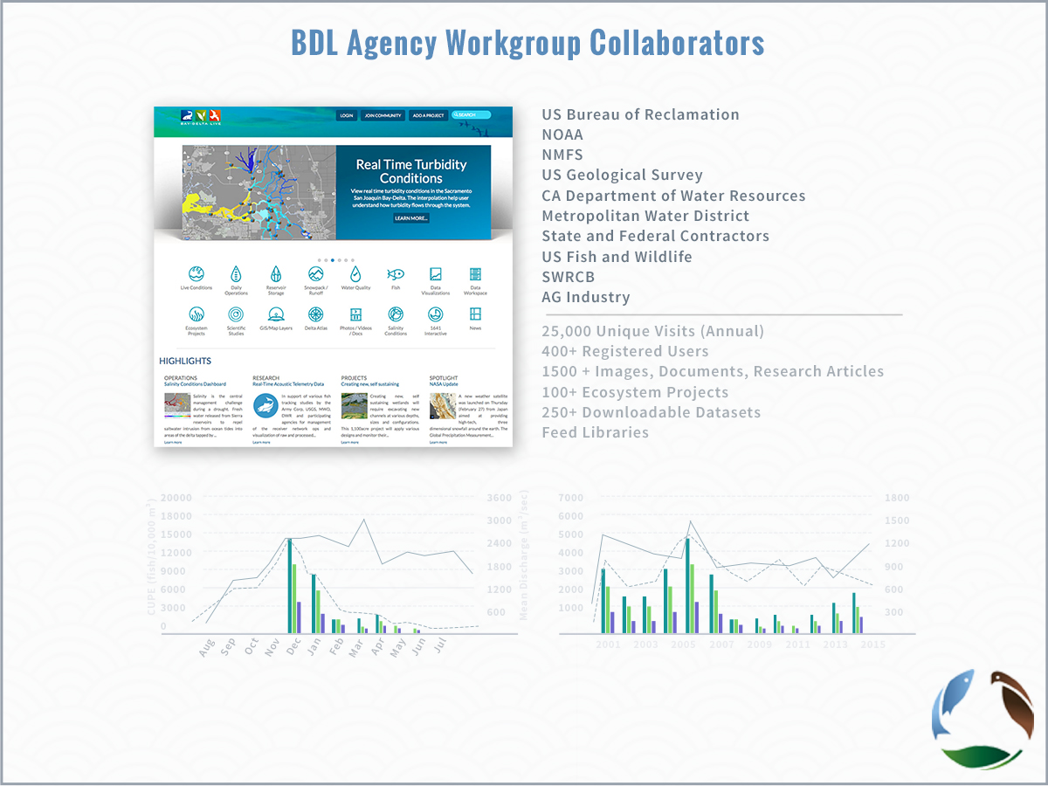

Slide 8
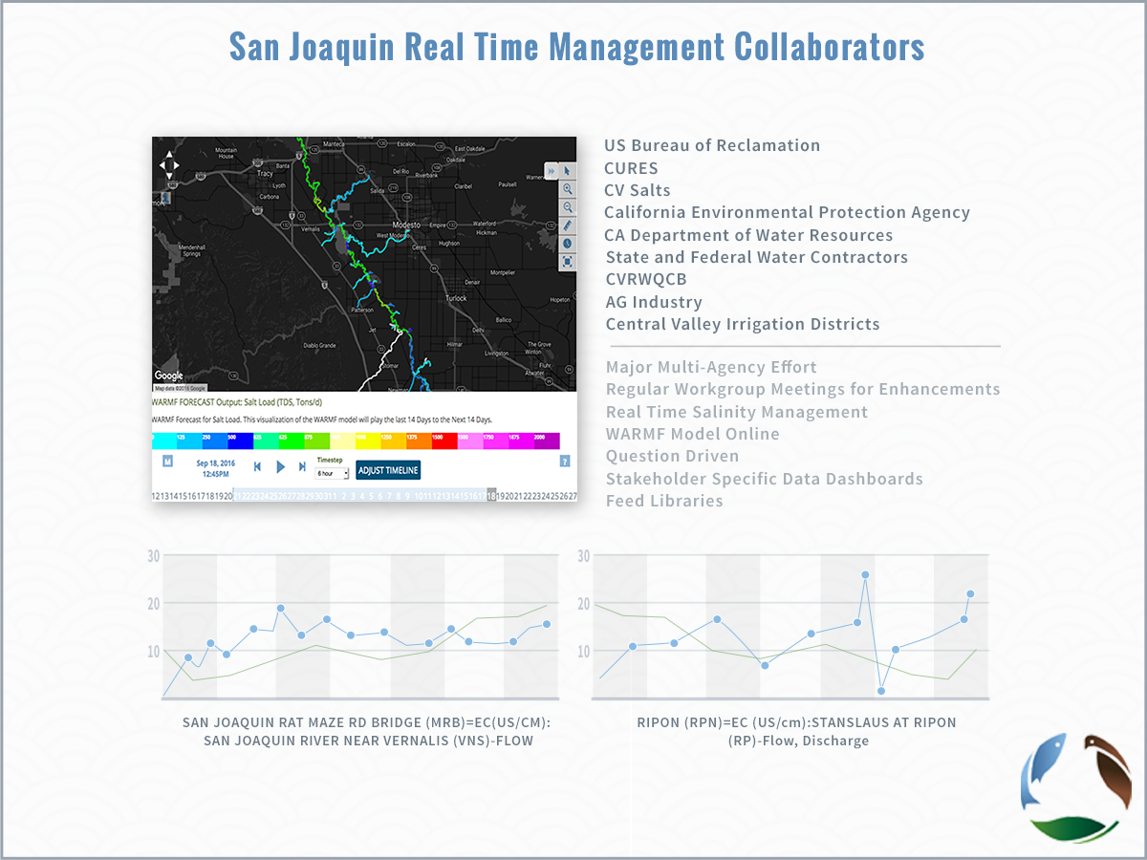

Slide 9
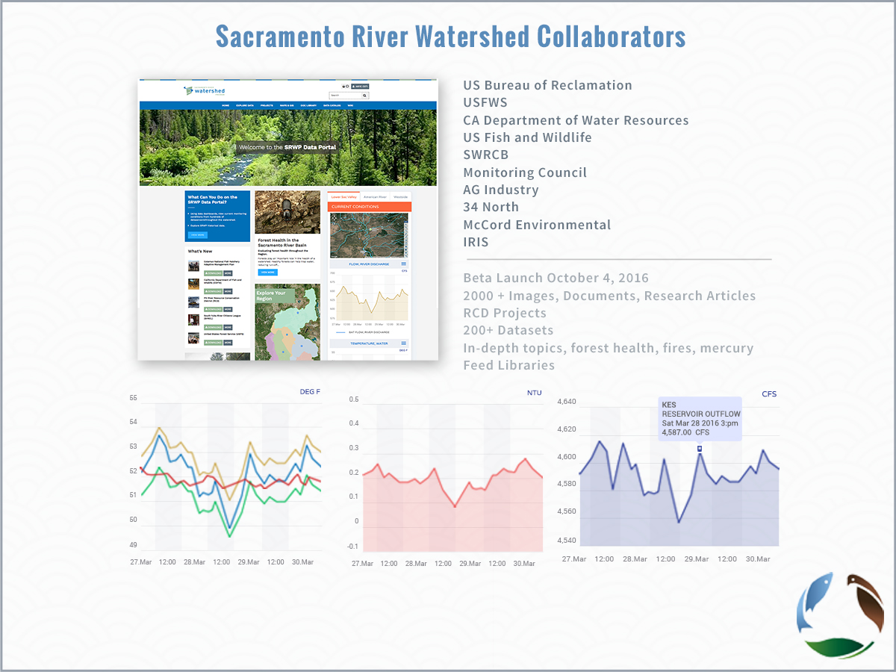
SRWP Collaborators

Slide 10
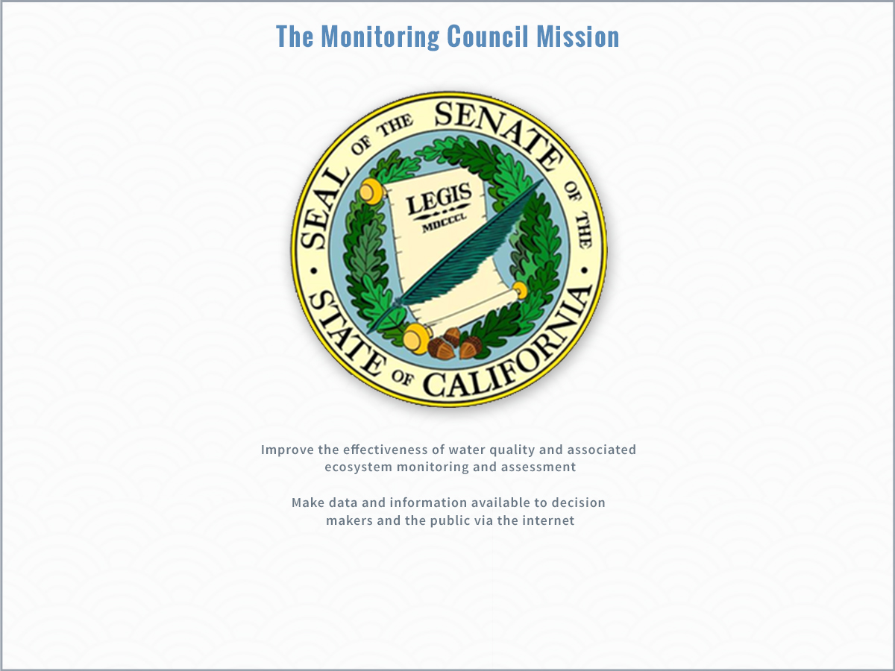

Slide 11
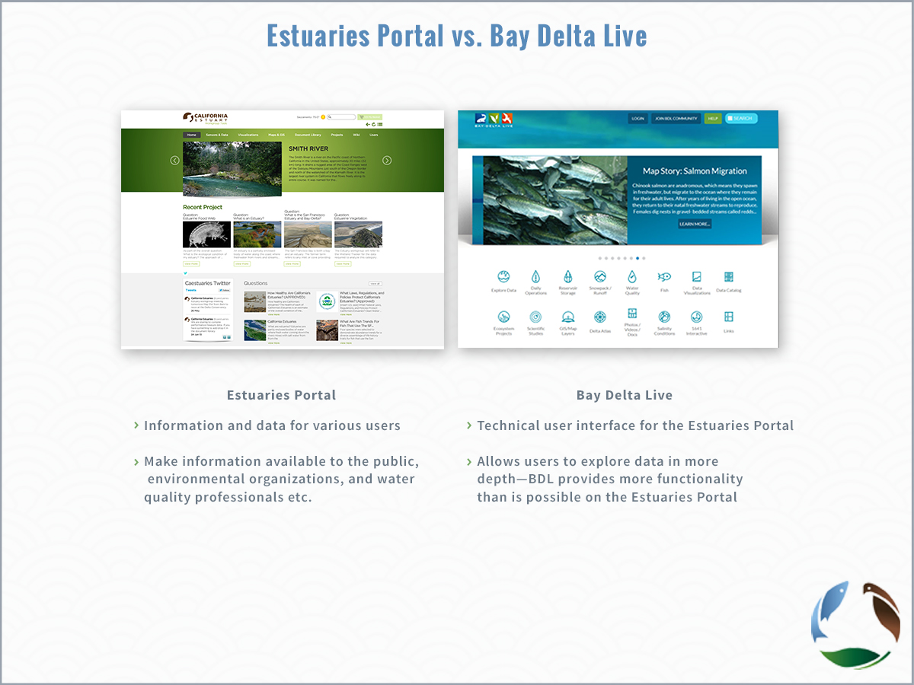

Slide 12
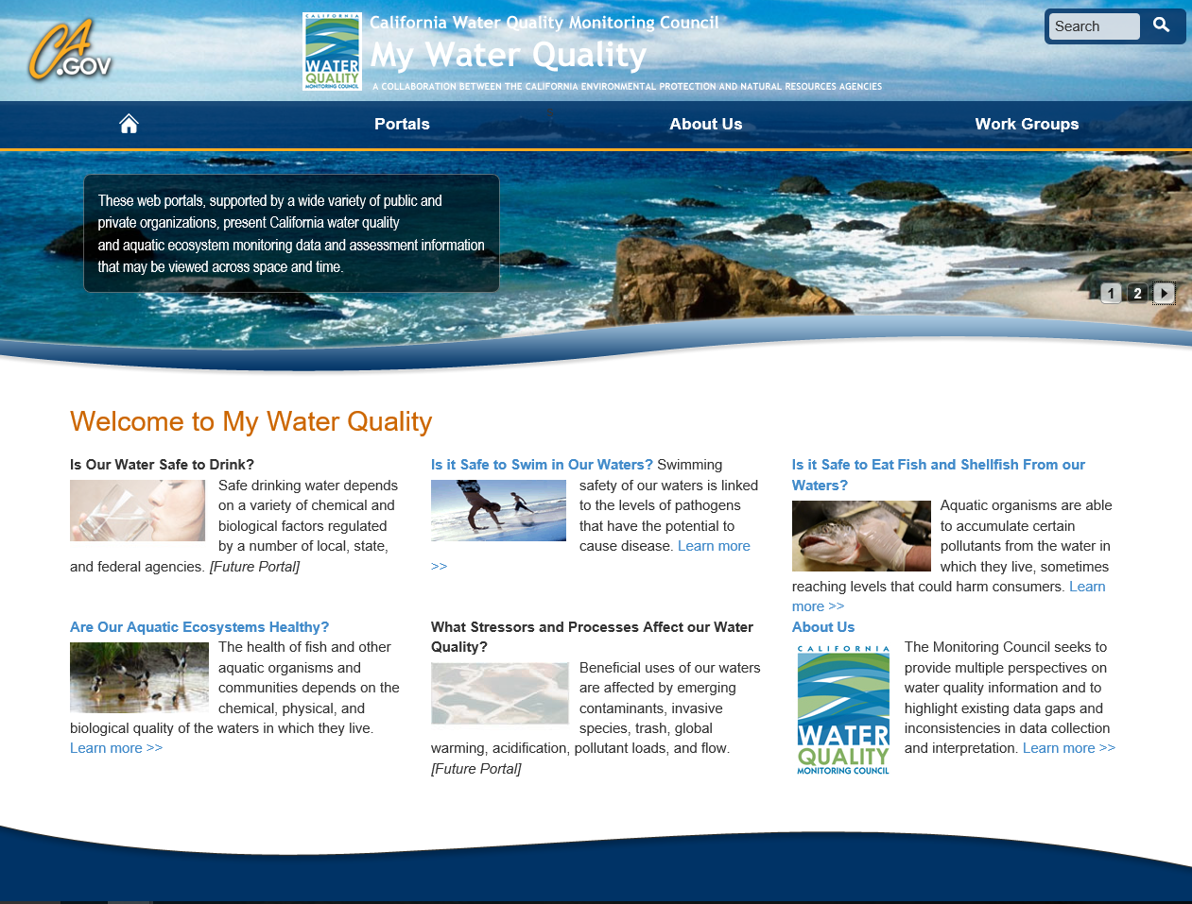
Notes:
As most of you already know, the Monitoring Council has created a number of theme specific portals that seek to make publically published data available to decision makers—focusing on topics such as….. (see slide)
For the purpose of today’s presentation, we’ll focus on those efforts relevant to the Bay Delta—specifically those toolsets developed by 34North for the California Estuaries Portal and Bay Delta Live.

Slide 13
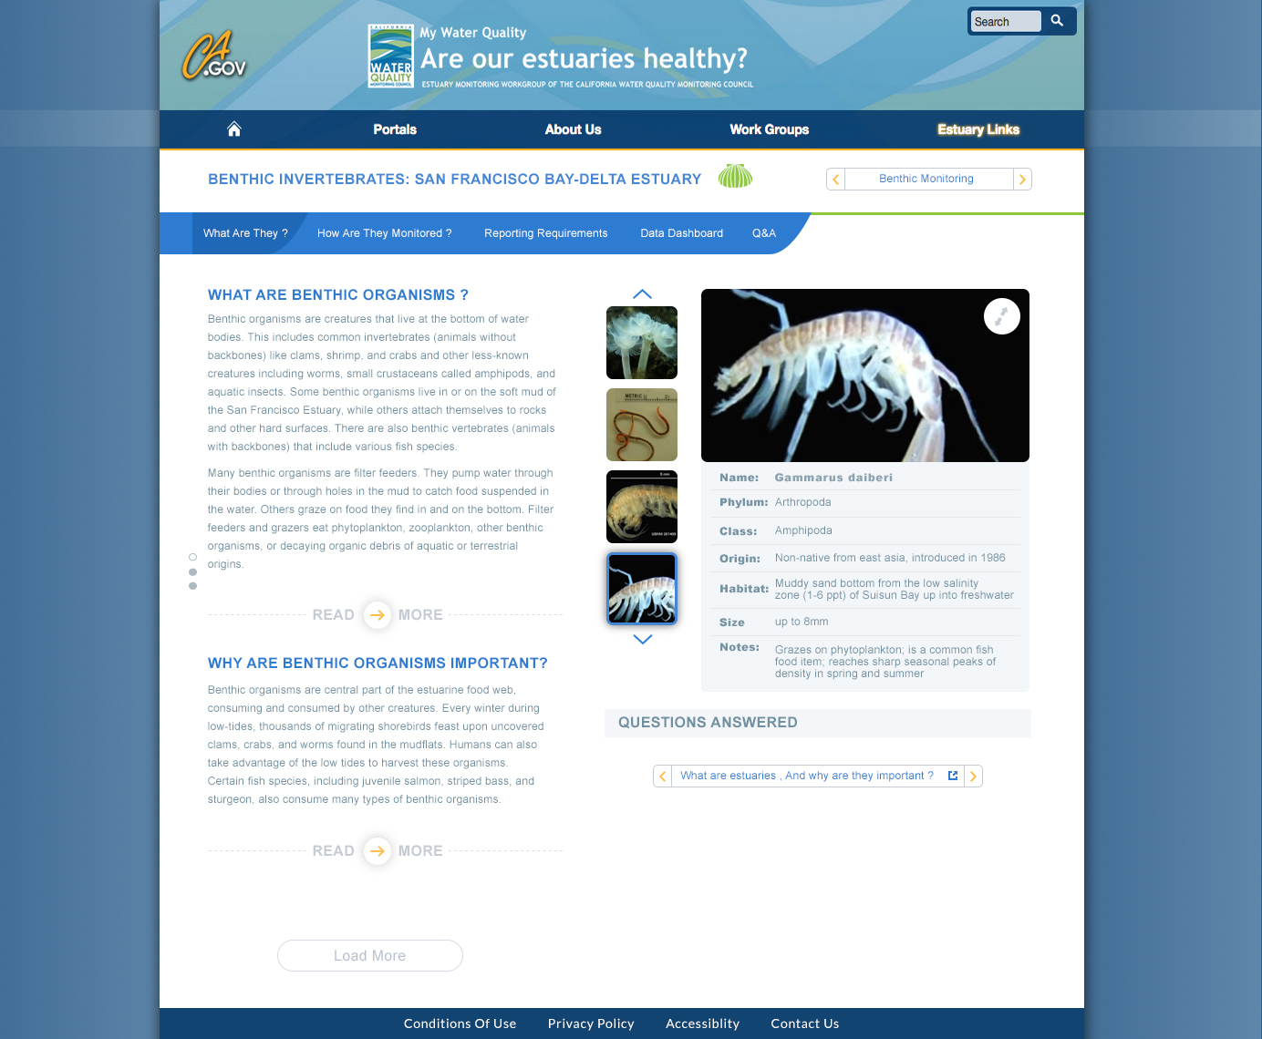
Design 1: Benthic What? (A)
Notes:
Set up a species database for the viewer widget

Slide 14
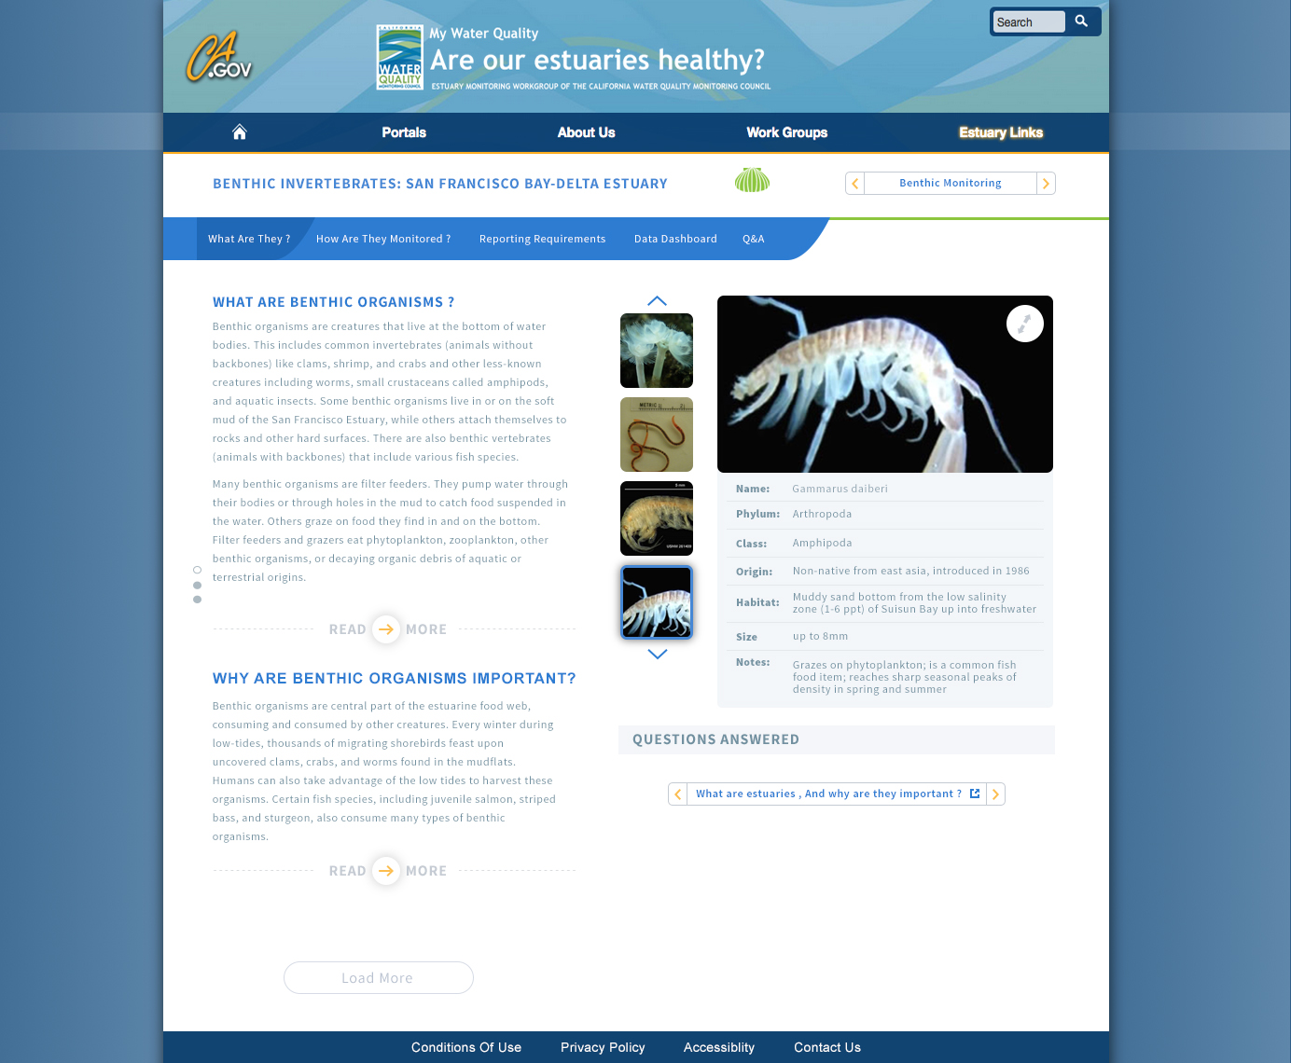
Design 1: Benthic What? (P)
Notes:
Set up a species database for the viewer widget

Slide 15
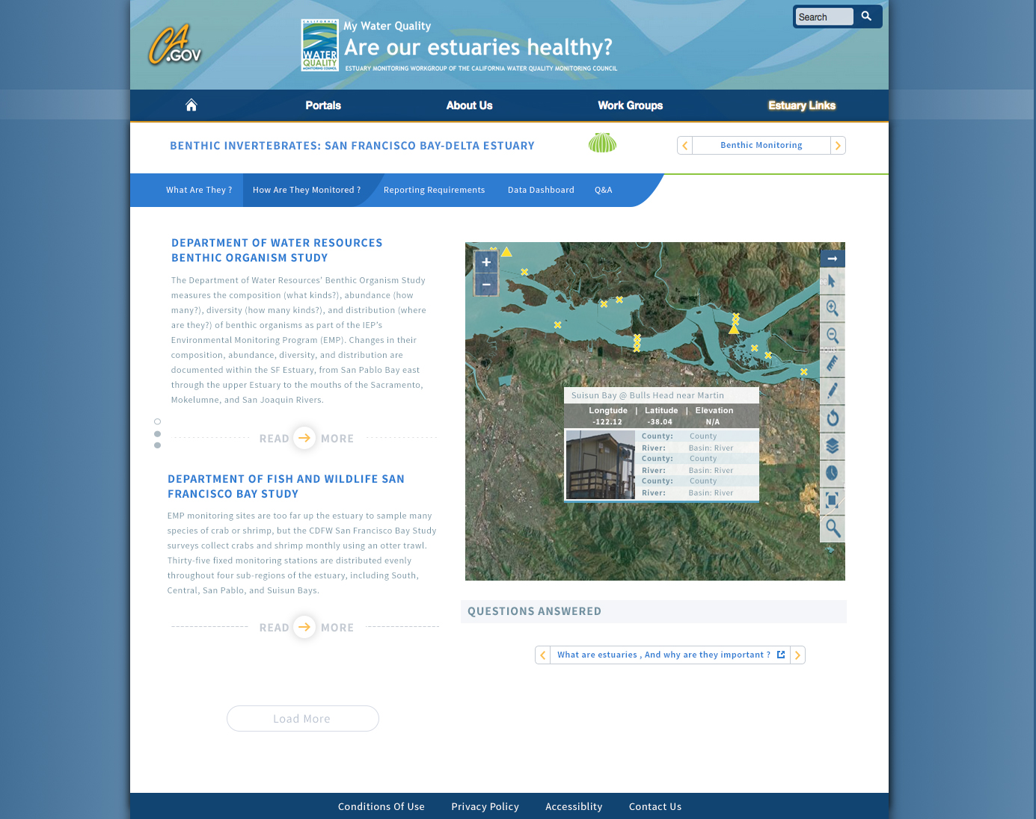
Design 1: Benthic How?

Slide 16
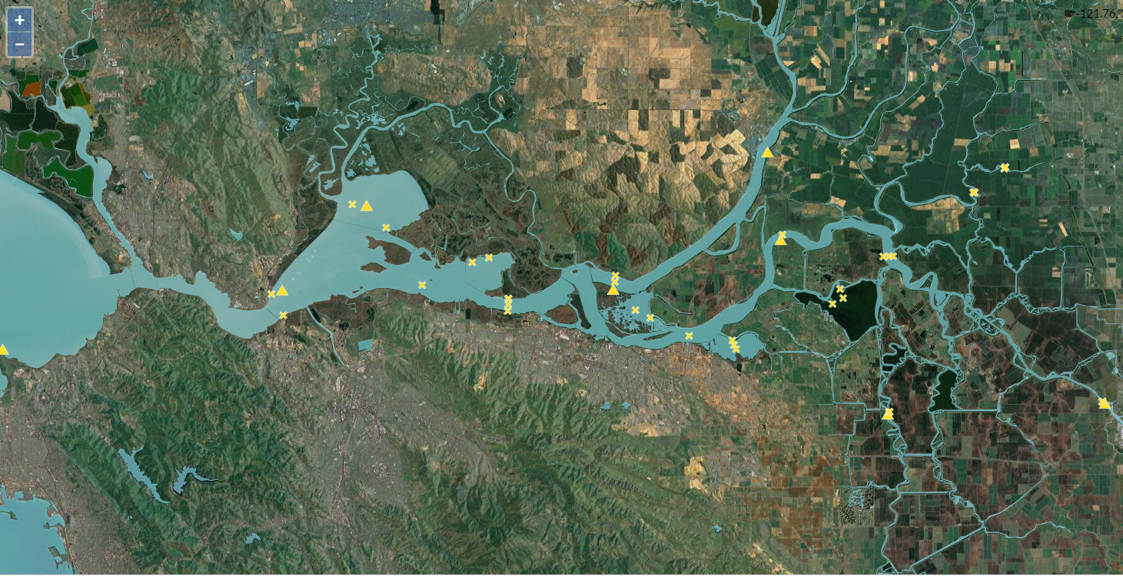
EMP: Benthic

Slide 17
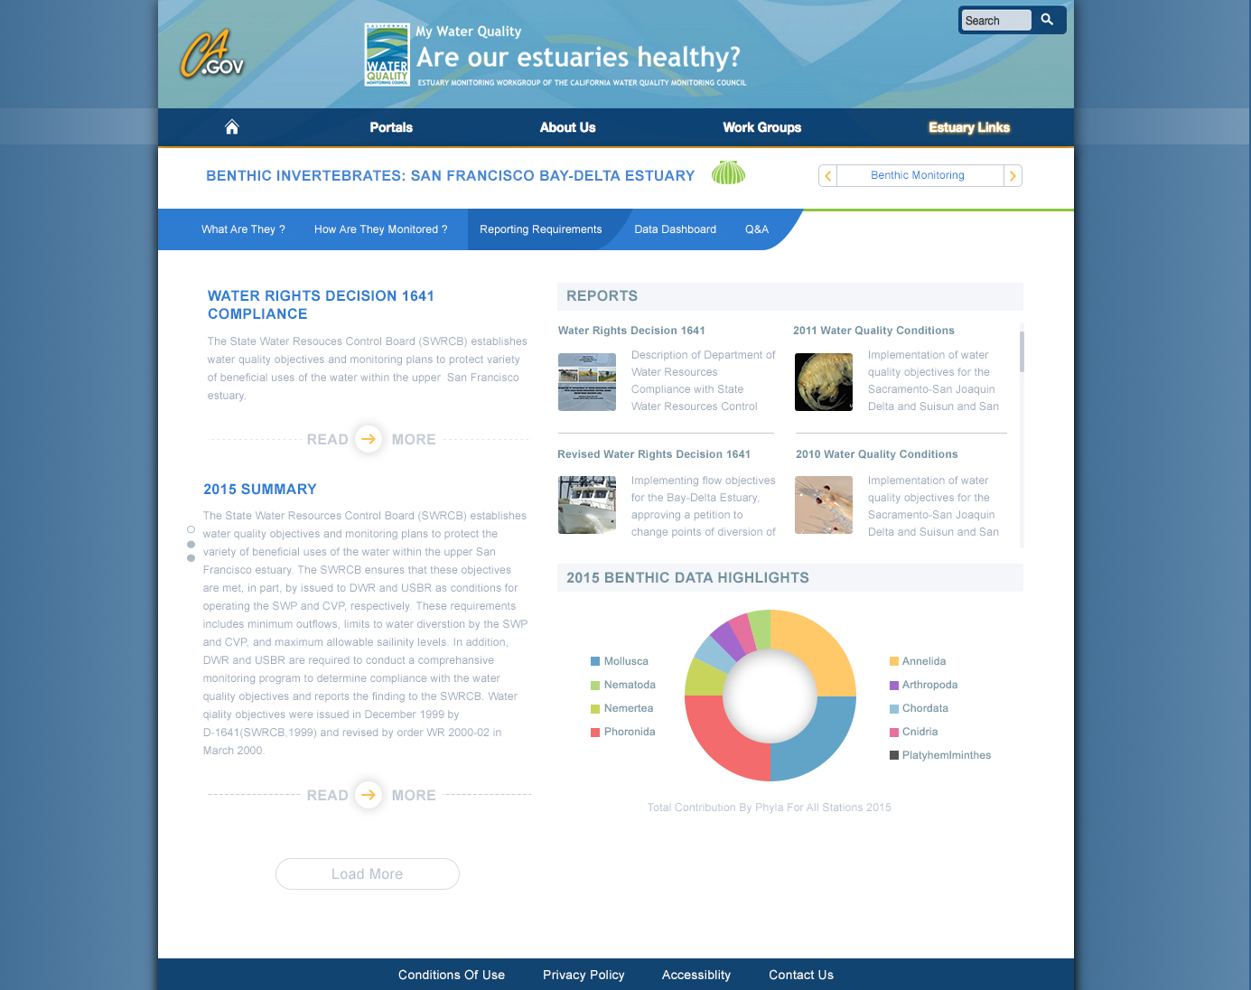
Design 1: Benthic Reporting? (PS)
Notes:
Pro-Source Sans

Slide 18

Design 1: Benthic Reporting (A)
Notes:
Arial

Slide 19
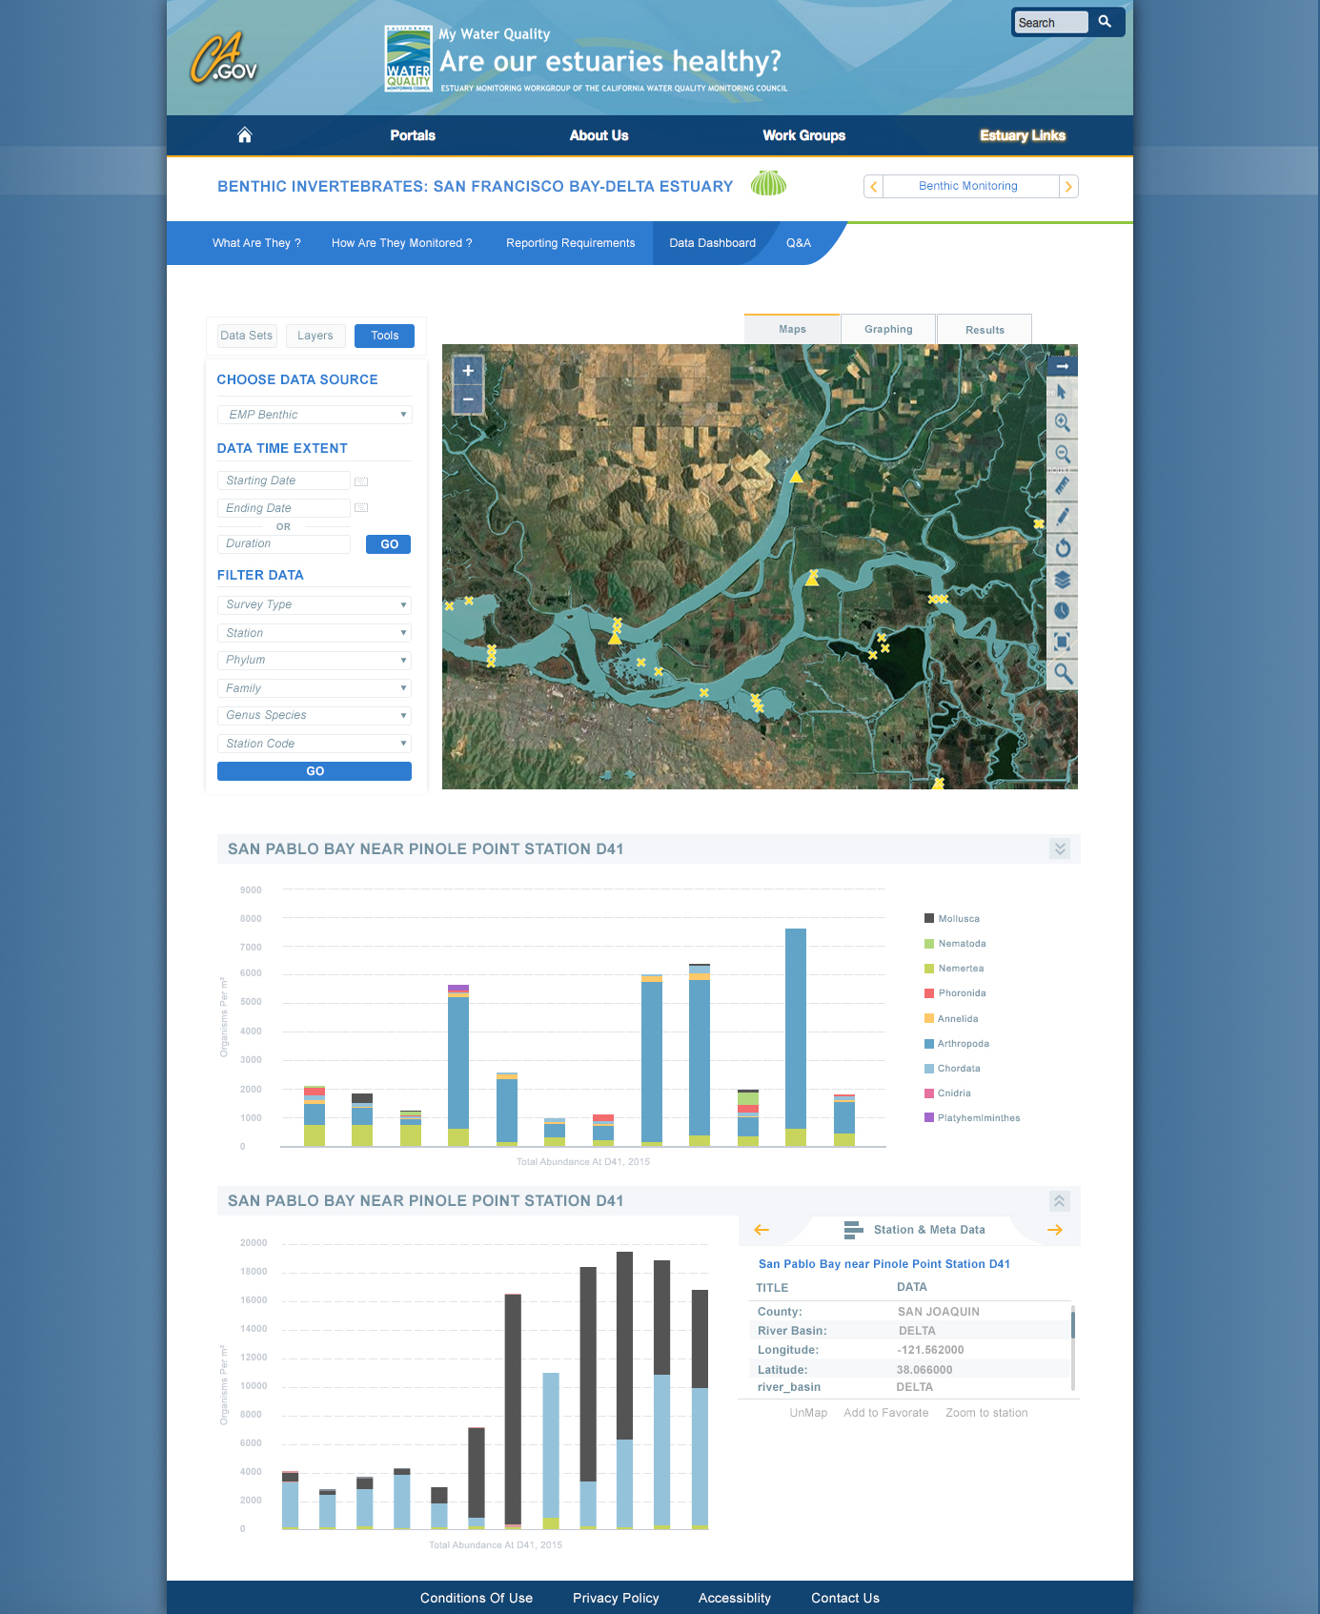
Design 1: Benthic Dashboard

Slide 20
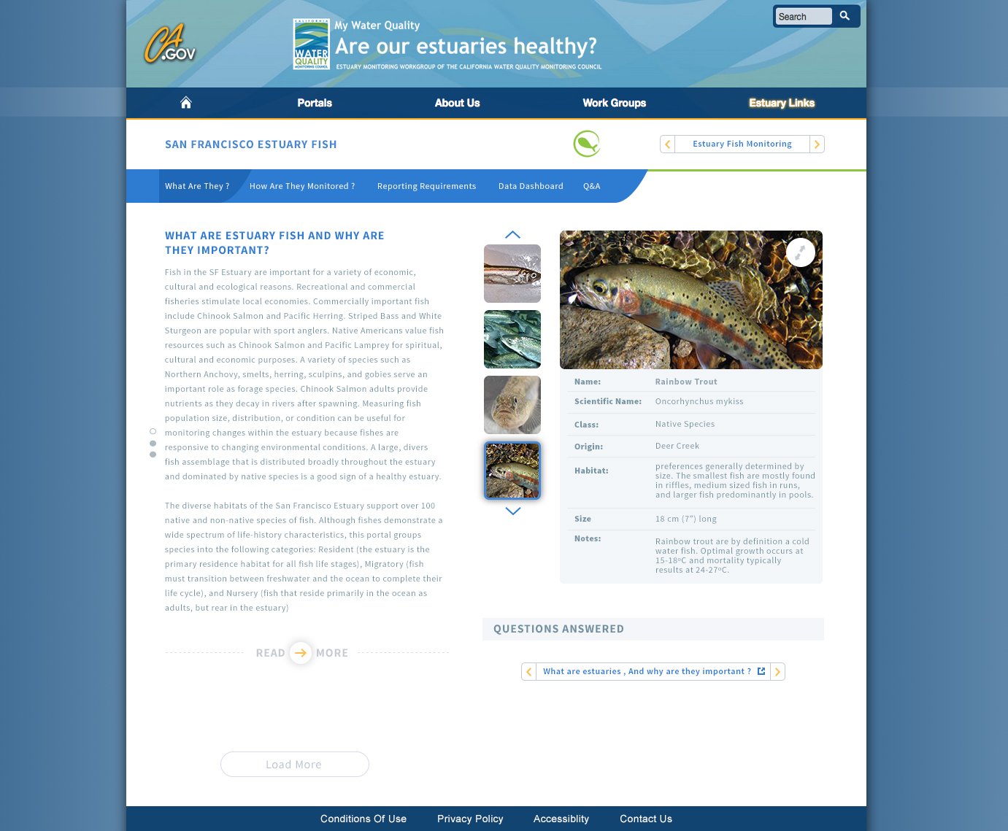
Design 1: Fish What?

Slide 21
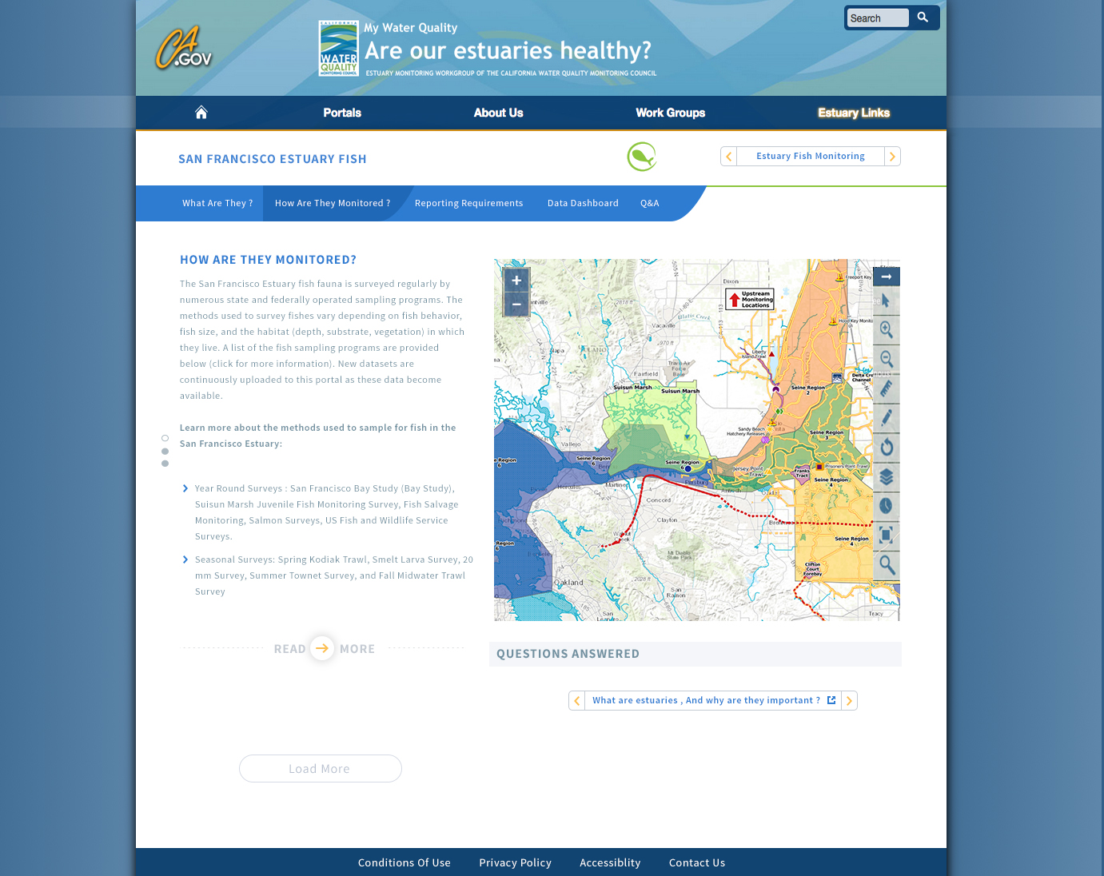
Design 1: Fish How?

Slide 22
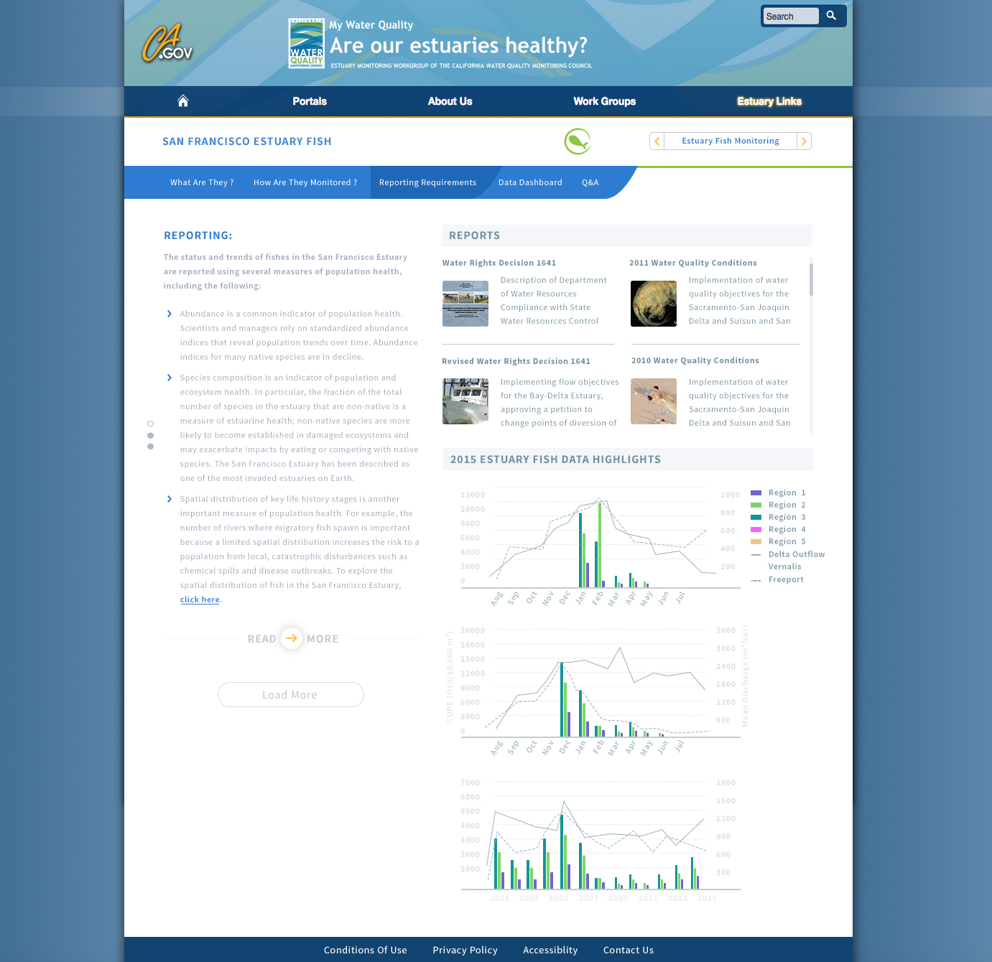
Design 1: Fish Reporting?

Slide 23
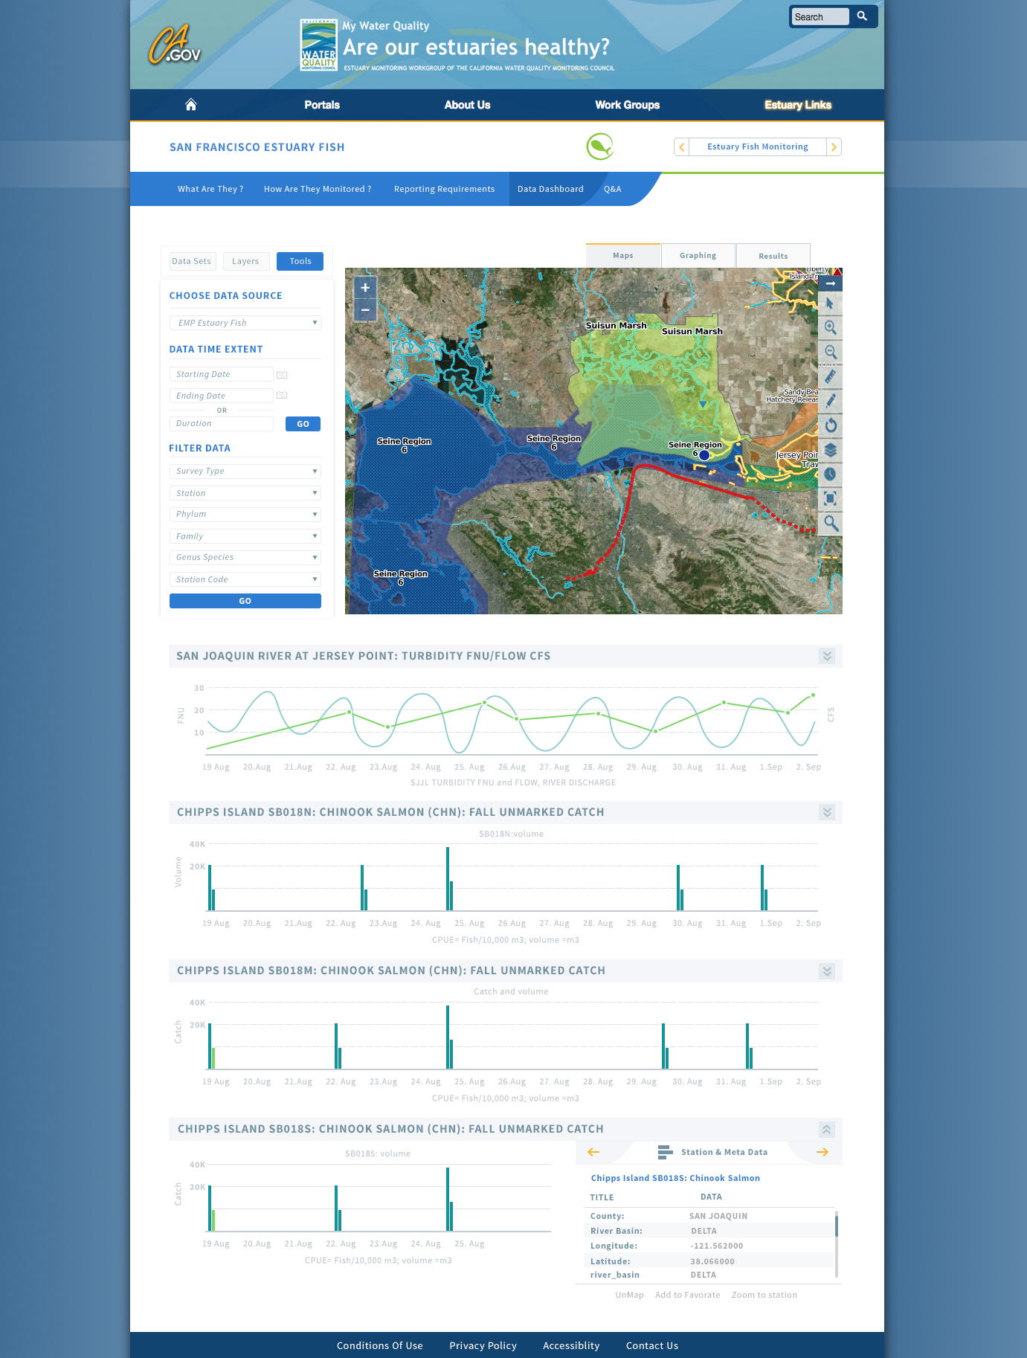
Design 1: Dashboard

Slide 24
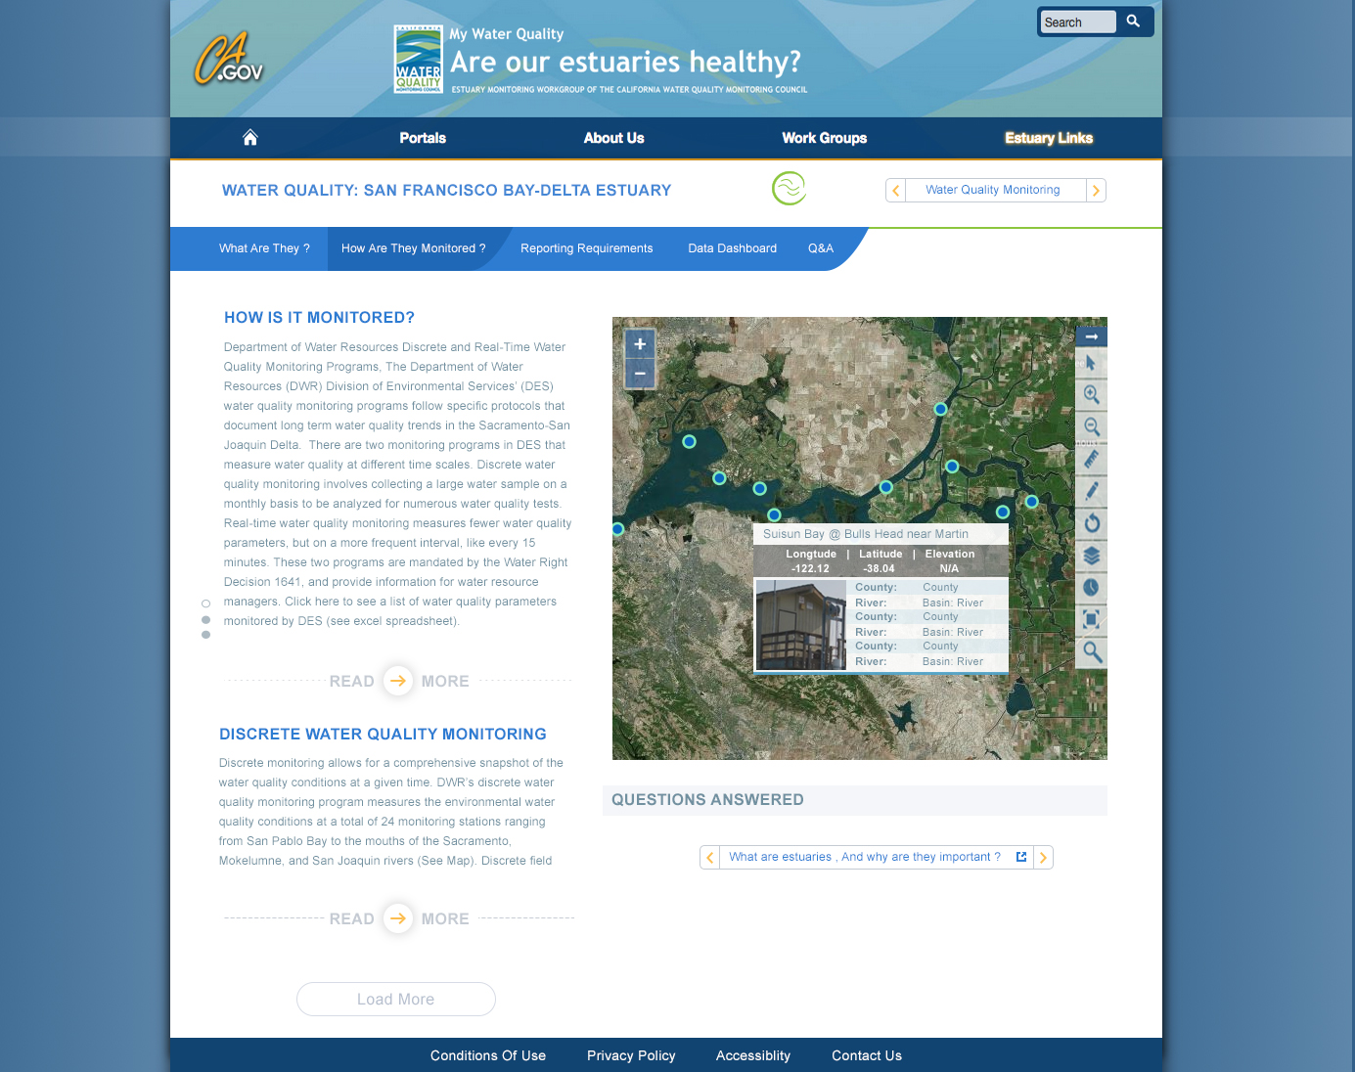
Design 1: WQ How?

Slide 25
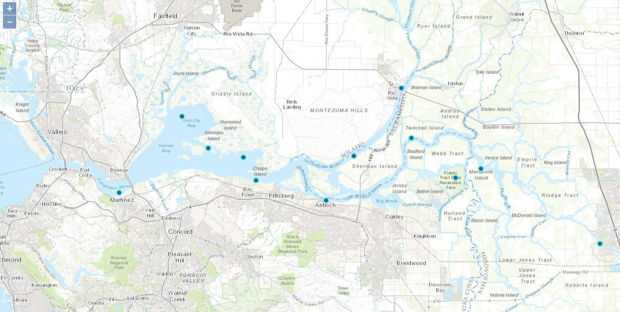
EMP: Water Quality

Slide 26
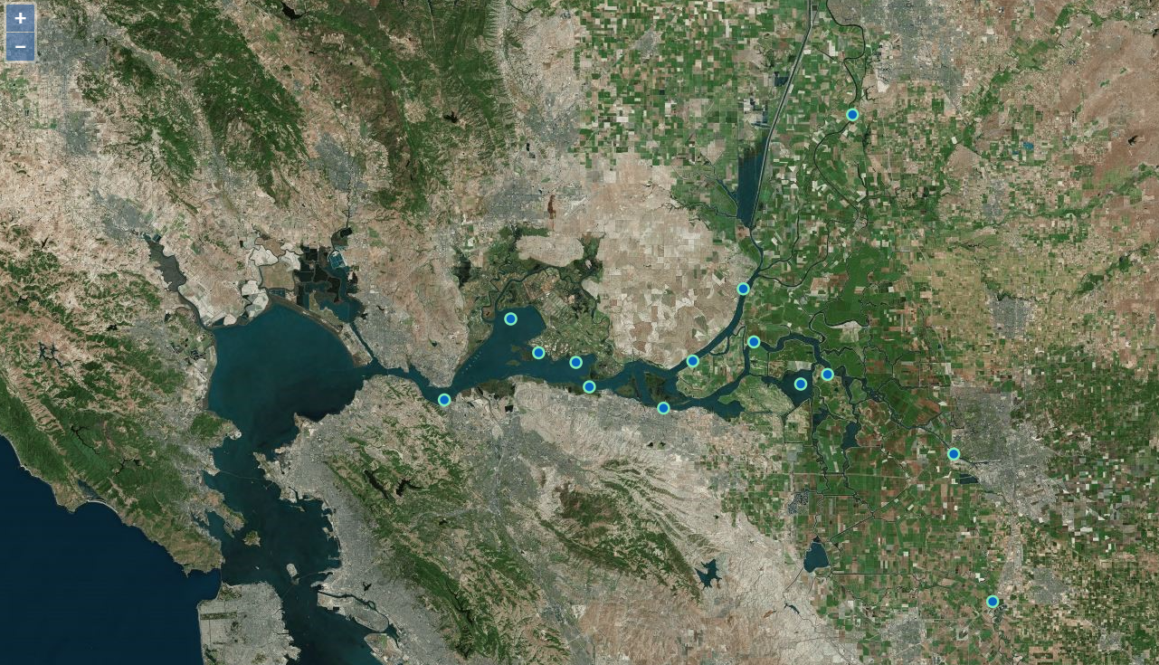
EMP: Continuous WQ

Slide 27
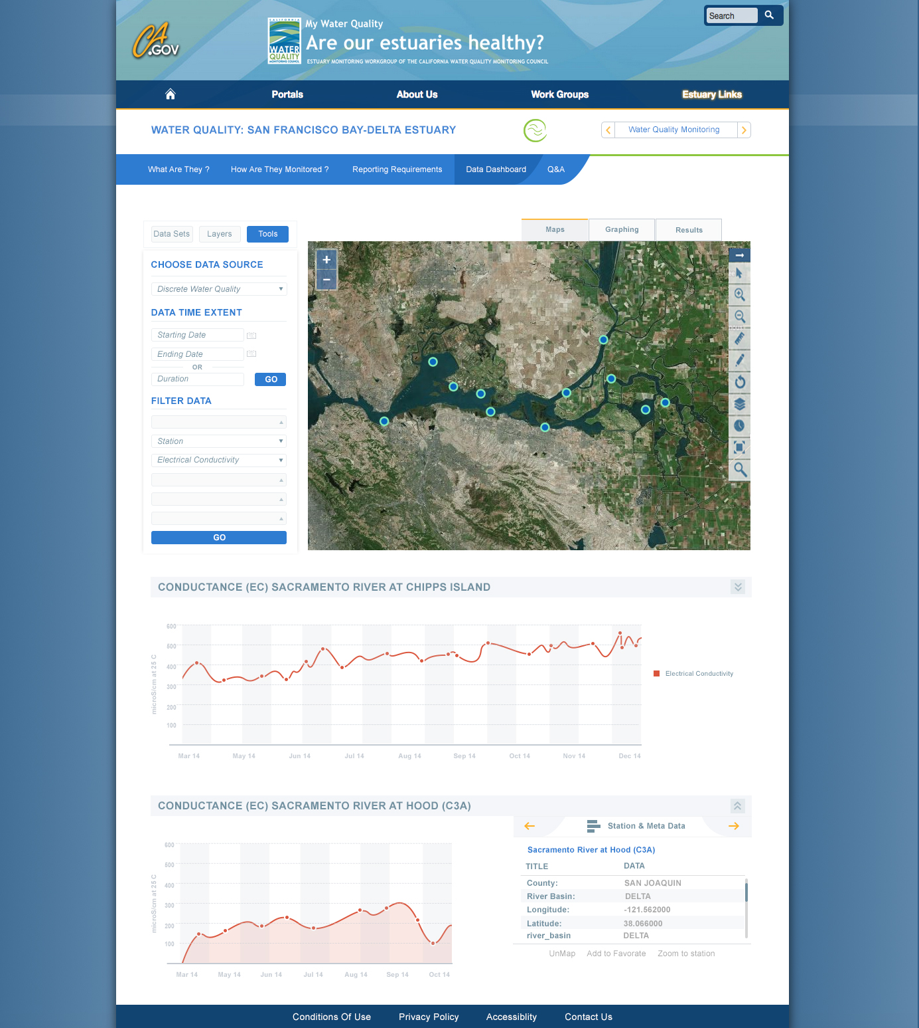
Design 1: WQ Dashboard?

Slide 28
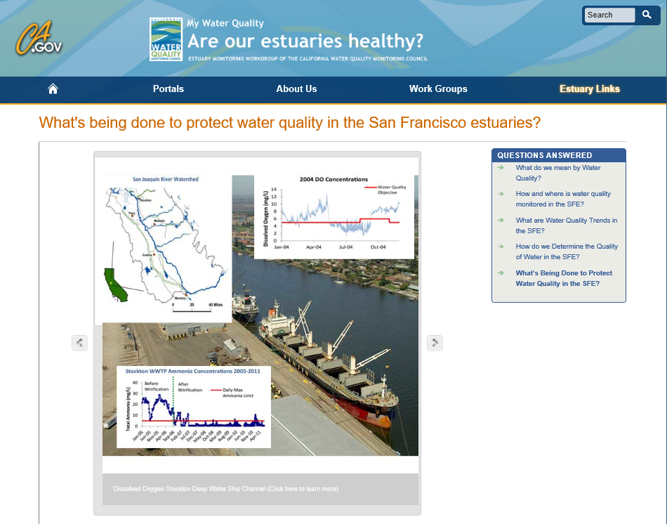
Notes:
In our first effort to present performance measures, we worked closely with Water Board and EPA staff to develop pages for the existing Total Maximum Daily Loads, and I’ll detail the Stockton Deep Water Shipping Channel Dissolved Oxygen TMDL to give you an idea of the types of performance measure tracking presented on the Estuaries Portal

Slide 29
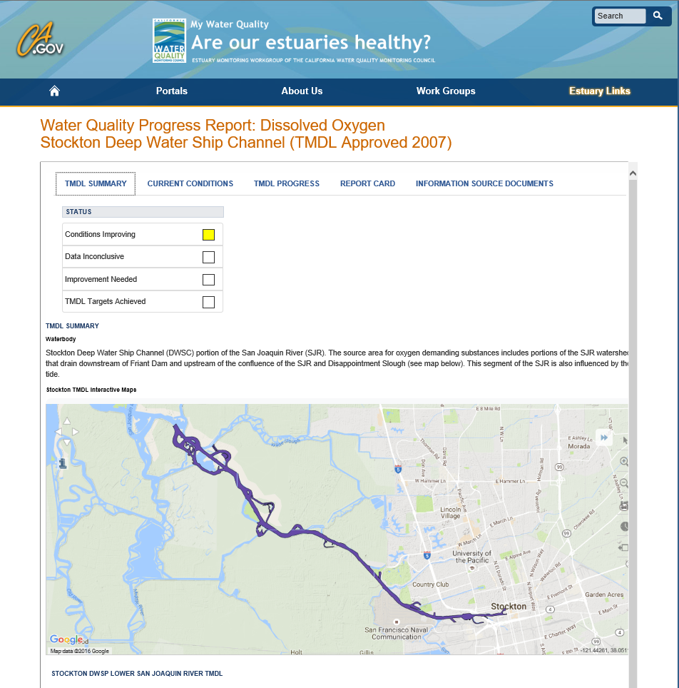
Notes:
The TMDL summary starts with a very simple assessment of where we are with the TMDL. In this case, conditions are improving. The summary tab also includes a map of the impaired reach and a couple larger-scale maps to give people who aren’t familiar with the area some frame of reference.
As you scroll down, you can get more information like what the goal is for the particular pollutant, why the TMDL was necessary, sources, loading allocation, and the timeline for attainment.

Slide 30
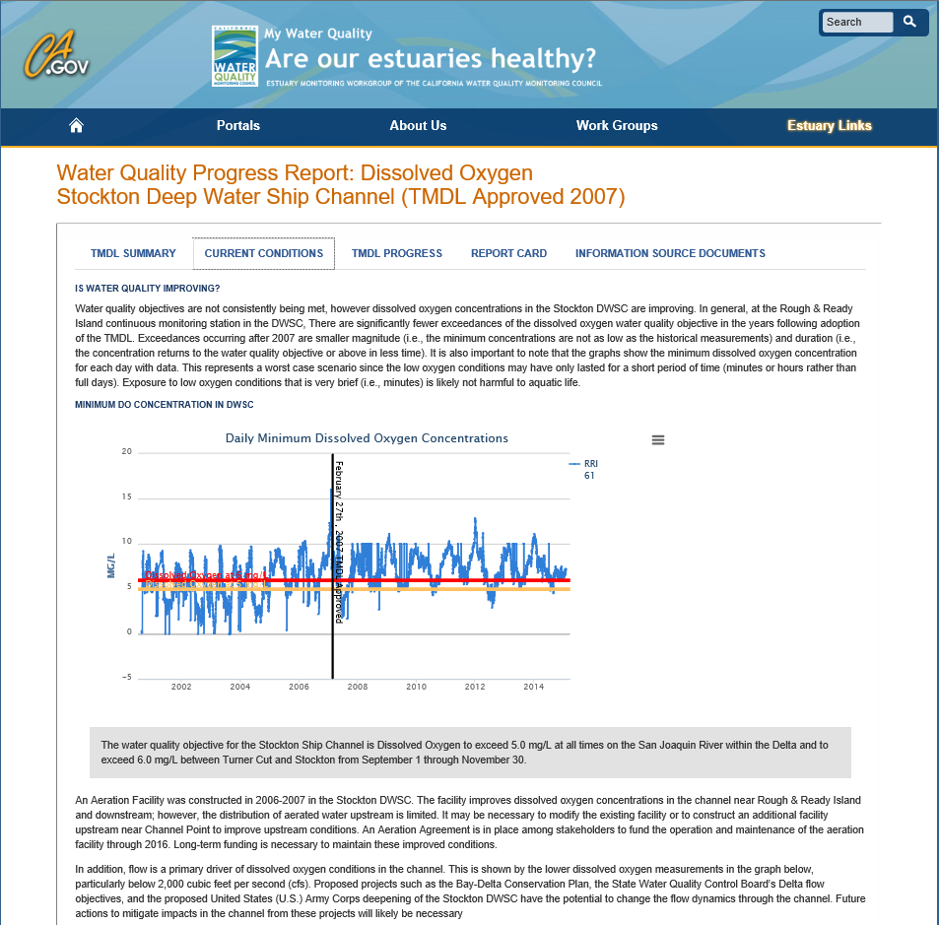
Notes:
We also have a tab for Current Conditions that gives you text explaining what’s being presented and why that information is important

Slide 31
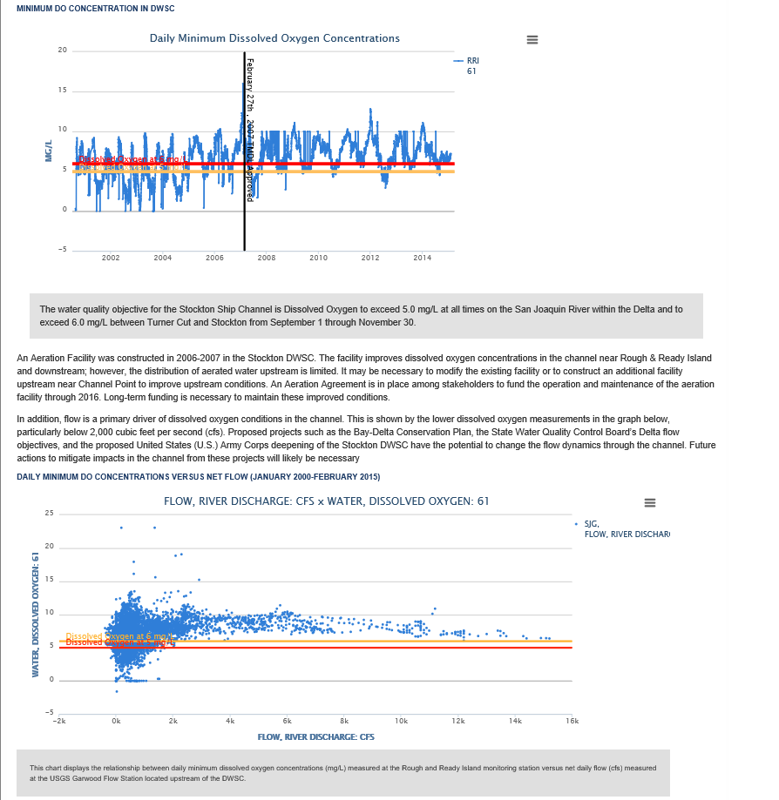
Notes:
In this particular case, there are plots of the dissolved oxygen over time as well as flow, and because the TMDL Objective is different in different parts of the year, both limits are reflected as the red and yellow lines on these graphs. As you can see from the top graph, shortly after the TMDL was approved, there were fewer exceedances and the exceedances themselves were of lesser magnitude

Slide 32
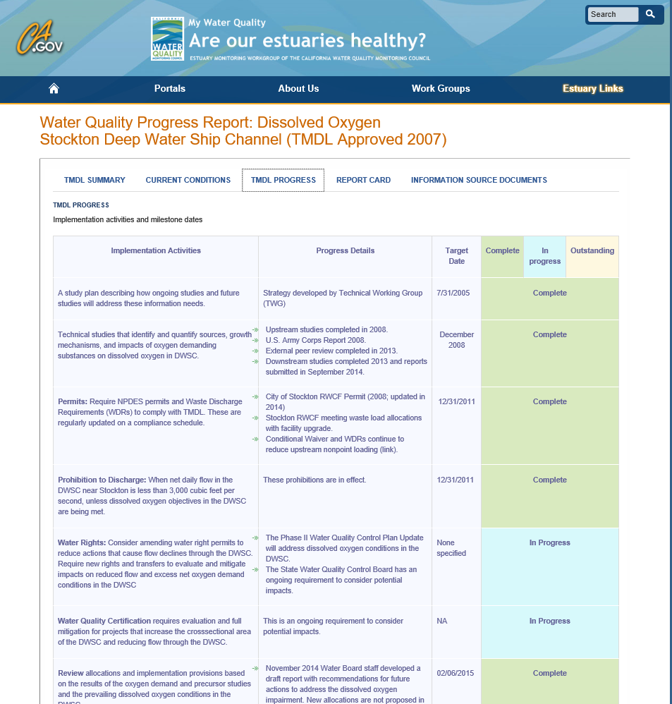
Notes:
The TMDL Progress tab was something important to EPA. They really wanted to visualize the different timelines involved and where they were on implementing those milestones

Slide 33
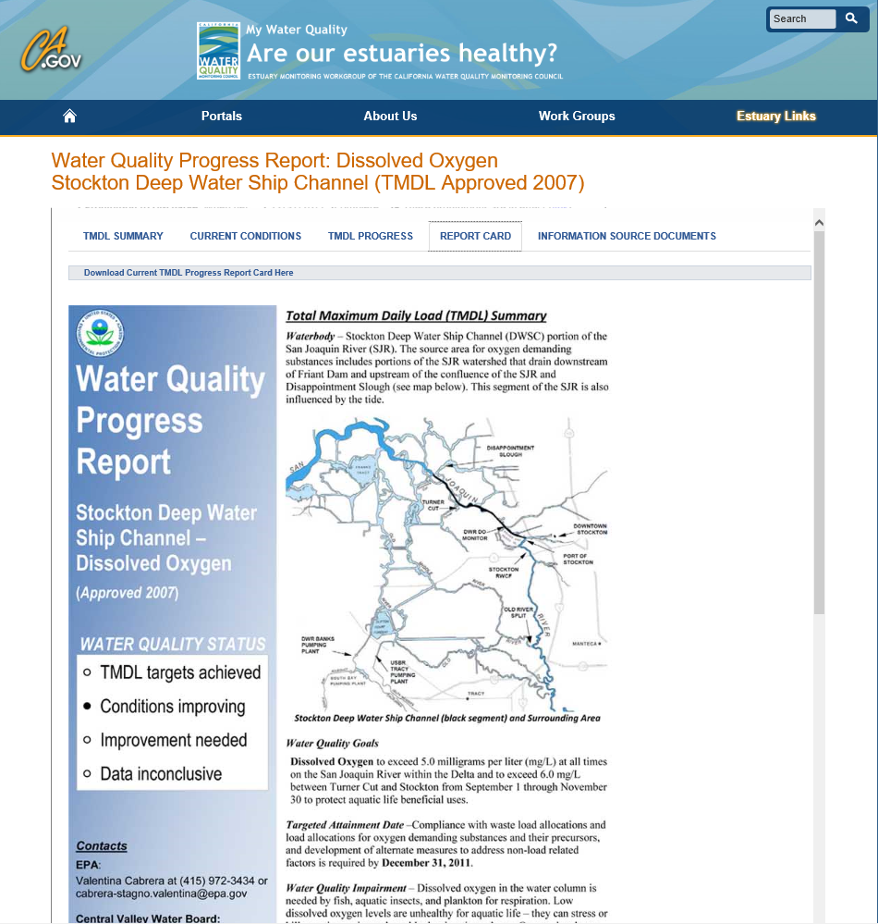
Notes:
The Report Card is formatted after the reporting required from the Water Board to EPA and gives you much more detailed information that is summarizes on the TMDL Summary tab, and it provides you with additional links

Slide 34
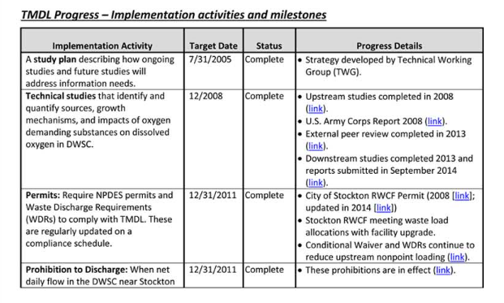
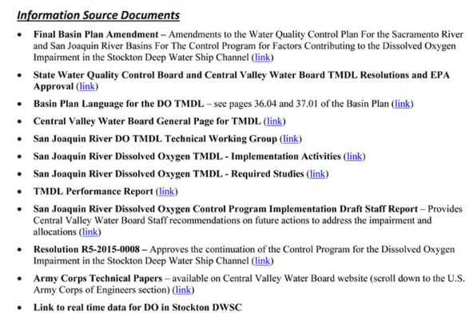
Notes:
To documents and deliverables

Slide 35
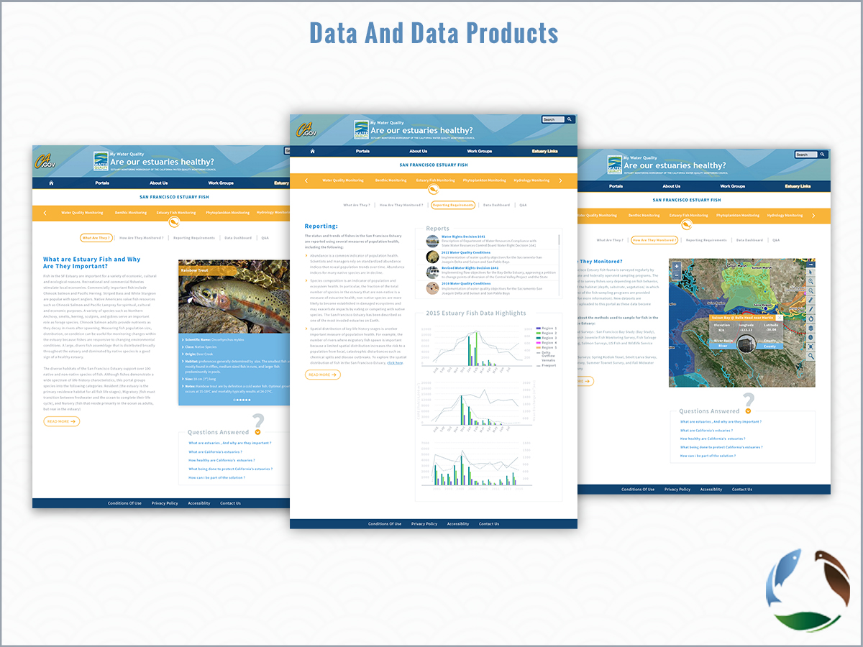
Notes:
My Water Quality Portals, Report Card and TMDLs
Demo DOSS/CAMT/ DJFMP, discuss phase 2
- DCT Salinity/Turbidity (Val)
By the Numbers (TBD)
Build your own Dashboard

Slide 36
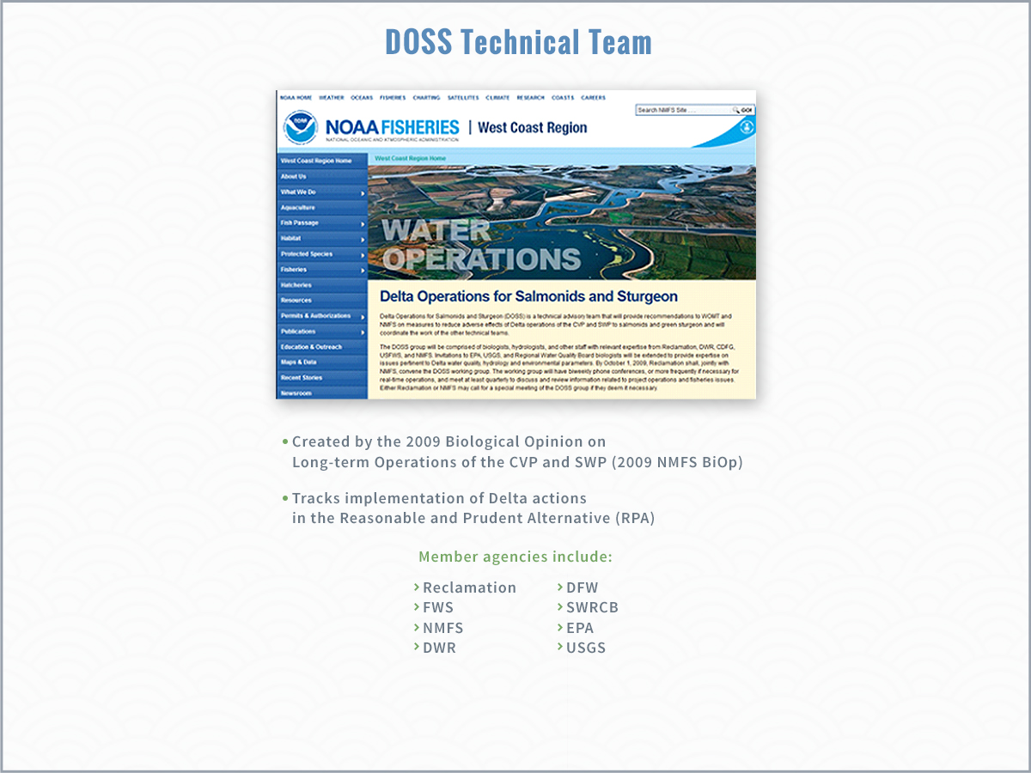

Slide 37
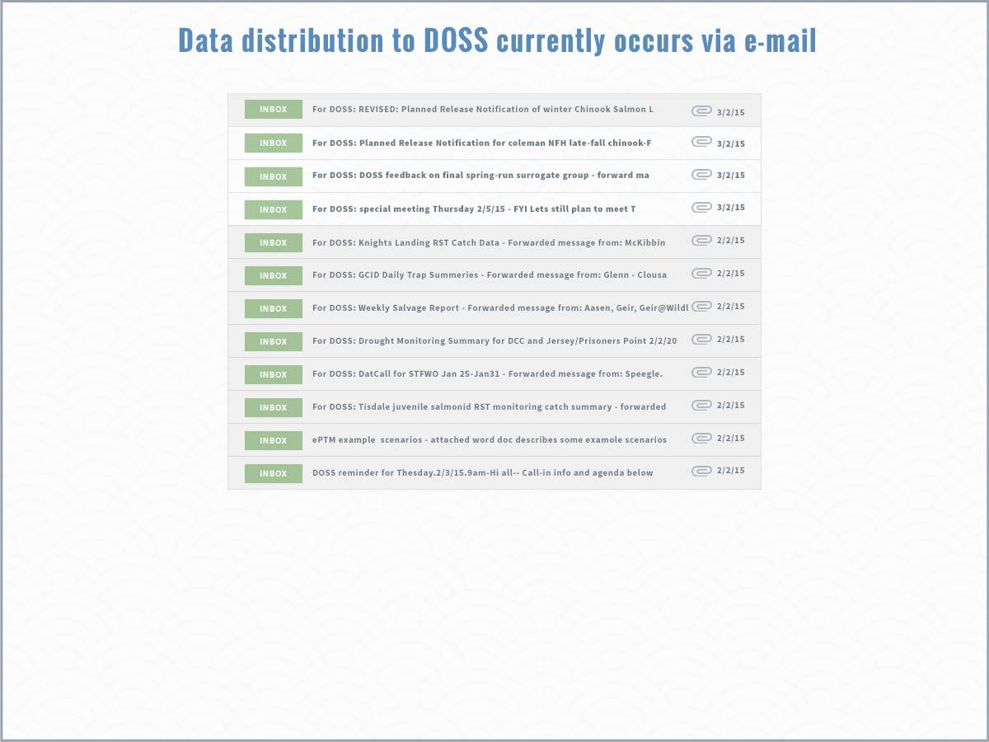

Slide 38
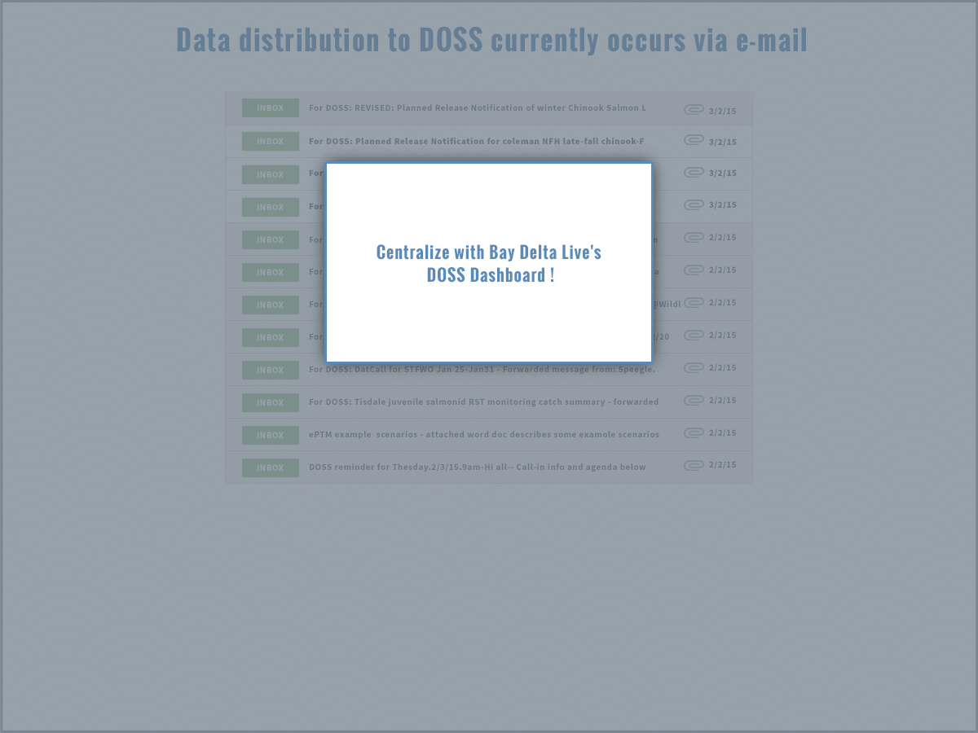

Slide 39
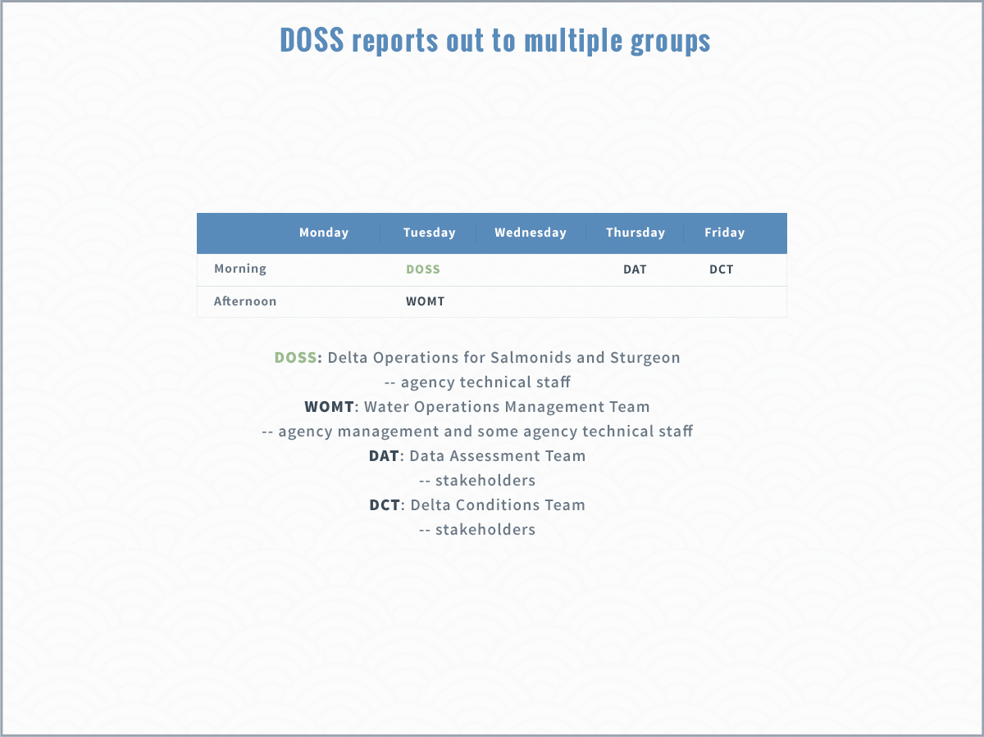

Slide 40
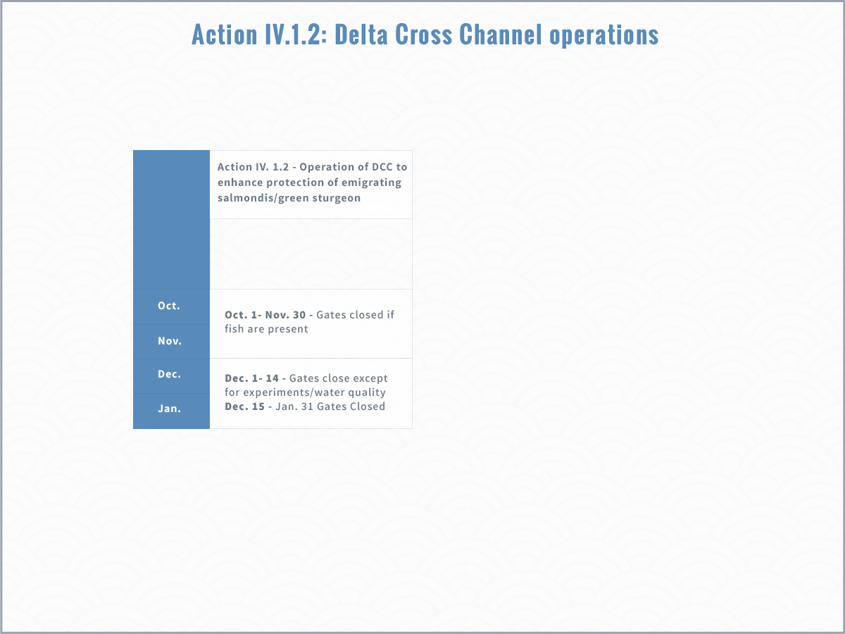
Notes:
Action IV.1.2 of the RPA provides guidelines for Delta Cross Channel operations. Before Dec 15th, the DCC gates may be open unless certain conditions are met. DOSS tracks those conditions, which consist of a set of “alerts” and also a set of triggers that may require DCC closure.

Slide 41
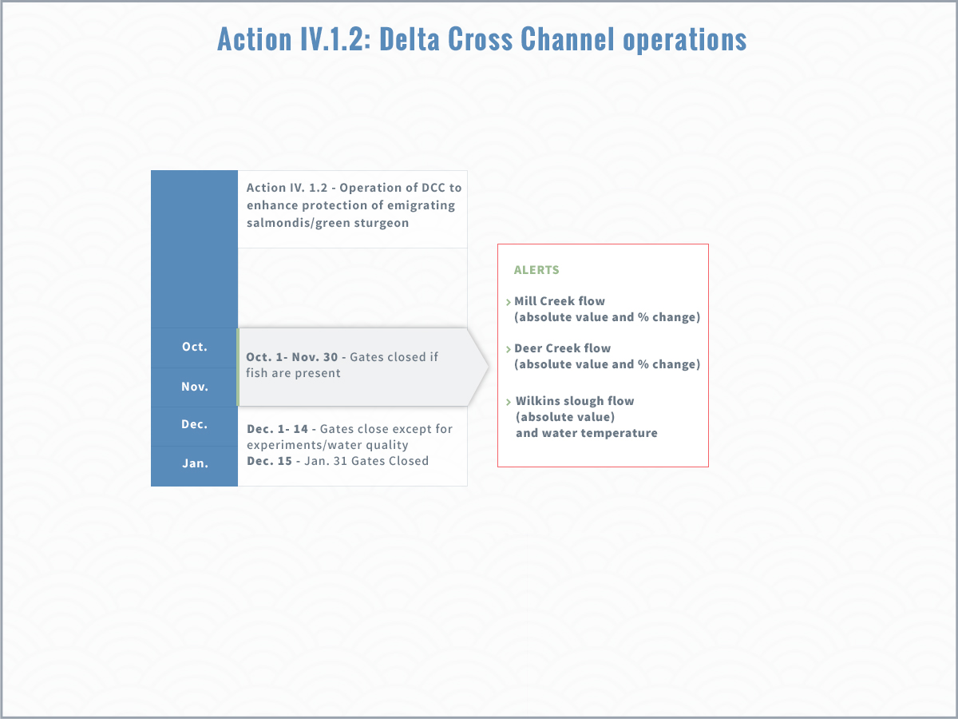

Slide 42
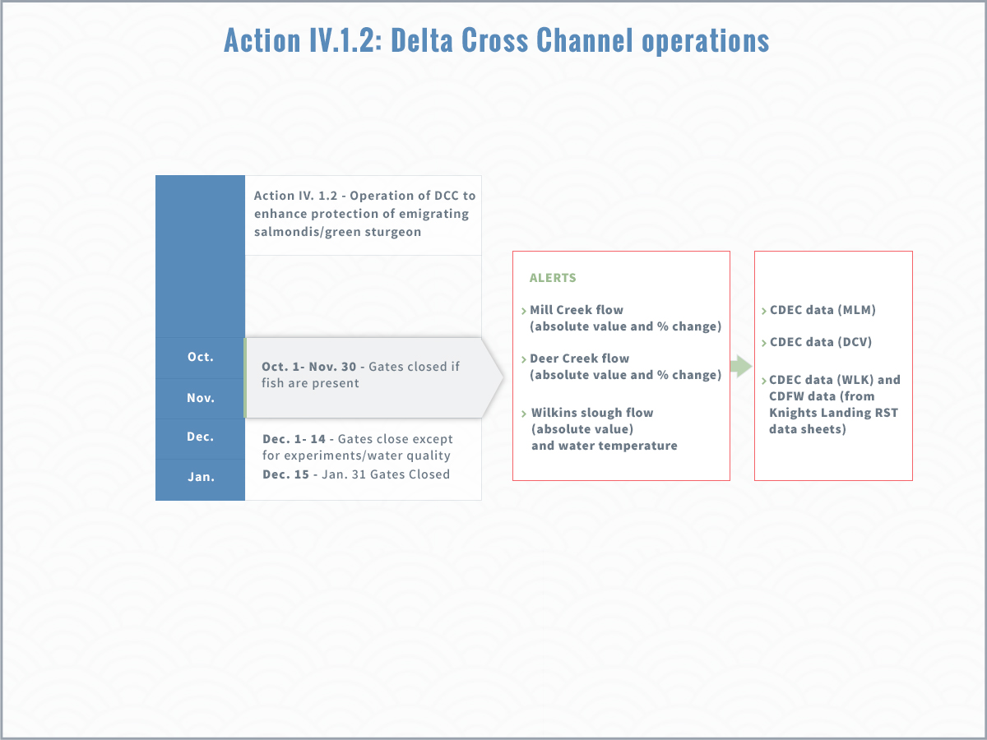
Notes:
The triggers that may require DCC gate closure rely on fish catch at several key monitoring locations, and on WQ conditions. The catch info comes from KL, the Sac Trawl, and the beach seines. WQ conditions are monitored by the Projects, not by DOSS, and relate to requirements in D-1641.

Slide 43
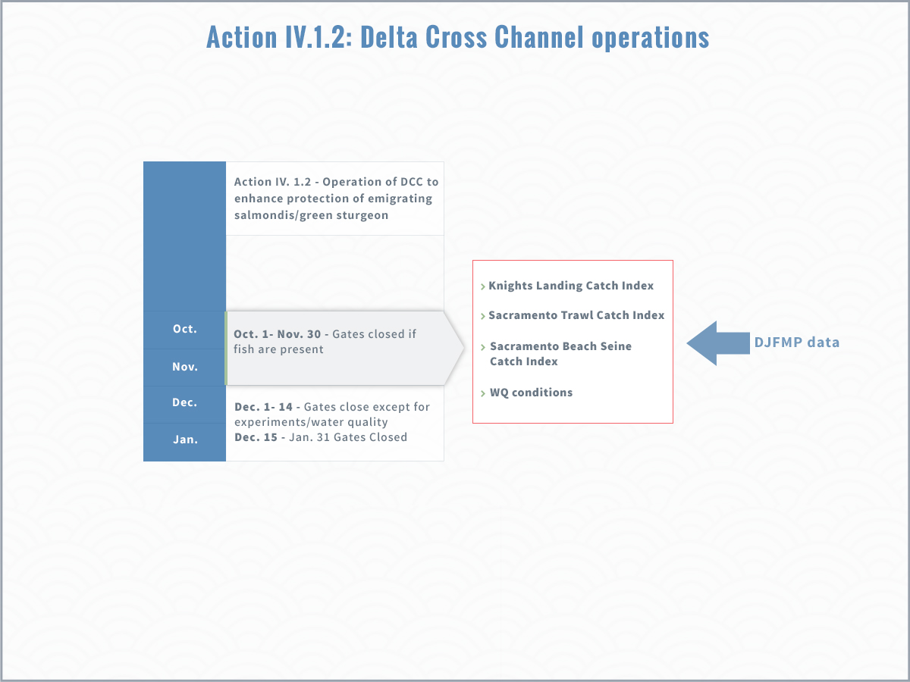
Notes:
Note that these two monitoring locations rely on DJFMP data.

Slide 44
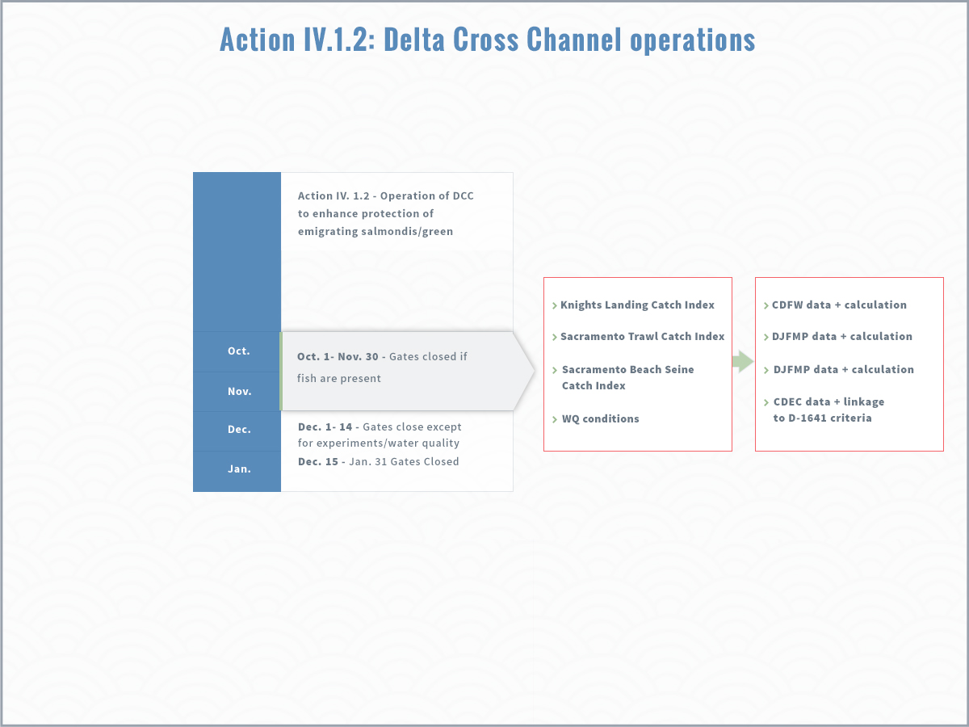
Notes:
As for the alerts, Bay Delta Live pulls data from these listed sources and summarizes on the DOSS Dashboard <go to BDL to show>

Slide 45
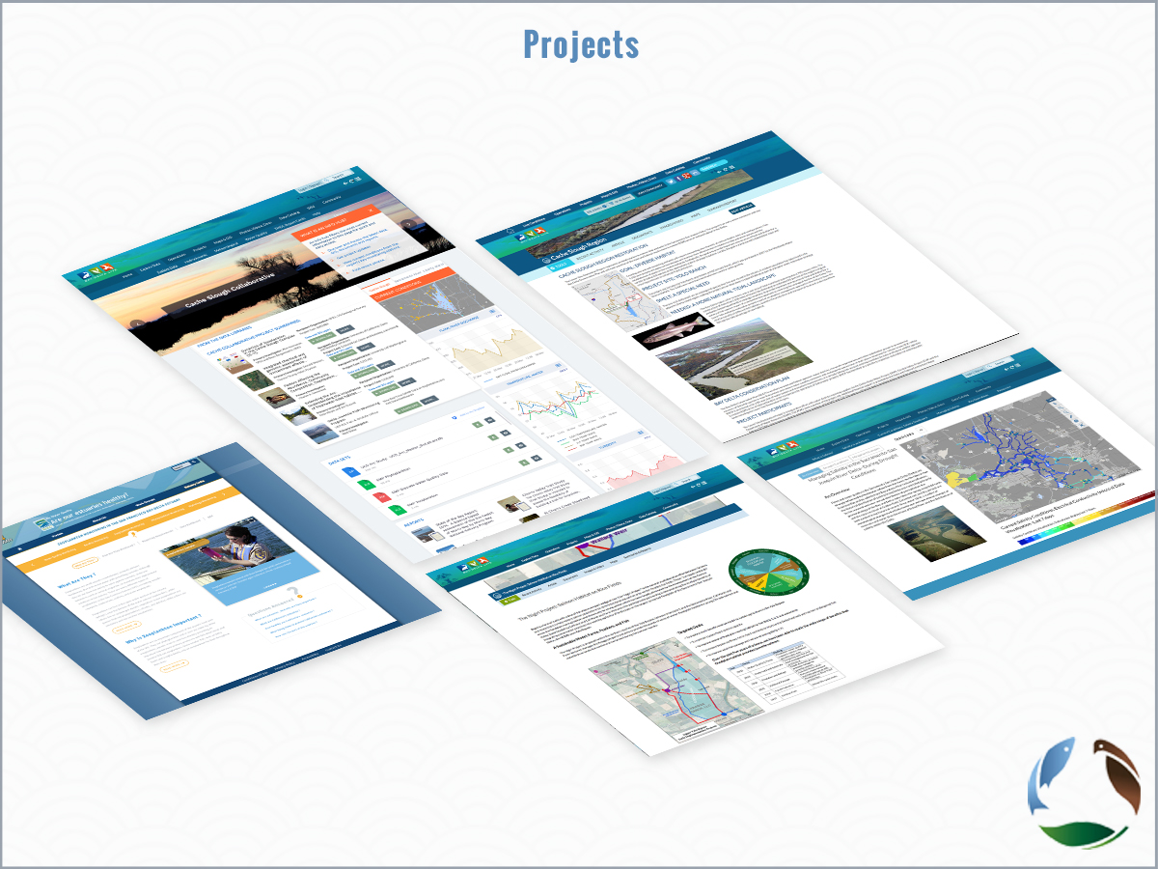

Slide 46
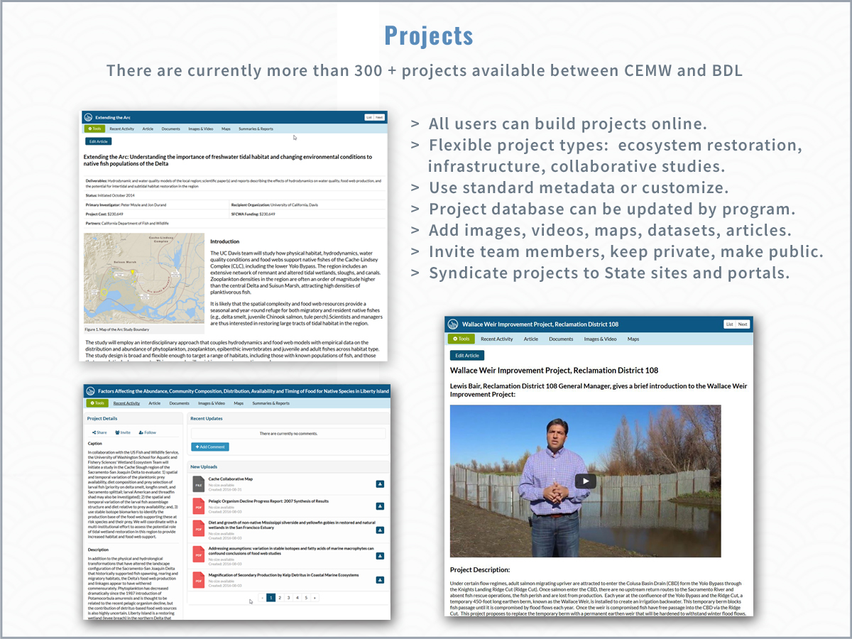

Slide 47
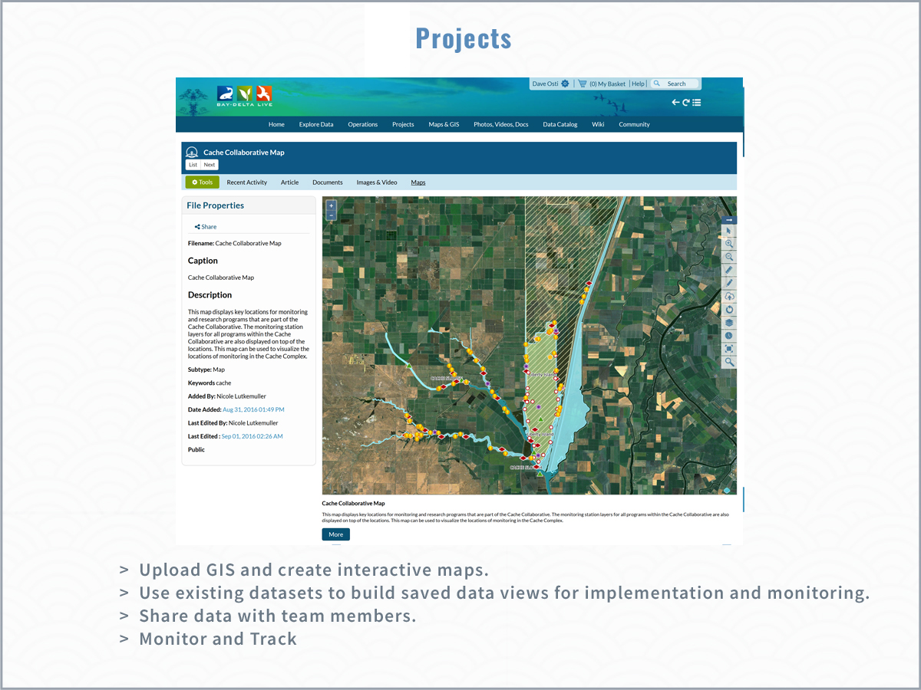

Slide 48
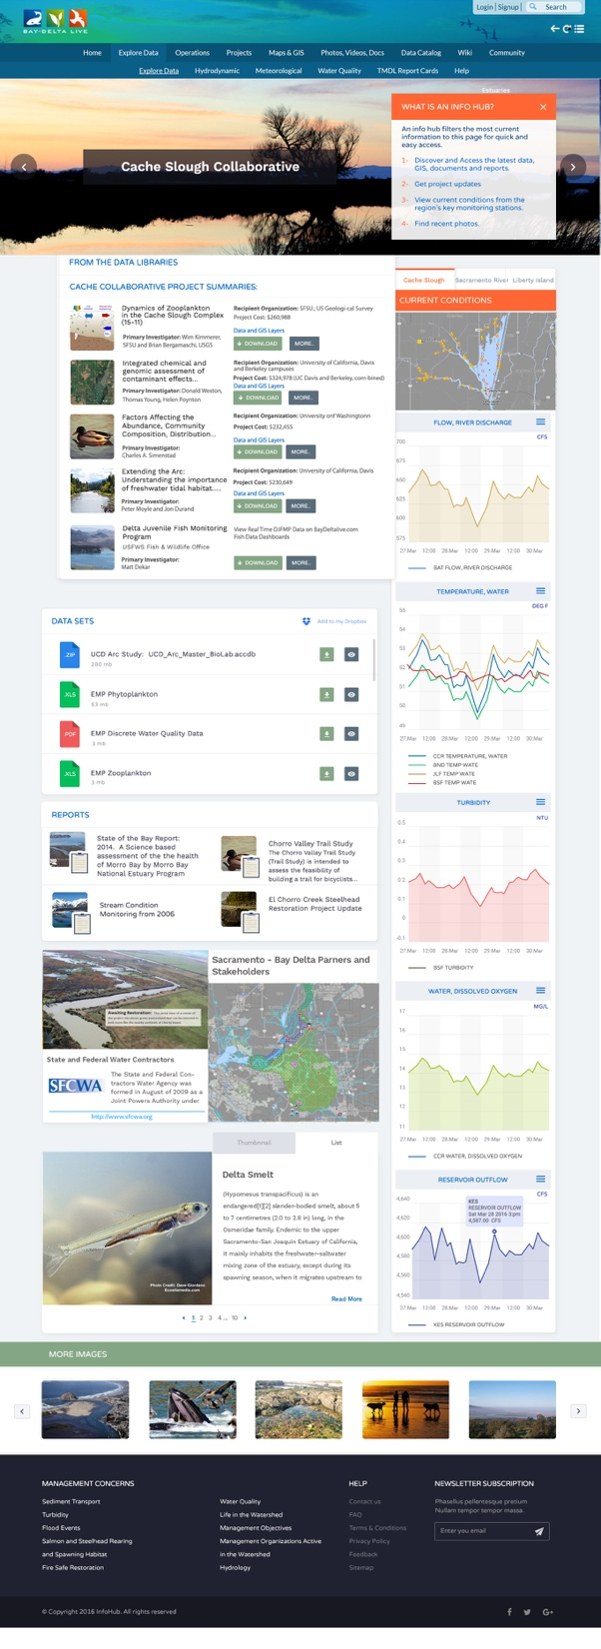
Project Info hubs

Slide 49
Project Info hubs

Slide 50
IEP and Delta Juvenile Fish Program Data
Water Quality
Phytoplankton
Zooplankton
Benthics
Fish

Slide 51
Comparability across multiple scales and programs
Research Studies
Regional (IAMIT)
IEP- Delta Wide
Restoration Site (FRPA)
Compliance Data
Indicator
Methods
Measurement Quality Objectives
Data Quality Objectives
Data Management

Slide 52
Reconciling Approaches and Getting to Comparability
Options:
Consistent Methodology
Performance Based Approach
Inter-calibration
This will require multi-agency participation, time, special studies, and a commitment to the value of comparability

Slide 53
Explore Data & Dashboard Builder
  Creating the baseline, effort toward transparency
  Review Current Datasets: Discuss data integration, interoperability, techniques, transformation and portability
  Reporting back to agencies and data owners for improved data quality
  Demo exploring and graphing key datasets
  Data federation: querying aggregated data (status and goals).
  Linking: BDL: SRWP, Caestuaries and SJR Real Time Management portals.

